Slide 1
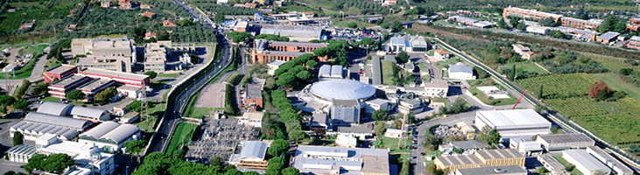

The INFN Infrastructures of Research
Umberto Dosselli – INFN/ LNF

Slide 2
INFN, since its infancy, has strong construction capabilities, both dedicated to detectors and much larger infrastructures
“ recent” contributions from INFN groups to LHC experiments are well known
interesting infrastructures built ad hoc for that (SC toroid and solenoid construction lines, crystal EMC regional production centers, etc) also together with industries
“local” infrastructures exist in many INFN units (with large clean rooms, detector construction facilities etc)
I will concentrate on National Laboratories plus some interesting further example...

Slide 3
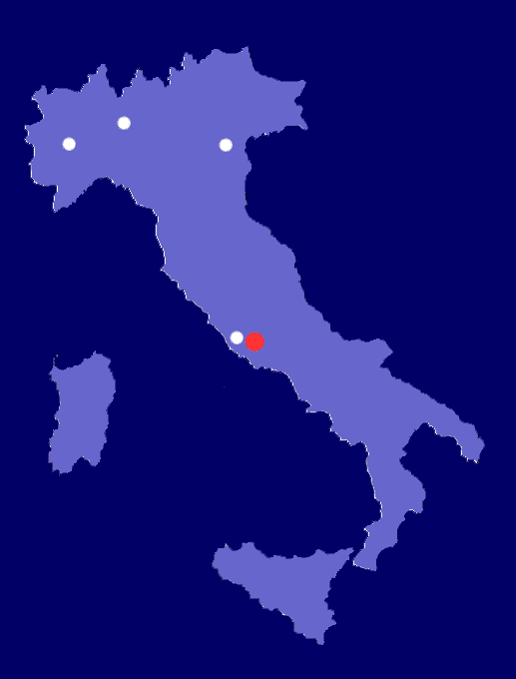

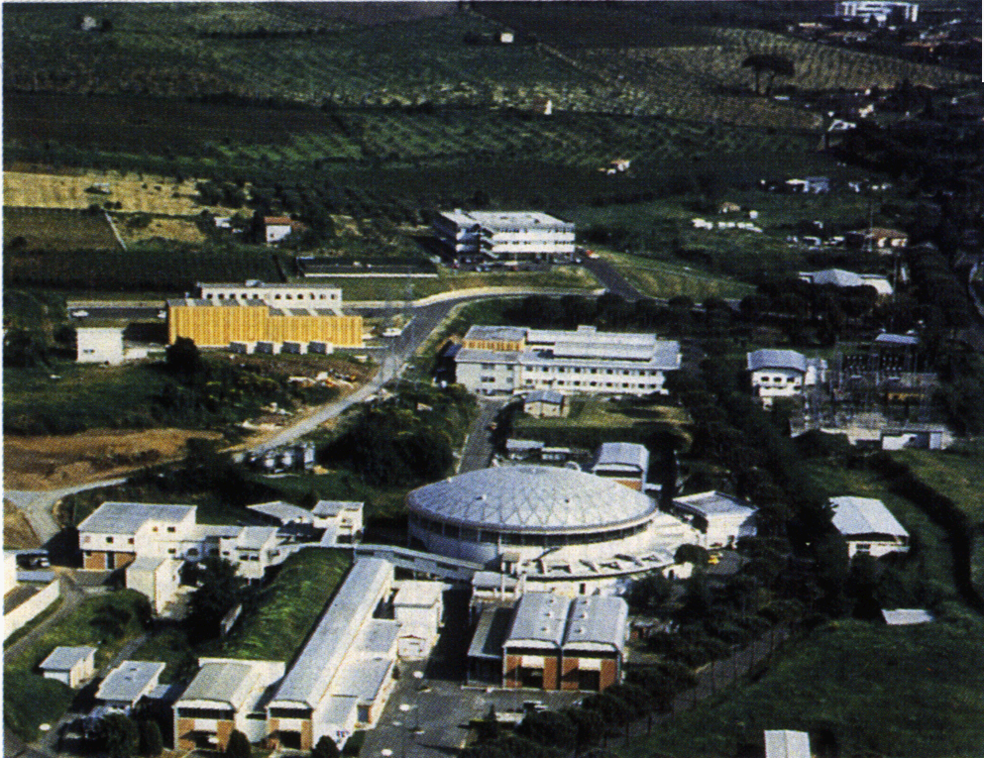

1951
4 “Sezioni”
Milano, Torino, Padova and Roma
1957
Frascati National labs.
Frascati
Notes:
“Ragazzi di via Panisperna” → Fermi: necessita’ di “strumenti” costosi (acceleratori, gia’ in costruzione negli USA) e infrastrutture (servizi tecnici specializzati)
Dai gruppi di lavoro di Enrico Fermi (Roma) e Bruno Rossi (Firenze) nasce l’idea di un “Istituto Nazionale di Fisica” (anni ‘30); bisognera’ attendere la fine della guerra e l’impegno di Edoardo Amaldi (unico dei “Ragazzi” rimasto in Italia) per veder nascere nel 1951 l’INFN e poco dopo il primo Laboratorio Nazionale (Frascati)
The group of “the boys of Via Panisperna,” the most famous member of which was Enrico Fermi, conducted a series of nuclear physics experiments of fundamental importance at the Isitiuto di Fisica at the University of Rome in the 1930’s. Fermi realized that continuing progress in the field would require costly scientific instruments (such as accelerators, which were already under construction in the USA), and technical infrastructure (specialized technical services).
The idea of an “Istituto Nazional di Fisica” had its origins in the research groups of Fermi (at Rome) and Bruno Rossi (at Florence) in the 1930’s. However, societal unrest during the war years made such a vision impossible to achieve until Edoardo Amaldi (the only one of the “boys” to remain in Italy) worked to found the INFN in 1951. Shortly afterwards, in 1957, the first national laboratory was founded at Frascati.

Slide 4
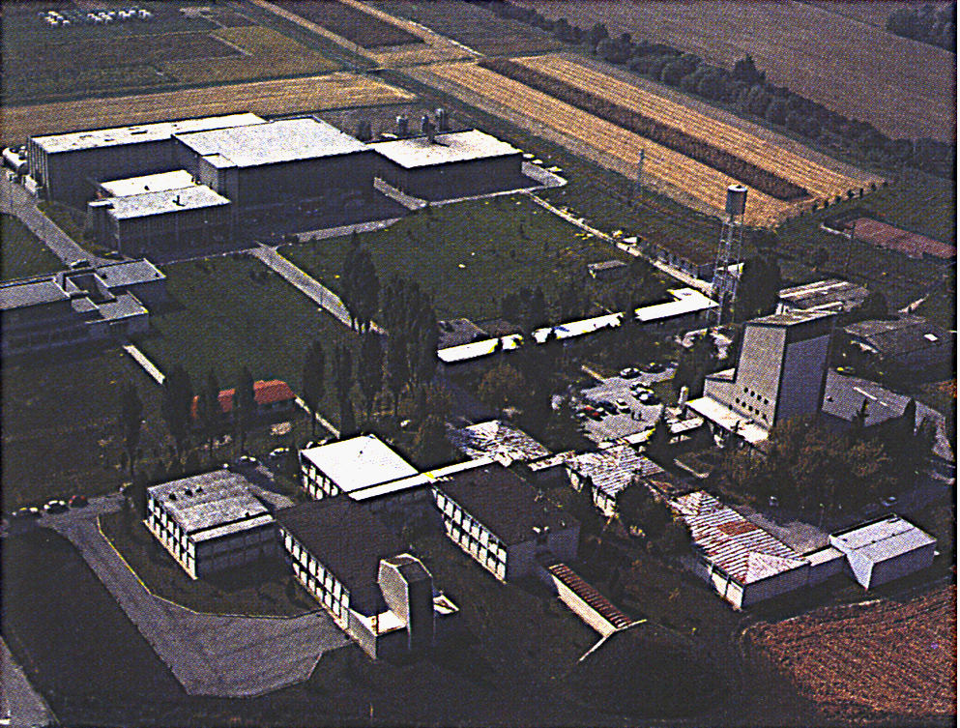
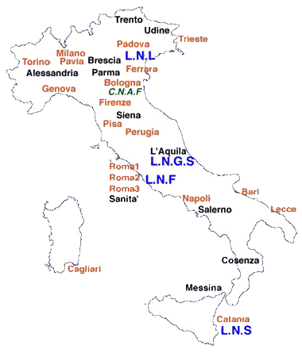
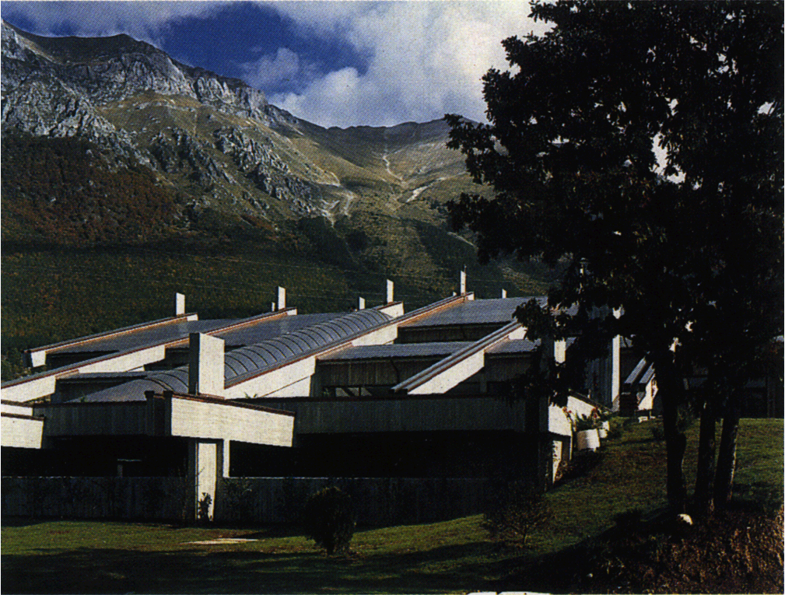
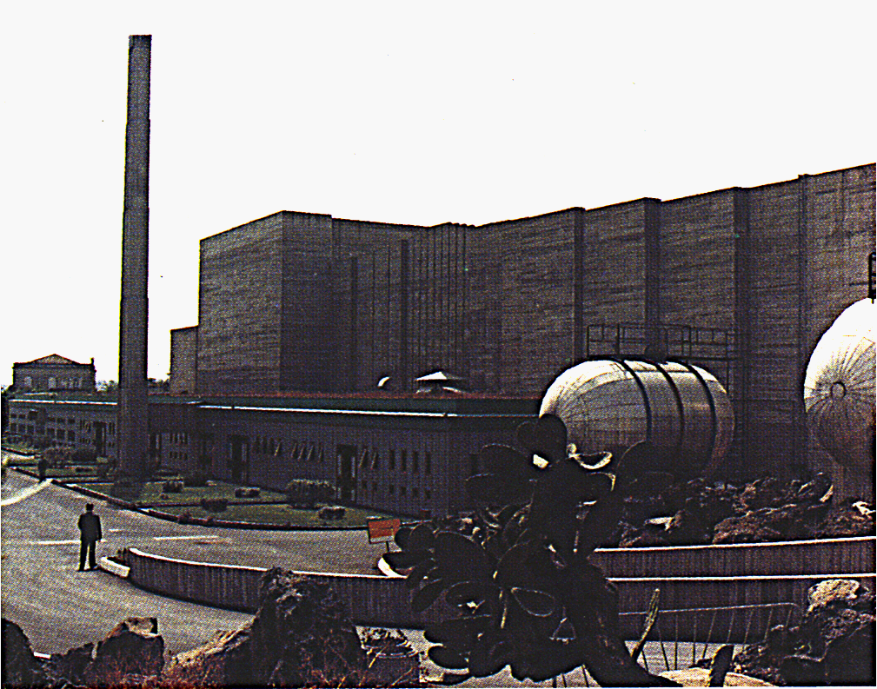
INFN oggi
Gran Sasso
Legnaro
20 “Sezioni”
11 Gruppi collegati
4 National Labs.
LNS
(Catania)
Notes:
Con il passare degli anni sono nate sezioni dell’INFN presso quasi tutti I dipartimenti di Fisica delle Universita’ italiane → possibilita’ tecnica e logistica per coloro che vogliono fare ricerca di fisica nei “campi propri dell’INFN”
Sono nati, oltre I LNF, altri 3 Laboratori Nazionali
Legnaro: fisica dei nuclei pesanti, studio della struttura nucleare, comprensione delle reazioni di nucleo sintesi all’interno delle stelle; onde gravitazionali (Auriga = Nautilus). Attivita` di tipo interdisciplinare: radiobiologia, microdosimetria, studio degli elmenti inquinanti dell’ambiente. Programmi/studi per l’incenerimento delle scorie radioattive.
Laboratori del Sud (Catania): fisica nucleare fondamentale, astrofisica nucleare;studio di tecniche di conservazione e restauro dei beni artistici (Botticelli), storici (Petrarca) e archelogici; terapie mediche, in part. cura del melanoma oculare.
Gran Sasso (1400 m di roccia; reiezione cosmici 1;1 000 000; 12 esperimenti): esperimenti di fisica passiva: studio di raggi cosmici, studio di eventi astrofisici che avvengono a energie non raggiungibili dagli acceleratori; proprieta’ dei neutrini (solari, da supernova, da acceleratori –CERN-); ricerca/studio materia oscura. Lab. usato anche da geologi e biologi.
Virgo: progetto speciale dell’INFN in collaborazione con il corrispondente ente di ricerca francese, per la ricerca e lo studio delle onde gravitazionali.
During the last 50 years, INFN sections have been established at the physics departments of practically every Italian university. These sections are the primary institutional link between the INFN and the university sector, and provide the technical and logistical support for university research in high-energy physics in Italy
In addition, three other national laboratories have been established.
Legnaro: physics of heavy nuclei, studies of nuclear structure, and gravitational wave research (AURIGA = NAUTLIUS)
Laboratori del Sud (Catania): fundamental nuclear physics, technologies for the conservation and restoration of our artistic hertiage.
Gran Sasso: “Passive” high-energy experiments (without accelerators): studies of cosmic rays and the properties of neutrinos.
VIRGO is a special project involving collaboration between the INFN and the corresponding French research organization for the experimental search for gravitational waves and the study of their properties.
The annual budget of the INFN is about the same as that of the F.C. Juventus.

Slide 5

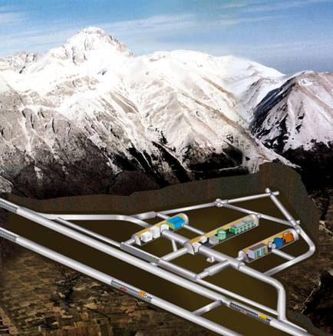
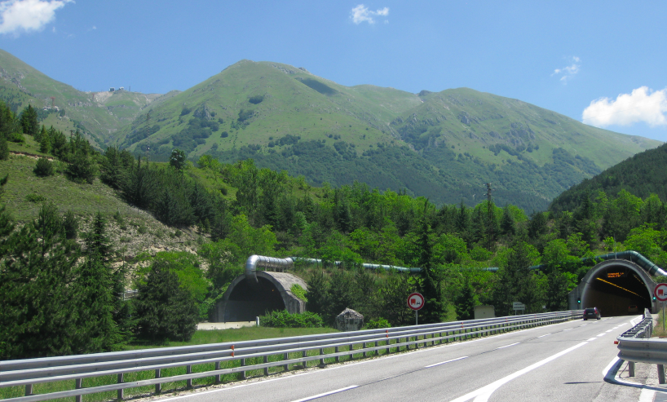
Highlights from Gran Sasso Laboratory
Gran Sasso National Laboratory
LNGS
Lucia Votano – INFN Gran Sasso National Laboratory

Slide 6
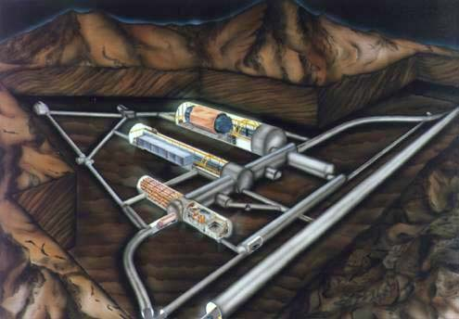
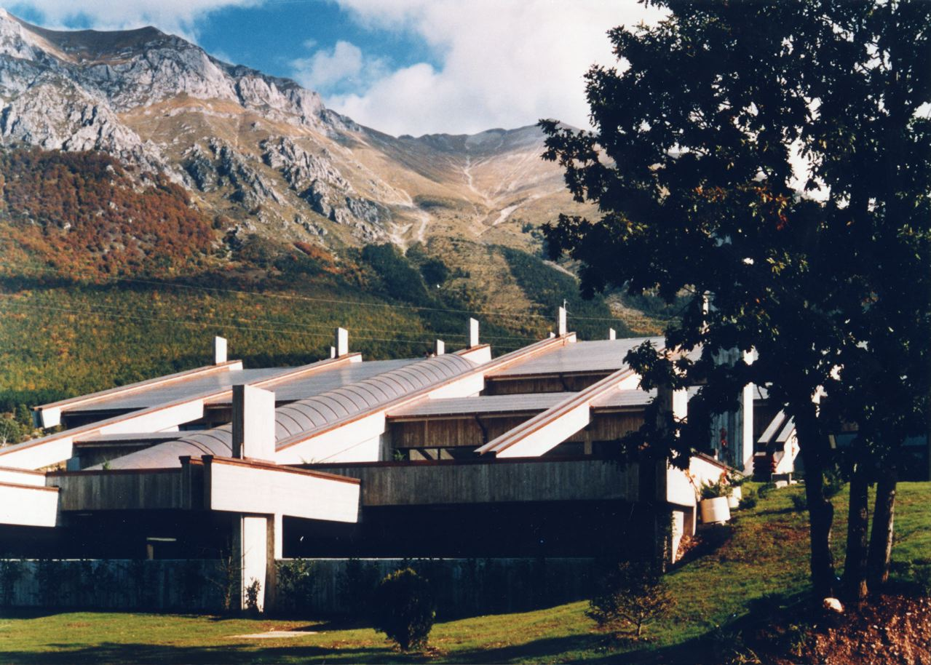
Gran Sasso Laboratory
3 main halls A B C ~100 x 20 m² (h 20 m)
Muon Flux
3.0 10⁻⁴ μ m⁻² s⁻¹
Neutron Flux
2.92 10⁻⁶ n cm⁻² s⁻¹ | (0-1 keV)
0.86 10⁻⁶ n cm⁻² s⁻¹ | (> 1 keV)
Depth: 1400 m (3800 m w.e.)
Surface: 17800 m²
Volume: 180000 m³
Rn in air: 20-80 Bq/m³
ISO 14001
Ventilation: 1 Lab volume/3 h
Electrical power: 1300 kW
Access: horizontal
External facilities

Slide 7
Gran Sasso Laboratory
Research activities:
Dark matter searches
Neutrino physics
Nuclear Astrophysics
Associate Sciences:
Environmental Radioactivity for Earth Sciences,
Geophysics, Fundamental Physics, Biology

Slide 8
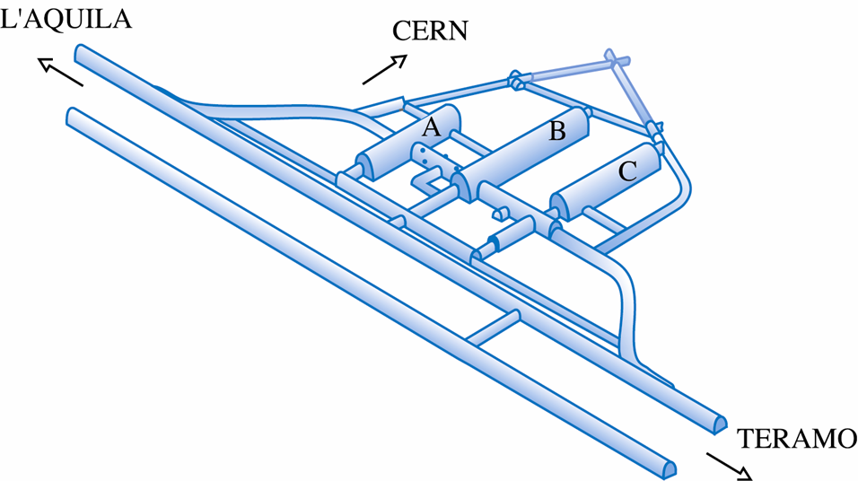
OCCUPANCY
XENON 1T
CRESST
GERDA
ERMES
LUNA MV
LUNA
LVD
XENON
ICARUS
CUORE
BOREXINO
DarkSide 50
ERMES-WORLD
VIP
OPERA
COBRA
LOW ACTIVITY LAB
DAMA/LIBRA
DS-50

Slide 9
Neutrino physics @ LNGS
Basic neutrino properties
  0νDBD (GERDA, CUORE, LUCIFER, COBRA)
Solar neutrinos (BOREXINO)
  ⁷Be the main target
  ⁸B, pep first evidence, CNO limit, and possibly pp
Geo anti-neutrinos (BOREXINO)
CNGS neutrinos
  OPERA and ICARUS
SuperNova neutrinos
  LVD, BOREXINO and ICARUS
  LVD and Borexino are in the SNEWS network

Slide 10
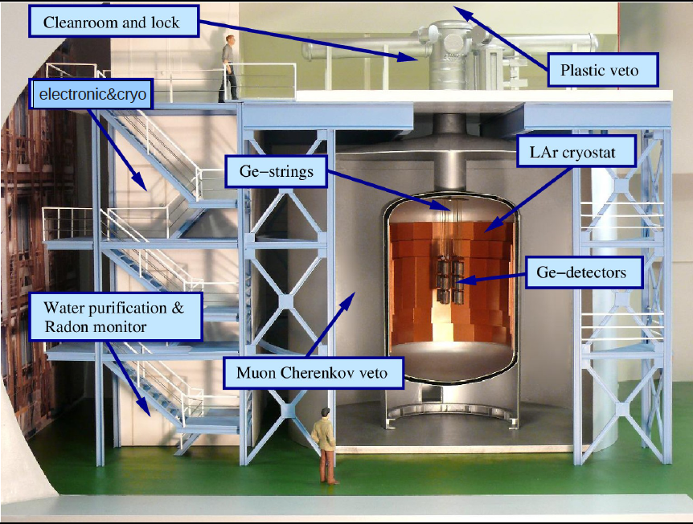
GERDA DETECTOR

Slide 11
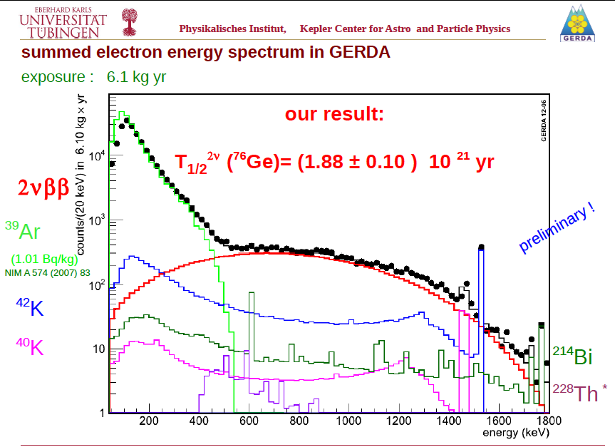
GERDA 2νββ preliminary results
Summed electron energy spectrum

Slide 12
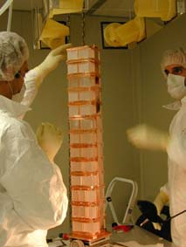
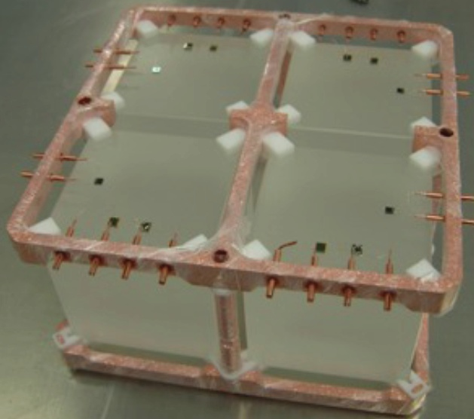
CUORE (Cryogenic Underground Observatory for Rare Events)
The aim of CUORE experiment is is to study 0νββ from ¹³⁰Te by using cryogenic detectors made of TeO₂ crystals
The prototype CUORICINO, operated at LNGS up to 2008, demonstrated the feasibility of the large scale detector CUORE
In Construction at LNGS
Notes:
12
12

Slide 13
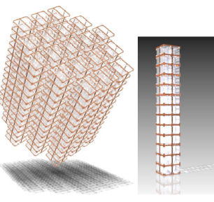
From CUORICINO to CUORE
closely packed array of 988 detectors
19 towers - 13 modules/tower - 4 detectors/module M = 741 kg ⇒ ∼ 10²⁷ ¹³⁰Te nuclides
200 kg ¹³⁰Te
Expected 5 Years sensitivity:
T_{1/2} = 2.1 x 10²⁶ y, m_{ββ}=41−95 meV
background counting rate
10⁻² c/keV/kg/y
Compact structure, ideal for active shielding
the first tower CUORE-0
in commissioning phase
Custom dilution refrigerator
Notes:
13

Slide 14
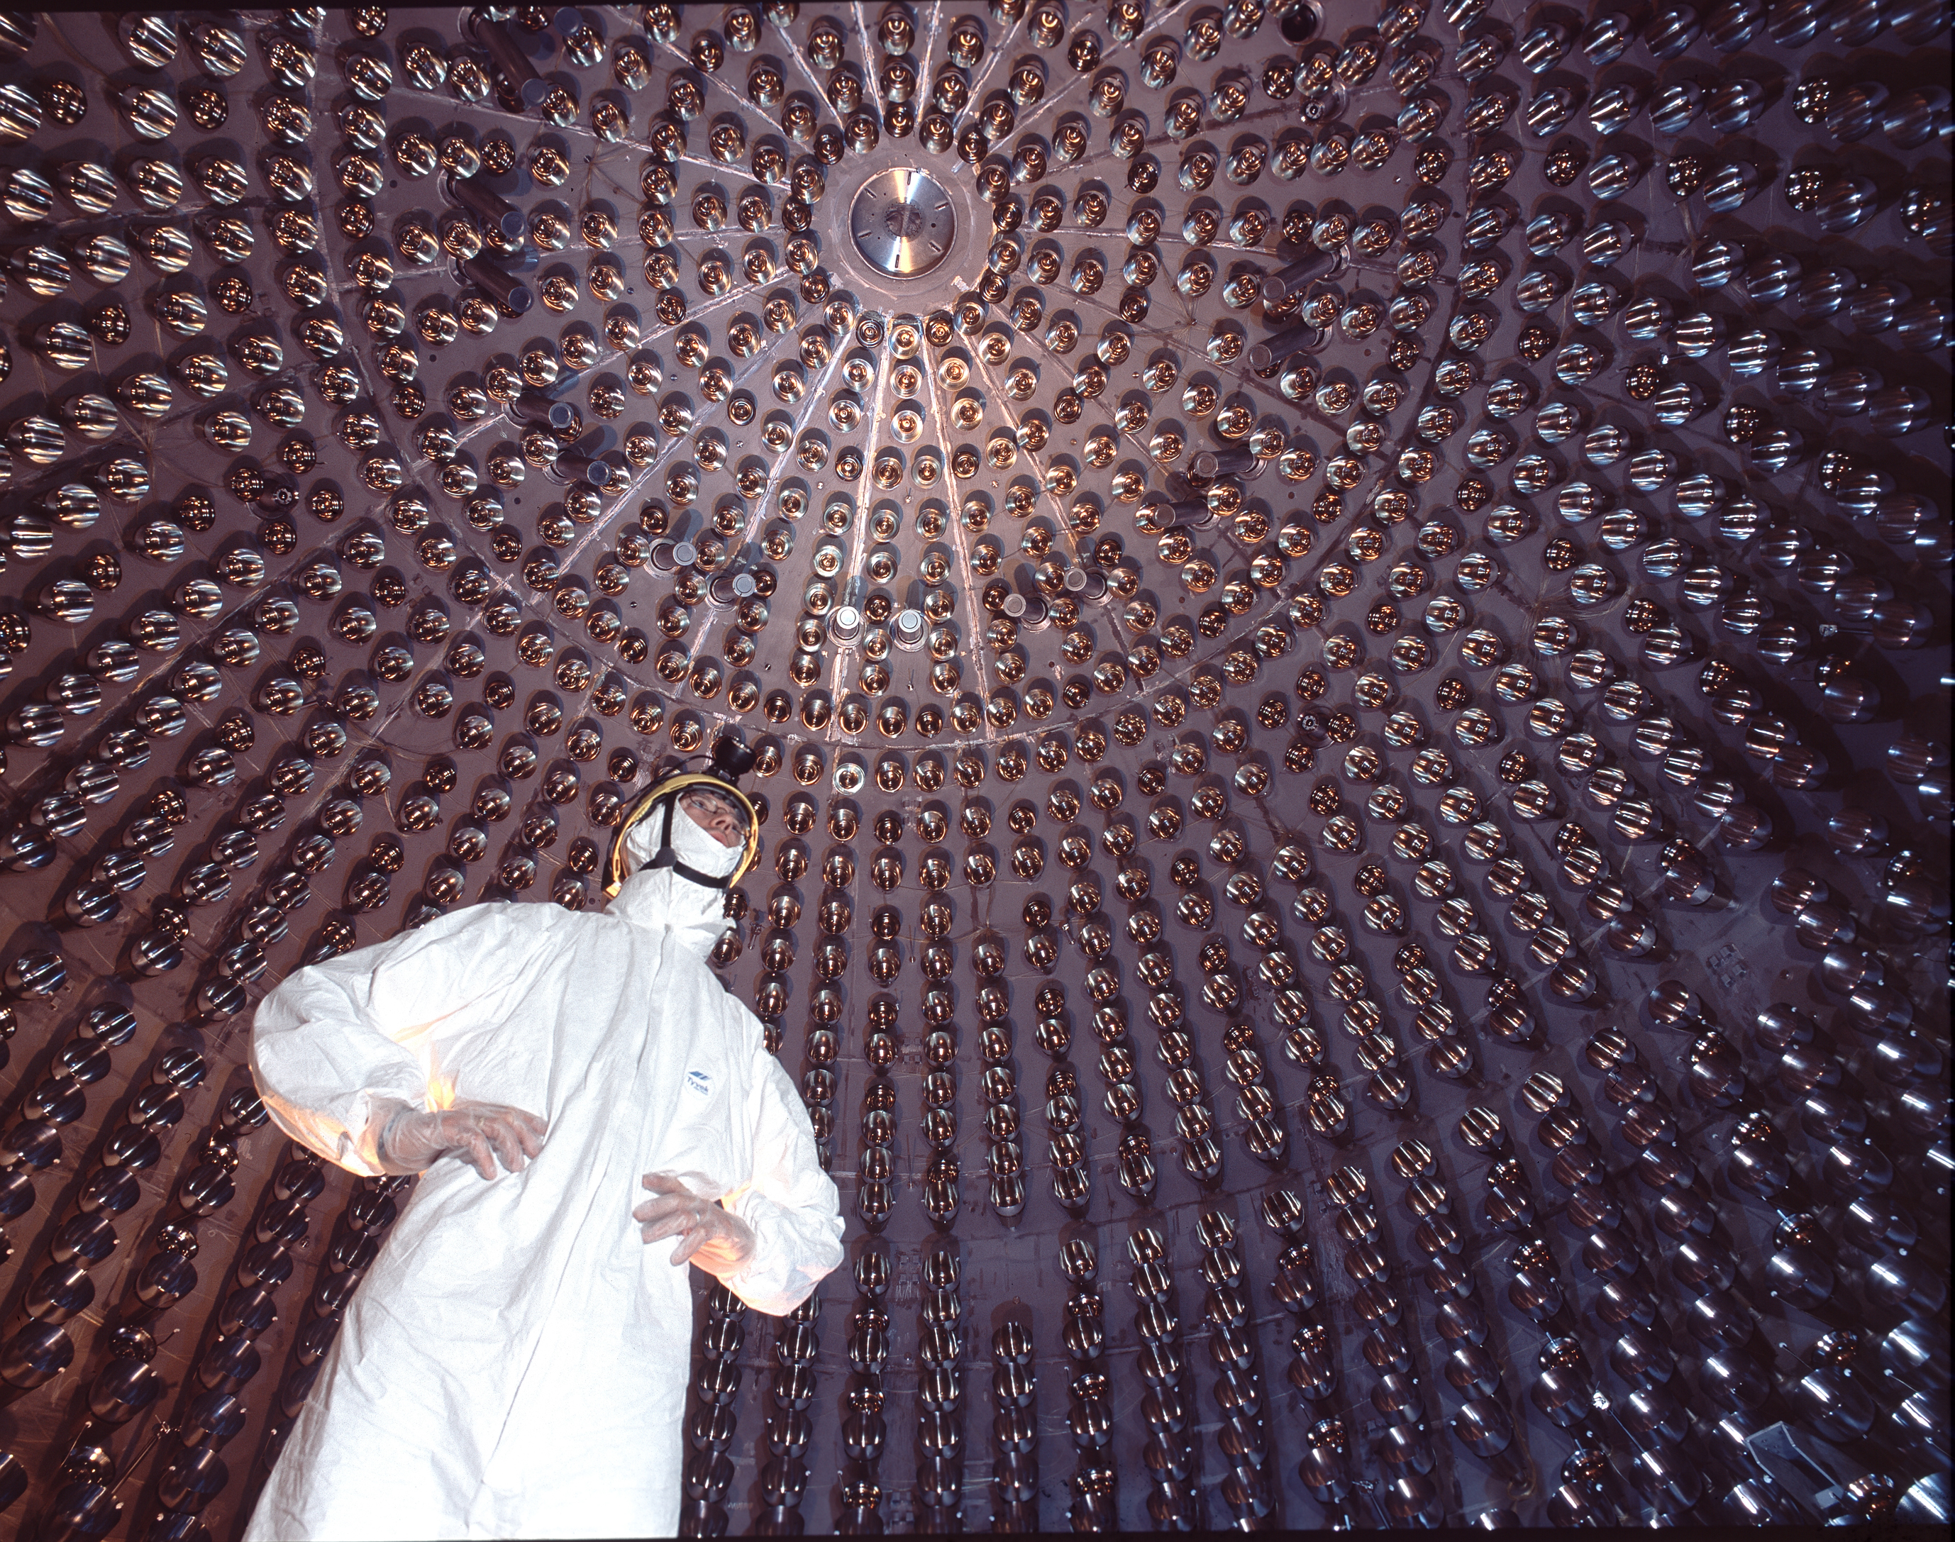
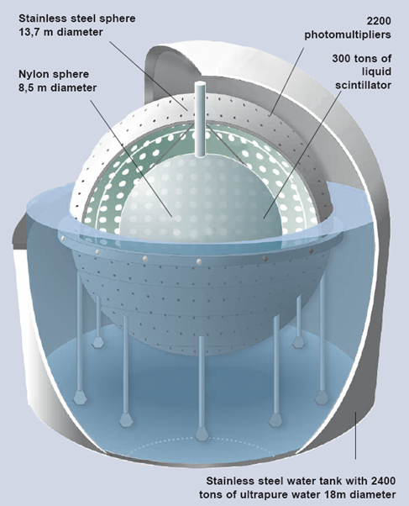
BOREXINO:
a real time liquid scintillator detector for solar neutrinos
  278 tons of PC+PPO in a nylon bag
  2200 photomultipliers
  2500 tons ultrapure water

Slide 15
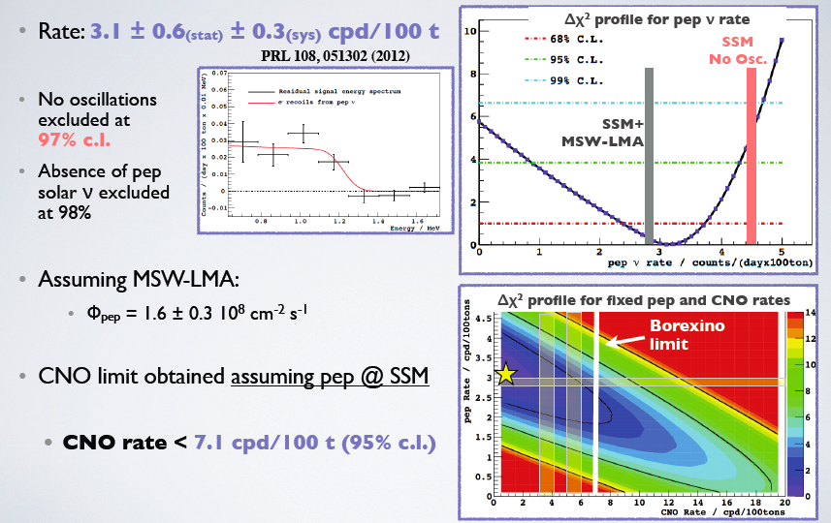
FIRST DETECTION OF PEP NEUTRINOS
Courtesy M. Pallavicini

Slide 16
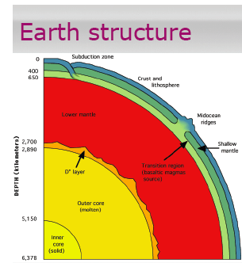
Geo-ν: a unique direct probe of the Earth interior
The radioactive isotopes inside the Earth generate heat.
The Earth shines in anti-ν
  ²³⁸U → ²⁰⁶Pb + 8 α + 8 e⁻ + 6 ν_{e} + 51.7 MeV
  ²³²Th → ²⁰⁸Pb + 6 α + 4 e⁻ + 4 ν_{e} + 42.8 MeV
  ⁴⁰K → ⁴⁰Ca + e⁻ + 1 ν_{e} + 1.32 MeV
Only two detectors (Kamland,Borexino) are presently able to detect Geo ν
Relevance of geoneutrinos study: a new probe of the Earth interior
The movement of the heat within the Earth is central in the theory of plate tectonics
What is radiogenic contribution to the Earth energy budget (50%??)?
What is the distribution of the radiogenic elements?
How much in the crust and how much in the mantle?

Slide 17
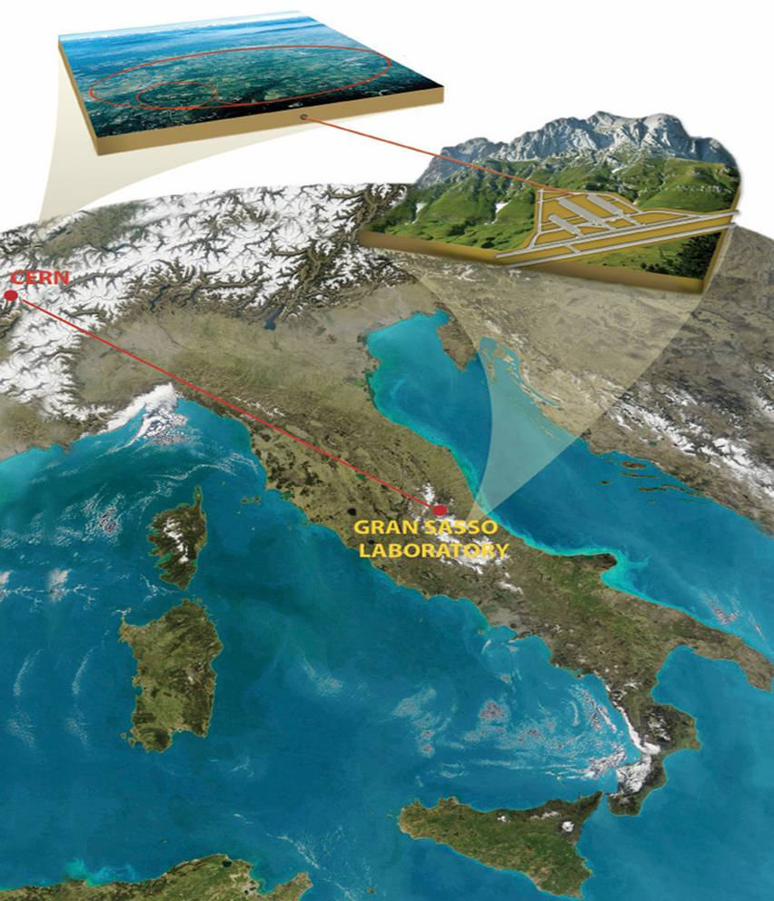
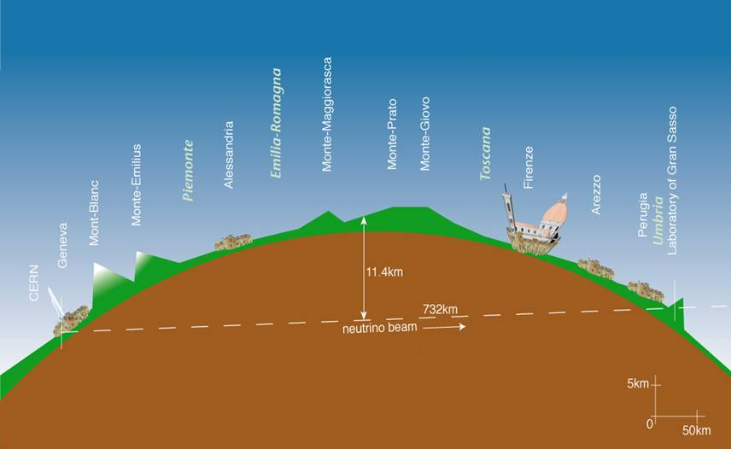
CNGS beam:
CERN Neutrino to Gran Sasso
Energy:
optimized for ν_{t} appearance mode
Goal:
prove definitely the neutrino oscillations
Project INFN-CERN: approved in 1999, started in 2006
ν_{μ} beam produced at CERN and detected at LNGS
Experimental halls designed in the CERN direction
OPERA running since 2006
ICARUS running since 2010
L = 730 km
CERN
T_{flight} = 2.44 ms
LNGS
Notes:
17
17

Slide 18
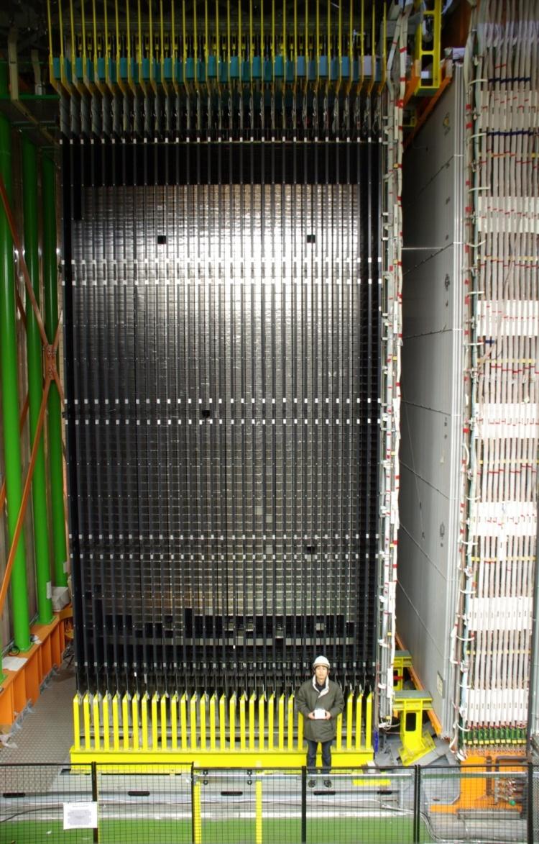
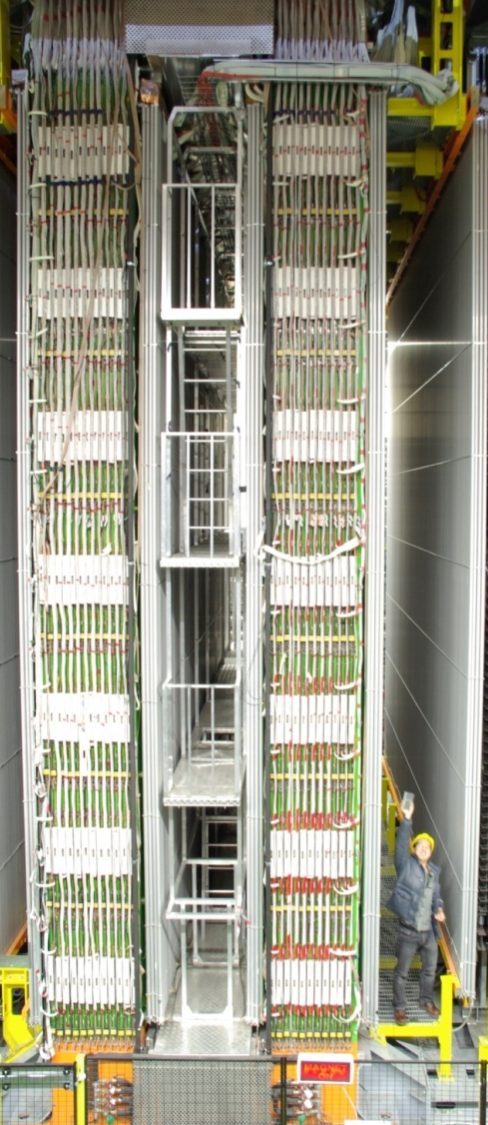
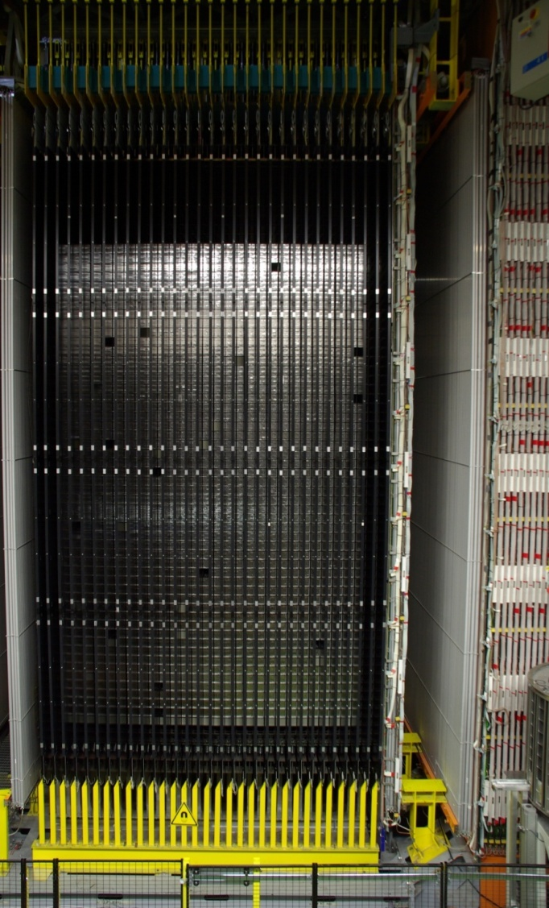
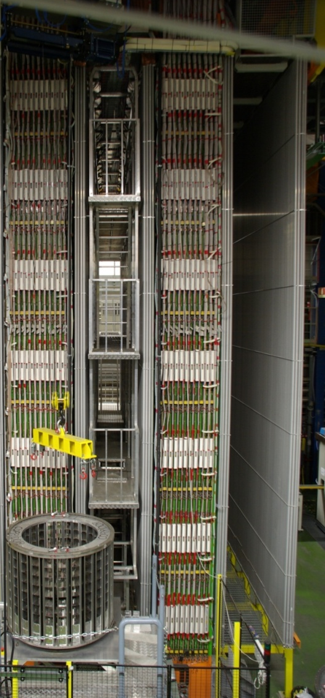
OPERA: Oscillation Project with Emulsion tRacking Apparatus
Direct search for ν_{μ}→ ν_{τ} oscillations by looking at the appearance of
ν_{τ} in a pure ν_{μ} beam
• Search for the sub-dominant ν_{μ}→ ν_{e} oscillations for ₁₃ measurement
Hybrid target structure.
ν_{μ}
μ⁻
ν_{μ}
ν
decay “kink”
ν_{μ}
oscillation
μ⁻
ν_{τ}
τ^{-}
e⁻
h⁻
~1 μm
 | Signal Δm² = 2.5 x 10⁻³ eV² | Background
Counts for 22.5x10¹⁹ pot | 10.4 | 0.75
(CS)

Slide 19
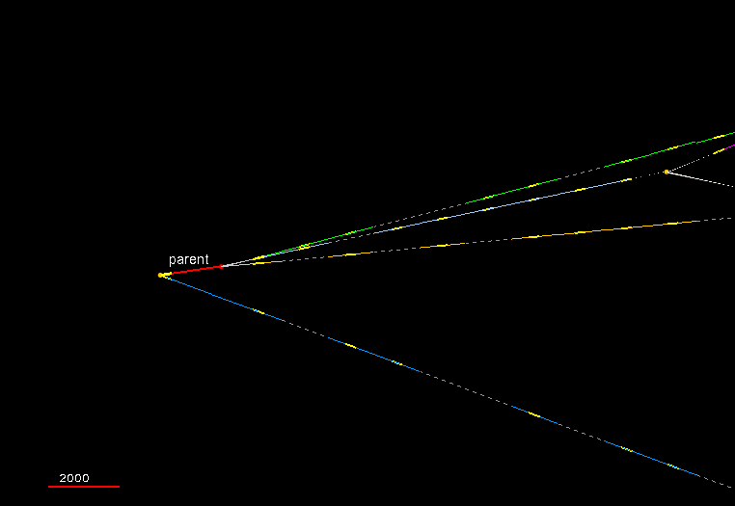
Neutrino Oscillations: OPERA
animation
In 2012 the second ν_{τ} candidate. Event taken on April 2011
Topology and reconstruction
2000 μm

Slide 20
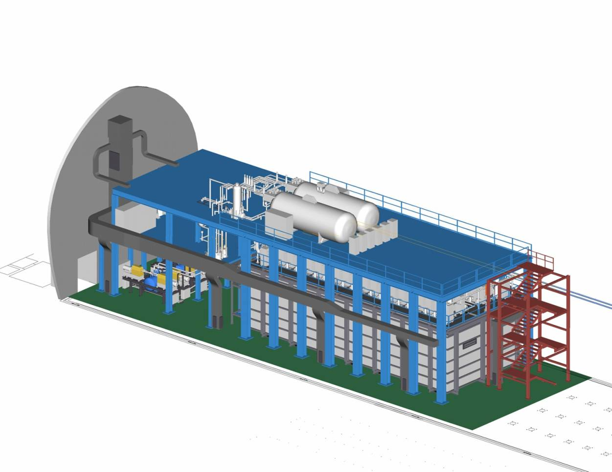
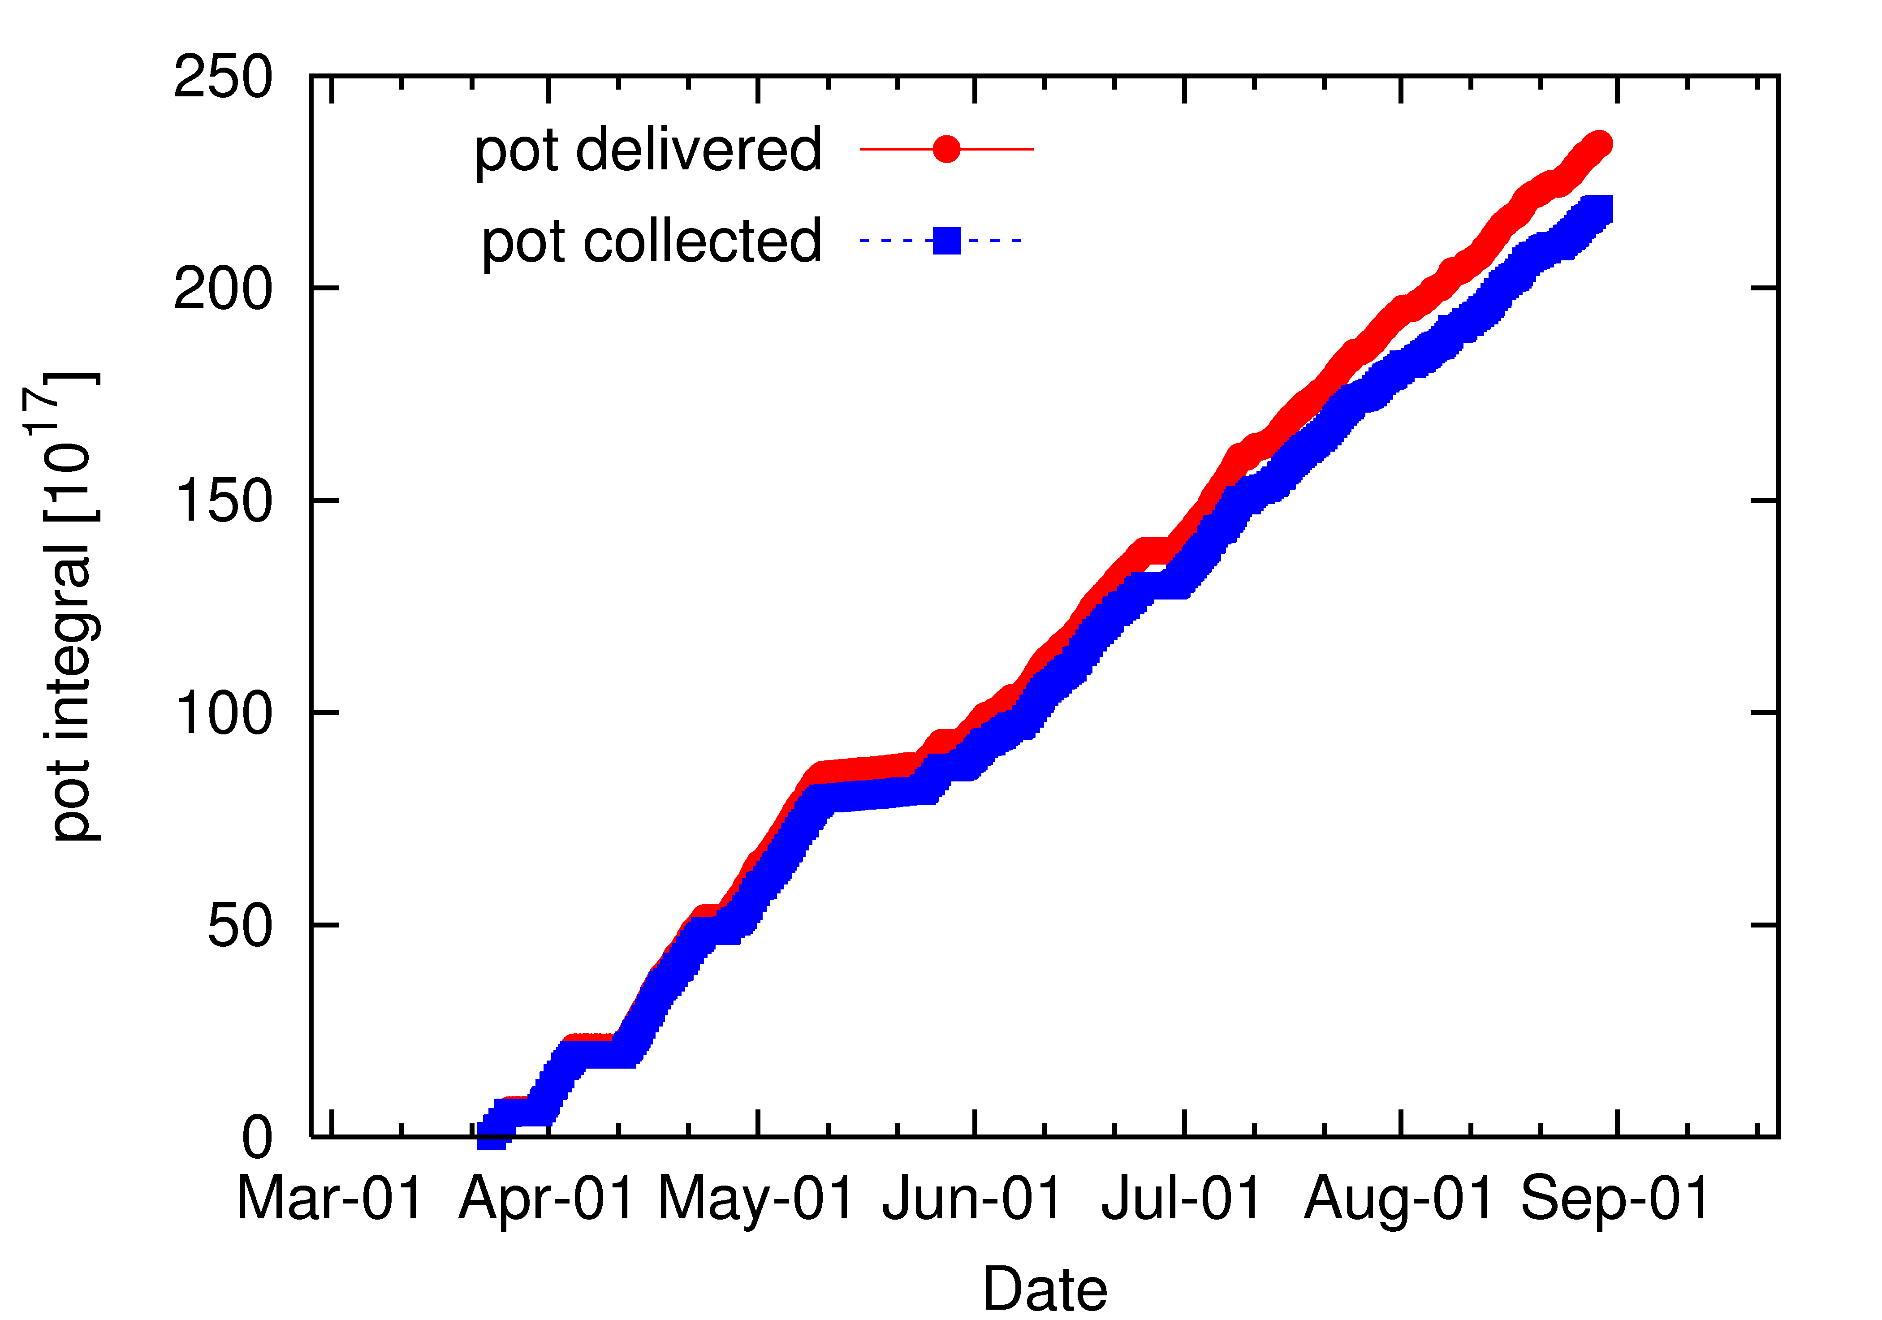
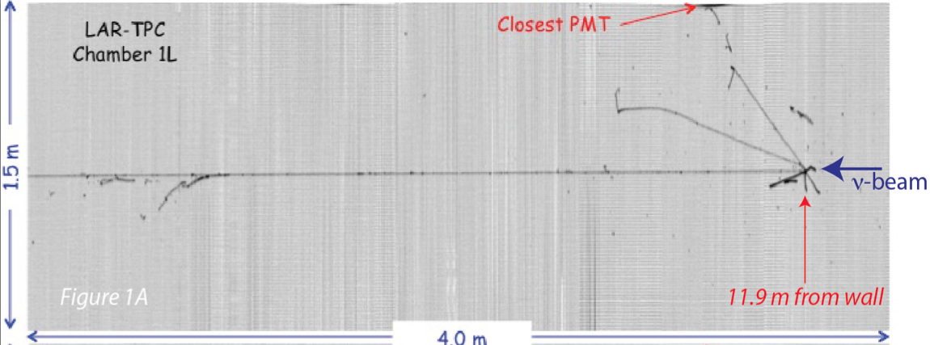
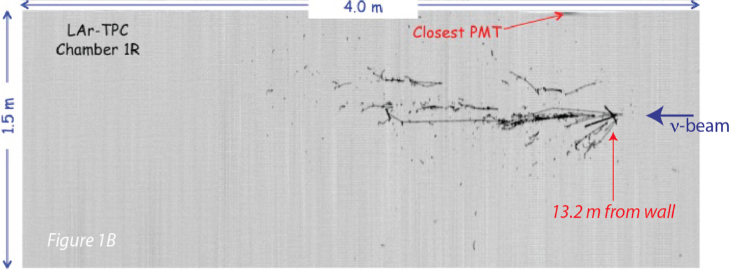
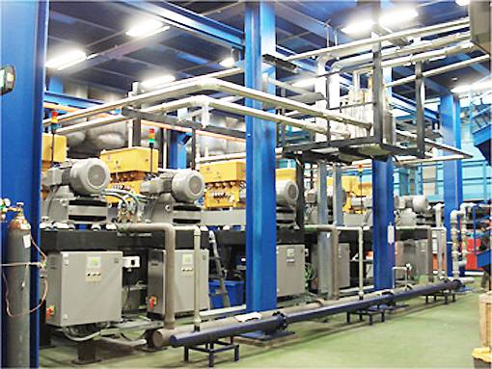
ICARUS T600 @ LNGS
Two identical modules
3.6 x 3.9 x 19.6 ≈ 275 m³ each
Liquid Ar active mass: ≈ 476 t
Conceived as a Multi-purpose detector: atmospheric, solar (>8 Mev), supernovae neutrinos, nucleon decay searches in “exotic” channels, CNGS beam
The most important Milestone
towards a multi-kton LAr detector
with unique imaging capability,
and spatial/calorimetric resolutions
CNGS neutrino events
  2012 detector live-time > 93%
  May 10th ÷ 24th 2012: timing measurement with bunched beam.
  2010-2011 data sample (3.3 10¹⁹ pot)
  1091 neutrino interaction analyzed.
2012
NC event
CC event

Slide 21
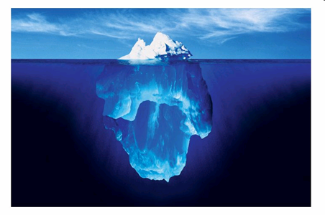
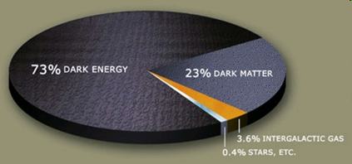
The dark side of the Universe...
Notes:
21

Slide 22
Dark Matter @LNGS
Rich experimental program at LNGS in the next years many complementary techniques and target materials available
  Ultrapure scintillating NaI Crystals
    DAMA/LIBRA: continues observations on annual modulation with improved set-up (lower energy threshold)
  Liquid XENON
    Xenon 100: Running, new results expected by 2012
    XENON 1T: approved by INFN and LNGS SC, location: Hall B,
    MOU signed, installation will start by fall 2012
  Liquid Argon Technology
    Pioneered by Warp, continues with DarkSide 50
  CRESST
    Results shown one year ago, will resume Data Taking with low bkg
    precursor of the next-generation dark matter project EURECA

Slide 23
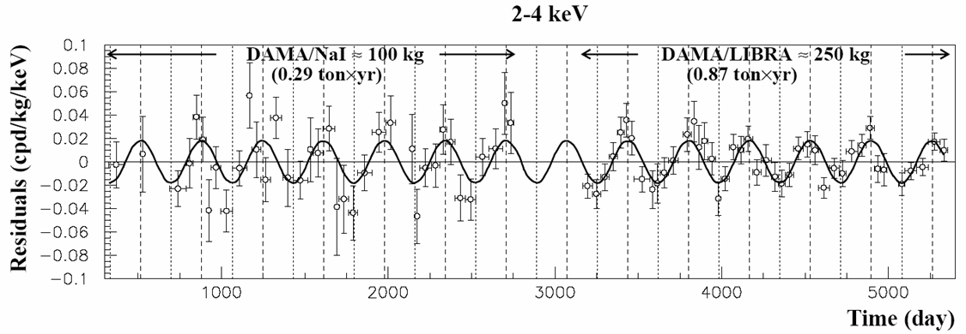
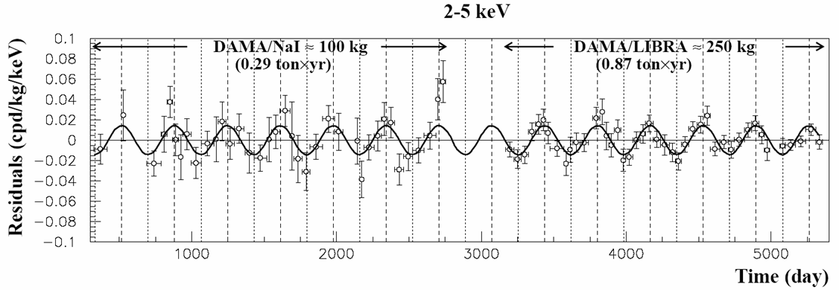

DAMA/LIBRA: Model Independent Annual Modulation Result
DAMA/NaI (7 years) + DAMA/LIBRA (6 years) Total exposure: 425428 kg·day = 1.17 ton·yr
experimental single-hit residuals rate vs time and energy
EPJC67(2010)39; see also refs therein
Acos[w(t-t₀)] ; continuous lines: t₀ = 152.5 d, T = 1.00 y
2-4 keV
A=(0.0183±0.0022) cpd/kg/keV
χ²/dof = 75.7/79 8.3 σ C.L.
Absence of modulation? No
χ ²/dof=147/80 → P(A=0) = 7 · 10⁻⁶
2-5 keV
A=(0.0144±0.0016) cpd/kg/keV
χ²/dof = 56.6/79 9.0 σ C.L.
Absence of modulation? No
χ²/dof=135/80 → P(A=0) = 1.1·10⁻⁴
2-6 keV
A=(0.0114±0.0013) cpd/kg/keV
χ ²/dof = 64.7/79 8.8 σ C.L.
Absence of modulation? No
χ ²/dof=140/80 → P(A=0) = 4.3·10⁻⁵
The data favor the presence of a modulated behavior with proper features at 8.8σ C.L.

Slide 24

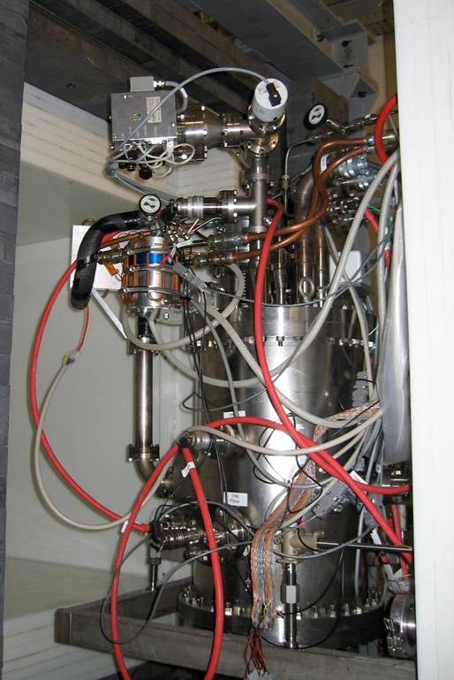
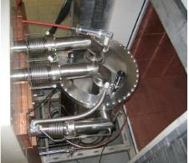
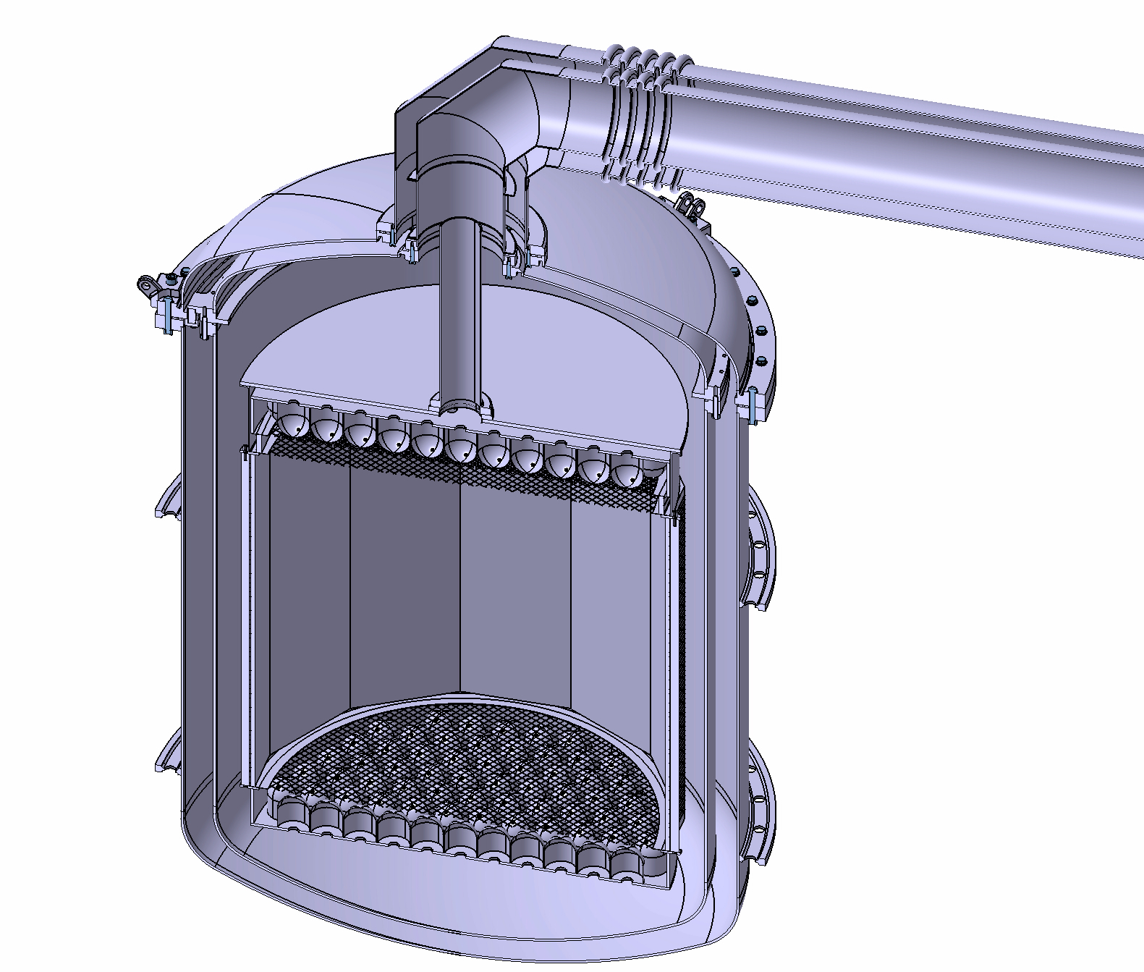
The XENON Dark Matter Program
past (LNGS)
(2005 - 2007)
current (LNGS)
(2008-2011)
future
(2012-2015)
XENON10
Achieved (2007) σSI=8.8 x10⁻⁴⁴ cm²
XENON100
Achieved (2010) σSI=2.4 x10⁻⁴⁴ cm²
Achieved (2012) σSI=2x10⁻⁴⁵ cm²
XENON1T
Projected (2015) σSI ~10⁻⁴⁷ cm²
Installation in Hall B @LNGS will start this Fall

Slide 25
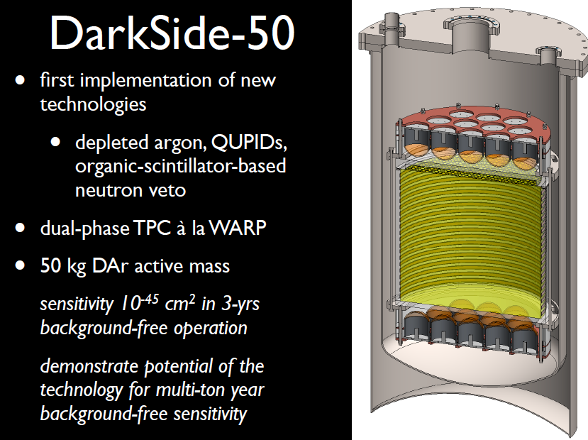

Slide 26
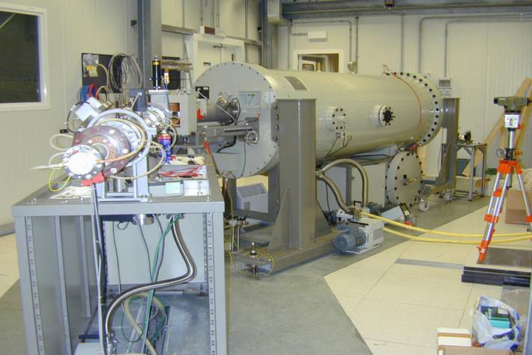
Laboratory for Underground Nuclear Astrophysics
400 kV Accelerator : E _{beam} ≈ 50 – 400 keV
I _{max} ≈ 500 μA protons I _{max} ≈ 250 μA alphas
Energy spread ≈ 70 eV Long term stability ≈ 5eV/h

Slide 27
Nuclear astrophysics FUTURE: LUNA MV key reactions of the He burning and neutron sources for the s-process
¹²C(α,γ)¹⁶O, ¹³C(α,n)¹⁶O, ²²Ne(α,n)²⁵Mg, (α,γ) reactions on ^{14,15}N and ¹⁸O → reactions relevant at higher temperatures than reactions belonging to the hydrogen-burning studied so far at LUNA
higher energy machine required: 3 MV
CERN
Location underground has been identified: interferometric area
n production could be an issue with other experiments
no major impact in the foreseen position

Slide 28
Nuclear astrophysics FUTURE: LUNA MV key reactions of the He burning and neutron sources for the s-process
¹²C(α,γ)¹⁶O, ¹³C(α,n)¹⁶O, ²²Ne(α,n)²⁵Mg, (α,γ) reactions on ^{14,15}N and ¹⁸O → reactions relevant at higher temperatures than reactions belonging to the hydrogen-burning studied so far at LUNA
higher energy machine required: 3 MV
CERN
Last news
The Project has been funded (2.805 K€)
by MIUR

Slide 29
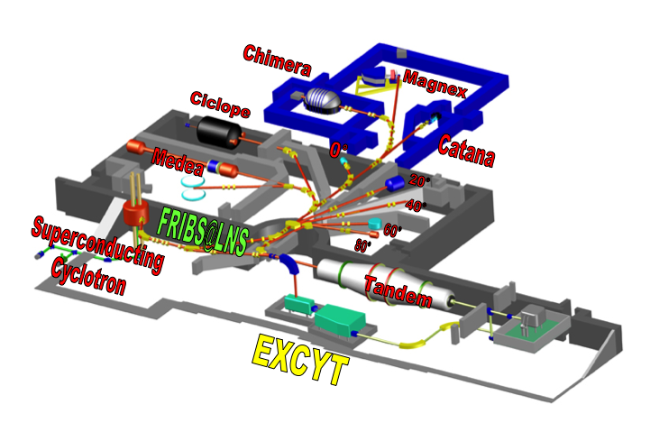
LNS lay-out: accelerators and experimental halls
FRIBS@LNS: in Flight
Radioactive Ion Beams at LNS
EXCYT: Exotics at the
Cyclotron and Tandem

Slide 30
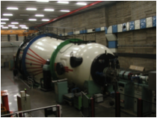
Tandem status
The HVEC MP Tandem has been operating since 1984
In 2012 two major problems are being faced
Vacuum losses in the first accelerating tube
after repairing by means of a special vacuum leak sealant the residual pressure is now around the operating value
Charging system
find a new belt with good mechanical and electrical properties since HVEC is not providing belts any longer
  → Tandem upgrading
  Alternative to the belt : Pelletron (NEC)
  Replacement of the first and eighth (damaged) accelerating tubes

Slide 31
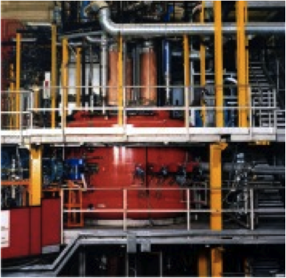
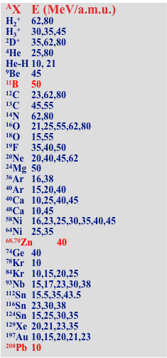
Superconducting Cyclotron developed beams
A wide variety of beam types have been developed. In red the most recent beams, among the most difficult ones to be produced.

Slide 32
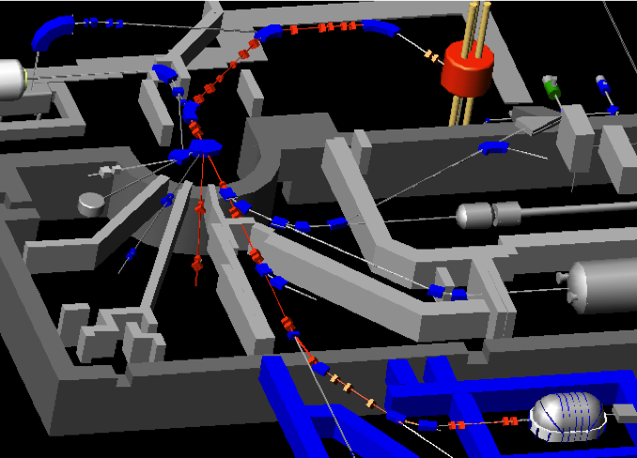
FRIBS@LNS: in Flight Radioactive Ion BeamS
Production Target:
0.5, 1.5, 2.5 mm Be
FRIBs
station
20° beam line - HODO
≈ 90% vs. FRIBs station
CHIMERA beam line
≈ 50% vs. FRIBs station

Slide 33
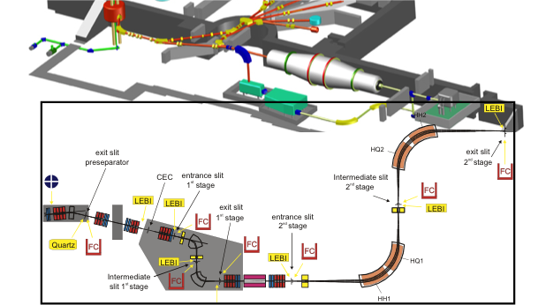
EXCYT: the LNS ISOL facility
Preseparator
2° stage
1° stage
The mass separator system consists of a pre-separator and 2 main stages, the pre-separator and the first stage being assembled on two 250 kV platforms
(M/ΔM)_{Pre} ≈ 180 (pre-separator : 18° magnet and a quadruplet of 4 electrostatic quadrupoles)
(M/ΔM)_{1st} ≈ 2000 (I stage: 2 magnets (77°, 90°) and 2 quadruplets of 4 electrostatic quadrupoles)
(M/ΔM)_{2nd} ≈ 20000 (II stage: 2 magnets (90°) and a quadruplet of 4 electrostatic quadrupoles)

Slide 34
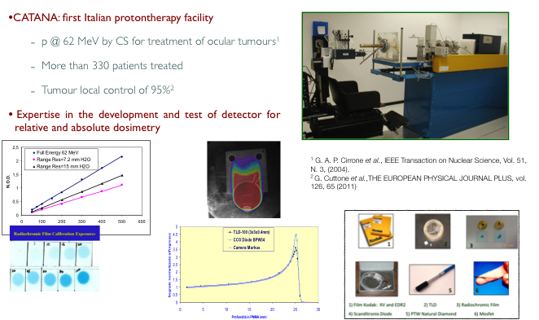

Slide 35
Follow-up on 220 patients
PATIENTS FOLLOW-UP
350 patients treated (Feb. 2002-Jul 2012)
336 uveal melanomas
8 conjunctival melanoma
6 other malignancies (orbital RMS, non-Hodgkin Lymphoma, various metastases)

Slide 36
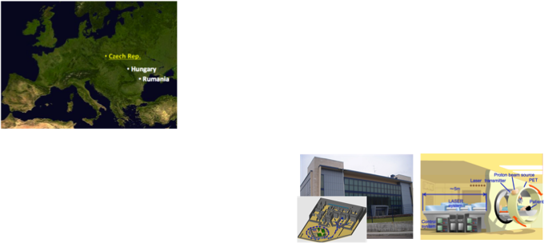
ELI-Beams and the ELIMED idea
ELI (Extreme Light Infrastructure)
new type of European large scale laser infrastructure specifically designed to produce the highest peak power (10 PW) and focused intensity;
ELI-Beamlines
(Czech Rep.)
Ungary
Romania
...
ELIMED
X-ray sources
Exotic physics
...
Why ELIMED?
  Realization of a facility at ELI-Beamlines, to demonstrate the clinical applicability of the laser-driven protons
  Compactness, cost-reduction, new pioneering treatment modalities
today
tomorrow?
Why ELIMED at INFN?
The project we are proposing is related to the preparatory phase of ELIMED (2013-2015): optimisation of the proton beams, transport, diagnostic dosimetric and radiobiologic studies.

Slide 37

European Spallation Source – Lund (Sweden)
ACCELERATORS
High power, highly reliable Front Ends
High intensity light ions Linacs : systems design, beam dynamics, performance and current projects, reliability issues,
Synergies with ongoing and planned projects on accelerator driven systems, transmutation, neutrino factories, HEP injectors, materials science
Beam loss handling and diagnostics systems for high brightness hadron accelerators (≪1 W/m with localized exceptions)
Current state of theory and simulation tools, confronting predictions with experiment,
Low-energy superconducting structures, to be checked: how competitive they are for energies below 100 MeV…
 | Nominal | Upgrade
Average beam power | 5.0 MW | 7.5 MW
Macropulse length | 2.86 ms | 2.86 ms
Repetition rate | 14 Hz | 14 Hz
Proton energy | 2.5 GeV | 2.5 GeV
Beam current | 50 mA | 75 mA
Duty factor | 4% | 4%
Beam loss rate | < 1 W/m | < 1 W/m

Slide 38
Collaboration model for linac design update (ADU)
Work Packages
1. Management Coordination – ESS Lund (Mats Lindroos)
2. Accelerator Science – ESS Lund (Steve Peggs)
3. Infrastructure Services –ESS Lund
4. SCRF Spoke cavities – IPN, Orsay (Sebastien Bousson)
5. SCRF Elliptical cavities – CEA, IRFU-Saclay (Guillaume Devanz) with contribution by INFN
6. Front End and NC linac – INFN (Santo Gammino)
7. Beam transport, NC magnets and Power Supplies – Århus University (Søren Pape-Møller)
8. RF Systems – ESS (Dave Mc.Ginnis)
19. Test stand – Uppsala university (Roger Ruber)
ITALIAN CONTRIBUTION : WP6-Units
WU 1 – Management (S. Gammino) WU 2 – Proton Source & LEBT (L. Celona) WU 3 – RFQ (B. Pottin) WU 4 – MEBT (I. Bustinduy) WU 5 – DTL (A. Pisent) WU 6 – Prototype & Tests (S. Gammino)
WP6 except for the RFQ and the MEBT is managed by INFN, DTL at LNL, Ion Source&LEBT at LNS; for the construction phase a contribution for WP5-Superconducting Elliptical Cavities is considered.

Slide 39

Status of the KM3NeT-Italia Project
1998-2012: NEMO R&D, NEMO, ANTARES
2006-2009: Km3Net Consortium Design Study
2009-2012: Km3Net Consortium Preparatory Phase (INFN)
2012-2015: Km3Net Italia (22 M€ funding regione Siciliana and MIUR)
Catania Test Site, 2100 m water depth (25 km)
NEMO Phase 1: test of key deep-sea technologies, muon flux reconstructed
First Cabled node of EMSO: geo-hazard and (bio-)acoustic monitoring
Capo Passero Km3Net-Italia Site, 3500 m water depth (100 km)
Optimal deep-sea Conditions: site search and monitoring activity
NEMO Phase 2: demostrator for the tower-shape detection unit
20 Detection Units in 2015: the largest telescope in the Northern Hemisphere
Seabed network and GARR-X: An open Science Gateway to deep sea
CP Site

Slide 40

Laboratori Nazionali di Legnaro: status and perspectives
α
β
γ
δ

Slide 41



Space and connectivity
Where is LNL ?
Highway
LNL
LNL

Slide 42
Legnaro National Laboratories of INFN
Mission: Research on fundamental nuclear physics and nuclear and nuclear-astrophysics, together with applications of related nuclear technologies
Strength points : developments of accelerators and radiation detectors
Personnel : Every day about 250 people work at LNL, half of these are INFN employees
Cost for INFN : 20 MEuro/year (half for handling and research , half for personnel)
Users: about 700 scientists, half from Italy
Available accelerators: AN2000 e CN plus TANDEM-XTU and ALPI-PIAVE: they deliver in total, some 8000 hours of beam time per year

Slide 43



Gamma detection: from GASP to Galileo
The international dimension of LNL in gamma detection was recognized in the nineties, with the detector GASP, which is being dismantled after 20 years of honorable work
The years 2011-2012 have been characterized by the succesful performance of the AGATA demonstrator, which has just moved to GSI
Since 2013 a new gamma detector, GALILEO, will be available at LNL. Galileo is a priority for LNL

Slide 44
SPES*: the hope of the laboratory
α
β
γ
δ
SPES is a research project centered on basic nuclear physics and astrophysics, with applications to :
- production of radionuclides of medical interest;
- generation of neutrons, for material studies, nuclear technologies and possibily health
SPES, together with the operation of existing machines, is the future of the laboratory
There has been a strong acceleration in the last twelve months
* SPES, Selective Production of Exotic Species, is the latin word for Hope

Slide 45


SPES layout:
Spes (new) building
Charge Breeder
RFQ
Exp. Hall 3
Cyclotron
ALPI building
HRMS
Beam Cooler
RIB target stations
Applications and Radioisotopes

Slide 46

LARAMED
(LAboratory for RAdionuclides of MEDical interest)
INFN, CNR (National Research Council) and BEST-theratonics have shown a joint interest for the creation of a laboratory at LNL for research and production of radionuclides and radio-pharmaceuticals. An agreement is being discussed so that:
BEST would operate and mantain the cyclotron, with 50% of the beam for radionuclides and 50% granted to basic reasearch
BEST would provide investment for the radiopharmaceutical plant (around 15Meuro) and operate it
BEST would pay a fee to INFN for INFN investment in the cyclotron
INFN will develop research on targetry and nuclear cross sections
CNR will have access to radio nuclides and radio pharmaceuticals for research
A joint project will be presented to the government in a few months….

Slide 47
Radio frequency quadrupoles
A tradition of LNL
The TRASCO RFQ is to be seen as a prototype for the IFMIF/EVEDA RFQ
This latter is the italian contribution, in kind, to the “Broader approach”
It is receiving special funding from MIUR, for a total of 25 Meuro (about 23 already given)
Its realization is a collaborative effort of the LNL and INFN departments of Padua, Turin an Bologna

Slide 48
IFMIF EVEDA RFQ challenges
2008
design and prototype
production
650 kW beam should be accelerated with low beam losses and activation of the structure so as to allow hands-on maintenance of the structure itself ( Beam losses<10 mA and <0.1 mA between 4 MeV and 5 MeV). (Tolerances of the order of 10-50 um)
600 kW RF dissipated on copper surface: necessity to keep geometrical tolerances, to manage hot spots and counteract potential instability.
The RFQ will be the largest ever built, so not only the accelerator must be reliable, but also the production, checking and assembling procedure must be reliable
  Fully exploit INFN internal production capability (design machining, measurement and brazing)
  Make production accessible for different industrial partners
At present and we are in the production of the modules phase. The construction of 12 modules have been commissioned to industry, 6 modules will be produced internally. Tenders for vacuum, cooling system and other ancillaries are starting.
2009
2010
Modules production
2011
today
2012
Partial RF tests
2013
Installation and commissioning
2014
Delivery to Rokkasho

Slide 49

The small accelerators
CN (oper. since1961)
AN2000 (oper. 1971)
7 measurement-stations (1-6MV, ¹H,²H,³He,⁴He,¹⁴N)
  Radio-Biology (broad beam in air, single ion microbeam in air – resolution: 5μm)
  Neutron micro-dosimetry (monoenergetic ⁷Li(p,n))
  Neutron Spectrometry (Be(p,n))
  Radiation Damage
  Ion Beam Analysis (NRA,EBS,IBIL)
  Nuclear experiments / nuclear target activation
5 end-stations (0.25-2.0MV ¹H,³He,⁴He)
  Micro-beam (resolution: 1 μm)
    MicroPIXE, microIBICC, microIBIL
    Ion Beam Writing
    Ultra rarefied beam / single event)
  Ion Beam Analysis
    NRA, RBS, ERD, IBIL
    Ion Channelling
  PIXE
    Archaeology
    Environmental

Slide 50


SMALL ACCELERATORS
Research groups and institutions involved in the interdisciplinary activities at LNL (AN2000 and CN)

Slide 51


Monitoring of environmental radioactivity
The knowledge of natural radioactivity of the territory is important for geological studies as well as for environmental aspects
Natural radioactivity provides a background which one has to know in case of accidents and when one si planning to install nuclear power plants
LNL is actively pursuing a research line which has already produced a map of Tuscany, financed by that region
work for a map of Veneto is in progress ( financed by the CaRiPaRo foundation)
An extension to whole Italy is planned . With this aim, project ITALRAD has been been funded by MIUR in the framework of the “Premium projects 2011” for 1.5 Meuro

Slide 52


INFN Frascati National Labs (LNF)
Istituto Nazionale
Di Fisica Nucleare
Laboratori Nazionali di Frascati
Total Staff of which: 364 | Researchers 98 | Technologist/ Engineers 57 | Technicians 170 | Administration/ Services 39
External Users 546 | Italian 346 |  | Foreign 200
Visitors 3960 | Stages 310 | Conference Workshops 17 | Participants to Conf. / Work. 776 | Master Courses 1 (27 positions)

Slide 53
LNF
The Φ-Factory complex
DAFNE-light
DAFNE
LINAC
BTF

Slide 54

DAΦNE
The Φ-Factory complex
Abundant production of Φ particles coming from the annihilation of electrons and positrons at the energy of the Φ- resonance.
Syncrotron ligth from DAFNE
LNF are part of the European
Infrastructure
for syncrotron light
BTF
UV 2 - 10 eV
X-ray 900 - 3000 eV
IR 1.24 meV - 1.24 eV

Slide 55
Luminosity Frontiers in Leptons Factories
New colliding schemes for reducing beam-beam effects
(limiting beam currents and increasing beam dimensions)
Intensity frontiers
Power frontiers
+ Energy frontiers
Dimension frontiers
Operating factories Crossing scheme
BEPC II - tau ‘classical’ scheme
VEPP2000 -2 GeV round beam
DAFNE - PHI crab waist - > (SuperB)
KEKB - B crab cavity

Slide 56

DAΦNE – LNF - FRASCATI
e+ e-
E = 0.51 GeV
L = 4.5 10³² cm⁻² sec⁻¹

Slide 57

Gain in luminosity
KLOE classical with apparatus solenoidal field
Siddharta CRAB waist without solenoidal field
L_{max} =1.7 10³² cm⁻² sec⁻¹
0.4 pbarn⁻¹ / hour
L_{max} = 4.5 10³² cm⁻² sec⁻¹
1.0 pbarn⁻¹ / hour

Slide 58

Layout
SuperB @ Tor Vergata University campus
Main parameters
Parameter | SuperB
 | HER (e⁺) | LER (e⁻)
Luminosity (cm⁻²s⁻¹) | 10³⁶
C (m) | 1200
E (GeV) | 6.7 | 4.18
Crossing angle (mrad) | 60
Piwinski angle | 20.8 | 16.9
I (mA) | 1900 | 2440
ε_{x/y} (nm/pm) (with IBS) | 2/5 | 2.5/6.2
IP σ_{x/y} (mm/nm) | 7.2/36 | 8.9/36
σ_{l} (mm) | 5 | 5
N. bunches | 978
Part/bunch (x10¹⁰) | 5.1 | 6.6
σ_{E}/E (x10⁻⁴) | 6.4 | 7.3
bb tune shift (x/y) | 0.0026/0.107 | 0.004/0.107
Beam losses (MeV) | 2.1 | 0.86
Total beam lifetime (s) | 254 | 269
Polarization (%) | 0 | 70-80
RF (MHz) | 476
IP
Main Rings
LER Spin Rotators
FEL Hall
Injection & RF section
Linac complex

Slide 59

DAΦNE IR for the KLOE-2 run

Slide 60

KLOE Experiment Detector: magnet and calorimeter

Slide 61

KLOE Experiment Detector: wire chamber

Slide 62



KLOE-2 Status
Inner Tracker : based on cylindrical GEM (C-GEM)

Slide 63

Beamlines @
DAΦNE-Light
SINBAD - IR beamline
DXR1 - Soft x-ray beamline
DXR2 - UV setup
Open to Italian and EU users
DXR2 - New VUV setup ready in 2012
2 new XUV beamlines
Low Energy Beamline (35-200 eV) commissioning in 2012;
High Energy Beamline (60-1000 eV) commissioning in 2012

Slide 64

Activities at the DAΦNE-Light Beamlines
The IR ,the Soft X-ray and the UV-VIS beamlines are already open to users . Beamtime was given to Italian and EU users, in the framework of the INFN-Group V experiments, of collaborations with Italian Universities, of the Transnational Access to Research Infrastructures FP7 E.Li.S.A. program and of collaborations using F.A.I. (2011/2012).
2012 - The EU project E.Li.S.A. for transnational access ended in August 2011- A new proposal C.A.Li.P.S.O. was submitted in November 2011 –Negotiation procedure July 2012.
The new VUV setup is now completed.
The two new XUV beamlines are both ready for commissioning.

Slide 65

Beam Test Facility (BTF) Infrastructure
@DAFNE Linac
The Frascati Beam Test Facility infrastructure is a beam extraction line optimized to produce electrons, positrons, photons and neutrons mainly for HEP detector calibration purposes. The quality of the beam, energy and intensity is also of interest for experiments (~ 20% of the users) studying the electromagnetic interaction with matter

Slide 66
Beam Test Facility e⁺/e⁻characteristic
parasitic dedicated
Number (particles/pulse) 1÷10⁵ 1÷10¹⁰
Energy (MeV) 25-500 25÷750
Repetition rate (Hz) 20-50 50
Pulse Duration (ns) 10 1 or 10
p resolution 1%
Spot size (mm) s_{x,y} ≈ 2 (single particle)
Divergence (mmrad) s’_{x,y} ≈ 2 (single particle)
HEP detector calibration and setup
Low energy calorimetry & resolution
Low energy electromagnetic interaction studies
High multiplicity efficiency
Detectors aging and efficiency
Beam diagnostics
Main applications

Slide 67



SPARC_LAB
Sources for Plasma Accelerators and Radiation Compton with Lasers And Beams
A facility based on
the unique combination of
high brightness electron beams with
high intensity ultra-short laser pulses

Slide 68




SPARC
150 MeV S-band linac
Velocity Bunching
Diagnostic and Matching
Undulators
λ_{u} = 2.8 cm
K_{max} = 2.2
λ_{r} = 500 nm
12 m
Long Solenoids
S-band Gun
15 m
Seeding
THz Source

Slide 69

SPARC Photoinjector
E= 150 - 200 MeV
Q= .1 - 1 nC
ε_{x,y}= 1 mm*mrad

Slide 70

FEL undulators and THz line

Slide 71

FLAME:Frascati Laser for Acceleration
and Multidisciplinary Experiments
FLAME Laser, gas-jet target, beam transport fully commissioned in 2011.
-250 TW achieved.
-Beam focused into gas cell for plasma acceleration.

Slide 72

Test @ SPARC_LAB
Self-
injection
External
injection
Demonstrated accelerating Gradients up to 3 orders of magnitudes beyond presently used RF technologies.

Slide 73



ELI-NP

Slide 74



TDR ready in Oct. 2012
To be built in 4 years
E beam energy : 720 MeV
Photon energy : 20 MeV
Laser pulse energy : 0.5 J
Laser wavelength: 2.4 eV
Rep rate : 100 Hz
# of recirculations: up to 40

Slide 75

NAUTILUS : Antenna for Gravitational Waves detection
Aluminum bar
M = 2270 Kg
L = 2.91 m, diameter = 0.6 m
cooled to T= 100 mK !!
Supernova in our Galaxy ΔL/L = 10⁻¹⁸
Thermal noise @ T=300 mK → ΔL=10⁻¹⁸ m
It is (possibly) the coldest object of large dimensions inside the Universe
lnf, luglio 2008
75

Slide 76








Slide 77


Slide 78

PROTONS
September 22, 2011: first treatement
Notes:
78

Slide 79
Clinical Activity at CNAO:
22 September 2011- 30th September 2012
30 patients treated (1050 sessions)
20 base of skull
8 spine
1 oropharynx
1 nasopharinx
10 under treatment
(morning shift 6:00-14:00 – rooms 1 and 3)
First carbon ion patient to be treated end of November
Tumor type
Chordoma 23
Condrosarcoma 5
Head & Neck carcinoma 2
Notes:
Saranno 7 pz in trattamento il 4 giugno

Slide 80
Research is a must
Experimental Room
Project ready Fall 2013
Beam line devoted to clinical, radiobiology and physics research

Slide 81


Slide 82



The quest for gravitational waves

Slide 83

EGO/VIRGO
A large infrastructure :
3 km long arms: ΔL / L = 10⁻²¹
60 ha of land; ~150000 m³ of buildings
The largest high vacuum system in Europe : 7000 m³ P ≅10⁻⁹ mbar
High tech optics
Several class 10 clean rooms
15000 m³ thermo stabilized to +- 0.2 °C
600 kW electrical power
24h/24h data taking; 1 TB/day collected

Slide 84

Cutting edge technology: highest quality fused silica mirrors
35 cm diameter, 10 cm thickness
Bulk absorption: 1 ppm
Reflection losses: <5 ppm
Surface flatness: 0.01 micron
Maintenance of a mirror in a clean room

Slide 85






EGO / VIRGO
LAPP – Annecy
NIKHEF – Amsterdam
RMKI - Budapest
INFN – Firenze-Urbino
INFN – Genova
LMA – Lyon
INFN – Napoli
OCA – Nice
LAL – Orsay
APC – Paris
LKB - Paris
INFN – Padova-Trento
INFN – Perugia
INFN - Pisa
INFN – Roma 1
INFN – Roma 2
POLGRAV - Warsaw

Slide 86




http://labec.fi.infn.it

Slide 87

photo copyright Luca Casonato, 2009
Tandetron, 3 MV max terminal voltage
3 independent ion sources
5 beamlines for Ion Beam Analysis (IBA) (+ 1 to be completed)
1 beamline for Accelerator Mass Spectrometry (AMS)

Slide 88



Slide 89
Two main branches of activity using the accelerator:
Accelerator Mass Spectrometry (AMS)
Ion Beam Analysis (IBA)

Slide 90

The Tandetron facility at LABEC
3 MV Tandetron
external beam
(Environment)
IBA dual
source
external
micro-beam
multi-sample
AMS source
high-energy
AMS
spectrometer
external beam
(Cultural Heritage)
chopped beam line
multi-angle scattering chamber
multipurpose IBA vacuum chamber

Slide 91



Ion Beam Analysis (IBA)
Material composition analysis through beam particle bombardment
  typically proton or alpha beams at some MeV energy
Radiation detection and spectral analysis
Emission of radiation of characteristic energies (X-rays, γ, particles…)
particle beam
Object to analyse
particle accelerator

Slide 92

At LABEC, not only accelerator-based techniques: portable instrumentation also developed, e.g. innovative XRF (X Ray Fluorescence) instrumentation

Slide 93

Madonna del Granduca
Raffaello
Galleria Palatina

Slide 94
INFN E-infrastructures
basic … for INFN scientific activities
main components:
  computing centers:
    Tier1 center at CNAF in Bologna
    10 Tier2 centers located in INFN labs and University sites
  high speed network connectivity
    10 Gbit links on dark fibers provided by the Italian National Research and Education Network (GARR)
  Grid infrastructure
    Grid certified computing services deployed everywhere
    Grid national operation service

Slide 95

The Tier1 center at CNAF
main INFN computing center
operational since 2009
1.3 MW available power
  fully redundant power distribution and cooling systems
  electrical continuity provided by two industrial 1.4 MVA flywheel UPS
120 racks with hot/cold aisle arrangement for efficient cooling
more than 12000 logical CPU (cores)
9/12 Pbyte of data currently stored on disk/tape

Slide 96


The INFN Tier1 today
successfully used by the four big LHC experiments
often best performer among the European Tier1s in terms of CPU cycles delivered, reliability and availability
top CPU efficiency in accessing resident experimental data
CERN
FNAL
CNAF
CNAF
LHCb
CMS
(July ’12)
(July ’12)

Slide 97

Tier1 CPU activity
used also by many other INFN communities besided LHC
~ 12k jobs constantly running
up to 30k jobs waiting to be processed

Slide 98

Tier2
3 Tier2 federations (CMS, Atlas and Alice)
  each composed by 4 computing centers
providing all together CPU and disk storage capacity comparable to the Tier1

Slide 99

The Italian Grid infrastructure
INFN has played a seminal role in the development of the Grid middleware
  committed in contributing to the development of the main middleware components since the very early stages
  leading the Italian efforts in the EC Grid R&D programs, with more than 22 Millions Euro of EC grants awarded form 2001 to 2010

Slide 100
The Italian Grid Today
architecture mainly motivated by the stringent requirements of the LHC experiment
composed today by more than 50 computing centers, featuring a total amount of:
  40.000 cores
  30 Pbyte data storage and 15 Pbyte of permenent tape storage
exploited by researchers belonging to several scientific disciplines (physics, biology, chemistry, astrophysics, medicine, environmental science, etc.)
one of the leading component of the European Grid Infrastructure (EGI)

Slide 101
.... in conclusion ...
INFN net of Research Infrastructures represent an important asset both for our field and for Italy at large
it is important to explore synergies and promote their coordination in order to guarantee their maximal exploitation
Thank you!

