Slide 1
human resources and funding
Director-General
R-ECFA - Laboratori Nazionali di Frascati, 5th October 2012

Slide 2
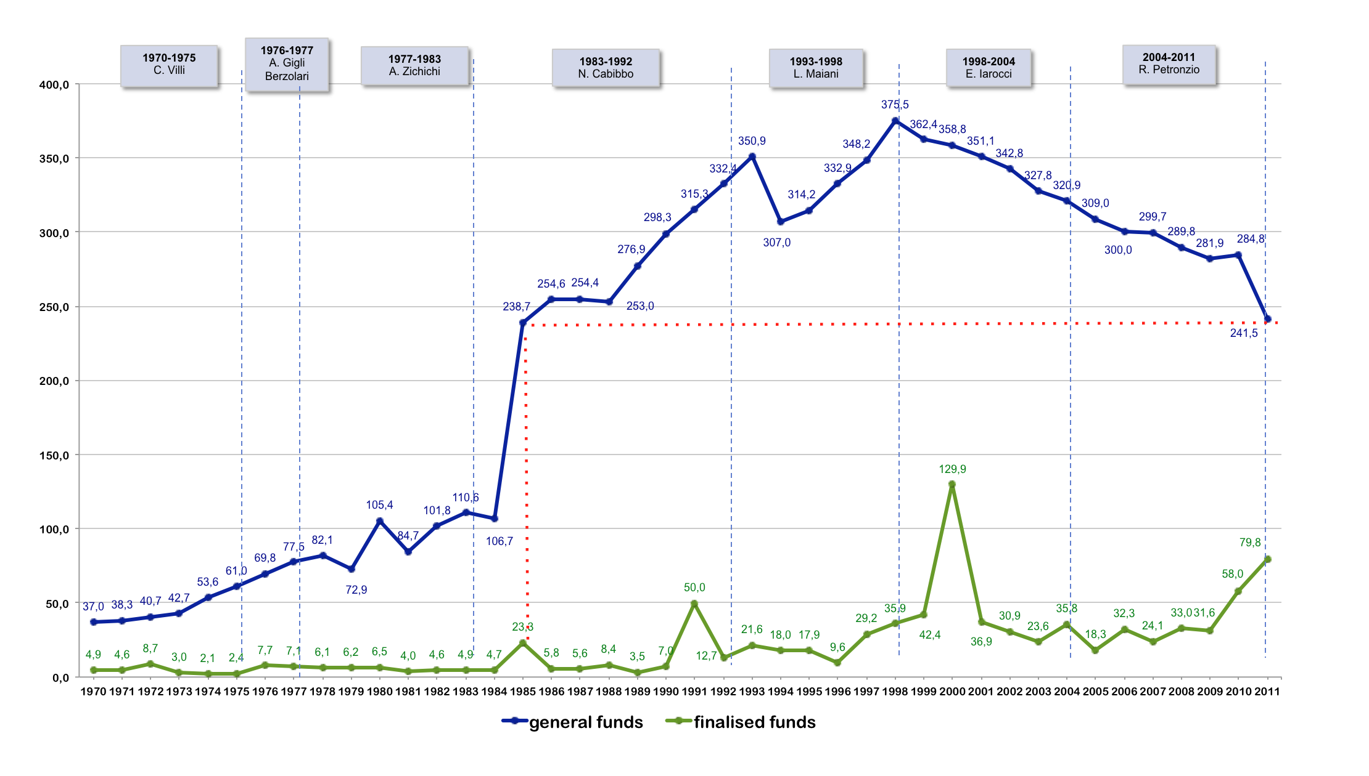
sources of funds
adjusted to 2011 costant prices
(millions of Euro)

Slide 3
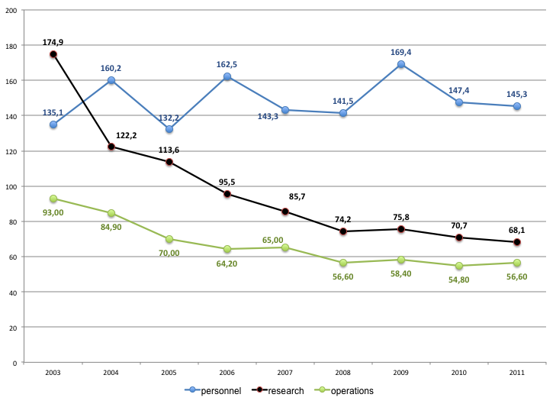
personnel, reseach and operations expenses
(millions of Euro)
personnel
average 2008-2011
Vs.
average 2003-2006
+ 2,3%
research
average 2008-2011
Vs.
average 2003- 2006
- 43,0%
operations
average 2008-2001
Vs.
average 2003-2006
- 27%

Slide 4
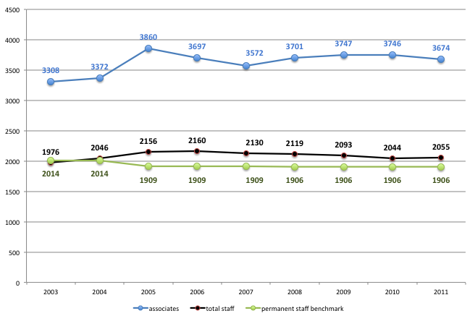
human resources
associates
average 2008-2011
Vs.
average 2003-2006
+ 4,4%
total staff
average 2008-2011
Vs.
average 2003-2006
- 0,3%
permanent staff benchmark
average 2008-2001
Vs.
average 203-2006
2,8%

Slide 5
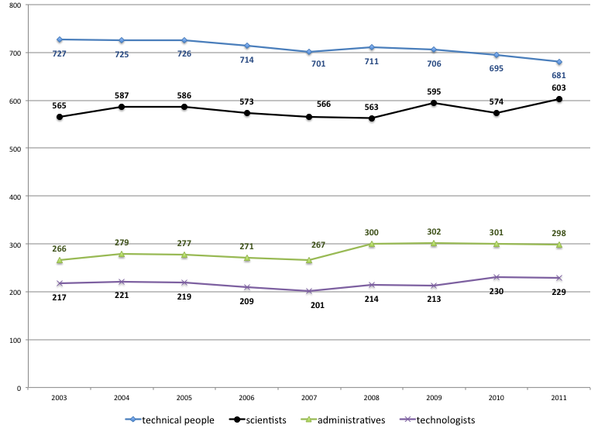
permanent staff
technical people
average 2008-2011
Vs.
average 2003-2006
- 3,4%
scientists
average 2008-2011
Vs.
average 2003-2006
+1%
administratives
average 2008-2011
Vs.
average 2003-2006
+ 9,9%
technologists
average 2008-2011
Vs.
average 2003-2006
+2,3%

