Slide 1
SuperB project

Slide 2
The origin: infn roadmap 2006
early motivations
  e+ e- after Dafne at LNF
  SuperB’s synergy with ILC damping rings

Slide 3
Additional motivations
The italian infrastructures roadmap and the definition of the European research area
The scientific and geographic CERN enlargement process
The european strategy for particle physics roadmap

Slide 4
The SuperB way to high luminosity
Low currents, nanobeams, low emittance
The crab waist

Slide 5
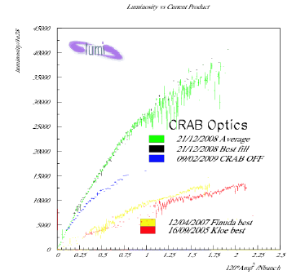

Slide 6
physics
New physics
  The Higgs: standard or not??
  Limits on Susy tend to escape the LHC reach

Slide 7
Beyond SM physics at LHC motivates the superb case

Slide 8
Beyond SM physics at LHC motivates the superb case
Absence of

Slide 9
The competition
LHCb
SuperKEKB

Slide 10
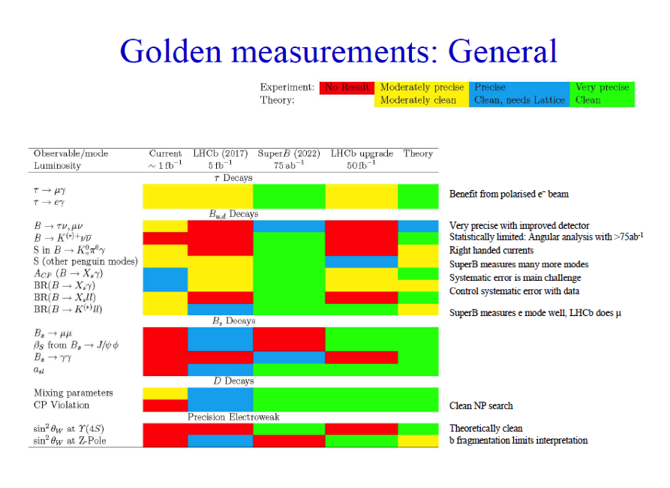

Slide 11
SuperKEKB
Earlier start
Existing lab
Lower project luminosity
No polarisation

Slide 12
SuperB and the Cabibbo Lab
The legal framework for superb construction: a consortium with initial partners the University of Rome Tor Vergata and INFN
Cern like structure (directorate, departments, scientific advisory (MAC for the construction years), auditors, finance committee
Begins oct 7 2011
First money available (4 Meuro) february 2012
Full 2010 funds (19 MEuro) available september 2012
2011 + 2012 funds amount roughly to additional 45 MEuros.

Slide 13
Activities I
Administration and project organization
  Definition of the directorate
    General infrastructures (W.Scandale), research and computing (M.Giorgi), adm.director (M.D’Agostino), light sources
  Creation of the administrative services
    personnel, finance, international affairs (INFN), legal service (University), procurements (under construction)
  Identification of departments heads ( accelerator, technical, physics, computing, integration) and of about 15 out of roughly 23 group leaders for accelerator and technical depts
  Staff regulations
  Procurements regulations ( elaborated, to be approuved)

Slide 14
Activities II
Project milestones
  The costing document ( ready middle of june)
  The planning document ( ready now)
  The lattice completion including final focus region
    V0 available, accelerator footprint priority
  The accelerator TDR completion
    V0 likely outsourced to BINP and ready beginning 2013
  Civil engineering preliminaries
    Agreement with University of Tor Vergata being formalized

Slide 15
Activities III
Team recruitment
  Group leaders mainly INFN ( with current external about 25 people)
  Selection procedures from Cabibbo Lab for different expertise profiles
    18 selected and to be hired in two weeks (220 participants..)
    About 20 more selections to be issued within two weeks
  Discussions ongoing for external manpower from
    BINP
    Orsay
    Elettra
    Cern
  Mandatory 130 people team beginning 2013

Slide 16
Activities IV
Agreements with consortium partners
  INFN (july)
  University of Rome Tor Vergata ( end of October)
Agreements with external partners
  BINP (signed)
  SLAC (PEPII components by the end of october)
  CERN cooperation agreement ( ask Sergio.., but soon)
  IN2P3 INFN (renewal signed)
  Elettra at the horizon
  Bresil beyond the horizon

Slide 17
Light physics
SuperB can offer some synchrotron light beams to the light community, but likely at the expenses of a high integrated luminosity
INFN and Cabibbo Lab have stimulated a study for a concurrent X-Fel operation mode of the SuperB Linac
Preliminary studies have show the feasibility and a document on the “parasitic X-FEL” performance, of the extra cost needed and of the possible user community will soon be available
This option may realize the original hybrid nature of the SuperB accelerator complex

Slide 18
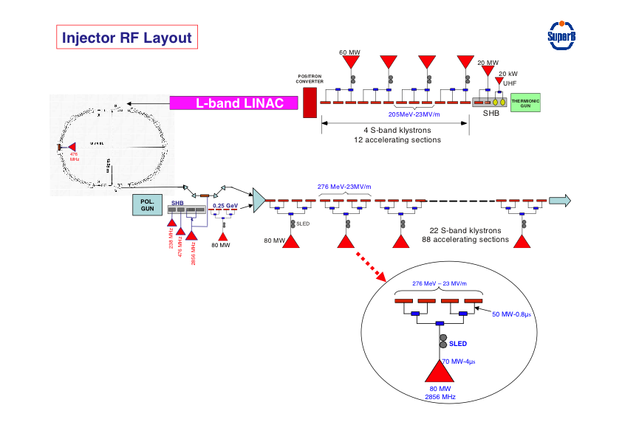
A hard X-ray FEL with the SuperB linac
Magn Comp
Undulators
Injector
600 MeV C-Band
Advanced Exp
Undulators
The costing for the X-FEL extra accelerator components will be quoted separately in the costing, anyway of the order of a few tens of ME compared to the few hundreds of a similar ad hoc facility

Slide 19
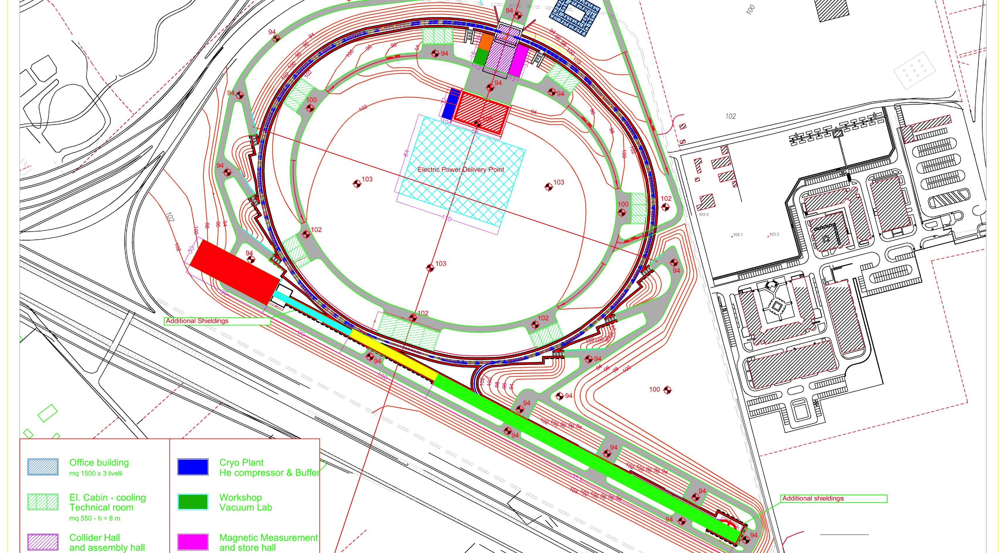
On the site

Slide 20
The costing
Bare cost from WBS 523 Meuros
Add:
  VAT ( about 100 Meuros)
  Contingency and spares ( 140 Meuros)
  Full personnel cost of 1500 man years (105 MEuros)
  The value of PEPII components ( about 80 Meuros)
TOTAL value around 960 MEuros

Slide 21
remarks
The original project bare cost presented for approval was 25 percent lower than the WBS based one
Approved and 250 MEuros assigned end 2010
Long term financial agreement badly needed
Fioni committee as a precondition

Slide 22
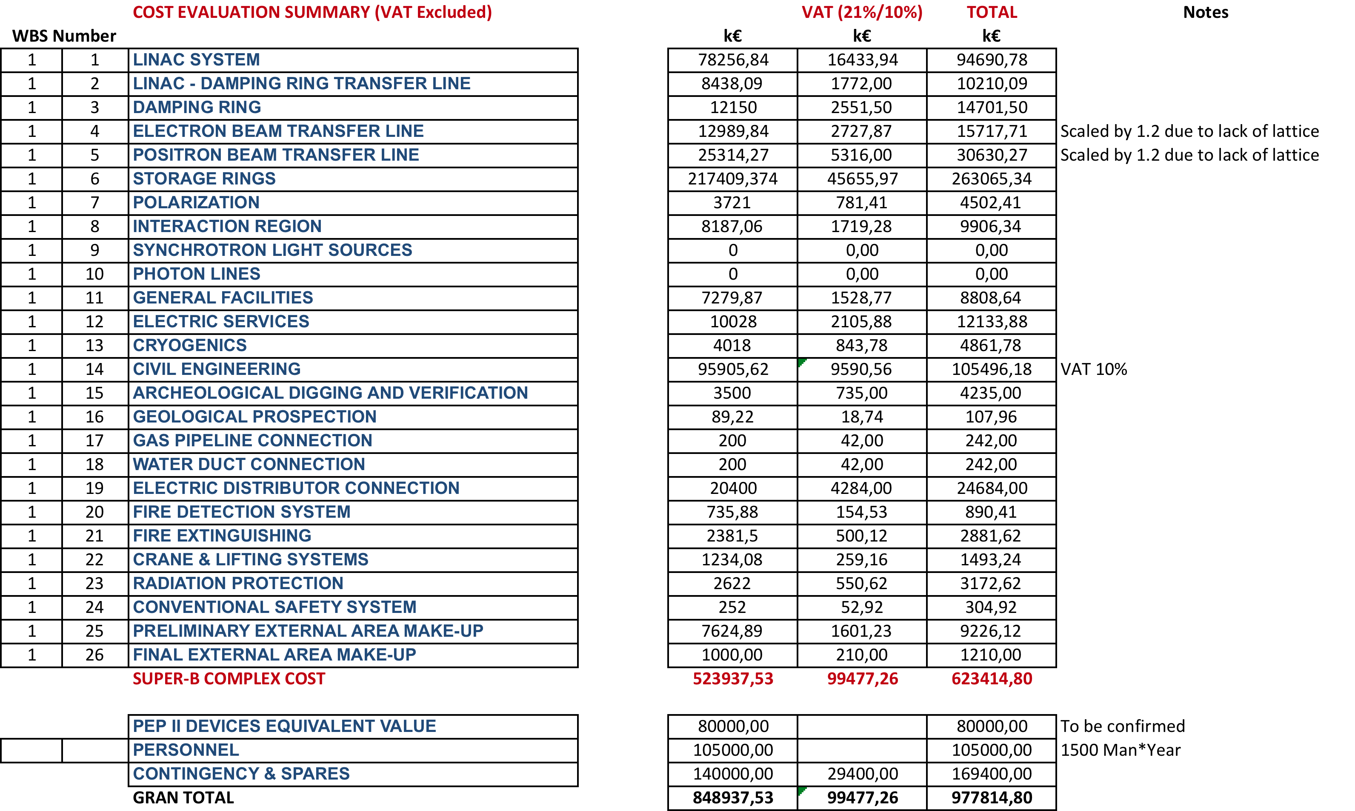
A WBS summary

Slide 23
The master planning
Caveats
  Success oriented
  Deeply related to the money and personnel flow

Slide 25
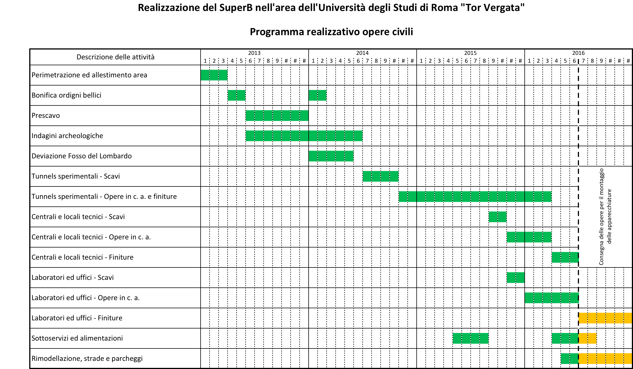
Very preliminary civil engineering details
(source Vianini, University partner)

Slide 26
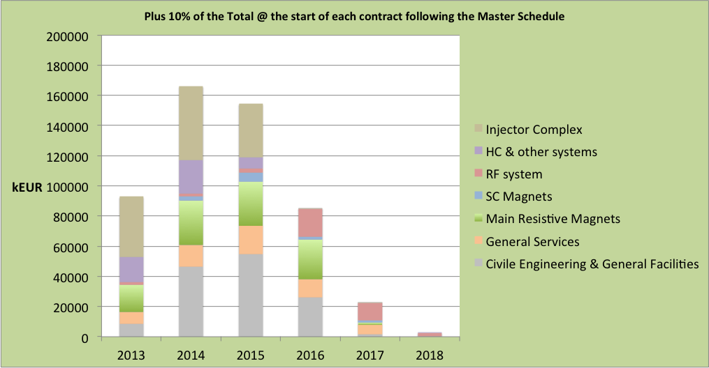
Money profile (523 Meuros)

Slide 27
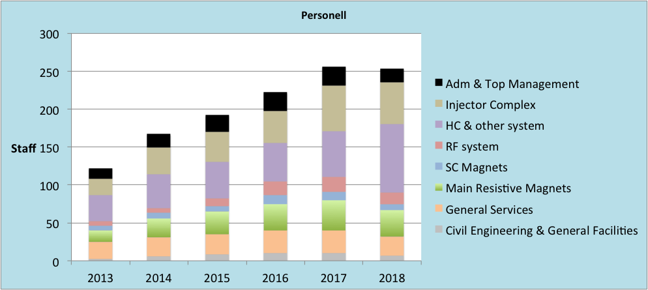
Personnel profile

Slide 28
conclusions
SuperB is an asset for European particle physics
The financial resources also depend upon the international support
The schedule is on a critical line
The hybridization of this infrastructure with light physics may turn the competition of the two sectors into a strong cultural and technological synergy

