Slide 1
HEP with Accelerators
Franco Bedeschi
INFN – Sezione di Pisa
Outline
Physics in progress
Organization
Future initiatives

Slide 2
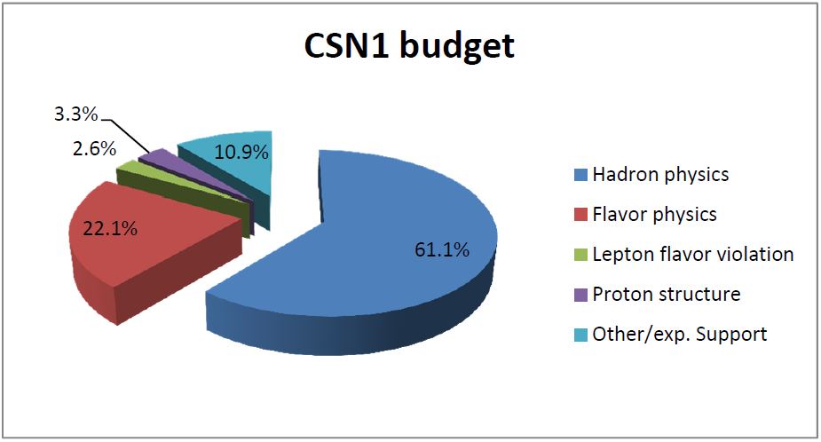
Lines of research
Hadronic physics at high energy:
  ATLAS, CMS, LHC-f, TOTEM @ LHC (running)
  CDF2 @ Tevatron (closed)
Flavor physics:
  BaBar @ PEP-II (closed)
  BES-III @ BES-III (running)
  KLOE @ DAFNE (running)
  LHC-B @ LHC (running)
  NA62 @ SPS (building)
  SuperB @ SuperB (R&D)
Lepton Flavor Violation:
  MEG @ PSI (running)
  Mu2E @ Fermilab (R&D)
Proton structure:
  COMPASS @ SPS (running)
  ZEUS @ HERA (closed)
Other:
  Future lepton colliders (Planning)
  UA9 @ SPS&LHC (R&D)
  Experiment support

Slide 3
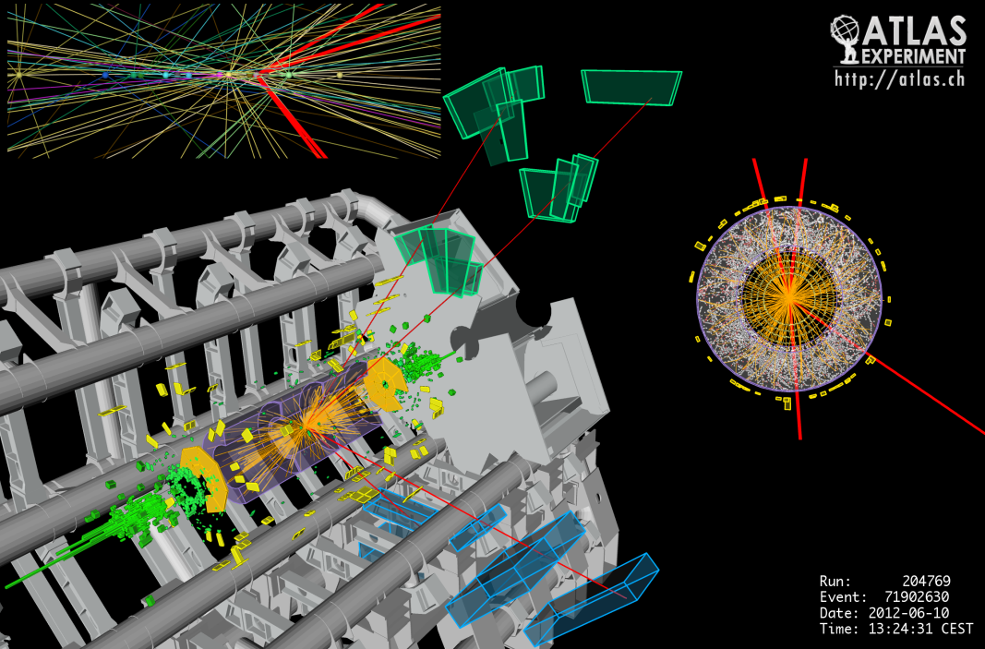
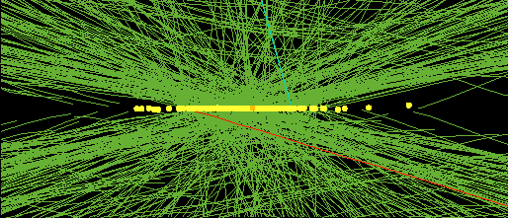
Physics highlights
CMS: 78 simultaneous interactions
(not a heavy ion event!)
H→4μ

Slide 4
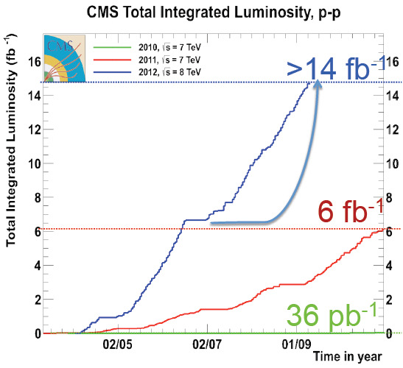
LHC performance
LHC luminosity profile
  L_{max} ~ 7.7x10³³
  Expect ~ 20-25 fb⁻¹
  for each experiment by
  end of run

Slide 5
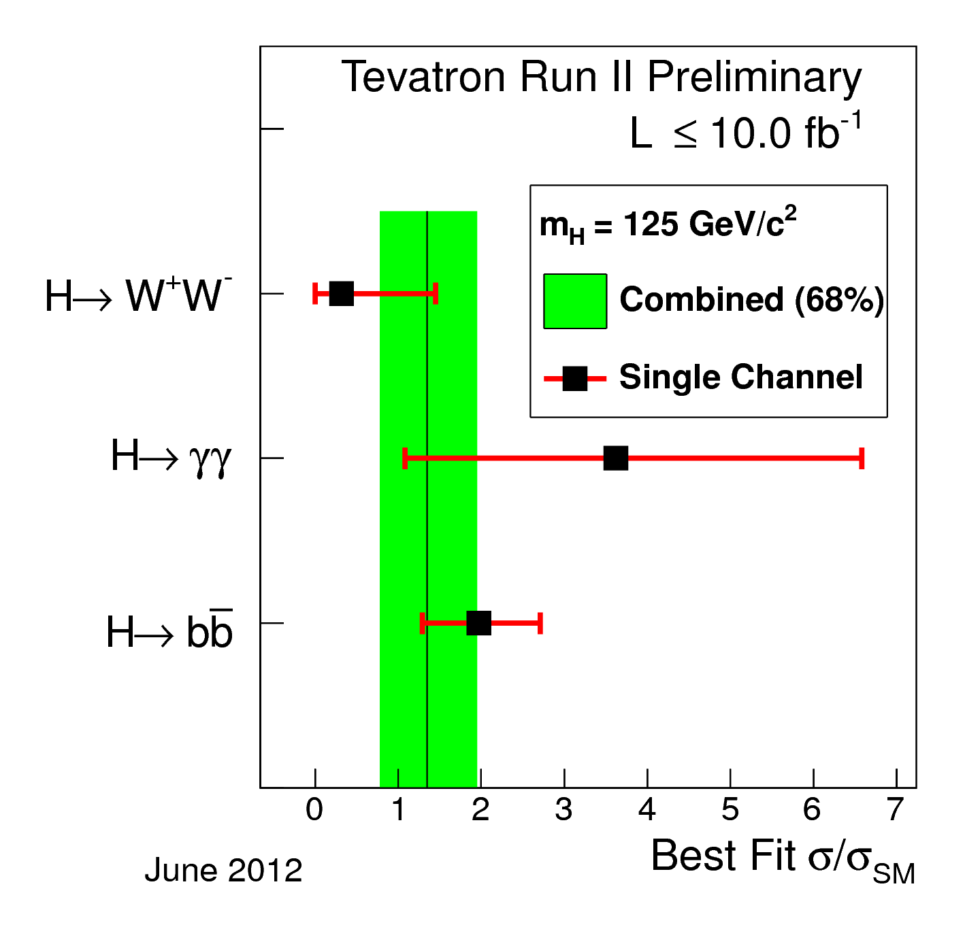
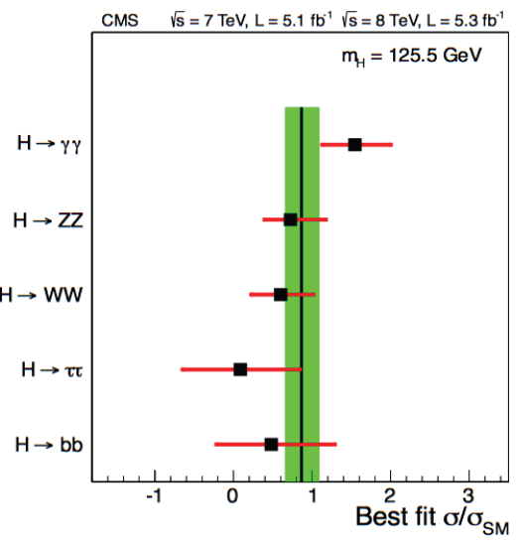
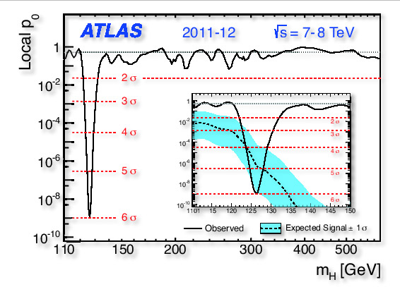
Higgs discovery
Higgs-like particle discovered in decays to vectors
  Indication of bb decay from Tevatron
New field of research opened

Slide 6
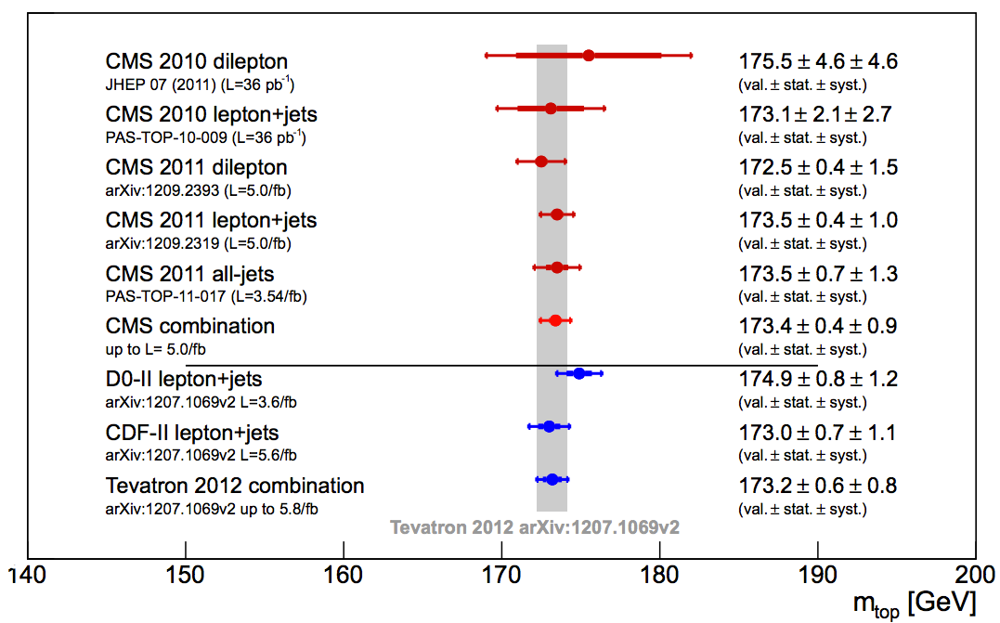
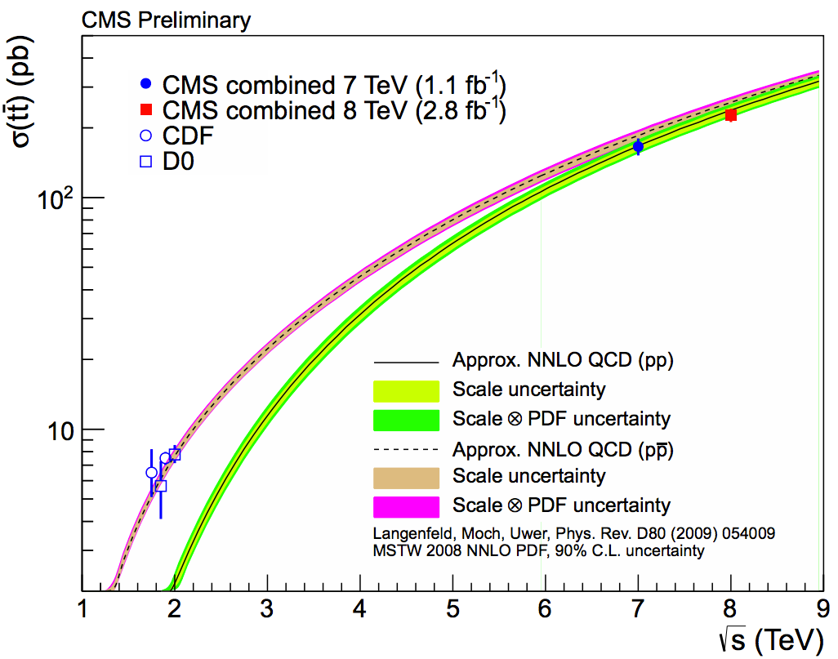
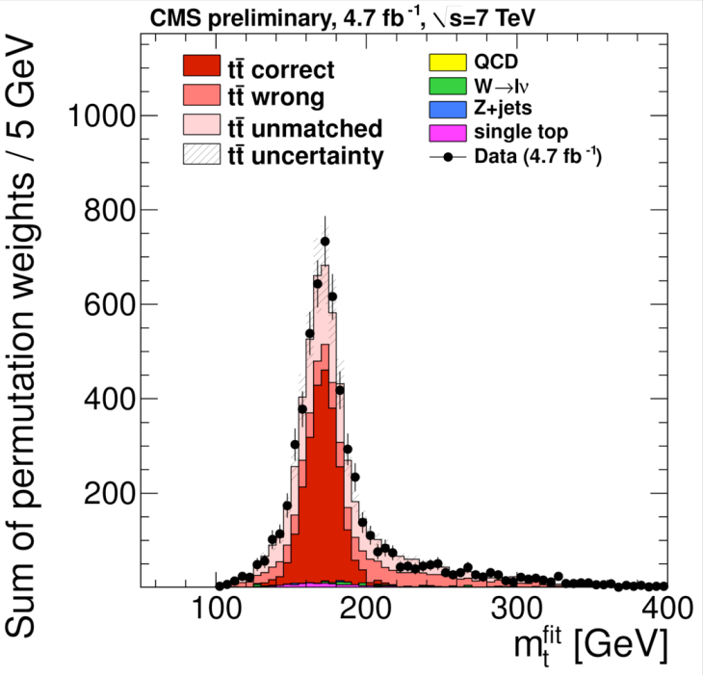
Top quark
X-section
  Precision ~theory
Mass
  LHC reaching Tevatron sensitivity

Slide 7
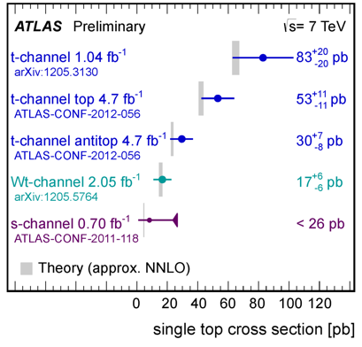
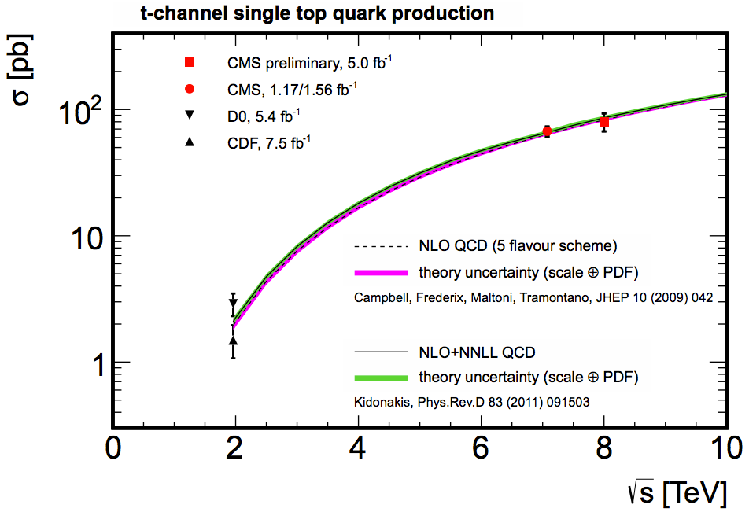
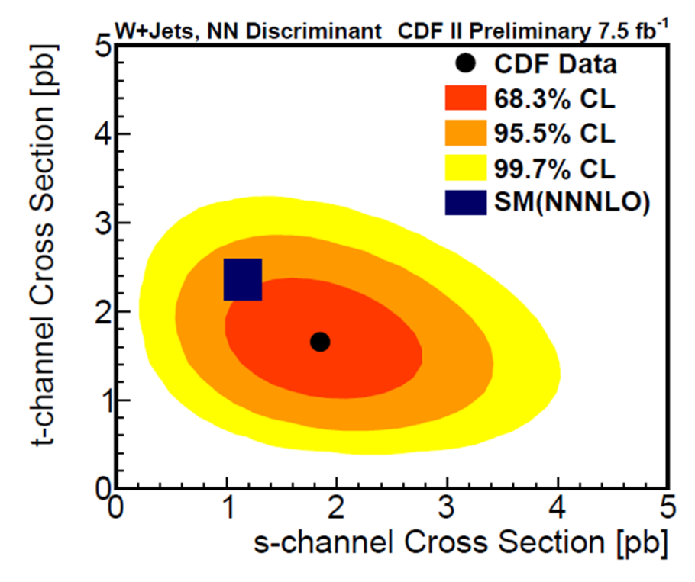
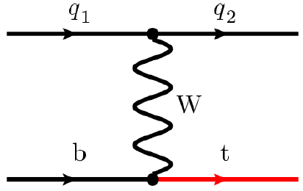
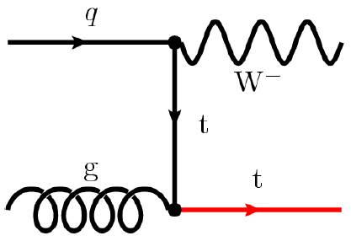
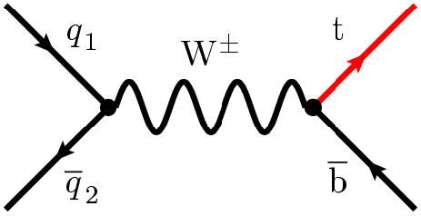
Single top
Several channels: t-channel, s-channel, tW
  S-channel not yet seen at LHC

Slide 8
W mass at CDF
Best world measurement with 2 fb⁻¹
  Can still improve with full 10 fb⁻¹ statistics
  WA consistent
  with LHC Higgs
  mass determination

Slide 9
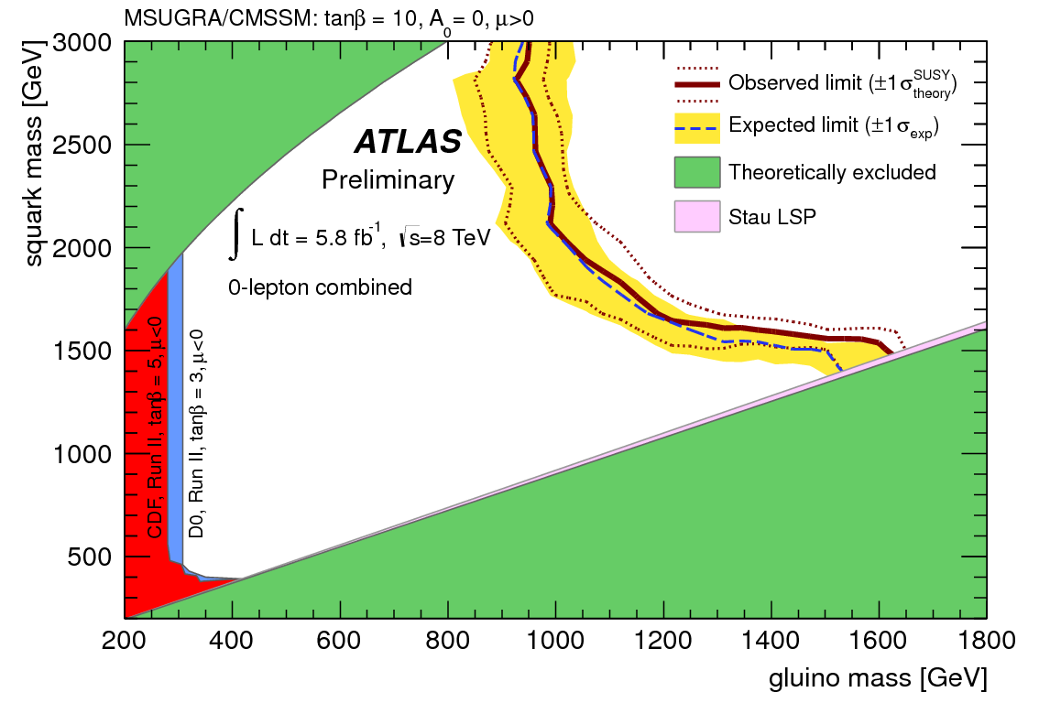
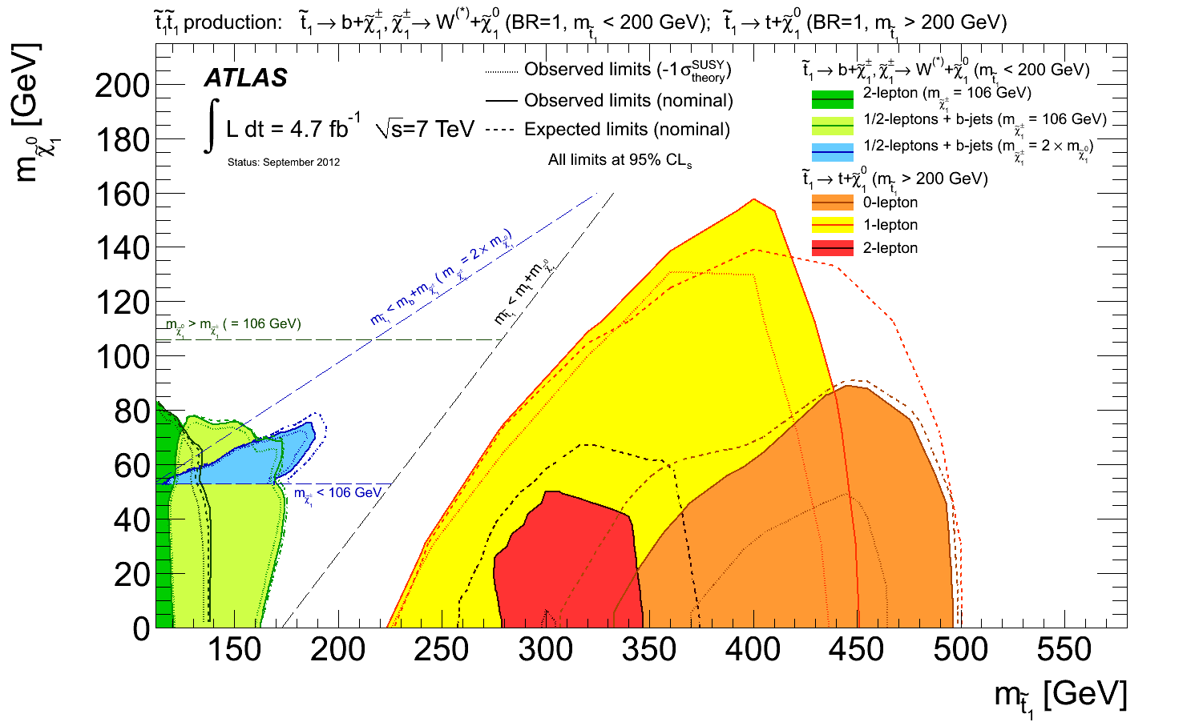
SUSY searches
Constraints on SUSY mass scales are reaching the TeV for squarks and gluinos
  Stop and gauginos limits weaker
No hints of other new physics models

Slide 10
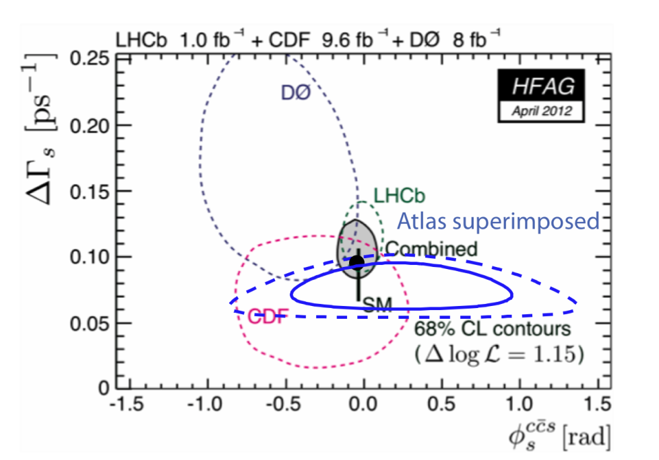
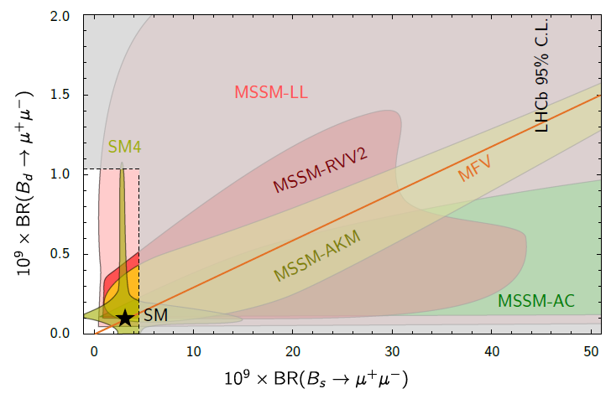
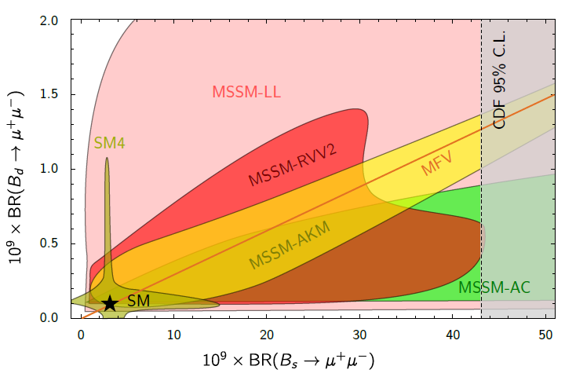
Flavor physics
David Straub: arXiv:1205.6094
Mostly from LHCb
  Luminosity leveled ~4e32
  1 fb⁻¹ in 2011/ 1.4 fb⁻¹ in 2012
  → 2 fb⁻¹ by end of run
Bs highlights
  Mixing phase error < 0.1 rad
  Detailed studies of rare decays
    BR(B→μμ), B0→K*μμ ….
  Close to releasing new results on angle γ in many channels
    Expect sensitivity ~ 10º
2012
2011

Slide 11
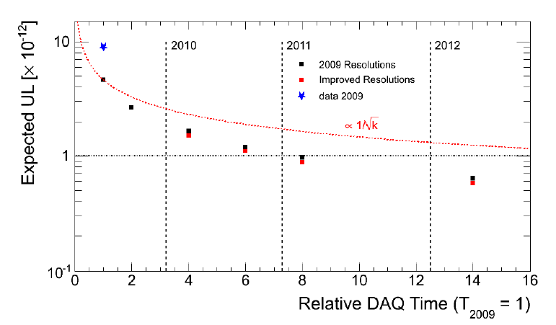
Charged lepton physics
Searches for μ→e γ (γ real MEG, γ virtual Mu2E)
  MEG improves limit (2010) → 2011 unblind this October
  Mu2E receives CD 1 in June 2012
NULL Signal hypothesis
New g-2 exp. received CD0
in Sept. 2012
2010
2011
2012
20
◉
✚
→10⁻¹³ range reachable
with 2011-2012 data
→10⁻¹⁴ range reachable
with upgrade
◉
Data 2009-2010 (freq.)
✚
Sensitivity 2009-2010
(freq.)

Slide 12
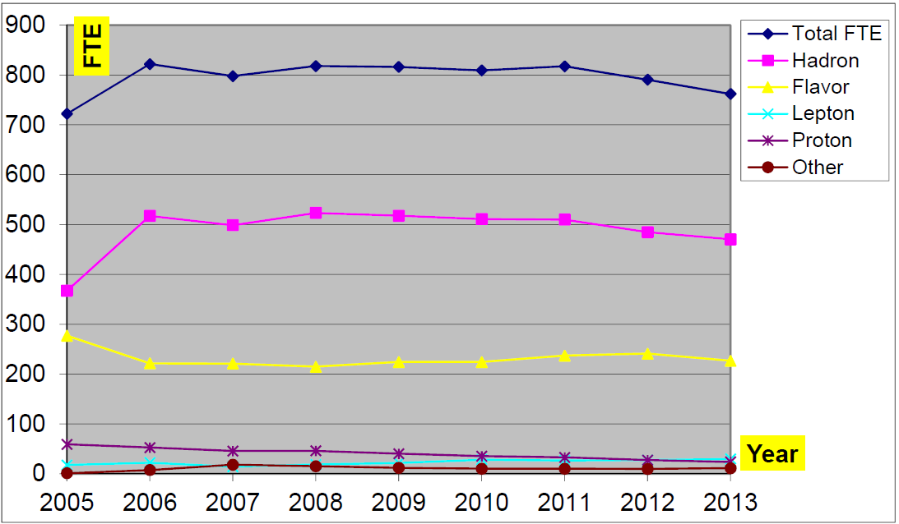
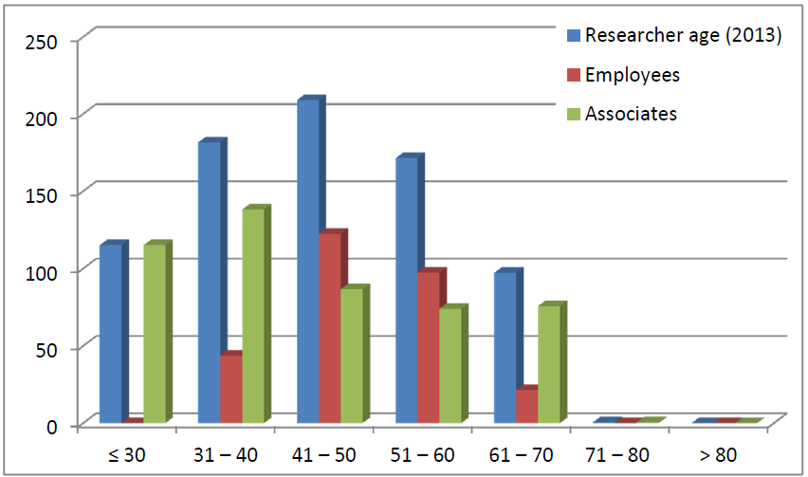
Personnel INFN&University
Researchers and engineers:
  #people fairly stable:
    ~1000 scientists/800 FTE
  Slow drop since 2011
    Over 70 excluded
    Recruiting issues
  Average researcher age is growing
    Difficult to hire post-docs
    Insufficient rate of hiring of new researches (INFN&U.)

Slide 13
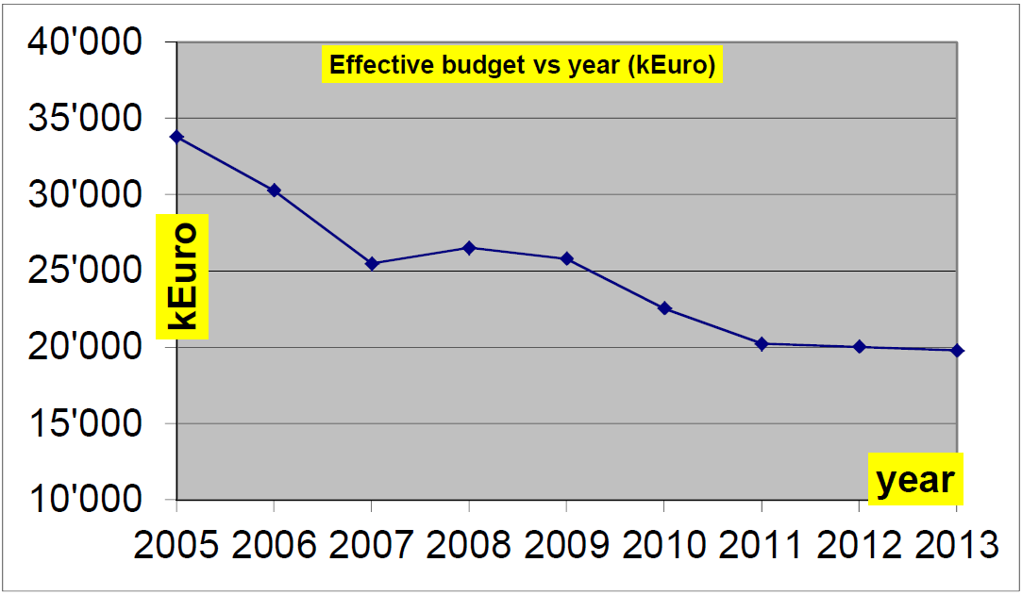
Budget evolution
Flat budget in last 3 years ~ 20 M€
  No correction for inflation
  Significant loss in last 10 years
  Little room for large new initiatives

Slide 14
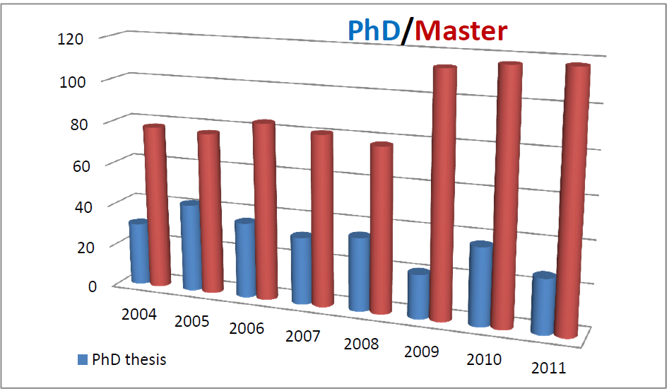
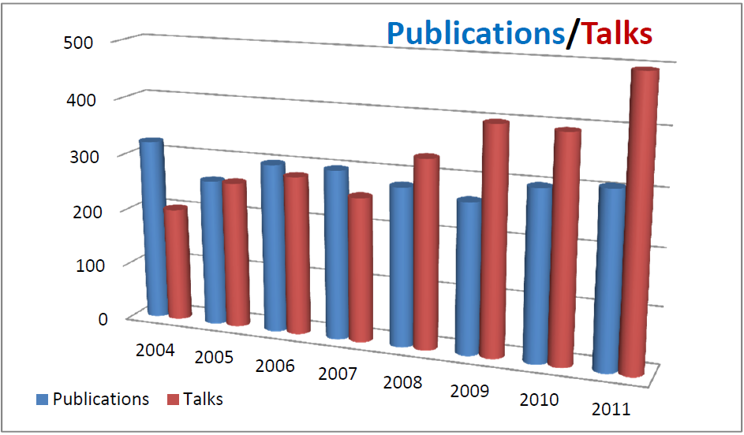
Scientific productivity
Publication rate high and rather stable
  Sustained mostly by large general purpose experiments
  Issue of productivity of single measurement experiments
Talk rate increase in the last years

Slide 15
Concerns on current program
KLOE/DAFNE
  Detector came up very well
  Detector upgrades ready to install
  Problems with luminosity/reliability of DAFNE
    INFN/LNF has put up a significant effort to fix the problem
    May take a good fraction of 2013 to complete
SuperB
  Detector almost ready to start constructions
  Machine funding still highly uncertain
  Timing is critical!

Slide 16
Future initiatives (1)
LHC:
  Atlas and CMS phase 1 upgrades well defined
    Phase 2 upgrades (beyond 2022) represent a huge investment and need a very careful assessment over the next few of years
  LHC-b upgrades under discussion
    Phase 1/2 coincide. Could be accessible with current budget levels
    Significant cost will be carefully reviewed during 2013
SuperB:
  Detector TDR ready this year. R&D almost complete.
  Funding of machine is critical. Hope for government response by end of 2012 after report from Fioni committee.
  Funding of detector will require budget increase for this line of research

Slide 17
Future initiatives (2)
MEG upgrade at PSI:
  Critical R&D to complete by end of 2012
  May start construction after full review in mid-2013
Mu2E at FNAL:
  INFN commitment to be defined during 2013-14
  Critical consolidation of Italian collaboration and possible returns to Italian industry
g-2 at FNAL:
  Exploratory phase. Not costly
COMPASS upgrade at CERN-SPS:
  Partial RICH upgrade close to approval

Slide 18
Conclusions
The accelerator based experiments handled by INFN are in good shape and a healthy amount of new experiments and upgrades is present
Many activities are very successful
  Often cashing in on past funding
New activities on a small/medium scale can be accommodated, but
  Impact on operating costs of existing experiments
  Need compression of original proposals
Long term strategy depends on evolution of HEP facilities

Slide 19
Backup slides

Slide 20
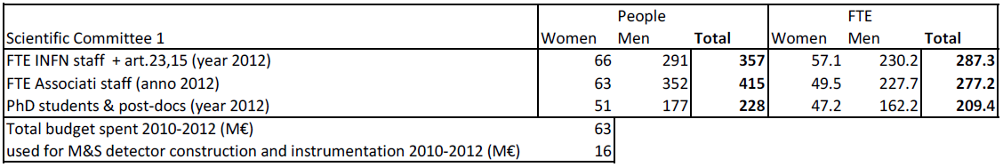
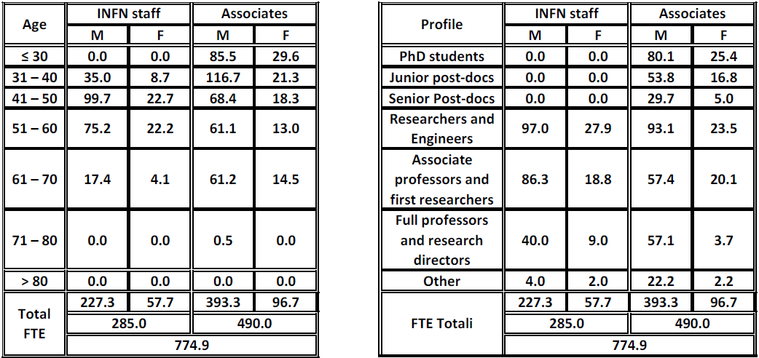
CSN1 summary tables
Cost and personnel
Age and role profiles

