Slide 1
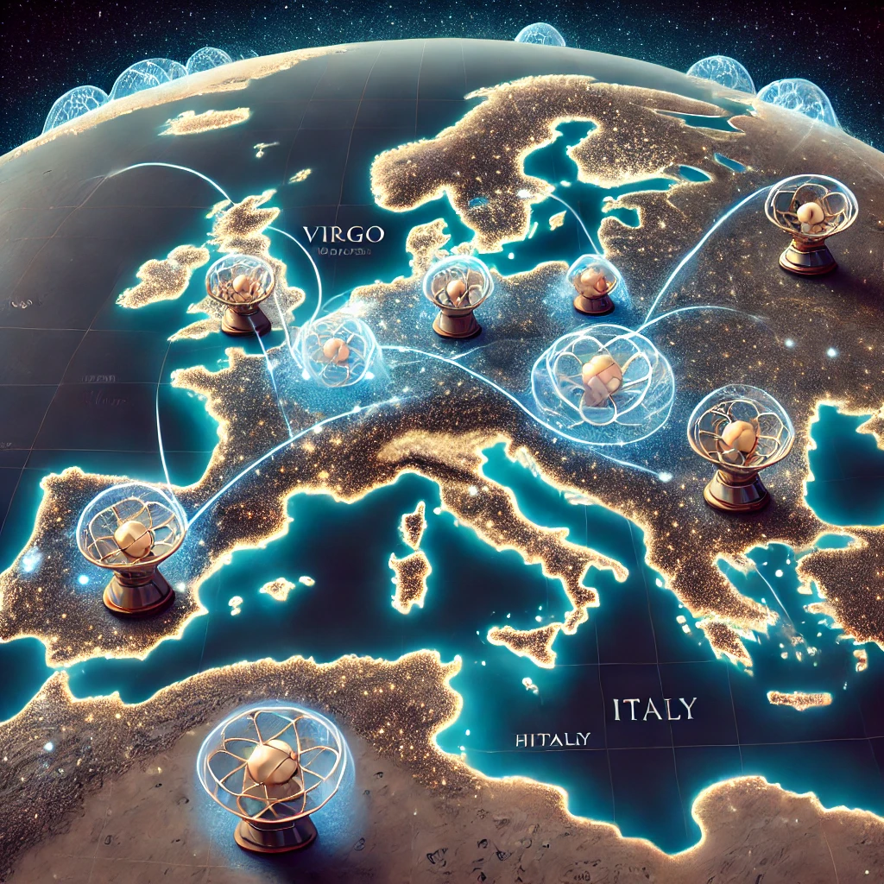



GravNet
Claudio Gatti
70th LNF Scientific Committee – November 2025

Slide 2
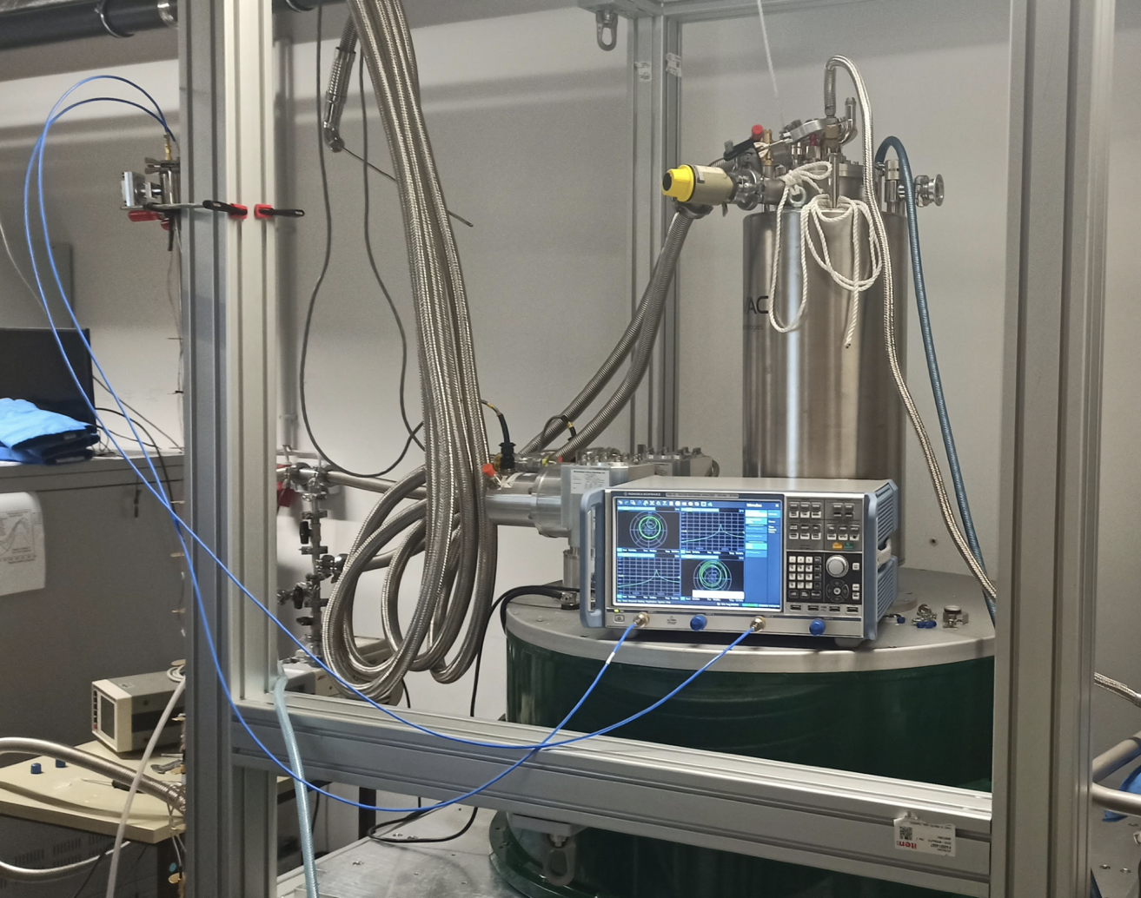
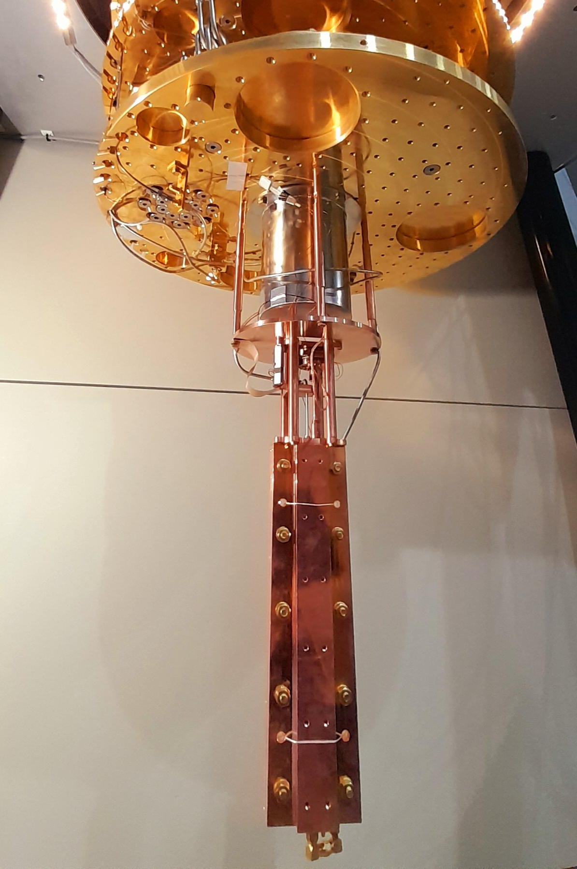

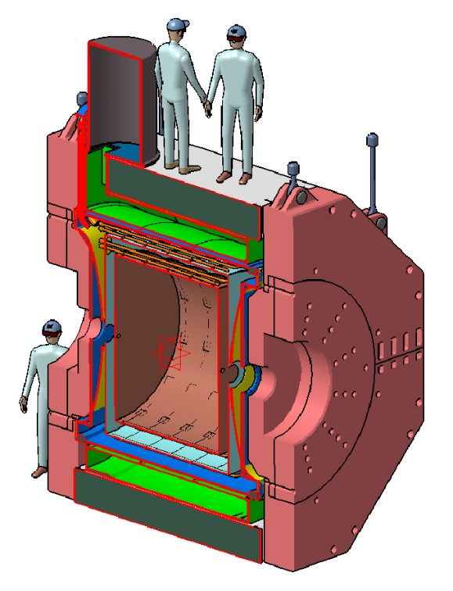
GravNet A Global Network for the Search of High Frequency Gravitational Waves
SUPAX
QUAX@LNF
3 high frequency RF cavities per site
One RF cavity at 100 MHz
Multi-mode readout
Initial sites: Mainz, Bonn, Frascati
Goal: Extend the network to more sites and technologies (BAW, Levitated Sensors …)
FLASH

Slide 3
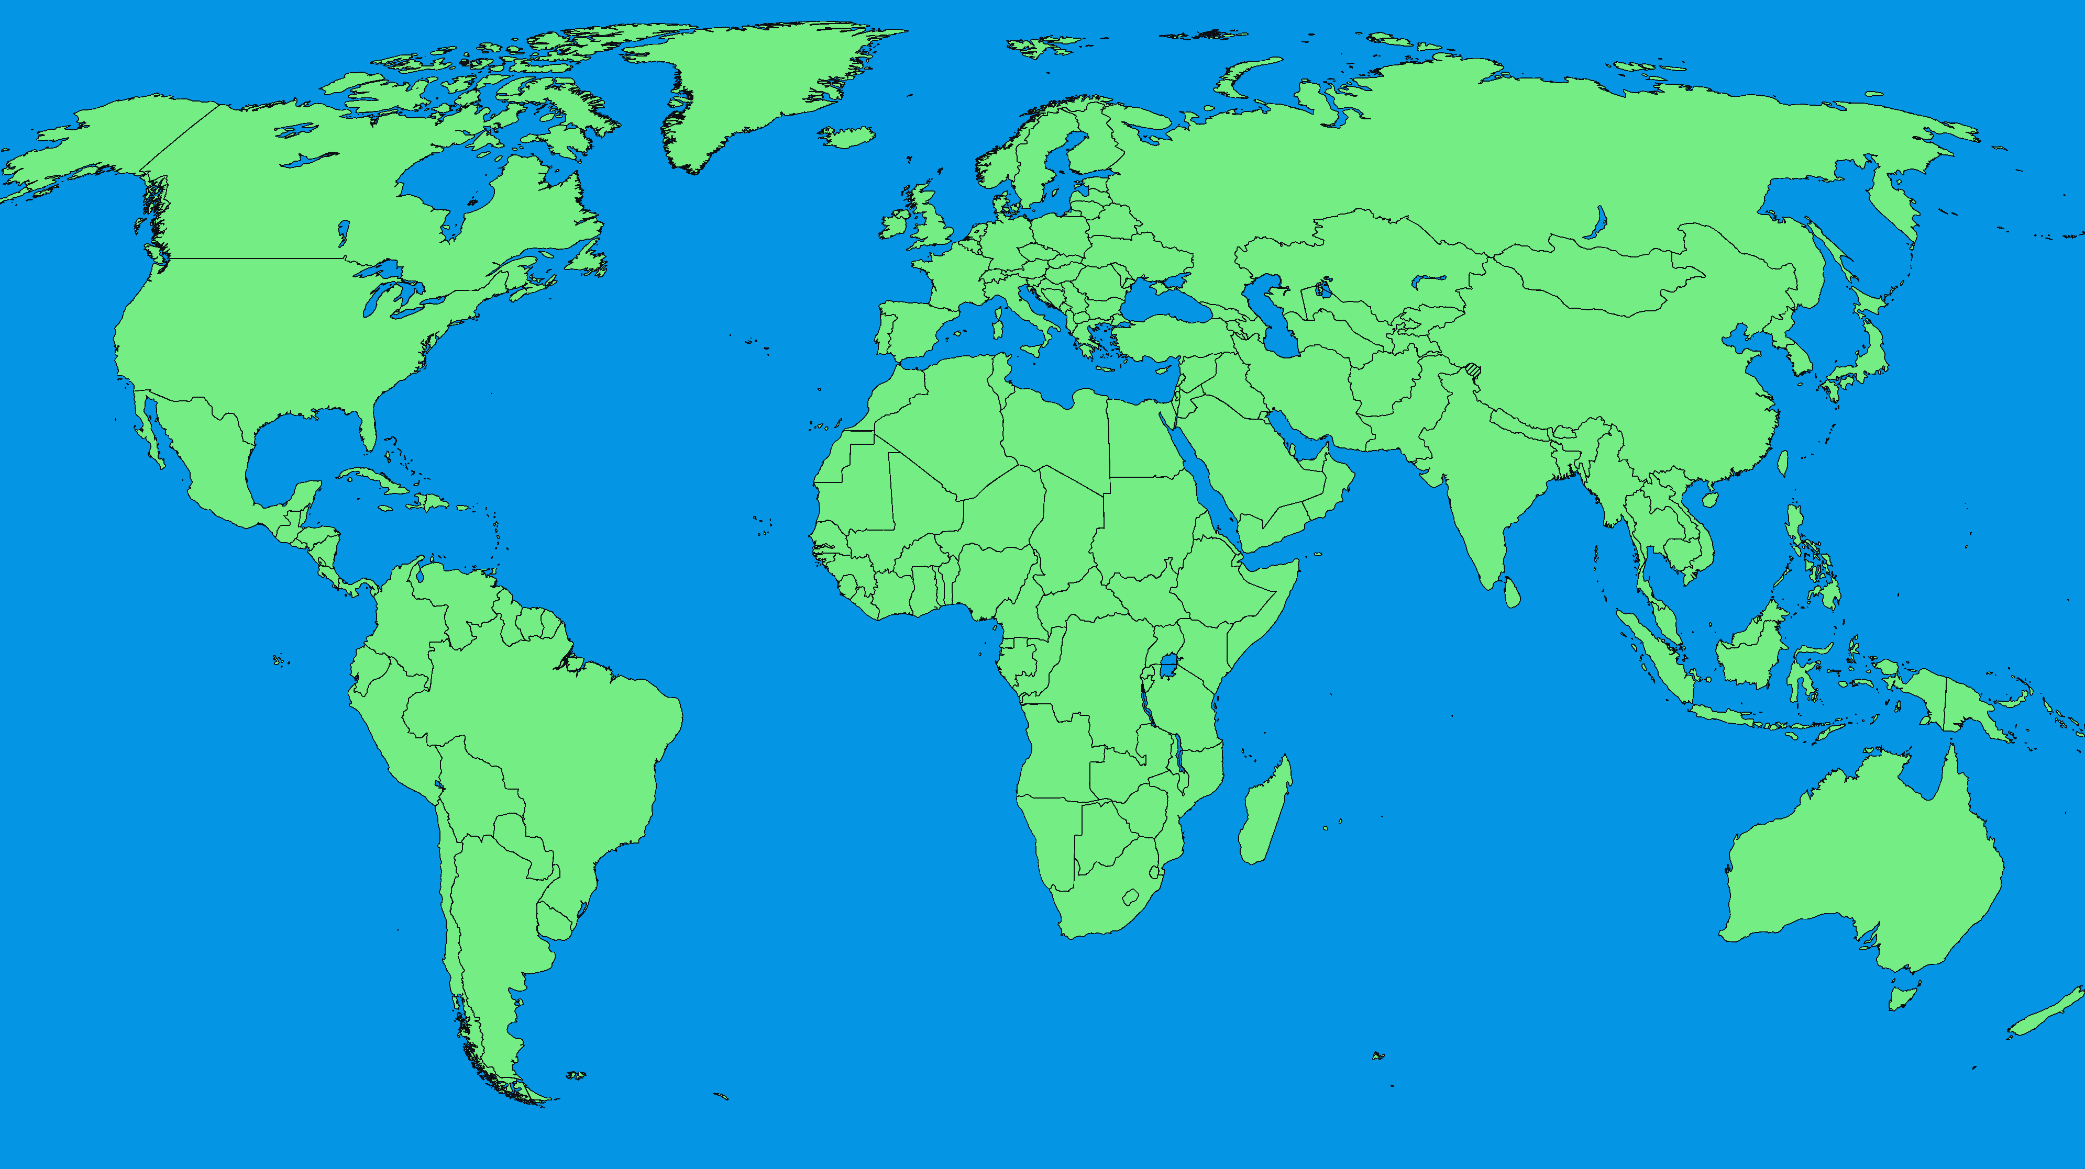
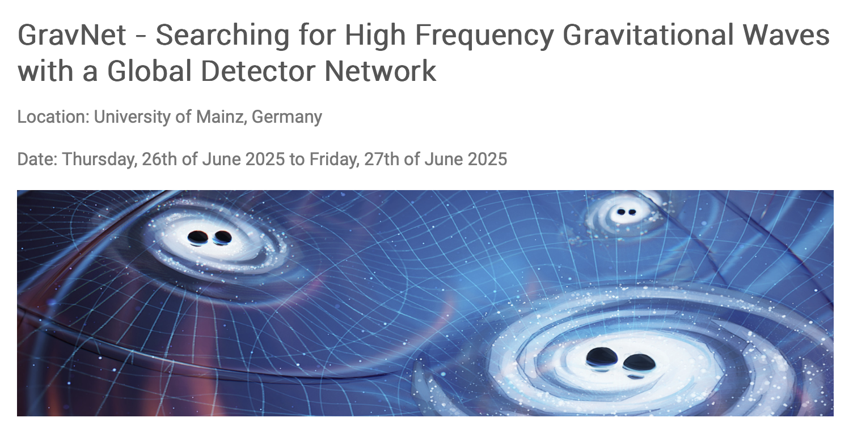
Beijing (CN): Magnetometer; Hz
Chicago (US): OLS; 100 kHz
Milan (EU-IT): BAW; 1 MHz
Perth (AU): BAW, RF Cavity; 1 MHz, 10 GHz
Mainz (EU-DE): RF Cavity, Magnetom.; Hz,10 GHz
Frascati (EU-IT): RF Cavity; 100 MHz ,10 GHz
Legnaro (EU-IT): RF Cavity, e-spin; 10 GHz
Bonn (EU-DE): RF Cavity; 10 GHz
Tenerife (EU-ES): Dielectric: 10 GHz, 30 GHz
Manchester (GB): RF Cavity: 30 GHz
Abu Dhabi (AE): Dielectric; 300 THz
https://indico.him.uni-mainz.de/event/229/overview

Slide 5
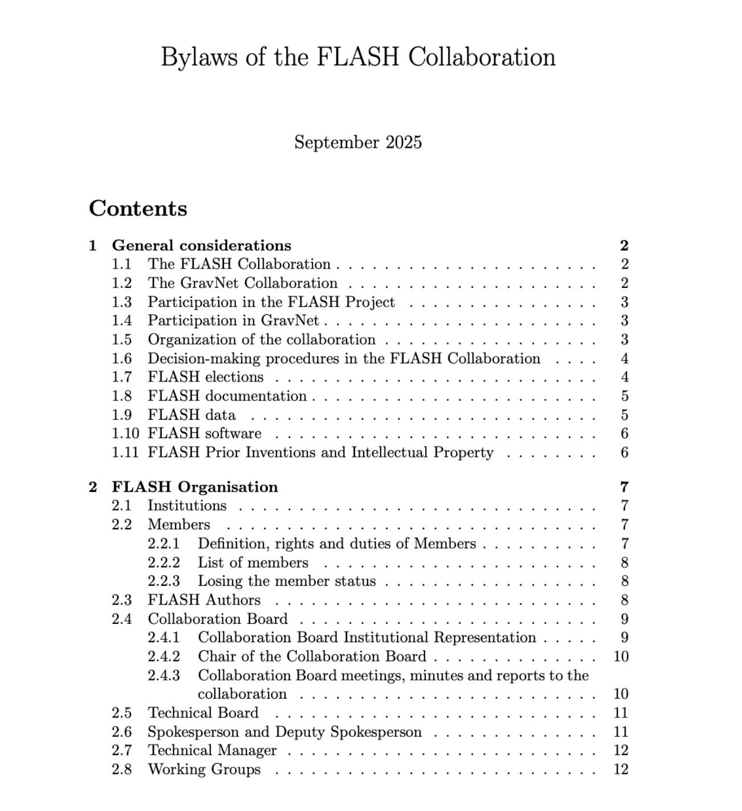



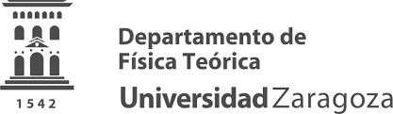











FLASH Collaboration
Technical Board
F. Bossi (Chair), S. Gazzana (Technical Manager), C. Ligi (Cryogenics), G. Mazzitelli (Computing), C. Gatti (PI)

Slide 6

WP1 Physics Reach (L. Visinelli and F. Mescia)
The theoretical work currently focuses on:
Detecting axion mini-clusters with FLASH
Relativistic axions and DP
Coupling to HFGW (within GravNet)
Concerning future applications and detector upgrades:
Investigating dilaton detection with Bulk Acoustic Wave (BAW) resonators
Searching for millicharged particles with FLASH

Slide 7
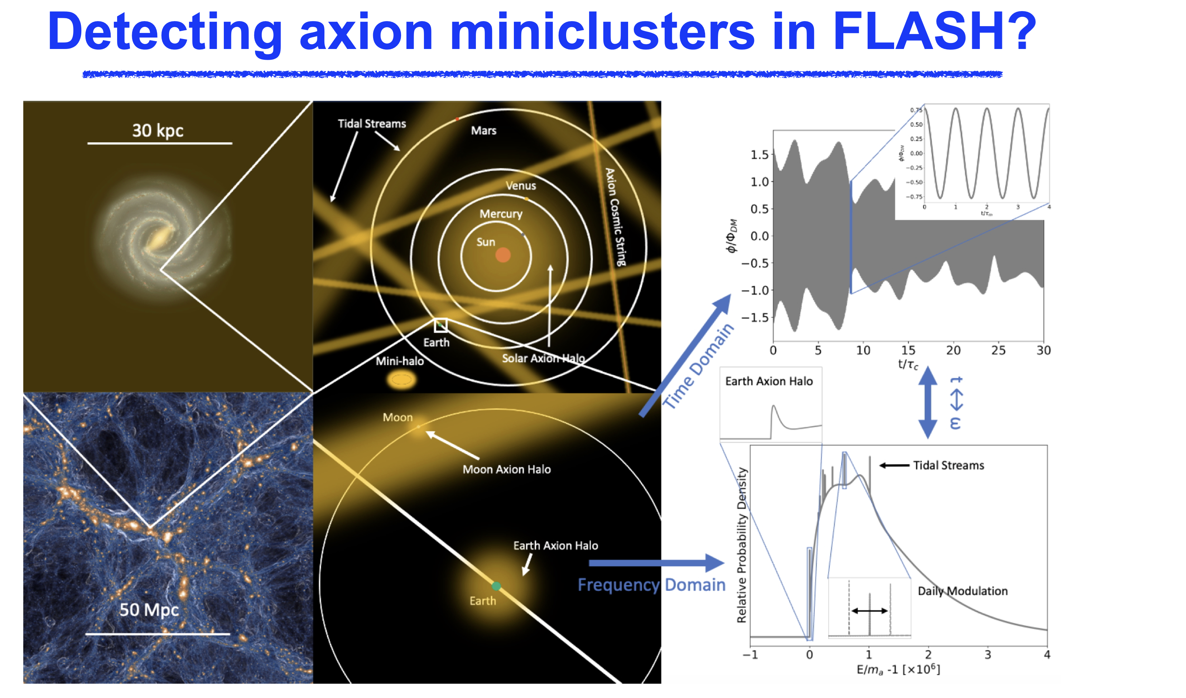
Visinelli arxiv:2011.05377

Slide 8
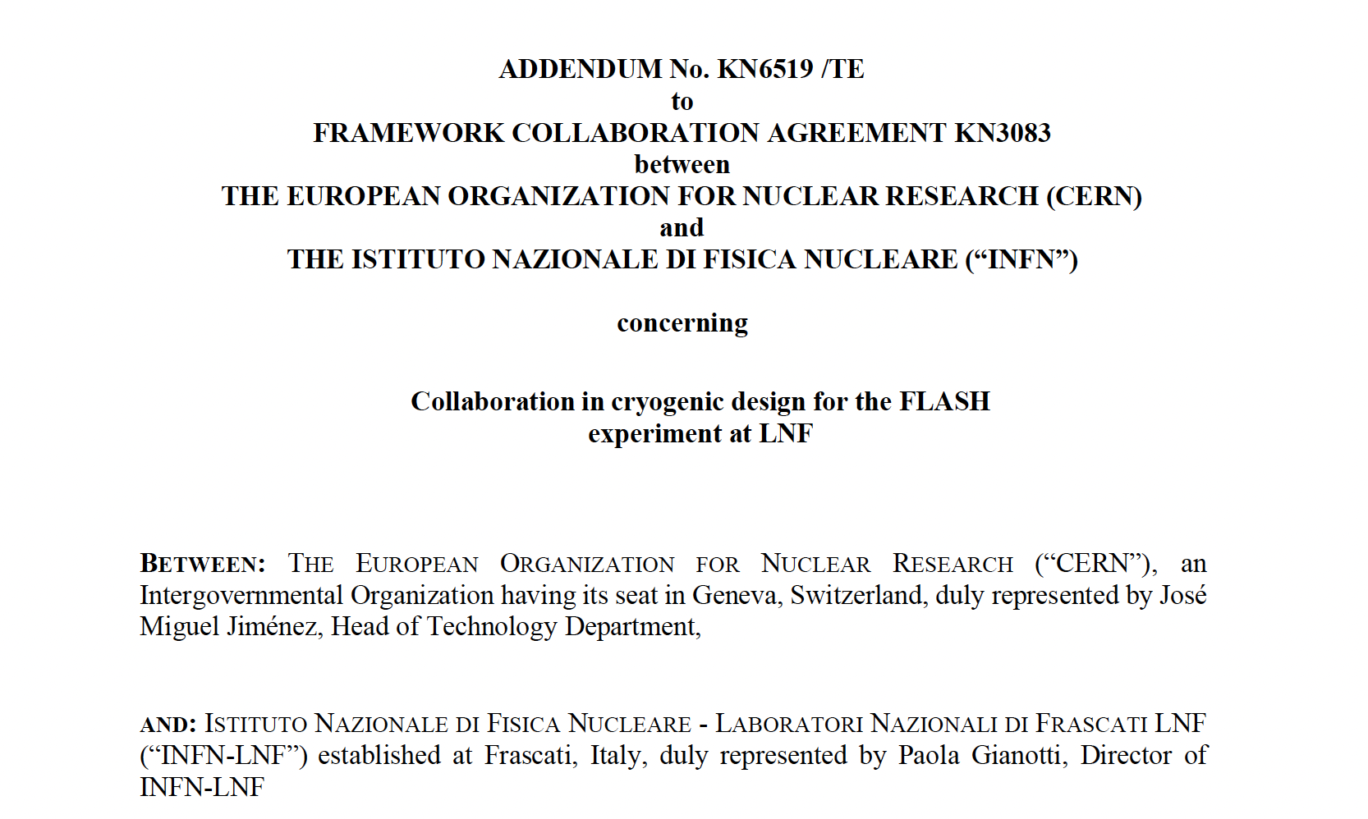
WP2: Cryostat Mechanical Design and Cryogenics (C. Ligi)
Signed by CERN and LNF a Collaboration Agreement for the cryogenic design of the FLASH experiment.
A PhD student in engineering from La Sapienza University is now working with the Cryogenic Service at CERN.
A report on FLASH cryogenics is expected in summer 2026 and the final report on its mechanical design before summer 2027.

Slide 9
Ongoing Work
Definition of the RF cavity cryostat general layout details
Cryostat cryo/mechanical design of
RF cavity
vacuum shield
70 K radiation shield
Cryogenic turret cryo/mechanical design
Cryogenic transfer lines design
Credit C. Capoccia

Slide 10
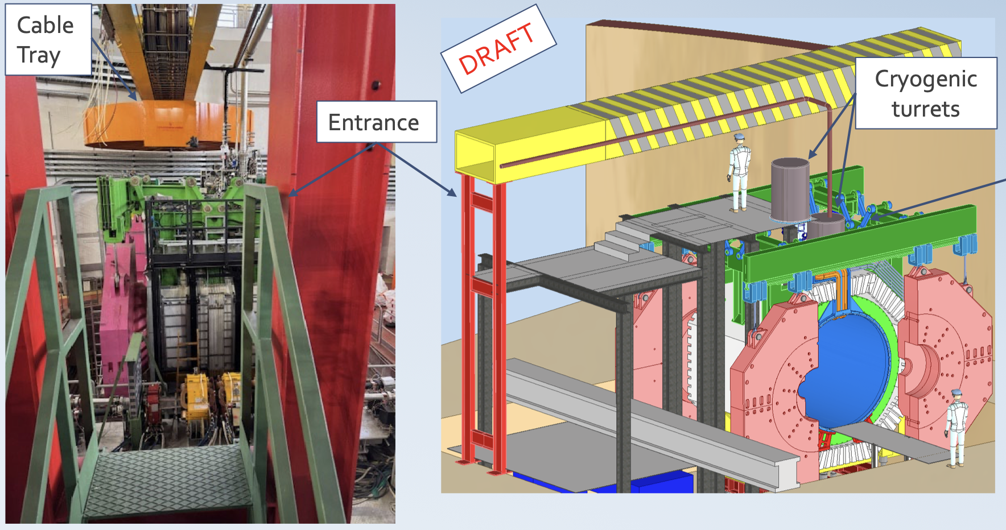
Carpentry Structure for the access to the experimental and technical area and for hosting the new cryogenic turret
Credit F. Rosatelli

Slide 11
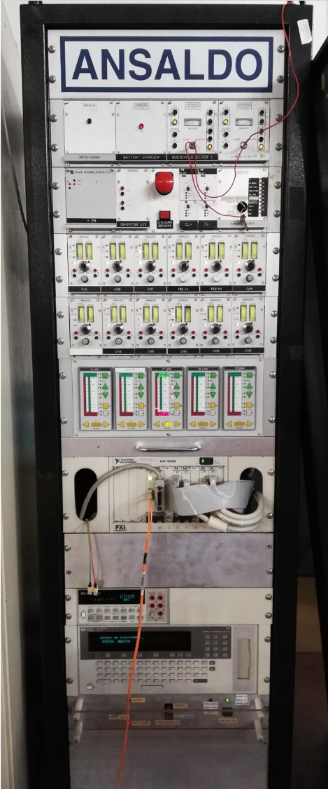
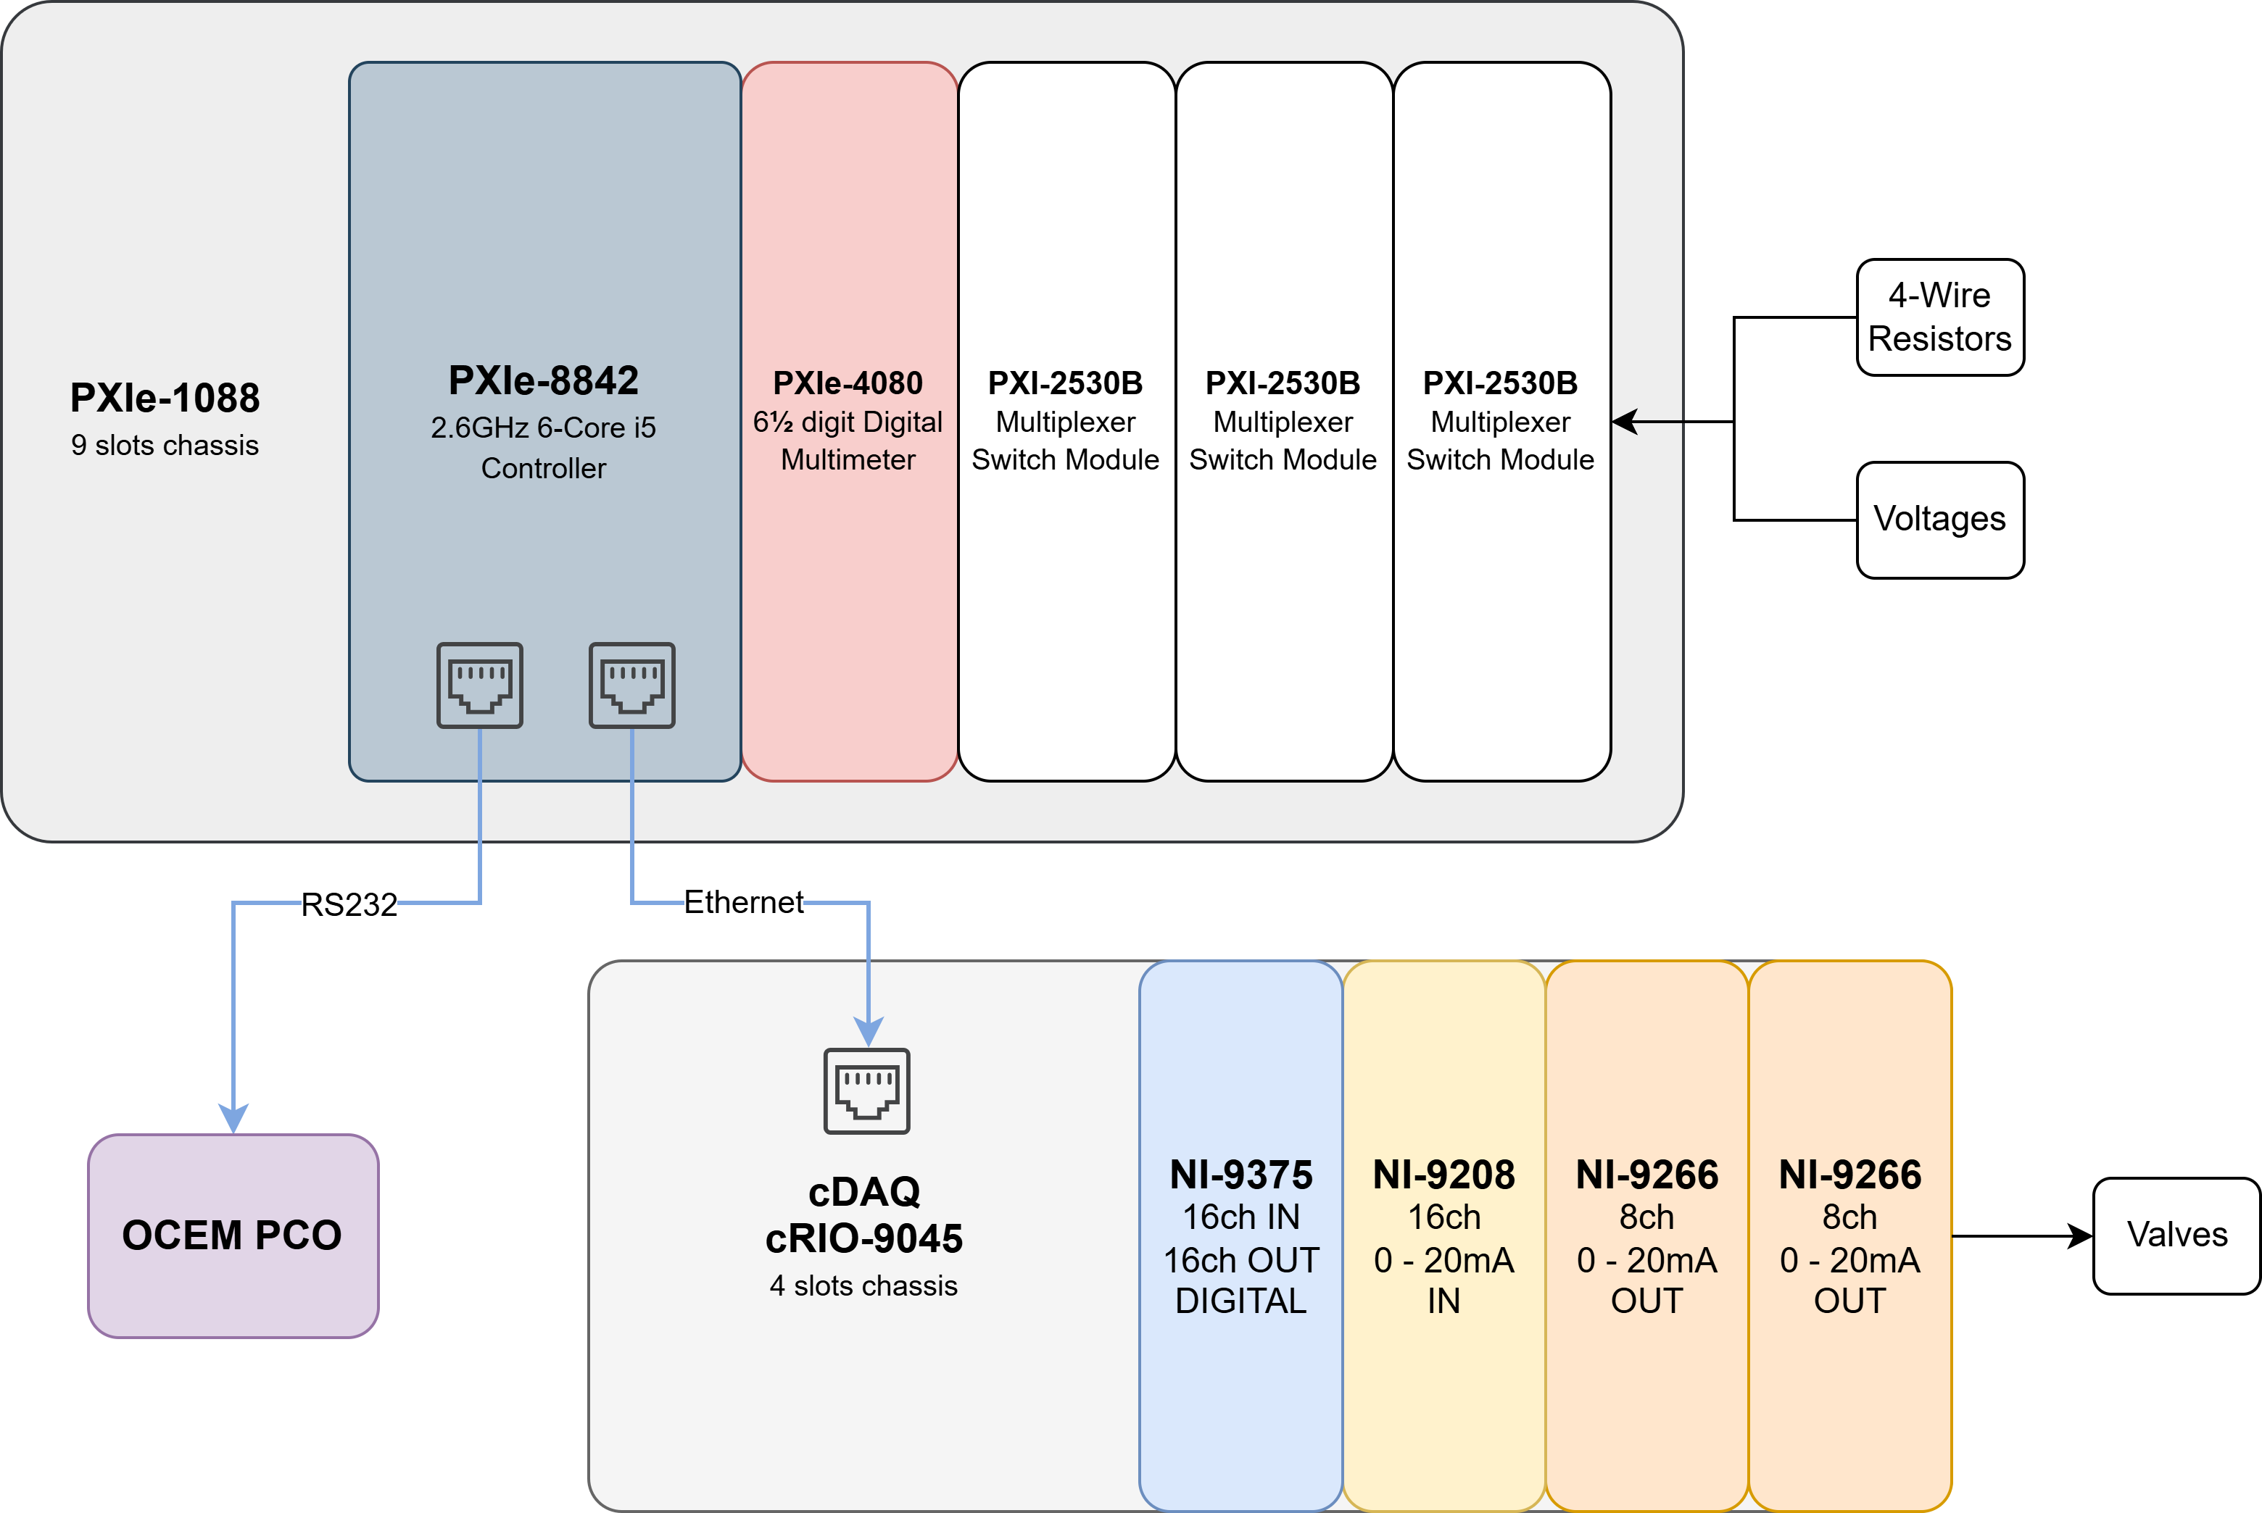
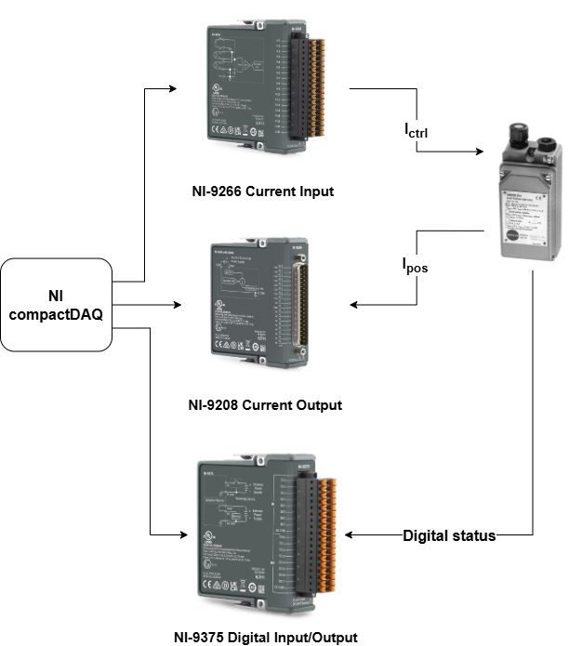
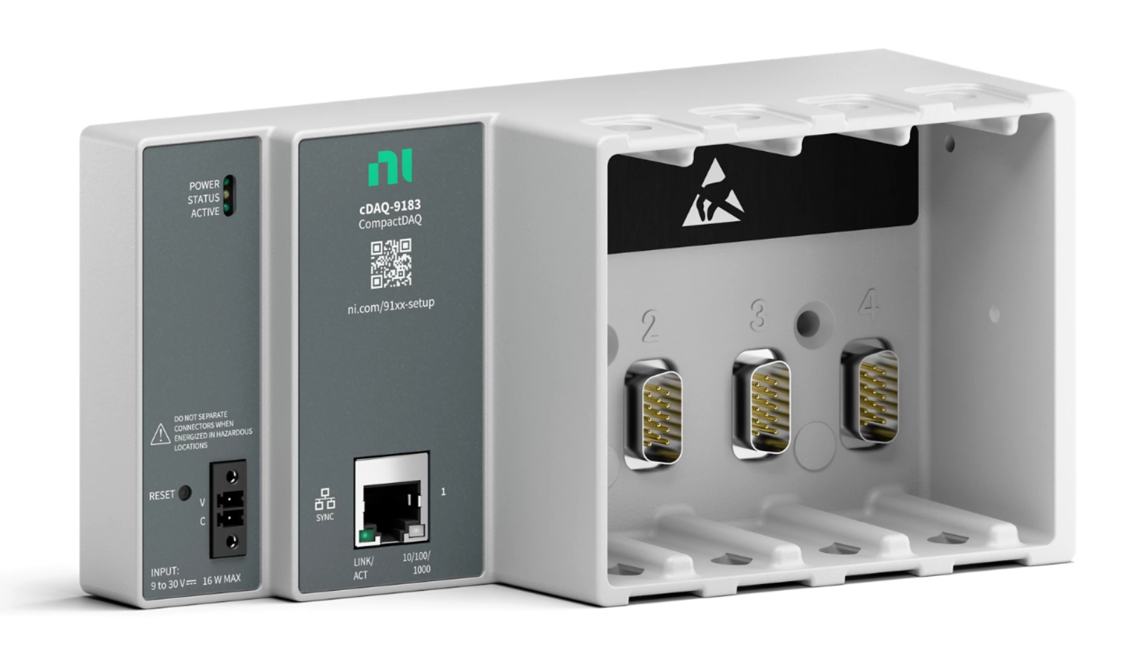
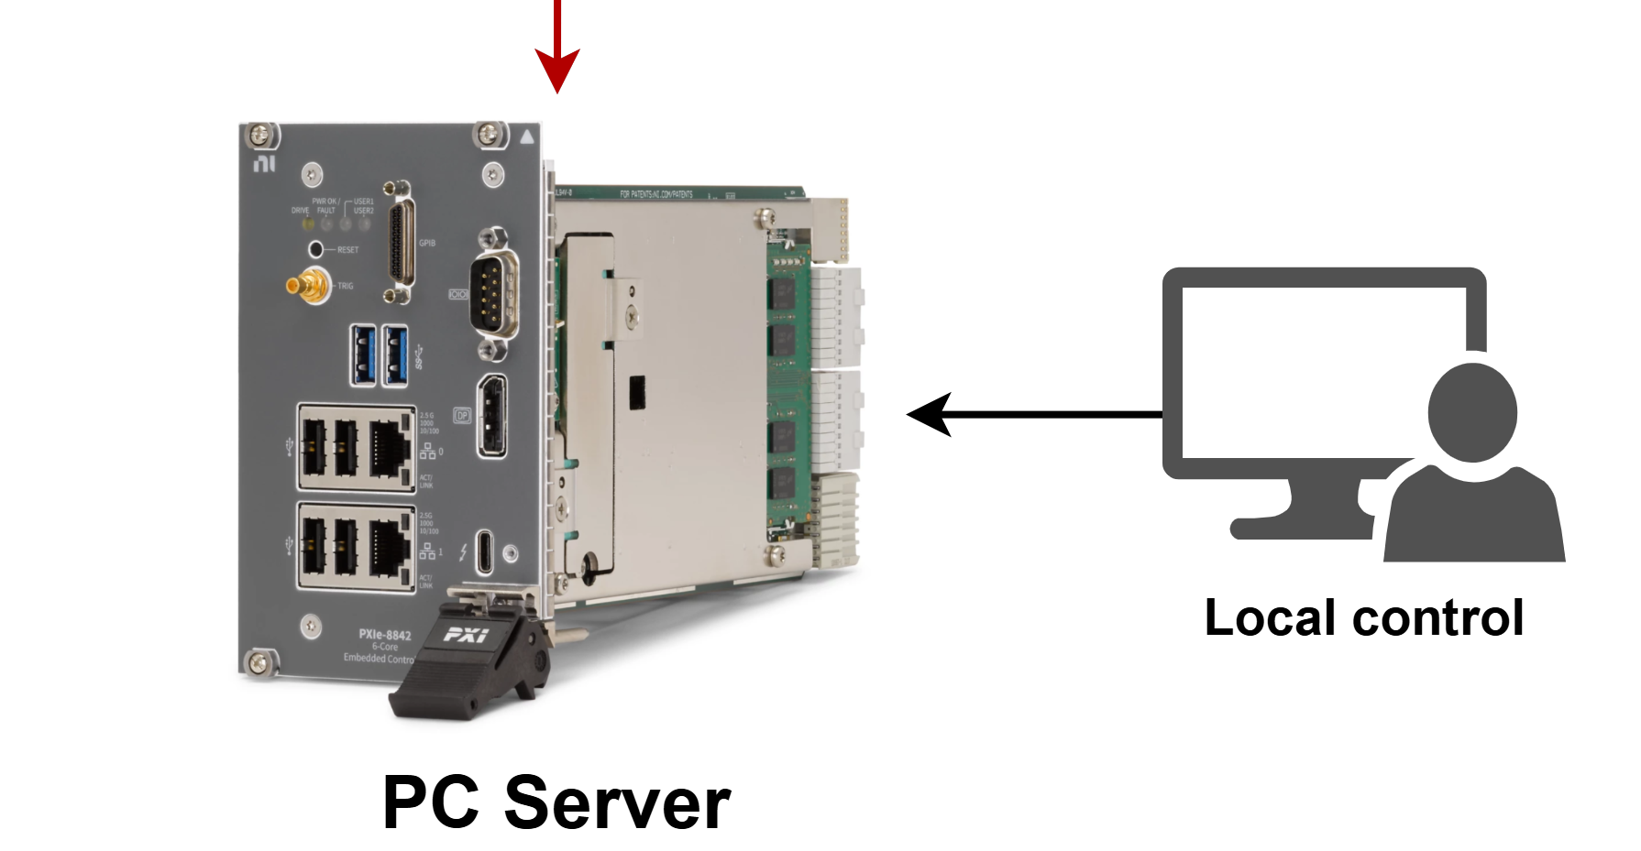
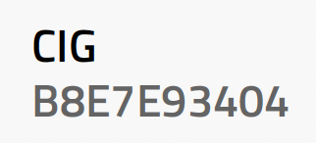
FINUDA Control System
Reconstructed the operating diagram for the magnet control and cooling system and the various components involved.
A new architecture was designed to replace the old control system, the instruments were identified, and the purchase process ongoing.
Credit Capuano, Petrucciani, DiPirro

Slide 12
WP3: RF Cavity (S. Tocci and A. Diaz)
Electromagnetic design ongoing and proceeding in synergy with mechanical design:
Electromagnetic design is in its final phases. The main parts of the FLASH detector have been defined
New mechanical designs for the cavity and tuners have been developed and electromagnetically simulated.
The dimensions and mechanics of the FLASH prototype have been defined and electromagnetic simulations to extract the main parameters have begun
Current Status Simulations Activity for FLASH | Status
Simulate the coupling effect between two orthogonal TE modes induced by the loop antenna | In progress
Study capacitive tuning | To be started
Study the effect of mechanical vibrations produced on the antennas (monopole and loop) | In progress
Perform an EM analysis to find the optimal monopole configuration for all TM modes of interest | In progress
Define the exactly position of the loop antenna on cavity end caps | In progress
Develop an algorithm for optimal monopole length | To be started
Calculate the maximum effective tuning sensitivity with optimal β (e.g., β=2) | In progress
Fine tuning with dielectric rod | In progress
Analyze the effect of losses from the mechanical moving parts of the tuners on the Q factor for all modes | To be started

Slide 13
Mechanical Design FLASH cavity and prototype
Loop Antenna (TE mode)
Tuner
Rotating disk
Cooling/connection rods for prototype only
Monopole Antenna (TM mode)
Cooling manifold is not needed for prototype
S. Tomassini LNF
S. Tocci LNF

Slide 14
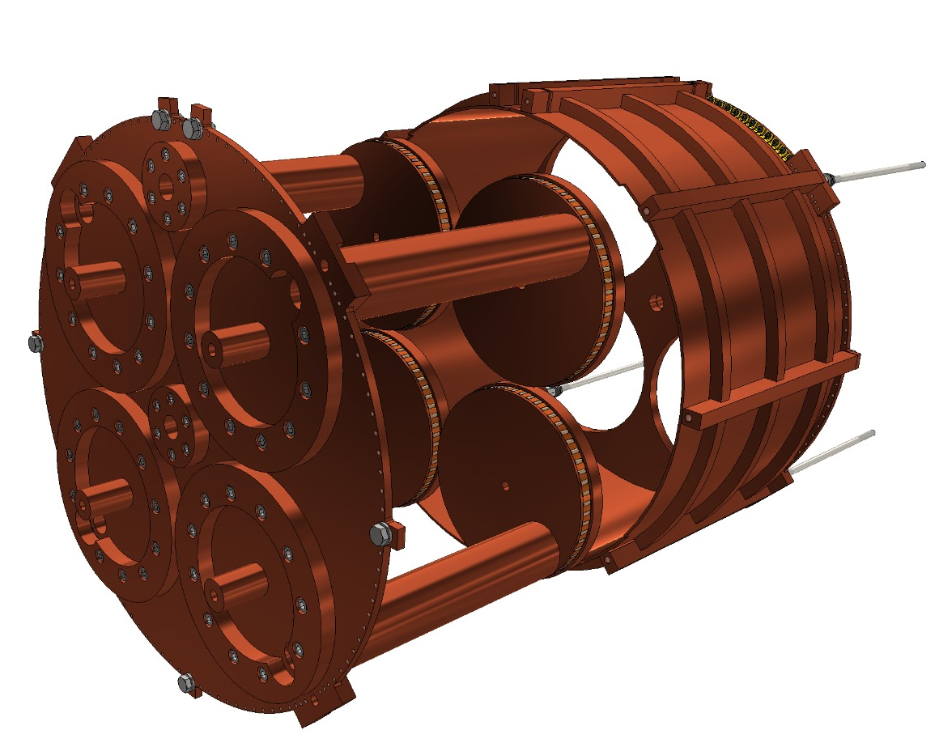
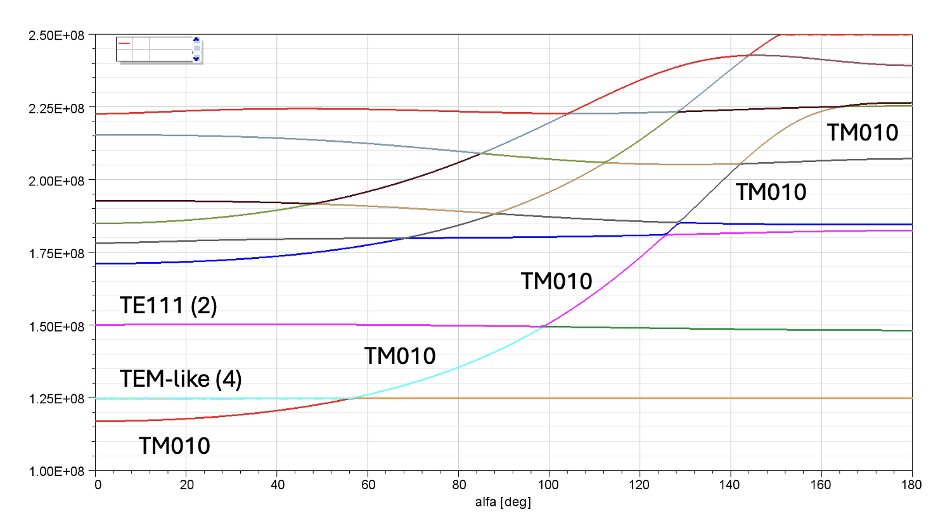
Tuning System
Credit S.Tocci
Credit S. Tomassini

Slide 15
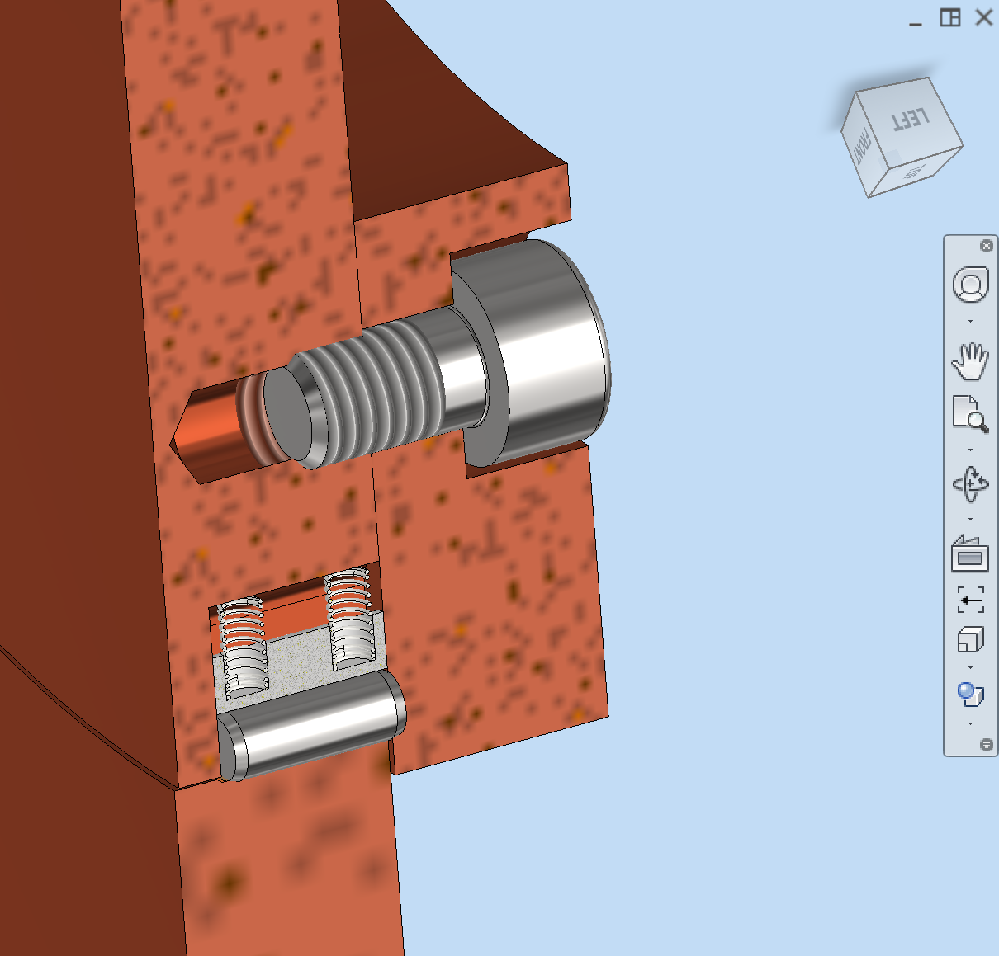
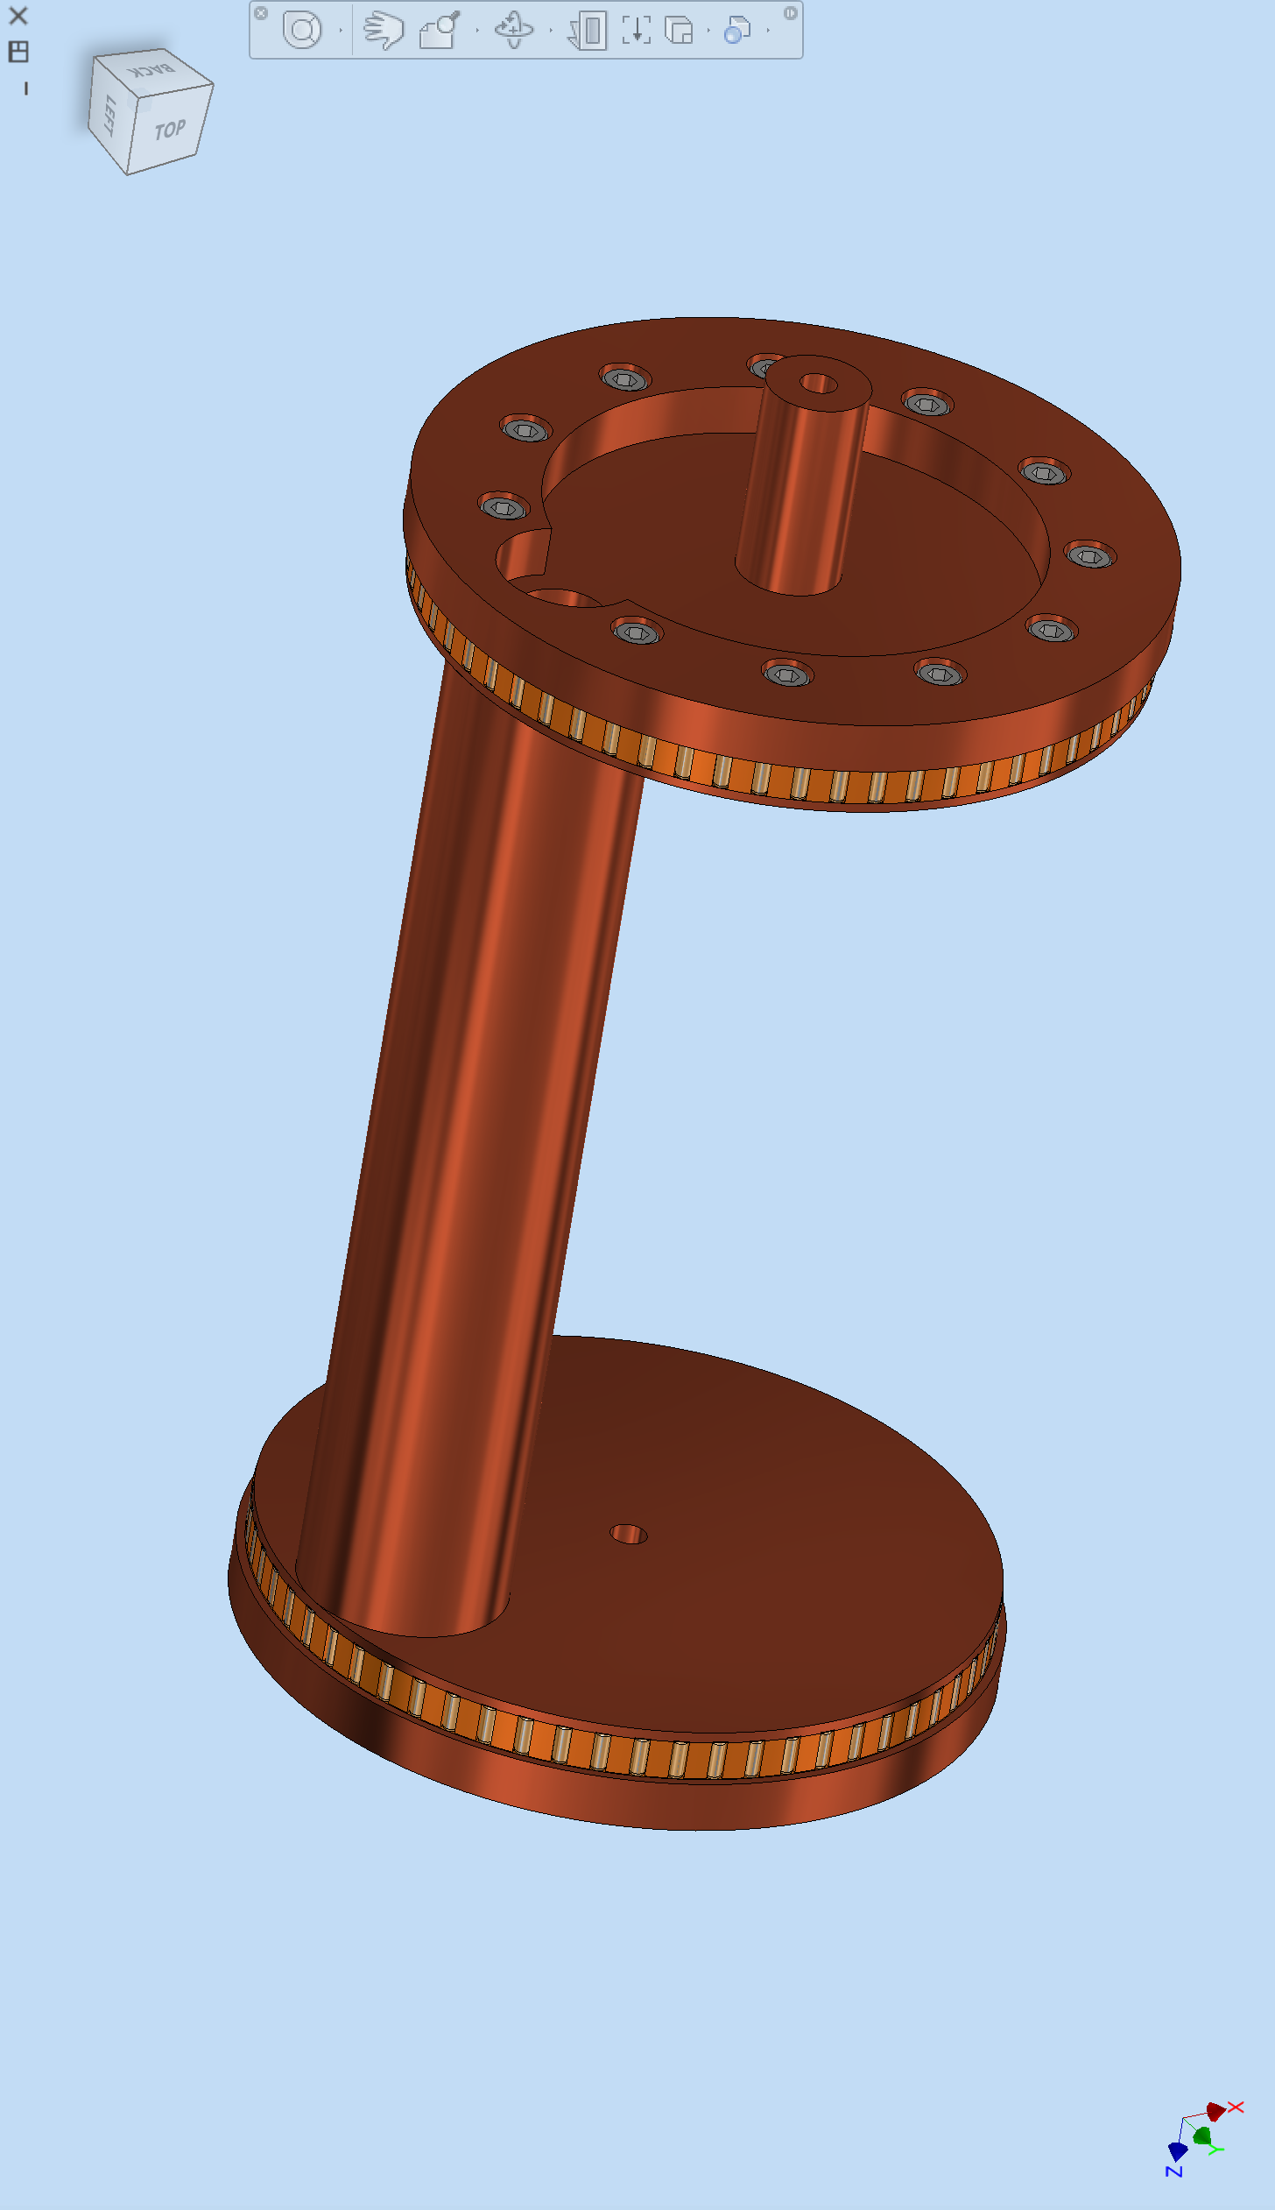
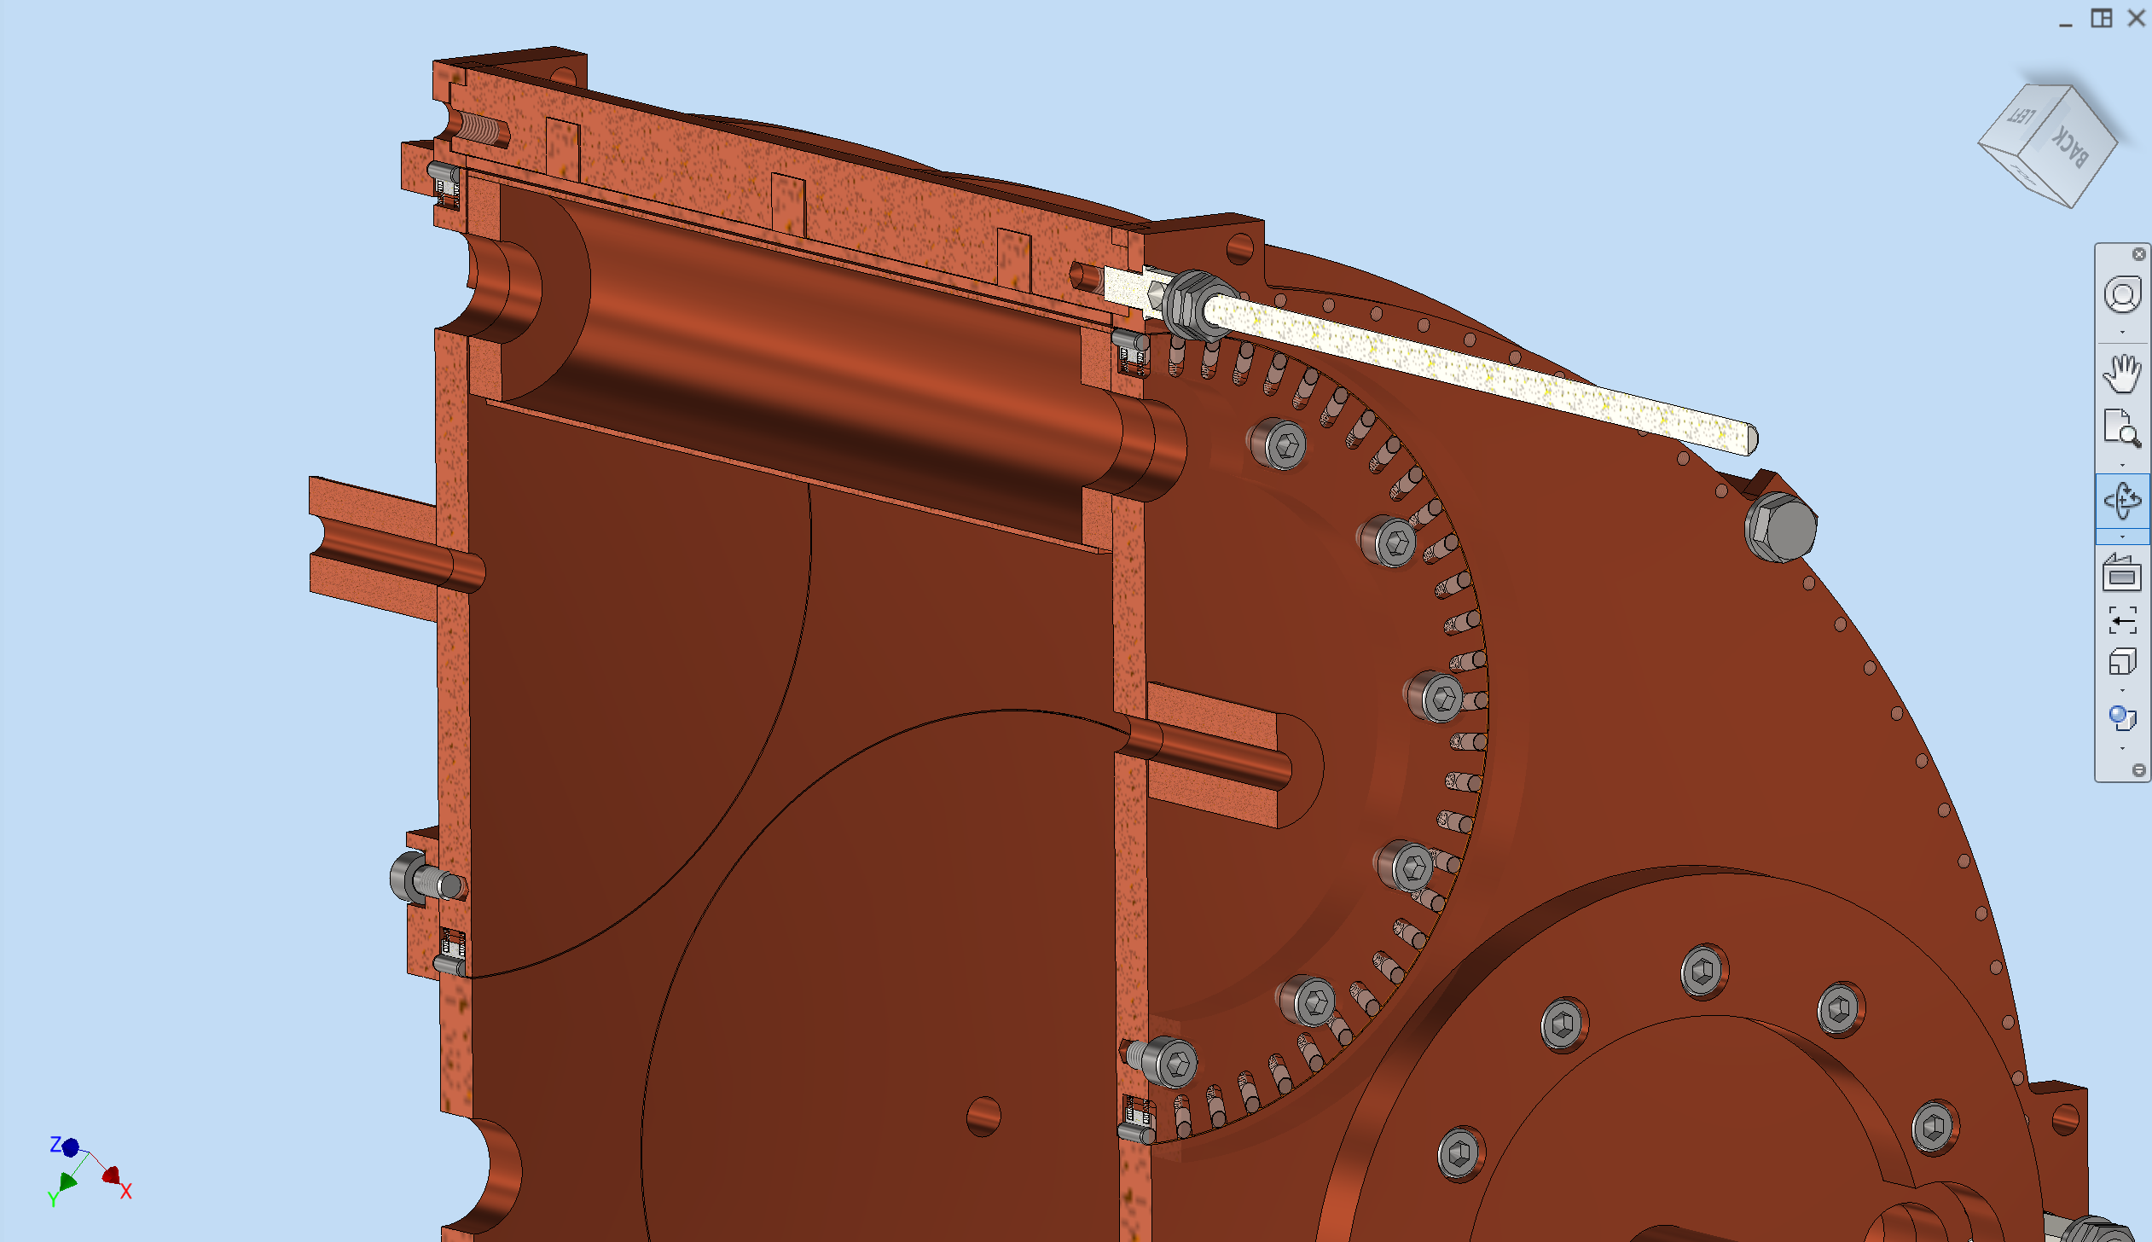
Mechanical Design: Tuners sliding contacts
Springs
Metal contact
RF sliding contact
Vacuum Hole
Tuner
Rotating disk
Credit S. Tomassini

Slide 16
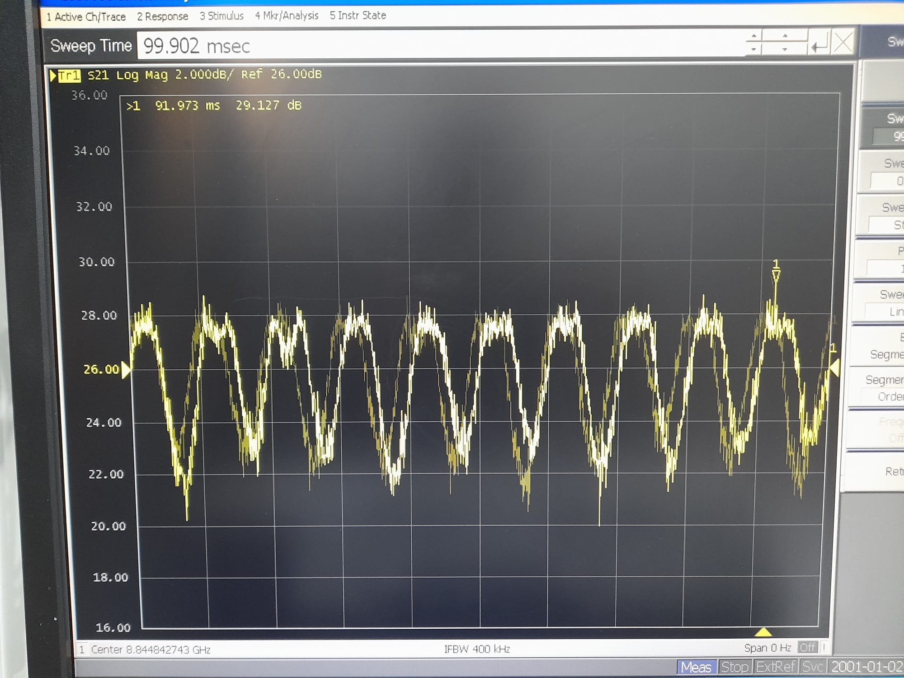

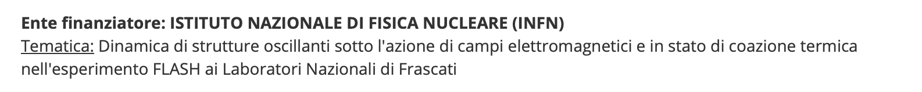
Analysis of Mechanical Vibrations
Vibrations, especially from the tuners, degrade the stability of the resonant frequency
Study the dynamic of the oscillating structures
Determine the impact on the RF modes
Determine the damping of oscillations due to the presence of 1.1 T magnetic field
PhD student in engineering in La Sapienza University

Slide 17
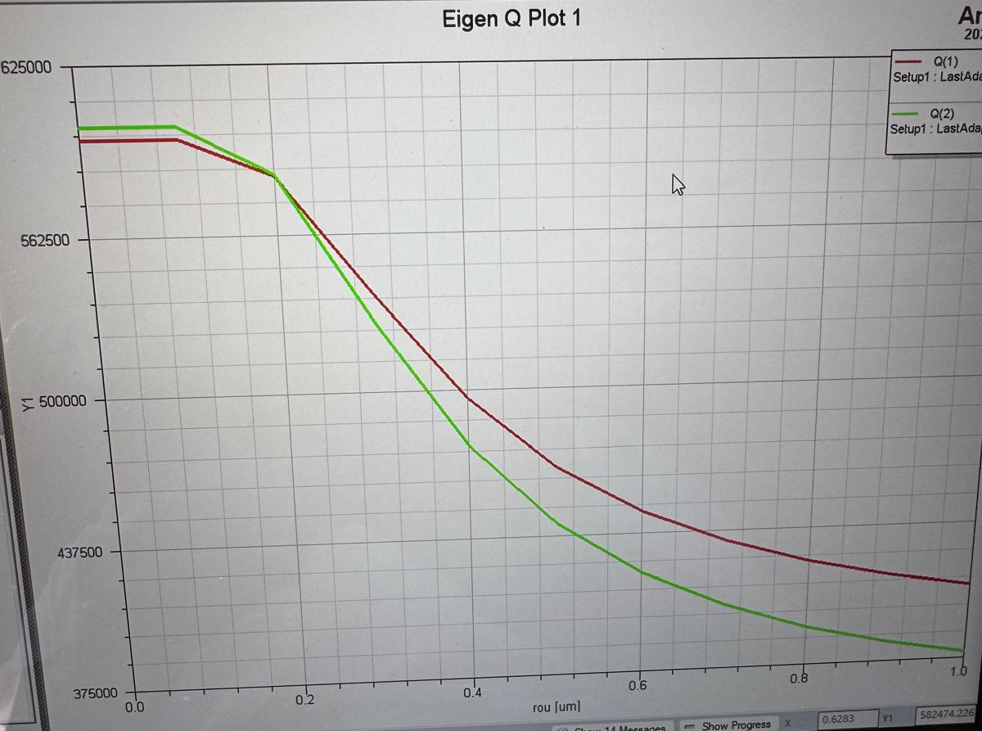
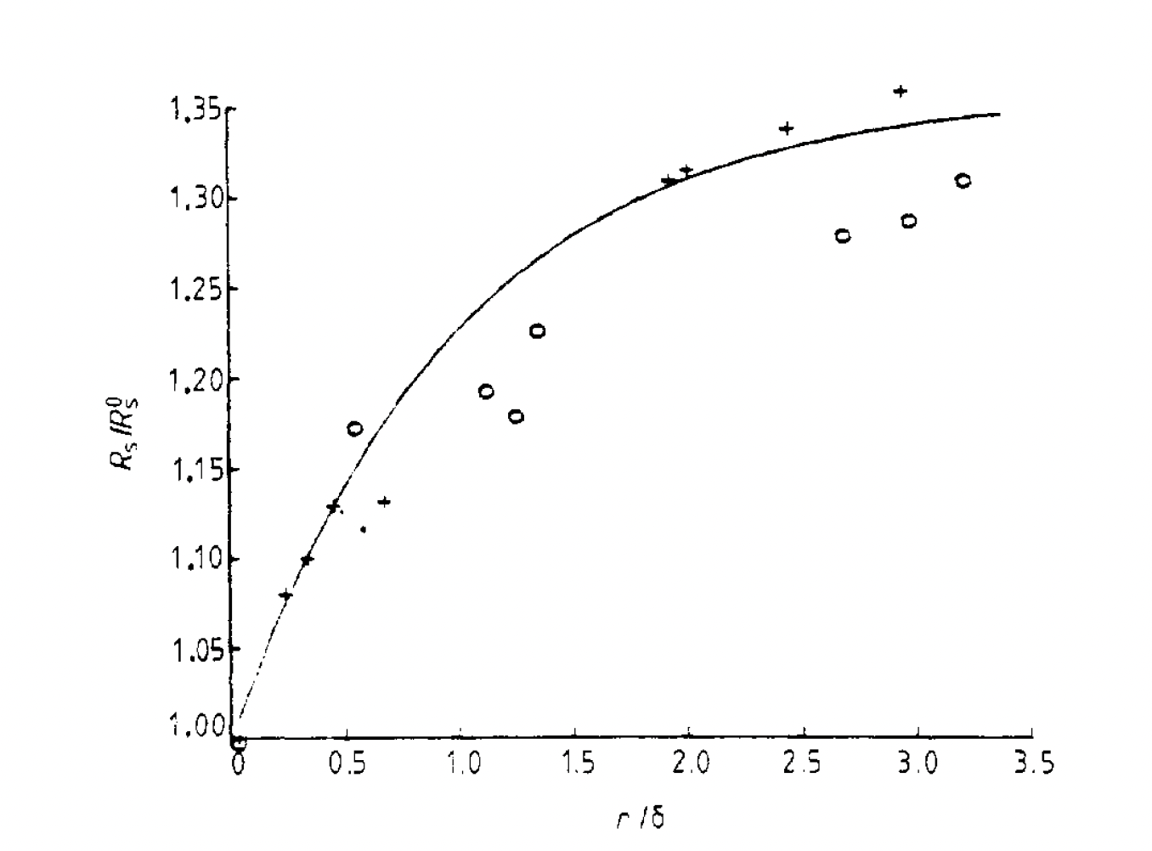
Surface Roughness
A Hernandez et al 1986 J. Phys. E: Sci. Instrum. 19 222
Q₀
600,000
-15%
Rule of thumb: roughness/skin depth<1
r(μm)
For cryogenic copper at 100 MHz we expect a skin depth delta=1 micron (RRR=50 in the CDR) and no less than 0.6 micron (in the anomalous limit for very high RRR).
The target is roughness below 0.4 microns:
1 micron mechanical
0.5 micron chemical surface treatment

Slide 18
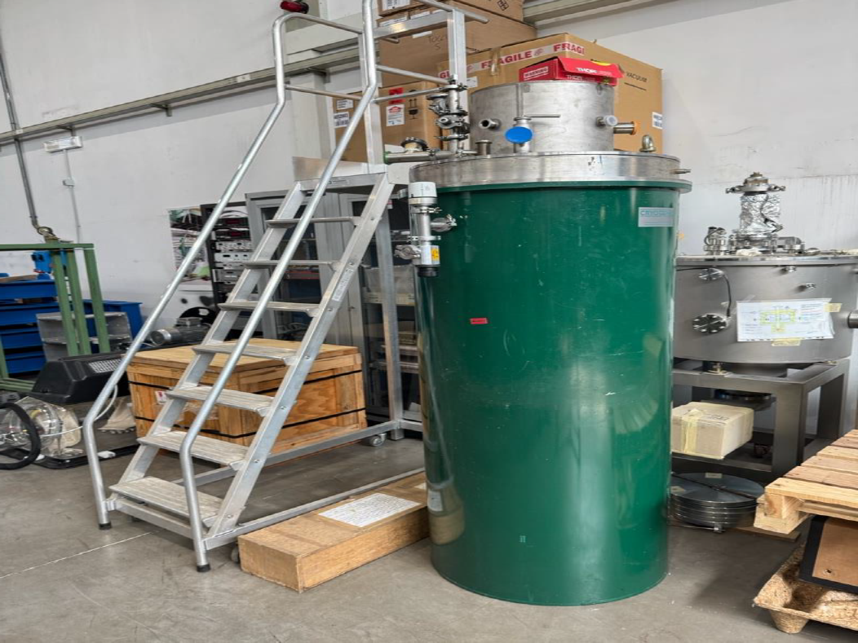
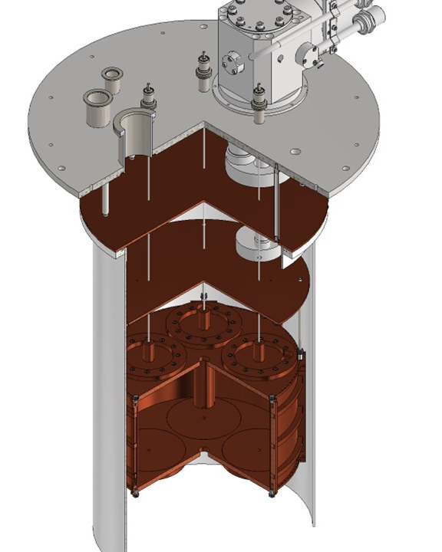
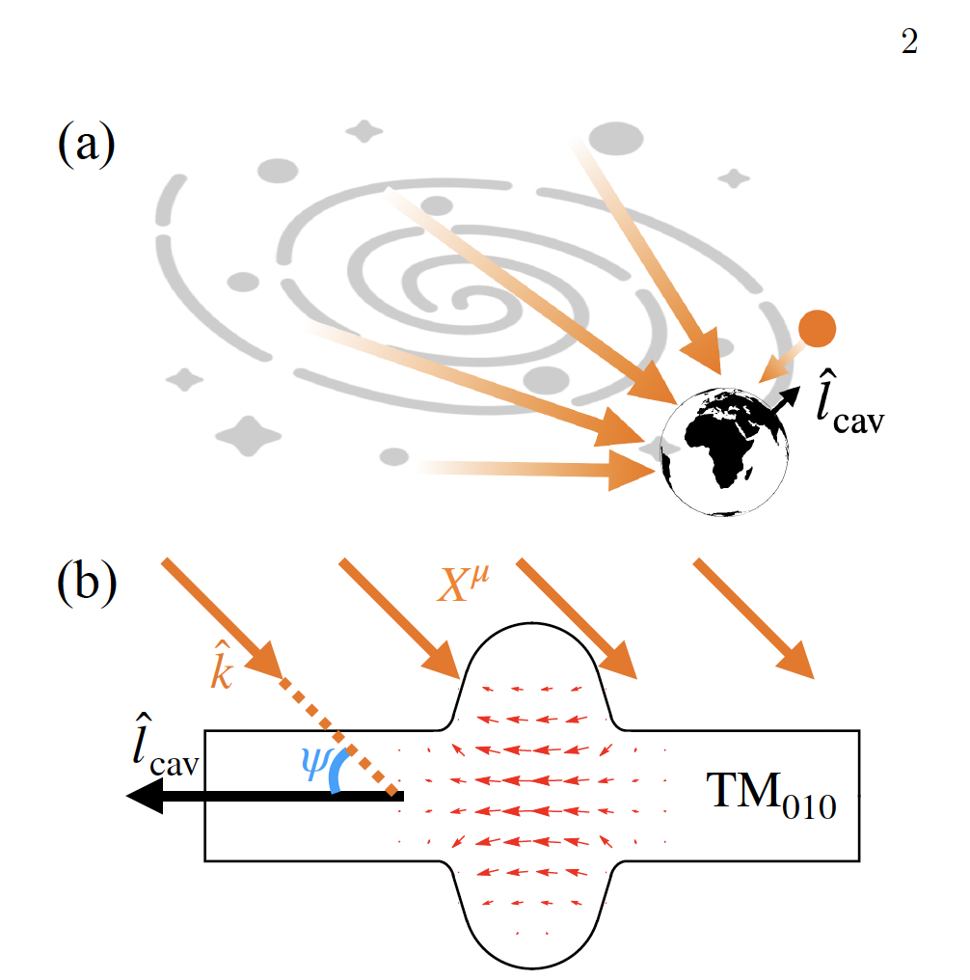
700MHz Prototype
4K cryostat (Ligi, Iungo, Beatrici, Tocci)
Cavity mechanical design(Tomassini)
Manufactoring (Uni Bonn)
Surface treatment (LNL)
Galactic dark photons as decay products from scalar dark matter
arXiv:2402.03432v2
S. Tomassini
A. Iungo

Slide 19
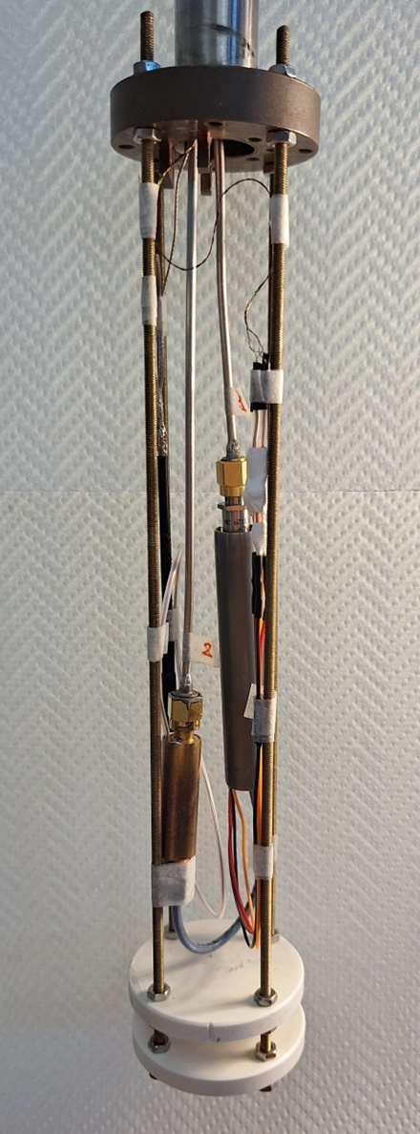
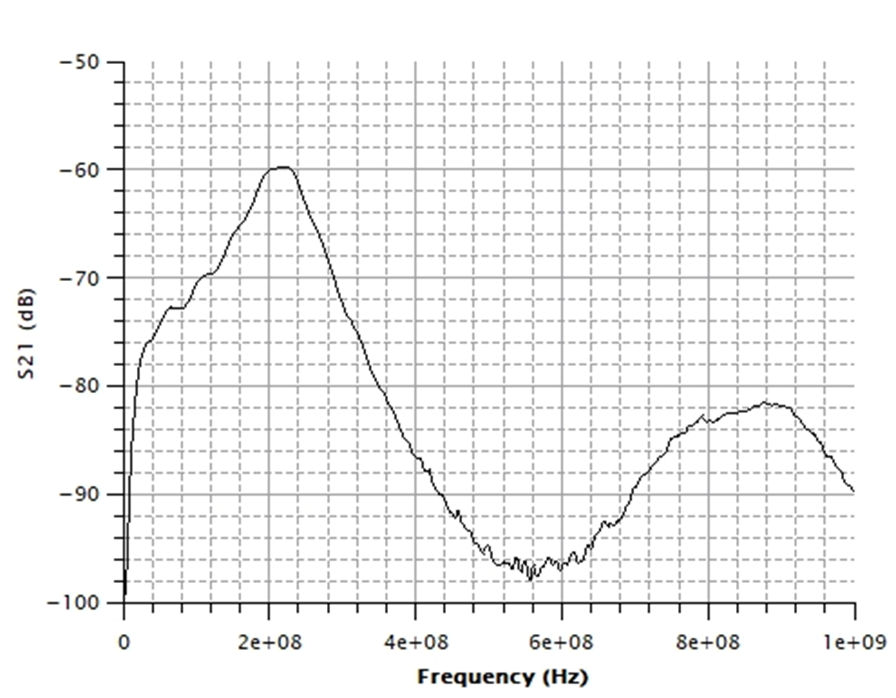
WP4: Signal Amplification and Acquisition (P. Falferi and G. Lamanna)
-60 dB @ 220 MHz
PostAmp Gain (200 MHz) ≅ 15 dB
MSA #425-1 Gain (200 MHz) ≅ 15 dB
MSA #425-1 Bandwidth ≅ 80 MHz
band (-3dB) ≅ 80 MHz
Further tests in preparation:
in B field at Camerino Uni. Shielding under study in Liverpool Uni.
Multiplexing to more SQUIDS in Pisa Uni.
Credit P. Falferi

Slide 20



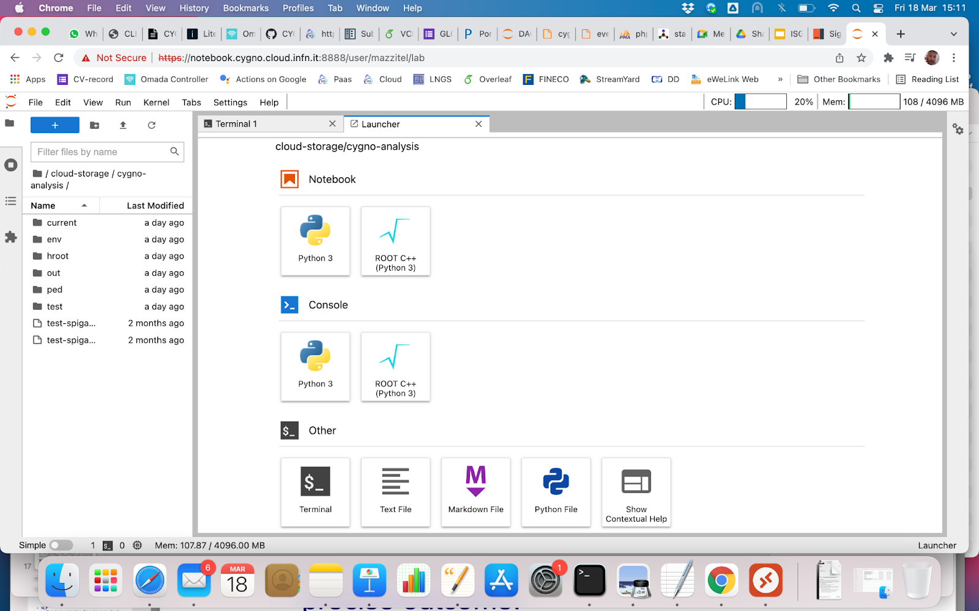
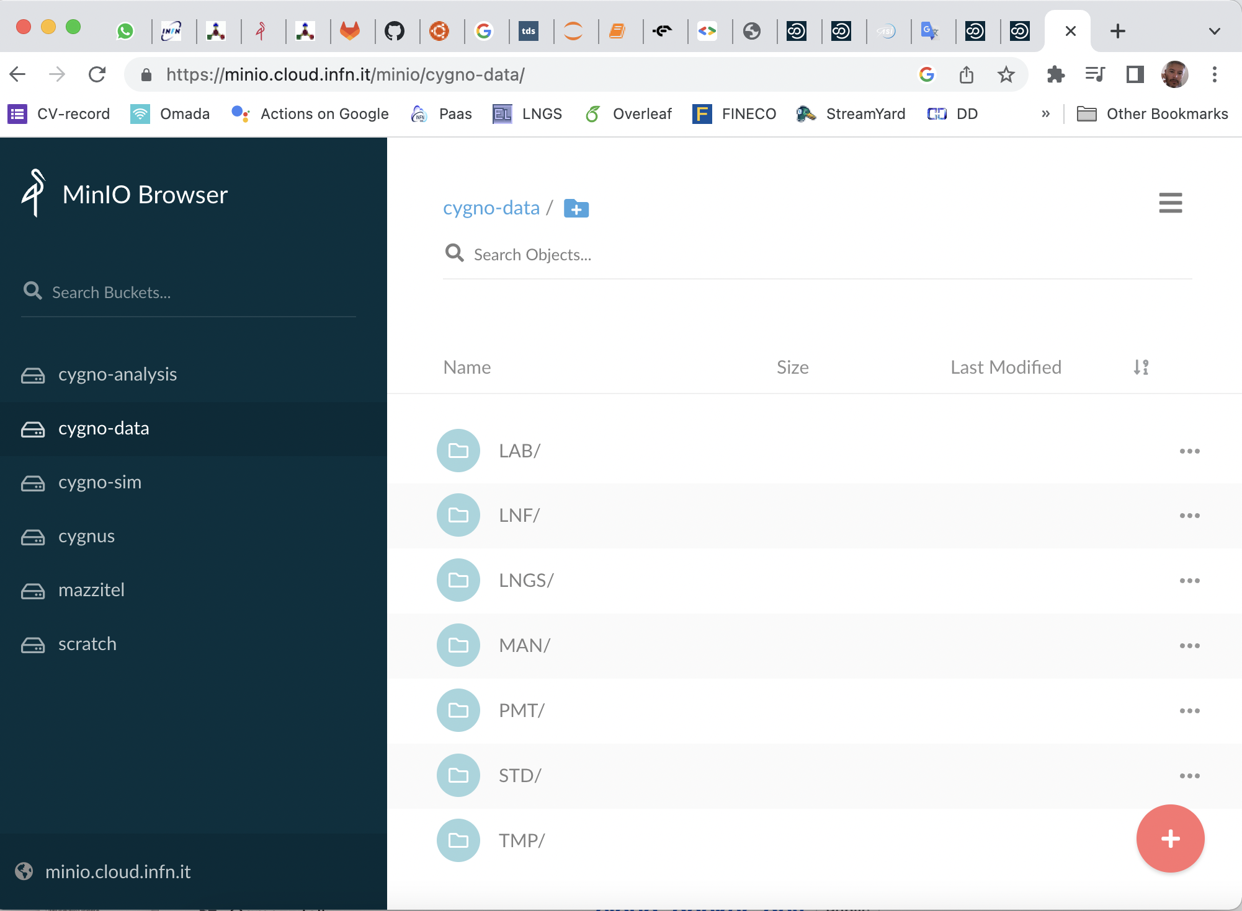
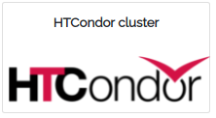

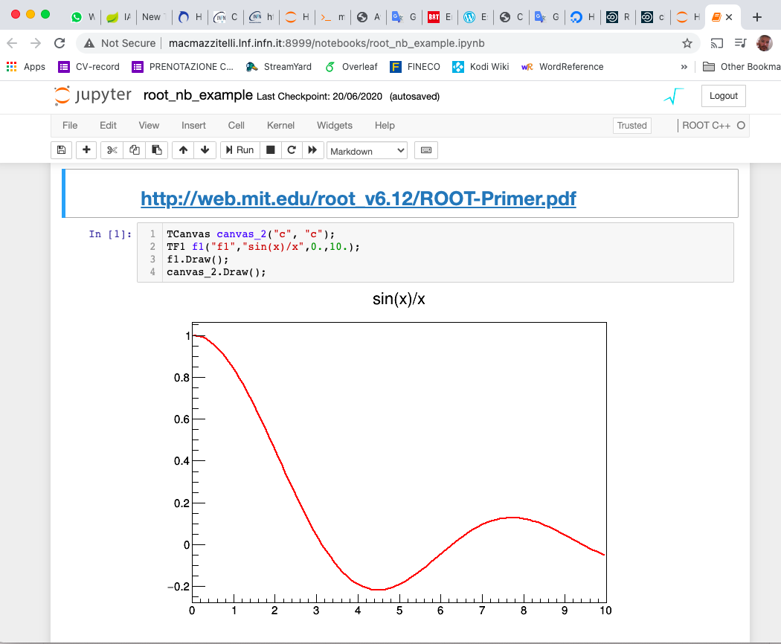

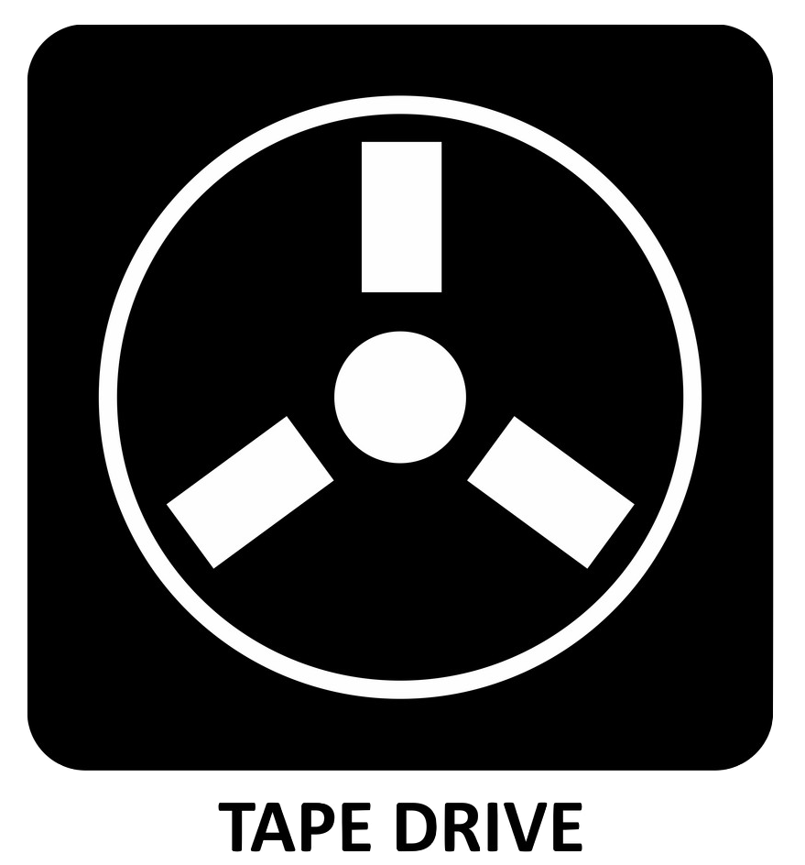
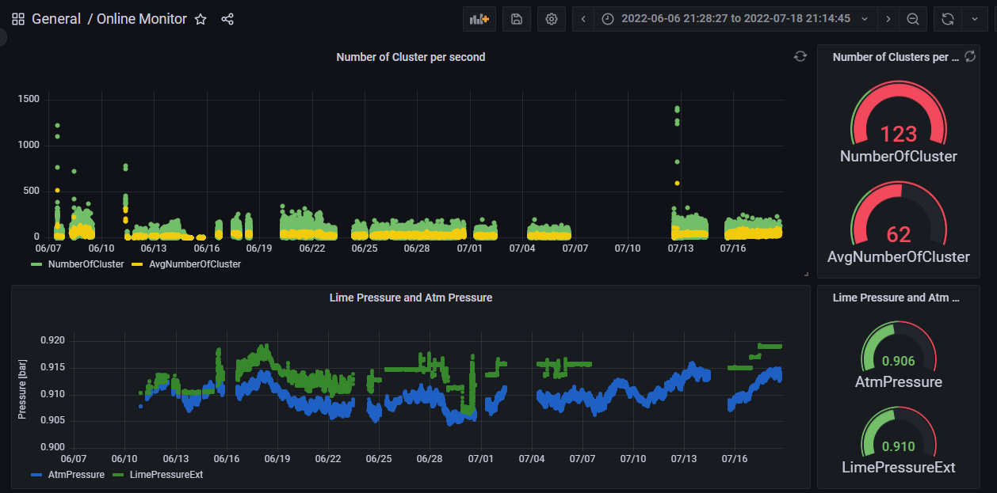
WP5: Data Analysis and Computing (K. Schmieden and G. Mazzitelli )
DAQ
GravNet Computing Model
MIDAS Triumf based DAQ; fast (test with QUAX ongoing with 70MB/s on disk) and slow control drivers under development
online data filtering for axion/HFGW search under study
local data buffer (3TB NVMe) and metadata (SQL)
streaming server for online data monitoring, pre-analysis and alert on events
remote storage and tape backend @CNAF with RUCIO data management
data access and analysis facility (notebooks, batch system, experiment software/CVMFS) open to all the members of the collaboration
BATCH
WEB GUI
ANALISYS
RESOURCES
S3
user
scratch
data
STORAGE/TAPE
METADATA &
SLOW CONTROL
Credit G Mazzitelli

Slide 21
WP6: FINUDA Decommissioning and FLASH Commissioning (S. Gazzana)
We found the option of outsourcing the dismantling work to an external company too expensive.
A new disassembly procedure was agreed with the Safety and Protection Service (S. Vescovi).
Some delay in the operations inevitable.
Refurbishing and certification of the original FINUDA assembly tools.
Extraction of the FINUDA Clepsydra
Dismounting of Scintillators and Phototubes
Ongoing activities:
Maintenance and testing of hydraulic and endcap handling systems.
Certification of the DAFNE cryogenic plant.

Slide 22
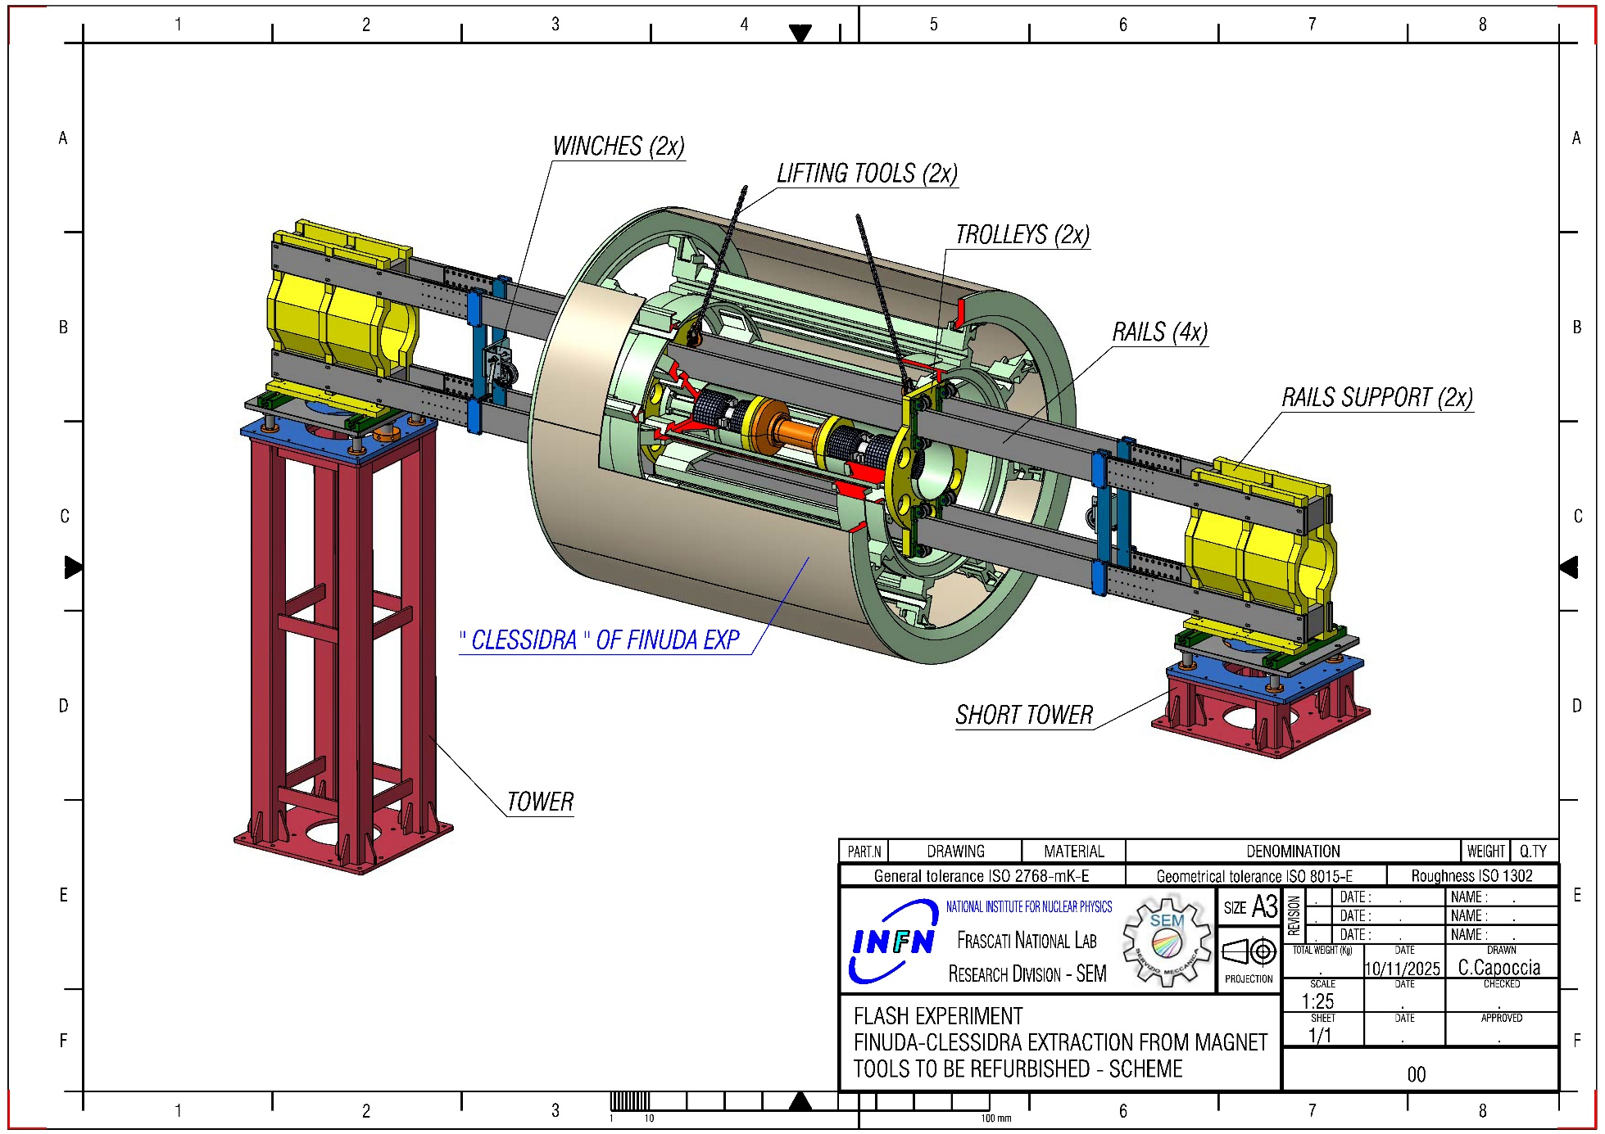
TOOLS & PROCEDURE TO REMOVE THE ‘’CLESSIDRA’’ OF FINUDA EXPERIMENT FROM MAGNET
THE IDEA IS TO RE-USE THE SAME TOOLS USED DURING THE INSTALLATION TRYING TO SEMPLIFICATE THE OPERATIONS IN ORDER TO PROCEED MORE FAST AND EASLY
WORK IN PROGRESS NOT FINAL
IN ORDER TO GO ON ON THIS DIRECTION WE HAVE A REFURBUSHING WORK TO DO ON THESE TOOLS
HERE A SCHEME OF TOOLS NECESSARY
Credit C. Capoccia

Slide 23
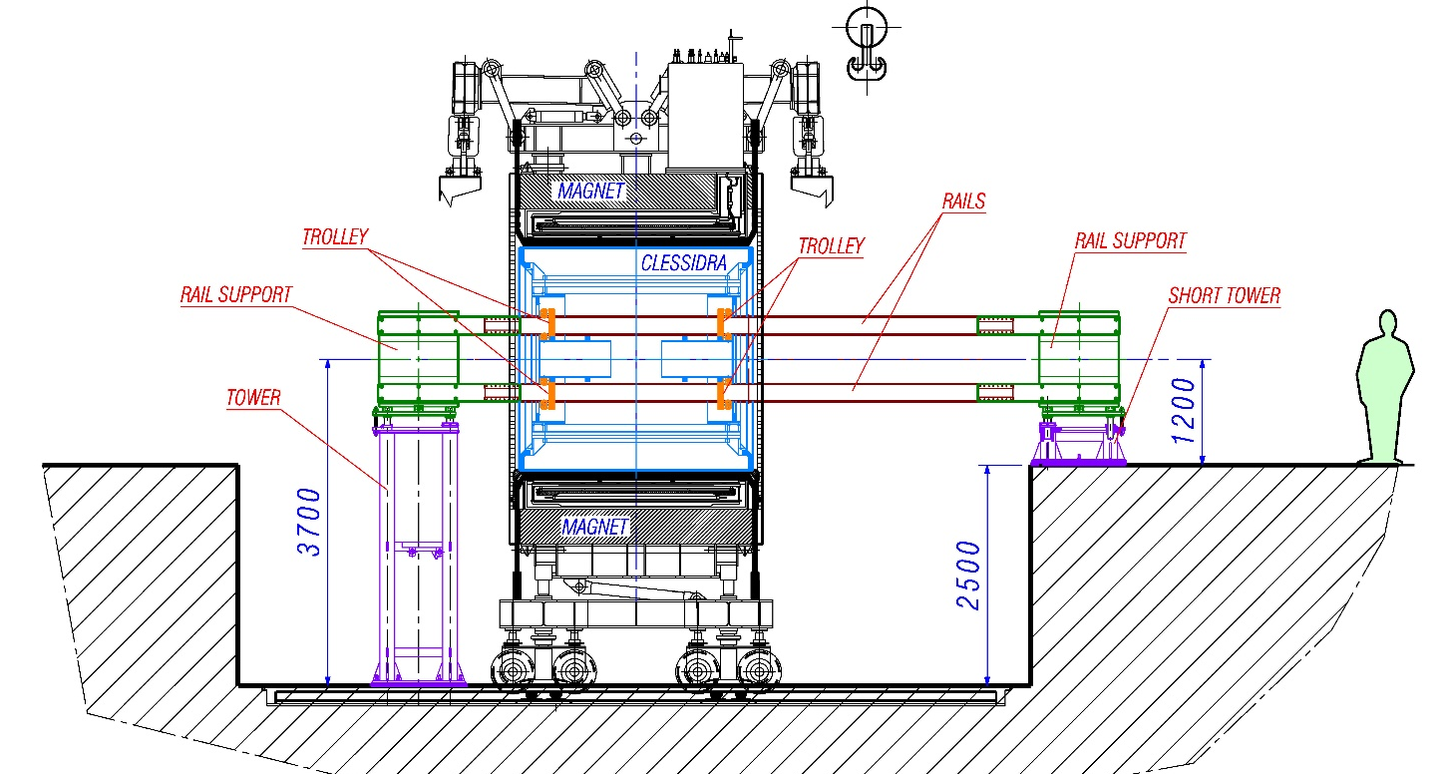
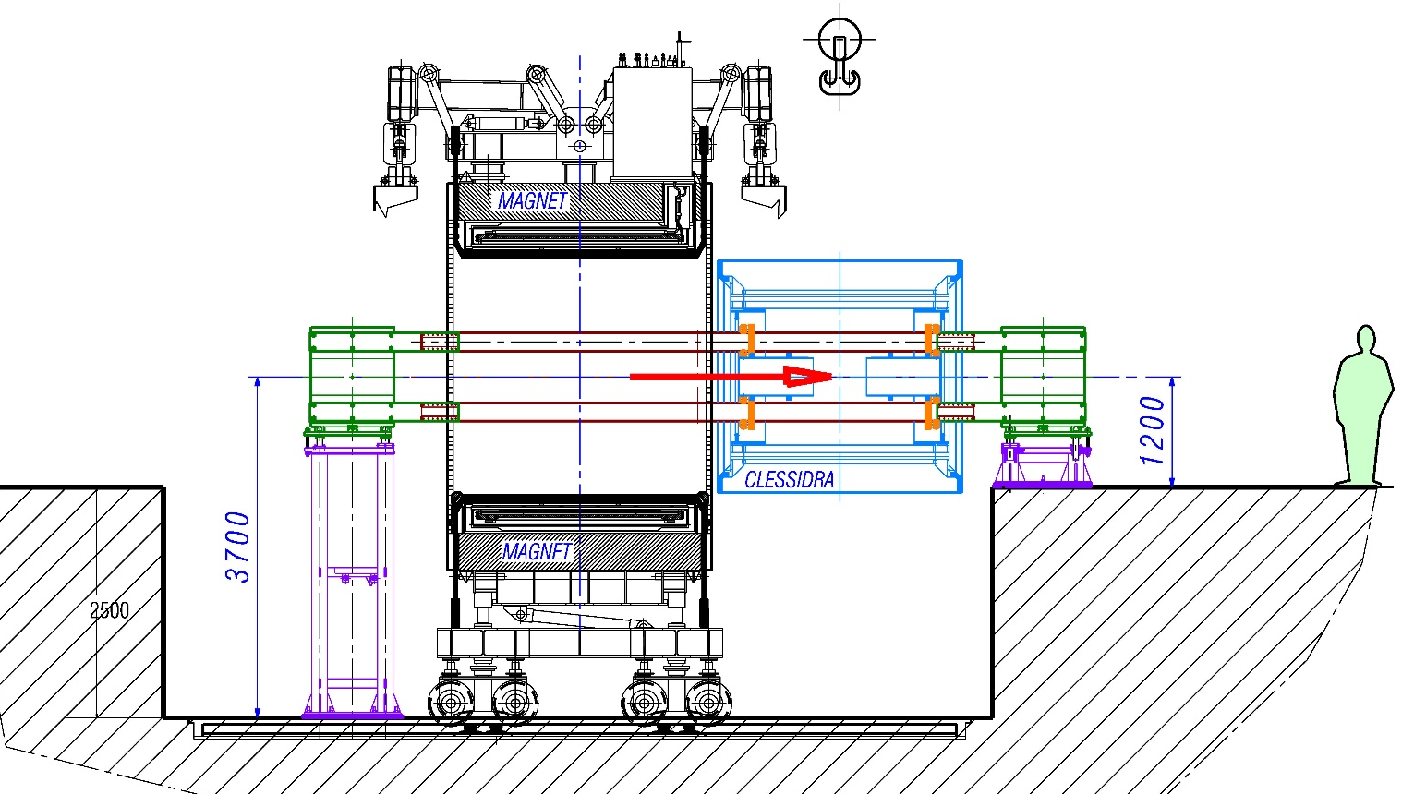

STARTING POINT OF PROCEDURE:
HERE A SCHEME OF TOOLS INSTALLED:
TOWERS
RAIL SUPPORT
RAILS
TROLLEY
WORK IN PROGRESS NOT FINAL
EXTRACTION: THE ‘’CLESSIDRA’’, PULLED BY WINCHES, TRANSLATE FOLLOWING RAILS LEAVING THE MAGNET
Credit C. Capoccia

Slide 24
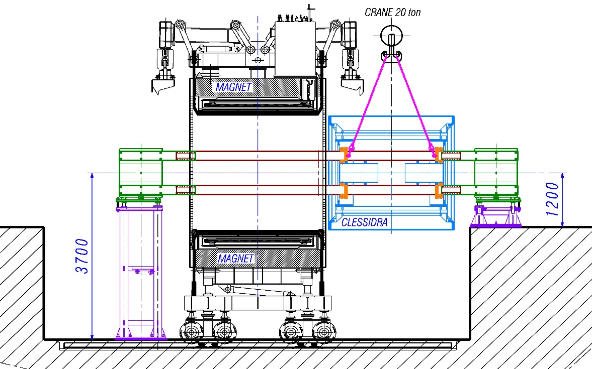
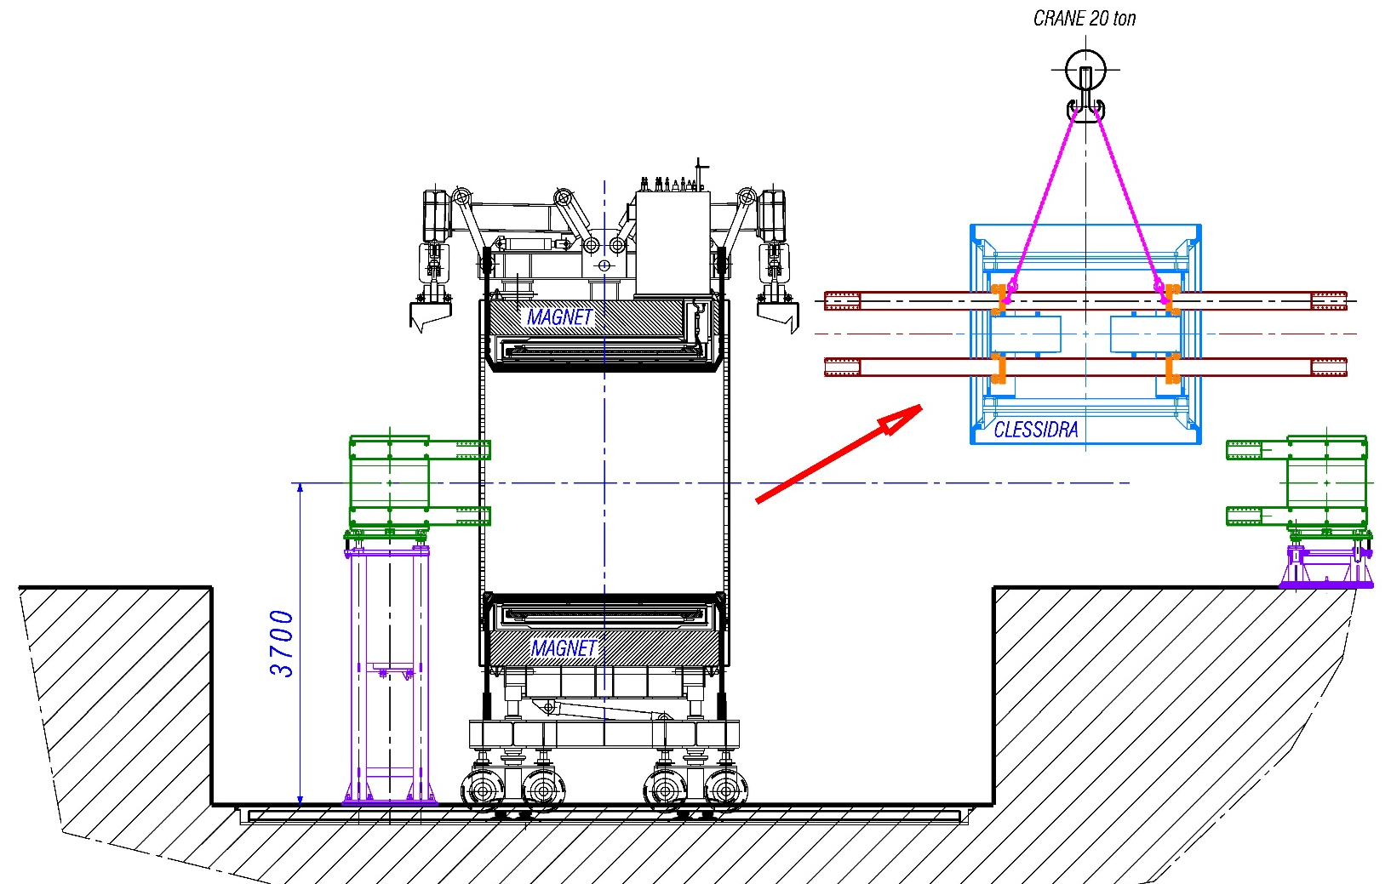
CONNECTION TO CRANE: REMOVING THE UPPER COVER OF ‘’CLESSIDRA’’ IS POSSIBLE TO CONNECT THE TROLLEYS (BOTH) BY CHAIN TO THE CRANE
WORK IN PROGRESS NOT FINAL
TAKE-AWAY THE ‘’CLESSIDRA’’:
DISMOUNT THE CONNECTIONS OF RAIL WITH SUPPORT AND FIXED THEM TOGETHER WITH TROLLEY
THAN MOVE AWAY THE ‘’CLESSIDRA’’

Slide 26
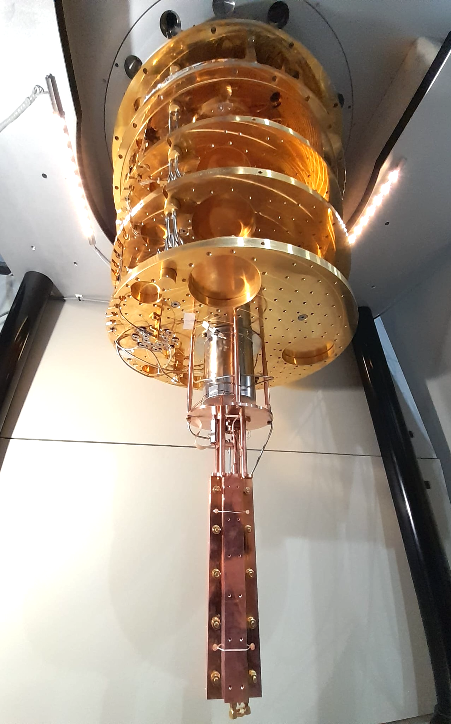
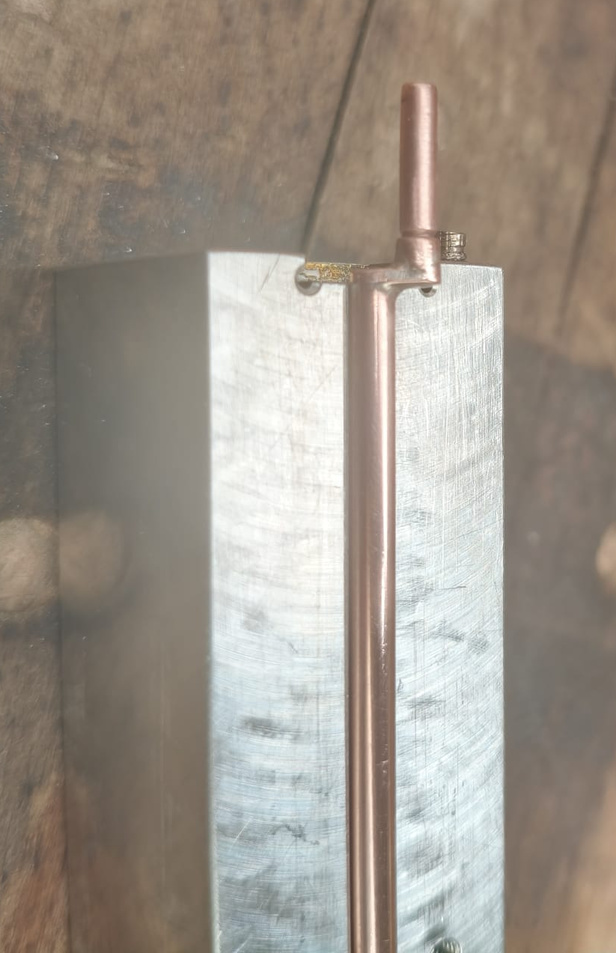
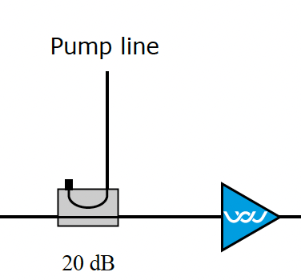

QUAX@LNF
New QUAX@LNL results in PRL
https://doi.org/10.1103/4dv9-72t5
Improvements in LNF haloscope:
Quantum limited TWPA amplifier
Improved cavity tuner
Calibration Noise source
Multi-mode acquisition for HFGW
GPS time acqusition
New digitizer
MIDAS DAQ
Technical stop of two months for a leak in the new thermal switch. Sending it back for repairs.
Phys. Rev. D 110, 022008 (2024)

Slide 27
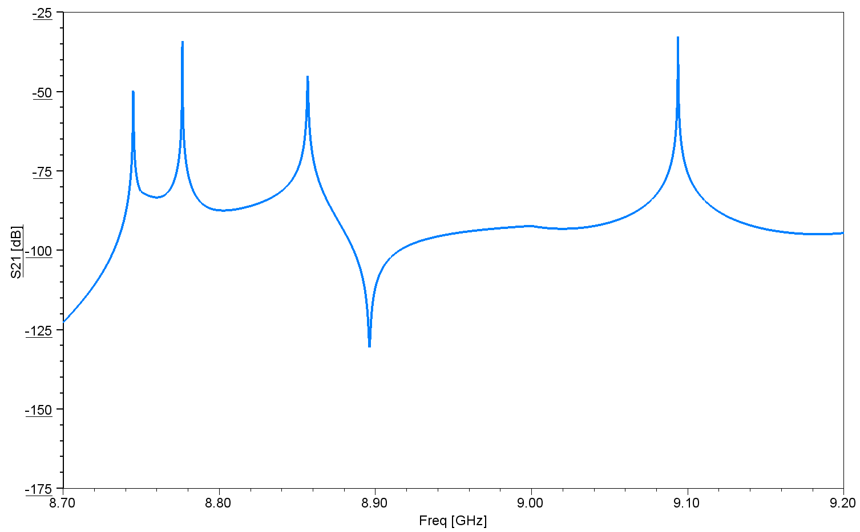
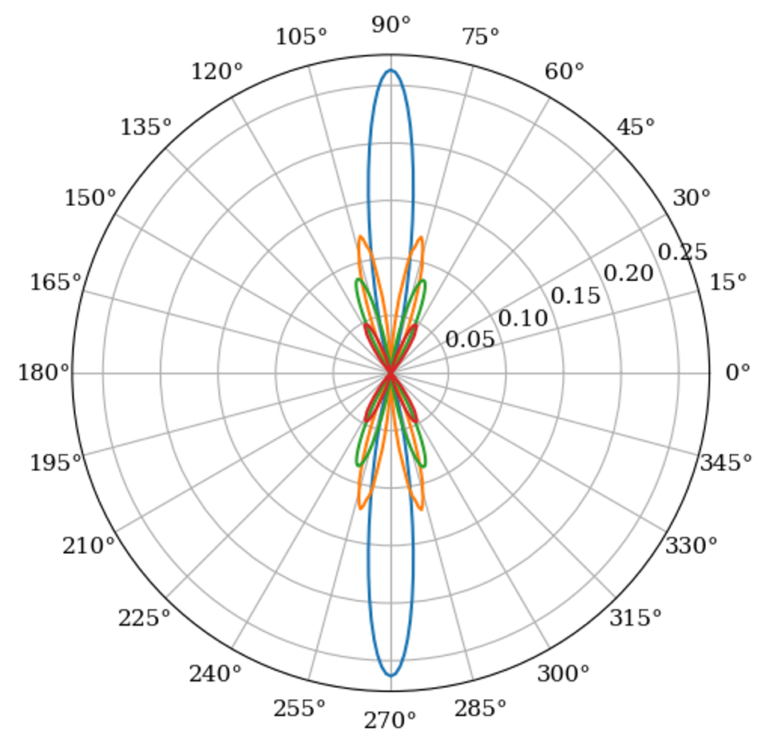
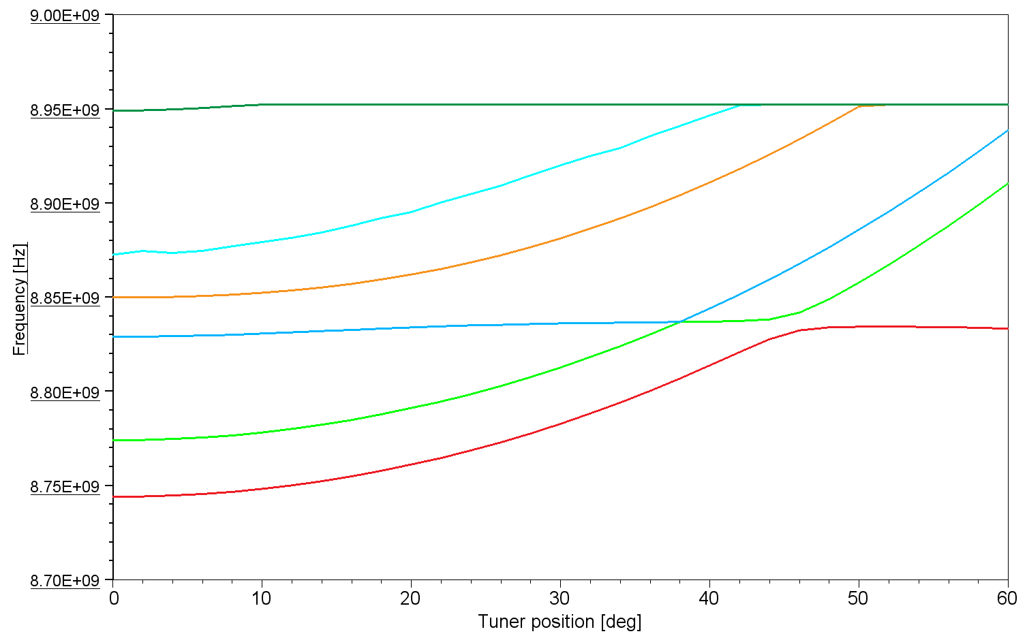
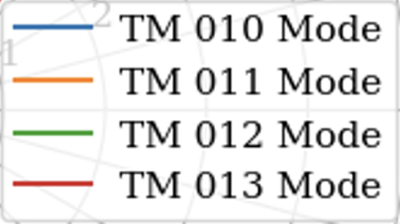
Multi-Mode Detection for HFGW
Acquisition setup for the next QUAX@LNF data take
TM010
TM012
Mode | Resonant Frequency [GHz] | Q factor (@4°K)
TM010 | 8.67 | 1e5
TM011 | 8.69 | 1e5
TM012 | 8.75 | 1e5
QUAX@LNF
TM011
TM012
TM011
TM010
Credit Y. Kim

Slide 28
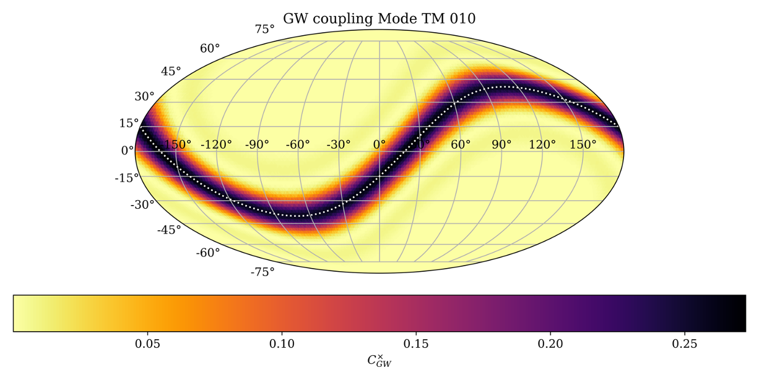

Daily Modulation
Credit Y. Kim
Coupling to GW from different directions

Slide 29


Characterization of TWPA Amplifier
In collaboration with Y. Kim (Mainz) and S. Horodenski (Bonn) that joind at LNF the COLD team (led by A. Rettaroli) in October for the TWPA characterization.

Slide 30


Slide 31




Coherent Oscillations in Weakly Anharmonic NbSe2 Qubit
Paper submitted!
A. D’Elia et al. arXiv:2509.17160
$$ν_{qubit}=12.6 GHz$$
$T_{1}∼6.5 μs$
PI Alessandro D’Elia

Slide 32

New NbSe₂ Qubit with large anharmonicity
Frequency ~10.8 GHz
Anharmonicity ~400 MHz
Full Rabi, Ramsey and Echo characterization
New paper in preparation!

Slide 33


2 Qubits Photon-Counter
The resonant cavity was fabricated at INFN-LNL and the qubits at CNR-IFN (not the final qubit design).
A. Piedju et al. Nuovo Cimento proceedings IFAE 2025

Slide 34





COLD Lab expansion works
Office
HFGW and Axion experiment
Storage Room
LHe 8T cryostat
SC cavities
BF DR for qubit tests
4K cryostat for FLASH prototype
NbSe2 qubit Lab

Slide 35
In summary
GravNet Collaboration expanding.
FLASH Collaboration is taking shape; Collaboration with CERN started; Periodic FLASH meetings; Engineering PhD students from La Sapienza etc.
WP teams formed and work is progressing.
Test of FLASH prototype foreseen in summer 2026: investigating the possibility of doing relativistic-DP searches.
Preparing QUAX@LNF/GravNet multimode run; TWPA amplifier characterized; 2 months technical stop for a leak in the thermal switch
Submitted paper on first NbSe2 qubit! New paper in preparation with results on new more anharmonic samples.
LNL sent the triple cavity for the 2-qubits photon counter. We are now commissioning a foundry to produce the qubits.

