Slide 1
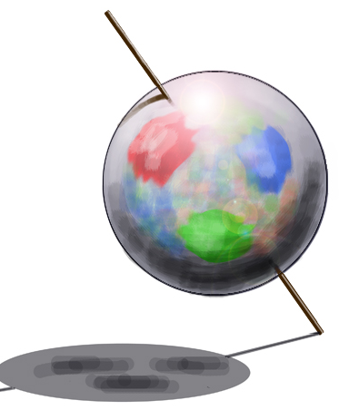
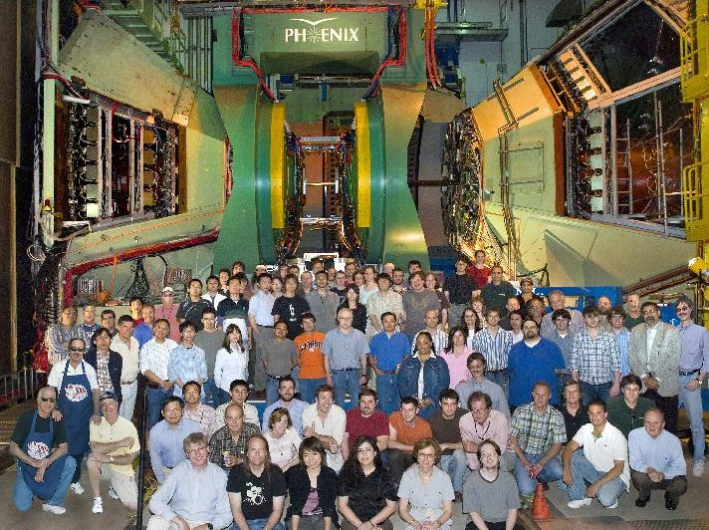


PHENIX Spin Program Recent results & prospects
Kenneth N. Barish
Diffraction 2012
September, 2012

Slide 2
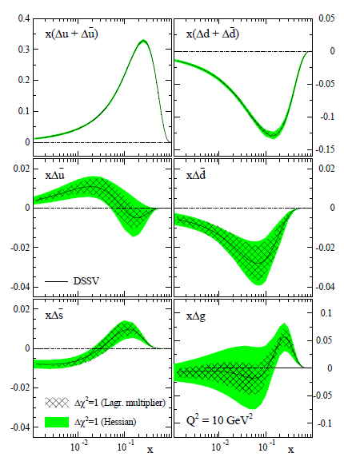
The Proton Spin Structure (p+p)
Polarization experiments
  Helicity
    Valence quarks
    Sea quarks
    Gluons
momentum
gluon spin
valence + sea quark spin
quark & gluon orbital motion
DSSV arXiv:0904.3821

Slide 3
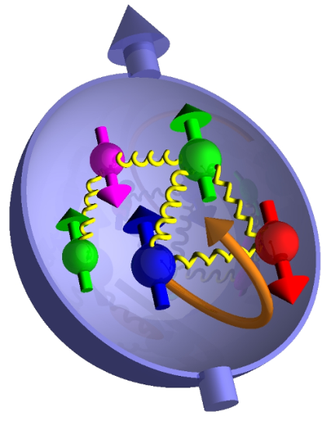
The Proton Spin Structure (p+p)
Polarization experiments
  Helicity
    Valence quarks
    Sea quarks
    Gluons
  Transversity
momentum
momentum
gluon spin
What is the connection to orbital angular momentum?
valence + sea quark spin
quark & gluon orbital motion

Slide 4
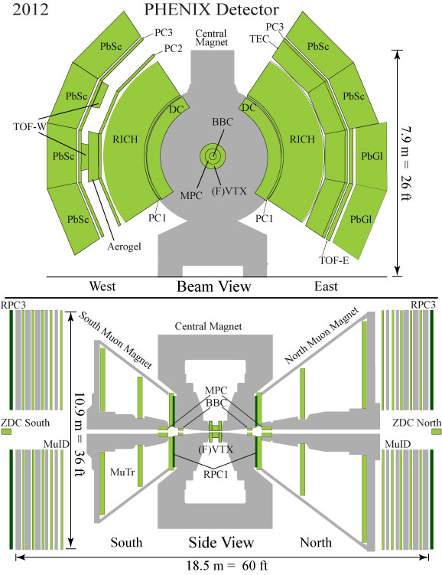
The PHENIX Detector for Spin Physics
Philosophy (initial design):
  High rate capability & granularity
  Good mass resolution & particle ID
  Sacrifice acceptance
π⁰/γ/η detection
Electromagnetic Calorimeter, MPC:
π⁺/π⁻
Drift Chamber
Ring Imaging Cherenkov Counter
J/ψ
Muon Id/Muon Tracker
Resistive Plate Chambers (RPC)
Relative Luminosity
Beam Beam Counter (BBC)
Zero Degree Calorimeter (ZDC)
Local Polarimetry - ZDC
Filters for “rare” events

Slide 5
Longitudinal Data
Year | √s (GeV) | L (pb⁻¹) | P | FoM (P⁴L) | FoM (P²L)
2003 | 200 | 0.35 | 27% | 0.0019
2004 | 200 | 0.12 | 40% | 0.0031
2005 | 200 | 3.4 | 49% | 0.20
2006 | 200 | 7.5 | 57% | 0.79
2006 | 62.4 | 0.08 | 48% | 0.0042
2009 | 500 | 10 | 40% | 0.26 | 1.6
2009 | 200 | 14 | 57% | 1.4
2011 | 500 | 16.7 | 48% | 0.88 | 3.8
2012 | 500 | 30.03 | 52% | 2.2 | 8.1

Slide 6
Transverse Data
Year | √s (GeV) | L (pb⁻¹) | P | FoM (P²L)
2002 | 200 | 0.15 | 15% | 0.0034
2005 | 200 | 0.16 | 47% | 0.035
2006 | 200 | 2.7 | 51% | 0.7
2006 | 62.4 | 0.02 | 48% | 0.0046
2008 | 200 | 5.2 | 46% | 1.1
2012 | 200 | 9.2 | 58% | 3.1

Slide 7
I. Gluon Polarization
Robust measurement covering wide x_{g} region through multiple channels:

Slide 8
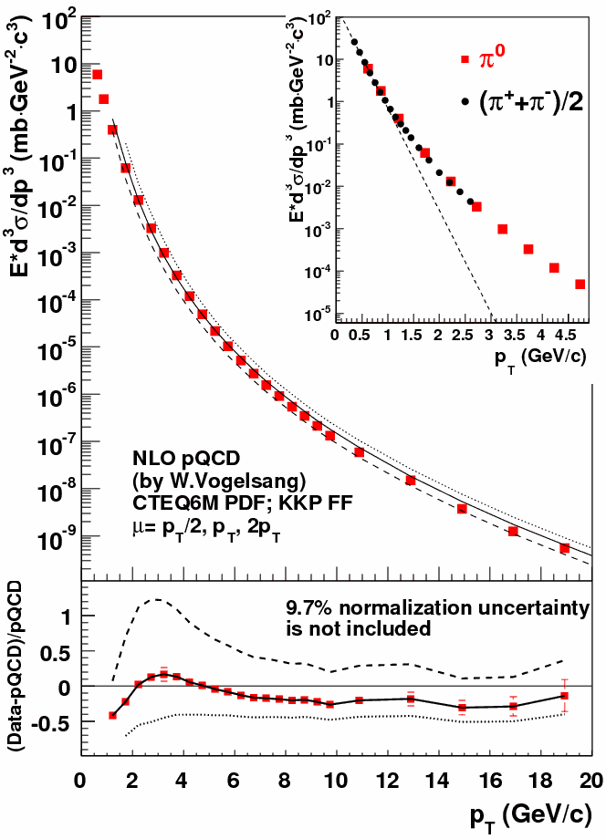



Cross sections
p⁰ (200 GeV)
p⁰
Dg²
DgDq
Dq²
π⁰ @ 200 GeV, η~0
PRD76:051106,2007
NLO pQCD calculations are consistent with cross-section measurements

Slide 9
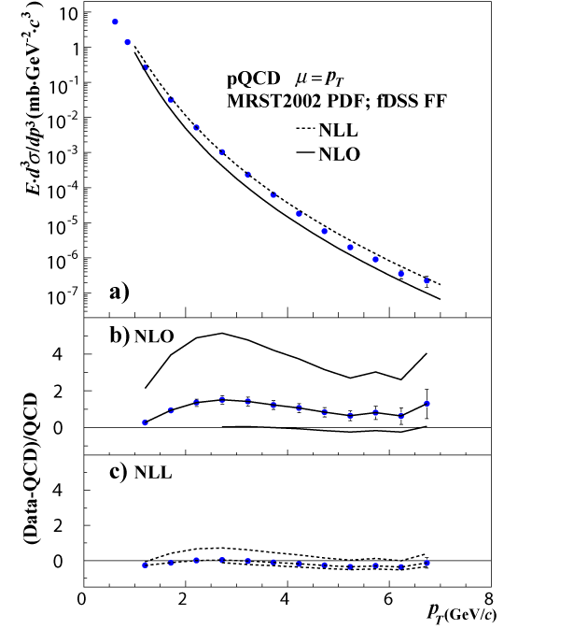
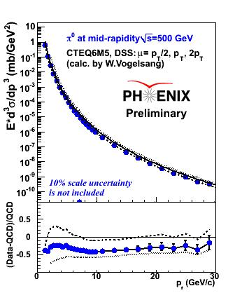
Cross sections
p⁰ (200 GeV)
p⁰ (62.4 GeV)
Also h, g …
p⁰ (500 GeV)
PRD76:051106,2007
NLO pQCD calculations are consistent with cross-section measurements

Slide 10
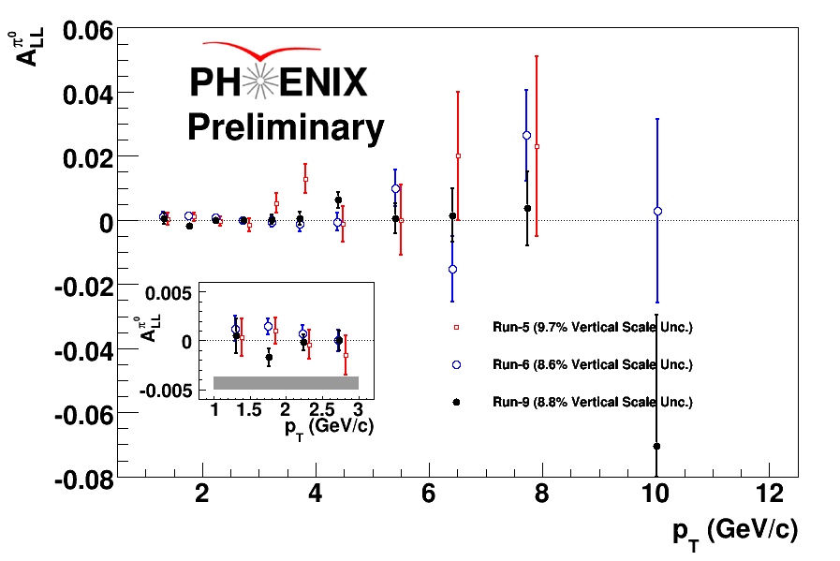
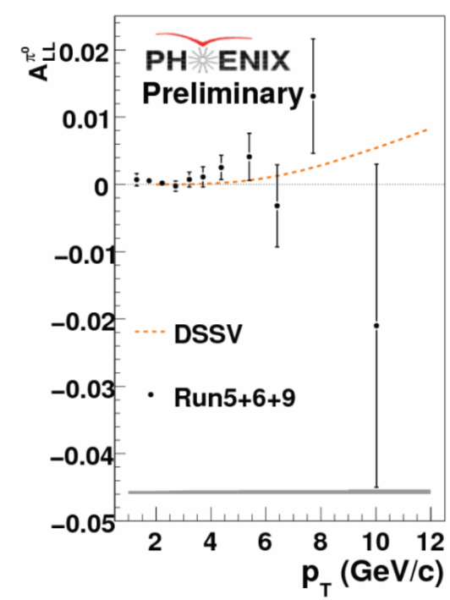
A_{LL} of π⁰ at √s=200GeV
Run 5
Run 6
Run 9
Combined asymmetries consistent with DSSV, and also with 0 to O(10⁻³)

Slide 11
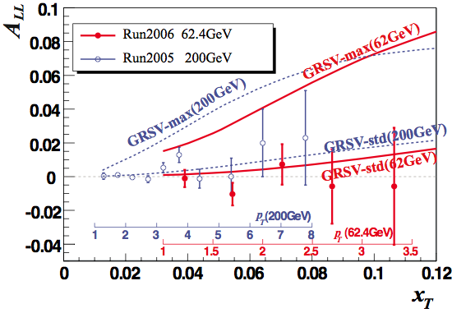
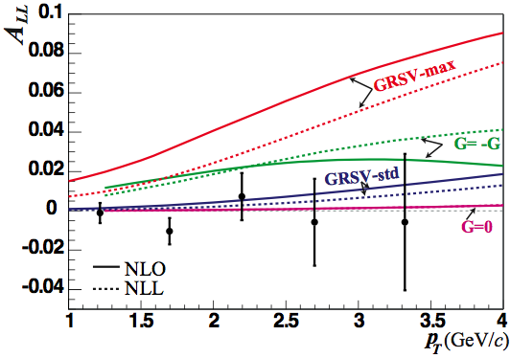
A_{LL} of π⁰ at √s=62.4GeV
Low FoM but good high-x coverage

Slide 12
DG Global Fit
DSSV
DSSV + PHENIX Run9 π⁰ A_{LL}
DSSV: Before
DSSV: After
Node is disfavored.
Uncertainties decreased
A node at x~0.1 ?
0.001
.01
0.1
1
0.001
.01
0.1
1
DSSV: Phys. Rev. Lett. 101, 072001(2008)
analysis carried out by Swadhin Taneja using fitting software from DSSV
12
Notes:
12

Slide 13
p⁰ Pairs
Constrains event kinematics
need more Luminosity

Slide 14
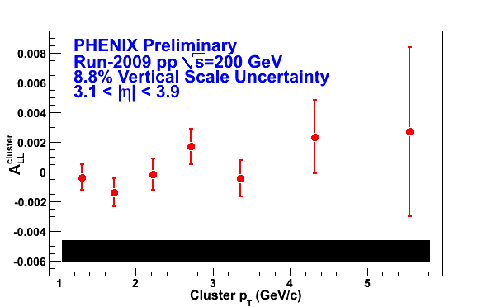
Forward Calorimetry: MPC
lower x→10⁻³
Cluster (p⁰ dominant) A_{LL}
P_{T}
Process decomposition skewed more heavily toward quark-gluon than mid-rapidity.

Slide 15
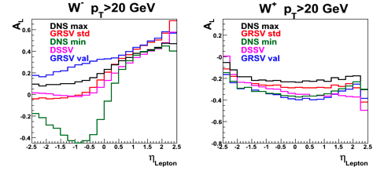

II. Sea Quark Helicity
Features
  High energy scale
  Flavor conserving
  Parity violating
Sensitive to flavor-selecting sea quark polarization.
different sea quark polarizations
Muon
Arms
Central
Arms
Muon
Arms

Slide 16
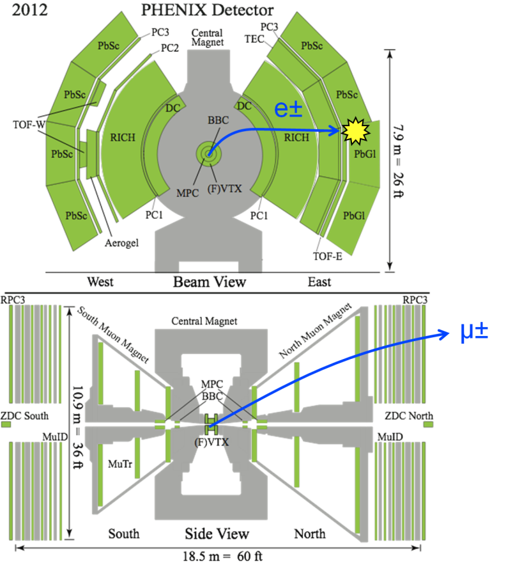
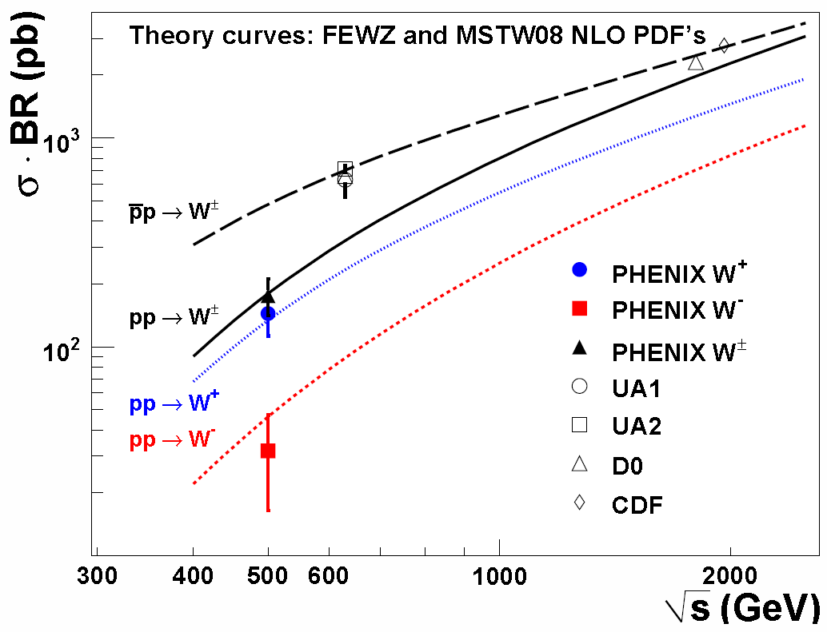
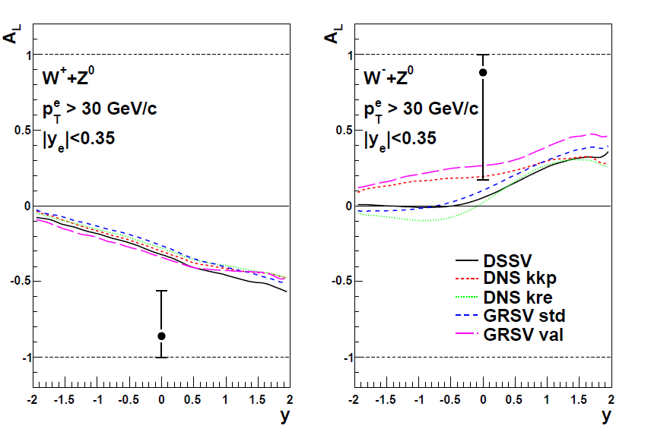
W→e in Central Arms (Run 9)
Run 9 P=0.39 L=8.6pb⁻¹ @ 500GeV
e⁺
e⁻
Run11: larger sample with P~0.52 to be released at Spin 2012.
Phys. Rev. Lett. 106, 062001 (2011)

Slide 17
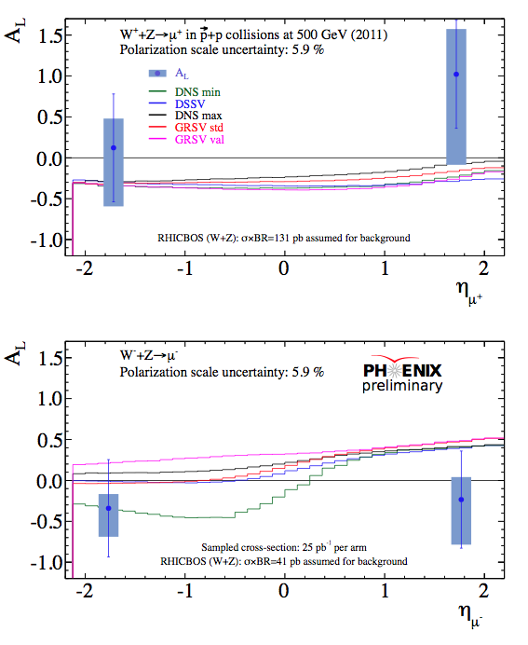
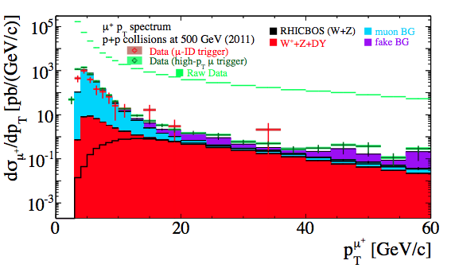
W→μ in Forward Arms (Run 11)
  Run11: L~15 pb⁻¹ P~0.52
Run 12: 30pb⁻¹ under analysis

Slide 18

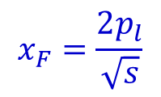
III. Transverse Spin (A_{N})
In (collinear) pQCD A_{N} should scale like
Asymmetries were expected to be very small.

Slide 19
III. Transverse Spin (A_{N})
In (collinear) pQCD A_{N} should scale like
Asymmetries were expected to be very small.
Z.Phys., C56, 181 (1992) IP Conf. Proc., vol. 915 (2007) PRL 101, 222001 (2008)

Slide 20
III. Transverse Spin (A_{N})
Sizable forward non-zero asymmetries
Asymmetries consistent over an order of magnitude in √s
Several theoretical frameworks to explain the results.
Z.Phys., C56, 181 (1992) IP Conf. Proc., vol. 915 (2007) PRL 101, 222001 (2008)

Slide 21
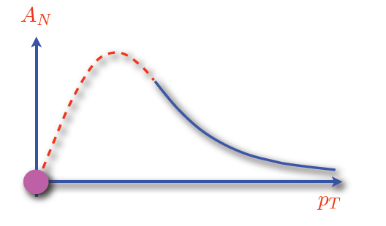
Transverse Spin Asymmetry Sources
X. Ji, J.-W. Qiu, W. Vogelsang, F. Yuan,
PRL 97, 082002 (2006)
(III) Higher-twist effects
Twist-3 quark-gluon/gluon-gluon correlators
Expectation: at large p_{T}, A_{N} ~ 1/p_{T}
So far, fall-off with p_{T} has not been observed.
(II) Sivers quark-distribution
Correlation between proton-spin and
intrinsic transverse quark momentum
Graphic from Zhongbo Kang
(I) Transversity quark distributions
and Collins fragmentation function
Correlation between proton & quark spin
+ spin dependant fragmentation function
Sivers distribution
  Access to non-collinear PDFs
  Needs orbital angular momentum of the quarks
Quark transverse
spin distribution
Collins FF
J. C. Collins, Nucl. Phys. B396, 161 (1993)
D. Sivers, Phys. Rev. D 41, 83 (1990)

Slide 22
Measurements
Initial state interaction
Sivers effect
Hard Scattering
Transversity
Twist-3
Final state interaction
Collins effect
Transverse Asymmetries
Inclusive A_{N} (central/forward)
Hadron Correlations (back-to-back)
Interference Fragmentation Functions
Drell-Yan (sPHENIX)
Jet correlations/structure (sPHENIX)
Upgrades
Upgrade plans
Separation of Sivers & Collins and test TMD parton distribution factorization and universality

Slide 23
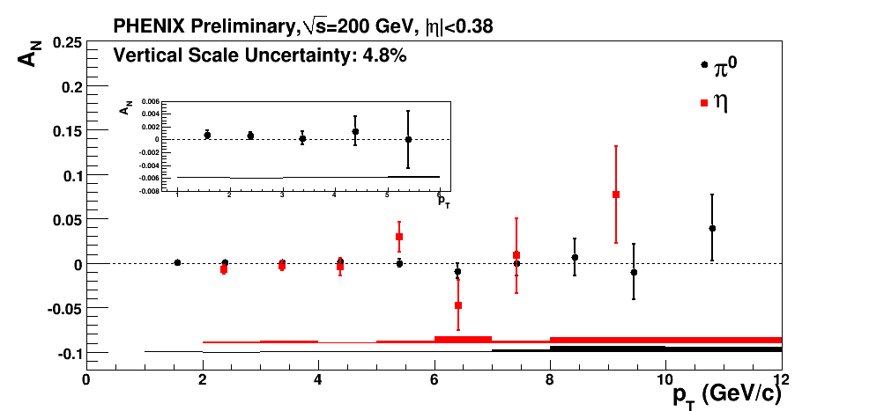
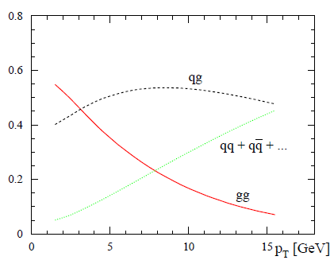
A_{N}: mid-rapidity π⁰ and η
Little or no Asymmetries observed over a wide p_{T} range
Constrains gluon Sivers
√s=200 GeV
Phys. Rev. D 74, 094011
Partonic Cross Sections
  quark-gluon dominated
  gluon-gluon at low p_{T} (Sivers)
  quark-quark at large p_{T} (Sivers+Collins)
Notes:
Color code

Slide 24
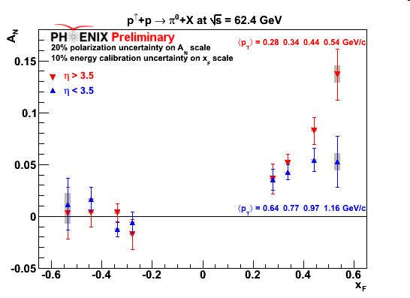
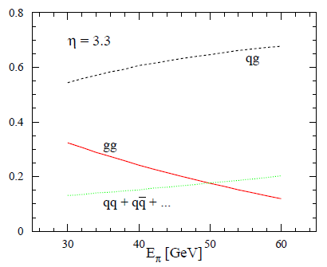
Forward π⁰ A_{N} @ 62.4 GeV
π⁰ processs contribution
η=3.3, √s=200 GeV
Guzey et al, PLB 603,173 (2004)
Significant asymmetries ~ p^{+/-}(Brahms).
Quark-gluon is the dominant partonic component.

Slide 25
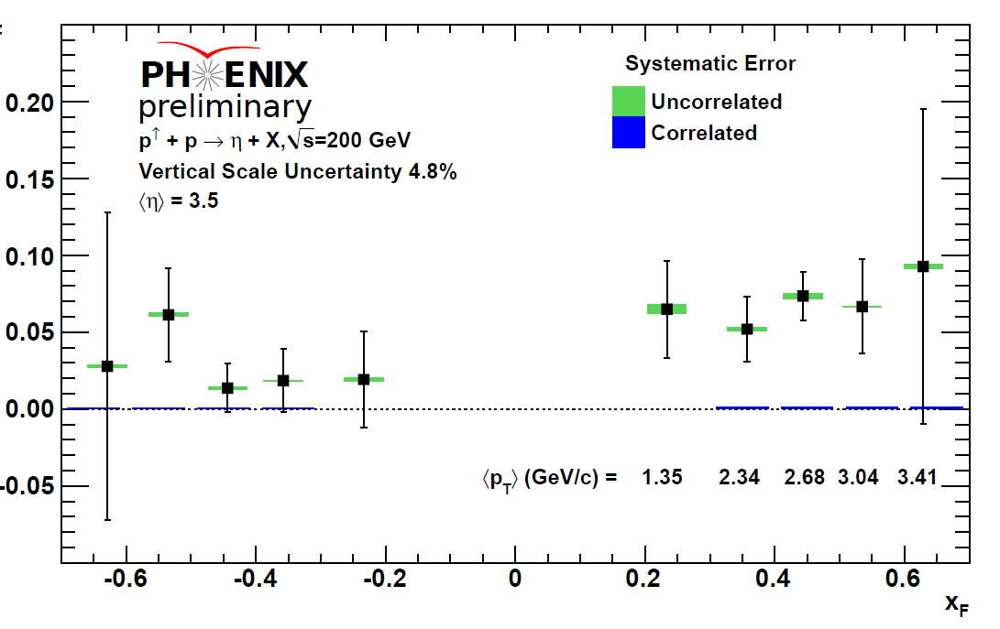
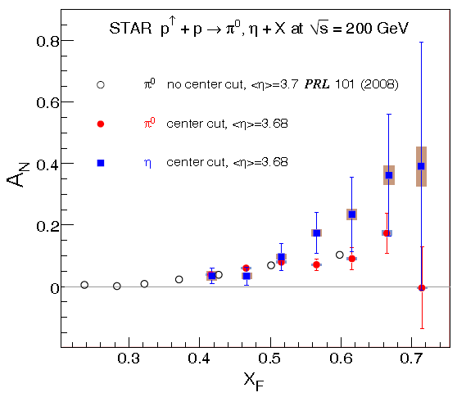
Forward A_{N}(η )
STAR
arXiv:1205.6826v1
Significant asymmetries observed for positive x_{F}
Asymmetries consistent with PHENIX p⁰ measurements
Difference in fragmentation mass, strangeness, isospin

Slide 26
IV. Future Prospects
High luminosity and polarization
  500 GeV Longitudinal Running
    Complete W measurements
    Access DG to lower x
  200 GeV Transverse Running
    Interference fragmentation functions
    Back to back jets (Collins)
Recent Upgrades
  W trigger
  Central and forward Silicon
  MPC electronics
  MPC-EX
Future Major Upgrade
  sPHENIX

Slide 27
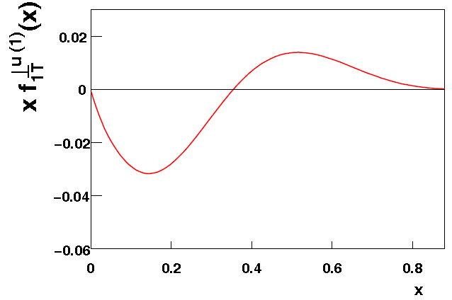
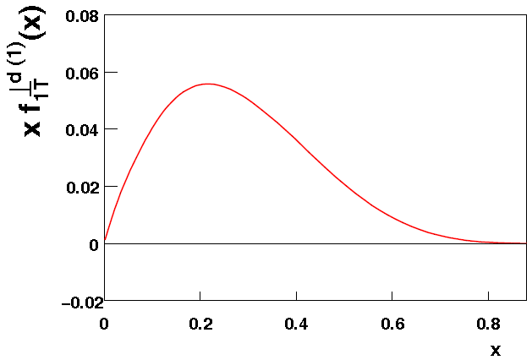
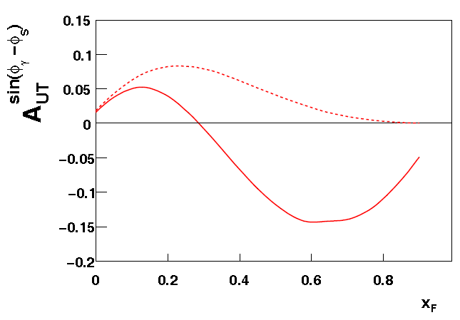
Global A_{N} Analysis
A. Prokudin, Z.-B. Kang
  arXiv:1201.5427 [hep-ph]
Input
    HERMES
    COMPASS
    STAR π⁰
Functional form similar to DSSV
u quark Sivers
d quark Sivers
SIDIS
PP
Need to map out Drell-Yan Sivers over a wide kinematic range

Slide 28
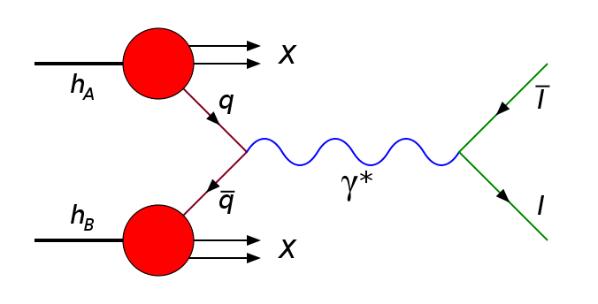
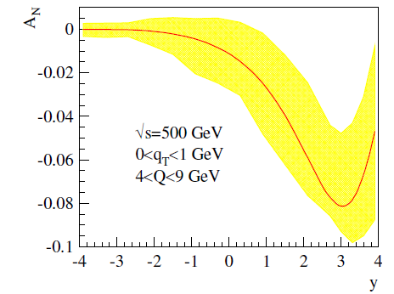
Polarized Drell-Yan Production
Estimated DY A_{N}
Proposed Acceptance
Current Acceptance
  No fragmentation
  Direct correlation of intrinsic transverse quark properties and proton spin
  Solid factorization
  Fundamental QCD test
Z. Kang and J. Qiu. Phys. Rev., D81:054020, 2010

Slide 29
Jet Correlations / Structure
Initial State (Sivers)
Jets with identified hadrons (measure A_{N} for jets)
Do jets from certain quarks prefer to go left or right?
Final State (Collins)
Left-right asymmetry of identified particle inside a jet
Do certain hadrons fragment from certain quarks to the left or right of the jet axis?
Goal: Separate the initial state effects (Sivers) from final state effects (Collins). Then compare with other measurements (such as Drell-Yan Sivers). This will provide a stringent test of TMD PDFs factorization and universality.

Slide 30
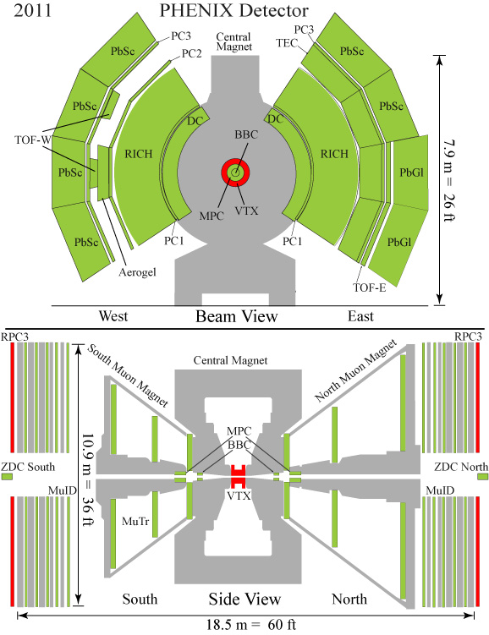
sPHENIX Conceptual Design
Tracker
EMcal
Hcal
2T Magnet
RICH
EMCal
HCal
MuID
*Not to scale

Slide 31
Summary and Outlook
Gluon polarization
  Significant constraints on Δg(x) for 0.02<x<0.3
  Higher energy and forward region => lower x
Flavor decomposed quark distribution via W
  Low statistics central arm (e) and forward (μ) measurements. High statistics to follow.
sPHENIX Forward will significantly extend physics capabilities
  With new Forward Detector, will be able to understand large SSA, separating contributions from Sivers and Collins.
  The sPHENIX forward would also be well matched with ePHENIX.

Slide 32
Extra slides…

Slide 33
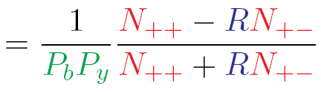
Measuring A_{LL}
++ same helicity
+− opposite helicity
Helicity Dependent Particle Yields
(Local) Polarimetry (ZDC)
Relative Luminosity (R=L₊₊/L₊₋) – BBC (ZDC)
A_{LL}

Slide 34
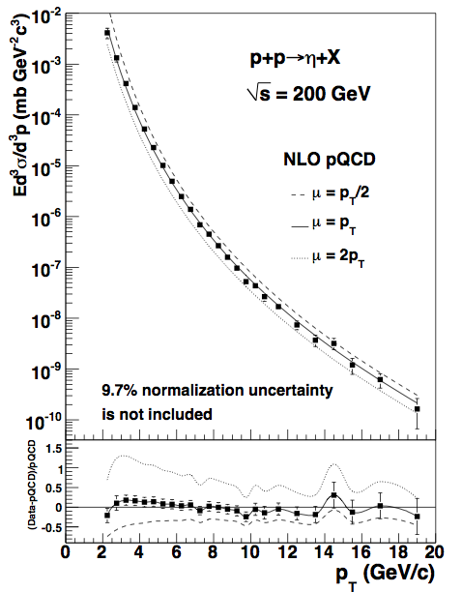
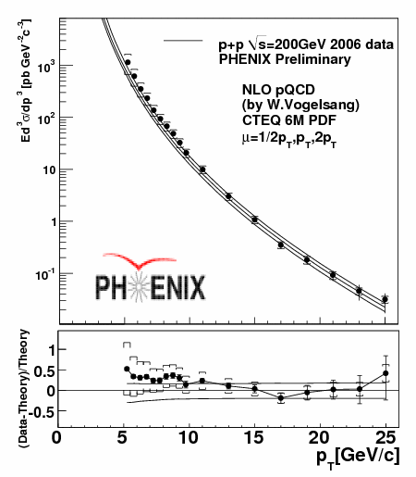
Cross sections
h (200 GeV)
g (200 GeV)
NLO pQCD calculations are consistent with cross-section measurements

Slide 35
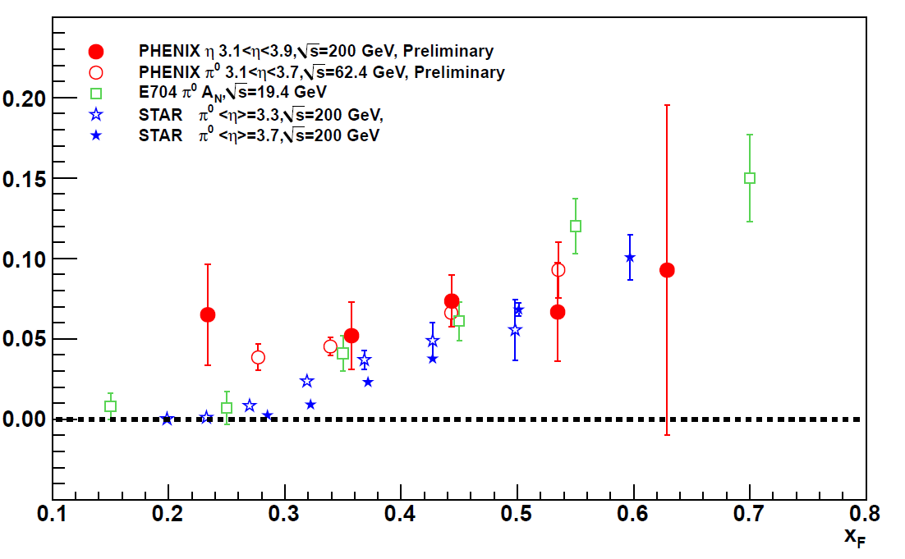
Forward Transverse Asymmetries
No strong dependence on √s from 19.4 ~ 200 GeV
Slight differences in pseudo-rapidity and/or p_{T}
η Asymmetries consistent with PHENIX π⁰ measurements

Slide 36
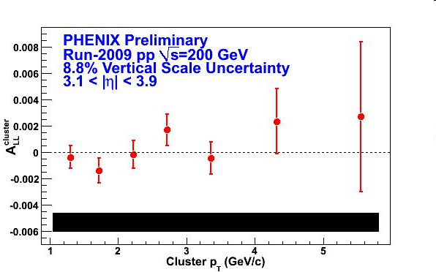
Single Cluster Asymmetry
Cluster Decomposition: Dominated by merged π⁰’s.
Process decomposition skewed more heavily toward quark-gluon than mid-rapidity.
Rel lumi uncertainty is significant compared to statistical.
p_{T} (GeV/c) 2 3

Slide 37
Factorization & Universality
Collinear factorization for hadron-hadron scattering is well established and universality of the parton distributions are justified.
  Less experimental data for polarized case, but the data is supportive and most theoretical foundations are common.
  Foundation for ΔG and Δq programs.
Going beyond the twist-2 collinearly factorized picture is essential to explore QCD dynamics and fully understand the spin structure of the nucleon
  Exploring the validity of factorization and universality of transverse momentum dependent (TMD) parton distributions factorization is key.

Slide 38
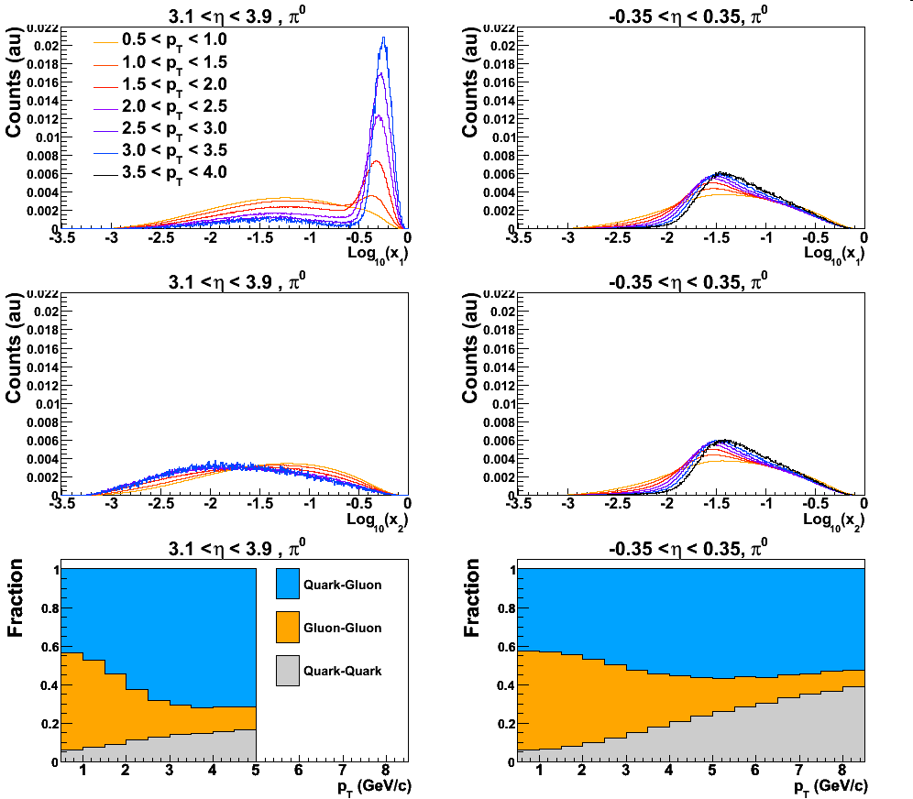
Event kinematics at √s = 200 GeV
Estimated with Pythia simulation package
Mid-rapidity: Low p_{T} dominated by
gluon gluon scattering
Forward-rapidity: High-x + Low-x
scattering
h
h
38

Slide 39
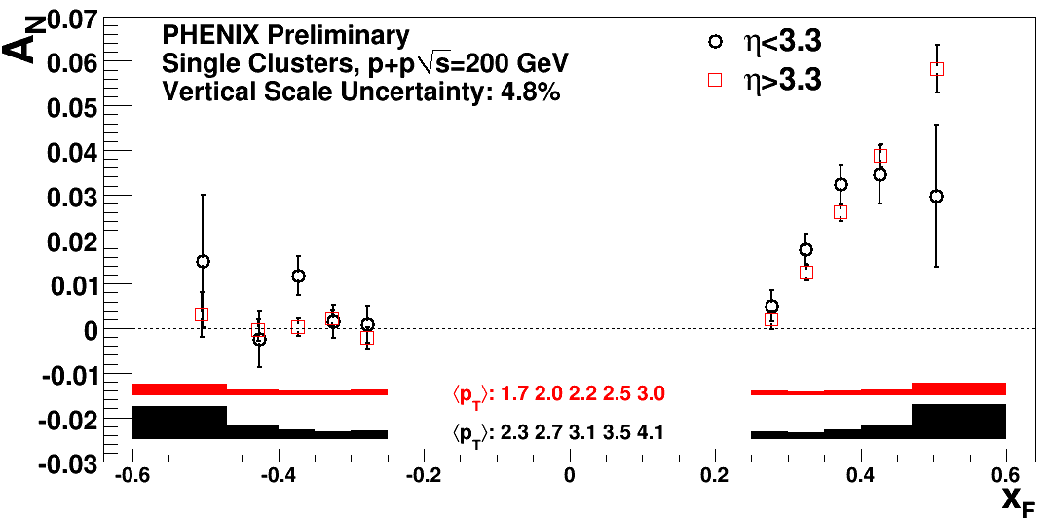
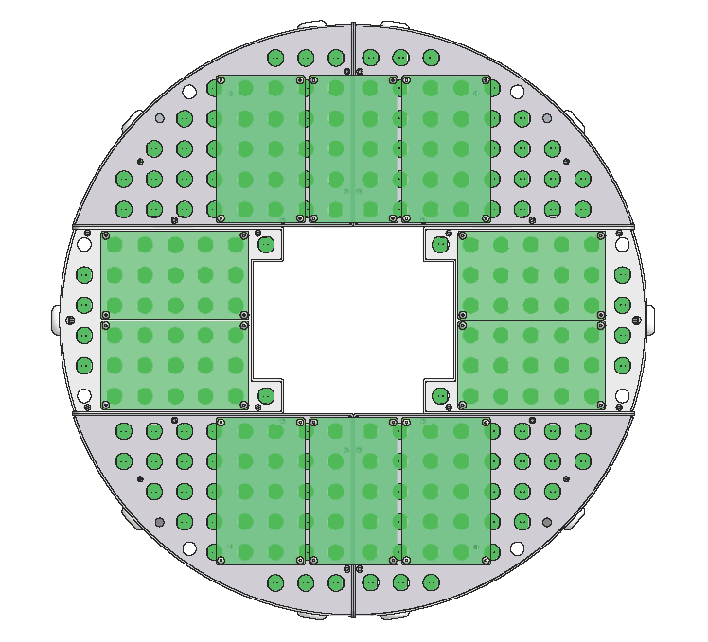
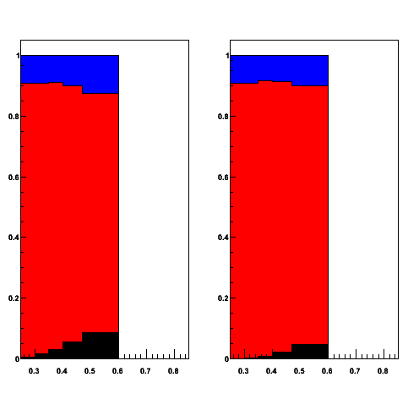
Forward A_{N} for Clusters
MPC
tower size 2.25² cm²
220 cm from vertex
√s = 200 GeV
Cluster contribution
decay photon
π⁰
direct photon
η < 3.3 η > 3.3
x_{F}
x_{F}

Slide 40
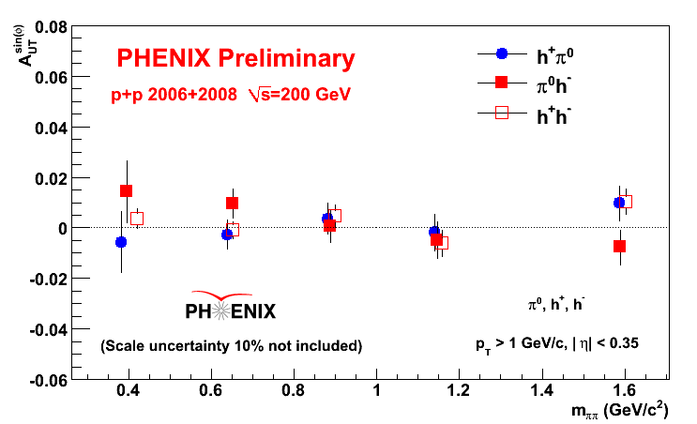
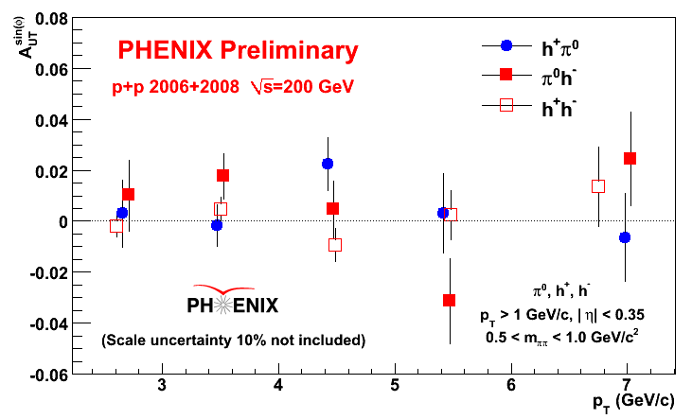
Interference Fragmentation
f_{a}
IFF
σ
f_{b}
IFF x transversity
input e⁺e⁻ annihilation
few percent @ Belle
Forward direction

Slide 41
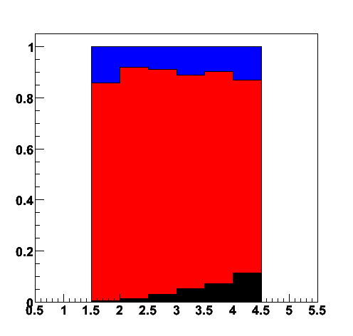
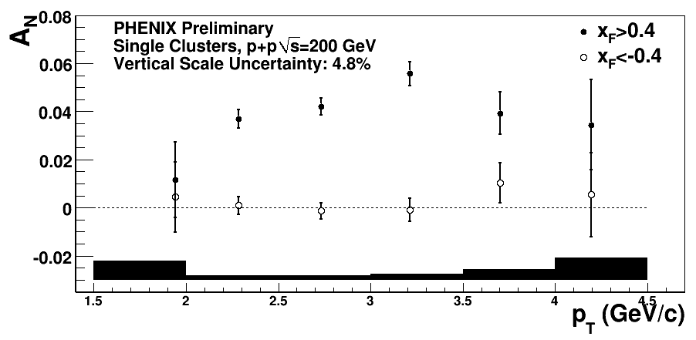
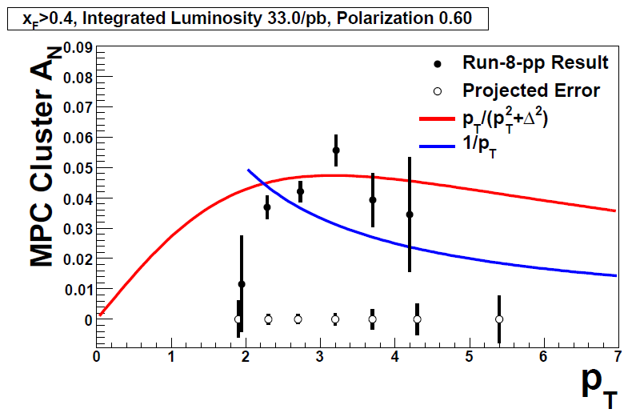
p_{T} Behavior
decay photon
π⁰
direct photon
Projection
for 2012/13

Slide 42
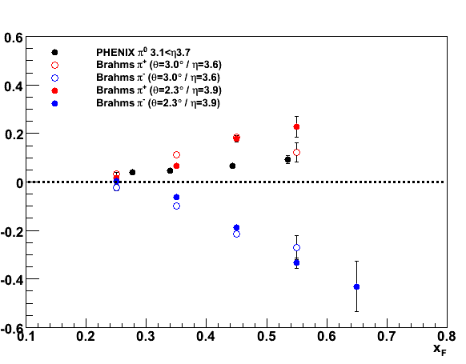
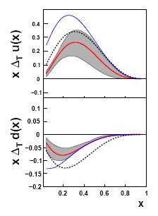
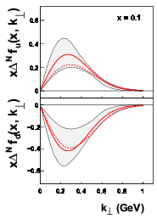
Isospin Dependence
√s = 62.4 GeV
fragmentation u/d
p⁺: 1:0
p⁺: 2:1
p⁺: 1:1
A_{N}(π⁰) ~ 2A_{N}(π⁺)
+ A_{N}(π⁻) ?
u
u
Transversity
Sivers
d
d

Slide 43







PHENIX Forward Upgrade Program
2011
2009, 2010
RPC3
2010
Absorber
RPC1
Mutrg
2009, 2010
RPC3
2011
FVTX

Slide 44

Mid Rapidity Region
Full 2π coverage
Electromagnetic and Hadronic calorimetry
2T Solenoidal Field
VTX detector for central tracker
  Also allow heavy quark jets
Primary (initial) focus of jet and di-jet measurements in HI
Designed to include possible upgrade path: additional tracking, EID, ePHENIX
Will take full advantage of RHIC’s flexibility: d+A, Cu+Au, U+U, etc.

Slide 45




Forward Region
Rely on central magnet field
  Studying other field/magnet possibilities
EMCal based on restack of current PHENIX calorimetry
  PbSc from central arm (5.52 cm²)
  MPC forward arm (2.2 cm²)
For tracker considering GEM technology
Interest of HI in forward direction may influence choices based on expected multiplicity.
PbSc restack
MPC restack
=12x12 towers
1 tower is 5.5cm²
= 2.2cm²

Slide 46


Towards eRHIC
Minimal configuration/requirements:
    Backward: electrons, photons
    Barrel: electron, photons, hadrons
    Forward: hadrons
    Roman Pots for forward protons
e-
p/A
←Forward
Backward →
Barrel cross section diagram
EMCal
Immediate focus:
Make sure sPHENIX concept of barrel consistent with upgrade plans for ePHENIX physics
sPHENIX central arm proposal (CD0) to be submitted on Jul 1, 2012
Is EMCal resolutions good enough?
Enough space for PID?
Momentum range for PID
Material budget limitation for tracking
Magnet
R [cm]
PID
70
60
10
0
Outer
tracker
Inner
Tracker
Additional
tracking
as needed

