Slide 1
DET. Integration and IR Hall
Summary of the Integration Status
SuperB Experimental hall.
Integration of inner detectors.
Integration of the tungsten supports tube in the inner detectors.
Services accounts.
Conclusions.

Slide 2
Summary of the status of superB Integration
-The architecture of the experimental area has been set considering:
1) the interaction region must be independent from the assembly area. 2)Most of activity are localized in the exp. area, like detector preparation, commissioning etc.
We would like to have the access to the experimental area directly from outside. We consider to have two access ramps. The proposed size is 60meter X 24meter including a service room.
Some implications:
we have to move all detectors including some services from the assembly to interaction area. The electronic house can be maintained always at 10 meter from the beam axis (cable length >10mter)
The SVT and the layer0 and beam pipe can be installed in interaction region.
We need a structure supporting the MDI during the acceleration commissioning.

Slide 3
Summary of the status of superB Integration
We took the SuperB layout and we revised the mechanical interface of Babar of the reused elements.
We received a service questionnaire from all sub detector at allow us to check and track the services inventory.
We integrate in the new SuperB detector layout DCH, FTOF, MDI and layer0.
We proposed a supporting scheme of SVT, MDI and layer0.
We cross check the overall dimension using the most trusted drawing from BABAR.
We still need to analyzed in detail the service inventory.

Slide 4
General considerations Exp. Hall.
The door sliding system must be redone. We have to include a central stops to protect the beam line and an large travel to clear IFR complete in the forward.
The position of the beam axis respected to the floor has been increase of .5m (Babar 3.5m SuperB 4m).
The increase of high of the beam axis respects to the floor is going to facilitate the positioning of doors and service passages on the bottom.
The overhead crane hook high was 34.10’ ( 10.39m). It was not comfortable for assembly the detector. We need to increase up .5 meter or more.

Slide 5
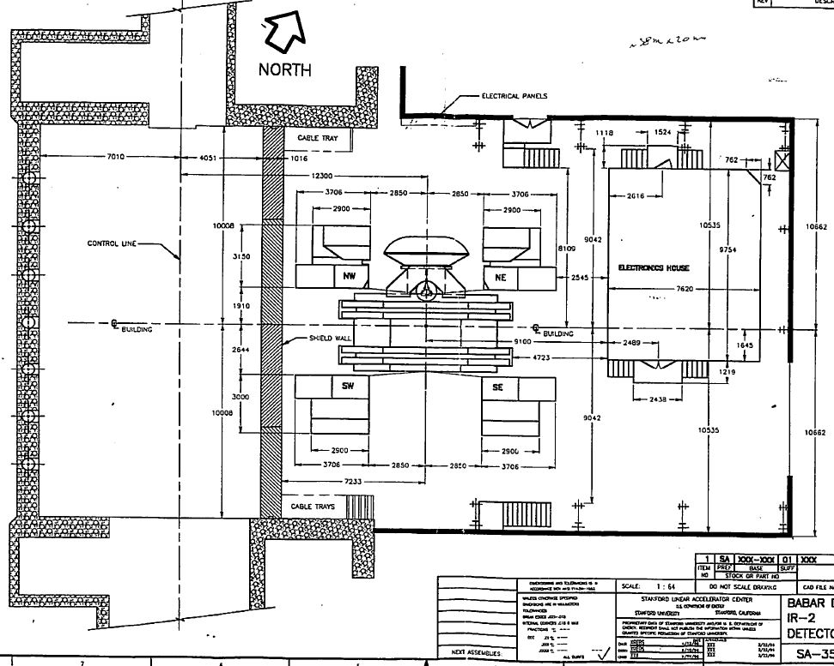
General considerations
38000
21324

Slide 6
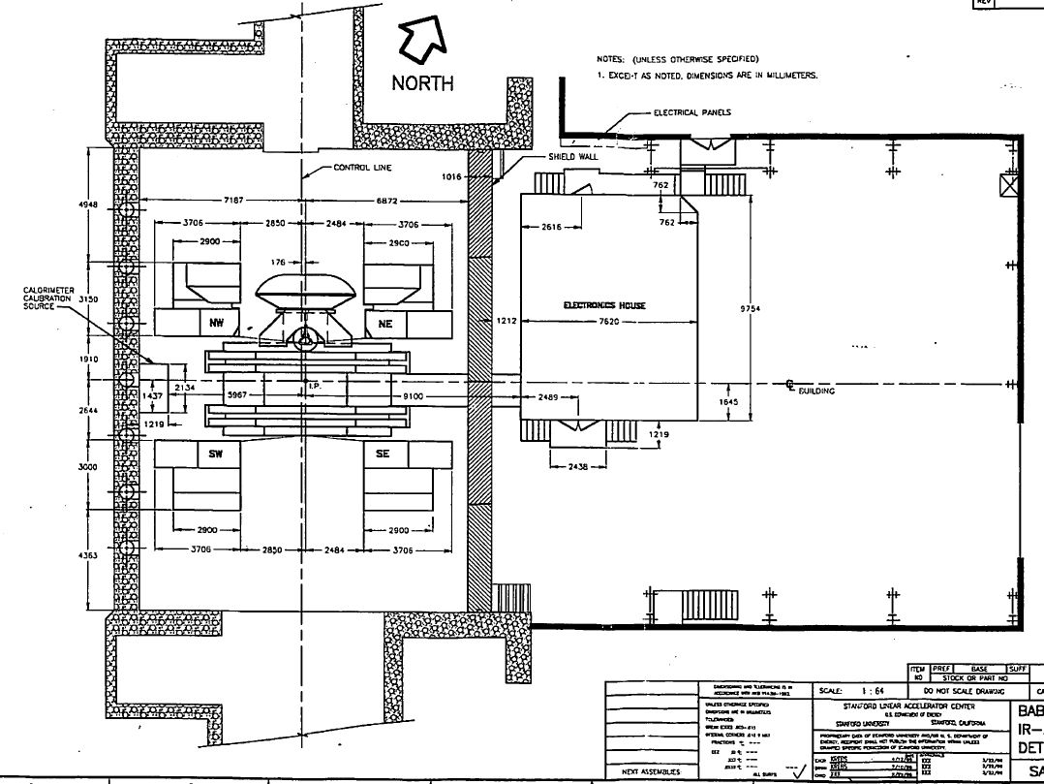
General considerations
21324
38000

Slide 7
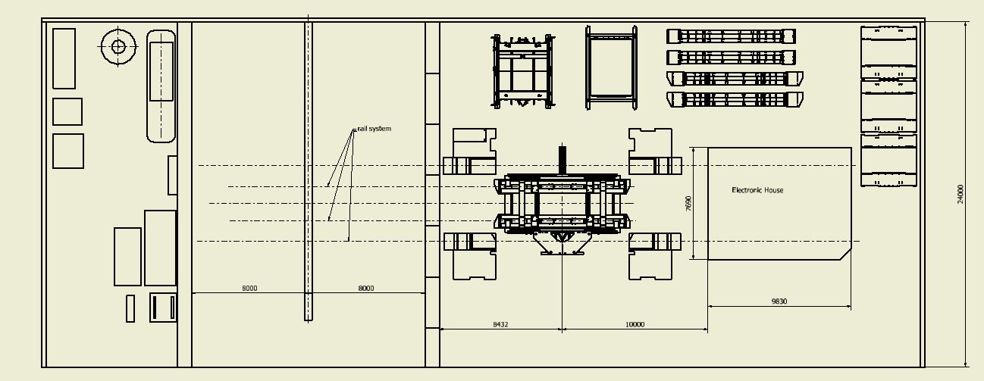
SuperB position during the assembly (Garage position)
+500mm up beam axis

Slide 8
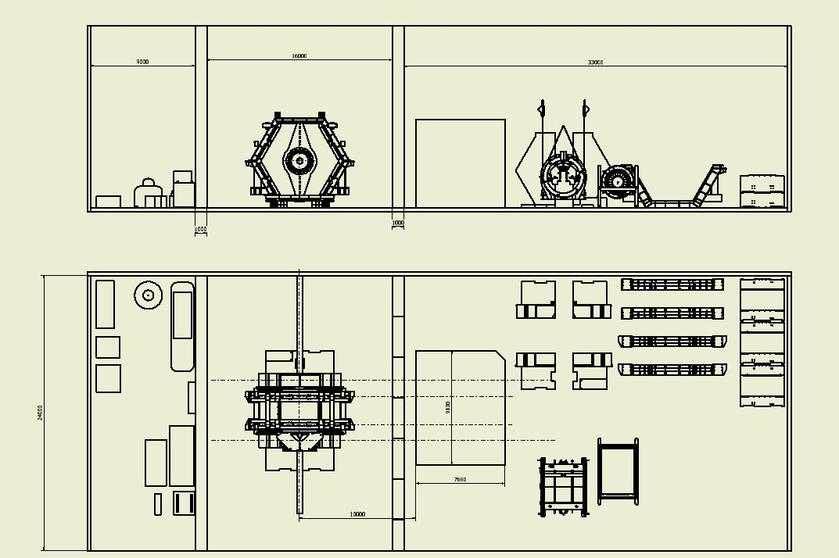
SuperB in the interaction position
Chiller
Gas mixing etc
Power cable
Read-out cable
500 mm more

Slide 9
Some considerations:
We need to have a new of translation system of superB from the two positions (interaction and garage).
We need a new system for opening the door efficiently.
The electronic house can be maintained always at same distance respect the detector (about 10m).
Power and read-out cables could go respectively on the top and bottom of the electronic house.
Power cables and read out cable of the doors must allow a compensation for their motions.
Cryogenic and cooling line can be extended for the two detector positions.

Slide 10
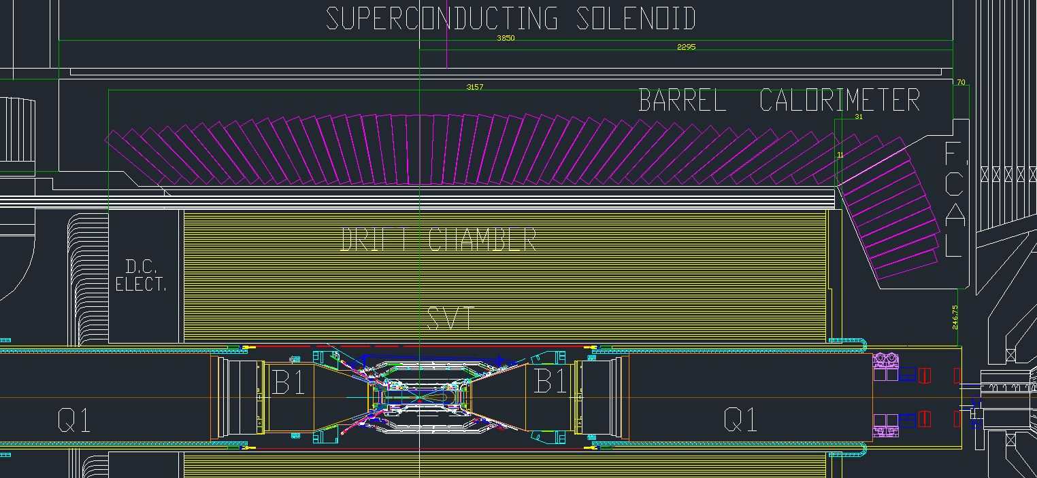
Integration of the inner detector
Establish the interaction point referring the forward face of the super conducting Solenoid Babar the ref dimension is 2295mm.

Slide 11
Mechanical Envelope and mass of the SuperB inner detectors
SOLENOID Inner diameter 2840 mm; outer dia 3540 Z=-1555, Z=2295, tot. length 3850 Mass
EMC Inner diameter 1820 mm outer dia 2740 , Z=-1555, Z=2295, tot. length 3850 Mass
DIRCH Inner diameter 1630 mm outer dia 1790 Z=-3117, Z=1786, Mass
DCH Inner diameter 500 mm, Outer diameter 1610mm Z=-1676.62; Z=1383mm tot. length=3059.62 Mass
FTOF inner and outer diameter 900mm outer diameter 1803mm; Z=1750, Z=1801 mm; tot length 50mm Mass
Tungsten tube : Inner diameter 22.20mm (beam pipe outer dia), outer diameter 400mm Z=-2165; Z=2365 Mass
BCAL Inner diameter 620mm outer diameter 1500mm Z=-1431mm,Z=-1559mm tot. length=128mm Mass
New removable horseshoes Inner diameter 740mm outer diameter 1494 mm Z=-16821mm,Z=-2831mm. Total length=1149mm Mass

Slide 12
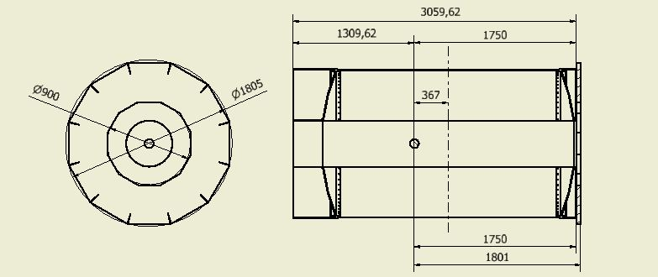
Envelope of the SuperB inner detectors
DCH and FTOF

Slide 13
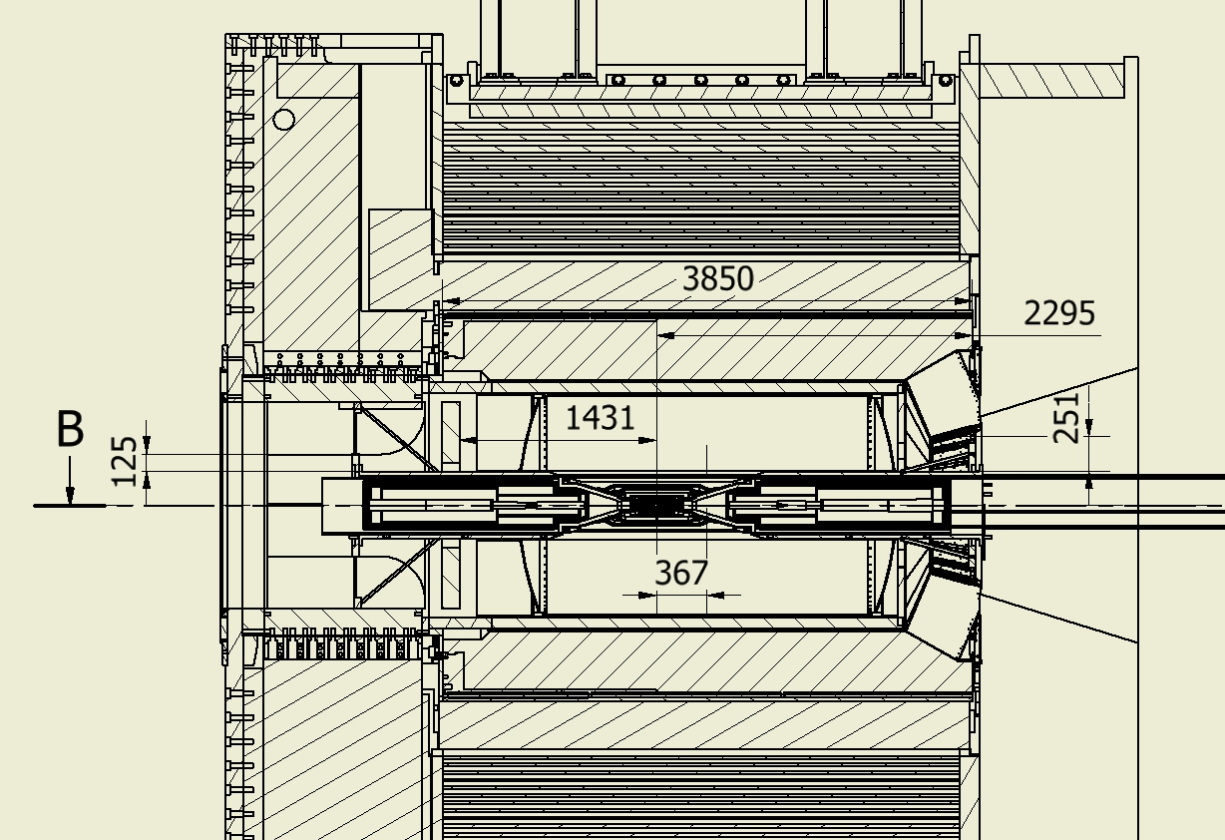
Envelope of the SuperB inner detectors

Slide 14
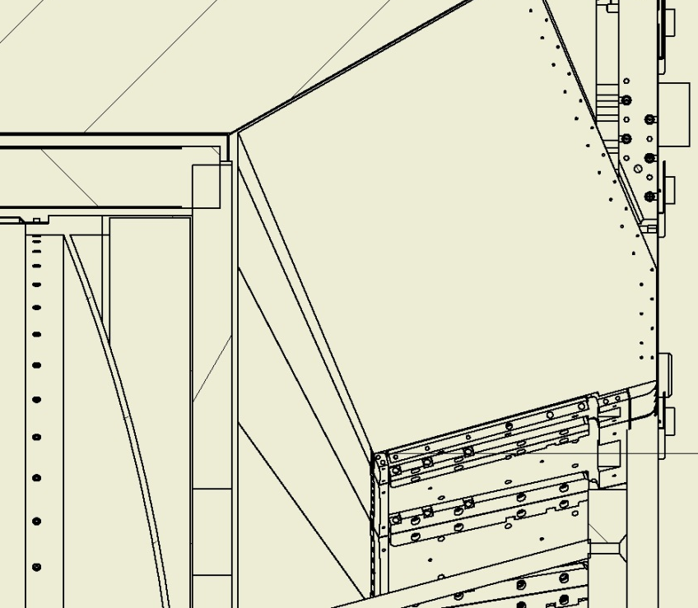
Envelope of the SuperB inner detectors

Slide 15
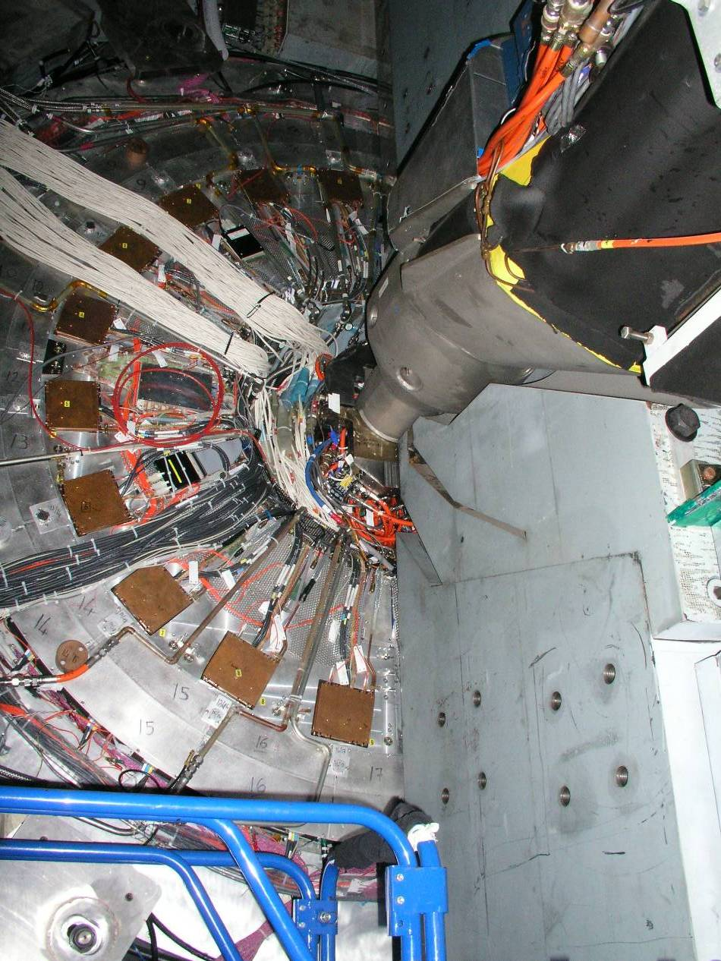
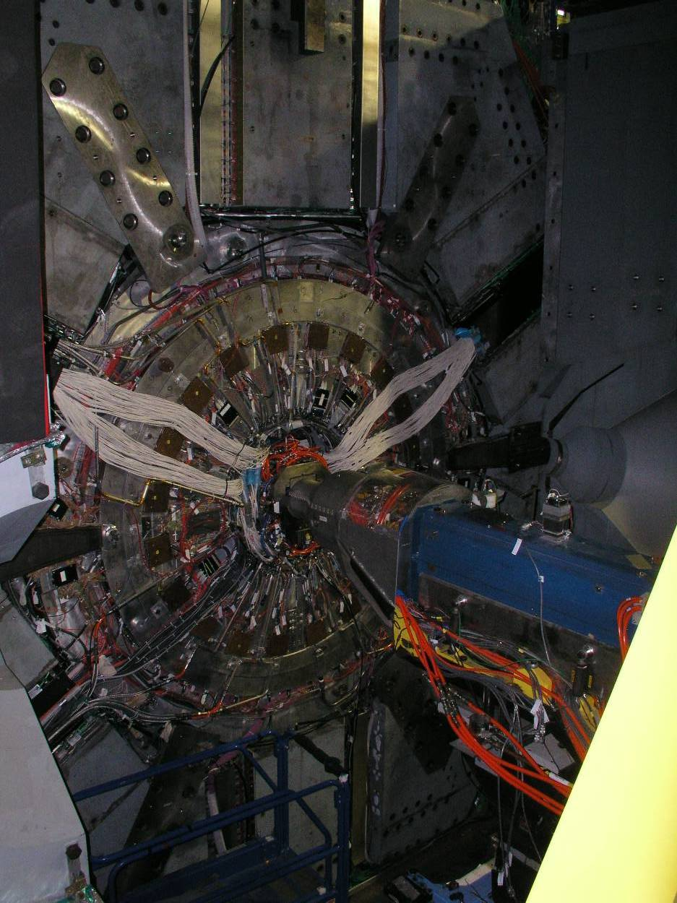
Forward services SuperB inner detectors
Services coining out DCH-FTOF-Inner tracker

Slide 16
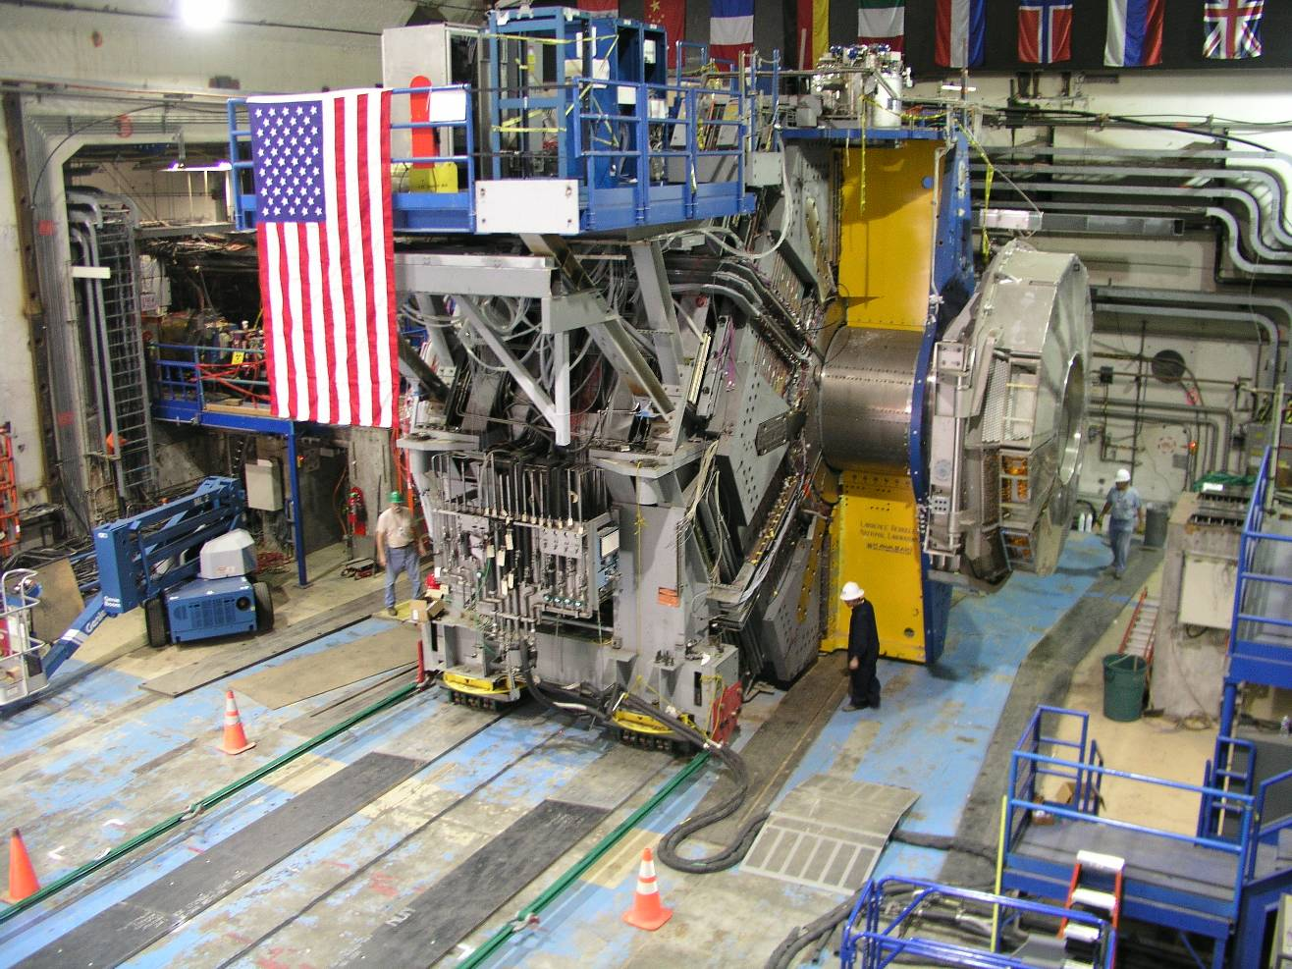
Backward Quadrant
A view of the exposed cableways on the backward side of the detector.
Slots contain services for EMC, IFR.
Services for inner detectors that are taken out in the backward direction must exit the end of the DIRC support tube.
View of the side also shows how services are distributed ‘around’ the detector.
Circumferential Cableways runs parrellel and close to the steel sextants behind the remnants of tubing for EMC cooling, etc
Slots for Services
Circumferential cableways
Temporary track plates for rolling detector
Pulling cables
Notes:
16

Slide 17
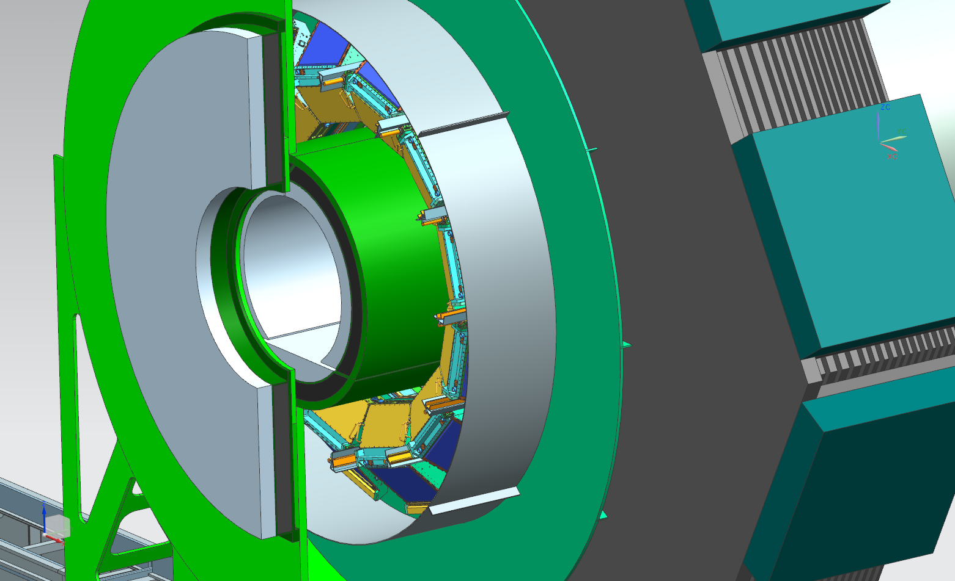
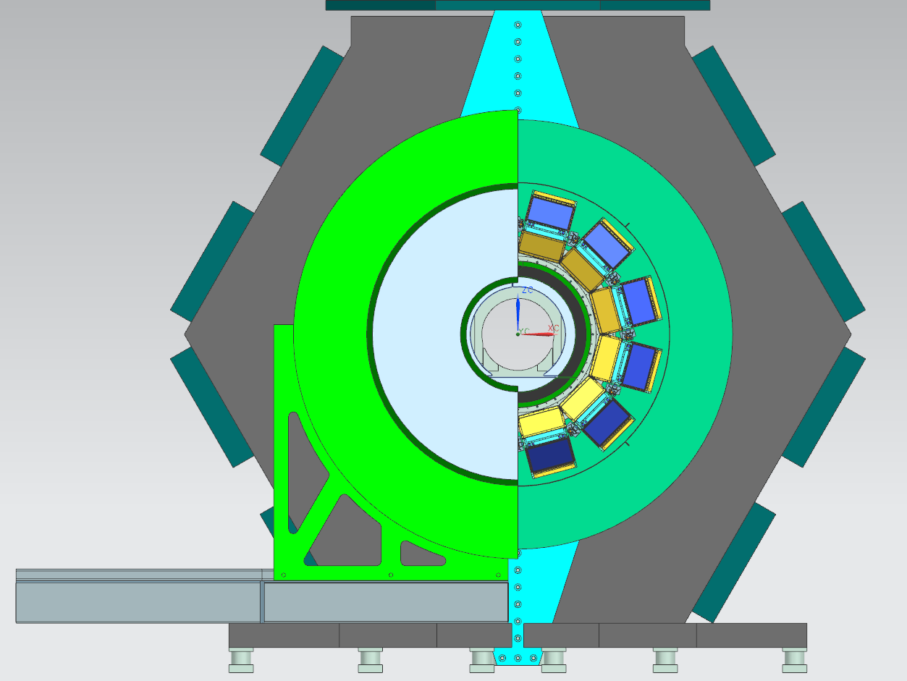
Focusing DIRC proposal of new Shielding must integrate on SuperB drawings
Plastic shield
Metallic shield

Slide 18
Functionality and mechanical requirements of the tungsten tube
Mechanical functionality of the tungsten tube:
1)Support the MDI magnet included cryostat and the beam pipe.
2)Support the SVT, layer00 and all services needed.
Mechanical Requirements:
Mechanical strength (in all configurations)
2) Initial positioning accuracy and mechanical stability. (???)

Slide 19
Load transfer to the tungsten tube proposed
The cryostats are in contact with the tungsten tube thru spherical bearings and the an anti rotation system. The cryostats support the conical shields.
The conical shields support SVT, Layer00 and the beam pipe in the interaction region.
For these reasons the tungsten supports need to allow an initial nominal mounting position and a fine alignments when everything will be installed. (internal and/or external)
Access to the forward electronic cards of EMC can be achieved dismount parts of the support.

Slide 21
Integration of the supports of tungsten tube in detector.
Forward:
Extension of the magnet ear restrains. Implication we go in front of calorimeter. (solution dismountable ears)
We limit the access inside (DCH, FPID)
Backward.
Structure inside the strong tube of DIRC
1) We limit the access for the (DCH, BCAL, etc)

Slide 22
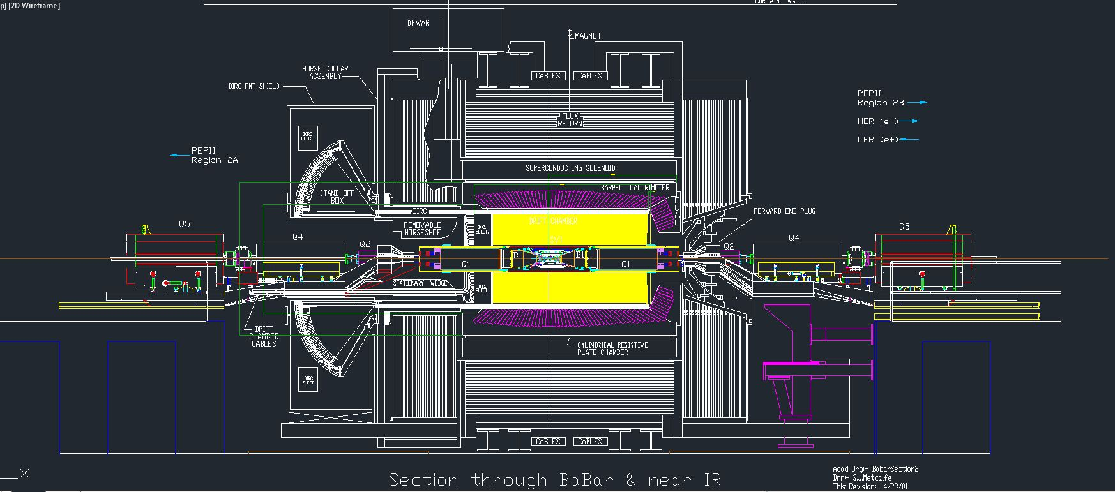
Babar reference geometry drawing
Access of the inner detector comparison between BABAR and the actual configuration
inner tube and backward shielding =146mm and inner tube and the forward calorimeter 246mm

Slide 23
Rails extension for quick demount
367
Forward 251mm and backward 125mm

Slide 24
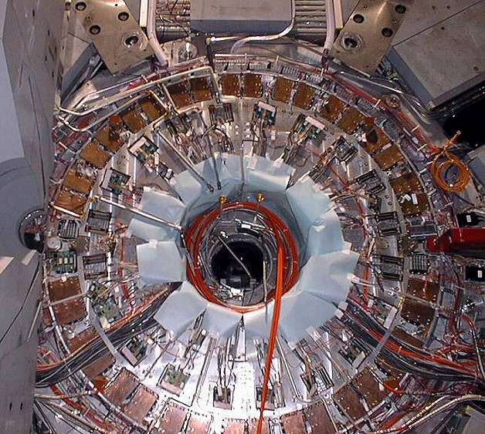
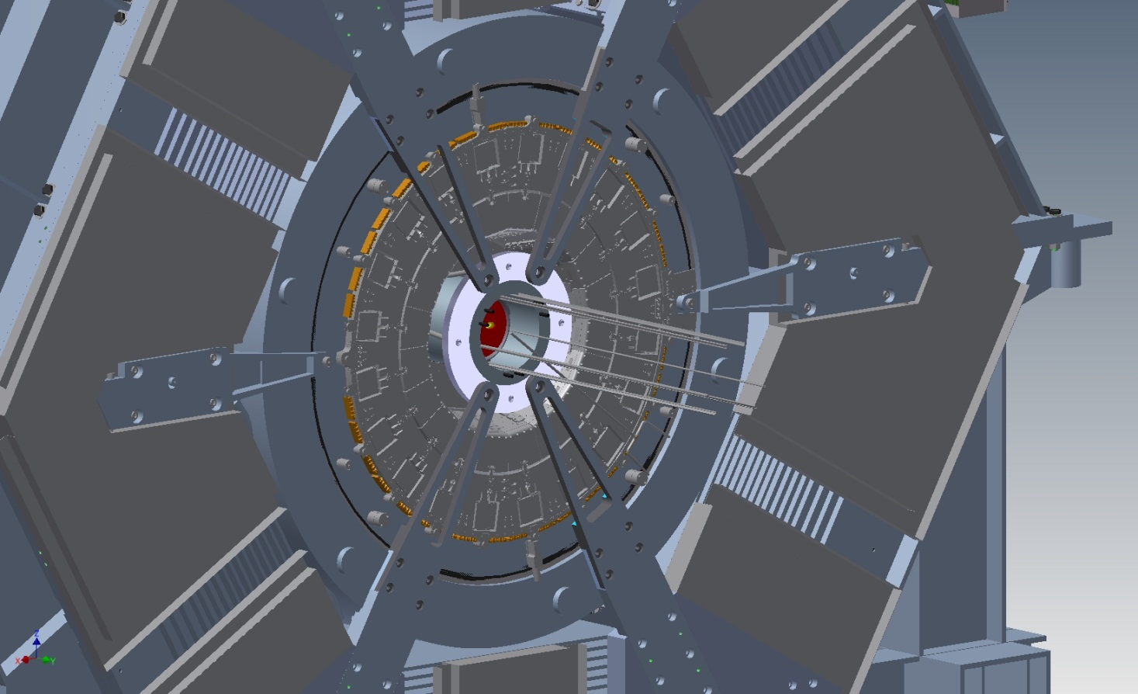
Integration DHC SVT layer0
Forward service of Babar
Extension of the Magnet ears
Struts and rods adjustable
Inner ring
Solution that allow to hold the tungsten tube with only three ears can give access to the calorimeter electronics.

Slide 25
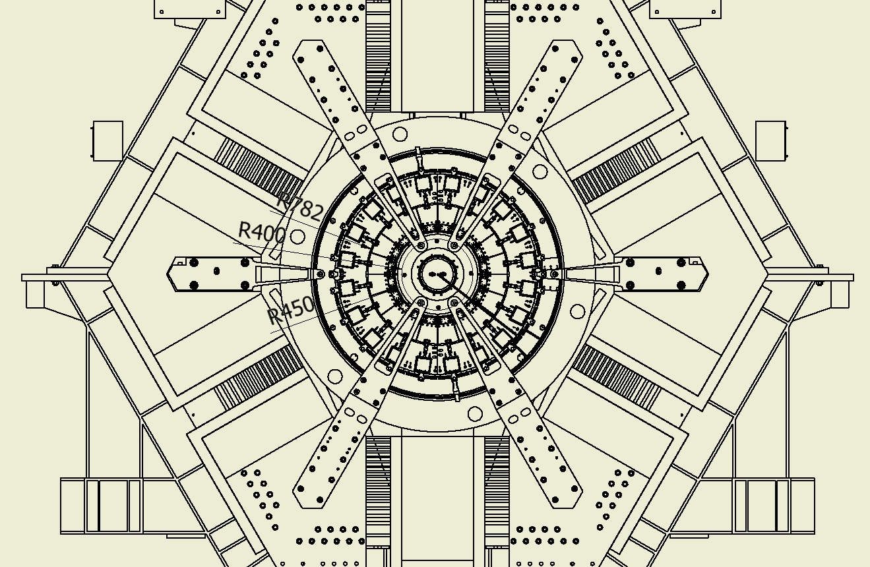
We have a 332mm to pass thru, but we can improve the space in a proper location. However
in the narrow area the space between the tungsten tube and FCAL is 225 mm

Slide 26
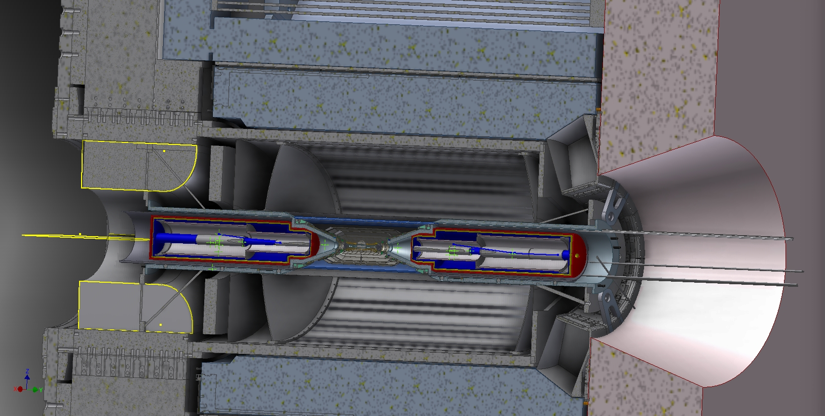

Slide 27
Conclusions
We have to review all the inner region of SuperB starting for the actual configuration with the available space.
So inner tracker DCH, FTOF, and BCAL must be consider the actual layout arrangement inside the detector to face the problems of supporting, mounting, detector and service access.
We can propose solution that must be validate by all parts involved.
Integration next step is to evaluate the service section and check the space for their way out (IFR slots, Inner regions)
Service inventories account needs to be complete.
Integration of the cryogenic system must be faced.

