Slide 1
Inner DET. Integration
Inner detector envelope
Radial clearances.
Longitude clearances
Cable distribution
Installation.
Integration of the tungsten supports tube in the inner detectors.
Conclusions.

Slide 2
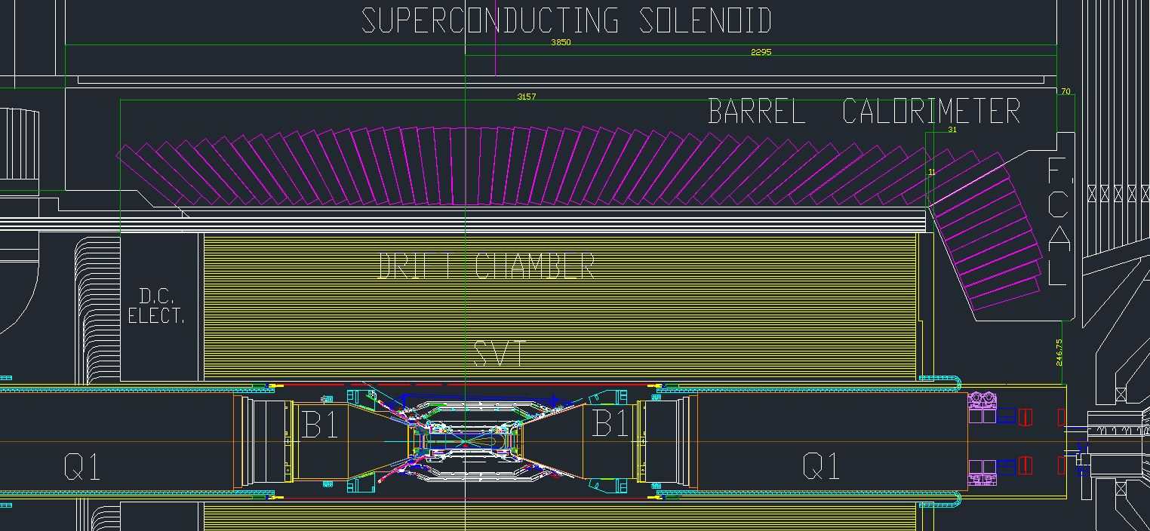
Integration of the inner detector
Establish the interaction point referring the forward face of the super conducting Solenoid Babar the ref dimension is 2295mm.

Slide 3
Mechanical Envelope and mass of the SuperB inner detectors
SOLENOID Inner diameter 2840 mm; outer dia 3540 Z=-1555, Z=2295, tot. length 3850 Mass
EMC Inner diameter 1820 mm outer dia 2740 , Z=-1555, Z=2295, tot. length 3850 Mass
DIRCH Inner diameter 1630 mm outer dia 1790 Z=-3117, Z=1786, Mass
DCH Inner diameter 500 mm, Outer diameter 1610 Z=-1309.62 Z=1750mm tot. length=3059.62; Mass
FTOF inner and outer diameter 900mm outer diameter 1805mm; Z=1750, Z=1801 mm; tot length 51mm Mass
Tungsten tube : Inner diameter 430mm (beam pipe outer dia), outer diameter 490mm Z=-2165; Z=2365 Mass
BCAL Inner diameter 620mm outer diameter 1500mm Z=-1431mm,Z=-1559mm tot. length=128mm Mass
New removable horseshoes Inner diameter 740mm outer diameter 1494 mm Z=-16821mm,Z=-2831mm. Total length=1149mm Mass

Slide 4
Mechanical Envelope and mass of the SuperB inner detectors

Slide 5
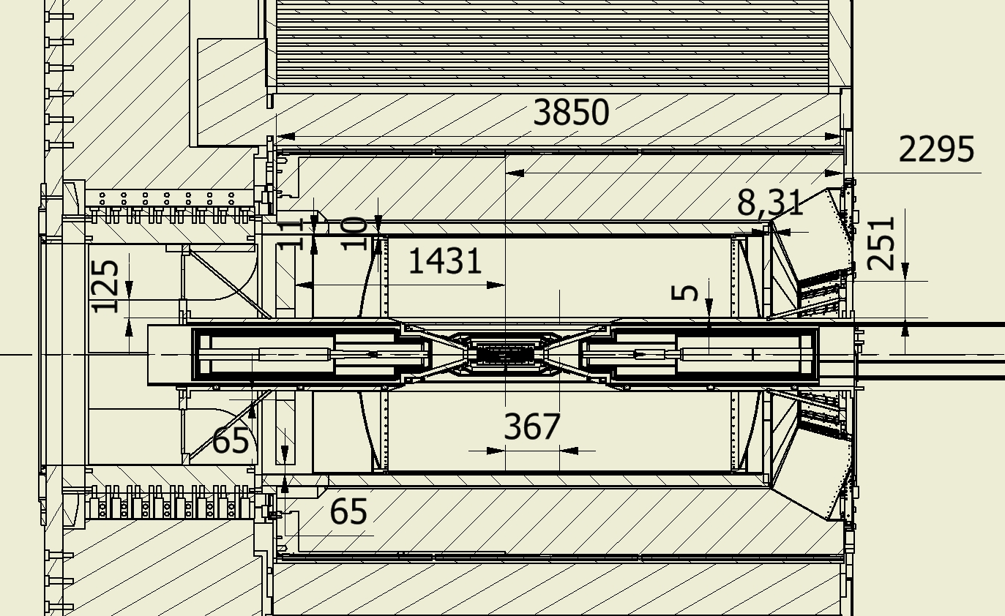
Envelope of the SuperB inner detectors

Slide 6
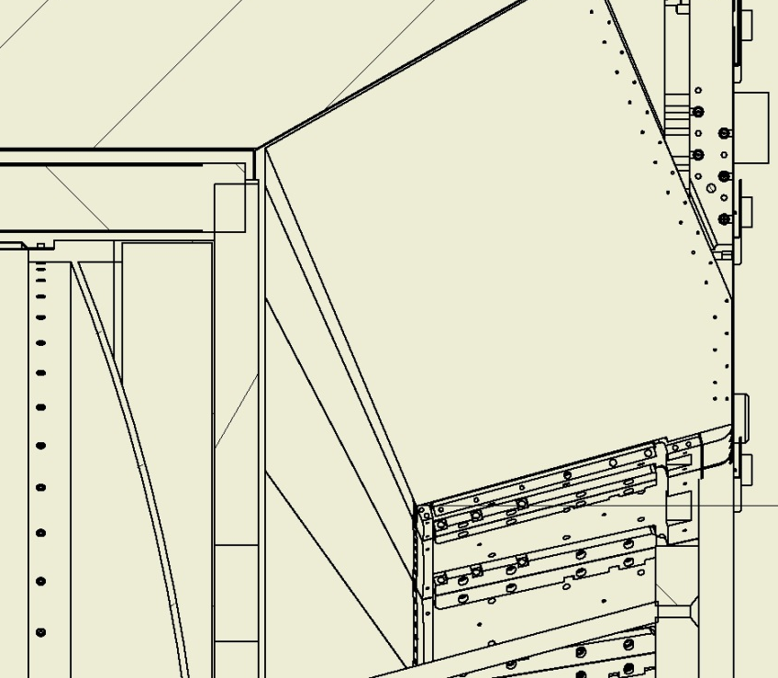
Envelope of the SuperB inner detectors

Slide 7
Envelope of the SuperB inner detectors
FTOF can reduce the outer diameter to the DCH outer diameter (1610mm) to fit inside the DIRCH.
We have still have to c check the longitudinal clearance with the FCAL Zmax 1801.
In the BABAR drawing the Zmax was 1917mm.
The FCAL calibration system must be surveyed.
The installation procedure could be:
Installation of the DCH with a inner cable support reusing the BABAR tooling
Installation of the FTOF (single piece or all unit ?) restraining it to the DCH. Cables supported a the inner radius using an inner cylinder.
We must clear the space for the insertion of the tungsten tube
3) Installation of FCAL.
4) Services going to in front of FCAL and HCAL and after in a IFR slots.
What is the real clearance between FCAL and HCAL and the door ? (30mm)
Mechanical verification on the DIRCH.

Slide 8
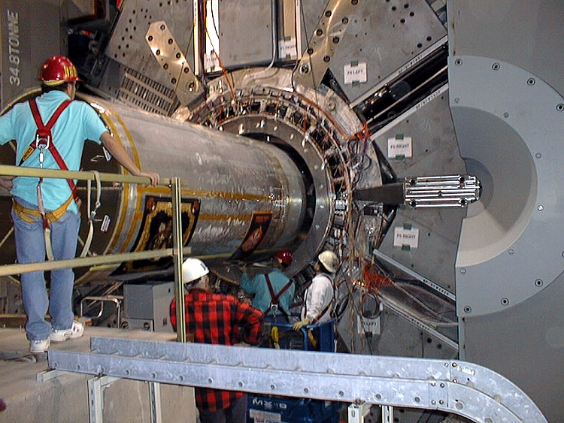
Envelope of the SuperB inner detectors

Slide 9
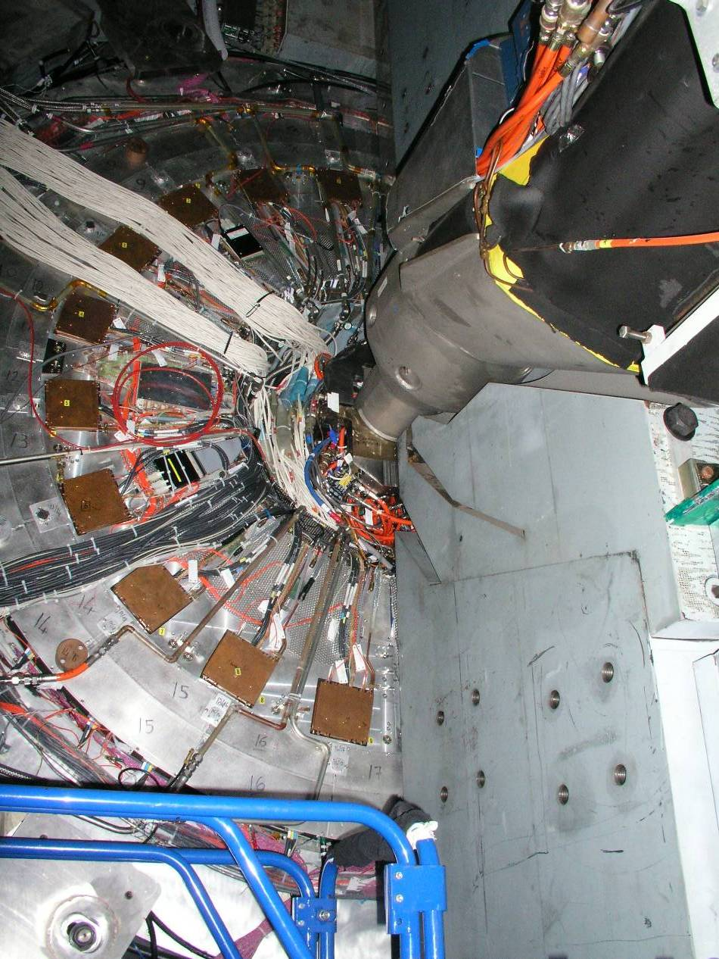
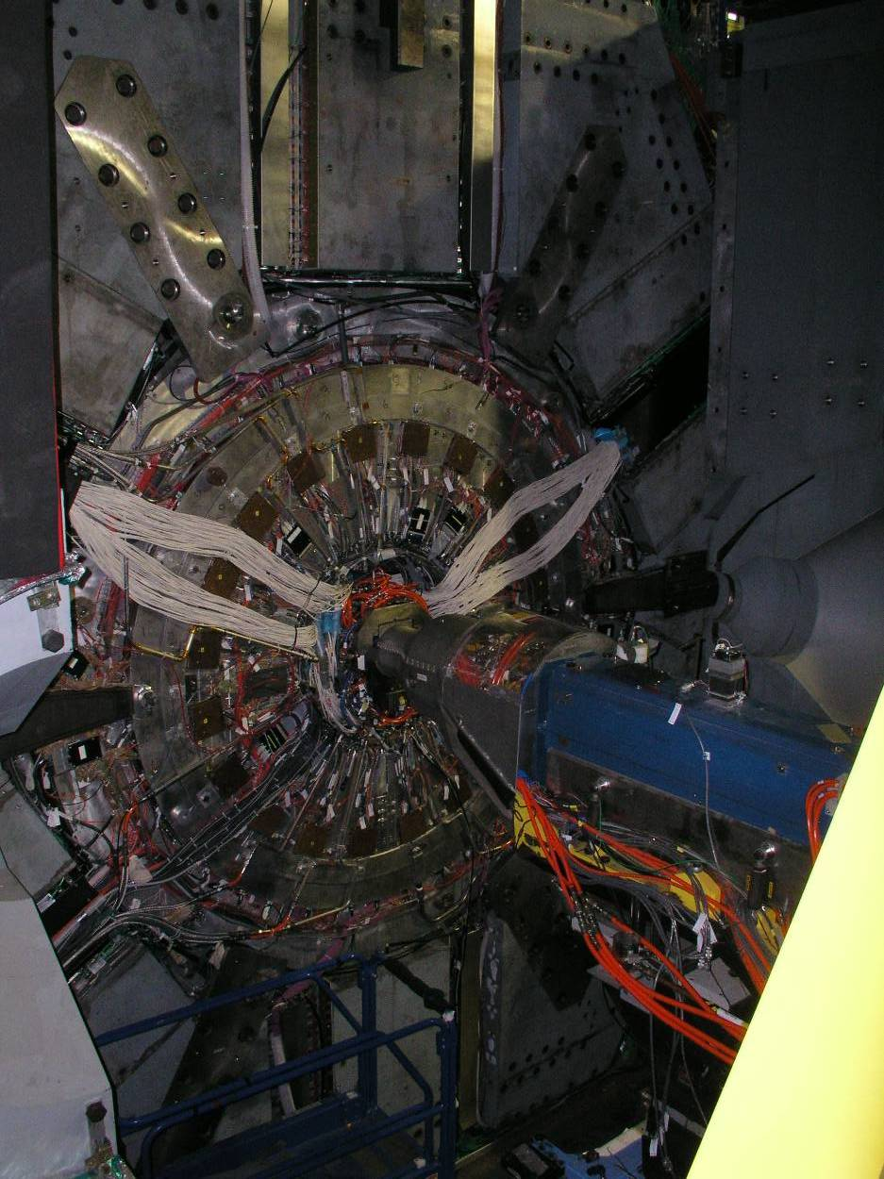
Forward services SuperB inner detectors
Services coining out DCH-FTOF-Inner tracker

Slide 10
Envelope of the SuperB inner detectors
DCH Backward services can be distribute uniformly around the DIRCH tube (radius 1630mm) The clearance between the BCAL and the DIRCH is 66mm but we need to have a supporting structure for it.
The scenario could be slots uniformly distribute of 30mm time ??
The slots are continuing thru the shielding.
In order to have access to DCH we have to dismount the shielding and BCAL. This implies cable protection like Cable Channel connected to the DIRCH
Service of BCAL can go on the inner tube of the DIRCH. Otherwise going at lower radius on top of the Shielding can make the access operations difficult.

Slide 11
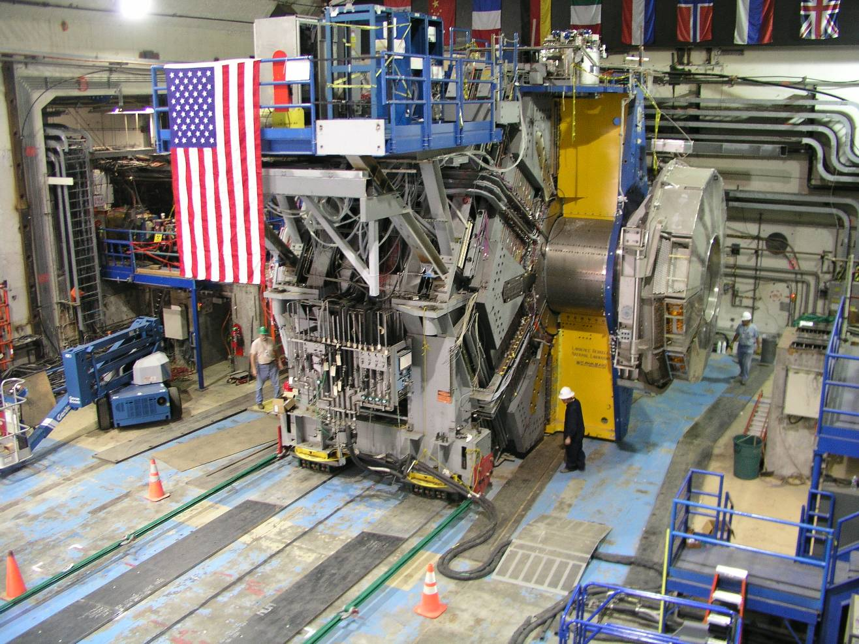
Backward Quadrant
A view of the exposed cableways on the backward side of the detector.
Slots contain services for EMC, IFR.
Services for inner detectors that are taken out in the backward direction must exit the end of the DIRC support tube.
View of the side also shows how services are distributed ‘around’ the detector.
Circumferential Cableways runs parrellel and close to the steel sextants behind the remnants of tubing for EMC cooling, etc
Slots for Services
Circumferential cableways
Temporary track plates for rolling detector
Pulling cables
Notes:
11

Slide 13
Services of inner silicon detector
Forward:
Support Extension for services to go thru the plug.
Backward.
Support Extension for services up the end of DIRCH.

Slide 15
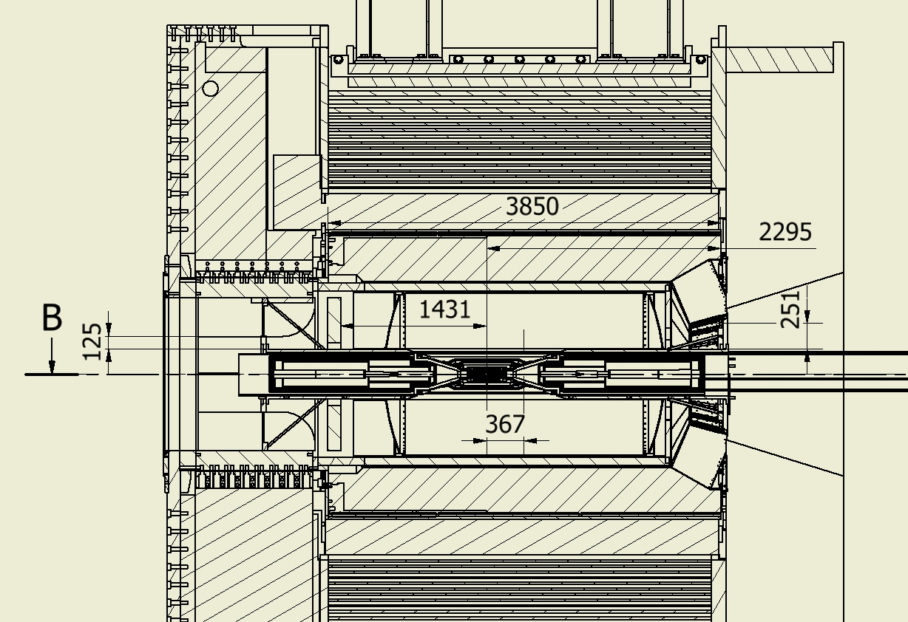
Rails extension for quick demount
367
Forward 251mm and backward 125mm

Slide 16
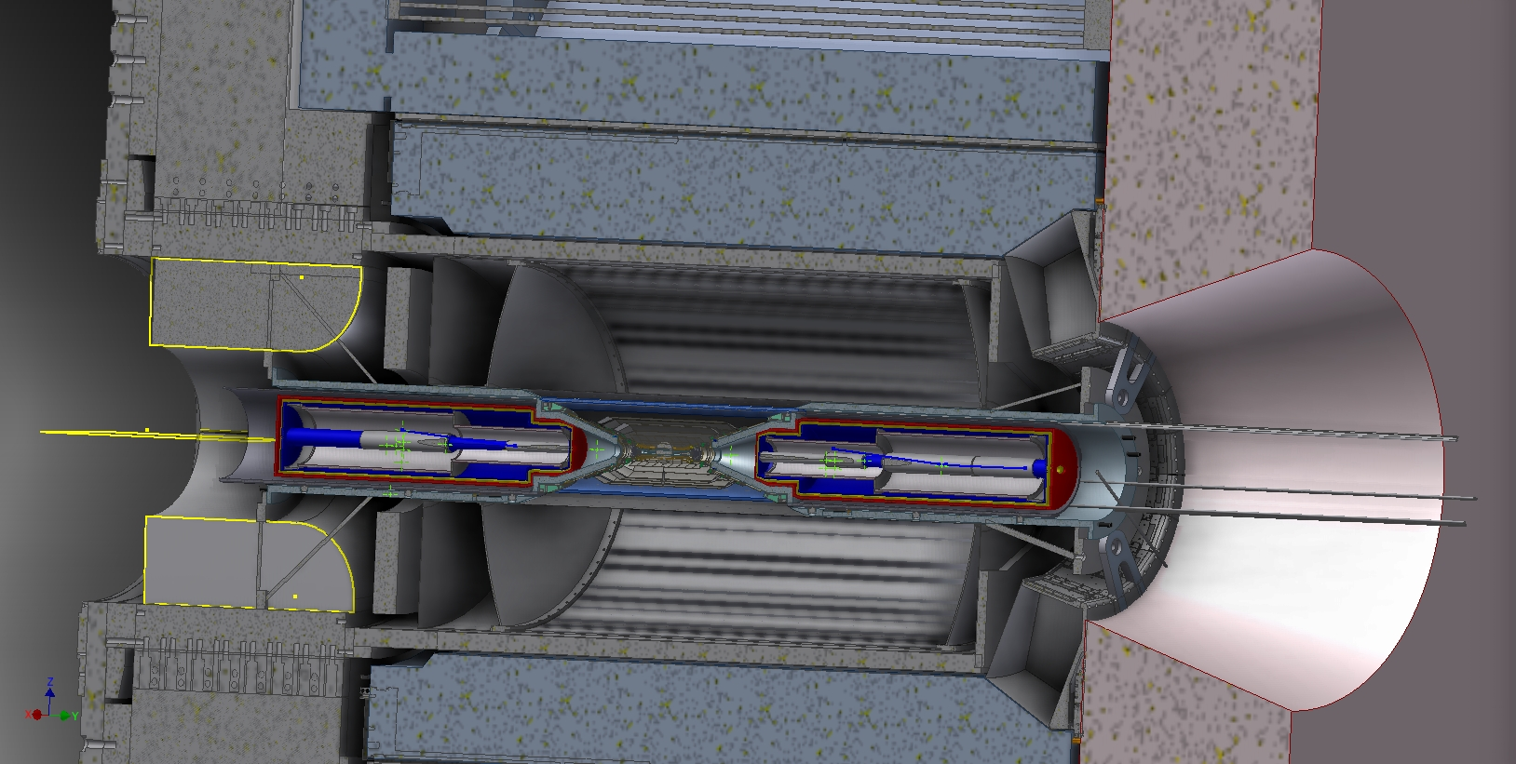

Slide 17
Conclusions
We can propose solution that must be validate by all parts involved.
Integration next step is to evaluate the service section and check the space for their way out (IFR slots, Inner regions)
Service inventories account needs to be complete.
Integration of the cryogenic system must be faced.

