Slide 1
Final doublet: future activity plan
P.Fabbricatore
INFN Genova
on behalf
The INFN groups working on this development and based in Genova, Pisa and Naples

Slide 2
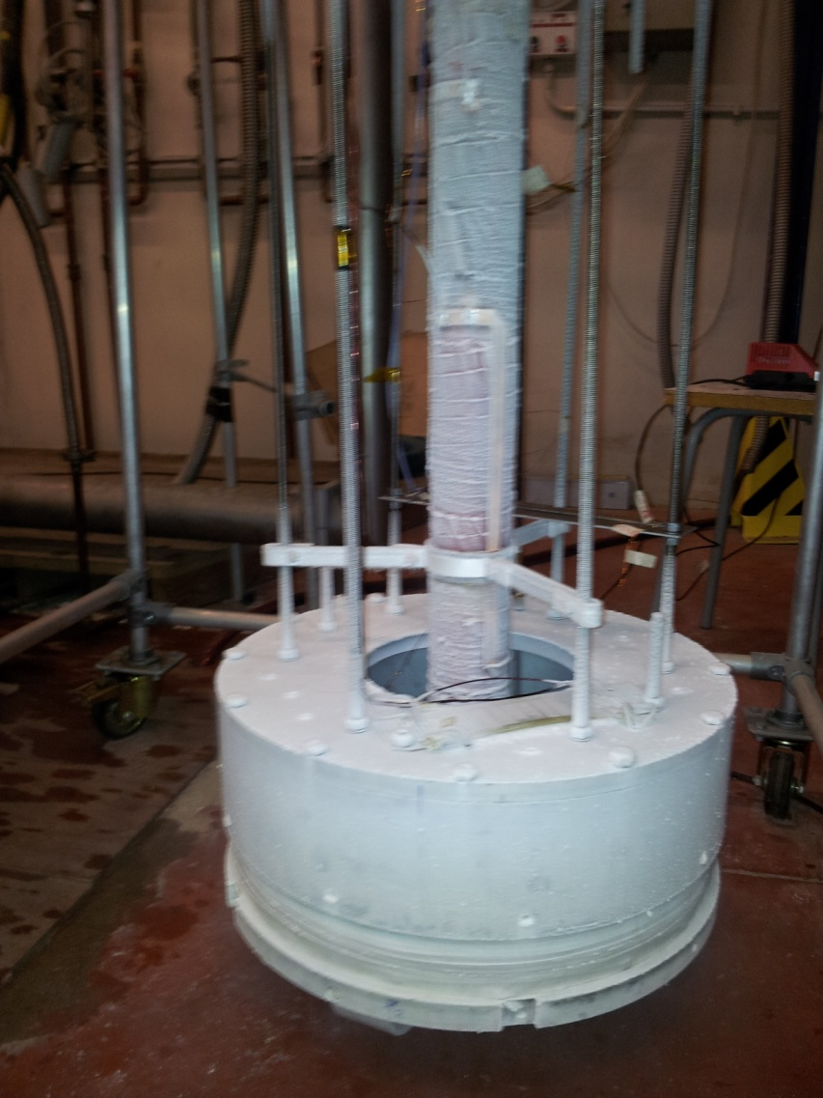
The cold test of the prototype finished
4 runs (each one cooling the coil from 300 K down to 4.2 K)
The excellent results are confirmed. Max current 2830 A

Slide 3
Last meeting I stressed the question “Why the magnet does behave so well?”. I remind that simple computations show that localised quench can damage the magnet.
In last runs a fast quench acquisition (1 kHz) was implemented.
The measured normal zone electrical resistance growth is compatible with a quench of he whole magnet.→ No localised quench

Slide 4
Confirmed 2D simulation: The magnet heating after 8 ms. The ac losses in the wires causes a temperature increase over the critical one, quenching almost the all magnet

Slide 5
Moving towards an updated design
The test of the prototype confirmed that high current can be involved (3000 A) with NbTi option →
We performed a re- design approach with higher angles and higher current. We also reduced the thickness of each layer down to 2.5 mm (4 mm used for the model). The pitch is the minimum one (turns touch each other at 45º)
The wire is the CMS one with formvar (Φ 1.28 + 0.08= 1.36 mm) or a Nb3Sn wire Φ 1.20 + 0.14= 1.34 mm
R ext II layer
R aver II layer
R ext I layer | R aperture + 2.5 mm
Gap | 0.5 mm
R ext II layer | R aperture + 5.5 mm
Cave hosting wire | 1.4 mm x 1.4 mm
R int II layer
R ext I layer
R aver I layer
R int I layer
R aperture

Slide 6
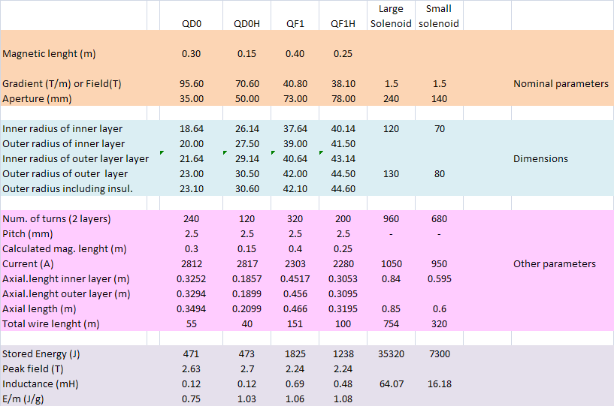
Main characteristics of all magnets/ revised version

Slide 7
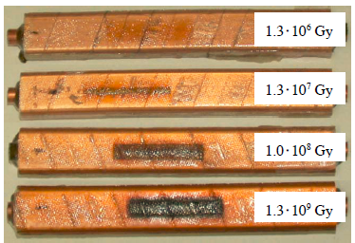
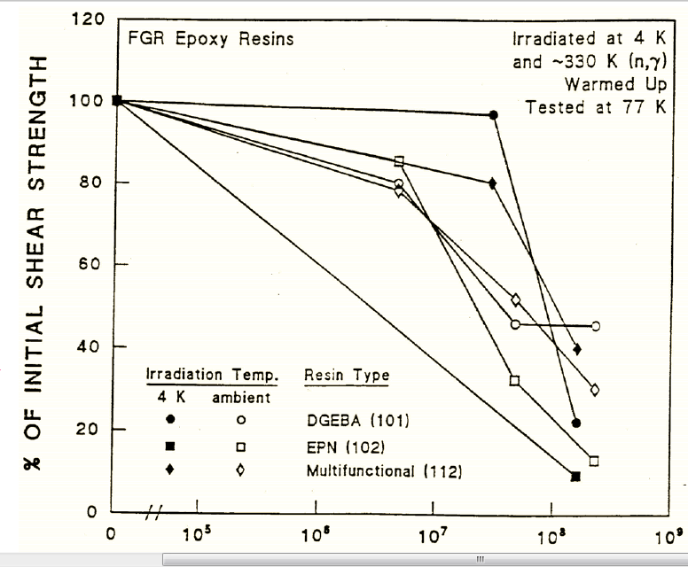
A problem to be addressed: radiation
According the simulation done by Alejandro some magnets of FF is exposed to high radiation. With 75 attobarn⁻¹, the dose is (at the best) 110 G Gy
Rare
Medium
Well done
Literature data of insulation damage

Slide 8
The present cryostat has 370 mm OD. The suspension system not yet studied. I remind here that we shall design it to hold high axial forces (4 t)
For progressing on cryostat design we need (and we are looking for) dedicated manpower for developing CAD drawings

Slide 9
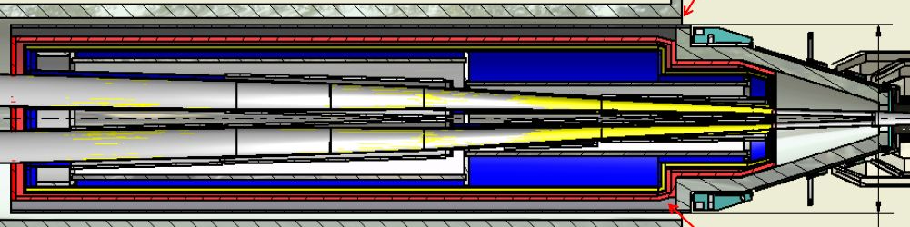
FF cryogenic system
Main refrigerator
The system is quite complex including three main items (Main cryostat, Cryogenic Line and Proximity Cryogenics) and a connection to the main refrigerator.
Main cryostat with quadrupoles , cross talk compensators (8 double helical coils) + 2 solenoids
Ancillary equipments:
Power supplies, controls and protection
HeII vacuum compressor
Proximity cryogenics including:
LHe reservoir, superfluid refrigerator transformers and current leads
Cryogenic lines with cooling pipes and bus bars

Slide 10
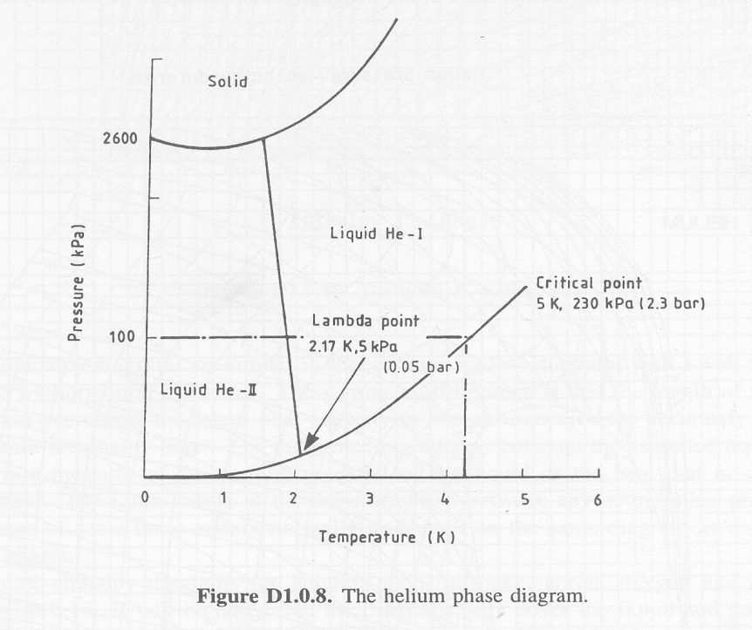
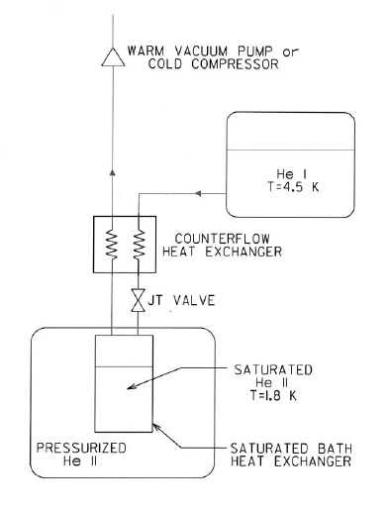
He superfluid refrigerator
For each cryostat Heat load 20W←→1 g/s → 1200 m³/h pumping system integrated into the main refrigerator

Slide 11
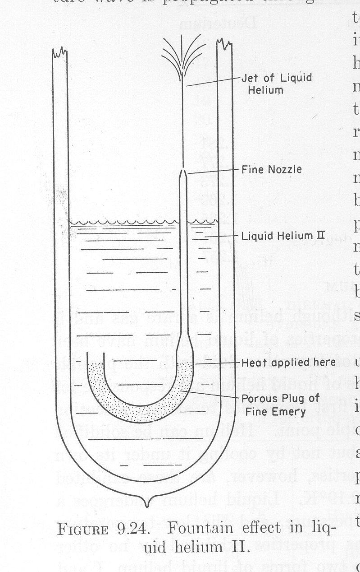
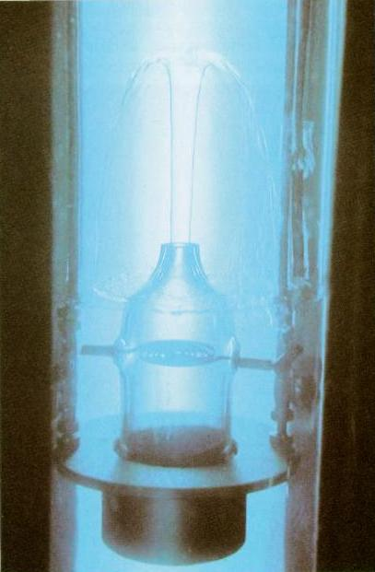
In cryostat we will have a superfluid circulation based on fountain effect

Slide 12
Next Steps of model development and coil design
Construction of a NbTi prototype of QD0 Funded April 2012→ June 2012
2.a) Construction of a Nb3Sn prototype of QD0. July 2012
2.b) Construction of a NbTi prototype of QF1 Sept. 2012 (wait for funds)
3) Cryogenic test of the prototypes Sept. 2012/Dec 2012
4) Finalize coil magnetic design Dec. 2012
5) Cryostat preliminary design Spring 2013
6) Proximity cryogenic design Spring 2013

Slide 13
OTHER ISSUES
B Shield with antisolenoids
B Field in the detector
Field compensation
Axial magnetic forces on FF system

Slide 16
Babar: axial forces

