Slide 1
Poland @ SuperB
Tadeusz Lesiak
June 2012

Slide 2
A bit of history
Proposal of joining the SuperB offered to „Krakow” by Achille Stocchi and Guy Wormser during conferences EPS09 and TESHEP09 (Kraków, summer 2009).
Acceptance of Krakow’s participation from the side of the SuperB governance (Frascati, Dec. 2009).
Marcello Giorgi and Alberto Lusiani visited all our groups (March 2011).
The agreement about formation of the polish (Krakow’s) SuperB consortium
(IFJPAN, AGH,CYFRONET,PK) (May 2011):
The visit of Roberto Calabrese (July 2011) .
First application for funding (May 2011) – rejected: „You Guys haven’t provided the TDR so far”.
Second application for funding (December 2011) - rejected (31.May) .
The Epiphany Conference in Krakow (Jan.2012): four SuperB talks: Marica Biagini and Alberto Lusiani.

Slide 3
Institutions
The H.Niewodniczanski Institute of Nuclear Physics Polish Academy of Sciences
Instytut Fizyki Jądrowej im. H.Niewodniczańskiego PAN (IFJ PAN)
The AGH University of Science and Technology
Akademia Górniczo-Hutnicza im. St.Staszica (AGH)
The T.Kosciuszko Cracow University of technology
Politechnika Krakowska im. T.Kościuszki (PK)
Academic Computer Center Cyfronet AGH
Akademickie Centrum Komputerowe Cyfronet AGH (CYFRONET)
Division of Particle Physics and Astrophysics
Division of Theoretical Physics
Division of Scientific Equipment and Infrastructure Construction
Interest from the side of synchrotron radiation community
Faculty of Electrical Engineering, Automatics, Computer Science and Electronics
Faculty of Physics, Mathematics and Computer Science
Faculty of Mechanical Engineering

Slide 4
IFJ PAN Physics & IFR & SVT
Tadeusz Lesiak (prof.; former expts: Crystal Ball, DELPHI, Belle, LHCb):
PI
Studies of T and CP violation in B and tau exclusive decays,
Development of the IFR software,
Overall coordination of polish efforts.
Jarosław Wiechczyński (Postdoc; former expts Belle, LHCb):
Studies of T and CP violation in B and tau exclusive decays,
Development of the IFR software,
Development of the overall computing system.
Marcin Chrząszcz (Ph.D. student, supervisor: T.Lesiak, 50/50 SuperB/LHCb):
Studies of T and CP violation in B and tau exclusive decays,
Development of the IFR software,
R&D and software studies of the SVT,
Development of the overall computing system.
FTE = 1.8

Slide 5
IFJ PAN Computing
Mariusz Witek (assoc. prof.) – NA32, DELPHI, LHCb.
Two young researches of computer science.
Development of the computing system: tools for distributed data analysis (Ganga, Dirac),
Implementation of the SuperB software on the resources of Polish-Grid (Plus).
FTE = 0.9
http://www.cloud.ifj.edu.pl/

Slide 6
IFJ PAN luminosity monitor
Leszek Zawiejski (assoc. prof.).
ZEUS lumi monitor; ILC
Bogdan Pawlik (Postdoc).
Advise and physics simulations related to the luminosity monitor @SuperB,
Studies of potential application @SuperB of (almost) ready-to-use luminosity monitors designed @ILC.
FTE = 0.2

Slide 7
IFJ PAN: Monte Carlo generators
Zbigniew Wąs (prof.) - author of TAUOLA and other MC packages.
Tomasz Przedziński (Ph.D. student; supervisor Z.Wąs).
M.Sc. Student.
Improvements in TAUOLA and KKMC along the needs of the SuperB,
Recent workshop in Krakow about the above topic,
The talk by Pablo Roig at the Physics Workshop (31.May).
FTE = 0.8

Slide 8
IFJ PAN: Engineering & Construction
Marek Stodulski (Ph.D.)
Jerzy Michałowski (Ph.D.)
DELPHI, PHOBOS,T2K,HESS,XFEL-DESY,LHC,ATLAS,LHCb…
Jaromir Ludwin (eng.)
Jerzy Kotula (eng.)
Technicians.
Participation in the fabrication of tools, quality checks and installation of modules of the IFR ( main activities in 2015; mirror works performed for the SMRD T2K),
Substantial participation in the construction of the accelerator (since 2015).
FTE = 1.5 (2012r)
FTE = 15-20 (2015)

Slide 9
AGH
PI
Wojciech Kucewicz (prof.) – DELPHI… ,30 years of experience with Si detectors.
Maria Sapor (Ph.D.).
Jacek Kołodziej (Ph.D.).
Mgr inż. Sebastian Głąb (Ph.D. student; supervisor W. Kucewicz).
Mgr inż. Mateusz Baszczyk (Ph.D. student; supervisor W. Kucewicz).
Mgr inż. Piotr Dorosz (Ph.D. student; supervisor W. Kucewicz).
Participation in tests of silicon photomultipliers (SIPM) and front-end electronics of the IFR,
Studies of readout and data acquisition systems of the IFR,
Future: participation in tests and assembly of the IFR modules.
FTE = 1.8

Slide 10
PK – Mechanical Engineering
PI
Bogdan Szybiński (Ph.D.)
Stanisław Łaczek (Ph.D.)
Paweł Romanowicz (Ph.D.)
Finite Element Analysis supporting the design and construction of the IFR.
FTE = 1.0

Slide 11
PK – Physics & Computing
Joanna Płażek (Ph.D.)
Agnieszka Łuszczak (Ph.D.)
Development of the computing system.
Studies of LFV tau decays.
Bartłomiej Rachwał (Ph.D. student, supervisor: T.Lesiak).
Participation in tests of silicon photomultipliers (SIPM) and front-end electronics of the IFR,
Studies of readout and data acquisition systems of the IFR,
Development of the IFR software.
Paweł Knap (M.Sc student; supervisor: T.Lesiak).
Development of the IFR’s event display (prototype → full size).
FTE = 1.9

Slide 12
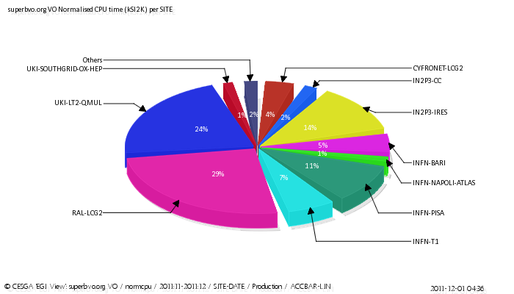
CYFRONET - Computing
PI
Tadeusz Szymocha (Ph.D.)
Tomasz Szepieniec (M.Sc.)
Marcin Radecki (M.Sc.)
See Marcin Chrzaszcz’s talk at computing session
Participation in the Monte Carlo production & development of the respective tools,
Development of the computing system: tools for distributed data analysis (Ganga, Dirac) ,
Implementation of the SuperB software on the resources of Polish-Grid (Plus),
Tests of the SuperB software on the GPGPU cards.
FTE = 1.0
CYFRONET
The CYFRONET’s share in the Monte Carlo production Dec. 2011 – Feb 2012:
7810 jobs – 3% of the total production
484 136 HEPSPEC06 hours
– 10% of the total prodution.

Slide 13
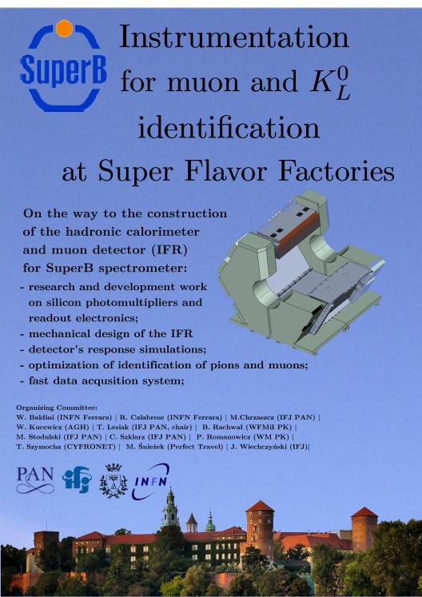
International Cooperation
Very close relations with the INFN/UNIFE Ferrara.
IFR workshop in Krakow: September 7-9
http://agenda.infn.it/conferenceDisplay.py?confId=5123
Aiming at the SuperB week in Krakow (2013, 2014…).
Web page
http://www.ifj.edu.pl/dept/no1/nz17/superb/SuperB_Paga/main.html
Polish discussion list:
superb-poland at lists.infn.it

Slide 14
Conference Talks:
T.Lesiak, „The SuperB Project”, 50th Cracow School of Theoretical Physics; Zakopane, June 2010; http://th-www.if.uj.edu.pl/school/2010/talks/lesiak.pdf
T.Lesiak, „The SuperB Project”, Quark Confinement and Hadron Spectrum, IX, Madrid, Sept. 2010. http://147.96.27.42//contributionDisplay.py?contribId=74&sessionId=103&confId=0
T.Lesiak, „Poland at SuperB”, SuperB Information Day, Strasburg, Sept. 2011,
http://indico.in2p3.fr/conferenceTimeTable.py?confId=5622#20110923
T.Lesiak, „The SuperB Project”, Strangeness in Quark Matter Conf., Kraków, Sept. 2011,
http://indico.ujk.edu.pl/contributionDisplay.py?sessionId=25&contribId=1&confId=0
J.Wiechczyński, „The IFR Detector at SuperB”, Epiphany Conf., Kraków, Jan. 2012, http://epiphany.ifj.edu.pl/current/pres/wiechczynski.pdf
M.Chrząszcz, „Vertex Detector for SuperB”, Epiphany Conf., Kraków, Jan. 2012, http://epiphany.ifj.edu.pl/current/pres/chrzaszcz.pdf
T.Lesiak, „The SuperB Project: a Window to the Matter-Antimatter Asymmetry and a Challenging Computing Platform, ”, KUKDM, Zakopane, marzec 2012, http://www.cyfronet.pl/kdm12/agenda.html
J.Wiechczyński, „The SuperB Factory, Physics Potential and Project Status”, MESON 2012, Kraków, June 2012.
T.Lesiak, „The SuperB Status”, 4th Workshop on Theory, Phenomenology and Experiments in Flavour Physics,
Capri, June 2012.

Slide 15
Financial Resources
Two grant proposals sent to the National Centre of Science.
The next attempt – deadline September 15.
Very limited resources inside of the labs (mainly at the INP PAN).
Some resources for „TAUOLA physics” from the National Centre of Science.
A prestigious „diamond grant” for Marcin Chrząszcz - 50 kEUR for three years.
A successful application to the Polish Academy of Sciences for the organization of the IFR workshop in Krakow.
Several common applications Ferrara-Kraków.
Interest of polish scientists and agencies in the SuperB ERIC and in future use of synchrotron light lines.

Slide 16
Summary
Non-negligible polish involvement of 10.6 FTE (30 persons working part time).
The basic limitation – lack of real funding so far.
We aim for truly visible and substantial participation in the accelerator construction and IFR assembly (2015).

