Slide 1
SuperB SVT Update on Sensor and Fanout Design in Trieste/Como
Luciano Bosisio, Livio Lanceri, Irina Rashevskaya, Erik Vallazza, Lorenzo Vitale
INFN Trieste and Università di Trieste
Daniela Lietti, Michela Prest
INFN Milano and Università dell’Insubria

Slide 2
Outline
Updated estimates of detector parameters (sensor + fanout) relevant for Signal/Noise evaluation
Radiation-induced leakage currents
Lorentz angles and Layer 3 readout options
Status of fanout design and prototyping

Slide 3
Detector (Sensor + Fanout) Parameters
Parameter tables have been updated:
Layer 0 now included
Noise contribution of series resistance reevaluated taking into account the distributed nature of R and C ( => a factor √3 lower noise from R_{s} !)
z-side options considered in the tables:
both pairing and ganging for Layers 1 to 3 (pairing will be adopted)
ganging only for Layers 4 & 5; the plan is to mix both pairing and ganging within the same module, but the worst S/N comes from ganging
Expected radiation fluences for 7.5 years of operation, with/without 5x safety factor
Two Layer 3 readout options considered:
Layer 3 p-type strips on Φ-side (100 µm readout pitch)
Layer 3 n-type strips on Φ-side, as in BaBar (but readout pitch 110 µm instead of 55 µm)
WARNING: Noise contribution from front-end electronics NOT included here

Slide 4
Φ-SIDE - No 5x safety factor - Option A for Ly3
Series resistance of sensors estimated assuming 2.5 µm aluminum thickness.
Current damage factor α = 2.8×10⁻¹⁷ A/cm (accounts for long term annealing).
Noise contributions from the sensor calculated assuming a simple CR-RC shaping (not CR-RC² as adopted for the preamplifier) ==> noise values are approximate and used for a first evaluation of the effects of sensor parameters.
OPTION A – LAYER 3 Φ-SIDE READ OUT BY SENSOR P-SIDE (at 100 µm pitch)

Slide 5
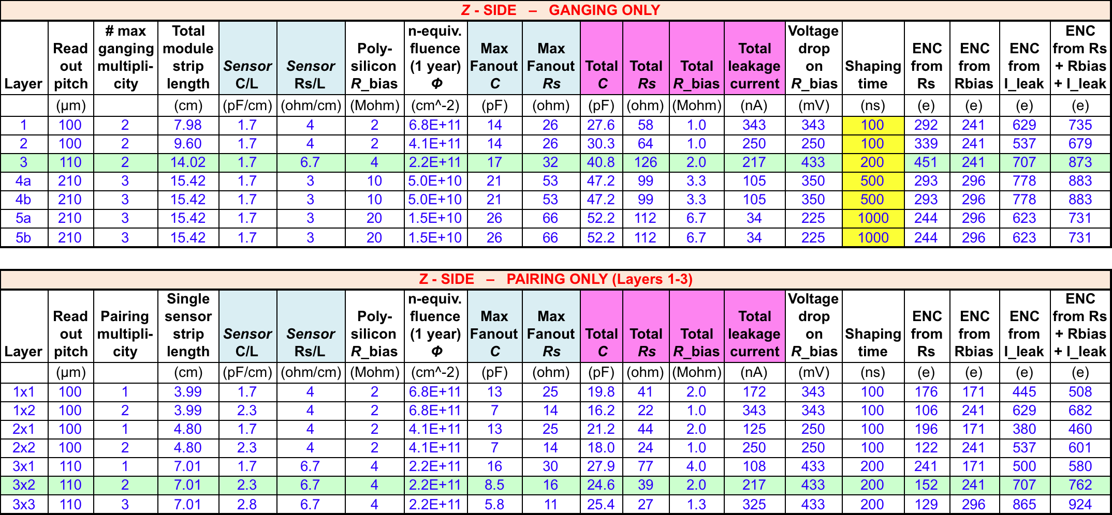
Z-SIDE - No 5x safety factor - Option A for Ly3
OPTION A – LAYER 3 z-SIDE READ OUT BY SENSOR N-SIDE (at 110 µm pitch)
Note: On Layer 3, we plan to implement pairing x2 max (light green row)

Slide 6
Φ-SIDE - With 5x safety factor - Option A for Ly3
Series resistance of sensors estimated assuming 2.5 µm aluminum thickness.
Current damage factor α = 2.8×10⁻¹⁷ A/cm (accounts for long term annealing).
Noise contributions from the sensor calculated assuming a simple CR-RC shaping (not CR-RC² as adopted for the preamplifier) ==> noise values are approximate and used for a first evaluation of the effects of sensor parameters.
OPTION A – LAYER 3 Φ-SIDE READ OUT BY SENSOR P-SIDE (at 100 µm pitch)

Slide 7
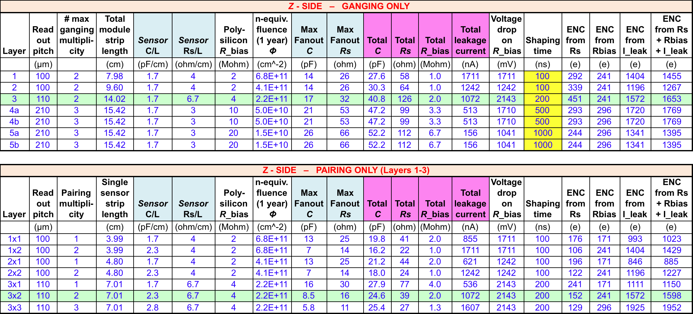
Z-SIDE - With 5x safety factor - Option A for Ly3
OPTION A – LAYER 3 z-SIDE READ OUT BY SENSOR N-SIDE (at 110 µm pitch)
Note: On Layer 3, we plan to implement pairing x2 max (light green row)

Slide 8
COMMENTS ON S/N
On z-side, pairing gives better S/N than ganging (as expected).
Radiation-induced leakage current gives a major contribution to noise (by far dominant with 5x safety factor). This suggests to investigate the possibility of cooling the sensors (∆T = − 8°C ⇒ 2x lower current).
The strip resistance brings an important contribution to noise. A metal thickness of 2.5 µm has been assumed (vs. a standard value ≤ 1 µm). Could be further increased? Waiting for feedback from suppliers.
Polysilicon bias resistor values has been increased to ~20 MΩ in Ly5, and reduced in Ly1-3, keeping into account both the noise and the voltage drop with the high leakage currents after irradiation.

Slide 9
COMMENTS ON S/N
The only effect of irradiation considered so far is on the leakage current. Other effects to be evaluated are the increase of depletion voltage after type inversion and a higher strip capacitance.
In evaluating the S/N ratio, we must keep in mind that there could be other possible noise contributions (the noise estimates have a tendency to be optimistic….). Furthermore, the collected charge is always less than the ‘standard’ 24 ke, due to angled tracks, low field regions (particularly at large pitch near the p-stops), charge collected by the p-stops, ballistic deficit at short shaping times…

Slide 10
Lorentz Angle
The B field along z will displace the carrier drift direction; the angle between the drift velocity and the electric field is given by tanθ = µ_{H}B, where the Hall mobility µ_{H} is ~ 4.5 times larger for electrons than for holes. For a 1.5 T magnetic field we get:
θ_{n} = 14 degrees for electrons
θ_{p} = 3.2 degrees for holes
The displacement will spread the collected charge in the r-Φ plane, perpendicular to the z axis. So the z readout will be unaffected (to first order) while the Φ clusters will be displaced and their width modified, depending on the track incidence angle. In order to minimize the effect, it would be desirable to read the rΦ coordinate with the hole-collecting p-type strips. This is our choice for Layers 4 and 5 and, in the present scheme, also for Layer 3.
However, Layers 1 and 2 will collect electrons on Φ-side, with a large Lorentz angle, and the inner layers (1 to 3) are arranged in a pinwheel geometry, with faces tilted by 5.4 degrees. It is desirable to orient the faces so that the tilt angle will partially offset the Lorentz angle on Layers 1 and 2.
Then the tilt angle will add to the (smaller) Lorentz angle on Layer 3. We would reach a symmetric situation between Layers 1+2 and 3 for a tilt angle equal to (θ_{n} – θ_{p})/2 = 5.4 degrees (!!!).

Slide 11
Layer 3 Readout Options
The choice of shifting the Layer 3 Φ readout from n-side (as in BaBar, and in Layers 1,2) to p-side was driven by the need to reduce the large noise contribution from the metal strip resistance. Since we have now reduced this estimate (by a factor √3) due to the distributed nature of R and C, and furthermore we plan to increase the aluminum thickness by a factor of ~ 2.5 or more, the situation for Layer 3 could be reconsidered.
Using the parameters reported in the tables, we find that, with the high leakage currents expected and by adopting a pairing scheme on z-side, the noise situation is more symmetrical between the two sides when Φ-side is readout by p-type strips (‘option A’).
However, considerations about the Lorentz angle favor the opposite choice (‘option B’).
The final decision should also take into account the different performance requirements (S/N, spatial resolution, etc.) on the two sides.

Slide 12
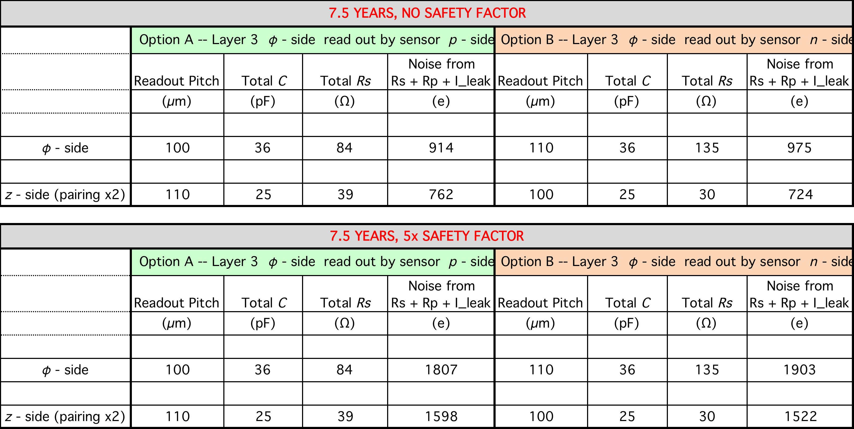
Comparison of Layer 3 Readout Options

Slide 13
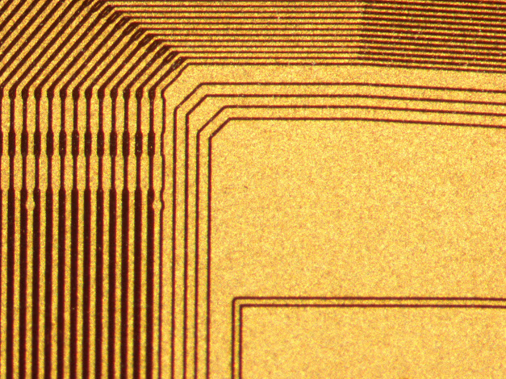
Fanout Status
Como/Trieste Group

Slide 14
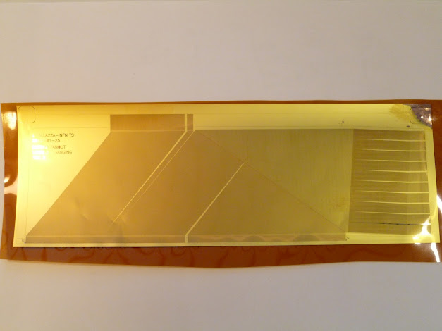
Design and production status
What CERN has produced up to now
layer 1 – phi (1x)
layer 3 - z with ganging (3x)
layer 3 with pairing (1x)
The layout conversion problems (causing the deposit of Cu and Au between the strips) were solved → a new production has started last month and the fanouts will be ready in a couple of weeks
Expected production yield
→ 20% perfect
→ 30 % with 1 short/open
→ 30% with 2 shorts/opens
→ more than 3 shorts/opens
What we have designd up to now
layer 1 – phi
layer 3 - z with ganging and pairing
layer 5b - z
ALL the produced fanouts have been cut @ Mipot and tested for bondability of the surface

Slide 15
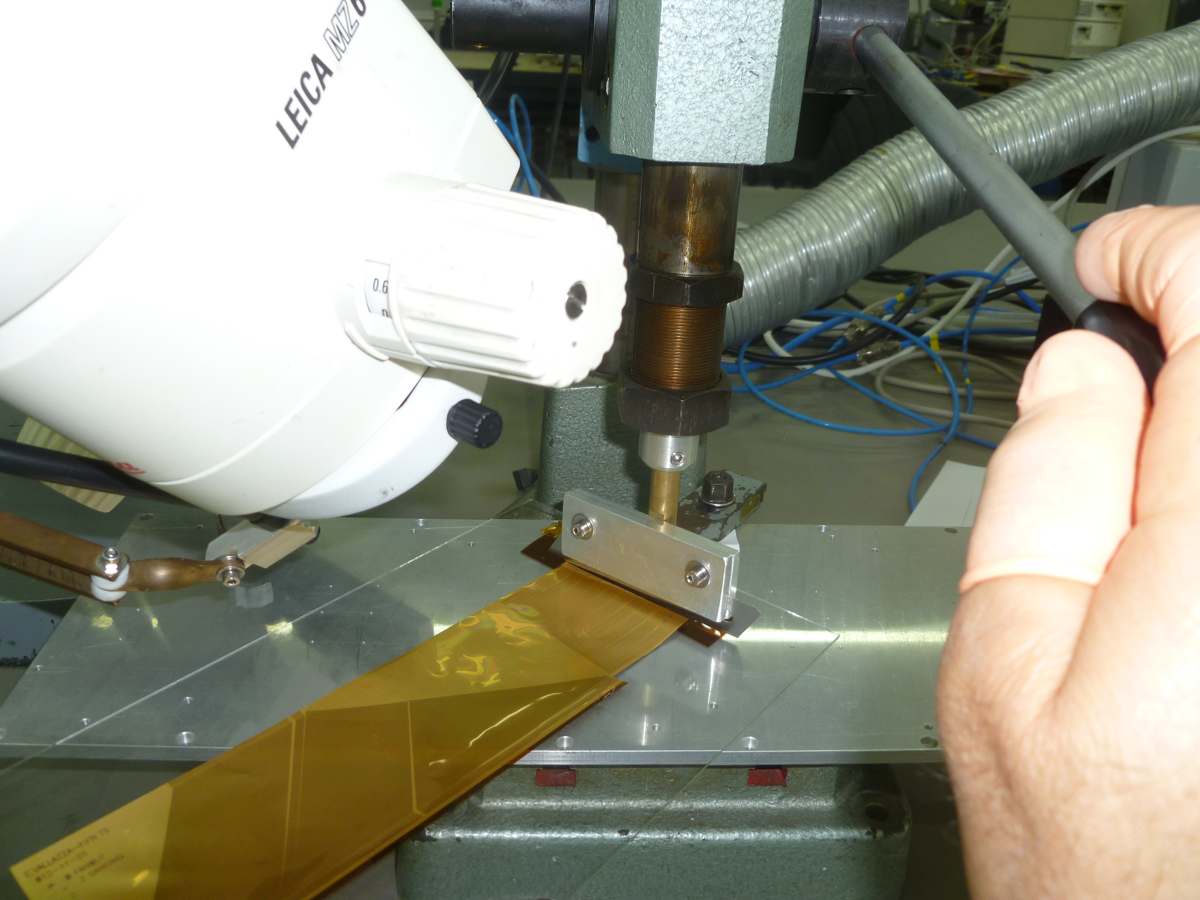
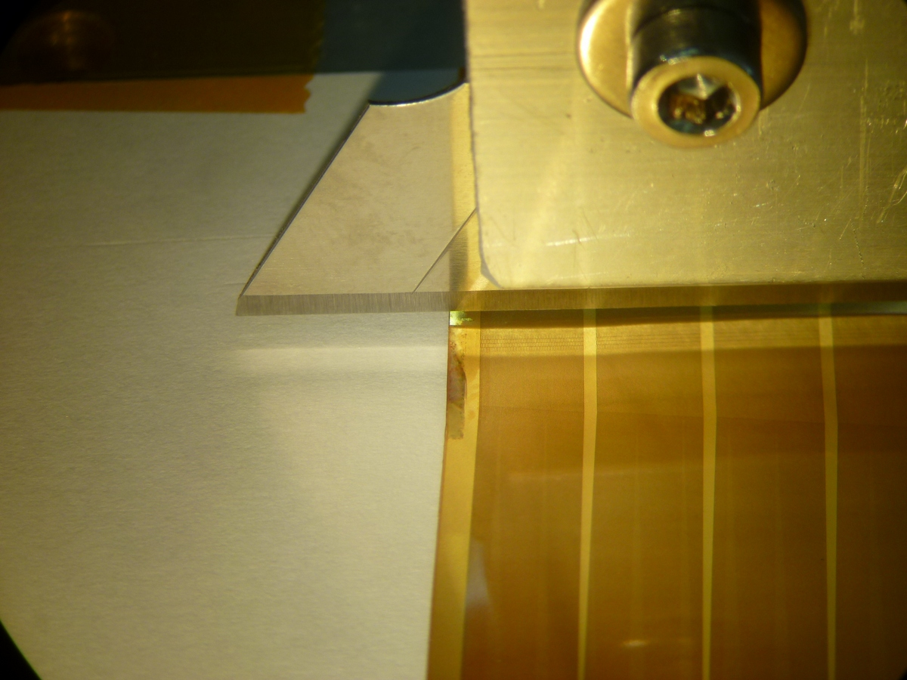
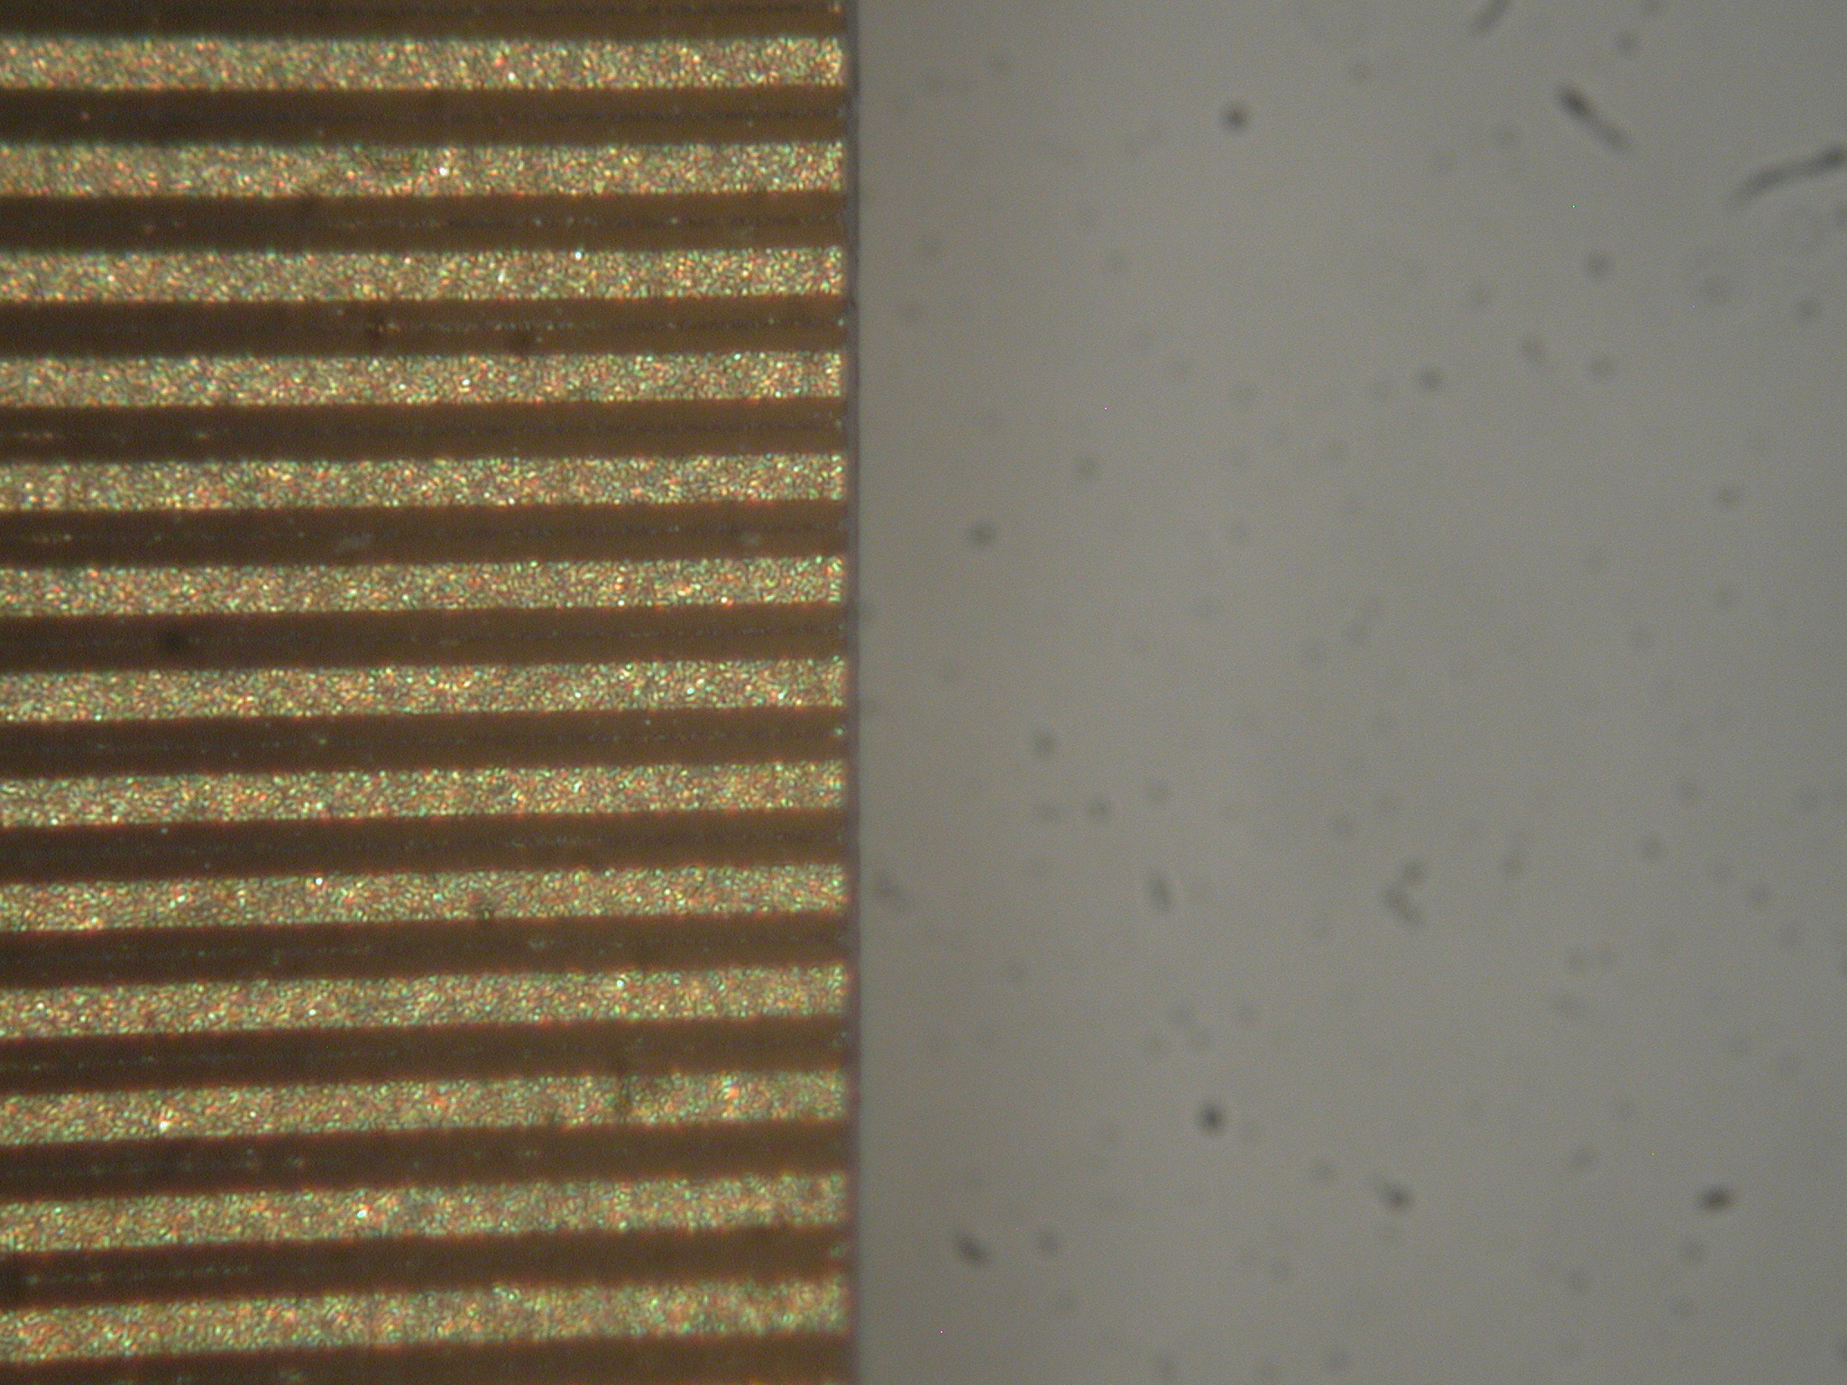
Cutting

Slide 16
To understand
From the design point of view
Final distances of the silicon sensors wrt the HDI
From the production point of view
Capacitance and noise measurements
Effective production yield

