Slide 1
Meeting Outlook
Marcello A. Giorgi Università di Pisa & Pisa
4th Collaboration & General Meeting
La Biodola June 4, 2012

Slide 2
The end of this Meeting
From my first slide last Friday June 1

Slide 3
The end of this Meeting
.
This meeting is devoted to:
Consolidation of SuperB Collaboration
Physics activity in preparation of the open symposium in Krakow, Poland, from Sept. 10-13, 2012, to update the European Strategy for Particle Physics.
Activity to complete TDR on physics, detector, computing.
Very little on accelerator

Slide 4
At the end
. Attention on:
PHYSICS
Documents for the european strategy:
Spectroscopy ready
Progress on other topics
Interesting presentations from the other Flavor
Communities (BESIII,CMS, LHCb)

Slide 5
New physics could strengthen the superb case
2011
R.Petronzio
CDF results may point to a new weak sector
MEG may open the pandora box of flavour changing neutral currents

Slide 6
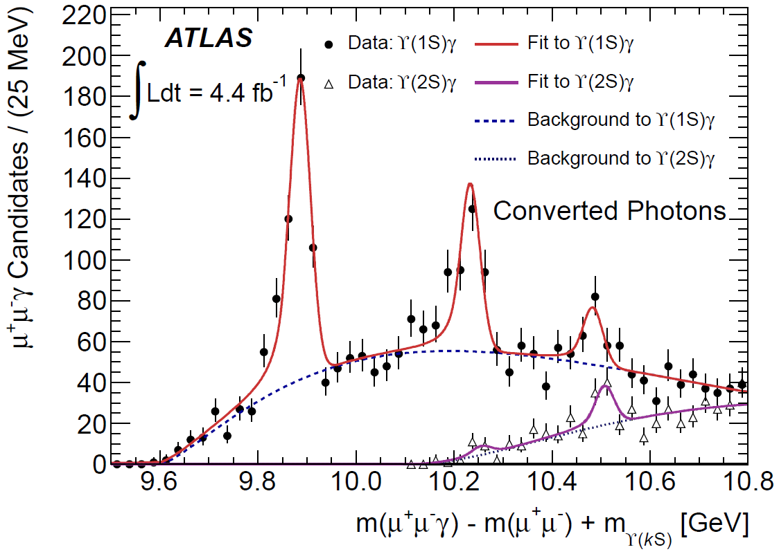
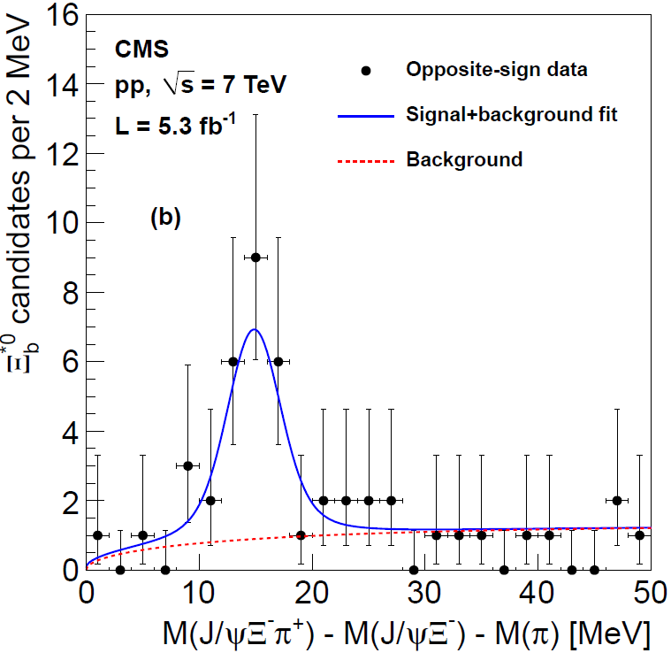
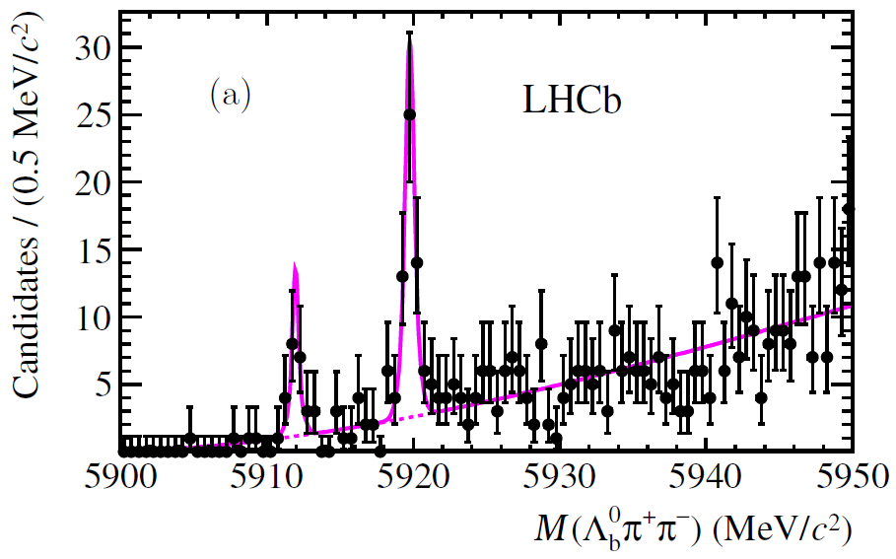
Pop Quiz
J Olsen talk
What are the only new particles discovered at the LHC to date?
Higgs boson
Black holes
Gluinos
Squarks
B hadrons
- ATLAS (Dec, 2011)
L. Martini
- CMS (April, 2012)
- LHCb (May, 2012)
- LHCb (May, 2012)

Slide 7
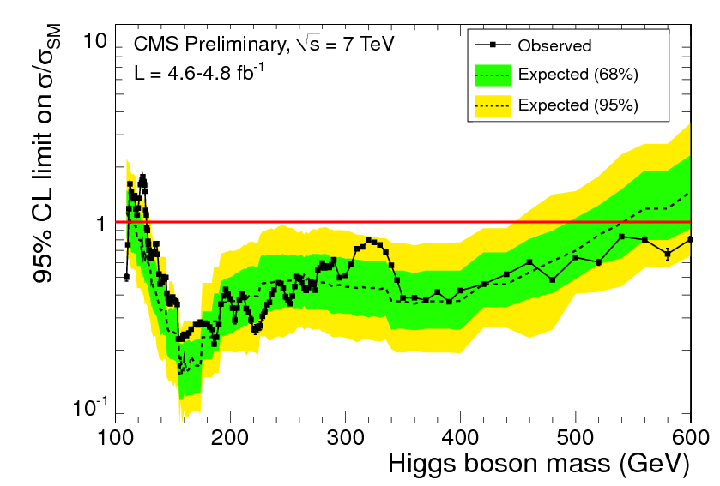
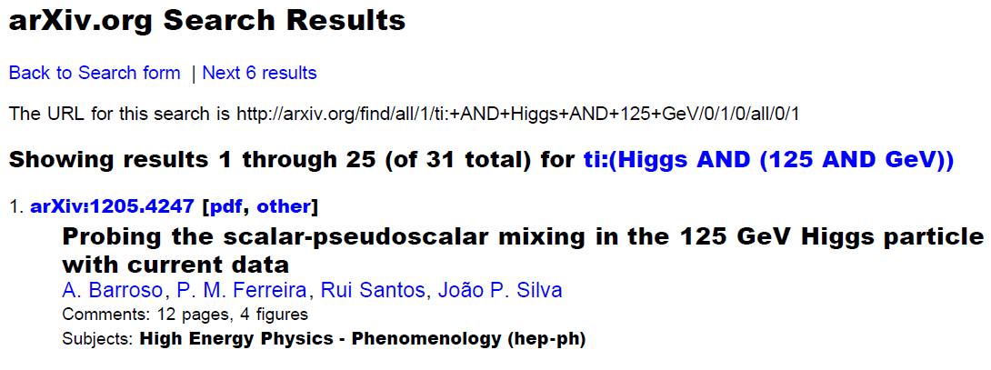
Where is the SM Higgs?
J Olsen talk
SM Higgs excluded:
127.5 – 600 GeV (95% CL_{S})
31 papers on arXiv with
“125 GeV Higgs”
in the title since Dec… (and zero before)
If not here… It must be way out here

Slide 8
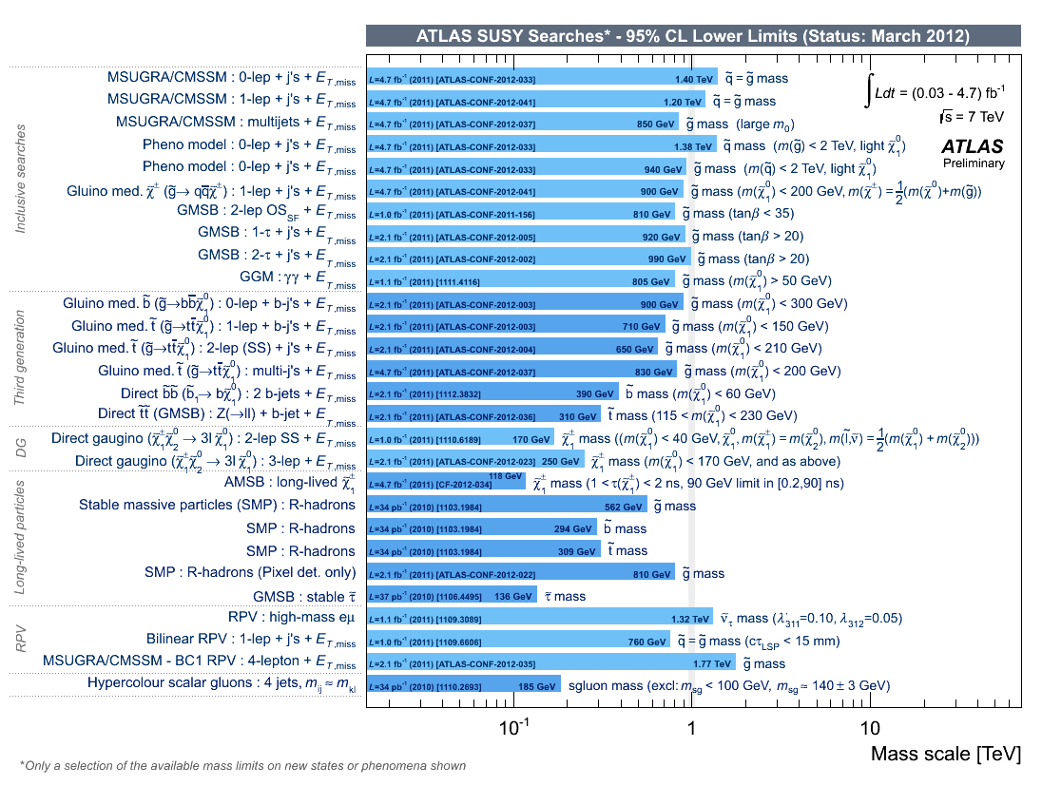
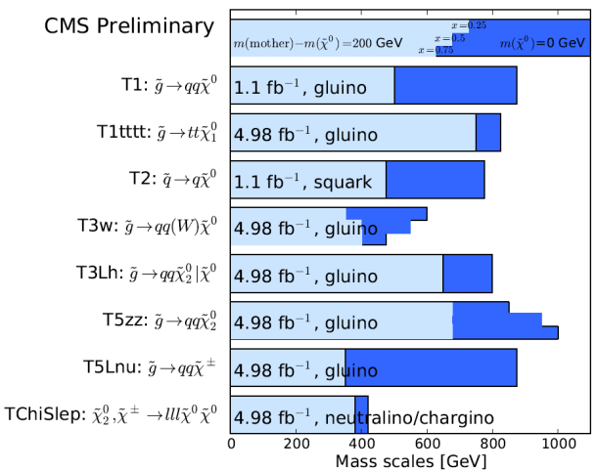
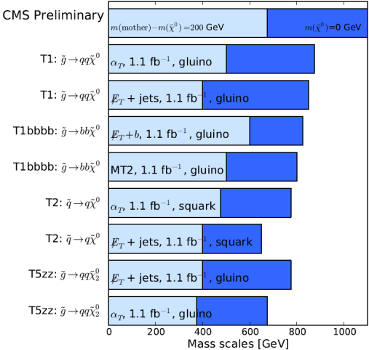
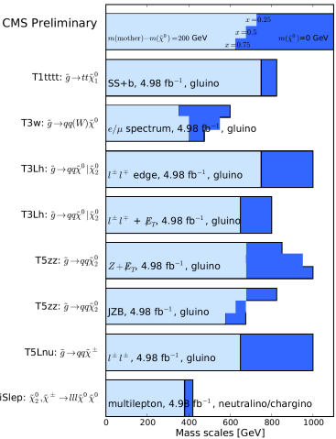
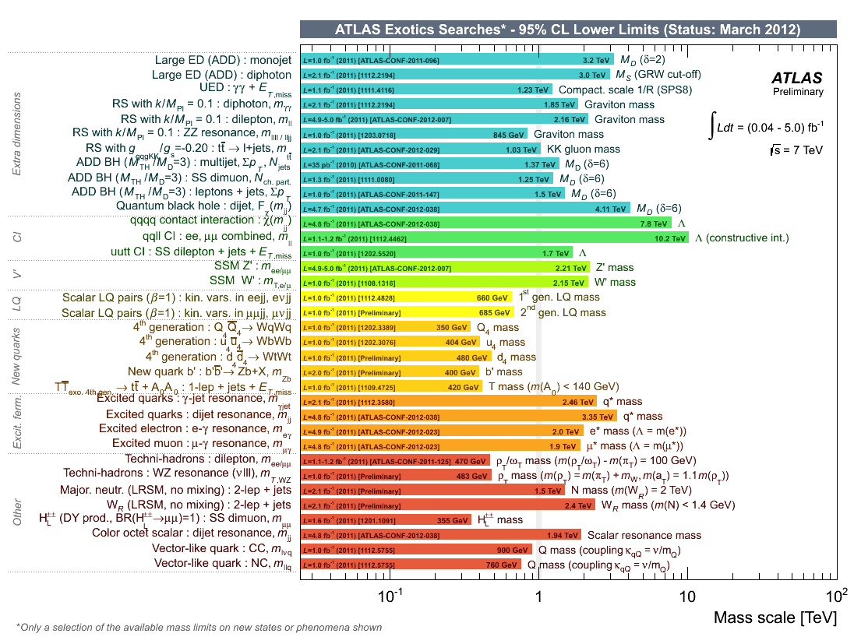
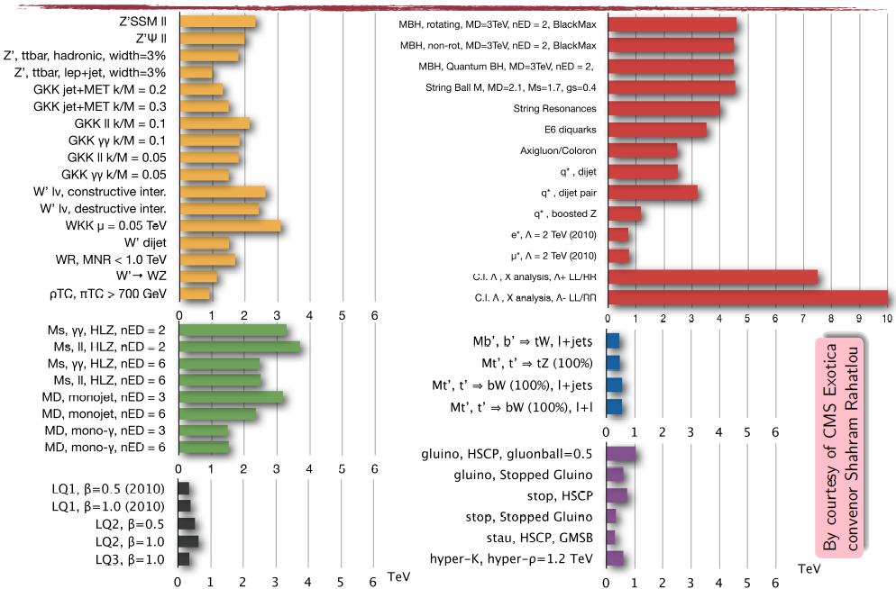
Where is “Everything Else”?
J Olsen talk
> 150 searches:
“no significant signal was found…”

Slide 9
New physics could strengthen the superb case
2011
R.Petronzio
CDF results may point to a new weak sector
MEG may open the pandora box of flavour changing neutral currents
and LHC new particle discovery

Slide 10
New physics could strengthen the superb case
Absence of
2012……
And the other flavor experiments
BesIII, LHCb and BELLEII

Slide 11
At the end
Interesting presentations from the other Flavor
Communities (BESIII,CMS, LHCb)
We have seen the staus report og SuperKEKB and BELLEII

Slide 12
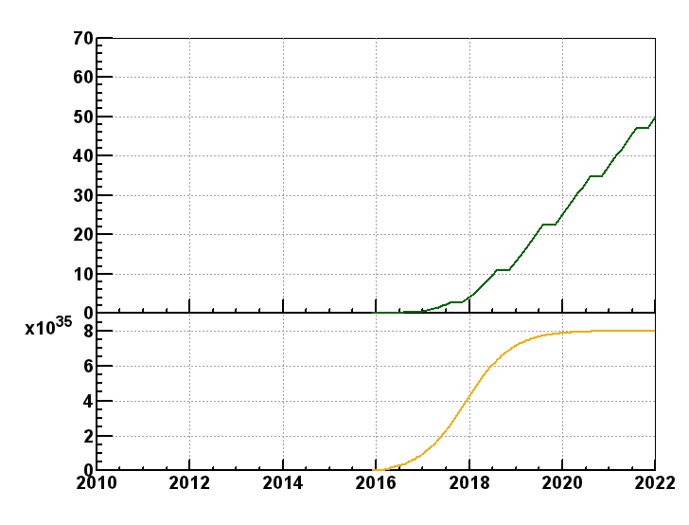
BELLEII luminosity expectation

Slide 13
Cabibbolab & Site
From M.Biagini, M.Ferrario,A.Variola, R.Petronzio:
Site is defined
Machine will contain Hybrid structure allowing X-FEL with no perturbation on SuperB fundamental Physics Mission
Cabibbolab Structure defined
Cabibbolab has started spending money.
Recruitment of technical staff started.
3/20/2012

Slide 14
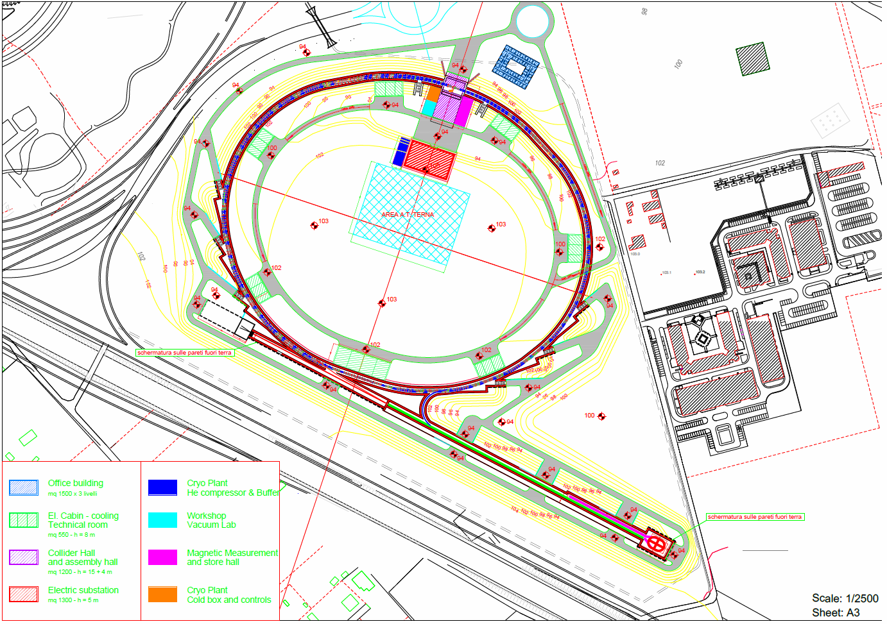
SuperB layout in TorVergata

Slide 15
Cabibbolab & Site
From M.Biagini, M.Ferrario,A.Variola, R.Petronzio:
Site is defined
Machine will contain Hybrid structure allowing X-FEL with no perturbation on SuperB fundamental Physics Mission
Cabibbolab Structure defined
Cabibbolab has started spending money.
Recruitment of technical staff started.
3/20/2012

Slide 17
Cabibbolab & Site
From M.Biagini, M.Ferrario,A.Variola, R.Petronzio:
Site is defined
Machine will contain Hybrid structure allowing X-FEL with no perturbation on SuperB fundamental Physics Mission
Cabibbolab Structure defined
3/20/2012

Slide 18
governance CABIBBO Lab
COMITATO FINANZE
ASSEMBLEA DEI. SOCI
COLLEGIO DEI REVISORI
DIRETTORE GENERALE ROBERTO PETRONZIO
CONSIGLIO TECNICO SCIENTIFICO
UNITA’ RADIAIZIONI E SICUREZZA
UNITA’ DI PROJECT MANAGEMENT
DIRETTORATO
INFRASTRUTTURE
WALTER SCANDALE
RICERCA E COMPUTING MARCELLO GIORGI
GESTIONE E AMMINISTRAZIONE MONIA D’AGOSTINO
SORGENTI DI LUCE
DIPARTIMENTO ACCELERATORE
DIPARTIMENTO INTEGRAZIONI
DIPARTIMENTO TECNICO
DIPARTIMENTO FISICA SPERIMENTALE
DIPARTIMENTO IT E MODELING
Anelli SuperB e iniettore complesso: Costruzione e Funzionamento
Relazioni con partners stranieri e integrazioni delle loro attività
Servizi Generali Tecnici incluso ingegneria civile
A esso correlati: esperimento di calcolo, sicurezza ambientale e salute, sensibilizzazione ed educazione.
FISICA DELL’ACCELERATORE
MAGNETE CONVENZIONALE
SISTEMI ELETTRONICI
GESTIONE ED ELABORAZIONE DATI SPERIMENTALI
ANELLI PRINCIPALI
CONVERTITORI DI POTENZA
SISTEMI MECCANICI
SERVIZI DI RETE E SICUREZZA
INSERIMENTO REGIONI
VUOTO
RILEVATORE TECNOLOGIE
SERVIZI DI GESTIONE DI COLLABORAZIONE E DI INFORMAZIONE
RADIOFREQUENZA
MECCANICA
DISTRIBUZIONE INFRASTRUTTURE DI CALCOLO
LINAC
ELETTROTECNICA
MODELLO FISICO E SIMULAZIONE SENSIBILITA’
INIETTORE COMPLESSO
FLUIDO E VENTILAZIONE
STRUMENTAZIONE
SUPPORTO TECNICO
FEEDBACKS
CRIOGENIA
CONTROLLI
SICUREZZA CONVENZIONALE
MAGNETE SUPERCONDUTTORE
SERVIZI GENERALI
APPROVVIGGIONAMENTO E STOCCAGGIO

Slide 19
Cabibbolab & Site
From M.Biagini, M.Ferrario,A.Variola, R.Petronzio:
Site is defined
Machine will contain Hybrid structure allowing X-FEL with no perturbation on SuperB fundamental Physics Mission
Cabibbolab Structure defined
3/20/2012

Slide 20
Cabibbolab & Site
From M.Biagini, M.Ferrario,A.Variola, R.Petronzio:
Site is defined
Machine will contain Hybrid structure allowing X-FEL with no perturbation on SuperB fundamental Physics Mission
Cabibbolab Structure defined
Cabibbolab has started spending money.
Recruitment of technical staff started.
3/20/2012

Slide 21
The Joint Integration Group Goals
Facilitate and solve problems related to common fields:
Integration
Utilities
Experimental Areas and services.
Other spaces (Clean rooms, laboratories..)
Computing resources and needs.
Joint general meetings.

Slide 22
Joint Integration Group
It has been set up:
Members:
M.G., W.Scandale, A.Variola, C.Sanelli, F.Forti, M.Morandin, B.Ratcliff, W.Wisniewski, P.Lubrano, R.Calabrese , L.Lilli.
Yesterday the first organizational meeting.
Chair M.G. and Secretary Lucia.

Slide 23
Final comment
Given the Government Review by Fioni Committee early October, we expect the center of mass of the accelerator community including BINP people around Rome in september therefore the mmetngf of Novosibirsk in September is cancelled.
However a Detect meeting devoted to TDR is needed and it will be rescheduled soon with another venue.

Slide 24
Final comment
USEFUL MEETING

Slide 25
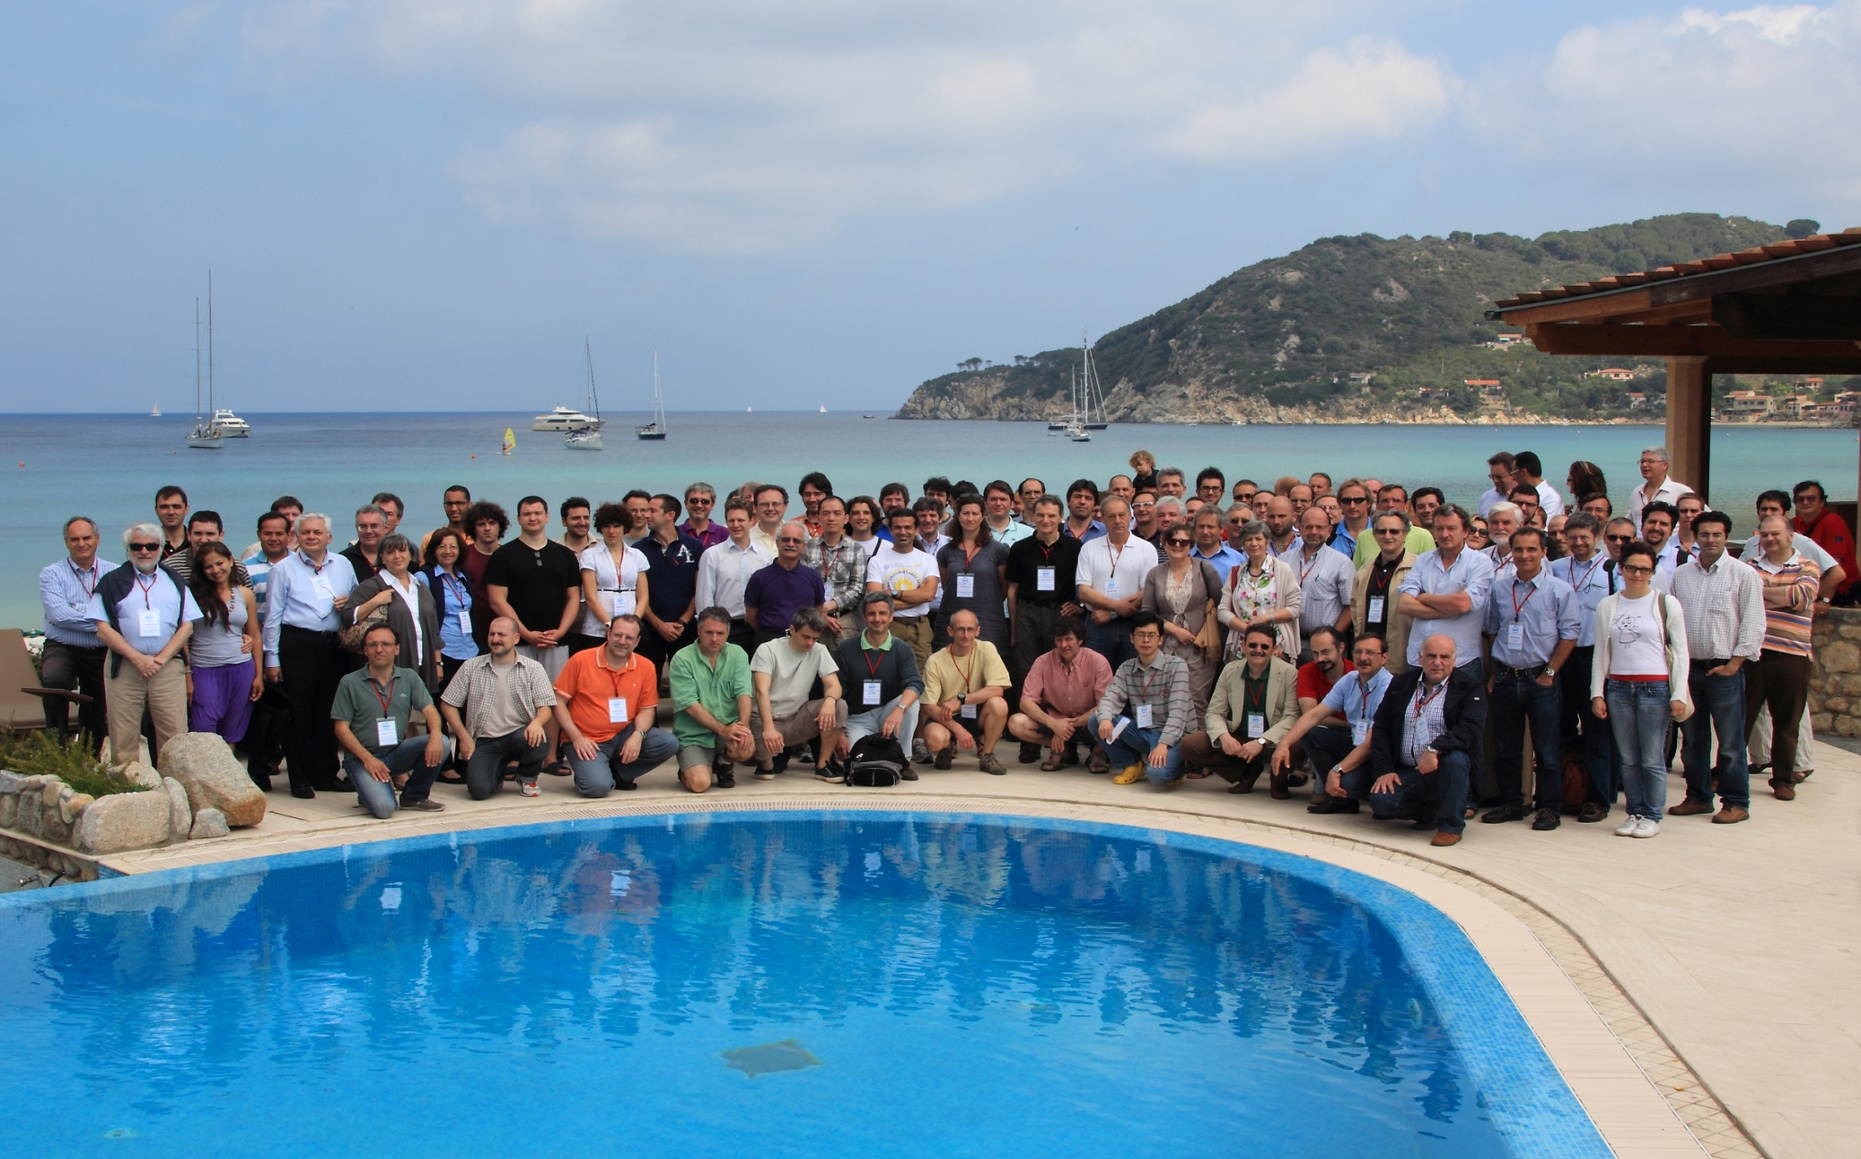
As we can see..

Slide 26
And now….
I intend to thank the help of the meeting secretariat
Rossana
Maria Rita
Claudia
Lucia
that has guaranteed a smooth

Slide 27
And ….
the technical staff:
Mauro
Dario
Maurizio
All together they have guaranteed the smooth running of the meeting

