Slide 1
Integration and IR Hall
Summary of the two integration sessions.
SuperB Experimental hall.
Integration of inner detectors.
Services accounts.
Conclusions.

Slide 2
Summary of the two Integration sessions.
We have two sessions for discussing integration issues.
In the first session we review the experimental area and the detectors integration general problems.
In the second one we focus on the mechanical envelopes and clearance and service distribution of inner detectors.

Slide 3
Summary of the status of superB Integration
-The architecture of the experimental area has been set considering:
the interaction region must be independent from the assembly area.
2)Most of activity are localized in the exp. area, like detector preparation, commissioning etc.
We would like to have the access to the experimental area directly from outside. We consider to have two access ramps.
The proposed size is 60meter X 24meter including a service room.
Some implications:
we have to move all detectors including some services from the assembly to interaction area. The electronic house can be maintained always at 10 meter from the beam axis (cable length >10mter)
The SVT and the layer0 and beam pipe can be installed in interaction region.
We need a structure supporting the MDI during the acceleration commissioning and the detector on the Beam axis.

Slide 4
Summary of the status of superB Integration
We took the SuperB layout and we revised the mechanical interface of Babar of the reused elements.
We received a service questionnaire from all sub detector at allow us to check and track the services inventory.
We integrate in the new SuperB detector layout DCH, FTOF, MDI and layer0.
We proposed a supporting scheme of SVT, MDI and layer0.
We cross check the overall dimension using the most trusted drawing from BABAR.
We still need to analyzed the service inventory in detail .

Slide 5
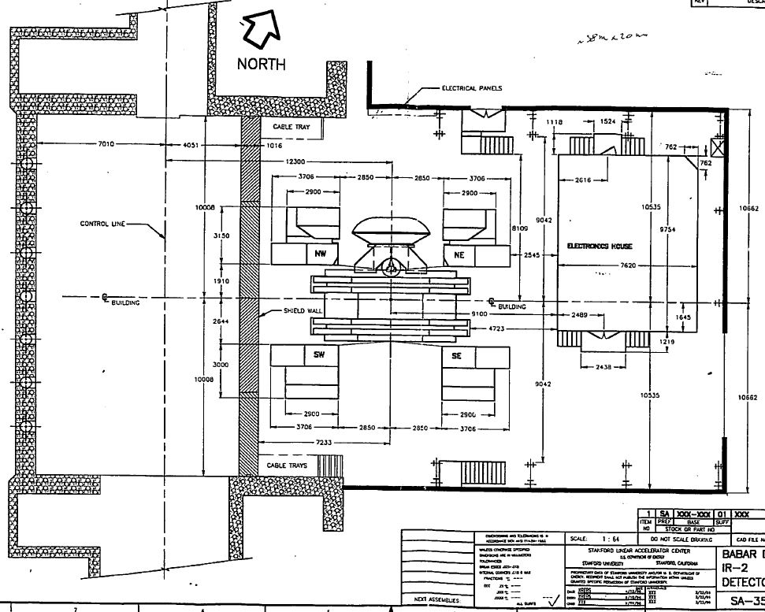
Babar IFR area
38000
21324

Slide 6
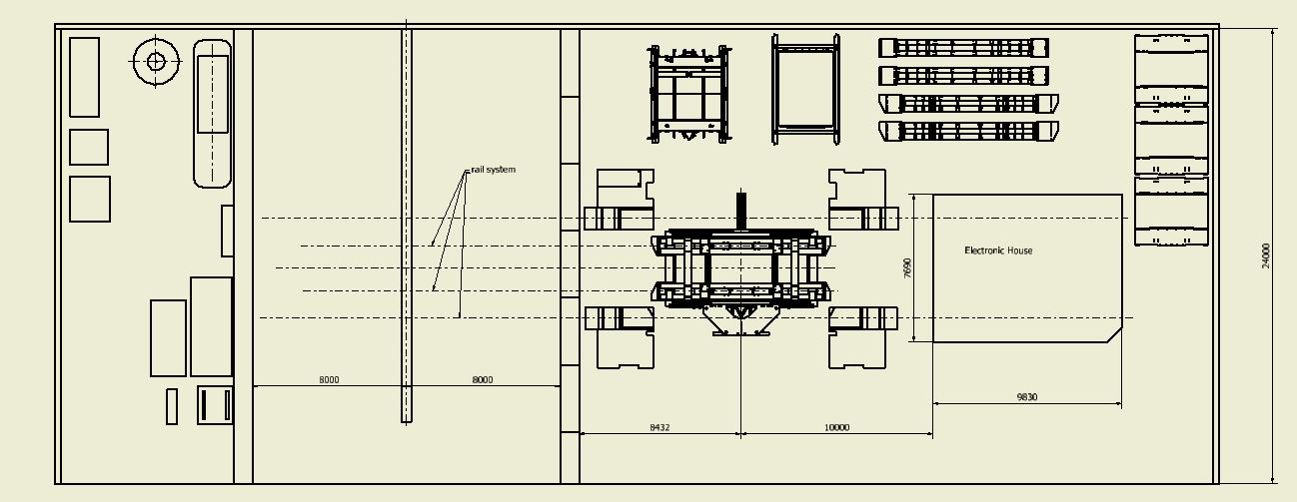
SuperB position during the assembly (Garage position)
+500mm up beam axis

Slide 7
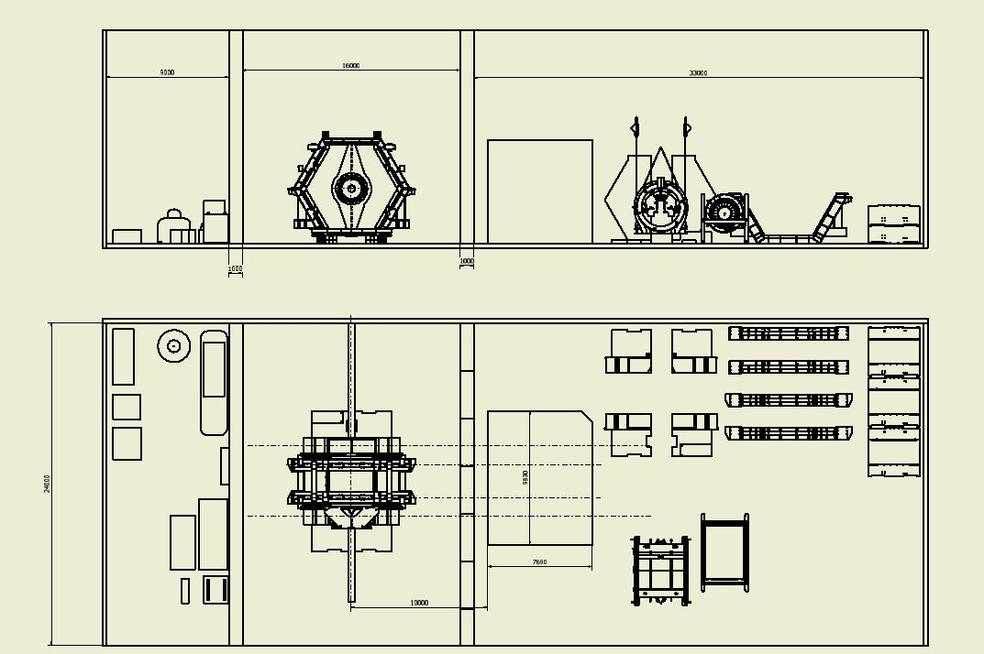
SuperB in the interaction position
Chiller
Gas mixing etc
Power cable
Read-out cable
500 mm more

Slide 8
Some considerations:
We need to have a new of translation system of superB from the two positions (interaction and garage).
We need a new system for opening the door efficiently.
The electronic house can be maintained always at same distance respect the detector (about 10m).
Power and read-out cables could go respectively on the top and bottom of the electronic house.
Power cables and read out cable of the doors must allow a compensation for their motions.
Cryogenic and cooling line can be extended for the two detector positions.
The commissioning of the accelerator is going to occur with Detector on the beam axis.

Slide 9
In the Inner DET. Integration session we covers:
Inner detector envelope
Radial clearances.
Longitude clearances
Cable distribution
Installation.
Integration of the tungsten supports tube in the inner detectors.

Slide 10
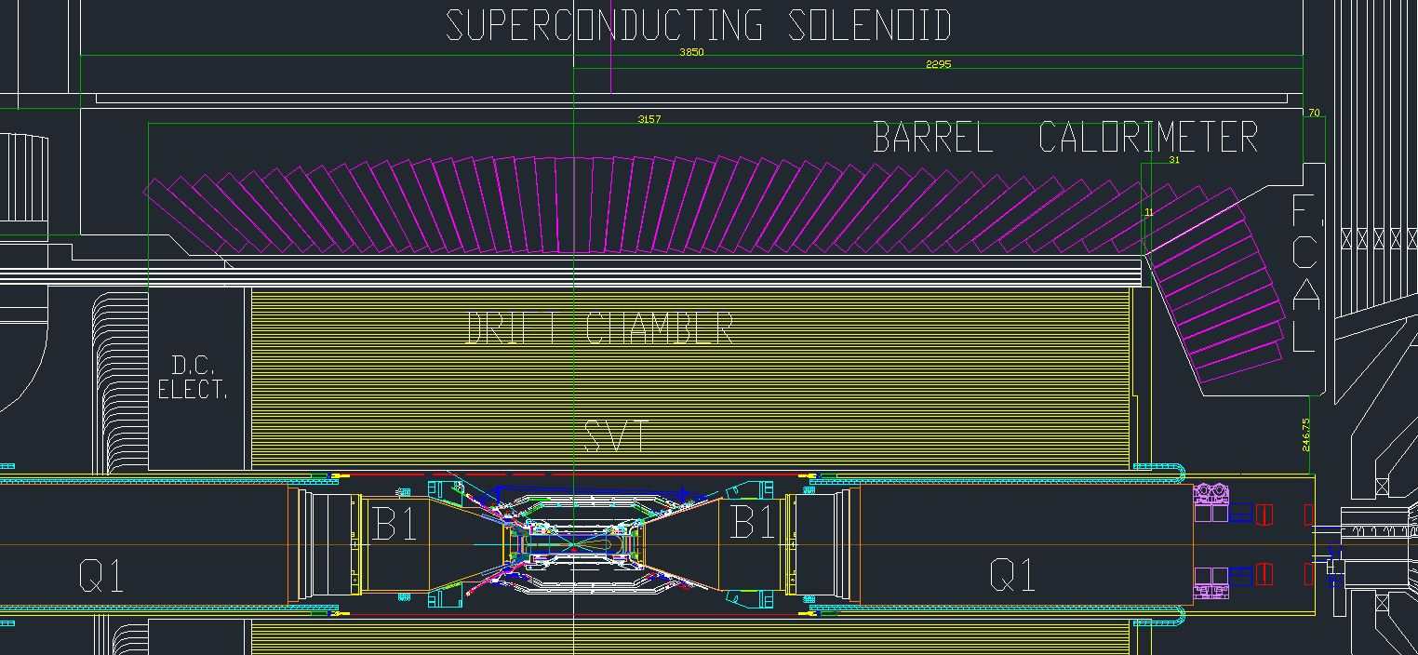
Integration of the inner detector
Establish the interaction point referring the forward face of the super conducting Solenoid Babar the ref dimension is 2295mm.

Slide 11
Mechanical Envelope and mass of the SuperB inner detectors

Slide 12
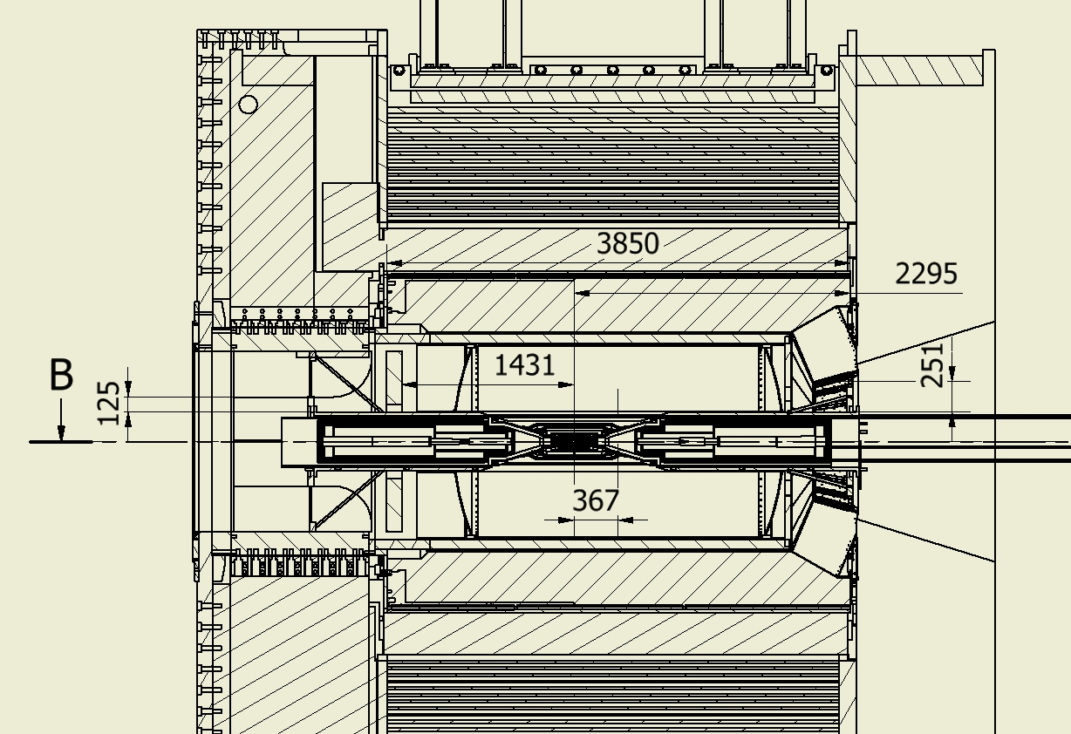
Envelope of the SuperB inner detectors

Slide 13
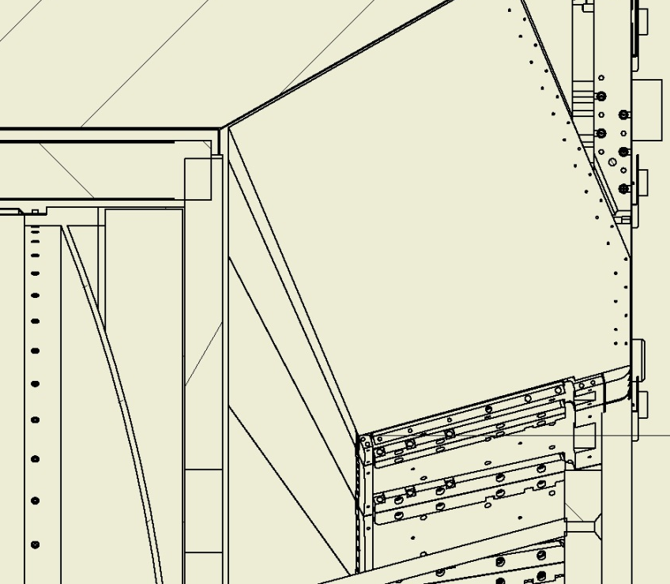
Envelope of the SuperB inner detectors
Radial Interference with DIRCH, possible with FCAL

Slide 14
Envelope of the SuperB inner detectors
FTOF have to reduce the outer diameter to fit inside the DIRCH so can have a max diameter like the DCH outer diameter (1610mm).
We have still have to check the longitudinal clearance with the FCAL
(Z max of FTOF is 1801mm)
In the BABAR reference drawing the Z max is 1917mm at the DCH radius. We are not sure that the detector can extend up this number for the presence of FCAL calibration system.

Slide 15
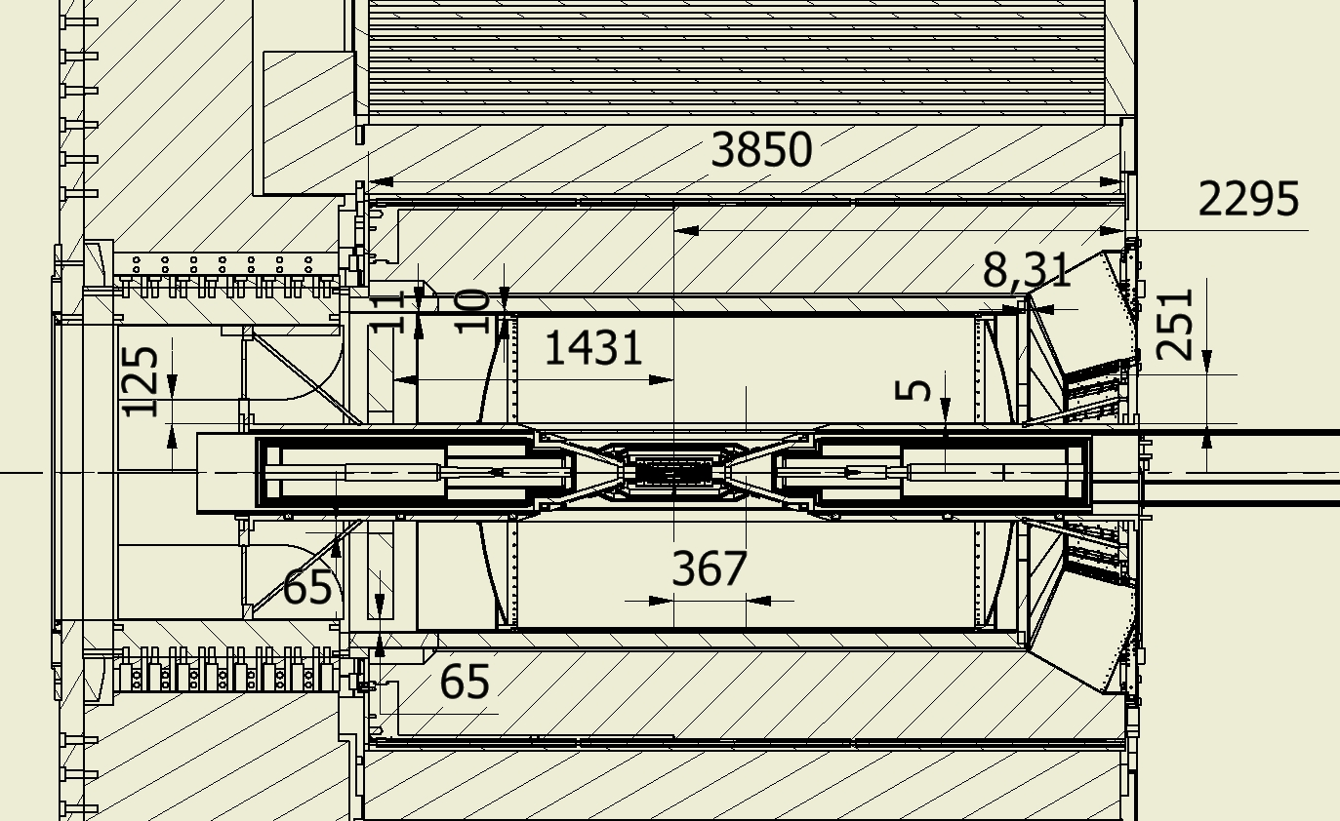
Envelope of the SuperB inner detectors
FTOF
DCH
BCAL
Tungsten shielding

Slide 16
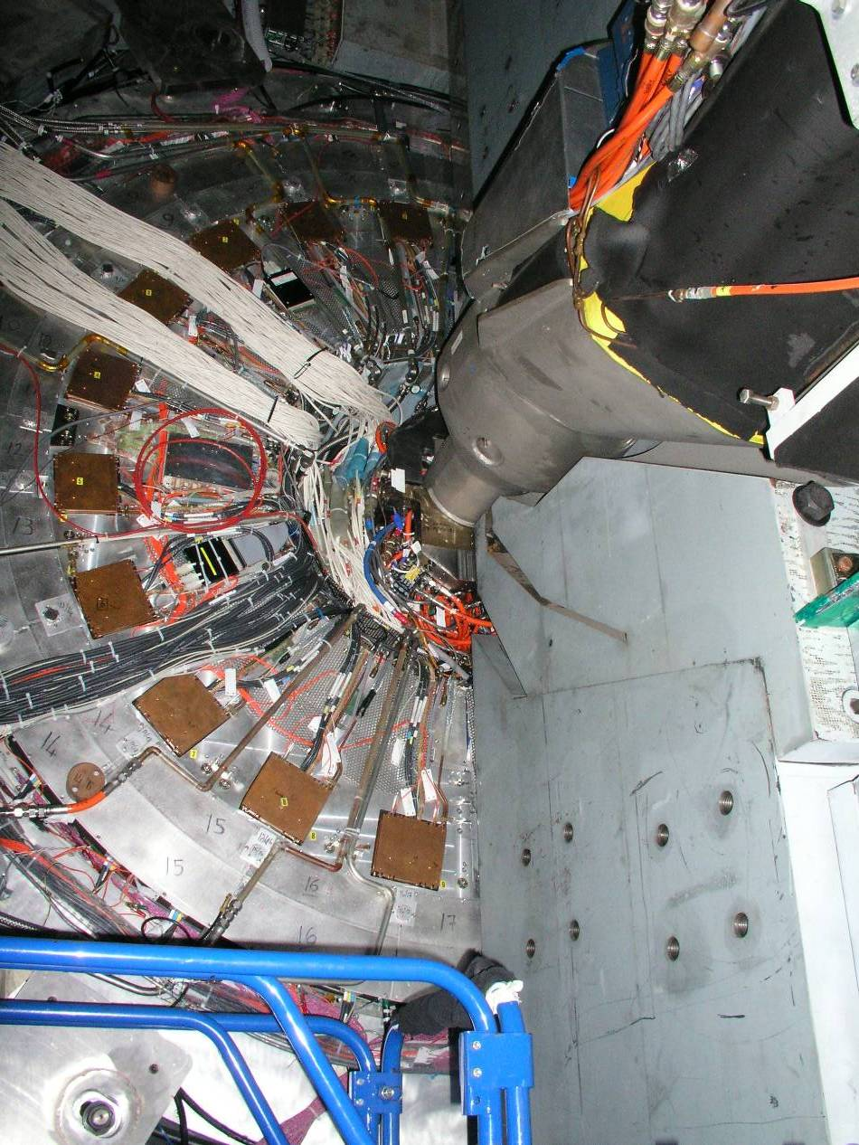
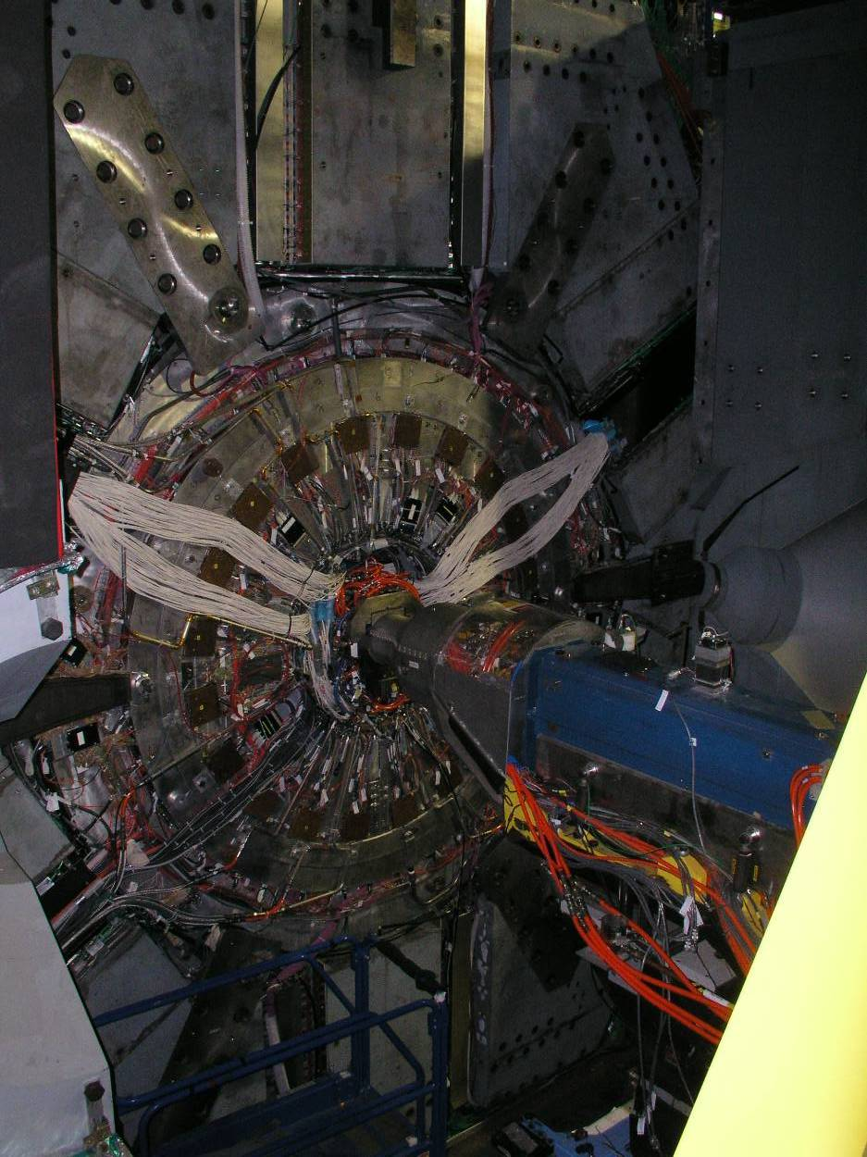
Forward services BABAR inner detectors
Services coining out DCH-FTOF-Inner tracker 30 mm gap with the door

Slide 17
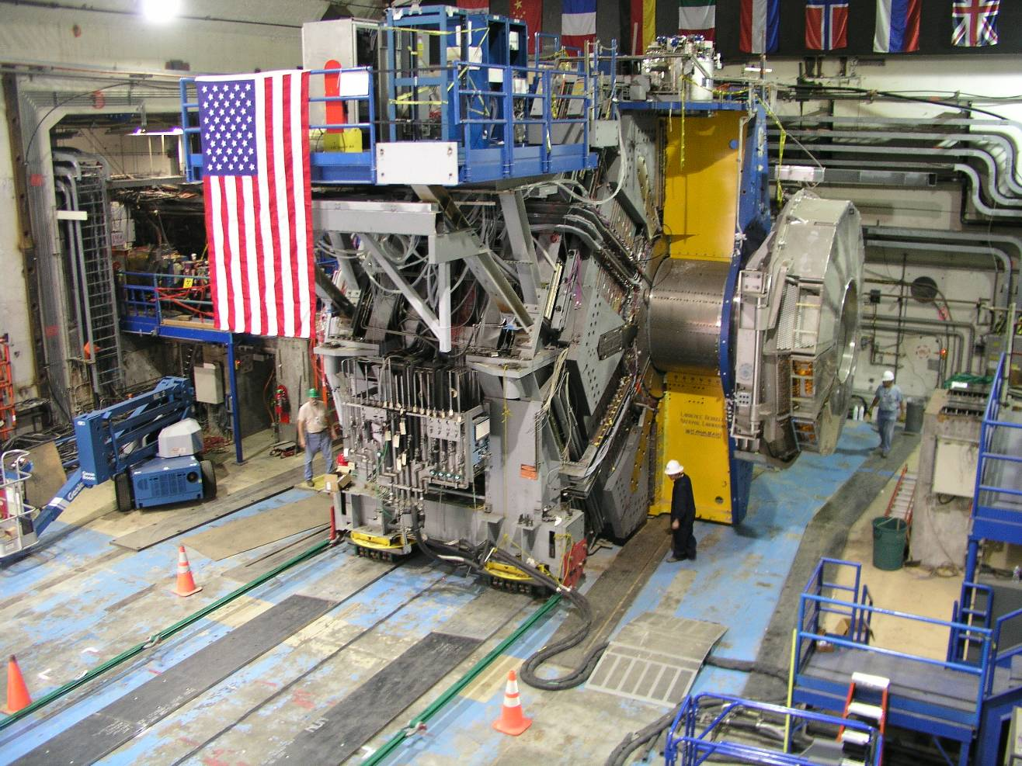
Backward Quadrant
A view of the exposed cableways on the backward side of the detector.
Slots contain services for EMC, IFR.
Services for inner detectors that are taken out in the backward direction must exit the end of the DIRC support tube.
View of the side also shows how services are distributed ‘around’ the detector.
Circumferential Cableways runs parallel and close to the steel sextants behind the remnants of tubing for EMC cooling, etc
Slots for Services
Circumferential cableways
Temporary track plates for rolling detector
Pulling cables
Notes:
17

Slide 18
Extension to contain the inner
services of silicon Detectors
Mini patch
Panel inner
Silicon det.
HV GAS line
Must leave
Clear space
For shielding
R>500mm
Unif. Radial distribution of service DCH and BCAL using metallic Channel
Modification of the Backward shielding for two reason access and int. support.

Slide 19
Problem that we have to consider and/or solve:
Loads on the DIRCH due to the new DCH and FTOF.
Reevaluation of the magnet force due to the changes of the backward shielding.
Accessibility on BCAL, DCH and FTOF.
Compatibility with the cryogenic lines
Extension of the cryogenic line for the quick demount operations.
The tungsten shielding we consider almost a permanent part of the detector.

Slide 20
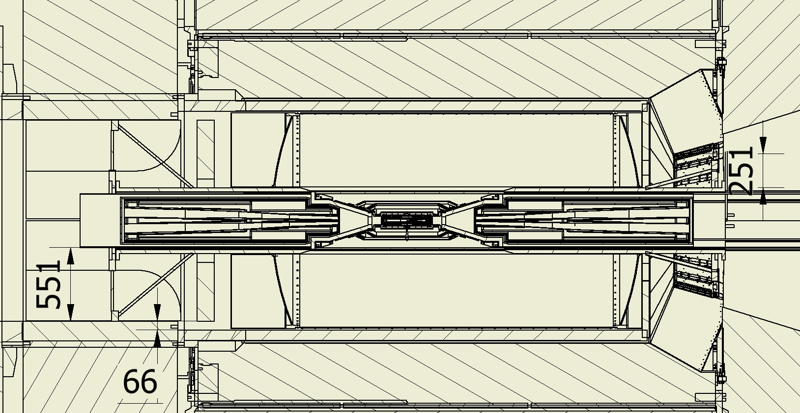
Backward shielding in 4 pieces
Housing the tungsten shielding
And cable channels
Bcal in 4 pieces with connector to be extracted

Slide 21
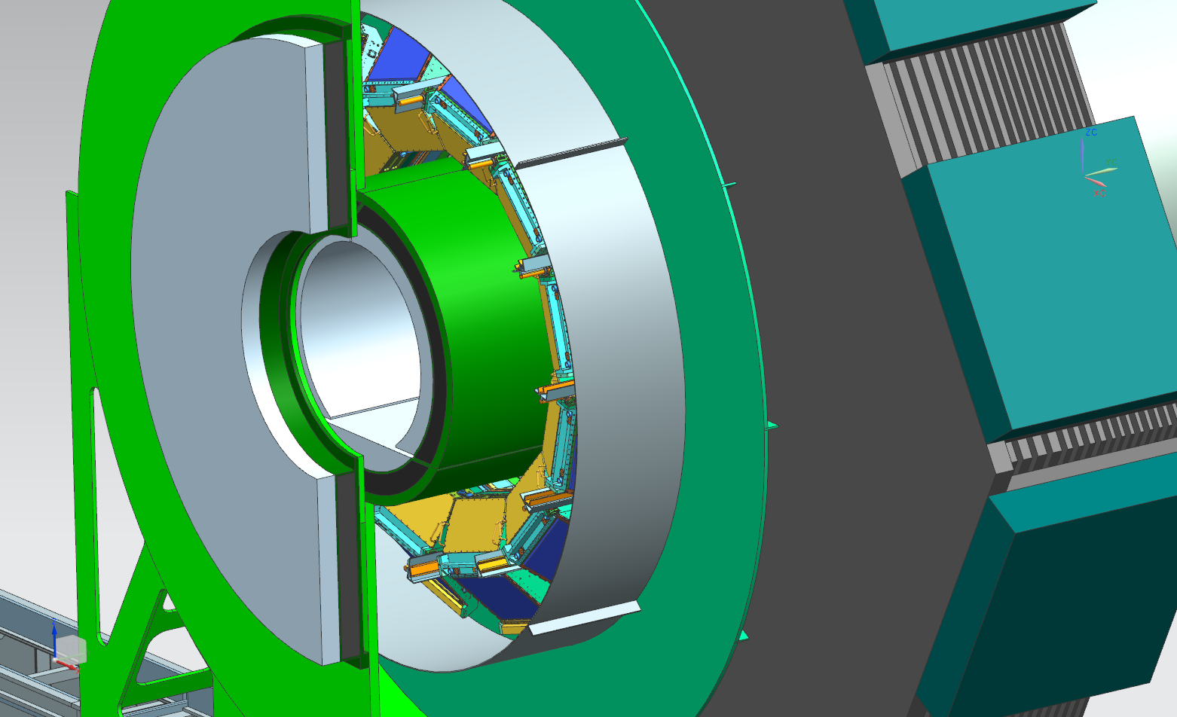
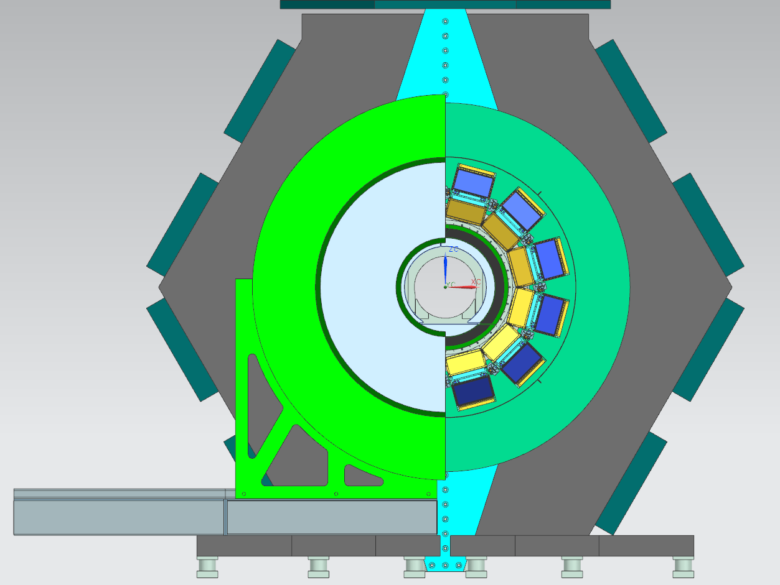
Focusing DIRC proposal of new Shielding must integrate on SuperB drawings
Plastic shield
Metallic shield

Slide 23
Load transfer to the tungsten tube proposed
The cryostats are in contact with the tungsten tube thru spherical bearings and the an anti rotation system. The cryostats support the conical shields.
The conical shields support SVT, Layer00 and the beam pipe in the interaction region.
For these reasons the tungsten supports need to allow an initial nominal mounting position and a fine alignments when everything will be installed. (internal and/or external)
Access to the forward electronic cards of EMC can be achieved dismount one ear of the support.

Slide 24
Integration of the supports of tungsten tube in detector.
Forward:
Extension of the magnet ear restrains. Implication we go in front of calorimeter. (solution dismountable ears)
We limit the access inside (DCH, FPID)
Backward.
Structure inside the strong tube of DIRC
We limit the access for the (DCH, BCAL, etc)
We need to verify the force on elements.

Slide 25
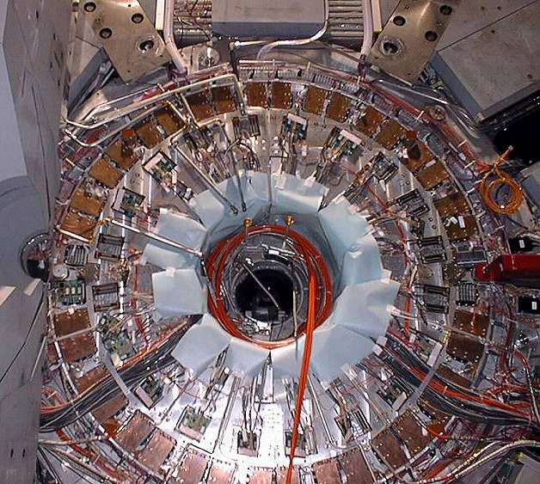
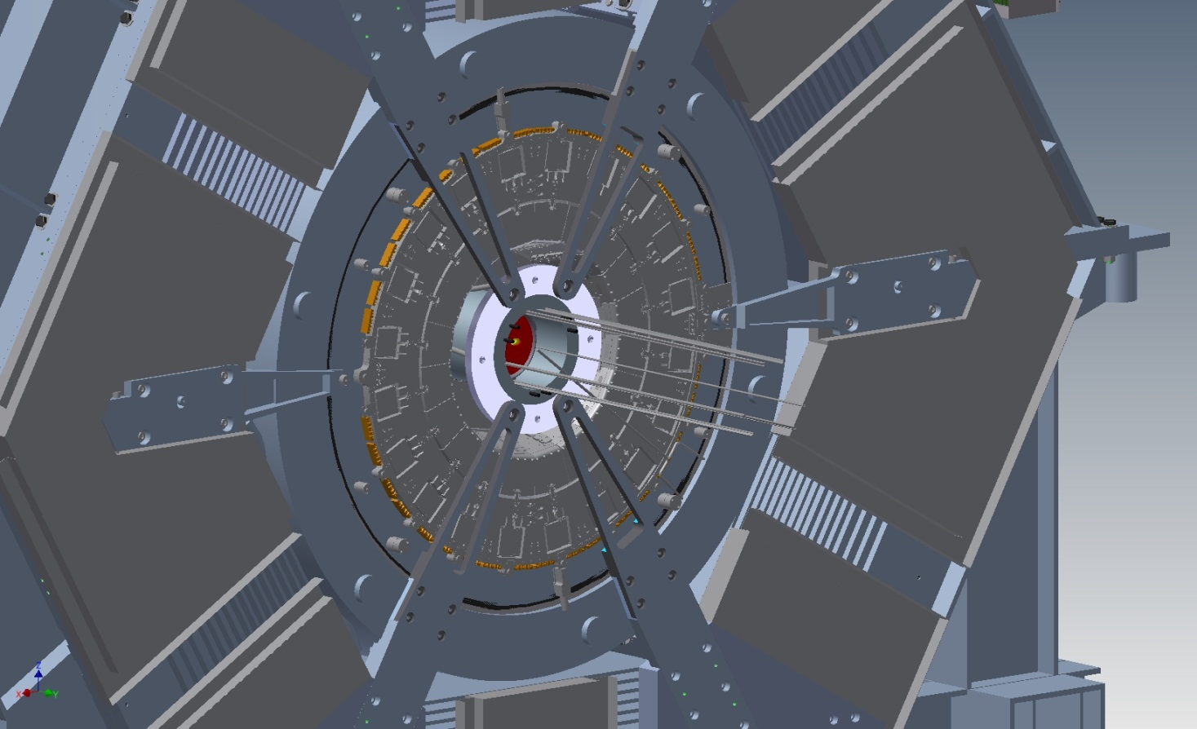
Integration DHC SVT layer0
Forward service of Babar
Extension of the Magnet ears
Struts and rods adjustable
Inner ring
Solution that allow to hold the tungsten tube with only three ears can give access to the calorimeter electronics.

Slide 26
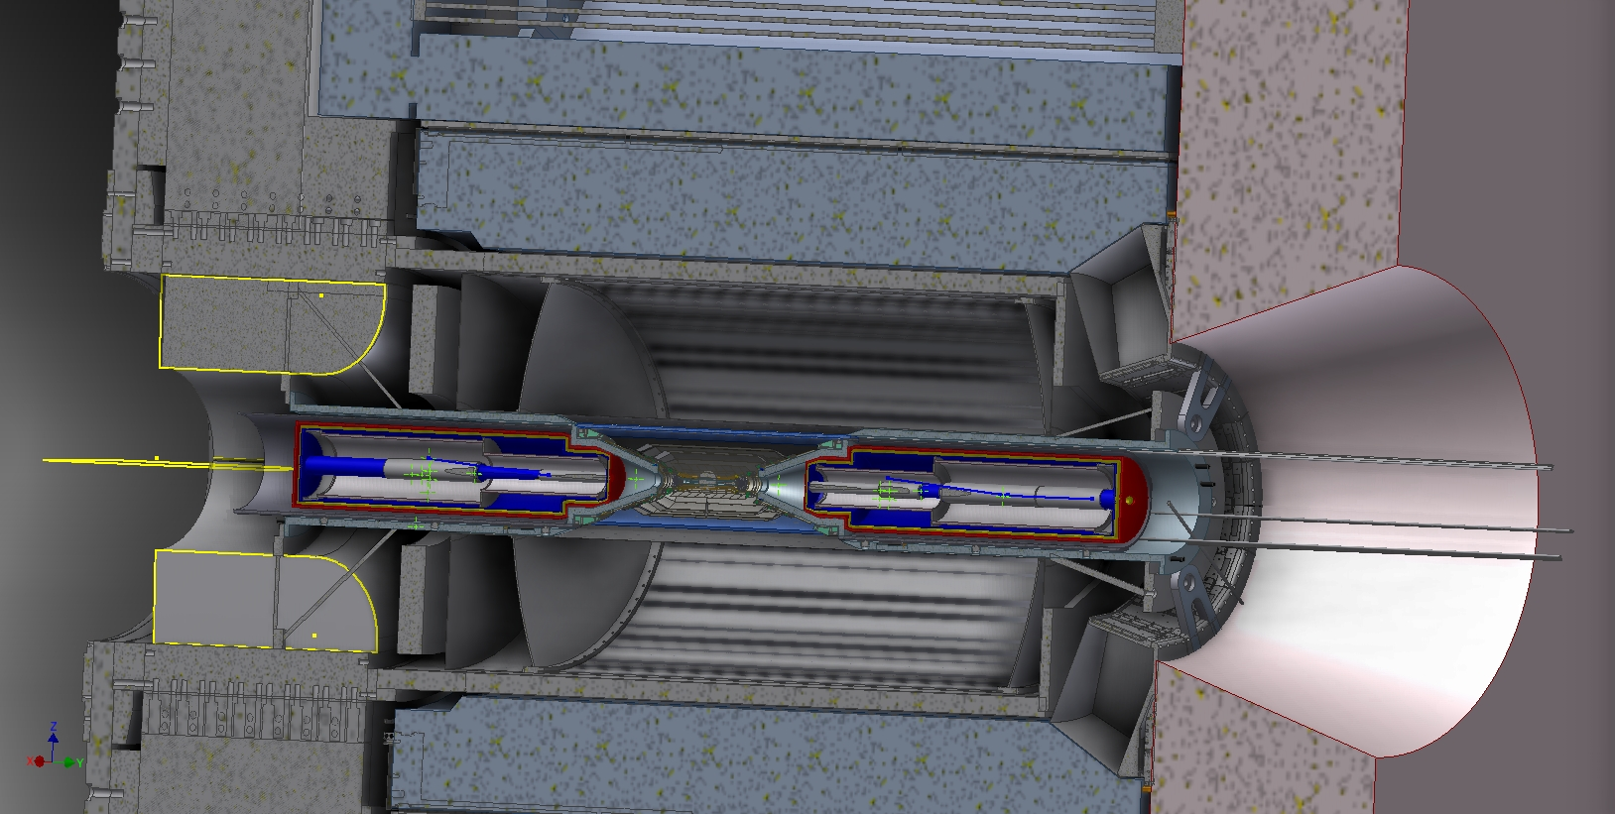
Shielding support backward
Shielding support forward

Slide 27
Conclusions
A strong requirement for the SuperB is to have the possibility to move the detector efficiently from the garage to the interaction position with the proper shielding.
Some inner detector envelopes are set, some other are still in progress
Magnet forces must be reevaluated as we change the iron.
The next integration step is to evaluate the service section and check the space for their way out (IFR slots, Inner regions)
Service inventories account needs to be complete.
Integration of the cryogenic system must be implemented.

