Slide 1
DC trigger
Present DC design
Lab tests and implementation.
Paolo Branchini – INFN Roma 3

Slide 2
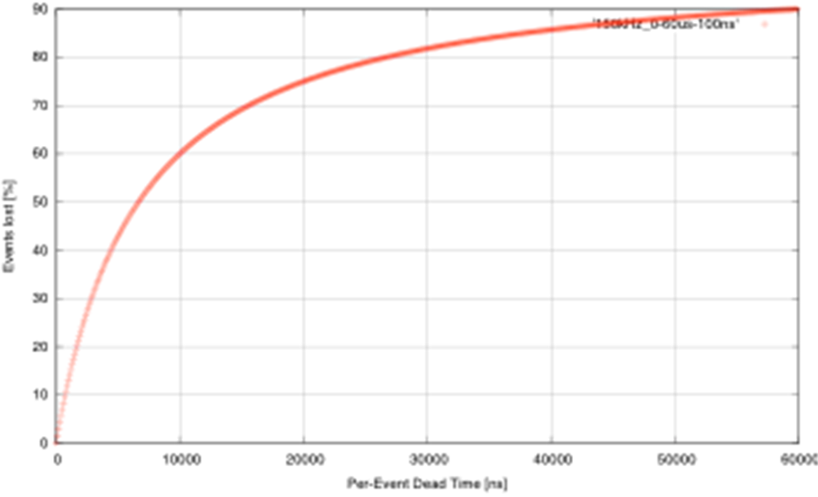
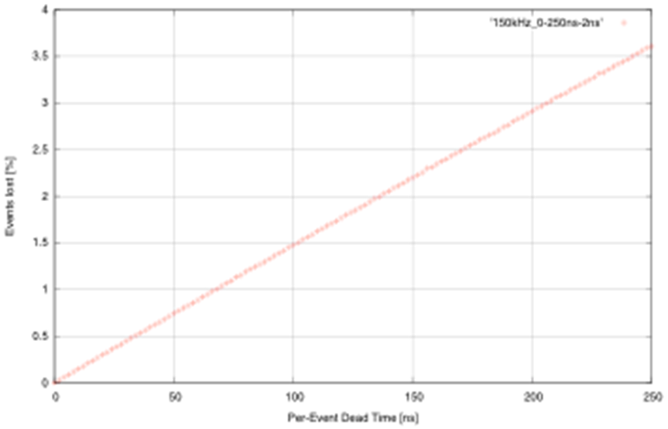
Let’s remember the specs in SuperB
Baseline:
re-implement BaBar L1 trigger with some improvements
  Shorter latency (~6us instead of 12us)
  Higher sampling frequencies (DCH and EMC)
  2-d map for calorimeter
Possible additions
SVT trigger
What about the TOF ? (in DELPHI we used it in the trigger)
Bhabha Veto
Do we need an absolute time stamp at the trigger level?
Challenge
To keep the event loss due to dead time below 1% => a maximum of ~70ns “per-event dead time” is allowed in trigger and FCTS
Other considerations
What goes in L1, what in L3, what’s the optimum?
150kHz
Exponential Inter-arrival time pdf.
Luitz 2010

Slide 3
DC Architecture

Slide 4
DC SuperB present design
 | SL1 | SL2 | SL3 | SL4 | SL5 | SL6 | SL7 | SL8 | SL9 | SL10 | TOT
Planes | 4 | 4 | 4 | 4 | 4 | 4 | 4 | 4 | 4 | 4
Type | A | A | U | V | U | V | U | V | A | A
#wires | 736 | 864 | 496 | 560 | 624 | 688 | 752 | 816 | 896 | 960 | 7392
#TSF 64 opt | 12 | 14 | 8 | 9 | 10 | 11 | 12 | 13 | 14 | 15 | 118
#NDCB 64 opt | 1 | 1 | 1 | 1 | 1 | 1 | 1 | 1 | 1 | 1 | 10
Number of wire could change due to internal radius uncertainties.
The 64 TSF layout depends on the form factor of the FE board used at the moment a conservative assumption has been made (i.e. 6U VME form factor)

Slide 5
What we have done so far
We have profitted of the LNF DC prototype to insert our eltx.
We have built our own RF emulator, clocked discriminators and used them all offline to setup a trigger algorithm (inspired by BaBar).
We have implemented the trigger algorithm on a Virtex 6 demo board.

Slide 6
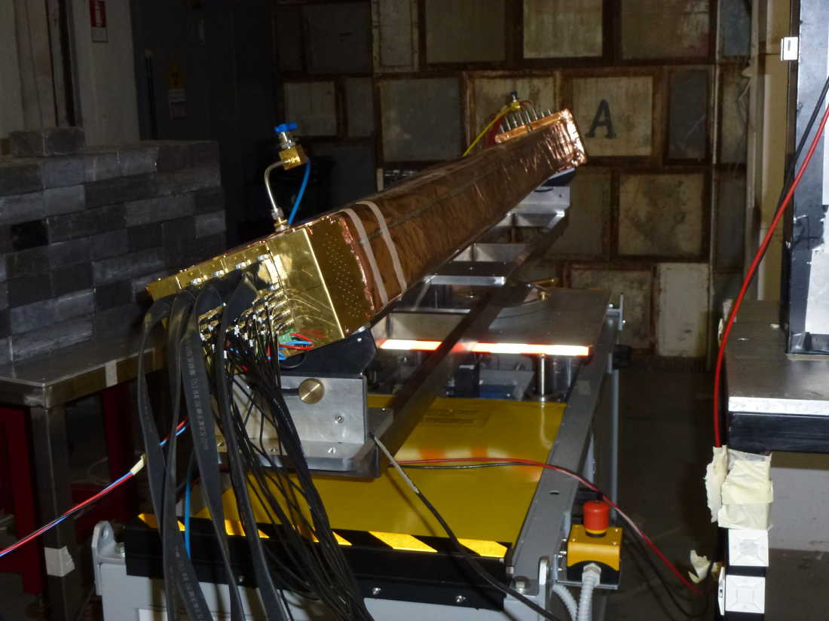
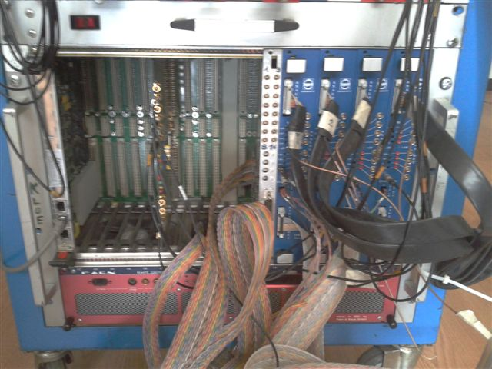
Trigger setup
Clocked discriminator
Discriminator
Ring Oscillator

Slide 7
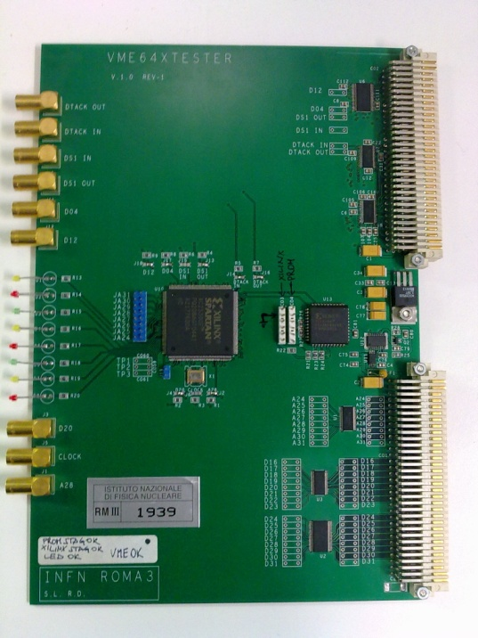
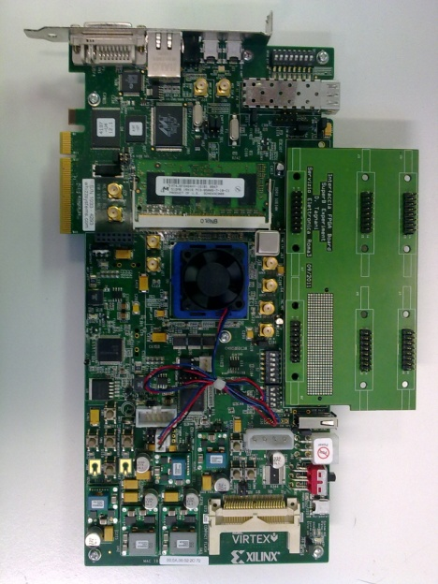
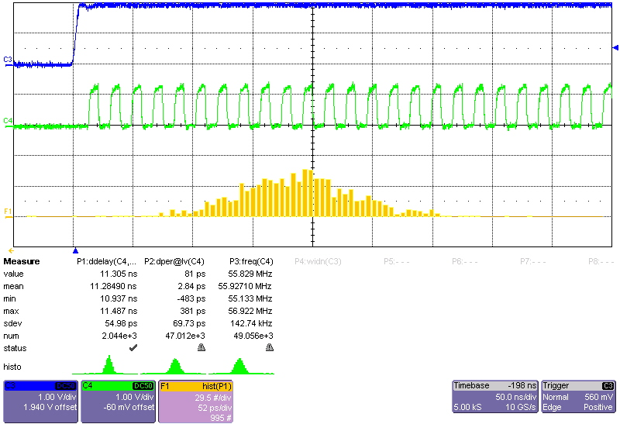
RF emulator needed @tbeam
We have also built a ring oscillator to emulate RF when a machine trigger occurs.
And a transition board to feed Virtex6 demo board with LVDS signals.

Slide 8
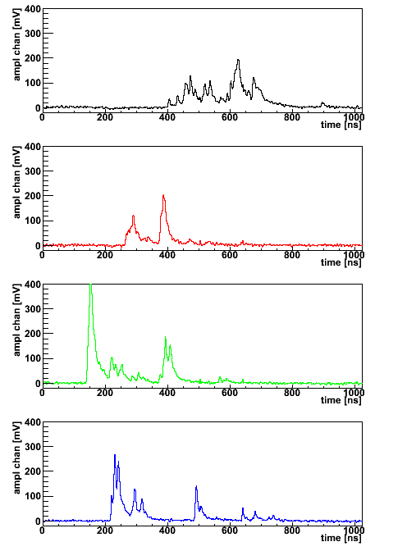
TSF (Track Segment Finder)
4 pattern for a fixed pivot tube. The other 4 pattern can be found via a parity transformation.
So in this example there are 8 patterns per pivot tube and 4 pivot tubes. In total 32 combinations.
P
P
P
P

Slide 9
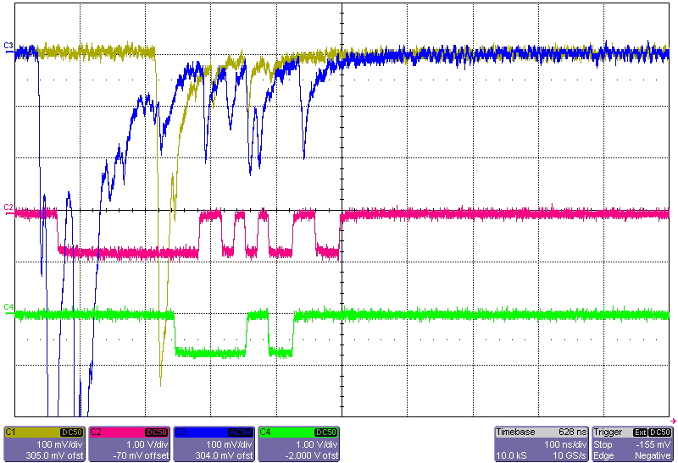
Analog and discriminated signals

Slide 10
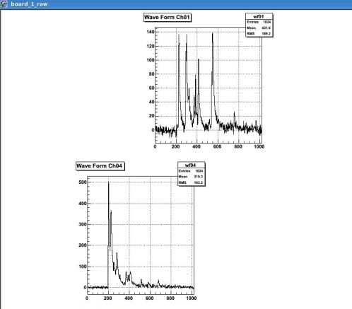
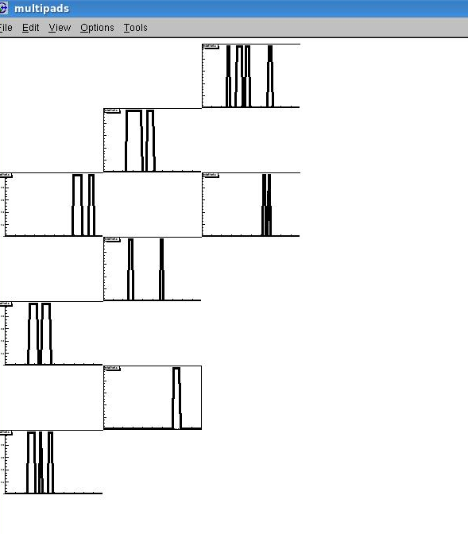
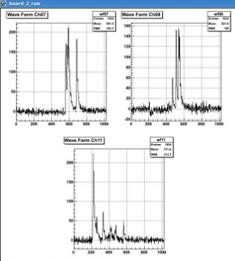
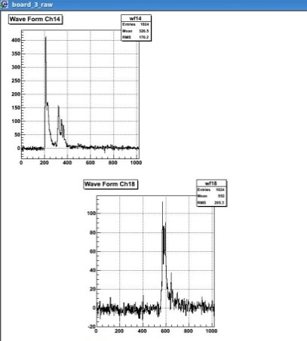
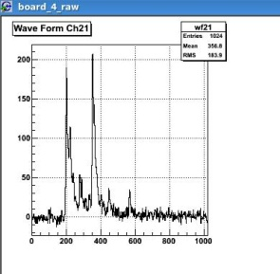
Results (flash adc distribution left side vs discriminated one right side)
Right side DC wave Form distribution left side clocked discriminator distribution
Triggered by scintillators

Slide 11
DC trigger
It’s based on track segment
The track segment is defined by 4 contiguous
hits in neighbouring layers.
Drift signal is stretched by one drift time (500 ns) in order to allora time coincidences.
When at least a TSF is found a trigger is asserted.
We collect this information using the DC daq
provided by Riccardo De Sangro.

Slide 12
ID for Serial Track outcome
Tracks_pattern
Start
Track 1
Track 2
Track 3
Track 4
Track 40
20 ns
i-th tick after the start pulse is fired when i-th look-up table. Simultaneous tracks can be detected.
Serial Track i-th first hit outcome
Hit_Tracks
The width of the pulse is proportional to the number of the track n, in which the first hit is detected. If there are simultaneous hits the track with lower value of n has priority.
20 ns + n*20ns
The rising edge of the Hit_Tracks signal is a copy of a synchronized and delayed version of the rising edge of the first hit signal of the track

Slide 13
Hit 1 from DC
Synchronizer
Hit 1 stretched
Strecher (480 ns)
Hit 1 stretched
Hit 2 stretched
Hit 2 from DC
Synchronizer
Strecher (480 ns)
Hit 2 stretched
Track 1
Hit 9 stretched
Hit 10 stretched
Hit 28 from DC
Synchronizer
Strecher (480 ns)
Hit 28 stretched
Hit 18 stretched
Hit 19 stretched
Track 40
Hit 27 stretched
Hit 28 stretched
Hit 1 stretched
Hit 2 stretched
Track 1 Hits or
Delay (480 ns)
Hit 9 stretched
Track 1_first Hit
Hit 10 stretched
Track 1
Strecher (2240 ns)
Track i-th first Hit has information of the first hit phase of the tracks i-th
Hit 18 stretched
Hit 19 stretched
Track 40 Hits or
Delay (480 ns)
Hit 27 stretched
Track 40_first Hit
Hit 28 stretched
Track 40
Strecher (2240 ns)

Slide 14
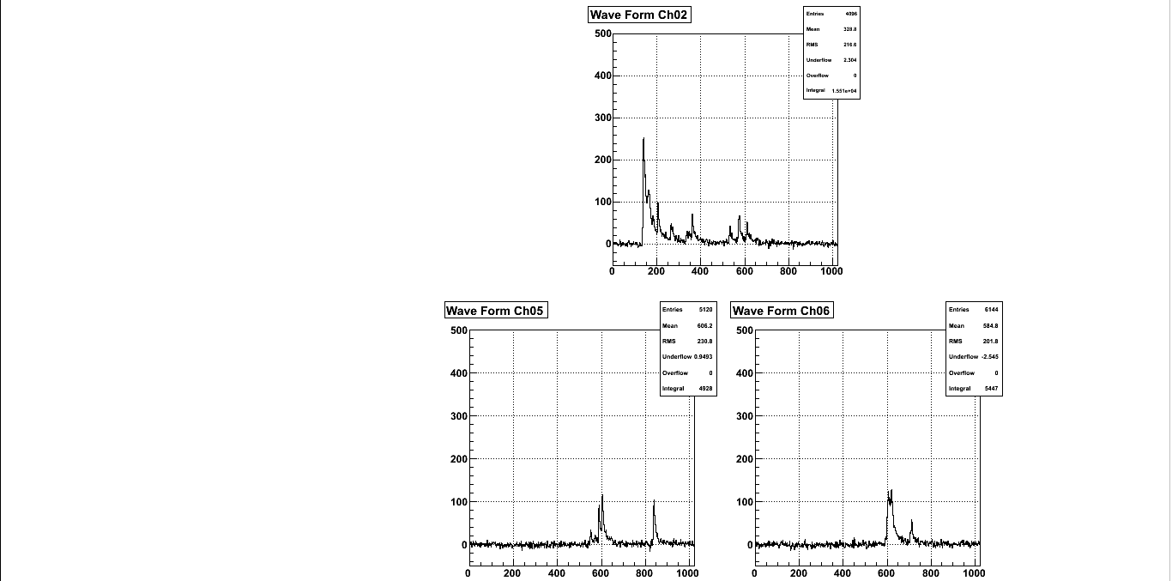
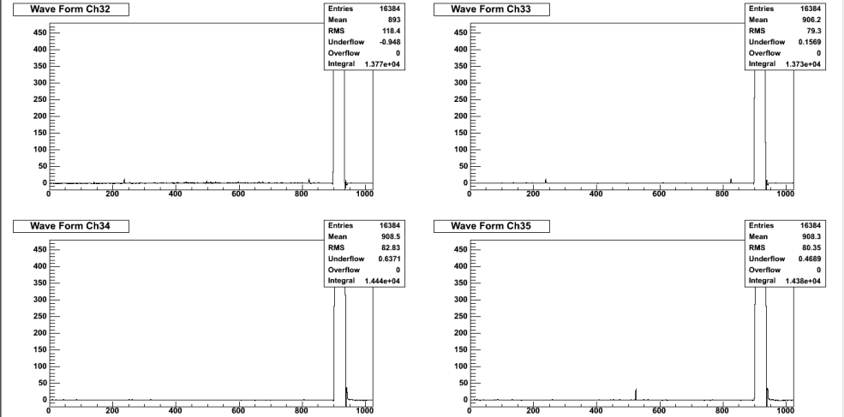
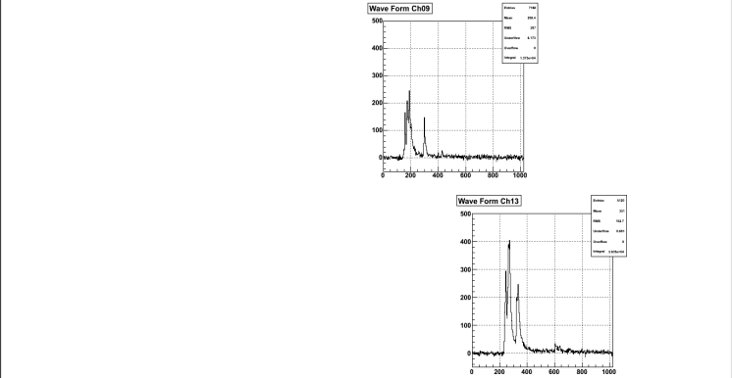
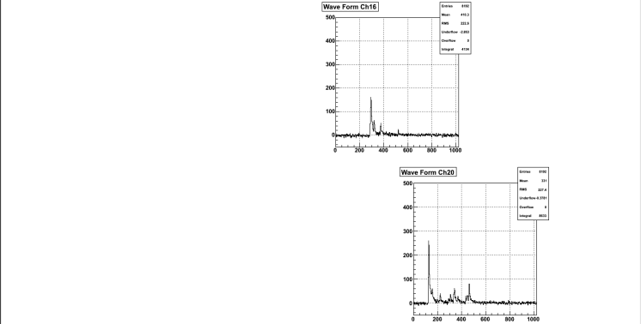
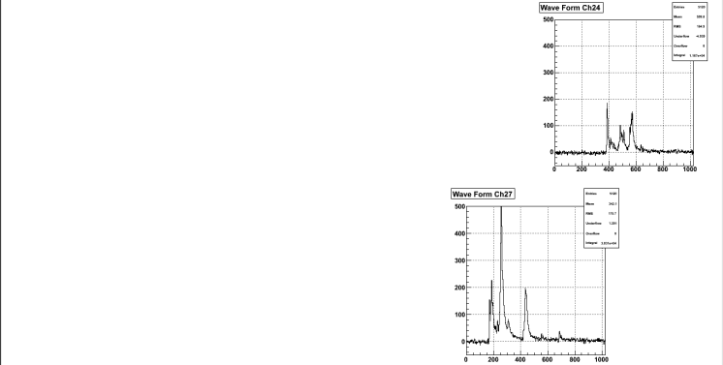
Triggered track
Example 1
Board 1
Trigger Time
Board 2
Board 3
Board 4

Slide 15
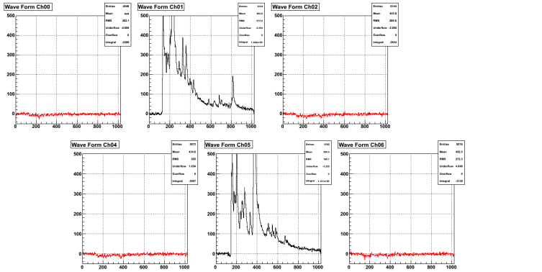
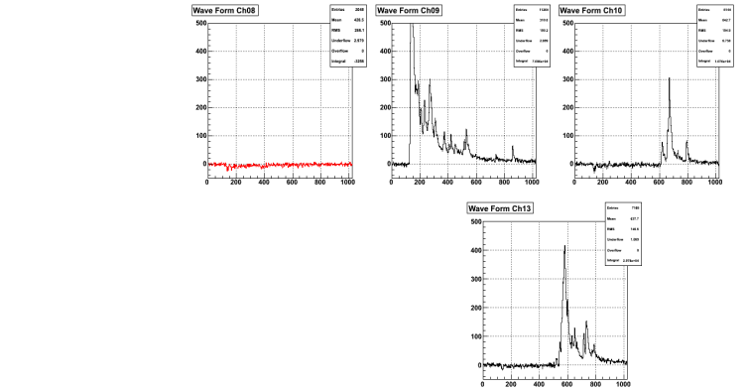
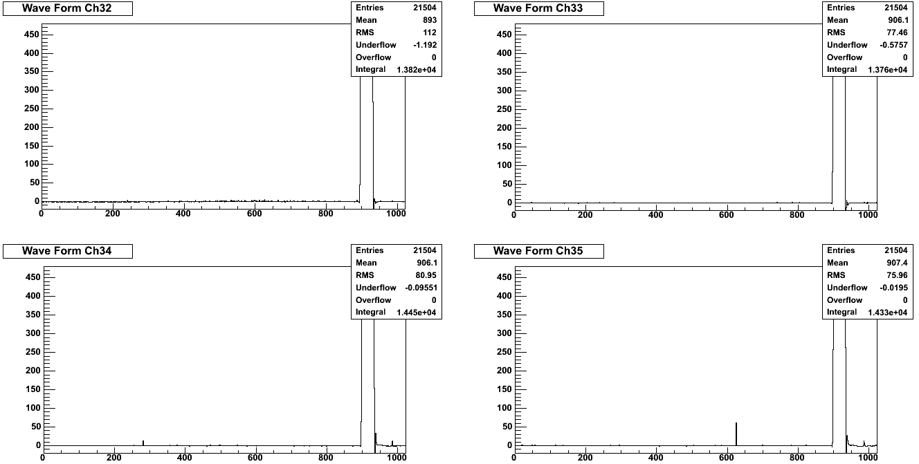
Triggered track
Example 2
Board 1
Trigger Time
Board 2
Board 3
Board 4

Slide 16
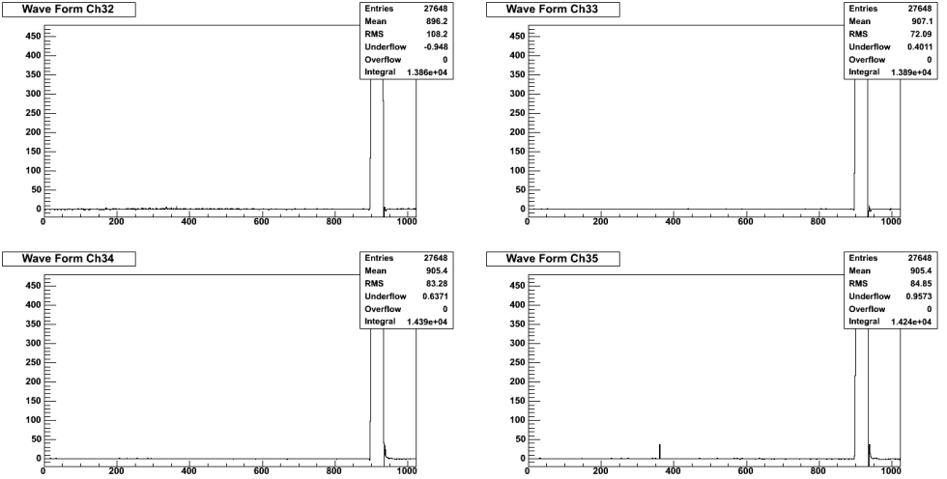
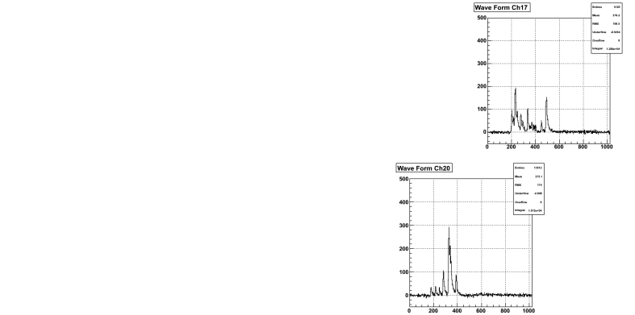
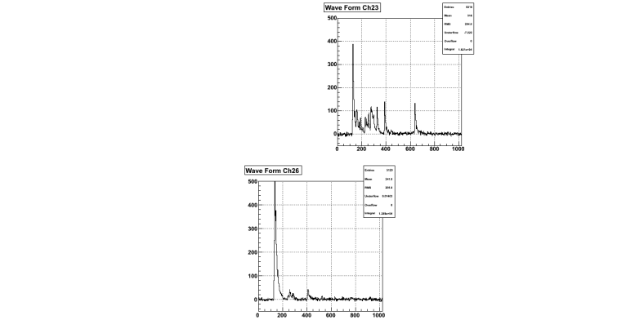
Triggered track
Example 3
Board 1
Trigger Time
Board 2
Trigger time occurs at about 900 ns
Board 3
Board 4

Slide 17
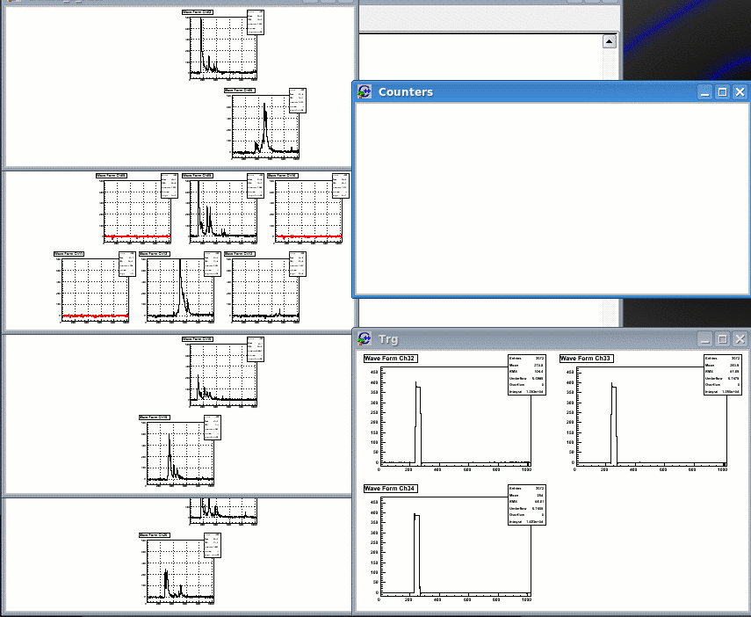
To be compared with ……
Trigger time occurs at
about 250 ns
TSF latency 750 ns
in this implementation

Slide 19
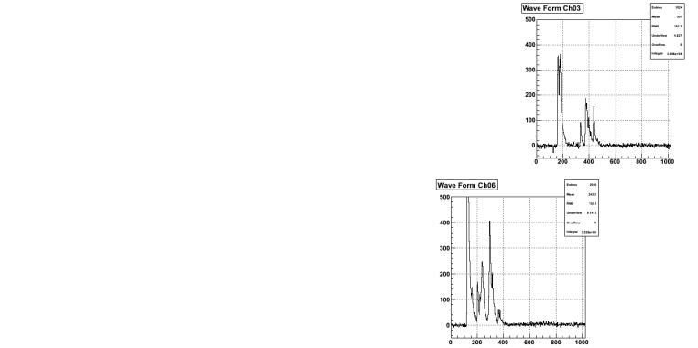
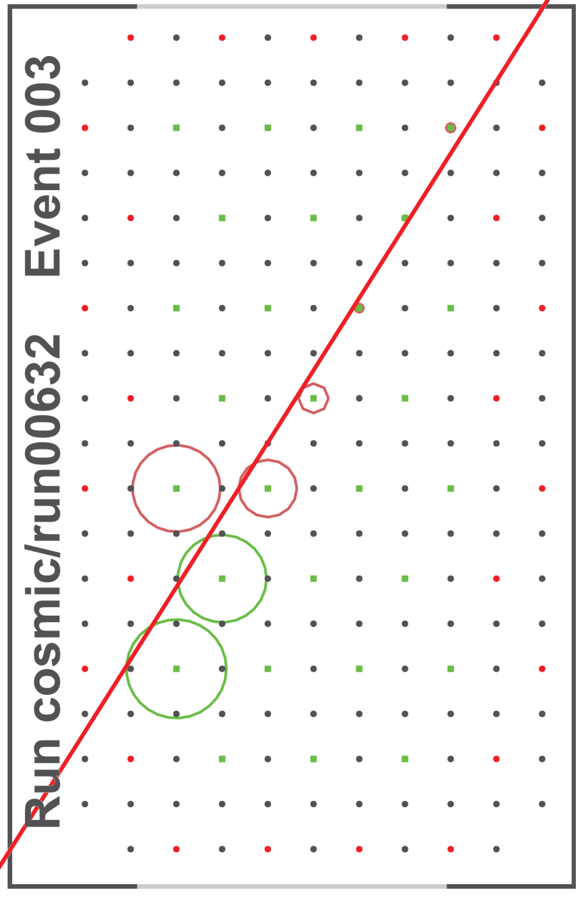
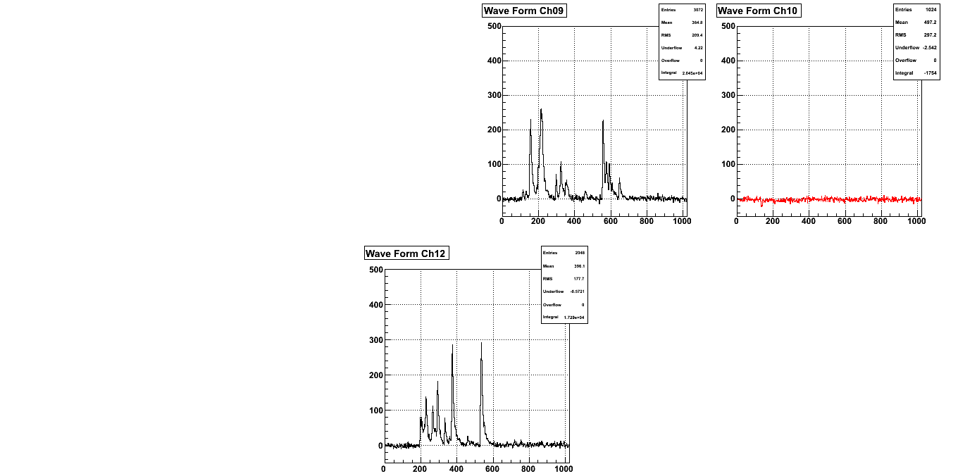
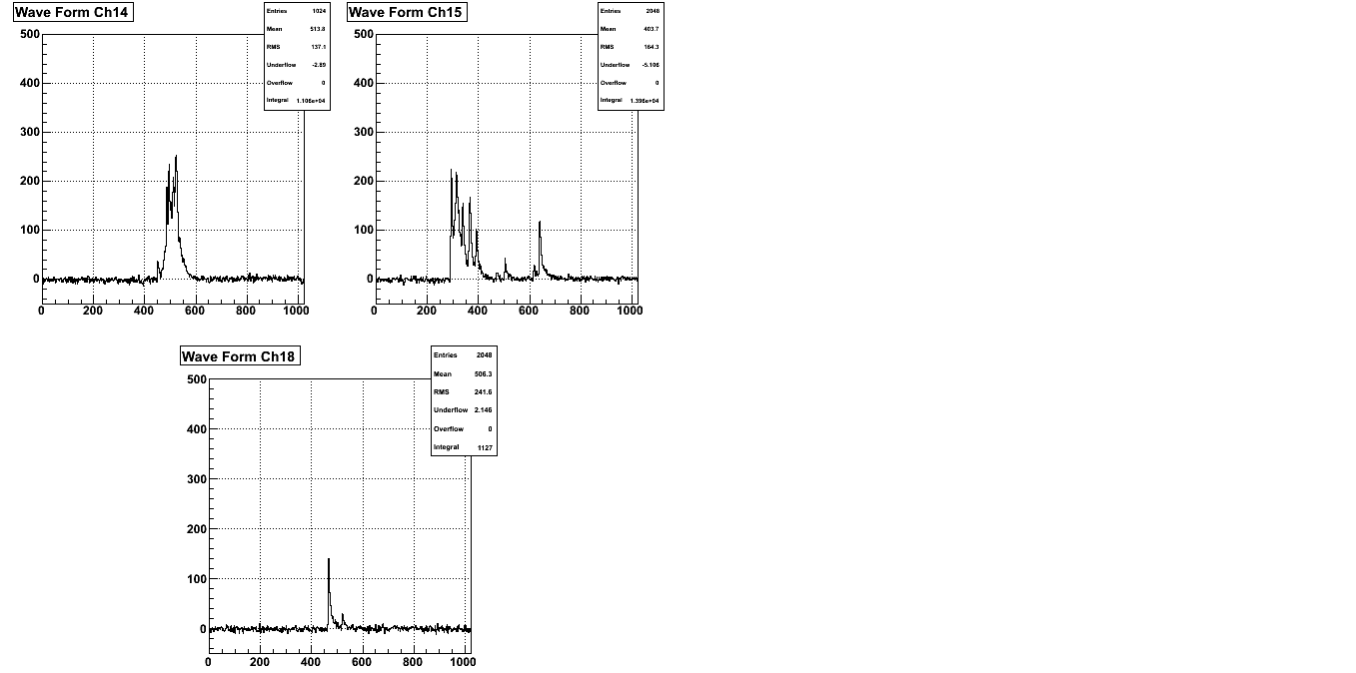
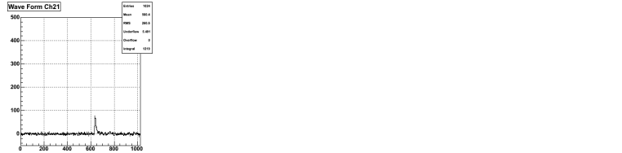
Board 1
Board 2
Board 3
Board 4

Slide 20
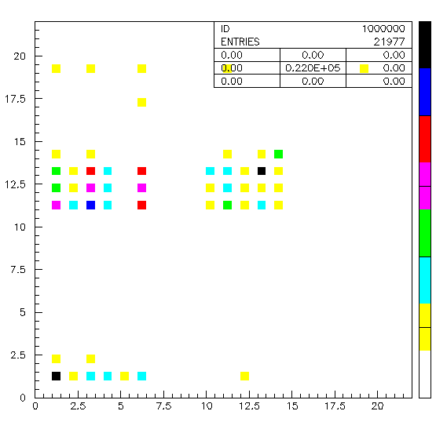
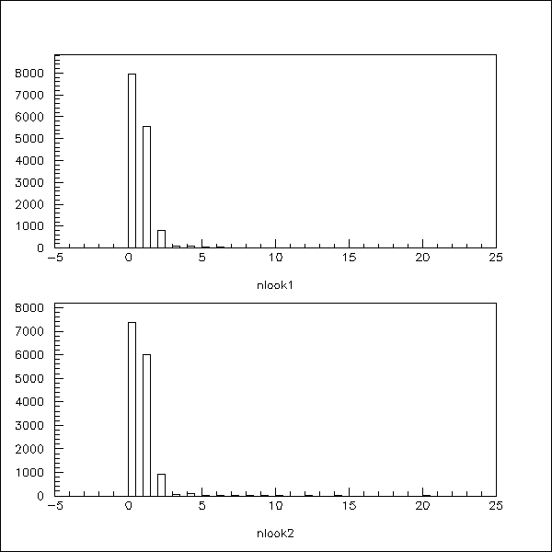
Look up tables (cosmic)

Slide 21
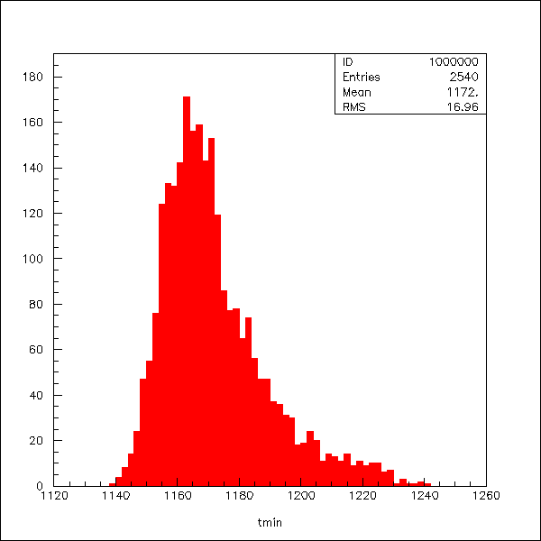
Timing resolution (cosmic)

