Slide 1
Silicon Photomultiplier's Gain Stabilization by Bias Correction for Compensation of the Temperature Fluctuations
M. Baszczyk, P. Dorosz,
W. Kucewicz, M. Sapor
(AGH University of Science and Technology)
Cracow, Poland

Slide 2
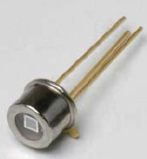
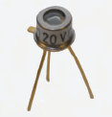
Silicon Photomultipliers (SiPM) Used in the Research
Silicon Photomultiplier | Serial Number | Breakdown Voltage, V | Number of Microcells | Microcell Gain
Hamamatsu s10362-11-100U | 698 | 69,2 | 100 | 2,4x10⁶
Hamamatsu s10362-11-100U | 699 | 69,32 | 100 | 2,4x10⁶
SensL S1020 | 21 | 28 | 848 | >1x10⁶

Slide 3
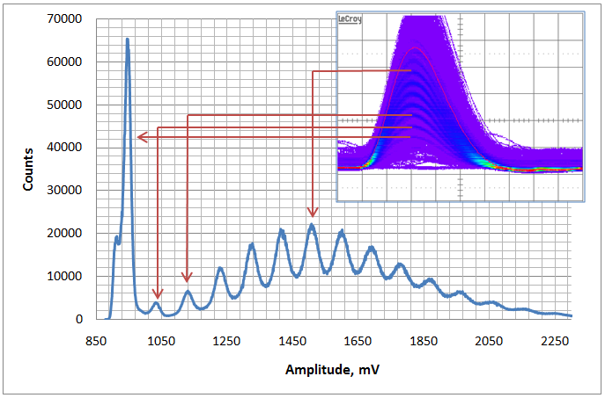
Acquisition of the Signal

Slide 4
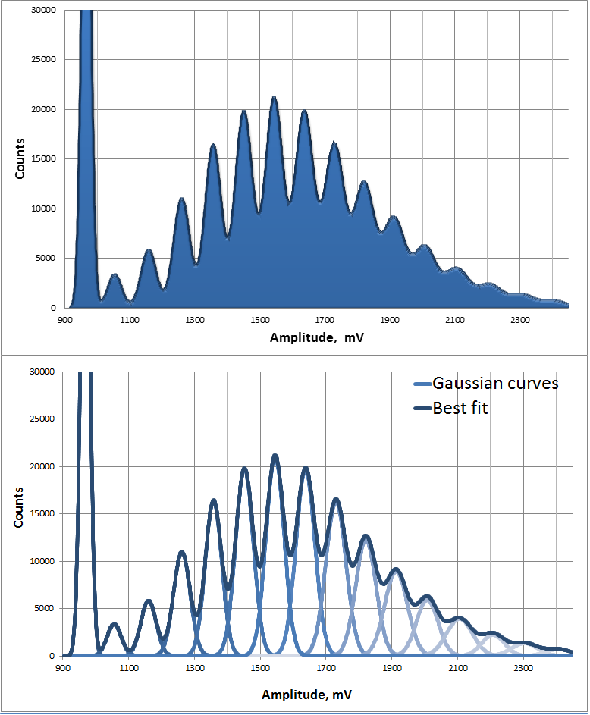
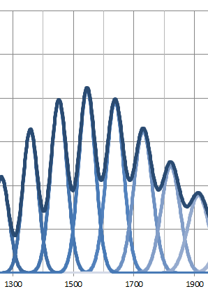
Gain of SiPM
Gain per photon, mV

Slide 5
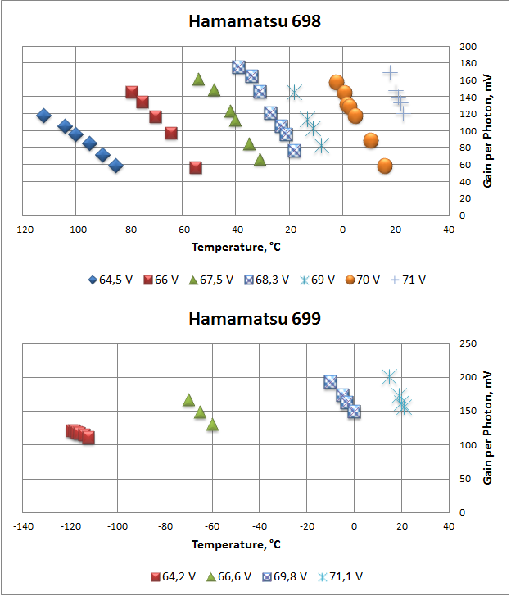
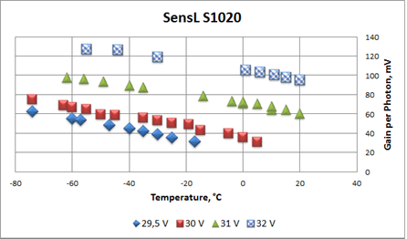
Bias Voltage – Gain Dependency

Slide 6
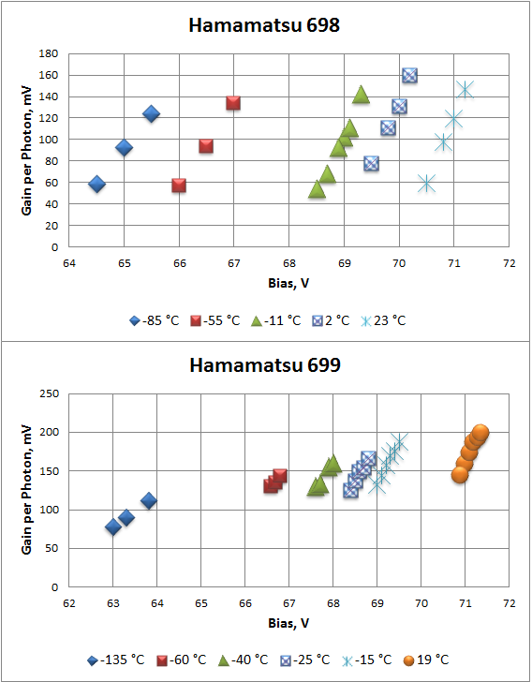
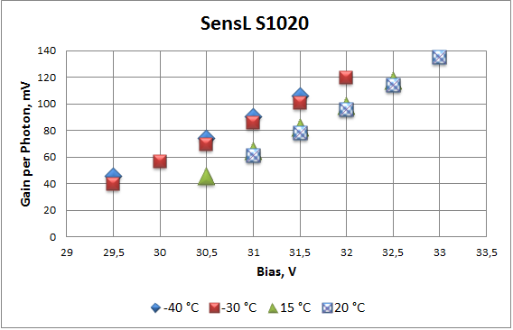
Temperature – Gain Dependency

Slide 7
Determination of the Parameters a, b and c
$$G\left(V,T\right)=aV+bT+c$$
The parameters are determined by minimazing the weight mean square error between the measured data $y_{i}$and the Levenberg-Marquardt best fit function $G(V_{i},T_{i},a,b,c)$:
$$\sum_{i=0}^{N}{{(y_{i}−G\left(V_{i},T_{i},a,b,c)\right)}^{2}}$$
N – the number of measured data points

Slide 8
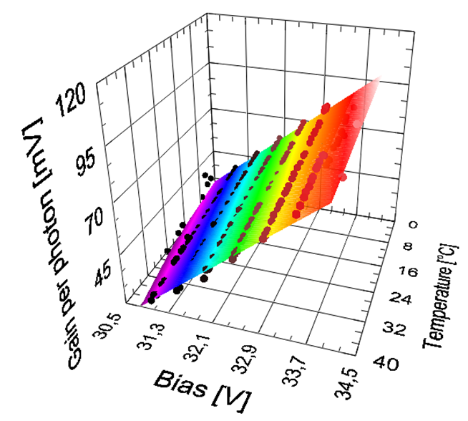
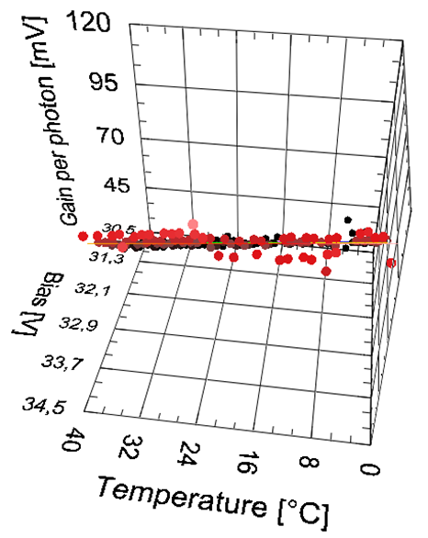
Best Fit Function and 3D Model (SensL S1020)
Each point represents single measurement. Plane is determined from parameters a, b and c.

Slide 9

Calculated parameters
$G\left(V,T\right)=aV+bT+c$
SiPM | a(V) | b(T) | c(°C) | c(K) | Residue
Hamamatsu s10362-11-100U (698) | 80,65 | -4,24 | -5556,32 | -4398,80 | 0,027
Hamamatsu s10362-11-100U (699) | 80,15 | -4,24 | -5521,29 | -4363,77 | 0,021
SensL S1020 | 20,70 | -0,30 | -605,20 | -523,30 | 0,037

Slide 10
Power Module
Acquisition System
Front--end ASIC
Pulse Generator
Laser
ADC
FPGA
PC LabView
Resistance Thermometer

Slide 11
Gain Compensation Results
0,44%

Slide 12
Gain Compensation Results
0,46%

Slide 13
Gain Compensation Results
0,55%

