Slide 1
R&D ongoing activities
Bartlomiej Rachwal, Wander Baldini
4-th SuperB Collaboration Meeting, March 31 – June 4 2012, La Biodola (isola d’elba)

Slide 2
R&D: Ongoing Activities
The choice of BIRO readout for the barrel requires some additional R&D studies: Light Yield studies for 10cm scintillator bars:
Light yield vs number of fibers
ITEP scintillator, length=25cm, wrapped in aluminum foil
Kuraray Y11(300) fibers, φ=1.2mm, length ≈ 40cm
3x3 mm² MPPC, 50x50 microns pixels
Preparation of the irradiation test at the GELINA facility @ IRMM (Geel Belgium):
Very useful visit to IRMM on May 8 to make arrangements and get more informations
Data taking on July 9-20

Slide 3
Preliminary results on light yield with 10 cm scintillator bar

Slide 4
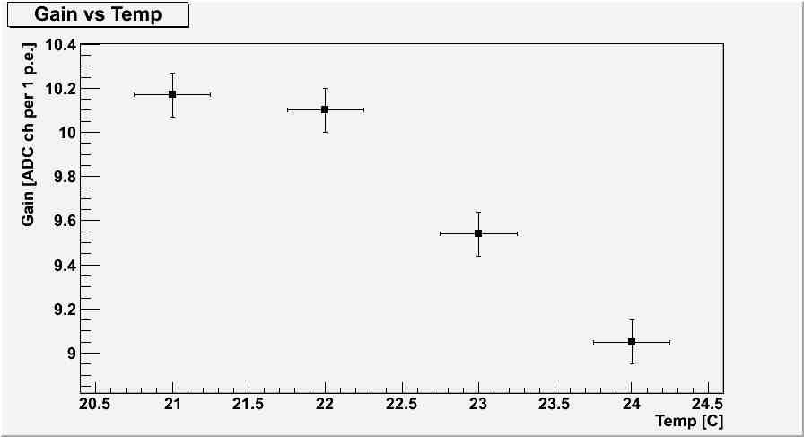
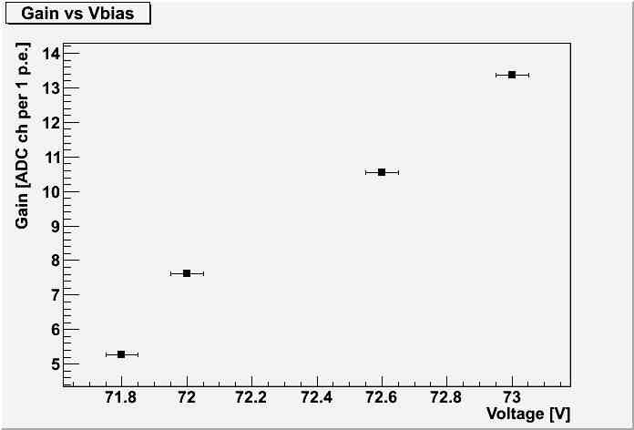
Calibration
Working conditions with cosmics
Vbias= 72.5V
T=22.5 C
Gain = 10.5 ADCch/p.e.

Slide 5
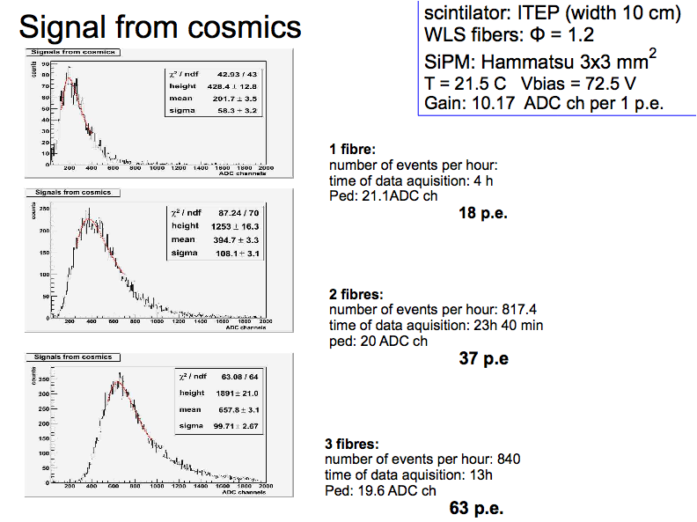
10.5
17.2 p.e.
little bit too low
Preliminary
35.7 p.e.
60.8 p.e.

Slide 6
60.8 p.e.
Preliminary
Between the two measurements the fibers were removed, the sensor was cleaned from the optical grease and put back again
61.1 p.e.

Slide 7
Preparation of the GELINA test

Slide 8
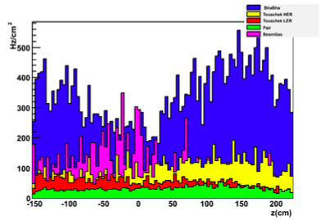
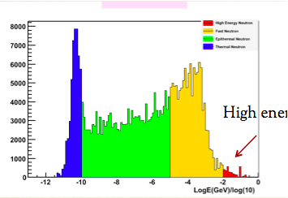
The radiation issue: Expected Neutron Rates
Expected maximum rates ~ 500 n/cm² ~1.5x10¹⁰ n/cm² year → 10 years x safety factor 5: ~ 7.5 x 10¹¹ n/cm² in 10 years
This with the present simulations (no shielding between magnet and IFR-L0), but also with 3 cm tungsten shielding (no 4.5cm).
With the new production, rates might change
New results should be presented at this meeting
Expected rates on L0 barrel
Energy distribution
1eV
1MeV

Slide 9
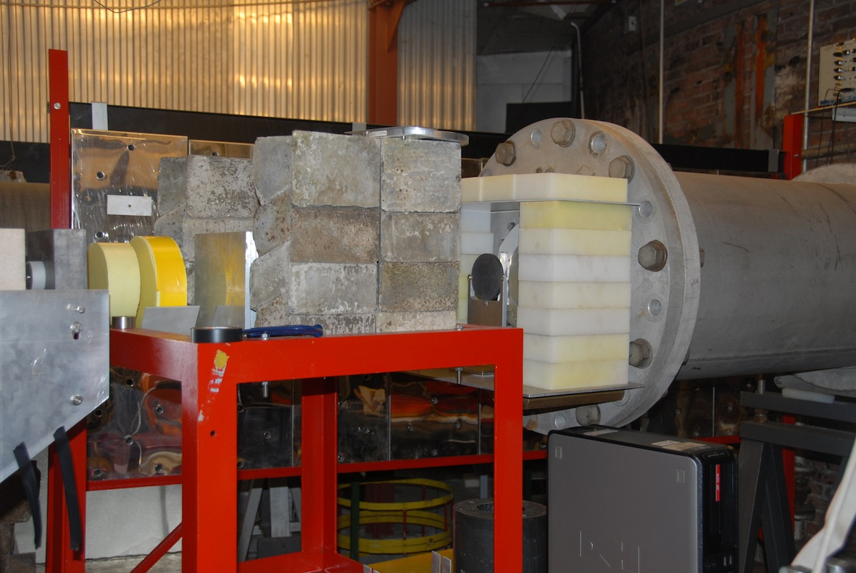
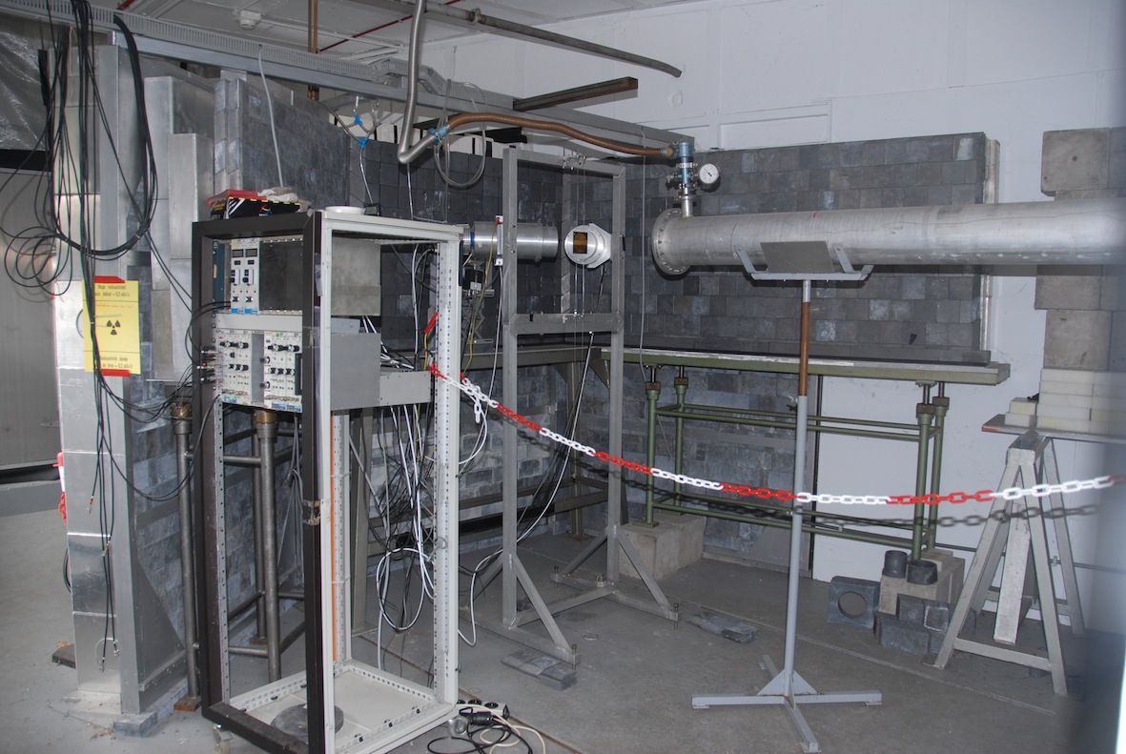
The radiation issue: Irradiation test at Gelina
The facility: 100 MeV linac, electrons on Uranium target + moderator to obtain a white spectra neutron beam
The main goals are:
Measure the Dark current/noise with dose
Monitor the gain and the signal waveform with dose (illuminating the devices with a LED)
Estimate the neutron flux reduction power of various amounts of Boron loaded Polyethylene (2 ,5, 10 cm)
Integrate a total dose of ~ 7.5 x 10¹¹ n/cm² (approximately 10 years x safety factor 5)

Slide 10
The setup
Neutron flux
monitor #1
Neutron flux
monitor #2
25 m downstream
BF3
Target Hall
6Li
Space for 24 Devices (3 on
each of the 8 wedges)
Neutron beam
(≈ 4cm diameter)
SiPMs
LEDs in the irradiated area and outside (need light guide)
Boron loaded Polyethylene (take data with and without it )
Dark Currents
Dark Rates
Bias Voltages
Waveform
Temperatures

Slide 11
Conclusions
R&D studies on 10cm scintillator bar are ongoing
Very preliminary results shows that with 3 fibers we collect ≈ the same amount of light of 5cm bars with 1 fiber (≈ 60 p.e.)
It Will be interesting to see the amount of light collected with 1,2,3 fibers on a 5cm scintillator bar
If with one fiber we are collecting already almost all the produced light we shouldn’t see a big increase
If this is the case maybe it’s not worth to put 3 fibers…. on 5 cm bars…
Preparation of the GELINA test is ongoing

