Slide 1
Continuum models for the endcap shell moduli in SUPER-B
T
the team at the “Università Politecnica delle Marche”:
Fabrizio Davì, Daniele Rinaldi (* and INFN)
Giovanni Lancioni, Michele Serpilli,
Dario Genovese, Moreno Paciaroni
Departments DICEA, SIMAU*

Slide 2
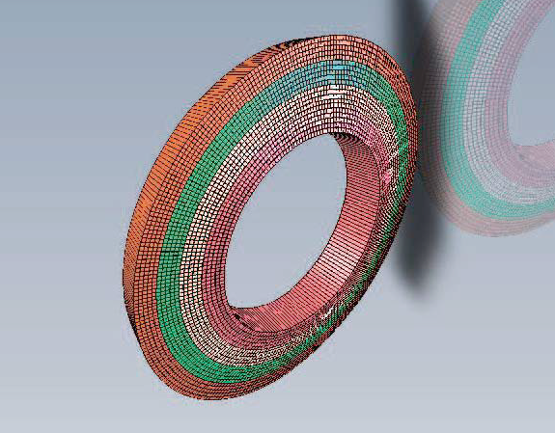
The SUPER-B endcap
180 “quasi-modular” fiberglass elements;
non-cylindrical geometry of the moduli;
minimal but non-negligible differences within the moduli.

Slide 3
Expected performances
Light-weight elements, non-metallic elements;
Very small deformation expected (very high stiffness);
0,35 g Dynamical load multiplicators (big earthquake)
Safety factors:
γ=2 (Exercise loads)
γ=1,15 (Collapse loads-static)
γ=1,5 (Collapse loads-dynamics)
No eiegen frequencies smaller than 100 Hz.

Slide 4
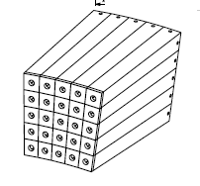
The moduli
FEM analysis is cumbersome and computationally heavy;
No parametric analysis possible;
We need a simple but reliable analytical model in order to describe the single modulus mechanical behaviour with a reduced set of parameters;
We can design a simple FEM macro element on the basis of such a model;
We shall perform mechanical tests on prototipes to validate the simple model parameters.

Slide 5
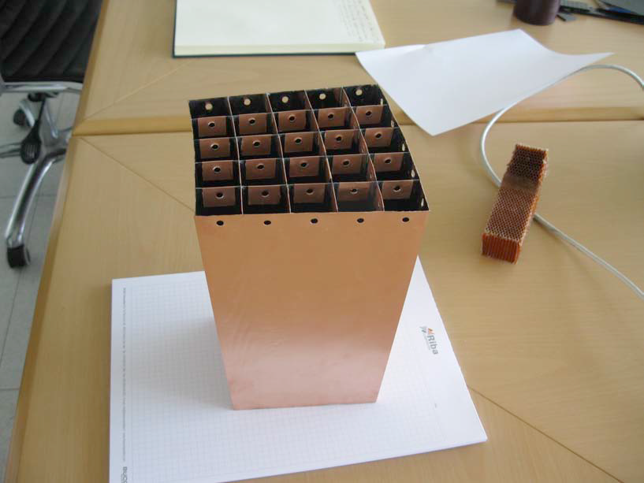
The macro-element
The moduli shall be modeled as a macroscopic continuum with microstructure, to account for the non-cylindrical geometry and the local behaviour of the thin walls:

Slide 6
The “standard” 3-d model of a beam: the Saint-Venant’s
The Saint-Venant’s Problem:
Find the deformation, displacement pairs in a cylindrical beam C bent by
terminal loads:
The solution can be fully described by means of only 6 parameters (the
components of terminal loads vectors on one base, say S₀)

Slide 7
The “standard” 3-d model of a beam: the Saint-Venant’s
Pro:
exact solution within the general framework of 3-d linear elasticity;
well-studied mathematical problem;
many well-posed approximated solutions;
a flood of experimental data to validate the constitutive parameters.
Contra:
Cilindrical geometry: the cross-section must have the same geometry along the axis;
the cross-section must be “compact” or with some “big-holes”: the solution fails to describe the local kinematics for “thin” objects.

Slide 8
The “standard” 3-d model of a beam: the Saint-Venant’s
Our “beam”:
Is not “slender” enough to consider the Saint-Venant solutions a good description of the kinematics;
It is not cylindrical: the shell is chamfered indeed;
the cross-section notion is nearly meaningless: too much “big-holes” compared to the small amount of material;
6 parameters aren’t enough to describe the rather complex kinematics and hence the stress within the object.
To account for these peculiarities we choose to model the element as a 3-d
continuum with local microstructure.

Slide 9
Continuum with microstructure
The cylinder C is modeled as standard body with a set of kinematical descriptors (directors) attached at each point;
The number and the kind of descriptors allows for different kinematics;
We choose as descriptors the position vectors of each thin wall “centroid”: the number can be reduced by selecting only those descriptors which are relevant to the measurable kinematics; at this stage we choose the 16 vectors d_{α}, α=1,2,…,16.
d_{α}
cylinder axis

Slide 10
Continuum with microstructure
In such a theory, besides the standard stress and deformation tensorial measures T (stress) and E (strain) we have two local stress measures which depends on the microstructure described by da:
The interactive microforce k, a vectorial quantity which accounts for the interactions between the body and the microstructure (in our case: the stress at the joints between the walls);
The microstress T, which accounts for the space changes of the microstructure (in our case the effect of chamfering).

Slide 11
Constitutive relations
The constitutive relations describe the the stress-strain relations induced by the
material, its geometry and the cross-section peculiarities: in our case besides the
standard terms we account for the local effects (in red):
T(E, d_{α})=C[E] + h_{α} [d_{α}]
T(grad d_{α})=A_{α} [grad d_{α}]
k(E, d_{α})=B_{α} [d_{α}] + h_{α}^{T}[E]
The tensorial quantities C, h_{α}, A_{α} and B_{α} can be measured by means of experiments
on the specimen.

Slide 12
Terminal loads
The two vectorial quantities r₀ and m₀ which express the terminal loads and that can
be controlled in an experiment, accounts in the present model for the local effects of
the thin walls and allows for a constitutive model which links these 6 parameters to
the “real” kinematic of the shell:
Further, the vector k(E, d_{α}), which accounts for the stress at the joint and can be
measured in an experiment, adds 3 more parameters.

Slide 13
Conclusions
The mathematical model allows for a reduced set of variables which describe the stress and strain in a macro-element;
The parameters which describes the stiffness of the material and the local and global geometry of the shell can be measured by means of “ad-hoc” mechanical tests.

