Slide 2
Meeting rooms
Conference center
  Sala Maria Luisa
  Sala Elena (upstairs)
  Sala Aiaccio (downstairs)
Next to the registration desk
  Sala Bonaparte 1
  Sala Bonaparte 2
  (Sometimes they are made into a single room)

Slide 3
Remote connections
Each room has an EVO conference reservation shown on the agenda
To reduce network usage we connect from Elba through the phone bridge
Connection information and codes are printed in each meeting room
Please do not connect to EVO from your laptop (for instance while sunbathing)

Slide 4
Wireless connections
You need credentials to connect to wireless
INFN people should use their INFN credentials
All the others should have requested and received a local account for connection
Please contact the registration desk for any problems.

Slide 5
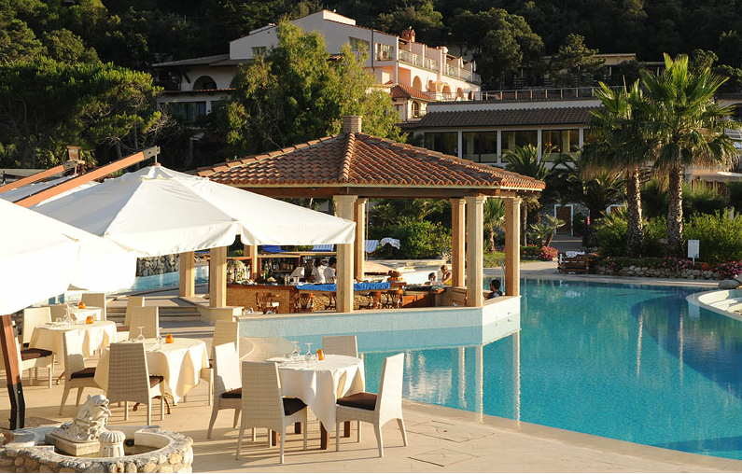
Surviving
We all need to eat ☺
Lunch will be at the
Fuoco di Bosco 12.45 – 14.00
  Please, if you haven’t book your accommodation through the conference you need to purchase a lunch ticket at the Hermitage Hotel desk
Dinner will be at the chosen hotel, except
Saturday, June 2nd , Social Dinner at the Fuoco di Bosco

Slide 6


CONCERT
ONIGHT
9.00 p.m.
MAITU’ HALL

