Slide 1


ASPIDES meeting 10
Tommaso Floris
9/10/2025

Slide 2
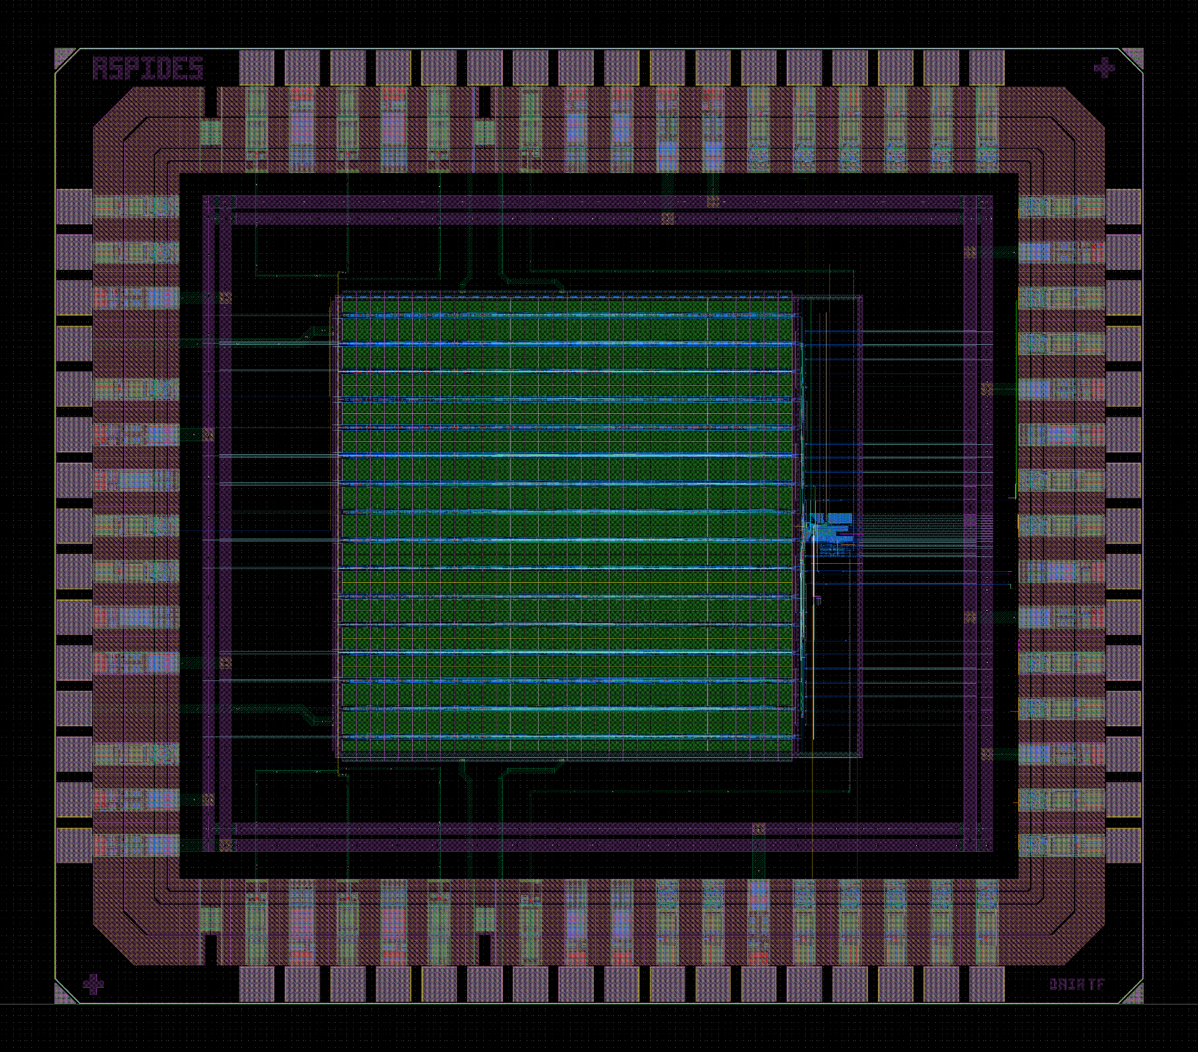
ASPIDES prototype CHIP layout

Slide 3
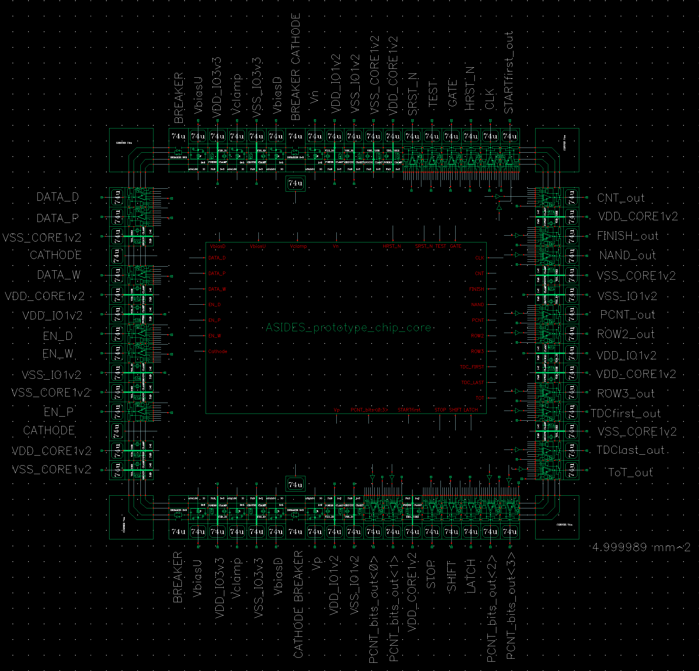
Pad Ring
66 total pads
28 digital pads
  14 outputs
  14 inputs
36 analog pads
  8 bias voltages
  24 power supply
  4 SPAD bias
2 breaker

Slide 4
Pin plan (digital input)
NAME | Function
HRST_N | Hard reset (active low): reset every register, the TDCs and the pixel latch
SRST_N | Soft reset (active low): reset only the PISO register, the TDCs and the pixel latch
CLK | System clock
GATE | Enable every pixels
TEST | Trigger the frontend electronics of the enabled pixels
LATCH | Enable the clock for the PISO register
SHIFT | Enable the shifting mode for the PISO register
STOP | Stop the measurement of the TDCs
DATA_P | Serial data for the programming register
EN_P | Enable the output of the programming register
DATA_W | Serial data for the write register
EN_W | Enable the output of the write register
DATA_D | Serial data for the data register
EN_D | Enable the output of the data register

Slide 5
Pin plan (digital output)
NAME | Function
PCNT | Serial output for the result of the parallel counter
CNT | Serial output for the result of the counter
TDCfirst | Serial output for the result of the TDC for first photon time-stamp
TDClast | Serial output for the result of the TDC for last photon time-stamp
STARTfirst | Trigger the the TDC for first photon time-stamp
FINISH | Signal that goes to 0 while the output of parallel counter is not stable
NAND | Output of the NAND tree
ToT | Output of the Time-over-Threshold circuit
ROW2 | Coincidence of local NAND tree of two adjacent double rows
ROW3 | Coincidence of local NAND tree of three adjacent double rows
PCNT_bits<0:3> | PCNT<0:3> or PCNT<4:7> bits

Slide 6
Configuration bits
NAME | Function
TestMode | 0: the TEST signal I distributed parallel to all double rows 1: a delay is introduced between one double row and the subsequent ones
DelayTrim<0:2> | The delay for the Time-over-Threshold signal can be tuned between 8 different values with a time step of 100ps and an offset of 600ps
EN_sCNT | Enabling the serial counter
Trig<0:1> | Select the trigger signal for the TDCfirst 00: NAND tree output 01: ToT signal 10: ROW2 11: ROW3
PCNT_bit | Select which are the 4 bits of the parallel counter available on 4 output pads 0: PCNT<0:3> 1: PCNT<4:7>

Slide 7
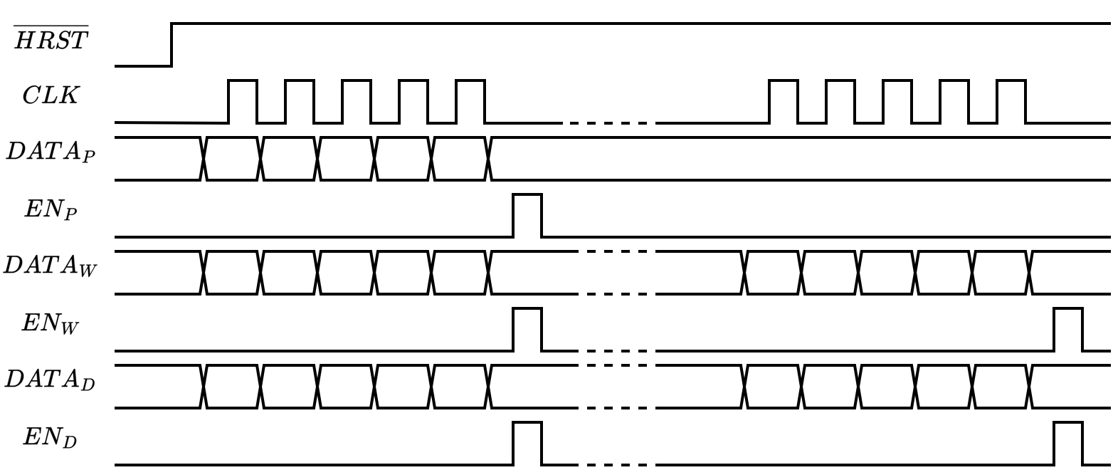
Programming phase

Slide 8
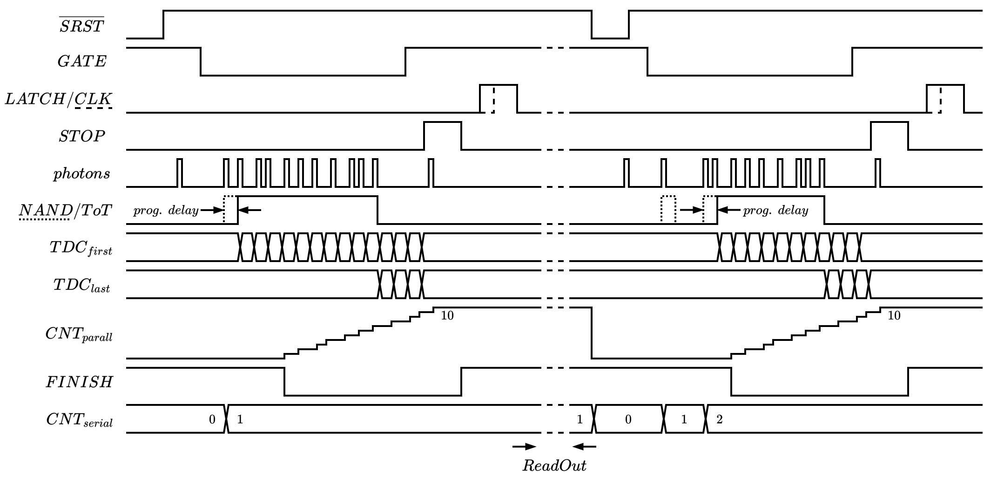
Measurement phase

Slide 9
ASPIDES meeting 10
Tommaso Floris
9/10/2025

