Slide 1
OLD LOGIC
AMBSlim5

Slide 2
AMBFTK I/O Format
ROAD: 2 words/road
EE EP
ADD bits 13-0
0
0
0
1
EE EP
ADD 19-14
BITMAP 7-0
HIT
14-0 Hit
EE
AGREEMENT with CHICAGO for tests:
for the transmission protocol we start to implement a simple solution with 2 states IDLE & DATA.
IDLE: transmit always the same K word
DATA: we are not in IDLE, so all data is good.
After testing the link we can implement the S-Link protocol with more control of link as CRC control (you can refer at this link http://hsi.web.cern.ch/hsi/s-link/devices/hola/hw_spec.html )

Slide 3
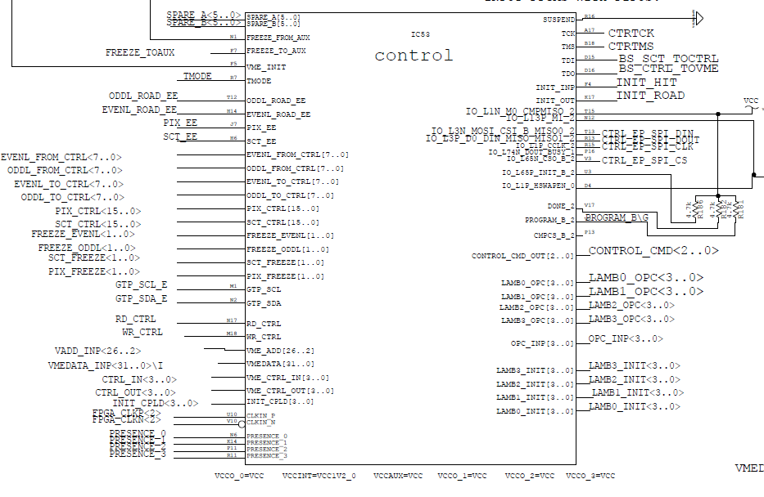
Control chip inputs/outputs
EE signals
Signals
to
communicate
Errors… etc.
Common to
Input/output
FPGAs
VME
signals
Control
Signals
To VME chip

Slide 4
Control chip Logic:
Generate INIT_event when: (a) EE is received by SCT, PIX and ROAD chips (4 signals)
Receive error (code & stream info) and generate an action (freeze or stopless-removal) comparing with Severity error
For Freeze: check that the event involved in the error is totally processed and than generate the freeze to all AMBFTK FPGAs. Send Freeze upstream.
Generate Operation Code to the LAMBs
FSM?? Molto semplice: INIT_EVENT e quando riceve I 4 EE, INIT_EVENT di nouvo.
Init_event
2
1
4 EE words received

Slide 5
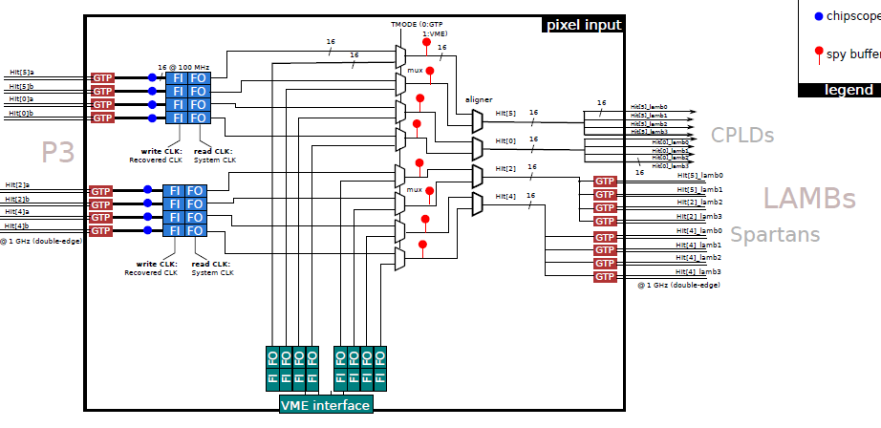
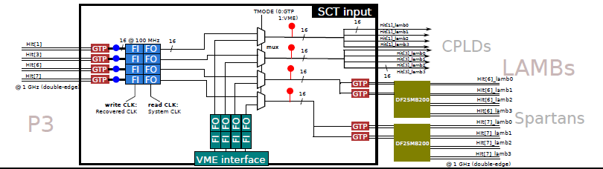
Move spy Buffer before
Far coincidere le FIFOs
Quanto grandi? Non mi torna quello che dice Alberto
INPUT
FPGAs

Slide 6
Errors to be monitored into the INPUT Chips
Parity or CRC error – for each link (8 pixel & 4 SCT) Parity (PA) or ‘sum check’ should be monitored. Error detection should be registered in a 8 bit (or 4 bit word)
FIFO Overflow – each FIFO full flag should produce error if set. Again 8 (or 4) bit word.
Invalid Input data (for example invalid HIT from ROD) ??
Lost Synchronism (event tags in different streams do not match) – Again 8 (or 4) bit word
Truncated output (for example too many hits in input) - Again 8 (or 4) bit word.
We can communicate to Control Chip the error using:
4 bits to identify the kind of error + 8 (or 4) bits to say which is the faulty stream.

Slide 7
INPUT VME registers
Error register – WR = clear; 8 (or 4) x 5 bits
For each FIFO: flag register (empty, HFull, Full)–RO (3x 8 or 4)
For each FSM: state machine - RO
Output Status (Hold flags) – RO (necessario? Esiste HFull)
For each Spy Buffer: Spy Buffer register: Pointer, OVFL flag, status(freeze/spy. WR=clear of Pointer & flag. Status is RO
chip firmware ID? (see Alberto slides) Firmware and date reg.
Input FiFos: R/W
Input Spy Buffers memories
Timing measurements: each chip has a counter. When Init_event is received it is started. When all the input EE event words are received it is stopped. All incoming words are written in the spy buffer with the counter content.

Slide 8
ROAD chips (OUTPUT)

