Slide 1
TARGET AND PARTICLE SOURCES
Alessandro Variola
INFN Roma1

Slide 2
Why a thesis on these topics?
Particle sources, interactions points, beam interactions with materials etc etc…
These are extremely multidisciplinary (beam physics and dynamics, production mechanisms, particle –matter interactions, complex systems…etc etc)
Many connections between accelerators physics and particle, statistical and plasma physics
Great possibility to have both theoretical and experimental thesis
Many EU first order laboratory involved….

Slide 3
What it will be illustrated
Intense positrons sources
Curved crystal technology for particle accelerators
Laser-driven plasma wakefield acceleration in CNT
Machine-Detector Interface at FCC-ee
Low Z absorbers for muon collider. Material characterization
UA9, beam merging data analysis and alternative configurations
UA9 high energy crystal rainbow
Crystal extraction with medical machines

Slide 4




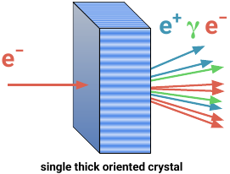
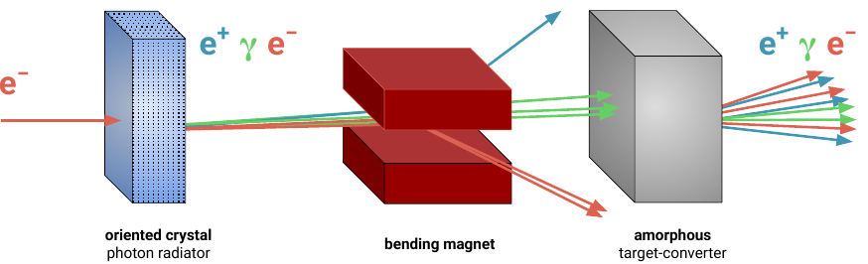
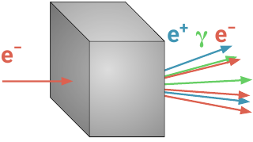
Crystal-based Intense Positron Sources for Future Colliders
Increased luminosity and better sustainability (lower primary e- current needed -> cost reduction)
More positrons
Solution: crystals!
Motivations:
Positron source are critical for the beam current achievable in e+e- colliders
Energy saving is mandatory for FCC-ee
Ideal for FCCee
Less heating and background
Conventional e+ source
baseline for FCC-ee
Ideal for linear colliders (CLIC or ILC)
Luminosity constraint
Target heating
Thick amorphous
high-Z target
Idea of R. Chehab, V. Strakhovenko and A. Variola,
NIM B 266 (2008) 3868
4

Slide 5

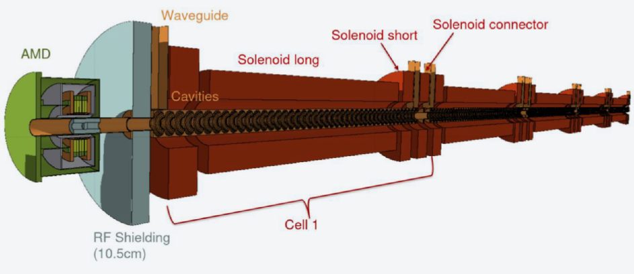



Crystal-based Intense Positron Sources for Future Colliders
Collaboration with the FCC-ee Injector Studies Group (I. Chaikovska, IJCLab) – possibility to spend a period at IJCLab
Ultimate Goal: Overcome positron source limits → higher reliability, more sustainable, compatible with existing collider designs
I. FCC-ee
A single thick crystal converter
Nearly zero additional cost
First result for the FCC-ee e+ source: better performance than conventional (decrease in e- current and in deposited energy)*
II. Other Colliders
CLIC & ILC: e+ rate 20-30 x FCC-ee rate
LHeC, LEMMA: e+ rate > 100 x linear collider
Issue: target resistance → conventional scheme at its limit
- > need improved scheme
W Crystal Converter
N. Canale et al. NIM A 1075 (2025) 170342
*F. Alharthi et al. NIM A 1075 (2025) 170412
L. Bandiera et al. Eur. Phys. J. C 699 (2022) 82
I. Chaikovska et al. 2022 JINST 17 P05015
M. Soldani et al. NIM A 1058 (2024) 168828
D. Boccanfuso et al. IL NUOVO CIMENTO 48 C (2025) 108
Final test at CHART P³ at PSI
Possible PhD Activities
Experiments with crystal targets @CERN PS
Text of full e+ capture system @PSI
MC simulations for the source optimization
Contacts: L. Bandiera - INFN Ferrara bandiera@fe.infn.it

Slide 6
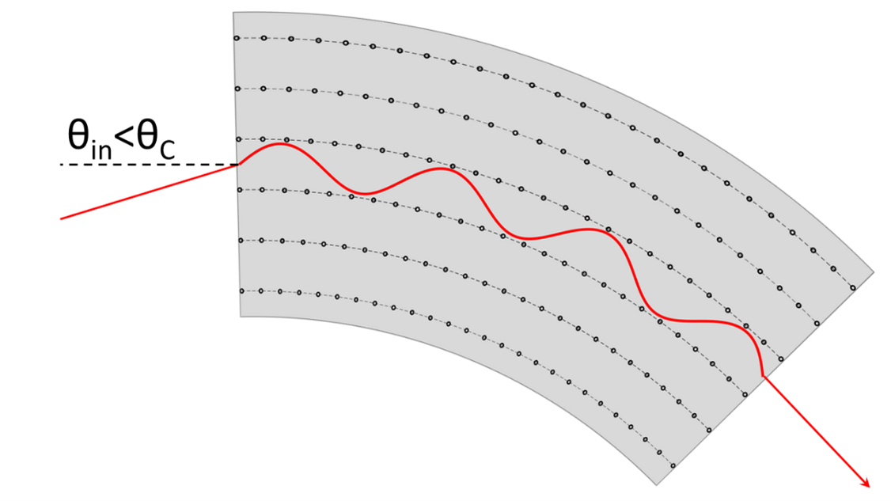
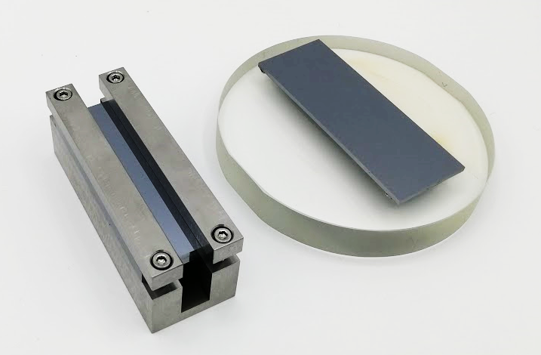
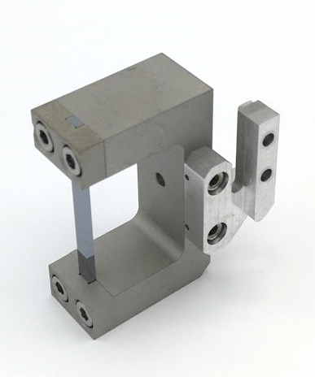
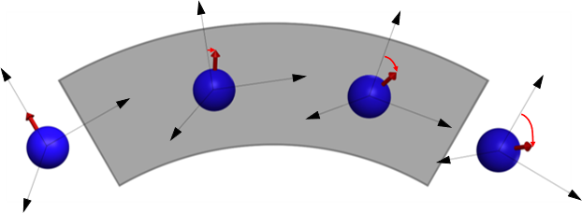
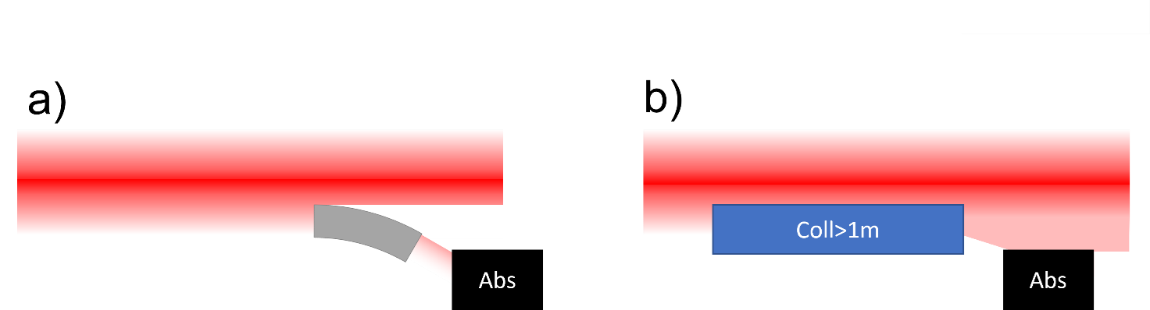






Curved crystals for particle accelerators
Possible PhD thesis
Curved crystals can act as waveguide for charged particle beams through the phenomenon of channeling, achieving steering power larger than 1000 T magnetic dipoles.
This effect can be exploited in accelerators for:
Collimation/extraction of beam halo
Protection of insertion devices in accelerators
(beam shadowing)
Spin precession of fast decaying particles
INFN Ferrara is currently involved in several projects:
  Mu2e proton beam extraction at Fermilab
  Collimation of Muon Collider
  Spin precession of charmed baryons in LHC
  Desing and manufacture of crystal for channeling experiments
M. Romagnoni et al., MDPI
Crystals 2022, 12(9), 1263
W. Scandale et al., Physics
Reports 2019, 04 003
Fabrication and characterization of crystals
as insertion devices in accelerators
Development of advanced crystal bending techniques
for charmed baryon spin precession experiments
Sample characterization at synchrotron facilities
Beam line experiments on bent crystals
Geant4-based simulation of channeling in bent crystals for Muon Collider collimation optimization
Contact: A. Mazzolari, M. Romagnoni – INFN Ferrara mazzolari@fe.infn.it and rmgmrc@unife.it

Slide 7
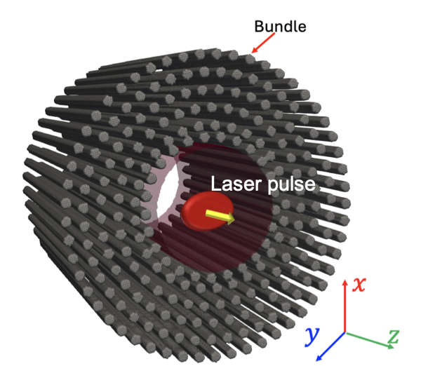
Advanced Particle-In-Cell simulations of laser-driven plasma wakefield acceleration
This research focuses on the simulation of laser-driven plasma wakefield acceleration (LWFA) in dense materials, in particular solid-state targets and carbon nanotubes (CNTs)
Possible PhD thesis
CNT array
C. Bontoiu et al. Scientific Reports 13, 2845 (2023)
Plasma wakefield acceleration in such materials offers the potential for producing extremely high-gradient acceleration and highly intense particle beams, critical for next-generation accelerators.
Using CNTs as the target medium, this study aims to optimize key parameters, such as laser intensity, plasma density, and beam-plasma interactions, to maximize the beam quality and charge. Additionally, the research explores methods for the production and preparation of CNT targets for LWFA, addressing challenges in target fabrication.
Monte Carlo modeling of laser-driven plasma wakefield acceleration in dense materials
Contact: A. Sytov – INFN Ferrara sytov@fe.infnit

Slide 8
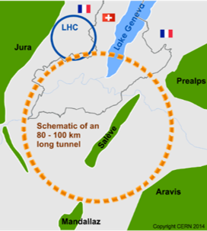
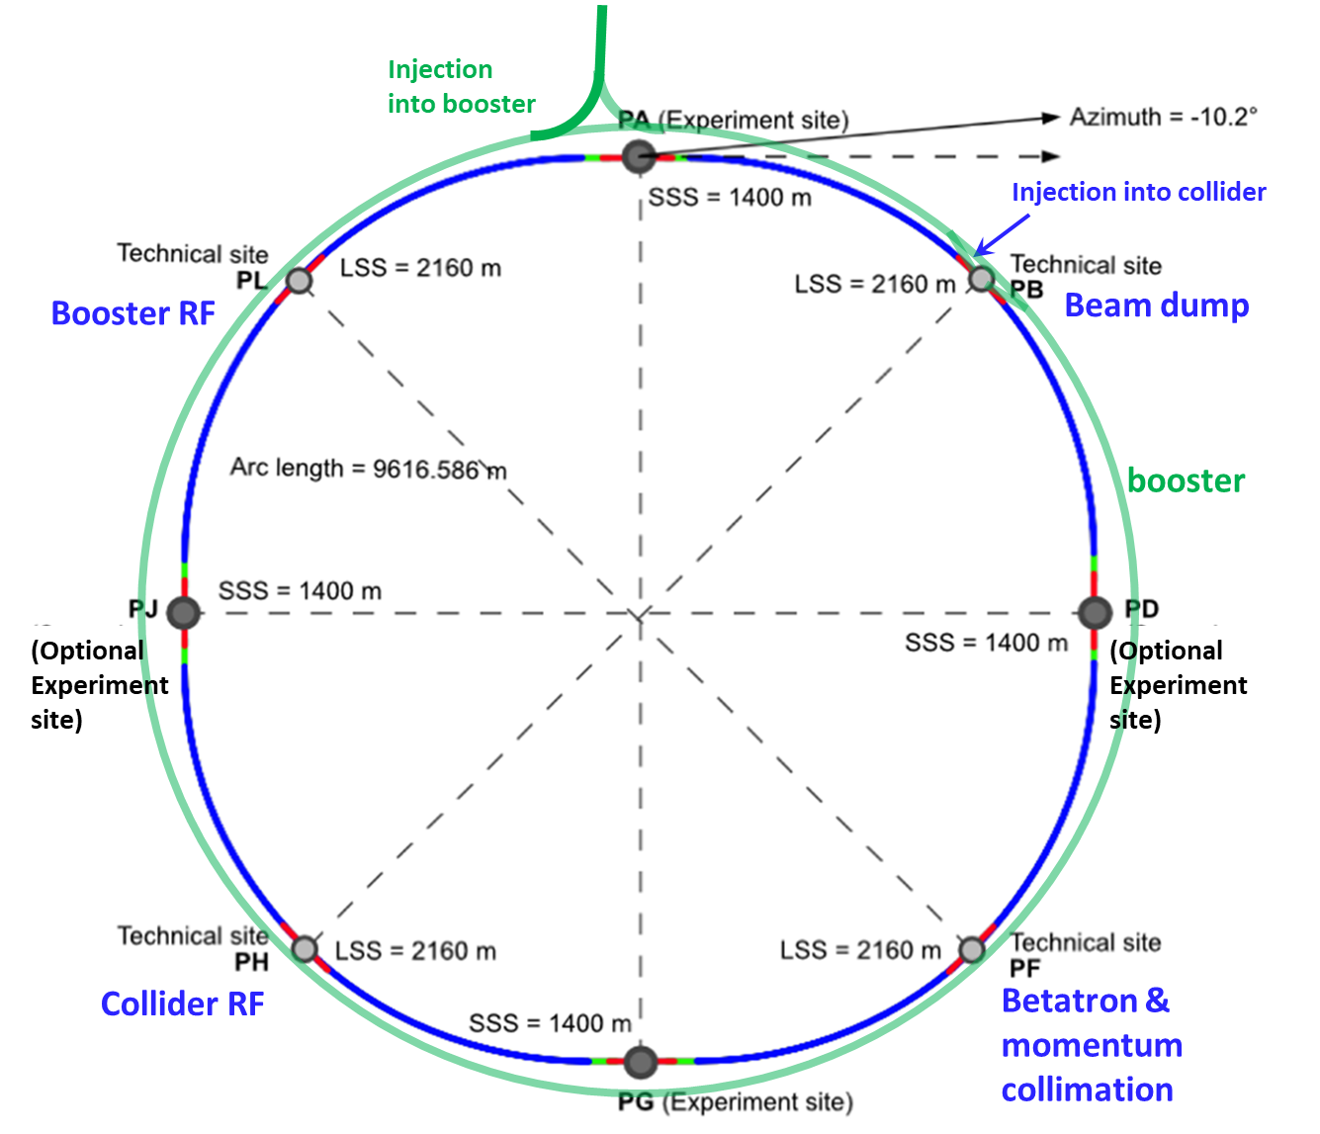
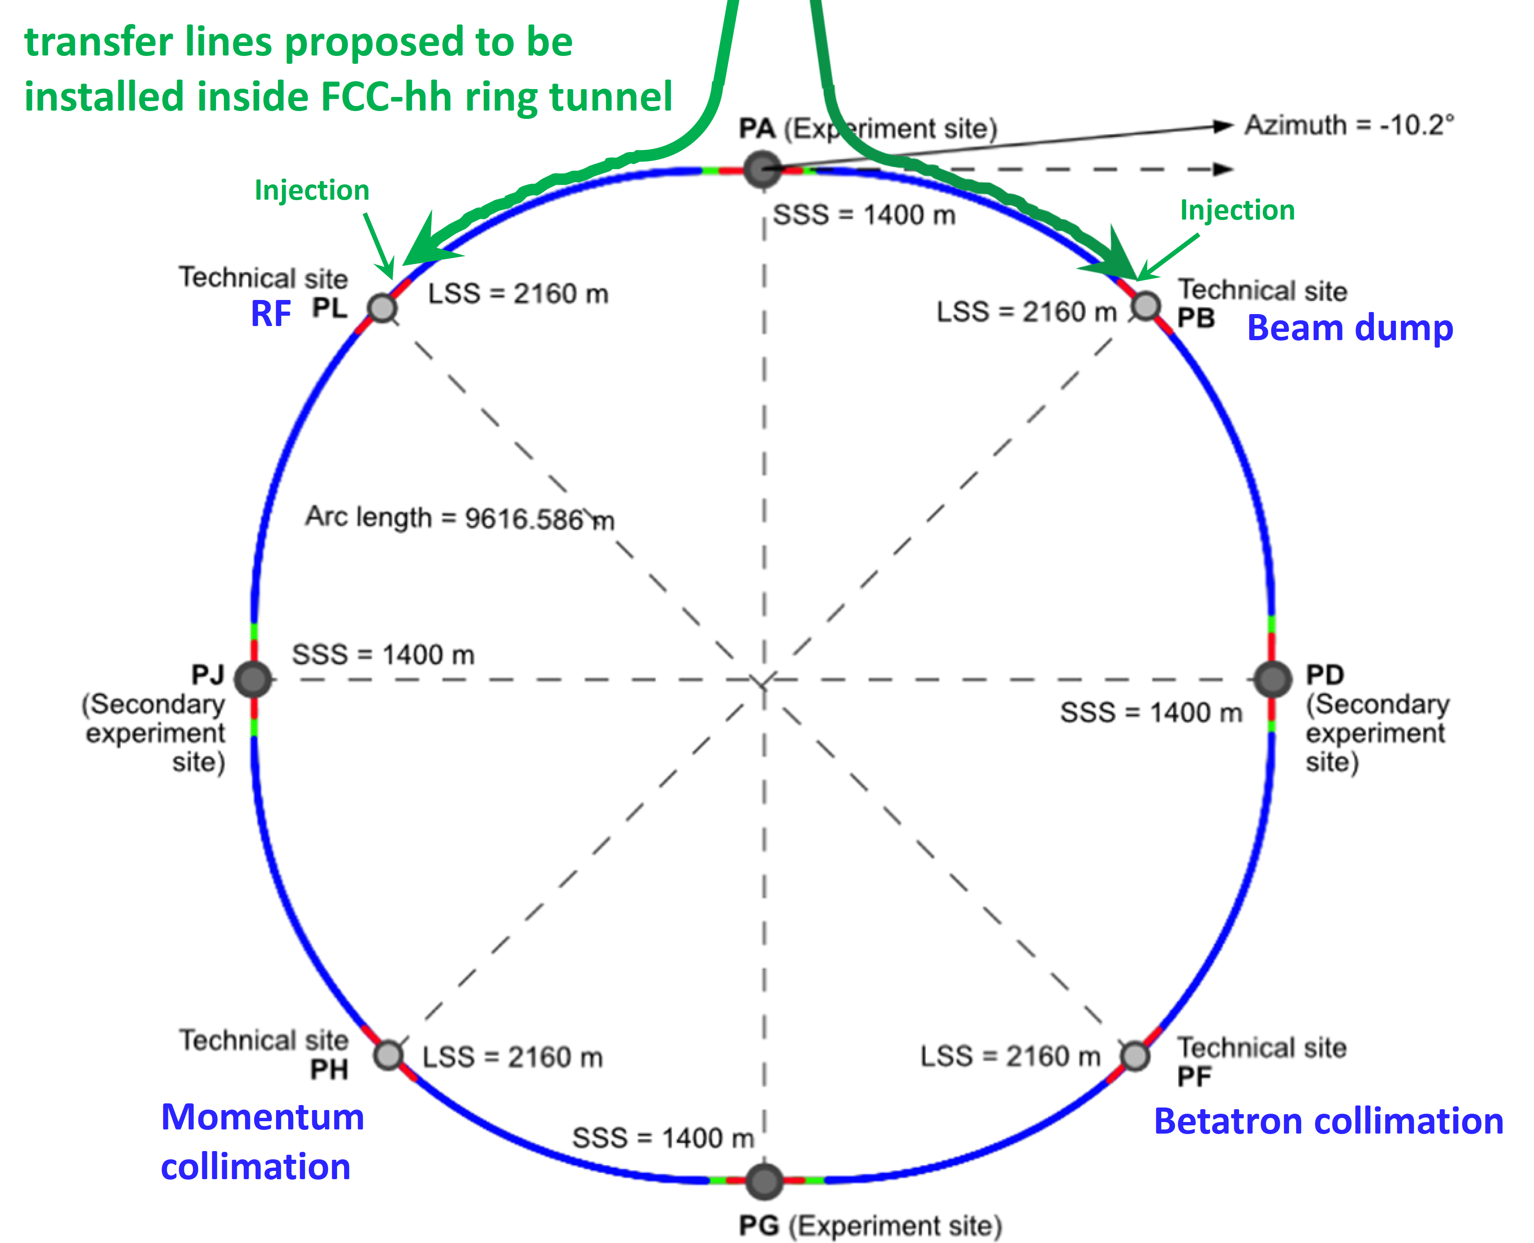
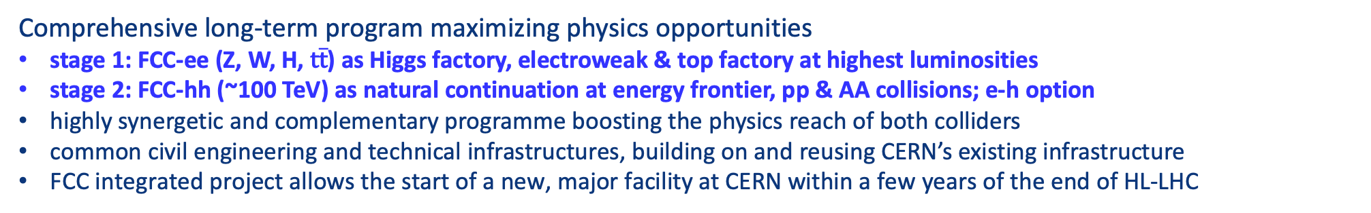
FCC integrated program
Comprehensive long-term program maximizing physics opportunities
stage 1: FCC-ee (Z, W, H, $\text{t}\overline{\text{t}}$) as Higgs factory, electroweak & top factory at highest luminosities
stage 2: FCC-hh (~100 TeV) as natural continuation at energy frontier, pp & AA collisions; e-h option
highly synergetic and complementary programme boosting the physics reach of both colliders
common civil engineering and technical infrastructures, building on and reusing CERN’s existing infrastructure
FCC integrated project allows the start of a new, major facility at CERN within a few years of the end of HL-LHC
FCC-ee
FCC-hh
2020 - 2040
2045 - 2063
2070 - 2095

Slide 9
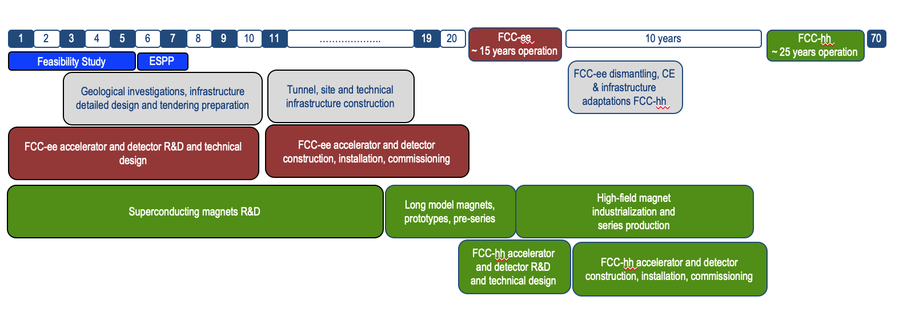
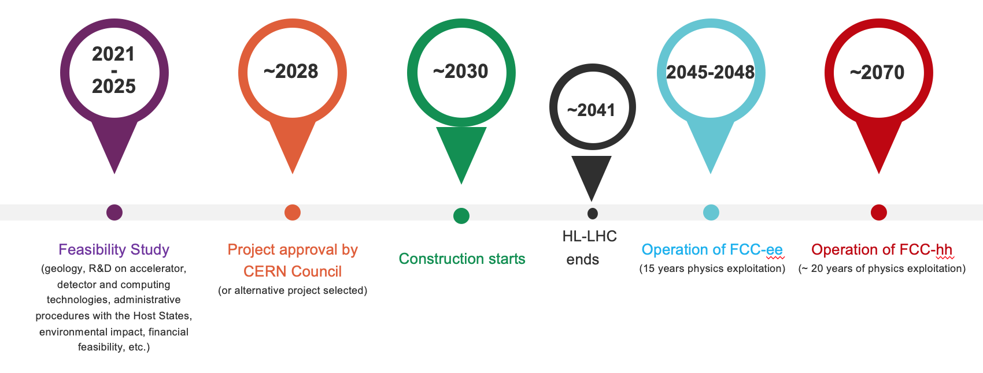
FCC integrated program - timeline
FCC Conceptual Design Study
started in 2014 leading to CDR
Feasibility Study started in 2021 leading to Feasibility Study Report (FSR) in 2025
Ambitious schedule taking into account:
past experience in building colliders at CERN
approval timeline: ESPP, Council decision
that HL-LHC will run until 2041
project preparatory phase with adequate
resources immediately after Feasibility Study
~2032
~2045
~2070
Updating the European Strategy for Particle Physics:
https://home.cern/news/news/physics/european-strategy-update-enters-final-straight

Slide 10
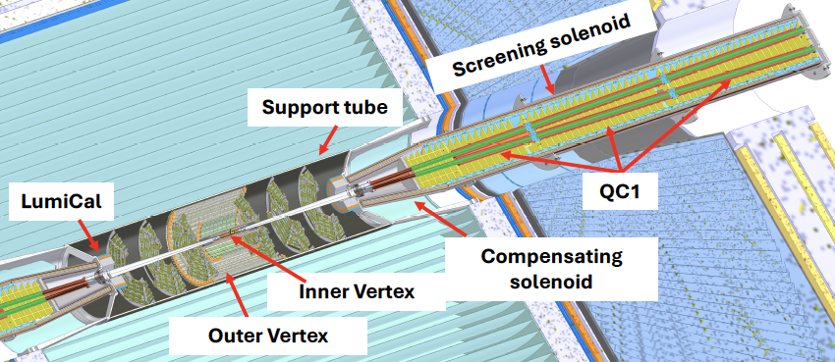
FCC Feasibility Study Report published Vol. 1 & Vol. 2:
https://arxiv.org/abs/2505.00272
https://arxiv.org/abs/2505.00274
[FSR Vol. 1, Fig. 82, p. 122]

Slide 11
Possible PhD Theses: Machine-Detector Interface at FCC-ee
Study of the compensating scheme and machine related backgrounds at FCC-ee
The future circular electron-positron collider at CERN (FCC-ee) aims at unprecedented luminosities obtained with the crab-waist collision scheme.
Several effects are at the origin of the beam-induced backgrounds at the interaction region, such as the beam-beam effect, the radiative Bhabha scattering, beam losses from the collimators, synchrotron radiation and beam-gas interactions. Different machine optics will have different impacts on some of these backgrounds. The student will take confidence on the beam transport simulations and evaluate the backgrounds in the machine elements as well as in the detectors of the experiments, such as the vertex detectors or the drift chambers, in particular. A similar crab-waist scheme has been adopted at the SuperKEKB collider at Tsukuba (Japan), where the candidate is expected to be seconded for some short periods to learn "in situ” the reduction of the beam-related backgrounds in a running machine.
Some Refs:
DOI 10.1016/j.nima.2025.171135
https://www.sciencedirect.com/science/article/pii/S0168900225009374
EPJ Techn Instrum (2025) 12:4,
“Status of the FCC-ee interaction region design”
https://doi.org/10.1140/epjti/s40485-025-00117-3
Contact: Manuela Boscolo
Manuela.boscolo@lnf.infn.it

Slide 12
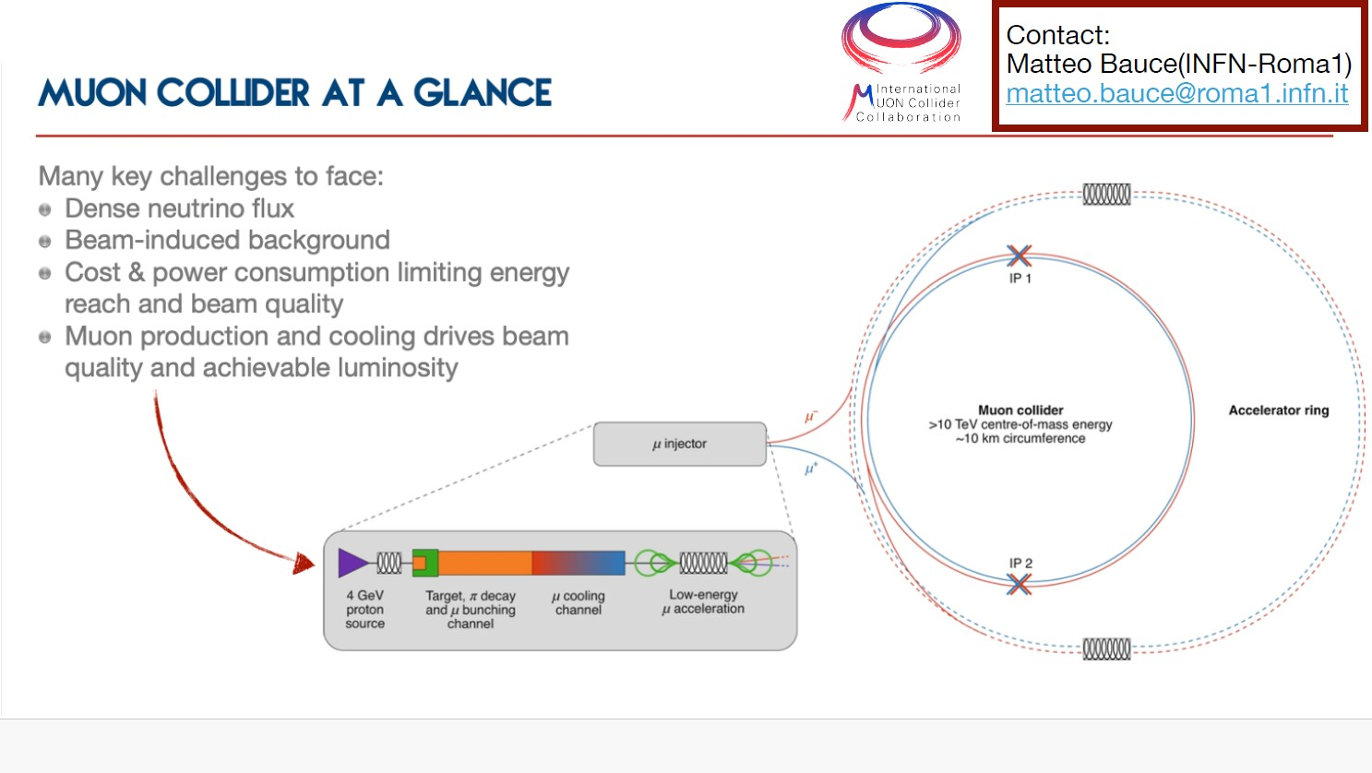

Slide 13
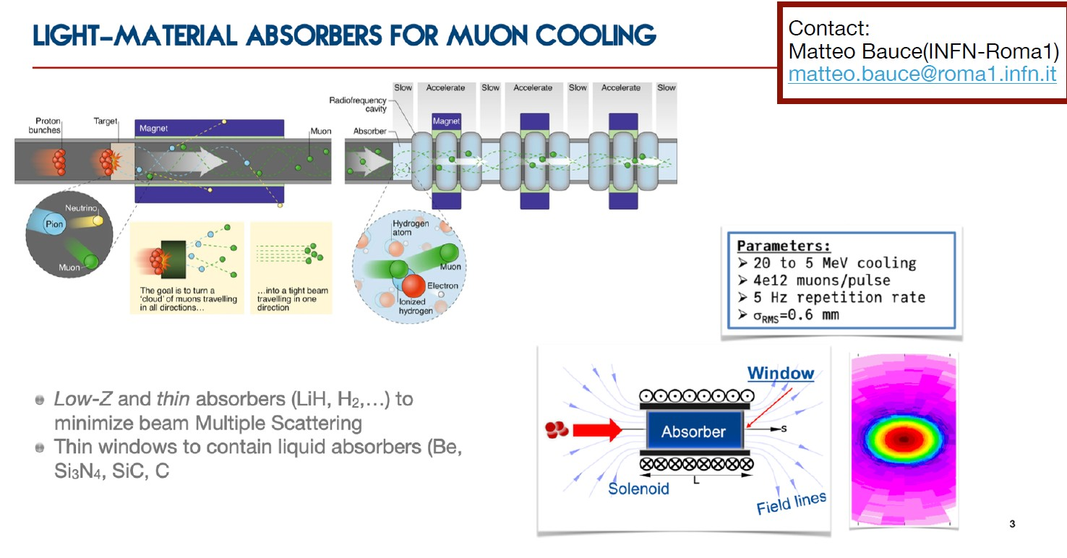

Slide 14
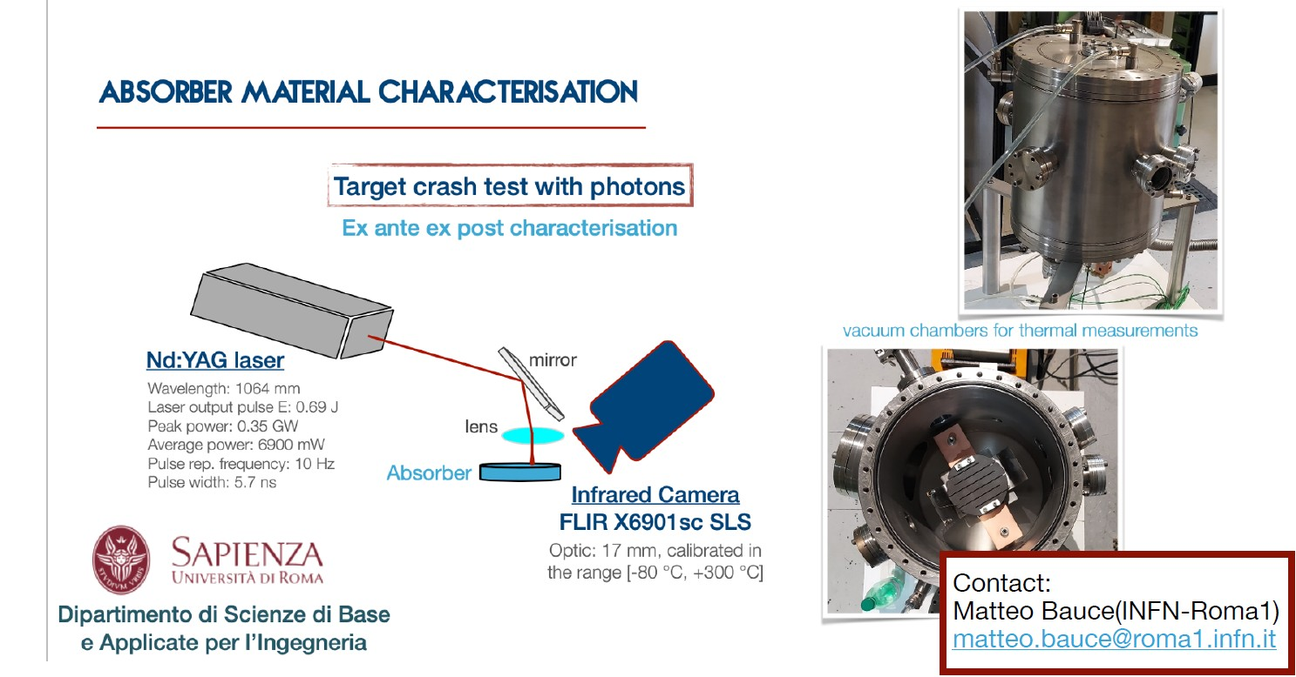

Slide 15

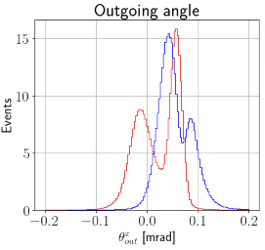
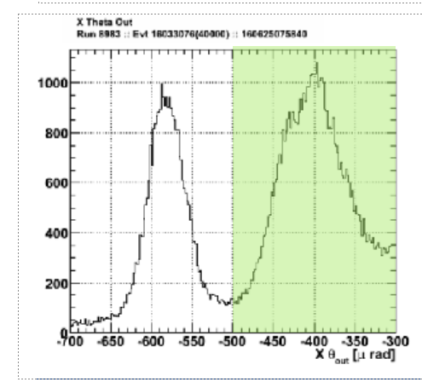
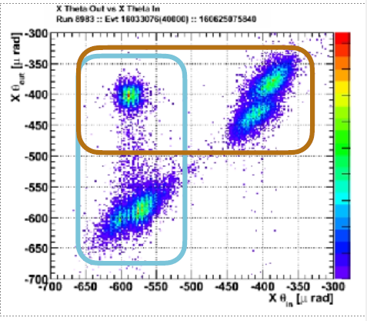

Beam merging crystal assisted
Goal
Increasing of the single bunch intensity b(x,y,s). If the emittance increase is limited this results in a net increase of the luminosity. What about the linear extension of the Liouville Theorem?
To be used, for examles on muons cooling lines (istantaneous recombination)
To merge two beams in the trace space one have to deflect only one beam in one point. Impossible in magntes….
In crystals coherent and incoherent motions….crystals act as an angular filter( also if not perfectly efficent…VR, MS)
No CH
No VR
Beam VR
Beam CH
Window selection

Slide 16
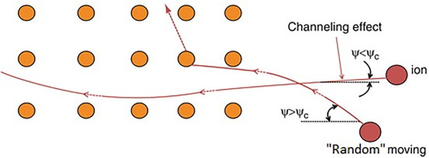
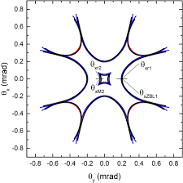
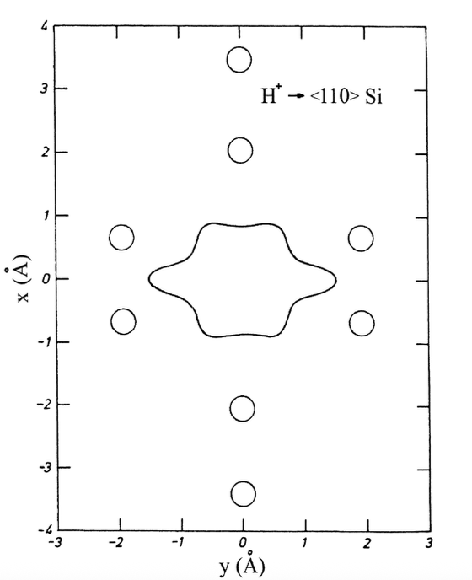
The "crystal rainbow effect" is observed in positive charged particles in axial channeling states in a flat, very thin crystal.
Particles, instead of moving straight through the crystal channels, are scattered in a rainbow-like angular pattern (corresponding to different colors). As particles pass through the crystal, they interact with the atoms, causing them to scatter and deflect.
Crystal is very thin (conventionally) if the reduced length Λ ⩽ 0.25
Λ = f_{channeling}× 𝓁_{crystal} / v_{particle}= 𝓁_{crystal} / 𝜆_{particle}
In H8 using a 15 μm crystal at 180 GeV: Λ = 0.37
Applications of the rainbow effect :
Subatomic Microscopy: for detailed analysis of very thin crystals.
Material Characterization: thermal vibrations and defects in materials like graphene or silicon.
Understanding Ion-Crystal Interactions: ions interacting with crystal lattices, crucial in materials science and nuclear physics.
Quantum Perspective:
The rainbow effect can be analyzed from a quantum mechanical perspective. This involves considering the wave nature of particles and the scattering of wave packets.
The observations are explained by the effects of wrinkling, concentration, and coordination of the wave packets as they interact with the array of atoms.
"rainbow channeling" also provide valuable insights into the properties of materials at the atomic and subatomic levels.

Slide 17
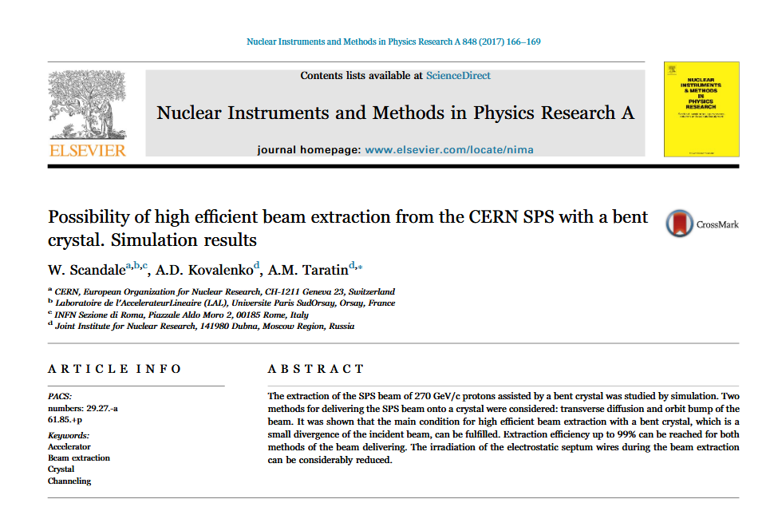
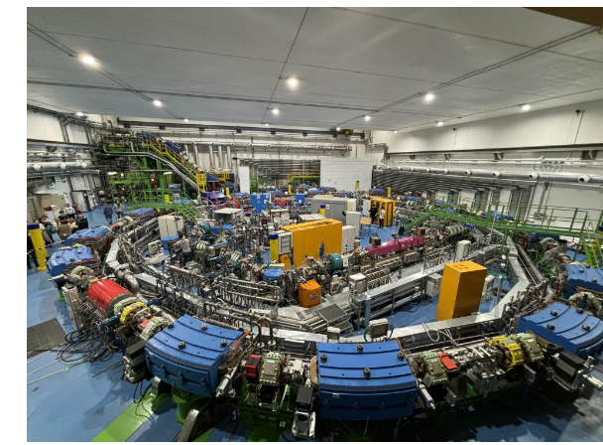
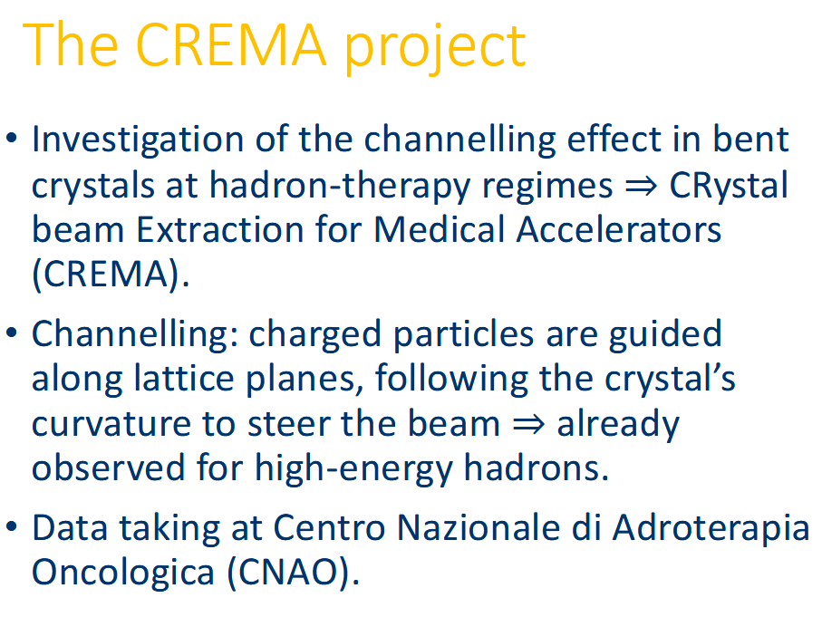
Crystal assisted Extraction for medical machines
The next step is a theoretical and simulation work (to be done at INFN and CERN) to establish a final
Extraction strategy for CNAO and medical machines in general (collaboration with Medaustron to be investigated)

Slide 18
SUMMARY
Intense positrons sources | INFN Fe - Laura Bandiera | bandiera@fe.infn.it
Curved crystal technology for particle accelerators | INFN Fe - Andrea Mazzolari, Marco Romagnoni | mazzolari@fe.infn.it rmgmrc@unife.it
Laser-driven plasma wakefield acceleration in CNT | INFN Fe – Alexei Sytov | sytov@fe.infn.it
Machine-Detector Interface at FCC-ee | INFN LNF – Manuela Boscolo | manuela.boscolo@lnf.infn.it
Low Z absorbers for muon collider. Material characterization | INFN Roma1 – Matteo Bauce | matteo.bauce@roma1.infn.it
UA9, beam merging data analysis and alternative configurations | INFN Roma1 – Alessandro Variola | alessandro.variola@roma1.infn.it
UA9 high energy crystal rainbow | INFN Roma1 – Alessandro Variola | alessandro.variola@roma1.infn.it
Crystal extraction with medical machines | INFN Roma1 – Alessandro Variola | alessandro.variola@roma1.infn.it

