Slide 1
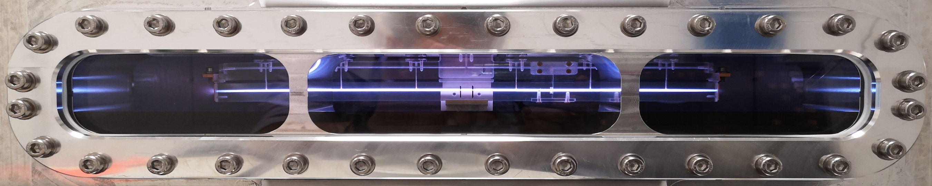
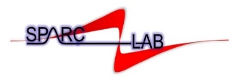

Accelerator Physics and Technology PhD: meeting first year students
Sapienza Università di Roma |Thursday 13 Nov 2025
Plasma acceleration
Angelo Biagioni
On behalf of the Sparc_lab collaboration

Slide 2

Outline
  Plasma acceleraiton experiments at Sparc_lab test facility
  Principles of plasma acceleration
  Gas-filled discharge capillaries
  Laser-induced plasma sources
  Plasma properties characterization
  Plasma sources for the EuPRAXIA@SPARC_LAB project
      Long plasma sources
      Material science
      Integrated plasma accelerating module
Sapienza Università di Roma |Thursday 13.11.2025
Pag. 2

Slide 3
Sparc_Lab facility
SPARC_LAB test facility
Energy | 6 J
Duration | 25 fs
Wavelength | 800 nm
Bandwidth | 80 nm
Spot@focus | 10 um
Peak power | 250 TW
Contrast ratio | 10¹⁰
Laser-driven plasma
acceleration (ExIn)
High-power laser (FLAME)
EuPraxia Betatron
Radiation Source (EuAPS)
Particle-driven plasma acceleration
Sapienza Università di Roma |Thursday 13.11.2025
Pag. 3

Slide 4
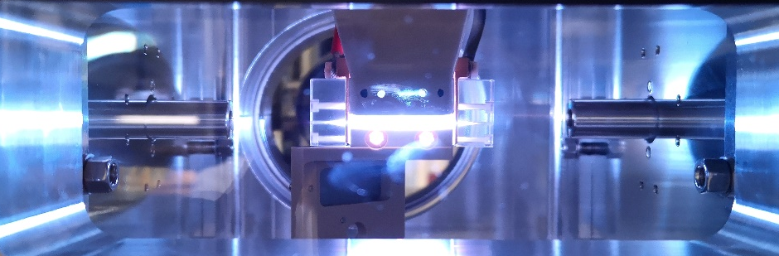
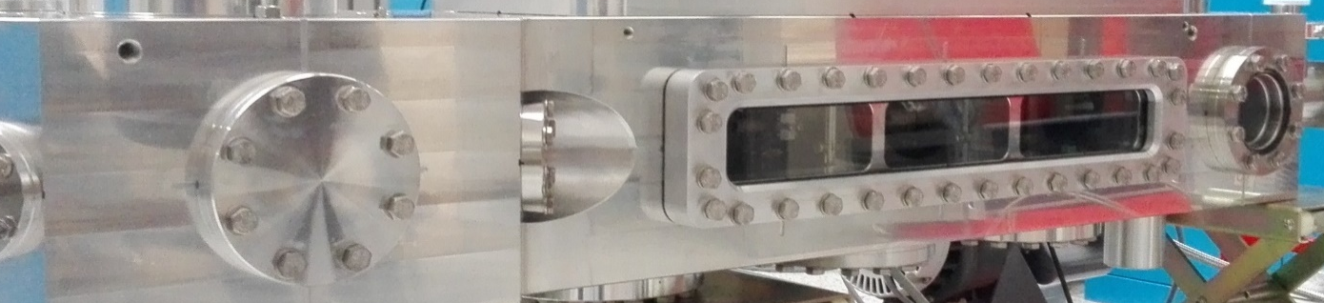
Sparc_Lab facility
SPARC_LAB test facility
3D-printed plasma sources (plastic)
3cmx2mm capillary
Plasma densities 10¹⁶ – 10¹⁷ cm⁻³
Energy | 6 J
Duration | 25 fs
Wavelength | 800 nm
Bandwidth | 80 nm
Spot@focus | 10 um
Peak power | 250 TW
Contrast ratio | 10¹⁰
High-power laser (FLAME)
EuPraxia Betatron
Source (EuAPS)
Particle-driven plasma acceleration
Sapienza Università di Roma |Thursday 13.11.2025
Pag. 4

Slide 5
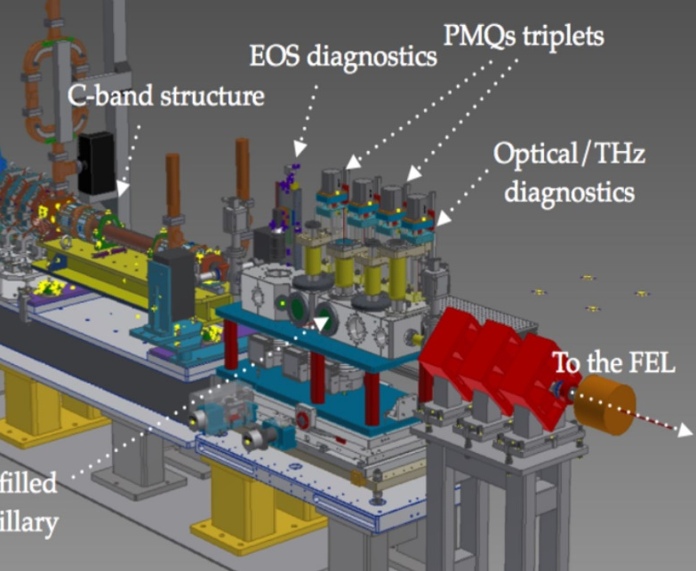
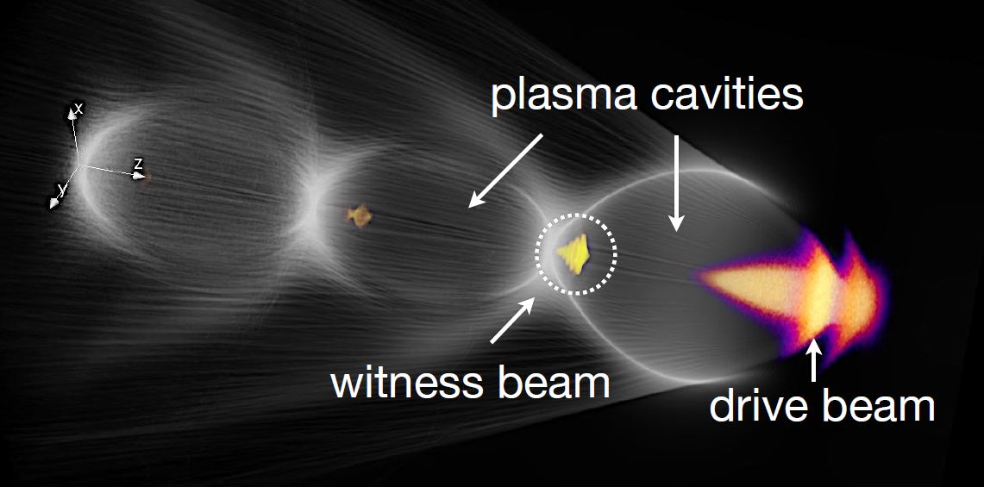



Principles of plasma acceleration
  Geometry to control density gradient, plasma ramps...
  Reproducibility
  Stability
  Uniformity/ramps
  High repetition rate (heat dissipation, materials)
  Vacuum requirements
Main topics related to the design of a plasma source:
n₀ = 10¹⁶ cm⁻³ λ_{p} = 300 µm
LWFA Drive beam is a laser pulse
PWFA Drive beam is high energy or proton beam
$$ω_{p}=\sqrt{\frac{n_{0}e^{2}}{m_{e}ε_{0}}}$$
Wakefield
λ_{p}
Wave-breaking field
$$\text{E}\text{wb}\left[\text{V}\text{/}\text{m}\right]\text{≈ 100}\sqrt{{\text{n}}_{\text{0}} \left[{\text{cm}}^{\text{−3}}\right]}$$
Pag. 5

Slide 6
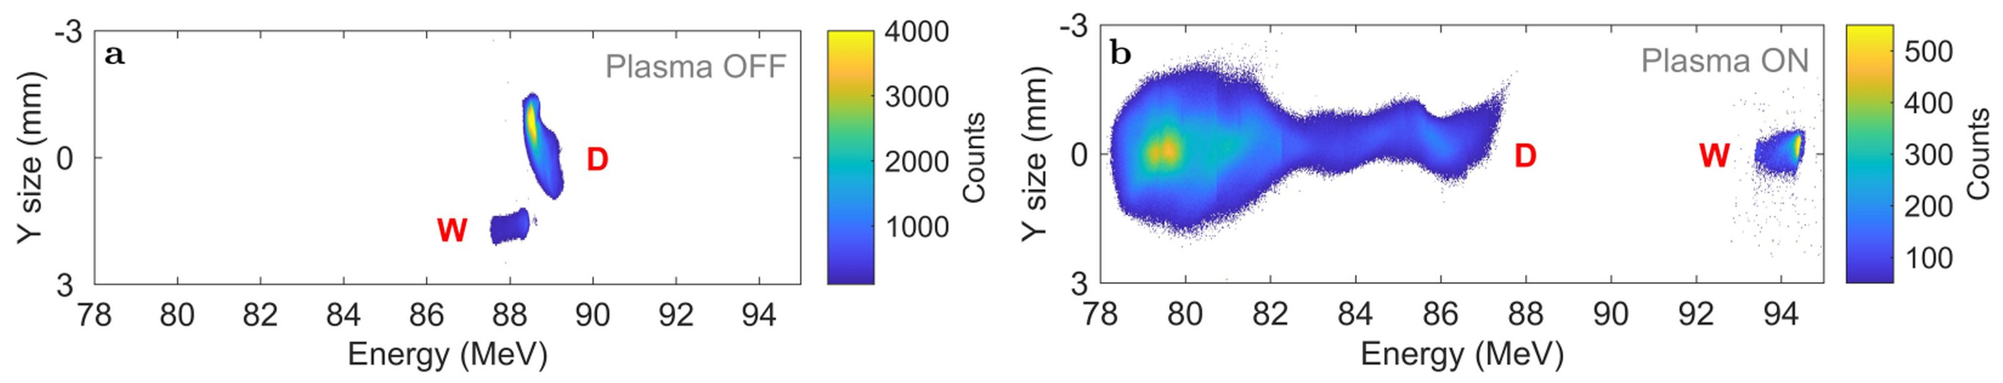

First results at Sparc_lab
Nearly the same energy
with plasma OFF
Driver
Driver
Witness
Witness
Initial Witness
energy
6 MeV acceleration in 3 cm long plasma capillary with 200 pC driver/20 pC witness
  Plasma density set to 2x10¹⁵ cm⁻³
  ~200 MV/m accelerating gradient (RF structures in the range 20-60 MV/m)
  Driver decelerated by almost 10 MeV
  During last experiments, accelerating gradient close to 1 GV/m has been reached
Demonstration of energy spread compensation
  Total projected spread from 0.2 MeV to 0.12 MeV
Discharge in 3 cm long gas-filled capillary
Pag. 6

Slide 7
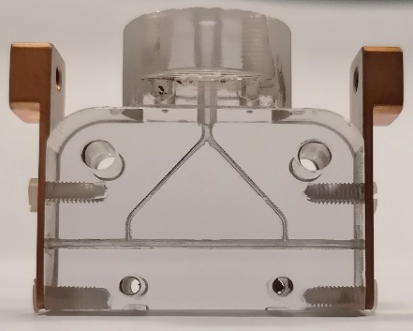
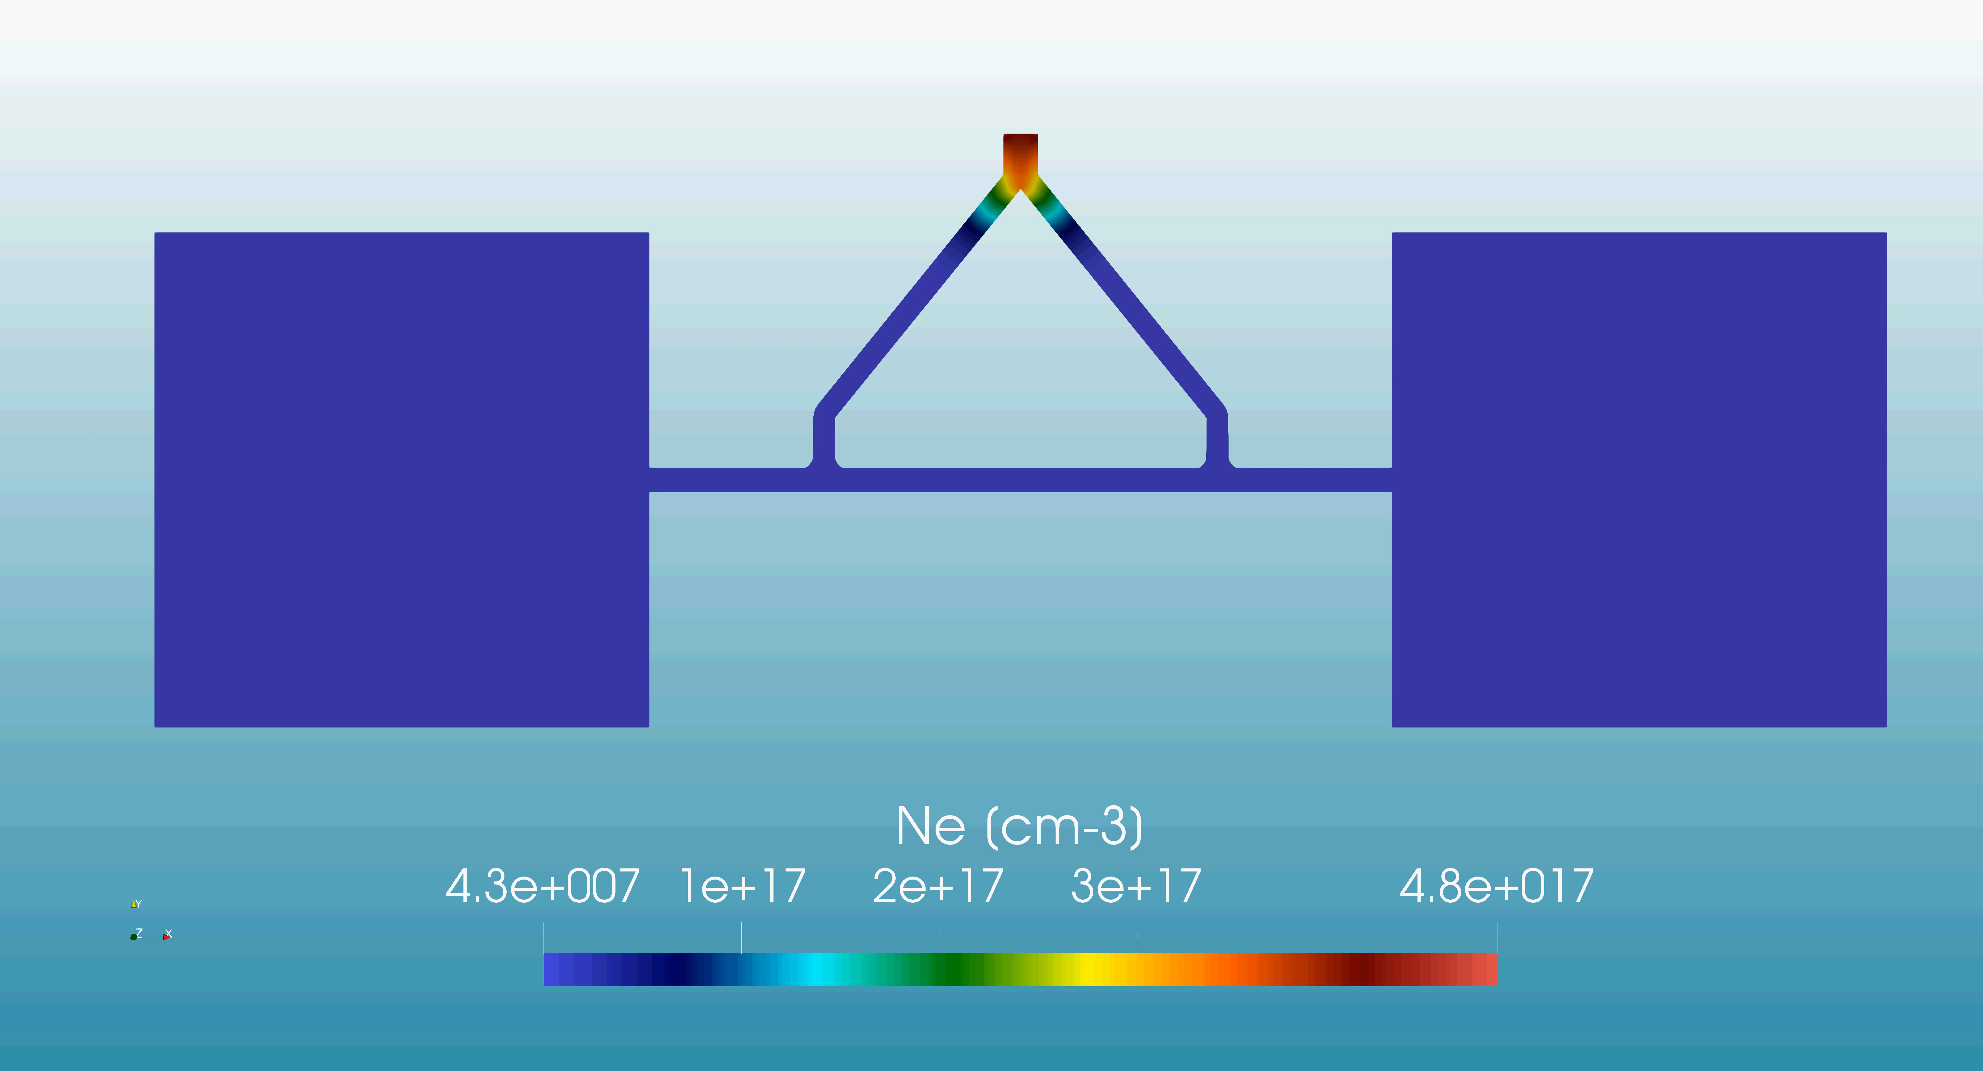
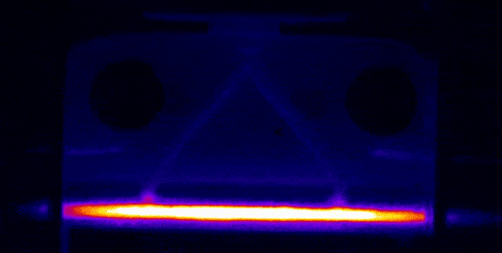
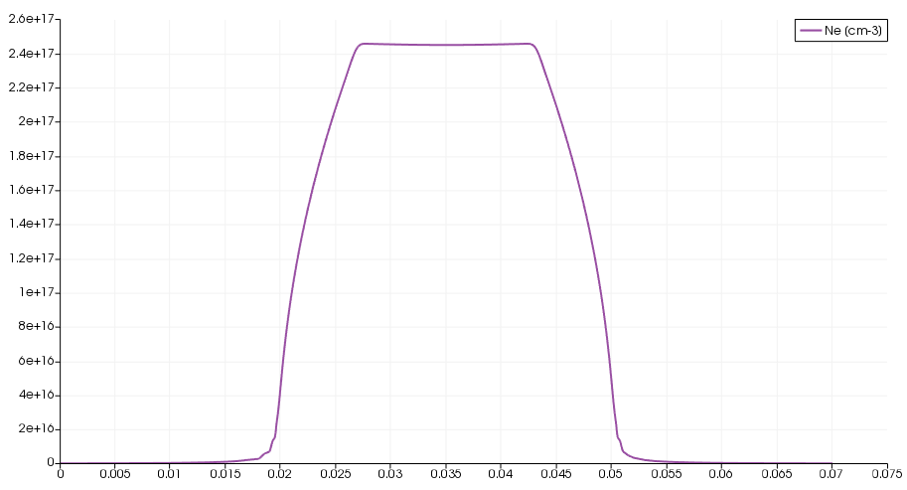
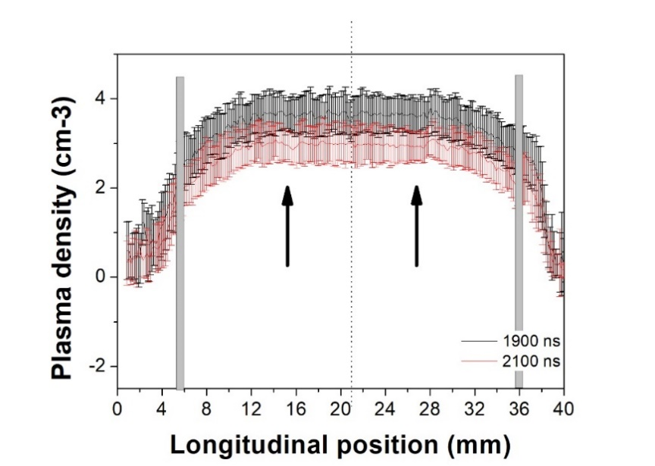
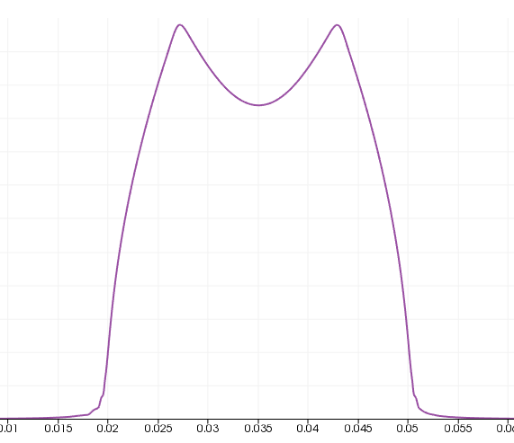
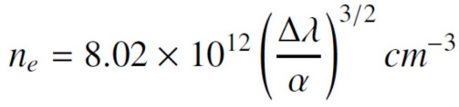
Design of plasma sources – Discharge capillary
Electrode
thin capillaries are used to confine a neutral gas (H, Ar, N…), which is injected through several inlets into the plasma channel
OpenFOAM code
for neutral gas distribution
0-5 ms
HV pulse
Gas inlets
Plasma channel
the plasma formation process is triggered by a high voltage pulse at the ends of the capillary
2.5E17
0 – 5 ms
1 ms
x10¹⁷
4.5 ms
The plasma characterization is based on spectroscopic techniques (Stark broadening effect)
6E16
2E16
Density profile
Pag. 7
4/28

Slide 8
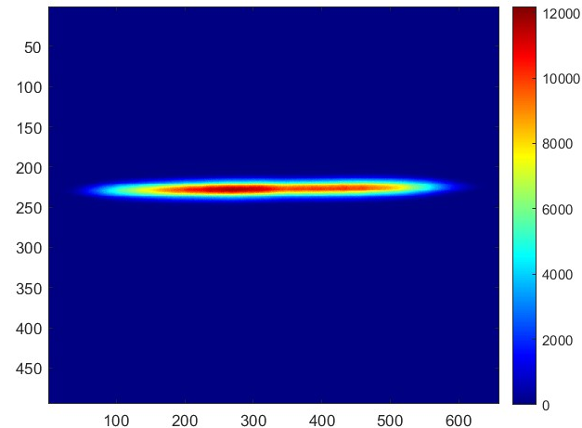
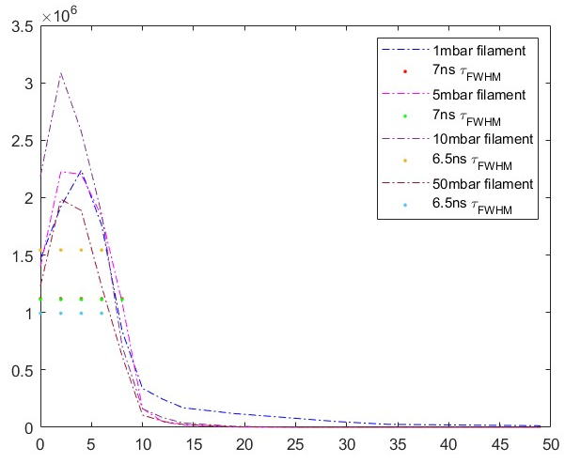
Design of plasma sources – Laser-induced plasma
Laser pulse: 15 mJ, 100 fs
N₂ 95% - H₂ 5%, 1-10 mbar
Tune laser energy, focal spot and gas pressure to change filament size and plasma density
N_{e} = 10¹⁶ - 10¹⁷ cm⁻³
Laser pulse
Intensity [a.u.]
7 ns Lifetime
1.2 mbar
L = 39.75 mm
d = 567.6 um
Time [ns]
Pag. 8

Slide 9
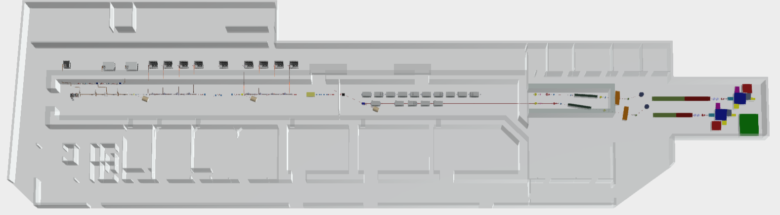
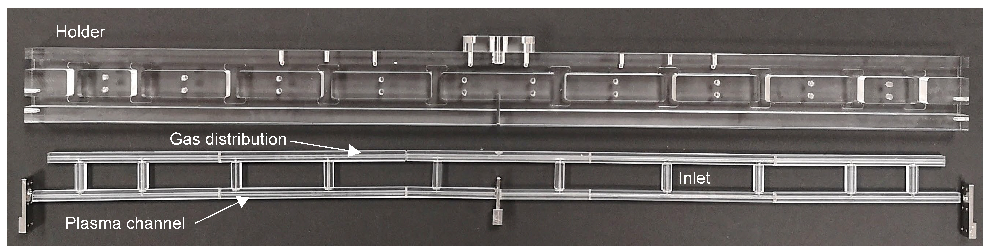
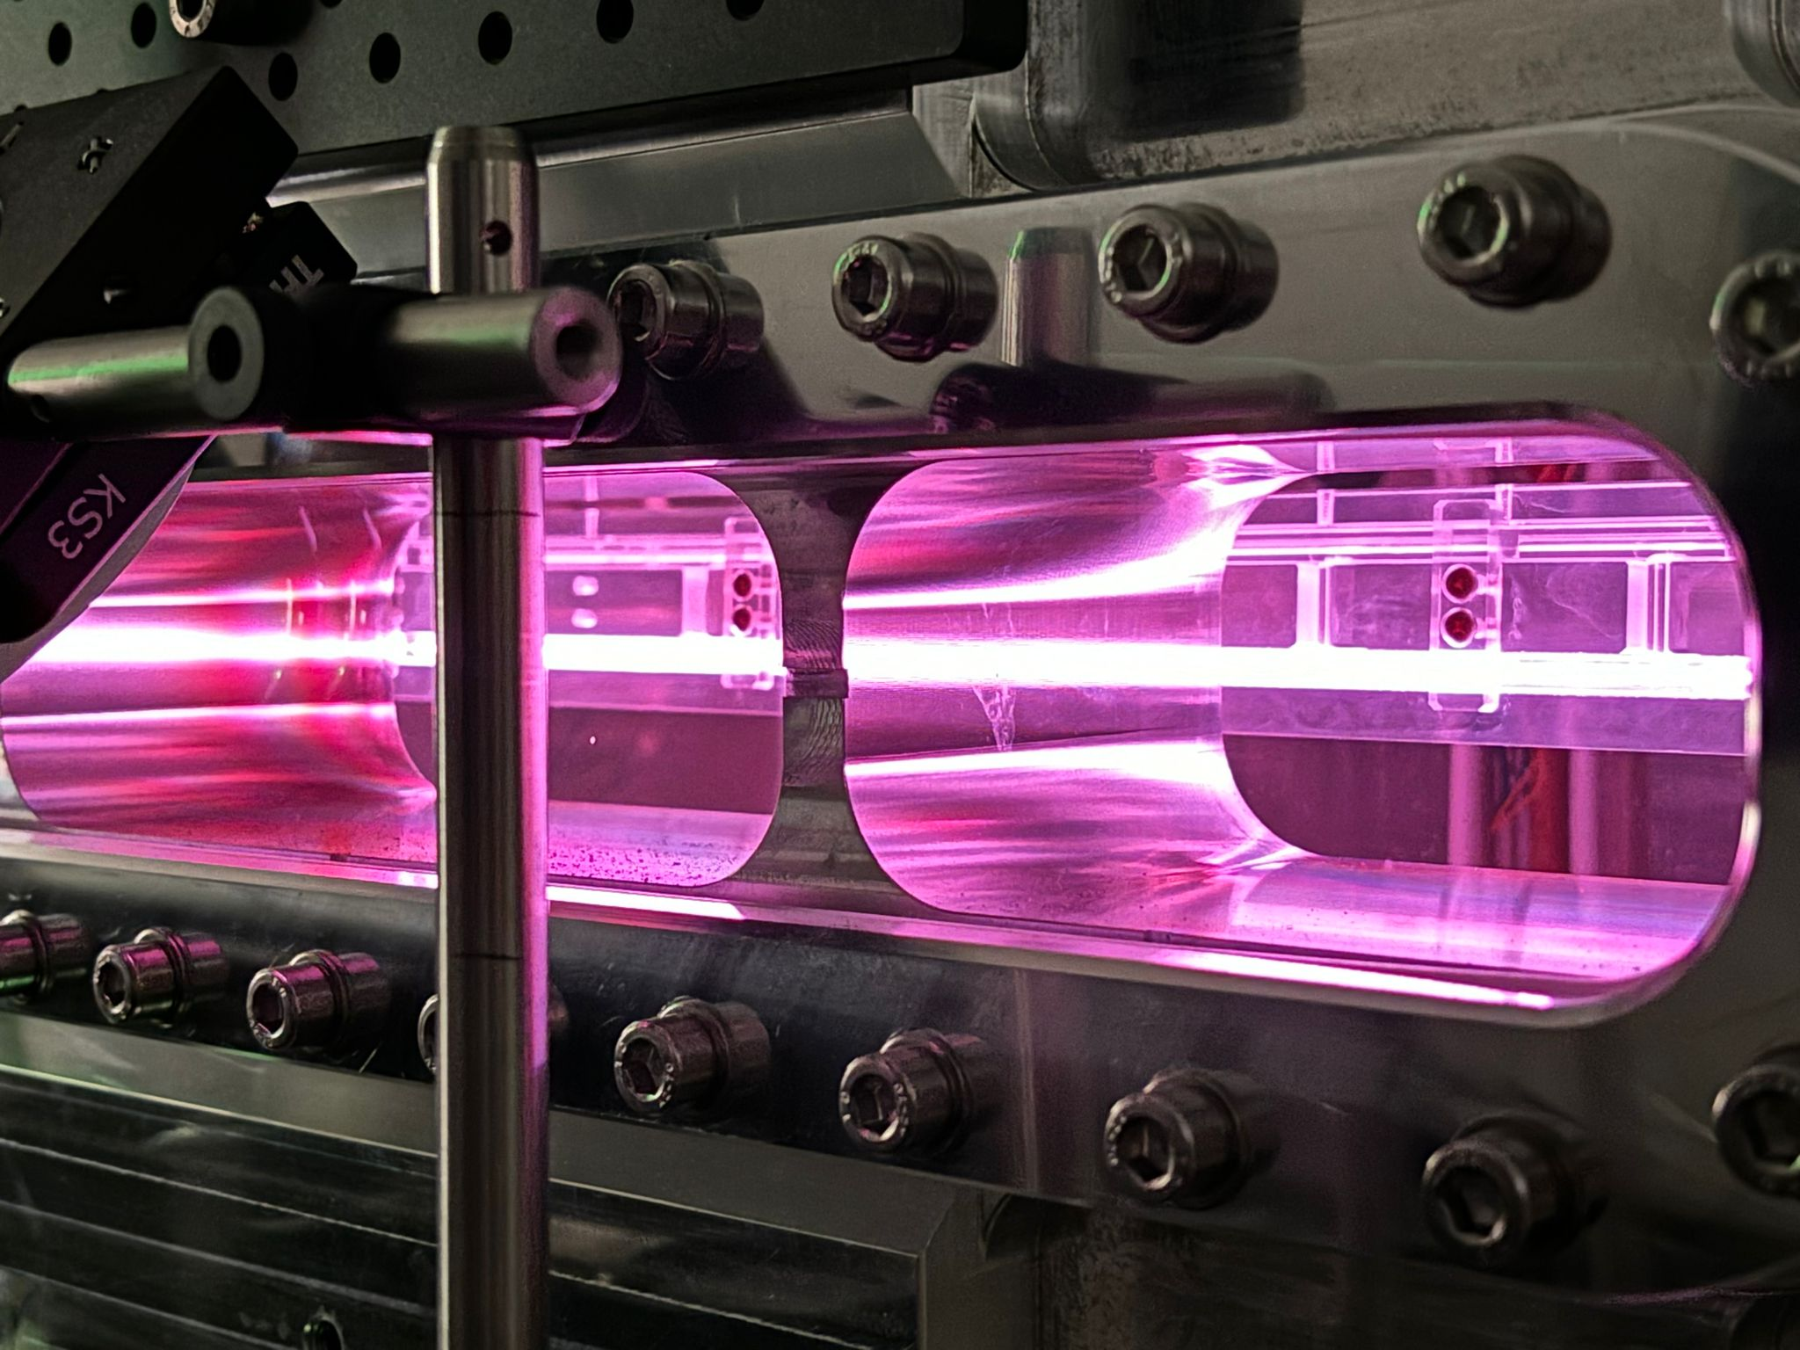
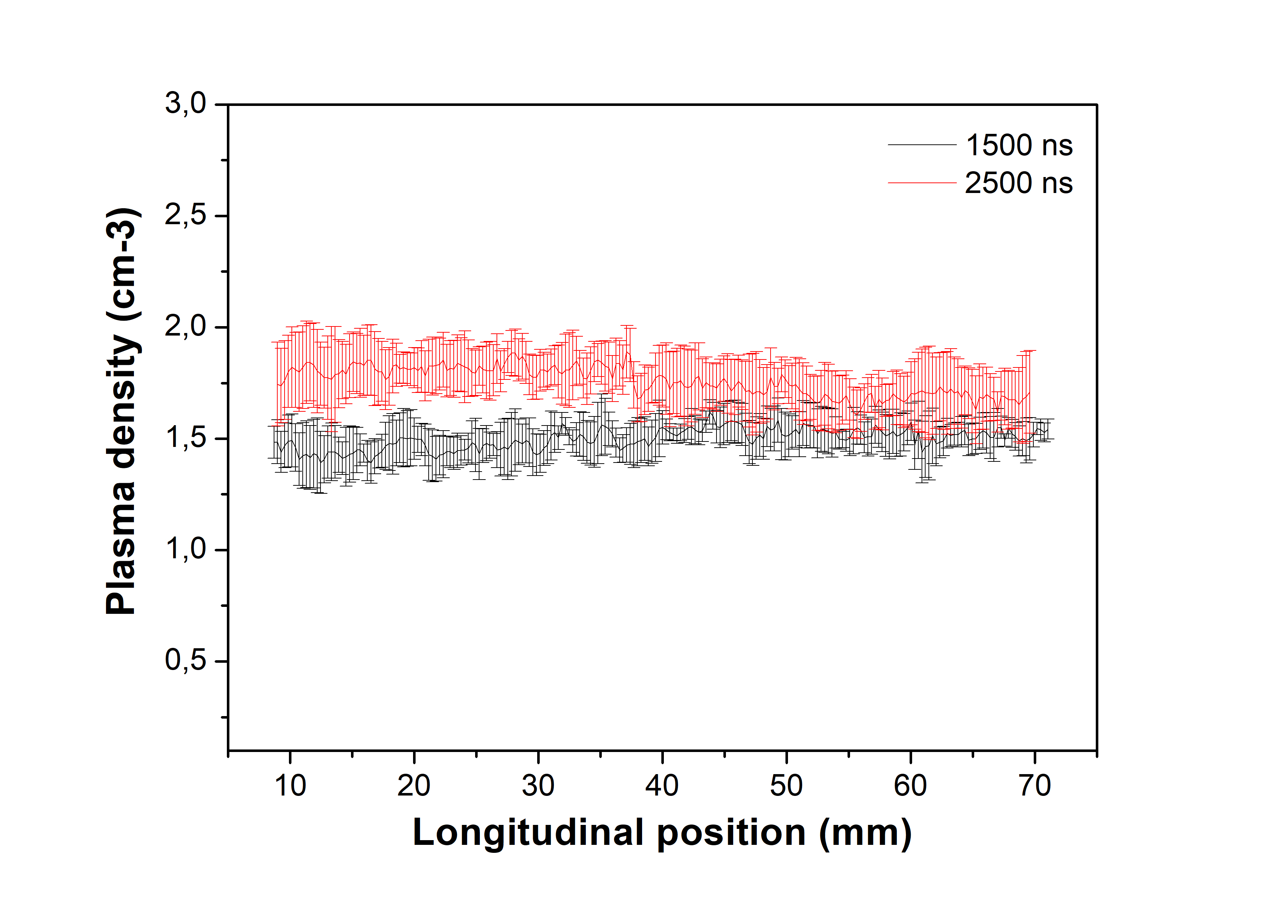
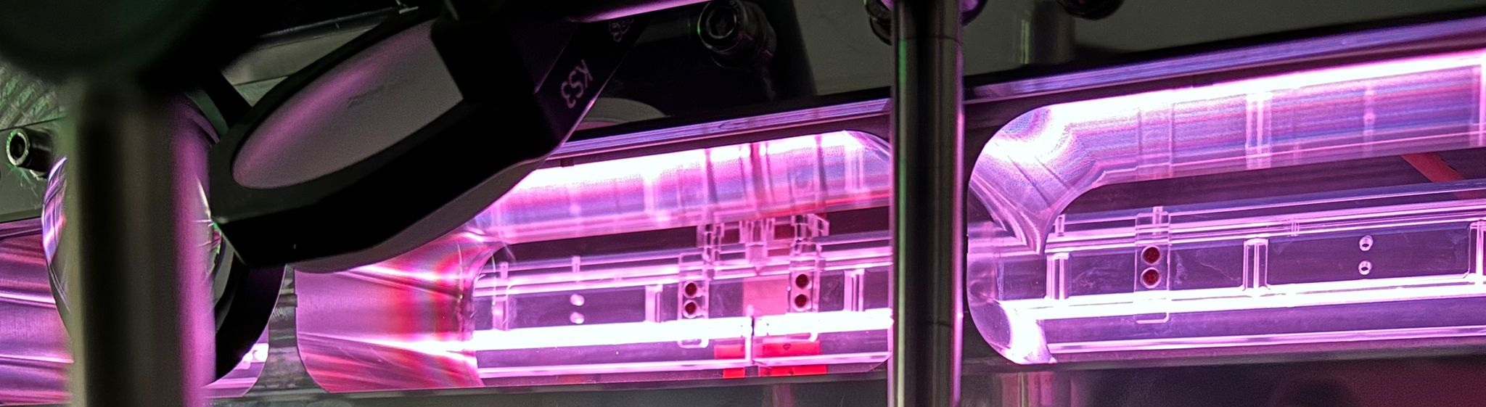
Design of long plasma sources for the EuPRAXIA project
1.1 GeV (1 GV/m 600 MeV in 60cm long capillary - density 10¹⁶ cm-3 )
60-cm long discharge capillary
Technical rooms
159 m
Klystron & power supplies hall
Preparations labs
45 m
Accelerator tunnel
Plasma
module
Undulator tunnel
Experimental hall
Lasers clean rooms
Laser and particle user rooms
10¹⁷
                Fabrication by machining
                10 increasing diameter
                Density range 10¹⁶ -10¹⁷ cm⁻³
                13 kV with 500 A
                100 Hz rep Rate
  V = 13 kV
  Ip = 500 A
Pag. 9

Slide 10
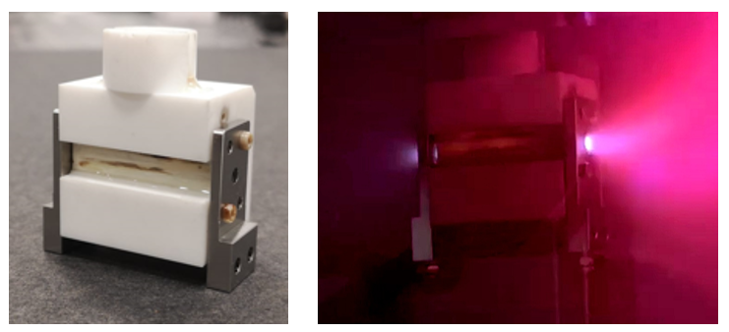
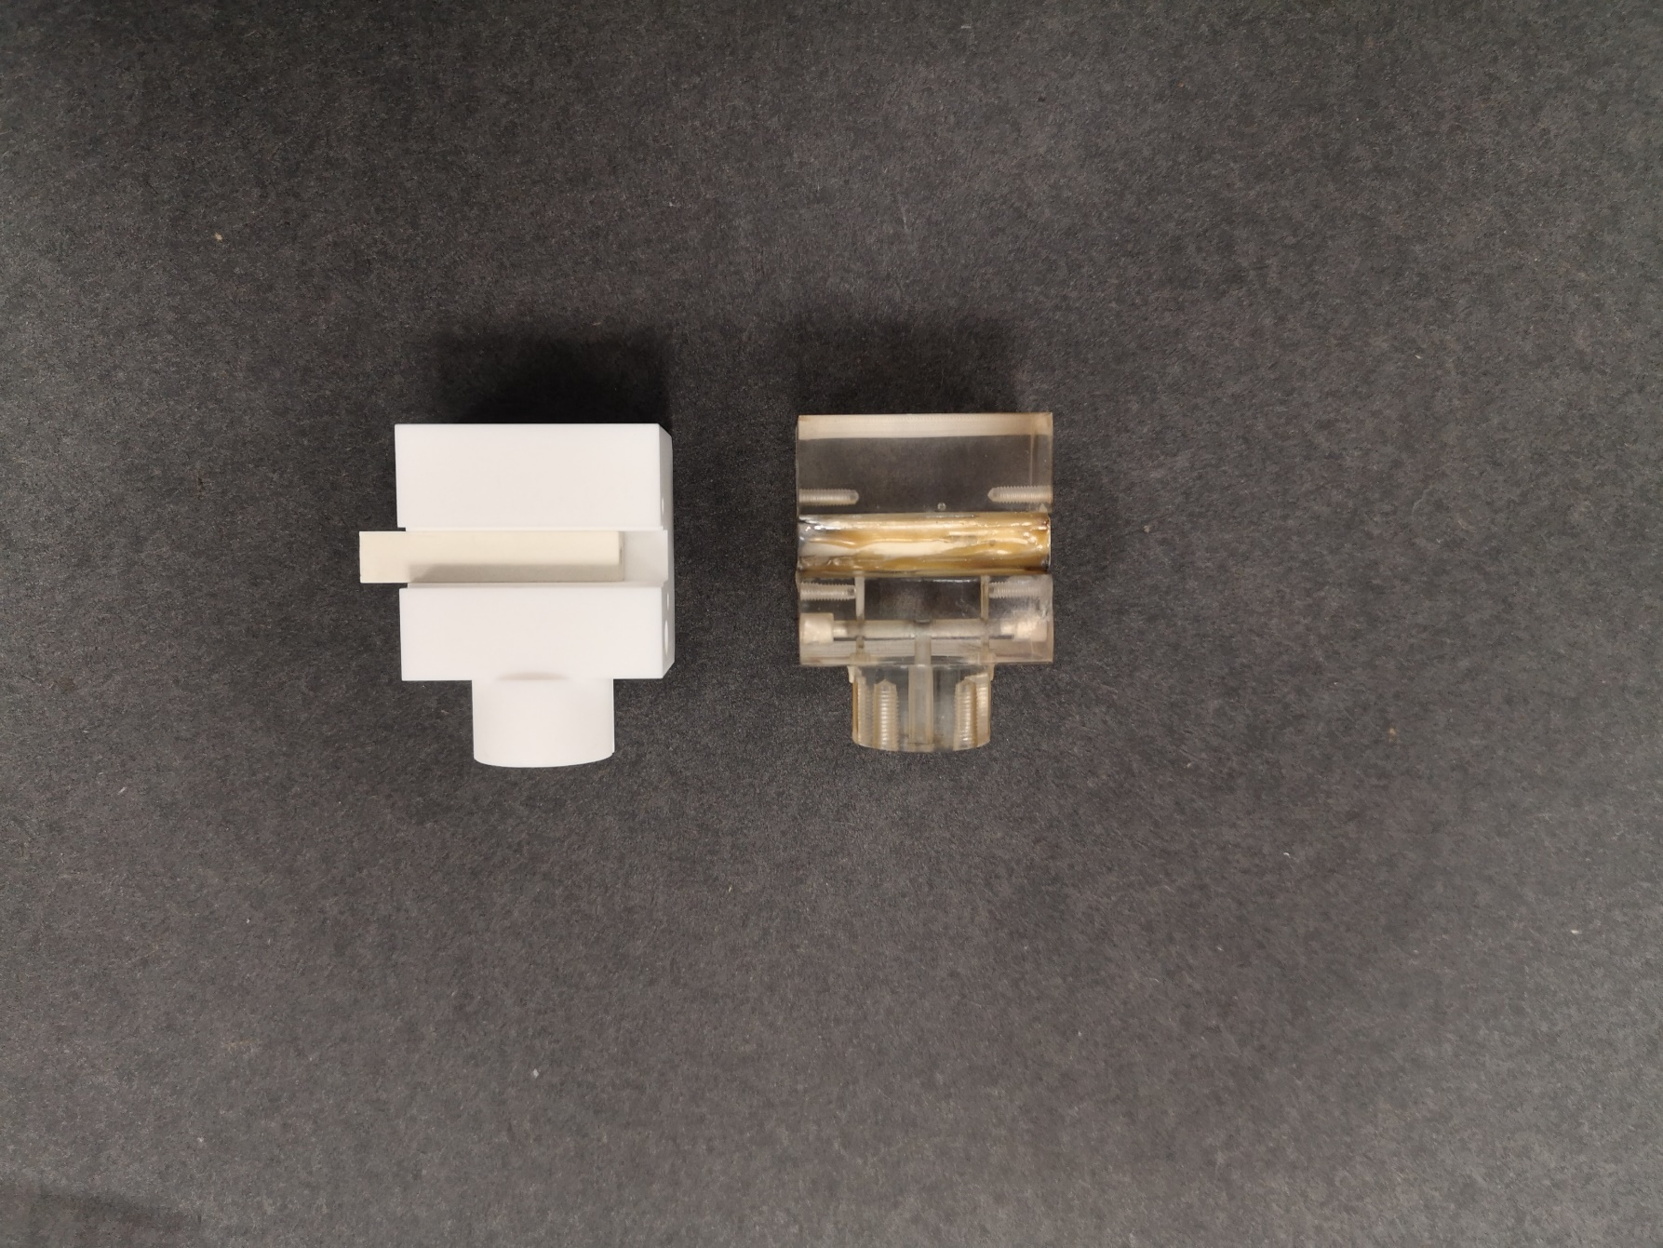
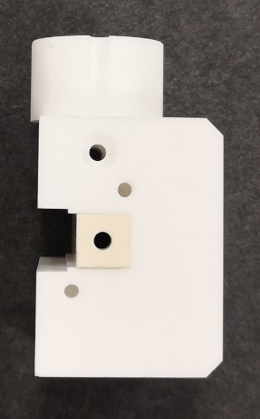
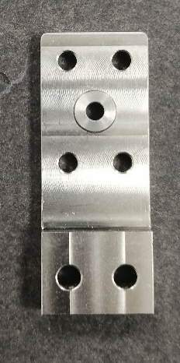
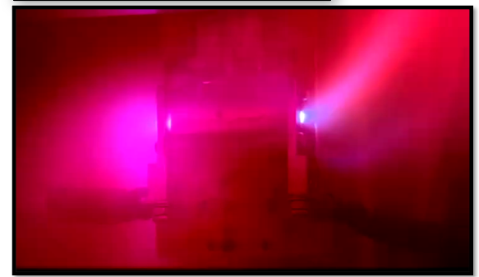
Design of plasma sources – High repRate operations
First prototype of the ceramic capillary
Molybdenum
10-150 Hz operation
N₂ 80-100 mbar in continuous flow
6 kV – 500 A
Shapal
150 Hz repetition rate discharges
Macor
Stainless
steel
High thermal conductivity
High max operating temperature
Good machinability, cost-effectiveness and availability for large geometries
New materials for electrodes
Sapienza Università di Roma |Thursday 13.11.2025
Pag. 10

Slide 11
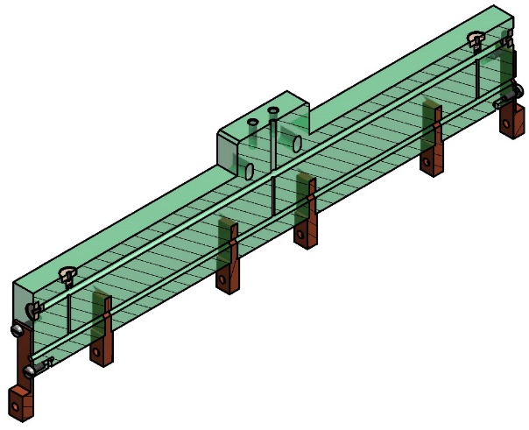
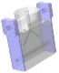
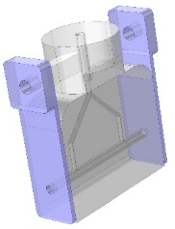
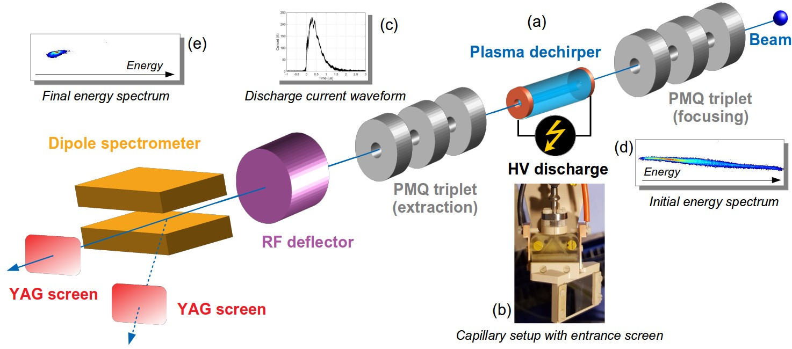
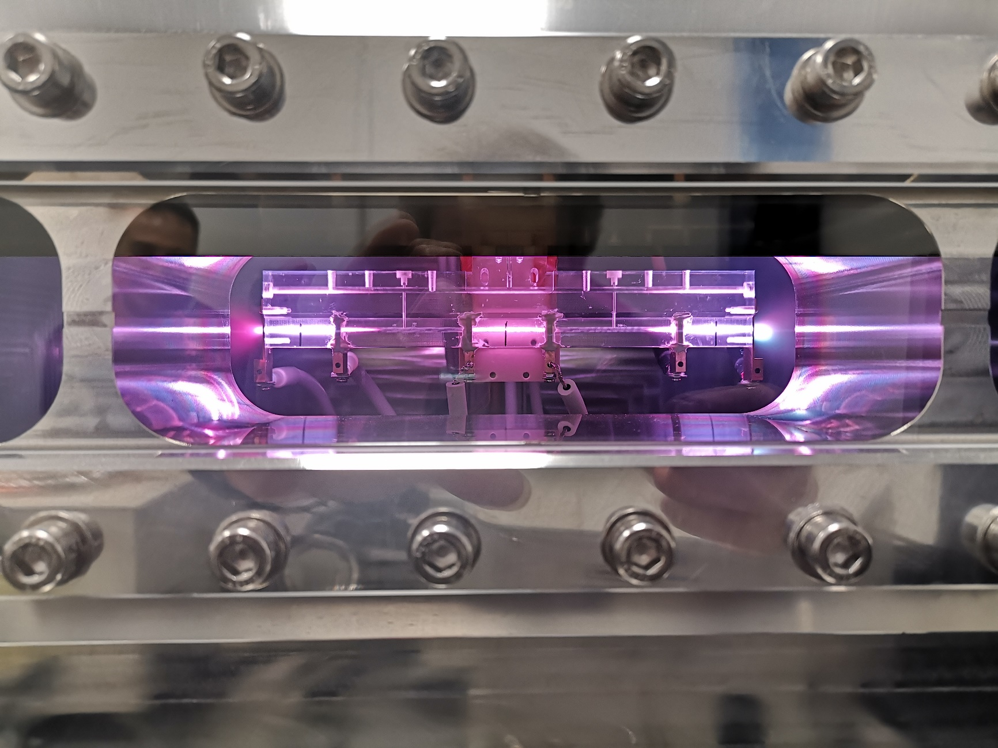
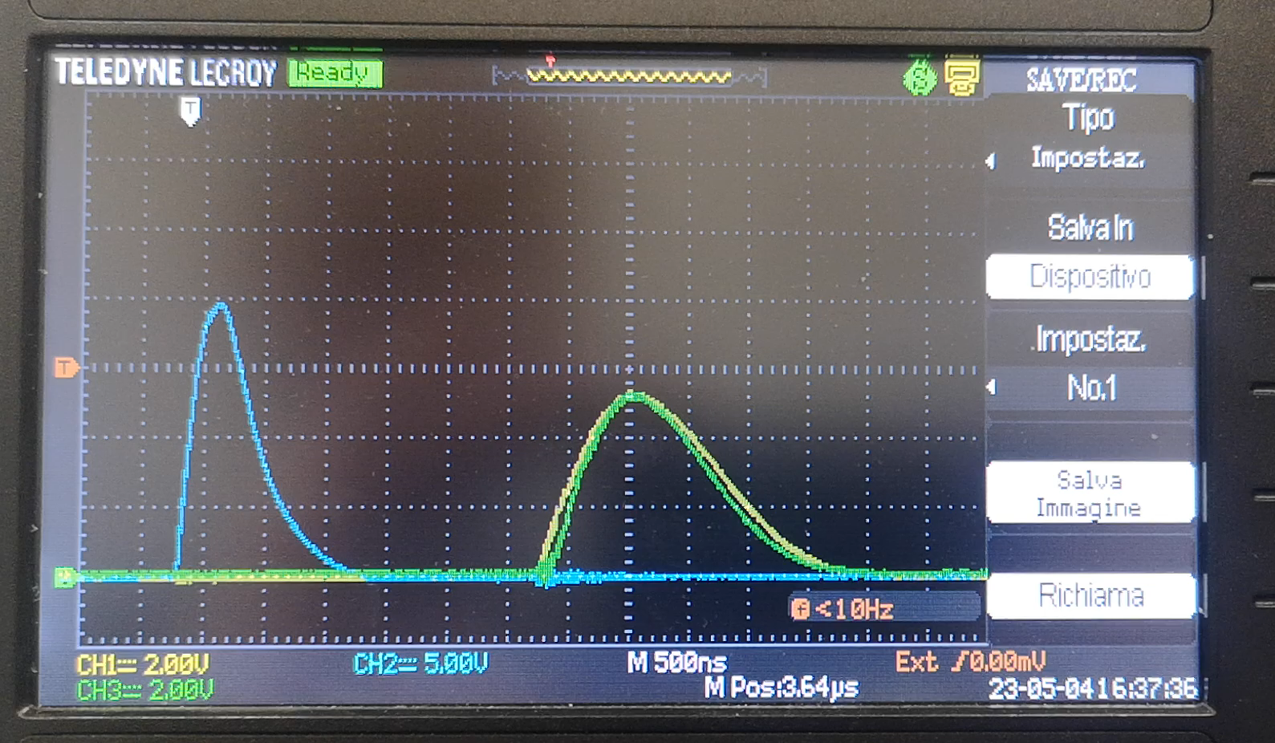
Compact plasma accelerating modules
Active plasma
lens
Acelerating
section
Integrated plasma module
Focusing
lens
Plasma capillary
Plasma capillary
Extraction
lens
Quadrupoles are essential
to achieve plasma acceleration
Alinegment issues
Compactness (20 cm)
No motors to move PMQs
Strong current-modulated magnetic field (1 kT/m)
Plasma formation
Lens ON Acc ON Lens ON
Current pulses
Acc-200A
3 us
Lens-500A
Pag. 11

Slide 12
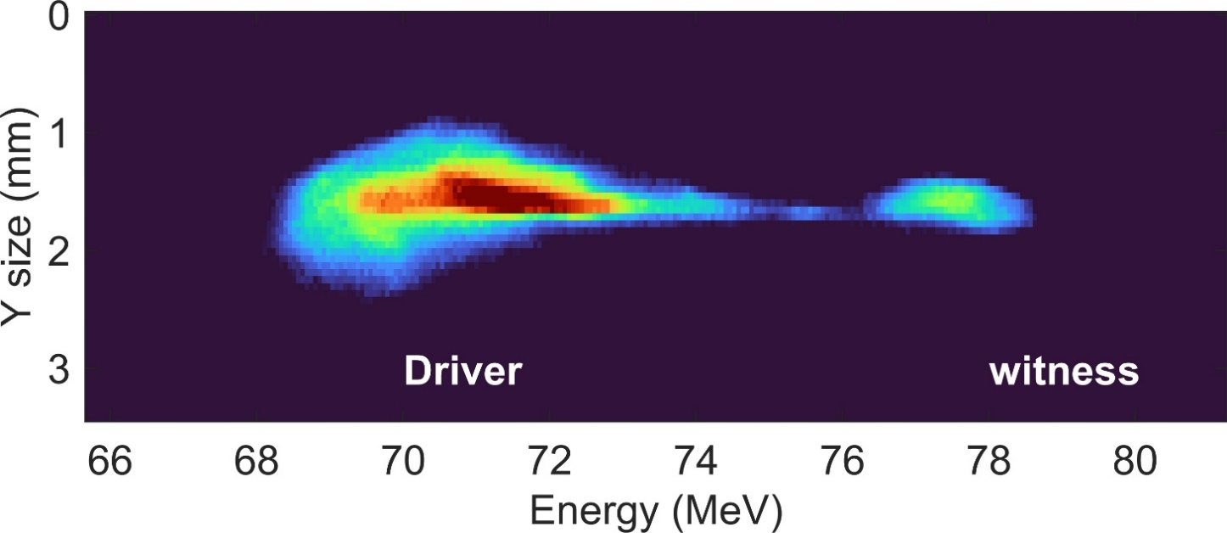
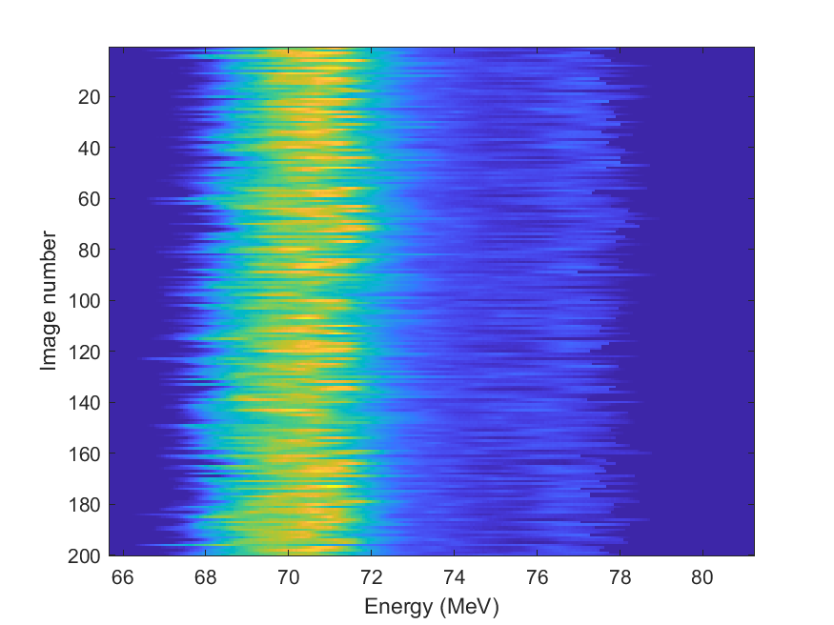
Compact plasma accelerating modules
200 consecutive shots taken with accelerated beam
Driver
Witness
5 MeV/3cm acceleration in 19 cm long integrated plasma module with 200 pC driver/50 pC witness
  3 cm long accelerator with 200 A ionization current
  3 cm long plasma lenses with 500 A ionization current
  Plasma density inside the accelerator set to 2x10¹⁵ cm⁻³
  ~150 MV/m accelerating gradient
  Stability of the accelerated beam
Pag. 12

Slide 13
Conclusions
Particle acceleration based on plasma technology involves research across a wide range of subjects related to the overall design of the plasma accelerator module. This includes studies on plasma generation techniques, plasma property measurements, and improvements in the geometric modeling of the plasma source:
    Design and development of plasma sources based on electrical discharge and laser pulses
          Lasers
          High voltage circuits
    Theoretical studies of magnetohydrodynamic models capable of simulating plasma formation from neutral gases
    Theoretical and experimental study of laser–plasma interaction
    Characterization of plasmas for particle accelerators
          Spectroscopy
          interferometry
Sapienza Università di Roma |Thursday 13.11.2025
Pag. 13

Slide 14
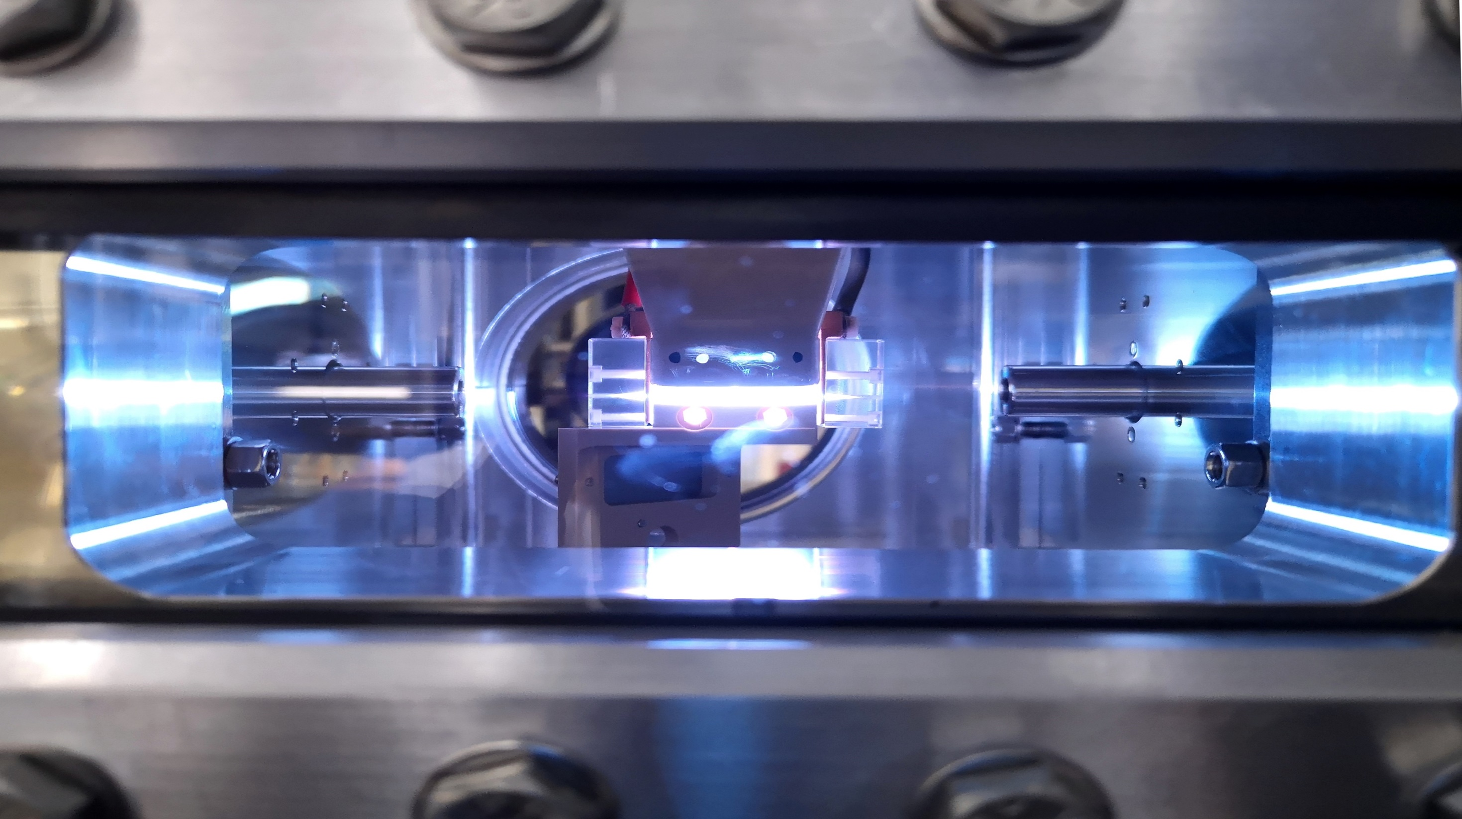
Thank you for your attention
Angelo.Biagioni@lnf.infn.it

