Slide 1


LHC Injection Dynamics for the HL-LHC Era
Longitudinal Beam Dynamics at Highest Intensity in the Super Proton Synchrotron
Ph.D. candidate: Birk Emil Karlsen-Bæck
Supervisors: Prof. M. Migliorati & Dr. H. Timko
XXXVIII Ph.D. School in Accelerator Physics – 3rd Year Final Seminar 12/11/2025

Slide 2
Contents
Introduction
Optimization and implementation in hardware
Experience with high-intensity beams in the LHC
Projections for HL-LHC operation
Conclusions

Slide 3
LHC Layout
26.7 km tunnel with two rings [1]
Beam 1 (clockwise) and beam 2 (counter-clockwise), each with up to 2760 bunches
Minimum 25 ns spacing between bunches
Injected at 450 GeV/c and accelerated to 6.8 TeV/c
Eight interaction regions (IRs)
Four experiements
Superconducting magnets
Injector: Super Proton Synchrotron
Second largest synchrotron at CERN
Can deliever up to 288 bunches per injection into the LHC
Notes:
Show LHC and SPS as injector

Slide 4
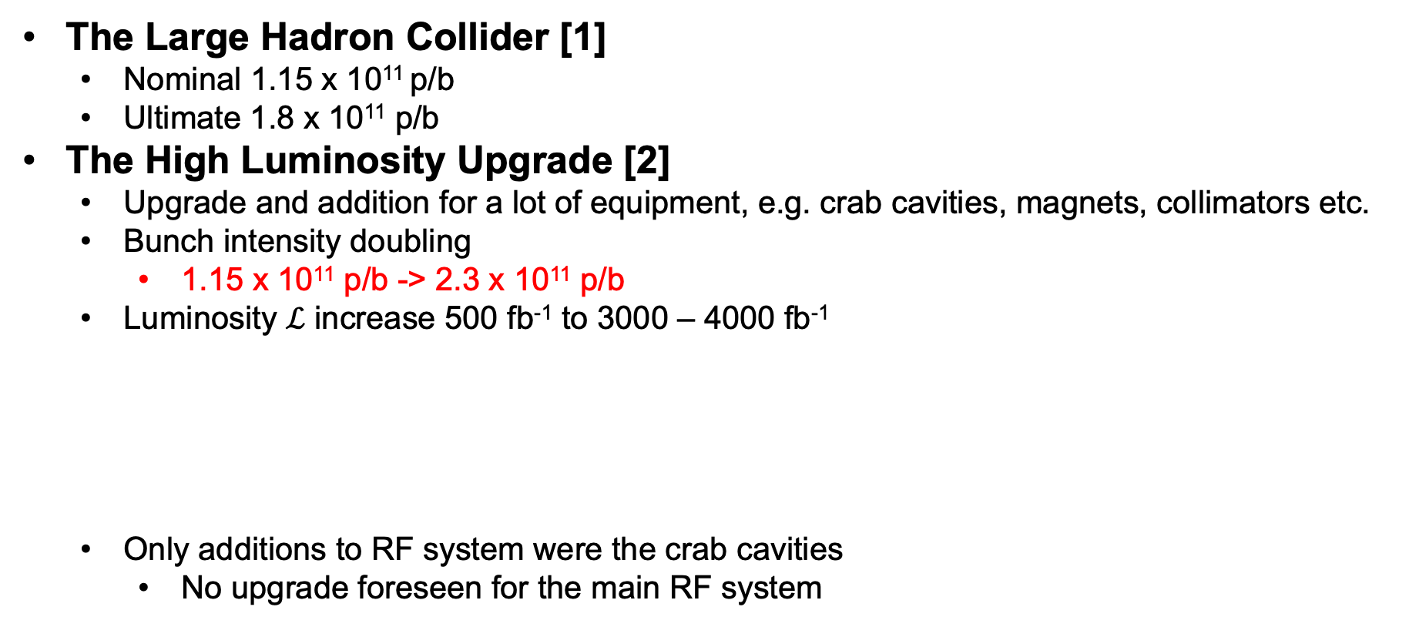
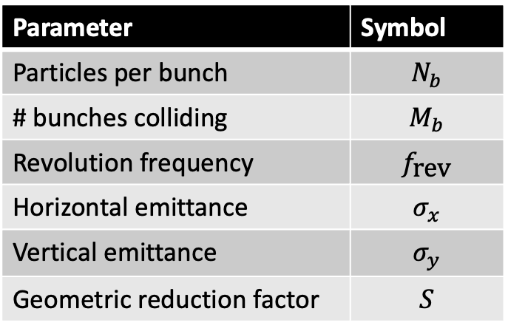
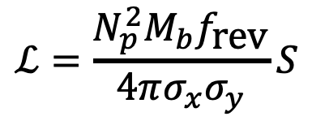
The High-luminosity LHC Era
The Large Hadron Collider [1]
Nominal 1.15 x 10¹¹ p/b
Ultimate 1.8 x 10¹¹ p/b
The High Luminosity Upgrade [2]
Upgrade and addition for a lot of equipment, e.g. crab cavities, magnets, collimators etc.
Bunch intensity doubling
1.15 x 10¹¹ p/b -> 2.3 x 10¹¹ p/b
Luminosity $ℒ$ increase 500 fb⁻¹ to 3000 – 4000 fb⁻¹
Only additions to RF system were the crab cavities
No upgrade foreseen for the main RF system
Parameter | Symbol
Particles per bunch | $$N_{b}$$
# bunches colliding | $$M_{b}$$
Revolution frequency | $$f_{\text{rev}}$$
Horizontal emittance | $$σ_{x}$$
Vertical emittance | $$σ_{y}$$
Geometric reduction factor | $$S$$
$$ℒ=\frac{N_{p}^{2}M_{b}f_{\text{rev}}}{4πσ_{x}σ_{y}}S$$
Notes:
Add color to equation and a table

Slide 5

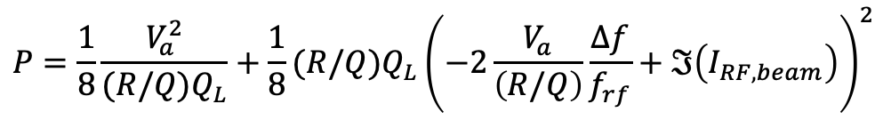
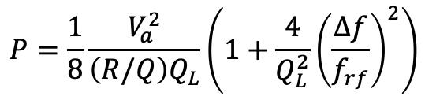



Beam Loading and Cavity Controllers
Oscillating voltage from an RF cavity
Half-detuning beam-loading compensation scheme [3]
Without beam
$$P=\frac{1}{8}\frac{V_{a}^{2}}{{\left(R/Q\right)Q}_{L}}\left(1+\frac{4}{Q_{L}^{2}}{\left(\frac{Δf}{f_{rf}}\right)}^{2}\right)$$
With beam
$$P=\frac{1}{8}\frac{V_{a}^{2}}{{(R/Q)Q}_{L}}+\frac{1}{8}(R/Q)Q_{L}{\left(−2\frac{V_{a}}{\left(R/Q\right)}\frac{Δf}{f_{rf}}+ℑ\left(I_{RF,beam}\right)\right)}^{2}$$
Total gap voltage, $V_{a}$
Total field in the cavity
Loaded quality factor, $Q_{L}$
Field for a given power
Cavity detuning, $Δf$
Difference between the resonant frequency and the rf frequency
R upon Q, $(R/Q)$
Accelerating field for a given energy stored in the cavity
Notes:
Introduce external voltage -> figure below with second line of the beam-induced voltage (beam loading)
You need power to counter act this beam-induced voltage.
In the LHC most of the power goes to counteracting this beam-loading
Show voltage and bucket:
No beam loading
With beam loading but with out CC
With beam loading and CC -> higher power

Slide 6
The LHC RF System
Eight 400 MHz superconducting standing-wave RF cavities per beam
Each cavity is power by its own klystron and has its own cavity controller
Each klystron can provide maximum 300 kW [4]
A circulator between the klystron and the cavity
The low-level RF system [5]
Fast RF feedback
One-turn delay feedback (OTFB)
Switch and protect (SWAP) unit
Prevent feedbacks from requesting too much power from klystron
Tuner loop
Controls position of power coupler
Controls stepper motor that mechanically tunes the RF cavity
Notes:
Use colors

Slide 7
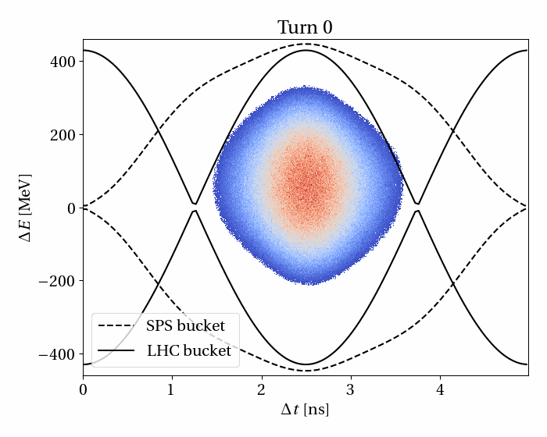
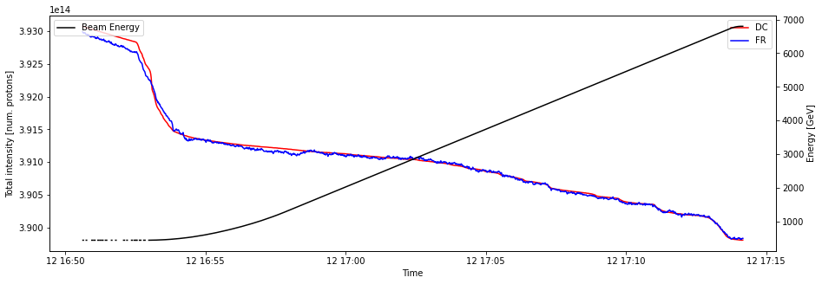
Beam Losses at the Start of the Ramp
Uncaptured beam generated at injection
Due to errors in energy and timing at transfer
Intra-beam scattering (IBS) [6]
Small angle scattering of particles inside the bunches
Lead to a diffusive effect in the LHC in all three planes
Due to diffusion from IBS and background noise in the RF system [7]
Particles slowly leak from buckets
Most particles outside the RF buckets at the start of the energy ramp will lost on the collimators in IR3
Part of the beam outside the RF buckets will be cleaned by the transverse damper
Losses are less 0.5% of the total circulating beam, but are lost over a few seconds
Notes:
Capture losses, IBS losses, and ADT cleaning

Slide 8
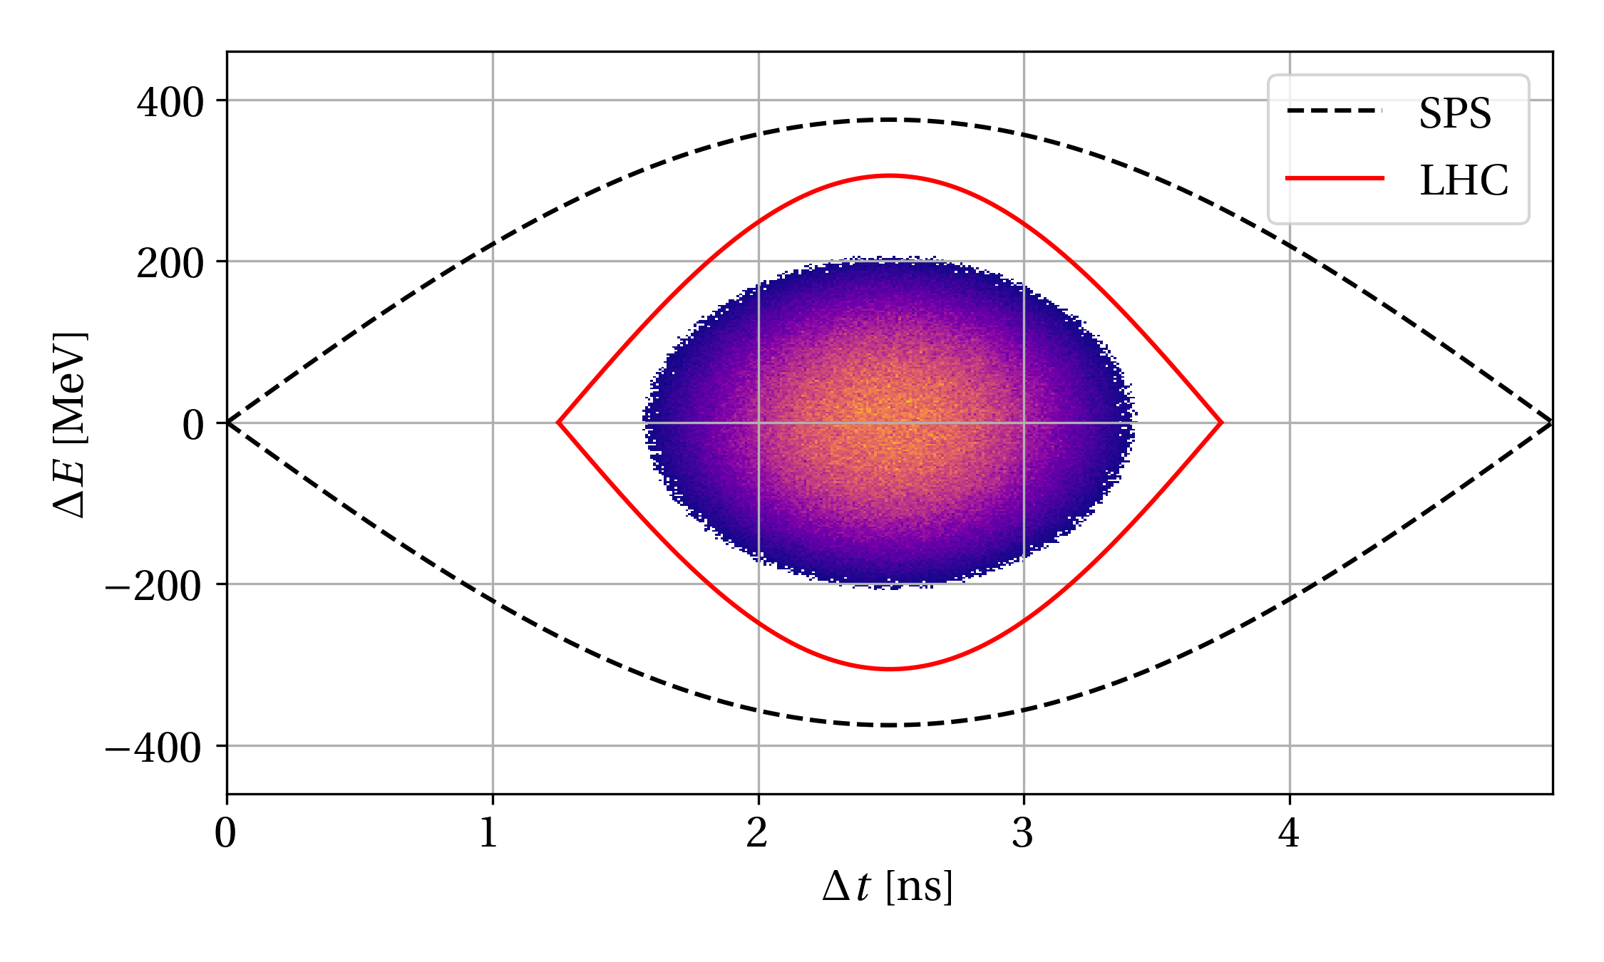
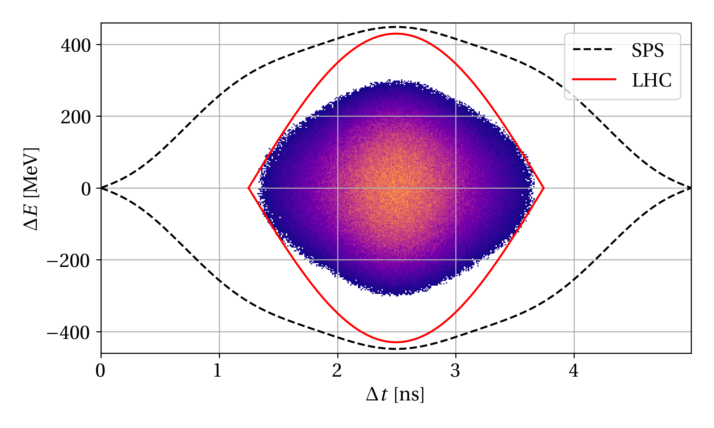
RF Power Limitations at Injection Energy
SPS and LHC bucket, 2018
SPS and LHC bucket, HL-LHC
Relative momentum spread increase
2018: 7 MV in SPS -> 4 MV in LHC
HL-LHC: 10 MV in SPS -> 7.9 MV in LHC
3.74 x 10⁻⁴ -> 5.32 x 10⁻⁴
84 kW average steady-state RF power in the LHC
265 kW average steady-state RF power in the LHC
Notes:
Table with power w/o beam, avg power, peak power

Slide 9
RF Power Limitations at Injection Energy
Voltage needed calculated simple scaling with momentum spread
Does not take into account:
Injection offsets
Beam loading
Debunching during flat bottom
What voltage do we need to have an acceptable amount of losses?
RF power requirements based on steady-state RF power demand
Does not take into account
power transients at injection
peak power when the beam is in steady state
Significant ±20% spread in RF power has been observed in the past in the LHC
What is the maximum voltage that can be achieved with HL-LHC beams?
Notes:
Table with power w/o beam, avg power, peak power

Slide 10
Overview of the Project
RF Hardware
Operation
Calibration of
RF parameters
High-intensity
MDs
Measurement
Campaign
Pre-detuning
At Injection
RF Power
Margins
Minimum RF
Capture Voltage
The HL-LHC
Operational Scenario
Half-detuning
Optimization
Operational
Beam Evolution
At flat-bottom
Beam Losses at
The Start of the Ramp
Modelling of LLRF
Control Loops
Intra-beam
Scattering
Simulation
Campaign
Notes:
Boxes from this diagram in the different slides to illustrate what the subject belongs to

Slide 11
Overview of the Project
RF Hardware
Operation
Calibration of
RF parameters
High-intensity
MDs
Measurement
Campaign
Pre-detuning
At Injection
RF Power
Margins
Minimum RF
Capture Voltage
The HL-LHC
Operational Scenario
Half-detuning
Optimization
Operational
Beam Evolution
At flat-bottom
Beam Losses at
The Start of the Ramp
Modelling of LLRF
Control Loops
Intra-beam
Scattering
Simulation
Campaign

Slide 12
Hardware Optimisations
Optimization of half-detuning [8]
Used to be manual but is now almost automatic
Algorithm developed to detect power in beam segment
Automatic optimization of LHC RF working point in half-detuning
Pre-detuning at injection [8,9]
Pre-detune RF cavities in anticipation of beam loading from first long bunch trains
Scans performed in operation and recreated in simulation using BLonD [10]
Is projected to reduce peak power of first long train injection for HL-LHC by almost 3 times
Notes:
Simplified picture of the LHC with the two rings and the experiments
Table with the main parameters

Slide 13
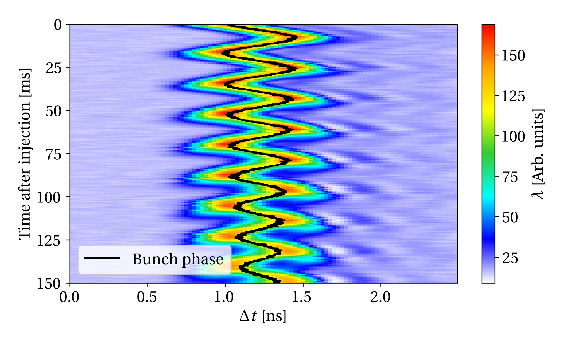
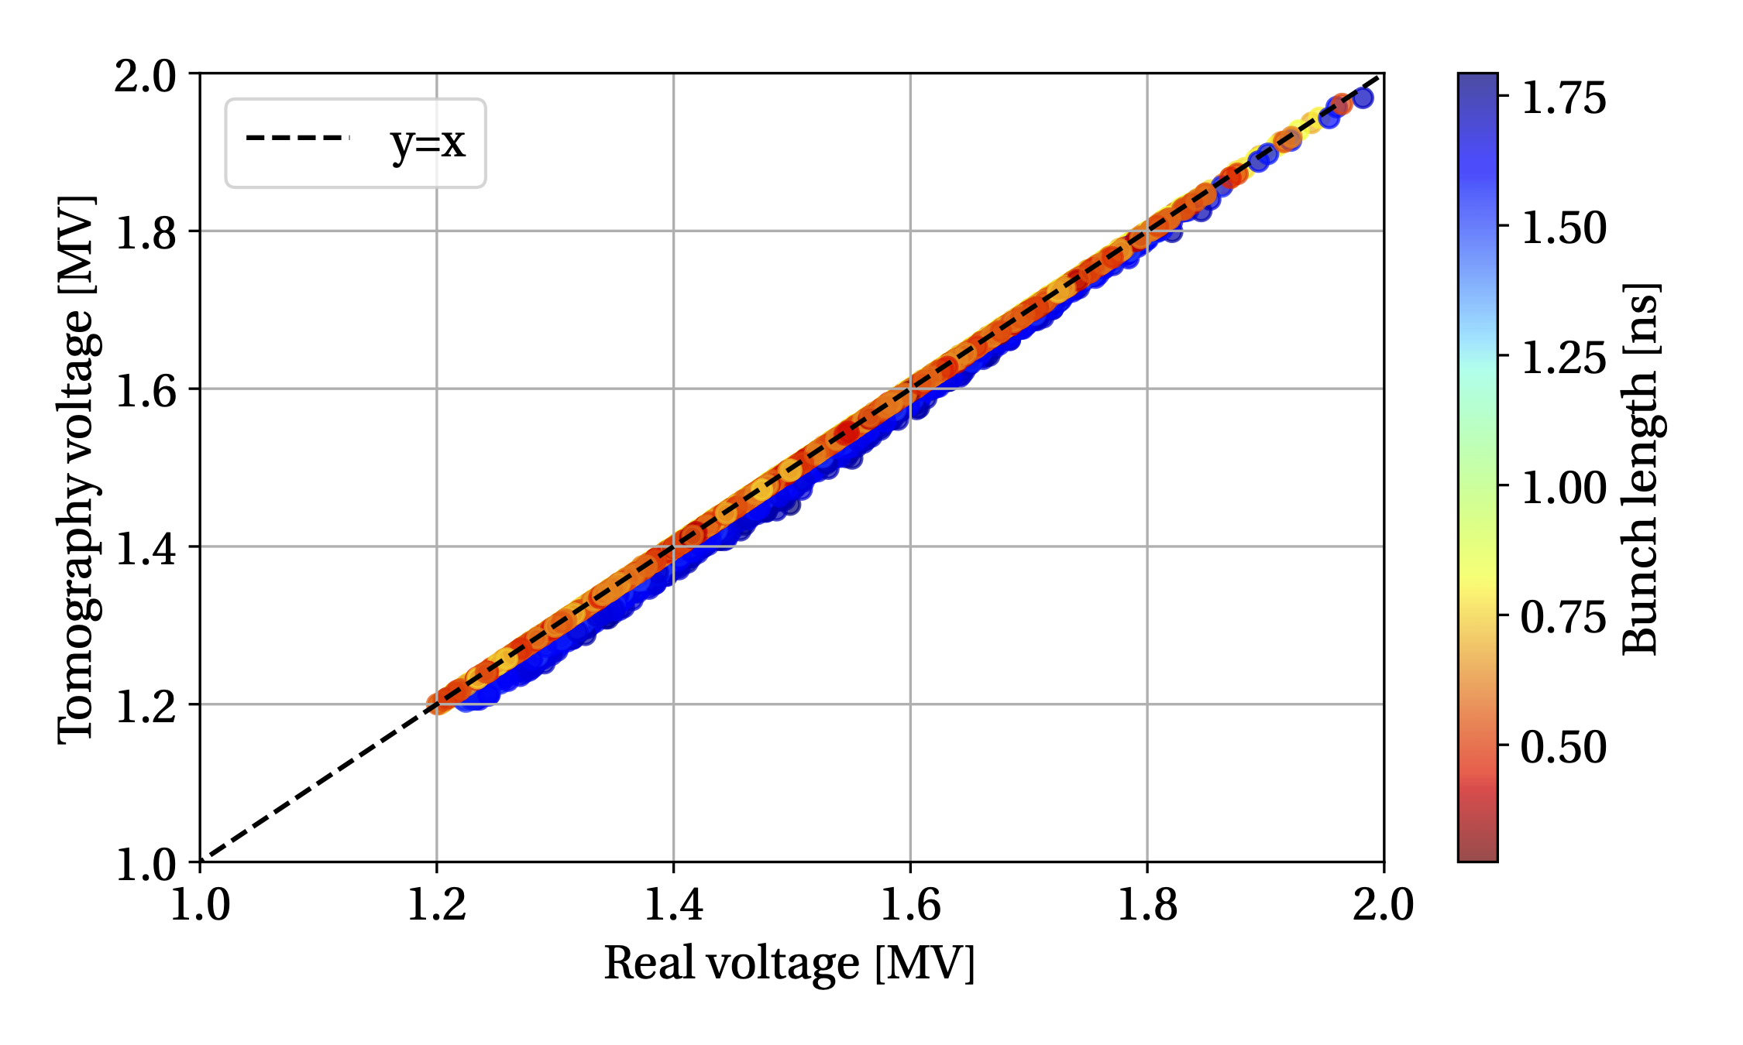
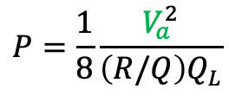
Calibration of the RF Voltage
10% uncertainty on RF voltage in the past
Two methods
Synchrotron frequency from bunch phase oscillations
Longitudinal phase-space tomography [11,12]
First measurement in 2022 [13]
Corrections implemented in the LLRF
Confirmed with measurements in 2024 and 2025
Simulation study using BLonD
Synchrotron frequency accurate within 3%
Tomography accurate within 1%
$$P=\frac{1}{8}\frac{V_{a}^{2}}{{\left(R/Q\right)Q}_{L}}$$
Results for Beam 1
Notes:
Simplified picture of the LHC with the two rings and the experiments
Table with the main parameters

Slide 14
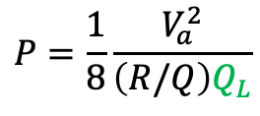
New Calibration method of the Quality Loaded
Participated during month-long LHC hardware commissioning in 2024
Previously calibrated from
power and voltage
Open-loop transfer function
Open-loop transfer function is very inaccurate 12% – 25%
New method
Observe the decay of voltage inside the cavity
Only fitting a single parameter
Simulations showed that this method should be very accurate
vs.
$$P=\frac{1}{8}\frac{V_{a}^{2}}{{\left(R/Q\right)Q}_{L}}$$
Notes:
Simplified picture of the LHC with the two rings and the experiments
Table with the main parameters

Slide 15
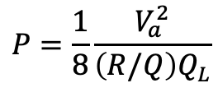
Available RF Power in the LHC and HL-LHC
Combining calibrated RF voltage and loaded quality factor without beam
Agrees with independent measurement
Based on calibration of the directional couplers measuring the forward power from the klystron
Some margin is lost when the SWAP is active
Based on the calibrated RF power up to 6.5 MV could be sustained [14]
High efficiency (HE) klystrons will be installed for HL-LHC [15]
Increase of power from 300 kW to 350 kW by design -> 7.4 MV
$$P=\frac{1}{8}\frac{V_{a}^{2}}{{\left(R/Q\right)Q}_{L}}$$
Notes:
Simplified picture of the LHC with the two rings and the experiments
Table with the main parameters

Slide 16
Overview of the Project
RF Hardware
Operation
Calibration of
RF parameters
High-intensity
MDs
Measurement
Campaign
Pre-detuning
At Injection
RF Power
Margins
Minimum RF
Capture Voltage
The HL-LHC
Operational Scenario
Half-detuning
Optimization
Operational
Beam Evolution
At flat-bottom
Beam Losses at
The Start of the Ramp
Modelling of LLRF
Control Loops
Intra-beam
Scattering
Simulation
Campaign
Notes:
Boxes from this diagram in the different slides to illustrate what the subject belongs to

Slide 17
Beam Measurements
In total 9 x 8-hour MDs performed
Overview of high intensity MDs
MDs in the LHC
Dedicated beam time to perform measurements and tests
MD milestones
2022: RF voltage calibration, capture of 1.8 x 10¹¹ p/b [13,16]
2023: Capture of 2.0 x 10¹¹ p/b [17]
2024: Capture of 2.3 x 10¹¹ p/b BCMS* beam and direct measurements of start-of-ramp losses
2025: Capture of 2.3 x 10¹¹ p/b standard and 8b4e beams
Year | Beam type | Bunch Intensity | RF Voltage
2023 | Standard | 1.9 x 10¹¹ p/b | 5 MV
2023 | Standard | 1.9 x 10¹¹ p/b | 7 MV
2024 | BCMS* | 2.0 x 10¹¹ p/b | 7 MV
2024** | BCMS* | 2.3 x 10¹¹ p/b | 6.5 MV
2025 | Standard | 2.3 x 10¹¹ p/b | 6.0 MV
2025 | 8b4e | 2.3 x 10¹¹ p/b | 8.0 MV
*Low transverse emittance beam type
**With the OTFB open, note a few bunches saturated FBCT
Notes:
Simplified picture of the LHC with the two rings and the experiments
Table with the main parameters
Say what is BCMS

Slide 18
Debunching during Run 3 and HL-LHC
Beam measurements [18]
Calculated debunching rate
Debunching and RF Voltage
HL-LHC bunches were found to suffer less from IBS than the operational beams
Confirmed from theory [19]
Due to larger transverse emittances
Using IBS model in BLonD [20]
More particles loss despite less IBS-driven bunch lengthening
Notes:
Say that stars are measurements

Slide 19
Off-position Beam and Start-of-ramp Losses
All particles leaking from the bunches drift off-momentum relative to the main bunches
This can be measured by comparing the DC and fast BCTs
Off-position beam: estimate the beam lost from the bunches but is still circulating [21]
From operation:
Linear correlation between off-position beam and start-of-ramp losses
Start-of-ramp losses correlate with maximum ratio to dump in IR3
Off-momentum beam
Bunch
Off-position beam
Satellite particles
Notes:
Simplified picture of the LHC with the two rings and the experiments
Table with the main parameters

Slide 20
Beam Losses during High-intensity MD Sessions
Off-position beam was estimated for high-intensity tests
Scaled to the full HL-LHC beam spending the a projected 20 – 25 min at injection energy
Operational correlations can be used to
calculate start-of-ramp losses for fills where the beam was not ramped
Project the maximum ratio to dump threshold for the beams injected during the MDs
This does not take into account uncaptured beam
47% of dump threshold has been reach despite 10 - 20 % expected from off-position beam
Beam type | RF Voltage | # Bunches | Ratio to dump, Beam 1 | Ratio to dump, Beam 2
BCMS | 6.5 MV | 2748 | 9.4 % | 29.8 %
Standard | 6.0 MV | 2760 | 23.2 % | 56.4 %
Standard | 6.0 MV | 2760 | 24.0 % | 30.8 %
8b4e | 6.0 MV | 1972 | 14.8 % | 10.8 %
Notes:
Simplified picture of the LHC with the two rings and the experiments
Table with the main parameters

Slide 21
Uncaptured beam generated at injection
Estimated by comparing BCTs in SPS and LHC for each injection
Tracking model used to calculate uncaptured beam generated at injection
Detailed model of beam dynamics at SPS flat top and LHC injection [22, 23]
Benchmarked against operational and MD measurements
Results show that around 1% of the high-intensity trains will be converted to uncaptured particles with present RF voltage
The bunches near head and tail of trains lose the most
For example, the standard beam
1% uncaptured would implie 6.3 x 10¹² p in total which would need to be cleaned before acceleration
Coupling of control loops for the first time in a tracking code [24]
Notes:
Simplified picture of the LHC with the two rings and the experiments
Table with the main parameters

Slide 22
Overview of the Project
RF Hardware
Operation
Calibration of
RF parameters
High-intensity
MDs
Measurement
Campaign
Pre-detuning
At Injection
RF Power
Margins
Minimum RF
Capture Voltage
The HL-LHC
Operational Scenario
Half-detuning
Optimization
Operational
Beam Evolution
At flat-bottom
Beam Losses at
The Start of the Ramp
Modelling of LLRF
Control Loops
Intra-beam
Scattering
Simulation
Campaign
Notes:
Boxes from this diagram in the different slides to illustrate what the subject belongs to

Slide 23
The HL-LHC Operational Scenario
Peak power from calibration
Currently: around 275 kW/klystron
HL-LHC: around 320 kW/klystron
Voltage for different beam types
Currently: 6.5 MV (8.0 MV for 8b4e)
HL-LHC: 7.4 MV (9.5 MV for 8b4e)
Simulated uncaptured beam
Increase of 3 – 7 times compared to Run 3
Relative losses of 0.43% to 0.94%
Simulated IBS-driven debunching
Increase of 0.16 to 0.8 times compared to Run 3
Relative losses of 0.12% to 0.65%
Expected 4.3 % lost from SPS extraction to collisions at LHC flat top
Uncaptured particles and IBS-driven leakage could reach up to one third of this budget
Notes:
Simplified picture of the LHC with the two rings and the experiments
Table with the main parameters

Slide 24
Mitigation Measures
Measures to accept more beam losses
Increasing the BLM thresholds in IR3
Up to a factor eight can be gained
Slower momentum increase at the start of the ramp
Spend twice the time amount of time below 460 GeV/c
Inter-train cleaning with the transverse damper
Promising results from beam tests in 2025
Measures to further reduce beam losses
High-efficiency klystrons
More voltage for better capture and less debuching
Regular optimization of the operatonal working point
Full-detuning at injection
Apply a different beam loading scheme at injection to reduce power and increase voltage
Larger transverse emittances to reduce IBS
Notes:
Simplified picture of the LHC with the two rings and the experiments
Table with the main parameters

Slide 25
Conclusions and Outlook
Hardware
Maximally optimized performance of hardware to capture HL-LHC beam
Projected a maximum of 6.5 MV currently and up to 7.4 MV with HE klystrons
Confirms voltage limits from calibration
HL-LHC projections from simulations and beam measurements
Debunched beam is predicted to be comparable to operational levels during Run 3
Predicted uncaptured beam will increase by up to several times compared to Run 3
With BLM threshold increase the beam could be accelerated this Run
Outlook
Studies of mitigation measures
Testing of full-detuning scheme at injection
LHC heat run to test the full beam at the end of 2026 Run
Notes:
BLM systems, Layout, RF system, UX45 sketch, LHC cycle
Start-of-ramp losses, uncaptured beam, debunching, etc.

Slide 26
List of Publications
H. Timko et al., ‘’Beam longitudinal dynamics simulation studies’’, Phys. Rev. Accel. Beams, vol. 26, 2023
B. E. Karlsen-Baeck et al., “Validation of control loop modelling for power limitation studies with beams for HL-LHC”, in Proc. IPAC’23, Venice, Italy, 2023
H. Timko et al., “Advances on LHC RF Power Limitation Studies at Injection”, in Proc. HB’2023, CERN, Geneva, Switzerland, 2023
M. Zampetakis et al., “Refining the LHC Longitudinal Impedance Model”, in Proc. HB’2023, CERN, Geneva, Switzerland, 2023
B. E. Karlsen-Baeck et al., “Effects of cavity pre-detuning on RF power transients at injection into the LHC”, JINST 19 T04005, Contribution to HB’2023
B. E. Karlsen-Baeck et al., “Correlating start-of-ramp losses with beam observables at flat-bottom in the LHC”, in Proc. IPAC’24, Nashville, TN, USA, 2024
K. Iliakis et al., “Machine learning-based extraction of longitudinal beam parameters in the LHC”, in Proc. IPAC’24, Nashville, TN, USA, 2024
M. Zampetakis et al., “Modelling intra-beam scattering in the LHC for longitudinal beam loss studies”, in Proc. IPAC’24, Nashville, TN, USA, 2024
B. E. Karlsen-Baeck et al., “LHC MD 6944: RF Voltage Calibration”, technical report CERN-ACC-NOTE-2023-0008, CERN, Geneva, Switzerland, 2024
B. E. Karlsen-Baeck et al., “LHC MD 6945: Injection Power Transients”, technical report CERN-ACC-NOTE-2024-0002, CERN, Geneva, Switzerland, 2024
B. E. Karlsen-Baeck et al., “Optimizing cavity detuning at high beam intensities at LHC injection energy”, in Proc. IPAC’25, Taipei, Taiwan, 2025
B. E. Karlsen-Baeck et al., “Comparison of BCMS and standard beams at LHC injection energy”, in Proc. IPAC’25, Taipei, Taiwan, 2025
H. Timko et al., “Upgrade of the LHC main RF system for HL-LHC”, in Proc. IPAC’25, Taipei, Taiwan, 2025
M. Zampetakis et al., “Benchmarking the LHC impedance model through loss of Landau damping measurements and simulations”, in Proc. IPAC’25, Taipei, Taiwan, 2025
L. S. Thiele et al., “Beam loading for counter-rotating high-intensity beams in the Muon Collider”, in Proc. IPAC’25, Taipei, Taiwan, 2025
S. Morales Vigo et al., “LHC BLM-based beam loss pattern recognition algorithm for off-momentum losses”, in Proc. IPAC’25, Taipei, Taiwan, 2025
B. E. Karlsen-Baeck et al., “LHC MD 9525: Injection Power Transients with Different RF Settings”, technical report to be submitted
B. E. Karlsen-Baeck et al. “Coupling of local and global rf feedback loops for macroparticle tracking simulations”, submitted for peer review
B. E. Karlsen-Baeck et al. “Calibration of the CERN Large Hadron Collider RF system”, to be submitted for peer review
Conferences
14th International Particle Accelerator Conference (IPAC’23), Venice, Italy, 7-12 May 2023
68th ICFA Advanced Beam Dynamics Workshop on High-intensity and High-Brightness Hadron Beams (HB’23), CERN, Geneva, Switzerland, 9-13 October 2023
Joint Accelerators Performance Workshop 23, Montreux, Switzerland, 5-7 December 2023
I.FAST Workshop 2024 on Bunch-by-bunch Feedback Systems and Related Beam Dynamics, KIT, Karlsruhe, Germany, 3-6 March 2024
14th HL-LHC Collaboration Meeting, Genoa, Italy, 7-10 October 2024
16th International Particle Accelerator Conference (IPAC’25), Taipei, Taiwan, 1-6 June 2025
15th HL-LHC Collaboration Meeting, Geneva, Switzerland, 29 September – 2 October, 2025

Slide 27
References
[1] | O. Bruning et al., “LHC Design Report,” CERN Yellow Reports: Monographs, Rep. CERN-2004-003-V-1, CERN, Geneva, Switzerland, 2004
[2] | O. Aberle et al., “High-Luminosity Large Hadron Collider (HL-LHC): Technical design report,” CERN Yellow Reports: Monographs, Rep. CERN-2020-010, CERN, Geneva, Switzerland, 2020
[3] | D. Boussard, “rf power requirements for a high intensity proton collider; parts 1 (chapters I, II, III) and 2 (chapters IV, V, VI),” Rep. CERN-SL-91-16-RFS, CERN, Geneva, Switzerland, 1991
[4] | O. Brunner et al., “RF Power Generation in LHC”, in Proc. PAC’03, Portland, OR, Unites States, 2003
[5] | P. Baudrenghien et al., “The LHC low level RF” , in Proc. EPAC’06, Edinburgh, Scotland, 2006
[6] | J. D. Bjorken and S. K. Mtingwa, “Intrabeam scattering”, Part. Accel. 13, pp. 115-143, 1983
[7] | T. Mastoridis et al., “Radio frequency noise effects on the CERN Large Hadron Collider beam diffusion”, Phys. Rev. ST Accel. Beams 14, p. 092802, 2011
[8] | B. E. Karlsen-Baeck et al., “Optimizing cavity detuning at high beam intensities at LHC injection energy”, in Proc. IPAC’25, Taipei, Taiwan, 2025
[9] | B. E. Karlsen-Baeck et al., “Effects of cavity pre-detuning on RF power transients at injection into the LHC”, JINST 19 T04005, Contribution to HB’2023
[10] | H. Timko et al., ‘’Beam longitudinal dynamics simulation studies’’, Phys. Rev. Accel. Beams 26, p. 114602, 2023
[11] | S. Hancock, “A simple algorithm for longitudinal phase space tomography”, Rep. CERN-PS-RF-Note-97-06, CERN, Geneva, Switzerland, 1997
[12] | D. Quartullo et al., “RF voltage calibration using phase space tomography in the CERN SPS”, in Proc. IPAC’22, Bangkok, Thailand, 2022

Slide 28
References
[13] | B. E. Karlsen-Baeck et al., “LHC MD 6944: RF Voltage Calibration”, Tech. Note CERN-ACC-NOTE-2024-0008, CERN, Geneva, Switzerland, 2024
[14] | B. E. Karlsen-Baeck et al., “Calibration of the CERN Large Hadron Collider RF system”, to be submitted for peer review
[15] | N. Catalan Lasheras et al., “High-efficiency klystrons from a dream to a reality”, in Proc. IPAC’24, Nashville, TN, USA, 2024
[16] | B. E. Karlsen-Baeck et al., “LHC MD 6945: Injection Power Transients”, Tech. Note CERN-ACC-NOTE-2024-0002, CERN, Geneva, Switzerland, 2024
[17] | B. E. Karlsen-Baeck et al., “LHC MD 9525: Injection Power Transients with Different RF Settings”, technical report to be submitted
[18] | B. E. Karlsen-Baeck et al., “Comparison of BCMS and standard beams at LHC injection energy”, in Proc. IPAC’25, Taipei, Taiwan, 2025
[19] | S. Nagaitsev, “Intrabeam scattering formulas for fast numerical evaluation”, Phys. Rev. ST Accel. Beams 8, p. 064403, 2005
[20] | M. Zampetakis et al., “Modelling intra-beam scattering in the LHC for longitudinal beam loss studies”, in Proc. IPAC’24, Nashville, TN, USA, 2024
[21] | B. E. Karlsen-Baeck et al., “Correlating start-of-ramp losses with beam observables at flat-bottom in the LHC”, in Proc. IPAC’24, TN, USA, 2024
[22] | B. E. Karlsen-Baeck, “Modelling Control Loops for SPS-LHC Beam Transfer Studies”, Master thesis, Norwegian University of Science and Technology, 2022
[23] | B. E. Karlsen-Baeck et al., “Validation of control loop modeling for power limitation studies with beams for HL-LHC”, in Proc. IPAC’23, Venice, Italy, 2023
[24] | B. E. Karlsen-Baeck et al., “Coupling of local and global RF control loops for macroparticle tracking simulations”, submitted for peer review

Slide 29
Motivation
Backup

Slide 30

Longitudinal Dynamics at LHC Injection
5 ns SPS bucket into 2.5 ns LHC bucket
Matched voltage would lead to particles arriving outside bucket
LHC operates at a higher-than-matched voltage to reduce amount of uncaptured particles
Voltage mismatch together offsets in timing and energy of the injected bunches
Excites oscillations of the bunches
Leads to generation of uncaptured particles
Notes:
Capture losses, IBS losses, and ADT cleaning

Slide 31
Scaling uncaptured beam and debunching to HL-LHC
Beam type | RF Voltage | Uncaptured beam Increase form Run 3 | Relative uncaptured beam | Debunched beam increase from Run 3 | Relative debunched beam | Total relative intensity lost
Standard | 6.5 MV | 5.36 | 0.76 % | 0.92 | 0.69 % | 1.45 %
Standard | 7.4 MV | 4.69 | 0.66 % | 0.42 | 0.32 % | 0.98 %
BCMS | 6.5 MV | 7.82 | 1.08 % | 1.66 | 1.23 % | 2.31 %
BCMS | 7.4 MV | 6.82 | 0.94 % | 0.88 | 0.65 % | 1.59 %
8b4e | 8.0 MV | 3.69 | 0.52 % | 0.44 | 0.33 % | 0.85 %
8b4e | 9.5 MV | 3.09 | 0.43 % | 0.16 | 0.12 % | 0.55 %
Notes:
Simplified picture of the LHC with the two rings and the experiments
Table with the main parameters

