Slide 1




Beam merging techniques assisted by curved crystals
Thesis assessment Ph.D. Seminar – 12/11/2025
Ph.D. Candidate: Davide Annucci
Sapienza Università di Roma – INFN Roma – CERN
Thesis Advisor: P. Valente
INFN Supervisor: A. Variola
CERN Supervisor: R. Rossi, W. Scandale
Ph.D. in Accelerator Physics
Cycle XXXVIII

Slide 2



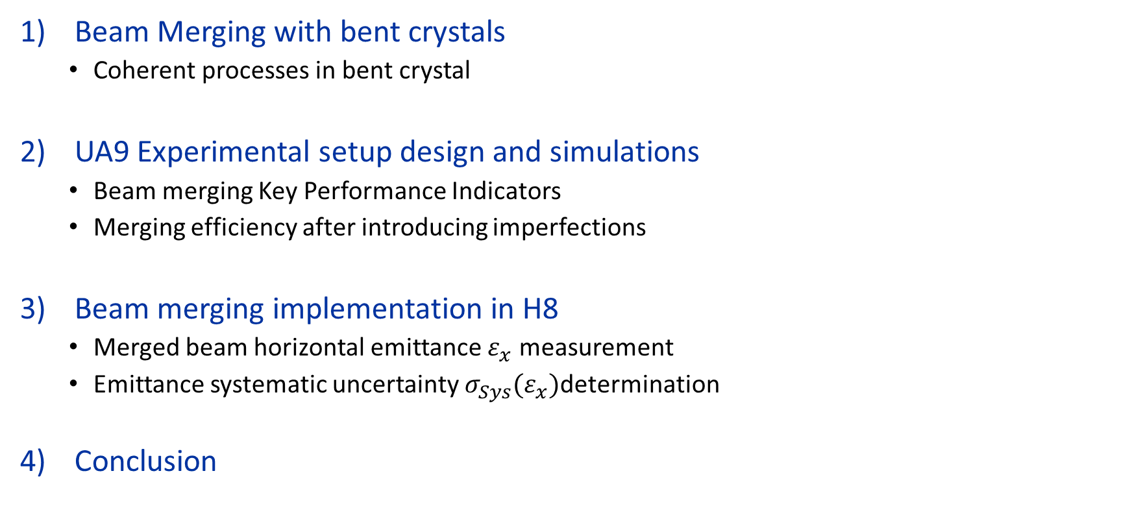
Outline of the Presentation
Beam Merging with bent crystals
  Coherent processes in bent crystal
UA9 Experimental setup design and simulations
  Beam merging Key Performance Indicators
  Merging efficiency after introducing imperfections
Beam merging implementation in H8
  Merged beam horizontal emittance $ε_{x}$ measurement
  Emittance systematic uncertainty $σ_{Sys}(ε_{x})$determination
Conclusion
12/11/2025
Davide Annucci – Beam merging techniques assisted by curved crystals
Page 1

Slide 3
1
Beam Merging with bent crystals
12/11/2025
Davide Annucci – Beam merging techniques assisted by curved crystals
Page 2

Slide 4
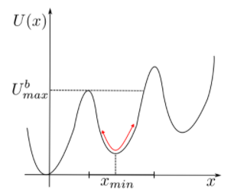
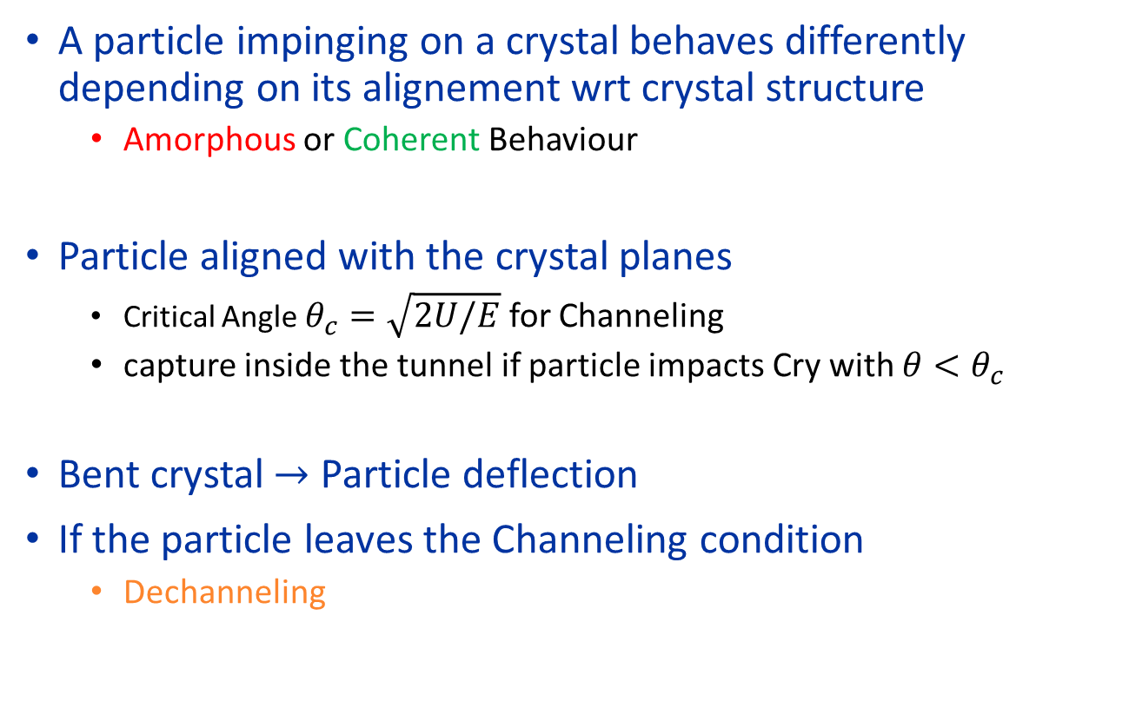
Coherent processes in bent crystals (1/2)
A particle impinging on a crystal behaves differently depending on its alignement wrt crystal structure
  Amorphous or Coherent Behaviour
Particle aligned with the crystal planes
  Critical Angle $θ_{c}=\sqrt{2U/E}$ for Channeling
  capture inside the tunnel if particle impacts Cry with $θ<θ_{c}$
Bent crystal $→$ Particle deflection
If the particle leaves the Channeling condition
  Dechanneling
12/11/2025
Davide Annucci – Beam merging techniques assisted by curved crystals
Page 3

Slide 5
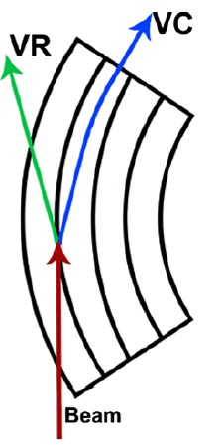
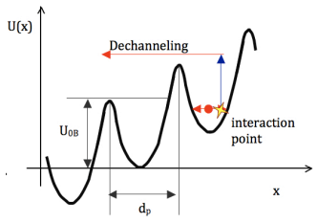
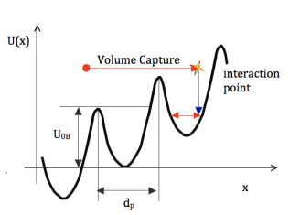
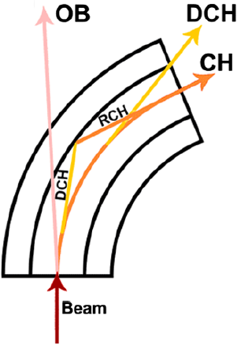
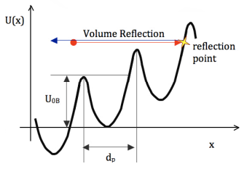
Coherent processes in bent crystals (2/2)
Dechanneling (DCH), Volume Capture (VC) and Rechanneling (RCH)
  No more CH condition DCH can happen (sometimes followed by RCH)
  VC conceptually similar to RCH
Volume Reflection (VR)
  Charghed particles reflected by the crystal potential barrier
Is it possible to exploit Coherent Processes to merge beams?
12/11/2025
Davide Annucci – Beam merging techniques assisted by curved crystals
Page 4

Slide 6



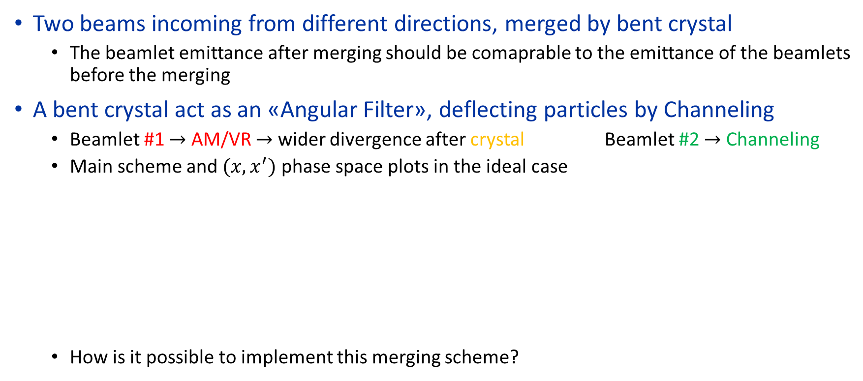




Beam merging Idea
Two beams incoming from different directions, merged by bent crystal
  The beamlet emittance after merging should be comaprable to the emittance of the beamlets before the merging
A bent crystal act as an «Angular Filter», deflecting particles by Channeling
  Beamlet #1 $→$ AM/VR $→$ wider divergence after crystal Beamlet #2 $→$ Channeling
  Main scheme and $(x,x^{′})$ phase space plots in the ideal case
  How is it possible to implement this merging scheme?
$$x′$$
$$x′$$
Beamlet #2
$$N_{2}$$
Bent crystal
$$N_{1}+N_{2}$$
$$N_{1}$$
Beamlet #1
Merged Beam
$$x$$
$$x$$
12/11/2025
Davide Annucci – Beam merging techniques assisted by curved crystals
Page 5

Slide 7
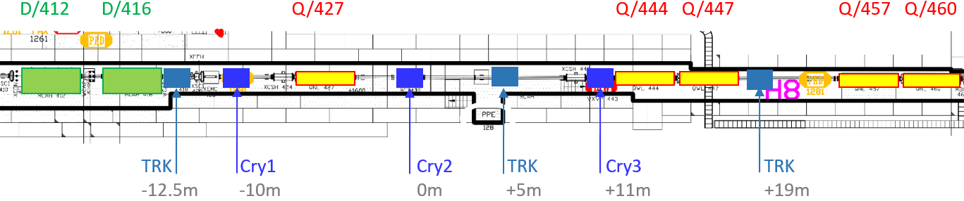

Beam merging proposed setups
Problem: A Two-Converging Beamlines setup does not exist
  Solution: Bent crystals $→$ create two beamlets which will converge at another point
  Third crystal at the convergence point $→$here the merge will happen!
CERN SPS H8 extracted Beamline is the UA9 experimental site since decades
Bent crystal #1
Bent crystal #2
H8 North Area Beam
Beamlet #2
Beamlet #2
Beamlet #1
Merged Beam
Bent crystal #3
H8
12/11/2025
Davide Annucci – Beam merging techniques assisted by curved crystals
Page 6

Slide 8
2
UA9 Experimental setup design and simulations
12/11/2025
Davide Annucci – Beam merging techniques assisted by curved crystals
Page 7

Slide 9
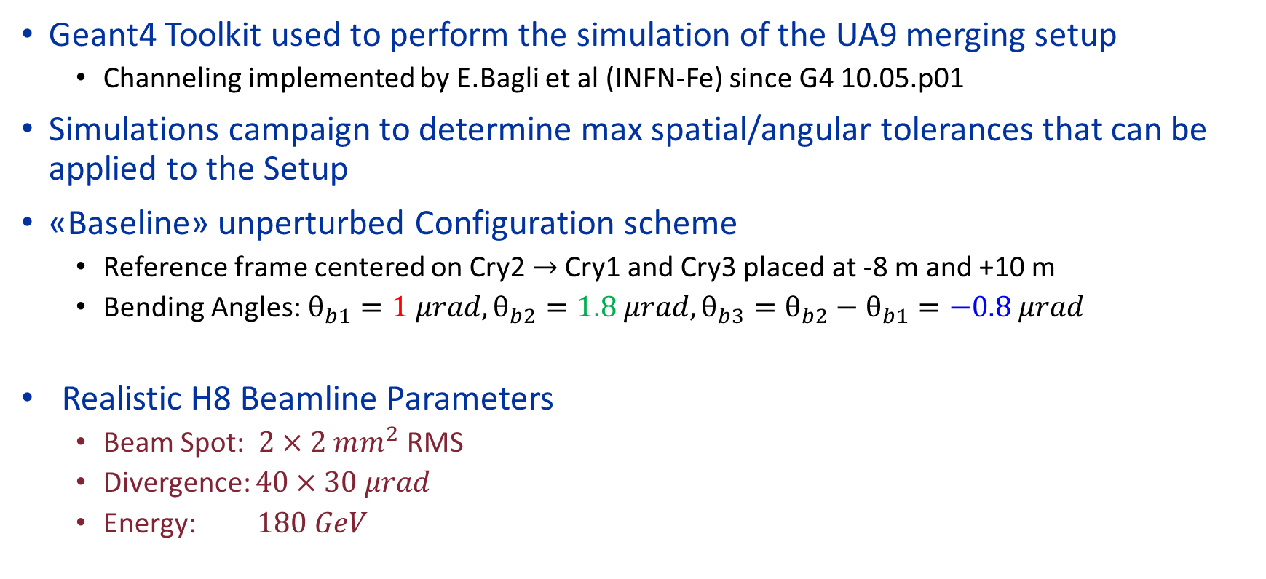
From the idea to the simulations
Geant4 Toolkit used to perform the simulation of the UA9 merging setup
  Channeling implemented by E.Bagli et al (INFN-Fe) since G4 10.05.p01
Simulations campaign to determine max spatial/angular tolerances that can be applied to the Setup
«Baseline» unperturbed Configuration scheme
  Reference frame centered on Cry2 $→$ Cry1 and Cry3 placed at -8 m and +10 m
  Bending Angles: $θ_{b1}=1 μrad,θ_{b2}=1.8 μrad,θ_{b3}=θ_{b2}−θ_{b1}=−0.8 μrad$
  Realistic H8 Beamline Parameters
  Beam Spot: $2×2 mm^{2}$ RMS
  Divergence: $40×30 μrad$
  Energy: $180 GeV$
Cry1
Cry2
H8 Beam
Ch1
Ch2
Merged
Cry3
-13.1 -8.1 -7.9 -0.5 +0.5 +5.0 +10.1 +19.1
Ch2-Am3
12/11/2025
Davide Annucci – Beam merging techniques assisted by curved crystals
Page 8

Slide 10



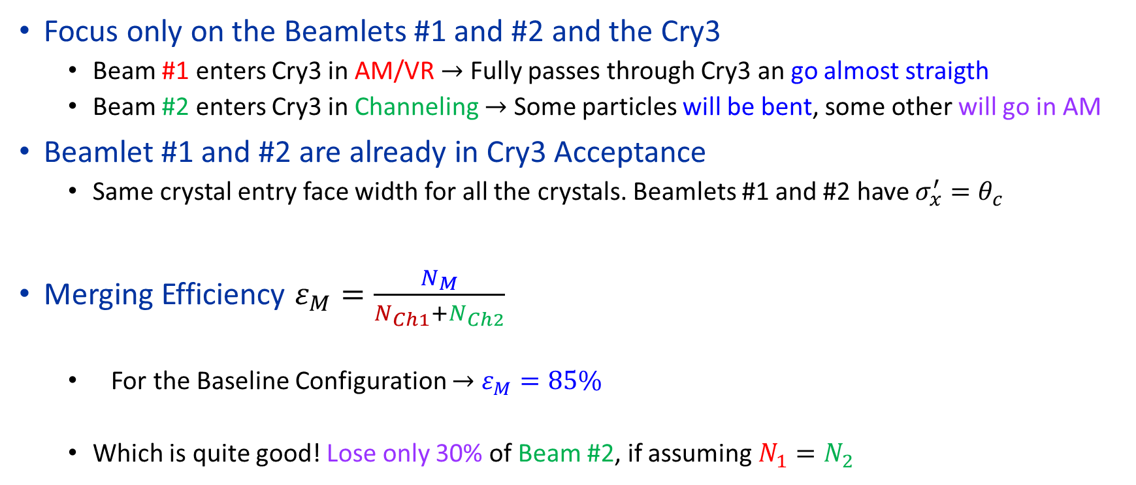

Beam Merging Efficiency
Focus only on the Beamlets #1 and #2 and the Cry3
  Beam #1 enters Cry3 in AM/VR $→$ Fully passes through Cry3 an go almost straigth
  Beam #2 enters Cry3 in Channeling $→$ Some particles will be bent, some other will go in AM
Beamlet #1 and #2 are already in Cry3 Acceptance
  Same crystal entry face width for all the crystals. Beamlets #1 and #2 have $σ_{x}^{′}=θ_{c}$
Merging Efficiency $ε_{M}=\frac{N_{M}}{N_{Ch1}+N_{Ch2}}$
  For the Baseline Configuration $→$ $ε_{M}=85\%$
  Which is quite good! Lose only 30% of Beam #2, if assuming $N_{1}=N_{2}$
Beamlet #1
Beamlet #2
$$N_{2}$$
$$N_{1}$$
Cry3
Merged Beam
$$N_{M}$$
12/11/2025
Davide Annucci – Beam merging techniques assisted by curved crystals
Page 9

Slide 11
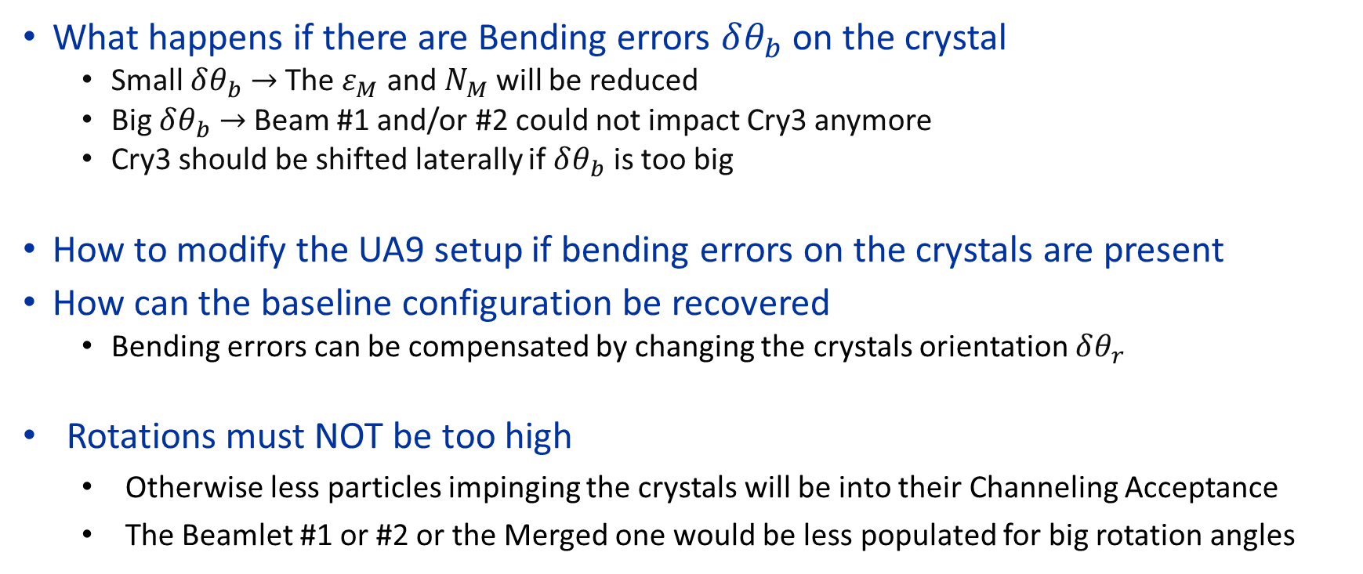
Introducing perturbation
What happens if there are Bending errors $δθ_{b}$ on the crystal
  Small $δθ_{b}$ $→$ The $ε_{M}$ and $N_{M}$ will be reduced
  Big $δθ_{b}$ $→$ Beam #1 and/or #2 could not impact Cry3 anymore
  Cry3 should be shifted laterally if $δθ_{b}$ is too big
How to modify the UA9 setup if bending errors on the crystals are present
How can the baseline configuration be recovered
  Bending errors can be compensated by changing the crystals orientation $δθ_{r}$
  Rotations must NOT be too high
    Otherwise less particles impinging the crystals will be into their Channeling Acceptance
    The Beamlet #1 or #2 or the Merged one would be less populated for big rotation angles
12/11/2025
Davide Annucci – Beam merging techniques assisted by curved crystals
Page 10

Slide 12
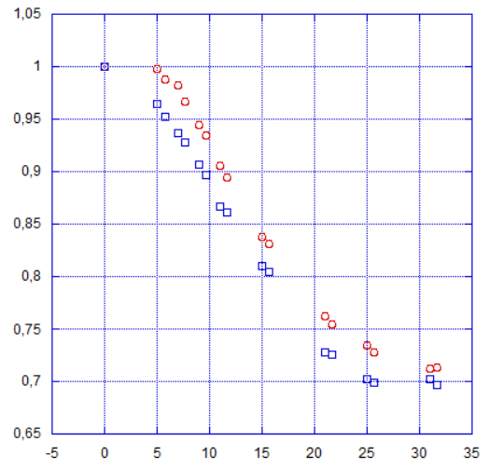
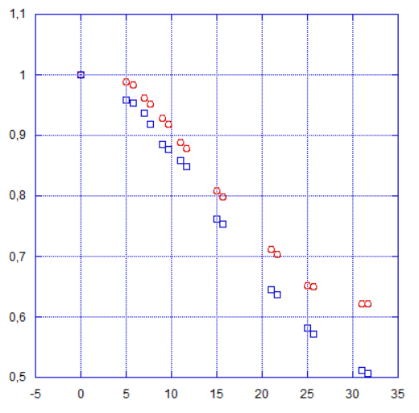

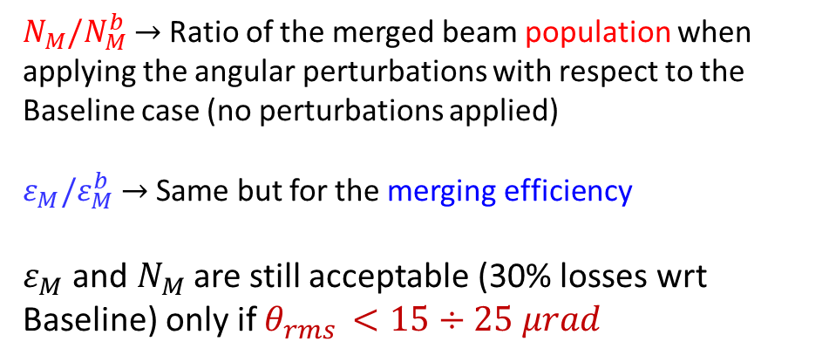

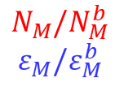




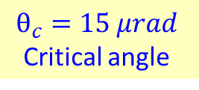
Introducing perturbation
$$θ_{c}=15 μrad$$
Critical angle
Apply Bending errors $δθ_{b}$ and rotations $δθ_{r}$ to the crystals
    Study how merging efficiency ($ε_{M}$) andmerged beam population ($N_{M}$) will be reduced
    $θ_{rms}$ $→$ Quadrature sum of all the source of angular errors
$N_{M}/N_{M}^{b}$ $→$ Ratio of the merged beam population when applying the angular perturbations with respect to the Baseline case (no perturbations applied)
$ε_{M}/ε_{M}^{b}$ $→$ Same but for the merging efficiency
$ε_{M}$ and $N_{M}$ are still acceptable (30% losses wrt Baseline) only if $θ_{rms }<15÷25 μrad$
Bending Errors Only
Bending Errors & Rotation
$$N_{M}/N_{M}^{b}$$
$$ε_{M}/ε_{M}^{b}$$
$$N_{M}/N_{M}^{b}$$
$$ε_{M}/ε_{M}^{b}$$
$$θ_{rms }[μrad]$$
Keep crystal $δθ_{b}$ BELOW $\sim 20 μrad$
$$θ_{rms }[μrad]$$
$$θ_{rms }[μrad]$$
12/11/2025
Davide Annucci – Beam merging techniques assisted by curved crystals
Page 11

Slide 13
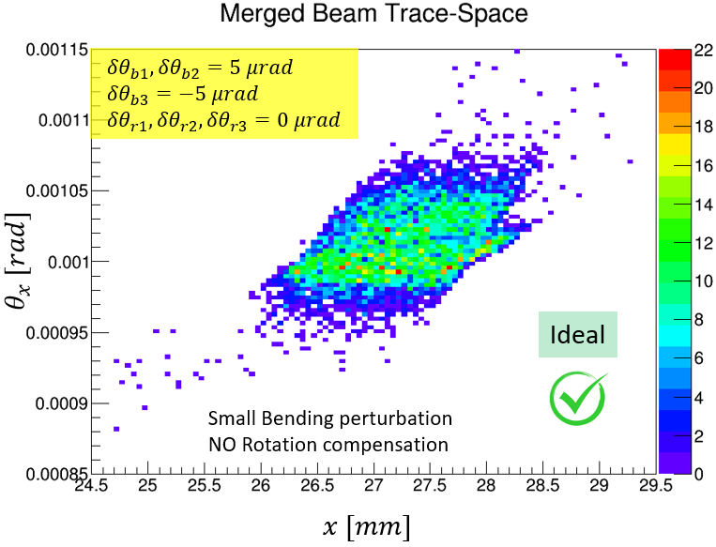
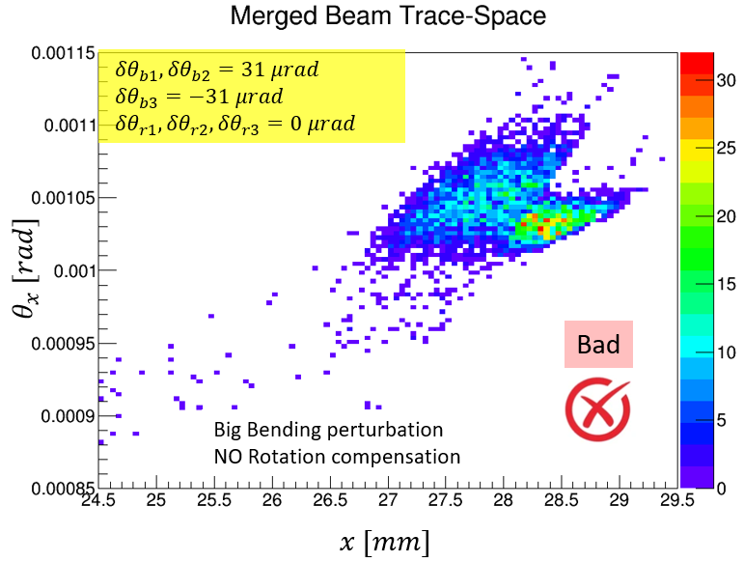
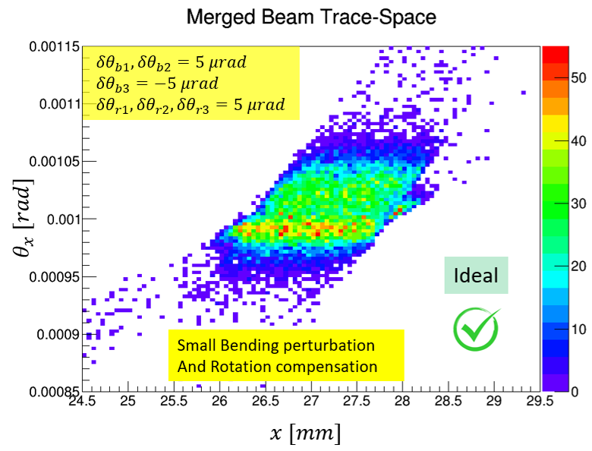
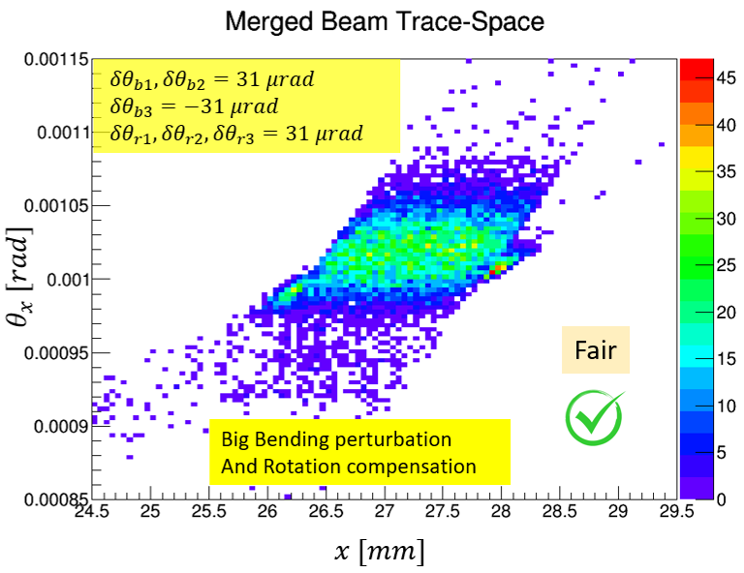
Recombined beam in the phase space
Fewer particles in the Merged Beam…
12/11/2025
Davide Annucci – Beam merging techniques assisted by curved crystals
Page 12

Slide 14
3/a
Beam merging implementation in H8
12/11/2025
Davide Annucci – Beam merging techniques assisted by curved crystals
Page 13

Slide 15
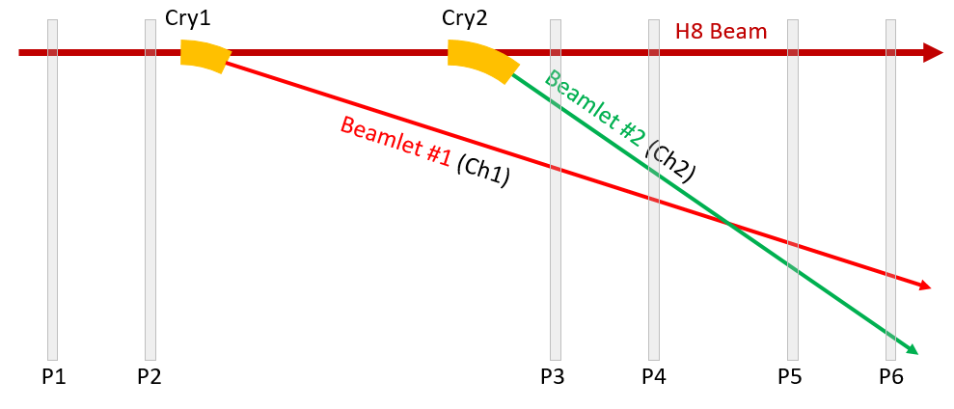
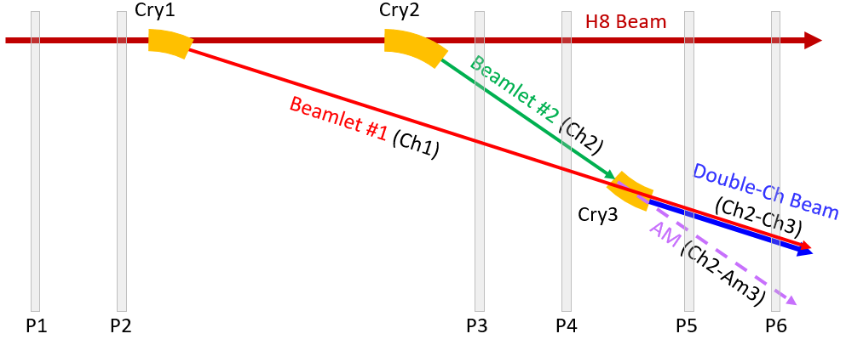
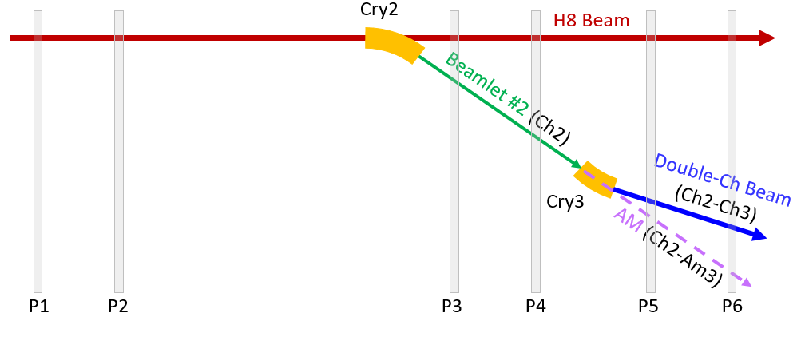
Roadmap towards the beam merging
Beam merging achieved in three steps
  (1) Double Extraction (2) Double Channeling (3) Full Merging setup
1
3
2
Reco Plane (Gonio 3)
12/11/2025
Davide Annucci – Beam merging techniques assisted by curved crystals
Page 14

Slide 16
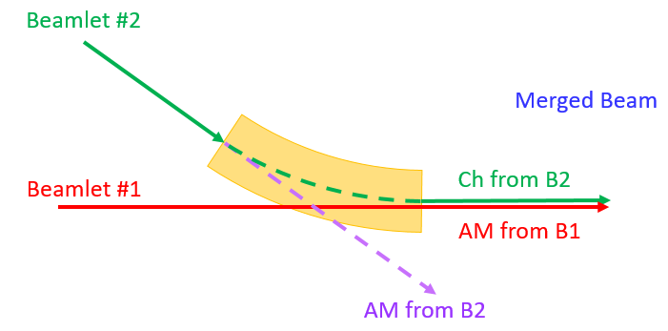
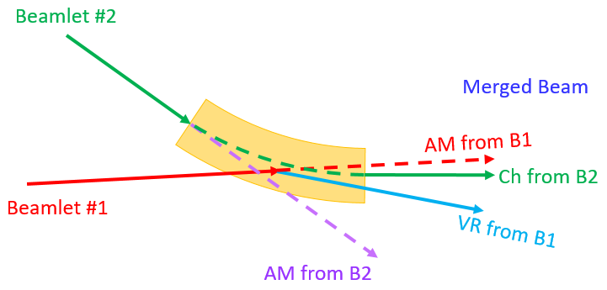
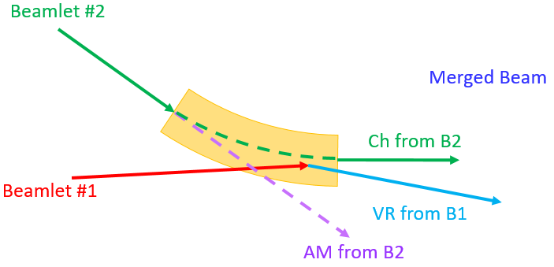
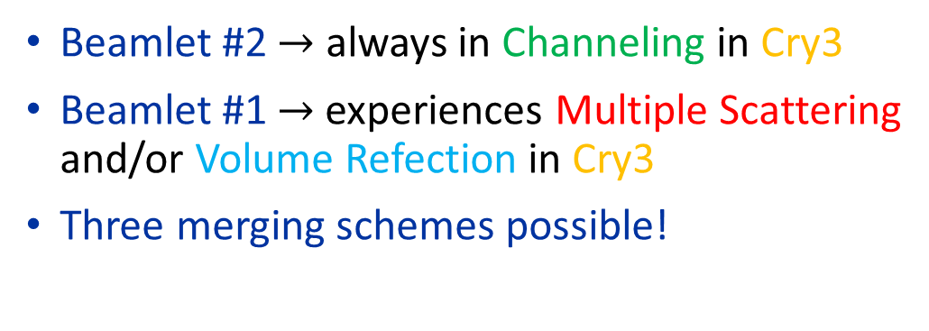
Merging configurations in a nutshell
Channeling + Amorphous
Beamlet #2 $→$ always in Channeling in Cry3
Beamlet #1 $→$experiences Multiple Scattering and/or Volume Refection in Cry3
Three merging schemes possible!
Cry3
Channeling + AM/VR Transition
Channeling + Volume Reflection
Cry3
Cry3
12/11/2025
Davide Annucci – Beam merging techniques assisted by curved crystals
Page 15

Slide 17
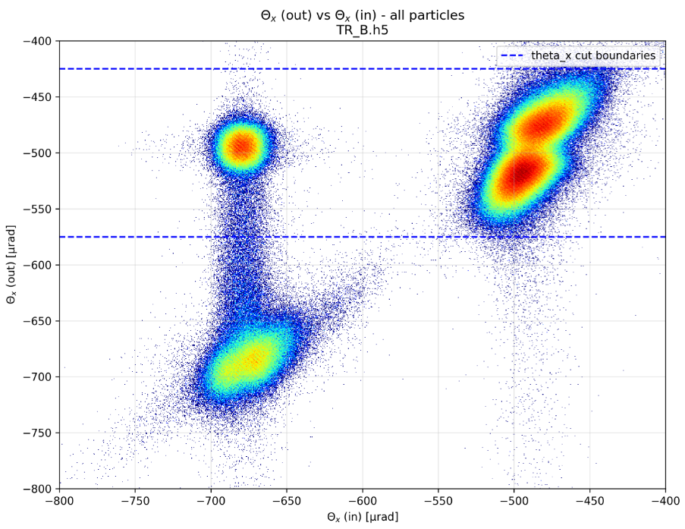
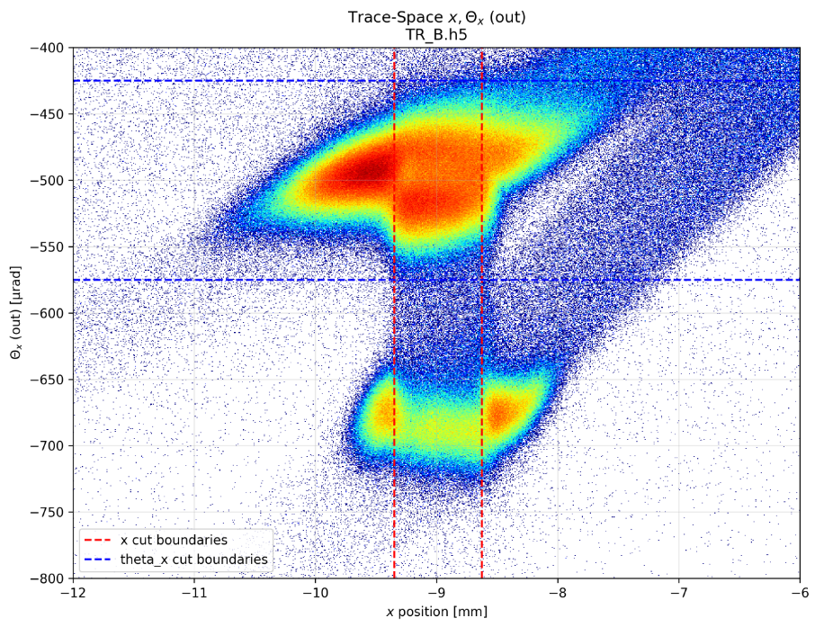
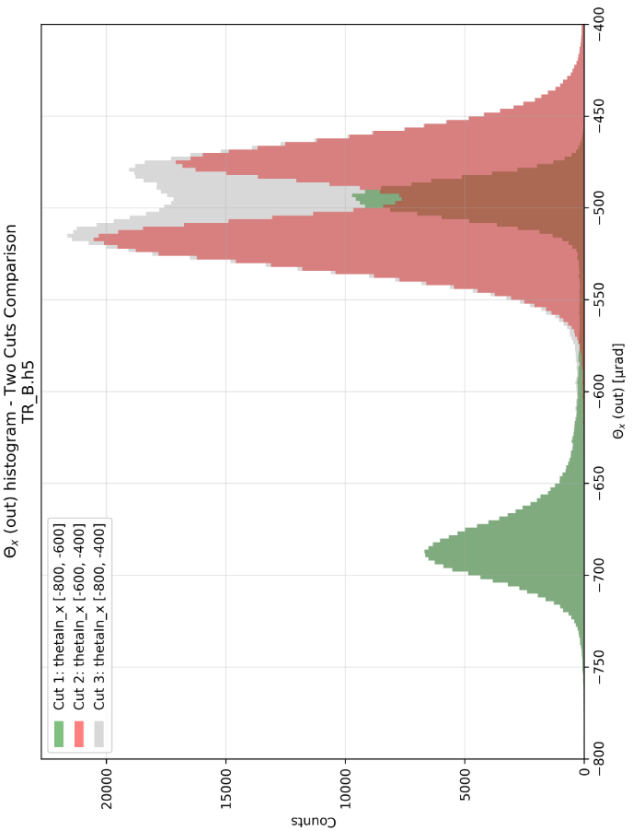

Merged beam identification
Ch(2)
(b)
Ch(1)
Ch(2)Ch(3)
Ch(1)Am/VR(3)
Ch(2)
Define appropriate spatial/angular cuts
  Spatial cuts $→$ defined by Cry3 active region width
  Angular cuts $→$ defined by outgoing angle distribution
  Emittance computation for particles in region (b)
Ch(1)
(c)
(a)
Ch(2)Am(3)
Ch(1)Am(3)
a
Merged Beam
Ch(2)Ch(3)
a
b
Ch(1)VR(3)
c
Ch(2)Am(3)
Ch + AM/VR Transition
12/11/2025
Davide Annucci – Beam merging techniques assisted by curved crystals
Page 16

Slide 18
Merged beam identification
Ch(2)
(b)
Ch(1)
Ch(2)Ch(3)
Ch(1)Am/VR(3)
(e)
Ch(2)
Ch(2)
Ch(1)Am(3)
Ch(1)
(d)
Ch(1)
(c)
Ch(1)VR(3)
(a)
(f)
Ch(2)Ch(3)
Ch(2)Am(3)
e
f
e
f
a
Merged Beam
d
d
a
b
c
c
c
Ch + AM/VR Transition
12/11/2025
Davide Annucci – Beam merging techniques assisted by curved crystals
Page 16/b

Slide 19
3/b
Merged beam emittance measurements
12/11/2025
Davide Annucci – Beam merging techniques assisted by curved crystals
Page 17

Slide 20
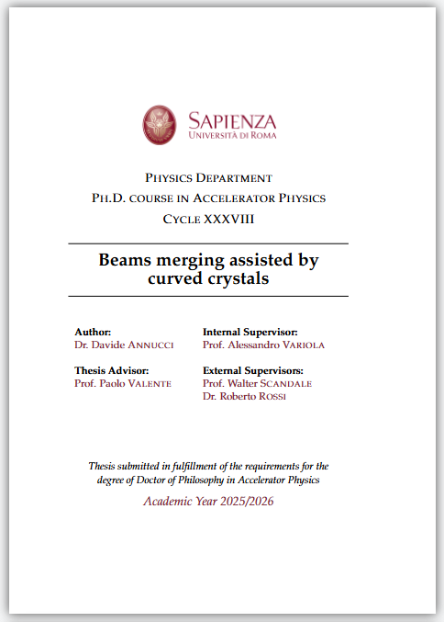
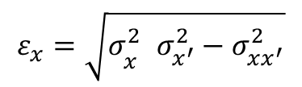
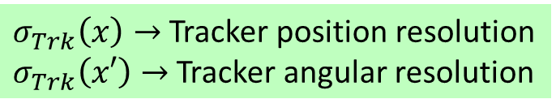
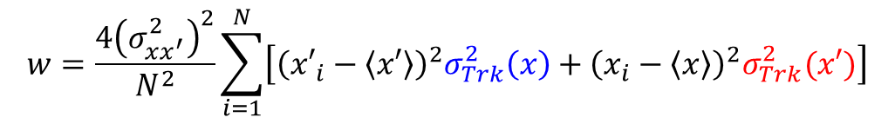
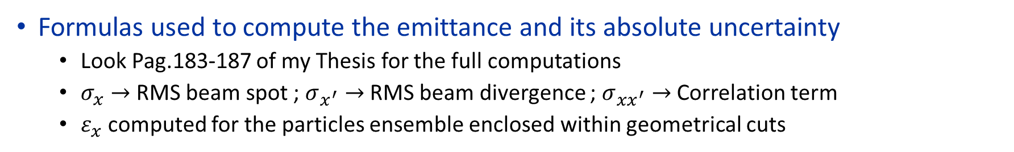
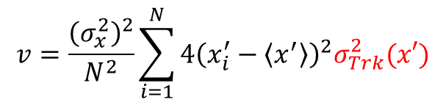
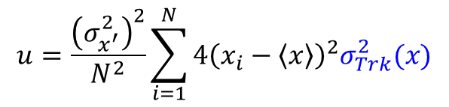
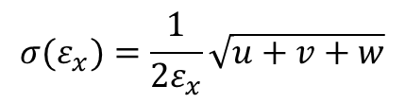
Merged beam emittance computation
Formulas used to compute the emittance and its absolute uncertainty
  Look Pag.183-187 of my Thesis for the full computations
  $σ_{x}→$ RMS beam spot ; $σ_{x^{′}}→$ RMS beam divergence ; $σ_{xx^{′}}→$ Correlation term
  $ε_{x}$ computed for the particles ensemble enclosed within geometrical cuts
$$ε_{x}=\sqrt{σ_{x^{}}^{2}σ_{x^{′}}^{2}−σ_{xx^{′}}^{2}}$$
$$σ(ε_{x})=\frac{1}{2ε_{x}}\sqrt{u+v+w}$$
$$u=\frac{{\left(σ_{x^{′}}^{2}\right)}^{2}}{N^{2}}\sum_{i=1}^{N}{4{\left(x_{i}−\left\langle x\right\rangle \right)}^{2}σ_{Trk}^{2}(x)}$$
$$v=\frac{{\left(σ_{x}^{2}\right)}^{2}}{N^{2}}\sum_{i=1}^{N}{4{\left(x_{i}^{′}−\left\langle x^{′}\right\rangle \right)}^{2}σ_{Trk}^{2}(x′)}$$
$$w=\frac{{4\left(σ_{xx^{′}}^{2}\right)}^{2}}{N^{2}}\sum_{i=1}^{N}{\left[{\left({x′}_{i}−\left\langle x′\right\rangle \right)}^{2}σ_{Trk}^{2}\left(x\right)+{\left(x_{i}−\left\langle x\right\rangle \right)}^{2}σ_{Trk}^{2}(x′)\right]}$$
$σ_{Trk}\left(x\right)→$ Tracker position resolution
$σ_{Trk}\left(x′\right)→$ Tracker angular resolution
12/11/2025
Davide Annucci – Beam merging techniques assisted by curved crystals
Page 18

Slide 21
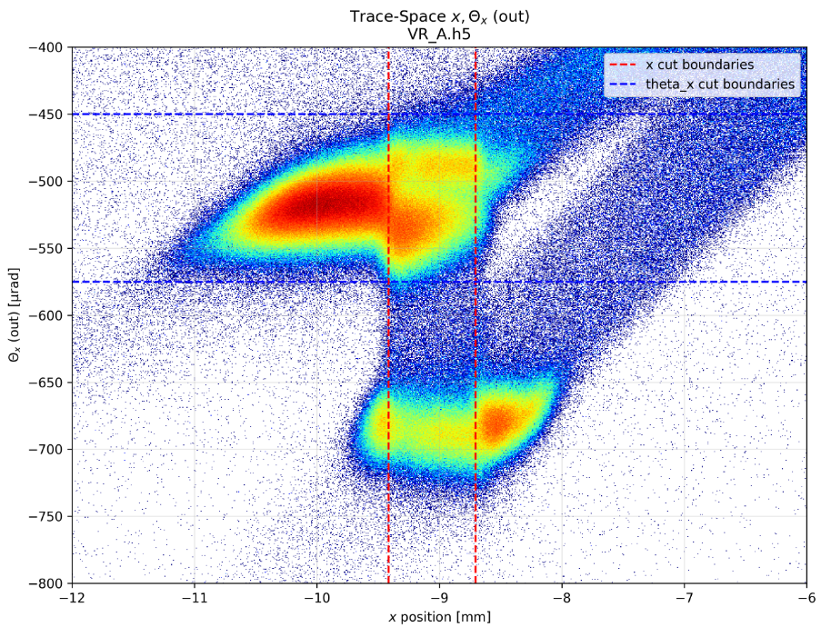
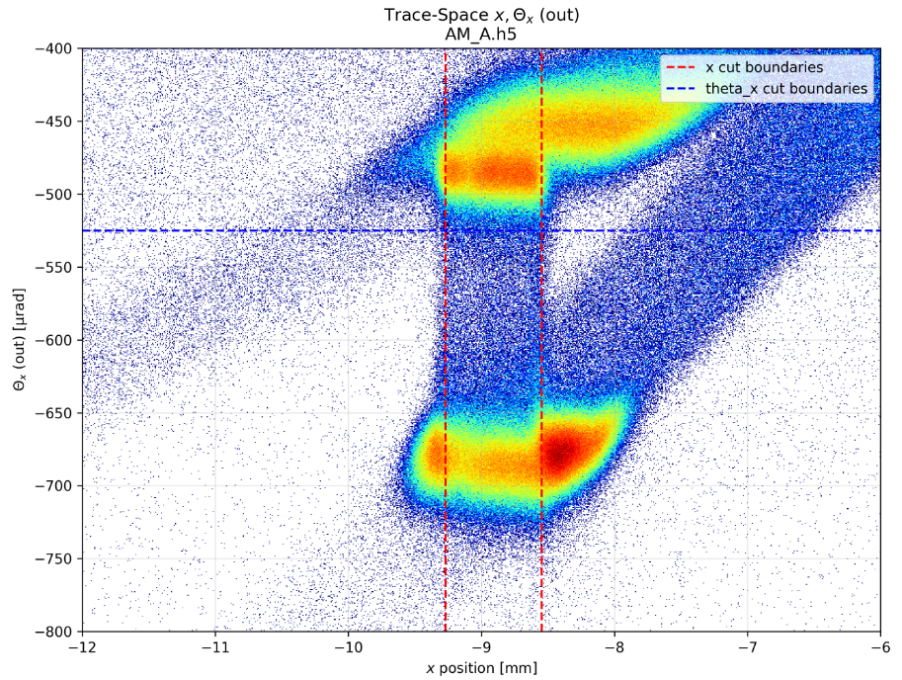
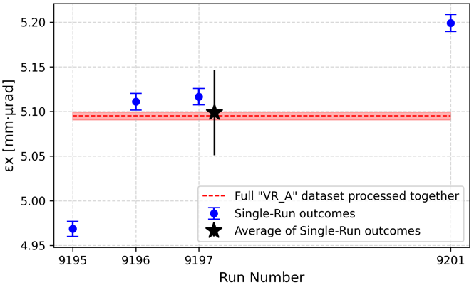
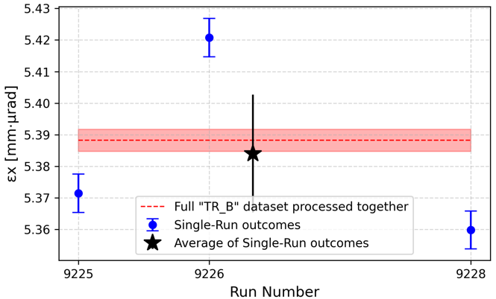
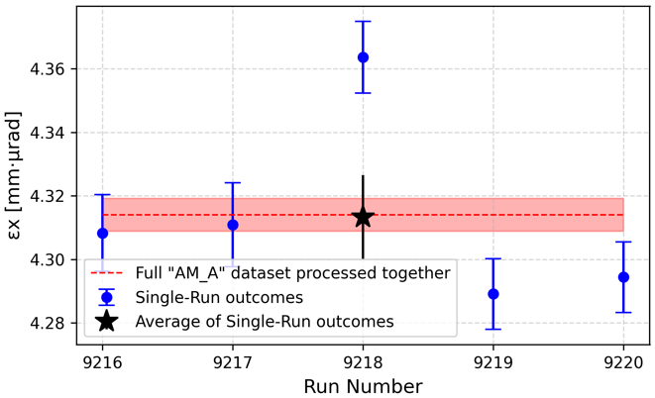


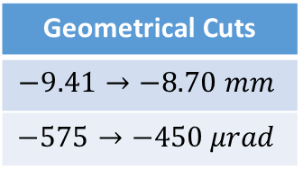
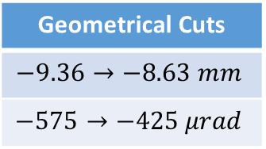


Merged beam emittance outcome
Different emittance values for the three merging configurations
  Because different coherent/incoherent processes are involved in the different cases
Ch + VR
Ch + Tr
Ch + AM
Geometrical Cuts
$$−9.41→−8.70 mm$$
$$−575→−450 μrad$$
Geometrical Cuts
$$−9.36→−8.63 mm$$
$$−575→−425 μrad$$
Geometrical Cuts
$$−9.27→−8.55 mm$$
$$−525→−400 μrad$$
$$ε_{x}=\left(5.095±0.005\right) mmμrad$$
$$ε_{x}=\left(5.388±0.004\right) mmμrad$$
$$ε_{x}=\left(4.314±0.005\right) mmμrad$$
12/11/2025
Davide Annucci – Beam merging techniques assisted by curved crystals
Page 19

Slide 22




Systematic uncertainty determination
$$θ_{c}=15 μrad$$
Critical angle
Geometrical spatial/angular cuts change $→$ Different emittance $ε_{x}$ values
Spatial cuts: Step $∆x=0.05 mm$ = 1/20 of Cry3 width
Range: $−5∆x→5∆x$ respect to cuts design values
Angular cuts fixed
Angular cuts: Step $∆θ_{x}=2.5 μrad$= 1/6 of critical angle
Range: $−5∆θ_{x}→5∆θ_{x}$ respect to cuts design values
Spatial cuts fixed
Ch + Tr
Ch + Tr
12/11/2025
Davide Annucci – Beam merging techniques assisted by curved crystals
Page 20

Slide 23




Systematic uncertainty determination
Geometrical spatial cuts changed, angular cuts unchanged
$σ_{Sys}\left(ε_{x}\right)<12 \%$ of the emittance design value
$σ_{Sys}\left(R\right)<9\%$ of the emittance relative error design value
Ch + Tr
Ch + Tr
12/11/2025
Davide Annucci – Beam merging techniques assisted by curved crystals
Page 21

Slide 24




Systematic uncertainty determination
Geometrical angular cuts changed, spatial cuts unchanged
$σ_{Sys}\left(ε_{x}\right)<2 \%$ of the emittance design value
$σ_{Sys}\left(R\right)<2.2\%$ of the emittance relative error design value
12/11/2025
Davide Annucci – Beam merging techniques assisted by curved crystals
Page 22

Slide 25

4
Conclusions
Now this is not the End
It is not even the Beginning of the End
But it is, perhaps, the End of the Beginning
- W.Churchill 10 Nov 1942
12/11/2025
Davide Annucci – Beam merging techniques assisted by curved crystals
Page 23

Slide 26

Conclusions
The beam recombination scheme with crystals can be implemented in NA H8
  From simulations $→$ Merging efficiency is 85% in the unperturbed case
  Maximum tolerance for bending errors and crystal rotation shoud not exceed $15÷25 μrad$
Three beam merging configurations (Ch+AM, Ch+VR and CH+AM/VR Transition)
  Careful geometrical cuts ensure menaingful merged beam identification
  Different coherent processes $→$ Different merged beam emittance in the three cases
  The merged beam emittance and its statistical error grow monotonically in the considered cuts parameters ranges $→$ reasonable to define Systematic error
  Emittance Systematic error is more sensitive to the spatial cuts variation than to the angular ones
Plenty of work (Autocollimator, TimePix3 measurements) not shown
  Autocollimator $→$ bending angle characterisation $→$ Allows crystals tuneability before putting in H8
  TimePix3 $→$ Used standalone to observe Ch and VR $→$ Can be used as beam diagnostics tool
12/11/2025
Davide Annucci – Beam merging techniques assisted by curved crystals
Page 24

Slide 27
Ph.D. Timeline
2022/2023
Classes and lectures
Geant4 Simulations implementation and debug
2023/2024
Geant4 Simulations with and without imperfections
2024/2025
Double Extraction and double Channeling achieved in October 2024
Test beam activity
Three different merging schemes (Ch+Am, Ch+VR, Ch+AM/VR) implemented and tested in September 2025
First beam merging in June 2025
Test beam activity
Monte Carlo data anaysis and simulated KPIs determination
12/11/2025
Davide Annucci – Beam merging techniques assisted by curved crystals
Page 25

Slide 28
Mobility and Duty Travel periods
2022/2023
10 Weeks (January-March): Joint Universities Accelerator School
2 Weeks (mid June): UA9 Test beam for single-Channeling crystal characterisation
2023/2024
2 Weeks (mid May): UA9 Test beam for single-Channeling crystal characterisation
2 Weeks (mid June): UA9 Test beam for single-Channeling crystal characterisation
1 Week (mid February):Crystal curvatire characterisation with Autocollimator
2 Weeks (mid September): UA9 Test beam for single-Channeling crystal characterisation
3 Months (September-November): Mobility period. UA9 Test beam for double Extraction and double-Channeling assessment
2024/2025
3 Months (May-July): Mobility period. UA9 Test beam for beam merging assessment
2 Weeks (mid September): UA9 Test beam for beam merging assessment and tuning
12/11/2025
Davide Annucci – Beam merging techniques assisted by curved crystals
Page 26

Slide 29
Thank You for your attention
Author e-mail: davide.annucci@uniroma1.it
Many thanks to my Ph.D. Supervisors for their precious advices, passion and dedication
Many thanks to GC,LS (and DDR former) for the smooth administrative operation of our Ph.D.
12/11/2025
Davide Annucci – Beam merging techniques assisted by curved crystals
Page 27

Slide 30
Backup Slides
12/11/2025
Davide Annucci – Beam merging techniques assisted by curved crystals
Page 28

Slide 31







Single-crystal KPI
crystal
Beam
AM
CH
Determine Single-crystal Channeling Efficiency
    Beam ${σ′}_{x}=40 μrad$; crystal $θ_{c}=15.8 μrad$.
    Only 30.7% of the beam in the CH Acceptance
    Deflection efficiency for Cry1,2,3 is in range $\sim 60÷70\%$
Effect of Cry Rotation on $ε_{CH}$
  Even less particles in the Acceptance
  i.e. rotatyng Cry by $75 μrad$ only 5% of particles in Acceptance
Effect of Cry Bending on $ε_{CH}$
  Sligthly increased Dechanneling if curvature radius get smaller
$$dN/dθ$$
No rotation
$$θ$$
$$dN/dθ$$
Rotation
$$θ$$
12/11/2025
Davide Annucci – Beam merging techniques assisted by curved crystals
Page 29

Slide 32



Channeling Acceptances (1/2)
12/11/2025
Davide Annucci – Beam merging techniques assisted by curved crystals
Page 29/b

Slide 33





Beam Merging scheme
Beamlet #1
Beamlet #2
$$N_{2}$$
$$N_{1}$$
Cry3
Cry3
AM/VR by Cry3
CH by Cry3
AM
Beamlet #1
Beamlet #2
$$N_{2}$$
$$N_{1}$$
Cry3
Merged Beam
$$N_{M}$$
12/11/2025
Davide Annucci – Beam merging techniques assisted by curved crystals
Page 30

Slide 34


Beams seen by the Tracker P7 (+19.1 m)
Cry1
Cry2
H8 Beam
Geant4 Setup
  Tracker Stations $42×42 mm^{2}$
  This constrain bending angles
Ch1
Ch2
Merged
Cry3
-13.1 -8.1 -7.9 -0.5 +0.5 +5.0 +10.1 +19.1
Ch2-Am3
Merged Beam
What does the most downstream Tracker Station observe (X-Y 2d-Plot)
  H8 Circulating Beam
  Merged Beam (Ch1-AM/VR3 + Ch2-Ch3)
  AM componet of B2 after Cry3 (Ch2-AM3)
H8 Beam
Ch2-Am3
12/11/2025
Davide Annucci – Beam merging techniques assisted by curved crystals
Page 31

Slide 35


Phase Space plot at P7 (+19.1 m)
Cry1
Cry2
H8 Beam
Ch1
Ch2
Merged
Cry3
-13.1 -8.1 -7.9 -0.5 +0.5 +5.0 +10.1 +19.1
Ch2-Am3
Ch2-Am3
Merged Beam
The Circulating Beam goes straight
  $\cos{θ}≈0$ and $x≈0$
The Ch1-Am/VR3 Beam goes at $1 mrad$
  Impacts Plane6 in $x=27.1 mm$
The Ch2-Am3 Beam goes at $1.8 mrad$
  Impacts Plane6 in $x=34.8 mm$
H8 Beam
H8 Beam
Ch2-Am3
12/11/2025
Davide Annucci – Beam merging techniques assisted by curved crystals
Page 32

Slide 36

Phase Space plot at P7 (+19.1 m)
Dch3
Dch2
Dch1
VR3
VR1
VR2
12/11/2025
Davide Annucci – Beam merging techniques assisted by curved crystals
Page 33

Slide 37


Phase Space plot at different Planes
12/11/2025
Davide Annucci – Beam merging techniques assisted by curved crystals
Page 33/b

Slide 38

Angular distributions at different Planes
12/11/2025
Davide Annucci – Beam merging techniques assisted by curved crystals
Page 33/b

Slide 39


Recovery Strategies
12/11/2025
Davide Annucci – Beam merging techniques assisted by curved crystals
Page 33/c

Slide 40

Recovery Strategies
12/11/2025
Davide Annucci – Beam merging techniques assisted by curved crystals
Page 33/d

Slide 41


Merged beam identification
Ch(2)
(b)
Ch(1)
Ch(2)Ch(3)
Ch(1)Am/VR(3)
Ch(2)
Define appropriate spatial/angular cuts
  Spatial cuts $→$ defined by Cry3 active region width
  Angular cuts $→$ defined by outgoing angle distribution
  Emittance computation for particles in region (b)
Ch(1)
(c)
(a)
Ch(2)Am(3)
Ch(1)Am(3)
a
Merged Beam
a
b
Ch(2)Ch(3)
c
Ch(2)Am(3)
Ch + AM
12/11/2025
Davide Annucci – Beam merging techniques assisted by curved crystals
Page 34

Slide 42


Merged beam identification
Ch(2)
(b)
Ch(1)
Ch(2)Ch(3)
Ch(1)Am/VR(3)
Ch(2)
Define appropriate spatial/angular cuts
  Spatial cuts $→$ defined by Cry3 active region width
  Angular cuts $→$ defined by outgoing angle distribution
  Emittance computation for particles in region (b)
Ch(1)
(c)
(a)
Ch(2)Am(3)
a
Ch(2)Ch(3)
a
b
Merged Beam
Ch(1)VR(3)
c
Ch(2)Am(3)
Ch + VR
12/11/2025
Davide Annucci – Beam merging techniques assisted by curved crystals
Page 35

Slide 43




Emittance Systematic error – Full study
Channeling + Amorphous recombination scheme
Left: Change spatial boundaries, Right: Change angular boundaries
Ch + Am
12/11/2025
Davide Annucci – Beam merging techniques assisted by curved crystals
Page 36

Slide 44
Emittance Systematic error – Full study
Channeling + Volume Reflection recombination scheme
Left: Change spatial boundaries, Right: Change angular boundaries
Ch + VR
12/11/2025
Davide Annucci – Beam merging techniques assisted by curved crystals
Page 37

Slide 45




Emittance Systematic error – Full study
Channeling + Amorphous/Volume Reflection Transtion recombination scheme
Left: Change spatial boundaries, Right: Change angular boundaries
Ch + Tr
12/11/2025
Davide Annucci – Beam merging techniques assisted by curved crystals
Page 38

Slide 46
Not Shown/I
TimePix3 measurements for Channeling detection in SPS H8 NA
Cooperation with M. Garattini
12/11/2025
Davide Annucci – Beam merging techniques assisted by curved crystals
Page 39

Slide 47

The TimePix3 in a nutshell and its application
Small and portable detector
  14x14 $mm^{2}$ sensitive area, 256x256 pixels, 55 $μm$ pixel pitch, 100 $μm$ thick Si sensor
  ToA, ToT, Itot functionalities $→$ Beam X/Y Profiles, Time distribution and energy deposit
  Acquisition in «Single Frame» or «Cumulative» mode (stacking more frames per single DAQ)
TimePix3 can be used as online beam monitor
Useful to perform the Angular Scan
  Cumulative mode $→$ See how the beam spot size and morphology change over time
  Real time CH/VR peak emerging from the Background when rotating the crystal (June 2024)
  Scheme of the setup
TimePix3
Bent crystal
VR
H8 Beam
AM
20 m
CH
12/11/2025
Davide Annucci – Beam merging techniques assisted by curved crystals
Page 40

Slide 48







TimePix3 angular scan – Compare with Tracker
Angular Scan performed using the TimePix3 and the UA9 Tracker Standalone
  Large impact angle acceptance bigger than $θ_{c}$ $→$ Twisted crystal
  At different time, different parts of the crystal are in Channeling
Angular Scan with the Tracker
Twisted crystal
TimePix Acquisition at different times RAW Data – Twisted crystal
11:33
11:03
(d)
(b)
(a)
(b)
(c)
(d)
(e)
10:53
11:18
Upper part in CH
12:03
(a)
(c)
(e)
Lower part in CH
h 10:47
START SCAN
h 12:06
END SCAN
Amorphous
crystal in CH
Amorphous
12/11/2025
Davide Annucci – Beam merging techniques assisted by curved crystals
Page 41

Slide 49








Bending Angle measurement with TimePix3
Readout in «Frame» mode $→$ Beam X/Y distribution
  Mandatory to record almost 10 Spills, otherwise the SNR is too low and data cannot be analyzed (more spills is better, i.e. 100)
  The two Runs are cleaned, normalized, and then subtracted.
Crystal bending angle: 170 $μrad$ from previous UA9 measurements
SPS Page 1 – SFTPRO Supercycle
2d-plot Run Channeling
Subtraction Y-Profile
2d-plot Run Channeling
Subtraction Y-Profile
$θ_{b}=\left(172.0±4.2\right) μrad$
$θ_{b}=\left(171.3±1.5\right) μrad$
10 Spills
100 Spills
10 Spills
100 Spills
12/11/2025
Davide Annucci – Beam merging techniques assisted by curved crystals
Page 42

Slide 50





100 Spills best CH and VR Runs
Best CH Run 2D Sub
Best VR Run 2D Sub
These two Runs are the best in CH and VR orientation
  TimePix3 can be used to measure precisely CH and VR angle
  In these plot the CH/VR-AM subtraction is applied
  VR Angle measurement: $θ_{VR}=\left(52.7±3.2\right) μrad$
Best CH Run
Sub Y-profile
Best VR Run
Sub Y-profile
Emptying Area
Emptying Area
VR Peak
CH Peak
12/11/2025
Davide Annucci – Beam merging techniques assisted by curved crystals
Page 43

Slide 51




Crystal Torsion measurement with TimePix3
SPS-Type Crystal with known torsion defect
  measured with UA9 Tracker: $T \sim 4 μrad$ (September 2023 – May/June 2024)
Beam impacts on the crystal at different heights
  CH particles are deflected at different angles despite Cry Channeling angle is the same!
  This means there is a Twist effect!
  Key goal: Obtain bending angle slice-by-slice to compute the torsion
Slope $\left(0.22±0.04\right)μrad/pxl$
Torsion $\left(4.04±0.07\right)μrad/mm$
5 Slices
Deflection Angle [$μrad$]
Compatible with Tracker
Center of the i-th slice [Pixel]
12/11/2025
Davide Annucci – Beam merging techniques assisted by curved crystals
Page 44

Slide 52



TimePix3 Differential Data Analysis
Necessary Runs to perform the Analysis
  DAQ in «Frame» mode $→$ One Run with Crystal in AM and one in CH or VR orientation
  Clean (eliminate frames with spikes) & normalize the two Runs separately
  Subtract the 2d cleaned beam distributions
  Obtain the Y profile $→$ Fit the CH or VR peak and the Emptying Region $→$ Compute CH/VR Angle
Raw
Clean
Raw and Cleaned data
X/Y Profiles for CH Run
CH–AM Subtraction 2d Plot
CH–AM Subtraction Y Profile
Raw
Clean
12/11/2025
Davide Annucci – Beam merging techniques assisted by curved crystals
Page 45

Slide 53

Transition Regions
One Run (-60) is pure VR, the other three Runs (30, 40, 50) are at CH/VR Transition
Very effective to check the crystal alignment in real time if the Tracker does not work
VR peak lowers
CH peak rises up
12/11/2025
Davide Annucci – Beam merging techniques assisted by curved crystals
Page 46

Slide 54
Not Shown/II
Autocollimator for optical bending angle measurements
Cooperation with S. Giroldi and S. Di Gennaro
12/11/2025
Davide Annucci – Beam merging techniques assisted by curved crystals
Page 47

Slide 55




Autocollimator in a nutshell
Optical device used to measure angles with precision
  Focal length (f) of the lens is known by construction
  Spatial offset (d) with respect to a straight-back reflection is measured
  Angle given by $θ=\frac{d}{2f}$
12/11/2025
Davide Annucci – Beam merging techniques assisted by curved crystals
Page 48

Slide 56


Why the Autocollimator?
Beam Merging setup with three Crystals
  Tracker Planes size $32×32 mm^{2}$
  Available space for UA9 setup in H8: 30 m
  mrad-order bending angles
Mandatory to precisely measure Xtals bending angle
  Otherwise merging is not feasible
H8
Keep crystal $δθ_{b}$ BELOW $\sim 20 μrad$
12/11/2025
Davide Annucci – Beam merging techniques assisted by curved crystals
Page 49

Slide 57



Bending angle measurement
Y
Autocollimator mounted on optical table
Slab Silicon crystal
  Mounted on a 2-axis movable support
  Size: $22 mm×11 mm×1 mm$
  Polished surfaces for enhanced reflectivity
Mechanical holder
  Produced by INFN Roma
  Impress tuneable Primary Curvature on the crystal
  This induces a secondary deformation on the crystal
X
Not shown: Slit-shaped window to narrow the Autocollimator ligth beam spot size
12/11/2025
Davide Annucci – Beam merging techniques assisted by curved crystals
Page 50

Slide 58






Bending angle measurement
$$y$$
$$y$$
Measurement strategy
$$x$$
$$x$$
Secondary curvature uniformity
$$z$$
$$z$$
Vertical Slit
Horizontal Slit
U/D Move
Primary curvature uniformity
L/R Move
12/11/2025
Davide Annucci – Beam merging techniques assisted by curved crystals
Page 51

Slide 59


Primary Curvature
Check Primary Curavature uniformity $→$ Move the crystal on the Y axis
  As expected, the Primary curvature remains quite constant $θ_{P}=\left(2908±13\right) μrad$
  AlpyX company (crystal manufacturer) has also an optical profilometer to benchark these measurements $→θ_{P}^{∗}=\left(3063±57\right) μrad$ at AlPyx
  Full compatibility between these measurements
  Nice shape of the «bean» allows to determine correctly the Primary Curvature
Autocollimator measurements
12/11/2025
Davide Annucci – Beam merging techniques assisted by curved crystals
Page 52

Slide 60


Secondary Curvature
Check Secondary Curavature uniformity $→$ Move the crystal on the X axis
  As expected, the Secondary curvature changes. Max value $θ_{A}=\left(425±106\right) μrad$
  With the optical profilometer $→θ_{A}^{∗}=\left(391±198\right) μrad$ at AlpyX
  Full compatibility between these measurements
  Fuzzy and almost spot-like «bean» allows to determine the Secondary Curvature with big error!
Autocollimator measurements
12/11/2025
Davide Annucci – Beam merging techniques assisted by curved crystals
Page 53

