Slide 1
Simulations and experimental activities on electron diagnostics for EuPRAXIA@SPARC_LAB
PhD Seminar Third Year
12-11-2025
Candidate:
F. Demurtas
Supervisor:
E. Chiadroni
A. Giribono

Slide 2
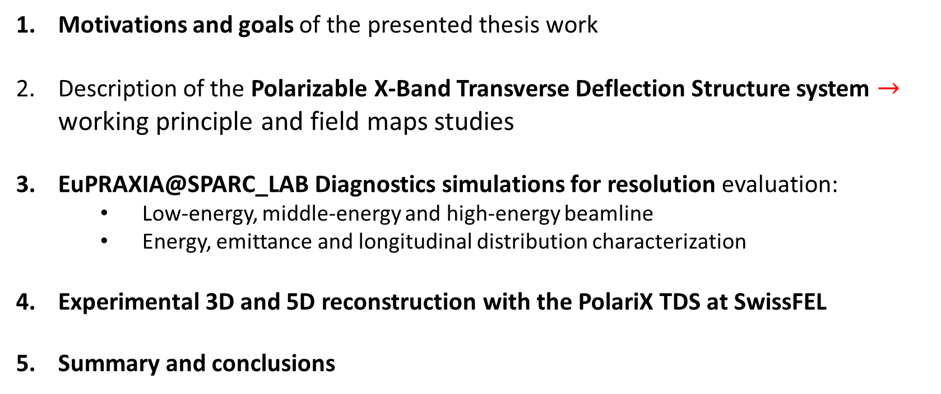
Talk outline
Motivations and goals of the presented thesis work
Description of the Polarizable X-Band Transverse Deflection Structure system $→$ working principle and field maps studies
EuPRAXIA@SPARC_LAB Diagnostics simulations for resolution evaluation:
Low-energy, middle-energy and high-energy beamline
Energy, emittance and longitudinal distribution characterization
Experimental 3D and 5D reconstruction with the PolariX TDS at SwissFEL
Summary and conclusions

Slide 3
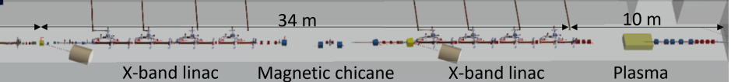
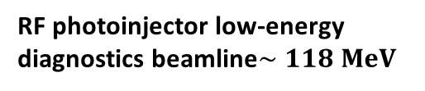
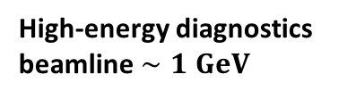
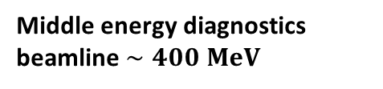
Motivations and goals
Motivations:
The EuPRAXIA@SPARC_LAB project aims to realize the first user-facility based on a Free-Electron Laser driven by a plasma-accelerated beam
RF photoinjector low-energy diagnostics beamline$∼118 MeV$
Middle energy diagnostics beamline $∼400 MeV$
High-energy diagnostics beamline $∼1 GeV$
Goals of the PhD work
Implement and characterize the PolariX Transverse Deflection Structure (TDS), focusing on the field maps studies of the 50-cell device
Evaluate the resolution limits of the EuPRAXIA diagnostic systems through beam-dynamics simulations for the three different beamlines
Application of the 3D and 5D tomographic reconstruction at SwissFEL

Slide 4
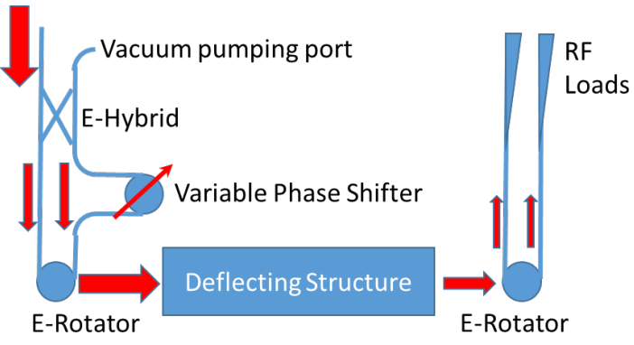
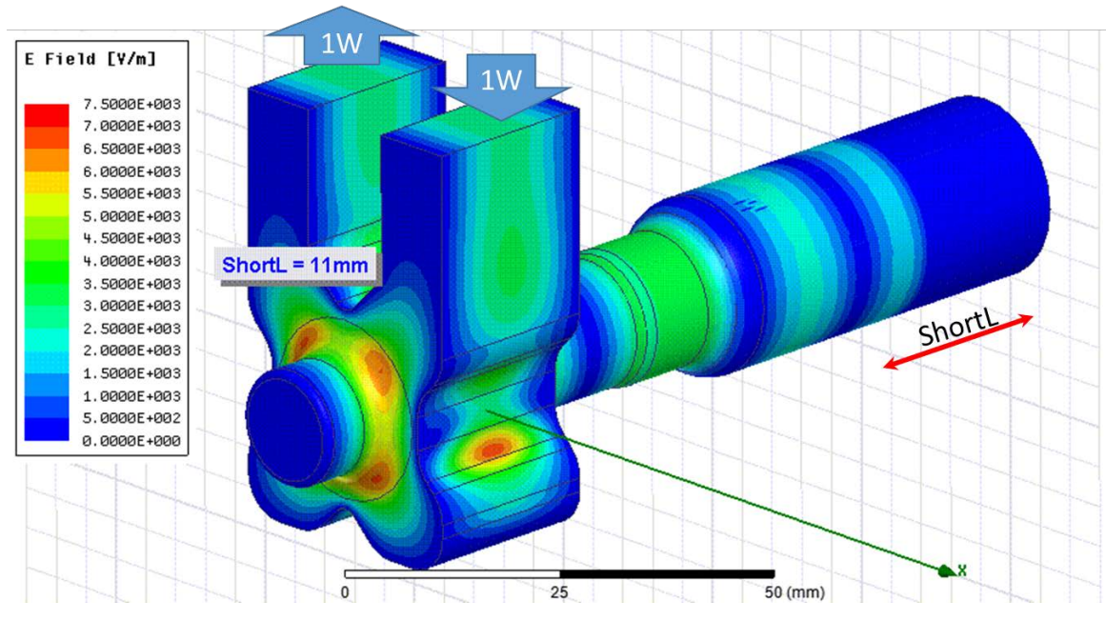
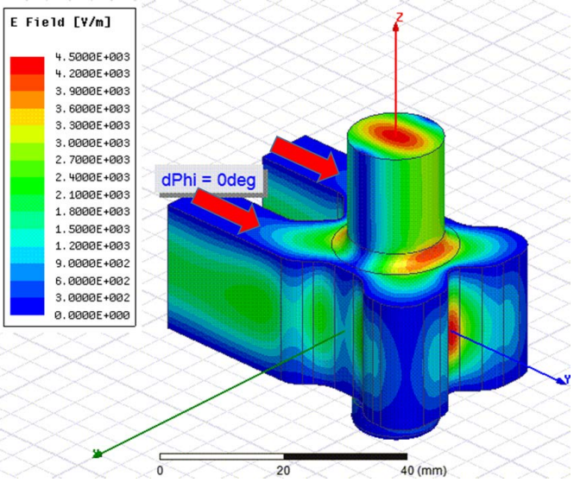
PolariX TDS: RF system
The PolariX is an X-band Transverse Deflection Structure with the feature of changing the beam streaking direction
Input RF power
The input RF power is split into two branches
The phase shifter introduces a phase difference between ports 1 and 2:
0 deg -> vertical polarization
180 deg -> horizontal polarization
The two branches are then recombined into the E-rotator
2
1
Phase Shifter
E-Rotator

Slide 5
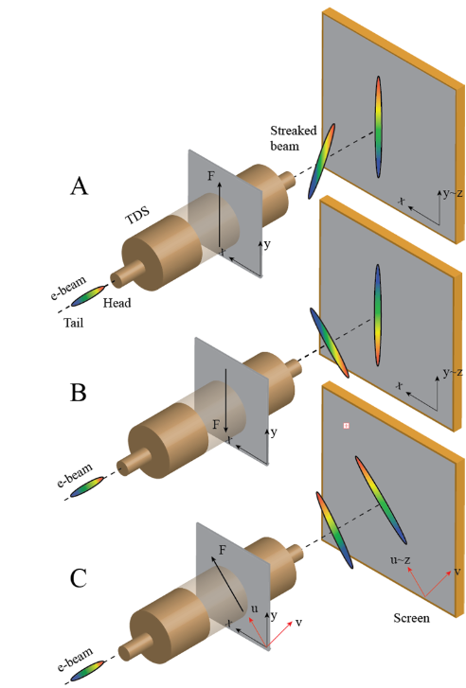
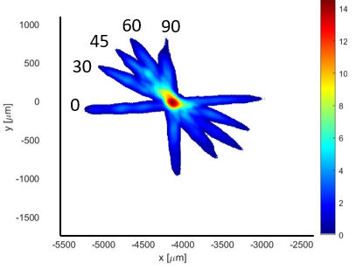
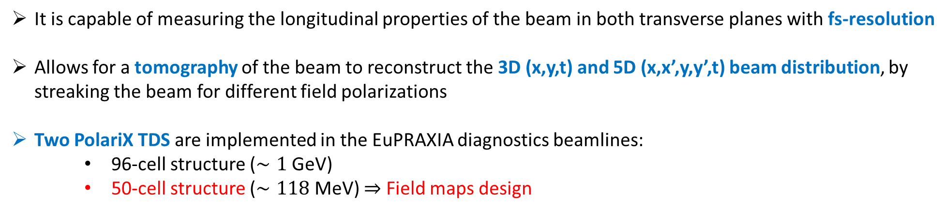
PolariX TDS: Working principle
It is capable of measuring the longitudinal properties of the beam in both transverse planes with fs-resolution
Allows for a tomography of the beam to reconstruct the 3D (x,y,t) and 5D (x,x’,y,y’,t) beam distribution, by streaking the beam for different field polarizations
Two PolariX TDS are implemented in the EuPRAXIA diagnostics beamlines:
96-cell structure ($∼1$ GeV)
50-cell structure ($∼118$ MeV) $⇒$ Field maps design

Slide 6
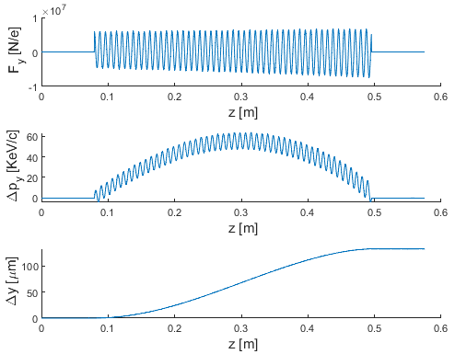
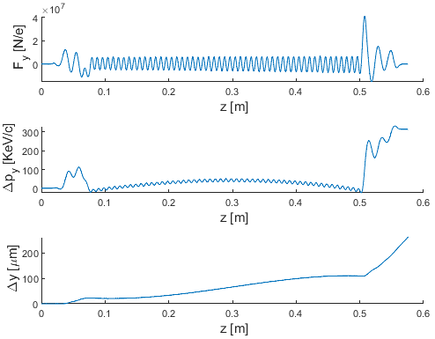
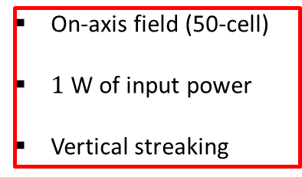
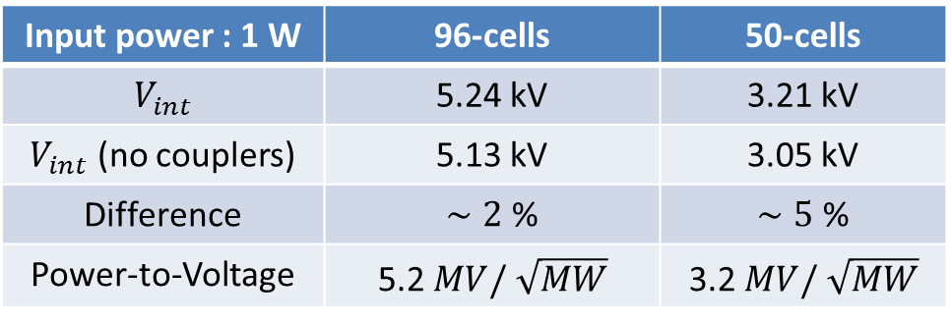
PolariX TDS: Coupler residual kick
Fields maps generated with HFSS to test the effect on the beam dynamics
On-axis field (50-cell)
$1$ W of input power
Vertical streaking
Residual kick from the output coupler
Field integral comparison:
Input power : 1 W | 96-cells | 50-cells
$V_{int}$ | 5.24 kV | 3.21 kV
$V_{int}$ (no couplers) | 5.13 kV | 3.05 kV
Difference | $∼2$ % | $∼5$ %
Power-to-Voltage | 5.2 $MV/ \sqrt{MW}$ | 3.2 $MV/ \sqrt{MW}$
Evaluate the coupler influence on the temporal profile reconstruction

Slide 7
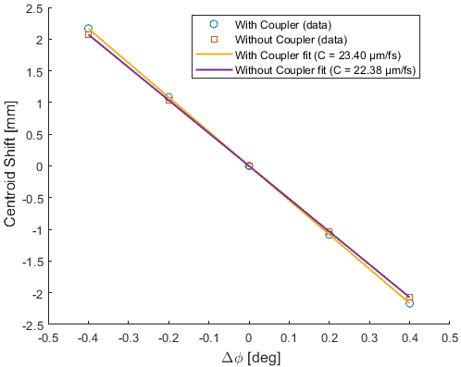
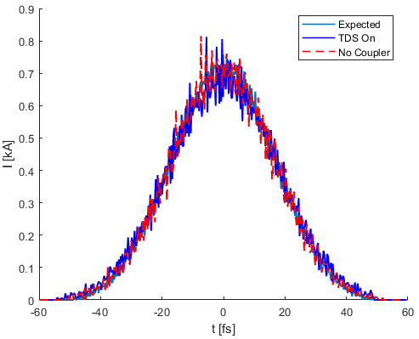
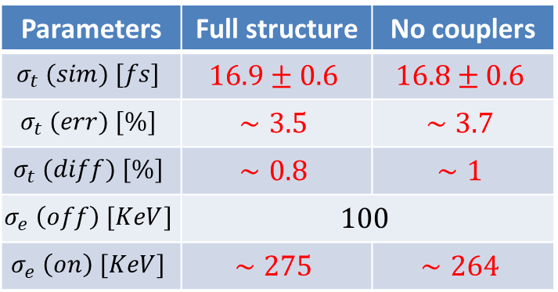
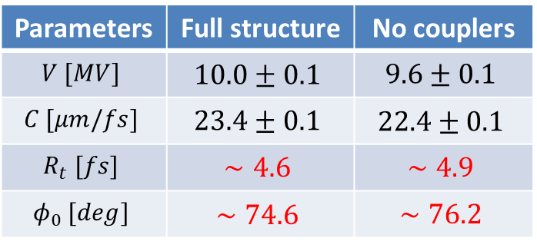
Ideal beam simulations
50 cells structure simulations (ideal beam at 118 $MeV$, $σ_{t}=17 fs$)
Parameters | Full structure | No couplers
$$V [MV]$$ | $$10.0±0.1$$ | $$9.6±0.1$$
$$C [μm/fs]$$ | $$23.4±0.1$$ | $$22.4±0.1$$
$$R_{t} [fs]$$ | $$∼4.6$$ | $$∼4.9$$
$$φ_{0} [deg]$$ | $$∼74.6$$ | $$∼76.2$$
Slightly overextimate the longitudinal calibration and resolution
Slippage effect that changes the zero-crossing phase
Parameters | Full structure | No couplers
$$σ_{t} (sim) [fs]$$ | $$16.9±0.6$$ | $$16.8±0.6$$
$$σ_{t} (err) [\%]$$ | $$∼3.5$$ | $$∼3.7$$
$$σ_{t} (diff) [\%]$$ | $$∼0.8$$ | $$∼1$$
$$σ_{e} \left(off\right) [KeV]$$ | $$100$$
$$σ_{e} \left(on\right) [KeV]$$ | $$∼275$$ | $$∼264$$
The reconstruction of the temporal profile is not affected significantly by the coupler contribution
The induced energy spread does not introduce errors in the measurement

Slide 8
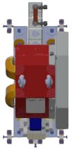
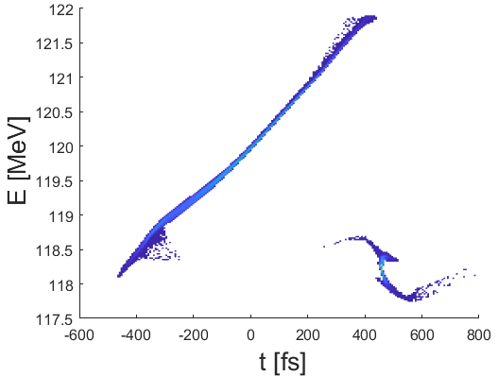
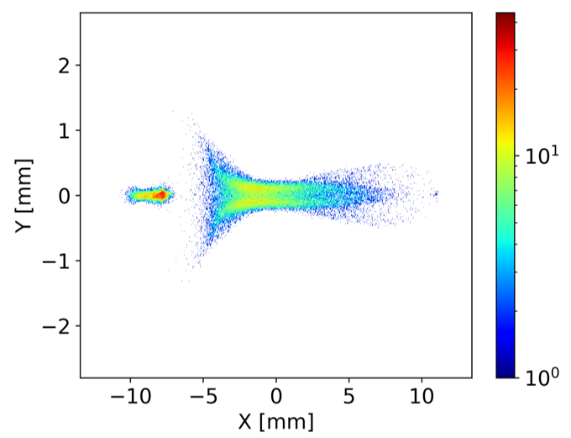

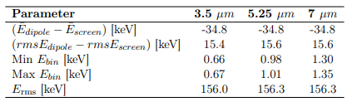

Low-energy beamline: energy measurement
Quadrupoles
25 cm Dipole
22 deg deflection angle
60 cm PolariX TDS
Screen
3.35 m Drift
$$0.1 m$$
Energy simulations:
The screen position provides an optimal trade-off between energy resolution and field of view, allowing to have both driver and witness in the same image
1.5 m
Driver
Witness
Synchrotron-radiation effects are included in the simulation and lead to a slightly broader energy spectrum, without affecting the separation between driver and witness
The measured energy and relative spread are stable across the explored screen resolutions, confirming the robustness of the diagnostic system

Slide 9
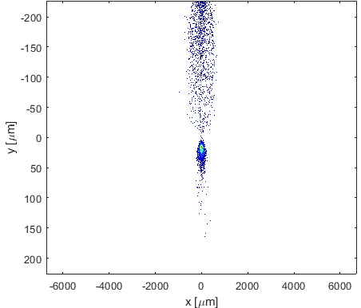
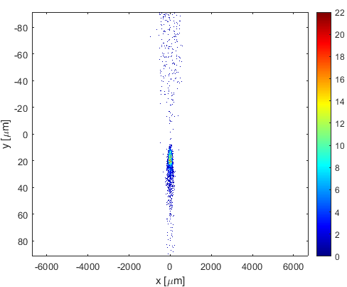
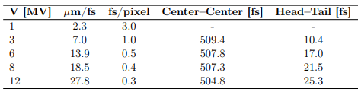
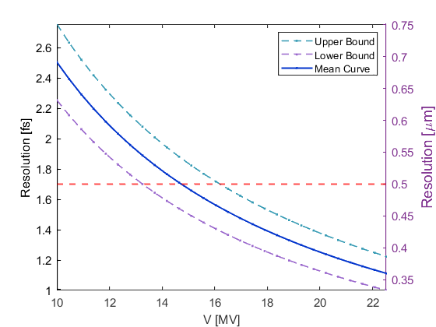
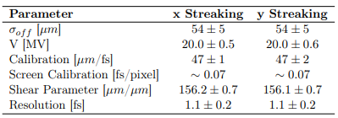
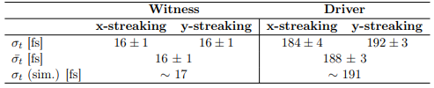

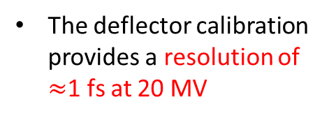

Low-energy beamline: TDS measurement
TDS simulations:
8$MV$
20 MV
The temporal separation between driver and witness increases with the deflecting voltage. For voltages above 8 MV, both bunches are clearly resolved on the screen.
$$R_{t}=\frac{σ_{off}}{C}$$
The deflector calibration provides a resolution of $≈$1 fs at 20 MV
Measured parameters in agreement with the expected input distribution

Slide 10
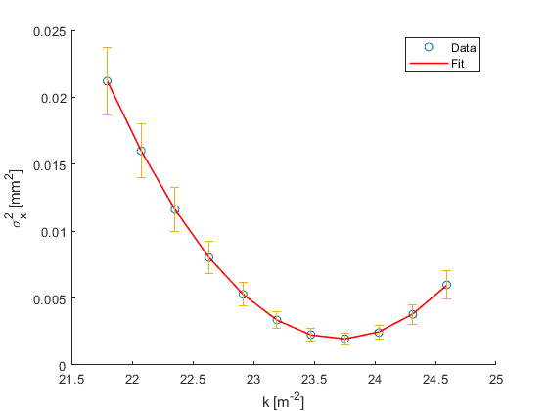
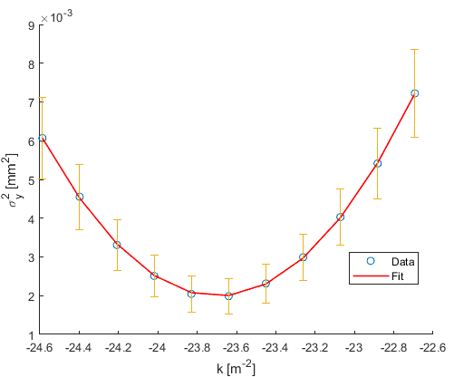
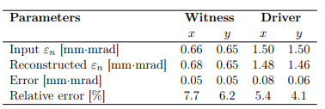
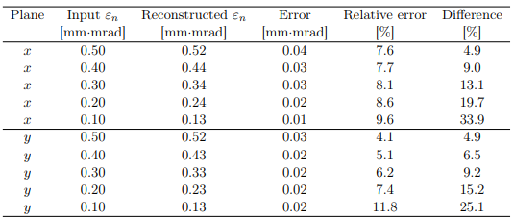
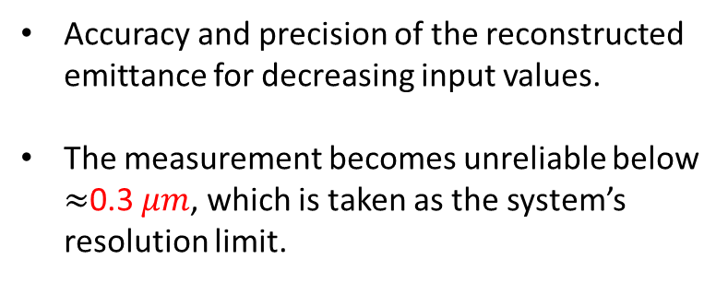


Low-energy beamline: emittance measurement
Emittance simulations:
$$α_{x} Range:[−2, 2]$$
$$α_{y} Range:[−2, 2]$$
These are the reconstructed values for driver and witness from the simulated scan
Accuracy and precision of the reconstructed emittance for decreasing input values.
The measurement becomes unreliable below $≈$0.3 $μm$, which is taken as the system’s resolution limit.

Slide 11
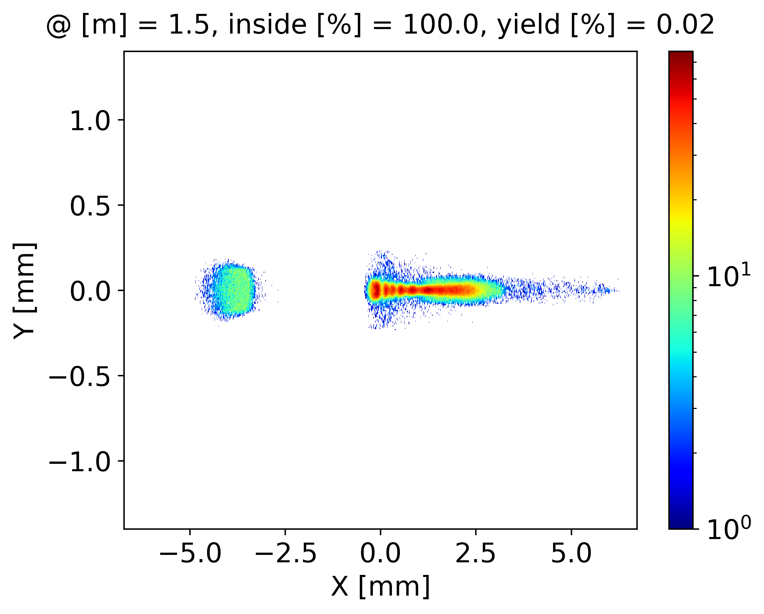
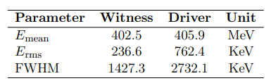
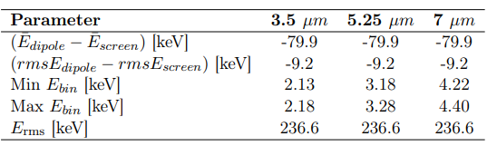
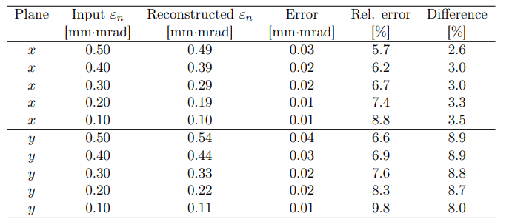
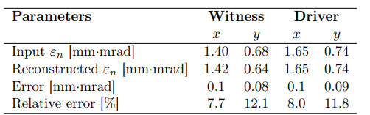

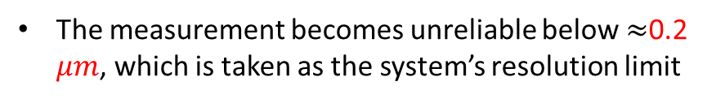
Middle-energy beamline
Dipole
Screen
$$0.15 m$$
2.55 m Drift
Energy simulations:
At 1.5 m the screen position and resolution allow to clearly measure driver and witness beam in the same image, with sufficient resolution for both bunches
Emittance simulations:
The measurement becomes unreliable below $≈$0.2 $μm$, which is taken as the system’s resolution limit

Slide 12
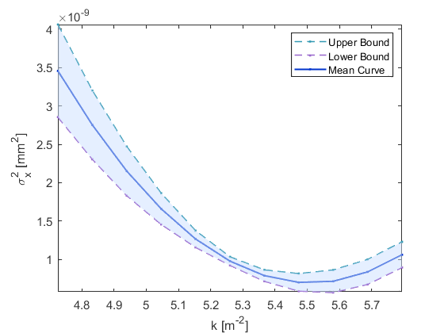
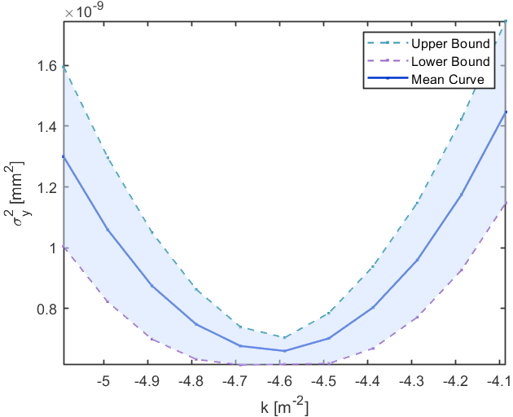
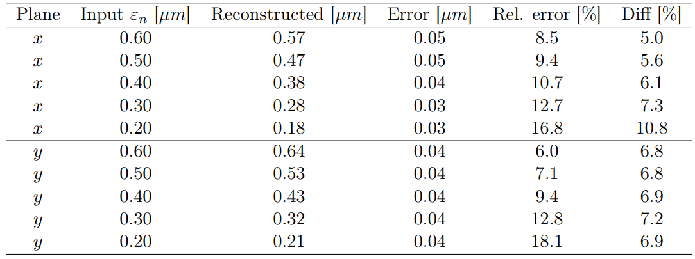
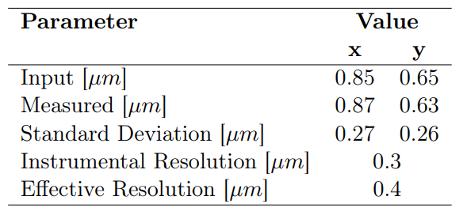

High-energy beamline: emittance
96 cm PolariX TDS
Dipole
Screen
3.07 m Drift
$$0.2 m$$
Emittance simulations:
Quadrupole-scan reconstruction at high energy to take into account shot-to-shot fluctuations in the fitted emittance
Resolution is not only determined by the instrumental component but also by the shot-to-shot variations
Considering the shot-to-shot fluctuations the effective emittance resolution at high-energy is $≈0.4 μm$

Slide 13
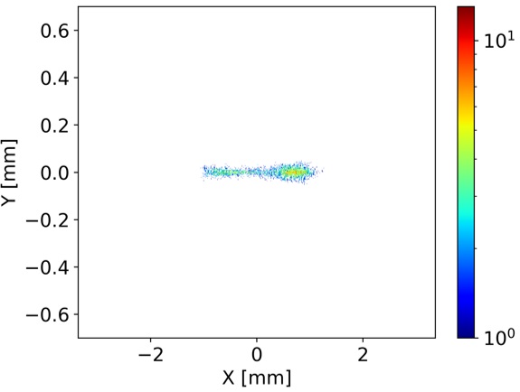
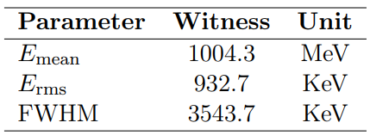
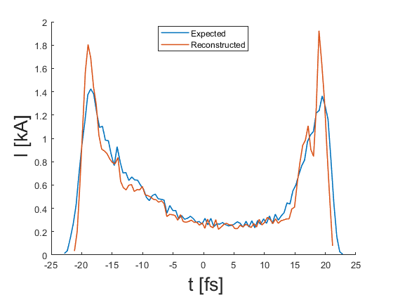
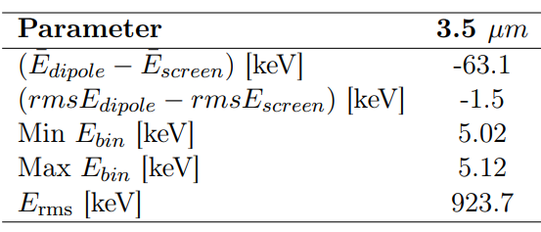
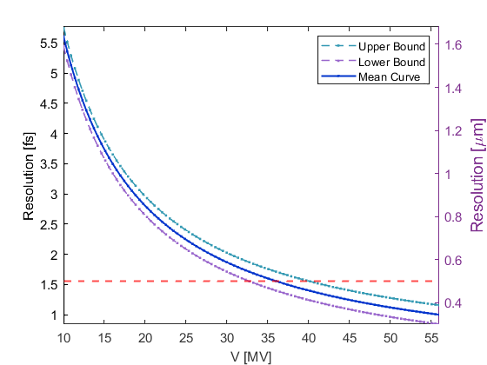




High-energy beamline: LPS Measurement
Energy simulations:
TDS simulations:
Longitudinal resolution:
The deflector calibration provides a resolution of $≈$1 fs at 50 MV in vertical streaking and $≈2$ fs at horizontal streaking, where is limited by the larger unstreaked beam size
$$R_{t}=\frac{σ_{off}}{C}$$

Slide 14





PolariX TDS: Tomographic reconstruction
The PolariX TDS at high-energy enables the beam characterization through 3D and 5D tomography$⇒$ Experimental campaign at the PSI center
Combination of two scans:
Quadrupole scan$→$ change optics, vary transverse phase advance
PolariX TDS scan$→$ streaking at 10 polarization angles ($∼180 deg$ coverage)
For each quadrupole setting and polarization:
Acquire streaked images
Each image is divided into longitudinal slices
3D Reconstruction
Each slice (1D in time) + 10 projections → tomographic 2D reconstruction (x–y)
Stacking slices → 3D charge distribution (x, y, t)
$$D_{1}(θ)$$
$$D_{n}(θ)$$

Slide 15




PolariX TDS: 5D tomography
4D Reconstruction
2D slice images interpreted as projections of full 4D phase space (x, x′, y, y′) rotated by an angle depending on the phase advance
$$I\left(x,y\right)=∫∫f_{b}\left(x,x^{′},y,y^{′}\right)dx^{′}dy′$$
$μ_{x}⇒\left(\begin{aligned}x_{1} \\ x_{1}^{′}\end{aligned}\right)=\left(\begin{aligned}cos⁡(θ_{x}) \\ sin⁡(θ_{x})\end{aligned}\begin{aligned} −sin⁡(θ_{x}) \\ cos⁡(θ_{x})\end{aligned}\right)$ $\left(\begin{aligned}x \\ x′\end{aligned}\right)⇒I_{y} (x_{1},θ_{x} )$
$I_{y} (x_{1},θ_{x} )$is the projection along the $θ_{x}$direction in the horizontal phase space
Filtered back-projection algorithm recovers transverse momenta $x’,y’$
1° iteration
2° iteration
$$I_{y,θ_{x}}\left(x\right)$$
$$f_{y }\left(x,x′\right)$$
$$f_{ }\left(x,x^{′},y,y′\right)$$
5D Reconstruction
Combine transverse phase space slices (4D) with longitudinal coordinate (t)
Result: full 5D beam distribution
Developed and demonstrated for the first time at DESY.

Slide 16


5D Reconstruction: Beamline layout
Athos 3-GeV Beamline at SwissFEL
Phase shifter system for polarization selection
PS3
Reconstruction Point
Measurement Screen
PS1
PS2
TDS 1
TDS 2
Quadrupoles upstream to the TDS used for matching to the screen
Quadrupoles off after the TDS$⇒$ Resolution depending on the TDS-screen distance, TDS parameters, and unstreaked beam transverse size at the screen
System of 3 Phase Shifters needed for polarization selection and opposite kick compensation
The measurement has been done in two settings: a short bunch ($σ_{t}∼19 fs$) and a less compressed ($σ_{t}∼40 fs$) to mitigate collective effects in the compressor and reduce the beam tilt
$$Beam and TDS parameters$$
$$Charge$$ | $$200 pC$$
$$Energy$$ | $3.4$ G$eV$
$$TDS length$$ | $1.2$ $m$
$$Klystron power$$ | $$28 MW$$
$$TDS Voltage$$ | $70$ $MV$
$$TDS calibration$$ | $$16.5 μm/fs$$

Slide 17


5D Reconstruction: Optics simulations
Single-particle simulations have been done to calculate the beam optics for the quadrupole scan
Reconstruction Point
Matching Quadrupoles
Measurement Screen
TDS 1
TDS 2
Phase advance scan: $μ_{x},μ_{y}$ from $96$ to $236 deg$
$β$ Twiss $∼$20 m
$α$ Twiss $∼$0
Scan index

Slide 18



5D Reconstruction: TDS polarizations
The beam is streaked, covering a polarization range of 180 degrees, and from the centroids, the streaking angle can be evaluated
The polarization is set by three phase shifters that set the single cavity phase and the relative one
$$θ=\tan^{−1}⁡(\frac{C_{y} }{C_{x}})$$
Polarization [deg] | Measured Angle [deg]
$$0$$ | $$2.3±0.3$$
$$18$$ | $$19.6±0.3$$
$$36$$ | $$37.9±0.2$$
$$54$$ | $$56.6 ±0.5$$
$$72$$ | $$74.7±0.5$$
$$90$$ | $$92.9±0.2$$
$$108$$ | $$111.4±0.4$$
$$126$$ | $$130.1±0.2$$
$$144$$ | $$148.2±0.3$$
$$162$$ | $$165.2±0.5$$
Angle from: Centroid Shift vs RF Phase
Beam Images at different polarizations

Slide 19






5D Reconstruction: Calibration results
TDS calibration for different streaking angles $→$ Measured the centroid shift when changing the cavity phase
Expecting a low variation in the calibration factors depending on the streaking angle, due to not using quadrupoles after the TDS
$$C=\frac{eV_{0}L}{E}2πν [μm/fs]$$
$$R_{t}=\frac{σ_{off}}{C}$$
$$R_{1}=6.4±1.6 fs$$
$$R_{2}=7.3±2.4 fs$$

Slide 20






Dataset 1 and 2 – 3D Analysis
Dataset 1, Optics: $μ_{x}=μ_{y}=96 deg$
Slice duration: 4.4 fs (25 slices)
2D projections:
Reconstructed beam parameters:
Dataset 2, Optics: $μ_{x}=μ_{y}=96 deg$
Slice duration: 7.1 fs (29 slices)
2D projections:
Reconstructed beam parameters:

Slide 21






Reconstruced temporal profile
Dataset 1:
Bunch 1 features a short temporal profile and a regular current distribution
Dataset 2:
Bunch 2 features a longer temporal profile and a peaked current distribution with a long tail

Slide 22






Slice resolution scan analysis
Superposition of the reconstructed temporal profiles and beam sizes for the various slice resolutions:
As the number of slices increases, the reconstructed value of $σ_{t}$ progressively converges toward the expected measurement from the conventional TDS measurement
When the slice resolution $Δt_{slice}$ is shorter than the intrinsic temporal resolution of the TDS measurement, the result is consistent with longer slice resolutions
In Dataset 2, the scan confirms the trend observed in the first dataset, showing even shorter deviations from the measured bunch duration (obtained from conventional TDS measurement)
Dataset 1:
Dataset 2:

Slide 23




5D Reconstruction: Preliminary results
3D beam charge density obtained as a projection of the reconstructed 5D distribution:
Beam 1: High compression ${FWHM}_{t}∼56 fs$
Beam 2: Moderate compression$FWHM\sim 103 fs$

Slide 24



5D Reconstruction: Bunch 1
$$x_{N}=\frac{x}{\sqrt{β_{x}} }$$
$$y_{N}=\frac{y}{\sqrt{β_{y}} }$$
Bunch 1, reconstructed 2D projections:
Preliminary
In the first beam configuration, the high compression produces a very short bunch with an evident tilt in the (x,t) plane

Slide 25

5D Reconstruction: Bunch 2
$$x_{N}=\frac{x}{\sqrt{β_{x}} }$$
$$y_{N}=\frac{y}{\sqrt{β_{y}} }$$
Bunch 2, reconstructed 2D projections:
Preliminary
In the second beam configuration, the relaxation of the bunch compression reduces the beam tilt

Slide 26

Summary and conclusions
Summary results
Determined the resolution limits and performarce of the diagnostics beamline at low, middle and high energy, for transverse and longitudinal phase space characterization
Designed and characterized the 50-cell PolariX TDS field maps needed at the low-energy beamline
Employed the 3D and 5D tomography at the 3 GeV Athos beamline at SwissFEL, to reconstruct beams for two different beam configurations with $∼fs Resolution$

Slide 27
Thank you for your attention

Slide 28
References
[1] Grudiev, Alexej. Design of compact high power RF components at X-band. No. CERN-ACC-NOTE-2016-0044. 2016.
[2] Marchetti, Barbara, et al. "Experimental demonstration of novel beam characterization using a polarizable X-band transverse deflection structure." Scientific reports 11.1 (2021): 3560.
[3] Jaster-Merz, S., et al. "5D tomographic phase-space reconstruction of particle bunches." Physical Review Accelerators and Beams 27.7 (2024): 072801.
[4] Marx, Daniel, et al. "Reconstruction of the 3D charge distribution of an electron bunch using a novel variable-polarization transverse deflecting structure (TDS)." Journal of Physics: Conference Series. Vol. 874. No. 1. IOP Publishing, 2017.
[5] Marx, Daniel, et al. "Simulations of 3D charge density measurements for commissioning of the PolariX-TDS." Journal of Physics: Conference Series. Vol. 1067. IOP Publishing, 2018.
[6] Hock, K. M., and A. Wolski. "Tomographic reconstruction of the full 4D transverse phase space." Nuclear Instruments and Methods in Physics Research Section A: Accelerators, Spectrometers, Detectors and Associated Equipment 726 (2013): 8-16.
[7] Jaster-Merz, S., et al. "5D tomographic phase-space reconstruction of particle bunches." Physical Review Accelerators and Beams 27.7 (2024): 072801
[8] Jaster-Merz, S., et al. "Experimental demonstration of a tomographic 5D phase-space reconstruction." arXiv preprint arXiv:2505.13724 (2025).

Slide 29
BACKUP SLIDES

Slide 30




PolariX TDS: Field maps outline
Fields maps generated with HFSS for the two structures to test the effect on the beam dynamics
On-axis field (50-cell)
$1$ W of input power
Vertical streaking
Phase Advance per cell : $−\frac{2π}{3}$
Backward travelling wave structure

Slide 31





Energy Jitter Measurement at SPARC
In plasma accelerated beams, the witness energy gain is directly related to the relative distance from the driver beam, so that in the velocity bunch compression scheme, it is affected by the stability of the RF system
This shot-to-shot jitter requires a complementary single-shot diagnostics to the TDS devices: Electro-Optical Sampling (EOS)
The witness energy measurement at the high-energy spectrometer is combined with the measurement of the relative distance between the driver and witness beams before the plasma chamber with the EOS
$e^{−}$ bunch
EOS Crystal
Laser
$$θ=30 deg$$
Witness
Driver
The resolution in the measurement of the beam arrival time is of fs, so it is suitable for measuring the beam's arrival time and the driver-witness relative distance in the same shot

Slide 32









Measurement Results
$$φ_{1}=132.10 deg$$
$$φ_{2}=131.30 deg$$
${t_{1}}_{mean}=\left(1.0±0.1\right) ps$
${t_{2}}_{mean}=\left(1.2±0.1\right) ps$
$$m_{1}=\left(10±1\right)\frac{KeV}{fs}$$
$$m_{2}=\left(8.2±0.6\right)\frac{KeV}{fs}$$
The compression phase is slightly different: when the phase is smaller the compression is larger and therefore, the distance between the bunches increases
The different slope is dependent on the plasma density (the used density for the experiment is $∼{10}^{15} cm^{−3}$): the first measurement corresponds to a larger density and so it is higher the slope with respect to the second case

Slide 33

SART tomographic algorithm
SART (Simultaneous algebraic reconstruction technique) TOMOGRAPHIC ALGORITHM
Working principle:
Sinogram: set of 1S projections $D_{j}$ (called ray) in input to the algorithm
Initial guess $I_{0}\left(x,y\right)$ to calculate the projection ${D_{0}}_{j}=R_{j}I_{0}\left(x,y\right)$
Calculated the projection ${D_{0}}_{j}$ we define the difference between $D_{j}$ and ${D_{0}}_{j}$ and update the initial guess $I_{0}\left(x,y\right)$ to reduce the difference at each iteration
Advantages:
It is simultaneous because it updates all pixels at the same time
More accurate and robust than other similar algorithms
Good reconstruction with few projection angles

Slide 34

Filtered Back Projection algorithm
FILTERED BACK PROJECTION TOMOGRAPHIC ALGORITHM
Working principle:
2D Projection of 4D distribution $I\left(x,y\right)=∫∫f_{B}\left(x,x^{′},y,y^{′}\right)dx^{′}dy′$
$\left(x,x^{′}\right)⇒\left(x_{1},x_{1}^{′}\right)$ after a rotation $θ_{x}⇒I\left(x_{1},y\right)=P_{y, θ_{x}}\left(x_{1}\right):$ Projection
Consider y as constant, and work only on the x,x’ variables
Apply Fourier transform to P: $S_{y,θ_{x}}\left(w\right)=\int_{−∞}^{∞}{P_{y,θ_{x}}}\left(x_{1}\right)e^{−2πiwx_{1}}dx_{1}$
Apply high-pass filter and revert the transform: $Q_{y,θ_{x}}\left(x_{1}\right)=\int_{−∞}^{∞}{S_{y,θ_{x}}\left(w\right)|w|}e^{2πiwx_{1}}dw$
Compute the back-projection: $g_{y }\left(x,x′\right)=\int_{−π}^{π}{Q_{y,θ_{x}}}\left(x_{1}\right)dθ_{x}$
Repeating the same process for y gives the 4D distribution

Slide 35


Athos beamline optics
The optics has been calculated to match the Twiss parameters to screen
Since there are no quadrupoles active, but only a drift after the TDS, the beta function at the TDS center and the beam size at the screen are dependent parameters
$$μ_{x}=μ_{y}=111 deg$$

Slide 36
Image treating methodology
The images have to be prepared to perform the tomographic reconstruction:
Remove background and apply gaussian filters to the images
Rescale images to have square pixels
Rotate the images by the streaking angle
Apply the calibration factor to the streaking axis and rescale the images to have the same temporal scale
Center the images
Set the ROI to select only the beam
This allows for the reconstruction, minimizing the artifacts that can arise from the disalignment in the images and from background contributions

Slide 37



Dataset 2 – Slice scan analysis
Superposition of the reconstructed temporal profiles and beam sizes for the various slice dimensions:
In Dataset 2, the slice duration scan confirms the trend observed in the first dataset, showing even shorter deviations from the measured bunch duration (obtained from conventional TDS measurement)

