Slide 1

IRIS Green Superconducting Line (GSL)
Stefano Maffezzoli Felis
Advisor: Dott. Marco Statera
Supervisor: Prof. Lucio Rossi
Third Year PhD Seminar
12/11/2025

Slide 2
Outline
The IRIS Project
The Green Superconducting Line (GSL)
Physical Behaviour
Power Consumption and Use Cases
Conclusion

Slide 3
The IRIS Project

Slide 4
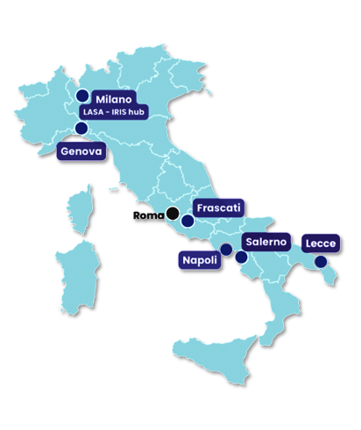
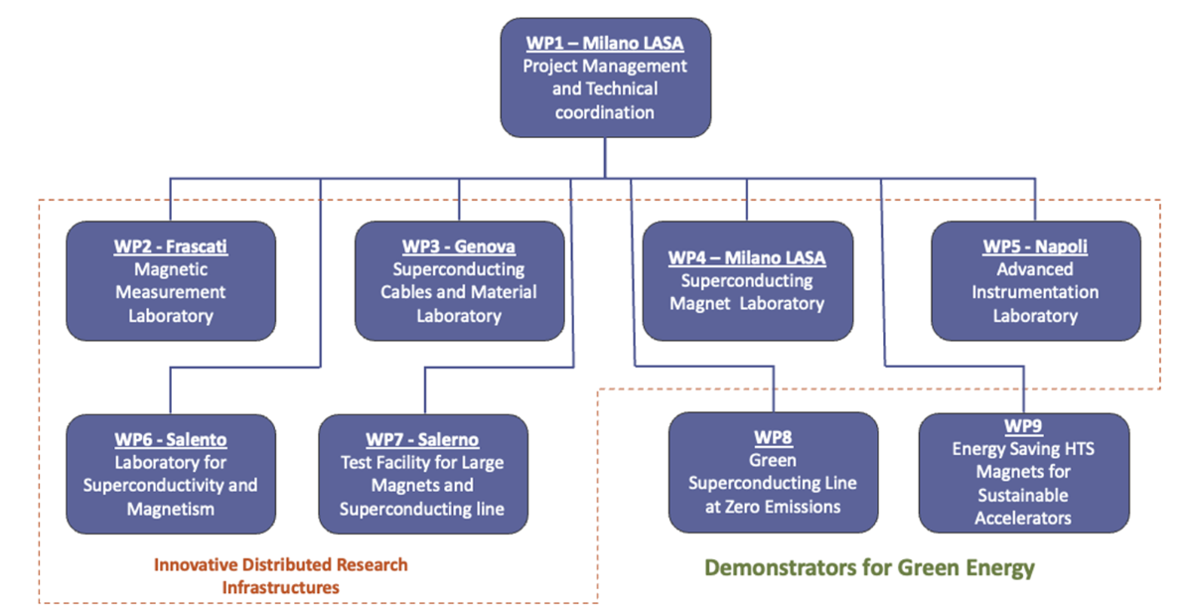
The IRIS Project Innovative Research Infrastructure for applied Superconductivity
Goal
Establishing a national research network to advance applied superconductivity in Italy for next-generation particle accelerators and energy-saving 'green' power solutions.
Work-packages Structure
Involved Institutions
Milano LASA (INFN, University)
Genova (INFN, University, CNR-SPIN)
Frascati (INFN LNF)
Napoli (University, CNR-SPIN)
Lecce (Salento University)
Salerno (INFN, University, CNR-SPIN)

Slide 5
The Green Superconducting Line (GSL)

Slide 6
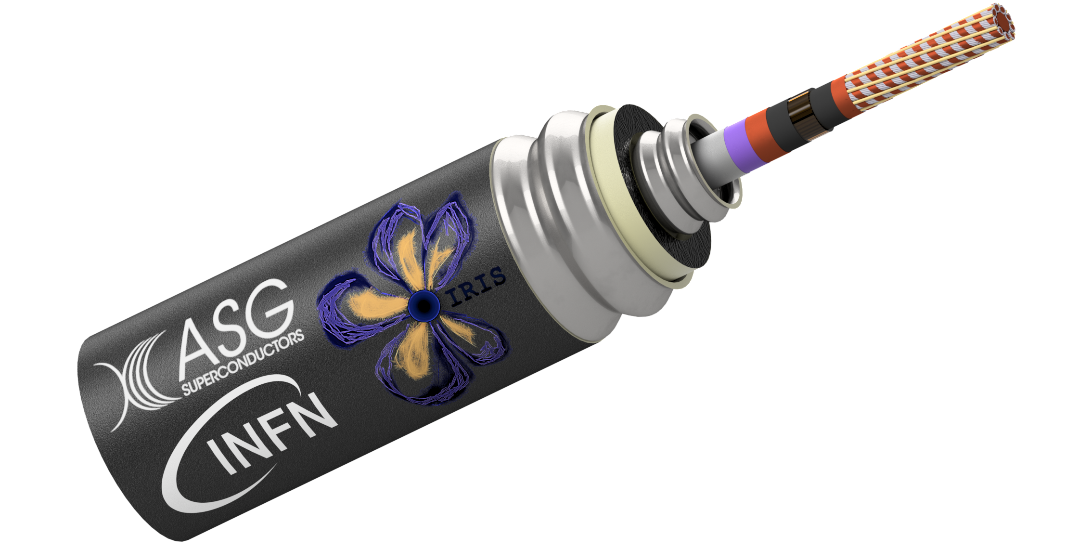
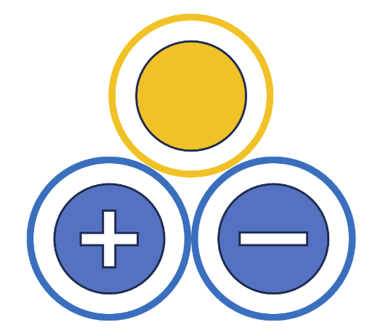
The Green Superconducting Line (GSL)
Line characteristics
Power transport | 1 GW
Voltage | 25 kV
Direct Current | 40 kA
Operating temperature | Min 18 K (inlet) Max 23 K (outlet)
Cooling | He gas
Line length | 130 m
Expected losses | <1.5 W/m at 20 K (single cryostat)
Bending radius | 2.2 m
Inner pressure | 10 bar
Superconductor | MgB₂
Redundancy | 2 active conductors
Single pole to be tested in Salerno IRIS test cable facility

Slide 7
The Green Superconducting Line (GSL)
Why Magnesium Diboride (MgB₂)
Higher Operating Temperature: MgB₂ can operate around 20 K, which is significantly higher than low-temperature superconductors (LTS), meaning it doesn't require expensive liquid helium.
Hydrogen Compatibility: Its operating temperature is compatible with liquid hydrogen infrastructure, allowing a doble energy vector.
Cost-Effectiveness: Material costs for MgB₂ wire are lower than those for high-temperature superconducting (HTS) tapes.
Simplified Cable Assembly: The round-wire geometry simplifies the assembly of a multi-wire cable.
Commercial Availability: It is available in long, continuous lengths, which reduces or removes the need for resistive joints common in HTS-based systems, improving overall performance and reliability.
Italian Excellence: Europe — and Italy in particular — is the world leader in research and development of MgB₂.

Slide 8

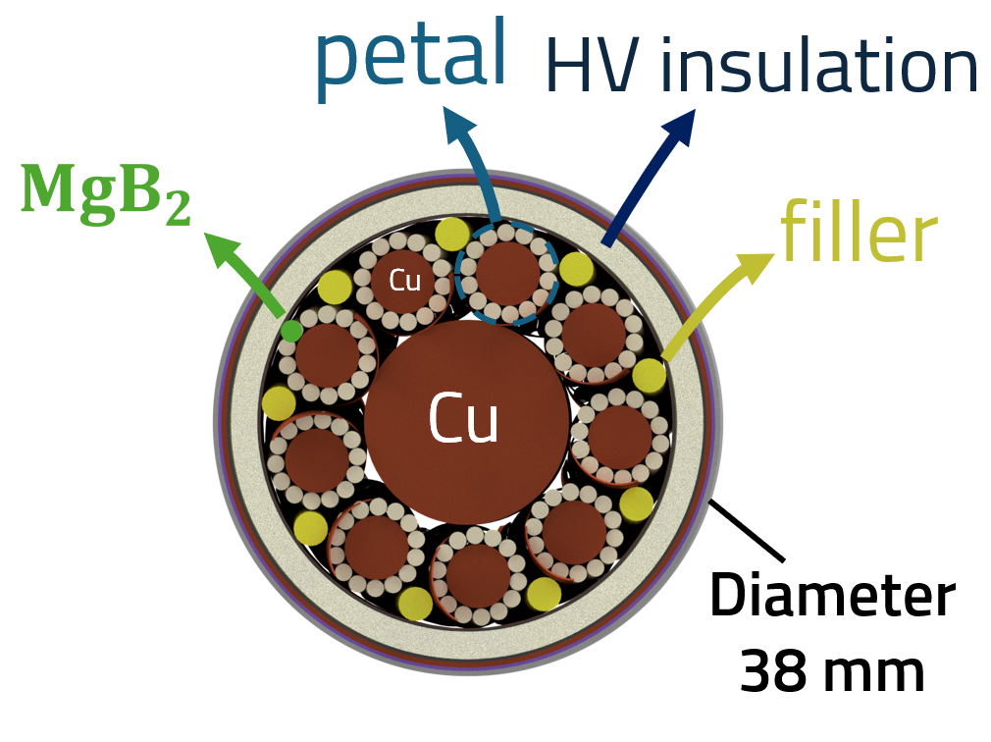
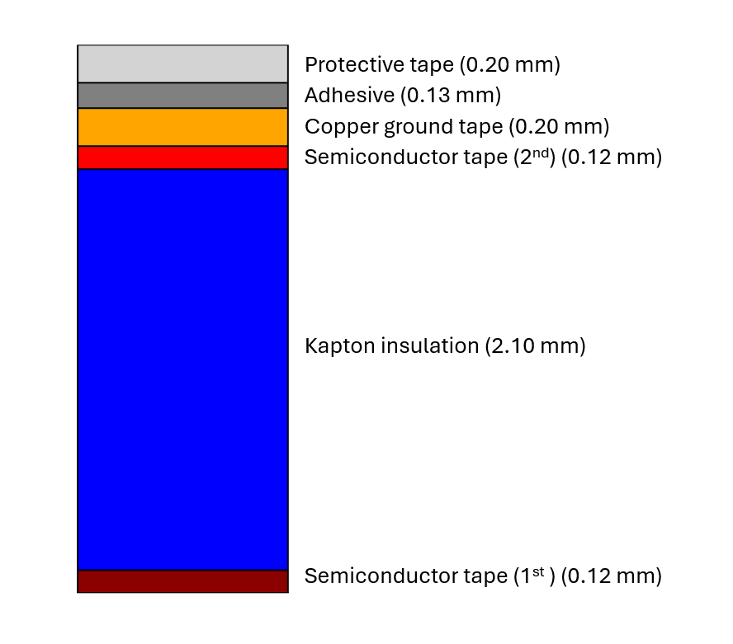

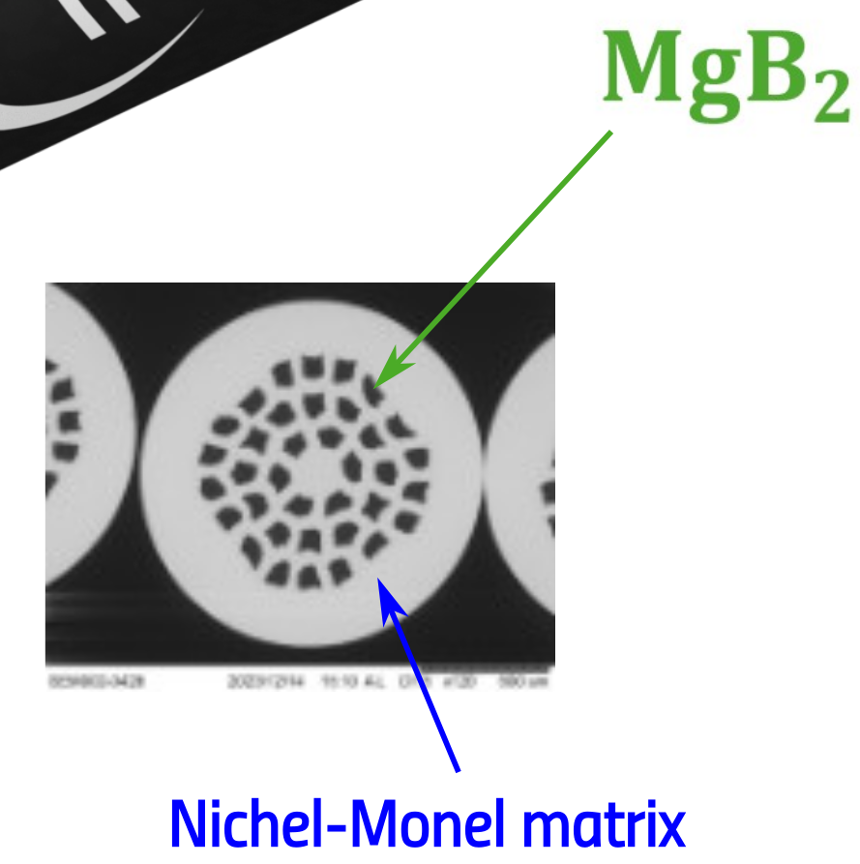
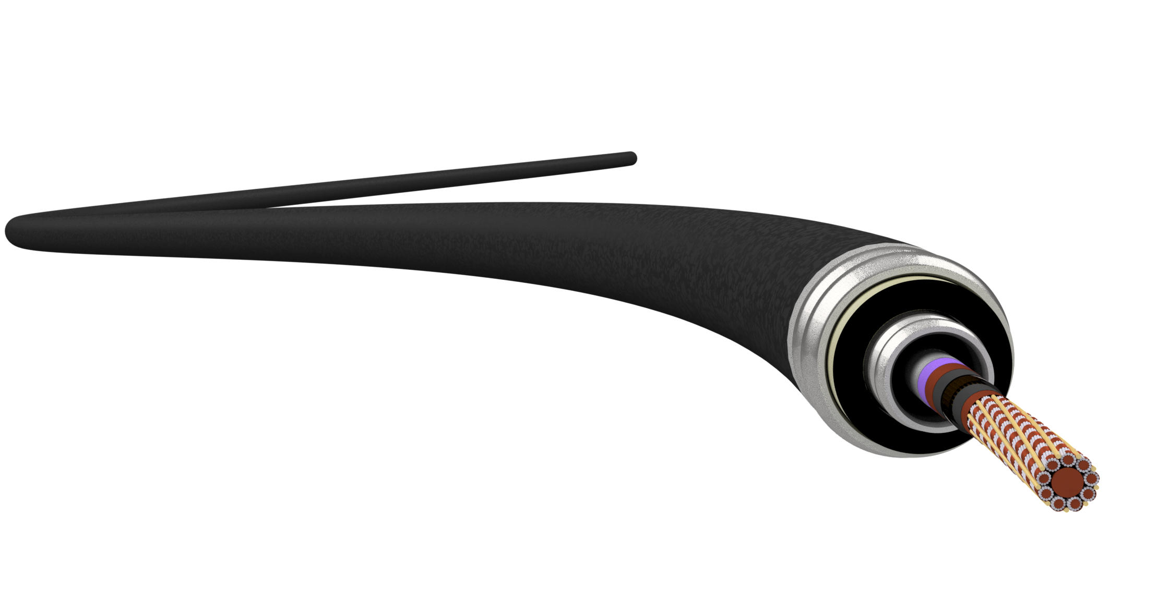
The Green Superconducting Line (GSL)
Diameter
93 μm
Polyimide insulation (2.10 mm)
Diameter
1.33 mm
Conductor Composition
9 petals
14 Superconducting Strands
36 MgB₂ Filaments
17.5% Filling Factor

Slide 9
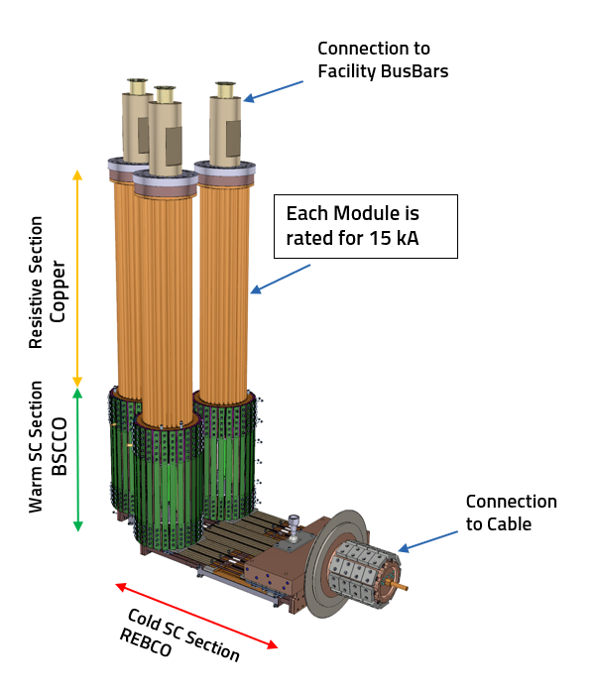
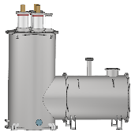
The Green Superconducting Line (GSL)
Current Leads

Slide 10
Physical Behaviour

Slide 11
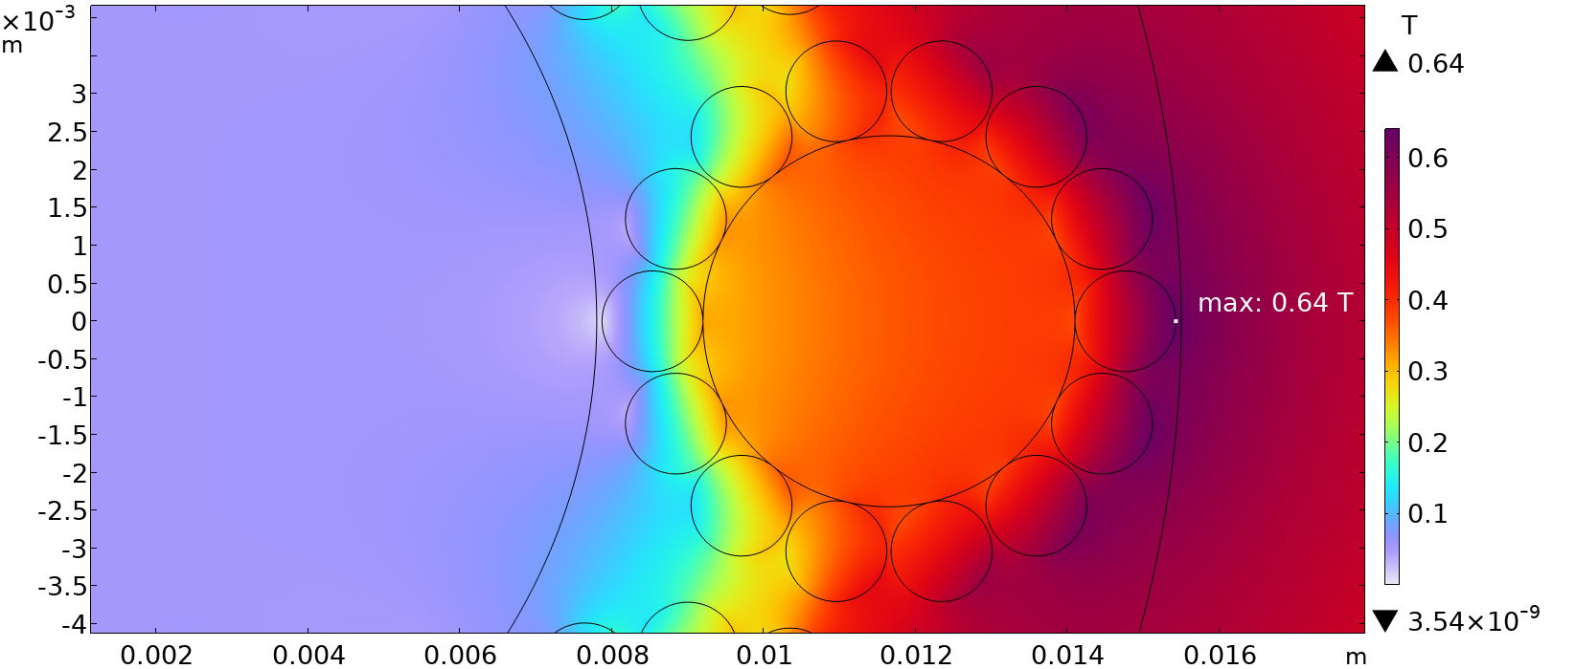
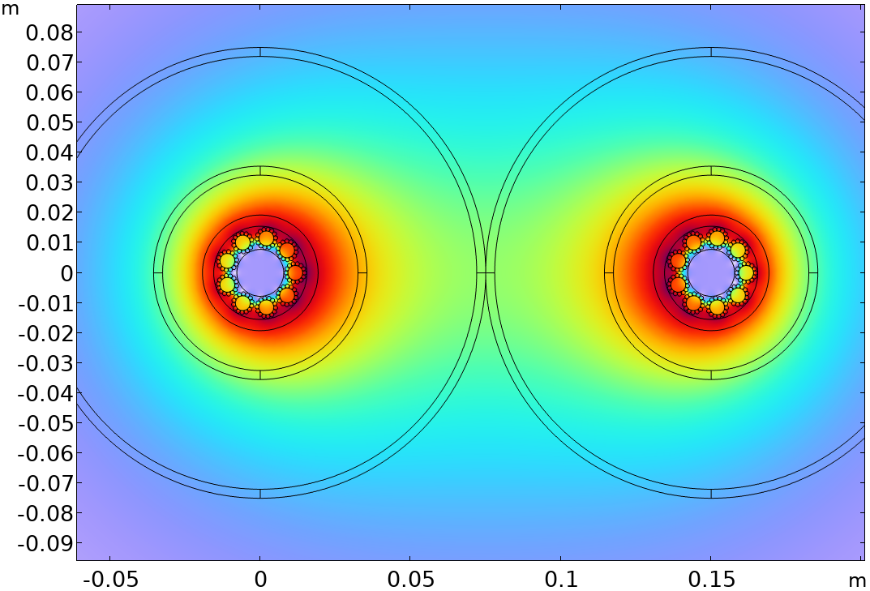
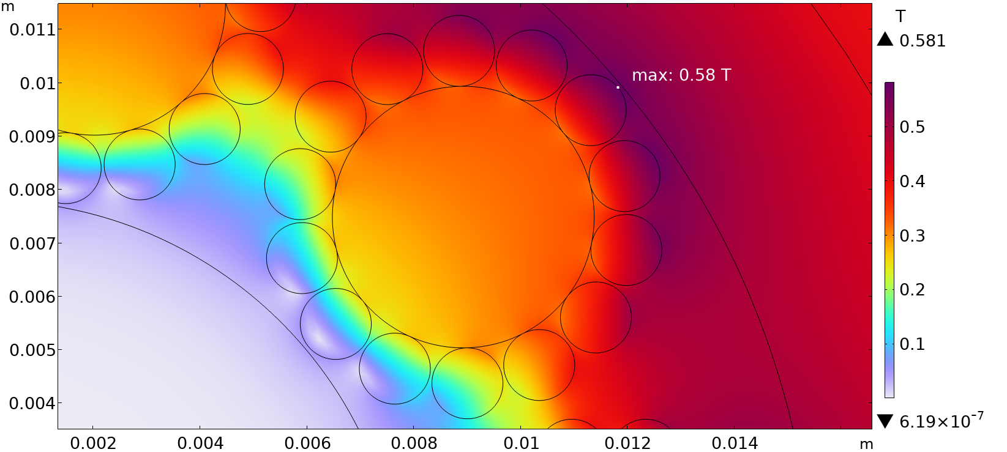
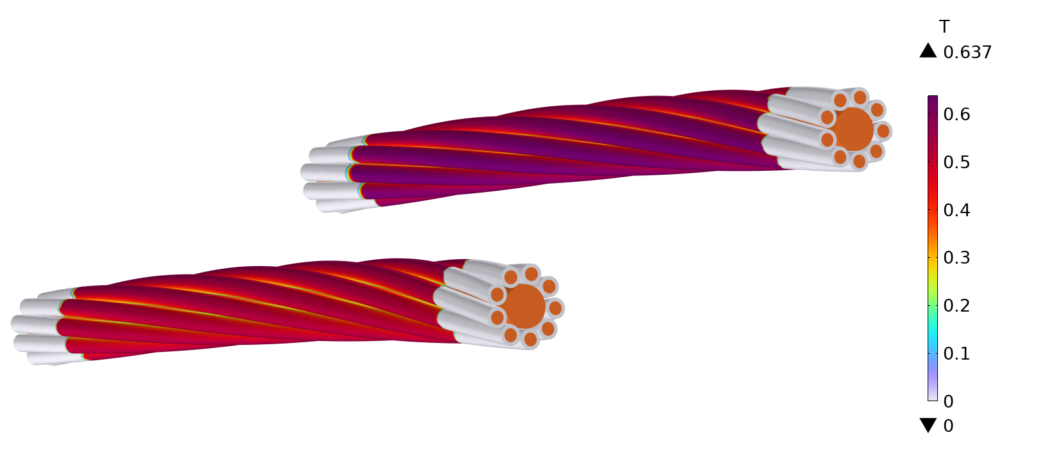
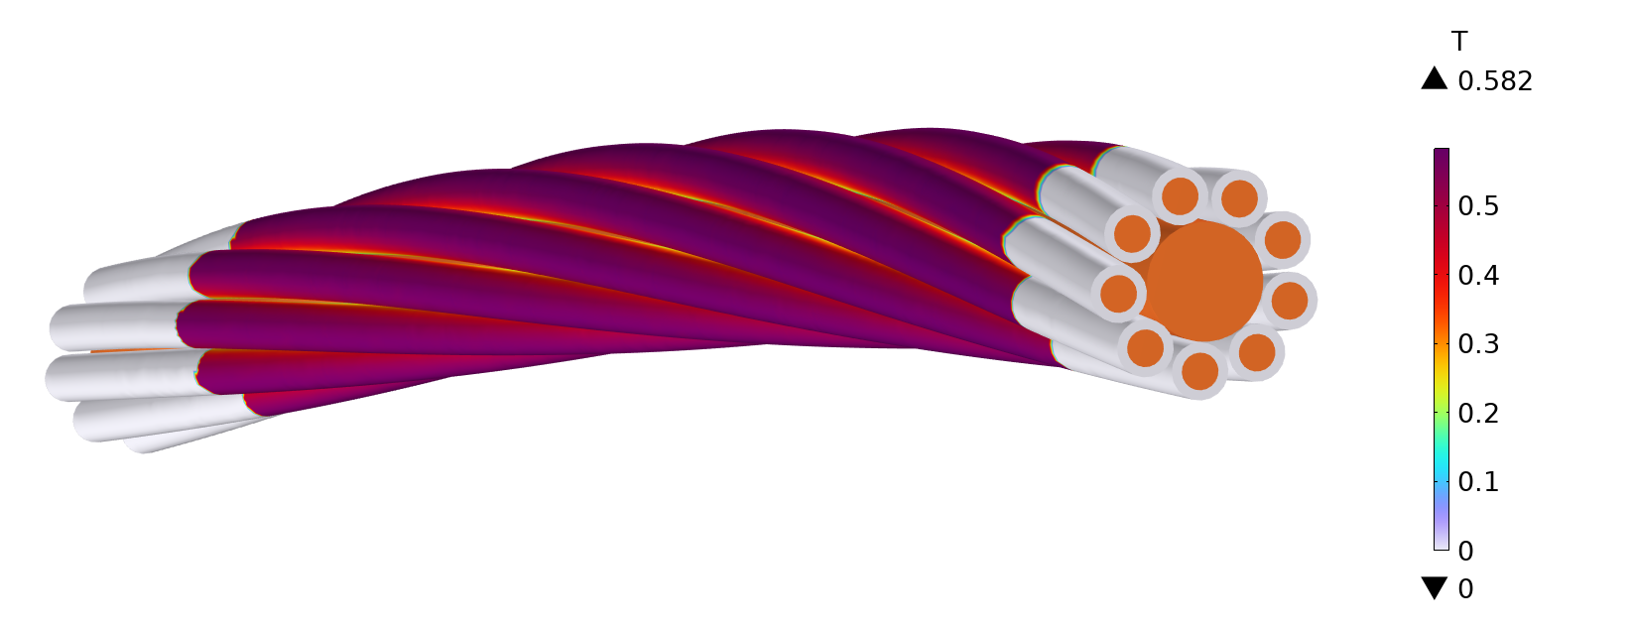
Physical Behaviour Magnetic Analysis - 2D&3D
Double Cable
Single Cable
Configuration | Peak Magnetic Field
Single | 0.58 T
Double | 0.64 T

Slide 12
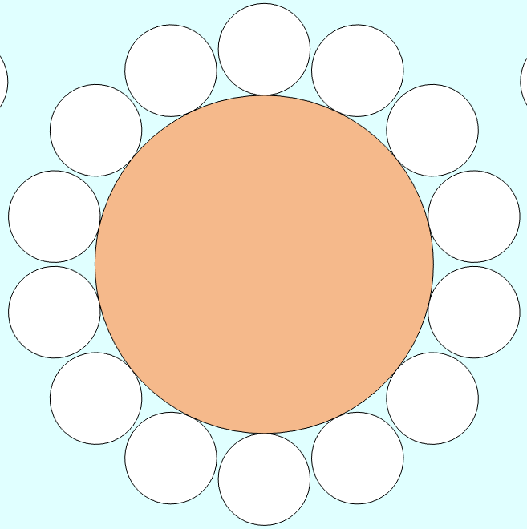
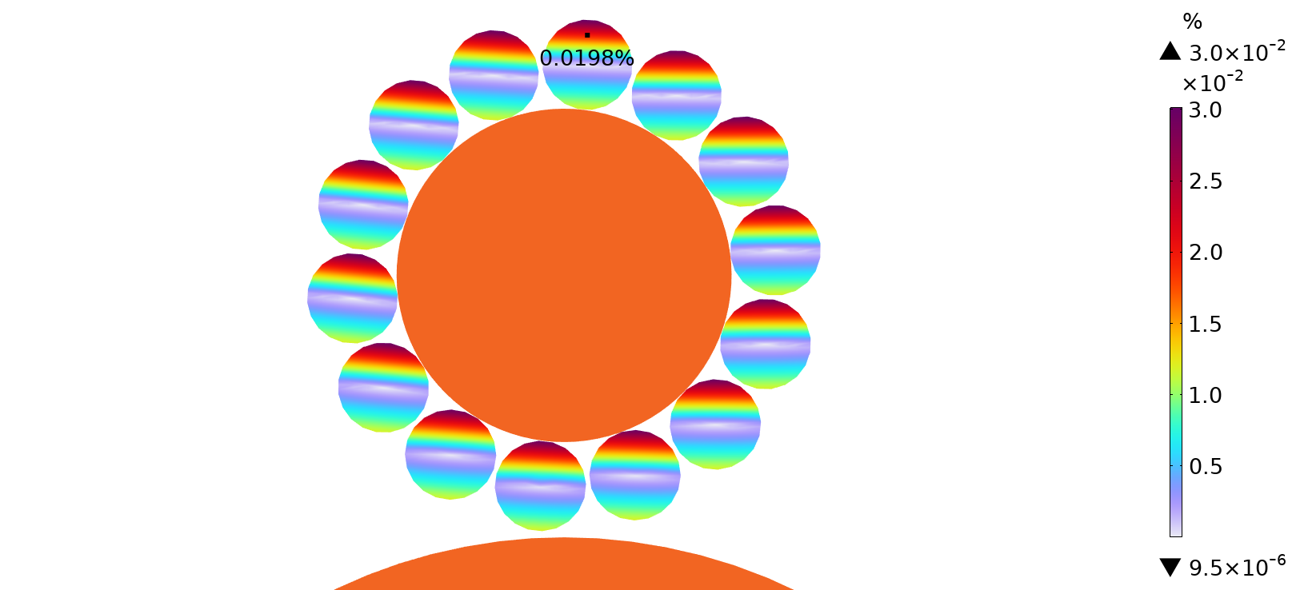

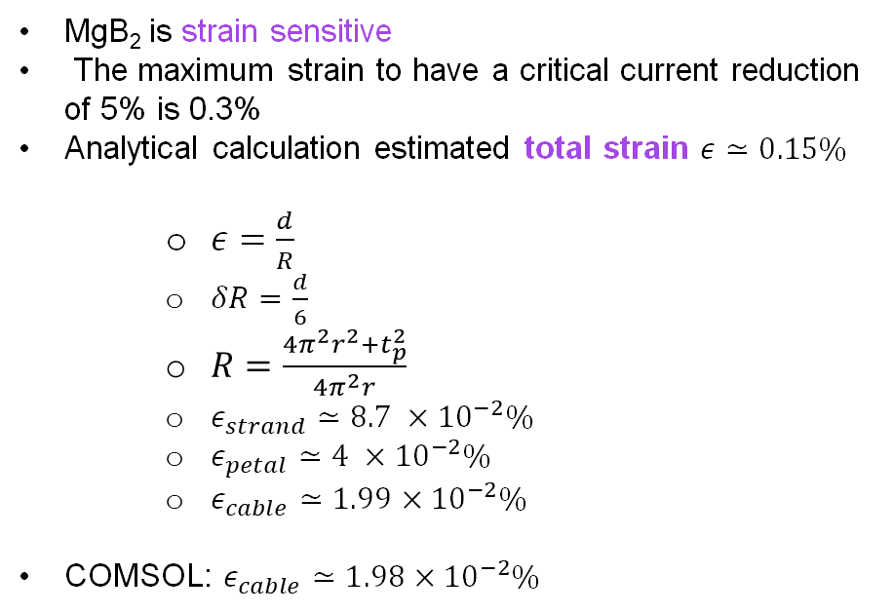
Physical Behaviour Mechanical Analysis - Analytic
MgB₂ is strain sensitive
The maximum strain to have a critical current reduction of 5% is 0.3%
Analytical calculation estimated total strain $ε≃0.15\%$
$ε=\frac{d}{R}$
$δR=\frac{d}{6}$
$R=\frac{4π^{2}r^{2}+t_{p}^{2}}{4π^{2}r}$
$ε_{strand}≃8.7 ×{10}^{−2}\%$
$ε_{petal}≃4 ×{10}^{−2}\%$
$ε_{cable}≃1.99×{10}^{−2}\%$
COMSOL: $ε_{cable}≃1.98×{10}^{−2}\%$
$$δR$$
Neutral axis
r
d

Slide 13
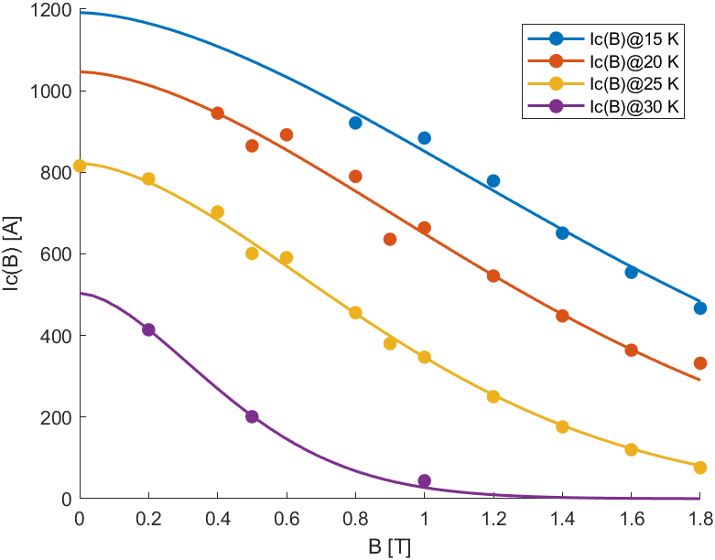
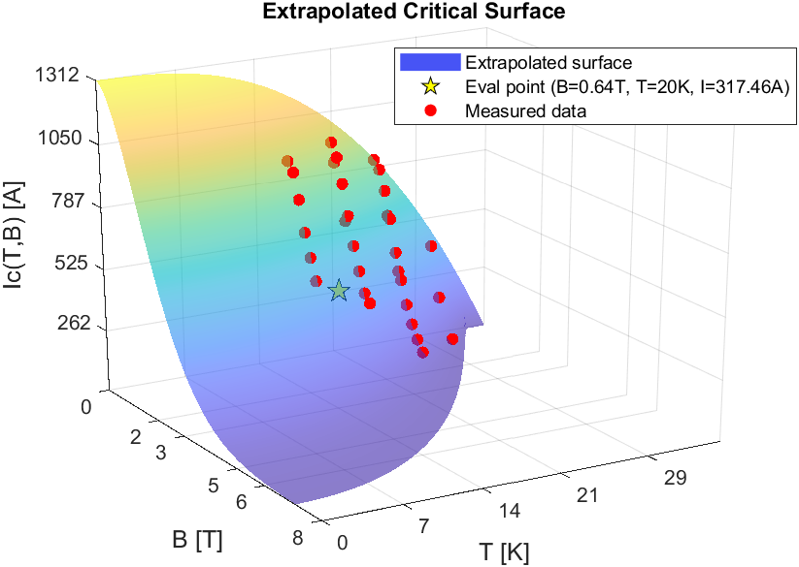
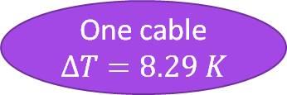
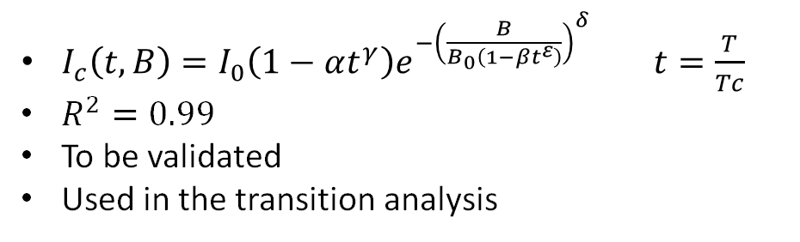
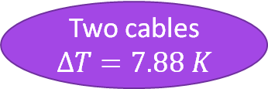
Physical Behaviour Critical Current - Data Fit
$I_{c}\left(t,B\right)=I_{0}\left(1−αt^{γ}\right)e^{−{\left(\frac{B}{B_{0}\left(1−βt^{ε}\right)}\right)}^{δ}} t=\frac{T}{Tc}$
$R^{2}=0.99$
To be validated
Used in the transition analysis
One cable
$$∆T=8.29 K$$
Two cables
$$∆T=7.88 K$$

Slide 14
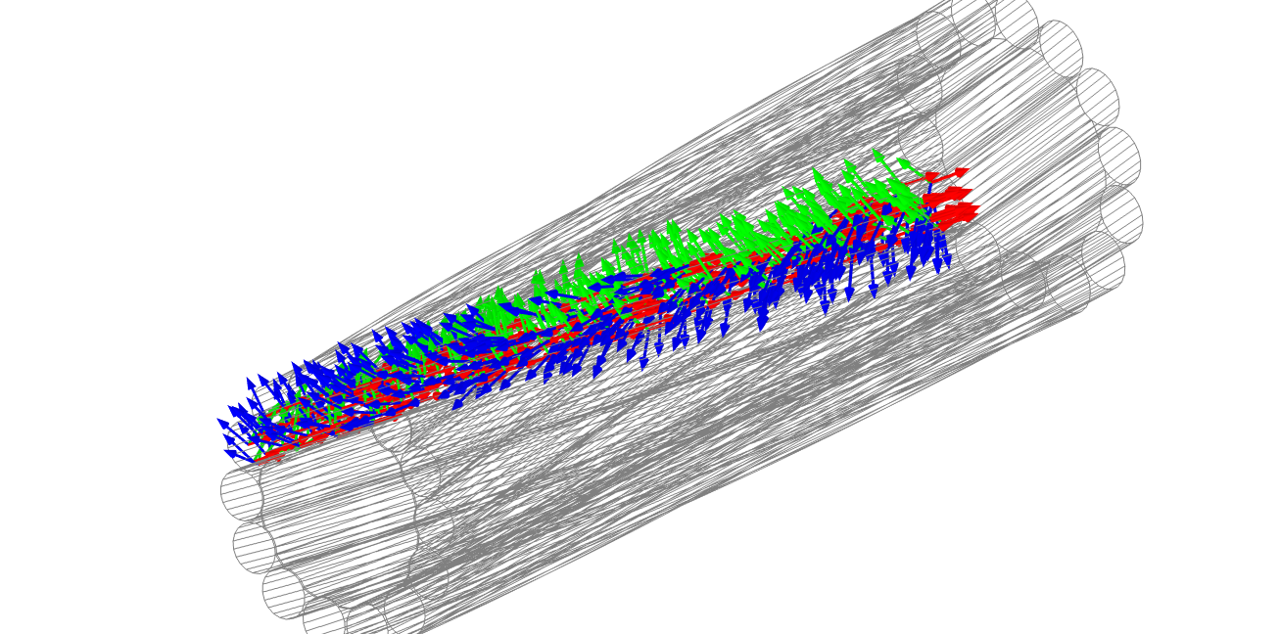
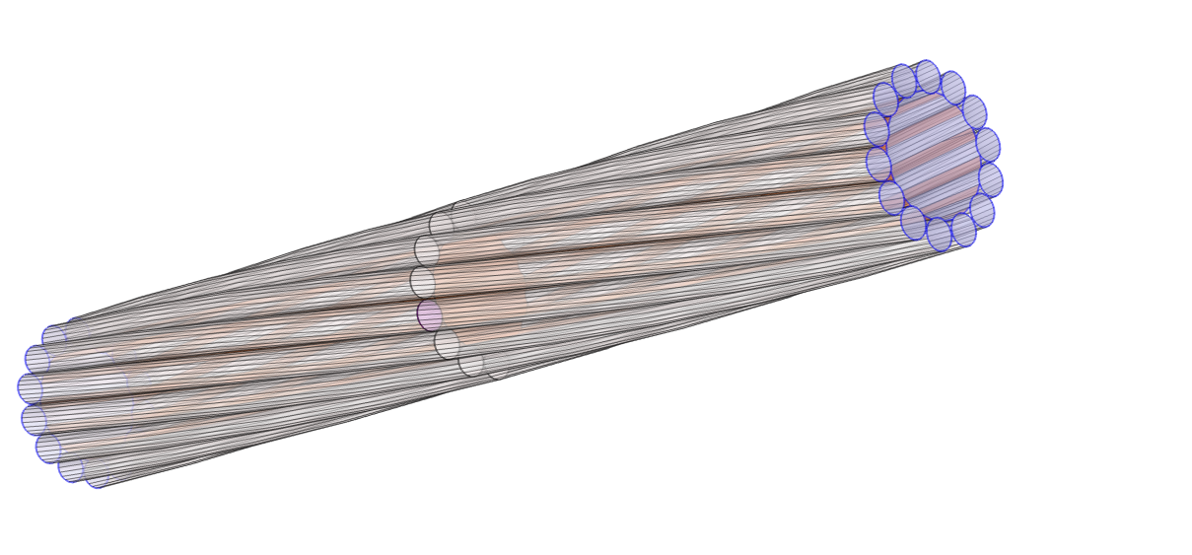
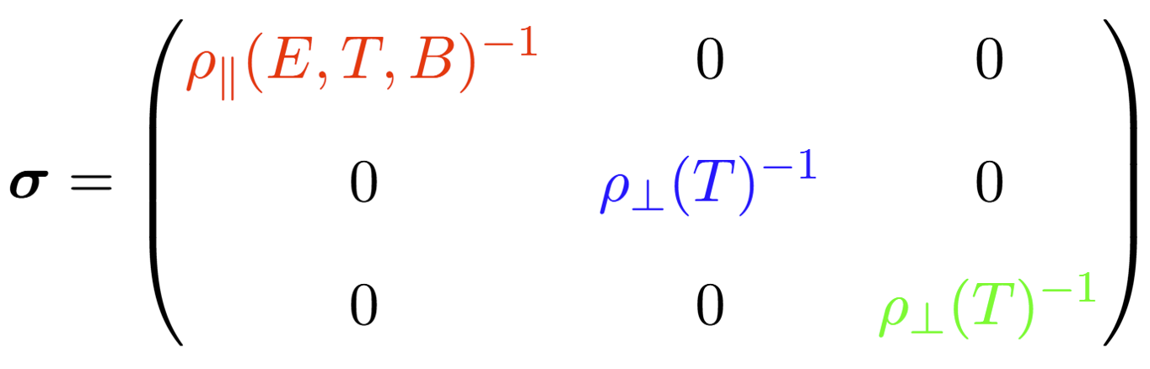
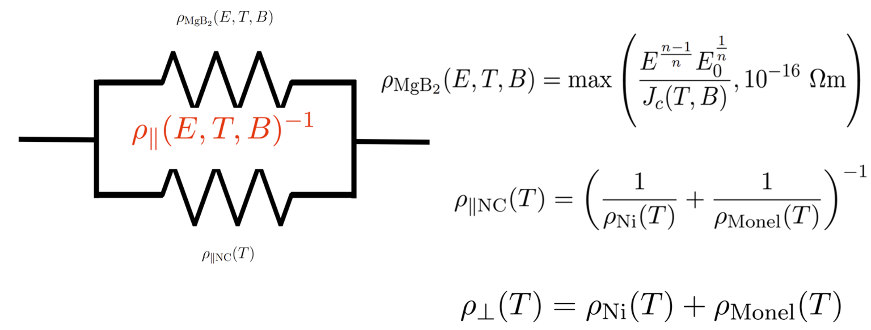
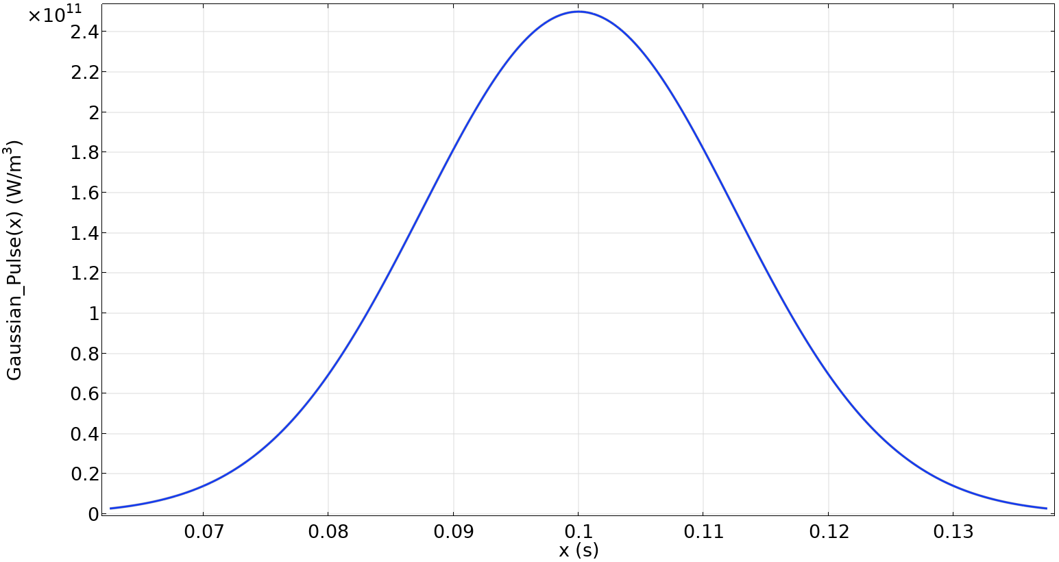



Physical Behaviour Transition Analysis - Model
20 K
Conductivity of the Strands
50 mm
Adiabatic cooling
hot-spot
$$I≈4.4×{10}^{3}A$$
20 K
$$V_{hs}≈7×{10}^{−2} mm^{3}$$
Q₀
$$2.5×{10}^{−2} s$$

Slide 15
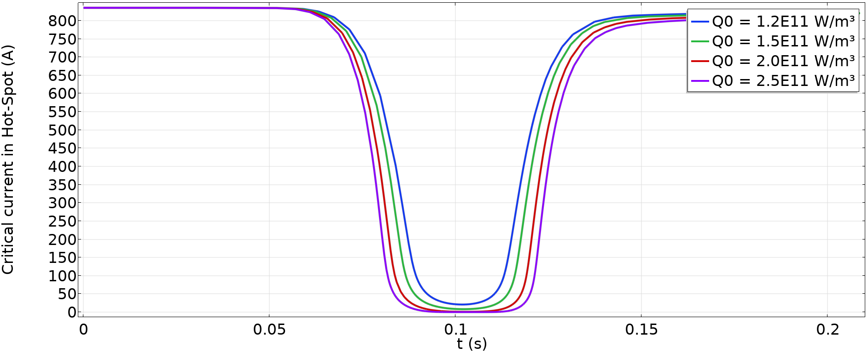

Physical Behaviour Transition Analysis - Results
Parametric evaluation of Q₀
$$I_{c}=0$$

Slide 16
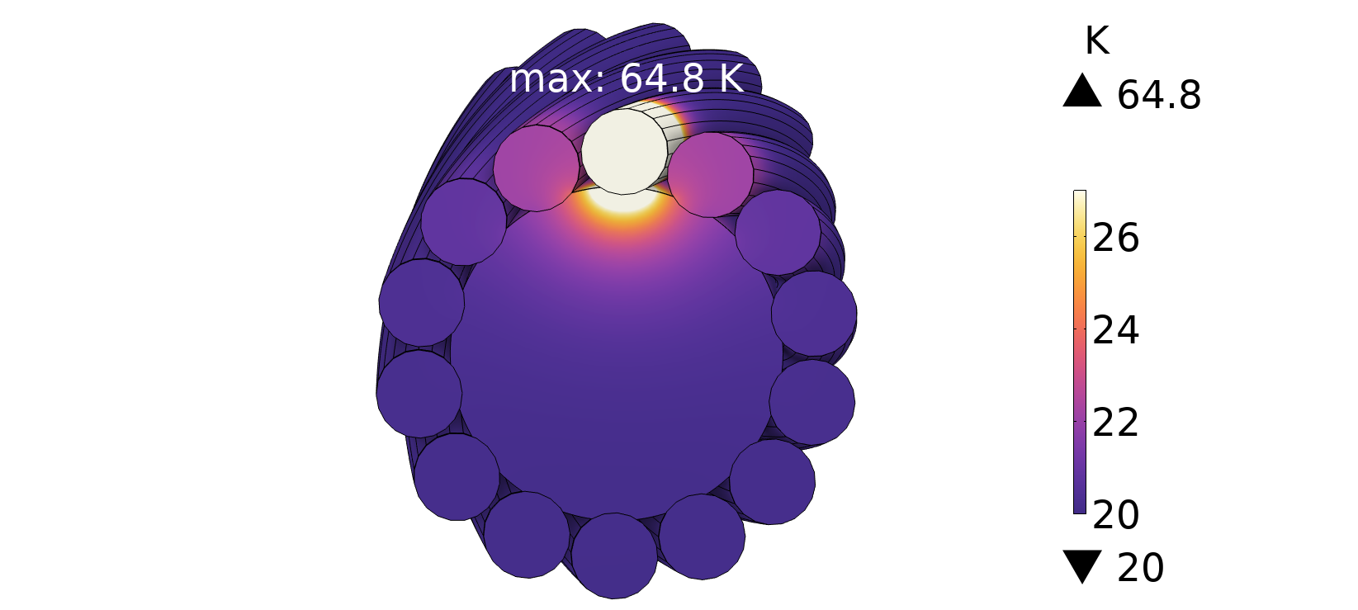
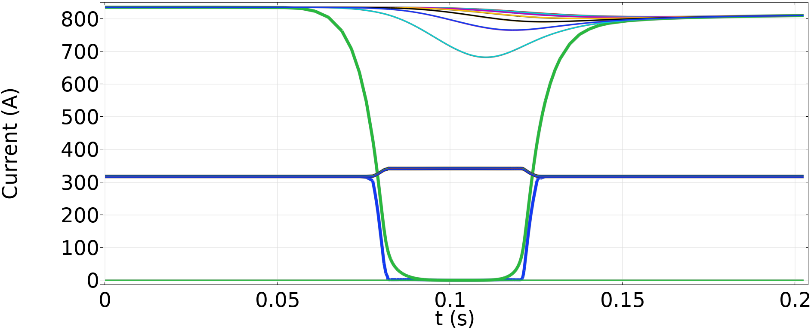
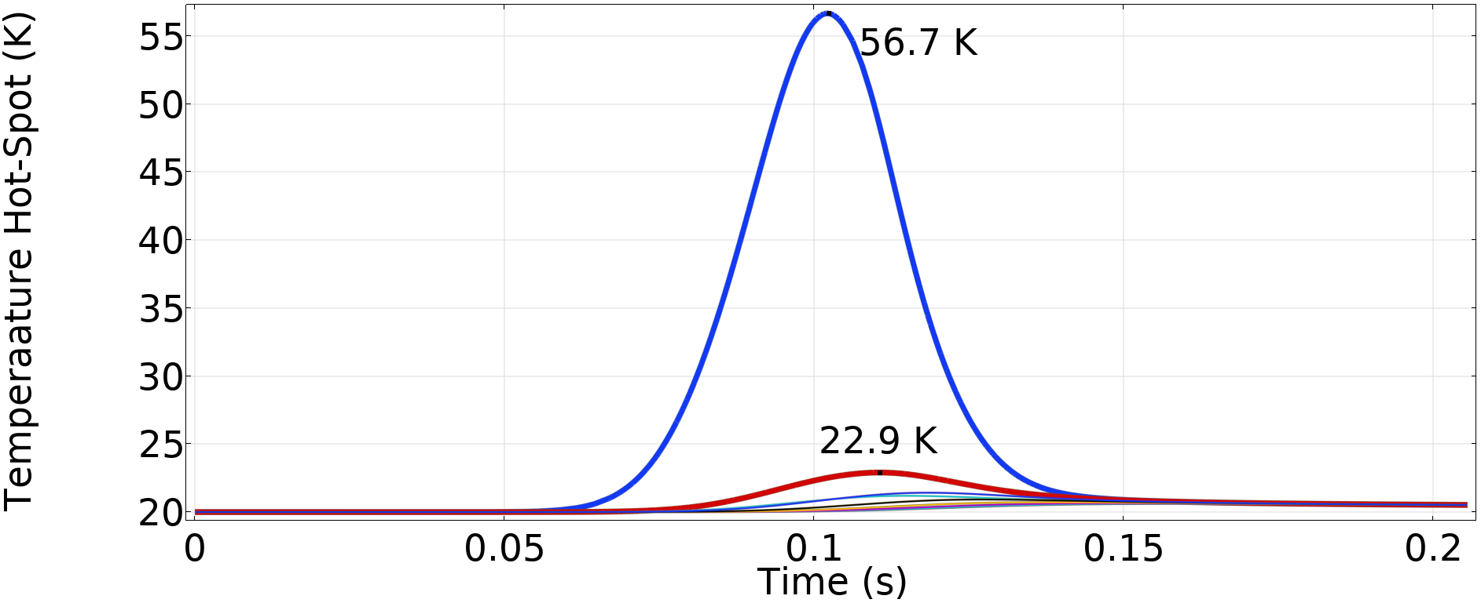




Physical Behaviour Transition Analysis - Results
Critical Current
$$835 A$$
$$Q_{0}=2.5×{10}^{11} \frac{W}{m^{3}}$$
Hot-Spot
Transport Current
$$317.46 A$$
$$342 A$$
Temperature
Hot-Spot
The cable recover after the transition
No thermal runaway
Adjacent strands

Slide 17
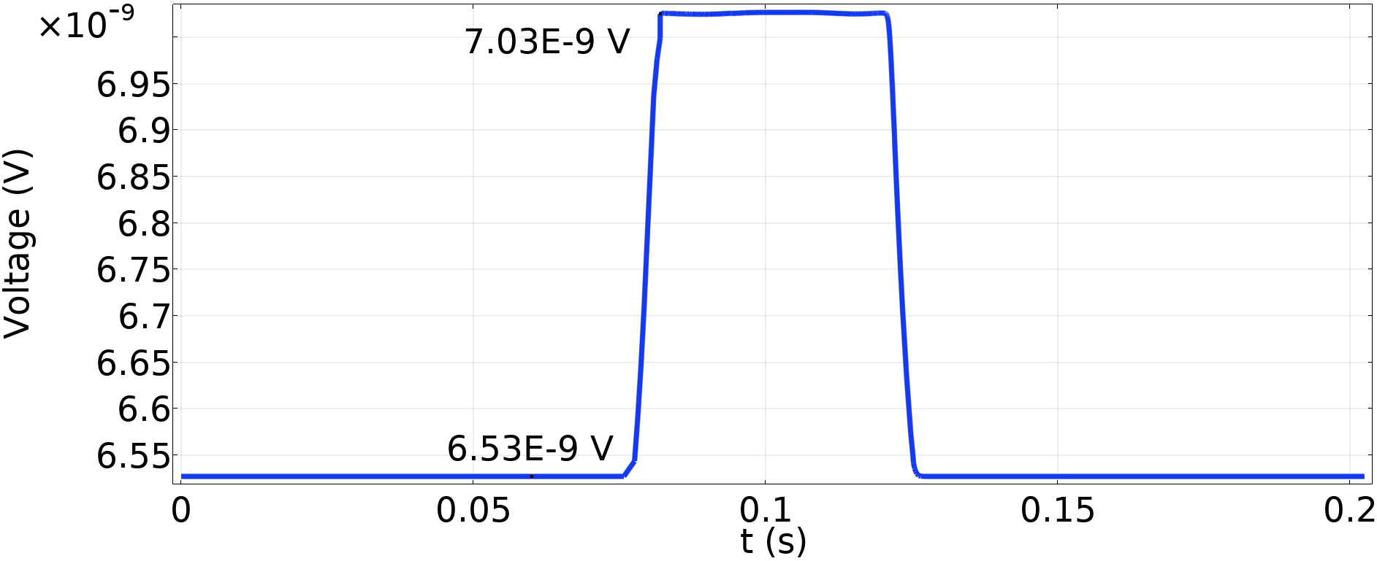

Physical Behaviour Transition Analysis - Results
Voltage Variation
$$Q_{0}=2.5×{10}^{11} \frac{W}{m^{3}}$$
Voltage
Value too low for common voltage taps
Protection system should rely mainly on temperature sensors (i.e. fibreglass)
$$δV≈0.5 nV$$

Slide 18
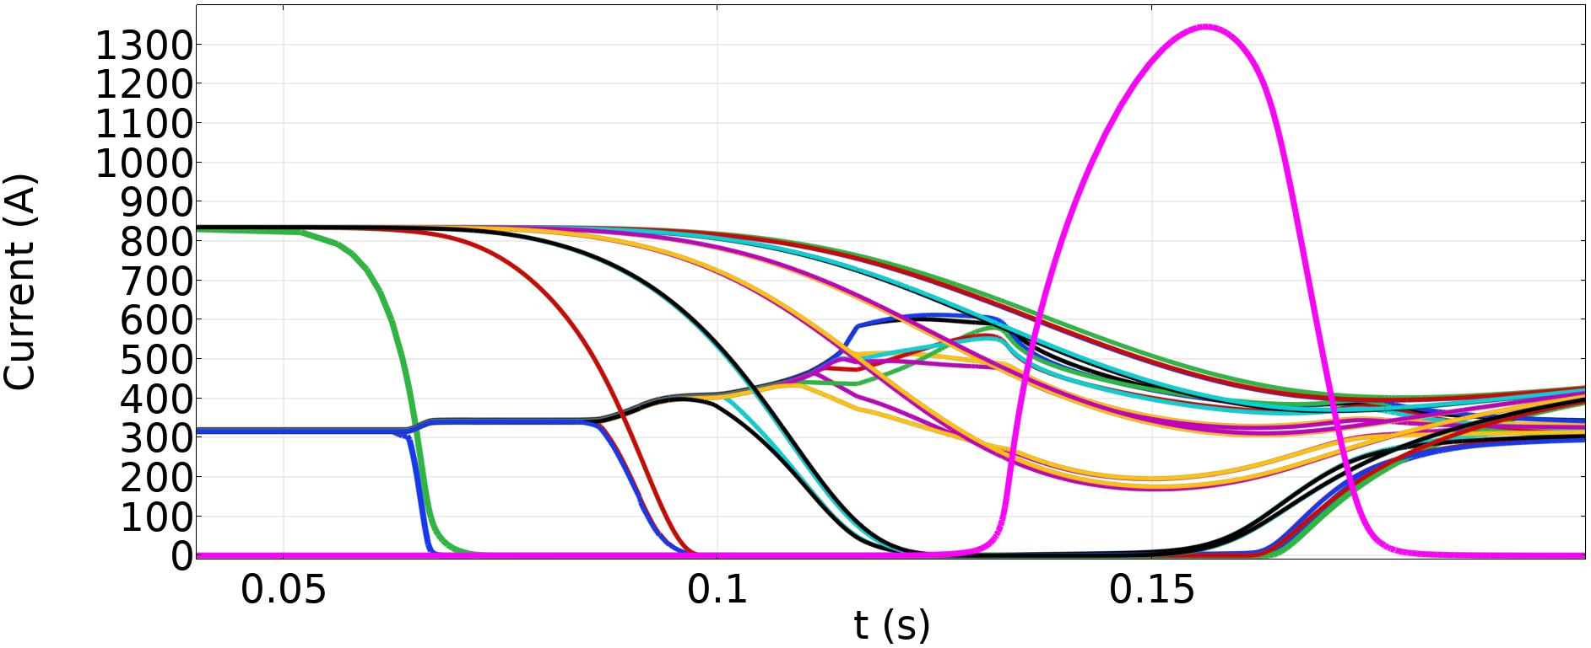
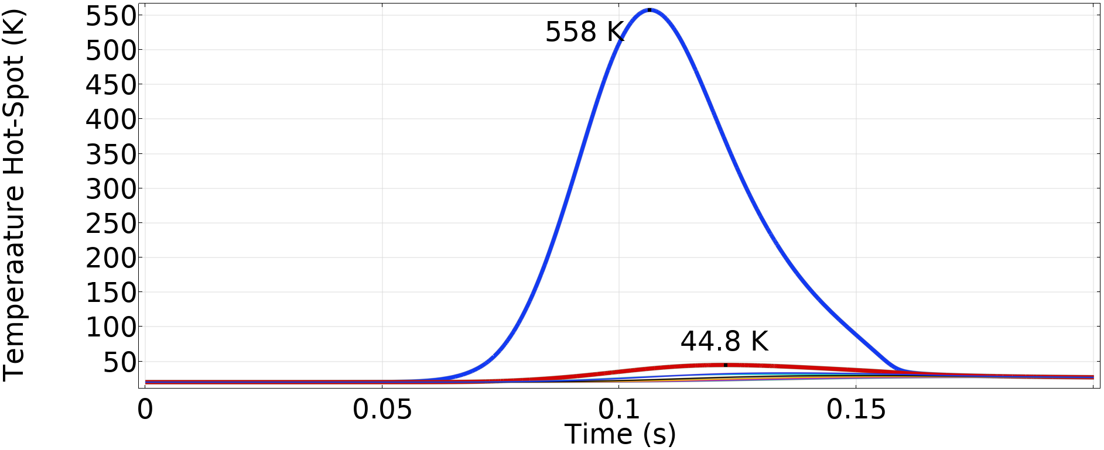
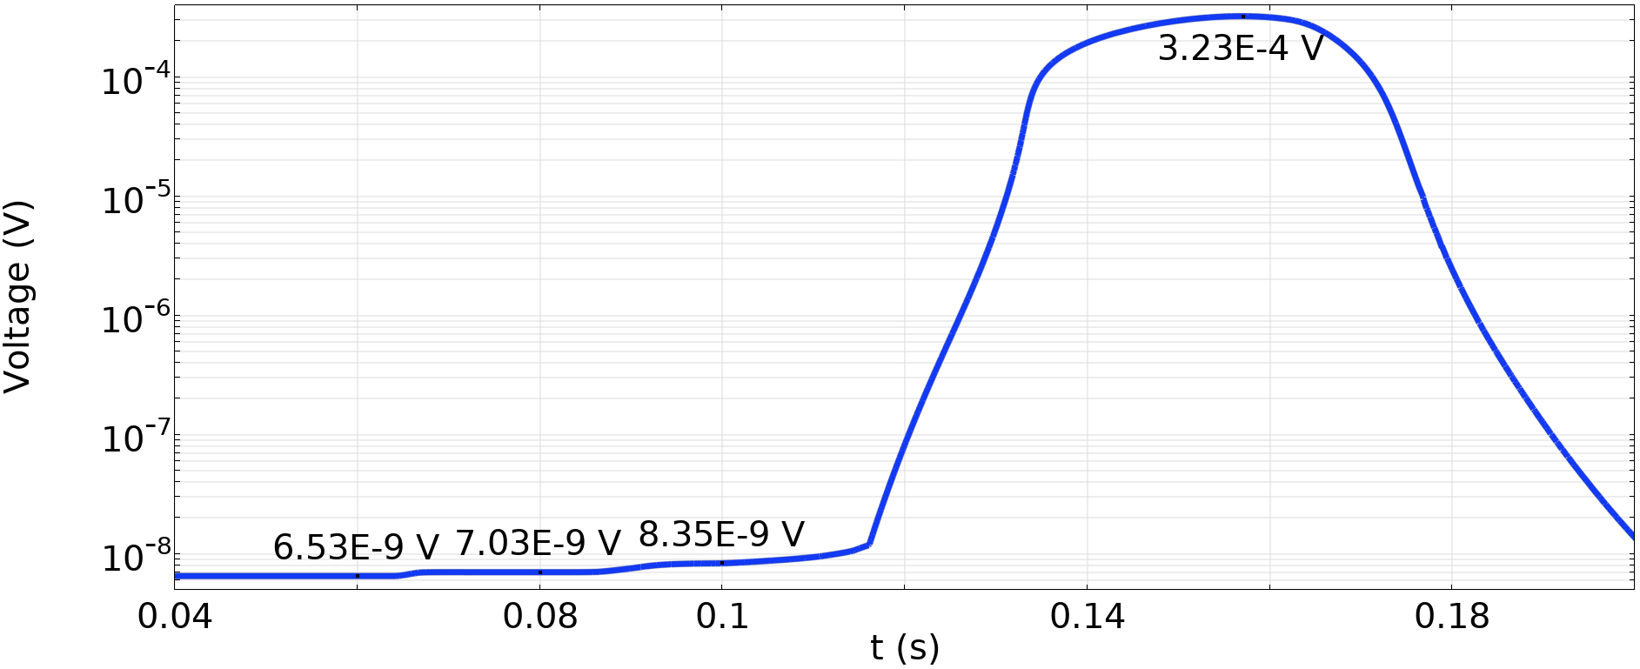

Physical Behaviour Transition Analysis - Results
Current Variation
Copper Core
$$Q_{0}=3×{10}^{12} \frac{W}{m^{3}}$$
The cable recover after the transition
No thermal runaway
Temperature
Hot-Spot
Voltage Variation

Slide 19
Power Consumption and Use Cases

Slide 20
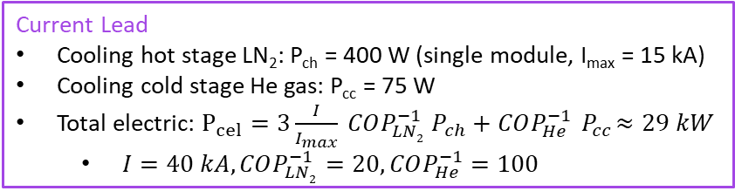
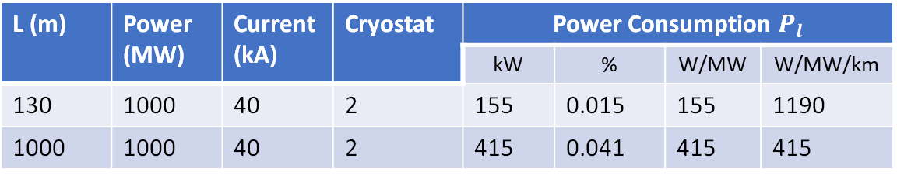

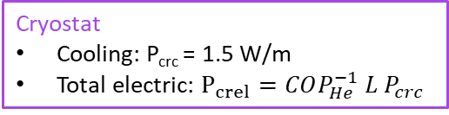
Power Consumption and Use Cases GSL Electric Consumption
Current Lead
Cooling hot stage LN₂: P_{ch} = 400 W (single module, I_{max} = 15 kA)
Cooling cold stage He gas: P_{cc} = 75 W
Total electric: $P_{cel}=3\frac{I}{I_{max}} COP_{LN2}^{−1} P_{ch}+COP_{He}^{−1}{ P}_{cc}≈29 kW$
$I=40 kA,COP_{LN2}^{−1}=20,COP_{He}^{−1}=100$
L
Line
$P_{l}=n_{cr} P_{crel}+n_{cl} P_{cel}$
L (m) | Power (MW) | Current (kA) | Cryostat | Power Consumption $P_{l}$
 |  |  |  | kW | % | W/MW | W/MW/km
130 | 1000 | 40 | 2 | 155 | 0.015 | 155 | 1190
1000 | 1000 | 40 | 2 | 415 | 0.041 | 415 | 415
Cryostat
Cooling: P_{crc} = 1.5 W/m
Total electric: $P_{crel}=COP_{He}^{−1} L P_{crc}$
For longer lines the power consumption due to the cryostat becomes the relevant component

Slide 21
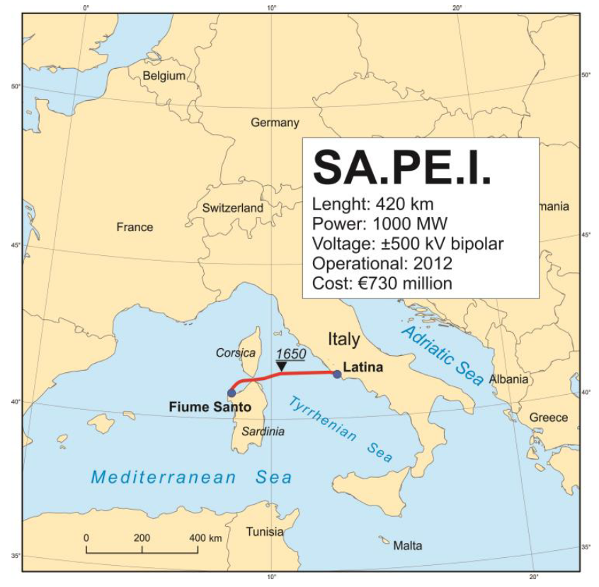
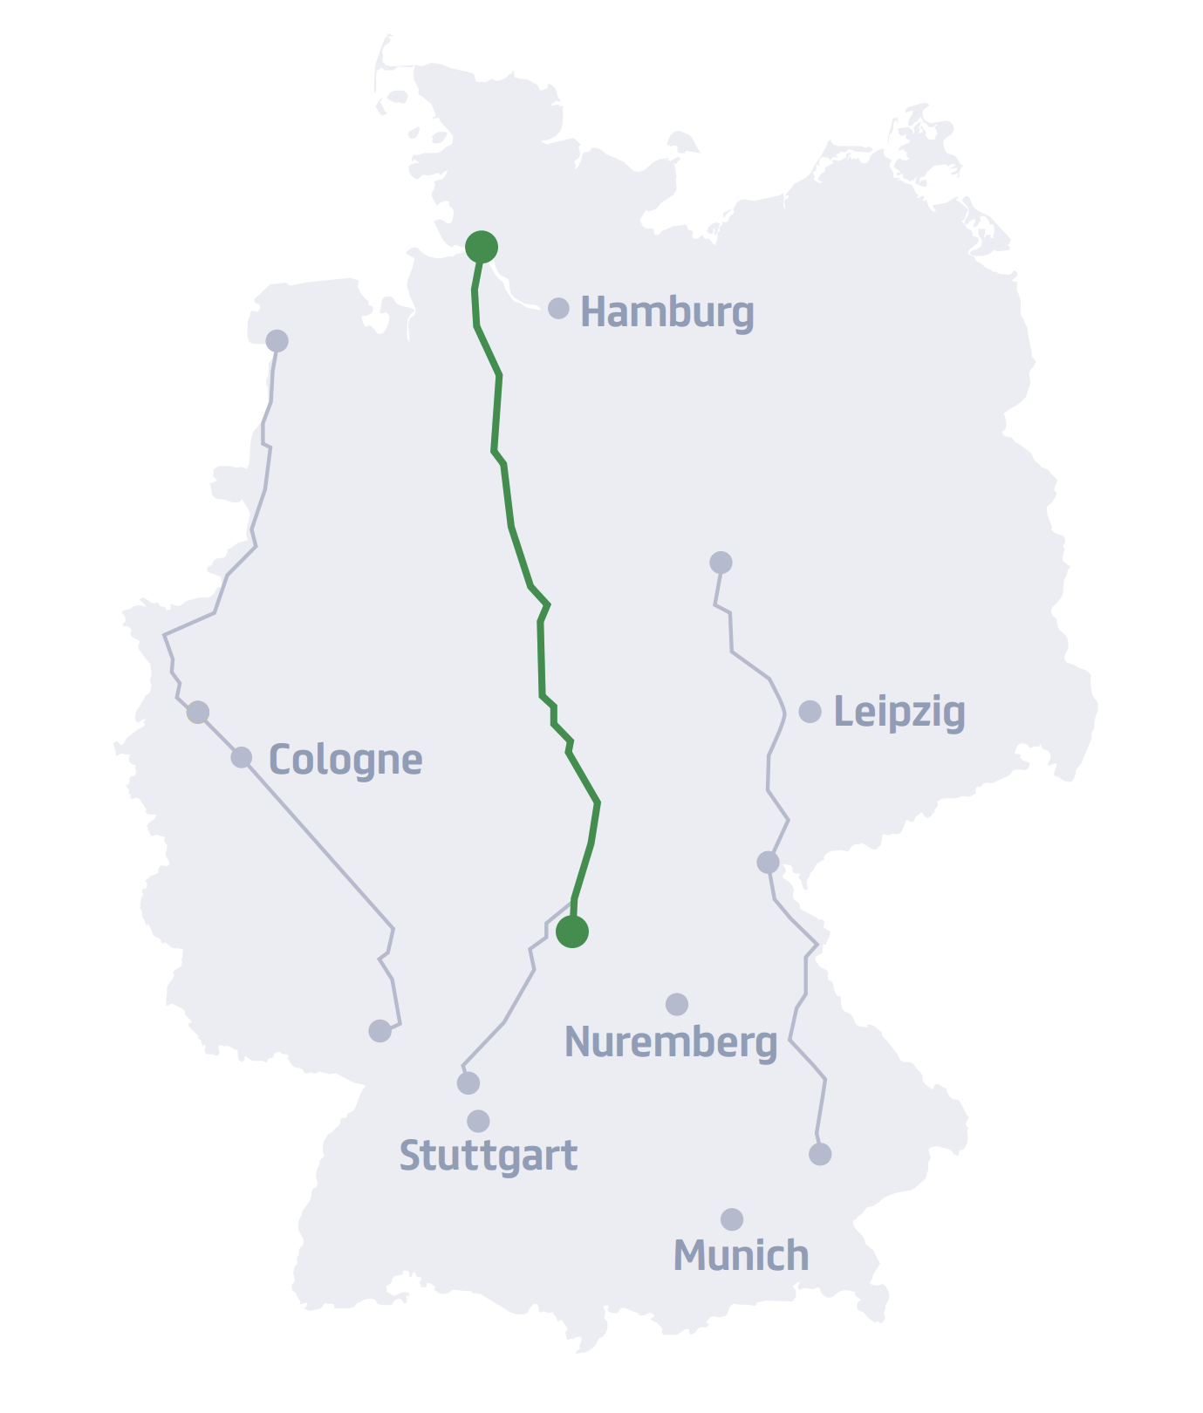
Power Consumption and Use Cases HVDC Comparative Analysis
SuedLink
Length: 540 km
Power: 2000 MW
Voltage: ±525 kV
Case | Power (MW) | Voltage (kV) | Power Consumption
 |  |  | kW | % | W/MW
SA.PE.I. | 1000 | 1000 | 40.4 | 0.004 | 40.4
SuedLink | 2000 | 1050 | 41.43 | 0.002 | 20.7
GSL IRIS | 1000 | 25 | 415 | 0.04 | 415
GSL (1x0.5 W/m) | 1000 | 25 | 165 | 0.016 | 165
Can be lowered with a more efficient cryostat to obtain W/MW in the same range of the showed HVDC

Slide 22


Power Consumption and Use Cases Modular Composition
Full configuration
L (m) | Power (MW) | Current (kA) | Cryostat | Power Consumption
 |  |  |  | kW | % | W/MW
1000 | 1000 | 40 | 2 | 415 | 0.041 | 415
1000 | 200 | 8 | 1 | 197 | 0.098 | 985
1000 | 2 | 0.08 | 1 | 180 | 9 | 90k
SURE
LNF Data Centre
$$200 MW$$
$$2 MW$$
Since the consumption depends on the cryostat losses, Higher Power means lower consumption
More suitable for high power application

Slide 23
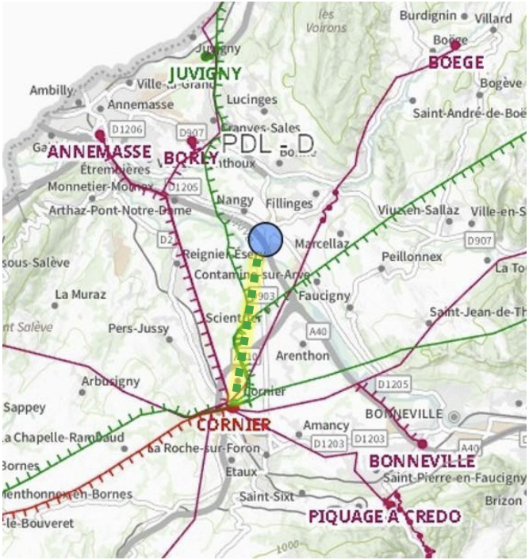
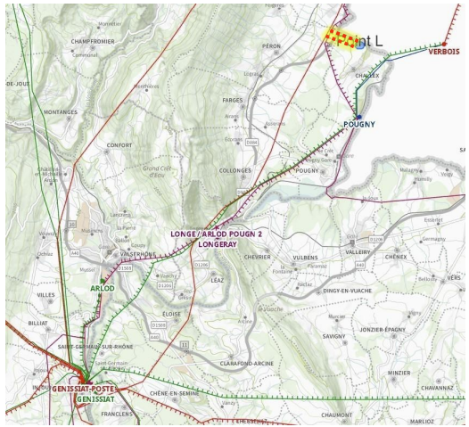

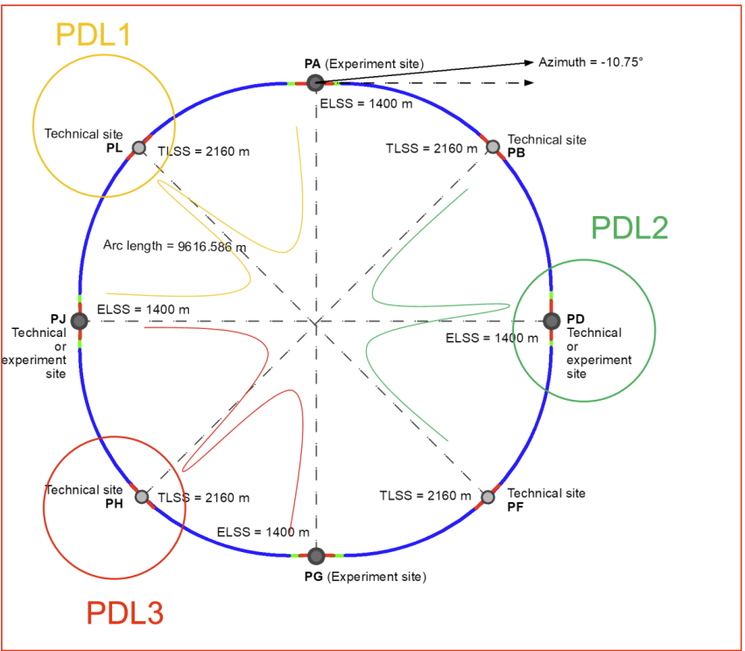
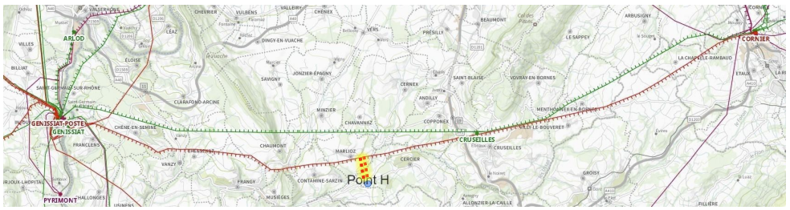
Power Consumption and Use Cases FCC Grid Connection Example
The cooling can be integrated in the existing cooling plants
Connection (2 petals, 25 kV, 0.5 W/m) | L (km) | Power (MW) | Cooling Systems (every 1.5 km) | Power Consumption
 |  |  |  | kW | % | W/MW
CORNIER–GENISSIAT – PH | 1.6 | 220 | 1 | 88 | 0.04 | 400
BOIS-TOLLOT–GENISSIAT – PL | 1.5 | 200 | 1 | 308 | 0.04 | 415
CORNIER – PD (redundancy) | 11 | 220 | 7 | 558 | 0.25 | 2540
CERN internal (i.e. magnets) | 30 | 200 | 20 | 1510 | 0.75 | 7540

Slide 24
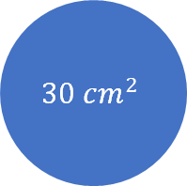
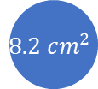
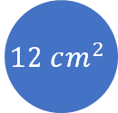
Power Consumption and Use Cases HVDC Comparative Analysis
HVDC: lower consumption
IRIS GSL:
lower voltage (less complex and less vulnerable)
higher power density (retrofit, urban areas, accelerator facilities and data centres)
Power Station (200 MW) (size estimation)
120 m
Conductor Coss-section Area
22 m
$$30 cm^{2}$$
8 m
$$12 cm^{2}$$
$$8.2 cm^{2}$$
60 m
50 m
50 m
SA.PE.I.
IRIS GSL
SuedLink
±525 kV
±12.5 kV

Slide 25
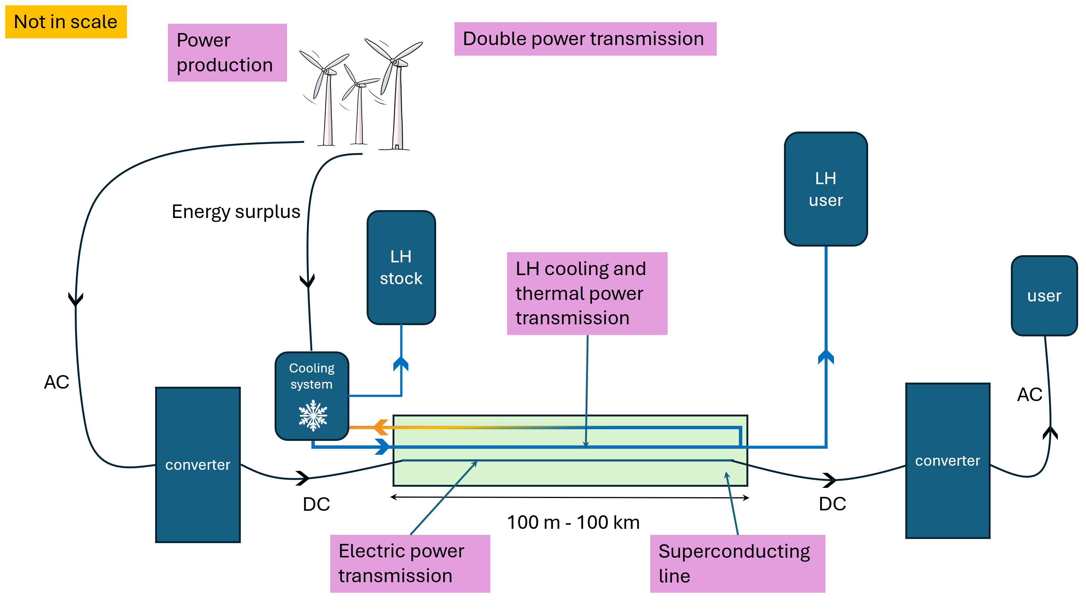
Power Consumption and Use Cases Double Energy Vector

Slide 26
Conclusion

Slide 27
Conclusion
Pros
Robust to electrical failure. Potential failures are more likely to originate in the cooling system; such faults are typically slower and are consequently easier to detect and assess (fibreglass detection).
Capable of carrying much larger currents than conventional conductors (e.g. 40 kA vs. ∼ 1 kA). Useful to powering accelerator magnets and data centres.
Operates at substantially lower voltages (e.g. 25 kV vs. ∼ 1000 kV), reducing the size and complexity of voltage-conversion equipment.
Offers higher power density, requiring less land take (urban areas, accelerator and data centres) and can be installed within existing HVDC trenches to upgrade transmission capacity (retrofit) without major enlargement of civil works.
May serve a dual function if cooled with liquid hydrogen: electrical trans-mission combined with integrated energy storage and free cooling, enabling novel system architectures in an eventually hydrogen dominated society.
Cons
Because the losses depend primarily on the cryostat, the technology maybe uneconomical for medium–low transmitted powers.
For distances greater than 1.5 km, multiple cooling stations are required in the most favourable (best-case) scenario. An alternative is the use of higher-pressure cooling systems.
It is not always advantageous: in some cases, the electrical power required for refrigeration exceeds the Joule losses saved. However, this can be reduced with optimised—albeit typically more expensive—cooling plants.

Slide 28
Conclusion
The IRIS Green Superconducting Line can represent a valid alternative to conventional HVDC systems for specific applications. Its suitability depends on the overall system context: it is particularly advantageous where very high currents and powers are required, where cryogenic infrastructure is already available, or where spatial and civil-engineering constraints make compact, high-power links desirable. The analyses are conducted under conservative assumptions, with improving margins.

Slide 29
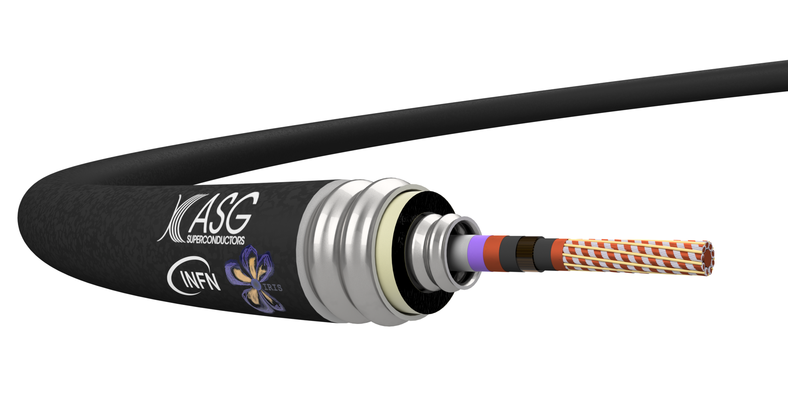
The End

