Slide 1






Development of Superconducting Magnets for the Future
Muon Collider
Daniel Novelli
Supervisors:
Stefania Farinon
Barbara Caiffi
Tutor:
Lucio Rossi
Ph.D. in Accelerator Physics
Final Seminar XXXVIII cycle
12 November 2025
Funded by the European Union (EU). Views and opinions expressed are however those of the author only and do not necessarily reflect those of the EU or European Research Executive Agency (REA). Neither the EU nor the REA can be held responsible for them.

Slide 2
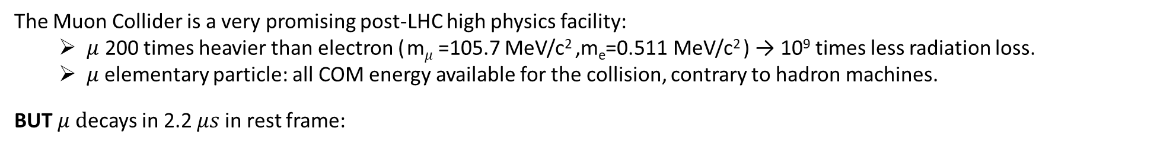
Why a Muon Collider?
IMCC (Internation Muon Collider Collaboration) aims at studying the feasibility of a 10 km, 10 TeV center of mass energy Muon Collider, as indicated by the European Strategy for Particle Physics.
The Muon Collider is a very promising post-LHC high physics facility:
$μ$ 200 times heavier than electron ( m$μ$=105.7 MeV/c² ,m_{e}=0.511 MeV/c² ) → 10⁹ times less radiation loss.
$μ$elementary particle: all COM energy available for the collision, contrary to hadron machines.
BUT $μ d$ecays in 2.2 $μs$in rest frame:
must be produced, accelerated and collided ASAP
decay products must be shielded to avoid damage to the machine or radiation
Notes:
The energy at which the proton collider cross-section equals that of a muon collider. The dashed line assumes comparable Feynman amplitudes for the muon and the proton production processes. A factor of ten enhancement of the proton production amplitude squared, possibly due to QCD production, is considered in the continuous line

Slide 3
Why a Muon Collider?
IMCC (Internation Muon Collider Collaboration) aims at studying the feasibility of a 10 km, 10 TeV center of mass energy Muon Collider, as indicated by the European Strategy for Particle Physics.
The Muon Collider is a very promising post-LHC high physics facility:
$μ$ 200 times heavier than electron ( m$μ$=105.7 MeV/c² ,m_{e}=0.511 MeV/c² ) → 10⁹ times less radiation loss.
$μ$elementary particle: all COM energy available for the collision, contrary to hadron machines.
BUT $μ d$ecays in 2.2 $μs$in rest frame:
must be produced, accelerated and collided ASAP
decay products must be shielded to avoid damage to the machine or radiation
J.P. Delahaye et al., Muon colliders,
arXiv:1901.06150 [physics.acc-ph].
Physics?
Muon collisions in the range of 14 TeV
have comparable discovery potential to hadron (proton) collisions in the range of 100 TeV
Comparable Feynman amplitudes for the muon and the proton production processes.
A factor of ten enhancement of the proton production amplitude squared,
possibly due to QCD production, is considered.

Slide 4
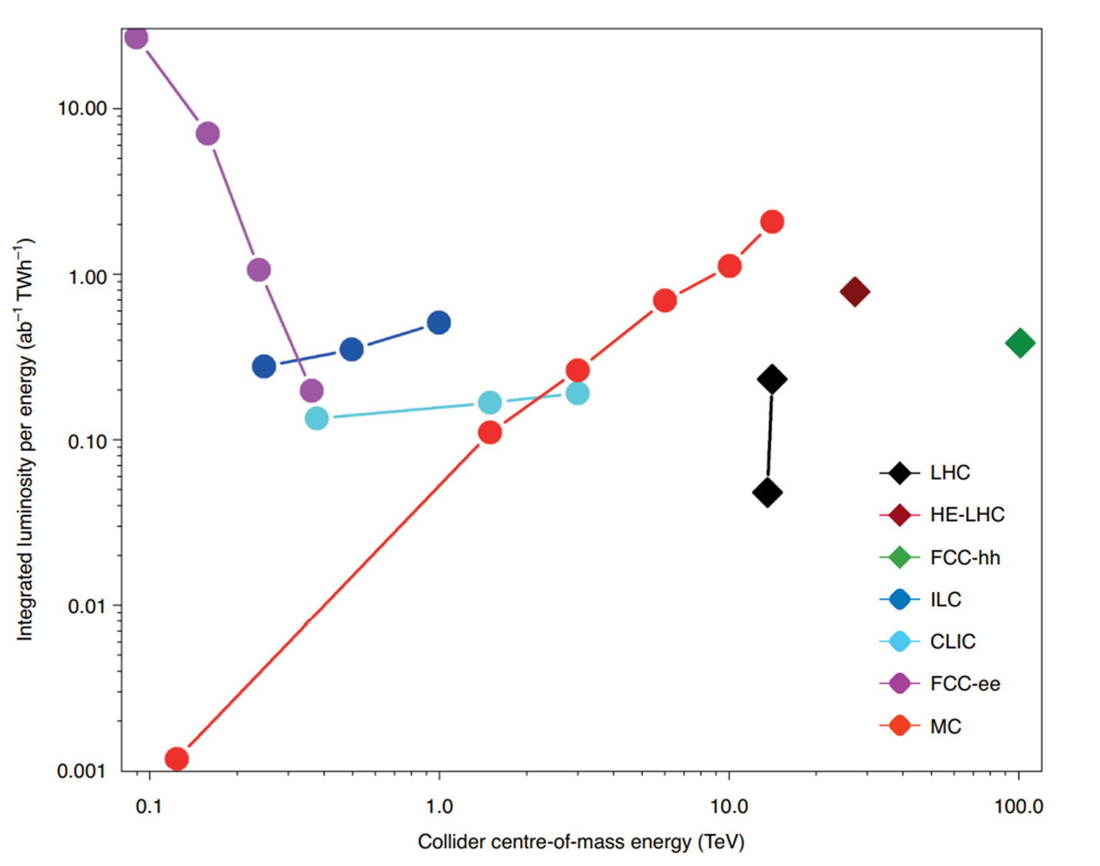
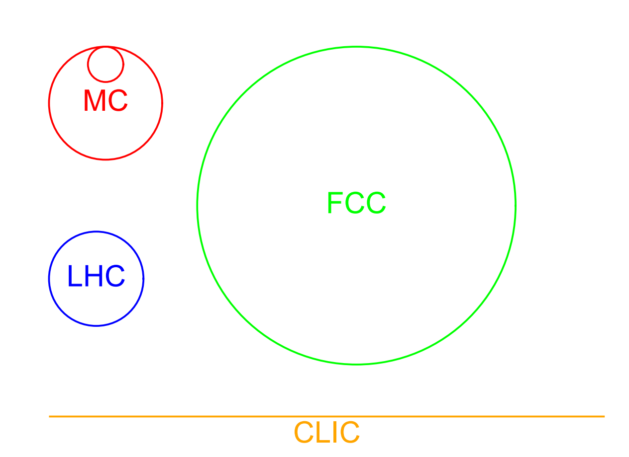
Why a Muon Collider?
IMCC (Internation Muon Collider Collaboration) aims at studying the feasibility of a 10 km, 10 TeV center of mass energy Muon Collider, as indicated by the European Strategy for Particle Physics.
The Muon Collider is a very promising post-LHC high physics facility:
$μ$ 200 times heavier than electron ( m$μ$=105.7 MeV/c² ,m_{e}=0.511 MeV/c² ) → 10⁹ times less radiation loss.
$μ$elementary particle: all COM energy available for the collision, contrary to hadron machines.
BUT $μ d$ecays in 2.2 $μs$in rest frame:
must be produced, accelerated and collided ASAP
decay products must be shielded to avoid damage to the machine or radiation
K. R. Long et al, Nature Physics, v.17, p.289, 2021.
Collider size comparison
Sustainability?
A 10 TeV muon collider
can provide the highest integrated luminosity
per unit of energy consumption.
D. Schulte, The muon collider, IPAC2022, Bangkok, Thailand.

Slide 5
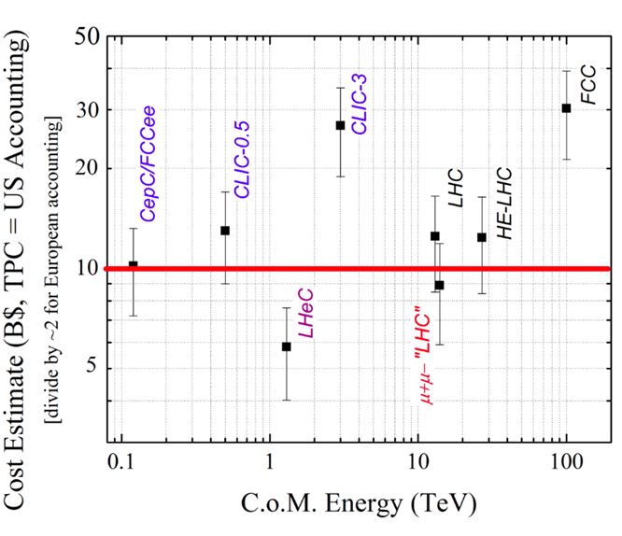
Why a Muon Collider?
IMCC (Internation Muon Collider Collaboration) aims at studying the feasibility of a 10 km, 10 TeV center of mass energy Muon Collider, as indicated by the European Strategy for Particle Physics.
The Muon Collider is a very promising post-LHC high physics facility:
$μ$ 200 times heavier than electron ( m$μ$=105.7 MeV/c² ,m_{e}=0.511 MeV/c² ) → 10⁹ times less radiation loss.
$μ$elementary particle: all COM energy available for the collision, contrary to hadron machines.
BUT $μ d$ecays in 2.2 $μs$in rest frame:
must be produced, accelerated and collided ASAP
decay products must be shielded to avoid damage to the machine or radiation
Collider size comparison
Affordability?
Its size is competitive because it is compact.
A 10 TeV muon collider making use of the LHC infrastructure could be the most cost-effective energy frontier collider
D. Schulte, The muon collider, IPAC2022, Bangkok, Thailand.
D. Neuffer and V. Shiltsev 2018 JINST 13 T10003

Slide 6
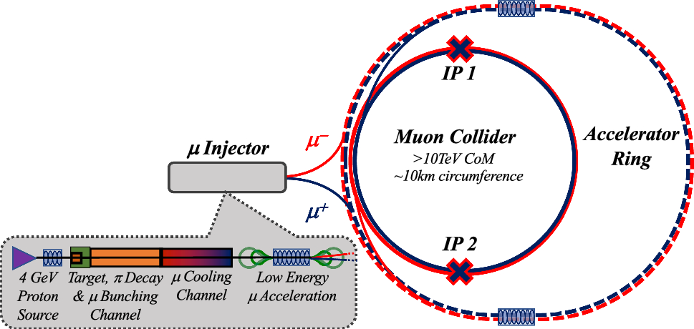
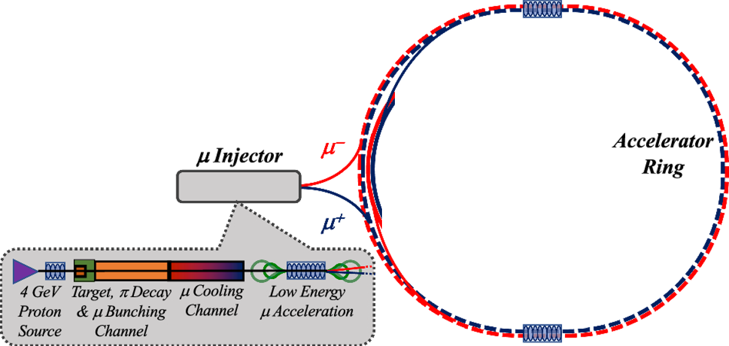
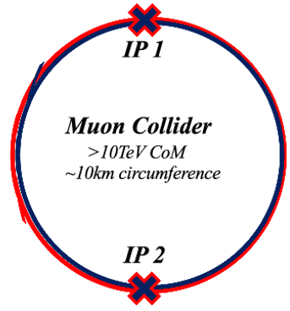
Why a Muon Collider?
Main stages of a muon collider complex
Magnets:
Dipoles
Quadrupoles
Sextupoles
Combined Dip + Quad
Combined Dip + Sext
Purpose:
Evaluate realistic performance targets for the collider magnets, in close collaboration with studies of beam physics, cryogenics, and energy storage.
Produce a credible and affordable design study (contain costs, energy efficiency, sustainable operation).

Slide 7
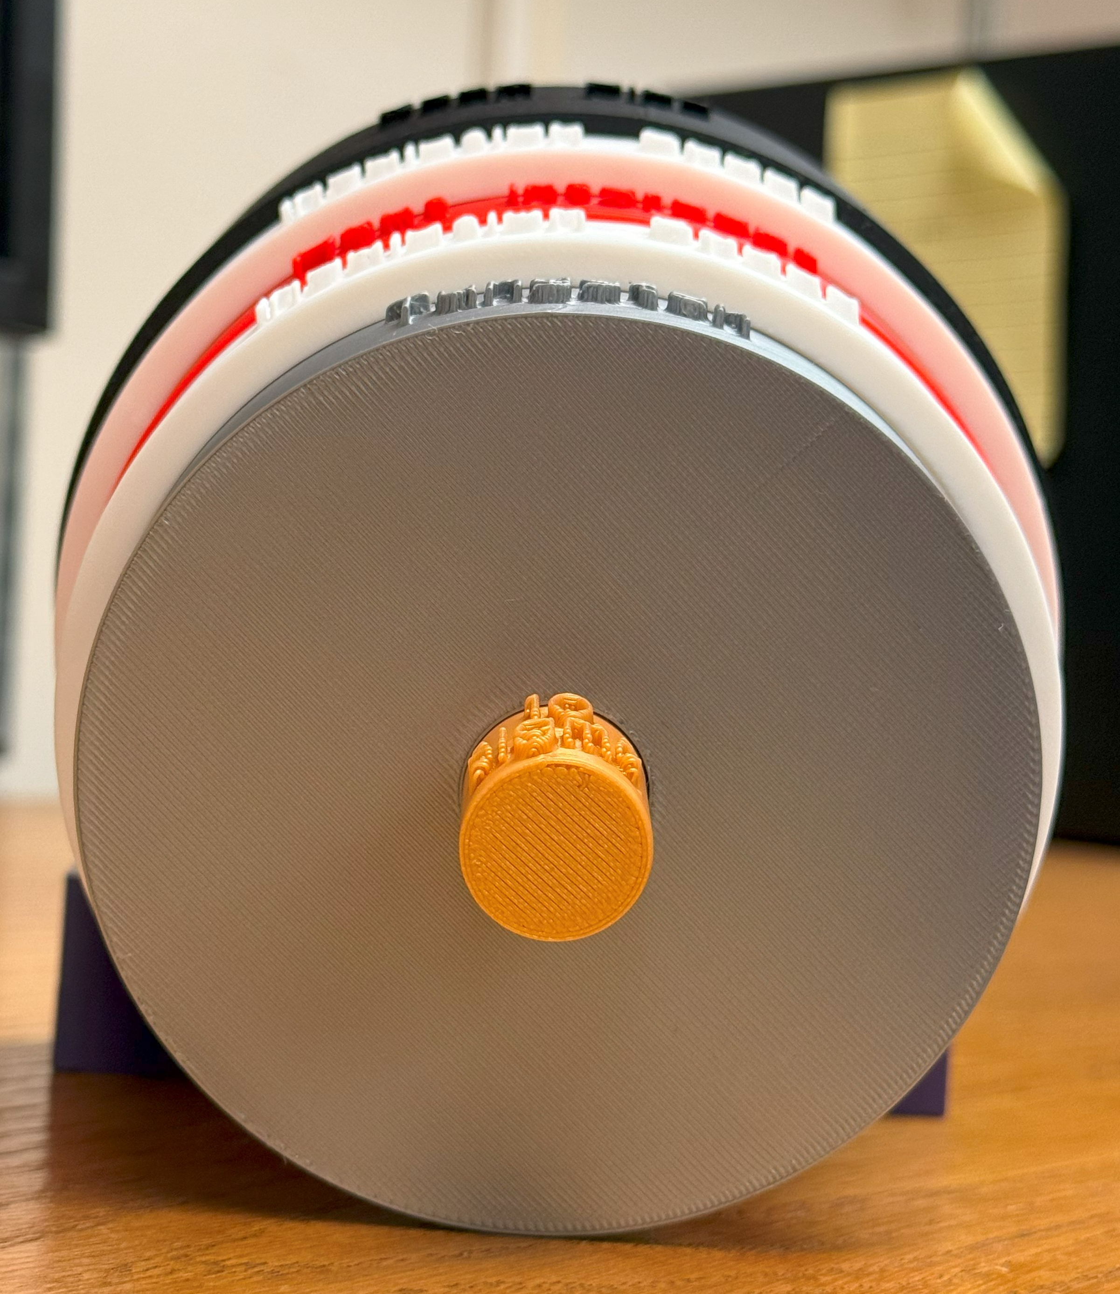
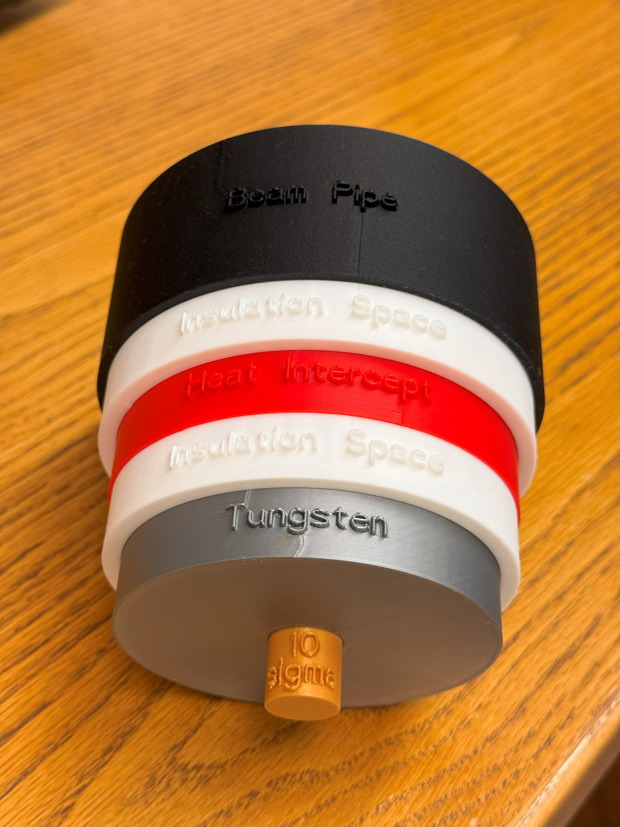
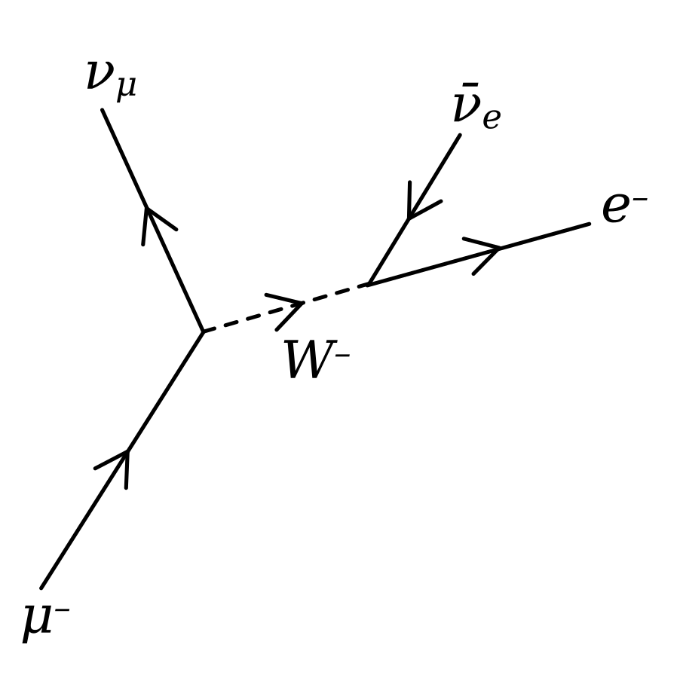


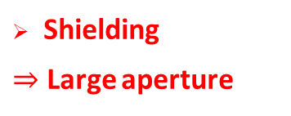
Collider Magnets Requirements
Dip + Quad combined-function
Circular magnet aperture, 4.5 K
Dimensions (130x130) mm
Tungsten = (40x40) mm
3 TeV collider (5 km ring):
Close to state of the art
$∼$11T/150mm (Nb₃Sn)
600 magnets, 5 m length
Operating temperature: 4.5 K
10+ TeV collider (10 km ring):
HTS magnets, R&D is required
$∼$16T/150mm (ReBCO, hybrid)
1200 magnets, 5 m length
Operating temperature: 4.5…20 K
High field dipoles to minimize collider ring size and maximize luminosity.
Beam loss protection
High-energy electrons and positrons arising from muon decay and striking the collider ring magnets can cause radiation damage and unwanted heat load.
Muon decay
Shielding
$⇒$ Large aperture
$$μ^{−}→e^{−}+\overline{ν_{e}}+ν_{μ}$$
$$μ^{+}→e^{+}+ν_{e}+\overline{ν_{μ}}$$

Slide 8
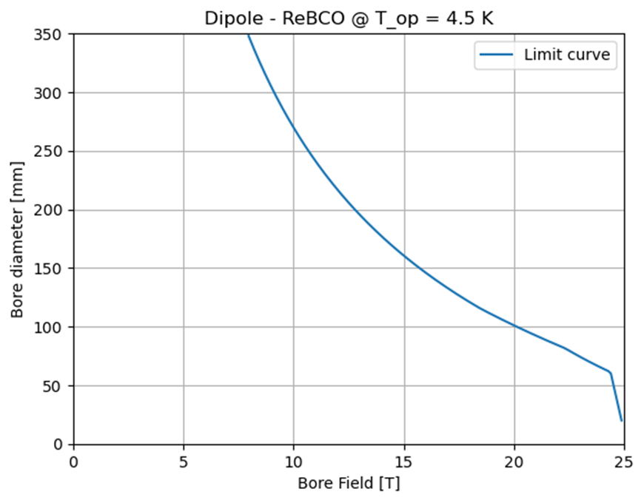
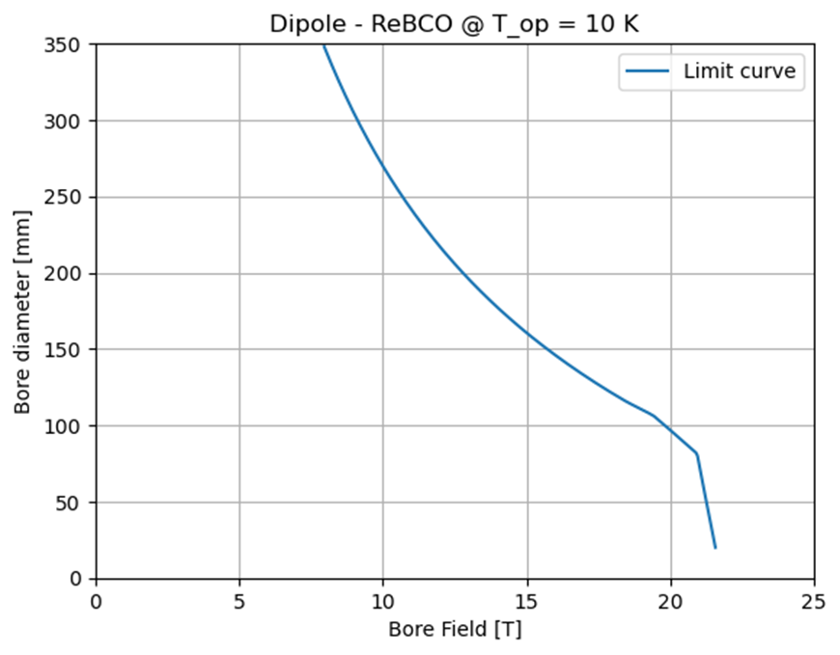
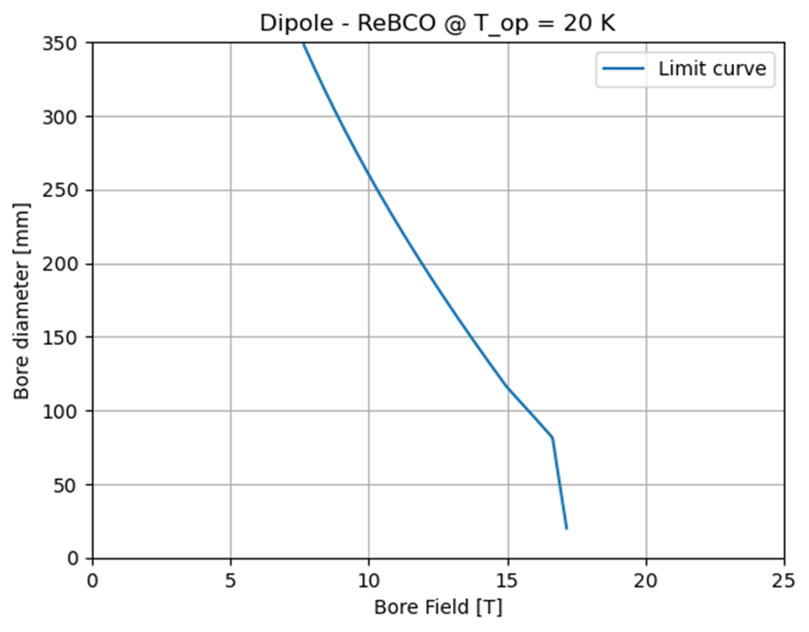
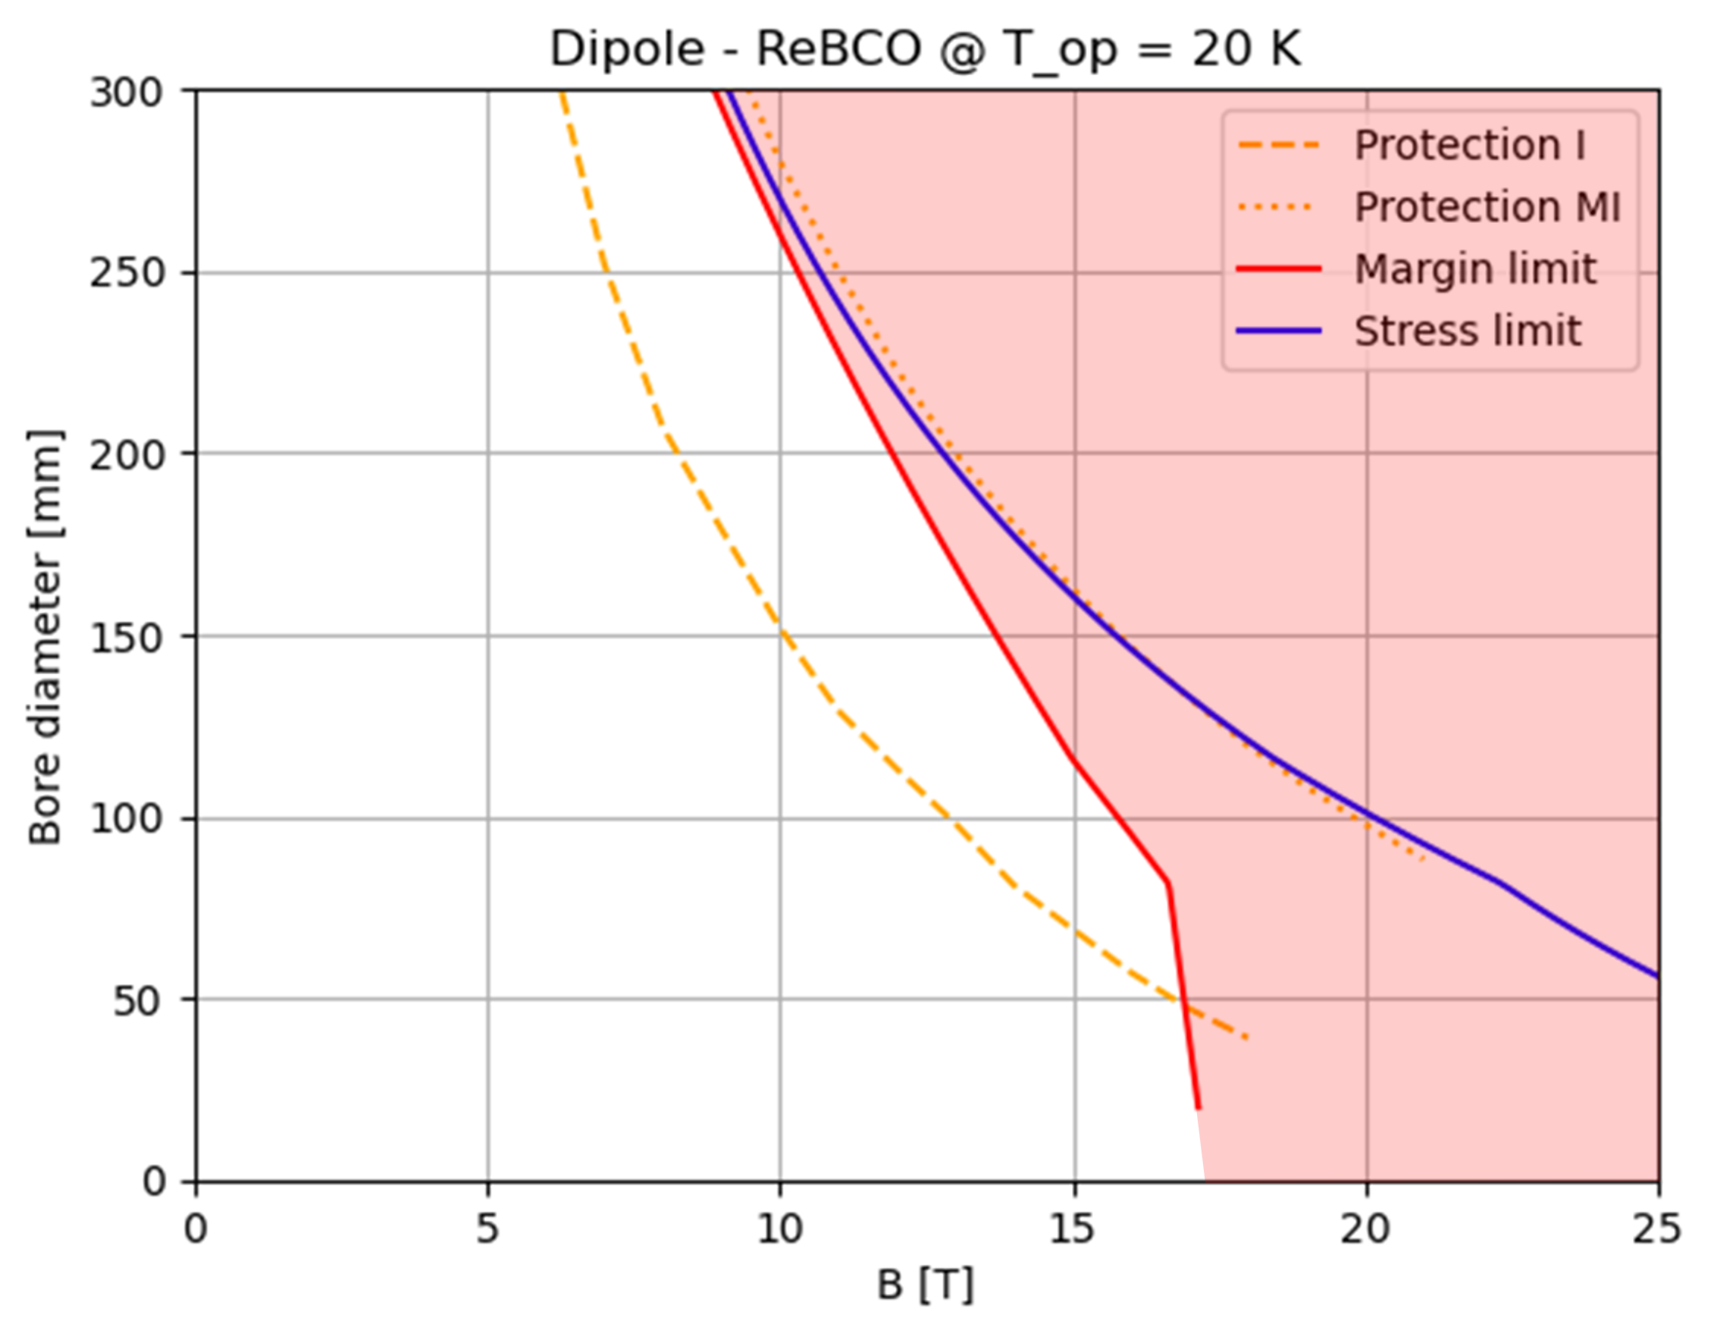
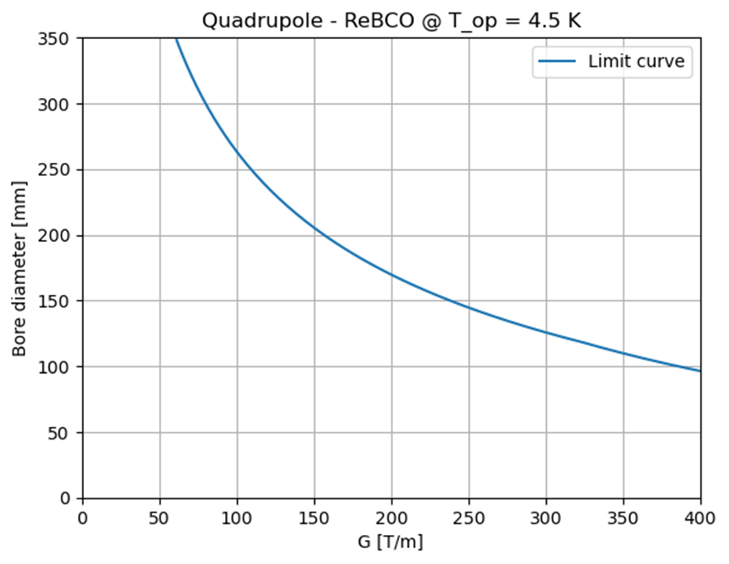
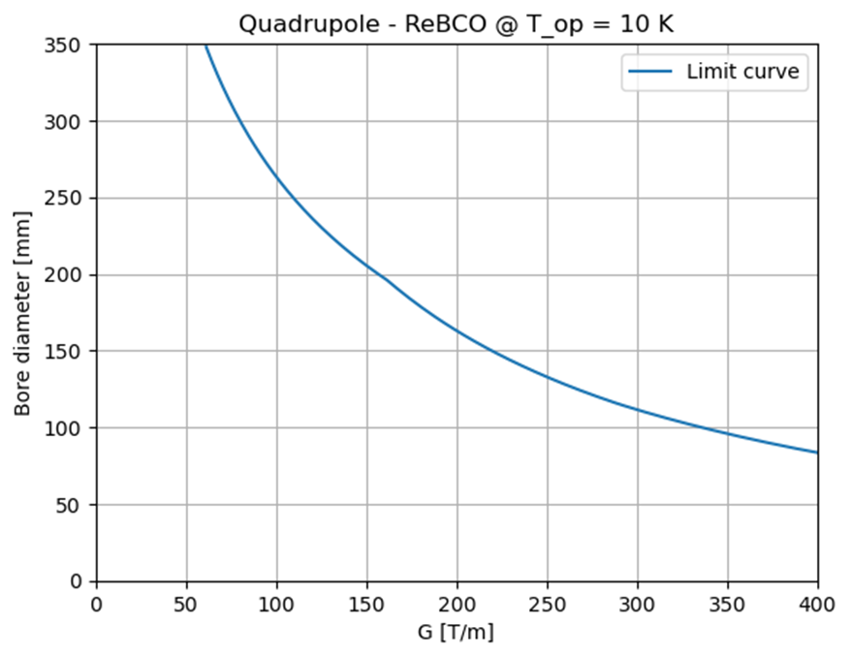
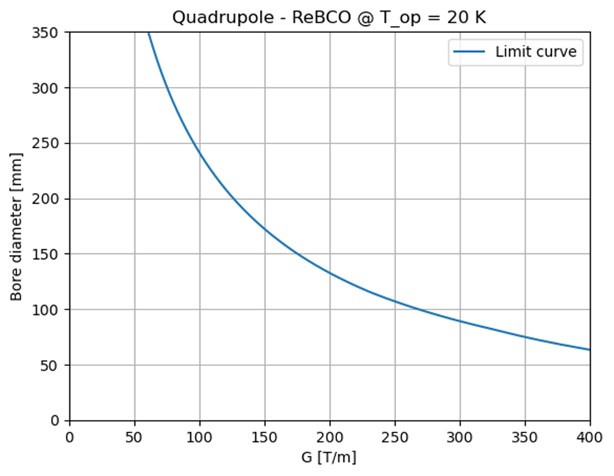
HTS arc A-B and A-G plots
Main assumptions:
– Cos-theta cross section in sector coil approx.
– Budget: 400 kEUR/m for each magnet.
– These plots apply to ARC magnets. For the IR quadrupoles, a double budget is assumed.
– SC cost: 2500 EUR/kg (aspirational value).
– Max. coil width: 80 mm
– Max. stress: 400 MPa
– Protection: MI or NI
– Tungsten screen: 3 cm at 20K, increasing to 4 cm if below 20K.
– HTS as baseline for the 10 TeV, NbTi and Nb₃Sn as options for the 3 TeV.
– Filling factor = 0.011 (Roebel cable)
Forbidden area
Forbidden area
Forbidden area
Allowed area
Allowed area
Allowed area
ANALYTICAL STUDY
Limit curves are introduced by mechanical challenges (stress limit), critical current density (margin limit) and stored magnetic energy (quench protection), depending on the superconducting material.
Forbidden area
Forbidden area
Allowed area
Allowed area
Forbidden area
Allowed area
Notes:
This is an innovative approach, useful for interfacing the needs of beam dynamics with the technological limits (of today and the near future) related to superconducting magnets.
Could provide an immediate feedback capable of analyzing many possible configurations in a single plot.

Slide 9
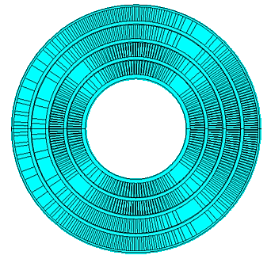
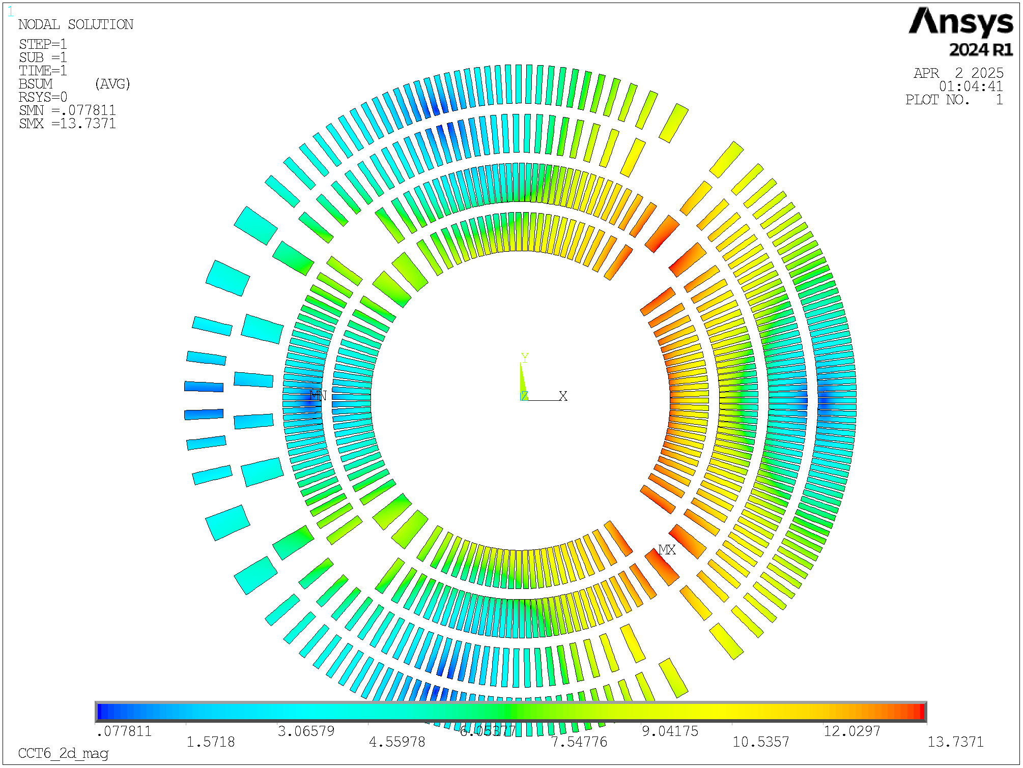
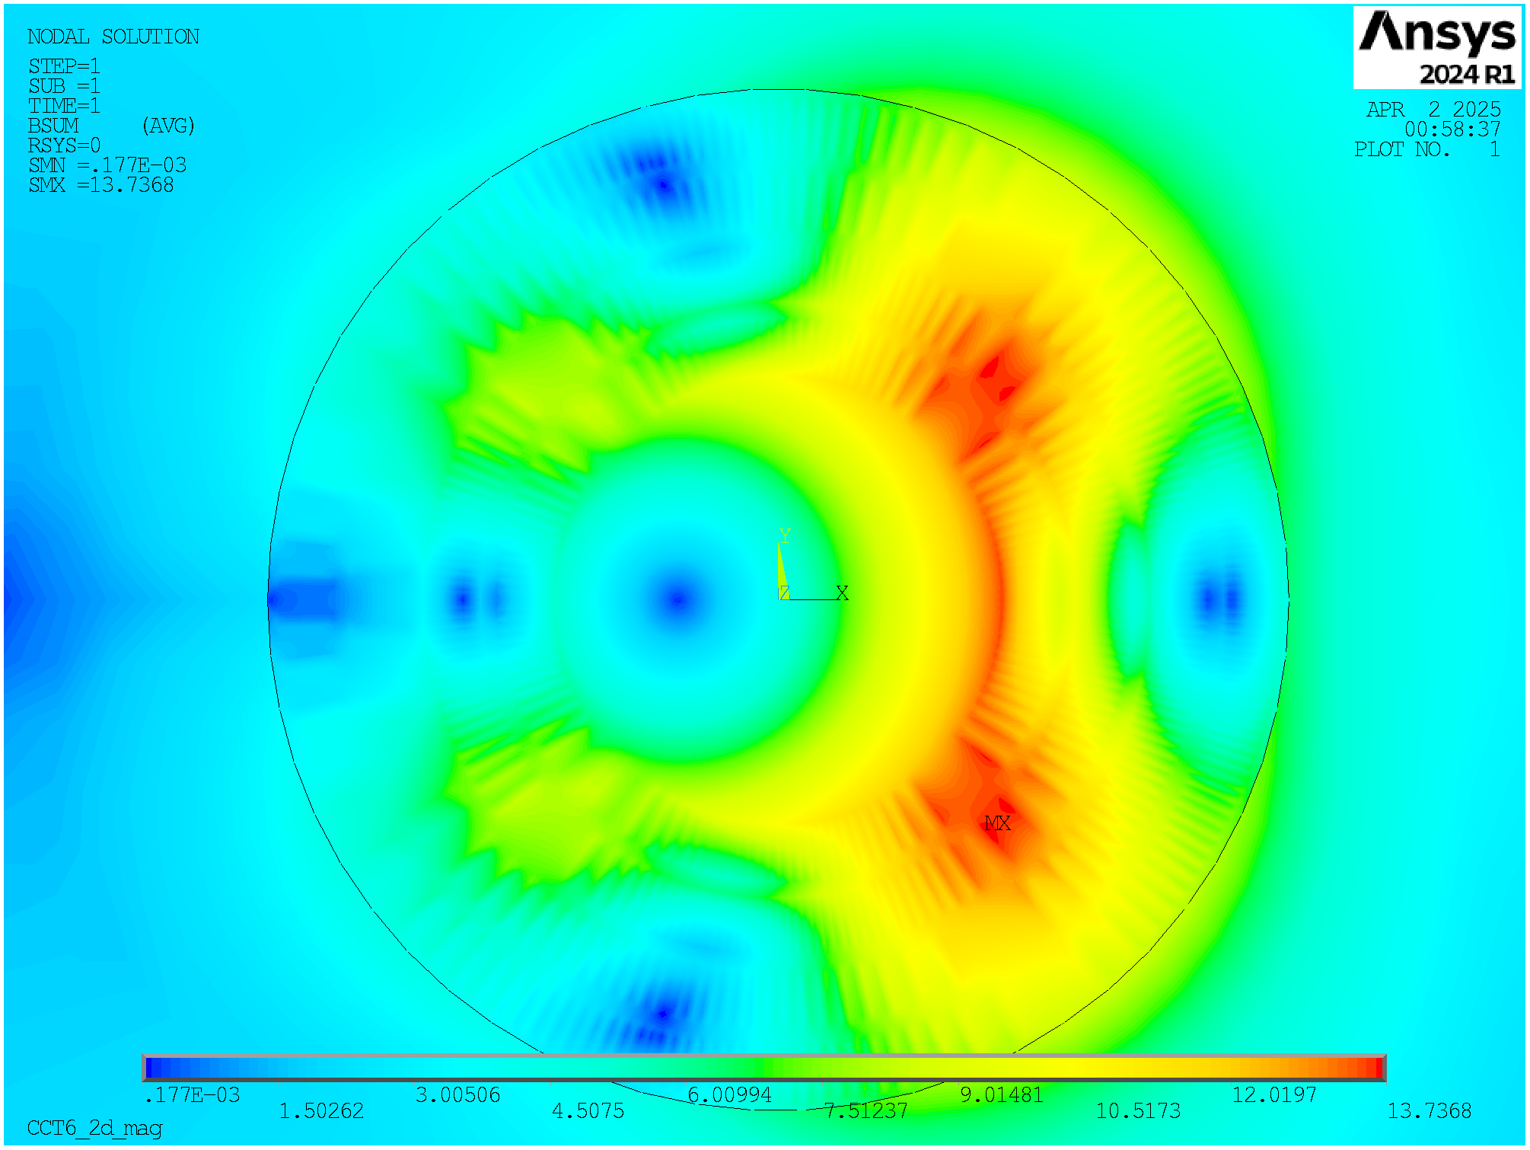
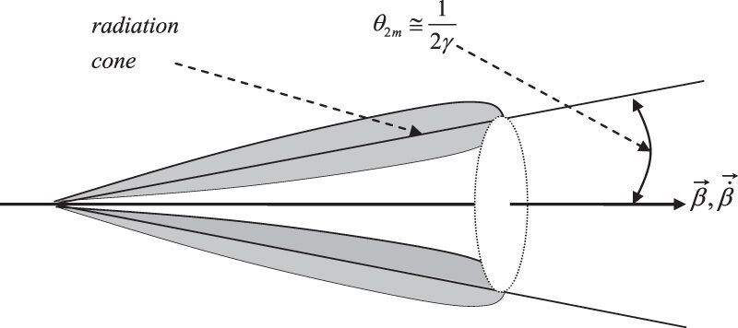
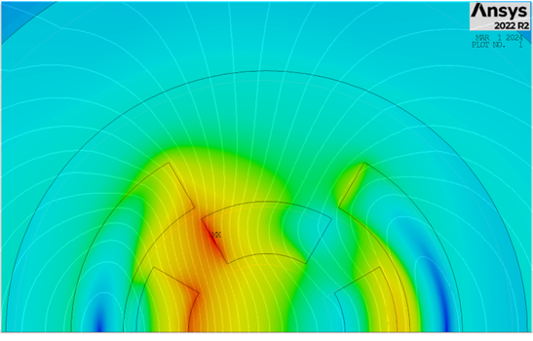
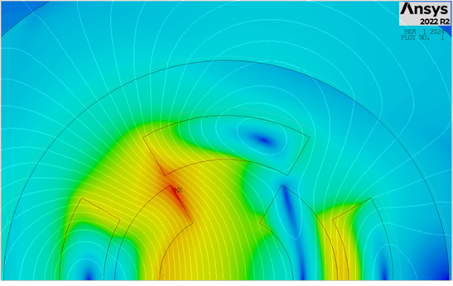
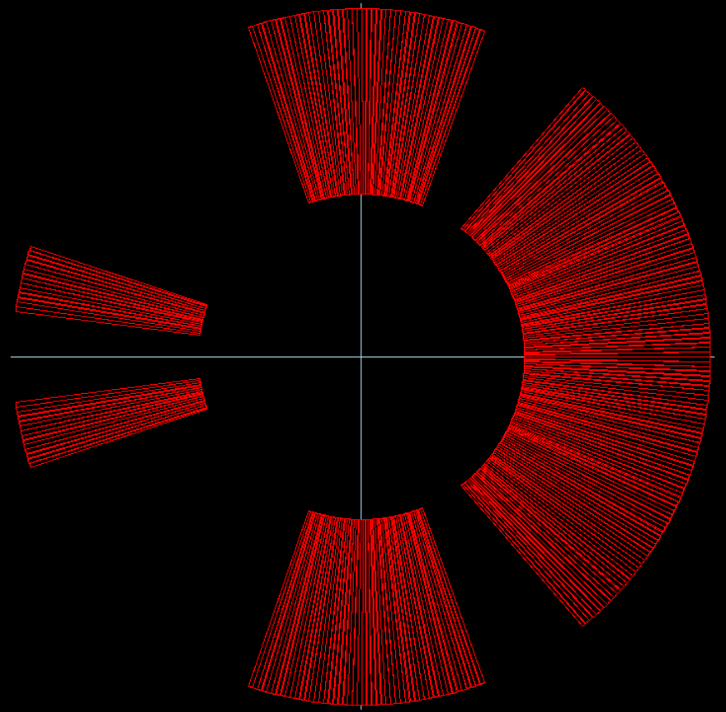
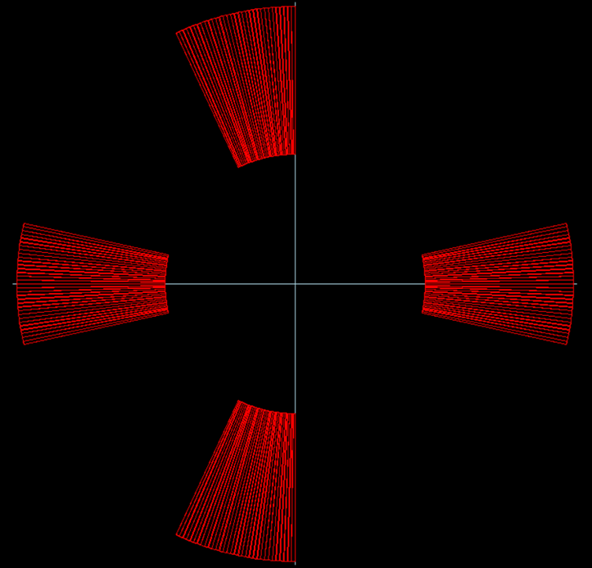
Combined-Function Magnets
Problem of the neutrino flux:
Beam physics requirements
Dip + Quad :
8 T, 100 T/m, aperture of 310 mm (FF)
8 T, 320 T/m, aperture of 130 mm (ARC)
4 T, 240 T/m, aperture of 170 mm (Corr.)
4 T, 330 T/m, aperture of 130 mm (Corr.)
Dip + Sext :
14 T, 7100 T/m², aperture of 130 mm (ARC)
4 T, 11555 T/m², aperture of 170 mm (Corr.)
$$μ^{−}→e^{−}+\overline{ν_{e }}+ν_{μ}$$
$$μ^{+}→e^{+}+ν_{e}+\overline{ν_{μ}}$$
Nested Configurations
Asymmetric Coils
Quad inside Dip
Dip inside Quad
Asym. Dip
Asym. Quad
Notes:
Purpose:
Evaluate realistic performance targets for the collider magnets, in close collaboration with studies of beam physics, cryogenics, and energy storage.
Produce a credible and affordable design study (contain costs, energy efficiency, sustainable operation).

Slide 10
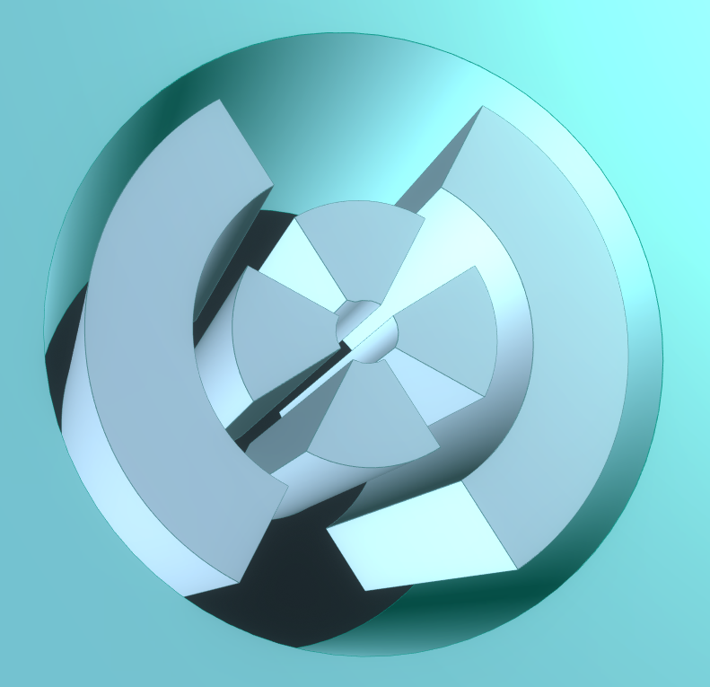
Python-Ansys Interface
A Python-ANSYS interface was developed to run FEM configurations capable of providing the electromagnetic performance of various designs.
Loops were implemented by varying the temperature, a1_quad and w_quad. For each fixed value, the maximum w_dip was calculated using a cost model, and an optimization code for electromagnetic performance was executed. This code aimed to maximize the current density while staying within stress and margin limits.
a1_quad
w_quad
w_dip
Electromagnetic optimization
Fixed geometry
Mechanical optimization
Cost model
Change geometry
For each temperature:

Slide 11
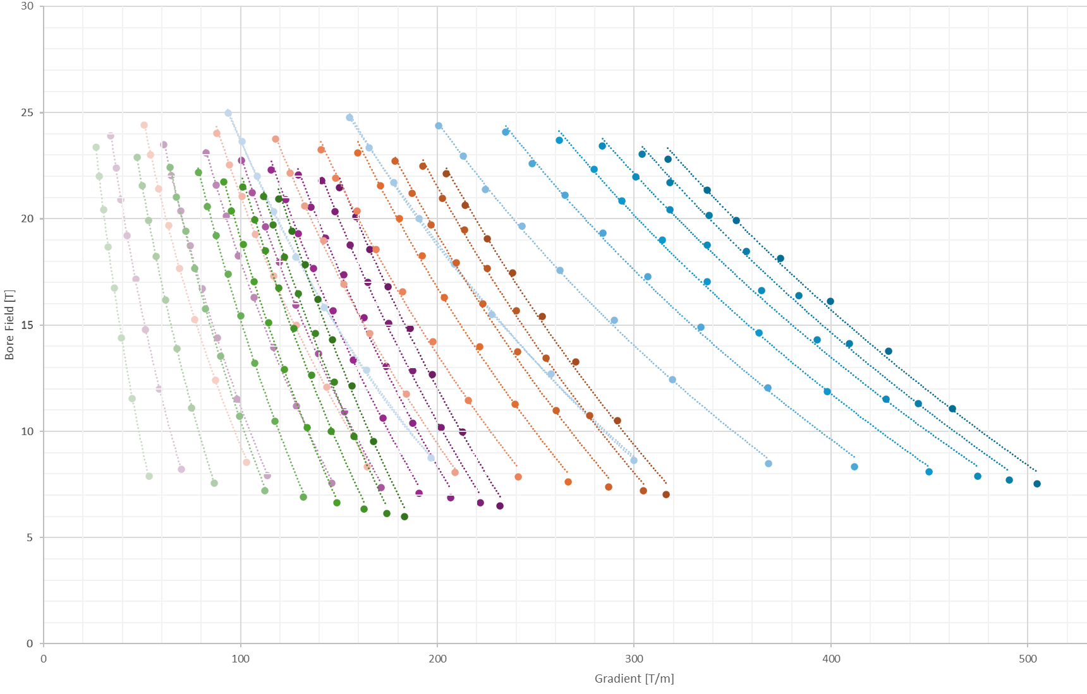
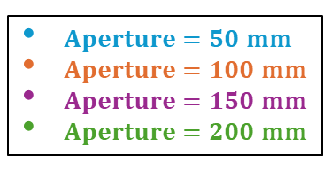
Method: B-G plot at 4.5K
Only EM optimization
$Aperture=50 mm$
$Aperture=100 mm$
$Aperture=150 mm$
$Aperture=200 mm$
Current density
Optimization (1%)
Optimize J_quad​ and J_dip​ to be close to the critical current density:
….
while not ( 0.99 < f < 1.01 ):
…..
→ ANSYS input (a1, w_quad, J_quad, w_dip, J_dip)
Run ANSYS
ANSYS output →
f = J_c (B_peak) / J
if f > 1: J=J*1.01
else: J = J*0.99
…..
…..
the optimization acts on J_quad and J_dip
with corrections of 1%,
and the cycle closes when either
J_quad or J_dip is within 1% of J_c
w_dip
w_quad
Limitations on stress and cost are still missing

Slide 12










Method: B-G plot at 4.5K
Only EM optimization
$Aperture=50 mm$
Current density
Optimization (1%)
$$w_{quad}=30mm$$
$$w_{dip}=80mm$$
Optimize J_quad​ and J_dip​ to be close to the critical current density:
….
while not ( 0.99 < f < 1.01 ):
…..
→ ANSYS input (a1, w_quad, J_quad, w_dip, J_dip)
Run ANSYS
ANSYS output →
f = J_c (B_peak) / J
if f > 1: J=J*1.01
else: J = J*0.99
…..
…..
the optimization acts on J_quad and J_dip
with corrections of 1%,
and the cycle closes when either
J_quad or J_dip is within 1% of J_c
$$w_{quad}=30mm$$
Increasing $w_{dip}$
$$w_{dip}=20mm$$
$$w_{quad}=10mm$$
$$w_{quad}=30mm$$
$$w_{dip}=10mm$$
$$w_{dip}=10mm$$
Increasing $w_{quad}$
Limitations on stress and cost are still missing

Slide 13
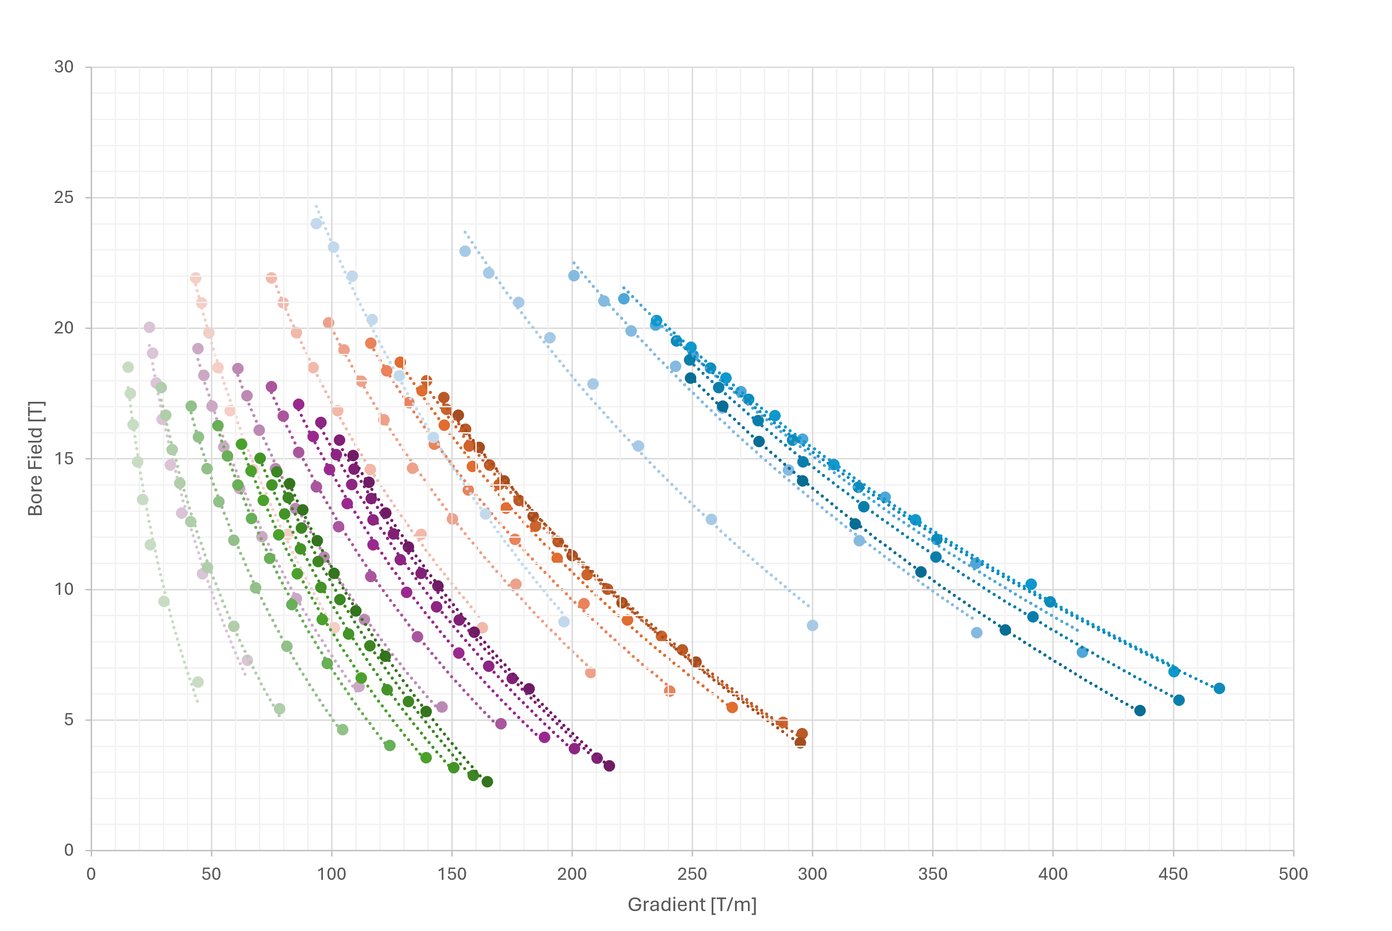
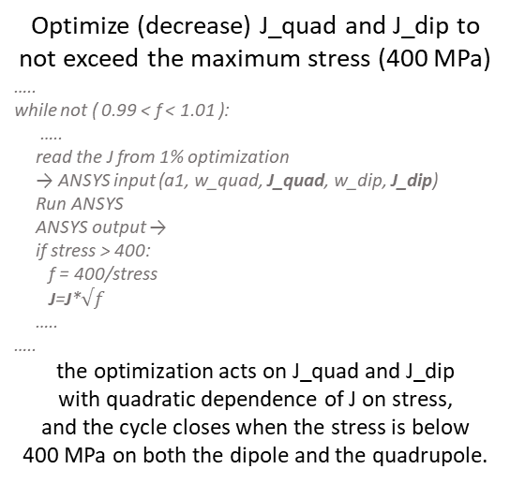
Method: B-G plot at 4.5K
EM and Stress optimization
$Aperture=50 mm$
$Aperture=100 mm$
$Aperture=150 mm$
$Aperture=200 mm$
Midplane pressure
Optimization (1%)
Optimize (decrease) J_quad​ and J_dip​ to not exceed the maximum stress (400 MPa)
…..
while not ( 0.99 < f < 1.01 ):
…..
read the J from 1% optimization
→ ANSYS input (a1, w_quad, J_quad, w_dip, J_dip)
Run ANSYS
ANSYS output →
if stress > 400:
f = 400/stress
J=J*$√f$
…..
…..
the optimization acts on J_quad and J_dip
with quadratic dependence of J on stress,
and the cycle closes when the stress is below
400 MPa on both the dipole and the quadrupole.
Limitation on cost is still missing

Slide 14
Method: B-G plot at 4.5K
EM, Stress and Cost optimization
$Aperture=50 mm$
$Aperture=100 mm$
$Aperture=150 mm$
$Aperture=200 mm$
Cost
Optimization
The dipole coil width (w_dip) can be computed if the aperture radius (a1_quad) and the quadrupole coil width (w_quad) are known.
…..
for a1_quad in range(25,151,25):
…..
for w_quad in range(10, 81, 10):
w_dip = round(cost_model(a1_quad,w_quad),0)
…..
…..
…..
The cost value for the structures and iron is taken from HL-LHC, while the cost of the superconducting material (ReBCO) is based on the aspirational value of 2500 EUR/kg.
Maximum budget for each magnet: 400 kEUR/m
The cost model saves one point for each curve with the same aperture.

Slide 15
Method: B-G plot at 4.5K
EM, Stress and Cost optimization
$Aperture=50 mm$
$Aperture=100 mm$
$Aperture=150 mm$
$Aperture=200 mm$
Cost
Optimization
The dipole coil width (w_dip) can be computed if the aperture radius (a1_quad) and the quadrupole coil width (w_quad) are known.
…..
for a1_quad in range(25,151,25):
…..
for w_quad in range(10, 81, 10):
w_dip = round(cost_model(a1_quad,w_quad),0)
…..
…..
…..
The cost value for the structures and iron is taken from HL-LHC, while the cost of the superconducting material (ReBCO) is based on the aspirational value of 2500 EUR/kg.
Maximum budget for each magnet: 400 kEUR/m
For different costs, we will have different limit curves, but not different points. Each point is EM- and stress-optimized using FEM code;
the selection of the maximum point on each dotted curve depends on the cost.
The cost model saves one point for each curve with the same aperture.

Slide 16
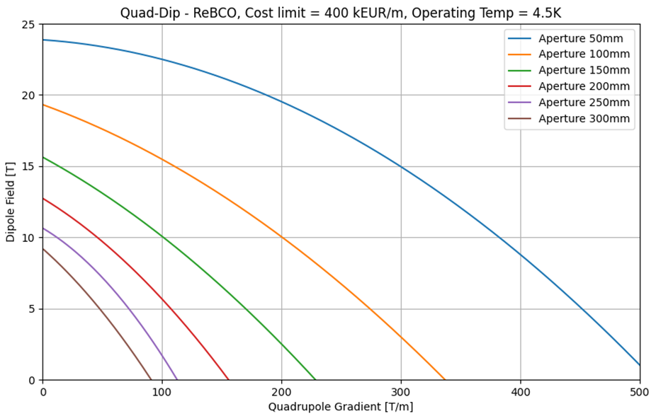
Results: B-G plot at 4.5K
Each curve of a different color corresponds to a different magnet aperture.
For a fixed aperture, the area under the curve is the allowed area for identifying a target design, while the area above the curve is the prohibited area where some maximum limit (stress, margin, quench protection or cost) will be exceeded.
For example:
Green area = allowed area
Red area = forbidden area
The same method can be applied for sextupole – dipole combined function magnets, which are essential in the arc and in the chromaticity correction and matching sections
8 T, 320 T/m, aperture of 130 mm (ARC)

Slide 17
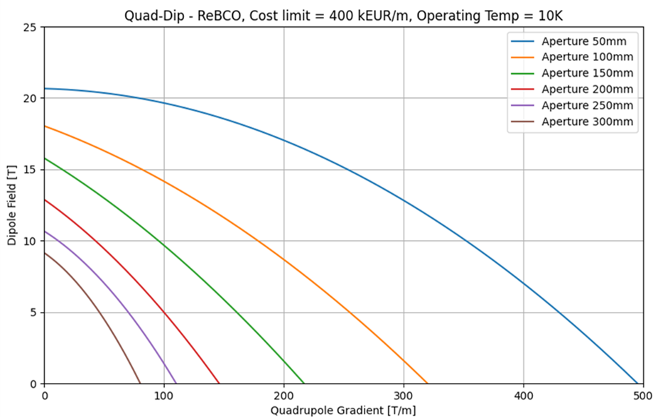
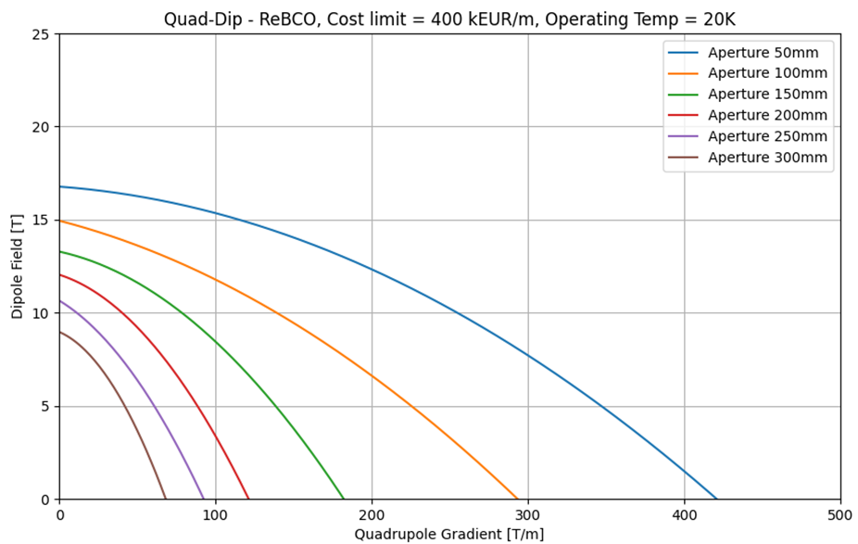
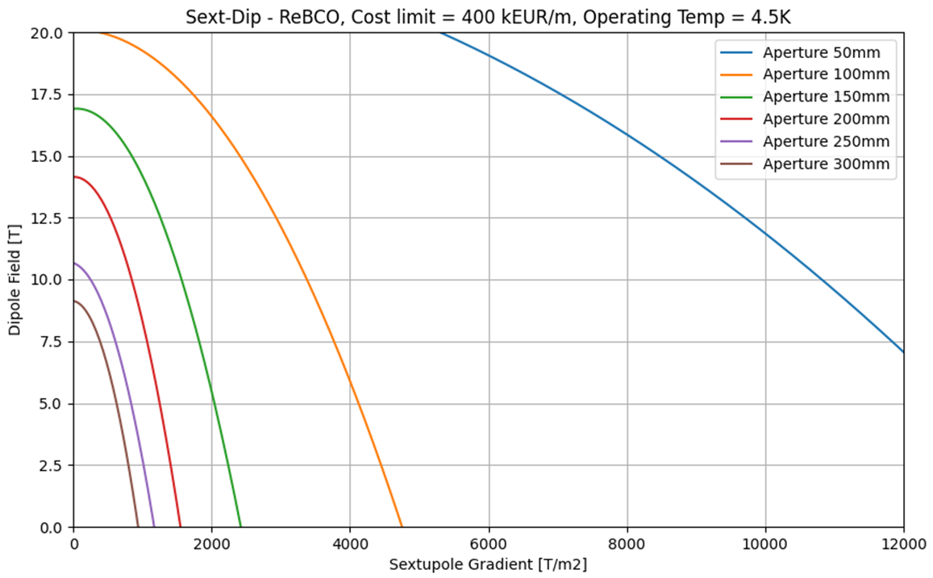
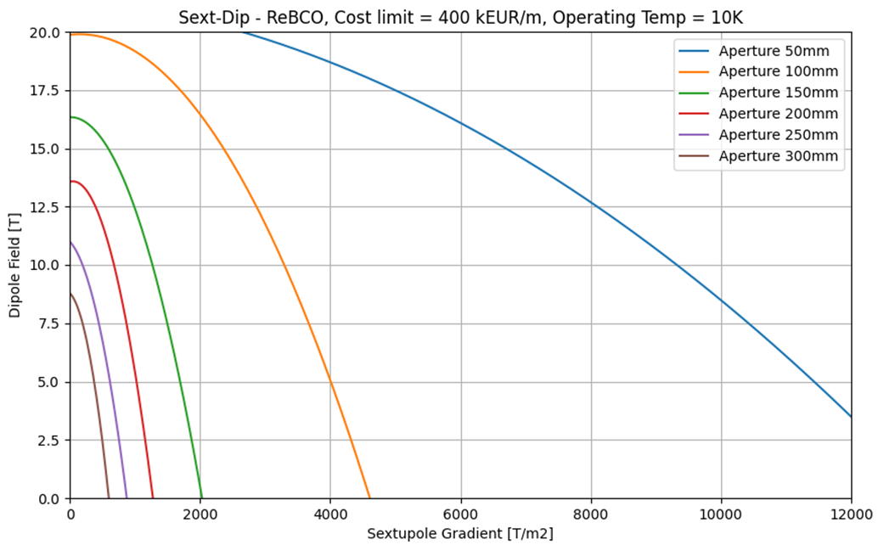
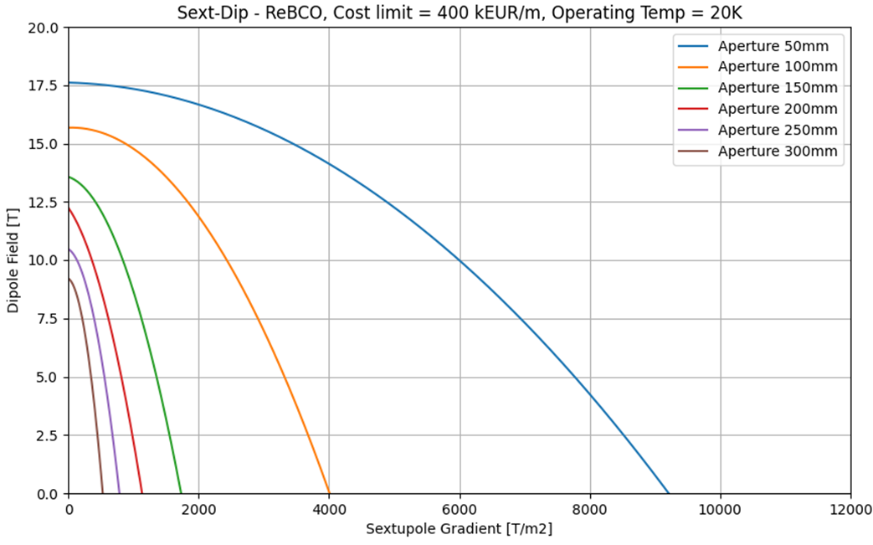
Limits of Combined–Function Magnets
Dip + Quad B–G plots
Dip + Sext B–G₂ plots

Slide 18

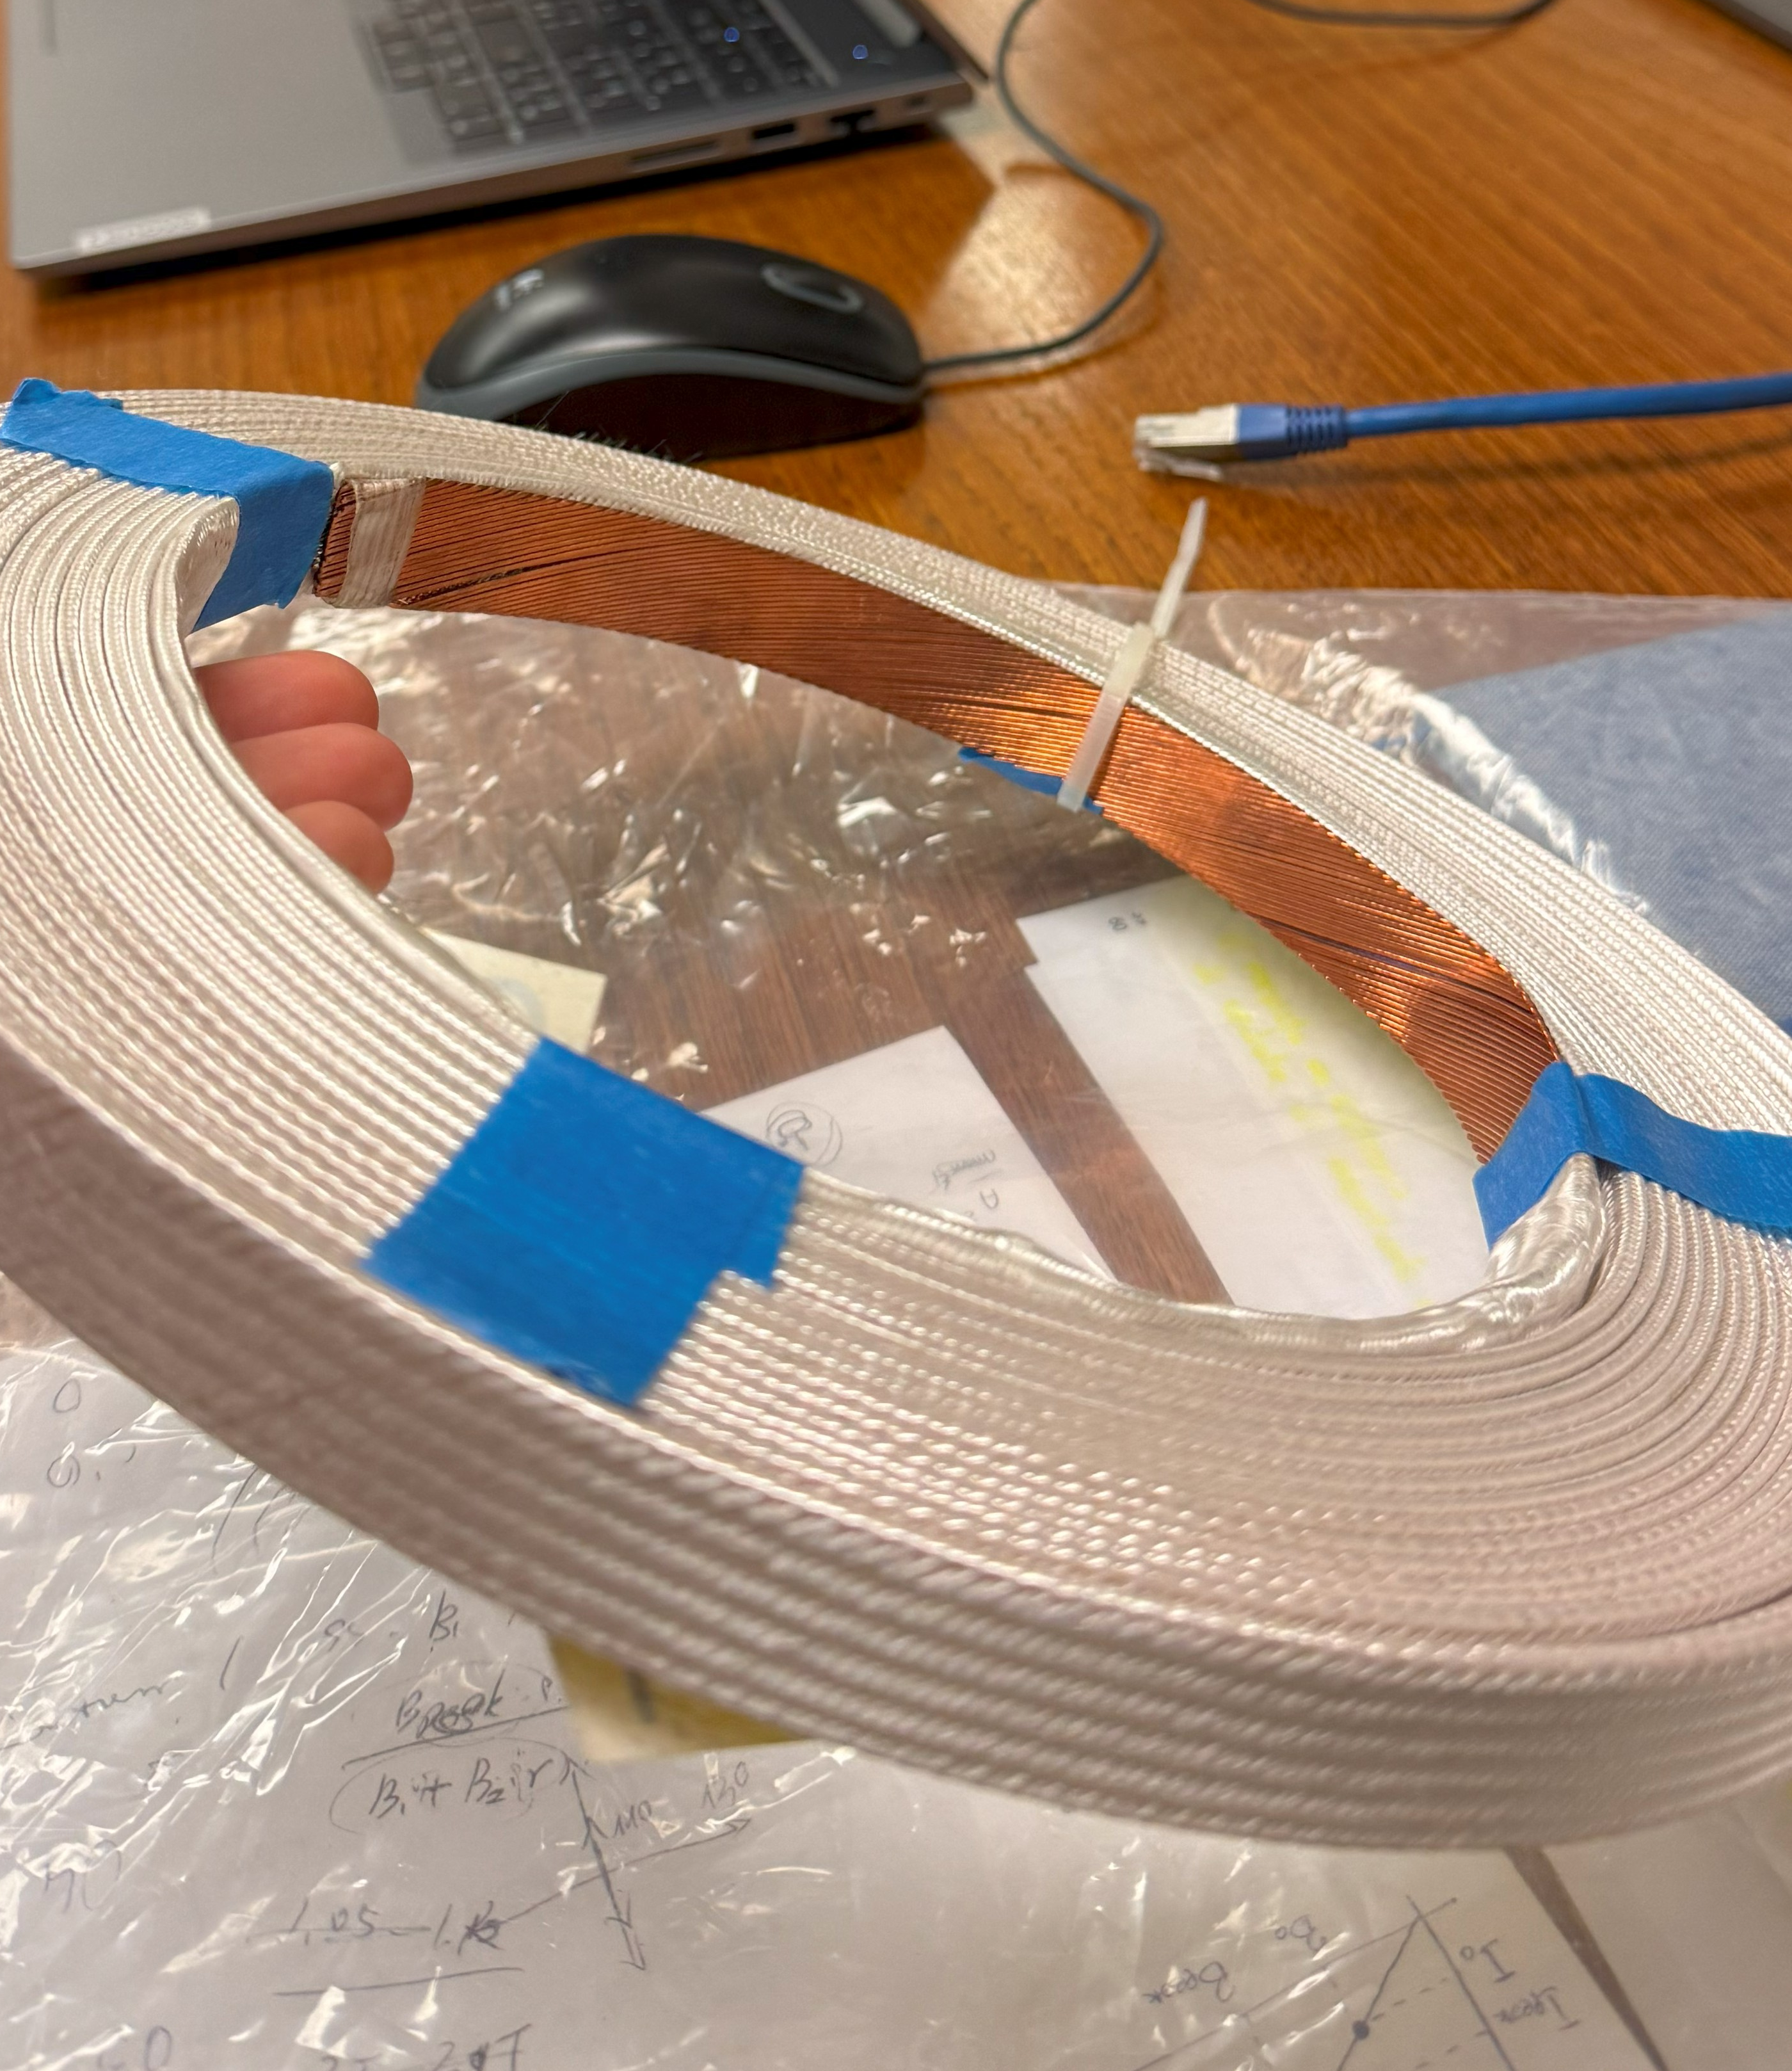
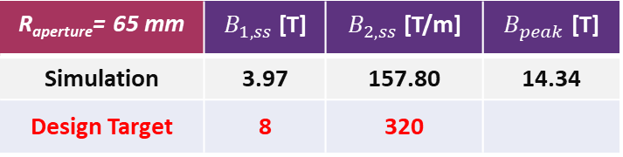
Practical studies
One of the most effective technologies available today is Nb₃Sn cables, while R&D is still required for HTS.
What performance can be achieved with a quad + dip magnet using this cable?
How far are we from meeting the beam optics requirements?
Removing the constraint of having the quadrupole inside and the dipole outside, the study revealed that the best configuration is having a quadrupole inside and a combined function outside with B1[T] / (B2[T/m]*R_{aperture} ) = 1.4, that means with a stronger dipolar component.
R_{aperture}= 65 mm | $B_{1,ss}$ [T] | $B_{2,ss}$ [T/m] | $B_{peak}$ [T]
Simulation | 3.97 | 157.80 | 14.34
Design Target | 8 | 320
With the technology available today, only up to half of the required performance can be achieved.
Layer 4
Dip+Quad
Specific design for this configuration:
4 layers, canted cos-theta (two double-pancakes):
- first two layers = B2
last two layers = B1+B2
Nb₃Sn cable used for the MQXF magnets of HL-LHC.
Aperture of 130 mm.
Ansys model to evaluate the performance @ 4.2 K.
Winding test to prove the configuration feasibility
Layer 3
Layer 2
Quad
Layer 1
MQXF cable

Slide 19
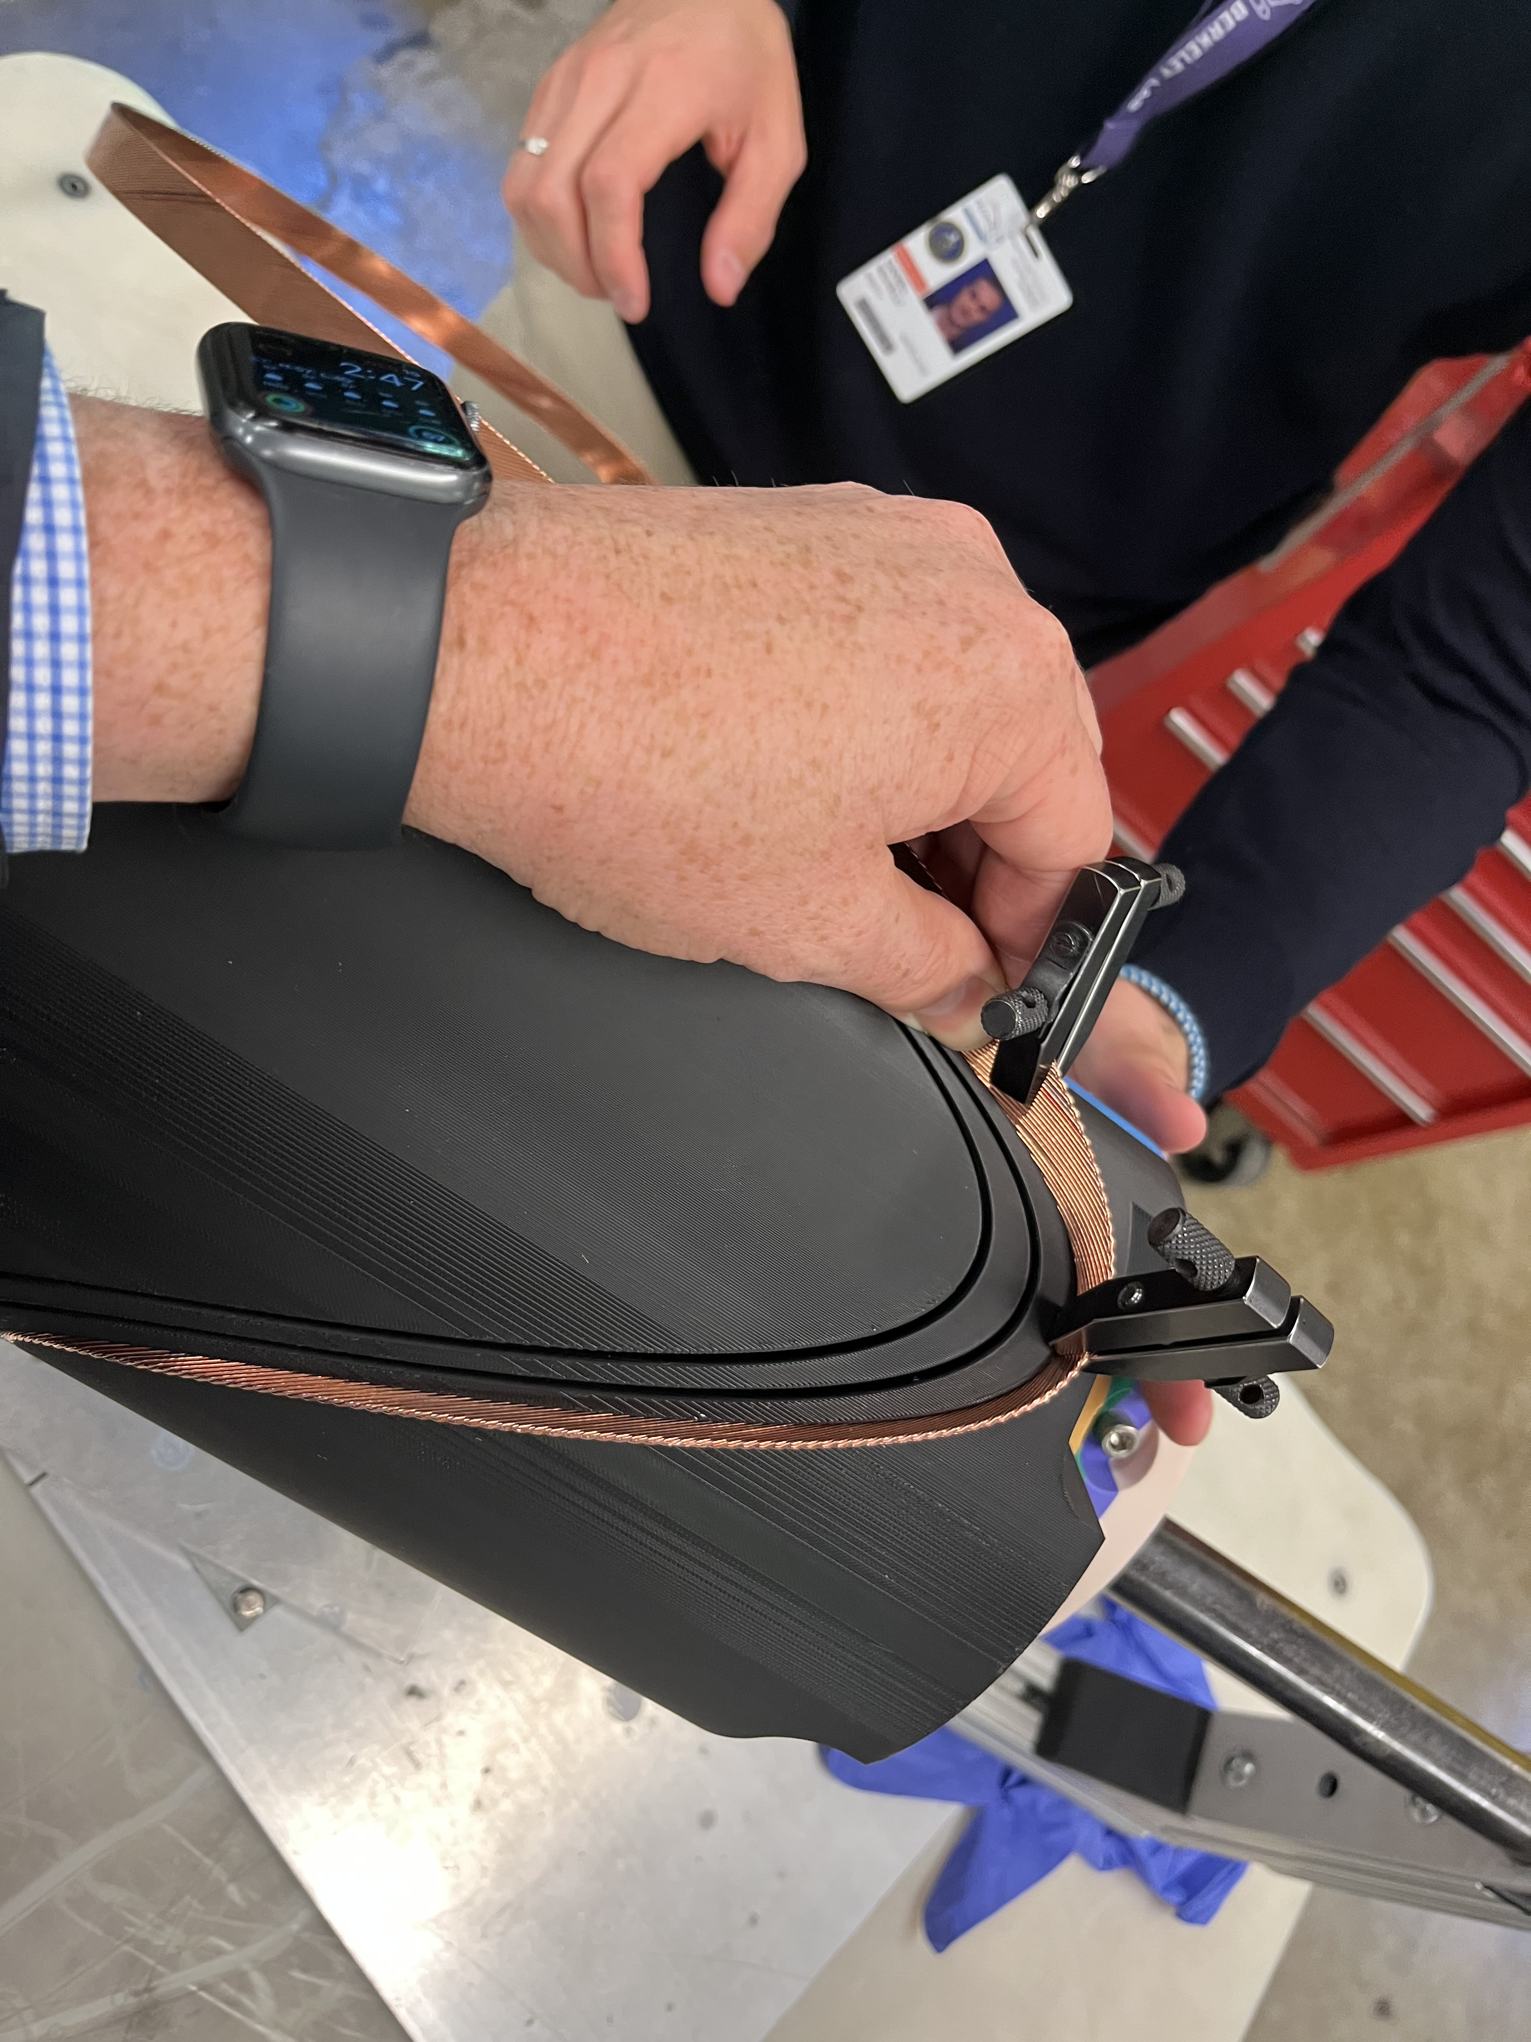
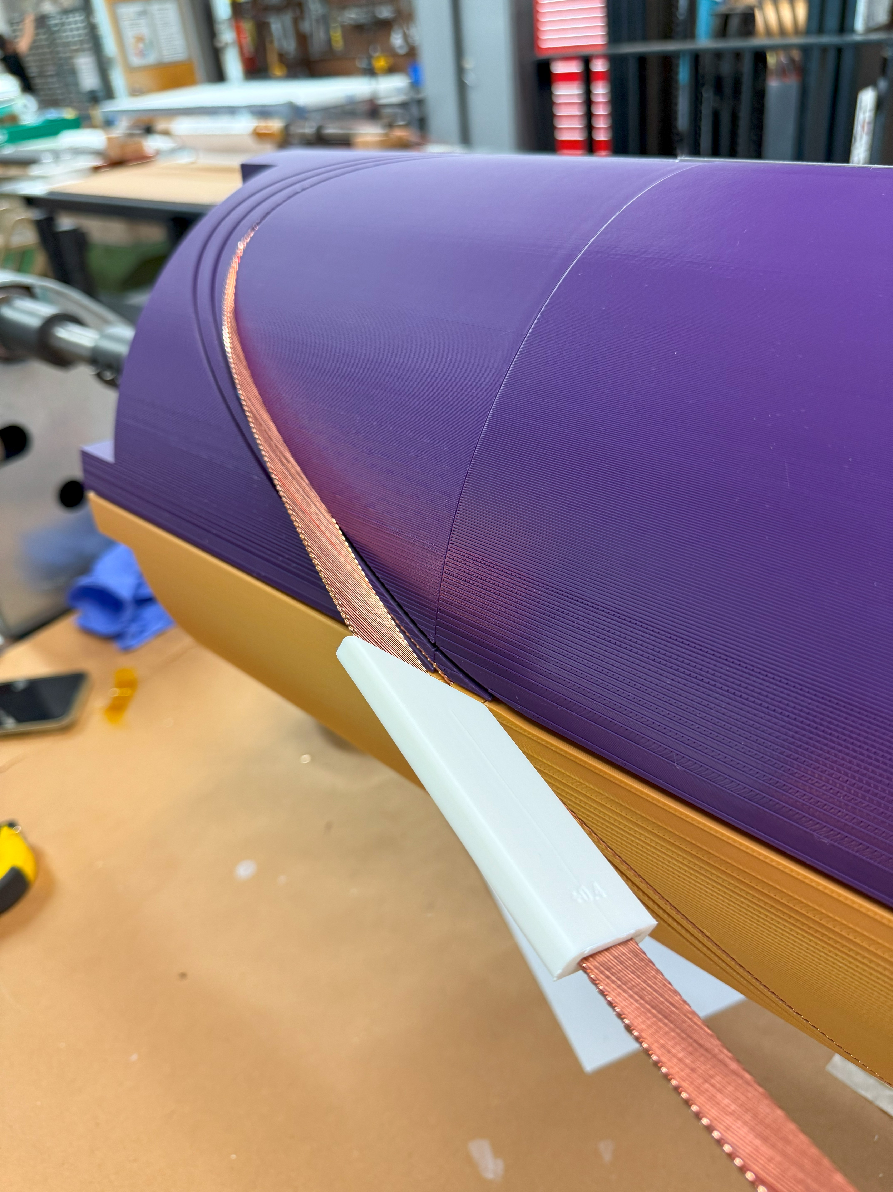
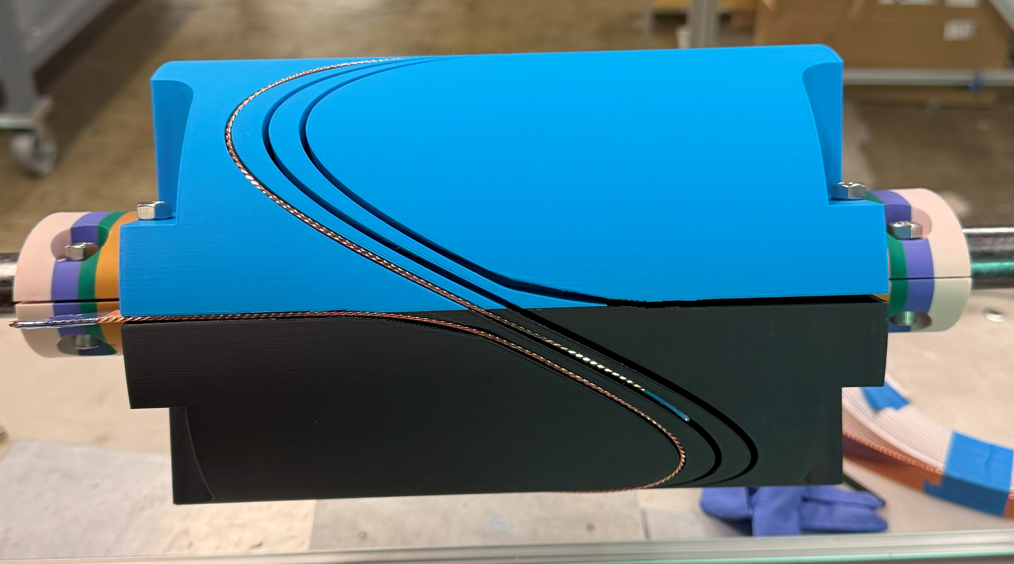
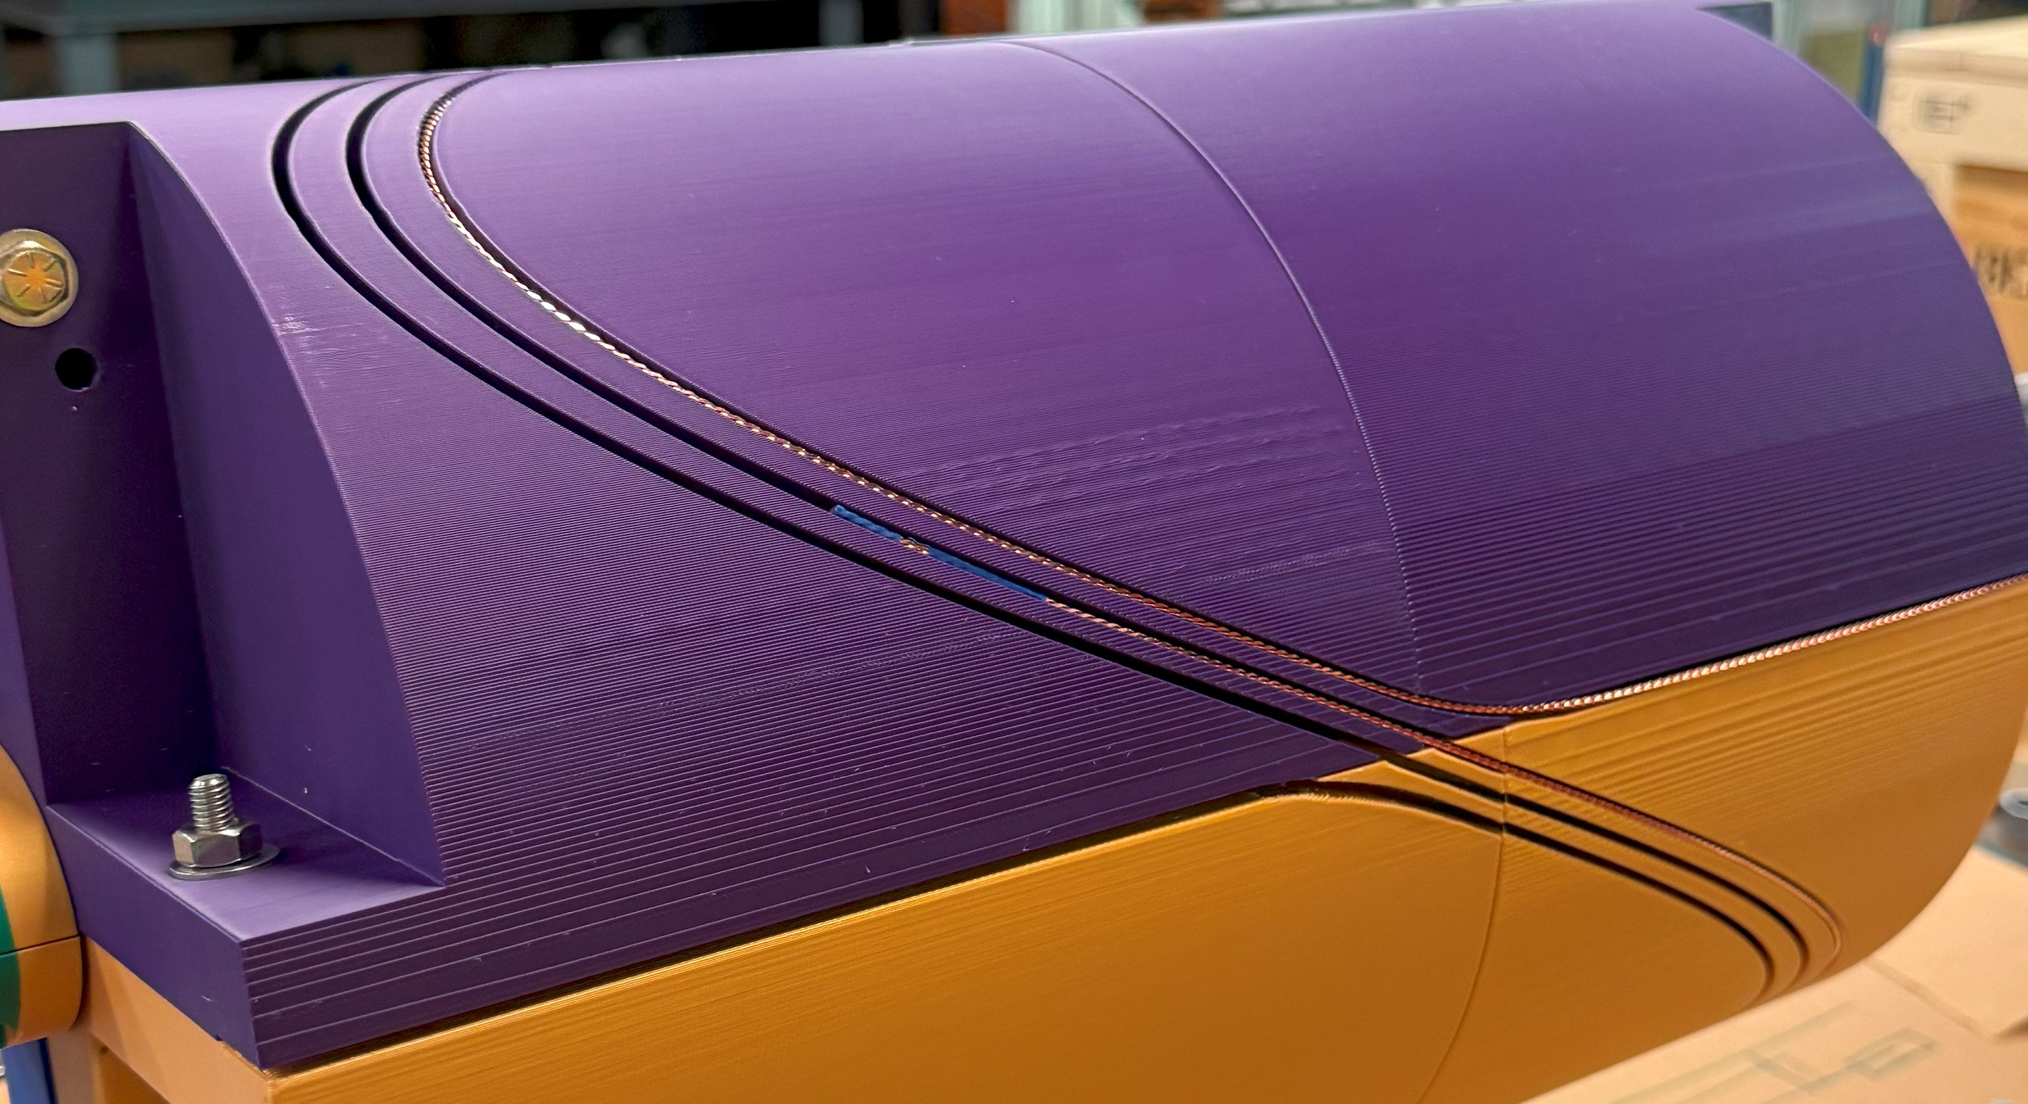
Feasibility Study
Layer 1, quadrupole
Layer 3, combined function
Analytical and
numerical study
3D model
Winding test
3D printing
The winding test was successfully executed.
The large aperture facilitate the winding process.
The winding was stopped after the first turn in order to save the cable for other tests, as each turn should be identical to the others.
Conclusion: the windability of this magnet has been proved for a CCT geometry.

Slide 20
Summary and conclusions
The limit plots are provided and discussed using both analytical and FEM approaches, serving as a starting point for defining possible beam optics that are also compatible with current technological constraints.
B-G plots:
Combined dipole + quadrupole magnets
B-G₂ plots:
Combined dipole + sextupole magnets
These plots represent a powerful method for identifying new design targets for each magnet type. The allowed area does not imply that a magnet there is feasible, but that—based on analytical calculations and numerical simulations using simplified models—it is worth exploring a detailed design study within that region.
This work enable the comparison of a wide range of electromagnetic configurations within a single plot, providing a comprehensive view of the trade-offs between aperture and electromagnetic performances. Although these plots were developed in the framework of the Muon Collider, the methodology itself is general. By adjusting the underlying assumptions, it can be readily extended to any other accelerator project.
A-B plots: Dipoles
A-G plots: Quadrupoles
A-G₂ plots: Sextupoles

Slide 21
Thank you
For your attention
Daniel Novelli
Ph.D. in Accelerator Physics
Final Seminar XXXVIII cycle
12 November 2025
Funded by the European Union (EU). Views and opinions expressed are however those of the author only and do not necessarily reflect those of the EU or European Research Executive Agency (REA). Neither the EU nor the REA can be held responsible for them.

Slide 22
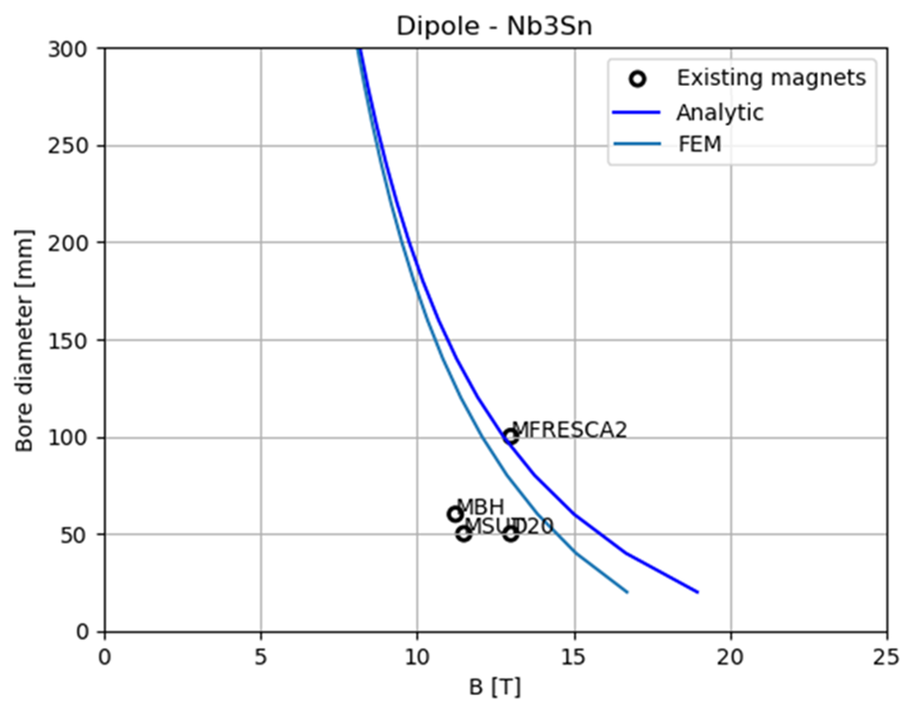
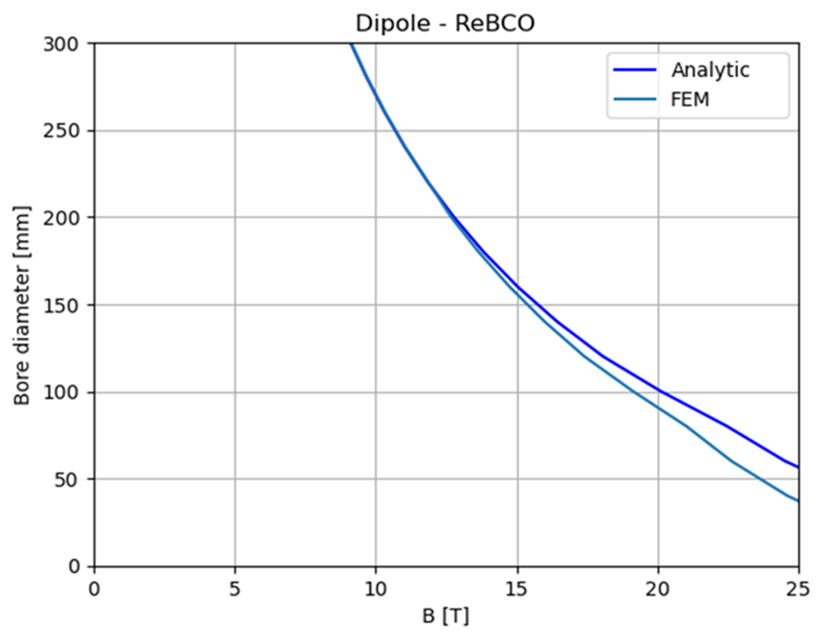
FEM Crosscheck for Stress Curves
We implemented a FEM model for a sector dipole in ANSYS.
We implemented a Python code able to work with Ansys software
to run FEM simulations with the same inputs as the analytical study.
In the comparison, the FEM curves are always more restricting than the analytical ones
since they take the maximum pressure on the midplane instead of an average over the coil width.

Slide 23
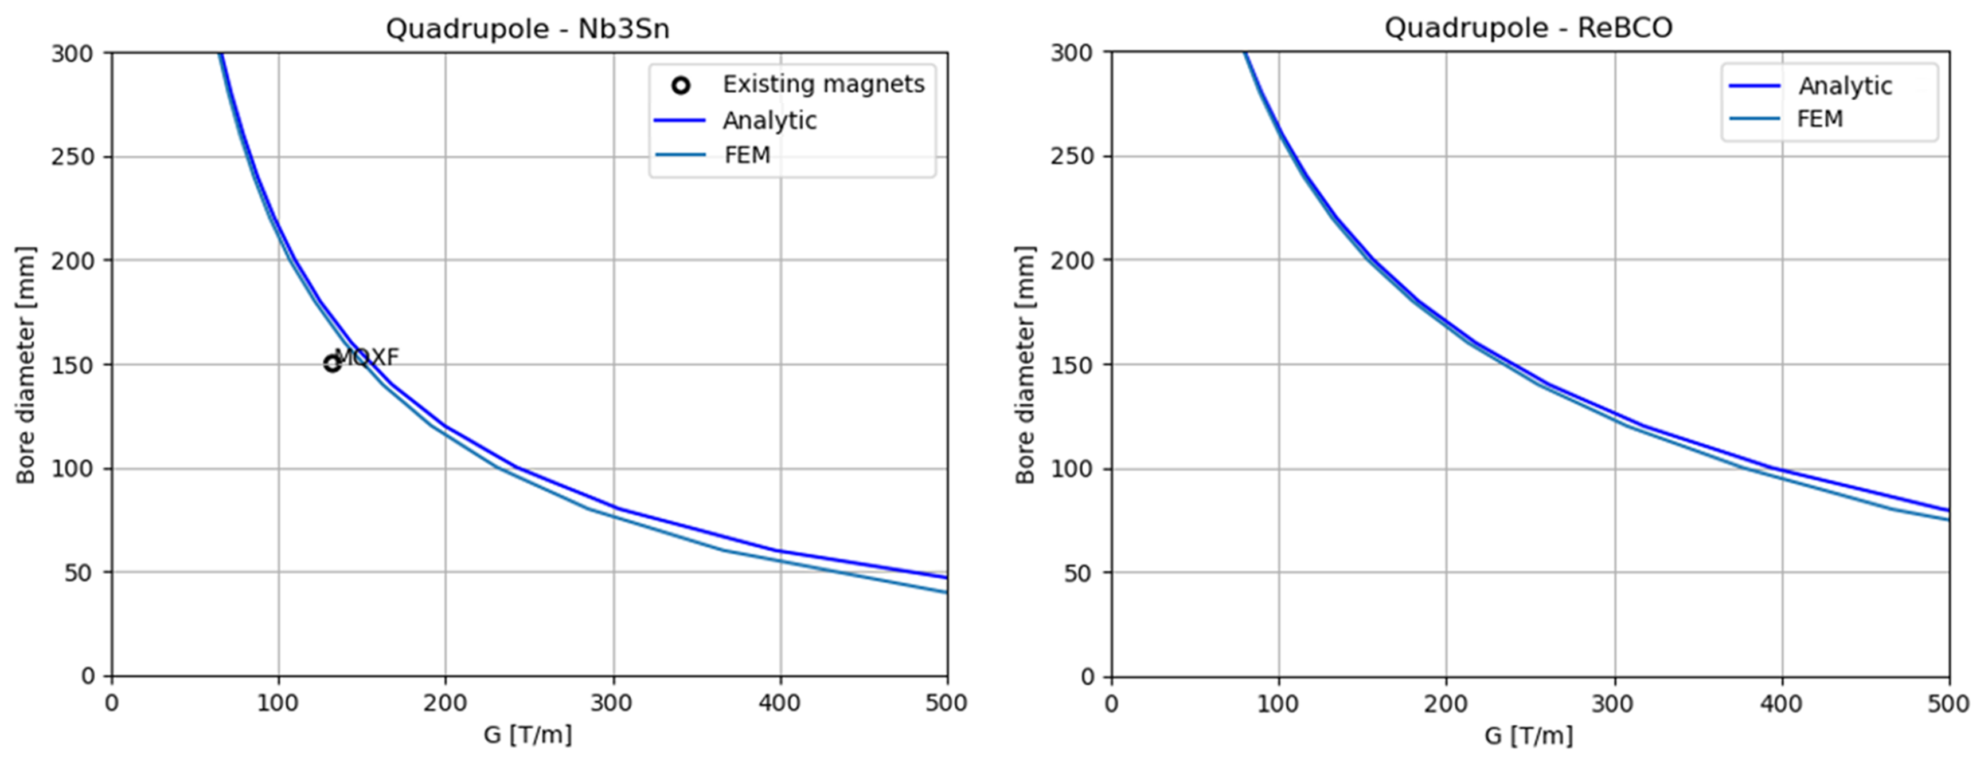
FEM Crosscheck for Stress Curves
We implemented a FEM model for a sector quadrupole in ANSYS.
We implemented a Python code able to work with Ansys software
to run FEM simulations with the same inputs as the analytical study.
In the comparison, the FEM curves are always more restricting than the analytical ones
since they take the maximum pressure on the midplane instead of an average over the coil width.

Slide 24
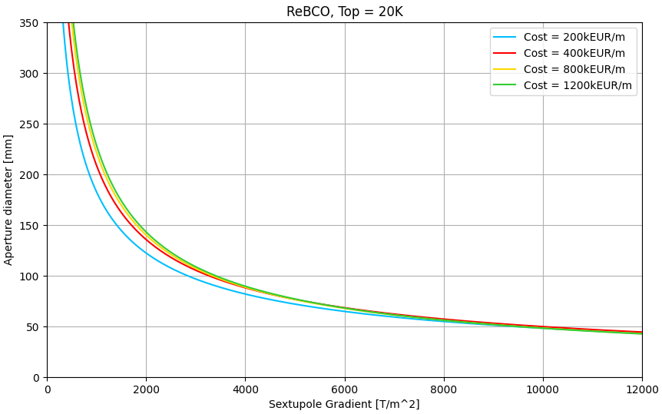
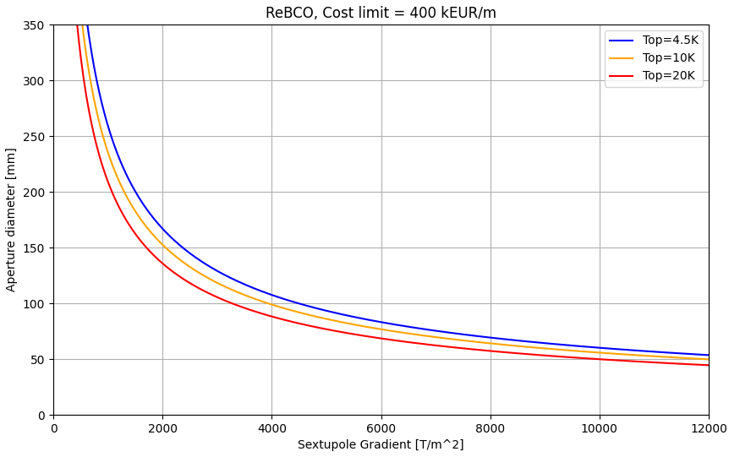
Sextupole Standalone
The A - G2 plots of the sextupole standalone corresponds to the points on the x-axis of the combined function B - G2 plots.

Slide 25
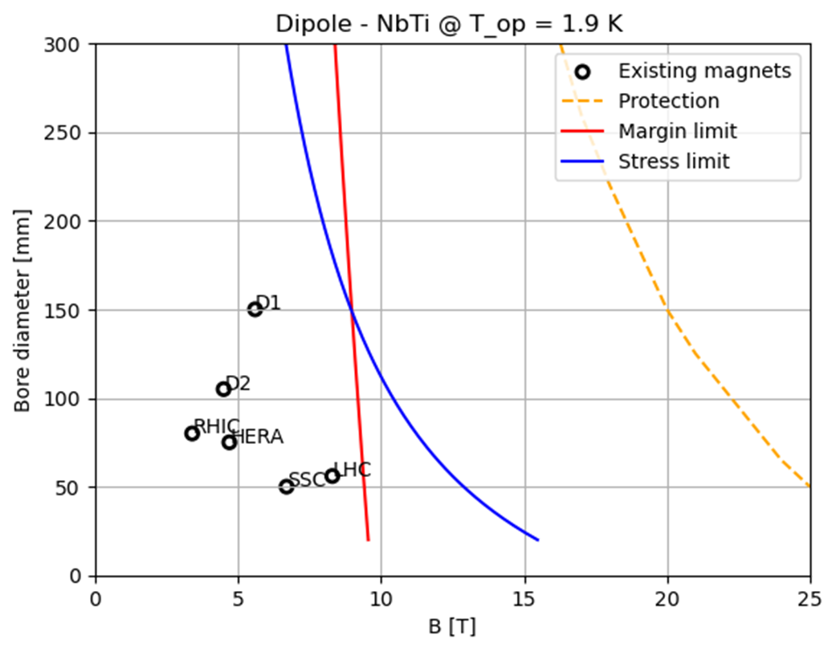


Dip. A-B Plots with LTS technologies
NbTi is intrinsically limited by the $J_{c}$ which doesn’t allow to reach high field
Nb₃Sn is limited by peak stress and operating margin

Slide 26


Quad. A-B Plots with LTS technologies
NbTi is intrinsically limited by the $J_{c}$ which doesn’t allow to reach high field
Nb₃Sn is limited by peak stress and operating margin

Slide 27




Quad. A-B Plots with LTS technologies
$T_{op}$reduction
$T_{op}$reduction
A reduction of operating temperature will result in wider design A-B range
The curves shown in the plots are the limit curves,
i.e., for each aperture value the strictest limit is taken, excluding the limit for insulated magnets.
Baseline:
400 kEUR/m
for each magnet

Slide 28



HTS dipole – A-B Plots behavior
Cost reduction
Cost reduction
Cost reduction
Summary of cost assumptions:
We use the ReBCO’s aspirational cost 2500 EUR/kg
Today’s price is around 8000 EUR/kg
The starting budget of 175 kEUR/m is taken from the FCC cost model
Cryogenic, protection and shielding costs are not taken into account.
Summary of technical assumptions:
Single sector coil
Maximum allowed stress: 400 MPa
Fujikura Tape, Roebel cable
Non-insulated or Metal-insulated cable
Maximum coil width: 80 mm

Slide 29



HTS dipole – A-B Plots behavior
Cost
reduction
Cost
reduction
Cost
reduction
Summary of cost assumptions:
We use the ReBCO’s aspirational cost 2500 EUR/kg
Today’s price is around 8000 EUR/kg
The starting budget of 175 kEUR/m is taken from the FCC cost model
Cryogenic, protection and shielding costs are not taken into account.
Summary of technical assumptions:
Single sector coil
Maximum allowed stress: 400 MPa
Fujikura Tape, Roebel cable
Non-insulated or Metal-insulated cable
Maximum coil width: 80 mm

Slide 30







Combined: Nested Configuration
Quad into dipole:
(ReBCO @20 K)
$J=3.5⋅{10}^{8}A/m^{2}$
$B_{ }∼11.7 T$
$G∼143.3 T/m$
Dipole into quad:
(ReBCO @20 K)
$J=3.5⋅{10}^{8}A/m^{2}$
$B_{ }∼12.4 T$
$G∼90.4 T/m$
These two configurations are NOT realistic.
Arc:
Combined function magnets: B1, B1+B2 and B1+B3
B ≈ 8…16 T; G ≈ 320 T/m; G’ ≈ 7100 T/m²
Aperture ≈ 130 mm
Final focus:
Combined function magnets: B1, B2, B1+B2 , B1+B3
B ≈ 4…16 T; G ≈ 100…300 T/m; G’ ≈ 12000 T/m²
Aperture ≈ 120…300 mm
The quadrupole into dipole configuration is the most efficient one, in accordance with US-MAP. Additionally, for combined function magnets in the muon collider, quadrupoles are generally required to be stronger than dipoles.

