Slide 1





FCC-ee collimation system design
G. Broggi ^{1,2,3}
Advisor: Dr. Manuela Boscolo³
Supervisor: Dr. Roderik Bruce²
¹ Sapienza University of Rome, Italy ² CERN, Meyrin, Switzerland ³ INFN-LNF, Frascati, Italy
Final 3rd year seminar of the PhD in Accelerator Physics, Rome, Italy, 12/11/2025
Acknowledgements:
A. Abramov, K. Andre, S. Boogert, X. Buffat, H. Burkhardt, A. Ciarma, A. Frasca, D. Gibellieri, M. Hofer, G. Iadarola, T. Ishibashi, B. Jablonski, R. Kersevan, P. Kicsiny, B. Lindstrom, A. Lechner, S. Marin, M. Migliorati, A. Natochii, L. Nevay, G. Nigrelli, D. Mirarchi, K. Oide, A. Perillo-Marcone, D. Proniakova, P. Raimondi, T. Raubenheimer, S. Redaelli, J. Salvesen, S. Terui, F. Van der Veken, C. Zannini, F. Zimmermann

Slide 2
Outline
Introduction
FCC-ee: the Future Circular electron-positron collider
Collimation for the FCC-ee
FCC-ee collimation system
FCC-ee halo collimation system
FCC-ee SR collimation system
Studies and simulations of beam losses in the FCC-ee
FCC-ee beam loss scenarios
FCC-ee collimation simulations
Simulation tool benchmark at SuperKEKB
FCC-ee collimation performance under selected beam loss scenarios
Generic beam halo, off-momentum, beam-gas, Touschek, beam-beam losses
Generic failure scenario
Crystal collimation for the FCC-ee: an alternative design
Outlook and future work
12/11/2025
G. Broggi | FCC-ee collimation system design

Slide 3
Outline
Introduction
FCC-ee: the Future Circular electron-positron collider
Collimation for the FCC-ee
FCC-ee collimation system
FCC-ee halo collimation system
FCC-ee SR collimation system
Studies and simulations of beam losses in the FCC-ee
FCC-ee beam loss scenarios
FCC-ee collimation simulations
Simulation tool benchmark at SuperKEKB
FCC-ee collimation performance under selected beam loss scenarios
Generic beam halo, off-momentum, beam-gas, Touschek, beam-beam losses
Generic failure scenario
Crystal collimation for the FCC-ee: an alternative design
Outlook and future work
12/11/2025
G. Broggi | FCC-ee collimation system design

Slide 4
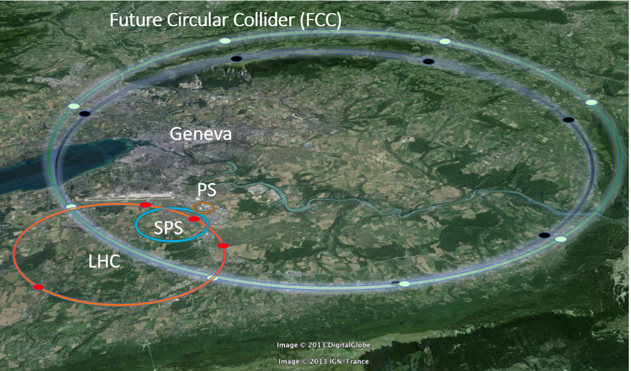
FCC: the Future Circular Collider
1st stage
2nd stage
FCC-ee
luminosity-frontier highest-energy
electron-positron collider
FCC-hh
energy-frontier
hadron collider
≈90 km circumference
FCC tunnel construction
LEP
LEP2
LEP shutdown
LHC
HL-LHC
LHC shutdown
FCC-ee
FCC-hh
year
1989
1995
2000
2008
2029
∼2030
∼2040
∼ 2045
∼ 2070
FCC-ee is the FCC first stage e⁺e⁻ collider [1,2]
90.7 km circumference, tunnel compatible with FCC-hh
4 beam operation modes with beam energies optimized for the production of different particles:
Z (45.6 GeV), W (80 GeV), H (120 GeV), ttbar (182.5 GeV)
12/11/2025
G. Broggi | FCC-ee collimation system design
4
Notes:
The Future Circular Collider is a project for 90 km circumference collider.
It foresees a first stage as luminosity-frontier and highest-energy electron-positron collider (FCC-ee, on which my work is focused on), followed by an energy-frontier hadron collider (FCC-hh). The idea is then to repeat the succesfull LEP-LHC strategy. FCC-ee foresees four different operation modes (Z, W, H and ttbar), with beam energies optimized for the production of different particles.

Slide 5
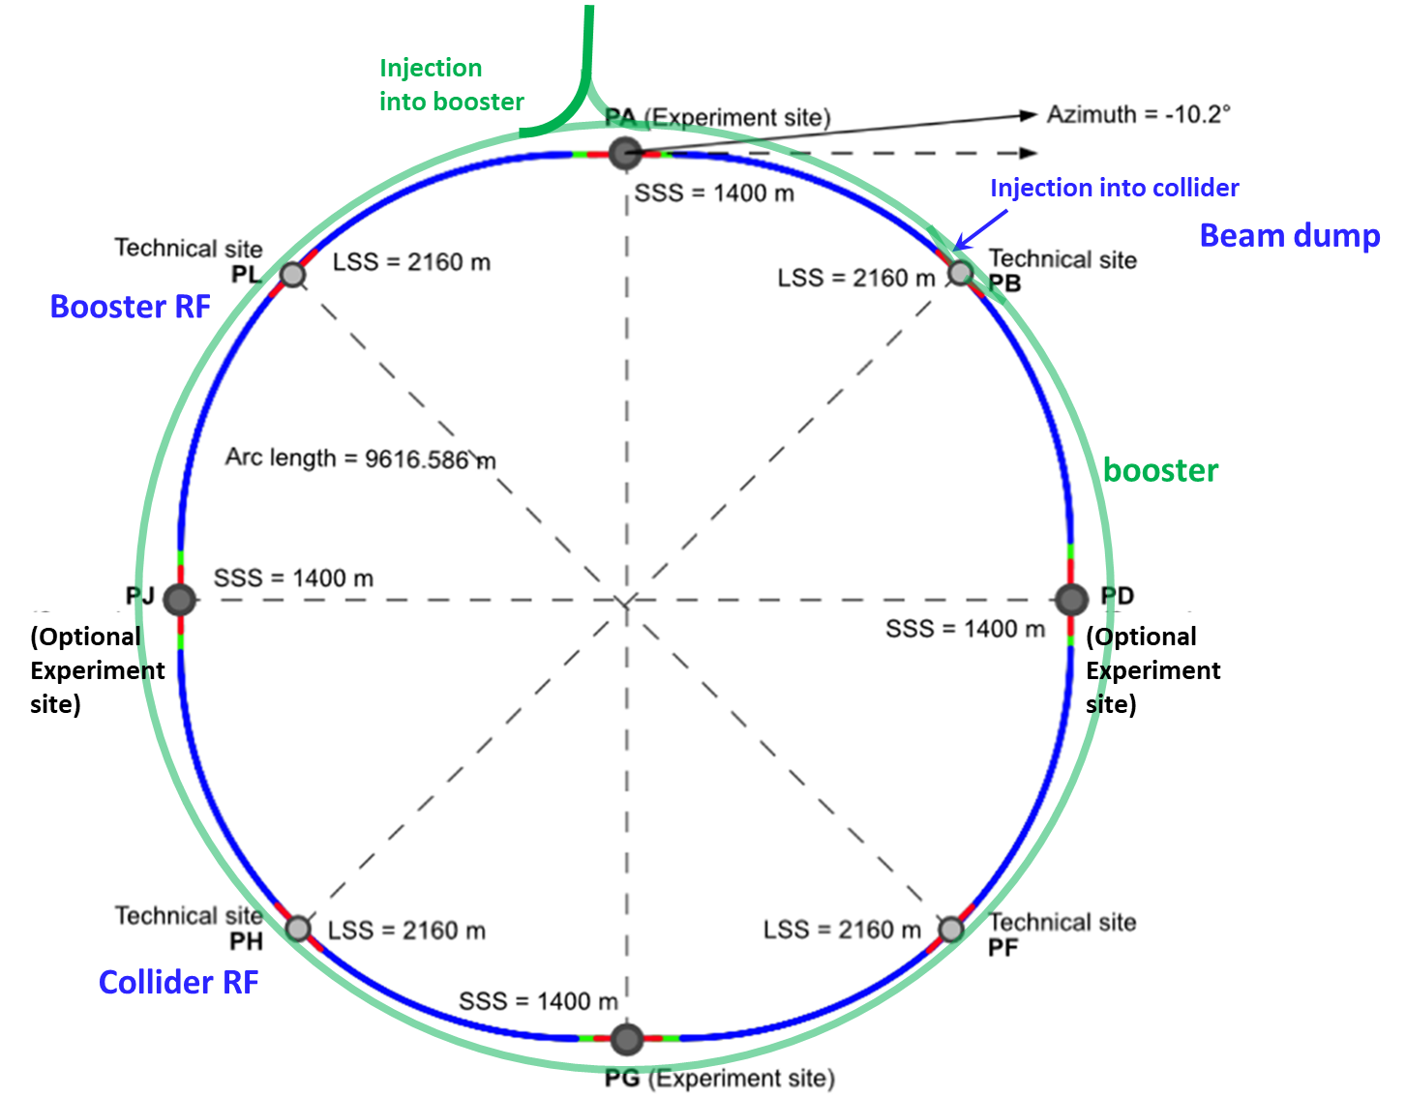
FCC-ee layout and technical baseline
Double ring e+e- collider with 90.7 km circumference
Common footprint with FCC-hh, except around IPs
Perfect 4-fold super-periodicity allowing 2 or 4 IPs; large horizontal crossing angle 30 mrad, crab-waist collision optics
Synchrotron radiation power 50 MW/beam at all beam energies
Top-up injection scheme for high luminosity.
Requires booster synchrotron in collider tunnel and 20 GeV e+/e- source and linac
Collimation in PF
Why do we need collimation in the FCC-ee?
collimation
12/11/2025
G. Broggi | FCC-ee collimation system design

Slide 6

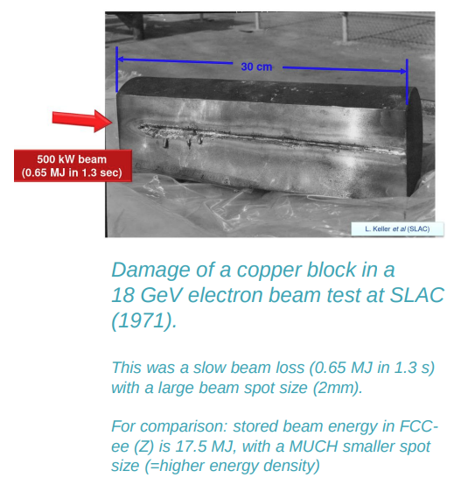
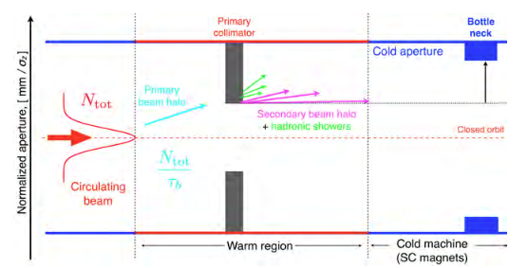
Why do we need collimation in the FCC-ee?
FCC-ee: up to 17.7 MJ stored beam energy
Corresponds to the kinetic energy of a middle-size car at 155 km/h
Typical beam sizes in the FCC-ee are σ_{x} ~ 200-300 µm; σ_{y} ~ 10 µm
17.7 MJ concentrated into a spot size of ~0.002 mm²
Energy densities up to several thousands of MJ/mm²
The FCC-ee beams are highly destructive
We need a collimation system to safely dispose of any beam losses
Collimation system: set of dedicated movable absorbers that intercept stray particles before they hit sensitive components
From [3].
12/11/2025
G. Broggi | FCC-ee collimation system design

Slide 7
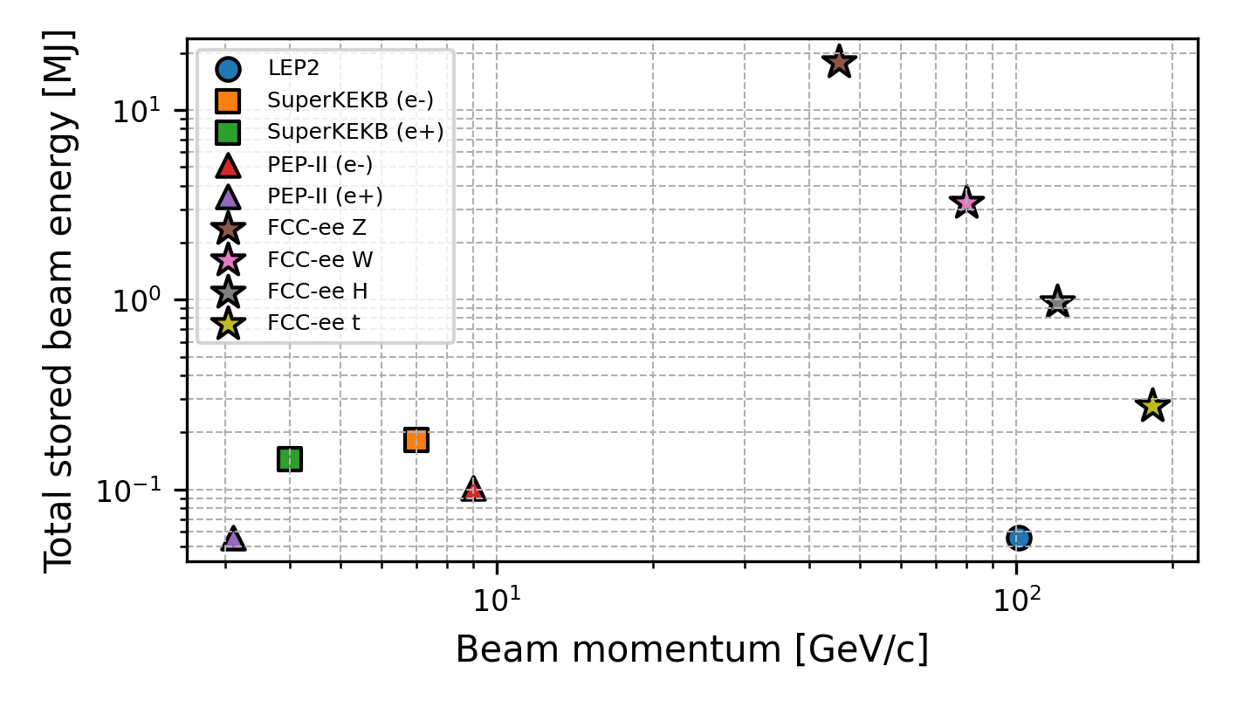
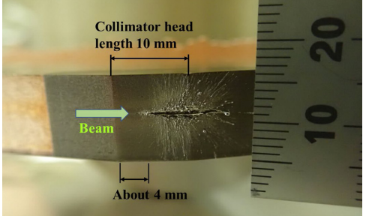
Collimation for the FCC-ee
FCC-ee presents unique collimation challenges
Unprecedented stored beam energy for a lepton collider
17.7 MJ in the Z operation mode (45.6 GeV beam energy)
New regime for e+e- colliders
Highly destructive beams: collimation system indispensable
The main roles of the collimation system are:
Reduce background in the experiments
Protect the machine from unavoidable beam losses
~2 orders of magnitude
Collimation strategy for the FCC-ee
Beam-halo (global) collimation (+ local protection collimation)
Focus of this PhD thesis project
Secondary particle shower absorbers
Studied in the CERN SY-STI group
Synchrotron radiation (SR) collimation – upstream of the IPs
Studied in the FCC-ee MDI group
Damaged Cu coated Ta collimator in SuperKEKB (LER) due to sudden beam loss [4]
12/11/2025
G. Broggi | FCC-ee collimation system design

Slide 8
Outline
Introduction
FCC-ee: the Future Circular electron-positron collider
Collimation for the FCC-ee
FCC-ee collimation system
FCC-ee halo collimation system
FCC-ee SR collimation system
Studies and simulations of beam losses in the FCC-ee
FCC-ee beam loss scenarios
FCC-ee collimation simulations
Simulation tool benchmark at SuperKEKB
FCC-ee collimation performance under selected beam loss scenarios
Generic beam halo, off-momentum, beam-gas, Touschek, beam-beam losses
Generic failure scenario
Crystal collimation for the FCC-ee: an alternative design
Outlook and future work
12/11/2025
G. Broggi | FCC-ee collimation system design

Slide 9
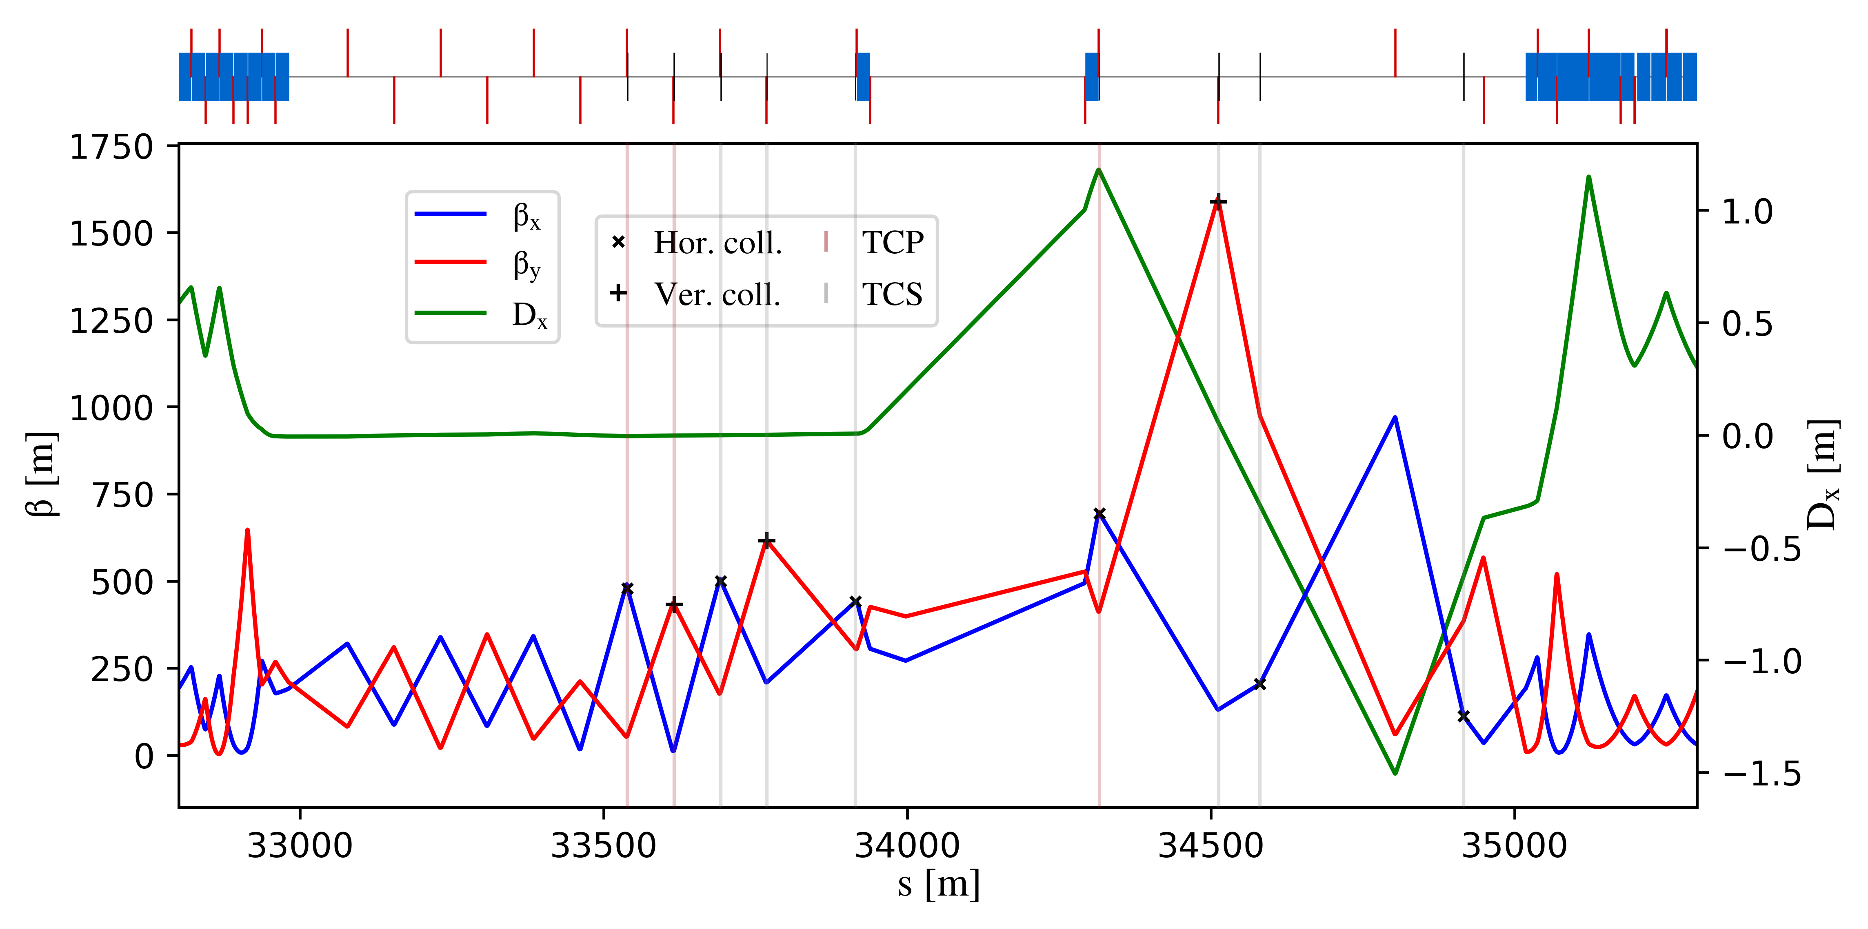
FCC-ee halo collimation system
Dedicated long straight section in PF
Universal technical insertion optics [5]
Primary and secondary betatron and off-momentum collimators
Ensure protection of the aperture bottlenecks in different conditions
Aperture bottleneck at Z: 11.5σ (H plane), 81.5σ (V plane)
First collimator design for cleaning performance
Sizeable impedance contribution by vertical primary collimator [6]
Collaboration with optics, impedance, energy deposition, and engineering team to optimize the design
Crystal collimation for the FCC-ee has also been explored [7]
collimation insertion
betatron
off-momentum
FCC-ee (Z) beam halo collimator parameters and settings
Name | Plane | Material | Length [cm] | Gap [σ] | Gap [mm] | δ_{cut} [%]
TCP.H.B1 | H | C-based | 25 | 9.5 | 5.6 | -
TCP.V.B1 | V | C-based | 25 | 50 | 1.4 | -
TCS.H1.B1 | H | Mo-based | 30 | 10.5 | 6.2 | -
TCS.V1.B1 | V | Mo-based | 30 | 65 | 2.2 | -
TCS.H2.B1 | H | Mo-based | 30 | 10.5 | 6.5 | -
TCS.V2.B1 | V | Mo-based | 30 | 65 | 3.6 | -
TCP.HP.B1 | H | C-based | 25 | 18 | 12.5 | 1.1
TCS.HP1.B1 | H | Mo-based | 30 | 28 | 11.0 | 3.5
TCS.HP2.B1 | H | Mo-based | 30 | 28 | 8.3 | 1.3
G. Broggi | FCC-ee collimation system design

Slide 10
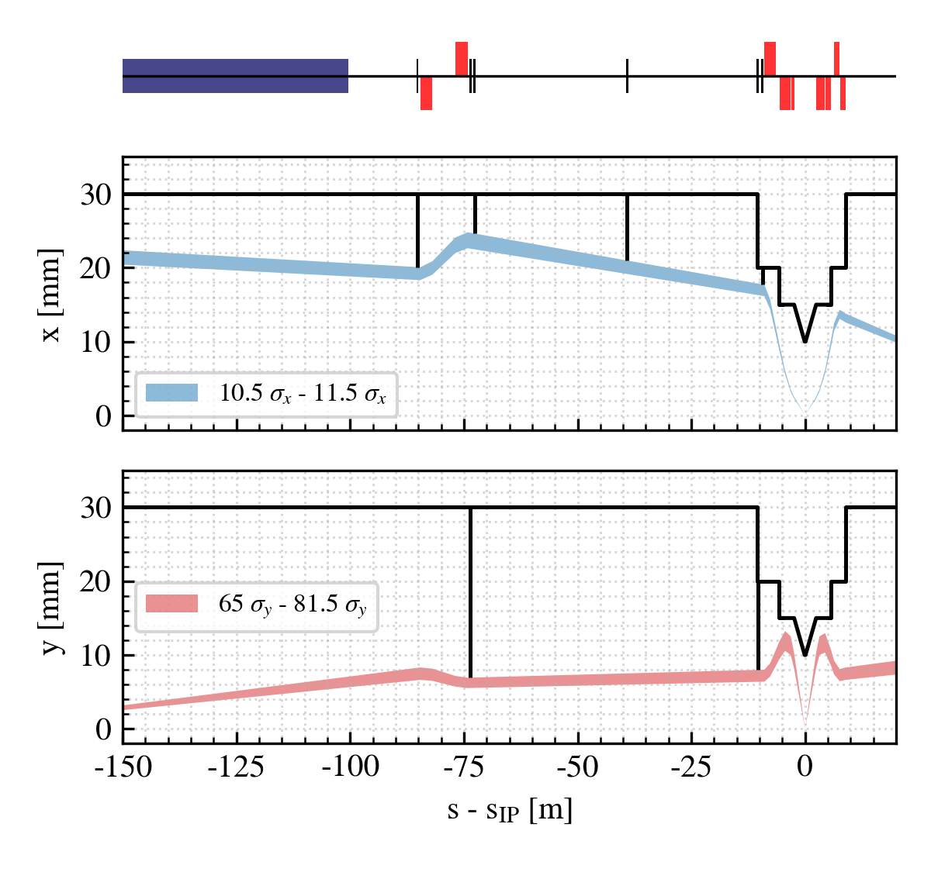
FCC-ee SR collimation system
Beam particles radiate SR photons
SR photons may impact the experimental detectors and cause backgrounds
Synchrotron radiation collimation [9, 10]
6 collimators and 2 masks upstream of the IPs
Designed to reduce SR-induced detector backgrounds and power loads in the inner beampipe
FCC-ee (Z) SR collimators parameters and settings (V25.2 GHC)
Name | Plane | Material | Length [cm] | Gap [σ] | Gap [mm]
TCR.H.WL.B1 | H | W-based | 10 | 11.5 | 20.4
TCR.V.C0.B1 | V | W-based | 10 | 81.5 | 7.1
TCR.H.C0.B1 | H | W-based | 10 | 11.5 | 25.0
TCR.H2.C0.B1 | V | W-based | 10 | 11.5 | 21.3
TCR.V.C2.B1 | V | W-based | 10 | 81.5 | 8.2
TCR.H.C2.B1 | H | W-based | 10 | 11.5 | 18.0
SR collimator apertures = estimated aperture bottlenecks
Courtesy K. Andre, FCC-ee MDI team
12/11/2025
G. Broggi | FCC-ee collimation system design

Slide 11
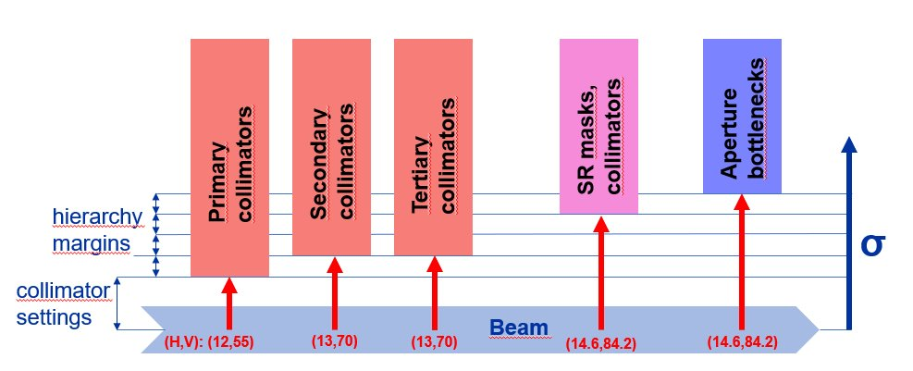
Tertiary collimators
In case of fast loss events SR collimators or even final focus magnets may be exposed to beam losses
SR collimators are not designed to intercept large beam losses: risk of damages/backgrounds
Two (H+V) tertiary collimators (TCTs) for local protection included in the collimation system
Placed upstream of each IP
position optimized for optimal phase-advance (multiple of π) w.r.t.
Further shower absorbers and local protection devices (e.g., injection protection) to be studied in the future by energy deposition, beam transfer and engineering team
SR collimators
aperture bottlenecks
FCC-ee (Z) collimation hierarchy
Hierarchy margins set to 100-300um
~1 σ_{βx}, ~15 σ_{βy}
Name | Plane | Material | Length [cm] | Half-gap [σ] | Half-gap [mm]
TCT.H.B1 | H | C-based | 25 | 10.5 | 2.4
TCT.V.B1 | V | C-based | 25 | 65 | 7.3
12/11/2025
G. Broggi | FCC-ee collimation system design

Slide 12
Outline
Introduction
FCC-ee: the Future Circular electron-positron collider
Collimation for the FCC-ee
FCC-ee collimation system
FCC-ee halo collimation system
FCC-ee SR collimation system
Studies and simulations of beam losses in the FCC-ee
FCC-ee beam loss scenarios
FCC-ee collimation simulations
Simulation tool benchmark at SuperKEKB
FCC-ee collimation performance under selected beam loss scenarios
Generic beam halo, off-momentum, beam-gas, Touschek, beam-beam losses
Generic failure scenario
Crystal collimation for the FCC-ee: an alternative design
Outlook and future work
12/11/2025
G. Broggi | FCC-ee collimation system design

Slide 13
FCC-ee beam loss scenarios
The FCC-ee Z mode is the focus: has the highest stored beam energy 17.7 MJ
Important to identify different beam loss scenarios and define the ones to protect against
Current selection of beam loss scenarios to study and simulate:
Generic beam halo losses
Off-momentum beam halo losses
Beam losses from interactions with residual gas
Beam losses from Touschek scattering
Beam losses from beam-beam interactions
Beam losses from a generic failure scenario
Beam losses due to impedance-driven fast instabilities
Beam losses from top-up injection
Sudden beam losses from beam-dust interactions as observed at SuperKEKB
Beam losses from interactions with thermal photons: future study planned for 2026
Accidental scenarios
Injection failure: work in progress
asynchronous dump, others: waiting for inputs to set up models
In this PhD thesis work
Being studied in parallel
(G. Nigrelli, PhD student XXXIX cycle)
12/11/2025
G. Broggi | FCC-ee collimation system design
Notes:
- Go fast on second part

Slide 14
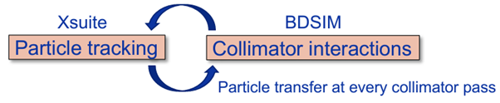
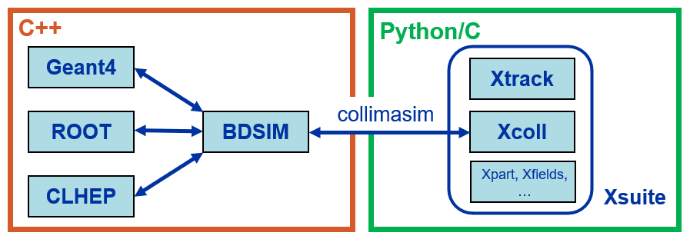
FCC-ee collimation simulations
FCC-ee presents unique challenges for collimation simulations
Synchrotron radiation and magnet strength adjustment (tapering) to compensate it
Complex beam dynamics – strong sextupoles in the lattice and strong beam-beam effects
Detailed aperture and collimator geometry modelling
Electron/positron beam particle-matter interactions
Large accelerator system – 90+ km beamline
Xsuite + BDSIM (Geant4) coupling [11-19]
Developed for FCC collimation simulations
Benchmarked against
Other tools available (e.g., Xsuite-FLUKA coupling)
Simulation routines for specific processes
Beam-residual gas interactions and Touschek scattering
Developed in this work
other simulation codes: MAD-X, pyAT, Sixtrack-FLUKA
measured data from: SPS, LHC, SuperKEKB
12/11/2025
G. Broggi | FCC-ee collimation system design
Notes:
Go fast on first part
Stress when introducing Xsuite-BDSIM that Xsuite provides detailed element-by-element tracking of particles though the electromagnetic fields, and that BDSIM accounts for the full particle-matter interaction in collimators (refer to workflow image)

Slide 15
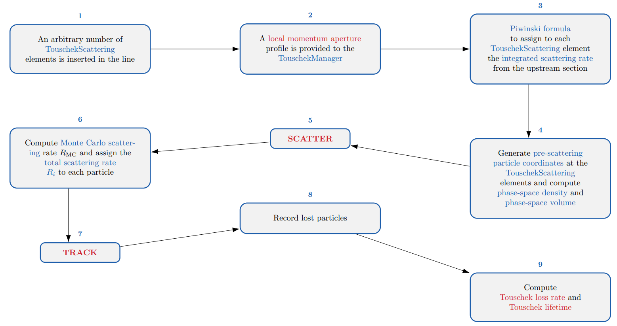
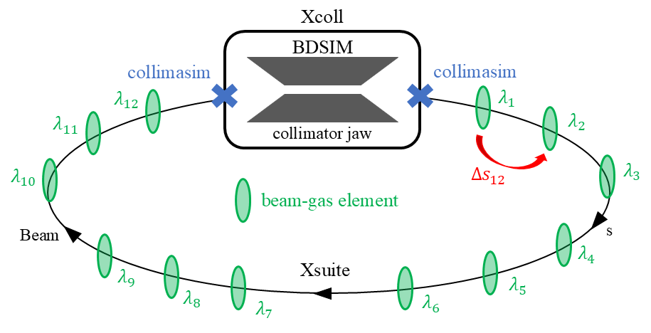
Simulation of beam-gas and Touschek scattering
Beam-gas
Touschek*
A Monte Carlo routine to simulate Touschek scattering in Xsuite has been developed
Follows the Xiao-Borland approach [21, 22] implemented in ELEGANT [23]
Combines Monte Carlo and Piwinski formula [24]
A Monte Carlo routine to simulate beam-gas interactions in Xsuite has been developed [20]
Beam-gas bremsstrahlung interactions
Beam-gas Coulomb scattering interactions
Arbitrary pressure profile and gas composition provided as input
*Touschek scattering refers to intra-bunch Coulomb scattering in which the transfer of transverse to longitudinal momentum causes particles to be lost from the beam.
12/11/2025
G. Broggi | FCC-ee collimation system design
Notes:
- Just mention “simulation of these effects at arbitrary discrete locations along the beamline”.

Slide 16

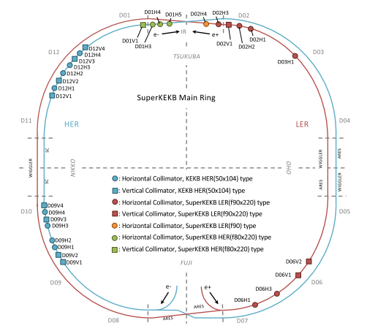
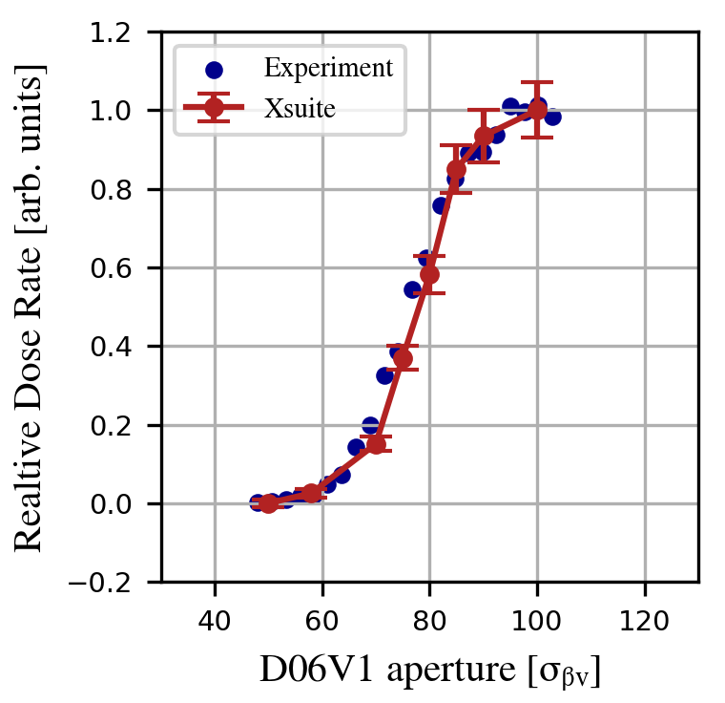
Xsuite-BDSIM benchmark at SuperKEKB
Comparison of Xsuite–BDSIM simulations with measured Belle II backgrounds at SuperKEKB [25]
Carried out during an exchange at KEK (EAJADE programme)
Dedicated single-beam background study at SuperKEKB LER (e+ ring) [26]
D06V1 collimator aperture scan
Radiation dose rates measured by Belle II radiation monitors
SuperKEKB collimator layout as of June 2020
Relative total dose rate for QCS-FW diamond detector vs. D06V1 collimator aperture in units of σβV
Simulations reproduce the measured background trend with excellent accuracy
Validates Xsuite–BDSIM for collimation and background studies in e+e− machines
*background sources included in simulations: beam-gas (Bremsstrahlung, Coulomb) and Touschek scattering
12/11/2025
G. Broggi | FCC-ee collimation system design

Slide 17
Outline
Introduction
FCC-ee: the Future Circular electron-positron collider
Collimation for the FCC-ee
FCC-ee collimation system
FCC-ee halo collimation system
FCC-ee SR collimation system
Studies and simulations of beam losses in the FCC-ee
FCC-ee beam loss scenarios
FCC-ee collimation simulations
Simulation tool benchmark at SuperKEKB
FCC-ee collimation performance under selected beam loss scenarios
Generic beam halo, off-momentum, beam-gas, Touschek, beam-beam losses
Generic failure scenario
Crystal collimation for the FCC-ee: an alternative design
Outlook and future work
12/11/2025
G. Broggi | FCC-ee collimation system design

Slide 18
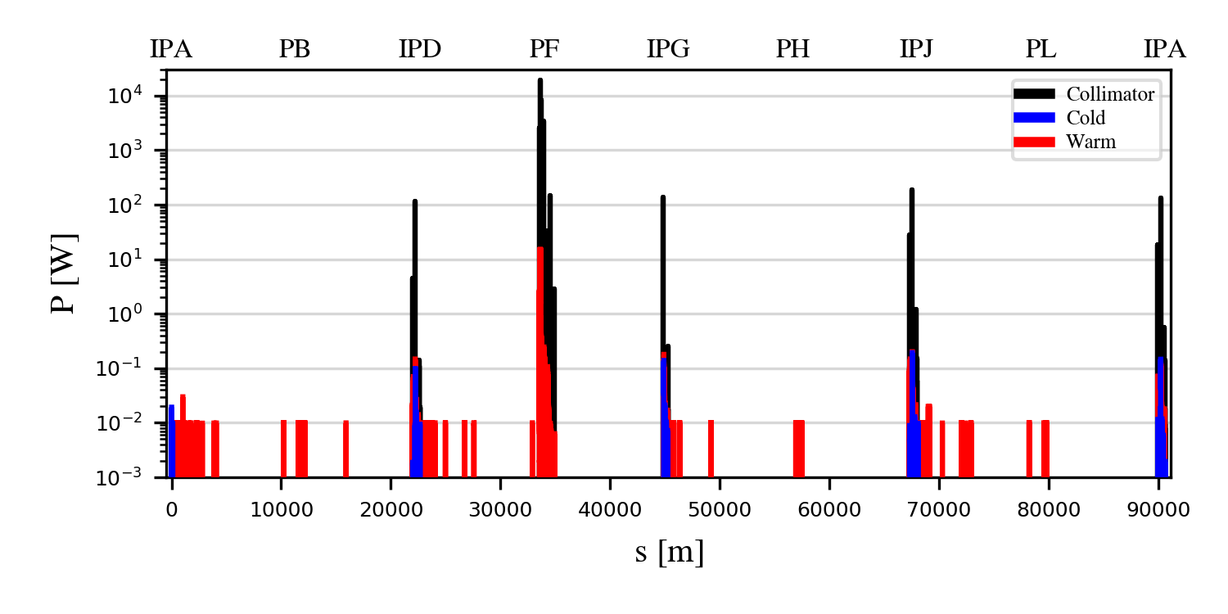
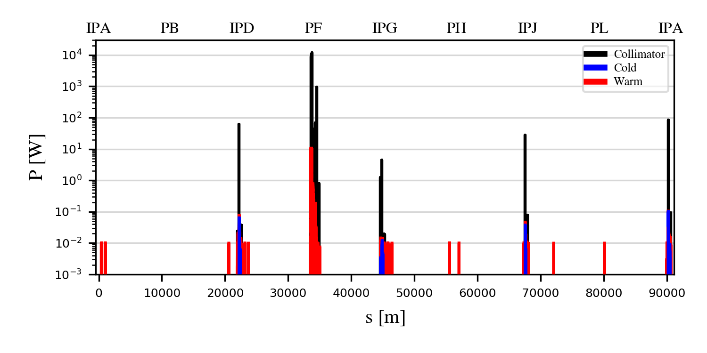
Generic halo losses for the Z mode
Generic halo losses:
Slow loss process assumed*
The loss process itself is not simulated
Beam halo directly impacts one of the primary collimators
Beam lifetime drop to 5 min is assumed
Horizontal and vertical betatron collimation losses (B1H, B1V)
Collimation system effectively localizes generic halo losses and protects sensitive components
Most losses confined within PF collimation insertion for both horizontal and vertical halos.
Loss suppression:
∼2 orders of magnitude on the tertiary collimators
∼4-5 orders of magnitude on the SR collimators
>5 orders of magnitude on all the other elements outside PF
B1H
B1V
*This is strictly valid only if dynamic aperture (DA) is under control w.r.t. TCP gaps: currently, this is not the case for the V-plane
12/11/2025
G. Broggi | FCC-ee collimation system design
Notes:
- Generic halo losses: generic losses on the smallest normalized aperture of the machine (primary coll) as a consequence of a slow loss process

Slide 19
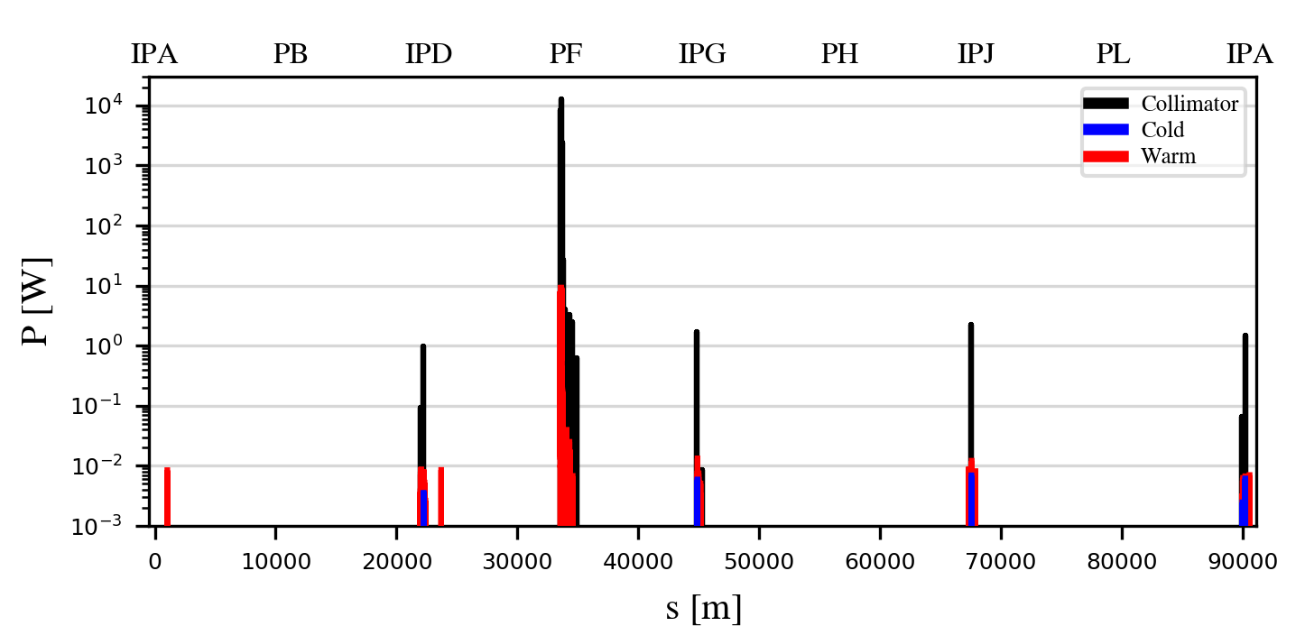
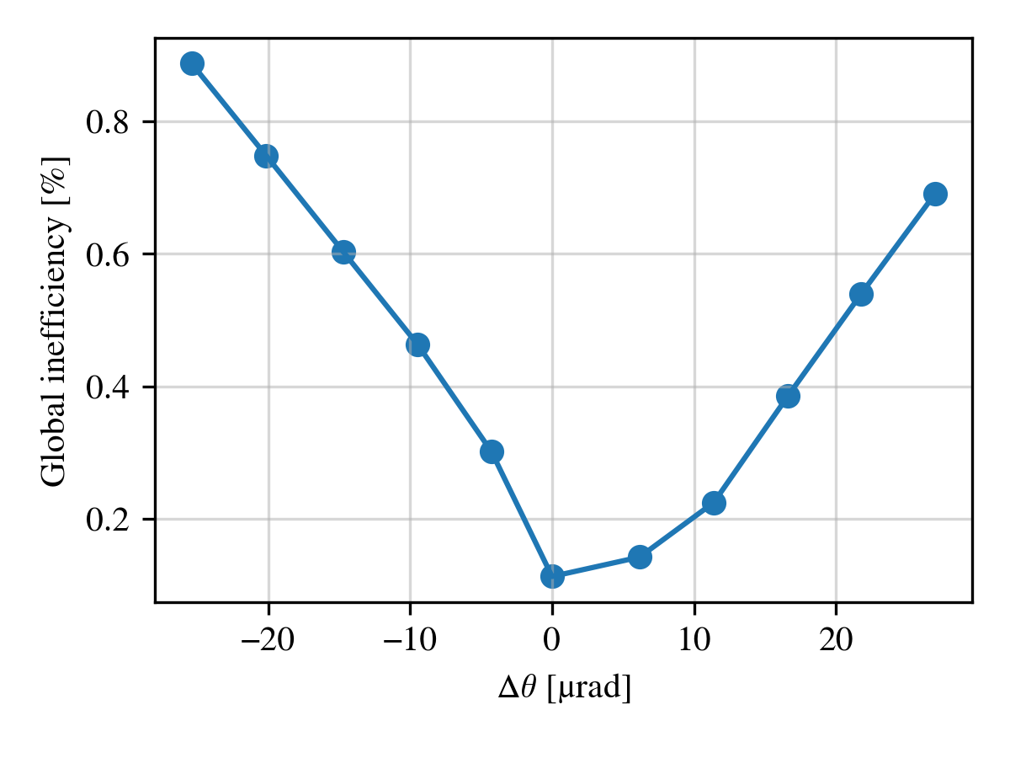
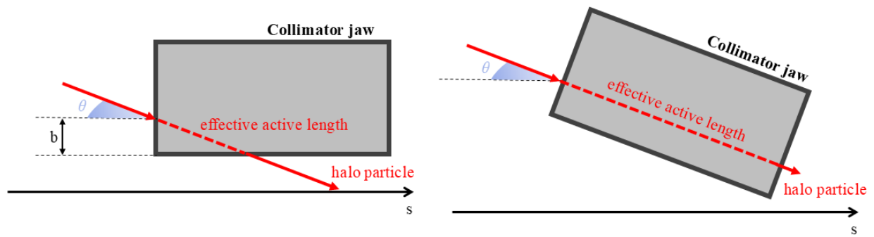

Collimator angular alignment
Collimator angular alignment can significantly improve the collimation performance
B1H
B1H + tilt
$$Global ineff.= \frac{losses outside PF}{total losses}$$
Losses outside of PF are significantly suppressed
Improvement factor ~100
Collimation performance remains robust against angular tilt deviations from the optimal alignment
Important input for hardware design
Mechanical design of FCC-ee collimators updated based on these reuslts
12/11/2025
G. Broggi | FCC-ee collimation system design

Slide 20
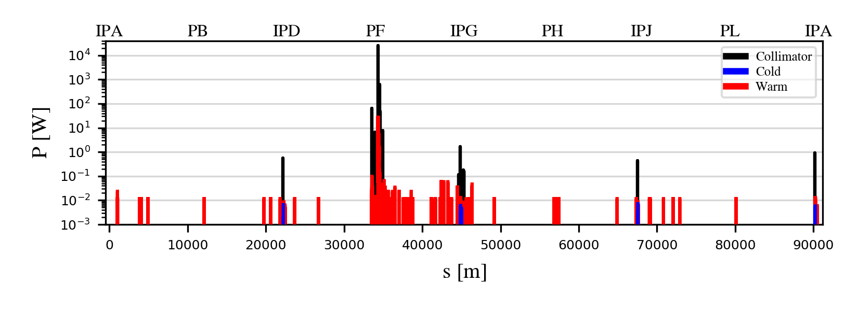
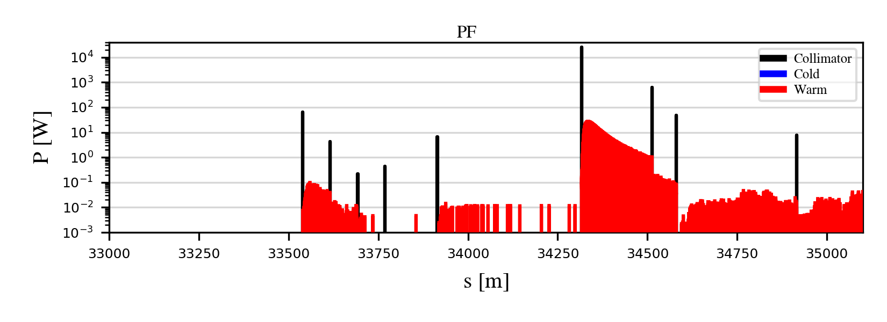
Off-momentum losses for the Z mode
Off-momentum losses
Dedicated RF-sweep simulation progressively shifts the bunch central momentum (Δδmax ≈ –2.6%): simulates slow RF failures or other slow off-momentum loss scenarios
Beam lifetime drop to 5 min is assumed
The FCC-ee collimation system effectively confines off-momentum losses
Losses concentrated in PF collimation insertion — primarily on the off-momentum TCP
Secondary collimators absorb remaining debris; minimal leakage elsewhere
Residual losses at IPs suppressed by ~4 orders of magnitude; negligible losses elsewhere
Performance expected to further improve with optimized collimator jaw tilts
12/11/2025
G. Broggi | FCC-ee collimation system design
Notes:
- Just introduce the RF sweep here, 5 min lifetime normalization introduced before

Slide 21
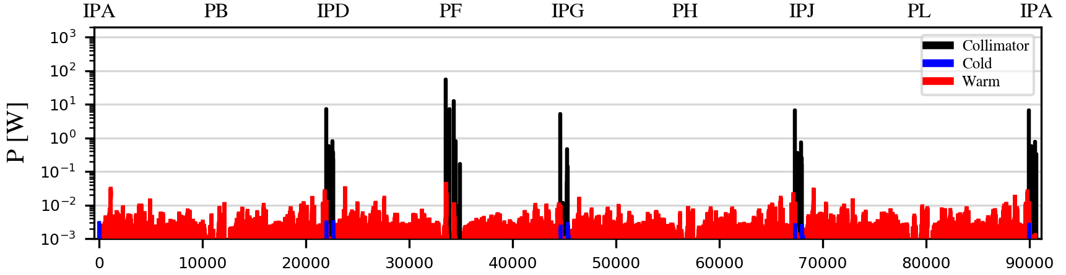
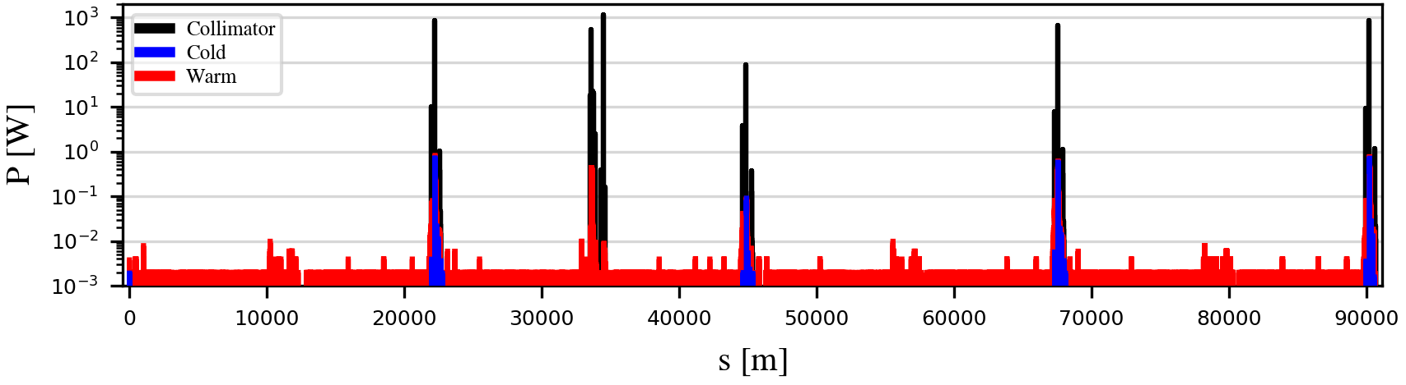
*1h beam conditioning at full nominal current (1.27 A): pressure is expected to condition down further (up to a factor ~100) over time
Beam-gas losses for the Z mode
Using the beam-gas routine developed as a part of this work and based simulated gas pressure profiles
Beam-gas bremsstrahlung
Estimated lifetime after only 1h of beam conditioning*: 274 min
Expected to increase to > 100 h in a fully conditioned machine
Beam-gas Coulomb scattering
Estimated lifetime after only 1h of beam conditioning*: 41 min
Expected to increase to > 10 h in a fully conditioned machine
Beam–residual gas interactions have not been identified as a performance limitation for the FCC-ee, and the FCC-ee collimation system has proven effective in mitigating related beam losses
12/11/2025
G. Broggi | FCC-ee collimation system design

Slide 22
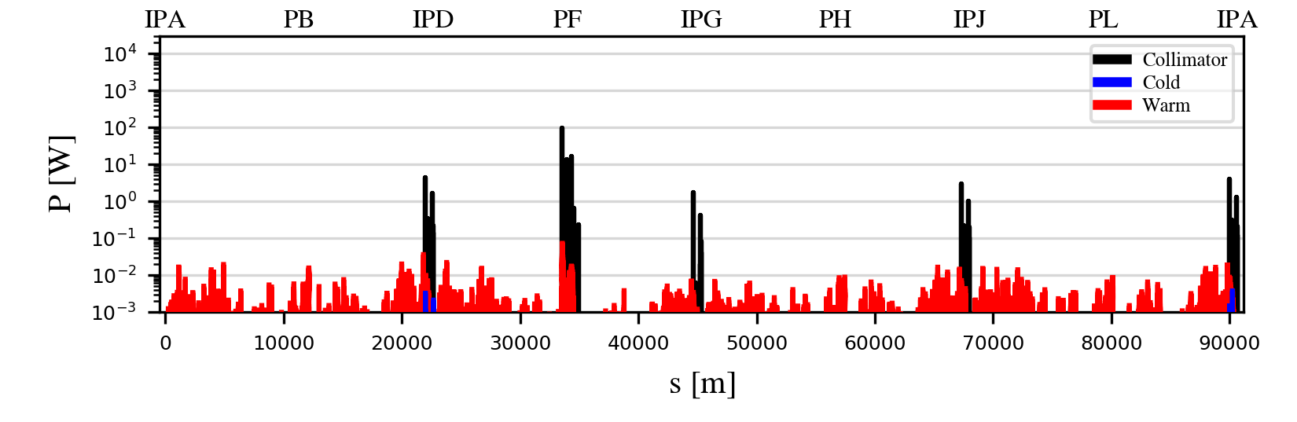
Touschek scattering losses for the Z mode
Using the Touschek scattering routine developed as a part of this work
Touschek lifetime ~13 h
Consistent with prior analytical estimates [27]
Expectation confirmed: Touschek scattering is not a performance-limiting effect in the FCC-ee
Touschek losses well localized in collimation insertion in PF
Mainly on horizontal betatron and off-momentum TCP
Minimal leakage to the experimental IRs
Modest loads on tertiary and SR collimators
No significant loads on superconducting magnets
Process | Beam Lifetime
Touschek scattering | 13 h
Radiative Bhabha scattering | 22 min
Lattice (quantum + BS* + lattice) | 83 min
Beam-gas (1 h conditioning) | 36 min
Beam-gas (conditioned machine) | > 10 h
*beamstrahlung
12/11/2025
G. Broggi | FCC-ee collimation system design
Notes:
- Mention lifetime at last, this nicely introduce next slide

Slide 23
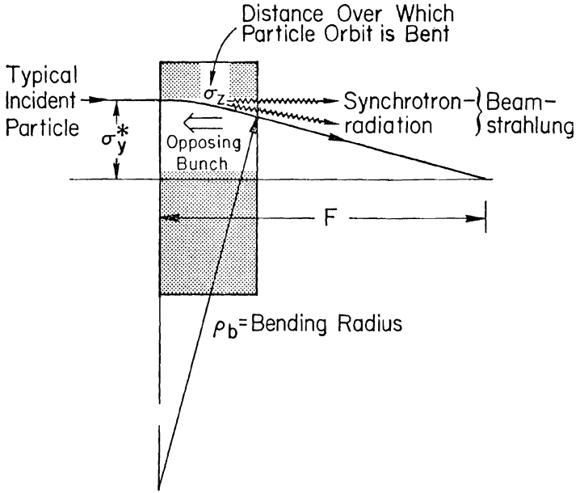
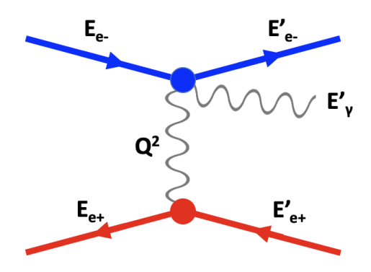
FCC-ee Z beam-beam losses
Interactions at the IPs have a crucial role on the FCC-ee beam dynamics
Beamstrahlung (BS), radiative Bhabha scattering (RBS), beam-beam kicks
Main contribution to the beam lifetime in nominal operation
Can produce distinct beam loss distributions around the ring
These effects are modeled in Xsuite (Xfields)
Can be integrated in Xsuite-BDSIM collimation tracking simulations
Schematic illustration of Bhabha scattering (electron-positron scattering) [29]
The scattering particles exchange a virtual photon. The process can occasionally result in the emission of extra real photons, in which case the process takes the name radiative Bhabha scattering.
Schematic illustration of beamstrahlung [28]: an incoming bunch emits beamstrahlung radiation because of the electromagnetic field of the opposing bunch
12/11/2025
G. Broggi | FCC-ee collimation system design

Slide 24
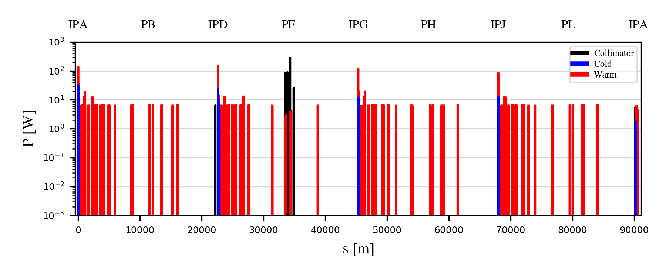
*quantum + lattice + BS + lum.
Beam-beam losses for the Z mode
Xsuite allows to set-up complex combined-effects simulations: beam-beam + collimation
Beam-beam kicks, radiative Bhabha, beamstrahlung in 4 IPs + detailed aperture and collimator model
Beam lifetime*: ~14 min vs. ~17 min estimated without aperture and collimators and without beam-size effect
Primary collimator gaps: 9.5σ (H plane), 50σ (V plane)
(Long-range) beam-beam losses intercepted by the collimation system in PF
Local beam-beam losses downstream of the IPs unavoidably present
Originate from hard RBS events
Tungsten shielding (few-mm) in SC quads: already proposed by CERN SY-STI group [30]
Additional collision debris collimators to be studied in the future
12/11/2025
G. Broggi | FCC-ee collimation system design

Slide 25
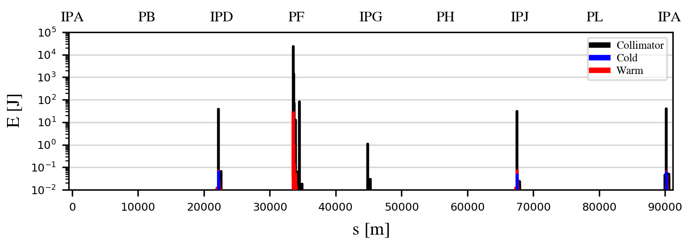
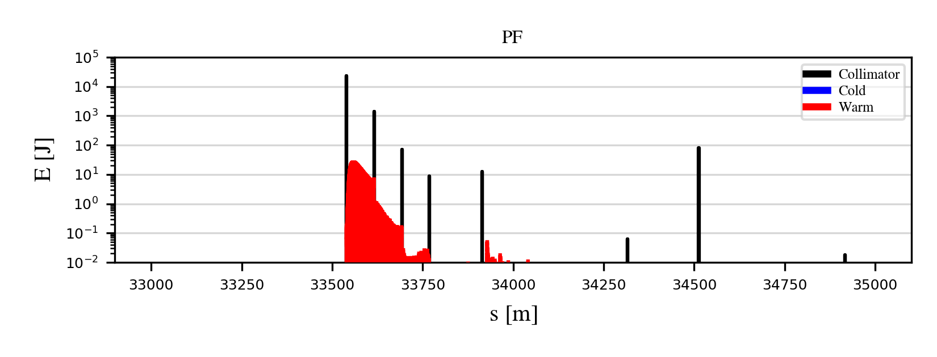
Generic failure: deep impact at TCP.H.B1 (Z mode)
Gaussian bunch directly hits TCP.H.B1 at 1σₓ (fast-failure proxy)
Result scaled to 40 bunches impacting TCP.H.B1 (estimated damage threshold for TCPs) [31]
Losses remain confined in PF and the impacted TCP is the only potentially vulnerable device
The collimation system shows robust protection under these failure-like conditions*
Beam pipe in PF: ~100 J/m far below a conservative ~70 kJ/m Cu melting threshold [32]
To reach Cu melt in these conditions would require ~×350 higher pipe load → ~14000 deep-impact bunches (higher than stored 12000 stored bunches)
*Dedicated modeling of specific failure scenario is nevertheless required
12/11/2025
G. Broggi | FCC-ee collimation system design

Slide 26
Outline
Introduction
FCC-ee: the Future Circular electron-positron collider
Collimation for the FCC-ee
FCC-ee collimation system
FCC-ee halo collimation system
FCC-ee SR collimation system
Studies and simulations of beam losses in the FCC-ee
FCC-ee beam loss scenarios
FCC-ee collimation simulations
Simulation tool benchmark at SuperKEKB
FCC-ee collimation performance under selected beam loss scenarios
Generic beam halo, off-momentum, beam-gas, Touschek, beam-beam losses
Generic failure scenario
Crystal collimation for the FCC-ee: an alternative design
Outlook and future work
12/11/2025
G. Broggi | FCC-ee collimation system design

Slide 27
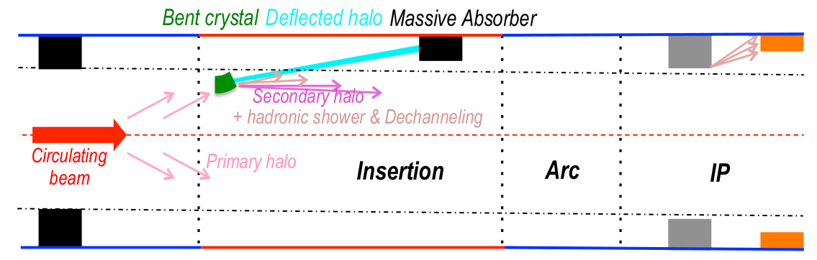
Crystal collimation for the FCC-ee
As an alternative to the baseline design relying on amorphous collimators, crystal collimation was also explored:
Impedance
Short (sub-mm) bent crystals in place of tens of cm long amorphous primary collimators
Potentially larger absorber (secondary collimator) mechanical gaps
Power deposition on collimators
Short (sub-mm) bent crystals in place of tens of cm long amorphous primary collimators
Potentially increase beam halo spot size at the absorbers employing bent crystals
Power deposition on absorber could still be challenging
Cleaning efficiency
Angular deflection by bent crystals increases the impact parameter of beam halo particles on the absorbers (secondary collimators)
Working principle of a crystal collimation system [33]
12/11/2025
G. Broggi | FCC-ee collimation system design

Slide 28
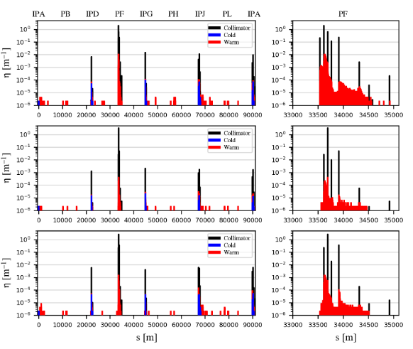
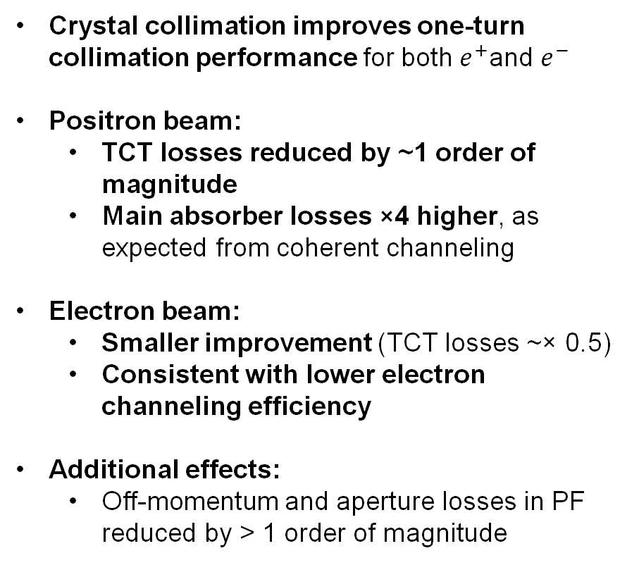
FCC-ee Z one-turn crystal collimation performance
Replacement of 25 cm C-based primary collimators with 100-200 μm bent Si crystals (100 μrad bending angle)
Generic beam halo impacting the horizontal betatron TCP (standard or crystal)
Crystal collimation improves one-turn collimation performance for both $e^{+}$and $e^{−}$
Positron beam:
TCT losses reduced by ~1 order of magnitude
Main absorber losses ×4 higher, as expected from coherent channeling
Electron beam:
Smaller improvement (TCT losses ~× 0.5)
Consistent with lower electron channeling efficiency
Additional effects:
Off-momentum and aperture losses in PF reduced by > 1 order of magnitude
standard
crystal e+
crystal e-
12/11/2025
G. Broggi | FCC-ee collimation system design

Slide 29
Outline
Introduction
FCC-ee: the Future Circular electron-positron collider
Collimation for the FCC-ee
FCC-ee collimation system
FCC-ee halo collimation system
FCC-ee SR collimation system
Studies and simulations of beam losses in the FCC-ee
FCC-ee beam loss scenarios
FCC-ee collimation simulations
Simulation tool benchmark at SuperKEKB
FCC-ee collimation performance under selected beam loss scenarios
Generic beam halo, off-momentum, beam-gas, Touschek, beam-beam losses
Generic failure scenario
Crystal collimation for the FCC-ee: an alternative design
Outlook and future work
12/11/2025
G. Broggi | FCC-ee collimation system design

Slide 30
Outlook
A beam collimation system for the FCC-ee has been designed
Multi-stage betatron and off-momentum collimation + local protection in sensitive regions
Monte Carlo simulation routines for beam-gas and Touschek scattering have been developed
FCC-ee collimation performance evaluated through an extensive campaign of complex simulations
Based on the Xsuite-BDSIM simulation tool
Focus on the most challenging Z operation mode (17.7 MJ stored beam energy)
No show-stoppers identified - the proposed collimation system provides
Effective loss localization in dedicated regions
Strong suppression of losses in experimental interaction regions
Robust protection under both steady-state and failure-like conditions
First validation of Xsuite-BDSIM and of the beam-gas and Touschek routines against measured data from an electron-positron collider
Excellent agreement between measured and simulated backgrounds at SuperKEKB
Exploratory crystal-collimation studies show promising performance gain
Crystal collimation identified as a potential upgrade path for the FCC-ee collimation system
12/11/2025
G. Broggi | FCC-ee collimation system design

Slide 31
Future work
Extend collimation performance evaluation to all FCC-ee operation modes
Z, W, H, ttbar
Extend the studies to alternative optics design (e.g., Local Chromatic Correction design)
Investigate additional beam loss mechanisms, both regular and accidental
Thermal photon scattering, beam-dust interactions, equipment failures, others
Quantify loss tolerances for critical components (e.g., detectors, superconducting magnets)
Continued iterative studies including
Energy deposition, radiation and activation, impedance and engineering aspects
Explore alternative collimation strategies
Crystal collimation, nonlinear collimation
Converge on a fully-optimized design for the upcoming FCC-ee technical design phase
12/11/2025
G. Broggi | FCC-ee collimation system design

Slide 32
Thank you!
12/11/2025
G. Broggi | FCC-ee collimation system design

Slide 33
References
[1] A. Abada et al. (FCC Collaboration), "FCC-ee: The Lepton Collider," *Eur. Phys. J. Spec. Top.*, vol. 228, no. 2, pp. 261–623, 2019.
[2] M. Benedikt, F. Zimmermann, B. Auchmann, W. Bartmann, J.-P. Burnet, C. Carli, A. Chancé, P. Craievich, M. Giovannozzi, C. Grojean, J. Gutleber, K. Hanke, A. Henriques, P. Janot, C. Lourenço, M. Mangano, T. Otto, J. Poole, S. Rajagopalan, T. Raubenheimer, E. Todesco, L. Ulrici, and T. Watson, G. Wilkinson (editors), Future Circular Collider Feasibility Study Report, Volume 2, CERN, Geneva, Switzerland, 2025, CERN-FCC-ACC-2025-0004.
[3] A. Lechner, "Beam losses and damage potential of the FCC-ee beams," presented at the 2nd FCC-ee Machine Protection Task Force Meeting, CERN, Prévessin-Moëns, France, May 2024.
[4] S. Terui, Low-Z collimator for SuperKEKB, Nucl. Instrum. Methods. Phys. Res. A, vol. 1047, 2023.
[5] K. Oide, "GHC Optics: Smaller βx* / Technical Insertion," presented at the 206th FCC-ee Accelerator Design Meeting, April 2025.
[6] D. Gibellieri, "Impact of Collimators' Geometric Impedance on Beam Stability in the FCC-ee: Analysis and Optimization Techniques," presented at FCC Week 2025, Vienna, Austria, May 2025.
[7] G. Broggi, A. Abramov, M. Boscolo, R. Bruce, D. Mirarchi, and S. Redaelli, "First studies of crystal collimation for the FCC-ee," Nucl. Instrum. Methods Phys. Res. A, vol. 1076, p. 170479, 2025.
[8] S. Marin et al., "Power deposition studies for the FCC-ee halo collimation system," in Proc. IPAC'25, Taipei, Taiwan, pp. 486–489, June 2025, JACoW Publishing, Geneva, Switzerland.
[9] K. Andre, "Synchrotron radiation backgrounds," presented at the 8th FCC Physics Workshop, CERN, Meyrin, Switzerland, January 2025.
12/11/2025
G. Broggi | FCC-ee collimation system design

Slide 34
References
[10] M. Boscolo, F. Palla, G. Ammirabile, K. D. J. Andre, G. Baldinelli, P. B. de Sousa, F. Bosi, G. Broggi, R. Bruce, H. Burkhardt, S. Candido, M. Calviani, A. Ciarma, M. Dam, B. François, R. F. Ximenes, F. Fransesini, A. Frasca, A. Gaddi, A. Ilg, R. Kieffer, M. Koratzinos, S. Lauciani, A. Lechner, G. Lerner, G. Nigrelli, A. Novokhatski, K. Oide, A. Perillo Marcone, B. Parker, P. Raimondi, J. T. Seeman, C. Turrioni, L. Watrelot, and F. Zimmermann, "Status of the FCC-ee interaction region design," EPJ Tech. Instrum., vol. 12, no. 1, p. 4, 2025, doi:10.1140/epjti/s40485-025-00117-3.
[11] A. Abramov et al., Collimation simulations for the FCC-ee, JINST, vol. 19, p. T022004, 2024.
[12] G. Iadarola et al., Xsuite: An Integrated Beam Physics Simulation Framework, in Proc. HB’23, Geneva, Switzerland, Oct. 2023, paper TUA2I1.
[13] L. Nevay et al., BDSIM: An accelerator tracking code with particle-matter interactions, Comput. Phys. Commun., vol. 252, p. 107200, 2020.
[14] L. Nevay et al., BDSIM: Automatic Geant4 Models of Accelerators, in Proc. ICFA Mini-Workshop on Tracking for Collimation, CERN, Geneva, Switzerland, p. 45, 2018.
[15] J. Allison et al., Recent development in Geant4, Nucl. Instrum. Method. Phys. Res. B, vol. 835, pp. 186-225, 2016.
[16] S. Agostinelli et al., Geant4 – a simulation toolkit, Nucl. Instrum. Method. Phys. Res. A, vol. 506, pp. 250-303, 2003.
[17] J. Allison et al., Geant4 developments and applications, IEEE Trans. Nucl. Sci., vol. 53, pp. 270-278, 2006.
[18] A. Abramov et al., Development of collimation simulations for the FCC-ee, in Proc. IPAC’22, Bangkok, Thailand, June 2022, paper WEPOST016, pp. 1718-1721.
12/11/2025
G. Broggi | FCC-ee collimation system design

Slide 35
References
[19] B. Lindström et al., "Xcoll–BDSIM coupling for beam collimation," in Proc. IPAC'25, Taipei, Taiwan, pp. 653–656, June 2025, JACoW Publishing, Geneva, Switzerland.
[20] G. Broggi et al., "Beam losses due to beam–residual gas interactions in the FCC-ee," in Proc. IPAC'25, Taipei, Taiwan, pp. 383–386, June 2025, JACoW Publishing, Geneva, Switzerland.
[21] A. Xiao and M. Borland, "Monte Carlo simulation of the Touschek effect," Phys. Rev. Spec. Top. Accel. Beams, vol. 13, no. 7, p. 074201, 2010.
[22] A. Xiao and M. Borland, "Monte Carlo simulation of Touschek effects in a linac beam," in Proc. LINAC'08, Victoria, BC, Canada, pp. 293–295, 2008, TRIUMF, Vancouver, Canada.
[23] M. Borland, ELEGANT: A flexible SDDS-compliant code for accelerator simulation, Argonne National Laboratory, IL, USA, Aug. 2000.
[24] A. Piwinski, The Touschek effect in strong focussing rings, Deutsches Elektronen-Synchrotron (DESY), Tech. Rep. DESY 98-179, 1998.
[25] G. Broggi et al., "Comparison of Xsuite simulations with measured backgrounds at SuperKEKB," in Proc. IPAC'25, Taipei, Taiwan, pp. 379–382, June 2025, JACoW Publishing, Geneva, Switzerland.
[26] A. Natochii, S. E. Vahsen, H. Nakayama, T. Ishibashi, and S. Terui, "Improved simulation of beam backgrounds and collimation at SuperKEKB," Phys. Rev. Accel. Beams, vol. 24, no. 8, p. 081001, 2021.
[27] M. Boscolo, "Overview of MDI issues toward the TDR," presented at FCC Week 2019, Brussels, Belgium, June 2019.
[28] J. E. Augustin et al., Limitations on performance of e+e- storage rings and linear colliding beam systems at high energy, SLAC report.​
12/11/2025
G. Broggi | FCC-ee collimation system design

Slide 36
References
[29] P. Kicsiny et al., Benchmark and performance of beam-beam interaction models for Xsuite, in Proc. IPAC’23, Venice, Italy, May 2023, paper MOPL063, pp. 686-689.​​
[30] A. Frasca et al., "Radiation load from radiative Bhabha scattering in the FCC-ee experimental insertions," in Proc. IPAC'25, Taipei, Taiwan, pp. 478–481, June 2025, JACoW Publishing, Geneva, Switzerland.​
[31] S. Marin and A. Lechner, "Material effects on maximum beam loss on collimators," presented at the FCC-ee Collimation Meeting, CERN, Meyrin, Switzerland, November 2024.​
[32] A. Lechner, private communication, 2025.​​
[33] D. Mirarchi, "Crystal collimation for the LHC", PhD thesis, Imperial College London, 2015, CERN-ACC-2015-0143.
12/11/2025
G. Broggi | FCC-ee collimation system design

Slide 37
Backup
12/11/2025
G. Broggi | FCC-ee collimation system design

Slide 38
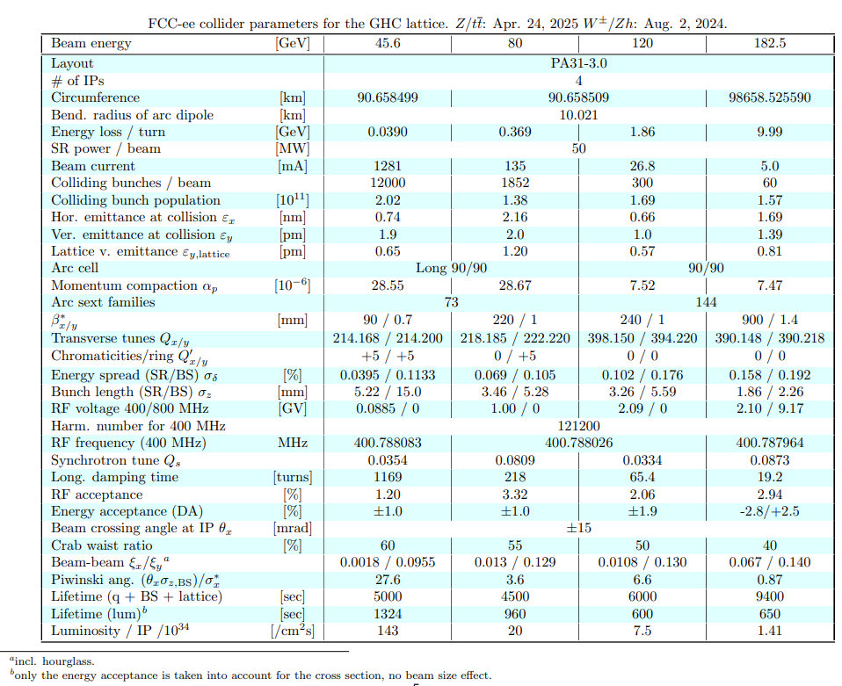
FCC-ee V25.2 GHC collider parameters
12/11/2025
G. Broggi | FCC-ee collimation system design

Slide 39
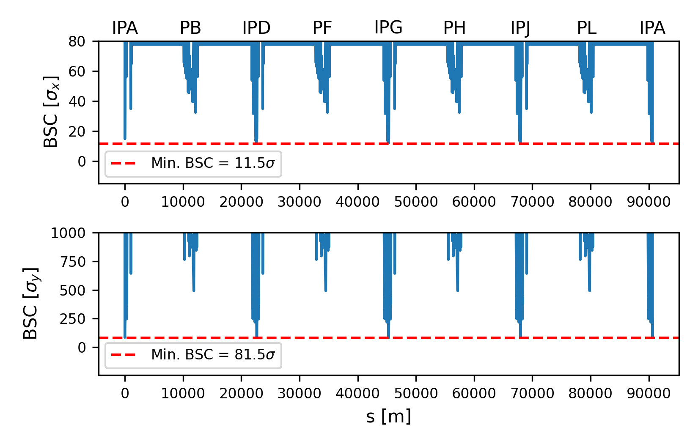
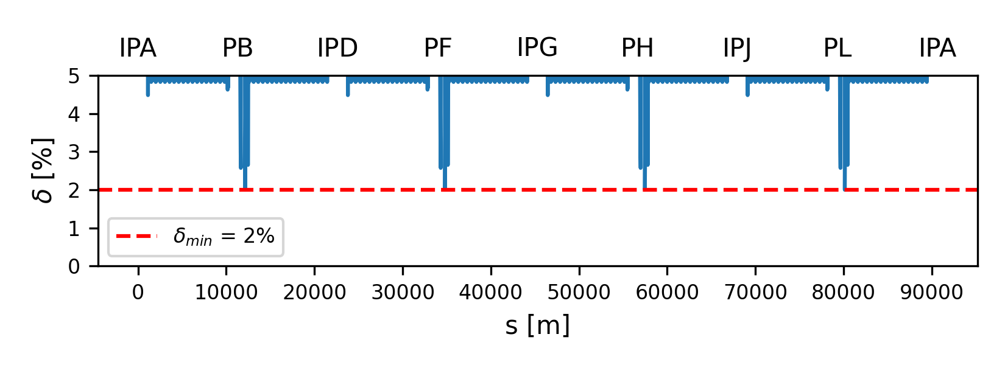
FCC-ee aperture
Closed orbit tolerance: 250 μm
Maximum beta-beating: 20%
The Beam-Stay-Clear (BSC) is the beam-to-aperture distance in units of beam size
The linear momentum acceptance is δ=A/D_{x}, where A is the mechanical aperture and D_{x} is the dispersion
12/11/2025
G. Broggi | FCC-ee collimation system design

Slide 40
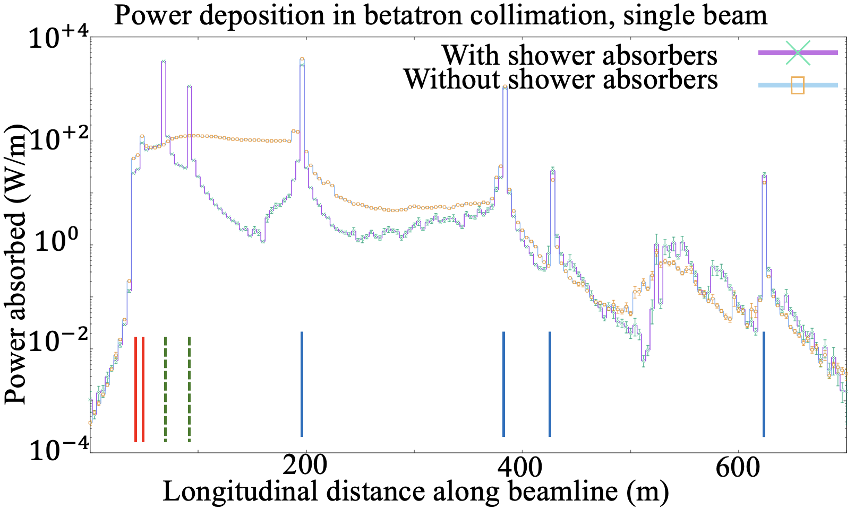
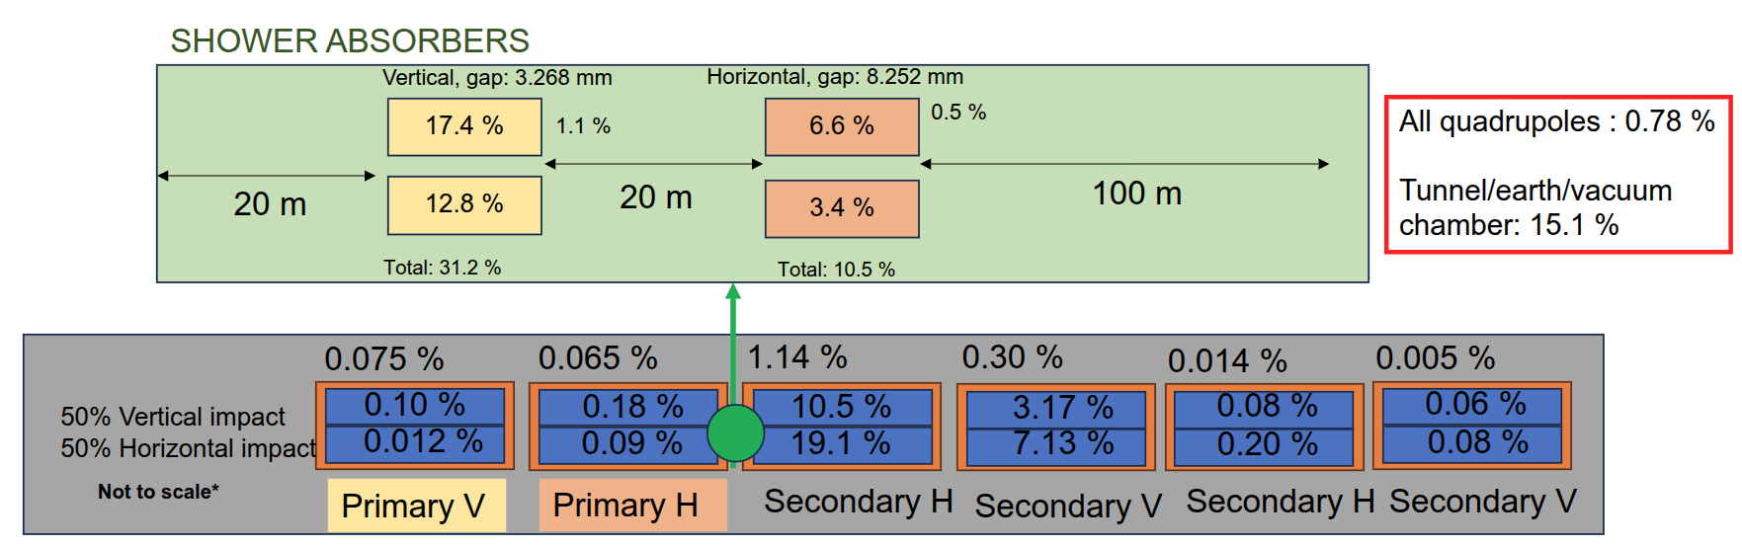
Shower absorbers
Courtesy S. Marin, A. Lechner
Collimators are not perfectly absorbing the incoming energy
Particle showers typically leak out and irradiate nearby elements
The use of a few (~2 per beam) strategically placed shower absorbers can reduce the fraction of the power absorbed by vacuum chamber, tunnel, and environment [8]
From ~50 %, close to the LHC values, to ~15 %
Quadrupole magnets receive a small fraction of power, even w/o absorbers.
12/11/2025
G. Broggi | FCC-ee collimation system design

Slide 41
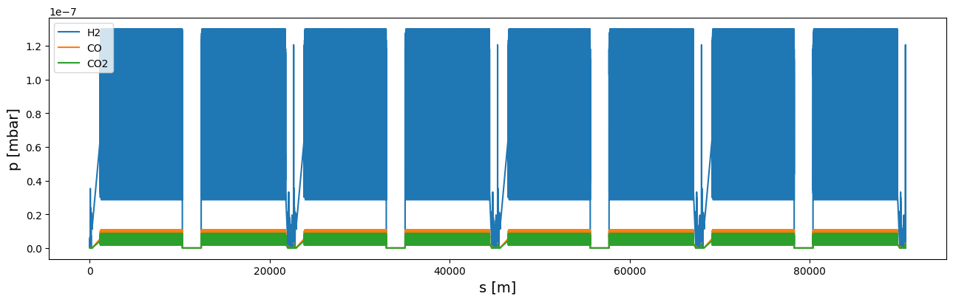
FCC-ee Z full ring pressure profile
*1h beam conditioning at full nominal current (1.27 A): pressure is expected to condition down further over time
Pressure profile for an arc section and for the MDI region provided by the vacuum team (R. Kersevan)*
Gas species and composition: 85% H₂, 10% CO and 5% CO₂
Arc section pressure profile repeated multiple times to cover the whole arc length
Because of the absence of dipoles generating SR the pressure in the straight sections is much lower compared to the pressure in the MDI and in the arcs
Arc pressure profile merged with the MDI and straight section pressure profiles to get a full ring pressure profile
13/06/2024
G. Broggi | FCC-ee beam-gas beam losses
Notes:
5°-10 in long straight sections
100^0.67

Slide 42
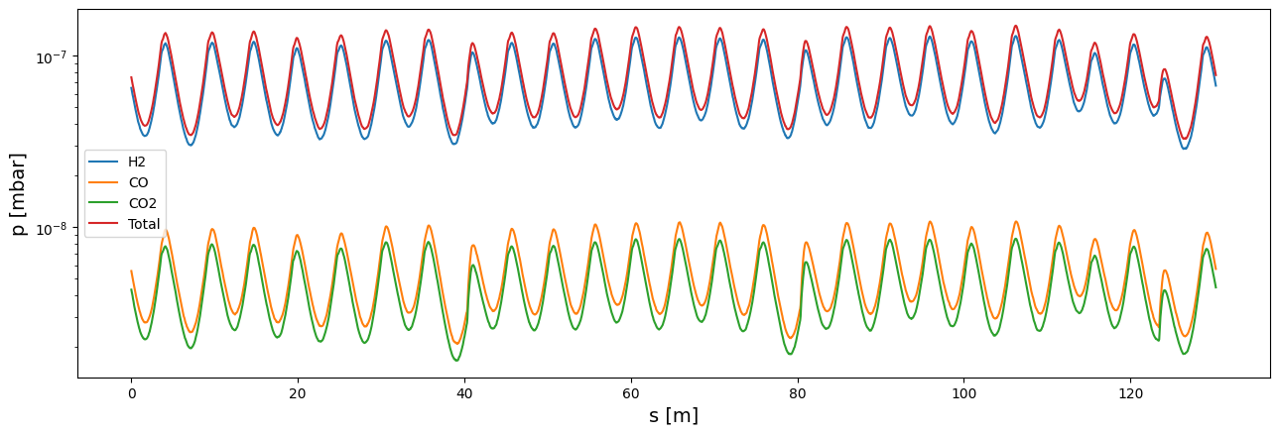
Arc pressure profile in the FCC-ee
Provided by the vacuum team (R. Kersevan)
FCC-ee (Z mode) – beam 1 (B1): 45.6 GeV positron beam, 1270 mA current
Gas species and composition: 85% H₂, 10% CO and 5% CO₂
Pressure profiles for 1h beam conditioning at full nominal current
13/06/2024
G. Broggi | FCC-ee beam-gas beam losses

Slide 43
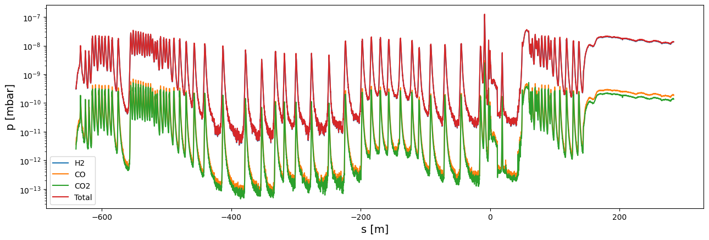
MDI pressure profile in the FCC-ee
Provided by the vacuum team (R. Kersevan)
FCC-ee (Z mode) – beam 1 (B1): 45.6 GeV positron beam, 1270 mA current
Gas species and composition: 85% H₂, 10% CO and 5% CO₂
Pressure profiles for 1h beam conditioning at full nominal current
IP
13/06/2024
G. Broggi | FCC-ee beam-gas beam losses

Slide 44
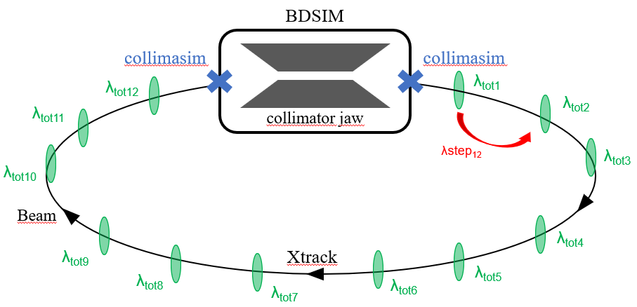
Simulation workflow
Xsuite-BDSIM simulation tool with addition of arbitrary number of beam-gas elements (based on local gas parameters from FCC-ee full ring pressure profile)
beam-gas element
At each beam-gas element
The mean free path is computed from cross sections and local gas densities
Random number compared to mean free path to determine if beam-gas interaction takes place
If interaction takes place, further sampling of which gas species and which interaction type
Kicks in angle and energy from the relevant physics model (differential cross section)
13/06/2024
G. Broggi | FCC-ee beam-gas beam losses

Slide 45
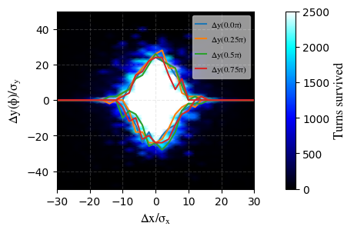
Beam-gas losses for the Z mode
Vertical DA in the FCC-ee Z-mode lattice is limited to ~25σ
Beam is highly sensitive to vertical angular kicks
Typical vertical divergence (arcs): σₚᵧ ≈ 0.3 μrad
A 10 μrad vertical kick → >25 σₚᵧ → particle loss
Sensitivity increases near IPs
βᵧ reaches several km → σₚᵧ further reduced
Even smaller kicks can cause losses
Horizontal sensitivity is lower
σₚₓ ≫ σₚᵧ (due to much larger εₓ and lower IR-βₓ )
Same kick → smaller normalized deflection
Horizontal DA ≈ vertical DA
Bremsstrahlung losses more sensitive to momentum acceptance
Caused by photon emission → off-momentum particles
Despite this, beam–residual gas interactions have not been identified as a performance limitation for the FCC-ee, and the FCC-ee collimation system has proven effective in mitigating related beam losses
FCC-ee Z V25.2 GHC XY-DA
The Dynamic Aperture (DA) defines the region in phase space where particle motion remains stable and can be well described by linear optics.
12/11/2025
G. Broggi | FCC-ee collimation system design

Slide 46
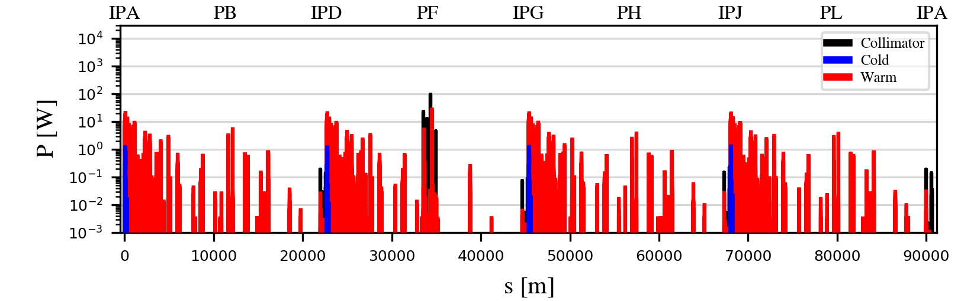
Beam-beam losses for the Z mode
Improved statistical sampling of radiative Bhabha scattering losses
Artificially increased RBS rate: large sample of post-RBS trajectories
Resulting beam loss pattern normalized to RBS lifetime (22 min – total power loss 13 kW)
RBS losses localized in the PF collimation insertion and downstream of the IPs
Horizontal betatron and off-momentum TCPs intercept surviving RBS debris
Unavoidable local losses on downstream final-focus quads & crab sextupoles
Tungsten shielding (few-mm) in SC quads: already proposed by CERN SY-STI group [30]
Additional collision debris collimators to be studied in the future
12/11/2025
G. Broggi | FCC-ee collimation system design

Slide 47
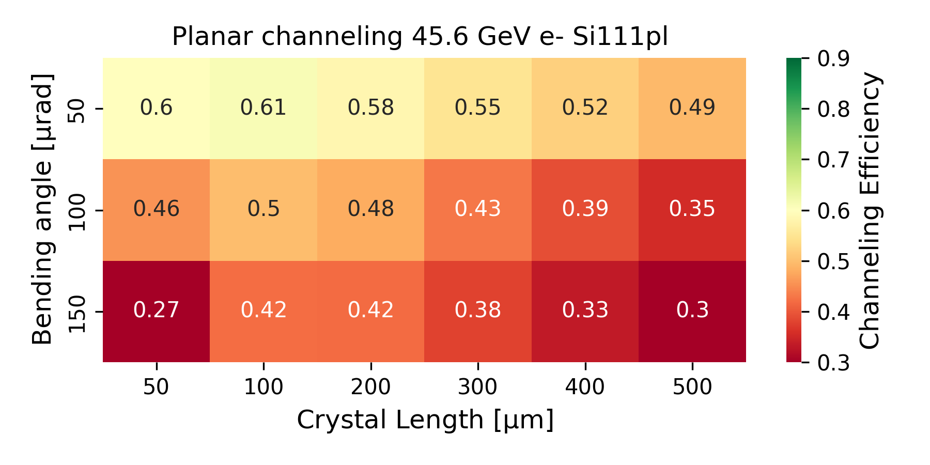
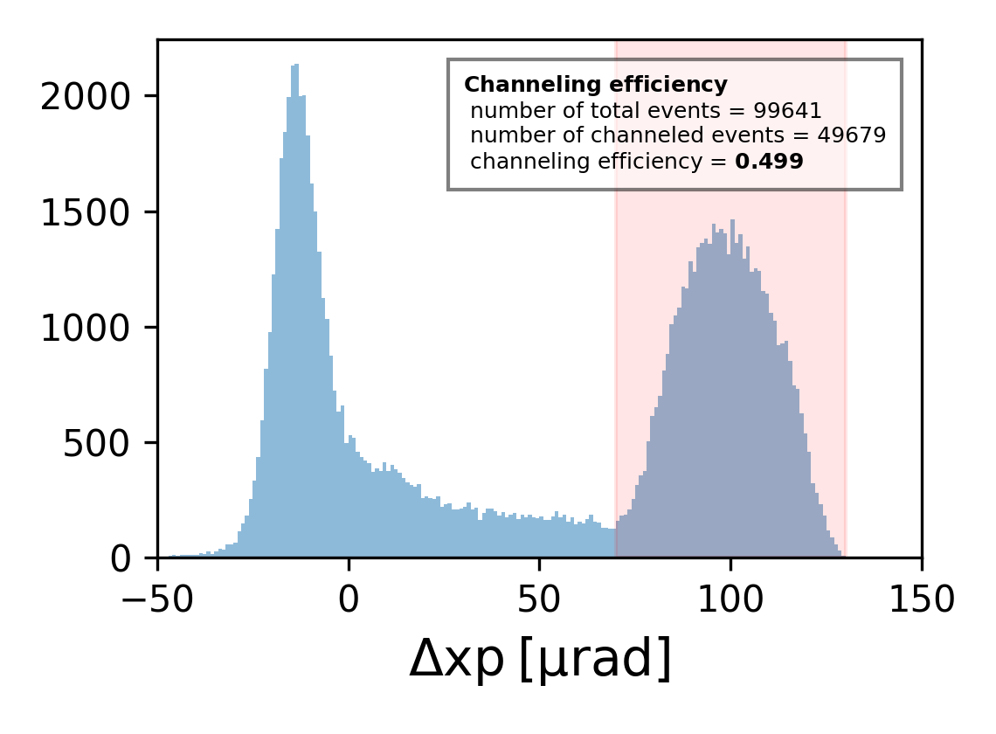
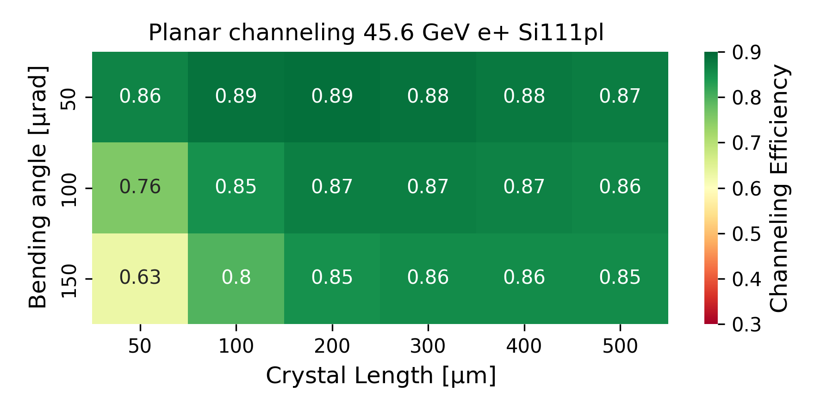
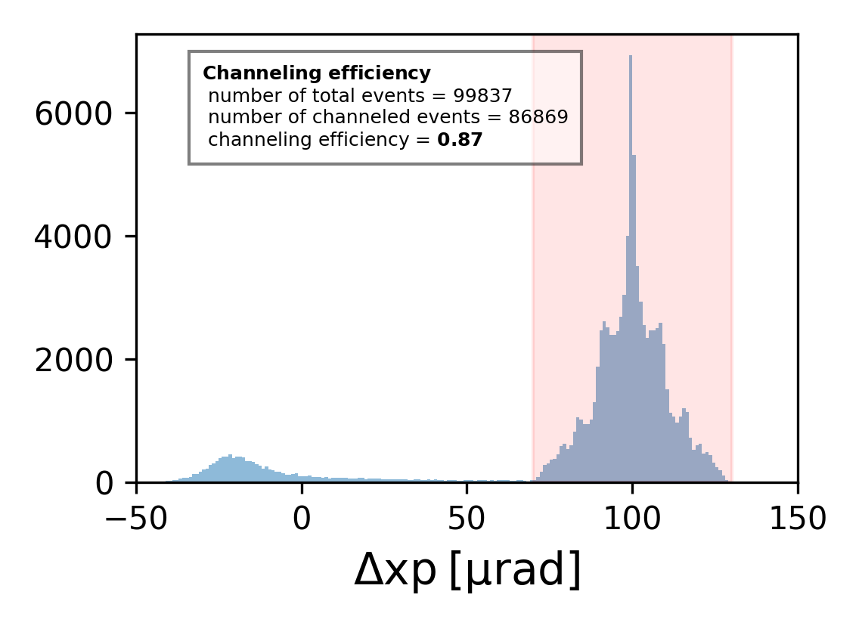
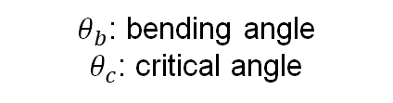
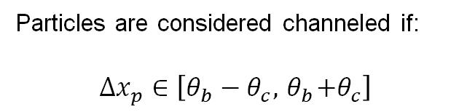
Particles are considered channeled if:
$$∆x_{p}∈\left[θ_{b}−θ_{c},{ θ}_{b}+θ_{c}\right]$$
Channeling efficiency
$θ_{b}$: bending angle
$θ_{c}$: critical angle
Deflection of 100 μrad of 45.6 GeV e- using the Si (111) planar potential of a 100 μm long Si crystal.
Deflection of 100 μrad of 45.6 GeV e+ using the Si (111) planar potential of a 200 μm long Si crystal.

