Slide 1
High Temperature Superconducting Solenoids for the Muon Collider Cooling Section
Giuseppe Scarantino, PhD Candidate in Accelerator Physics,
XXXIX Cycle

Slide 2
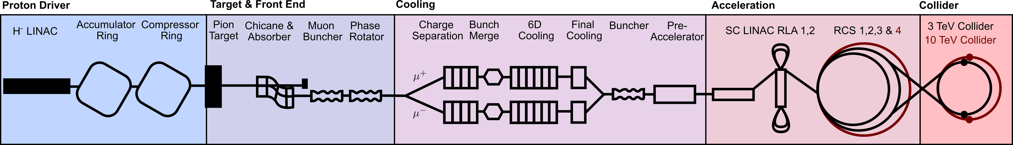

The Muon Collider: Overview
A multi-TeV 𝜇-collider is a promising candidate for a future lepton collider
precision physics and discovery machine.
Due to short 𝜇 lifetime, unique features with respect to p-p / e-e colliders.
Need of steady state superconducting magnets and fast ramped resistive magnets.
Short protons bunches
$p^{+}$ produce $π^{±}$ which decay into muons to be captured
Ionisation cooling of muons
Acceleration to collision energies
Collisions
→ Magnetic field along the machine: 1.8 T … 40 T.

Slide 3
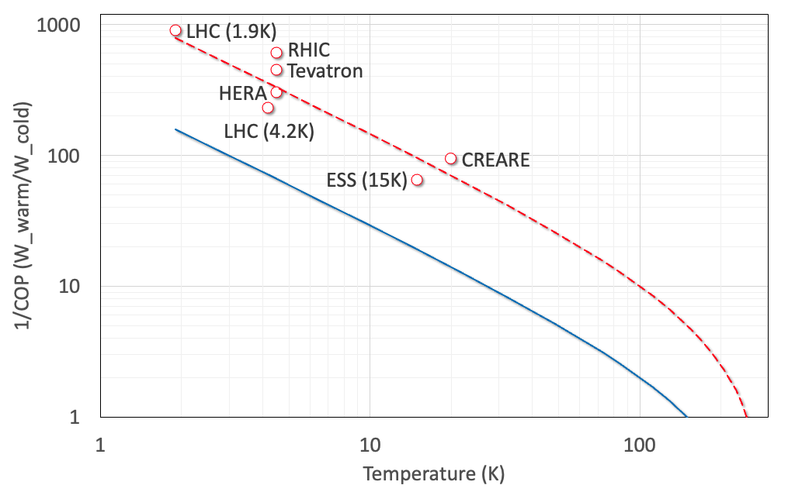

HTS Magnet Technology: Motivation
Increase operational temperature to 20 K → one order of magnitude increase in cryogenic system efficiency.
High cryogenic temperature:
Large enthalpy margin,
Reduced He inventory,
Reduced power consumption.
Reach higher fields with respect to LTS magnets in a compact, high current density design.
Cryogenic Efficiency vs. Operating Temperature
Nb-Ti
COP⁻¹
8T
5T
Nb₃Sn
16T
12…14T
HTS
18-16 T
12-14 T
This could be the best range of $T_{op}$ for future HEP
1.9
4.5
Credits: L. Bottura

Slide 4
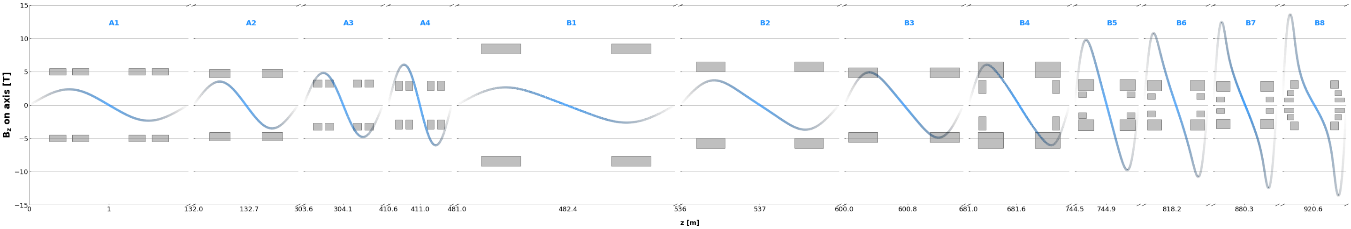
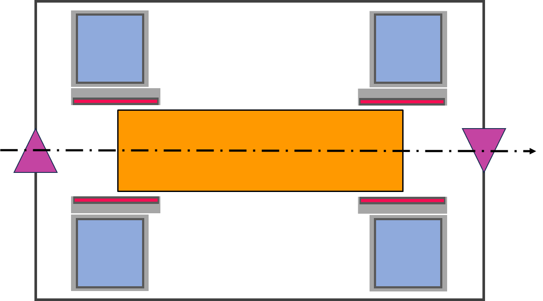


6D Cooling Section
B5-type cells selected as the candidate demonstrator cell
More than 3000 HTS coils (12 different types) for 1 km string integrating absorbers and RF cavities for muon re-acceleration.
$J_{e}$ > 700 $A/mm^{2}$
On z-axis Fields: 2…14 T, $φ=$ 90mm…1.5 m
Challenges:
Large bore derived from RF cavity constraint.
High field gradient: need of high current density at high fields.
Mechanical forces in the order of tens of MN, affecting structural support design, cost and cryogenics.
Dipole
HTS Solenoid
z
Absorber
RF Cavity

Slide 5
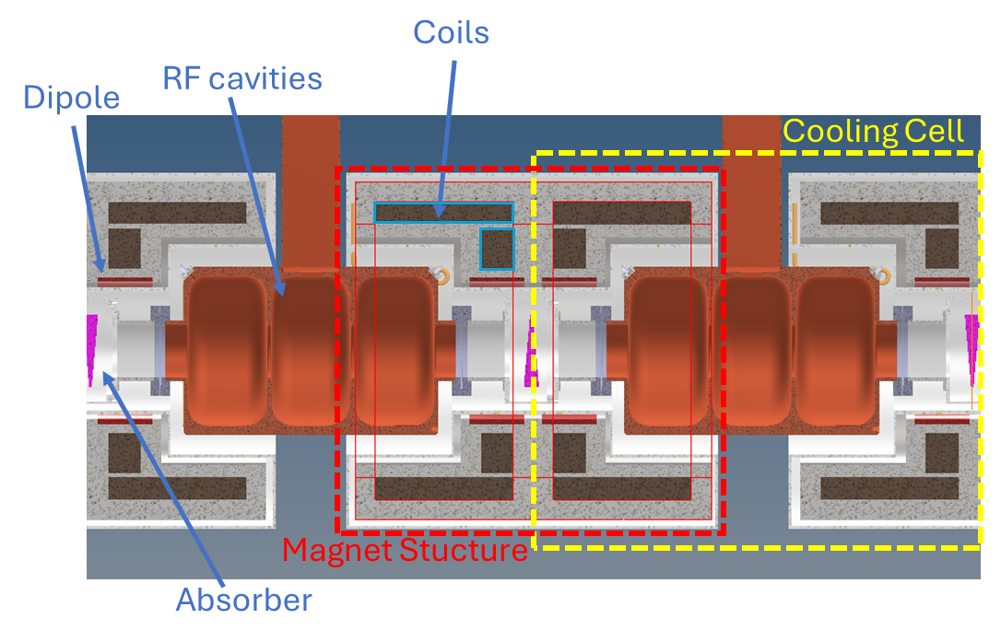
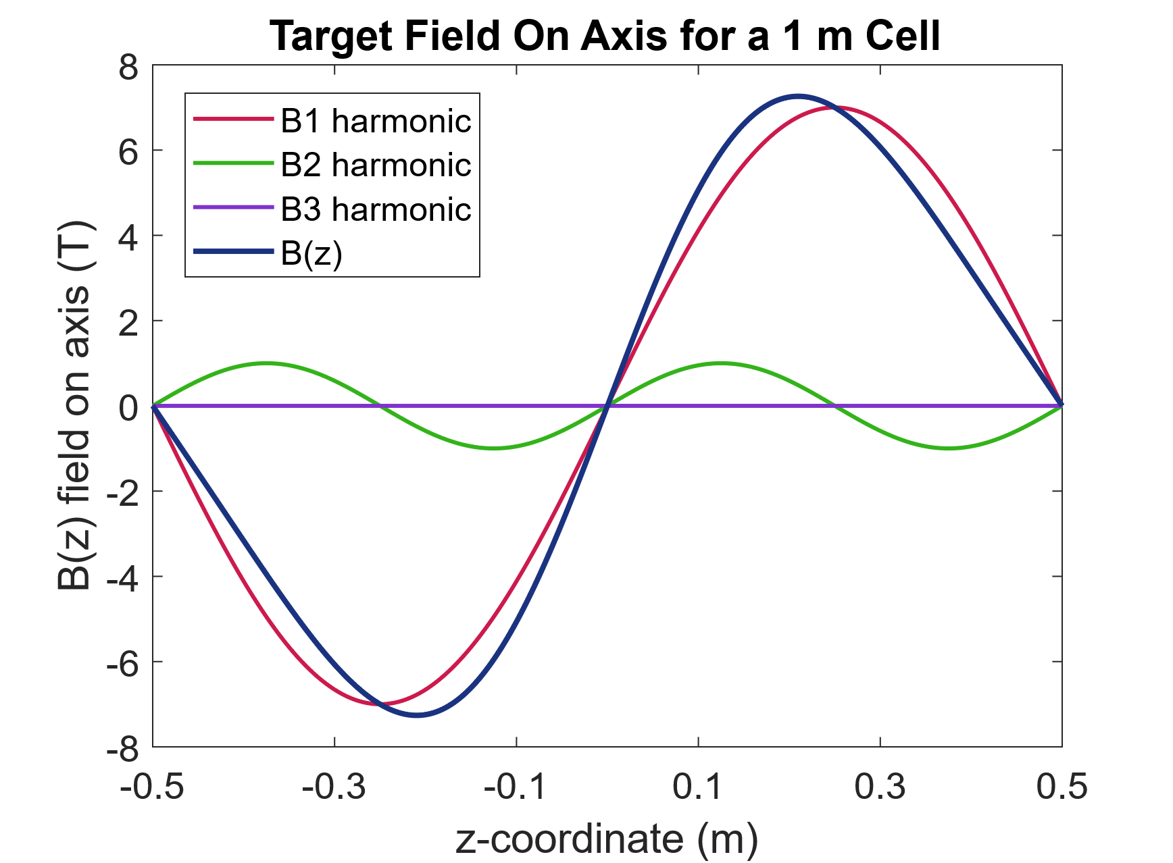
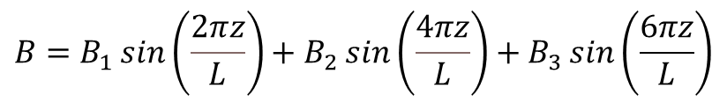
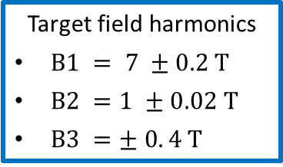
B5 Demonstrator Cell
10 units cell array for 𝜇 beam testing.
Inter-cell cryostat design: magnet structure decoupled from the cell unit.
Design improved for force intercepting and reduced cryogenic load.
Input for the magnet design
Target field harmonics
$B1 = 7 ±0.2 T$
$B2 =1 ±0.02 T$
$B3 =± 0. 4 T$
Target Field - Longitudinal Harmonics Expansion
$$B=B_{1}\sin\left(\frac{2πz}{L}\right)+B_{2}\sin\left(\frac{4πz}{L}\right)+B_{3}\sin\left(\frac{6πz}{L}\right)$$

Slide 6
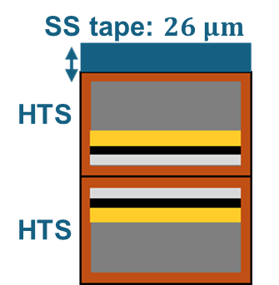
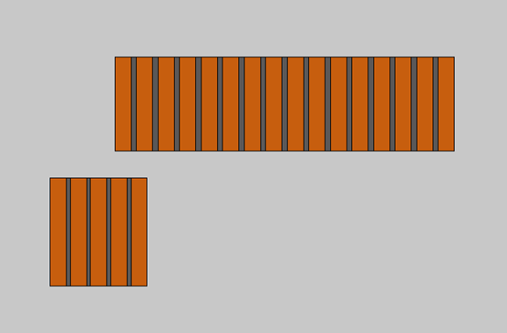




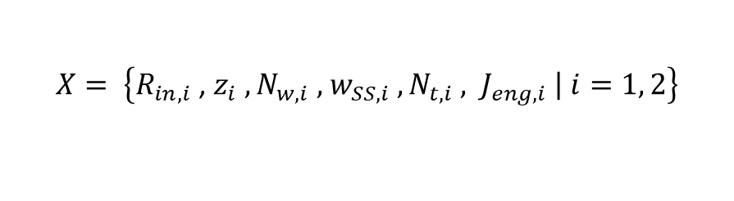






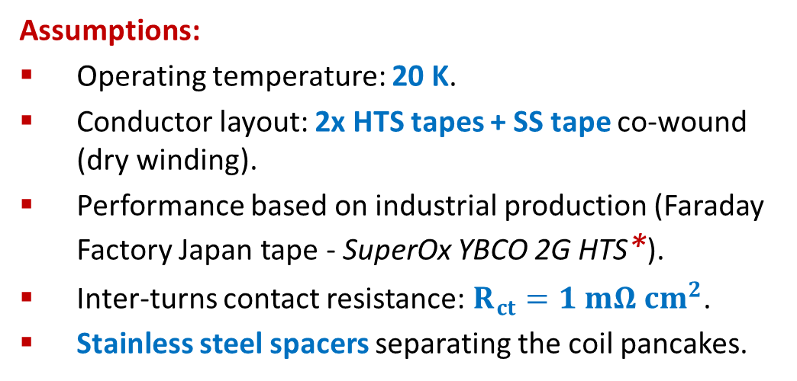


B5 Demo Magnet Design: Parameter Space and Assumptions
Parameter Space:
$$X= \left\{R_{in,i} \text{, }z_{i} ,N_{w,i} \text{,}{ w_{SS,i} , N}_{t,i} \text{, }J_{eng,i} \left| i=1, 2\right.\right\}$$
Conductor Section
HTS coil
SS Spacer
$$w_{SS,1}$$
Coil 1
$$z_{2}$$
$$N_{t,1}$$
$$w_{SS,2}$$
Assumptions:
Operating temperature: 20 K.
Conductor layout: 2x HTS tapes + SS tape co-wound (dry winding).
Performance based on industrial production (Faraday Factory Japan tape - SuperOx YBCO 2G HTS*).
Inter-turns contact resistance: $R_{ct}=1 mΩ{ cm}^{2}$.
Stainless steel spacers separating the coil pancakes.
$$N_{w,1}$$
$$z_{1}$$
$$N_{t,2}$$
$$R_{in,1}$$
$$N_{w,2}$$
Coil 2
$$J_{eng,1}$$
$$R_{in,2}$$
$$J_{eng,2}$$
*Tape data from: [University of Victoria Wellington, Robinson HTS critical current database, SuperOx YBCO 2G HTS data. https://htsdb.wimbush.eu]

Slide 7
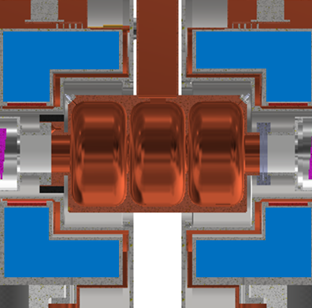
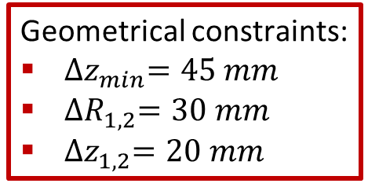
B5 Demo Magnet Design: Parameter Space and Assumptions
Constraints:
Space available for coils
Conductor Section
Geometrical constraints:
${∆z}_{min}=45 mm$
${∆R}_{1,2}=30 mm$
${∆z}_{1,2}=20 mm$
Assumptions:
Operating temperature: 20 K.
Conductor layout: 2x HTS tapes + SS tape co-wound (dry winding).
Performance based on industrial production (Faraday Factory Japan tape - SuperOx YBCO 2G HTS*).
Inter-turns contact resistance: $R_{ct}=1 mΩ{ cm}^{2}$.
Stainless steel spacers separating the coil pancakes.
*Tape data from: [University of Victoria Wellington, Robinson HTS critical current database, SuperOx YBCO 2G HTS data. https://htsdb.wimbush.eu]

Slide 8
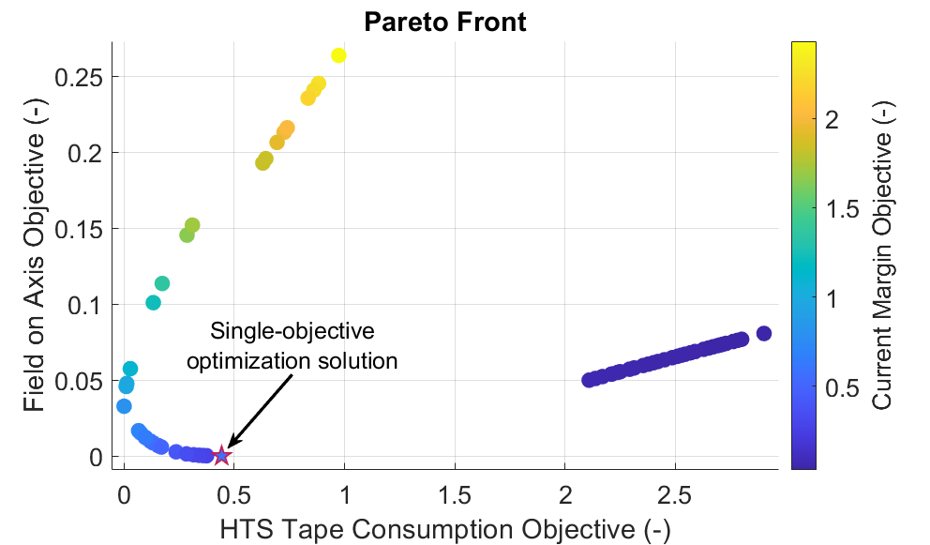
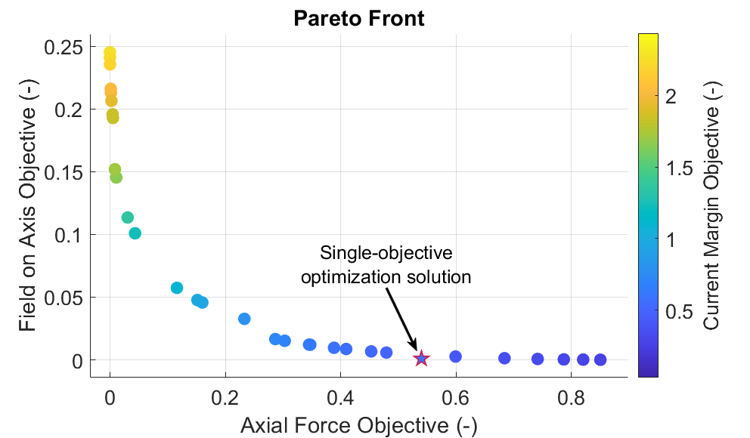


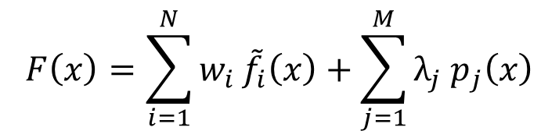



B5 Demo Magnet Design: Optimization Approach
$$B_{1} ,B_{2} ,B_{3}$$
$$B_{peak}$$
$$F_{z}$$
$I_{c}$ margin
Field Obj. – Conductor Cost
Optimal Design
$$l_{HTS}$$
spatial constraints
Field Obj. – Forces on Coils
$$T_{hot}$$
$$F\left(x\right)=\sum_{i=1}^{N}{w_{i }{\tilde{f}}_{i}\left(x\right)}+\sum_{j=1}^{M}{λ_{j} p_{j}\left(x\right)}$$

Slide 9
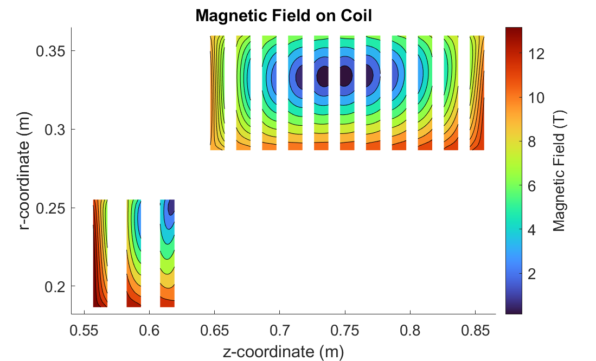
B5 Demo Magnet Design: B5 Demo Mag 2.4
Obtained Solution Main Parameters | Coil 1 / Coil 2
Coil current (A) | 761.2 1193
SS spacers width (mm) | 7.9 13.7
Axial Force (Total) (MN) | -4.6 / 11.7 (7.09)
Temperature Margin (K) | 13
Mag. Energy Density (MJ/m3) | 152 147
Hotspot Temperature (K) | 142 144
Total HTS tape length | 50.9
Configuration obtained from single-objective optimization

Slide 10
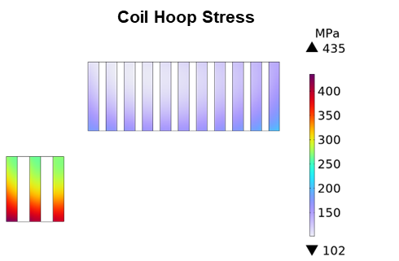
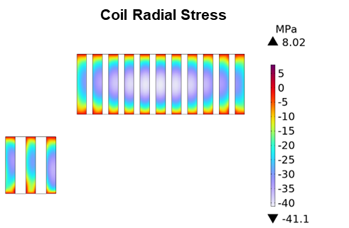
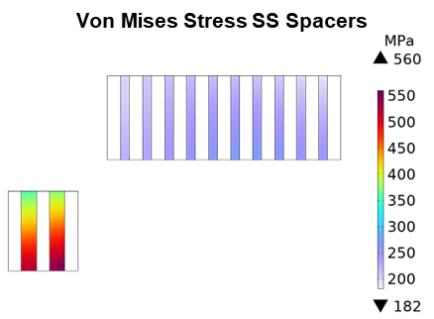
B5 Demo Magnet Design: B5 Demo Mag 2.4
Obtained Solution Main Parameters | Coil 1 / Coil 2
Coil current (A) | 761.2 1193
SS spacers width (mm) | 7.9 13.7
Axial Force (Total) (MN) | -4.6 / 11.7 (7.09)
Temperature Margin (K) | 13
Mag. Energy Density (MJ/m3) | 152 147
Hotspot Temperature (K) | 142 144
Total HTS tape length | 50.9
Mechanical stresses within material limits in nominal operative conditions.
Configuration selected for cell integration studies!

Slide 11
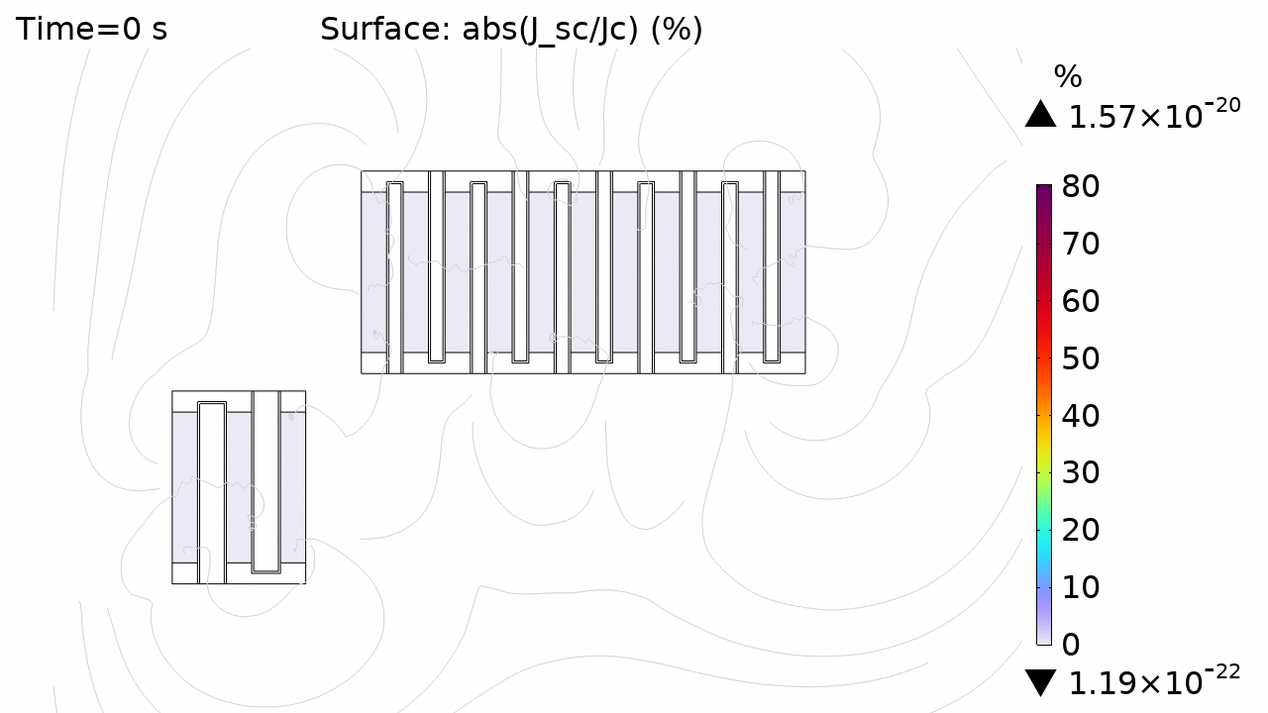
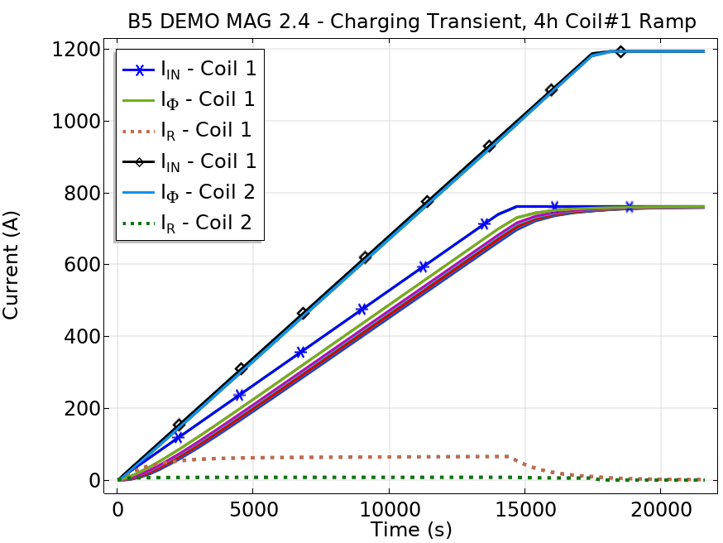
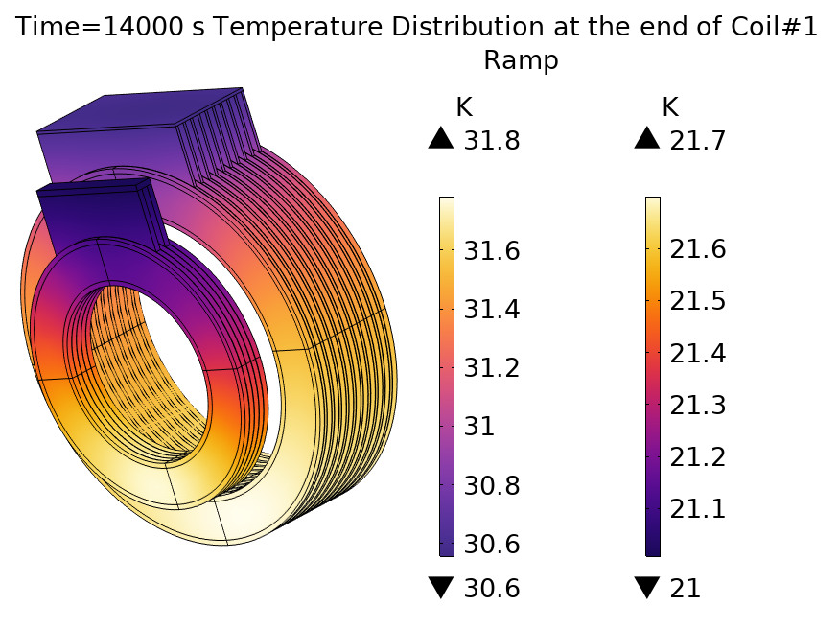
B5 Demo Mag 2.4: Coil Charging Transient
Ramp rates of the two coils tuned to match the same ramping time.
Assumed 6h charging time: 4h current ramp in Coil 1.
Conduction cooling of the two magnets via cryocoolers.
Critical current fraction during charging
Coil 1
Coil 2
Coil margins and peak stress limits satisfied during charging.

Slide 12
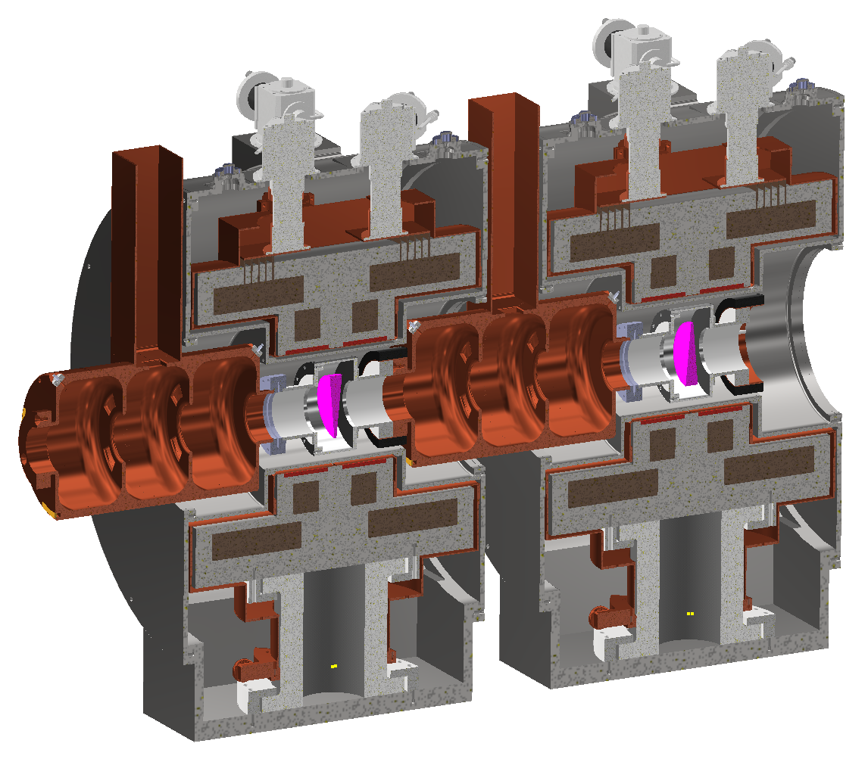
B5 Demo Cell Design and Integration
Engineering design of the B5 demo cell.
Inter-cell cryostat design: specific solutions for the cell assembly and installation have been considered:
Soldered flanges for the RF waveguide.
Custom pillow seals based on elastomers for vacuum connections.
Girder layout → improved modularity for installation and maintenance.
Credits: M. Castoldi

Slide 13
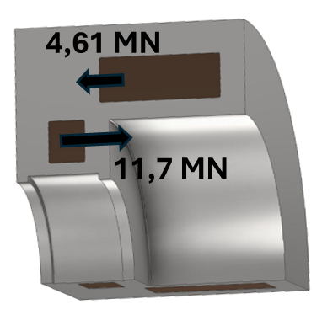
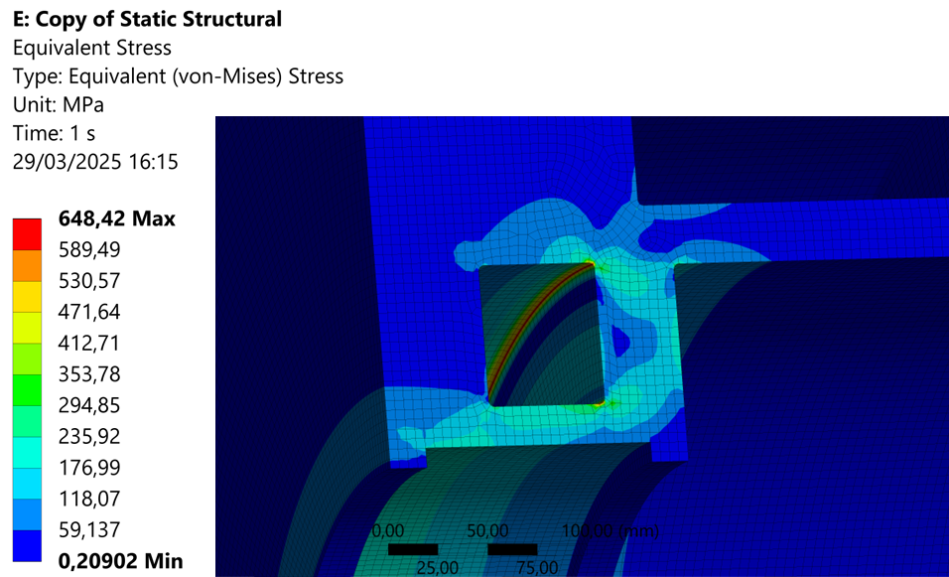
B5 Demo Cell Design and Integration
Mechanical design of the magnet structure
0.32 MN*m bending moment
Von Mises Stress
Stress concentration in coil casing. Peak value within material limits.
Credits: M. Castoldi

Slide 14
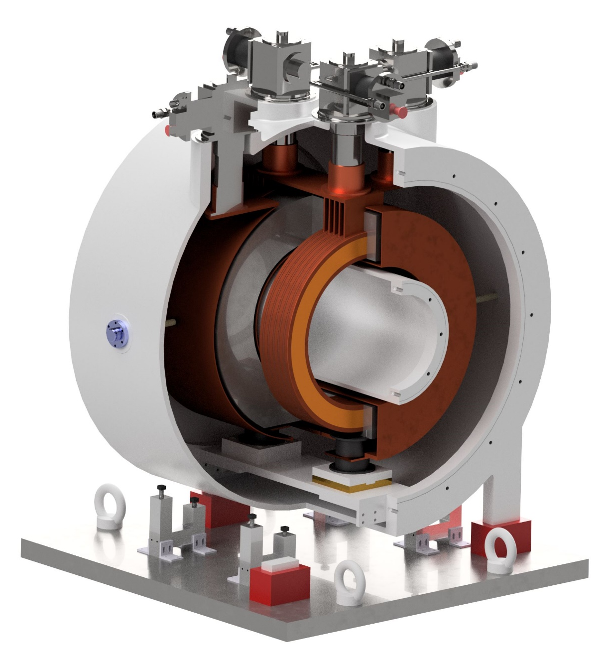
HTS Split-Coil Facility for RF Cavity Testing
Cu fins for thermal connections to cryocooler interfaces
60 K cryocooler for thermal shield
First step in the realization of a muon cooling demonstrator:
Magnet design and system integration.
Target: 400 mm magnet inner bore, 320 mm free-bore. 20 K operation: cryocooled.
Technology validation:
Breakdown limit of RF cavities (> 704 MHz) under high magnetic field (7 T peak).
Design, manufacturing and testing of 7 T split-solenoids, with metal-insulated HTS.
Coil stack
Credits: M. Castoldi

Slide 15
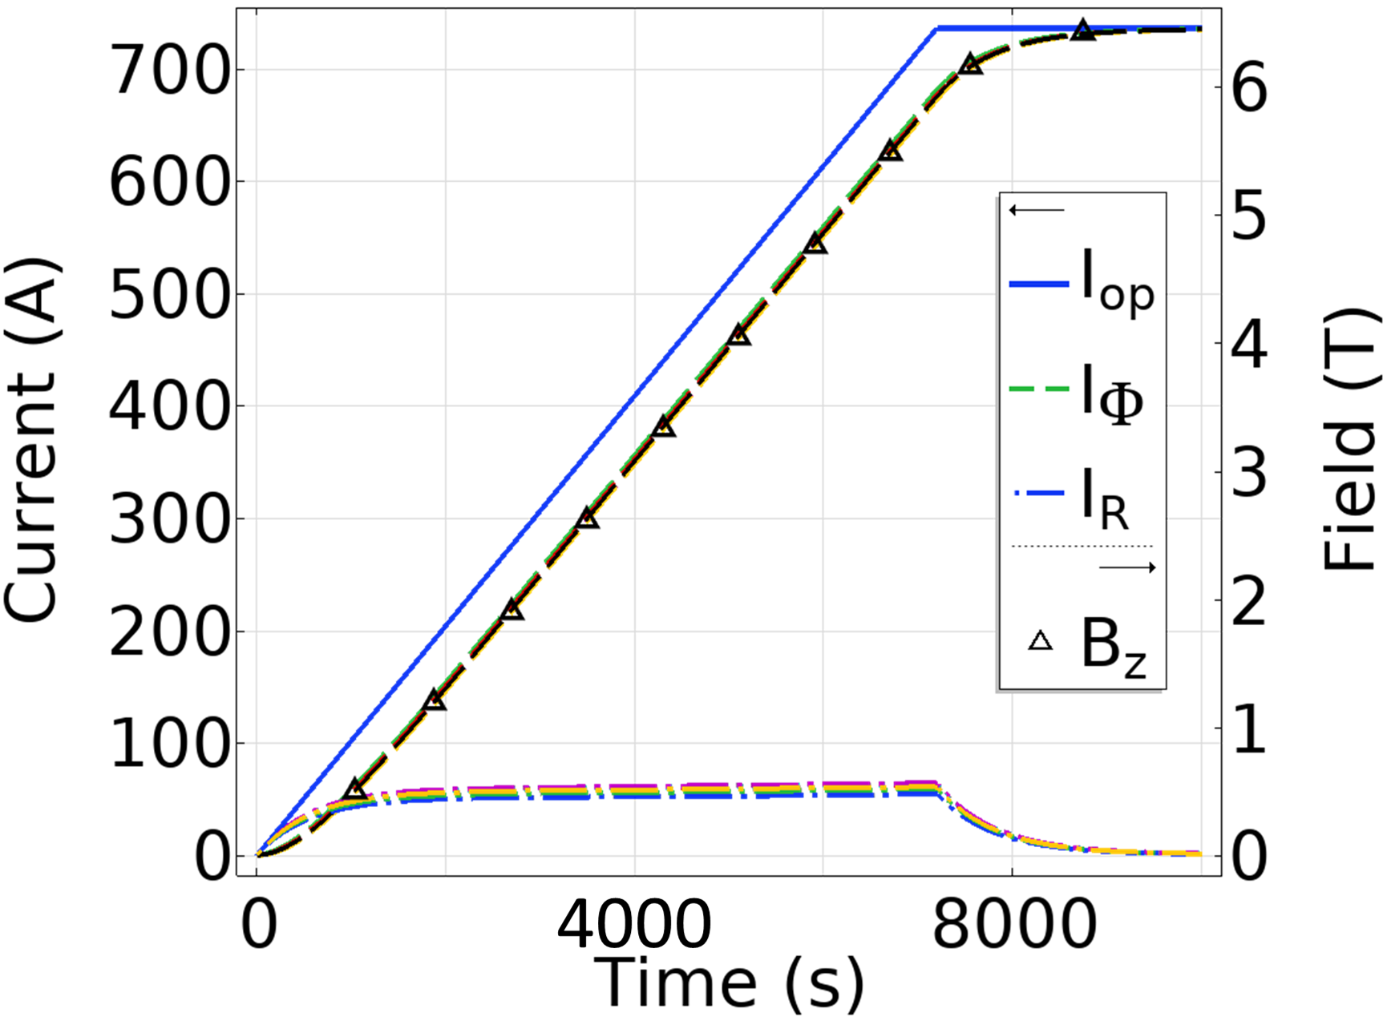
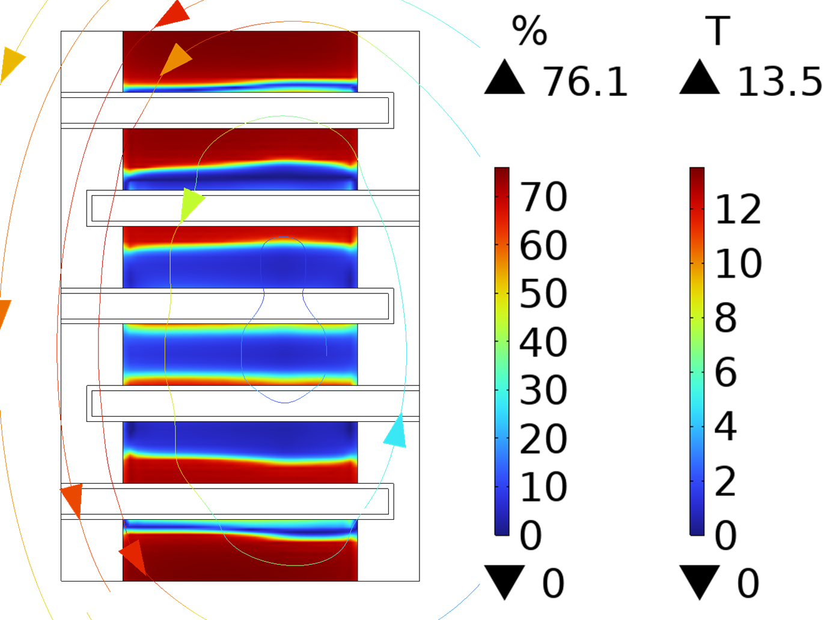
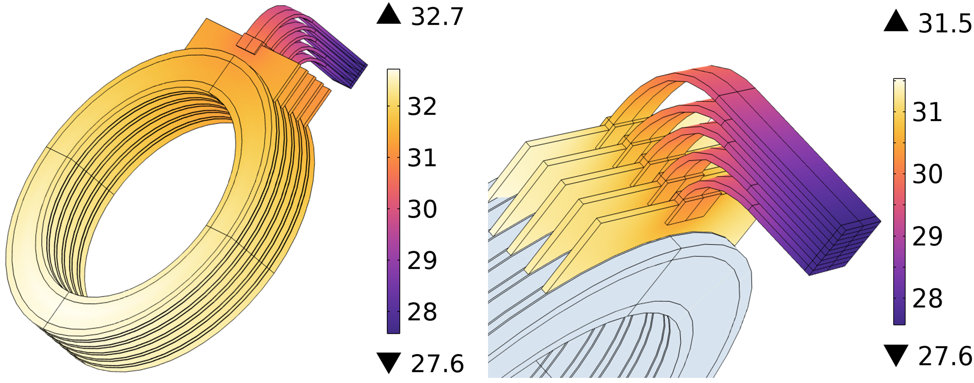
HTS Split-Coil Facility for RF Cavity Testing
Coil Charging Transient Analysis
Cu fins for thermal connections to cryocooler interfaces
60 K cryocooler for thermal shield
Coil stack
Coil margins and peak stress limits satisfied during charging.
Credits: M. Castoldi

Slide 16
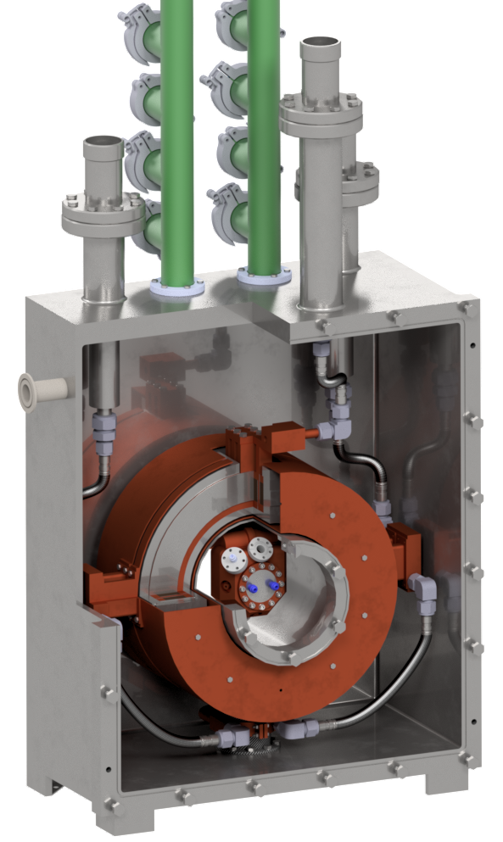
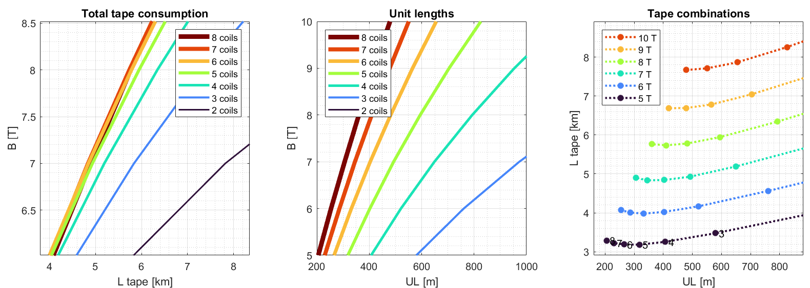
HTS Single-Coil Facility: EU funded EPITA
Scaled-down version of the HTS split-coil facility: single-magnet layout.
Test of RF cavities of > 1 GHz frequency.
Peak field on axis: 7 T. Magnet inner bore: 250 mm, 170 mm free bore.
5 km HTS tape (4 mm width) acquired by INFN-LASA.
Construction and assembly will be part of the EPITA program.
Vacuum and cooling pipes (He gas cooling)
Thermal shield
Coil stack
1 GHz RF cavity
Credits: M. Castoldi

Slide 17
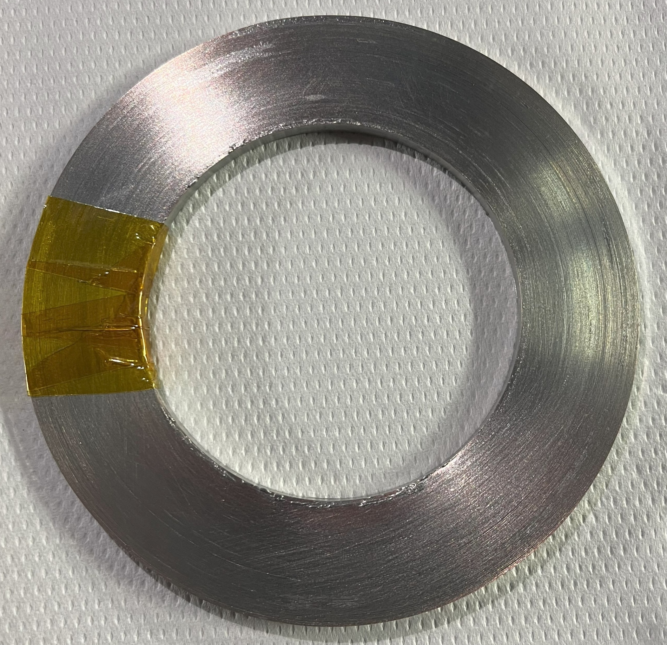
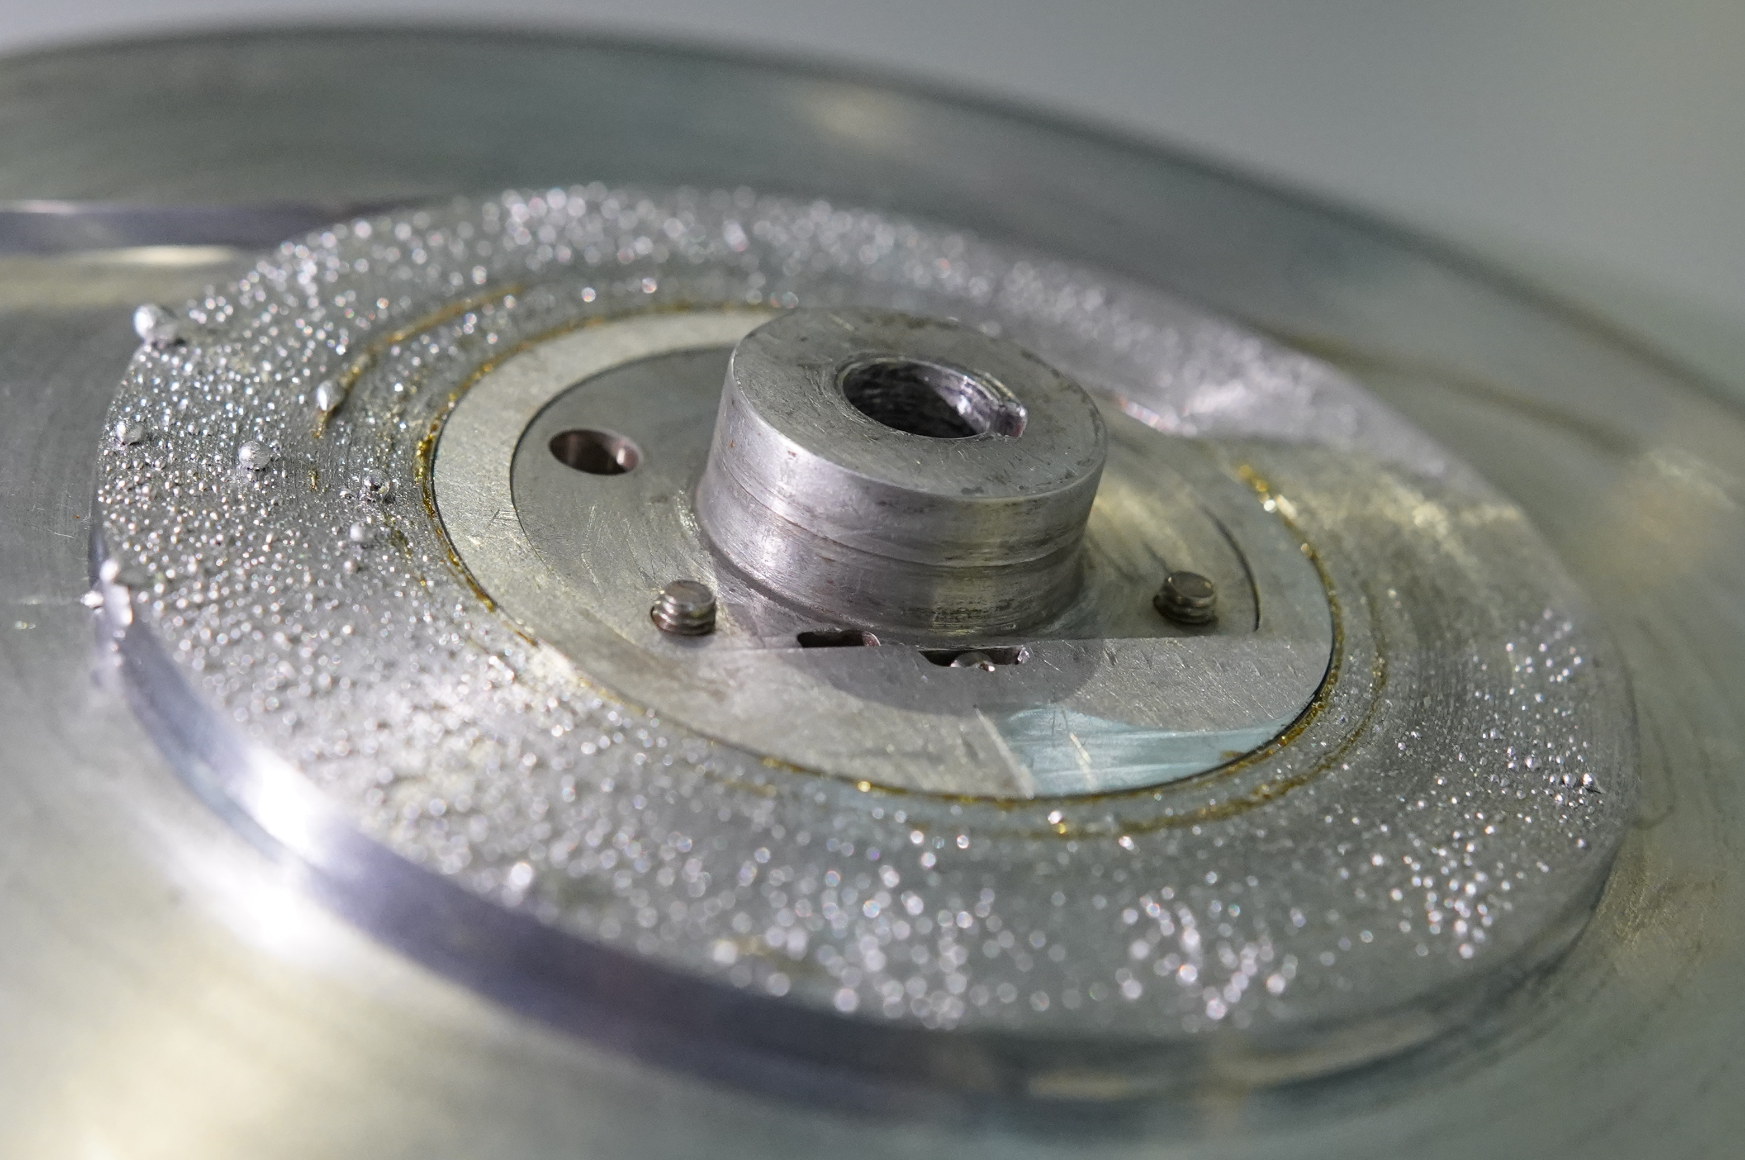
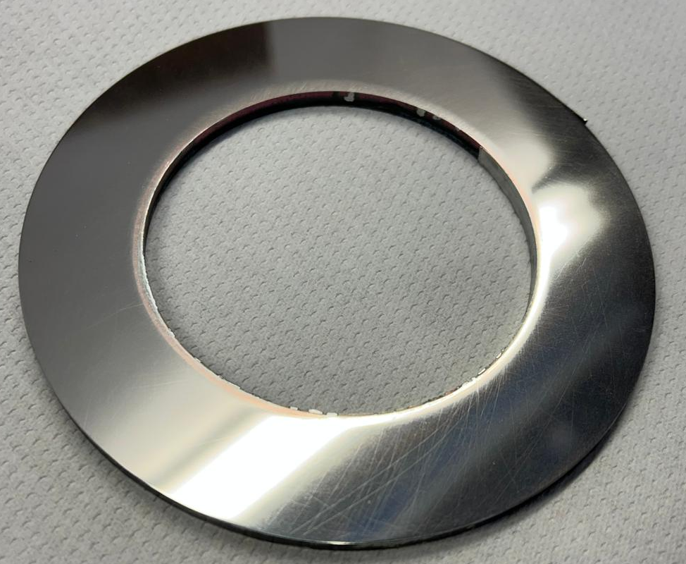
Fully Soldered - Non-insulated HTS Coils Experimental Campaign

Slide 18
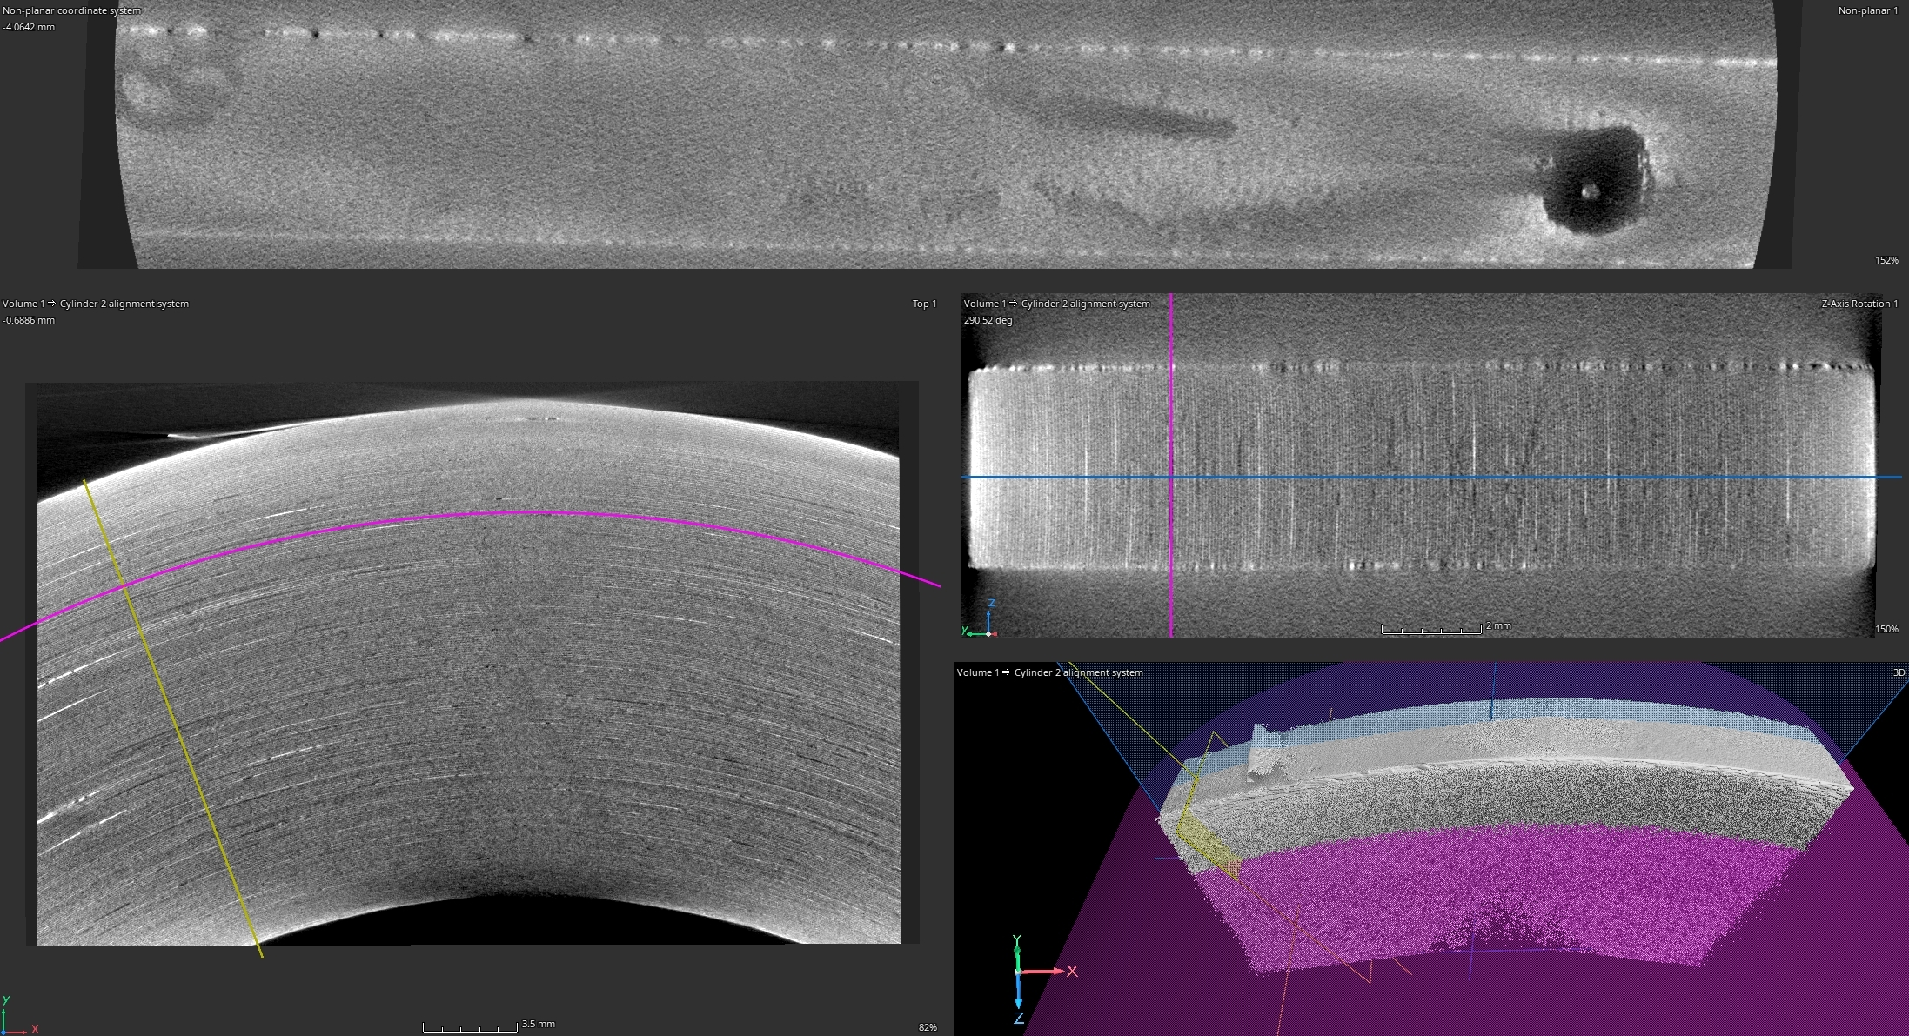
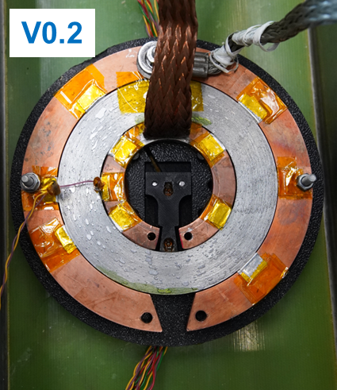
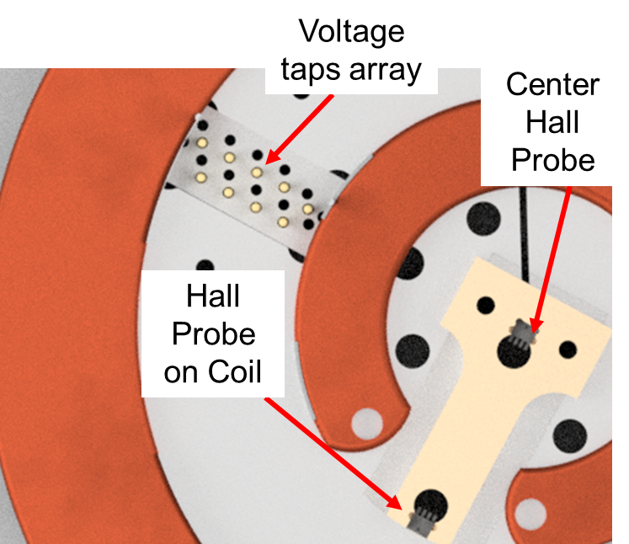
Soldered Coil Test Campaign
Analysis on the Manufactured Samples
Coil Measurements at 77 K in LN2 bath
Non-invasive and post-mortem characterizations:
Tomography/microscopy to assess quality and uniformity of soldered layers, and for void fraction measurement.
V0.2: 3D printed test stage:
11 voltage taps (2 mm spacing) upgradeable to 21 per sector
8 hall-probe positions
2 slots for alternative instrumentation

Slide 19
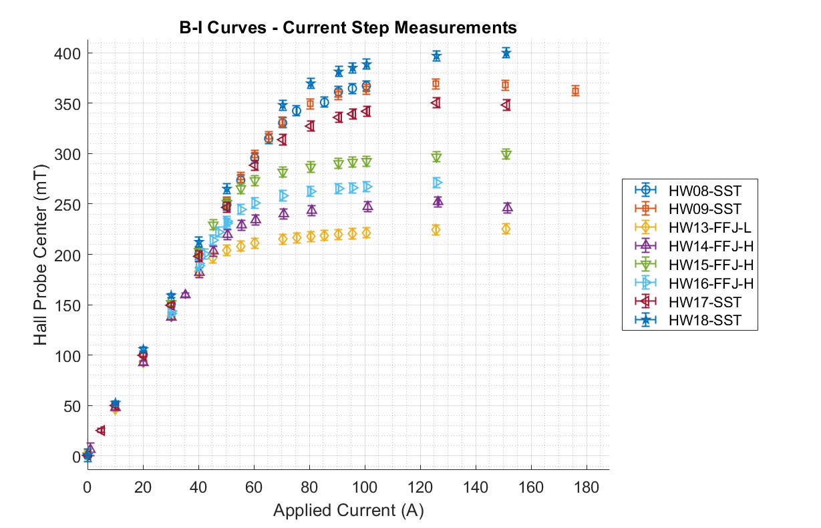
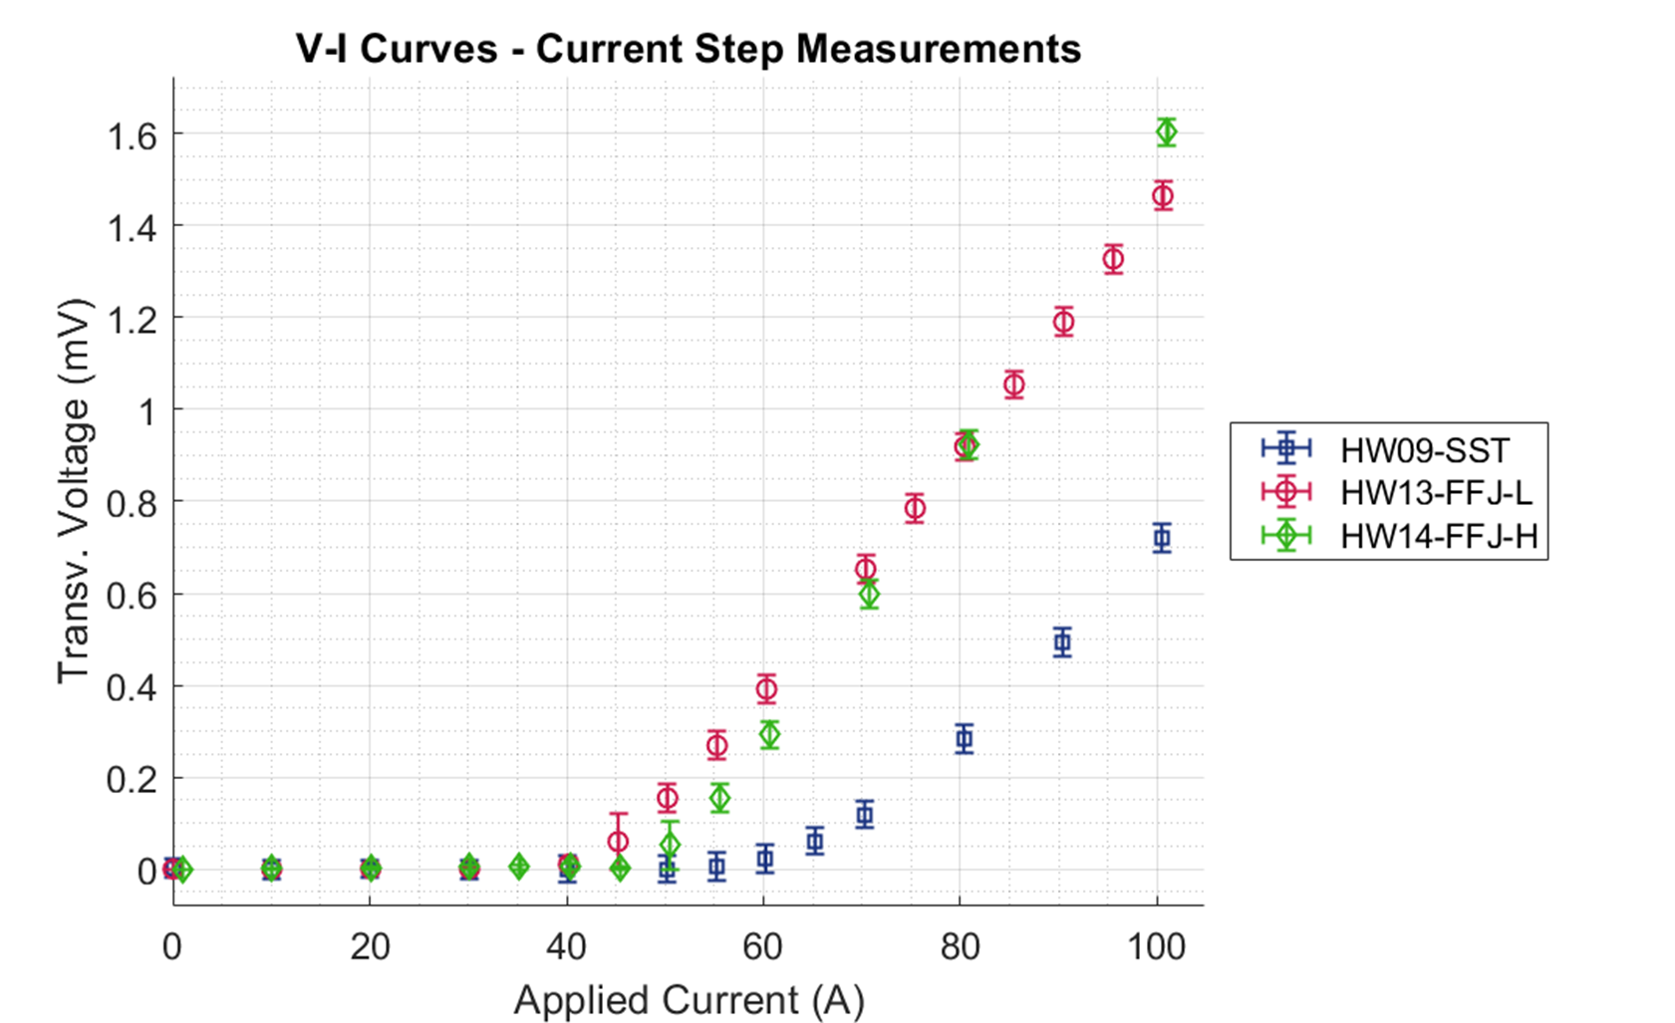
Current Step Measurements Results
Coil Transversal Voltage vs Current
Center Hall Probe Field vs Current
Onset of residual resistance
Variations of saturation field are expected: 10-15% of Ic variation in self-field.

Slide 20
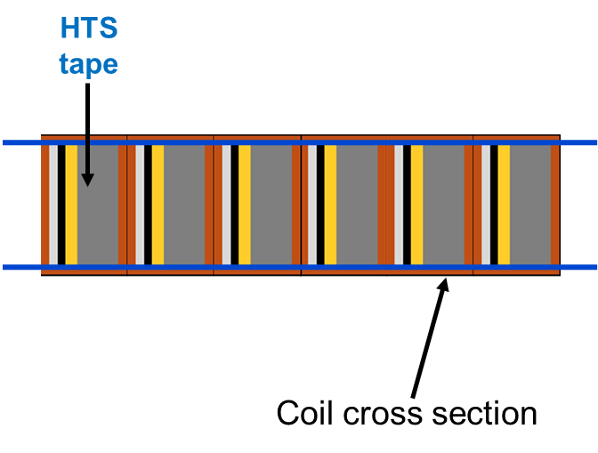
First Coil Polishing Test
Polished Coil
Removing the Cu stabilizer layer on the coil sides significantly reduces the coil time constant.
>3 order of magnitude increase in the turn-to-turn resistance.
Hastelloy Surface

Slide 21
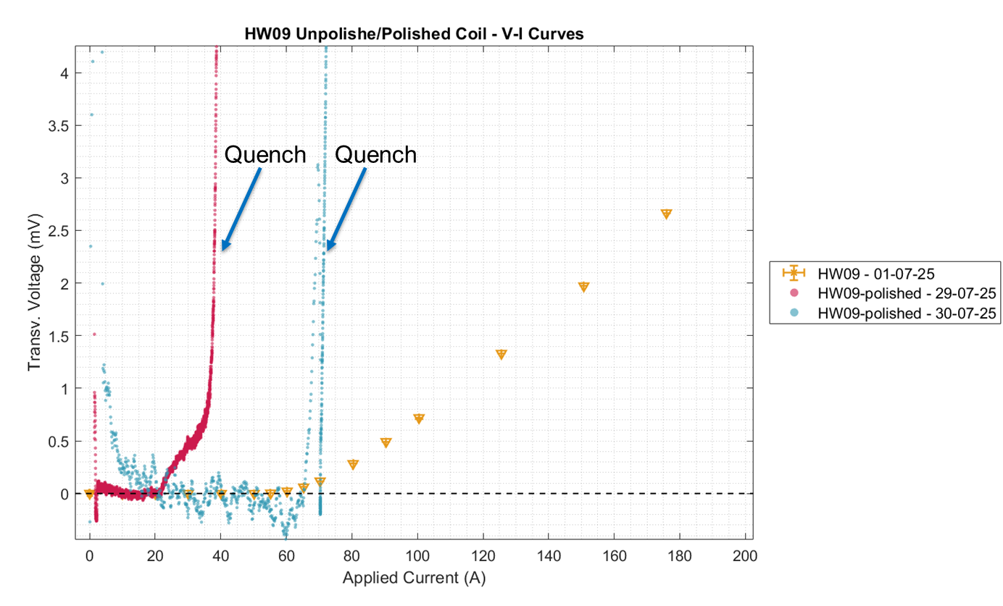
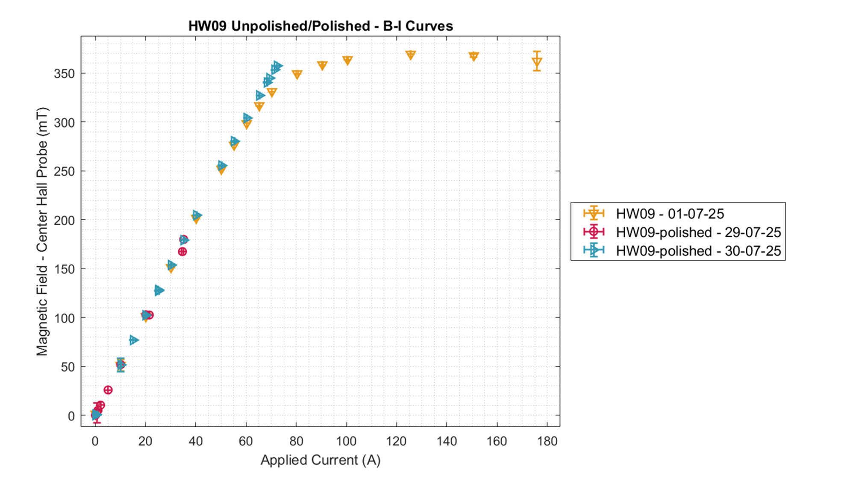
Polished Coil Measurement Results
V-I current ramp test comparison
Center Hall Probe Field vs Current
Coil time constant after polishing: 2 s !
Factor 150 reduction in the coil time constant compared to the non-polished coil.
Behaviour as insulated coil: quenched at 40 A / 75 A depending on the setup.
B-I curve follows the same behaviour of non-insulated in the linear regime.

Slide 22
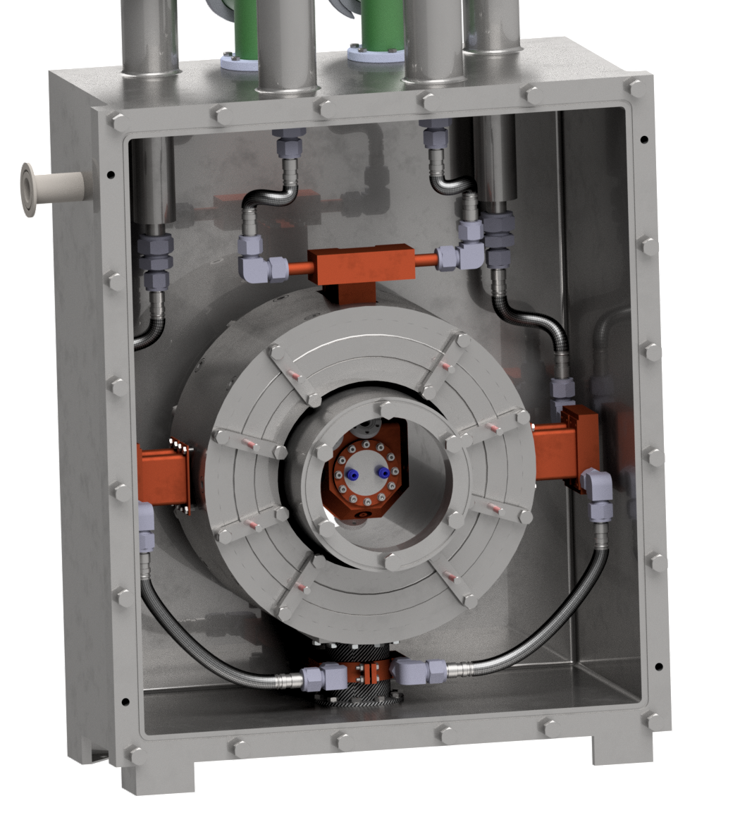
Next Steps
Finalize the design of the B5 demonstrator magnets and the magnet of the HTS facility for RF cavities accounting for fault scenarios:
Quench simulations are critical for the design (unbalanced forces in the MN range)!
Update the 6D cooling section magnets based on the design solutions of the B5 demonstrator.
Manufacture and test prototype metal-insulated coils for the design of the HTS facility.
Construction and commissioning of the single-magnet HTS facility by 2026.

Slide 23

Thank you for your attention!
Funded by the European Union (EU). Views and opinions expressed are however those of the author only and do not necessarily reflect those of the EU or European Research Executive Agency (REA). Neither the EU nor the REA can be held responsible for them.

