Slide 1
Beam-induced background studies at the FCC-ee
20/10/2025
Giulia Nigrelli
Seminar for the admission to the 3rd year of the PhD in Accelerator Physics
G. Nigrelli^{1,2,3}
Advisor: M. Boscolo^{2,3},
Supervisors: R. Bruce², S. Redaelli²
¹ Sapienza Università di Roma, Roma, Italy, ² CERN, Geneva, Switzerland,
³ INFN-LNF, Frascati, Italy
Acknowledgements:
K. Andre, X. Buffat, G. Broggi, A. Ciarma, Y. Dutheil, A. Frasca, M. Le Garrec, A. Lechner, G. Iadarola, P. Kicsiny, G. Lerner, S. Marin, T. Mori, H. Nakayama, J. Salvesen, K. Skoufaris, F. Van der Veken, S. Yue.

Slide 2
Outline
20/10/2025 Seminar for the admission to the 3rd year of the PhD in Accelerator Physics
Giulia Nigrelli
Introduction
  FCC: the Future Circular Collider
  FCC-ee collimation overview
  FCC-ee beam induced background (BIB) sources
Beam Induced Background full simulation workflow
Case studies:
  Steady loss - injection background
  Failure case - fast instabilities
SUPERKEKB benchmark plan
Conclusions and future steps

Slide 3
Outline
20/10/2025 Seminar for the admission to the 3rd year of the PhD in Accelerator Physics
Giulia Nigrelli
Introduction
  FCC: the Future Circular Collider
  FCC-ee collimation overview
  FCC-ee beam induced background (BIB) sources
Beam Induced Background full simulation workflow
Case studies:
  Steady loss - injection background
  Failure case - fast instabilities
SUPERKEKB benchmark plan
Conclusions and future steps

Slide 4
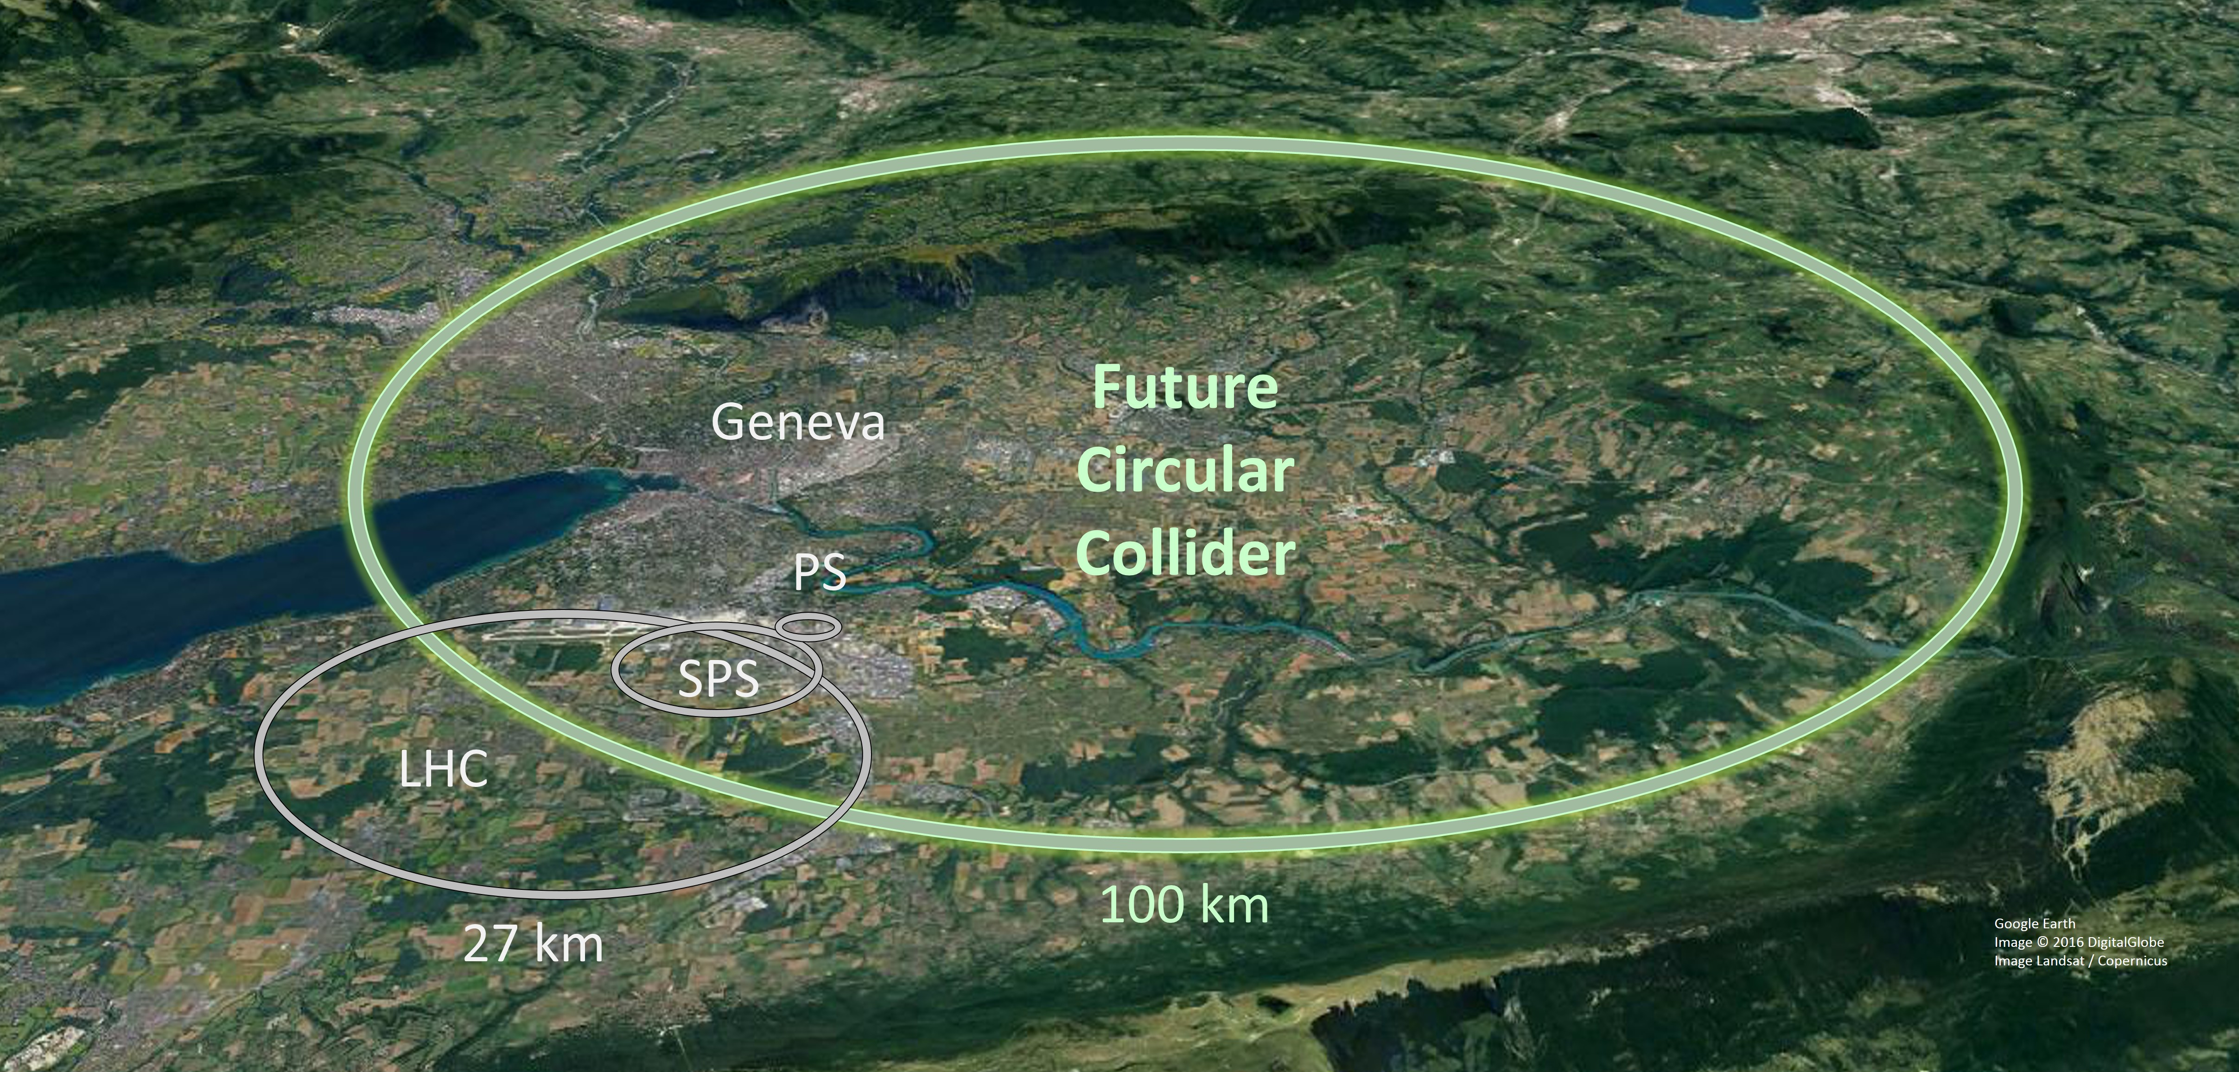
FCC: the Future Circular Collider
20/10/2025 Seminar for the admission to the 3rd year of the PhD in Accelerator Physics
Giulia Nigrelli
FCC-ee is the first stage $e^{+}$/ $e^{−}$collider of the FCC project, later followed by a hadron collider.
Feasibility Study Report completed successfully,
entering the Pre-TDR phase.
4 beam operation modes with beam energies :
Z (45.6 GeV), W (80 GeV), H (120 GeV),
ttbar (182.5 GeV).
Double ring with 90.7 km circumference.
4-fold super-periodicity allowing 2/4 IPs.
Challenging accelerator design:
  Large horizontal crossing angle 30 mrad.
  Crab-waist collision optics.
  Top-up injection scheme for high luminosity.
  Synchrotron radiation (SR) power 50 MW/beam.
  Requires booster synchrotron in collider tunnel and 20 GeV e+/e- source and linac.

Slide 5
Motivation
20/10/2025 Seminar for the admission to the 3rd year of the PhD in Accelerator Physics
Giulia Nigrelli
Identify beam loss mechanisms in FCC-ee that could generate background to the experiment.
Model realistic background source scenario and study their beam dynamics.
Estimate background flux to detectors via Monte Carlo studies.
Propose mitigation strategies (e.g. collimator optimization).
Providing key insights to support detector design.
Support FCC-ee design study with identification of critical background scenario and their effects.

Slide 6
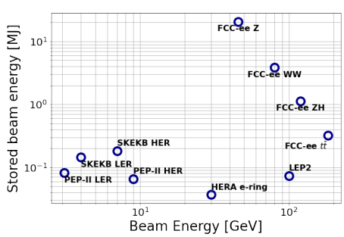
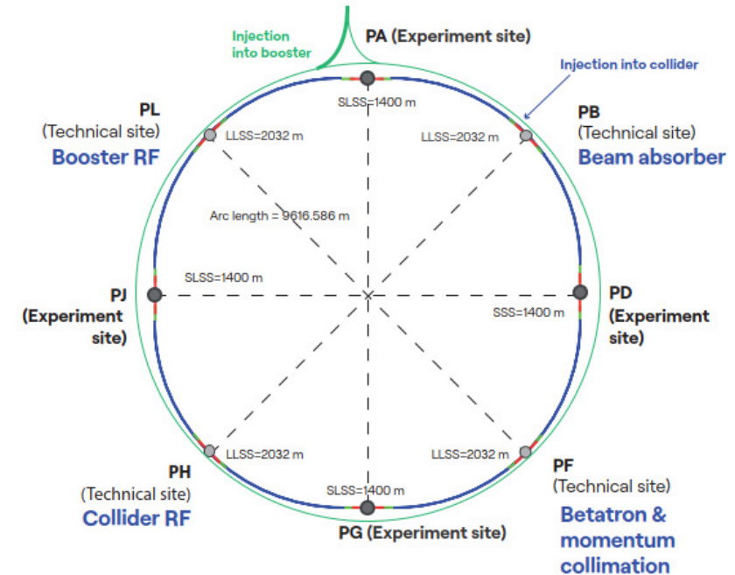
Beam collimation challenges
20/10/2025 Seminar for the admission to the 3rd year of the PhD in Accelerator Physics
Giulia Nigrelli
FCC-ee presents unique challenges:
  At Z pole 17.5 MJ of stored beam energy (two orders of
  magnitude bigger than any other lepton collider).
  Beams are highly destructive.
Collimation system must:
  Protect the machine and the detectors from unavoidable beam losses.
  Minimize background for the experiments.
Collimation layouts (for details see here):
  Global system in PF: 2 stage betatron + momentum.
  Experimental IRs: synchrotron radiation collimators
  and mask + robust tertiary collimator.
  Local protection for injection, extraction, etc..
  Secondary particle shower absorber.
Notes:
Collimation design and performance studies are performed with
Xsuite-BDSIM simulation tool, combining tracking and scattering
routines.

Slide 7
Beam loss scenarios
20/10/2025 Seminar for the admission to the 3rd year of the PhD in Accelerator Physics
Giulia Nigrelli
Important to investigate different beam loss scenarios and identify the most critical ones for the collimation system design.
Current focus on Z mode, and the status is:
More details can be found here.
Completed
Beam halo
In progress
Injection failure
To be started
Thermal photon
Beam-gas
Beam-beam
Touschek scattering
Synchrotron radiation
Fast instabilities (this talk)
Top-up injection (this talk)
SuperKEKB-like sudden beam loss
Extraction failure
Other failures (extraction, RF, missing beam-beam,…)

Slide 8
Outline
20/10/2025 Seminar for the admission to the 3rd year of the PhD in Accelerator Physics
Giulia Nigrelli
Introduction
  FCC: the Future Circular Collider
  FCC-ee collimation overview
  FCC-ee beam induced background (BIB) sources
Beam Induced Background full simulation workflow
Case studies:
  Steady loss - injection background
  Failure case - fast instabilities
SUPERKEKB benchmark plan
Conclusions and future steps

Slide 9
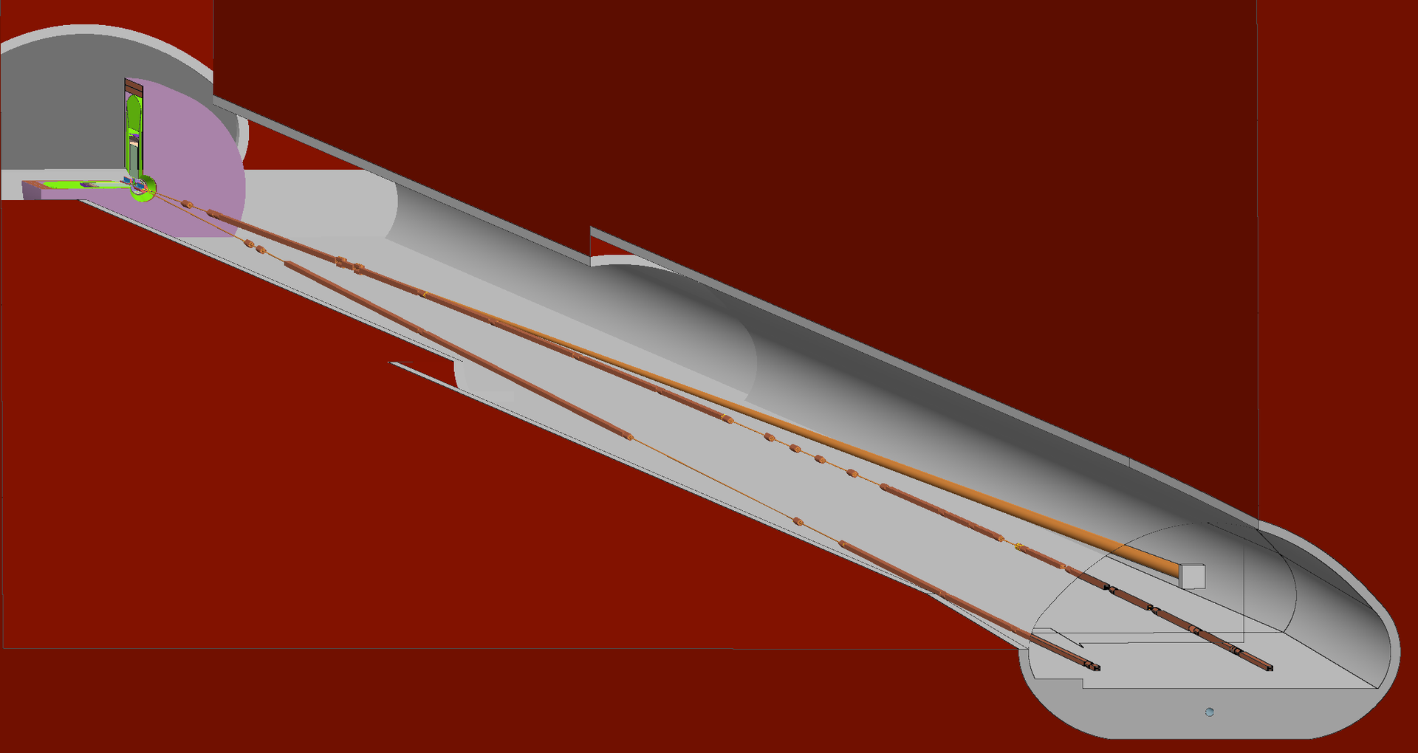
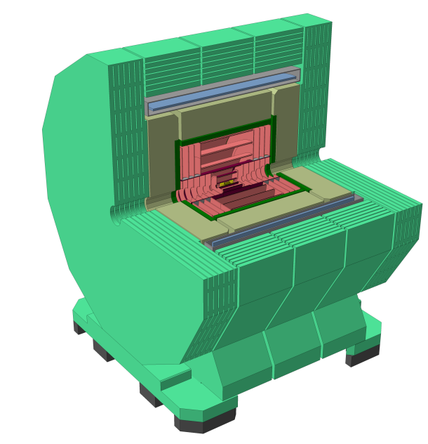
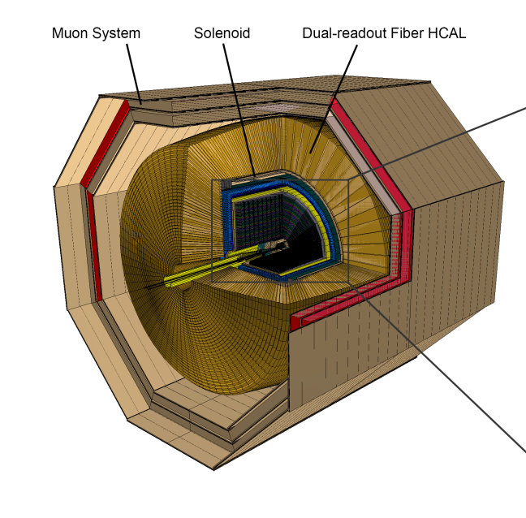
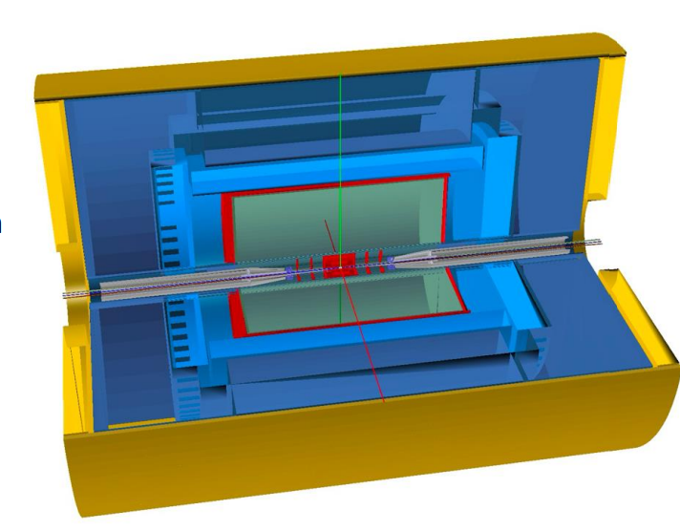
Background simulation workflow
20/10/2025 Seminar for the admission to the 3rd year of the PhD in Accelerator Physics
Giulia Nigrelli
IP
IPB
FLUKA*
BDSIM
IP
IP
XSUITE
IPF
IP
* FLUKA geometry includes detailed description of beam line elements from IP up to 700 m downstream
*Geometry provided by A. Frasca
Notes:
The impacts on the tertiary collimators close to the Ips have been used in the FLUKA geometry of the Interaction region, developed by A. Frasca et al, to track electromagnetic shower that can produce background to the experiment.

Slide 10
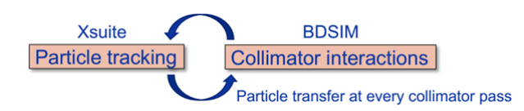
Collimation studies with Xsuite
20/10/2025 Seminar for the admission to the 3rd year of the PhD in Accelerator Physics
Giulia Nigrelli
Collimation/beam losses studies for FCC-ee are mainly conducted with Xsuite (G. Iadarola - ICAP’24 talk, HB’23 paper) .
Xsuite embed both accelerator-specific and general-purpose Python tools.
Allows to study complex simulation scenarios, such as injection process.
Xcoll module (F. Van der Veken, ICAP’24 talk, HB’23 paper) is dedicated to collimation studies in particle accelerators.
Allows integration of detailed aperture models
with precise loss location identification.
Allows beam-matter interaction simulations within
collimators in particle tracking with various scattering models (Everest-K2, FLUKA, Geant4/BDSIM).
Xsuite-BDSIM/Geant4 coupling (A. Abramov, JINST paper) is the standard for FCC-ee collimation studies.
Even though Xsuite capabilities have been proven and benchmarked against hadron colliders, we still need benchmarks against lepton collider to validate FCC-ee simulation.
SuperKEKB is an excellent candidate for benchmarks.

Slide 11
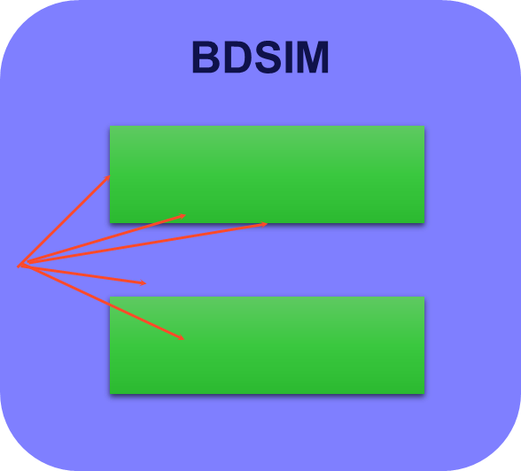
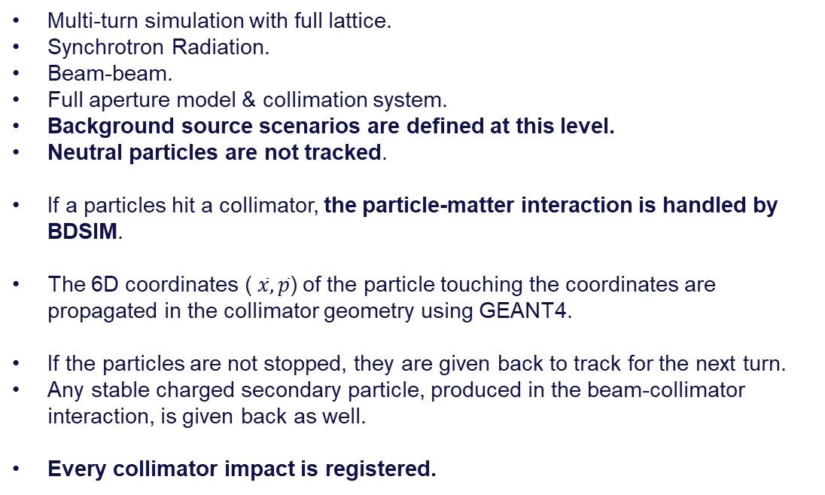
Workflow - step 1&2
20/10/2025 Seminar for the admission to the 3rd year of the PhD in Accelerator Physics
Giulia Nigrelli
* Synchrotron radiation background not studied with xsuite.
IP
IPB
Multi-turn simulation with full lattice.
Synchrotron Radiation.
Beam-beam.
Full aperture model & collimation system.
Background source scenarios are defined at this level.
Neutral particles are not tracked.
If a particles hit a collimator, the particle-matter interaction is handled by BDSIM.
The 6D coordinates ($\overline{x},\overline{p}$) of the particle touching the coordinates are propagated in the collimator geometry using GEANT4.
If the particles are not stopped, they are given back to track for the next turn.
Any stable charged secondary particle, produced in the beam-collimator interaction, is given back as well.
Every collimator impact is registered.
IP
IP
XSUITE
IPF
IP
Notes:
The impacts on the tertiary collimators close to the Ips have been used in the FLUKA geometry of the Interaction region, developed by A. Frasca et al, to track electromagnetic shower that can produce background to the experiment.

Slide 12
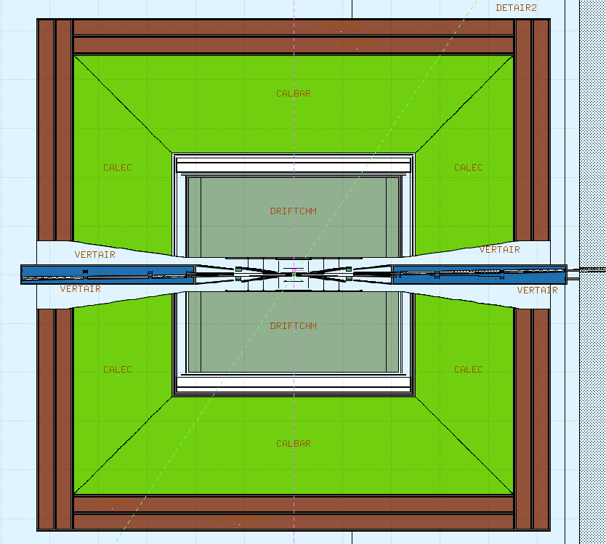
Workflow - step 3
20/10/2025 Seminar for the admission to the 3rd year of the PhD in Accelerator Physics
Giulia Nigrelli
For background studies the relevant impacts are the one in the tertiary collimators, placed upstream of the IP.
The 6D coordinates of every primary electron is propagated in FLUKA from the collimators up to the Machine-Detector Interface surface (in red).
The particles reaching the MDI are saved and then converted into HEPEvt format, ready to be used in detector simulation.
Notes:
The impacts on the tertiary collimators close to the Ips have been used in the FLUKA geometry of the Interaction region, developed by A. Frasca et al, to track electromagnetic shower that can produce background to the experiment.

Slide 13
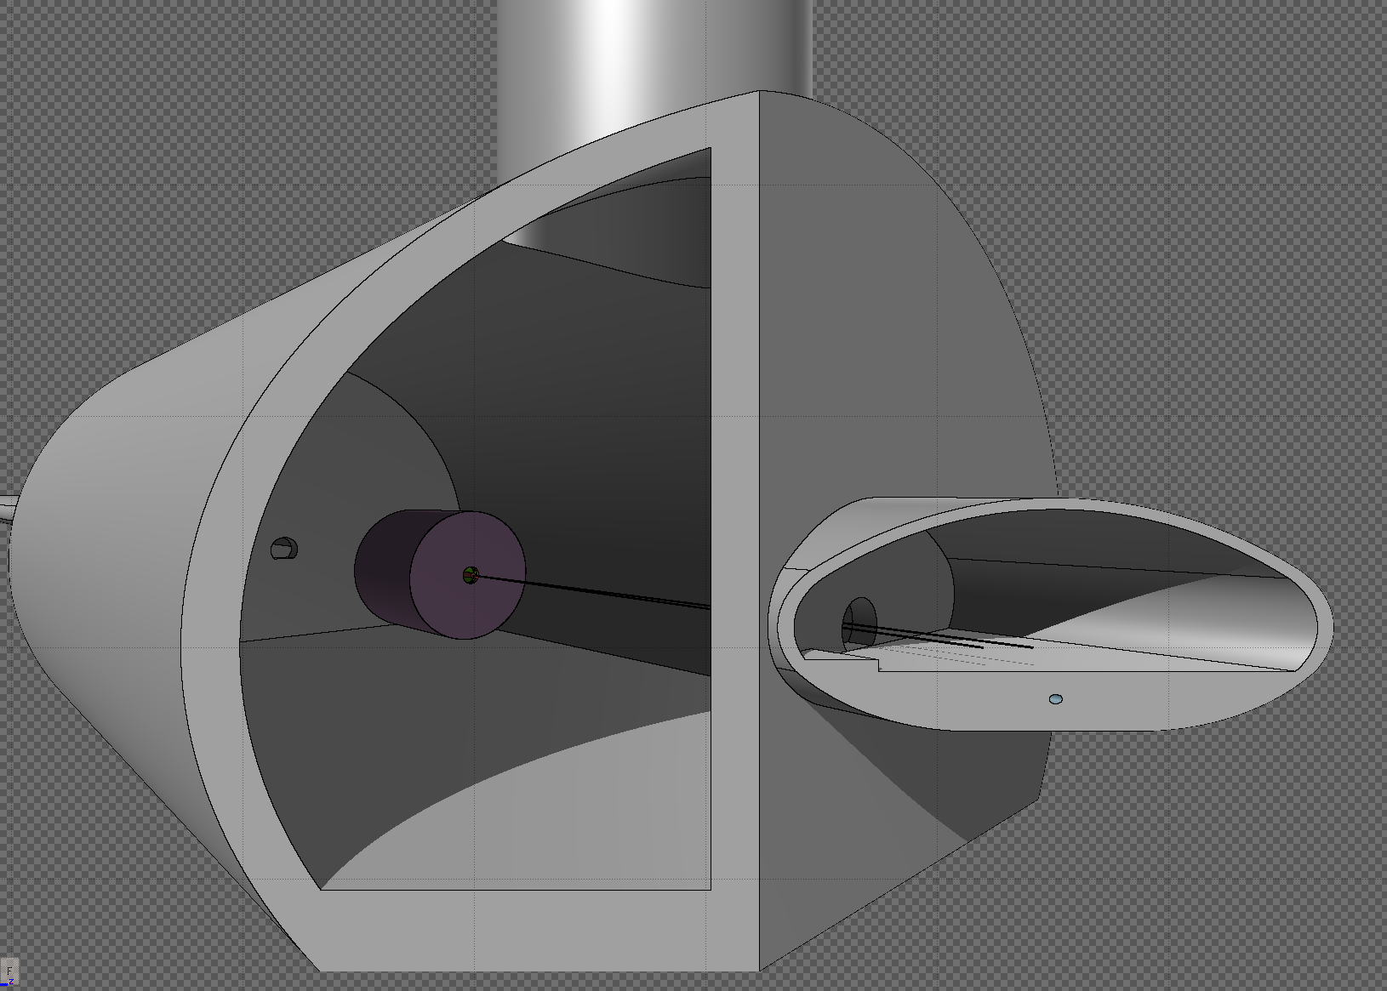
Workflow - step 3
20/10/2025 Seminar for the admission to the 3rd year of the PhD in Accelerator Physics
Giulia Nigrelli
We observed many particles reaching the detector from the outside.
It is not realistic to have all that empty space in the cavern.
A wall in front of the cavern is been introduced to screen these particles.
Needs to be further investigated.
Beam

Slide 14
Outline
20/10/2025 Seminar for the admission to the 3rd year of the PhD in Accelerator Physics
Giulia Nigrelli
Introduction
  FCC: the Future Circular Collider
  FCC-ee collimation overview
  FCC-ee beam induced background (BIB) sources
Beam Induced Background full simulation workflow
Case studies:
  Steady loss - injection background
  Failure case - fast instabilities
SUPERKEKB benchmark plan
Conclusions and future steps

Slide 15

Introduction
20/10/2025 Seminar for the admission to the 3rd year of the PhD in Accelerator Physics
Giulia Nigrelli
We focus on ring losses during the injection process, since they might cause backgrounds to the experiment. The cases of interest include:
Perfect injection:
  Injected beam, losses due not 100% efficiency.
  Losses due to the bump: the beam circulating in the collider must be brought close to the injected one. In this procedure part of the beam is scraped at the septum/absorber placed at the injection point. (More information here)
$π−$bump
Injection failures scenarios (not yet studied) impact on collimation/experiments:
  Issues with the bump, like partial closure.
  Mismatched injected beam, like higher energy offset.
Circulating
beam
Septum blade
Injected beam

Slide 16
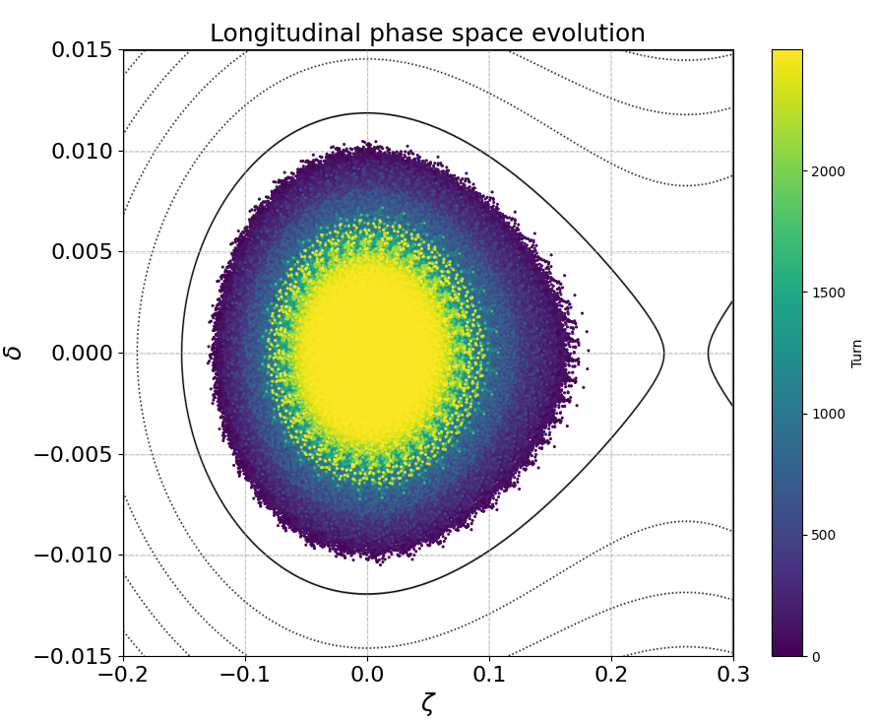
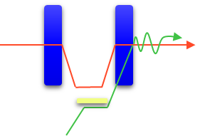
Top-up Injection for FCC-ee
20/10/2025 Seminar for the admission to the 3rd year of the PhD in Accelerator Physics
Giulia Nigrelli
This results have been produced with xutil.
Beam lifetime during collisions well below 1h → top-up injection scheme required.
Z-mode most critical for injection → up to 1 % of full beam intensity is injected every 10 s.
On-axis & Off-energy current baseline scheme. Hybrid mode, i.e., Off-axis & Off-energy, is considered as an option, and baseline for W-mode.
The injected beam synchronously damps until it merges with the stored one.
A collimator is introduced at the injection point, as a placeholder for the absorber (not yet being designed).
$π−$bump
Circulating
beam
Septum blade
Injected beam

Slide 17
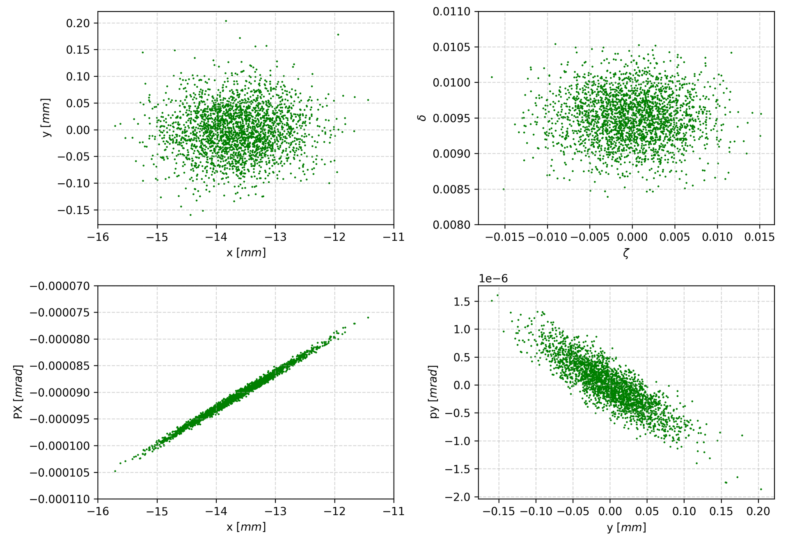
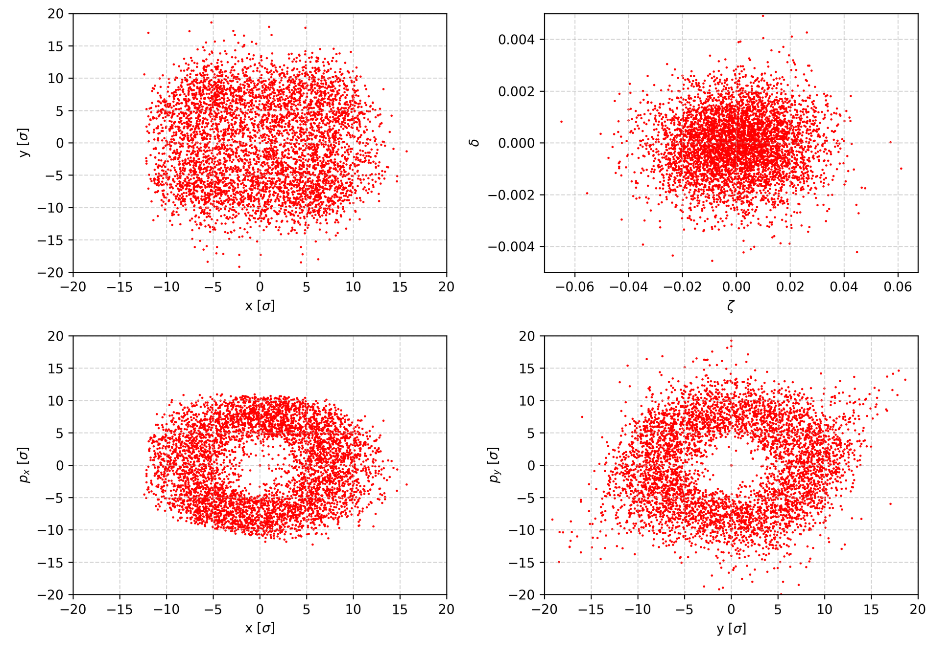
Simulation setup
20/10/2025 Seminar for the admission to the 3rd year of the PhD in Accelerator Physics
Giulia Nigrelli
Injected beam
Gaussian beam matched to the chromatic orbit with 𝛿=0.95%.
Assuming to be able to match perfectly to whatever condition at the injection point.
Circulating halo
Circular sector between $5 σ$ and $11σ$.
Circular sector between 𝟓 𝝈 and 𝟏𝟏𝝈.
In the future, distribution from the transfer lines should be used.
To be optimized with a more realistic description of the halo (studies undergoing).
$5×{10}^{5} e^{+}$ tracked for 2500 turns.
5×10^5 𝑒^+ tracked for 2500 turns.
$5×{10}^{5} e^{+}$ tracked for 100 turns.
5×10^5 𝑒^+ tracked for 100 turns.
Assumed storing 1% of the total beam energy.

Slide 18
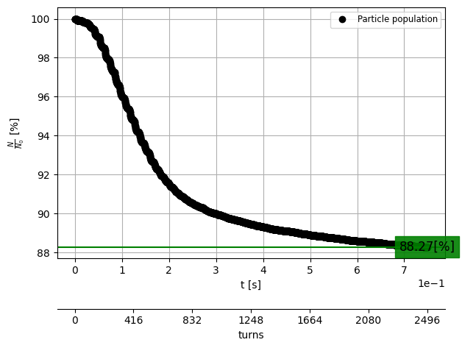
Injection efficiency
20/10/2025 Seminar for the admission to the 3rd year of the PhD in Accelerator Physics
Giulia Nigrelli
Injection efficiency is assessed in presence of collimator, beam-beam and SR, for the first time at 88% for lattice V25.1_GHC.
Beam-beam effect reduces the efficiency by a factor 20%.
Hybrid scheme could improve efficiency by 10%.
12% of the beam is lost around the ring.
On top of this 50% of the halo is scraped at the injection point and generates losses along the ring.

Slide 19
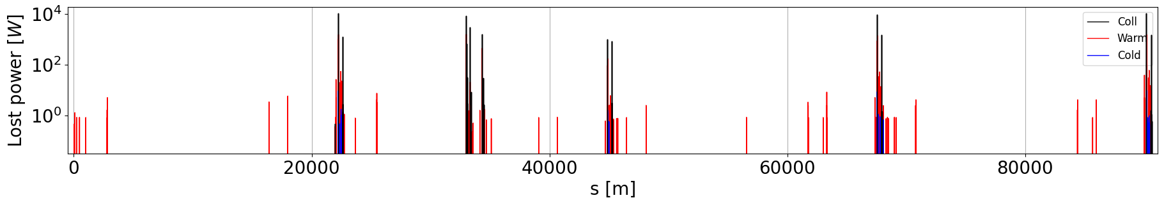
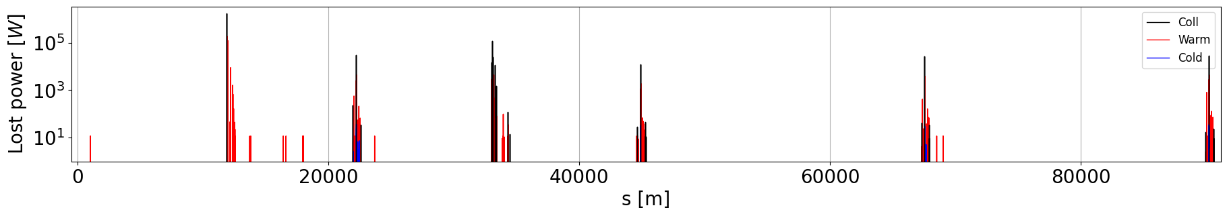
Losses distribution
20/10/2025 Seminar for the admission to the 3rd year of the PhD in Accelerator Physics
Giulia Nigrelli
Losses are focused on the collimation insertion and around the IPs.
The tertiary collimator close to the IPs get as much losses as the collimation insertion in PF.
Dedicated studies are needed to assess possible background.
The IP immediately downstream of the collimation insertion is better protected.
INJ
IP
COLL
IP
IP
IP
INJBEAM
HALO
*power calculated over 700 and 100 turns respectively.

Slide 20
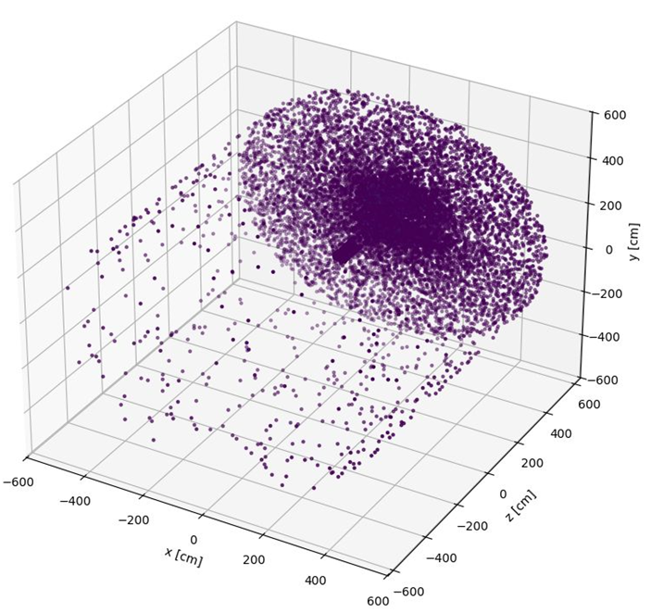
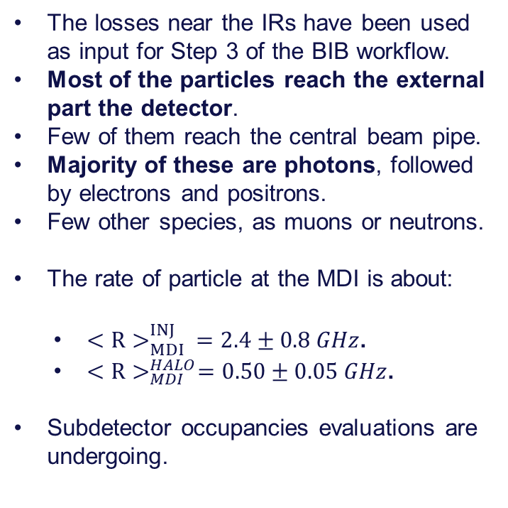

Particles at the MDI
20/10/2025 Seminar for the admission to the 3rd year of the PhD in Accelerator Physics
Giulia Nigrelli
The losses near the IRs have been used as input for Step 3 of the BIB workflow.
Most of the particles reach the external part the detector.
Few of them reach the central beam pipe.
Majority of these are photons, followed by electrons and positrons.
Few other species, as muons or neutrons.
The rate of particle at the MDI is about:
  $<R>_{MDI}^{INJ} =2.4±0.8 GHz$.
  $<R>_{MDI}^{HALO}=0.50±0.05 GHz$.
Subdetector occupancies evaluations are undergoing.
$$e^{−}$$
IP
Notes:
1.3% of simulated particles get to the detector for halo
0.6% of simulated particles get to the detector for injected

Slide 21
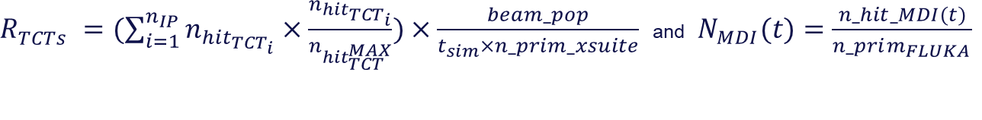
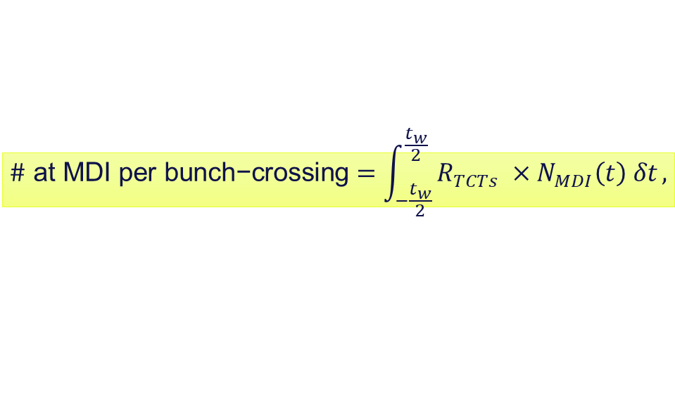

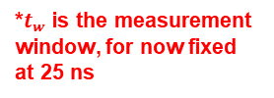

Hit at MDI calculation
20/10/2025 Seminar for the admission to the 3rd year of the PhD in Accelerator Physics
Giulia Nigrelli
For each scenario, a hit rate at the MDI is given as a normalization factor. Given the time structure of the particles at the MDI a possible normalization taken the time structure into account is:
Different detectors might need different normalization if integration time is longer.
Alternatively, not considering the time structure:
N.B. to have enough statistic the same collimator hits are reused, the resampling factor is estimated as:
$$\text{\#} \text{at} \text{MDI} \text{per} \text{bunch}\text{−}\text{crossing}=\int_{−\frac{t_{w}}{2}}^{\frac{t_{w}}{2}}{R_{TCTs} ×N_{MDI}\left(t\right) δt},$$
*$t_{w}$ is the measurement window, for now fixed at 25 ns
$R_{TCTs}^{} =(\sum_{i=1}^{n_{IP}}{n_{hit_{TCT_{i}}}×\frac{n_{hit_{TCT_{i}}}}{n_{hit_{TCT}^{MAX}}})}×\frac{beam_pop}{t_{sim}×n_prim_xsuite}$ and $N_{MDI}(t)=\frac{n_hit_MDI(t)}{n_prim_{FLUKA }}$
$$\text{r}\text{ate} \text{at} \text{MDI}=R_{TCTs} ×N_{MDI}$$
$$resampling factor= \frac{n_prim_{FLUKA }}{n_hit_tct}$$

Slide 22
Outline
20/10/2025 Seminar for the admission to the 3rd year of the PhD in Accelerator Physics
Giulia Nigrelli
Introduction
  FCC: the Future Circular Collider
  FCC-ee collimation overview
  FCC-ee beam induced background (BIB) sources
Beam Induced Background full simulation workflow
Case studies:
  Steady loss - injection background
  Failure case - fast instabilities
SUPERKEKB benchmark plan
Conclusions and future steps

Slide 23
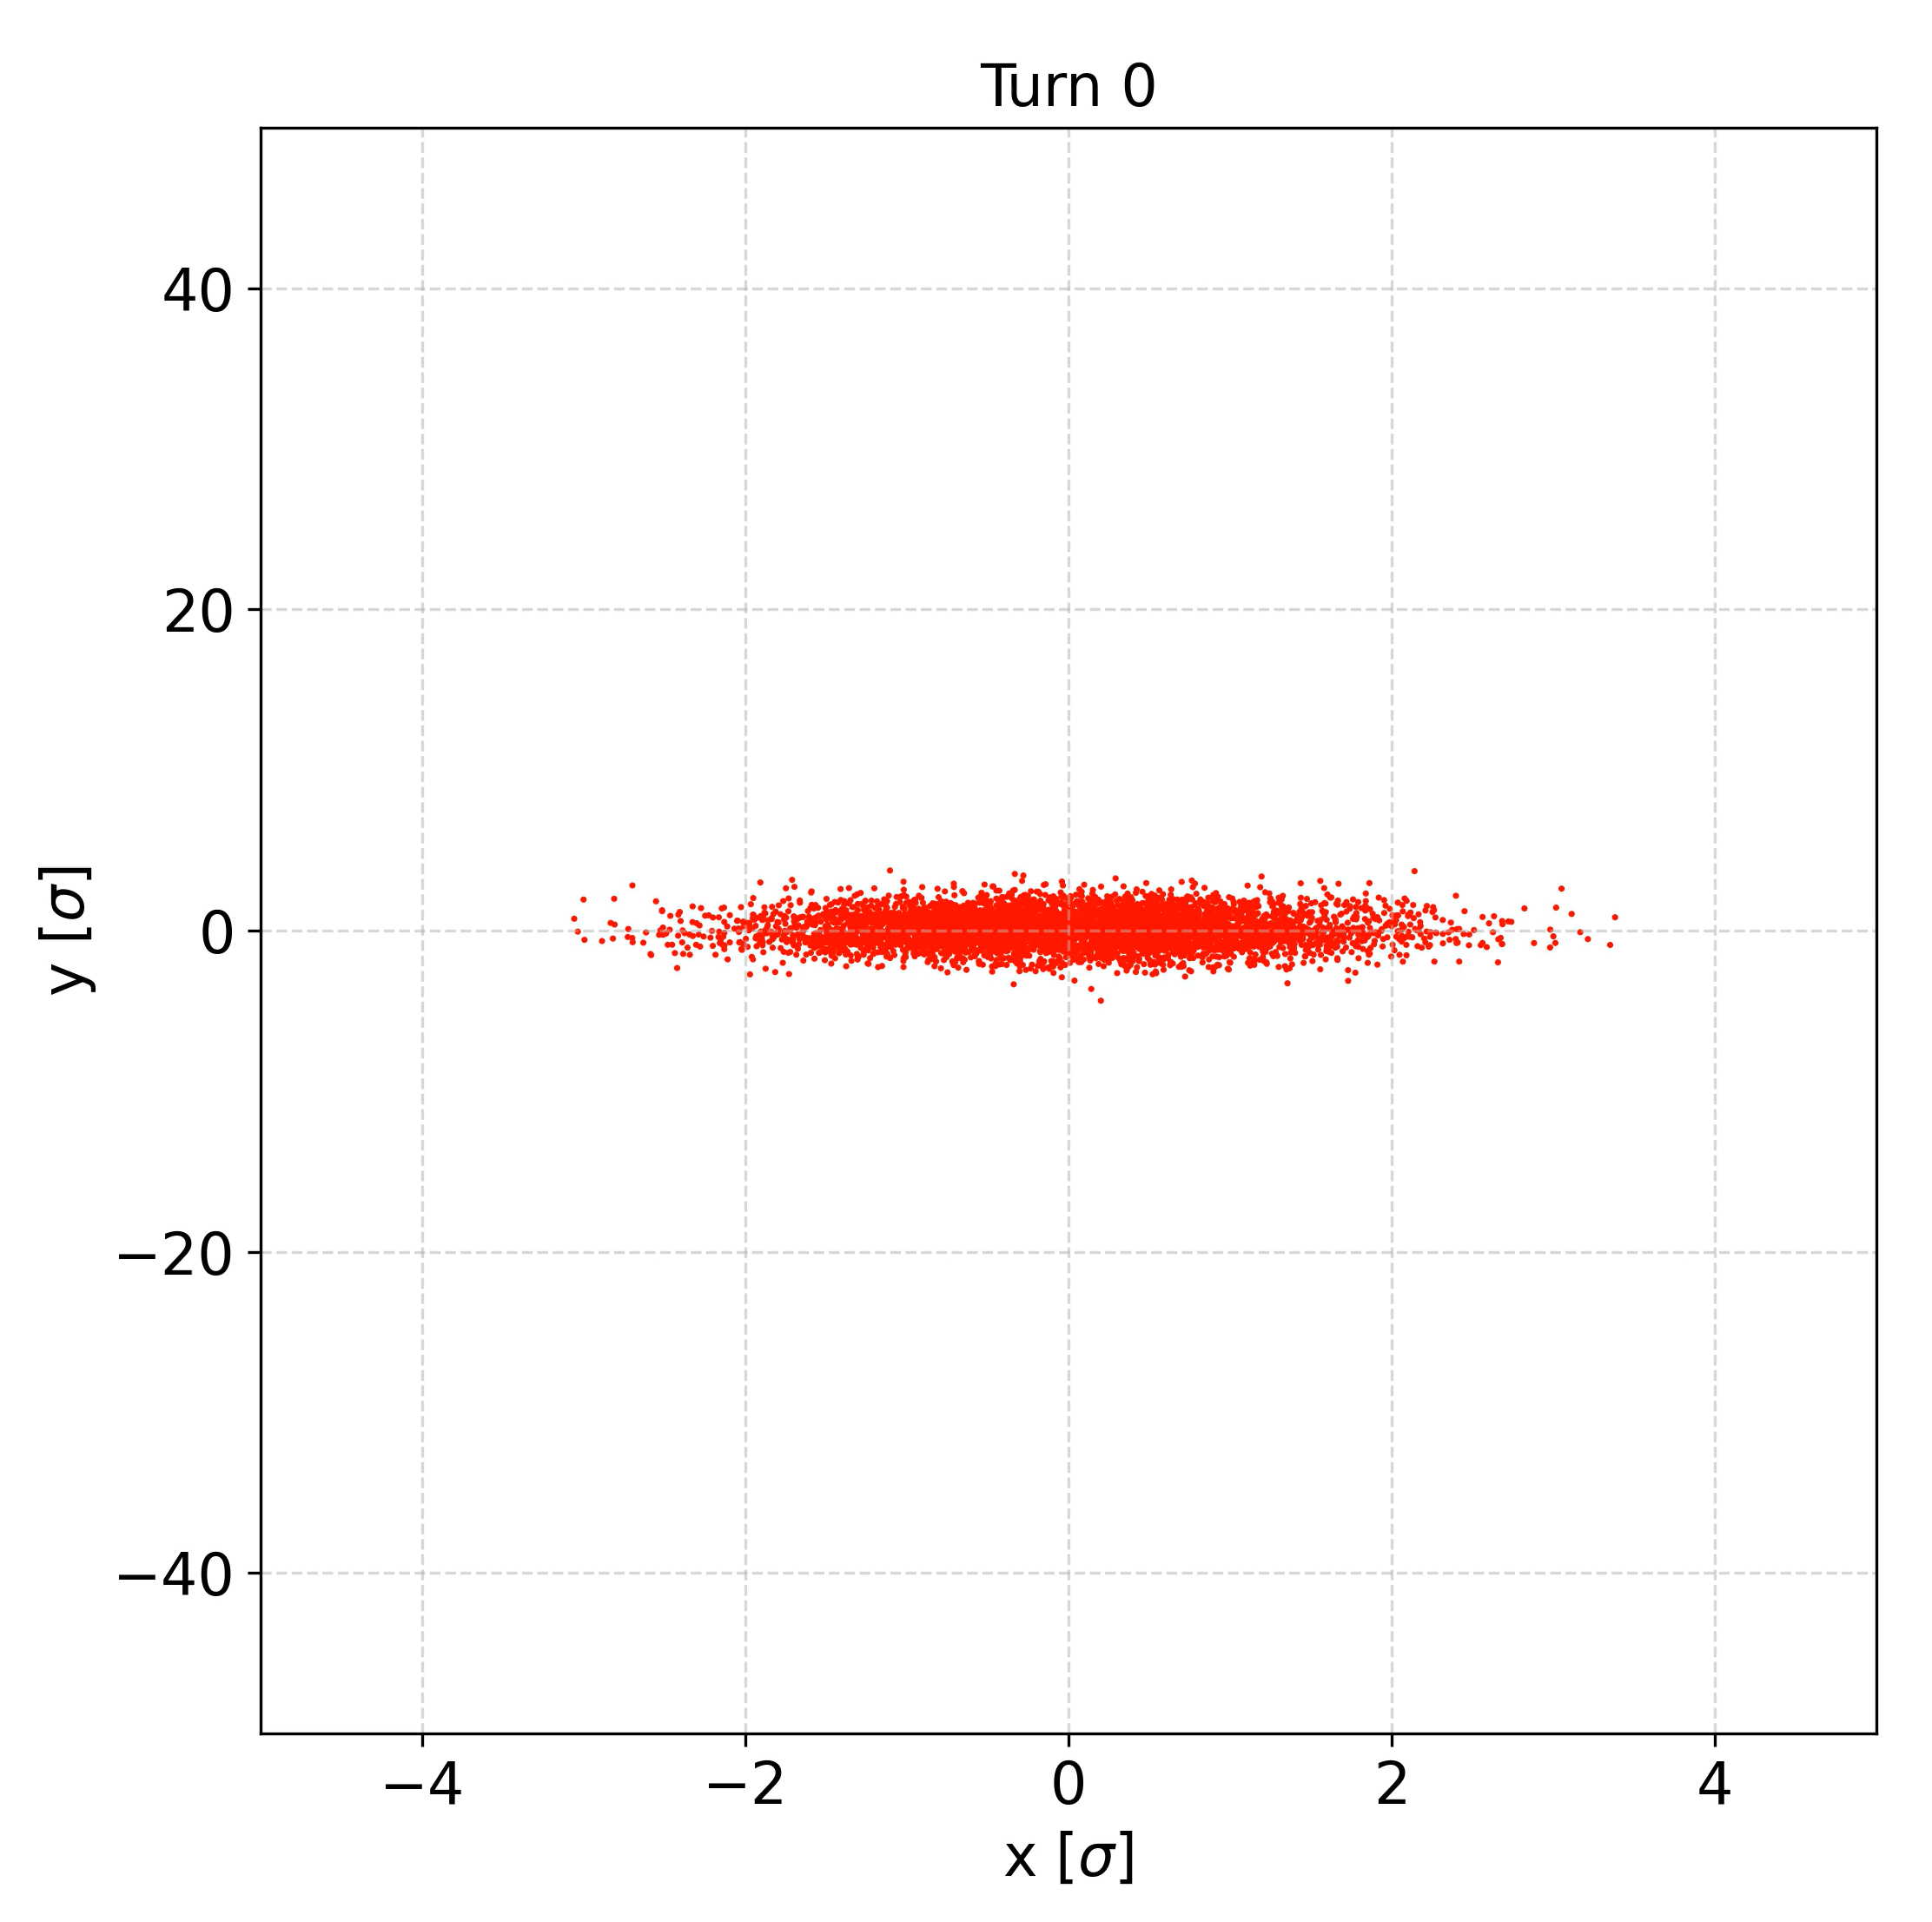
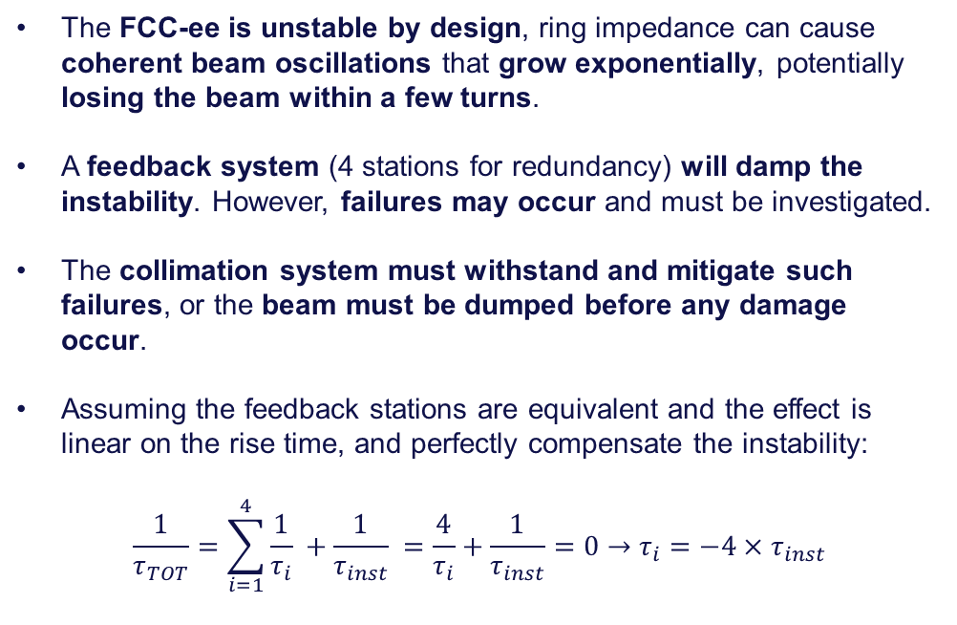
Fast instabilities
20/10/2025 Seminar for the admission to the 3rd year of the PhD in Accelerator Physics
Giulia Nigrelli
23
The FCC-ee is unstable by design, ring impedance can cause coherent beam oscillations that grow exponentially, potentially losing the beam within a few turns.
A feedback system (4 stations for redundancy) will damp the instability. However, failures may occur and must be investigated.
The collimation system must withstand and mitigate such failures, or the beam must be dumped before any damage occur.
Assuming the feedback stations are equivalent and the effect is linear on the rise time, and perfectly compensate the instability:
$$\frac{1}{τ_{TOT}}=\sum_{i=1}^{4}{\frac{1}{τ_{i}} }+\frac{1}{τ_{inst}} =\frac{4}{τ_{i}}+\frac{1}{τ_{inst}}=0→τ_{i}=−4×τ_{inst}$$

Slide 24
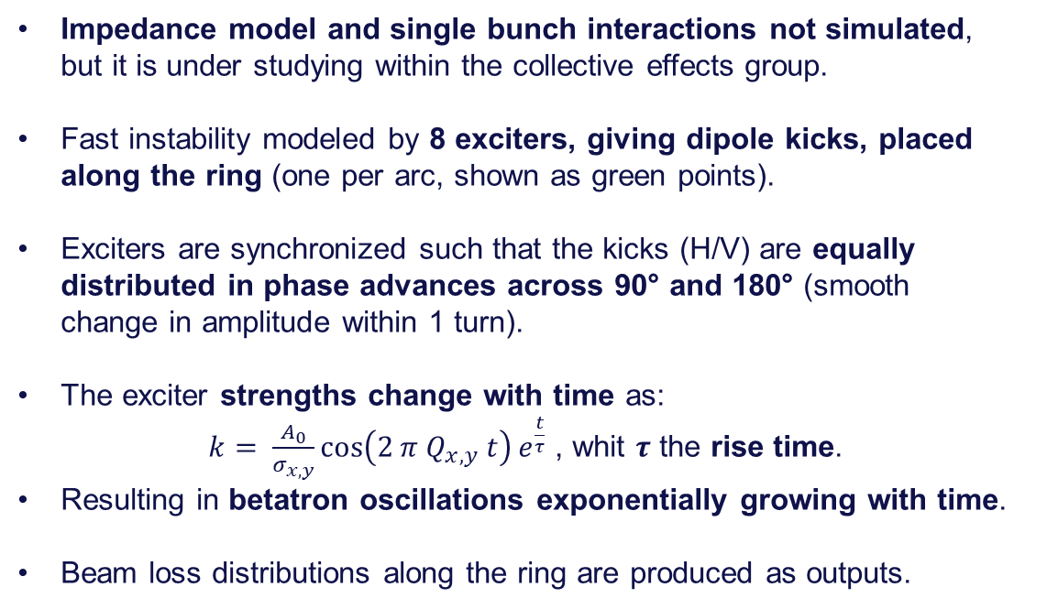
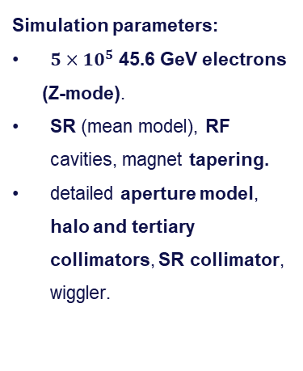
Simulation setup
20/10/2025 Seminar for the admission to the 3rd year of the PhD in Accelerator Physics
Giulia Nigrelli
IPA
IPB
Impedance model and single bunch interactions not simulated,
but it is under studying within the collective effects group.
Fast instability modeled by 8 exciters, giving dipole kicks, placed along the ring (one per arc, shown as green points).
Exciters are synchronized such that the kicks (H/V) are equally distributed in phase advances across 90° and 180° (smooth
change in amplitude within 1 turn).
The exciter strengths change with time as:
$k= \frac{A_{0}}{σ_{x, y}}\cos\left(2 π Q_{x,y} t\right)e^{\frac{t}{τ}}$ , whit $τ$ the rise time.
Resulting in betatron oscillations exponentially growing with time.
Beam loss distributions along the ring are produced as outputs.
IPJ
IPD
IPF
IPG
Simulation parameters:
$5×10^{5}$ 45.6 GeV electrons
(Z-mode).
SR (mean model), RF cavities, magnet tapering.
detailed aperture model, halo and tertiary collimators, SR collimator, wiggler.
Notes:
All the kickers are in phase?

Slide 25
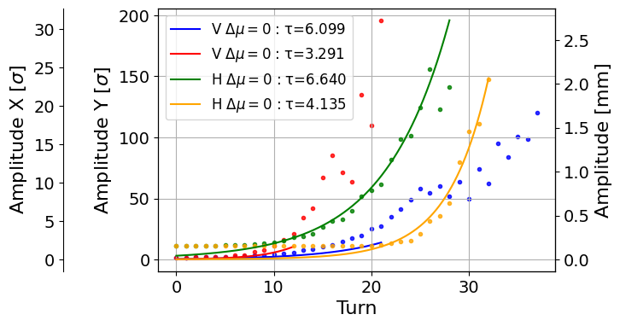
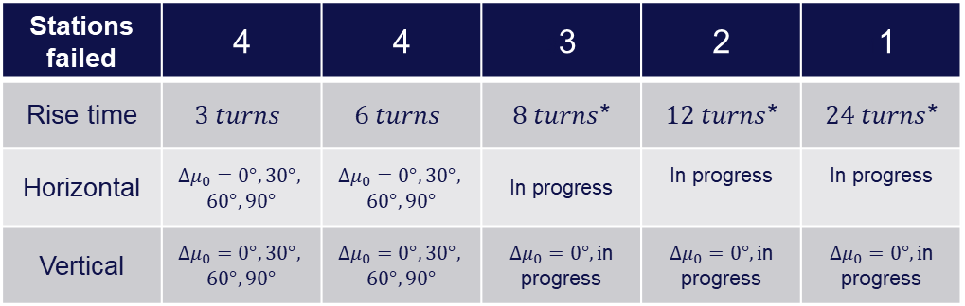


Case studies
20/10/2025 Seminar for the admission to the 3rd year of the PhD in Accelerator Physics
Giulia Nigrelli
25
$$A_{x}[σ]=\frac{\sqrt{2 J_{x}β_{x}}}{σ_{x}}$$
Fit of the amplitude growth to the average centroid of the beam.
Since the instability can start at any point, it is relevant to explore the phase dependence.
Exciters shifted along the ring to have four different phase advances between the first exciter and the primary collimator.
*assuming $τ_{inst}=6$
Stations failed | 4 | 4 | 33 | 2 | 11
Rise time | $$3 turns$$ | $$6 turns$$ | $8 turns$* | $12 turns$* | $24 turns$*
Horizontal | $${Δμ}_{0}=0°, 30°,$$ $$60°, 90°$$ | $${Δμ}_{0}=0°, 30°,$$ $$60°, 90°$$ | In progress | In progress | In progress
Vertical | $$Δμ_{0}=0°, 30°,$$ $$60°, 90°$$ | $$Δμ_{0}=0°, 30°,$$ $$60°, 90°$$ | $Δμ_{0}=0°, i$n progress | $Δμ_{0}=0°, i$n progress | $Δμ_{0}=0°, i$n progress
Energy deposition studies have shown that the complete failure of the feedback cannot be width stand by the collimation system.

Slide 26
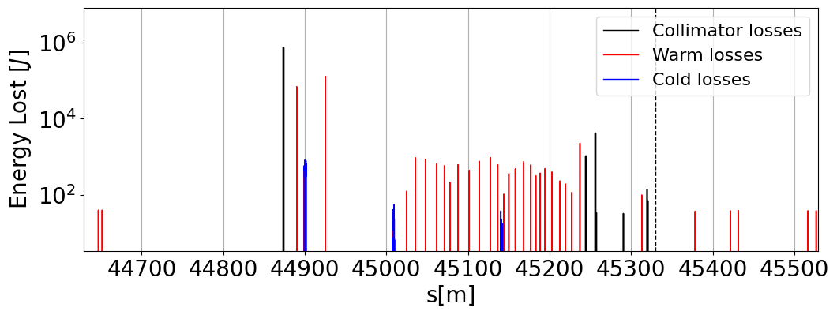
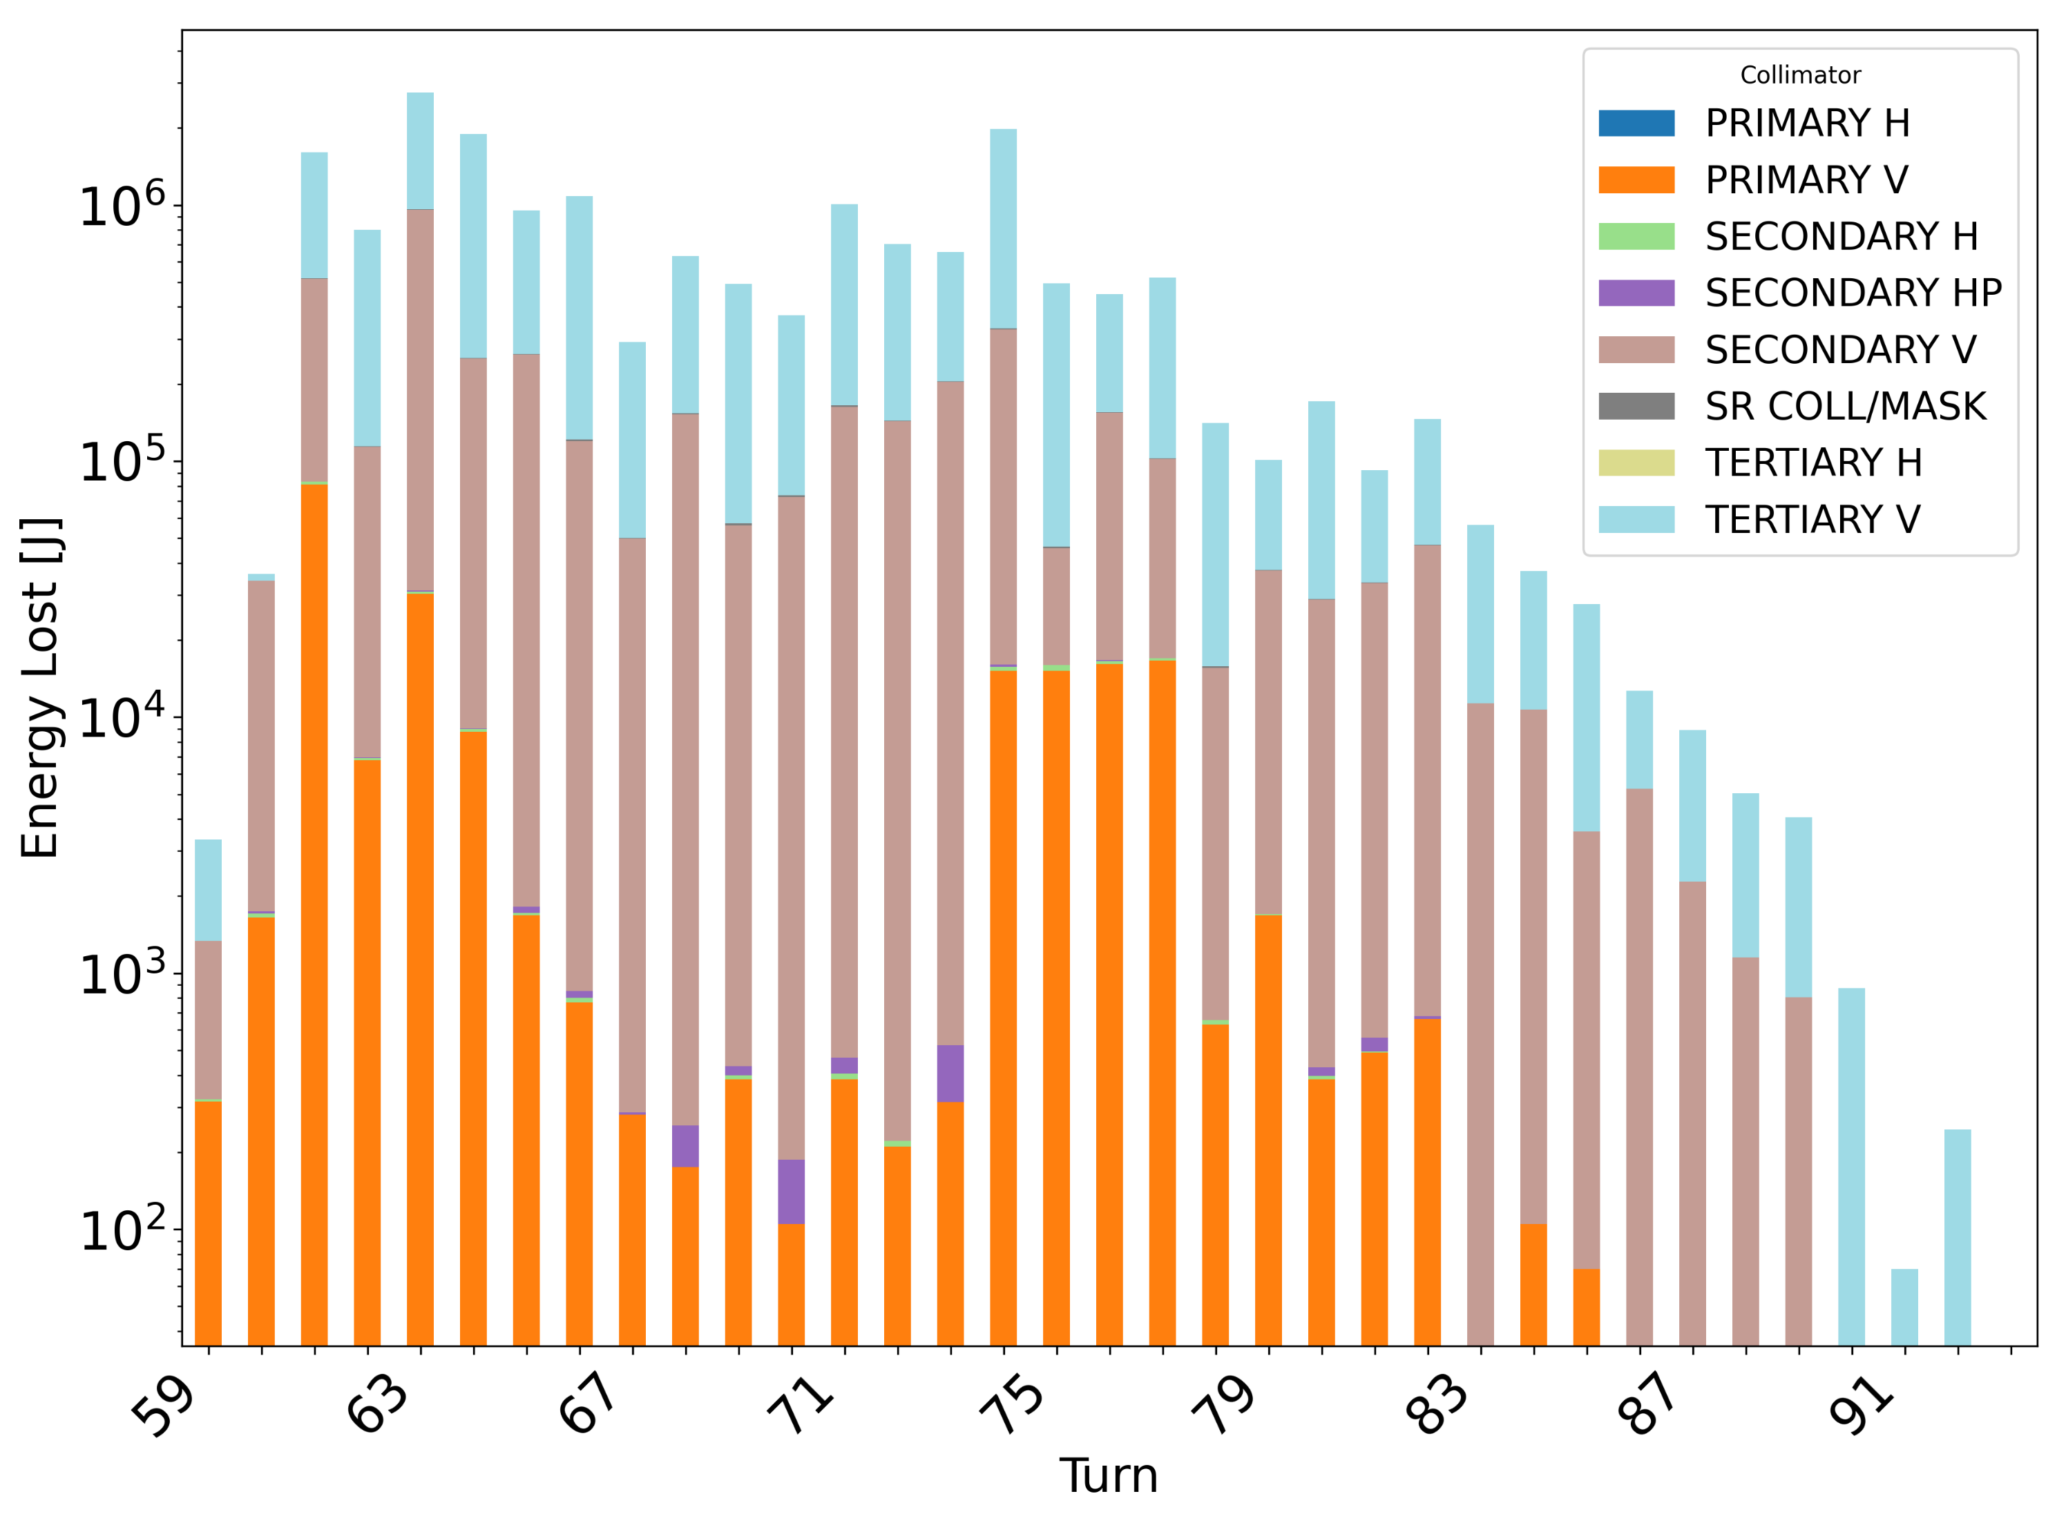

Instability loss patterns
20/10/2025 Seminar for the admission to the 3rd year of the PhD in Accelerator Physics
Giulia Nigrelli
$$τ=12 turn$$
TCT.V
IP
In general, fast instabilities could be dangerous if more than 1 station fail simultaneously.
Worst case full beam lost within few turns.
MJ losses in the collimator can be expected.
Too fast for beam loss monitor interlocks → use feedback/orbit-based interlocks.
Collimator hierarchy is not always respected → collimation system not fully efficient for fast losses.
Phase dependence is critical.
High losses in proximity of the interaction regions, producing potential background to the experiments.

Slide 27
Outline
20/10/2025 Seminar for the admission to the 3rd year of the PhD in Accelerator Physics
Giulia Nigrelli
Introduction
  FCC: the Future Circular Collider
  FCC-ee collimation overview
  FCC-ee beam induced background (BIB) sources
Beam Induced Background full simulation workflow
Case studies:
  Steady loss - injection background
  Failure case - fast instabilities
SUPERKEKB benchmark plan
Conclusions and future steps

Slide 28
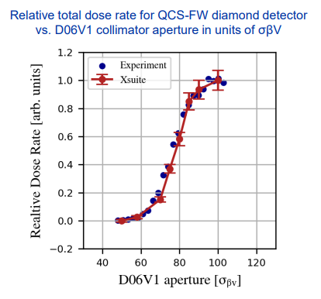
Xsuite benchmark at SuperKEKB
20/10/2025 Seminar for the admission to the 3rd year of the PhD in Accelerator Physics
Giulia Nigrelli
SuperKEKB data have already been used for Xsuite benchmark (G. Broggi – IPAC’25).
Backgrounds from beam-gas (Brems, Coulomb) and Touschek scattering have been simulated and compared to data.
Dedicated single-beam background study at SuperKEKB LER (June 2020, A. Natochii, PRAB):
  D06V1 collimator aperture scan.
  Radiation dose rates measured by Belle II radiation monitors.
Simulations accurately reproduce the measured background trend.
Validates Xsuite–BDSIM for collimation and background studies in lepton machines.

Slide 29
Plan for benchmark at SuperKEKB
20/10/2025 Seminar for the admission to the 3rd year of the PhD in Accelerator Physics
Giulia Nigrelli
SuperKEKB data have already been used for Xsuite benchmark (G. Broggi – IPAC’25) with promising results.
We would like to use Xsuite to model also the injection scenario at SuperKEKB.
  To validate our simulation framework as well as to help understanding better this dangerous background.
Participation at the collimator alignment in LER, planned for this November, is a great opportunity to benchmark Xsuite.
Possible observables (as function of collimator settings):
  Background levels at Belle-II.
  Beam losses close to beam loss monitors(to be used for full chain simulations).
  Injection efficiency.
Collaboration has already started with other injection working groups.

Slide 30
Outline
20/10/2025 Seminar for the admission to the 3rd year of the PhD in Accelerator Physics
Giulia Nigrelli
Introduction
  FCC: the Future Circular Collider
  FCC-ee collimation overview
  FCC-ee beam induced background (BIB) sources
Beam Induced Background full simulation workflow
Case studies:
  Steady loss - injection background
  Failure case - fast instabilities
SUPERKEKB benchmark plan
Conclusions and future steps

Slide 31
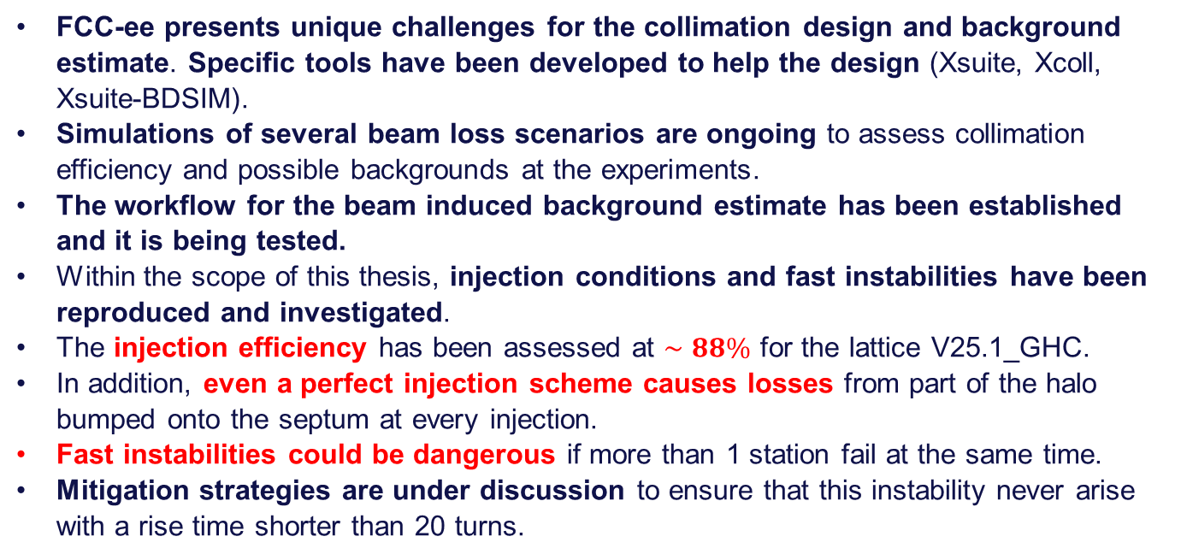
Conclusion
20/10/2025 Seminar for the admission to the 3rd year of the PhD in Accelerator Physics
Giulia Nigrelli
FCC-ee presents unique challenges for the collimation design and background estimate. Specific tools have been developed to help the design (Xsuite, Xcoll, Xsuite-BDSIM).
Simulations of several beam loss scenarios are ongoing to assess collimation efficiency and possible backgrounds at the experiments.
The workflow for the beam induced background estimate has been established and it is being tested.
Within the scope of this thesis, injection conditions and fast instabilities have been reproduced and investigated.
The injection efficiency has been assessed at $∼88\%$ for the lattice V25.1_GHC.
In addition, even a perfect injection scheme causes losses from part of the halo bumped onto the septum at every injection.
Fast instabilities could be dangerous if more than 1 station fail at the same time.
Mitigation strategies are under discussion to ensure that this instability never arise with a rise time shorter than 20 turns.
Notes:
In addition, even a perfect injection scheme causes losses from part of the halo bumped onto the septum at every injection

Slide 32
Future steps
20/10/2025 Seminar for the admission to the 3rd year of the PhD in Accelerator Physics
Giulia Nigrelli
Other beam induced background (BIB) scenarios:
  Reproduce injection failure scenarios and assess impact on collimators and detectors.
  Model sudden beam loss events (SuperKEKB-like) and estimate criticality for FCC-ee.
Full BIB workflow:
  Apply to different background sources.
  Evaluate impact on detector occupancy and performance.
SuperKEKB benchmark
  Participate in SuperKEKB operation (November) to collect data.
  Validate and tune Xsuite models for injection studies using data.
  Simulate synchrotron injection and propose dedicated experiment (if possible).
Notes:
In addition, even a perfect injection scheme causes losses from part of the halo bumped onto the septum at every injection

Slide 33
Thank you for your attention!
20/10/2025 Seminar for the admission to the 3rd year of the PhD in Accelerator Physics
Giulia Nigrelli

Slide 34
Backup
20/10/2025 Seminar for the admission to the 3rd year of the PhD in Accelerator Physics
Giulia Nigrelli

Slide 35
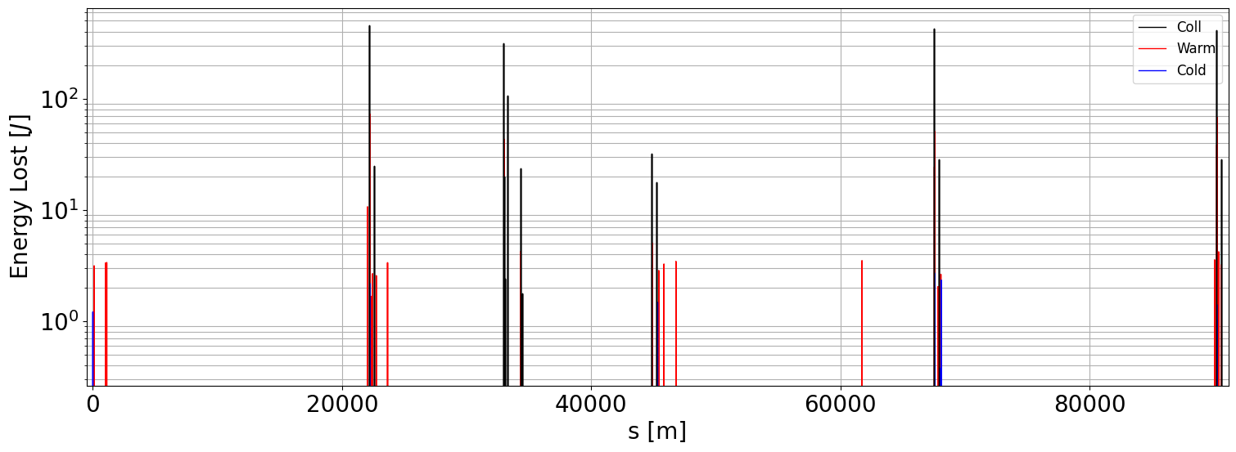
Injected beam – hybrid mode
20/10/2025 Seminar for the admission to the 3rd year of the PhD in Accelerator Physics
Giulia Nigrelli
In hybrid mode the beam is generated with lower energy offset, compesated by an horizontal offset.
Injection efficiency increase up to 98.5% hence only 1.5% of the injected beam is lost and distributed along the whole ring. With respect to the on-axis scheme, the hybrid mode presents better performances.
INJ
IP
COLL
IP
IP
IP

Slide 36
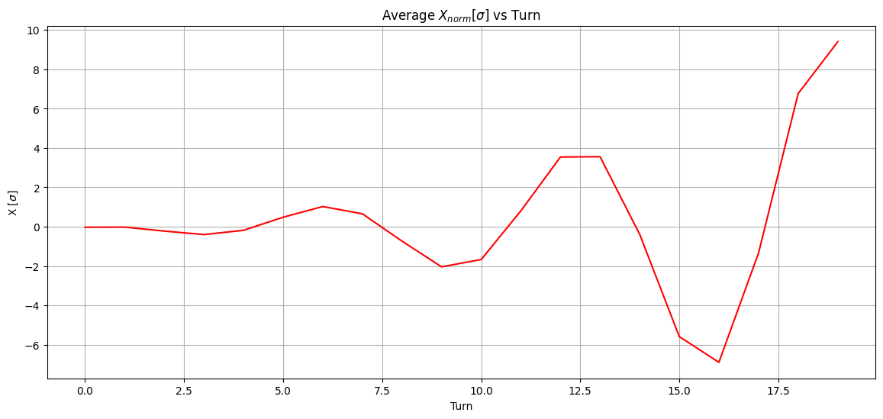
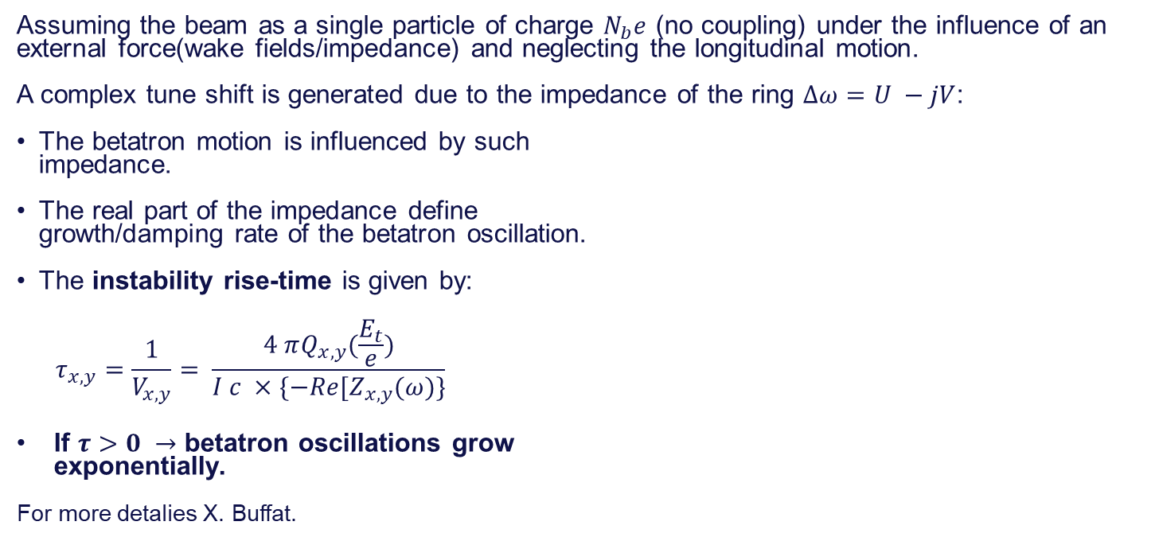
Fast instability theory
20/10/2025 Seminar for the admission to the 3rd year of the PhD in Accelerator Physics
Giulia Nigrelli
36
Assuming the beam as a single particle of charge $N_{b}e$ (no coupling) under the influence of an external force(wake fields/impedance) and neglecting the longitudinal motion.
A complex tune shift is generated due to the impedance of the ring $Δω=U −jV$:
The betatron motion is influenced by such
impedance.
The real part of the impedance define
growth/damping rate of the betatron oscillation.
The instability rise-time is given by:
$$τ_{x,y}=\frac{1}{V_{x,y}}= \frac{4 πQ_{x,y}(\frac{E_{t}}{e})}{I c ×\{−Re[Z_{x,y}(ω)\}}$$
If $τ>0 →$ betatron oscillations grow
exponentially.
For more detalies X. Buffat.

Slide 37
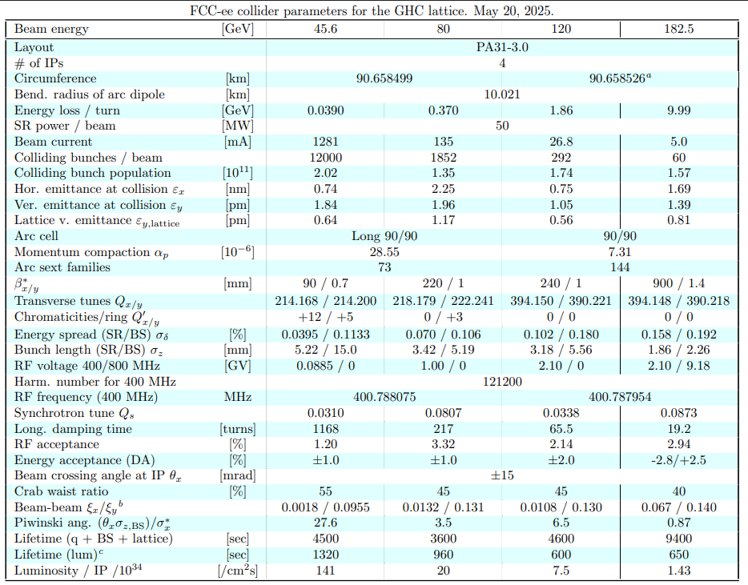
20/10/2025 Seminar for the admission to the 3rd year of the PhD in Accelerator Physics
Giulia Nigrelli

Slide 38
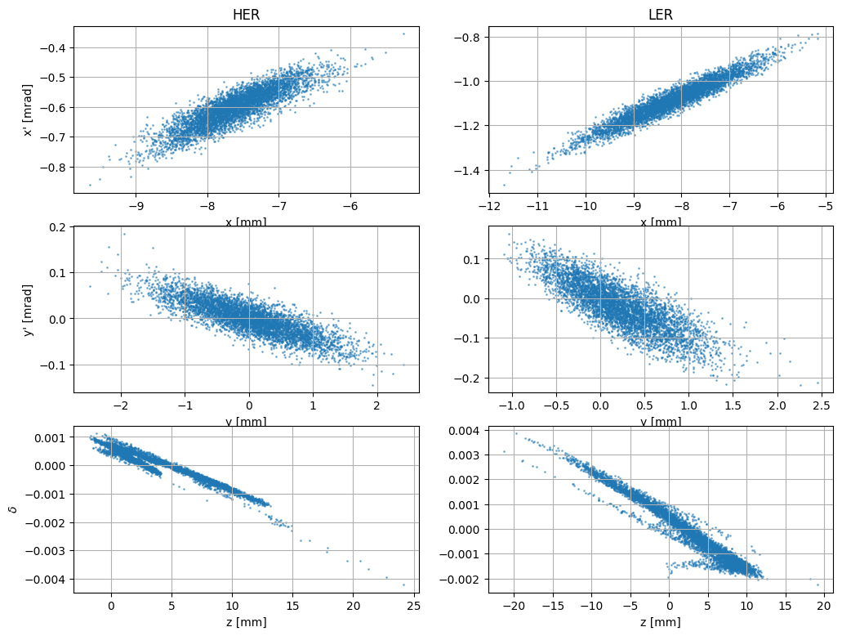
Simulation setup of SuperKEKB injection
08/09/2025 Injection study meeting
Giulia Nigrelli
The necessary simulation inputs have already been collected (big thanks to Meng Li), and first simulations have been performed.
Both HER and LER can be simulated.
The setup includes:
  Aperture model & collimators,
  Beam-beam effect,
  Synchrotron radiation,
  Distribution from transfer line
  (from Yoshimoto-san) with emittance
  adjustment + injection errors,
  Bunch-by-bunch feedback effect.
Additional features can be included in the future.

Slide 39
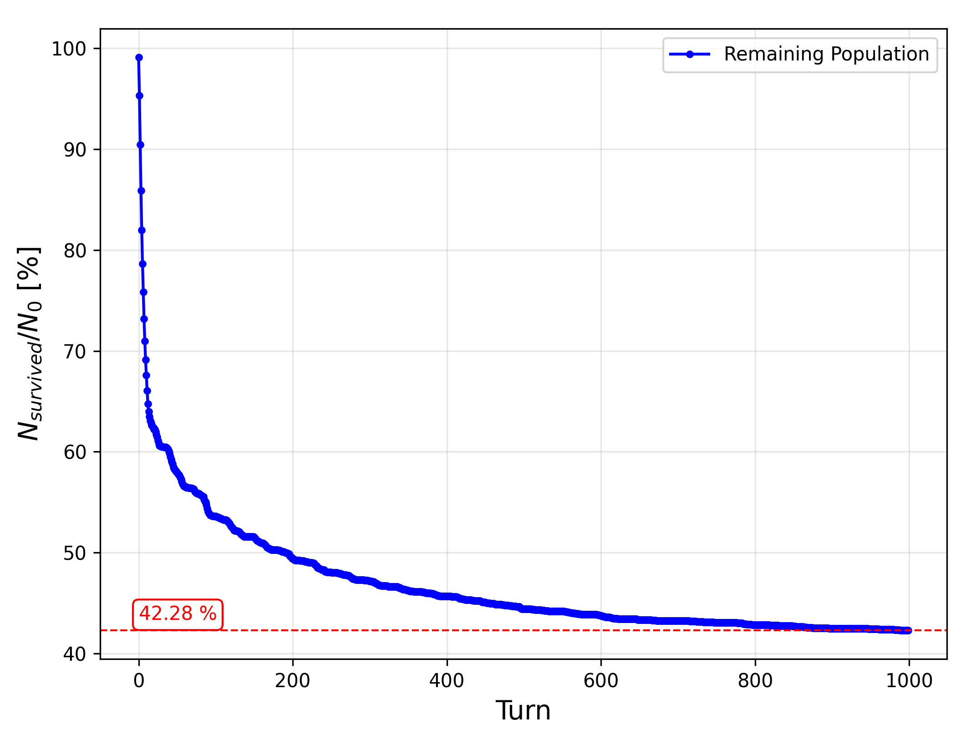
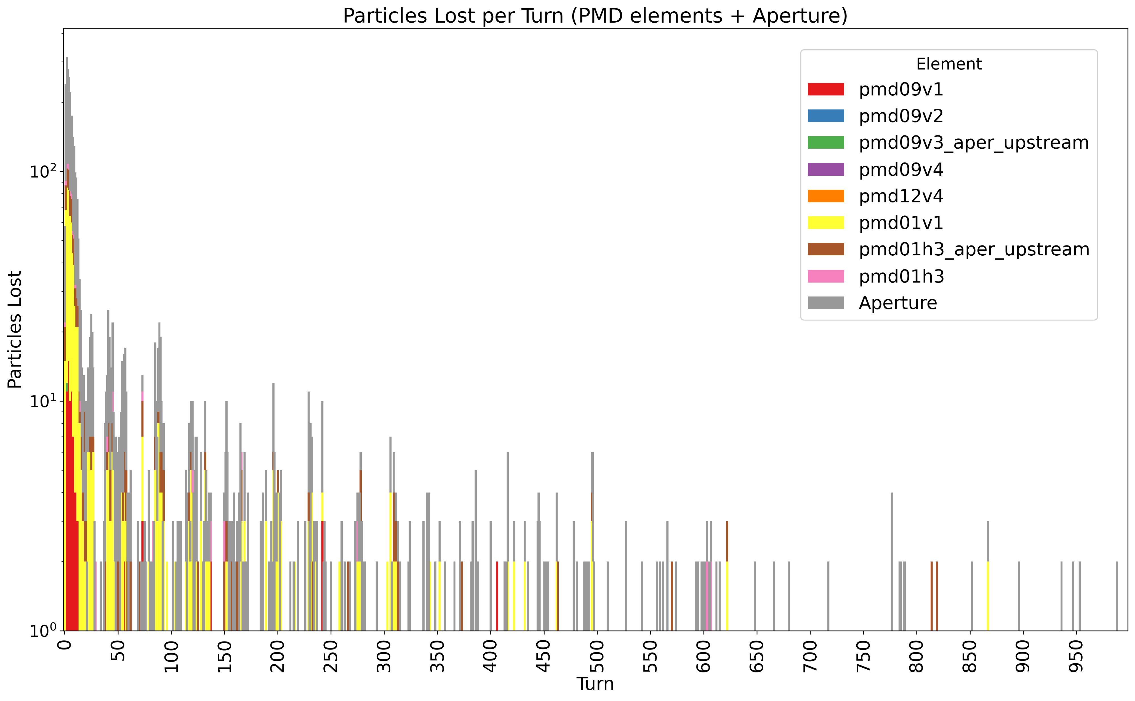
Injection at SuperKEKB: HER
08/09/2025 Injection study meeting
Giulia Nigrelli
The injection efficiency shows a similar behavior to Meng’s simulation (10% difference).
Also, from the Xsuite simulations emerges the primary role of the D01V1 collimator for the injection background as already found by Meng.

Slide 40
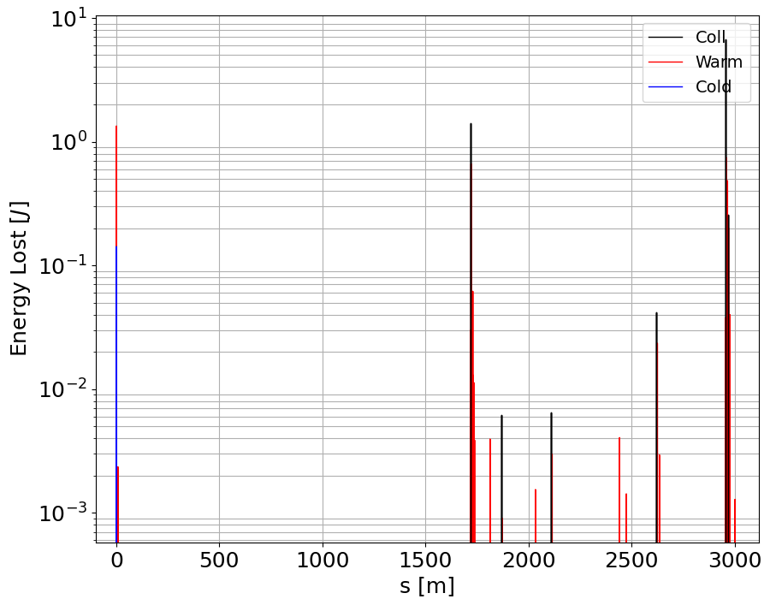
Losses distribution along the ring: HER
Belle-II
D09V1
D01V1
Highest peak at D01V1 as expected.
Very close to the Belle-II detector, likely background comes from there.
The other highest peak is D09V1, mostly impacted just after injection.
Injection

Slide 41
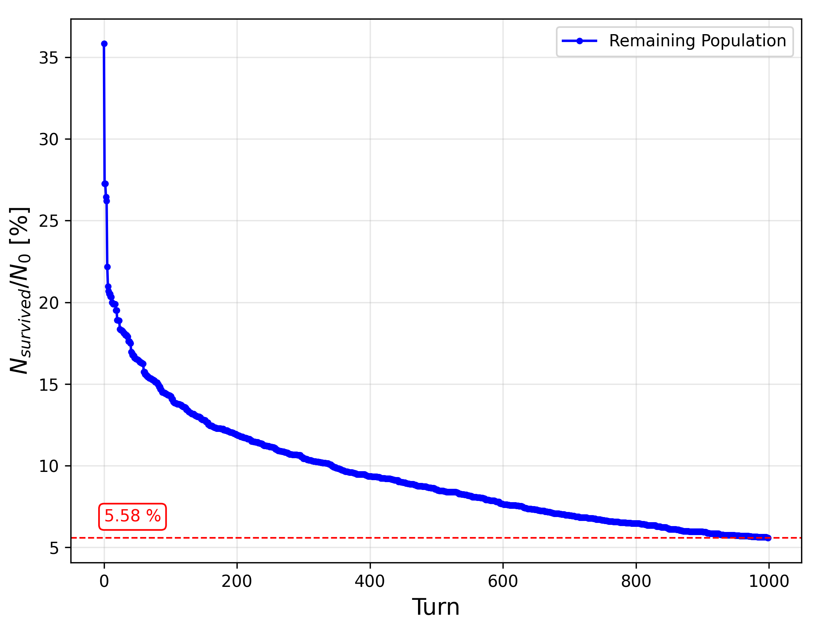
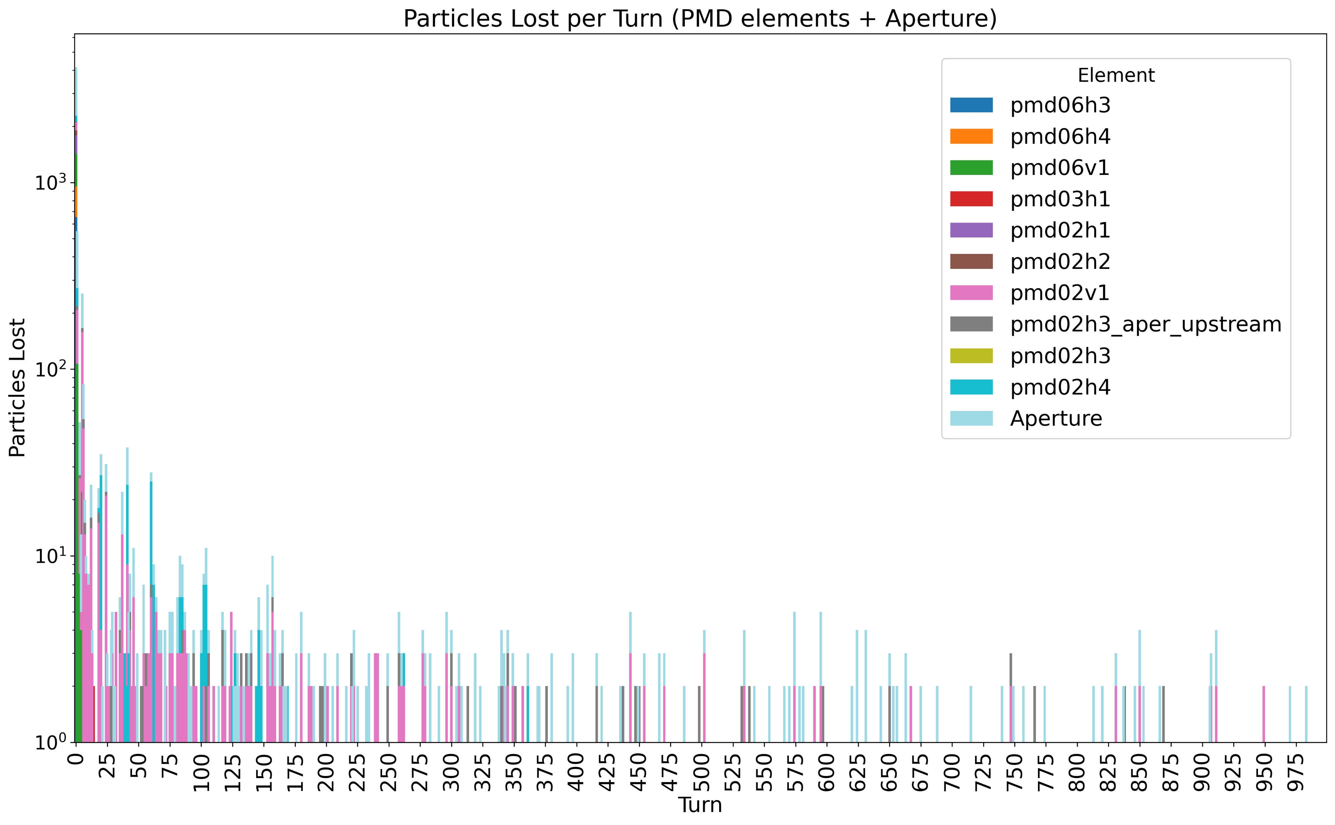
Injection at SuperKEKB: LER
08/09/2025 Injection study meeting
Giulia Nigrelli
The injection efficiency is much smaller for LER.
D02V1 seems to play a major role in this case.
Further investigation will be performed towards the collimator alignment in November.

Slide 42
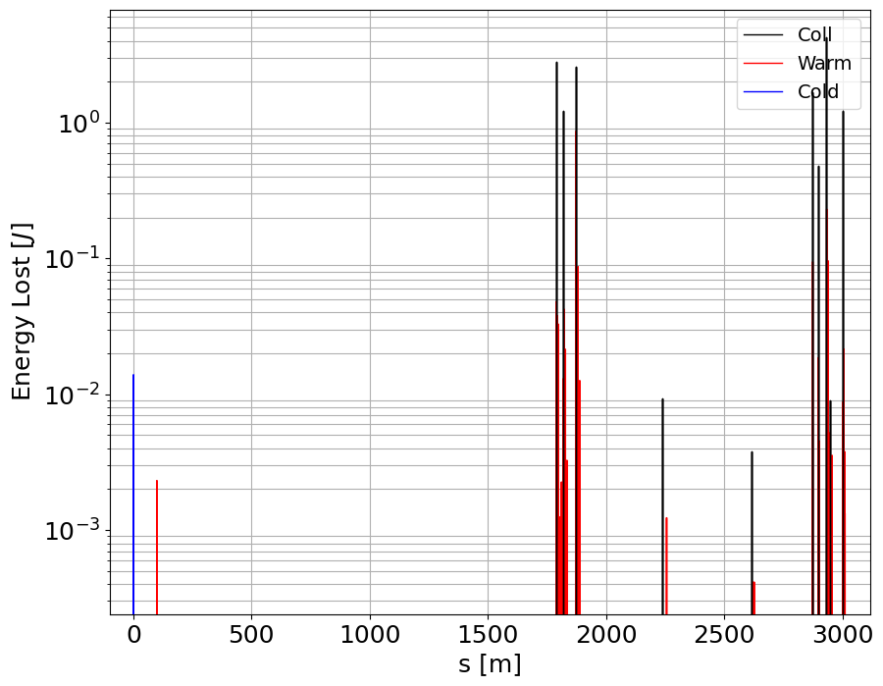
Losses distribution along the ring: LER
08/09/2025 Injection study meeting
Giulia Nigrelli
D06H3-D06H4
D02V1
Highest peak at D02V1 as shown before.
Very close to the Belle-II detector, likely background comes from there.
The other two highest peaks are D06H3 and D06H4, mostly impacted just after injection.
Belle-II
Injection

Slide 43
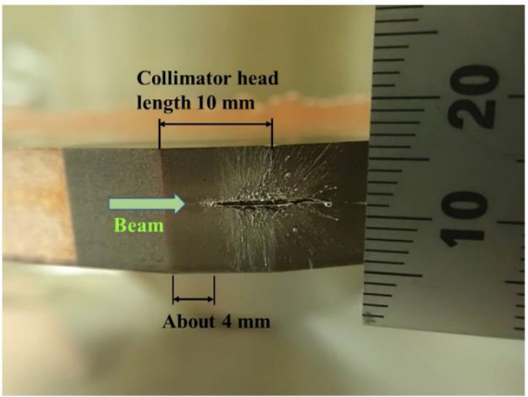
Motivation
19/06/2024 Topical meeting on FCC-ee beam-dust interactions
Giulia Nigrelli
Experience at SuperKEKB has demonstrated that sudden beam losses pose significant risks to both the machine and detectors.
FCC-ee beams are even more destructive, making it essential to understand and mitigate such events.
The current collimation system design for FCC-ee does not account for these beam loss scenarios.
Damage to coated collimator jaw due to accidental
beam loss in SuperKEKB – T. Ishibashi (slides)

Slide 44
Motivation
19/06/2024 Topical meeting on FCC-ee beam-dust interactions
Giulia Nigrelli
Understanding any unexpected loss scenarios at SuperKEKB is critical to the design of the FCC-ee collimation system.
Interest from collimation side to study global loss pattern following beam-dust interaction
  Losses on collimators,
  Losses in MDI regions,
  Potential impact on experiment.
Damage to coated collimator jaw due to accidental
beam loss in SuperKEKB – T. Ishibashi (slides)

Slide 45
Ways to simulated detailed loss patterns from beam-dust interactions
19/06/2024 Topical meeting on FCC-ee beam-dust interactions
Giulia Nigrelli
With inputs from external code:
  Need final-state coordinates bunch-by-bunch from beam-dust interaction.
  Track each bunch individually to obtain loss pattern.
  Multi-turn effect not included.
With dynamic beam-dust element:
  Could imagine to have beam-dust element inside XSuite tracking, similar to FLUKA/BDSIM collimator.
  Particle coordinates sent to beam-dust interaction code, final-state coordinates sent back to tracking.
  Multi-turn effects included.
  Not done yet – would require significant implementation work.

Slide 46
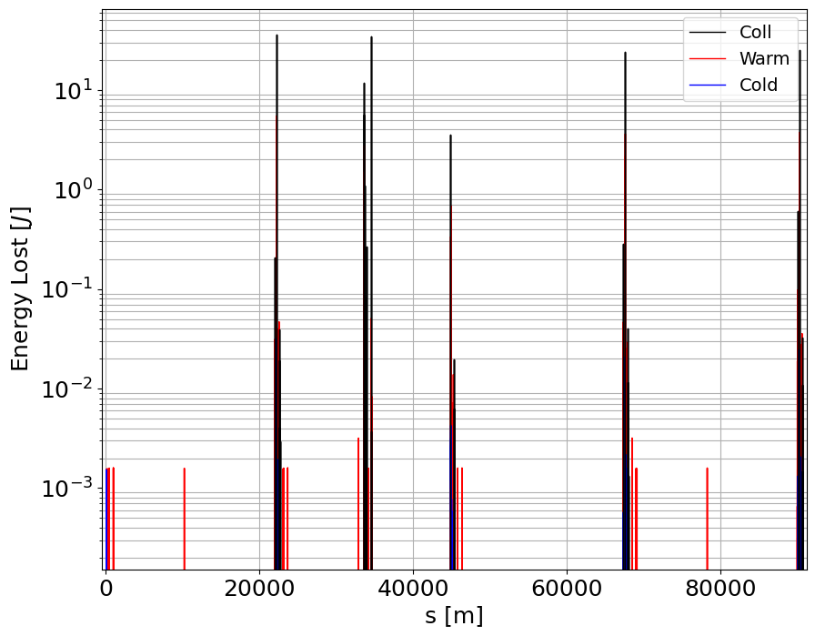
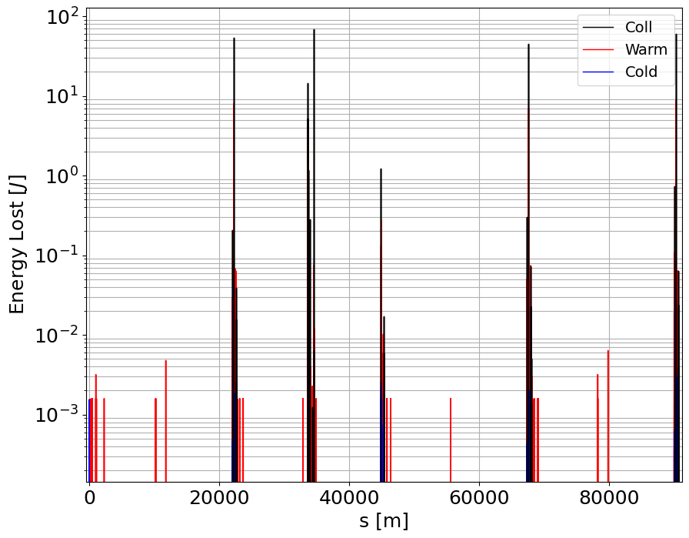
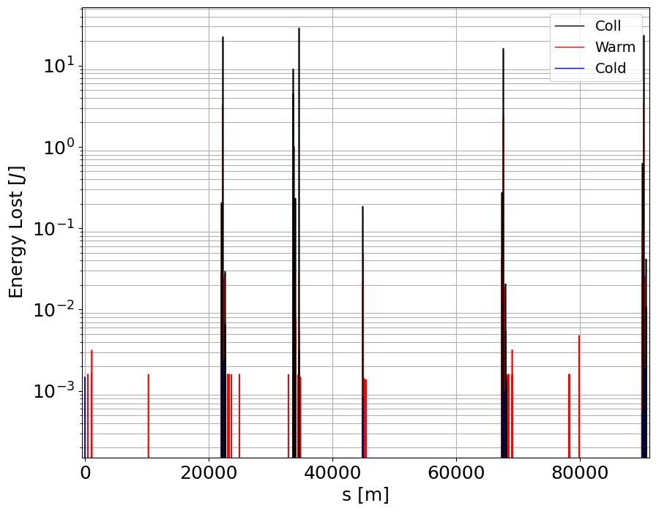
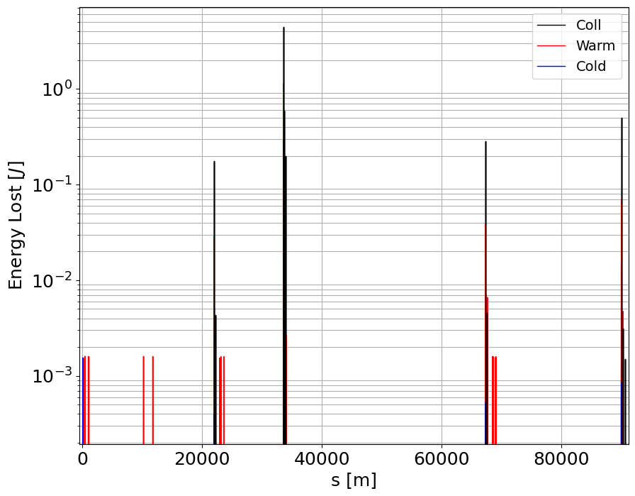
VERY Preliminary results
19/06/2024 Topical meeting on FCC-ee beam-dust interactions
Giulia Nigrelli
58th
100th
Starting from the output produced by Ohmi San’s simulation of the beam-dust interaction, we have tracked the single bunches just after the interaction.
Conditions:
Interaction in the middle of a defocusing quad,
1000000 e+ just after interaction,
50 micron dust particle,
dust fusion at the 59th bunch pass,
V25.2_GHC,
100 turn tracking.
Most of the losses within the first 20 turns then stabilize,
Disclaimer: dust interaction only on the first turn, still need multi turn effects
To be further investigated.
150th
300th

Slide 47
Colors
Backgrounds
Background Blue
Background Purple
Background Yellow
Background Grey
Use for Layout
Radiant Blue
Flash
Energy
Green
Red
Deep
Blue

Slide 48

Graphical Elements
Badges
This information is a badge because it is important!
This information is a badge because it is important!
Separation lines 1.5 pt
Arrows
Use blue badges on light backgrounds
Infographics
This information is a badge because it is important!
This information is a badge because it is important!
Use light badges on dark backgrounds

