Slide 1
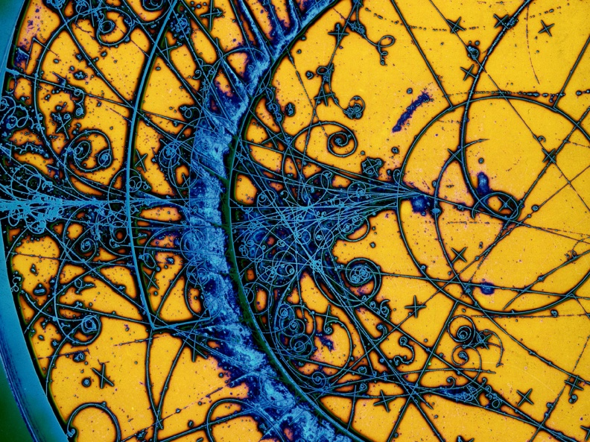

Artificial Intelligence–Driven Optimization of Light and Heavy Ion LINAC Design and Operation
Istituto Nazionale di Fisica Nucleare
The Italian National Institute for Nuclear Physics
Ysabella Kassandra Ong
Dottorato in Fisica degli Acceleratori: Seminari di passaggio al III anno (39 ciclo) 20 October 2025

Slide 2
Outline
Artificially intelligent algorithms
How are we using AI for accelerators?
ANTHEM MEBT line
TAP accelerator complex
European Spallation Source
ML algorithm generalization
Conclusions

Slide 3

What is Artificial Intelligence (AI)?
Artificial Intelligence (AI)
Enables computers and machines to simulate how a human mind works which allows them to learn, comprehend, solve problems, make decisions
Notes:
"Let’s take a quick look at what Artificial Intelligence, or AI, really is. At its core, AI is about enabling machines to think and act like humans — learning from experience, solving problems, and making decisions.
Now, within AI, we have Machine Learning — this is where we teach machines to learn from data, so they can make predictions or decisions without being explicitly programmed for every task.
And deeper within that, we have Deep Learning, a subset of Machine Learning. Deep Learning uses complex, multilayered neural networks that try to mimic how the human brain processes information — allowing AI to tackle more sophisticated problems, like image recognition or natural language understanding.
So, in simple terms: AI is the big picture, Machine Learning is how we teach, and Deep Learning is the brain-like structure doing the heavy lifting."

Slide 4

What is Artificial Intelligence (AI)?
Artificial Intelligence (AI)
Enables computers and machines to simulate how a human mind works which allows them to learn, comprehend, solve problems, make decisions
Machine Learning (ML)
Creates models by training an algorithm to make prediction or decisions based on data
Notes:
"Let’s take a quick look at what Artificial Intelligence, or AI, really is. At its core, AI is about enabling machines to think and act like humans — learning from experience, solving problems, and making decisions.
Now, within AI, we have Machine Learning — this is where we teach machines to learn from data, so they can make predictions or decisions without being explicitly programmed for every task.
And deeper within that, we have Deep Learning, a subset of Machine Learning. Deep Learning uses complex, multilayered neural networks that try to mimic how the human brain processes information — allowing AI to tackle more sophisticated problems, like image recognition or natural language understanding.
So, in simple terms: AI is the big picture, Machine Learning is how we teach, and Deep Learning is the brain-like structure doing the heavy lifting."

Slide 5

What is Artificial Intelligence (AI)?
Artificial Intelligence (AI)
Enables computers and machines to simulate how a human mind works which allows them to learn, comprehend, solve problems, make decisions
Machine Learning (ML)
Creates models by training an algorithm to make prediction or decisions based on data
Deep Learning (DL)
Uses multilayered networks to simulate complex human decision making
Notes:
"Let’s take a quick look at what Artificial Intelligence, or AI, really is. At its core, AI is about enabling machines to think and act like humans — learning from experience, solving problems, and making decisions.
Now, within AI, we have Machine Learning — this is where we teach machines to learn from data, so they can make predictions or decisions without being explicitly programmed for every task.
And deeper within that, we have Deep Learning, a subset of Machine Learning. Deep Learning uses complex, multilayered neural networks that try to mimic how the human brain processes information — allowing AI to tackle more sophisticated problems, like image recognition or natural language understanding.
So, in simple terms: AI is the big picture, Machine Learning is how we teach, and Deep Learning is the brain-like structure doing the heavy lifting."

Slide 6
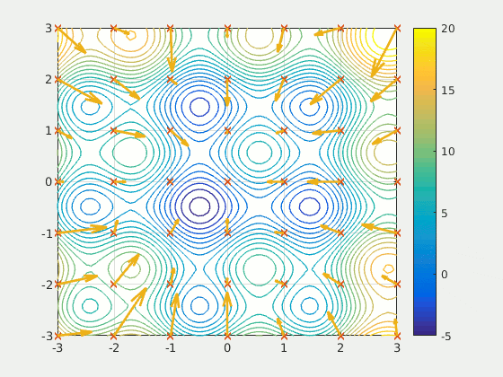
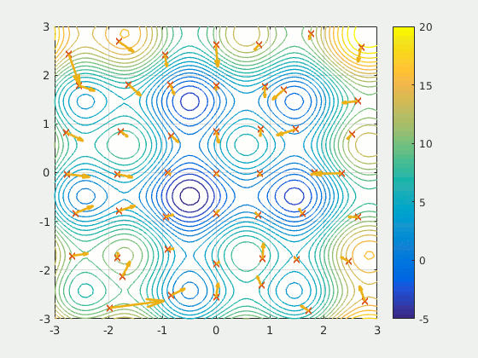
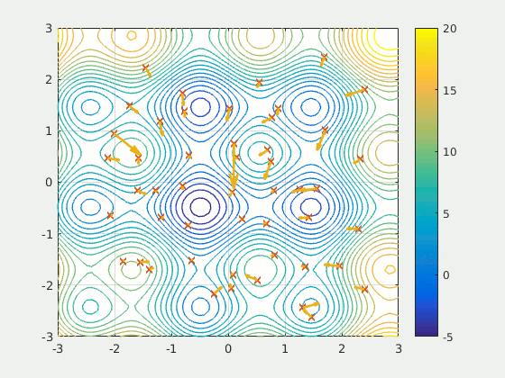
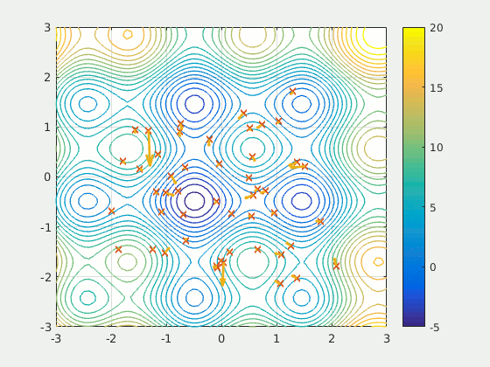
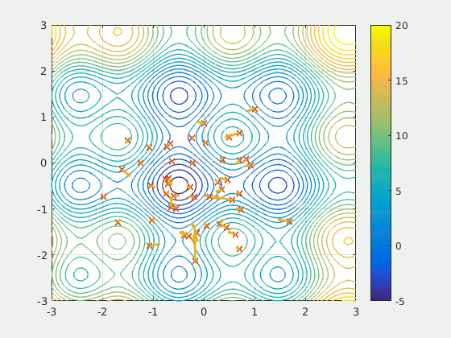
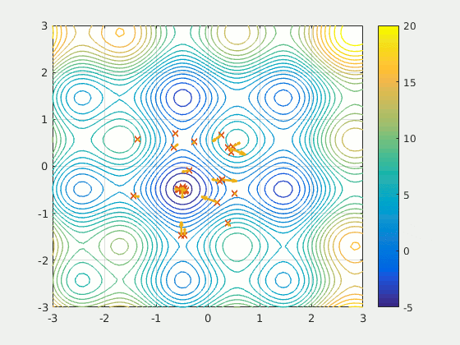
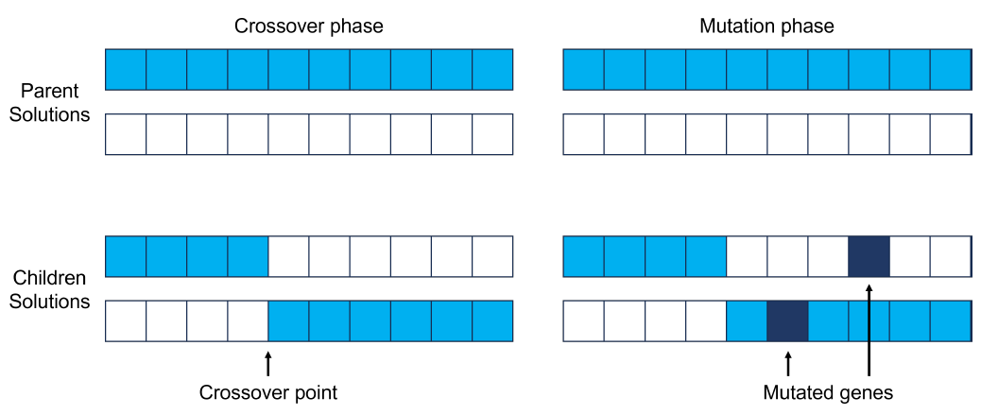
Examples of AI algorithms
Particle Swarm Optimization (PSO)
Artificial Intelligence (AI)
Particle Swarm Optimization (PSO)
Genetic algorithm (GA)
Machine Learning (ML)
GIF from https://en.wikipedia.org/wiki/Particle_swarm_optimization
Genetic algorithm (GA)
Deep Learning (DL)

Slide 7
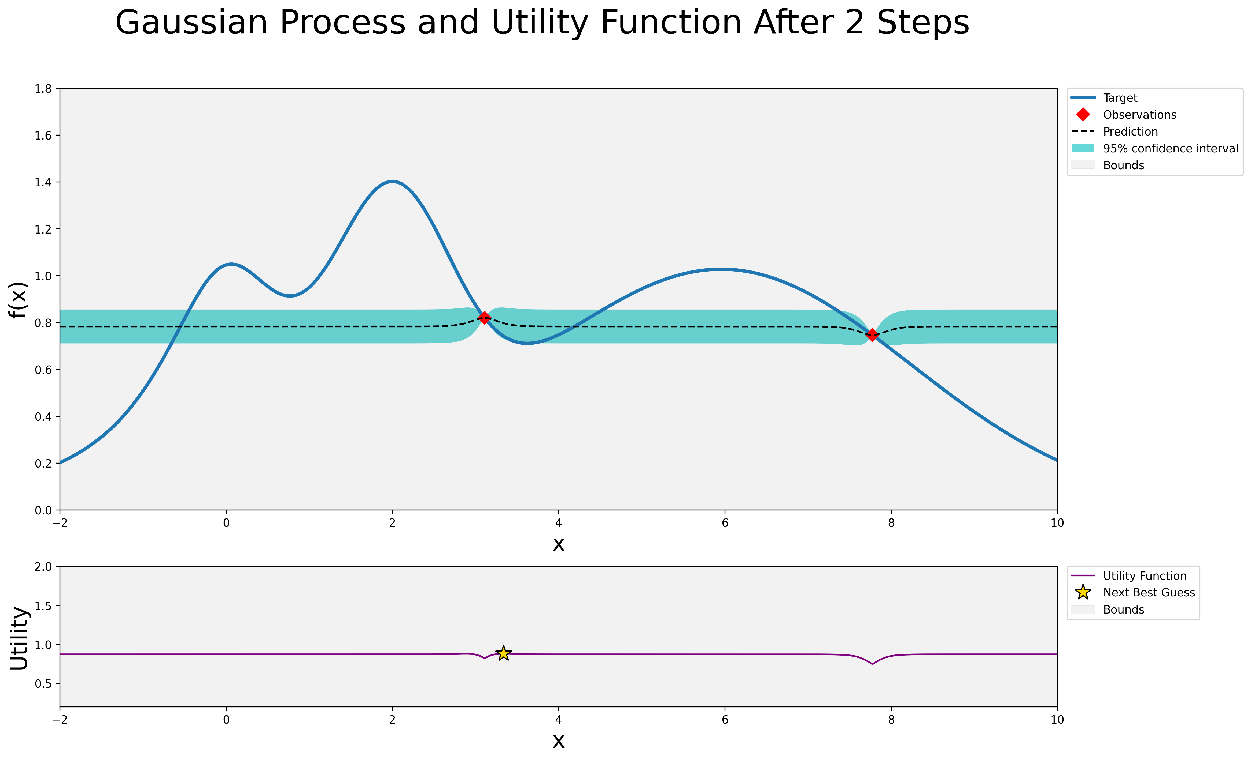

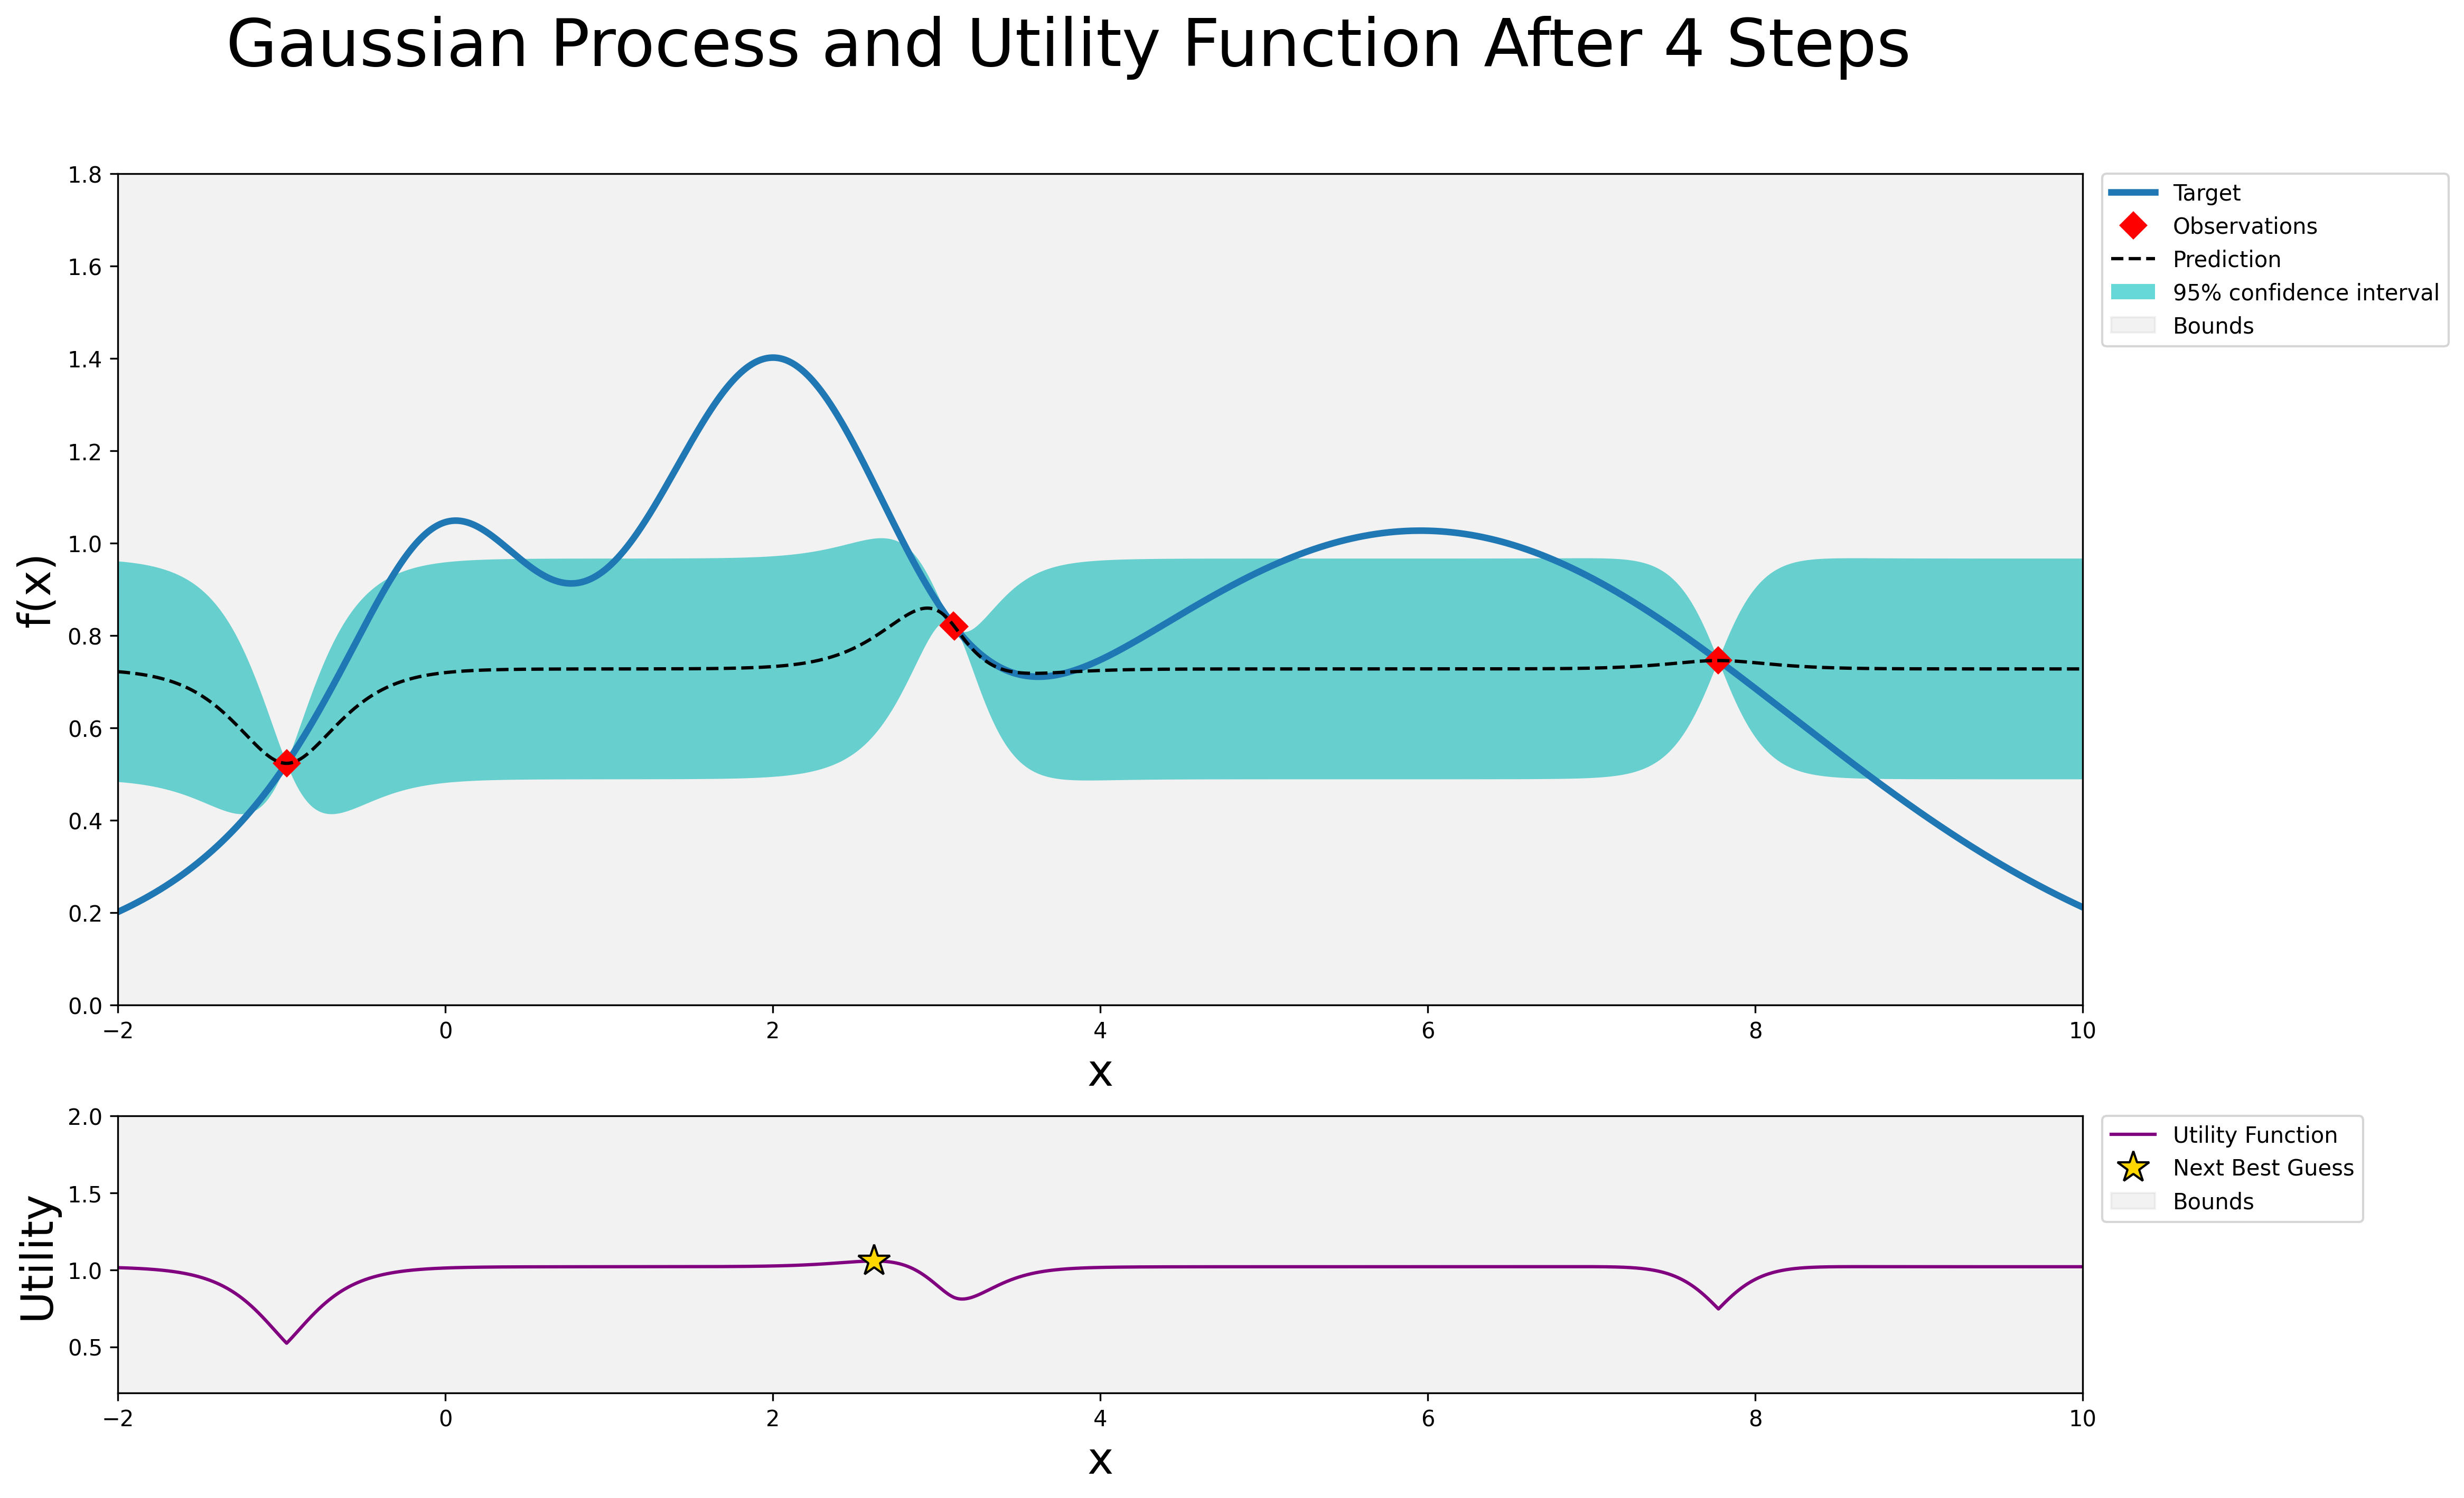
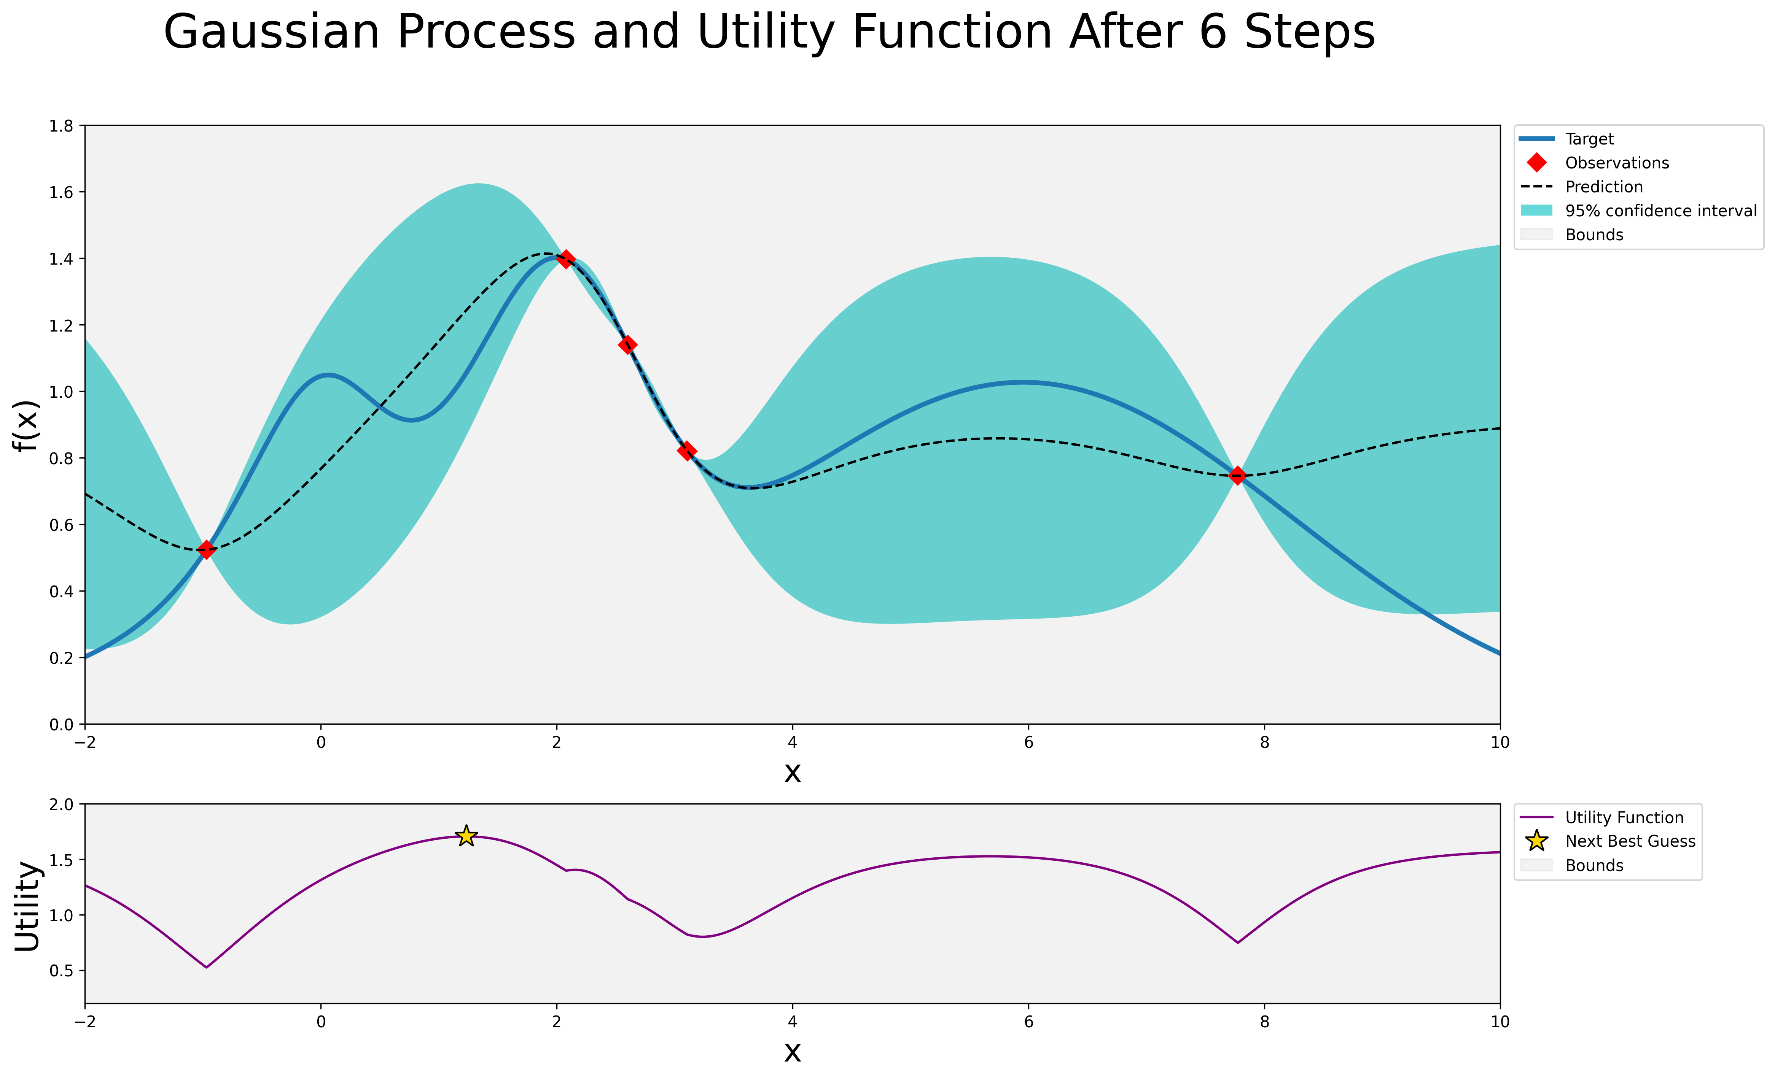
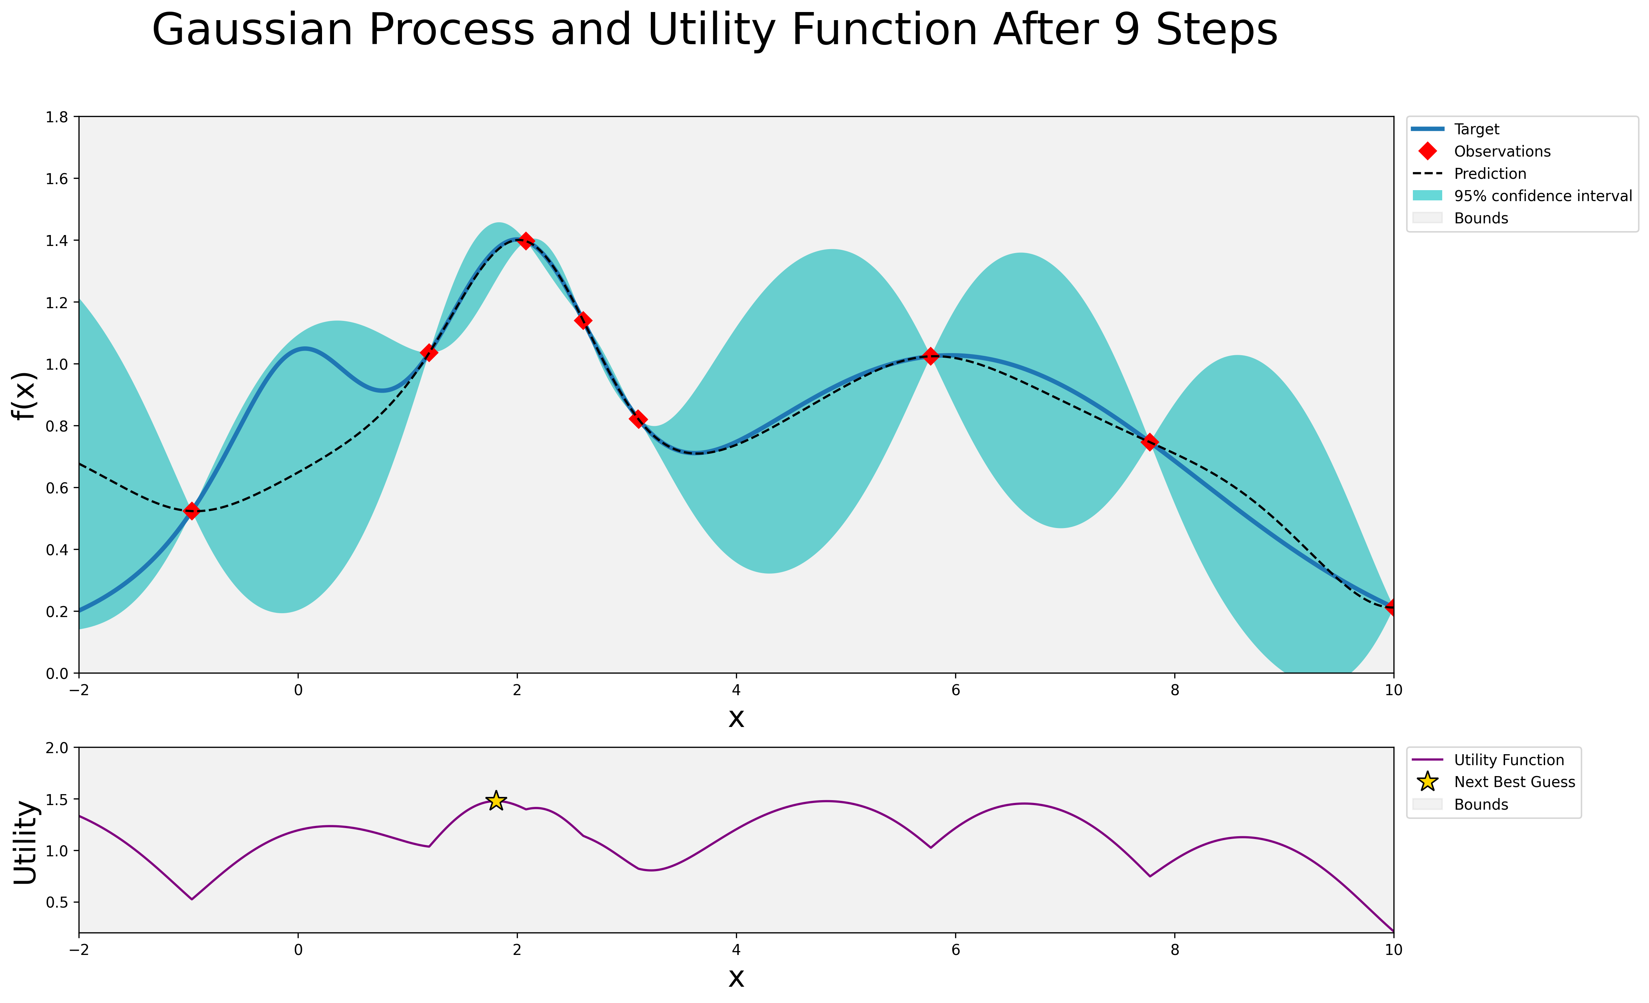
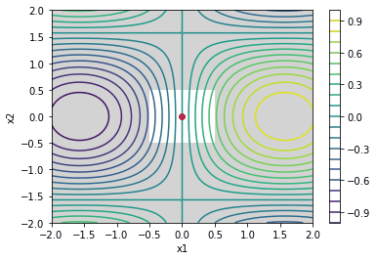
Examples of AI algorithms
Bayesian Optimization (BO)
Artificial Intelligence (AI)
Particle Swarm Optimization (PSO)
Genetic algorithm (GA)
Machine Learning (ML)
Bayesian Optimization (BO)
Trust Region Bayesian Optimization (TuRBO)
Adaptive Region Bayesian Optimization (ARBO)
Adaptive Region Bayesian Optimization (ARBO)
Deep Learning (DL)

Slide 8
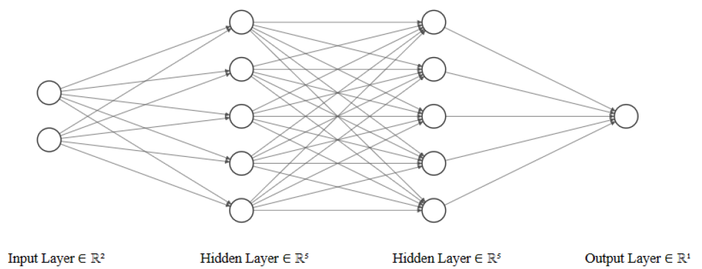
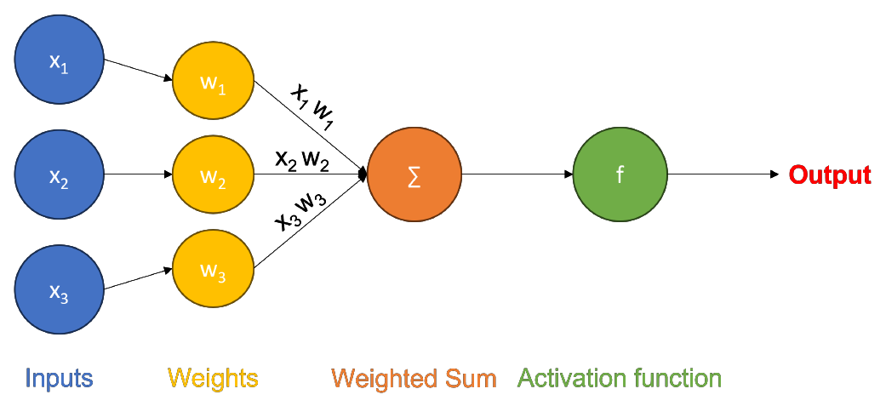
Examples of AI algorithms
Artificial Intelligence (AI)
Particle Swarm Optimization (PSO)
Genetic algorithm (GA)
Neural Networks (NN)
Machine Learning (ML)
Bayesian Optimization (BO)
Trust Region Bayesian Optimization (TuRBO)
Adaptive Region Bayesian Optimization (ARBO)
Deep Learning (DL)
Neural networks (NN)

Slide 9
How are we using AI for accelerators?
Artificial Intelligence (AI)
AI help in the following aspects of accelerator design and operations:
Automation & adaptivity
reduce operator workload in tuning and calibration
Real-time adjustment to environmental or system changes
Optimization
Improve beam quality, stability, and efficiency
Virtual diagnostics
Surrogate model of destructive or broken diagnostic
Online modelling / Simulations
Fast beam transport model
Fault detection & prediction
Identify anomalies before they occur, interlock prediction
Particle Swarm Optimization (PSO)
Genetic algorithm (GA)
Machine Learning (ML)
Bayesian Optimization (BO)
Trust Region Bayesian Optimization (TuRBO)
Adaptive Region Bayesian Optimization (ARBO)
Deep Learning (DL)
Neural networks (NN)
Notes:
We see the practical benefits of AI in different aspects of accelerator design and operation: AI reduces operator workload through automation and adaptivity, making real-time adjustments to changing conditions. It enhances optimization for better beam quality and efficiency. AI also supports virtual diagnostics, modeling systems when direct measurements are destructive or unavailable. Furthermore, it accelerates online simulations, and enables fault detection and prediction, spotting anomalies before failures occur.

Slide 10
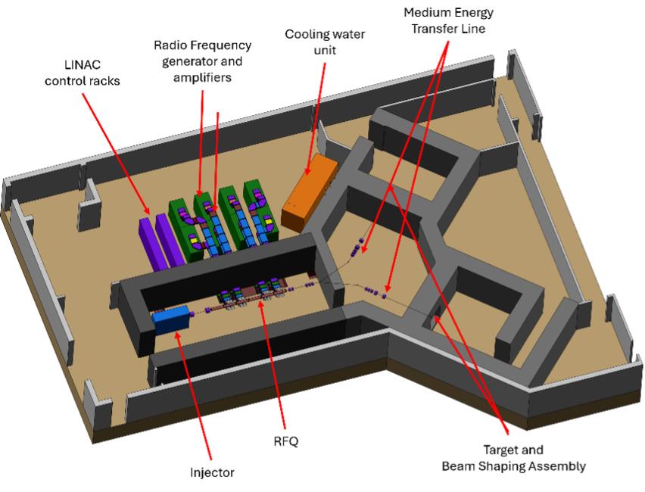
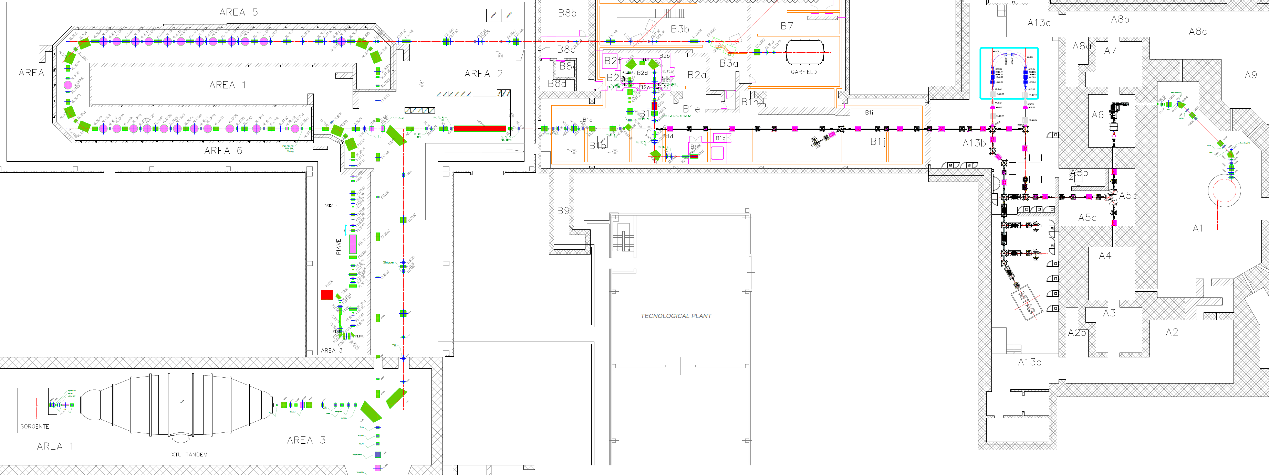
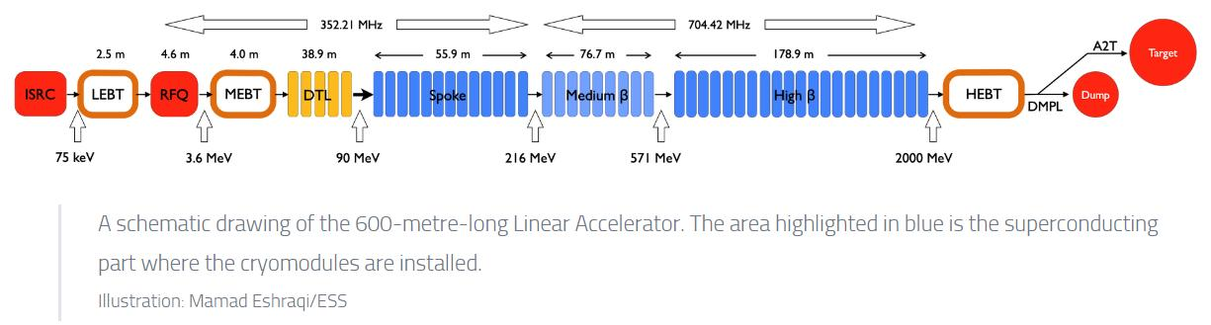
LNL accelerators
TAPA – Tandem ALPI PIAVE ADIGE
accelerator complex
Anthem BNCT facility
European Spallation Source

Slide 11

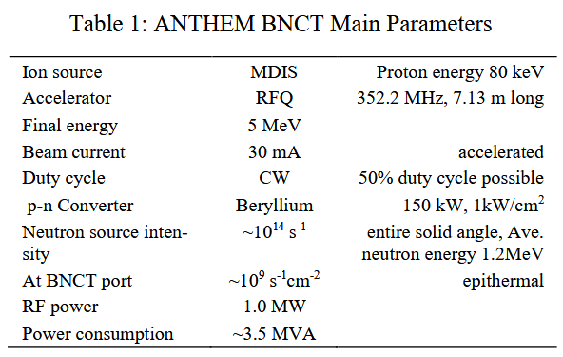
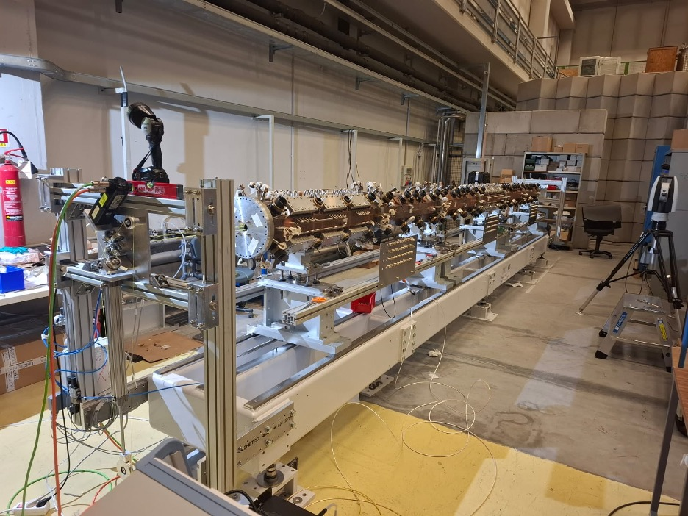
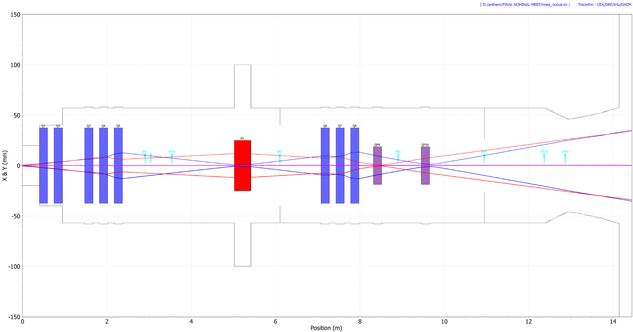
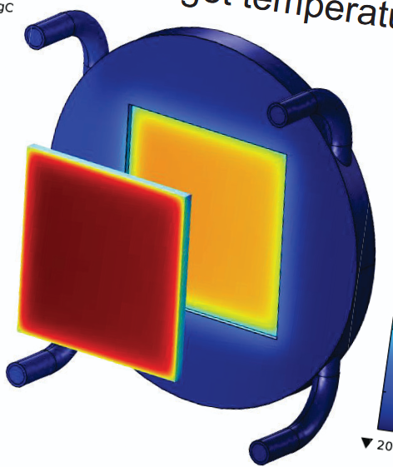
Anthem BNCT facility
High-intensity CW proton machine 150 kW beam power
Space-charge → non-linear effect
MEBT matching critical → beam shaping at the target (uniform power deposition)
Objective: High beam transmission and beam uniformity at the target → optimal neutron yield
Controlled losses in cooled collimators (for shaping)
TRASCO RFQ
MEBT
Target
AGATA
Notes:
Because of this complexity, optimizing their performance is a major challenge — and that’s where AI can play a crucial role."

Slide 12
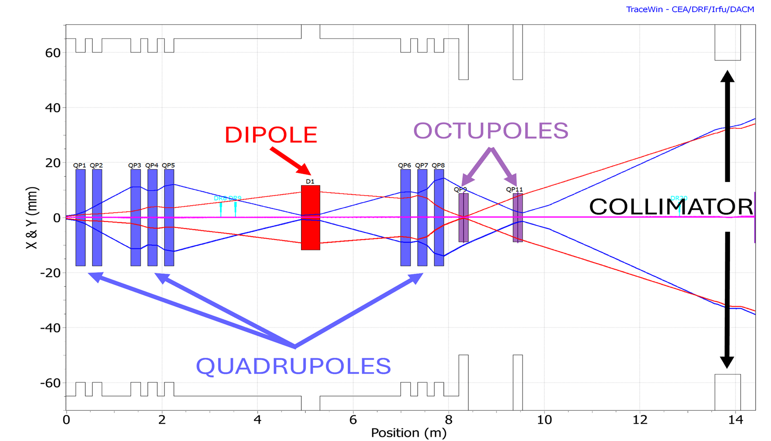
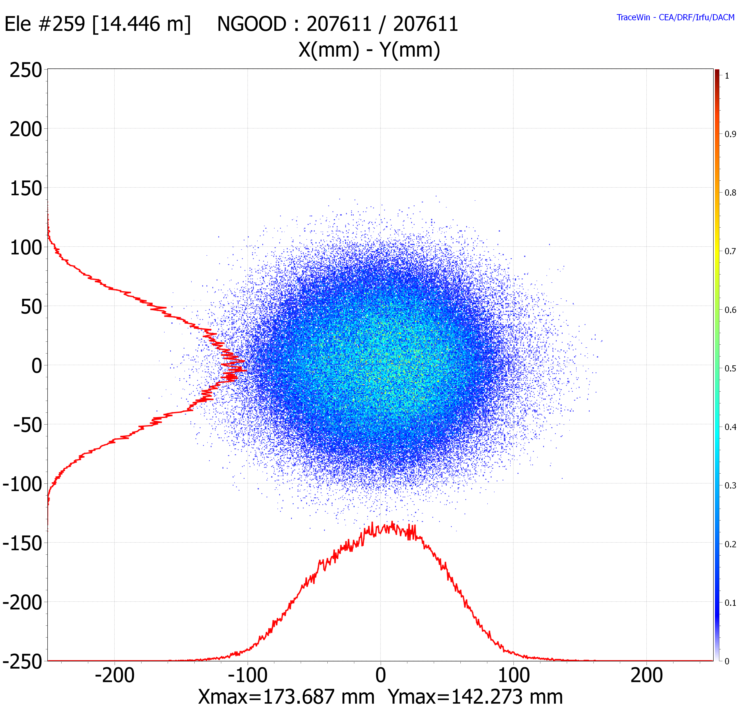
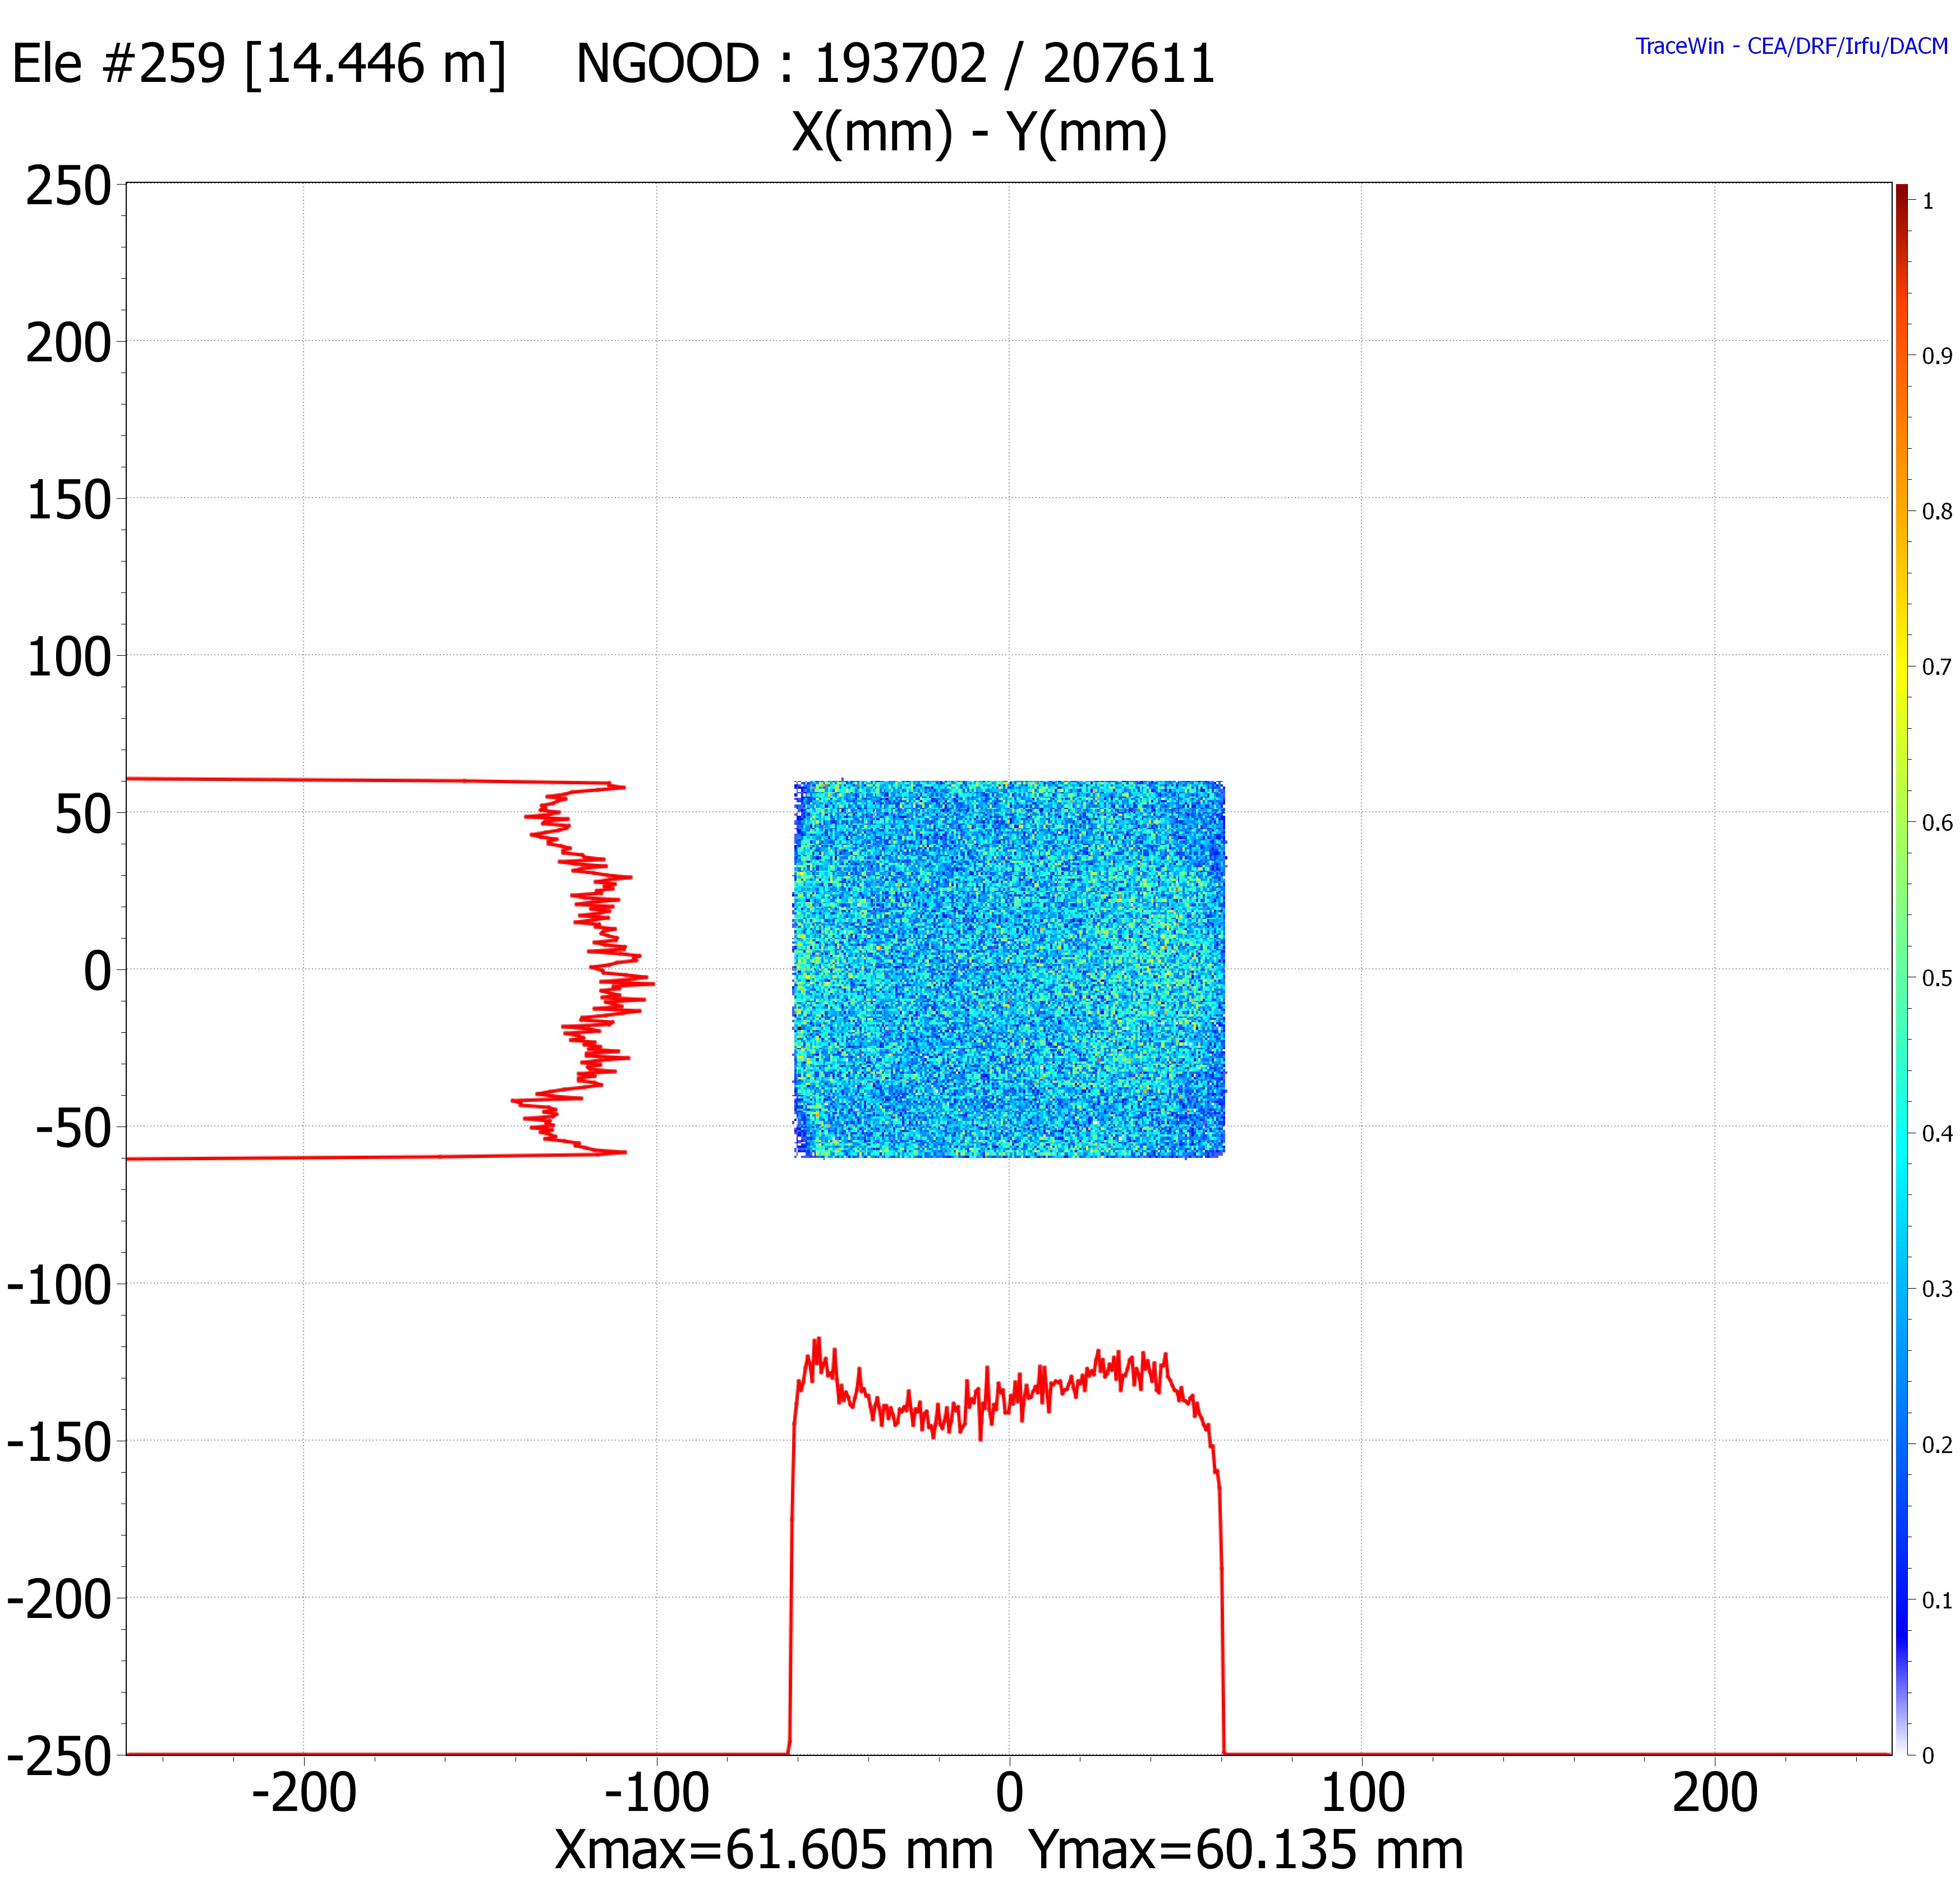

Offline Activities – ARBO
Shaping the target beam uniformity at ANTHEM high intensity MEBT line
Algorithm: Adaptive Region Bayesian Optimization (ARBO)
Parameters optimized: MEBT last three quadrupoles, two octupole magnets (Total: 5)
Goal: obtain good beam uniformity at the target with an area of 12×12 cm² to maintain the beam power deposition at around 1 kW/cm², transmission > 85% to maintain necessary neutron production yield (multi-objective!!)
ANTHEM MEBT
Beam distribution at the target
Target
Octupoles inactive,
No collimator
Octupoles active,
With collimator,
After BO
Optimization lasted about 500 iterations
Beam uniformity obtained through tail-folding technique of the octupole magnets
Asymmetry in the x-plane → uncorrected dispersion from the dipole
Uniformity x | Uniformity y | Transmission
± 10.76 % [-55 mm, 55 mm] ± 16.68 % [-60 mm, 60mm] | ± 12.19 % [-55 mm, 55 mm] ± 17.58 % [-60 mm, 60mm] | 92.16 % [-60 mm, 60mm]
Result: Nominal MEBT optics achieved with desired beam characteristics

Slide 13
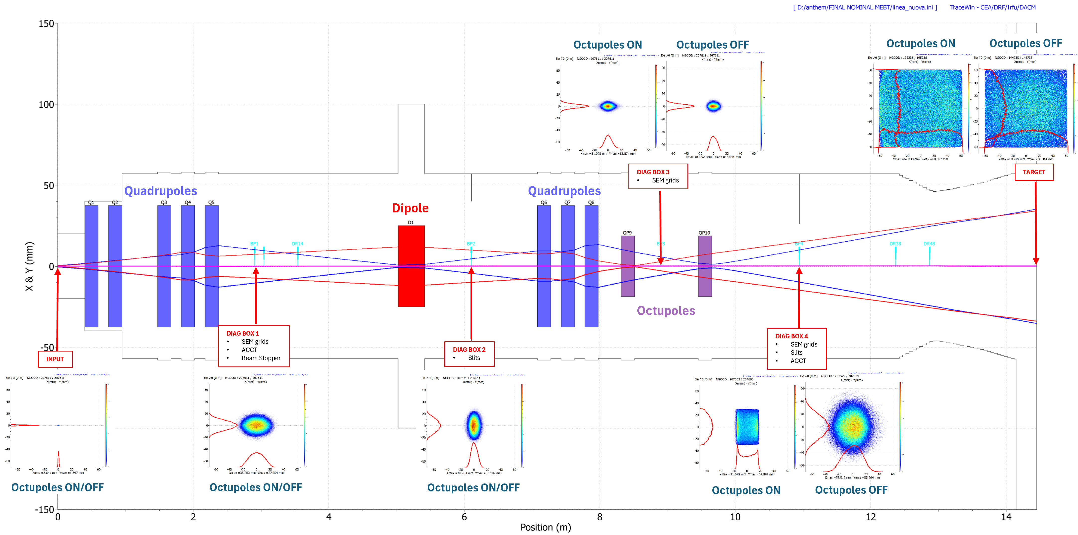
ANTHEM MEBT – Diagnostics definition
ANTHEM MEBT layout with diagnostic boxes and main components

Slide 14
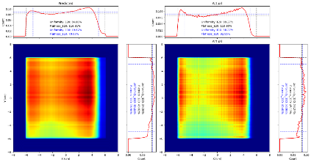
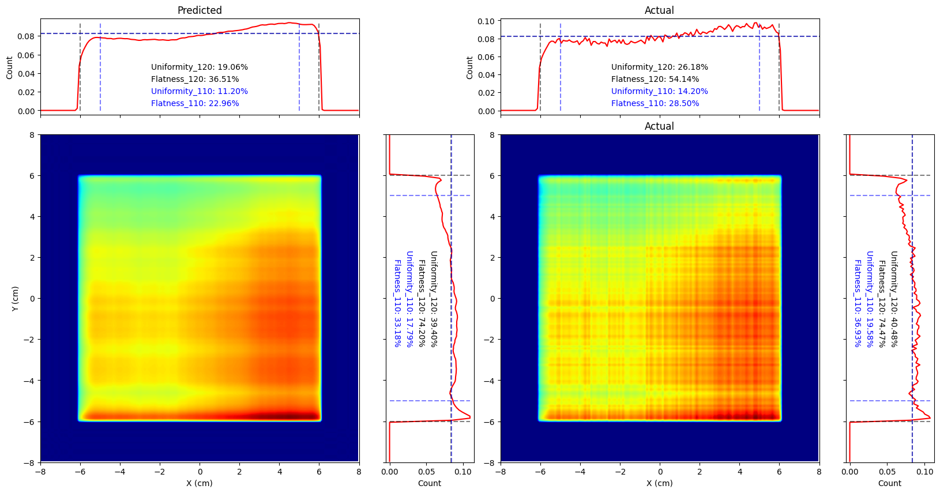
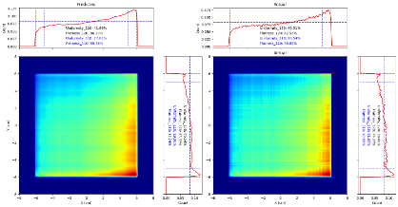
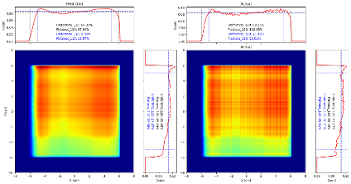
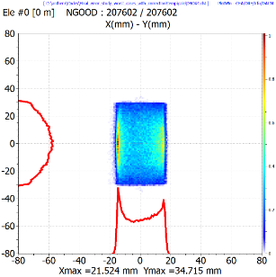
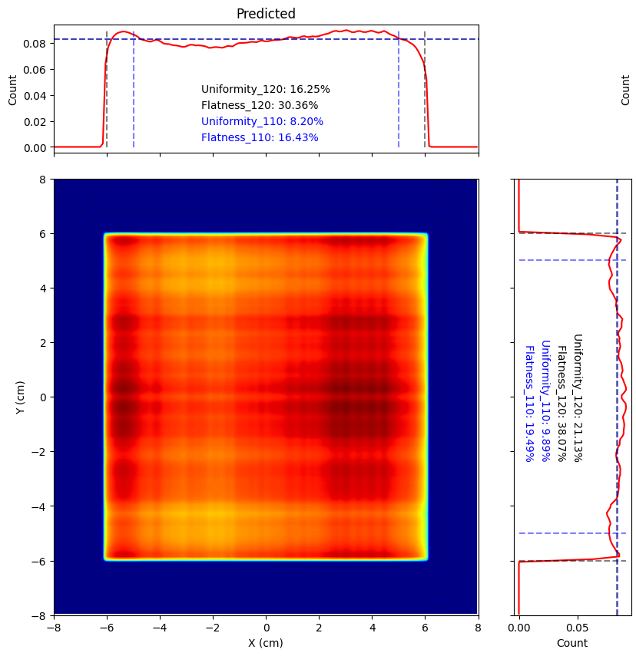
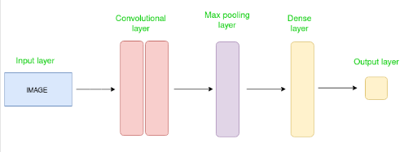
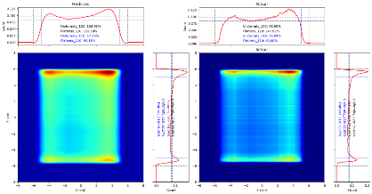
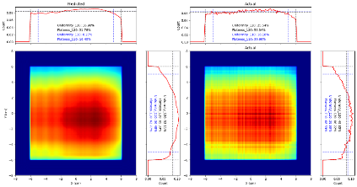
Offline Activities – CNN
Virtual diagnostics for the ANTHEM high intensity MEBT line
Algorithm: Convolutional Neural Network (CNN)
Goal: train a CNN to serve as a virtual diagnostic for determining the beam uniformity at the target position
ANTHEM MEBT line
DIAG BOX 4
SEM grids
Slits
ACCT
TARGET
CNN
Projections @ DBOX4
Predicted projections @ target
CNN SEM Grid predictions
Result: Applicable model for predicting beam distribution @ target position

Slide 15
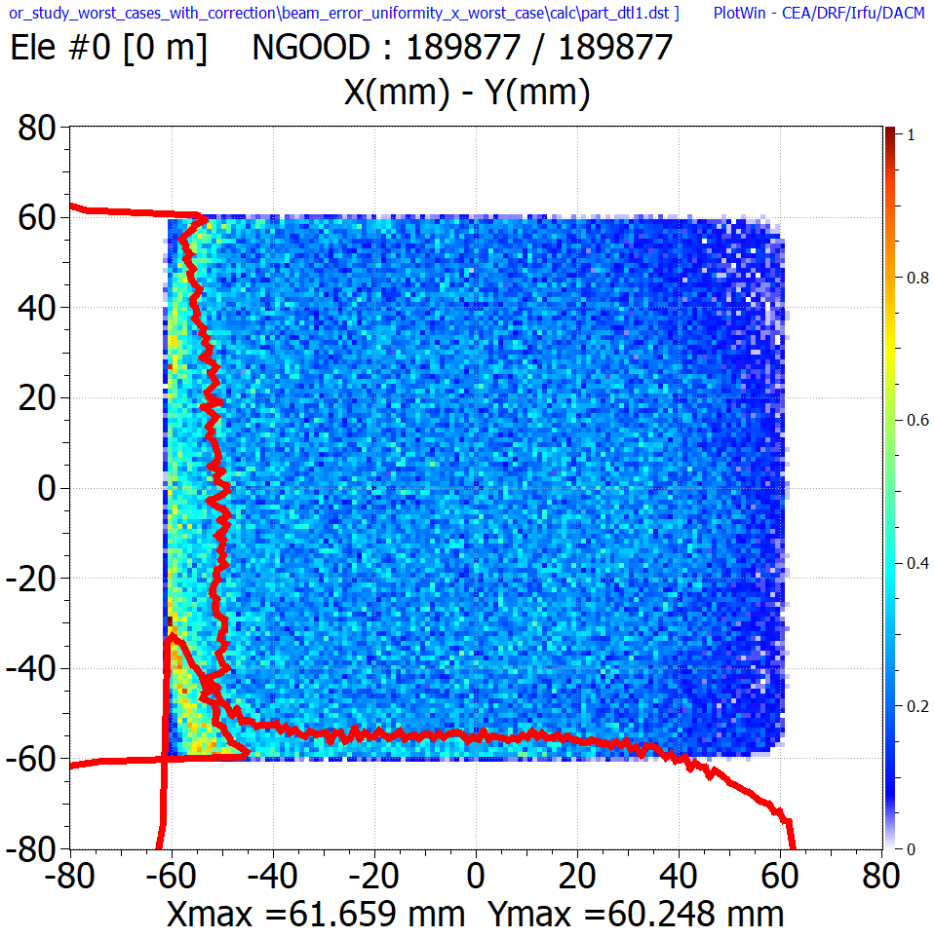
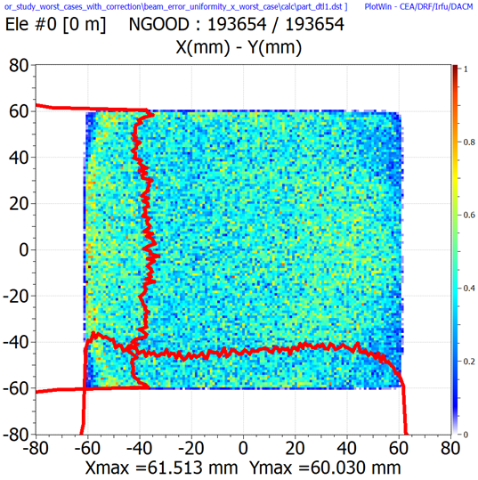
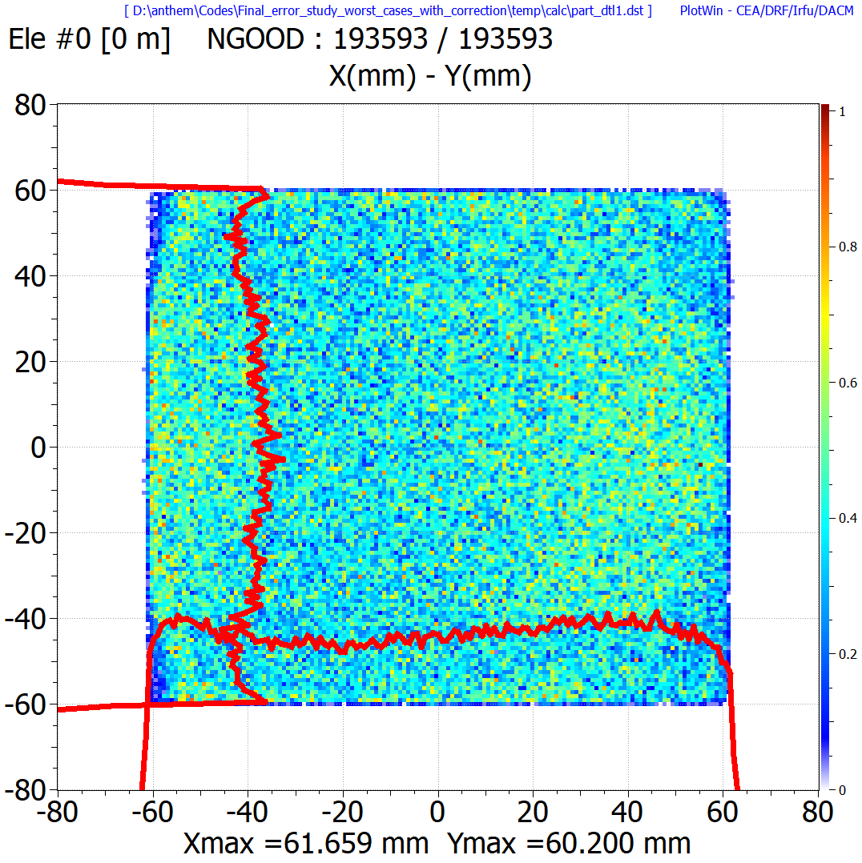
Offline Activities – ARBO + CNN
Virtual autotuning of the ANTHEM high intensity MEBT line with applied errors
Algorithm: Convolutional Neural Network (CNN) and Adaptive Region Bayesian Optimization (ARBO)
Parameters: Steerers (beam centering (oct off)); Steerers, last three quadrupoles, octupoles (uniformity + transmission (oct on))
Goal: Applying beam/magnet errors to the line, rematch the line by first centering the beam at DBOX3 and DBOX4 (oct off), then optimize the target uniformity (using the trained CNN model) and transmission (oct on)
Beam distribution @ target position
Worst case
TraceWin opt.
ARBO + CNN
 | Uniformity X | Uniformity Y | Transmission
Worst case | ± 73.81 % | ± 30.71 % | 89.94 %
TraceWin opt. (Steerers only) | ± 29.25 % | ± 19.31 % | 92.11 %
ARBO + CNN | ± 16.84 % | ± 19.77 % | 92.10 %
Result: Autotuning procedure will be applied in online operations

Slide 16
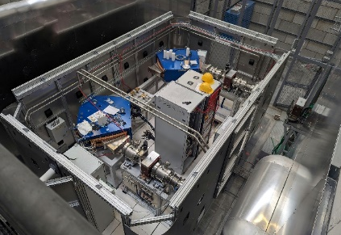
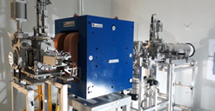
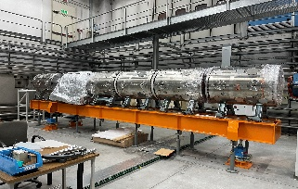
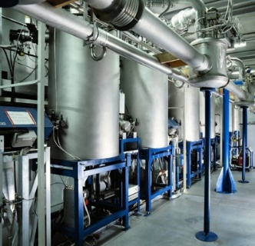
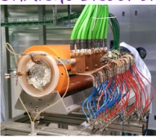
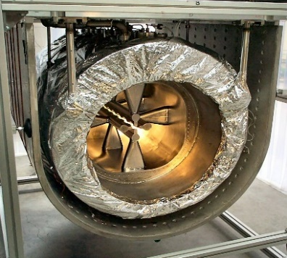
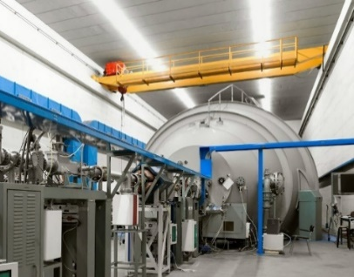
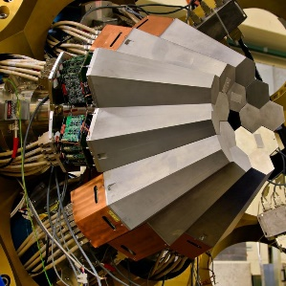
TAPA accelerator complex
SPES TIS
ALPI
SPES RFQ
SPES MRMS
ADIGE
SPES
PIAVE
ALPI QWR
SPES CB
PIAVE SRFQ
A heavy ion accelerator facility
~300 control parameters (transport and acceleration)
Parameters vary depending on the species, mass/charge ratio and the injector used
Two main objectives: beam energy and transmission
Tandem-XTU
Users
TANDEM-XTU
AGATA

Slide 17
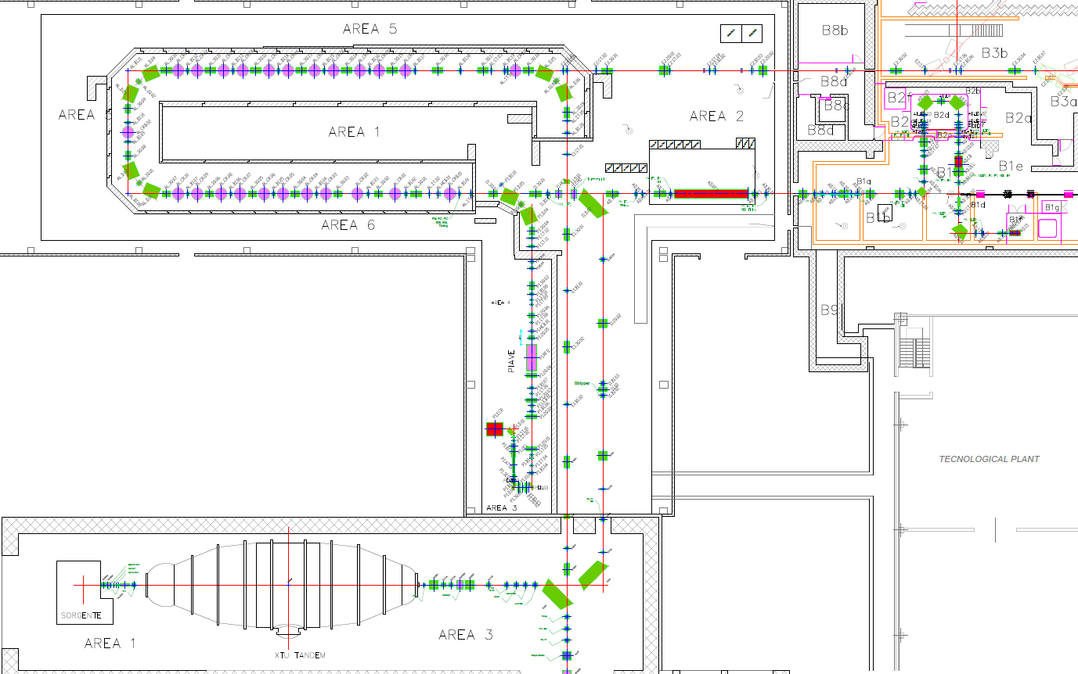
TAPA accelerator complex
ALPI
20 cryostats (each with 4 superconducting QWR cavities)
E_{acc}: 3MV/m (designed), up to 5 MV/m (improved)
Two types of QWR: 80 MHz and 160 MHz
1 triplet per 2 cryostats
3 stable ion injectors (2 active, 1 under installation)
ADIGE (being installed)
Stable +1 ion source
Charge breeder SPES-CB
MRMS (R = 1/1000, HVP -120 kV)
SPES RFQ (up to 727.3 keV/u for A/q=7)
3.5 < A/q < 7
ADIGE
ALPI
PIAVE (active)
ECR source LEGIS (HV platform 250 kV to 300 kV max)
Superconducting RFQ (@ 80 MHz), external bunching
RFQ output energy of 587.5 keV/u
PIAVE
Tandem (active)
Electrostatic accelerator
Terminal voltage: 14.5 MV
28 MeV/u for ¹H up to 1.5 MeV/u for ¹⁹⁷Au.
Can provide beams w/o ALPI
Tandem
Notes:
Ions are generated inside an external source and are extracted with a weakly positive charge state (q = +1). Before entering Tandem ions cross a charge-exchange region in which, by playing on the relative electronic affinity, they receive two electrons from the gas which they interact with (cesium, Cs). The first electron makes the atom neutral again, while the second gives the atom a weakly negative charge (q = -1).
For nuclei with an atomic number larger than A~100, at the beam current levels usually injected inside the Tandem, the stripper foils average life-time is so short to make it unsuitable in practice. When all the 250 stripper foils, available in a special, remotely operated carrier, are exhausted, a Tandem opening is indeed required, in order to replace them.
PIAVE-ALPI Energy: from 13.6 MeV/A with ¹⁴N to 6.0 MeV/A with ²³⁸U
Tandem-ALPI Energy: from 22.5 MeV/A with ¹²C to 5.5 MeV/A with ⁹⁶Zr
MRMS of 1/1000, which removes the CB contaminants.

Slide 18
TAPA accelerator complex
TAP Performance in 2024 | Time [hours]
Beam on target | 3277
Beam preparation | 850
Accelerator Division test | 480
Unscheduled maintenance | 481
Working time | 4607
ADIGE
ALPI
PIAVE
Data from Fagotti, E. (2025, April 3). LNL accelerator activities: Status and perspectives [Conference presentation]. 4ᵃ Giornata Acceleratori (National Accelerator Day), INFN Laboratori Nazionali di Legnaro, Padova, Italy. https://agenda.infn.it/event/43957/
Almost 20% of the accelerator operation is utilized for beam preparation.
Tandem
Users

Slide 19
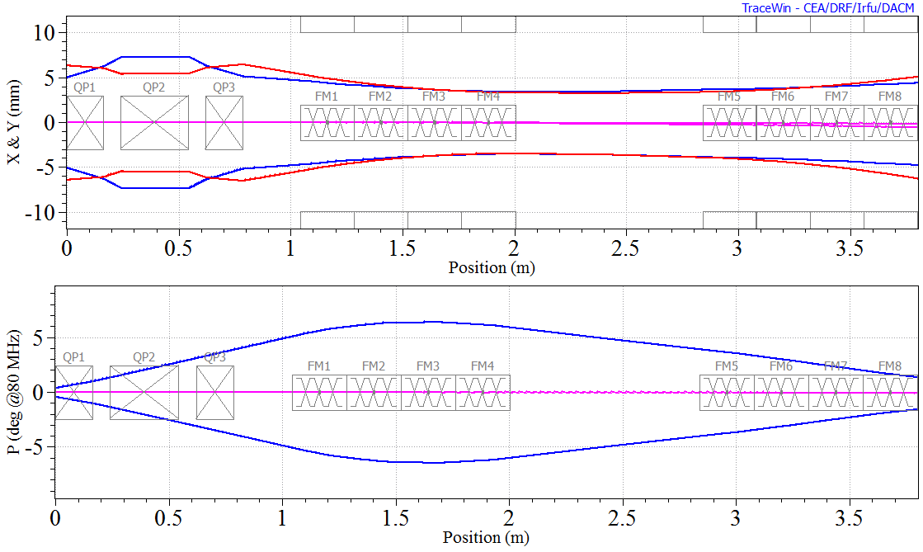
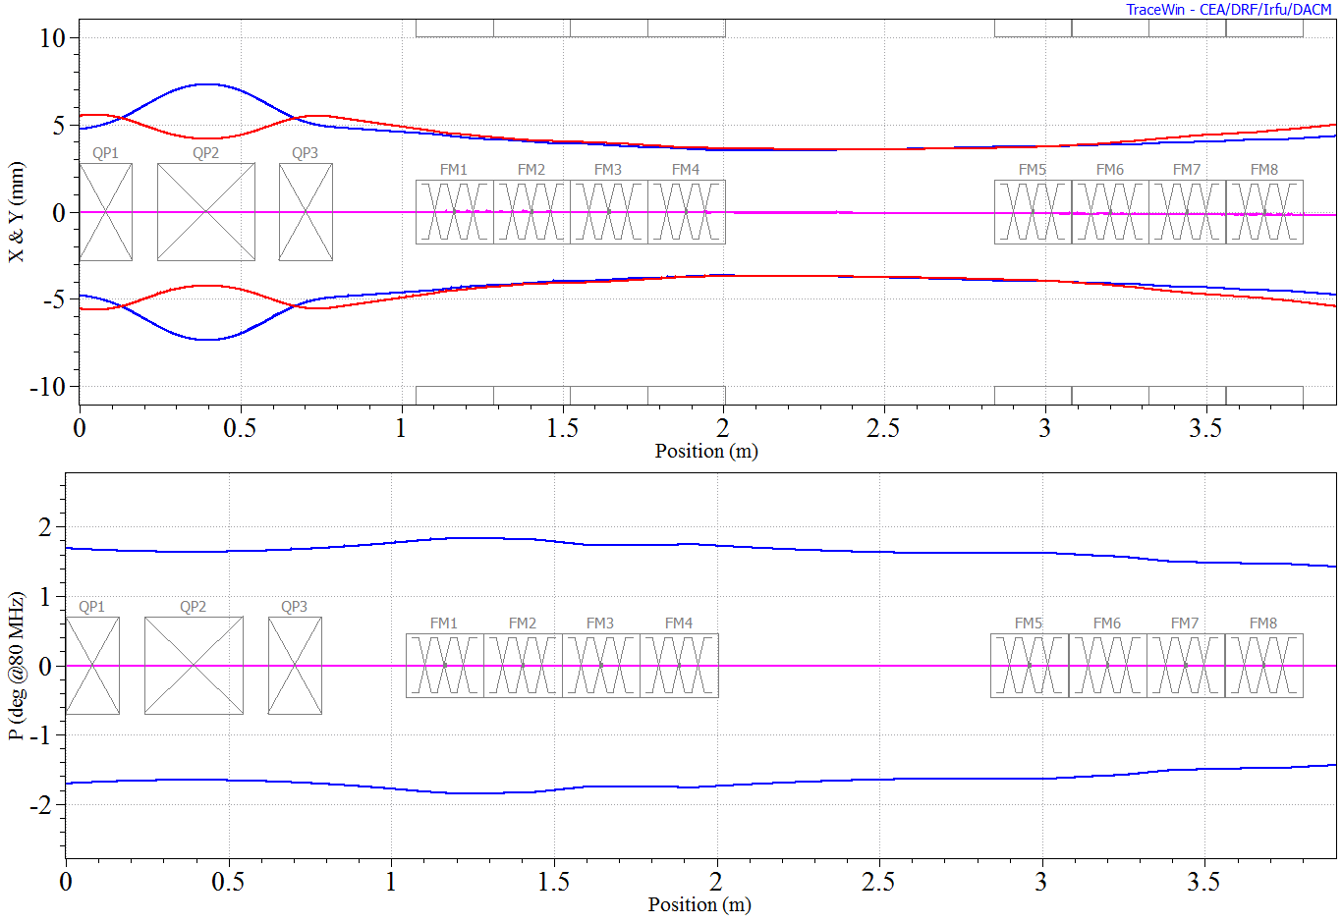
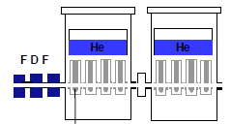







Online Activities – Tandem ALPI PIAVE Problem
TAP accelerator facility operation problem
$σ_{0l}>160−180$ deg
$σ_{0l}=65$ deg
20 mm diameter aperture of cavities
E₀ increased 4 times the initial design → unstable longitudinal phase advance 𝜎_{0𝑙}
ALPI lattice
-20 -20 -20 -20 – -20 -20 -20 -20
-20 -20 +20 -20 – -20 -20 +20 -20
Nominal Sync. Phases: Not stable!
APF: the beam can be accelerated and transported but still suffers from low transmission
Manual set-up of the accelerator → time-consuming (~ 6-8 hours)
Every ion beam type → optics need to be optimized, cavities independently tuned
Poor transmission (max 35% vs expected 93%)
Active injectors suffer low transmission to ALPI due to its aggressive transverse focusing → sensitive to beam misalignment
Frequent need for reoptimization due to beam and hardware instabilities (every few hours)
Small transverse and longitudinal acceptance
Nominal → beam not fully covered by acceptance
Small oscillations of input beam → beam losses
From PIAVE injector
Transverse acceptance
Longitudinal acceptance

Slide 20






Online Activities – ARBO
Longitudinal acceptance optimization of ALPI (2024)
Algorithm: Adaptive Region Bayesian Optimization (ARBO)
Beam: ¹²⁹Xe²⁵⁺
Parameters Optimized: ALPI Cryostats 1-6 (Total: 24)
Goal: Improve the beam transmission and acceptance of ALPI
ALPI
Synchronous phases along the linac
Longitudinal acceptance
BO range φ⁡_{ss} ±3.5 deg on the ALPI cavity phases (allowed to expand)
Algorithm had a total of 120 iterations (~ 5 mins.)
BO distorts the shape of the acceptance to increase the coverage towards +𝜙 → input beam phase offset from ALPI by a few degrees
No significant change in beam output energy
PIAVE
BO
BO
inital
inital
 | Initial | BO
Current | 122 nA | 180 nA (+47.54 % wrt initial)
Time taken | - | ~ 5 min
Result: Almost 9% increase in longitudinal acceptance

Slide 21


Online Activities – ARBO vs TuRBO
Transmission optimization of PIAVE (2024)
Algorithm: Adaptive Region Bayesian Optimization (ARBO) and Trust Region Bayesian Optimization (TuRBO)
Beam: ¹²⁹Xe²⁵⁺
Parameters Optimized: PIAVE Steerers (Total: 16)
Goal: Improve the beam transmission and acceptance of PIAVE
PIAVE
ARBO achieved the highest relative transmission of 23.1% in less than 20 iterations.
Moreover, although ARBO began with a smaller region 𝑅 than TuRBO, its adaptive region feature allowed it to eventually explore beyond TuRBO’s fixed global bounds, giving ARBO a potential advantage in discovering better solutions.
Result: ARBO achieved better transmission efficiency and explored a larger search region

Slide 22


Online Activities – ARBO
Transmission optimization of full PIAVE optics (2024)
Algorithm: Adaptive Region Bayesian Optimization (ARBO) and Trust Region Bayesian Optimization (TuRBO)
Beam: ¹²⁹Xe²⁵⁺
Parameters Optimized: PIAVE Steerers, Quadrupoles (Total: 37)
Goal: Improve the beam transmission and acceptance of PIAVE
PIAVE
63.9 % transmission
ARBO achieved maximum transmission of 63.9 % more than doubling the initial value in less than 20 minutes.
Against the «best operator» (~60 % trans. in one hour)
Changes in quadrupoles are fine-tuning (ΔG < 10%)
Result: Achieved higher transmission efficiency than the best operator in one-third of the time

Slide 23


Online Activities – ARBO
Full optics optimization of PIAVE-ALPI (2024)
Algorithm: Adaptive Region Bayesian Optimization (ARBO)
Beam: ¹²⁹Xe²⁵⁺
Parameters Optimized: Source optics, PIAVE-ALPI steerers, quadrupoles, cavities (Total: 48)
Goal: Improve the beam transmission @ Faraday Cup
ALPI
PIAVE
Official data and milestones related to PIAVE-ALPI
Sequential optimization
Source optics (in collaboration with the source group)
PIAVE-ALPI transverse optics
Longitudinal optics
Reached 85% of ALPI transmission (cavities on)
Record since its construction, roughly 20 years ago
Max theoretical transmission of 93%
Maximum current reached at 3 μA
Record, limited by uncooled diagnostics
Xe, 3 uA accelerated beam
Pb, 0.3 uA accelerated beam
Xe
O, 0.1 uA accelerated beam
Result: Record numbers for the facility reached, closer to expected values

Slide 24



European Spallation Source (ESS)
High-intensity machine (protons, 5 MW ave. beam power, 2 GeV energy, 62.5 mA current)
Even at low duty cycle (50 μs, 1 Hz) → 300 W ave. beam power at end of DTL (enough to damage the linac!!)
Testing the ML algorithm on the normal conducting linac NCL (MEBT, DTL)
Many diagnostics available (hundreds), compared to TAP accelerator (Faraday cup)
Beam Current Monitors (BCMs)
Beam Position Monitors (BPMs)
Beam Loss Monitors (BLMs)
MEBT
DTL
Optimization challenge?
Collapsing the objective function (diagnostic measurements) to a single value
Optimize the objective function to control of the losses along the line
Full beam transmission with the correct energy at the target
Our approach:
Start from a working solution
Restrict the parameter search range
Tune the hyperparameters of the ML optimization algorithm
Notes:
Because of this complexity, optimizing their performance is a major challenge — and that’s where AI can play a crucial role."

Slide 25






Offline Activities – ARBO
ESS NCL transverse transport optimization
Algorithm: Adaptive Region Bayesian Optimization (ARBO)
Beam: Protons @ 62.5 mA, low duty cycle (50 μs, 1 Hz)
Parameters Optimized: MEBT Quadrupoles, Steerers, Bunchers, DTL Steerers (Total: 69)
Goal: Optimize beam transmission and trajectory until the end of the DTL (multi-objective!! → 23 diagnostics BPMs, BCMs)
Nominal w/ induced losses
Bayesian optimized line
Beam transmission
MEBT
DTL
Result: Tuned the ML parameters and search range for online tests
Nominal w/ induced transmission loss
Bayesian optimized line

Slide 26



Online Activities – ARBO
ESS NCL transverse transport optimization (June 2025)
courtesy and fundamental support of ESS team
Algorithm: Adaptive Region Bayesian Optimization (ARBO)
Beam: Protons @ 6 mA current, 1 Hz repetition rate
Parameters Optimized: Steerers, quadrupoles (Total: 56)
Goal: Optimize beam transmission and trajectory until the end of the DTL (multi-objective!! → 52 diagnostics BPMs, BCMs)
Control parameters tuned for
transmission & trajectory optimization
Beam stop
Beam trajectory
Beam transmission
MEBT
DTL
SPK
ESS MEBT
MEBT
DTL
SPK
Starting condition → beam misaligned in x-axis, 20-30% beam current loss
Losses minimized with 20 iterations (~3mins, 7-10s per iteration)
Final beam transmission efficiency increased to 99.43%
Result: Beam trajectory corrected, beam transmission efficiency increased

Slide 27

Online Activities – ARBO
ESS NCL longitudinal transport optimization (June 2025)
courtesy and fundamental support of ESS team
Algorithm: Adaptive Region Bayesian Optimization (ARBO)
Beam: Protons @ 6 mA current, 1 Hz repetition rate, SCL active (energy @ Beam Dump ~800 MeV)
Parameters Optimized: MEBT buncher cavities field and phases (Total: 6)
Goal: Optimize beam transmission and minimize beam losses until the beam dump (multi-objective!! → 291 diagnostics BLMs, BCMs)
Optimize transmission and minimize beam losses in the SCL
Control parameters tuned
Measurement of beam loss monitors
BLM signals reduced significantly especially at MBL-HBL interface
Optimized settings caused only a small beam energy change (a few keV, from simulations)
Improved overall transmission efficiency from 96.27% → 99.12% (measured at the beam dump BCM)
Best point reached in 45 iterations (< 10 mins, 12s per iteration)
Beam Dump zone
Effect of frequency jump longitudinal acceptance shrinkage
Result: Beam loss minimized, beam transmission efficiency increased

Slide 28

ML algorithm generalization
We created ML python code based on the Bayesian Optimization (BO) python module from MIT [1] and on EPICS for controlling and reading PVs of different elements (magnets, cavities, diagnostics).
The code consists of the following:
BO wrapper
Configuration file (type of run, iterations)
Accelerator-specific dictionary (PVs, objective function)
Easily adaptable to different accelerator systems, important things required:
PVs (magnets, cavities, diagnostics, etc.) required for the optimization
Objective function (must be collapsed to a single value)
Starting range (initial set point ± x)
Easily executable in command line → interface currently being developed
Calling the configuration file and specifying the parameters of the optimization run
Notes:
Transverse obj function:
\textbf{max} $f(x_{RFQ}, x_{DTL5}, o_{i}, ..., o_{n})=\frac{\left [ w_{x}\left ( \frac{-|x_{RFQ}-x_{DTL5}|}{x_{RFQ}} \right )+w_{o}\sum_{i}^{n}\left ( -|o_{i}| \right ) \right ]}{w_{x} + w_{o}n}$
Longitudinal obj. function:
\textbf{max} $f(x_{RFQ}, x_{BD}, y_{i}, ..., y_{n})=\frac{\left [ w_{x}\left ( \frac{x_{BD}}{x_{RFQ}} \right )+w_{y}\left ( \frac{1}{n}\sum_{i}^{n}y_{i} \right ) \right ]}{w_{x} + w_{y}}$

Slide 29
Conclusions
AI and ML are powerful tools for accelerator operation and optimization
They support both offline tasks (data analysis, modeling) and online tasks (real-time tuning, anomaly detection).
Benefits:
Improved efficiency, beam quality, and stability
Reduced operator workload
Faster simulations and surrogate diagnostics
Accelerator physics knowledge is essential to guide ML application and ensure meaningful results
Early results at LNL and ESS show strong potential for ML-based optimization
Next steps:
Integrate ML more deeply into control systems
Develop robust models and optimization algorithms for scientific use
Scale methods to other future high-intensity machines
Develop a surrogate model for the ANTHEM MEBT line
Disclaimer:
Conventional Theory of Accelerator
AI support

Slide 30
References
[1] Ong, Y., Bellan, L., Pisent, A., Comunian, M., Fagotti, E., Bortolato, D., Montis, M., Giacchini, M., Carletto, O., et al. (2025, June). Enhancing ALPI-PIAVE performance at INFN-LNL with advanced optimization algorithms [Conference presentation]. HIAT 2025, Michigan State University, East Lansing, MI, United States. (Paper WEB04, unpublished).
[2] Ong, Y., Bellan, L., Pisent, A., Comunian, M., Fagotti, E., Bortolato, D., Montis, M., Giacchini, M., Carletto, O., et al. (2025, June). Enhancing ALPI-PIAVE performance at INFN-LNL with advanced optimization algorithms. In Proceedings of HIAT 2025 (pp. 250–253). Michigan State University. https://doi.org/10.18429/JACoW-HIAT2025-WEP12
[3] Ong, Y., Bellan, L., Pisent, A., Comunian, M., Fagotti, E., Bortolato, D., Montis, M., Giacchini, M., Carletto, O., et al. (2024). Advanced algorithms for linear accelerator design and operation. In Proceedings of the 32nd Linear Accelerator Conference (LINAC 2024) (pp. 288–291).
[4] Bellan, L., Carletto, O., Comunian, M., Fagotti, E., Giacchini, M., Montis, M., Ong, Y., & Pisent, A. (2024). New techniques method for improving the performance of the ALPI linac. Journal of Instrumentation, 19, T03005.
[5] Pisent, A., Grespan, F., Baltador, C., Bellan, L., Comunian, M., Conte, V., Esposito, J., Ferrari, L., Fagotti, E., Montis, M., Ong, Y., Palmieri, A., & Selva, A. (2024). ANTHEM project: Construction of a RFQ-driven BNCT neutron source. In Proceedings of the 32nd Linear Accelerator Conference (LINAC 2024) (pp. 291–294).
[6] Montis, M. (2025, April 4). AI and accelerators: The pilot experience at LNL as a base for a new INFN-A network [Conference presentation]. 4ᵃ Giornata Acceleratori, INFN-ACC.
[7] Bellan, L., & Montis, M. (2025, January 17). C’è dell’Intelligenza (Artificiale) negli Acceleratori [Conference presentation]. RPF@LNL: Risultati e Prospettive Future 2024, Istituto Nazionale di Fisica Nucleare.JUAS. (2020, February 26).
[8] Machine learning — JUAS-ML [Conference presentation]. JUAS, CERN. Retrieved from https://indico.cern.ch/event/977332/contributions/4116530/attachments/2198314/3717164/20200226JUAS-ML.pdf
[9] Ong, Y. K. (2023). Beam transfer lines design study for high-intensity proton beam (30 and 50 mA) for Boron Neutron Capture Therapy facility (Laurea magistrale thesis, Università degli Studi di Catania). Università degli Studi di Catania.
[10] F. Nogueira, Bayesian Optimization: Open source constrained global optimization tool for Python, 2014–. https://github.com/bayesian-optimization/BayesianOptimization

Slide 31

Thank you for your attention!

