Slide 1
HTS High Field Magnets for
Future Energy Frontier Colliders
Francesco Mariani – ID 2118962
Ph.D in Accelerator Physics - 39° cycle
Sapienza University of Rome
Supervisor: Prof. Lucio Rossi
Co-Supervisor: Dott. Samuele Mariotto

Slide 2
Table of contents
HTS for Future Colliders
Brandt Model Implementation
16T Dipole for Muon Collider
10T Dipole Demonstrator for FCC
Next Steps
Field Measurements of Racetrack Coils made at INFN-LASA

Slide 3


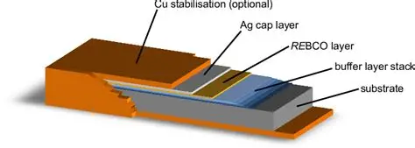
HTS for Future Colliders
¹ rare-earth barium copper oxide (REBCO, e.g., YBa₂Cu₃O₇–x)
Higher energies can be obtained inside a collider either by increasing the bending radius of the machine or by enhancing the magnetic field.
Magnets exploiting High Temperature Supercondoctor (HTS) technology can achieve higher field values and allow to reduce the cryogenic power.
REBCO ¹ is one of the most performant HTS materials in these terms.
HOWEVER…
REBCO superconductor is ceramic (so brittle) and anisotropic : it cannot be extruded in a filamentary structure!
This material needs to be deposited on flat substrate forming a tape-shaped conductor.
HTS High Field Magnets for Future Energy Frontier Colliders – Francesco Mariani

Slide 4
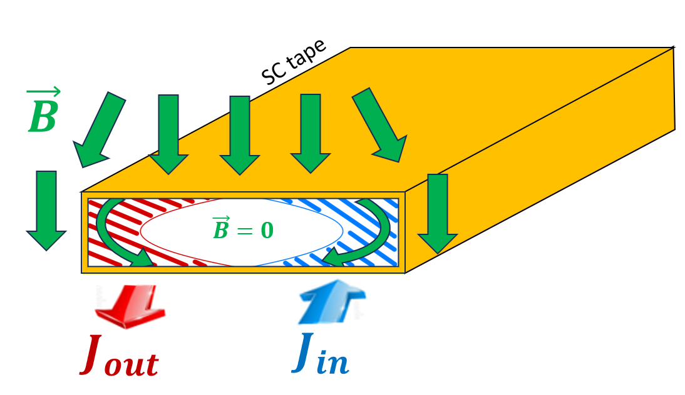
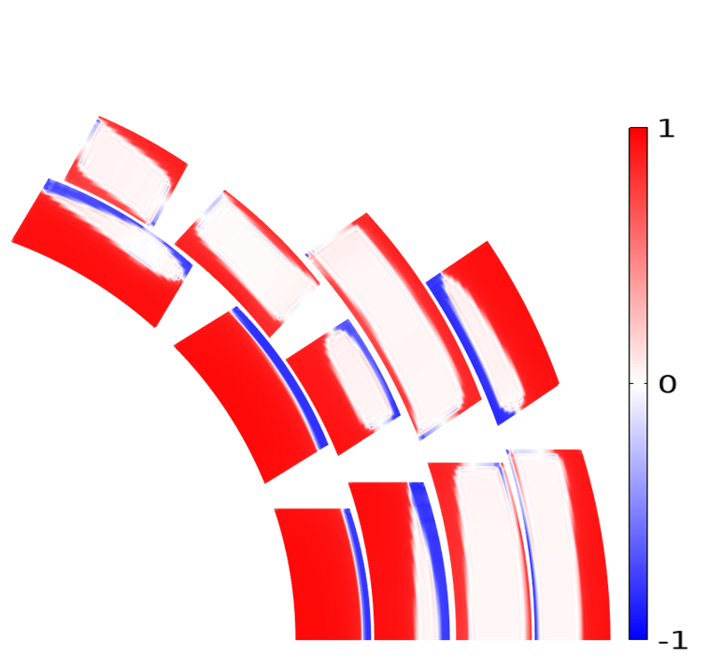
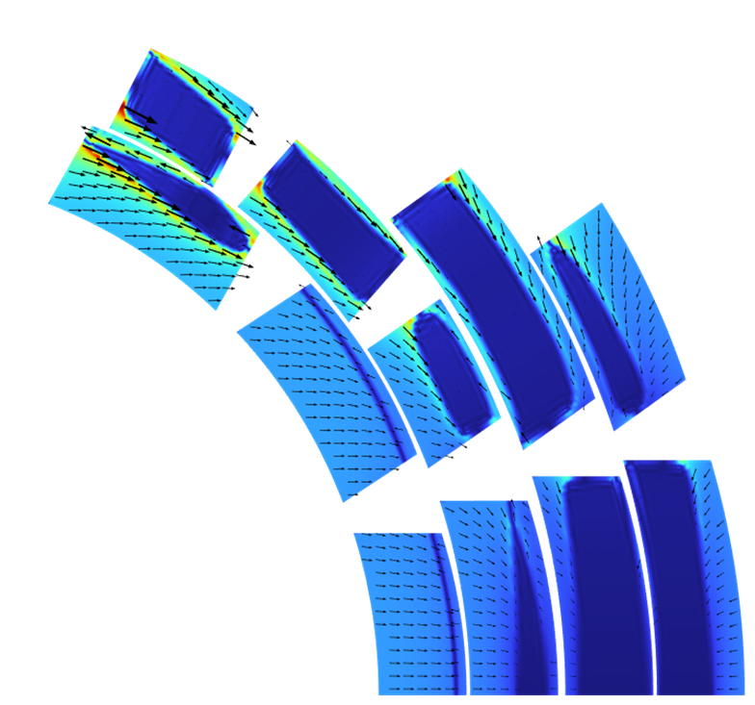
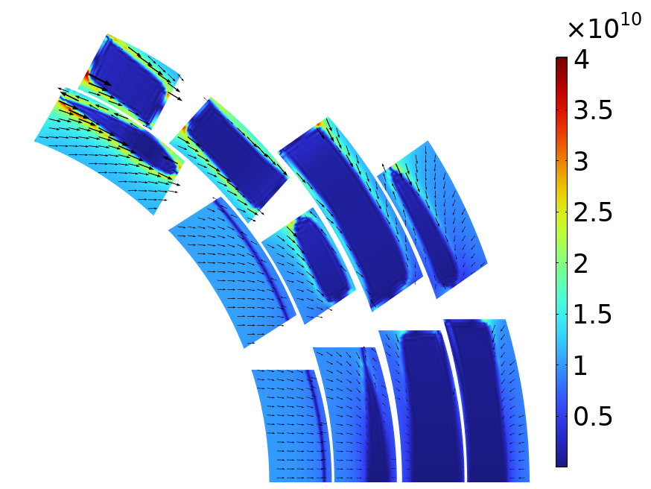
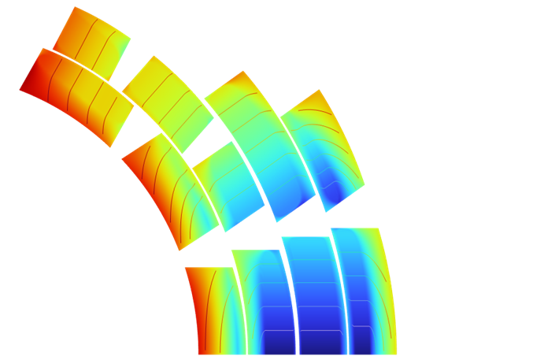
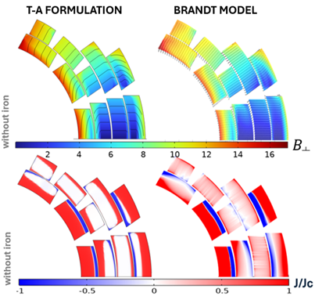




Screening Currents Magnetization
¹ Comsol multiphysics. [Online]. Available: https://www.comsol.com
Goal
Investigate screening current phenomenon by quantitative analysis and exploring mitigation strategies!
The high aspect ratio of REBCO tapes results in enhanced magnetization produced by the persistent currents flowing inside the superconductor to screen the external field.
This phenomenon negatively affect the magnet performances :
  Hysteretic losses
  Field quality degradation
  Additional mechanical stresses
$${J/J}_{c}$$
$$B[T]$$
$f_{L}$ $[N/m^{3}]$
16
12
10
8
6
4
2
0
¹
HTS High Field Magnets for Future Energy Frontier Colliders – Francesco Mariani

Slide 5
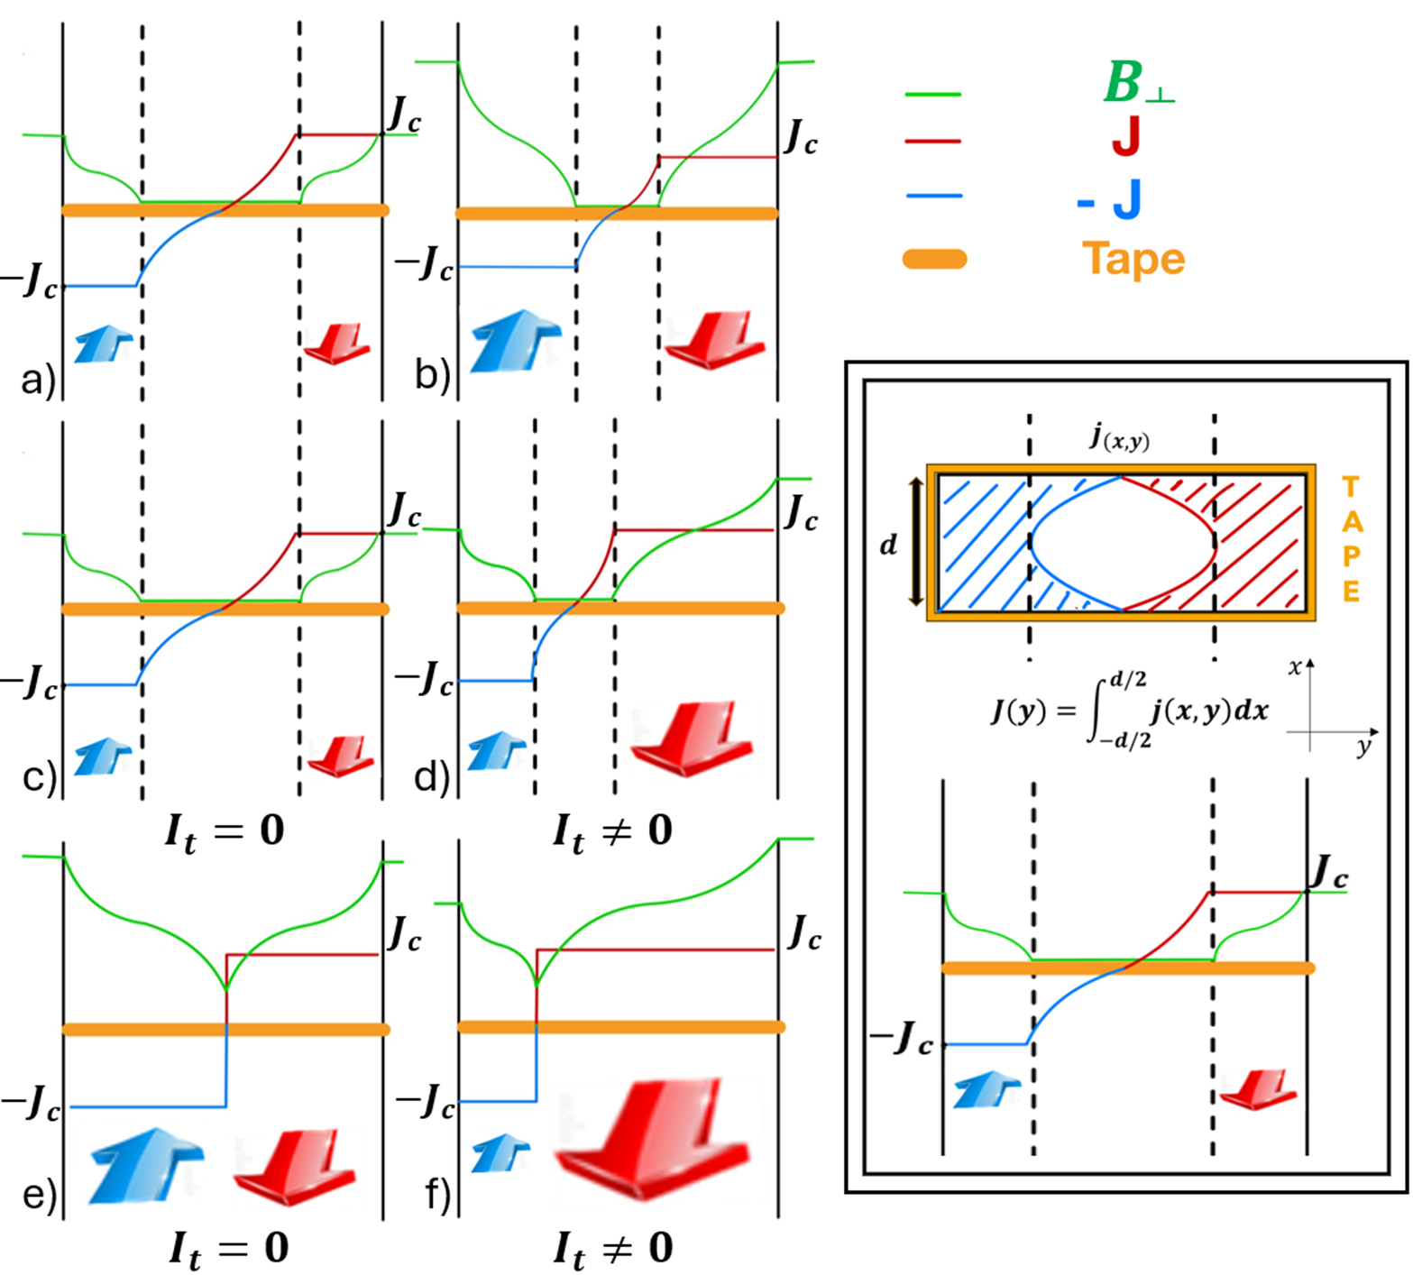
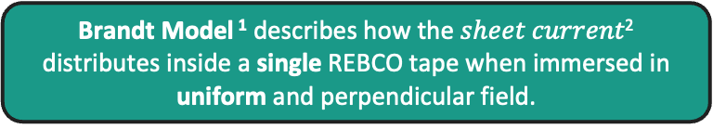

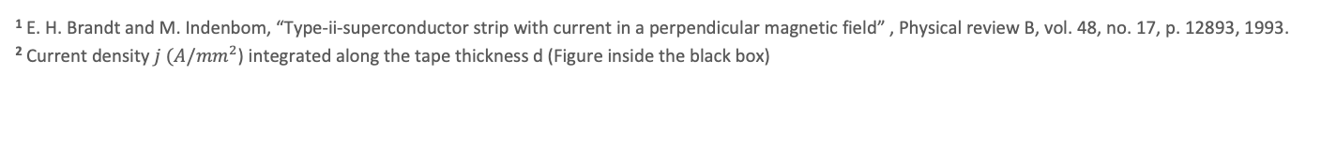
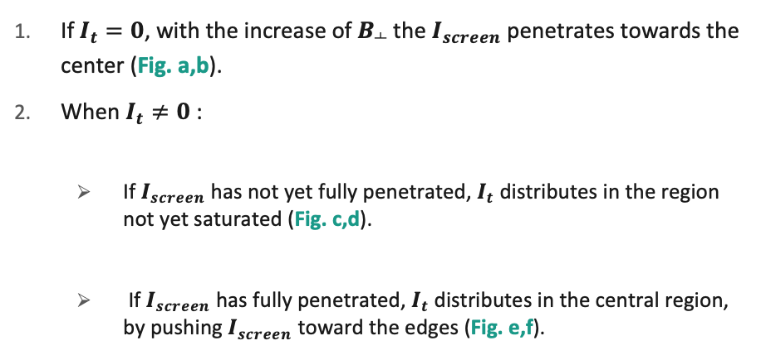
Brandt Model
¹ E. H. Brandt and M. Indenbom, “Type-ii-superconductor strip with current in a perpendicular magnetic field” , Physical review B, vol. 48, no. 17, p. 12893, 1993.
² Current density $j$ $(A/{mm}^{2}$) integrated along the tape thickness d (Figure inside the black box)
Brandt Model ¹ describes how the $sheet current\text{2}$ distributes inside a single REBCO tape when immersed in uniform and perpendicular field.
If $I_{t}=0$, with the increase of $B_{┴}$ the $I_{screen}$ penetrates towards the center (Fig. a,b).
When $I_{t}≠0$ :
  If $I_{screen}$ has not yet fully penetrated, $I_{t}$ distributes in the region not yet saturated (Fig. c,d).
  If $I_{screen}$ has fully penetrated, $I_{t}$ distributes in the central region, by pushing $I_{screen}$ toward the edges (Fig. e,f).
$$\text{2}$$
HTS High Field Magnets for Future Energy Frontier Colliders – Francesco Mariani

Slide 6
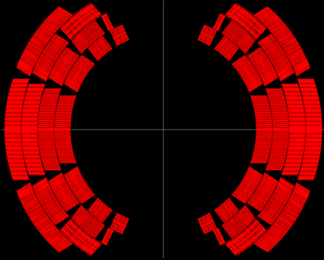
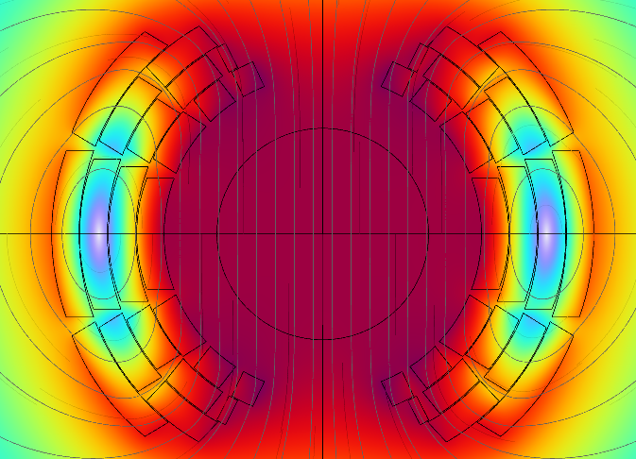

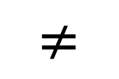


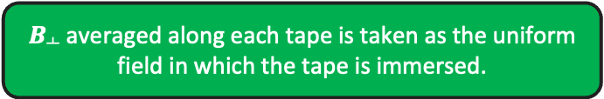

Brandt Model for Magnet Design
The model considers only a single tape, whereas the dipole magnet is made of thousands of tapes.
The model assumes a single value of $B_{┴}$ in which the tape is immersed.
uniform $B_{┴}$
non uniform $B_{┴}$
10736 tapes
1 tape
$$≠$$
$$≠$$
tape
Iterative solution needs to be performed to consider how each tape is affected by the current distribution of the others.
$B_{┴}$ averaged along each tape is taken as the uniform field in which the tape is immersed.
HTS High Field Magnets for Future Energy Frontier Colliders – Francesco Mariani

Slide 7
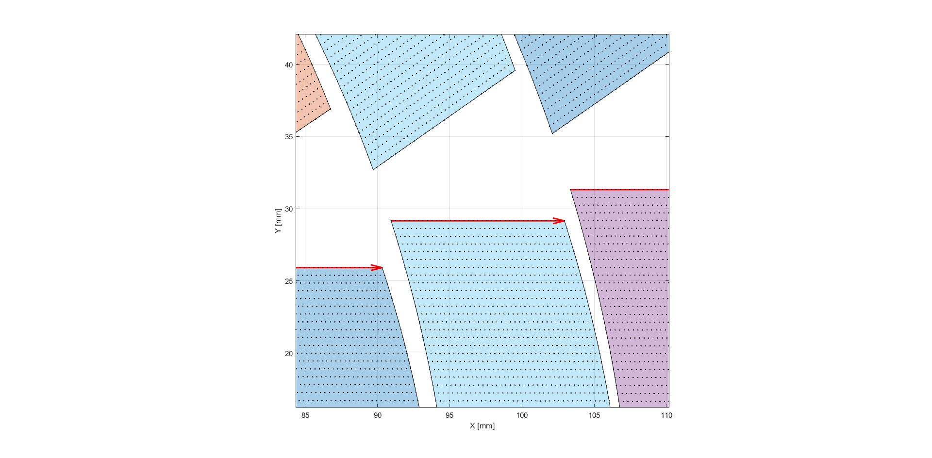
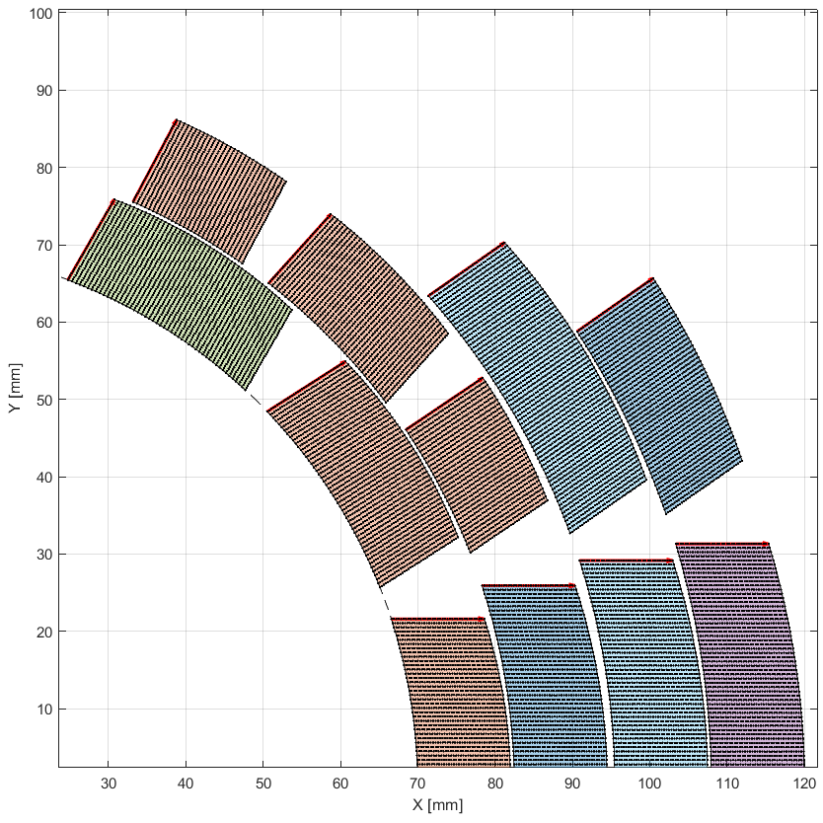
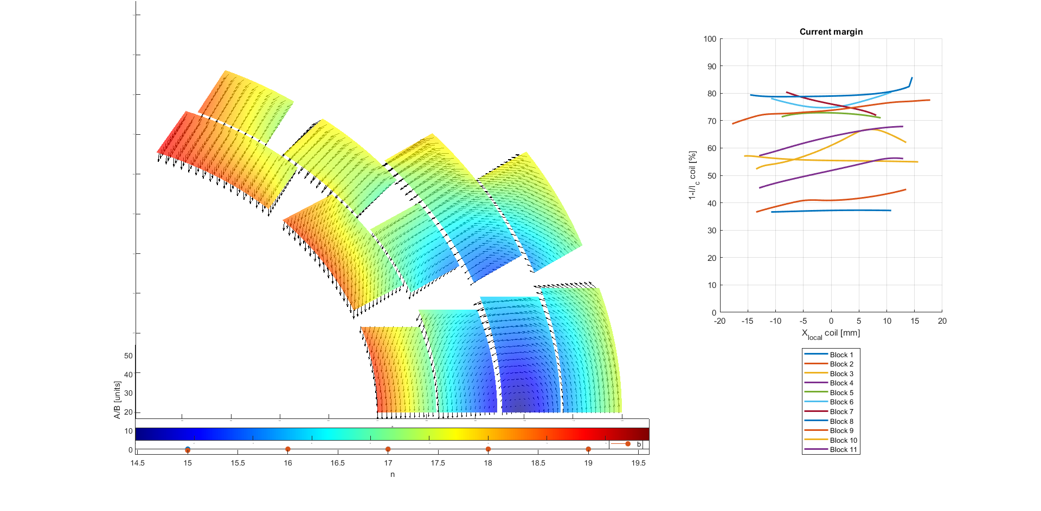
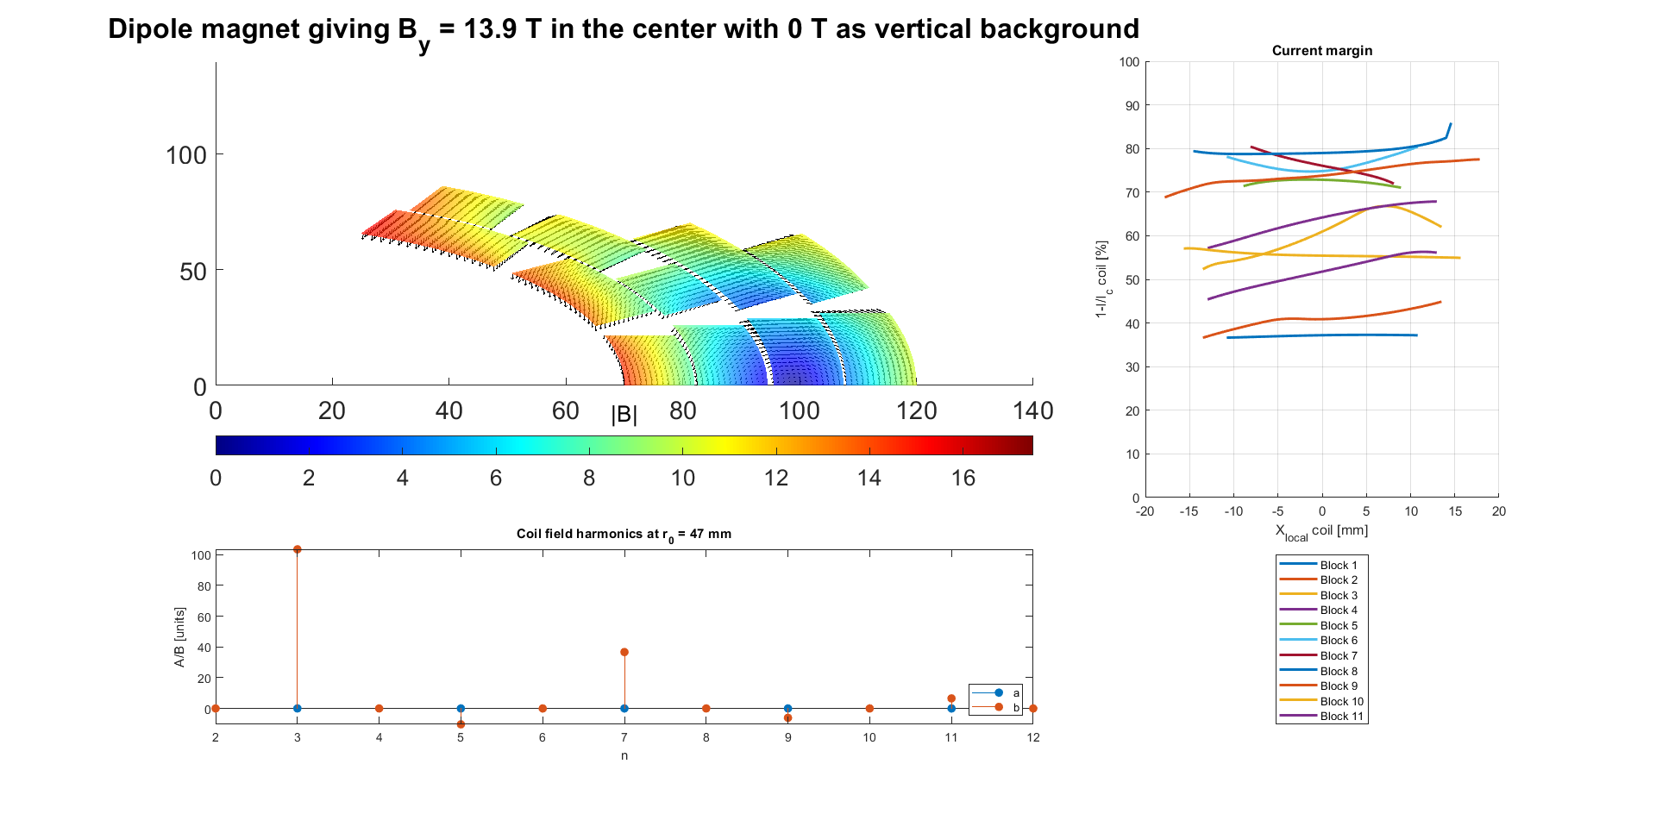
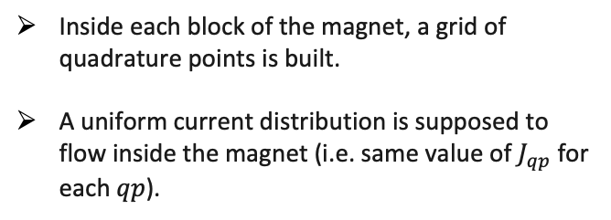

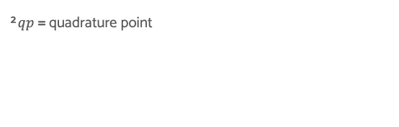
MATLAB code initialization
¹ MathWorks. 1994-2023 the mathworks, inc. [Online]. Available: https://matlab.mathworks.com
²$qp$= quadrature point
quadrature point qp
¹
Inside each block of the magnet, a grid of quadrature points is built.
A uniform current distribution is supposed to flow inside the magnet (i.e. same value of $J_{qp}$ for each $qp$).
²
The magnetic flux density value B is calculated in each quadrature point.
$$B[T]$$
HTS High Field Magnets for Future Energy Frontier Colliders – Francesco Mariani

Slide 8
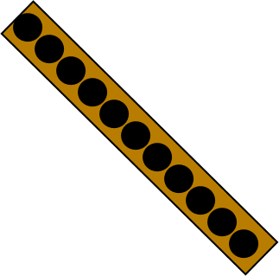
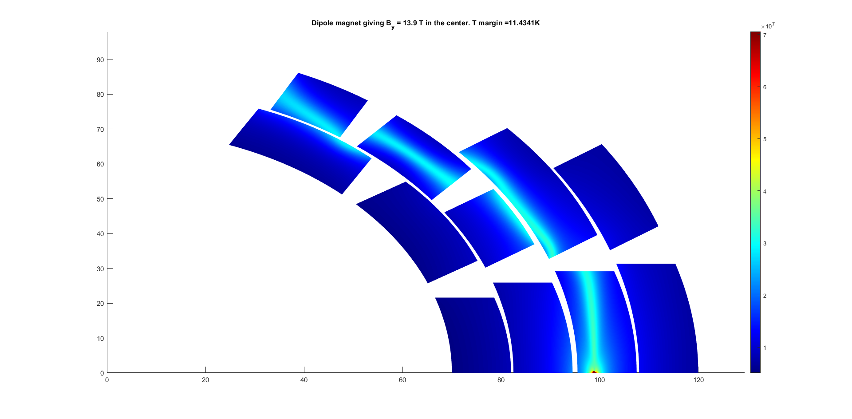
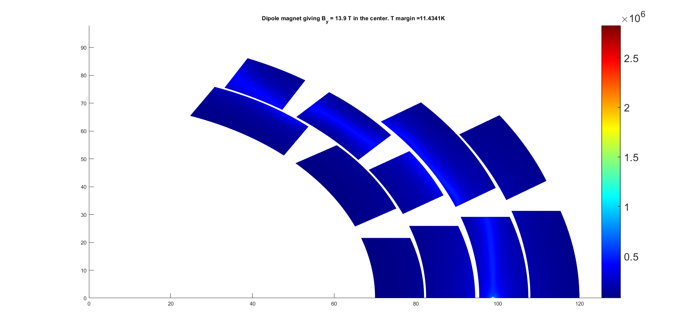
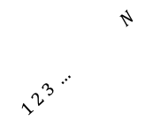

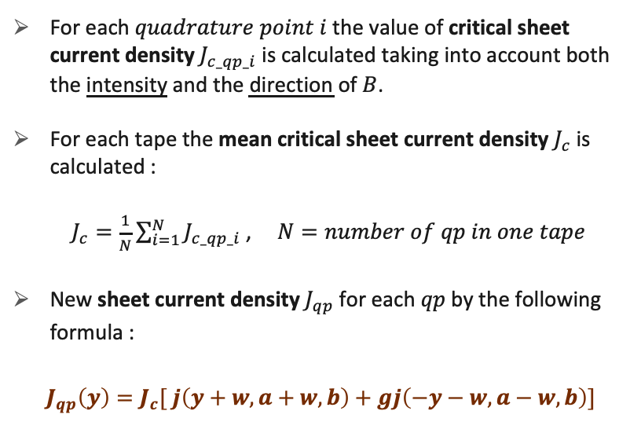
New current distribution
$$J_{c_{qp}}\left(\frac{A}{m}\right)(×{10}^{6})$$
For each $quadrature point$ $i$ the value of critical sheet current density $J_{c_qp_i}$is calculated taking into account both the intensity and the direction of $B$.
For each tape the mean critical sheet current density $J_{c}$ is calculated :
$J_{c}=\frac{1}{N}\sum_{i=1}^{N}{J_{c_qp_i}}$ ,$N=number of qp in one tape$
New sheet current density $J_{qp}$for each $qp$ by the following formula :
$J_{qp}\left(y\right)=J_{c}[ j\left(y+w, a+w, b\right)+gj\left(−y−w,a−w,b\right)]$
$1 2 3 … N$
HTS High Field Magnets for Future Energy Frontier Colliders – Francesco Mariani

Slide 9
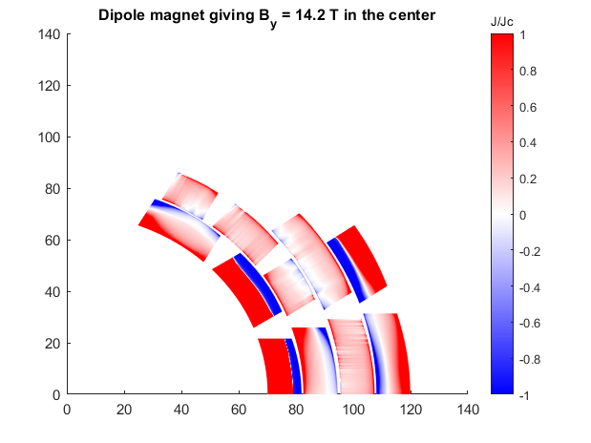
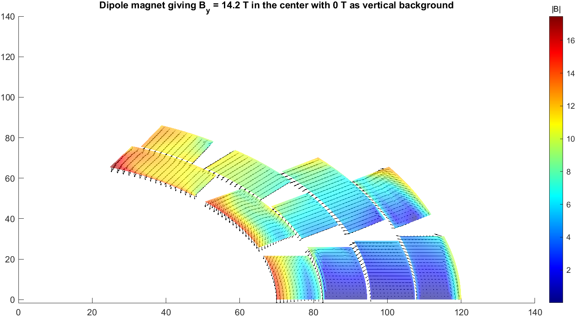
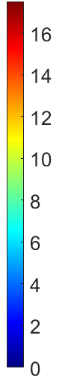





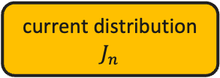



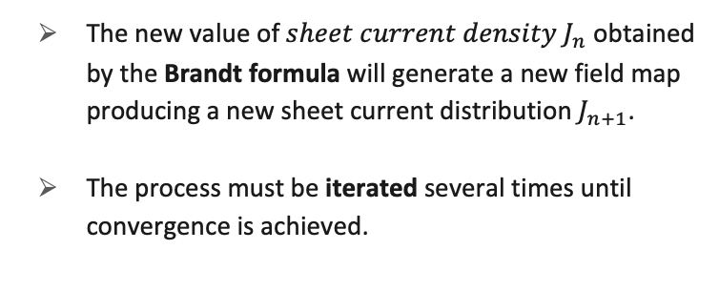
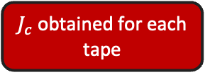
Iterative Process
¹$θ$= field orientation respect the tape surface
N.B. No time-dependent phenomena
The new value of $sheet current density J_{n}$ obtained by the Brandt formula will generate a new field map producing a new sheet current distribution $J_{n+1}$.
The process must be iterated several times until convergence is achieved.
Biot-Savart
current distribution $J_{n}$
Field map over the coils cross-section
$$J_{c}(B,θ^{1})$$
Brandt
1
$$B[T]$$
current distribution $J_{n+1}$
$J_{c}$ obtained for each tape
$$J/J_{c}$$
0
$$B_{bore}$$
Yes
Does it converge?
Iteration n
-1
No
HTS High Field Magnets for Future Energy Frontier Colliders – Francesco Mariani

Slide 10
Code Validation by comparison with FEM software
16T Dipole for Muon Collider
(steady state)
  10T dipole demonstrator for FCC (ramped)
HTS High Field Magnets for Future Energy Frontier Colliders – Francesco Mariani

Slide 11
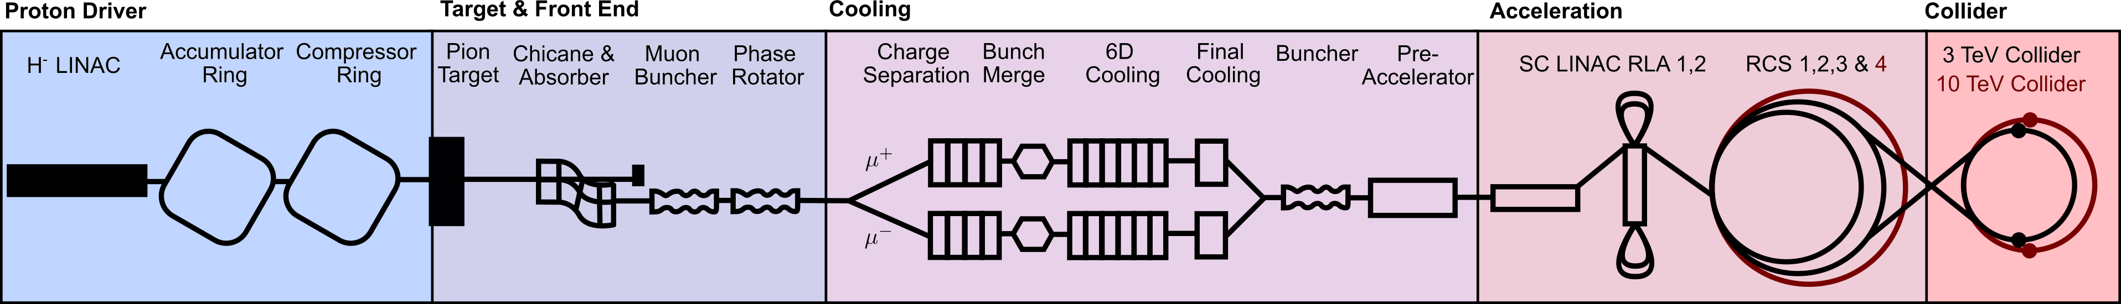
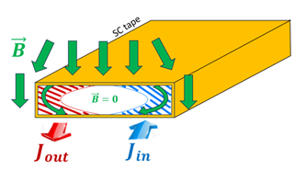
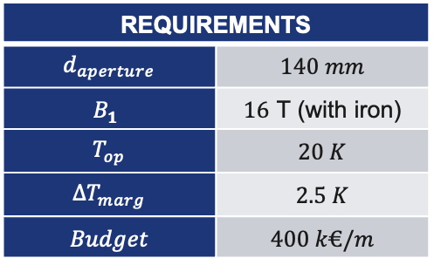
Muon Collider
Collider Ring Dipoles
featuring:
Highest field possible to have a compact ring.
Large aperture for shielding against beam induced heat.
(10 km-long ring, C.o.M of 10 TeV)
REQUIREMENTS
$$d_{aperture}$$ | $$140 mm$$
$$B_{1}$$ | $16 \text{T}$ (with iron)
$$T_{op}$$ | $$20 K$$
$${∆T}_{marg}$$ | $$2.5 K$$
$$Budget$$ | $$400 k€/m$$
GOAL
EM and MEC design considering effects produced by screening currents.
HTS High Field Magnets for Future Energy Frontier Colliders – Francesco Mariani

Slide 12
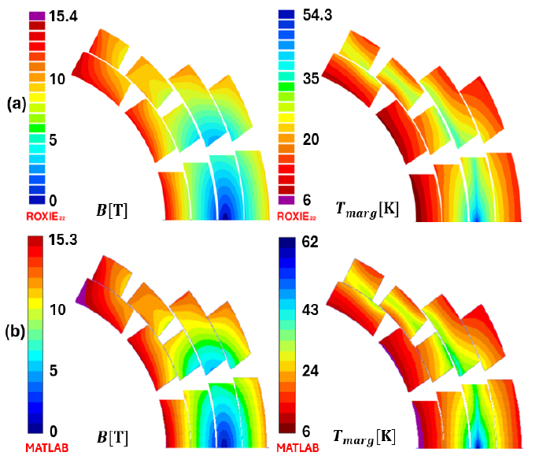
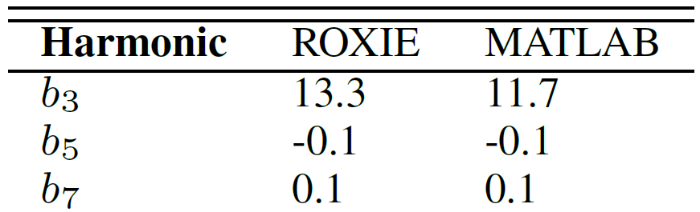
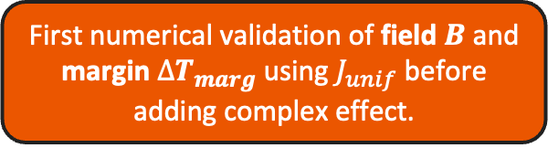
Comparison: ROXIE-MATLAB
¹ S. Russenschuck. Roxie. [Online]. Available: https://espace.cern.ch/roxie
¹
First numerical validation of field $B$ and margin ${∆T}_{marg}$ using $J_{unif}$ before adding complex effect.
ROXIE
MATLAB
HTS High Field Magnets for Future Energy Frontier Colliders – Francesco Mariani

Slide 13
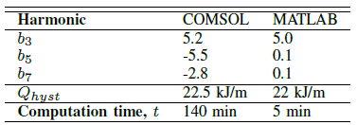
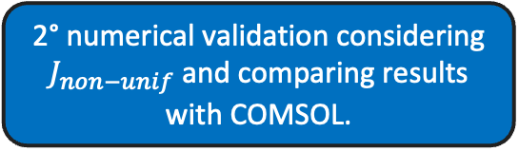
Validation by COMSOL
¹ Thinkbook Lenovo: RAM (16 GB), Processor (AMD Ryzen 5 5600 with Radeon Graphics, 2.3 GHz), 6 core
(COMSOL)
(MATLAB)
2° numerical validation considering $J_{non−unif}$ and comparing results with COMSOL.
¹
N.B. Iron yoke not considered
HTS High Field Magnets for Future Energy Frontier Colliders – Francesco Mariani

Slide 14
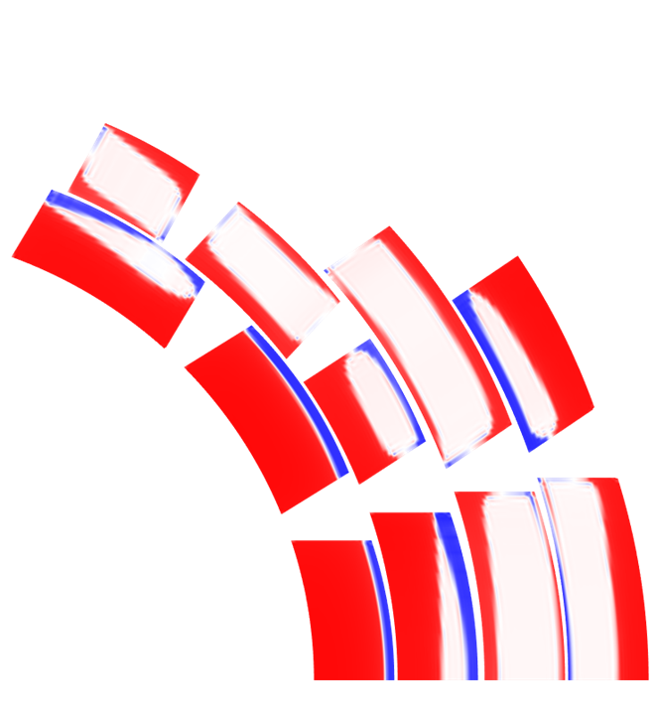
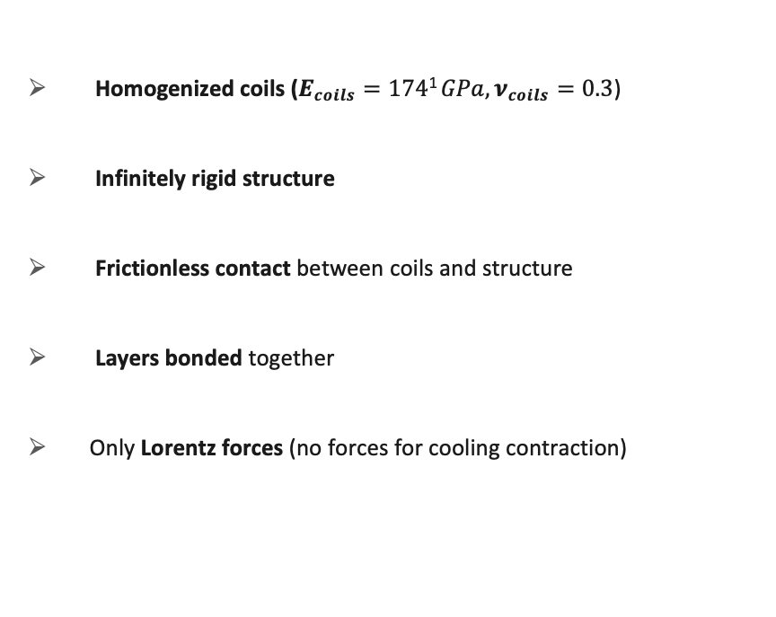

Mechanical Study: Lorentz Forces
Goal: evaluate how screening currents affect the stress analysis.
Homogenized coils ($E_{coils}=174\text{1} GPa,ν_{coils}=0.3$)
Infinitely rigid structure
Frictionless contact between coils and structure
Layers bonded together
Only Lorentz forces (no forces for cooling contraction)
$f_{L}$ $[N/m^{3}]$
HTS High Field Magnets for Future Energy Frontier Colliders – Francesco Mariani

Slide 15
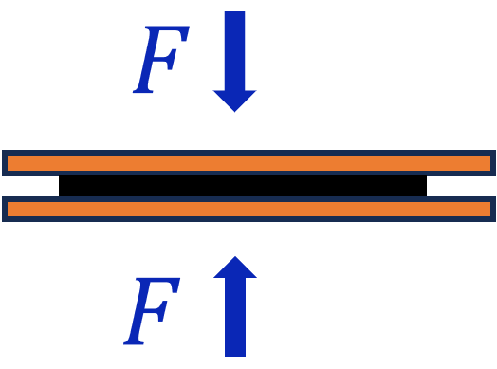
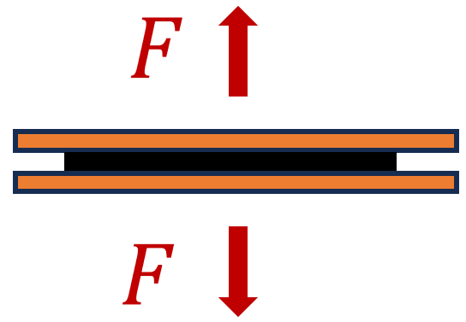
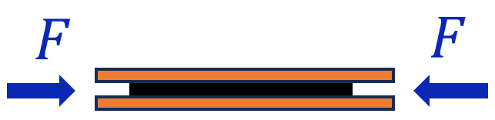
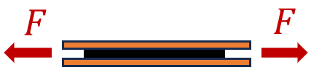
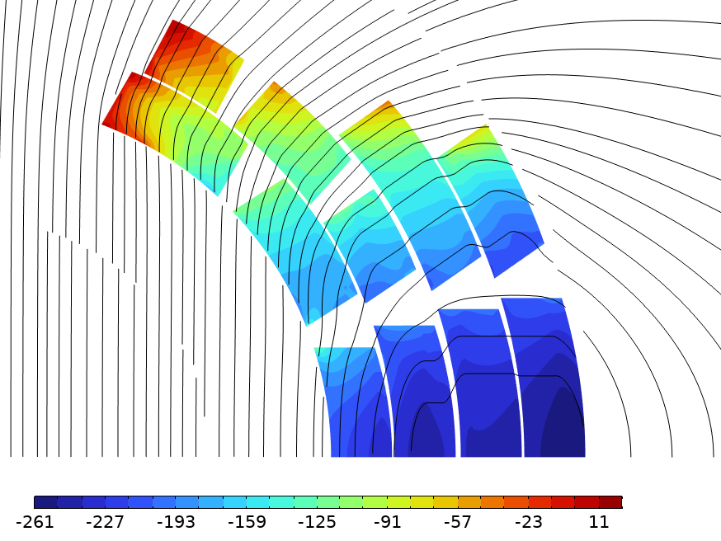
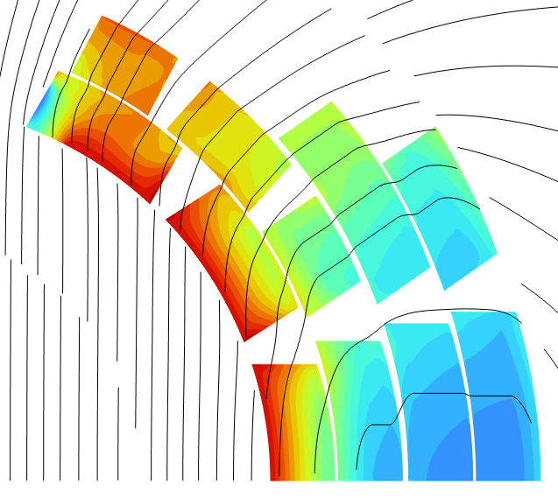



Mechanical Study: Stresses
¹ H. Maeda and Y. Yanagisawa, "Recent Developments in High-Temperature Superconducting Magnet Technology (Review)," doi: 10.1109/TASC.2013.2287707
² Superconductor Business Development Division Fujikura Ltd., “Introduction of Fujikura re-based high temperature superconductor,” Fujikura Global, Koto City, Tokyo, Japan, Tech. Rep., Jul. 2024. [Online]. Available: https://www.fujikura.co.jp/eng/products/newbusiness/
Transverse Compressive Stress
> 400 MPa²
Transverse Tensile Stress
10-100 MPa¹
Parallel Compressive Stress
< 100 MPa²
Parallel Tensile Stress
> 700 MPa¹
Azimuthal stress $σ_{θ}$
$σ$ (MPa)
Radial stress $σ_{r}$
$σ_{θ max}$= 17 Mpa
$σ_{θ min}$= -261 MPa
$σ_{r max}$= 22 Mpa
$σ_{r min}$= - 197 MPa
Radial compressive stress
needs to be reduced!
Next Study Step:
Stress management
HTS High Field Magnets for Future Energy Frontier Colliders – Francesco Mariani

Slide 16
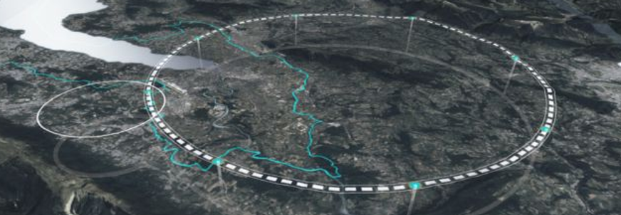
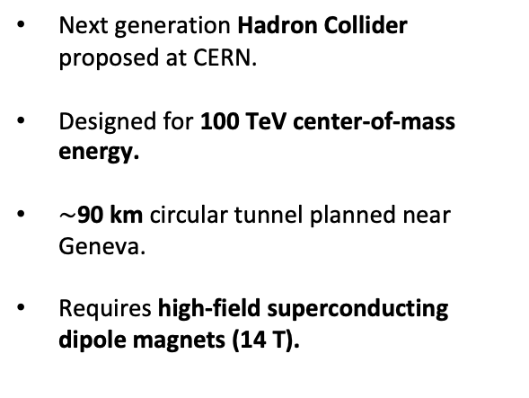
FCC-hh
Next generation Hadron Collider proposed at CERN.
Designed for 100 TeV center-of-mass energy.
$\sim$90 km circular tunnel planned near Geneva.
Requires high-field superconducting dipole magnets (14 T).
Preliminary target
INFN-CERN agreement within HFM program foresees the construction of a 10 T (with no iron contribution) HTS dipole demonstrator.
Key challenge: use of HTS materials in ramped-magnet!
HTS High Field Magnets for Future Energy Frontier Colliders – Francesco Mariani

Slide 17



10T HTS Dipole Demonstrator
REQUIREMENTS
$$d_{aperture}$$ | $$50 mm$$
$$B_{1}$$ | $1\text{0} \text{T}$
$$T_{op}$$ | $$20 K$$
$${∆T}_{marg}$$ | $$10 K$$
$$L_{mecc}$$ | $$1 m$$
$$Field quality$$ (geometric) | $$b_{3},b_{5}<1$$
ROXIE
COMSOL
COMSOL
MATLAB
$$J/J_{c}$$
EM design considering $J_{unif}$
HTS High Field Magnets for Future Energy Frontier Colliders – Francesco Mariani

Slide 18


Field Measurements on Racetrack Coils
GOAL
comparing the measurements with the simulated results for further validation.
Coil system must be designed to enhance the screening current effects.
Parametric simulations to identify the best layout.
HTS High Field Magnets for Future Energy Frontier Colliders – Francesco Mariani

Slide 19


Output Example ($Mirrored$)
HTS High Field Magnets for Future Energy Frontier Colliders – Francesco Mariani

Slide 20




The best configuration, also considering the ease in construction, is:
STAND ALONE
$$∆R$$ | $$y_{gap}$$
$$0 mm$$ | $$3 mm$$
Hall probe
HTS High Field Magnets for Future Energy Frontier Colliders – Francesco Mariani

Slide 21


Next Steps
winding
assembly
comparison
test of magnet performances
HTS High Field Magnets for Future Energy Frontier Colliders – Francesco Mariani

Slide 22
Timeline
3° year
1° year
Further code validation by comparison with experimental results through field measurements on Racetrack coils
Analytical Brandt Model Implementation in MATLAB
2° year
Code validation by COMSOL developing the 16T Muon Collider HTS dipole and the 10T FCC HTS dipole demonstrator
HTS High Field Magnets for Future Energy Frontier Colliders – Francesco Mariani
Notes:
.

Slide 23
Thank you for the attention!
HTS High Field Magnets for Future Energy Frontier Colliders
Francesco Mariani

Slide 24
References
Papers:
Images:
Slides:
  https://github.com/pietro-nardelli/sapienza-ppt-template
  [Attribution-NonCommercial-ShareAlike 4.0 International (CC BY-NC-SA 4.0)]
HTS High Field Magnets for Future Energy Frontier Colliders – Francesco Mariani

Slide 25
Backup Slides

Slide 26
















Brandt Model Implementation
¹ $r$ = self field contribution VS external field contribution
$J_{qp}\left(y\right)=J_{c}[ j\left(y+w, a+w, b\right)+gj\left(−y−w,a−w,b\right)]$
where
$$b≤y≤a$$
$$−b≤y≤b$$
$$−∞<y<−b$$
$j\left(y,a,b\right)= \left\{\begin{aligned}1 \\ \frac{1}{π}arccot⁡\frac{b^{2}−ay}{p} \\ 0\end{aligned} ,\right.$
the values of $b,w$ for each tape must be obtained ($2a=tape width$and $p={[\left|y^{2}−b^{2}\right|\left(a^{2}−b^{2}\right)]}^{1/2}$)
$\left\{\begin{aligned}b{=(1−f^{2})}^{1/2}{(1−c^{2})}^{1/2}a \\ w=afc \end{aligned}\right.$,
$f=\frac{I}{I_{MAX}}$ ,
$$c=tanh{\frac{H_{a}}{H_{c}}}$$
$qp$ 2
$qp$ $N$
$qp$ 1
$qp$ 3
…
$I_{MAX}=$ $J_{c}2a$
$H_{c}=$ $J_{c}/π$
N.B. the parameter g$=+1$ if $r\text{1}=\frac{I}{2πaH_{a}}>1$, while$g=−1$ if $r\text{1}=\frac{I}{2πaH_{a}}<1$
$$x$$
HTS High Field Magnets for Future Energy Frontier Colliders – Francesco Mariani
$$y$$

