Slide 1





Progress and Perspectives on Plasma Sources for Plasma-Based Accelerators
Candidate: Romain Demitra - XXXIX PhD School in Accelerator physics
Thesis Supervisors:
Dr. Angelo Biagioni (LNF-INFN)
Dr. Riccardo Pompili (LNF-INFN)

Slide 2
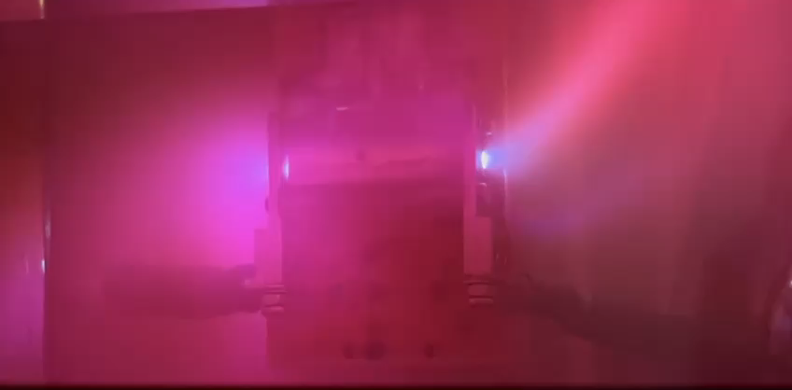
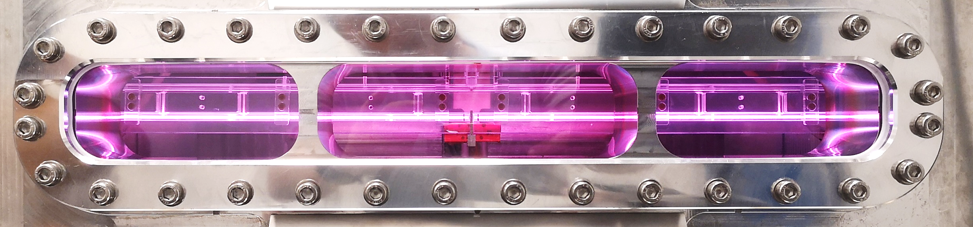
Outline
Gas-filled plasma capillaries discharge
Material studies of capillaries
Trasverse spectroscopic measurements
EuPRAXIA@SPARC_Lab capillary
High current discharge circuit
Conclusion

Slide 3
Outline
Gas-filled plasma capillaries discharge
Material studies of capillaries
Trasverse spectroscopic measurements
EuPRAXIA@SPARC_Lab capillary
High current discharge circuit
Conclusion

Slide 4
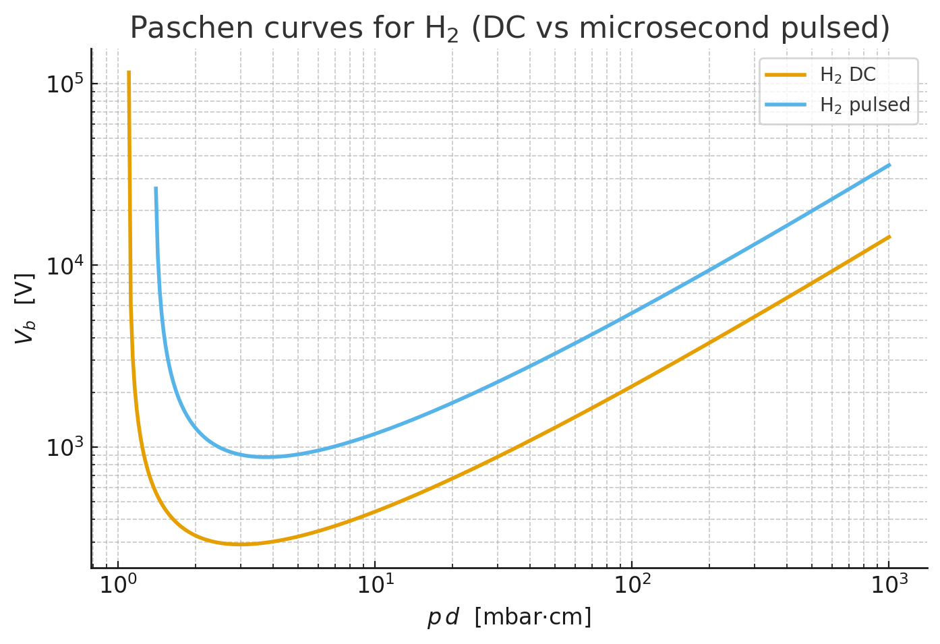
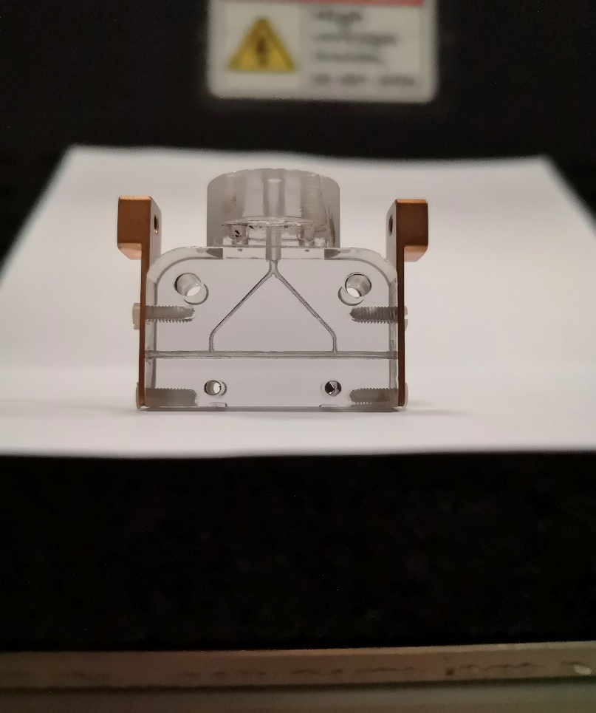
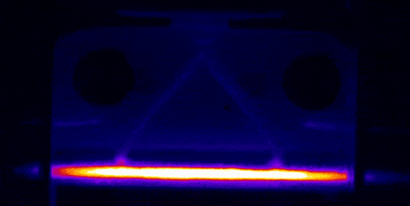
Gas-filled plasma capillaries discharge - Introduction
• Principle – A gas-filled dielectric capillary is ionized by a high-voltage discharge (5-25kV) – The resulting plasma column provides a well-defined density profile for beam or laser guiding
• Key Features – Self-consistent heating and ionization: fast current pulse (~hundreds of ns) → plasma channel formation – Plasma density tunable via gas type, pressure, and discharge parameters
– Small dimension of the HV source to produce plasma • Typical Parameters – Length: 1–60 cm · Radius: 0.5–2 mm – Pressure: 1–100 mbar (He, H₂, Ar...) – Peak current: 1–20 kA · Pulse duration: 100–1000 ns – Plasma density: 10¹⁶–10¹⁸ cm⁻³
• Technical Challenges – Stability and reproducibility (shot-to-shot, longitudinal uniformity) – High repetition-rate operation (≥ 100 Hz) – Synchronization with beam and diagnostics integration
Electrode
HV pulse
Gas inlets
Plasma channel
Gas injection
Plasma channel
Plasma/Gas ramps
Electrodes
HV

Slide 5
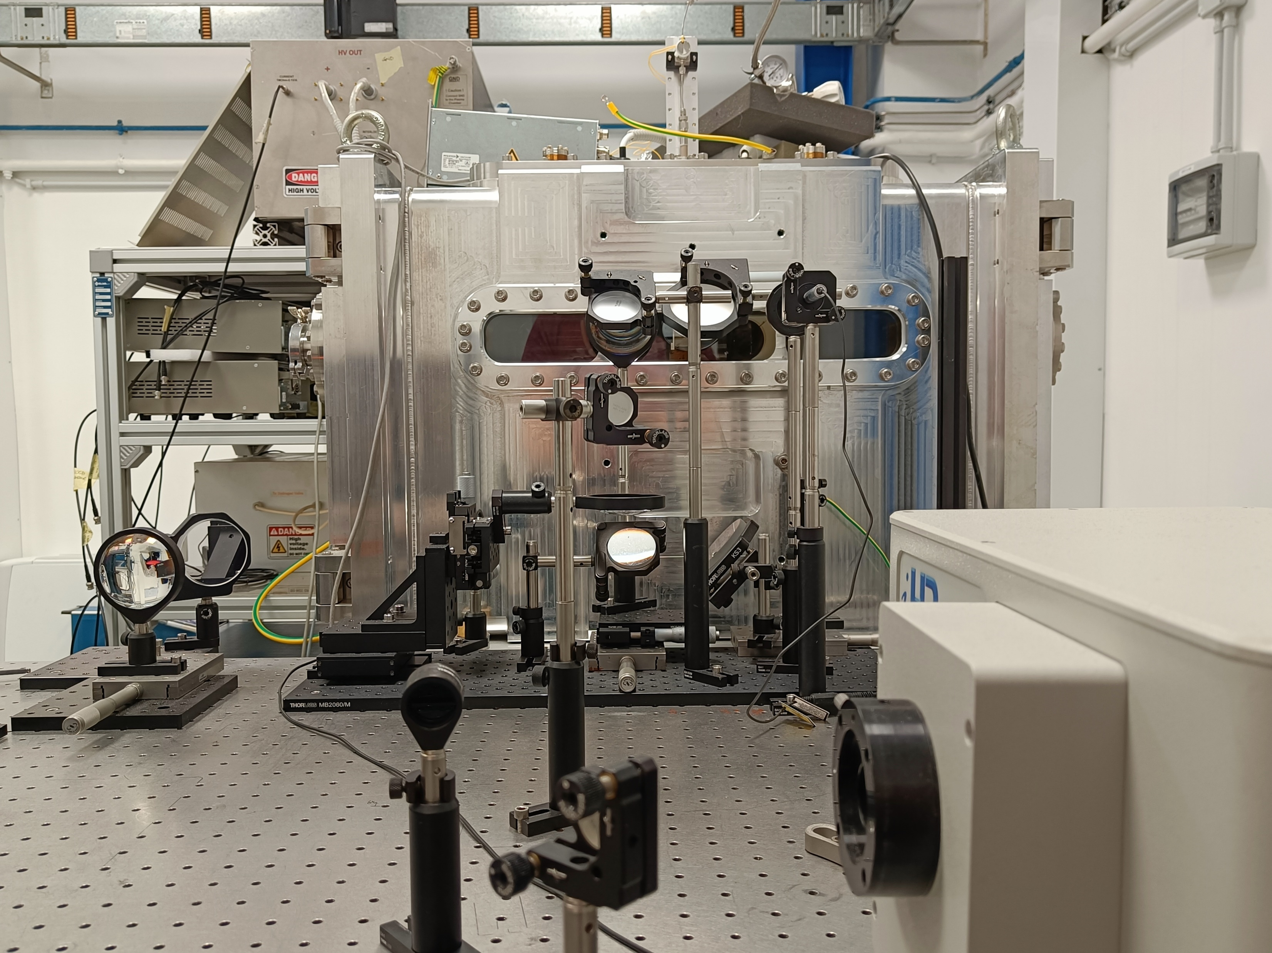
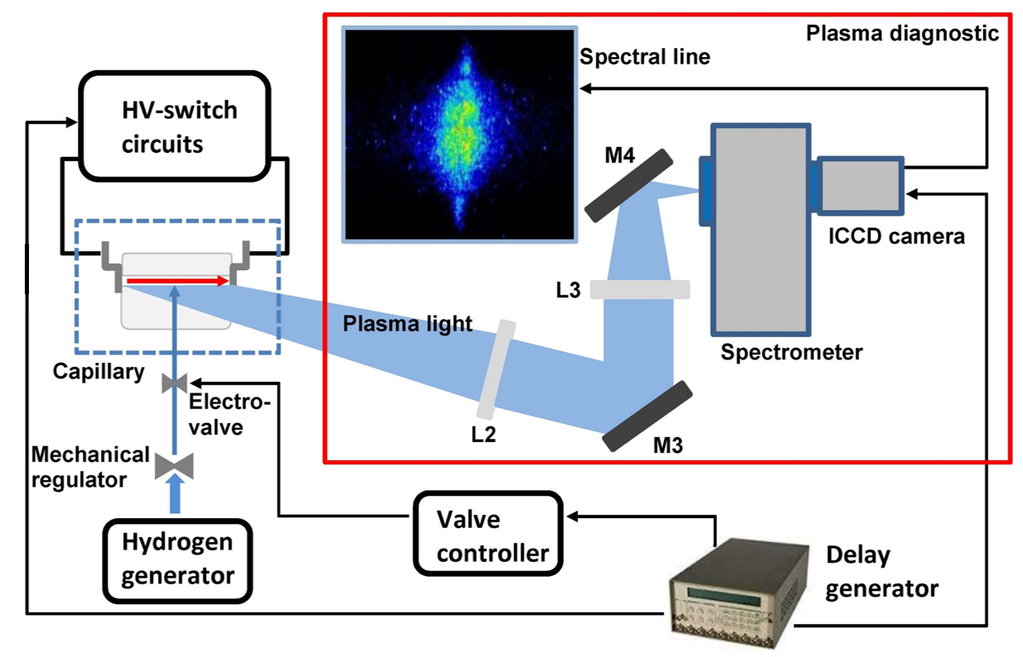
Gas-filled plasma capillaries discharge – Plasma module
Vacuum chamber
10⁻⁶ mbar, 2 primary scroll pumps, 1 turbo-molecular pump
Gas injection system
H₂, N₂, Ar
10-50 mbar at 1 Hz
High voltage system
HV generator and pulser circuit
5-20 kV us-short pulses
Delay generator
Diagnostic system
Optical line
Imaging spectrometer
ICCD camera

Slide 6

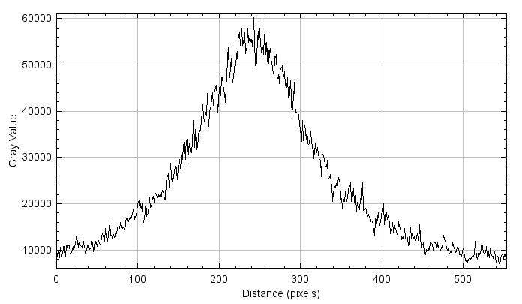
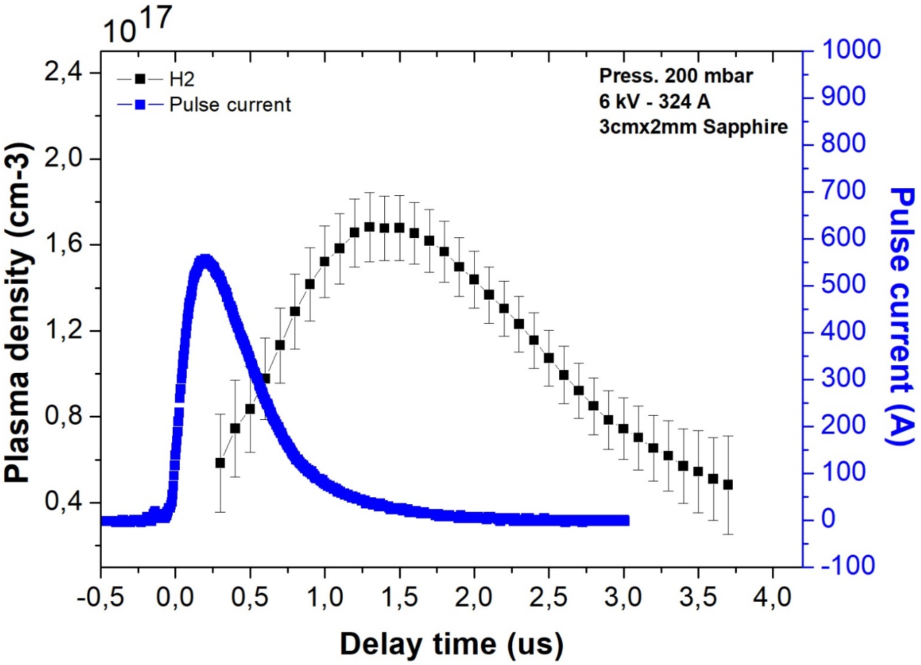
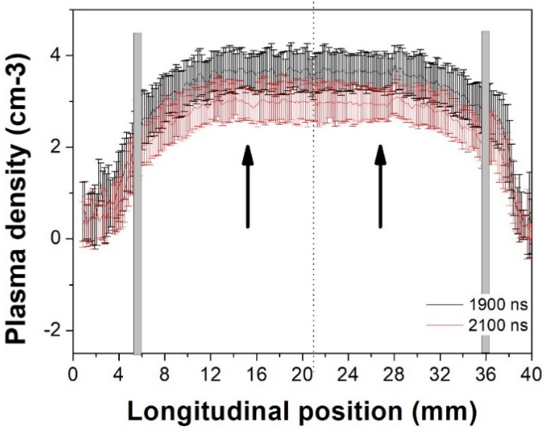
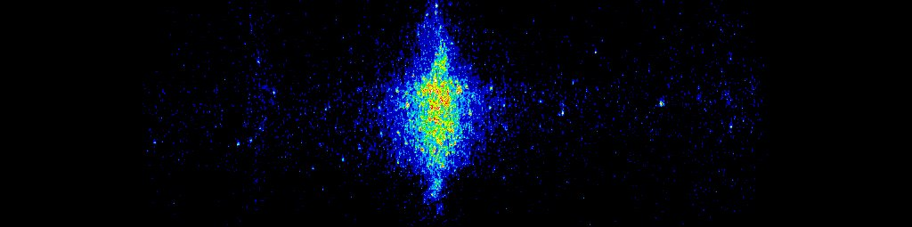

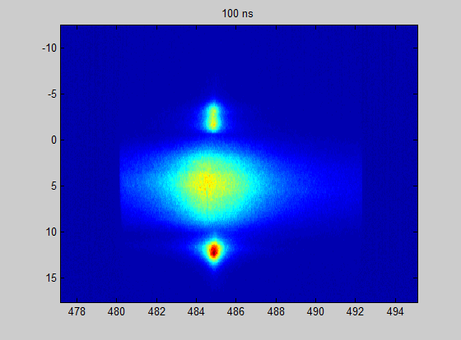
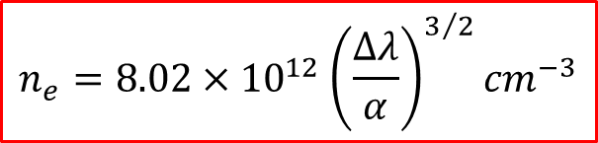

Gas-filled plasma capillaries discharge – Stark Broadening measurements
wavelength
434nm
Time profile
x10¹⁷
486nm
656nm
Lorentzian fit
Acceleration
$$∆λ$$
Stark broadening effect
Position (mm)
Δλ
The spectrometer acquires hydrogen spectral lines of Balmer series
Stark effect: correlation between plasma density and hydrogen spectral linewidth
Temporal and spatial resolved measurements of plasma density
Spatial profile
Electrode
shadow
Density profile
Plasma
channel
$$n_{e}=8.02×{10}^{12}{\left(\frac{∆λ}{α}\right)}^{3/2}{cm}^{−3}$$
Plasma plume
λ (nm)

Slide 7
Outline
Gas-filled plasma capillaries discharge
Material studies of capillaries
Trasverse spectroscopic measurements
EuPRAXIA@SPARC_Lab capillary
High current discharge circuit
Conclusion

Slide 8
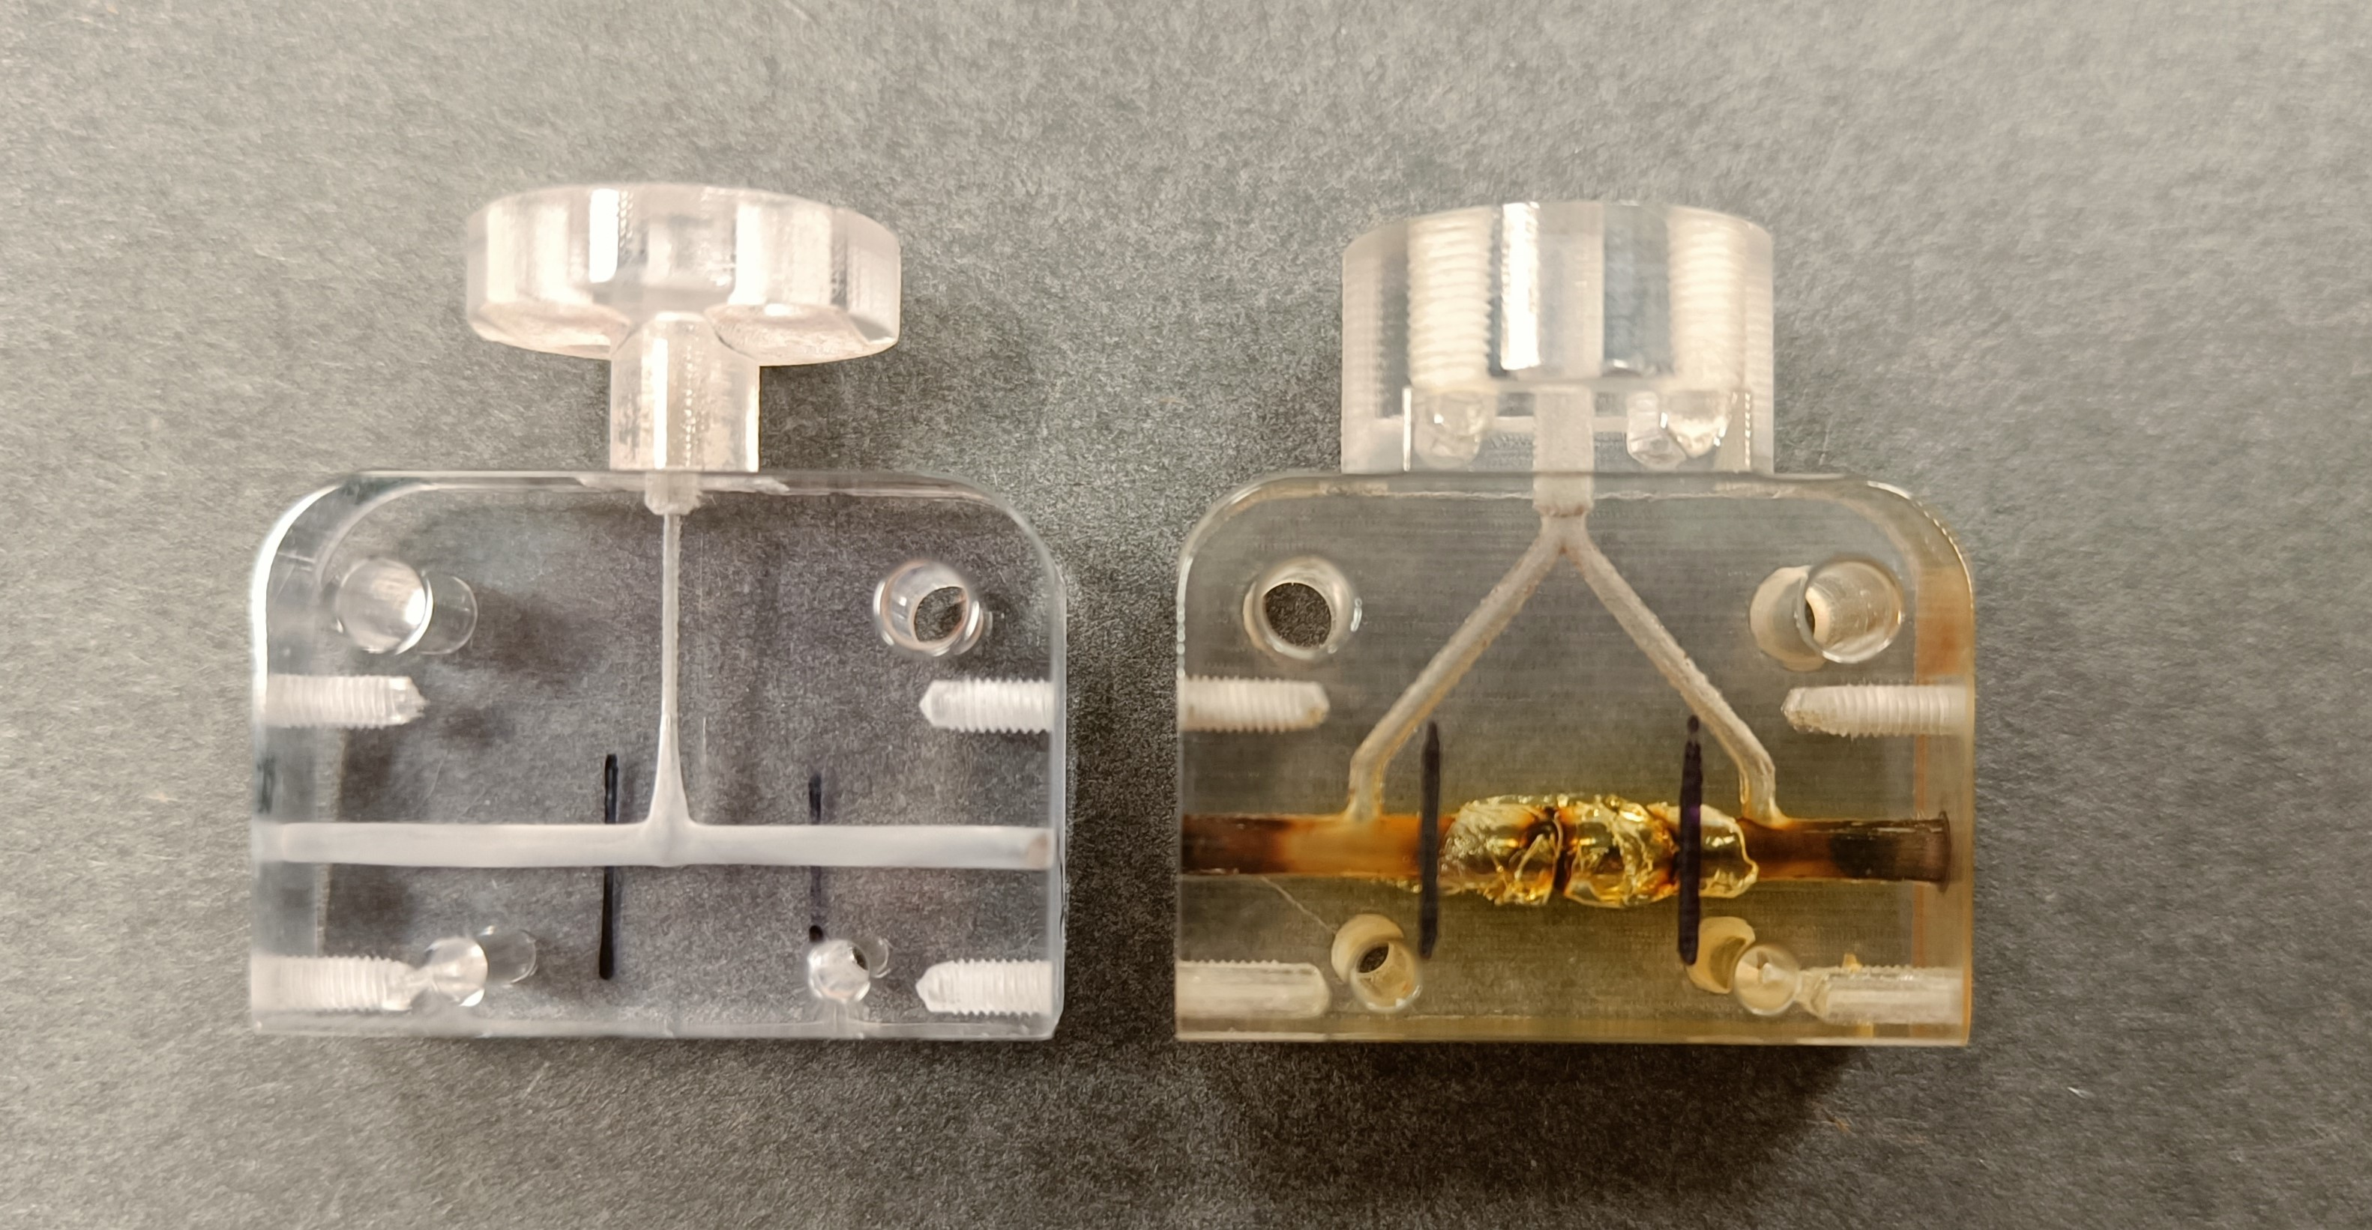
Material studies of capillaries – 3D printed plastic capillaries
• Measure plasma density evolution over time to assess capillary degradation • Compare density at first shot and after 110k discharges under identical conditions (1 Hz repitition rate) • Identify possible erosion or material aging affecting plasma uniformity and stability
1 mm between the lines
• After only 110k shots at 1 Hz, plasma density drops by ~20-30 % (depending on geometry) • Indicates limited durability of plastic capillaries under repetitive operation • Unsuitable for high-repetition accelerators like EuPRAXIA (≥ 100 Hz target) • Highlights the need for new, more resistant materials

Slide 9
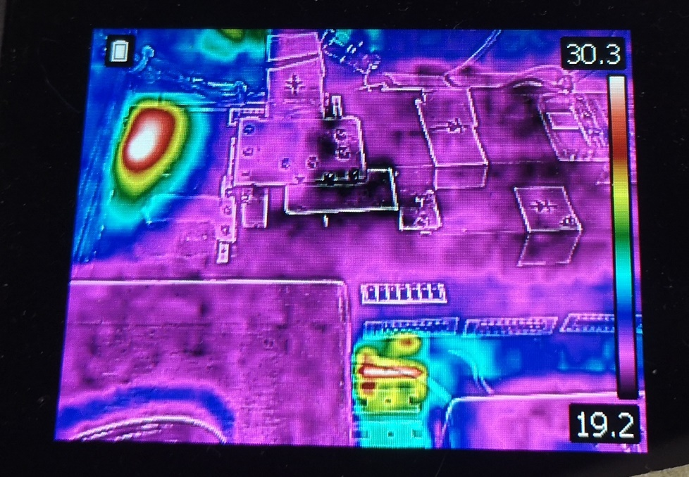
Material studies of capillaries – High repetition rate
Motivations
• EuPRAXIA requires stable plasma sources at ≥100 Hz, with high reproducibility and long lifetime • Current plastic capillaries show ~30 % plasma density loss after only 110 k shots at 1 Hz • Thermal limitations (vacuum system, discharge circuit, capillary material) restrict high-rate operation • Capillary erosion degrade plasma uniformity over time • Demonstrates the need for new materials and improved thermalfor reliable high-rep operation

Slide 10
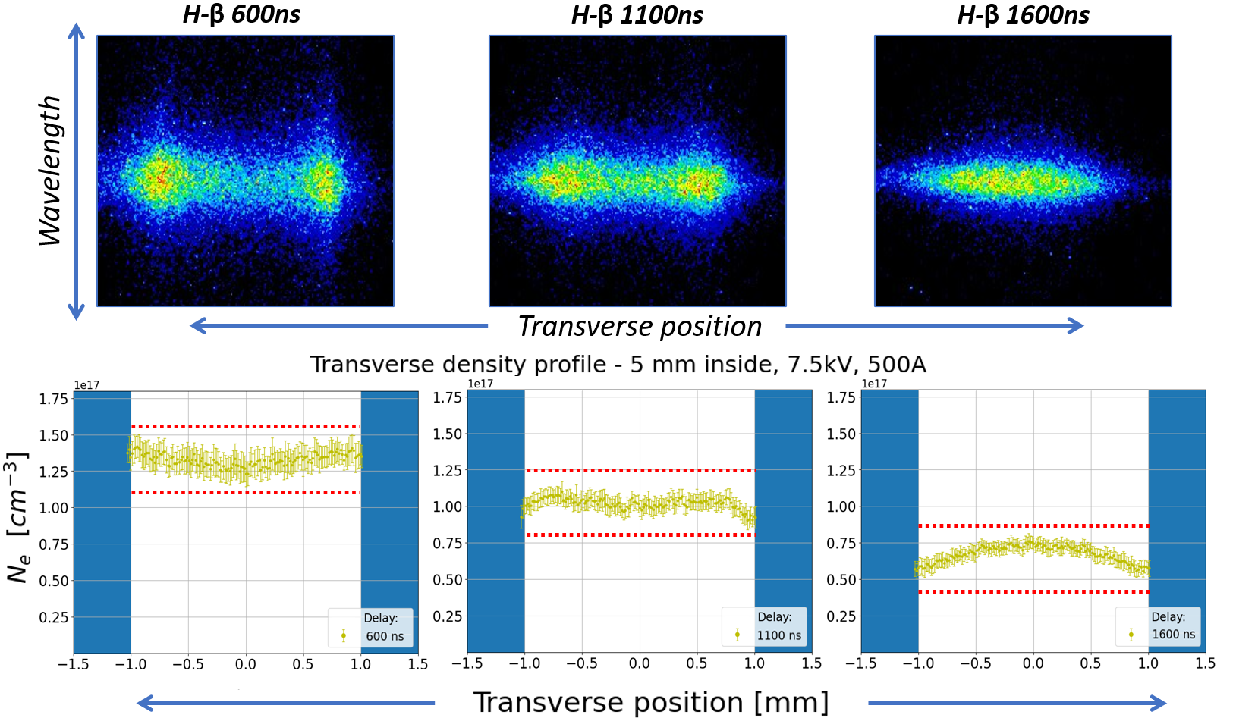
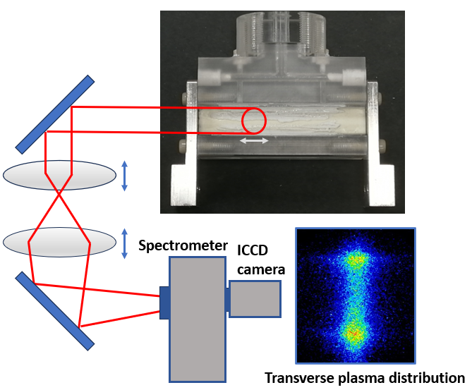
Material studies of capillaries– High repetition rate
• The plasma channel was redesigned using Shapal, a ceramic with high thermal conductivity to improve heat dissipation and lifetime • However, Shapal is opaque, preventing optical access for diagnostics through the capillary wall
Transverse Stark-Broadening:
Conditions: H₂ at 80–100 mbar, 1 Hz gas injection, 7.5 kV – 500 A discharge (peak).
Method: Image transverse slices of the plasma channel; record Stark-broadened Balmer line (e.g., Hβ) ⇒ fit linewidth → nₑ(r).
Time-resolved: Gated ICCD / fast spectrometer at set delays

Slide 11
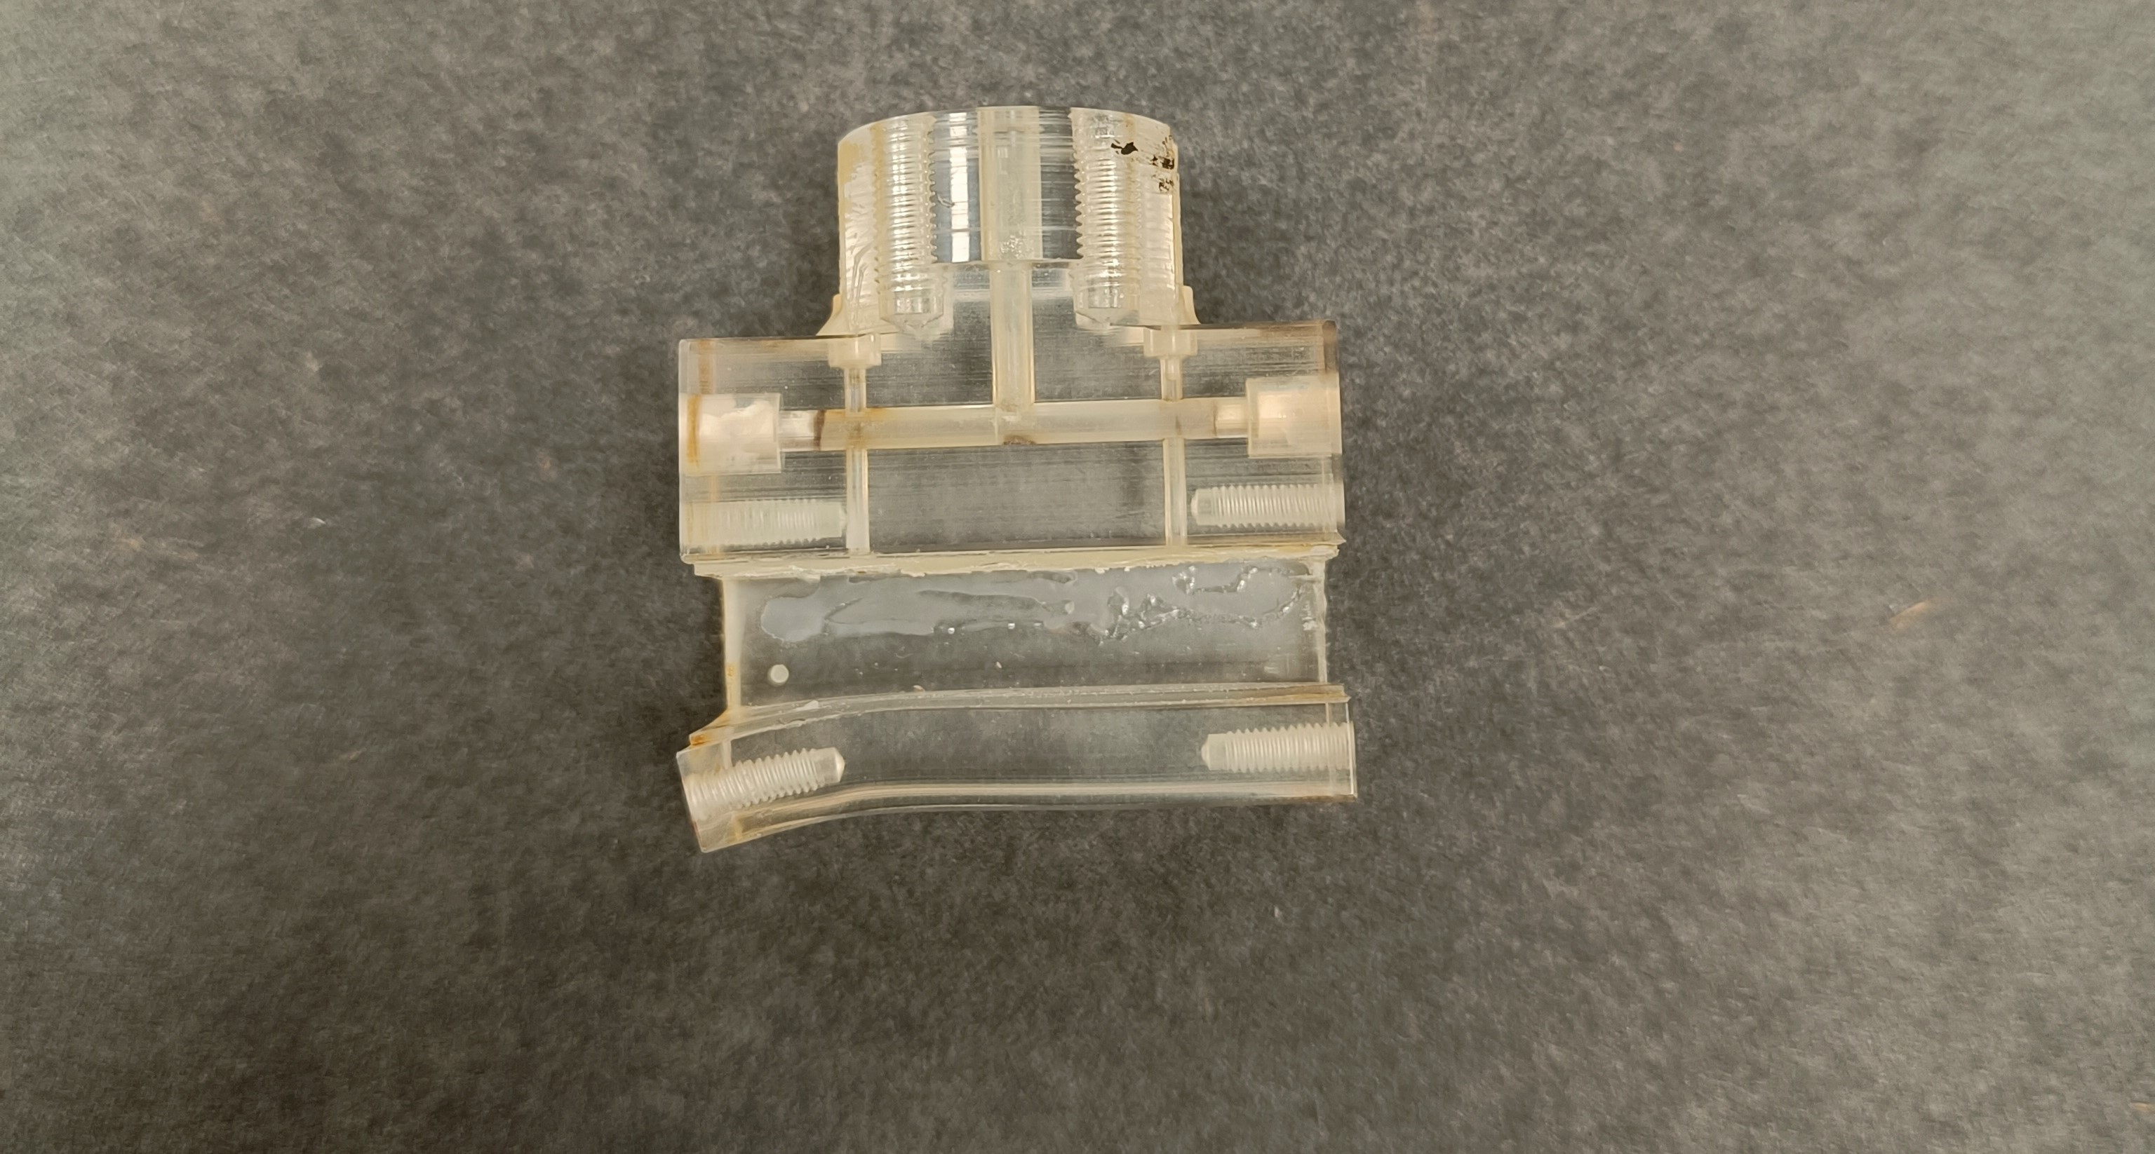
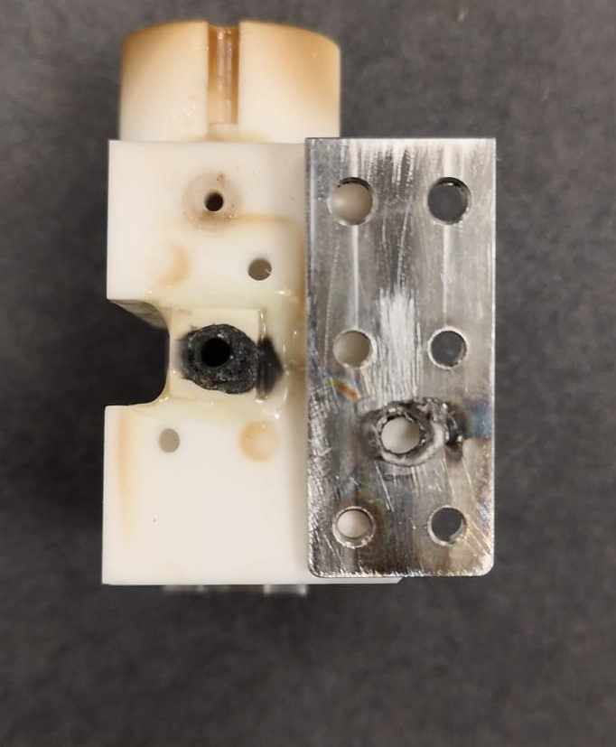
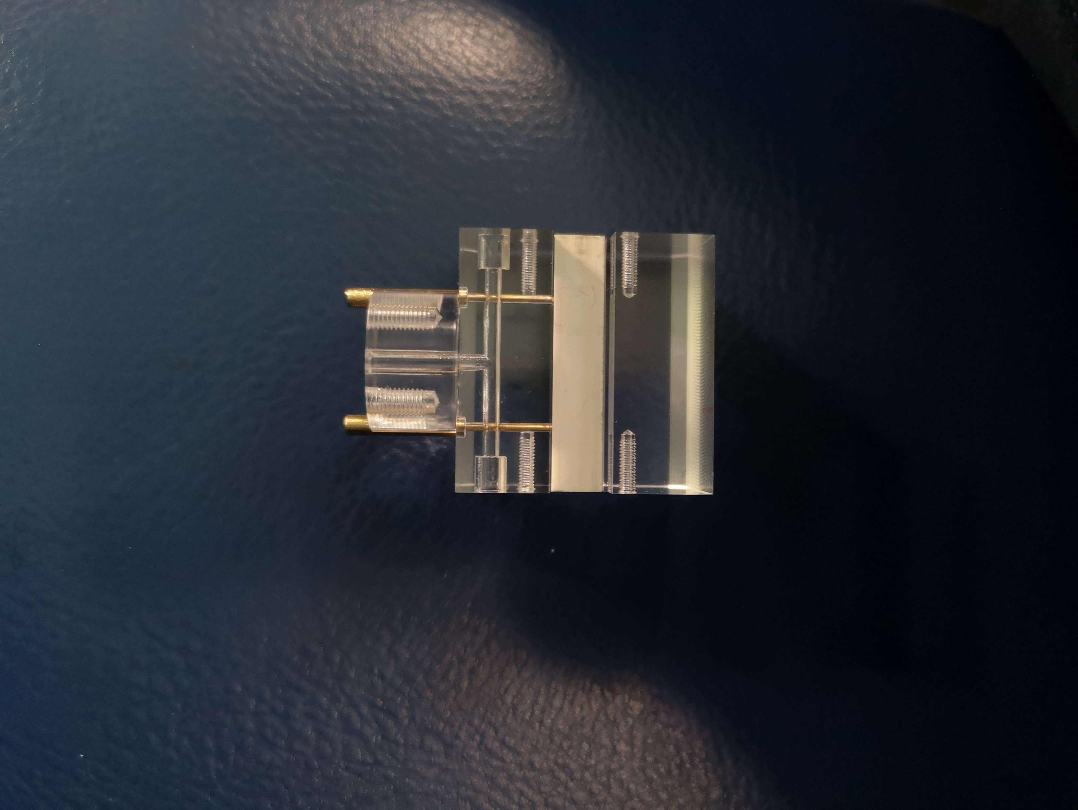
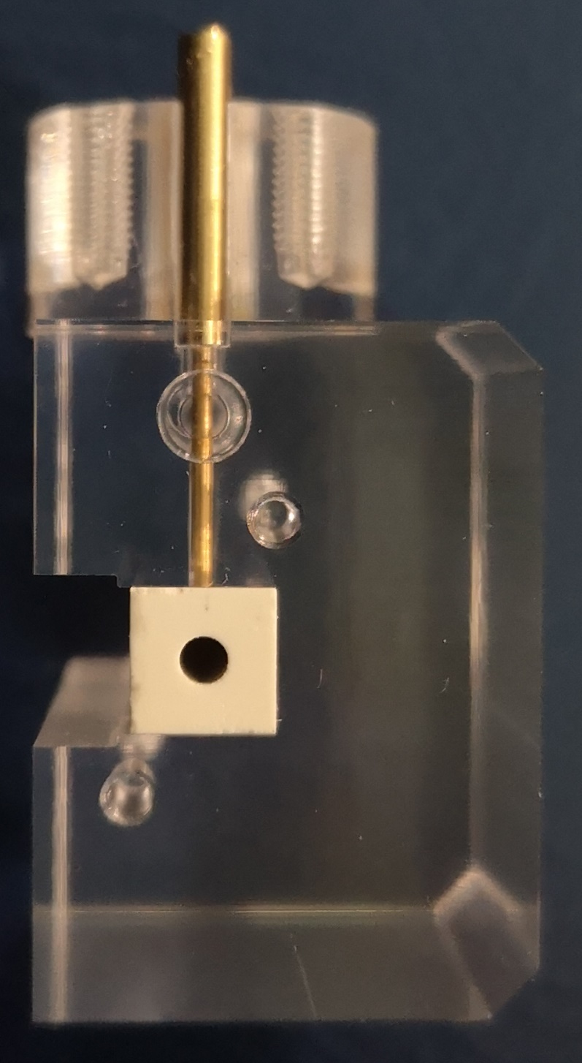
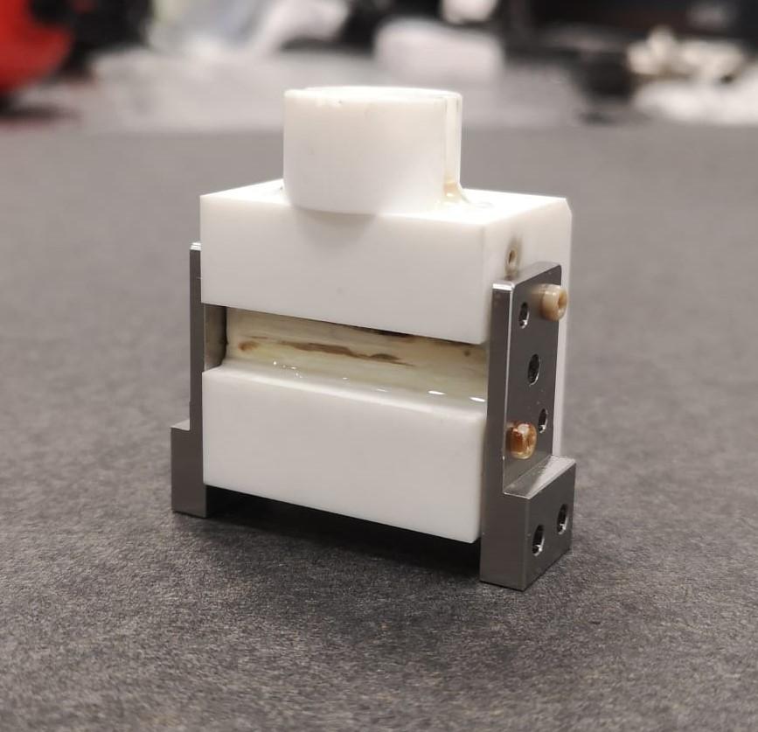
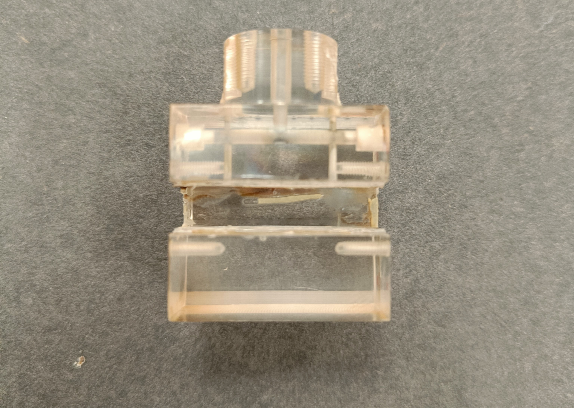
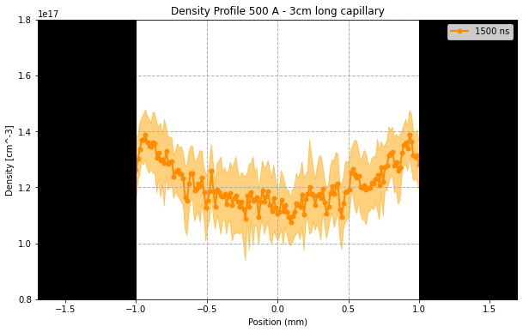
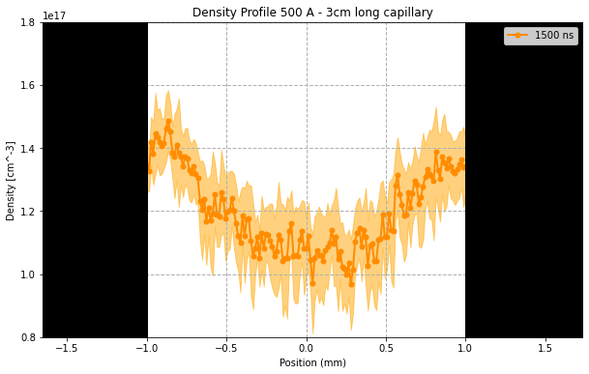
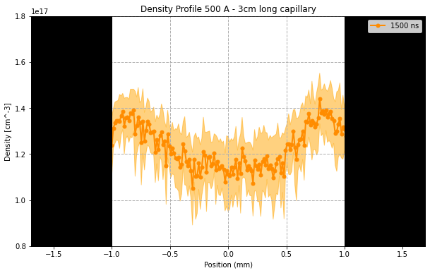
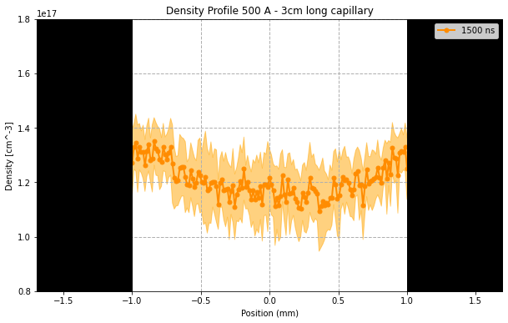
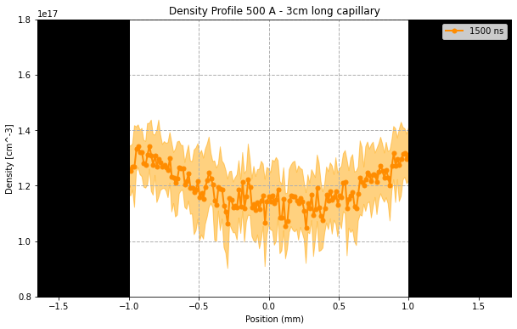
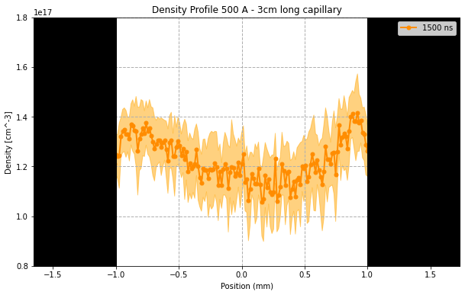
Material studies of capillaries– Chronology
10 Hz
20 Hz
40 Hz
40 - 50 Hz

Slide 12
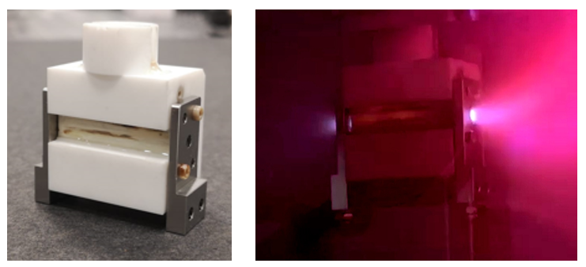
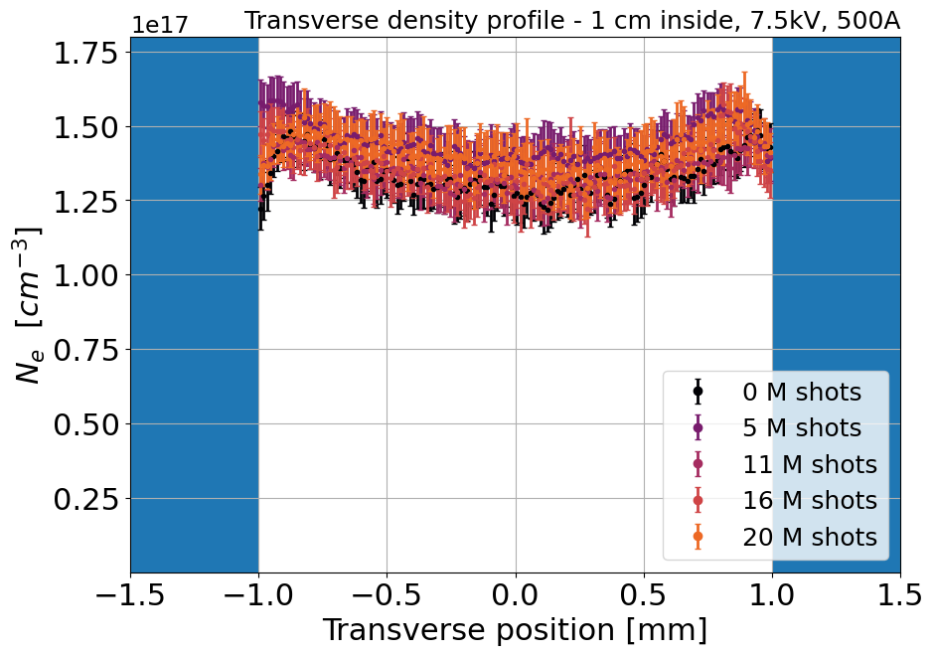
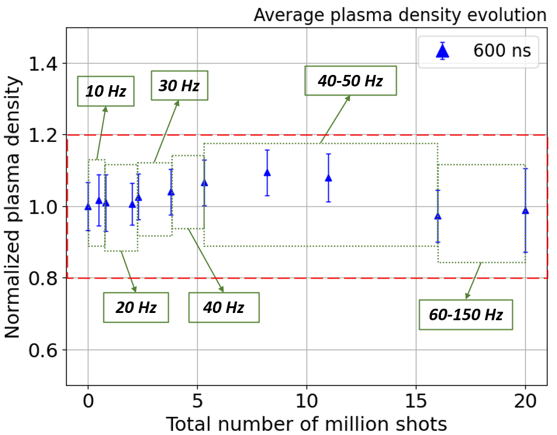
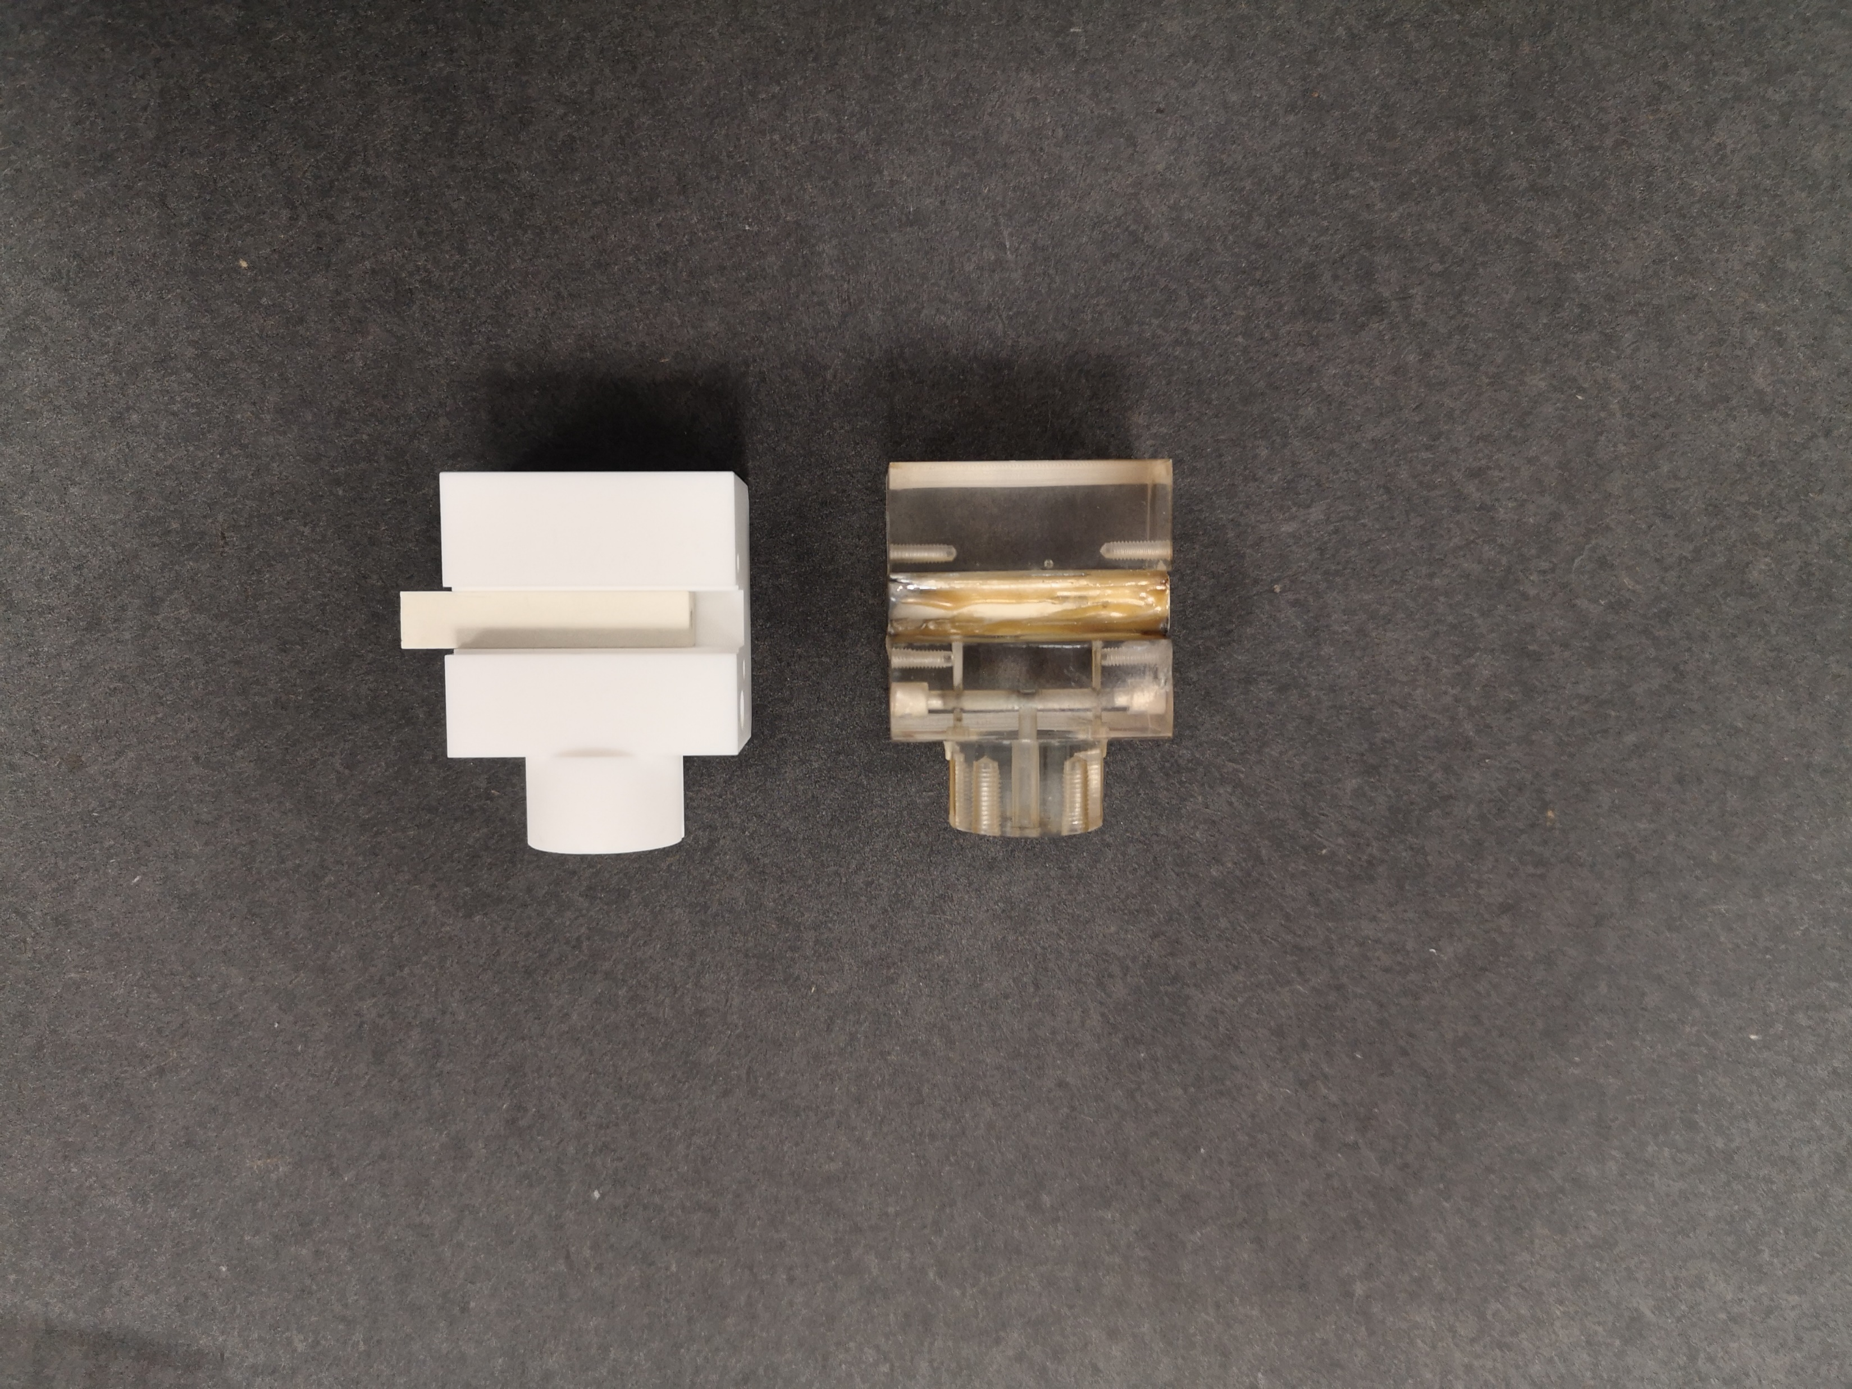
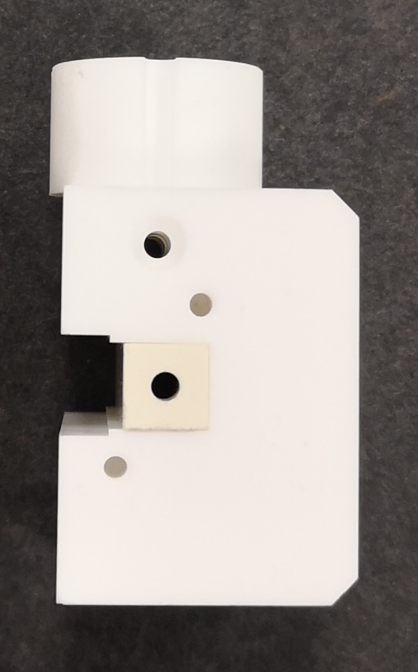
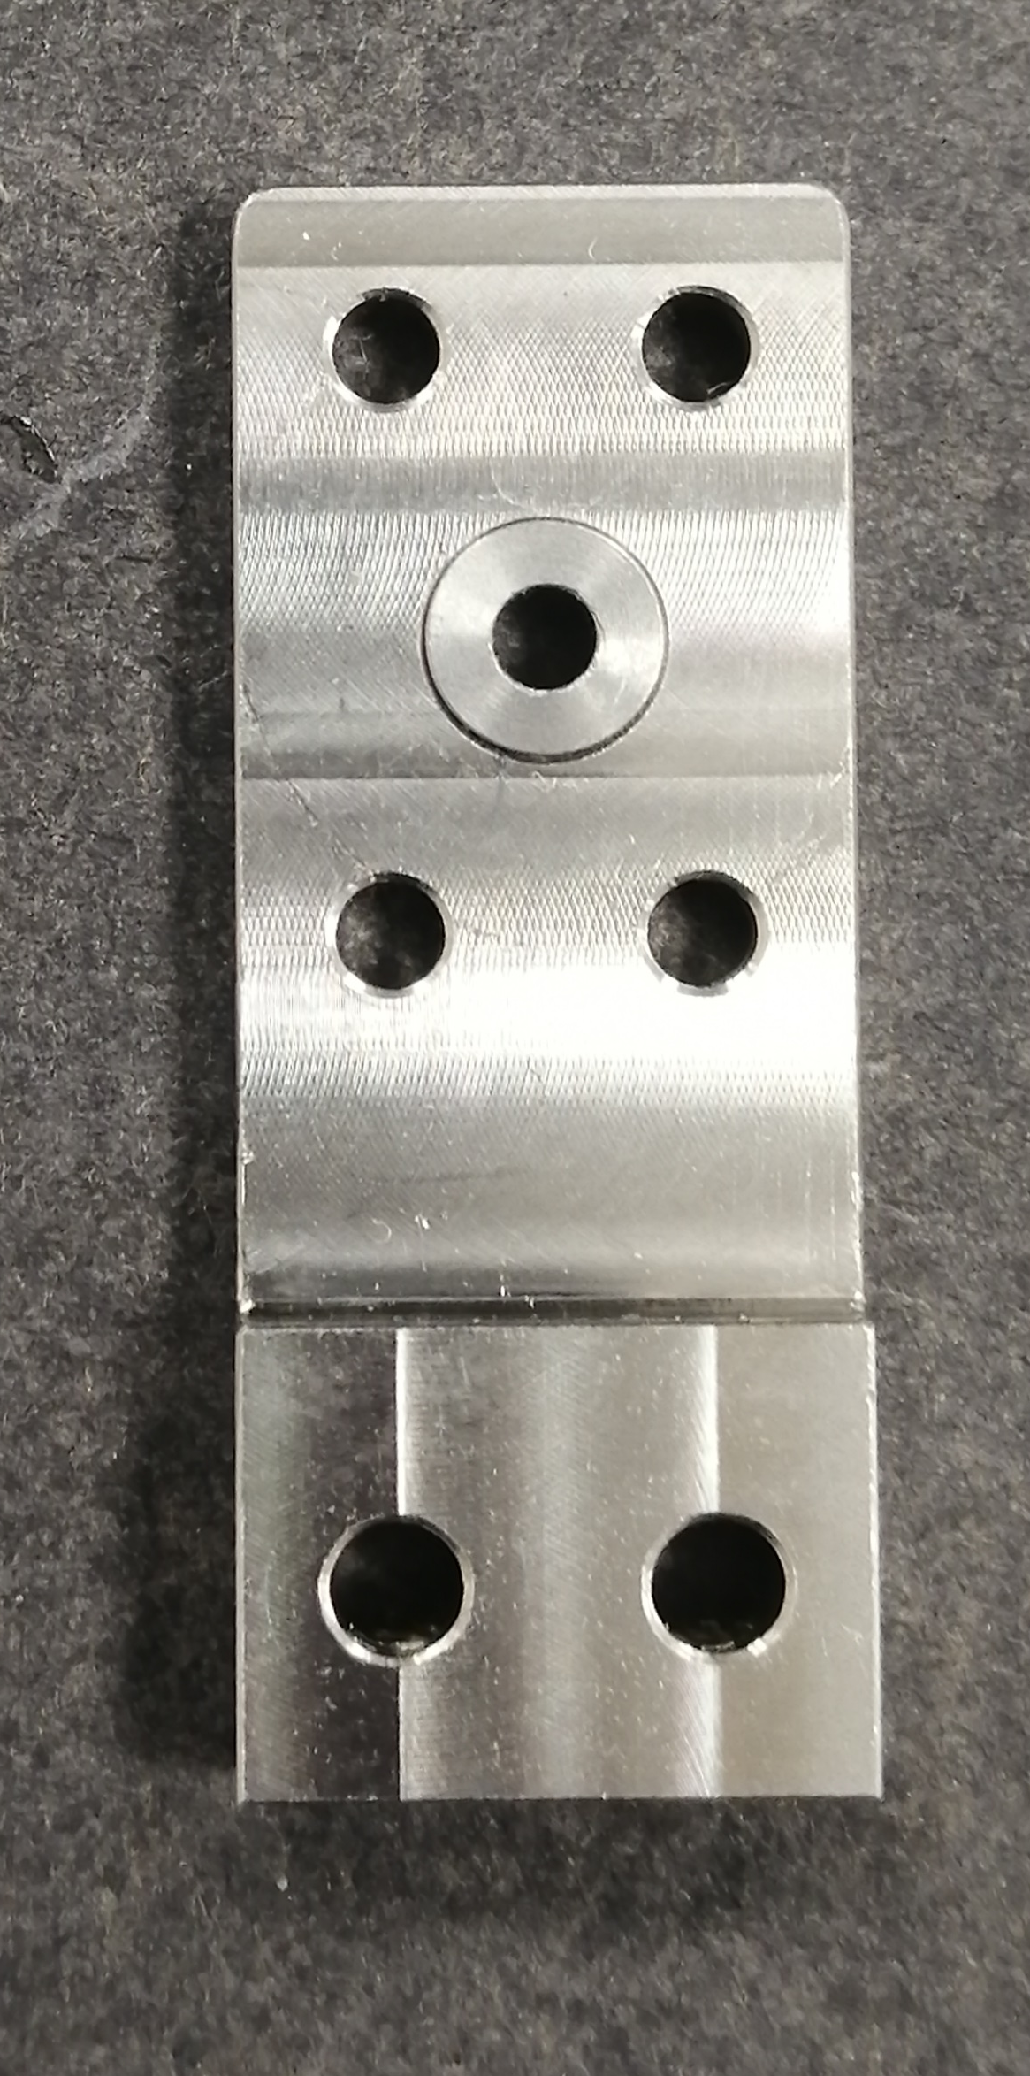
Material studies of capillaries– Final Results
Crincoli, L., Demitra, R., Lollo, V. et al. Advanced ceramic plasma discharge capillaries for high repetition rate operation. Sci Rep 15, 12456 (2025). https://doi.org/10.1038/s41598-025-96882-y
Final design of the capillary prototype
Sustained 20 millions shots without any plasma density degradation
Sustained a max repetition rate of 150Hz
New design of electrodes
Molybdenum
3 cm long, 2 mm diameter
Shapal
Stainless
steel
Macor

Slide 13
Outline
Gas-filled plasma capillaries discharge
Material studies of capillaries
Trasverse spectroscopic measurements
EuPRAXIA@SPARC_Lab capillary
High current discharge circuit
Conclusion

Slide 14
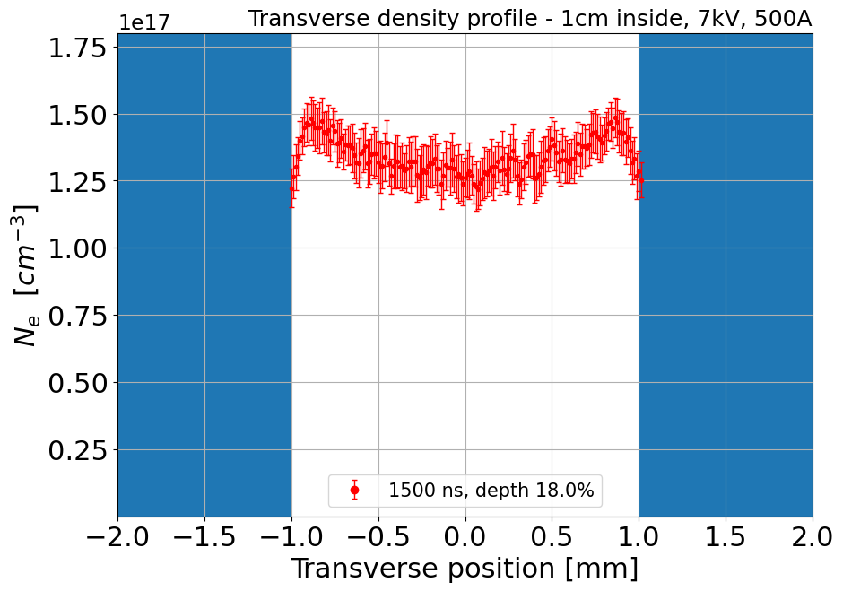
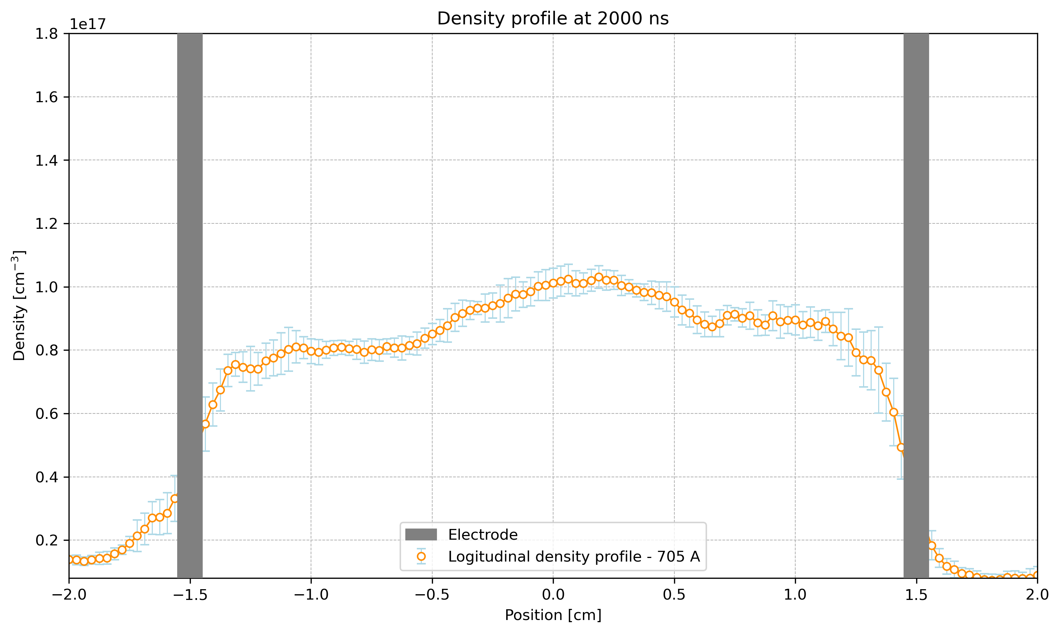
Transverse spectroscopic measurements
The new capillary is now made of ceramic (Shapal), which provides high thermal conductivity but is no longer transparent, preventing direct optical access to the plasma.
Therefore, it is necessary to develop an alternative diagnostic to measure key plasma parameters (electron density, temperature, etc.).
The chosen solution is to perform transverse spectroscopic measurements (e.g., Stark broadening of Balmer lines).
By moving the entire optical setup along the capillary, it is possible to image different plasma slices along its length.
Each image provides a transverse electron density profile, from which the average plasma density at that position can be extracted.
Repeating this process at multiple positions allows the reconstruction of the longitudinal plasma profile inside the capillary.
Ultimately, by combining longitudinal and transverse measurements, a full 3D plasma profile can be obtained.

Slide 15
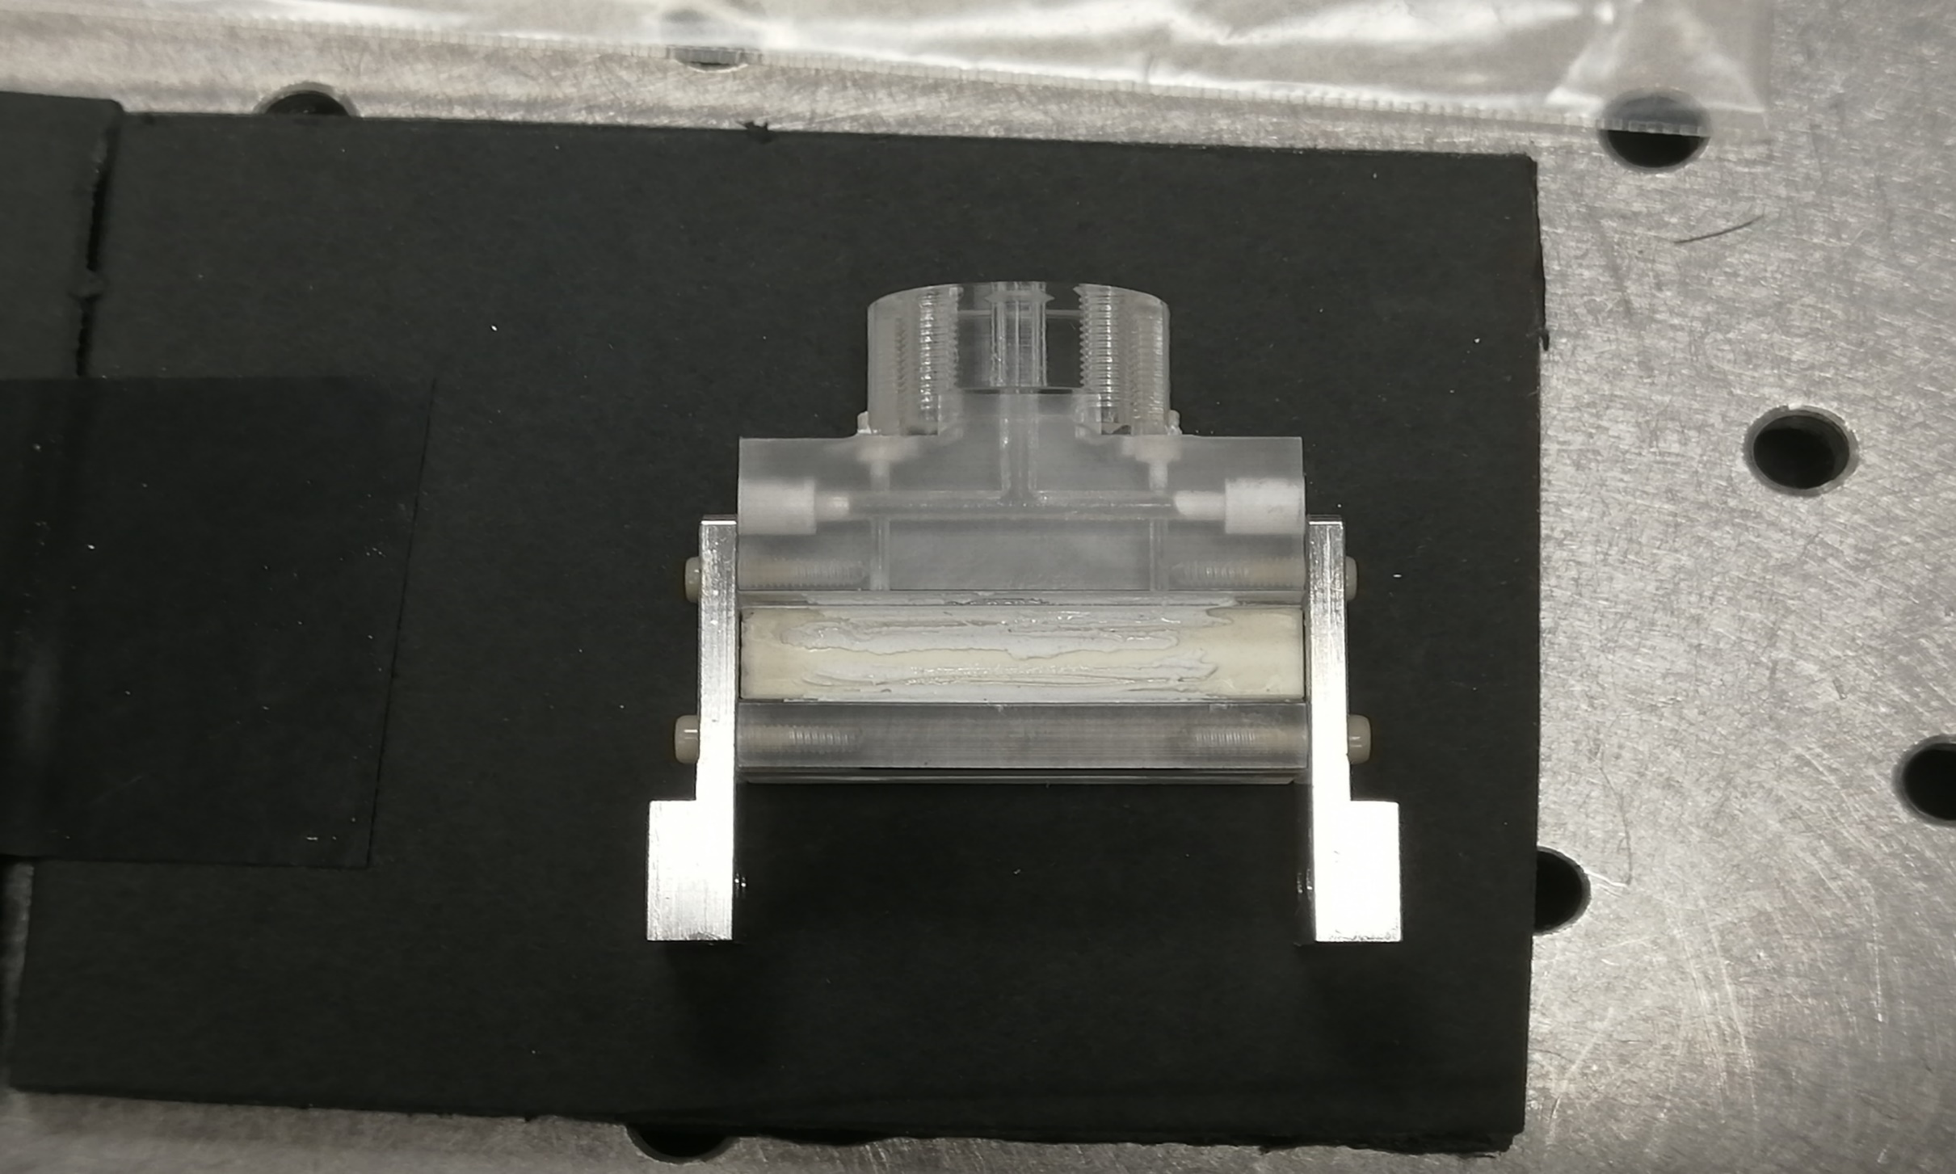

Transverse spectroscopic measurements – Depth Of Field
Depth of Field (DOF) = region where the plasma image remains sharp on the camera sensor
Determines effective plasma slice thickness seen by the optics
Even with a very small DOF, light emitted in front of or behind the focal plane still reaches the sensor
In our case (luminous cylindrical plasma), this means the image always includes integrated emission along the line of sight
Smaller DoF
30 mm
30 mm
Depth of Field (DOF) formula: DOF = (2 · u² · N · c) / f²
Parameters: • u = object distance = 188 cm • N = f / D = f-number = f/75mm • c = circle of confusion = 20µm
(pixel size of CCD) • f = focal length = 365mm
DOF ≈ 5.2mm

Slide 16
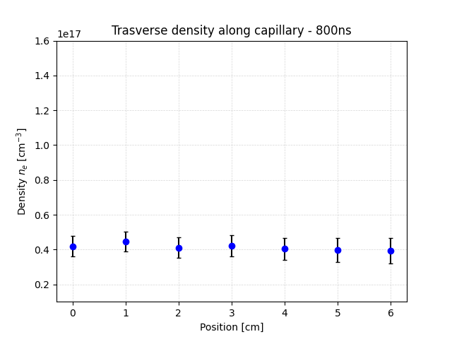
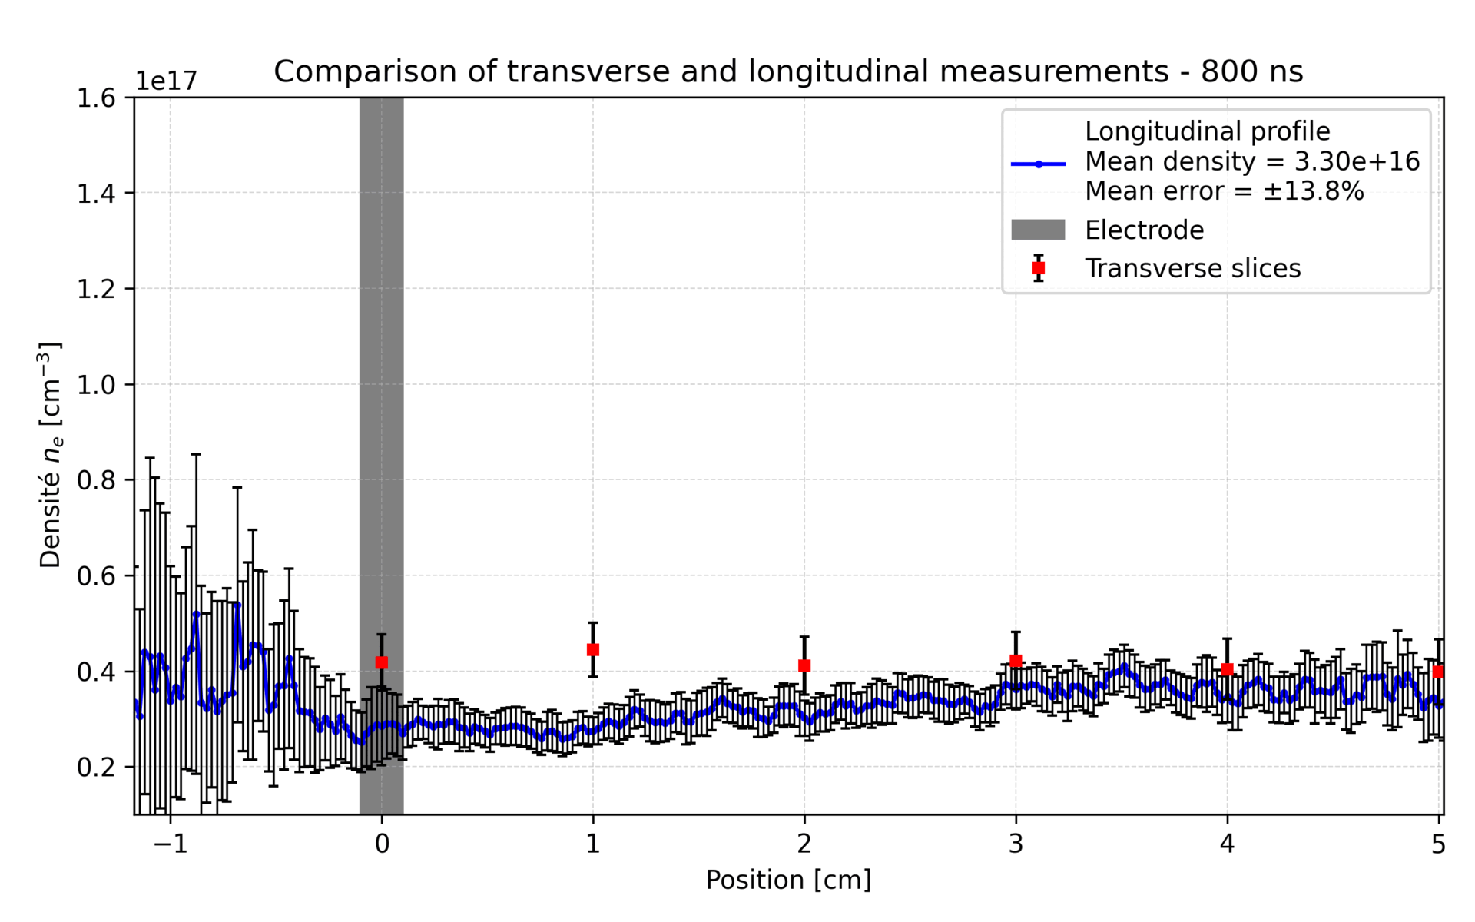
Transverse spectroscopic measurements– Transverse vs Longitudinal
Measurement campaign performed with a 10 cm plastic capillary
Due to space constraints, transverse measurements were carried out over 5 cm only, assuming longitudinal symmetry
Data shown here correspond to 10 kV discharge voltage and 620 A peak current
The measured transverse density is systematically lower than the longitudinal one
The key point is the trend - a clear ramp region is visible
The relative difference between longitudinal and transverse densities on the plateau is about 24%
This difference may result from two combined effects: -The transverse measurement integrates more light -The plastic capillary used at that time had undergone many discharge shots.

Slide 17
Outline
Gas-filled plasma capillaries discharge
Material studies of capillaries
Trasverse spectroscopic measurements
EuPRAXIA@SPARC_Lab capillary
High current discharge circuit
Conclusion

Slide 18
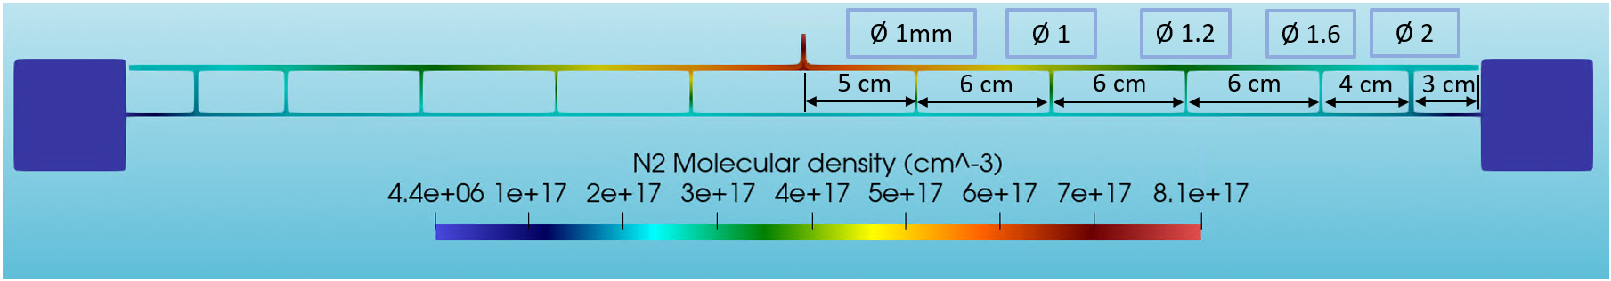
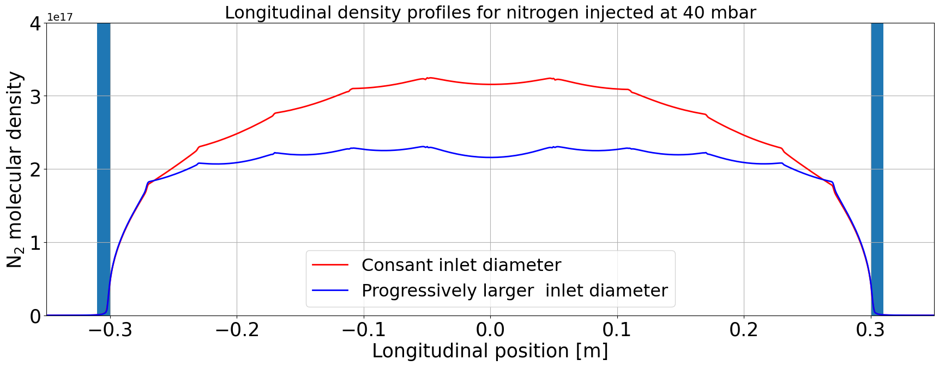
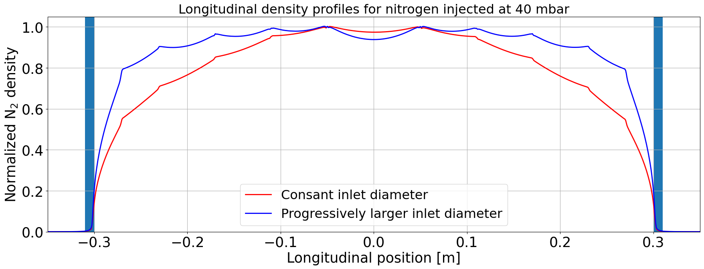
EuPRAXIA@SPARC_Lab capillary
60 cm long modular capillary
Numerical design:
Inlets arrangement for uniform gas distribution
Design and realization with a novel approach:
Modular structure for gas injection
Holder matrix

Slide 19
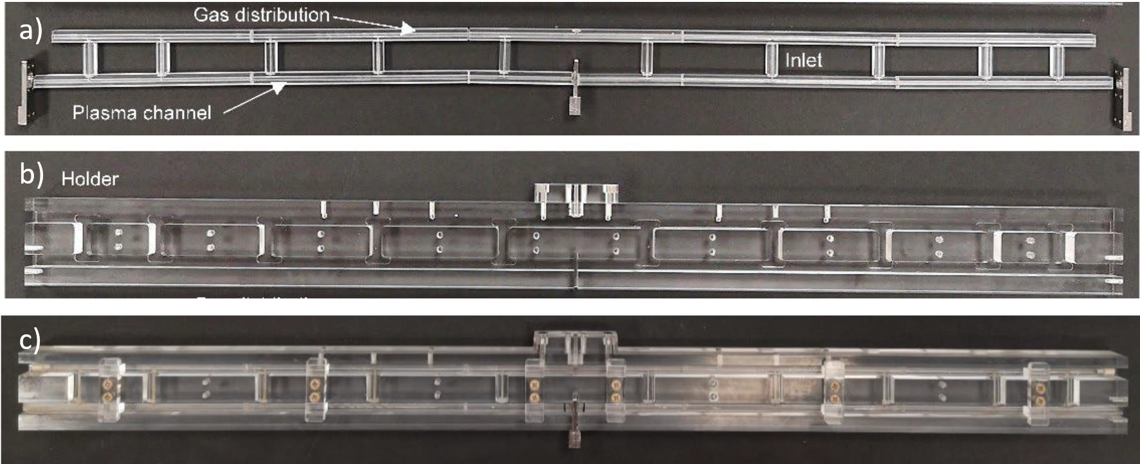
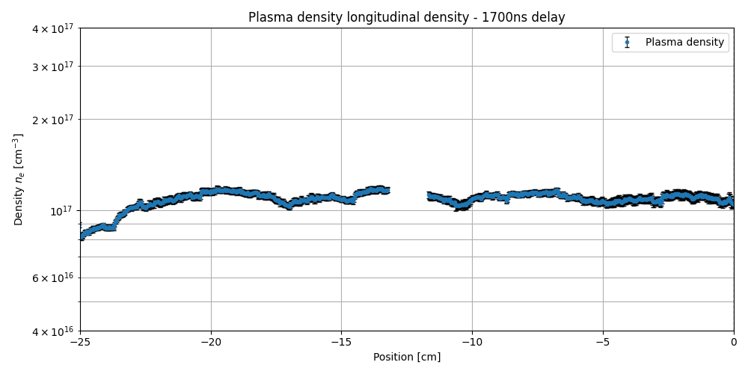
EuPRAXIA@SPARC_Lab capillary - Measurements
EuPRAXIA 60 cm capillary prototype made of plastic.
Tested at 15 kV, reaching a current of 640 A.
Average plasma density around 1 × 10¹⁷ cm⁻³ in the plateau region.
A clear density ramp is observed.
The ramp length is estimated to be ≈ 10 cm, although only 5 cm were experimentally accessible.
The measurement is challenging, as no setup is currently optimized to measure the full longitudinal profile of such a long capillary in a single shot.
Due to the plastic material, the plasma density fluctuates significantly from shot to shot, reducing stability and reproducibility.

Slide 20
Outline
Gas-filled plasma capillaries discharge
Material studies of capillaries
Trasverse spectroscopic measurements
EuPRAXIA@SPARC_Lab capillary
High current discharge circuit
Conclusion

Slide 21
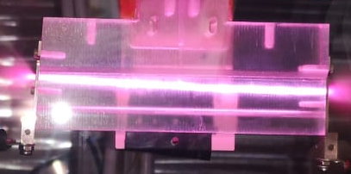
High current discharge circuit
Magnetic Field (B_{φ}) vs Force on electrons (F)
Plasma capillaries discharges enable compact beam focusing and bending : Active Plasma Lens and Active Plasma Bending (kT/m gradients, cm-scale)
Achromatic transport demonstrated (reduced sensitivity to energy spread)
Applications: compact X-ray sources, FEL transport, collider beamlines
Cheap solution (capillary+discharge pulser)
Requirement: short, high-current pulses (>10 kA, <500 ns)
APL
B_{φ}
F
-
-
-
-
-
-
-
-
-
-
-
-
e⁻ bunch
-
Current
+
APB
HV

Slide 22
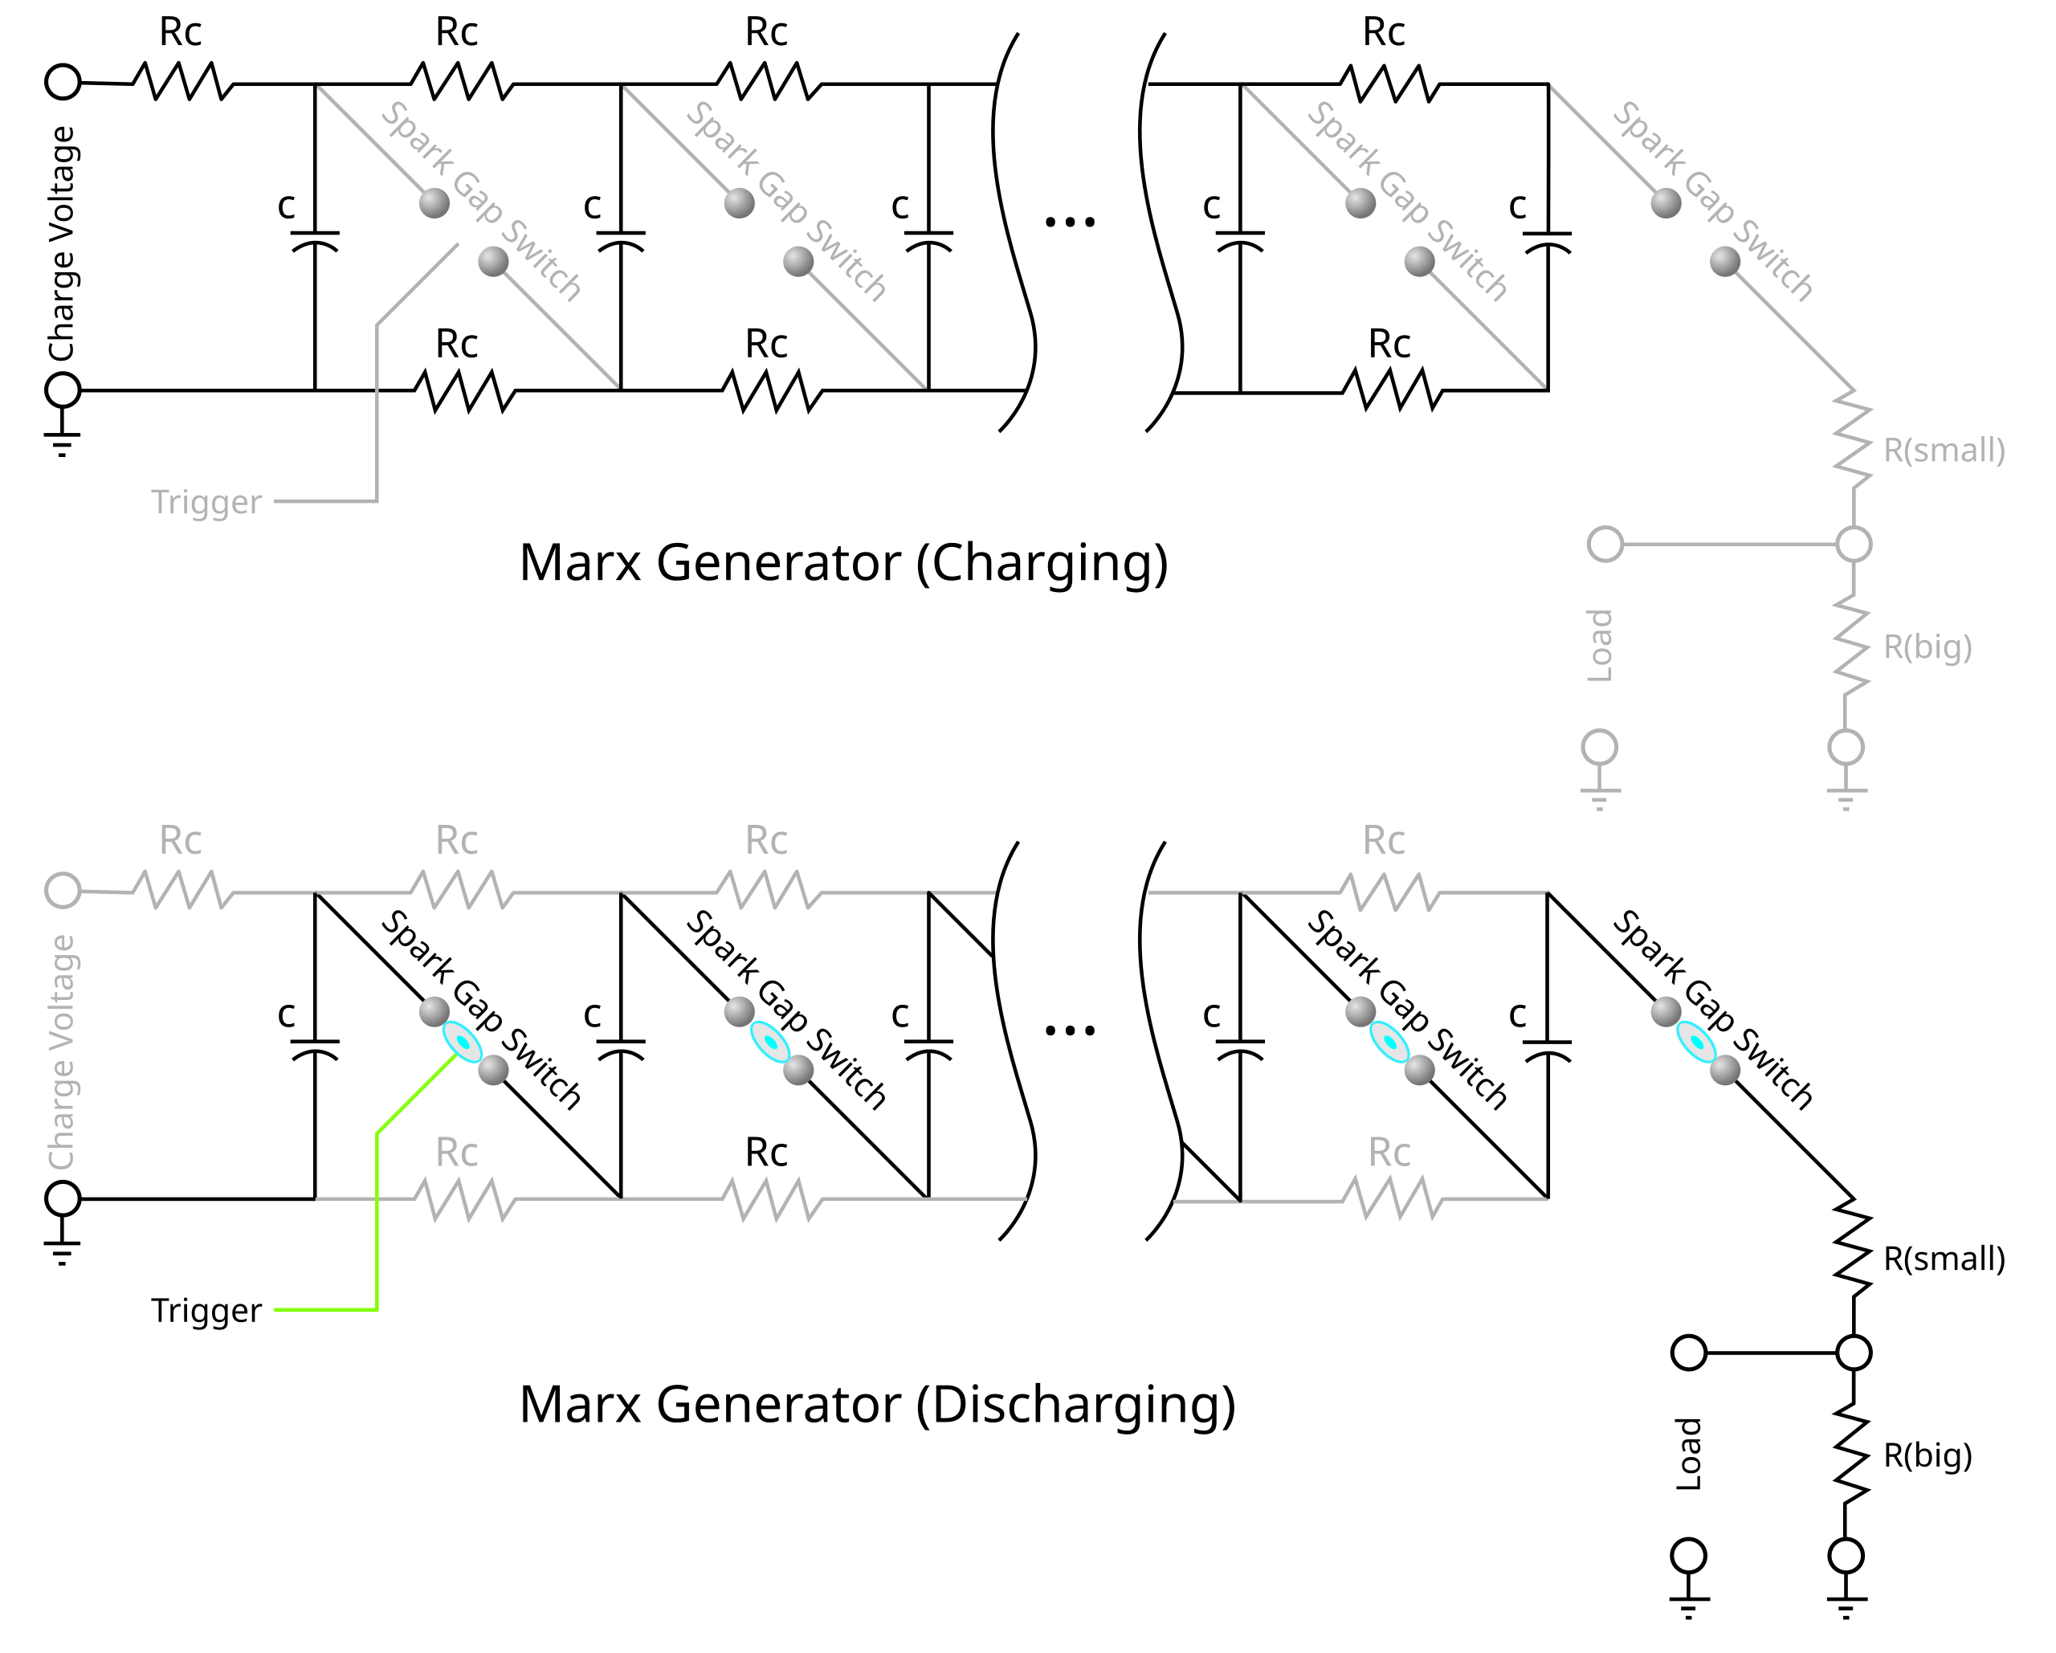
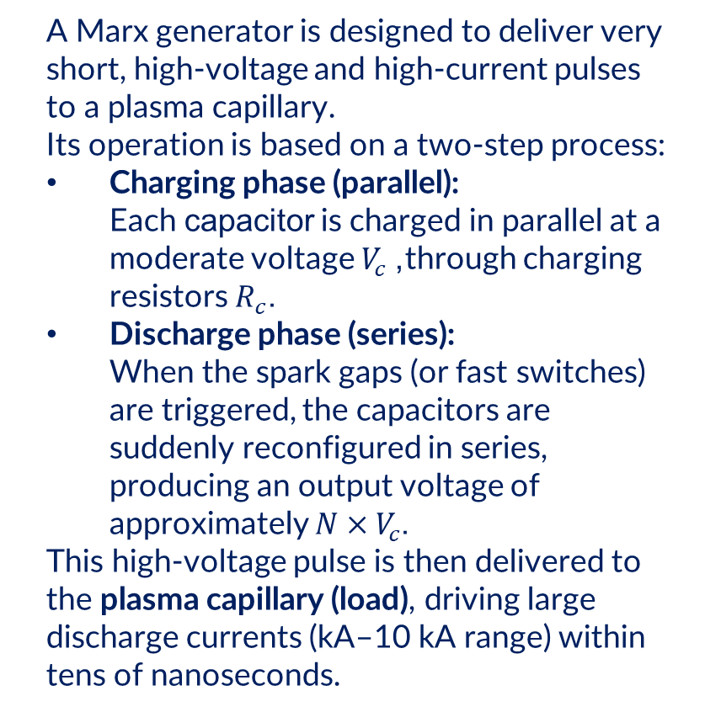
High current discharge circuit – Marx Generator
A Marx generator is designed to deliver very short, high-voltage and high-current pulses to a plasma capillary. Its operation is based on a two-step process:
Charging phase (parallel): Each capacitor is charged in parallel at a moderate voltage $V_{c}$, through charging resistors $R_{c}$.
Discharge phase (series): When the spark gaps (or fast switches) are triggered, the capacitors are suddenly reconfigured in series, producing an output voltage of approximately $N×V_{c}$.
This high-voltage pulse is then delivered to the plasma capillary (load), driving large discharge currents (kA–10 kA range) within tens of nanoseconds.
Very short pulses (tens of ns)
Laser ignition for spark gaps : Jitter reduction from ns to ps

Slide 23
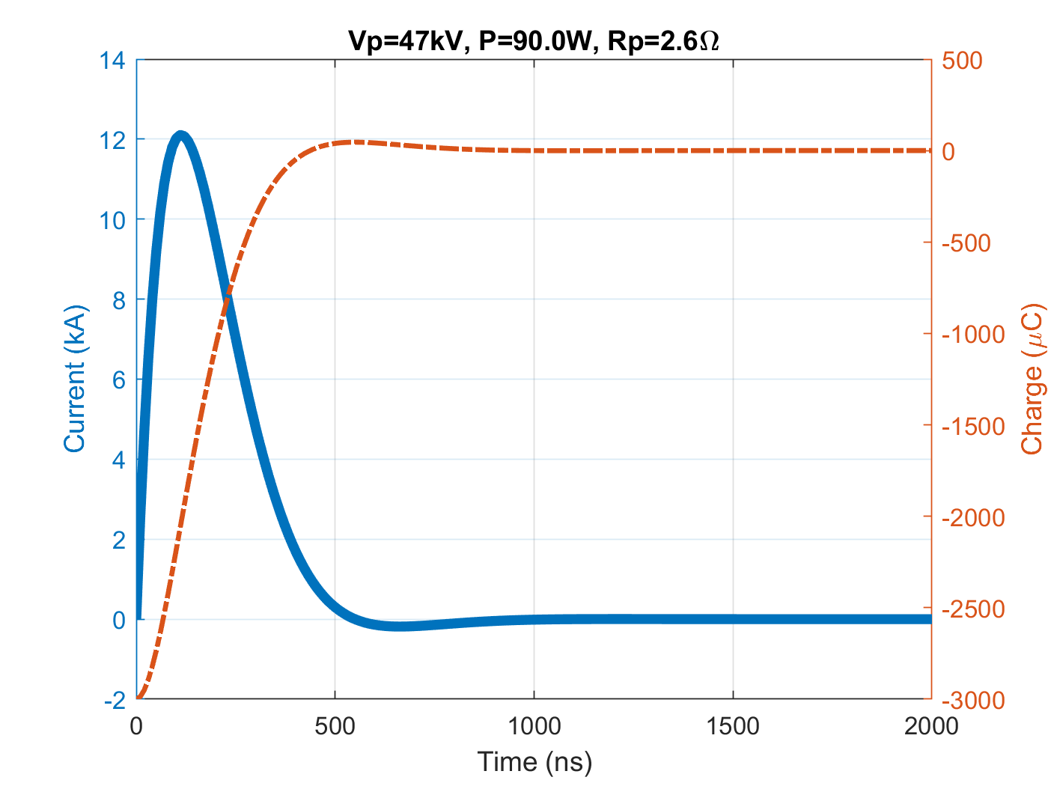

High current discharge circuit - Simulation
Parameters | Value | Comments
Numbers of gaps (N) | 2 | Equivalent to 2 stages at 30 kV each
Output voltage (V) | 60 kV | From 2 × 30 kV
Capacitance per stage (Cᵢ) | 100 nF | Equivalent capacitance = 50 nF
Inductance per stage (Lᵢ) | 18 nH | Total inductance ≈ 36 nH + plasma contribution
Cable length | ~0.1 m | ≈0.05 m effective half-length per side
Capillary length | 20 cm | Radius = 1 mm
Effective resistance (R) | ~2.6 Ω | Approximated load (plasma) resistance
$$V_{\text{plasma}}=V_{\text{tot}}⋅\frac{R}{R_{\text{tot}}}=47 kV$$

Slide 24
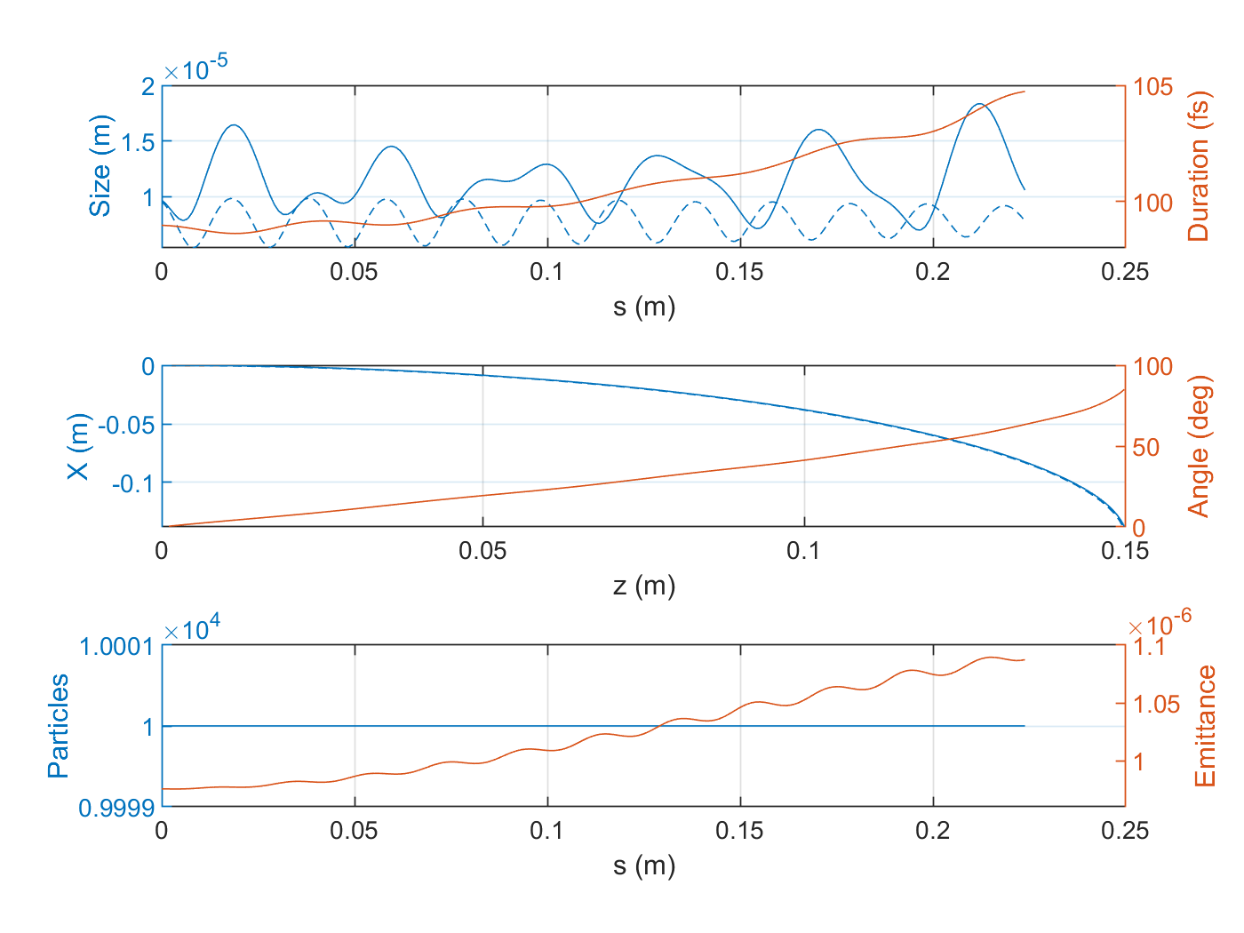


High current discharge circuit – 90° bending of 60 MeV Beam
A discharge current of 12 kA generates an azimuthal magnetic field up to ~2.6 T inside the capillary
The 60 MeV electron bunch is bent by ≈90° over the 20 cm long curved plasma channel
A weak energy–position correlation (dispersion) is observed at the exit, quantified by R₁₆ ≈ 0.46 mm
Emittance growth remains limited (<10%) and charge transmission is 100%
12

Slide 25


High current discharge circuit – Discharge analytical model
Simulate the discharge of an RLC circuit into a gas-filled capillary to predict current, plasma temperature, ionization and losses. 1. Governing equations • L·(d²I/dt²) + (R + Rₚ)·(dI/dt) + (1/C)·I = 0 • dT/dt = (Rₚ·I² − H_loss − P_rad) / C_V • dn/dt = − n / τ_out 2. Plasma physics • α = ( −A + √(A² + 4A) ) / 2 , nₑ = α·n • ν_ei = (nₑ·e⁴ / (2π·ε₀²·mₑ²·v_th³)) · lnΛ • Rₚ = ( mₑ / (nₑ·e²) ) · ( ν_ei + ν_ae ) · ( L_cap / (π·R_cap²) ) • Losses: H_loss ∝ κₑ·ΔT/λ_D, P_BR ∝ nₑ²√T, P_RR ∝ nₑ²/√T 3. Typical parameters R = 4 Ω, L = 1 µH, C = 40 nF, V₀ = 10 kV Capillary: L_cap = 3 cm, R_cap = 1 mm, H₂ @ 1000 Pa

Slide 26
Outline
Gas-filled plasma capillaries discharge
Material studies of capillaries
Trasverse spectroscopic measurements
EuPRAXIA@SPARC_Lab capillary
High current discharge circuit
Conclusion

Slide 27
Conclusion
Perspectives
Continue long-term testing of Shapal capillaries toward 200 million shots lifetime target.
Resume transverse spectroscopic measurements with sapphire capillaries to validate diagnostic robustness.
60 cm Shapal prototype nearly ready for experimental tests
Dedicated laboratory under construction for advanced Marx generator development and testing.
Ongoing work to numerically simulate the discharge with a more realistic plasma model.
Arrival of a kHz femtosecond laser enabling new studies on HOFI plasma channels and laser guiding experiments.
Conclusions
First test of “lifetime” of ceramic capillary achieved : 20 millions shots demonstrated, capability of the plasma module to go up to 150Hz
60cm capillary prototype already measured and tested (measurements directly integrated in start to end simulation of EuPRAXIA and in the TDR
Marx Generator development are ongoing as we speak
Analytical model of the plasma discharge good approximation but limited

Slide 28
Gas-filled plasma capillaries discharge
Papers :
Femtosecond laser-induced plasma filaments for beam-driven plasma wakefield acceleration, Physical Review E 111, 025202 (2025). Auteurs : M. Galletti, L. Crincoli, R. Pompili, L. Verra, F. Villa, R. Demitra, A. Biagioni, A. Zigler, M. Ferrario.
Advanced ceramic plasma discharge capillaries for high repetition rate operation, Scientific Reports 15, 12456 (2025). Auteurs : Lucio Crincoli, Romain Demitra, Valerio Lollo, Donato Pellegrini, Marco Pitti, Lucilla Pronti, Martina Romani, Massimo Ferrario, Angelo Biagioni.
Resonant excitation of plasma wakefields with a train of relativistic particle bunches, Physical Review E 112, 045205 (2025). Auteurs : L. Verra, M. Galletti, M. P. Anania, A. Biagioni, M. Carillo, E. Chiadroni, A. Cianchi, G. Costa, L. Crincoli, A. Del Dotto, M. Del Giorno, R. Demitra, G. Di Pirro, A. Giribono, V. Lollo, M. Opromolla, G. Parise, D. Pellegrini, R. Pompili, S. Romeo, G. Silvi, F. Stocchi, F. Villa, M. Ferrario.
Conferences and workshopp :
“Long plasma sources and material studies” — Plasma Components & Systems for EuPRAXIA Workshop, DESY (Hambourg).
“Beam driven plasma sources” — EuPRAXIA Camp 1, CNR (Pise). INVITED TALK
“Femtosecond laser-induced plasma filaments for beam-driven plasma wakefield acceleration” (poster) — EuPRAXIA Camp 2, IST (Lisbonne).
“3D characterization of plasma density in capillary discharges for plasma-based accelerators” (poster) — IPAC, Taïwan.
“Development of a Marx Generator Discharge Circuit for High-Current Plasma Capillary Discharges” (poster) — EAAC, Île d’Elbe.
“Development of a Marx Generator Discharge Circuit for High-Current Plasma Capillary Discharges” — EuPRAXIA Camp 3, Université de Pécs. INVITED TALK

