Slide 1
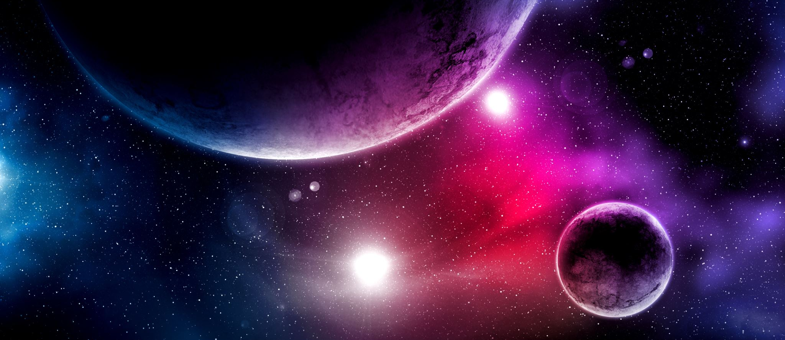


Scalar- and Vector- Dark Matter Admixed Neutron Stars
Francesco Grippa
Dip. di Fisica “E. Caianiello”, Università di Salerno & INFN, Sezione di Napoli, Gruppo Collegato di Salerno

Slide 2
Summary
Neutron Stars
  Formation and internal structure
  Equation of state
  Observational clues
Dark Matter admixed Neutron Stars
  Definition
  2-fluid framework
Fermionic Dark Matter
  Formalism
  Bayesian analysis
Models
  Linear scenario
  Quadratic scenario
Results
  Speed of sound
  Effect of the vector coupling
  Effect of the scalar coupling
Conclusions and future perspectives

Slide 3
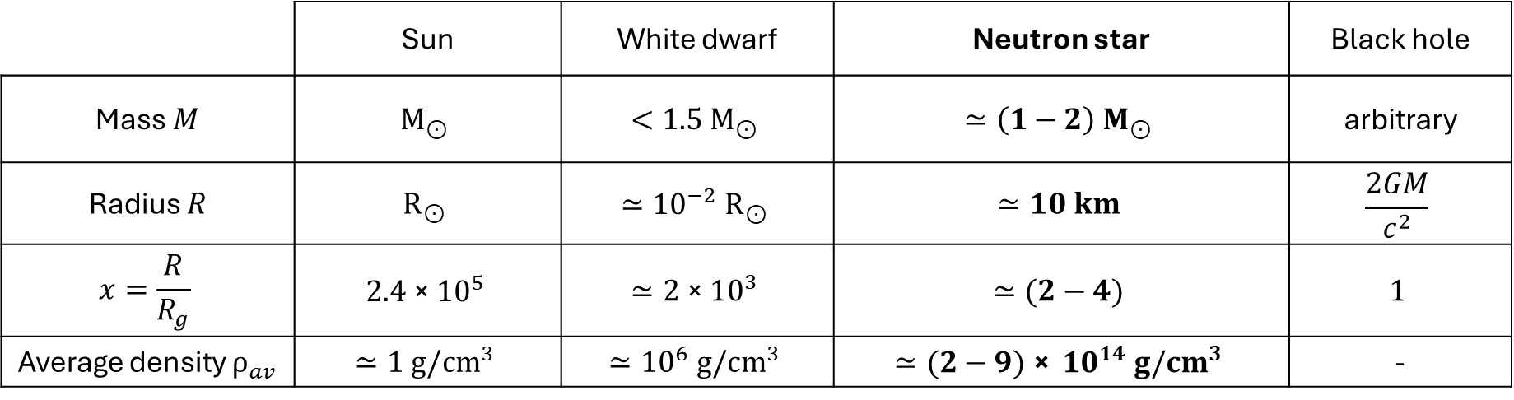
Classification of compact objects
Compact objects
 | Sun | White dwarf | Neutron star | Black hole
Mass $M$ | $$M_{⊙}$$ | $$<1.5 M_{⊙}$$ | $$≃\left(1−2\right) M_{⊙}$$ | arbitrary
Radius $R$ | $$R_{⊙}$$ | $$≃{10}^{−2} R_{⊙}$$ | $$≃10 km$$ | $$\frac{2GM}{c^{2}}$$
$$x=\frac{R}{R_{g}}$$ | $$2.4 \text{×} {10}^{5}$$ | $$≃2 \text{×} {10}^{3}$$ | $$≃(2−4)$$ | $$1$$
Average density $ρ_{av}$ | $$≃1 g/{cm}^{3}$$ | $$≃{10}^{6} g/{cm}^{3}$$ | $$≃(2−9) \text{×} {10}^{14} g/{cm}^{3}$$ | -
$M_{⊙}=1.989 \text{× }{10}^{33} g$ is the mass of the Sun $R_{g}=\frac{2GM}{c^{2}}$ is the Schwarzschild radius
$R_{⊙}=6.96 \text{× }{10}^{5} km$ is the radius of the Sun $ρ_{nucl}=2.6 \text{× }{10}^{14} g/{cm}^{3}$ is the nuclear saturation density
All astrophysical compact objects have in common a high mass relative to a relatively small radius.
As a consequence, their density is significantly higher compared to the Sun and to 'ordinary' celestial bodies.

Slide 4
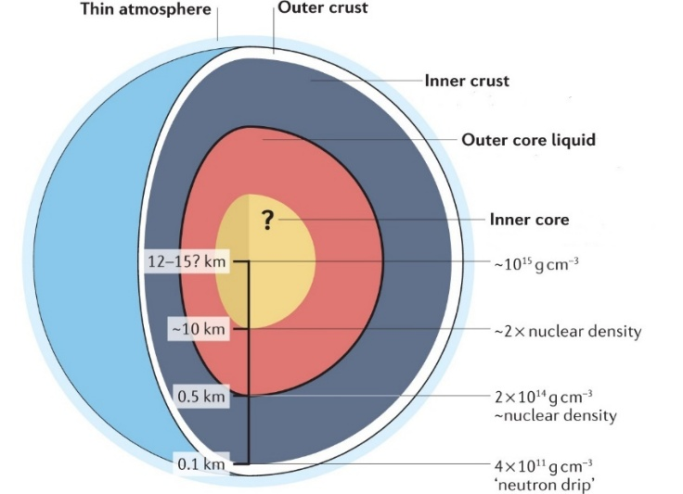
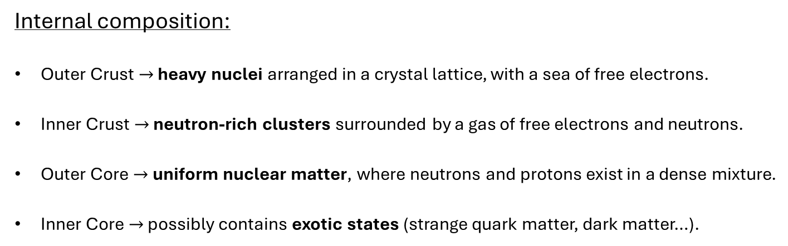
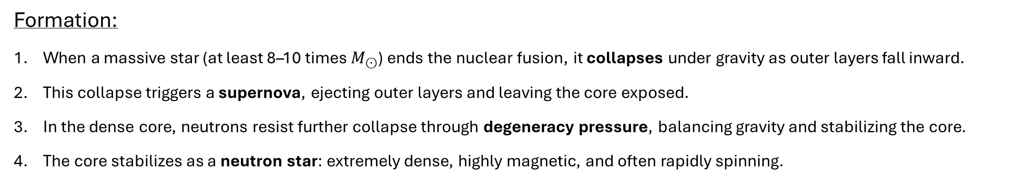
Neutron stars
Formation:
When a massive star (at least 8–10 times $M_{⊙}$) ends the nuclear fusion, it collapses under gravity as outer layers fall inward.
This collapse triggers a supernova, ejecting outer layers and leaving the core exposed.
In the dense core, neutrons resist further collapse through degeneracy pressure, balancing gravity and stabilizing the core.
The core stabilizes as a neutron star: extremely dense, highly magnetic, and often rapidly spinning.
Internal composition:
Outer Crust $→$ heavy nuclei arranged in a crystal lattice, with a sea of free electrons.
Inner Crust $→$ neutron-rich clusters surrounded by a gas of free electrons and neutrons.
Outer Core $→$ uniform nuclear matter, where neutrons and protons exist in a dense mixture.
Inner Core $→$ possibly contains exotic states (strange quark matter, dark matter…).

Slide 5
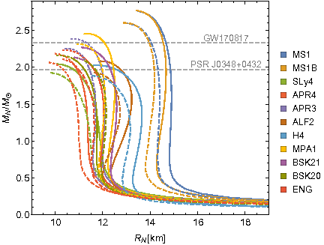
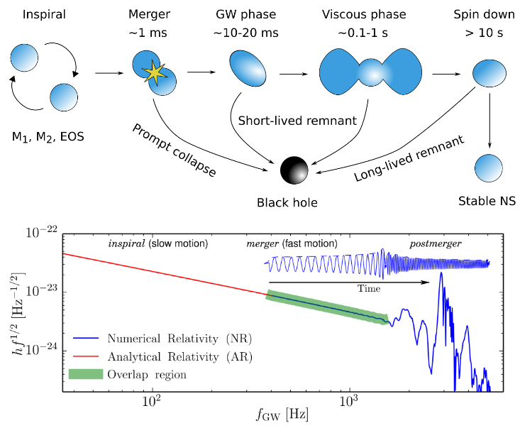
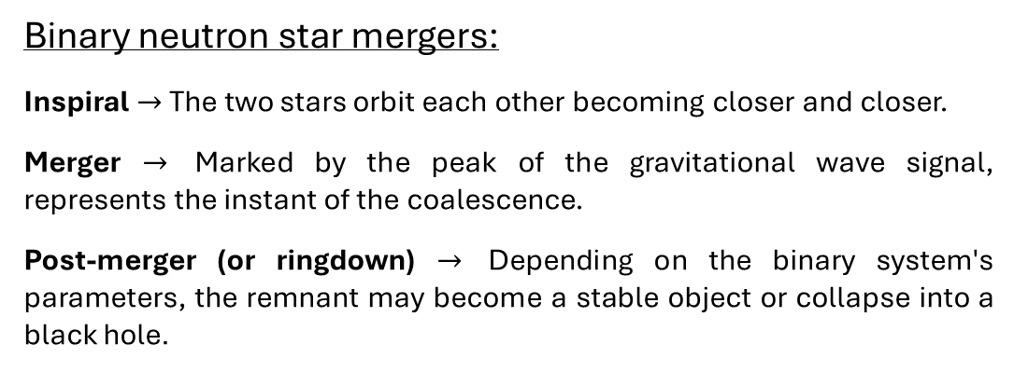
The Equation of state of Neutron stars
The Equation of State (EoS) of a neutron star:
fully characterize the star by determining its internal structure and properties;
describes the relationship between density and pressure in the star’s interior;
combined with the Tolman-Oppenheimer-Volkoff (TOV) equations, it defines the mass-radius relation and limits for stability.
Ellis et al., “Dark matter effects on neutron star properties”
Phys. Rev. D 97 (2018) 12, 123007
Binary neutron star mergers:
Inspiral $→$ The two stars orbit each other becoming closer and closer.
Merger $→$ Marked by the peak of the gravitational wave signal, represents the instant of the coalescence.
Post-merger (or ringdown) $→$ Depending on the binary system's parameters, the remnant may become a stable object or collapse into a black hole.
Simulations in Numerical Relativity are exploited to estimate the properties of merging stars and to probe the EOS.
Radice et al., “The Dynamics of Binary Neutron Star Mergers and GW170817”
Ann. Rev. Nucl. Part. Sci. 70 (2020) 95-119

Slide 6
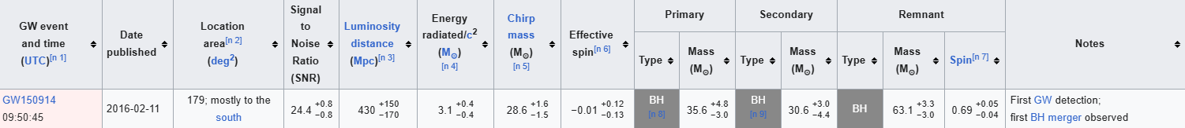
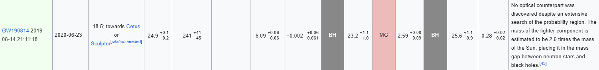
First GW detection from binary black holes
First binary neutron star merger
The lighter companions of some events belong to the so-called mass-gap (MG) and have an uncertain nature

Slide 7
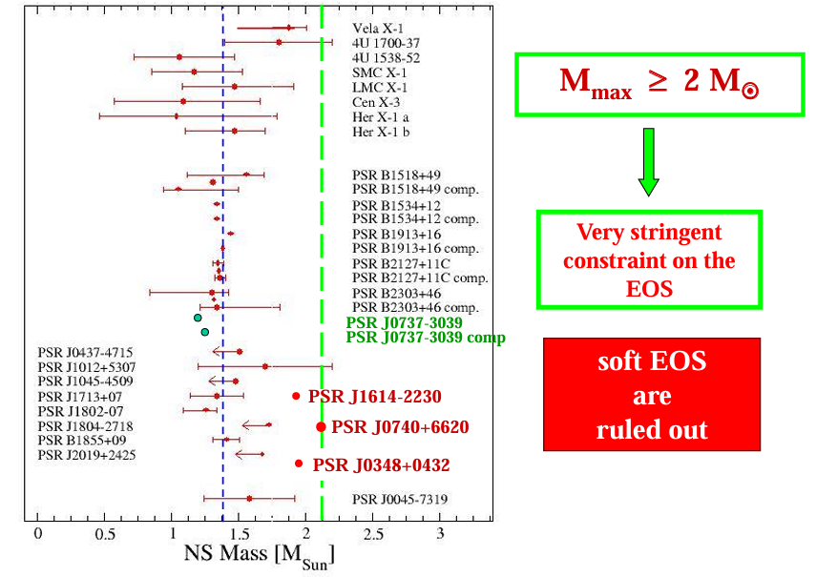
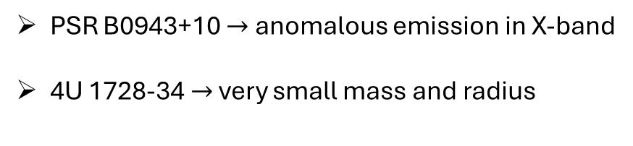
Measured Neutron Star Masses
The EOS of neutron star must provide a maximum TOV mass that is higher than the heaviest discovered pulsar PSR J0740+6620.
More exotic candidates:
PSR B0943+10 $→$ anomalous emission in X-band
4U 1728-34 $→$ very small mass and radius
To explain these anomalies observed from isolated pulsars, binary systems, and gravitational wave detections, several exotic types of compact objects similar to neutron stars have been proposed to exist:
Axion Stars, Boson Stars, Strange Stars, Dark Matter Admixed Neutron Stars.
Bombaci, “The ExtreMe Matter Institute (EMMI) at GSI Helmholtz Centre for Heavy Ion Research”, Darmstadt 2021

Slide 8



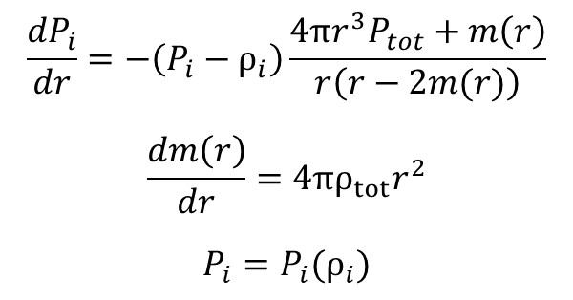

Dark Matter admixed Neutron Stars
Definition $→$ Dark matter admixed neutron stars (DANSs) are theoretical neutron stars that may contain a fraction of DM:
  $$f=\frac{M_{DM}}{M}=\frac{M_{DM}(R_{DM})}{M_{BM}\left(R_{BM}\right)+M_{DM}(R_{DM})}$$
Formation $→$ DANS may form in environments with high DM densities via capture and/or accretion from an initial seed.
Observational Implications $→$ The presence of dark matter in neutron stars could impact their mass, radius, and cooling rates as well as their associated gravitational wave signals.
Formalism
Null results from experiments suggest that that baryonic matter (BM) and dark matter (DM) interact solely through gravity.
Assuming that both BM and DM are perfect fluids, DANS’s stellar structure is obtained by solving the coupled TOV equations, describing the hydrostatic equilibrium of a single, non-rotating DANS:
$$\frac{{dP}_{i}}{dr}=−\left(P_{i}−ρ_{i}\right)\frac{4πr^{3}P_{tot}+m\left(r\right)}{r\left(r−2m(r)\right)}$$
$$\frac{dm\left(r\right)}{dr}=4πρ_{tot}r^{2}$$
$$P_{i}=P_{i}(ρ_{i})$$
${P_{tot}=P_{BM}+P}_{DM}$
${ρ_{tot}=ρ}_{BM}+ρ_{DM}$
with:
$P_{BM}=P_{BM}(ρ_{BM})$
$P_{DM}=P_{DM}(ρ_{DM})$

Slide 9
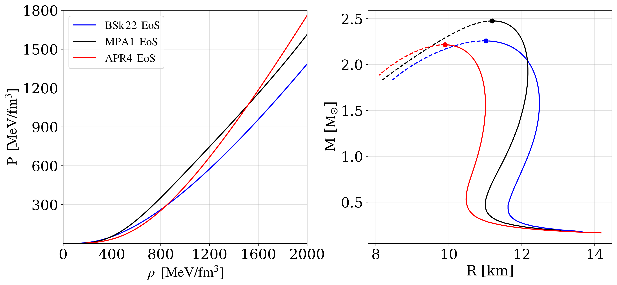
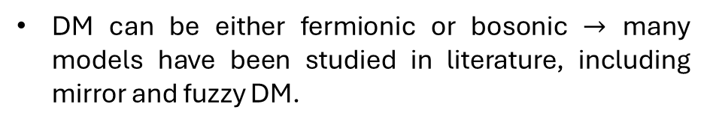
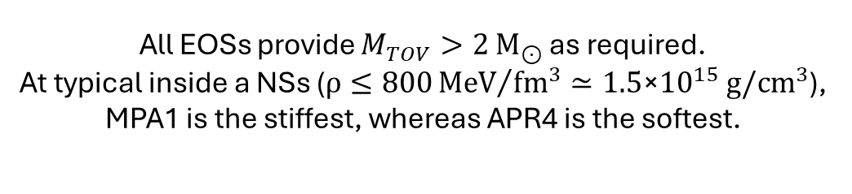
Baryonic Matter (BM)
Dark Matter (DM)
Baryonic matter is usually described through nuclear EOSs.
DM is a fundamental ingredient of the Universe, making up about 27% of its total energy density.
We use 3 different EOSs:
The nature of DM is still unknown and much debated: it does not emit, absorb, or reflect electromagnetic radiation and is only detectable via its gravitational influence on visible matter.
BSk22
MPA1
APR4
DM can be either fermionic or bosonic $→$ many models have been studied in literature, including mirror and fuzzy DM.
Grippa et al., “Constraints on scalar and vector dark matter admixed neutron stars with linear and quadratic couplings”, arXiv: 2407.16396
We assume fermionic Dark Matter
All EOSs provide $M_{TOV}>2$ $M_{⊙}$ as required.
At typical inside a NSs ($ρ≤800{MeV}/{{fm}^{3}}≃1.5\text{×}{10}^{15} g/{cm}^{3}$), MPA1 is the stiffest, whereas APR4 is the softest.

Slide 10

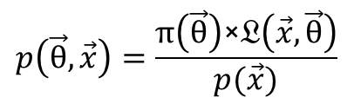
Fermionic Dark Matter
We assume that a DM fermion candidate $Ψ$, with mass $M_{D},$ can interact with each other by exchanging dark mesons.
We consider a dark scalar $φ$ and a dark vector $V_{μ}$, whose masses and couplings are respectively ${(m}_{s},g_{s})$ and ${(m}_{v},g_{v}).$
We analyze two scenarios, in which the interaction with the scalar meson can be linear or quadratic.
Starting from the respective Lagrangian, we derive the pressure and the energy density of DM (i.e., its EOS) within a Relativistic Mean Field approach. The mediator field operators are replaced by their ground state expectation values as:
$\left\langle φ(x)\right\rangle =φ_{0}$ $\left\langle V_{μ}(x)\right\rangle =V_{0}$
Bayesian analysis
We used Bayesian analysis to estimate the free parameters of the dark matter models, combining prior knowledge with the latest experimental and observational data (NICER and GW detections from LIGO-Virgo) to constrain their values.
Starting from prior information $π\left(\vec{θ}\right)$, the Bayes theorem allows to incorporate experimental evidence $𝔏\left(\vec{x},\vec{θ}\right)$ and quantify uncertainty about model parameters in terms of posterior probability distributions:
$$p\left(\vec{θ},\vec{x}\right)=\frac{π\left(\vec{θ}\right)\text{×}𝔏\left(\vec{x},\vec{θ}\right)}{p(\vec{x})}$$

Slide 11
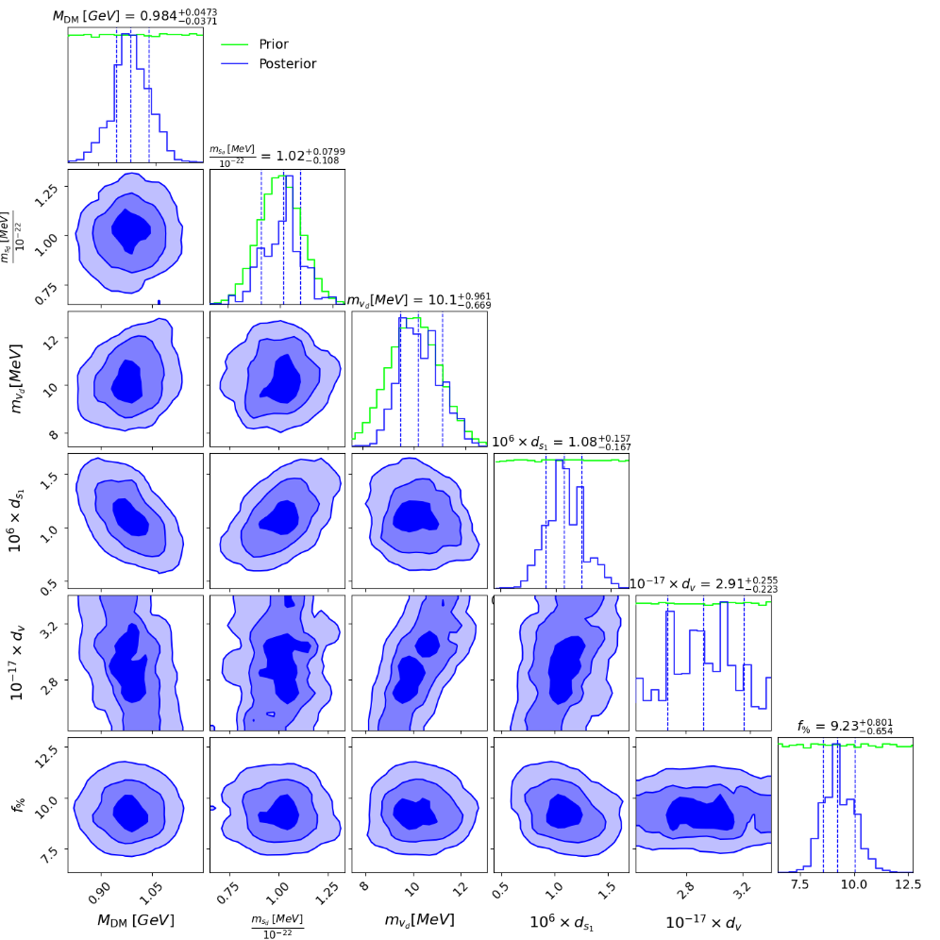


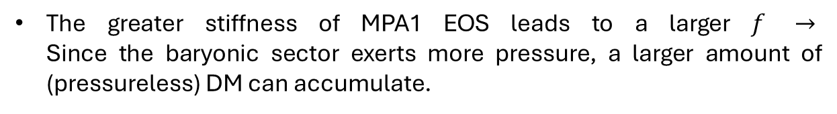
Linear scenario
The Lagrangian:
$$𝔏 =\overline{Ψ}\left(x\right)\left\{γ_{μ}\left[i∂^{μ}−g_{v}V^{μ}\left(x\right)\right]−\left[M_{D}−g_{s_{1}}φ\left(x\right)\right]\right\}Ψ\left(x\right)+\frac{1}{2} \left[∂_{μ}φ\left(x\right)∂^{μ}φ\left(x\right)−m_{s}^{2}φ^{2}(x)\right]−\frac{1}{4}V^{μν}V_{μv}+\frac{1}{2}m_{v}^{2}V_{μ}(x)V^{μ}\left(x\right)$$
$$ρ=\frac{{(M_{D}^{∗})}^{4}}{8π^{2}}\left[x\sqrt{1+x^{2}}\left(1+{2x}^{2}\right)−ln\left(x+\sqrt{1+x^{2}}\right)\right]+\frac{1}{2}m_{v}^{2}V_{0}^{2}+\frac{1}{2}m_{s}^{2}φ_{0}^{2}$$
yields the EOS:
with:
$$M_{D}^{∗}=M_{D}−g_{s_{1}}φ_{0}$$
$$P=\frac{{(M_{D}^{∗})}^{4}}{24π^{2}}\left[x\sqrt{1+x^{2}}\left(−3+{2x}^{2}\right)+3ln\left(x+\sqrt{1+x^{2}}\right)\right]+\frac{1}{2}m_{v}^{2}V_{0}^{2}−\frac{1}{2}m_{s}^{2}φ_{0}^{2}$$
The 6 parameters $(M_{D},m_{s},m_{v},d_{s_{1}},d_{v},f)$ inferred via Bayesian analysis:
$d_{s_{1}}$ and $d_{v}$ are dimensionless couplings given by:
$g_{s_{1}}=\frac{d_{s_{1}}\text{×} M_{D}}{M_{p}}$ $g_{v}=\frac{d_{v}\text{×} M_{D}}{M_{p}}$
Priors are assigned based on previous literature - Das et al. PRD 105 (2022) 12
Likelihoods from NICER and LIGO dare are assumed to be gaussians.
No significant correlations arise among the parameters.
The greater stiffness of MPA1 EOS leads to a larger $f$ $→$
Since the baryonic sector exerts more pressure, a larger amount of (pressureless) DM can accumulate.
Grippa et al., “Constraints on scalar and vector DANSs with linear and quadratic couplings”, arXiv: 2407.16396

Slide 12
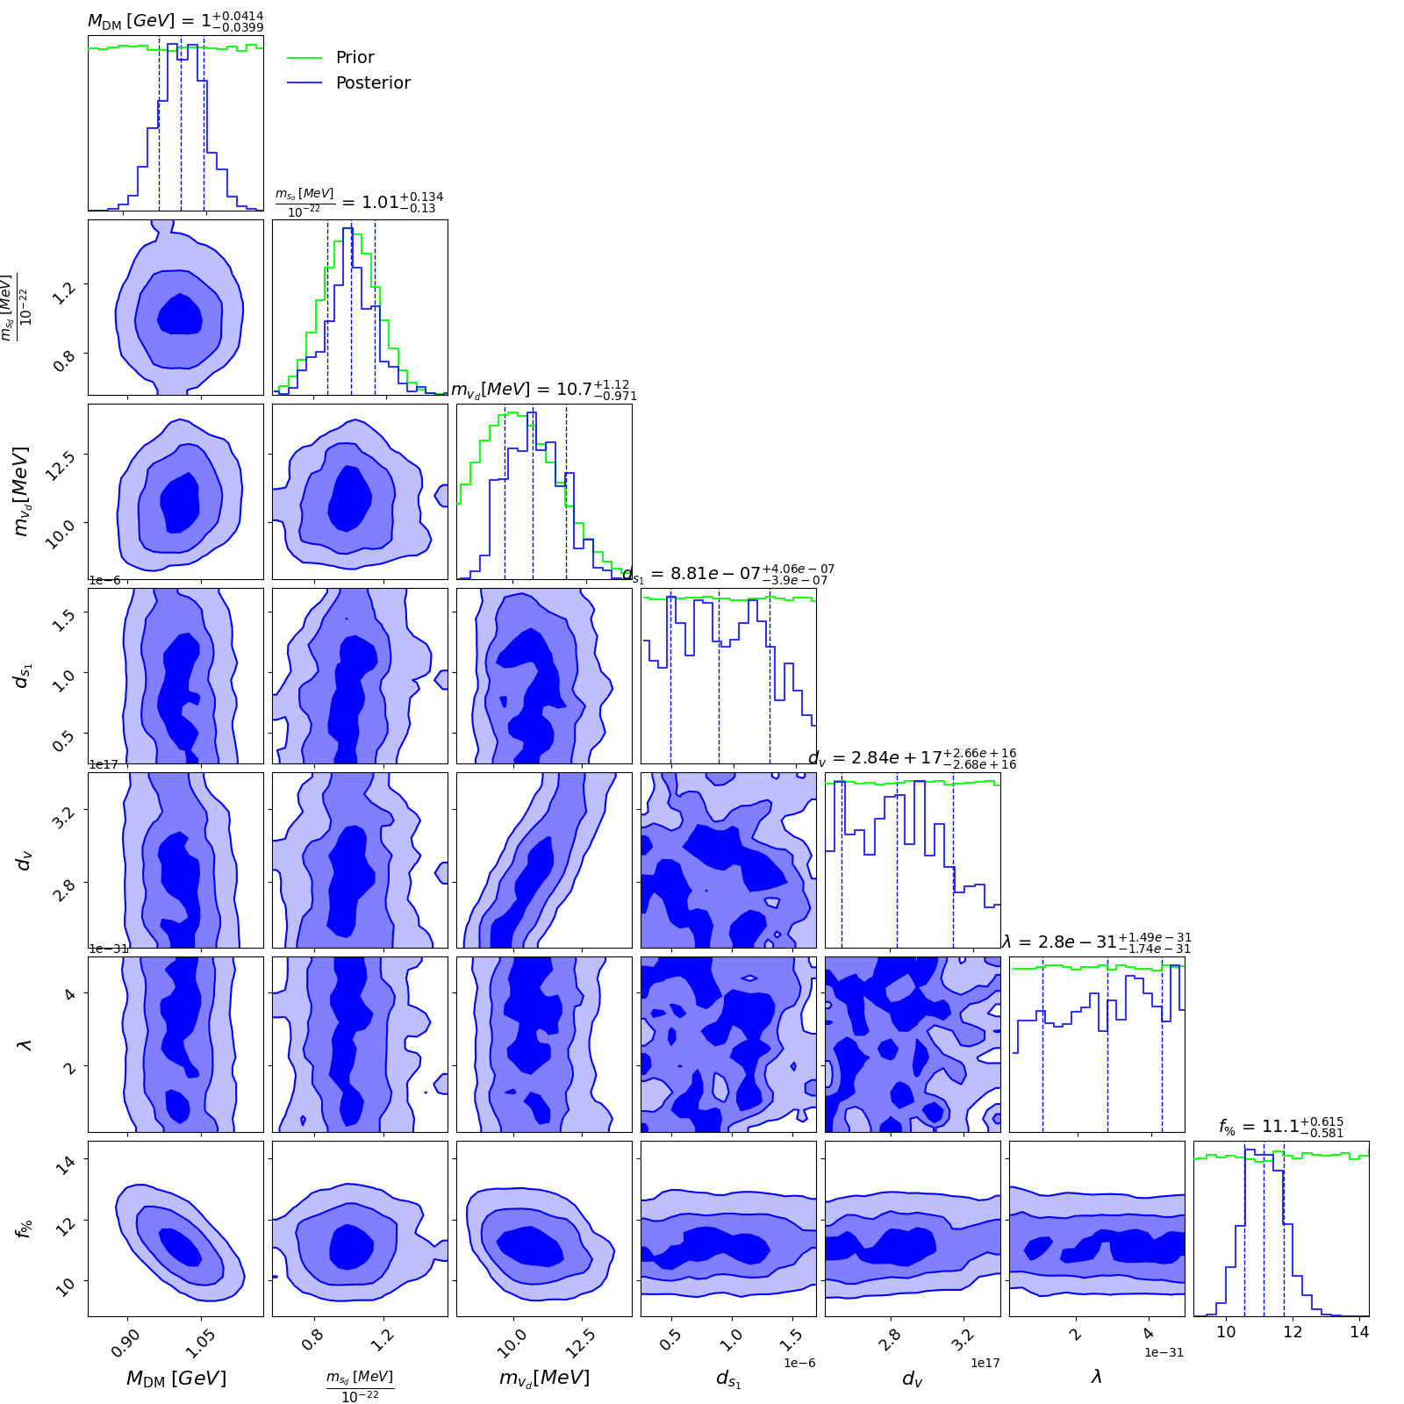


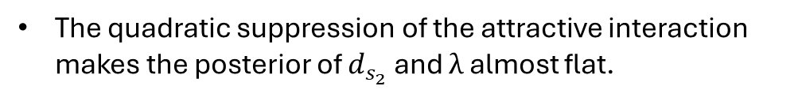
Quadratic scenario
$$𝔏 =\overline{Ψ}\left(x\right)\left\{γ_{μ}\left[i∂^{μ}−g_{v}V^{μ}\left(x\right)\right]−\left[M_{D}−g_{s_{2}}φ^{2}\left(x\right)\right]\right\}Ψ\left(x\right)+\frac{1}{2} \left[∂_{μ}φ\left(x\right)∂^{μ}φ\left(x\right)−m_{s}^{2}φ^{2}(x)\right]−\frac{1}{4!}λφ^{4}(x)−\frac{1}{4}V^{μν}V_{μv}+\frac{1}{2}m_{v}^{2}V_{μ}(x)V^{μ}\left(x\right)$$
$$ρ=\frac{{(M_{D}^{∗})}^{4}}{8π^{2}}\left[x\sqrt{1+x^{2}}\left(1+{2x}^{2}\right)−ln\left(x+\sqrt{1+x^{2}}\right)\right]+\frac{1}{2}m_{v}^{2}V_{0}^{2}+\frac{1}{2}m_{s}^{2}φ_{0}^{2}+\frac{1}{4!}λφ_{0}^{4}$$
yields the EOS:
with:
$$M_{D}^{∗}=M_{D}−g_{s_{2}}φ_{0}^{2}$$
$$P=\frac{{(M_{D}^{∗})}^{4}}{24π^{2}}\left[x\sqrt{1+x^{2}}\left(−3+{2x}^{2}\right)+3ln\left(x+\sqrt{1+x^{2}}\right)\right]+\frac{1}{2}m_{v}^{2}V_{0}^{2}−\frac{1}{2}m_{s}^{2}φ_{0}^{2}−\frac{1}{4!}λφ_{0}^{4}$$
The 7 parameters $(M_{D},m_{s},m_{v},d_{s_{2}},d_{v},λ,f)$ inferred via Bayesian analysis:
$d_{s_{1}}$ and $d_{v}$ are dimensionless couplings given by:
$g_{s_{2}}=\frac{d_{s_{2}}\text{×} M_{D}}{M_{p}^{2}}$ $g_{v}=\frac{d_{v}\text{×} M_{D}}{M_{p}^{2}}$
Priors and likelihoods are chosen in line with the linear scenario.
No significant correlations arise among the parameters.
The quadratic suppression of the attractive interaction makes the posterior of $d_{s_{2}}$ and $λ$ almost flat.
$f$is still larger with MPA1 EOS.
Grippa et al., “Constraints on scalar and vector DANSs with linear and quadratic couplings”, arXiv: 2407.16396

Slide 13
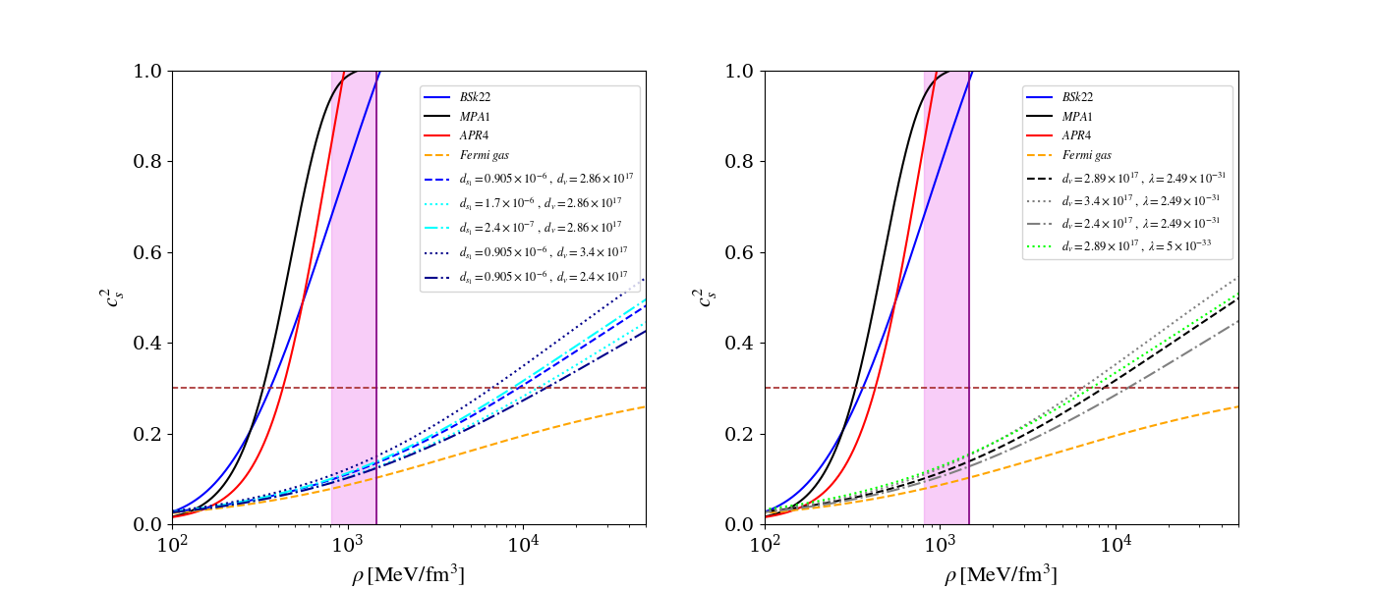
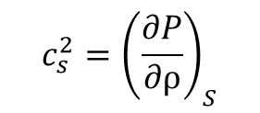
Results: speed of sound
We separately compute the sound speed of the baryonic
fluid (solid curves) and of the dark fluid (dotted/dashed curves):
$$c_{s}^{2}={\left(\frac{∂P}{∂ρ}\right)}_{S}$$
The sound speed of representative DM EOSs is first computed by selecting the central values of the posterior distributions. Then, the couplings are varied within their prior intervals to explore the impact of attractive and repulsive interactions in both the linear (left) and in the quadratic (right) scenario.
Grippa et al., “Constraints on scalar and vector DANSs with linear and quadratic couplings”, arXiv: 2407.16396
Unlike nuclear EOSs, all DM models satisfy the conformal limit at densities typically reached inside a NS (purple band)
$c_{s}^{2}$ increases with larger $d_{v}$ and/or smaller $d_{s}$ $→$ the repulsive contribution and the corresponding pressure are enhanced. This makes the star harder to compress and in turn stiffens the EOS.
Conversely, $c_{s}^{2}$ decreases with lower $d_{v}$ and/or greater $d_{s}$ $→$ the opposite effect arises from a weaker attraction.

Slide 14
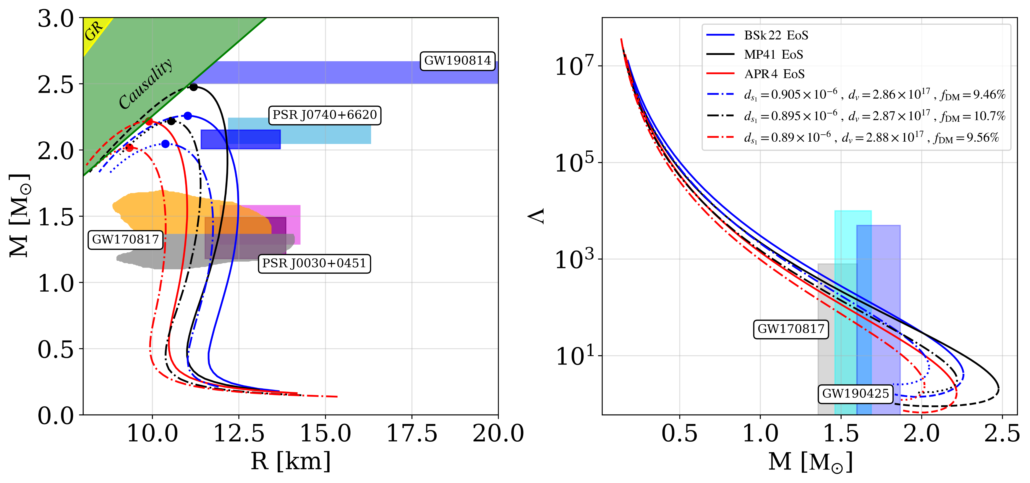
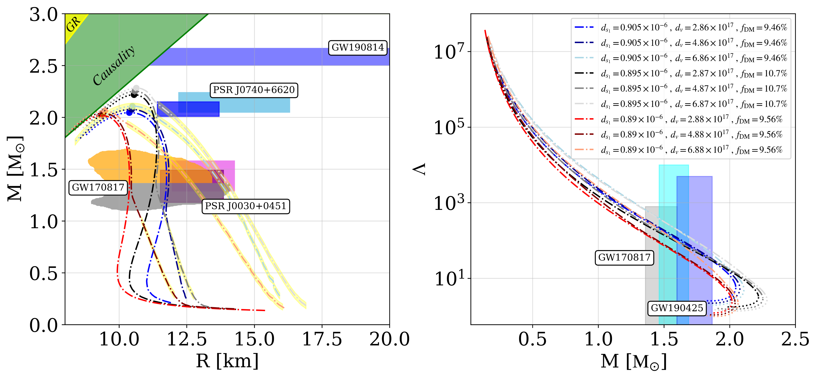
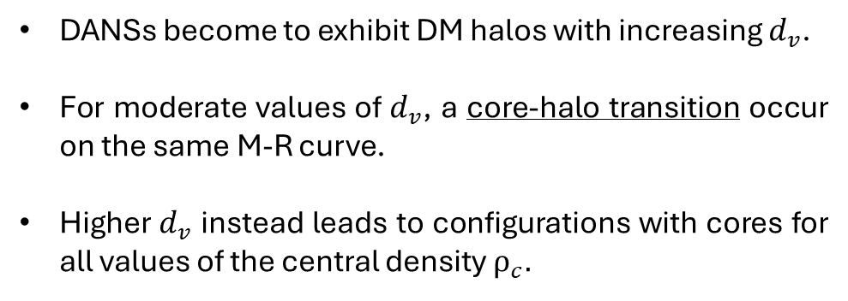
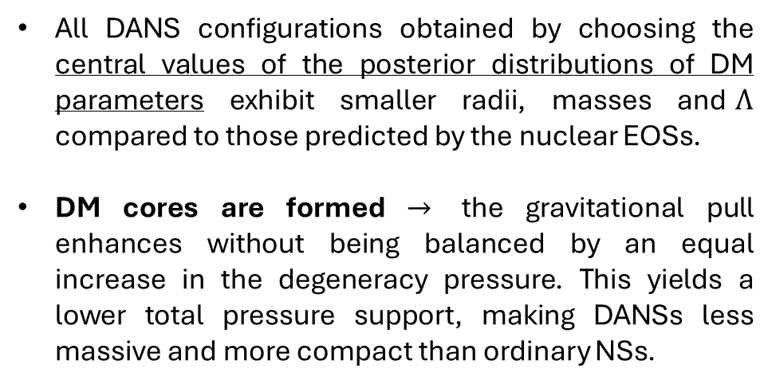
Results: linear scenario
All DANS configurations obtained by choosing the central values of the posterior distributions of DM parameters exhibit smaller radii, masses and$Λ$ compared to those predicted by the nuclear EOSs.
DM cores are formed $→$ the gravitational pull enhances without being balanced by an equal increase in the degeneracy pressure. This yields a lower total pressure support, making DANSs less massive and more compact than ordinary NSs.
Grippa et al., “Constraints on scalar and vector DANSs with linear and quadratic couplings”, arXiv: 2407.16396
Role of the vector field
DANSs become to exhibit DM halos with increasing $d_{v}$.
For moderate values of $d_{v}$, a core-halo transition occur on the same M-R curve.
Higher $d_{v}$ instead leads to configurations with cores for all values of the central density $ρ_{c}.$
Grippa et al., “Constraints on scalar and vector DANSs with linear and quadratic couplings”, arXiv: 2407.16396

Slide 15
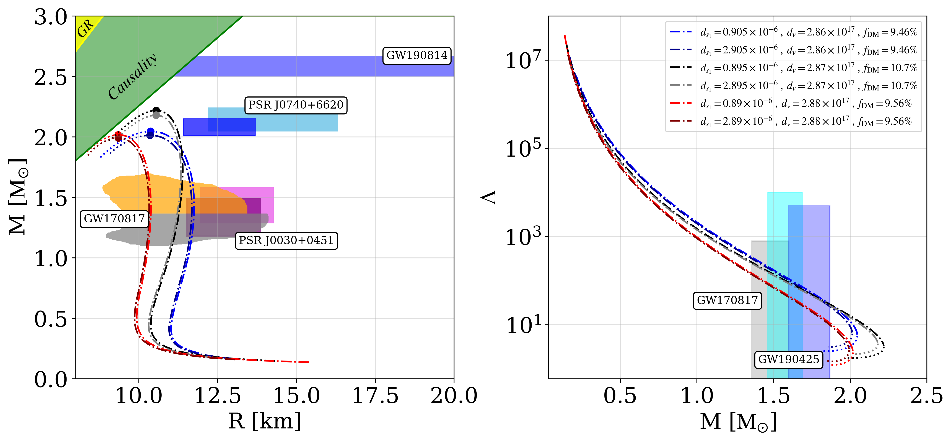
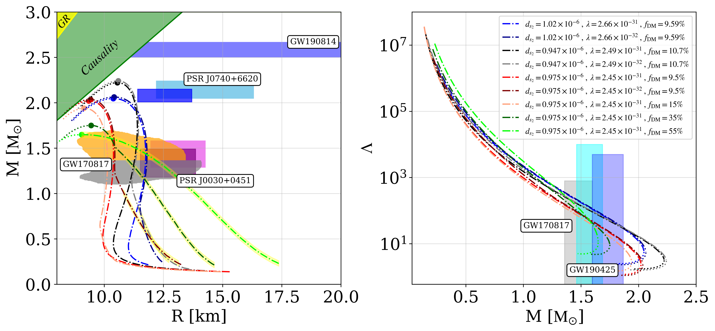
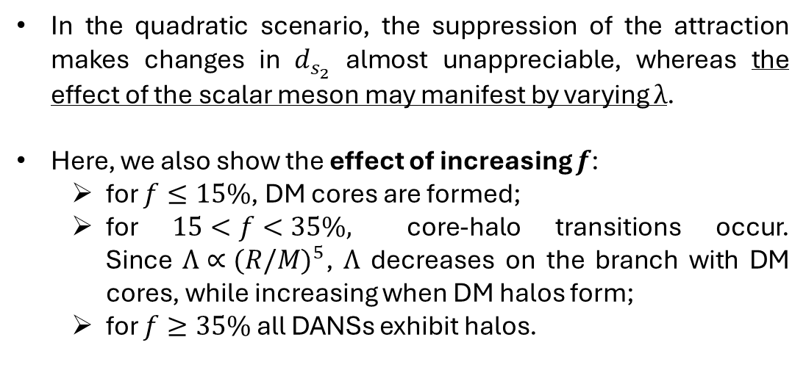
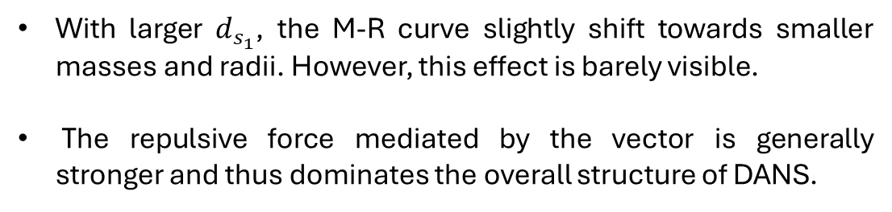
Role of the scalar field
With larger $d_{s_{1}}$, the M-R curve slightly shift towards smaller masses and radii. However, this effect is barely visible.
The repulsive force mediated by the vector is generally stronger and thus dominates the overall structure of DANS.
Grippa et al., “Constraints on scalar and vector DANSs with linear and quadratic couplings”, arXiv: 2407.16396
Quadratic scenario
In the quadratic scenario, the suppression of the attraction makes changes in $d_{s_{2}}$ almost unappreciable, whereas the effect of the scalar meson may manifest by varying $λ$.
Here, we also show the effect of increasing $f$:
  for $f≤15\%$, DM cores are formed;
  for $15<f<35\%,$ core-halo transitions occur.
  Since $Λ∝{(R/M)}^{5}$, $Λ$ decreases on the branch with DM cores, while increasing when DM halos form;
  for $f≥35\%$ all DANSs exhibit halos.
Grippa et al., “Constraints on scalar and vector DANSs with linear and quadratic couplings”, arXiv: 2407.16396

Slide 16
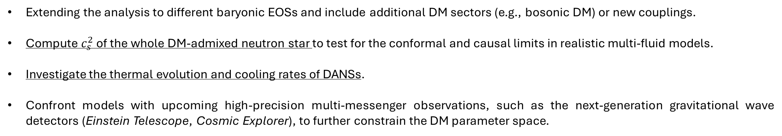
Role of the scalar field
Depending on the parameters of the DM EOS, either a dense DM core (smaller and more compact DANS) or an extended DM halo (wider and more massive stars) may form. In some cases, a core-halo transition may also occur along the same mass-radius curve.
Weak interaction couplings, low dark matter fractions, and high DM candidate masses favor the formation of a core.
In both scenarios, the contribution due to the vector meson dominates the EOS.
In the quadratic scenario, the suppression of the scalar term makes the attraction almost vanishing.
Λ is reduced with a core and is increased with a halo. This may impact gravitational wave signals from neutron star mergers.
NICER measurements of neutron star masses and radii as well as GW detections from the Virgo-LIGO collaboration provide constraints to validate or challenge dark matter models. DANSs with cores tend to be more consistent with these observational data.
Future perspectives
Extending the analysis to different baryonic EOSs and include additional DM sectors (e.g., bosonic DM) or new couplings.
Compute $c_{s}^{2}$ of the whole DM-admixed neutron star to test for the conformal and causal limits in realistic multi-fluid models.
Investigate the thermal evolution and cooling rates of DANSs.
Confront models with upcoming high-precision multi-messenger observations, such as the next-generation gravitational wave detectors (Einstein Telescope, Cosmic Explorer), to further constrain the DM parameter space.

Slide 17
Thank you for your attention!

