Slide 1
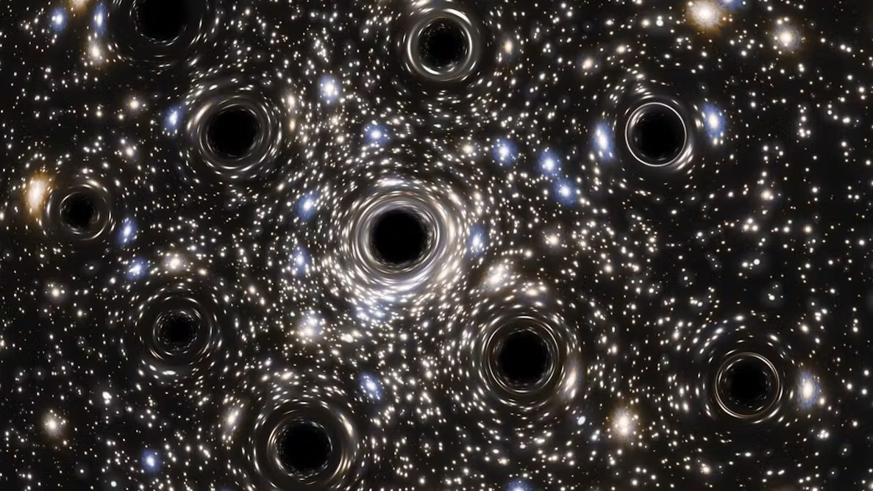


Probing Large Extra Dimensions induced Primordial Black Holes through the Stochastic Gravitational Wave Background
Outline:
What are Primordial Black Holes?
Introduction to Large Extra Dimensions
-The ADD formalism
Stochastic Gravitational Wave Background:
- Merger Rate Modeling
- Average Energy Spectrum in n-D
Results
Authors: G. F. Vitale, G. Lambiase,
L. Visinelli, T. Poddar

Slide 2
What are Primordial Black Holes ?
Primordial Black Holes (PBHs) are hypothetical black holes that could have formed in the very early universe, a fraction of a second after the Big Bang, from extremely dense fluctuations in matter and energy.
Tiny quantum fluctuations could have created slightly denser patches. If a region’s density exceeded a critical threshold, gravity could have caused it to collapse into a black hole.
Understanding whether PBHs exist could reshape our understanding of both cosmology and fundamental physics. For example they could :
Explain Seed galaxy formation, Provide insight into the early universe and quantum
gravity, Explain dark matter and unusual gravitational wave signals detected
by LIGO/Virgo.
My research focuses on studying them in the extra dimensions background where they could acquire a new meaning as a possible component for dark matter, and can be possibly detected by more precise observations in GWs
Before galaxies, before stars,
even before atoms
there might have been
Black Holes.

Slide 3



Introduction to Large Extra Dimensions:
The $85\%$ of the matter content of the Universe behaves as a cold, pressureless fluid, implying its existence since the early stages of cosmic evolution, Black holes, in the absence of significant accretion or evaporation, exhibit a similar dynamical behavior.
However, a primordial formation mechanism must be invoked to account for black holes that were present at earlier cosmic epochs. According to Hawking radiation theory, black holes gradually evaporate, and only those with masses greater than approximately ${10}^{15}g$ would have survived until the present day.
There are many constraints on their existence as Dark Matter and only masses up to ${10}^{10}g$ can exist, by the imprint of their Hawking evaporation on big bang nucleosynthesis, the CMB, extragalactic background light, and antimatter in the Milky Way.
Most searches to date have assumed that PBHs behave as semiclassical four dimensional black holes, as originally described by Hawking. However, an alternative and intriguing scenario has been proposed. In the framework of large extra dimensions (LEDs), where Gravity has new possibilities.

Slide 4
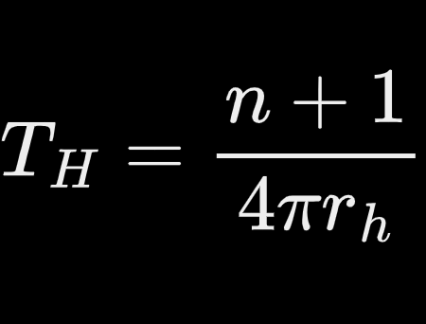
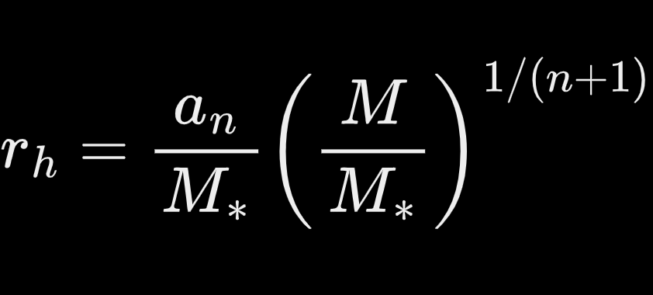
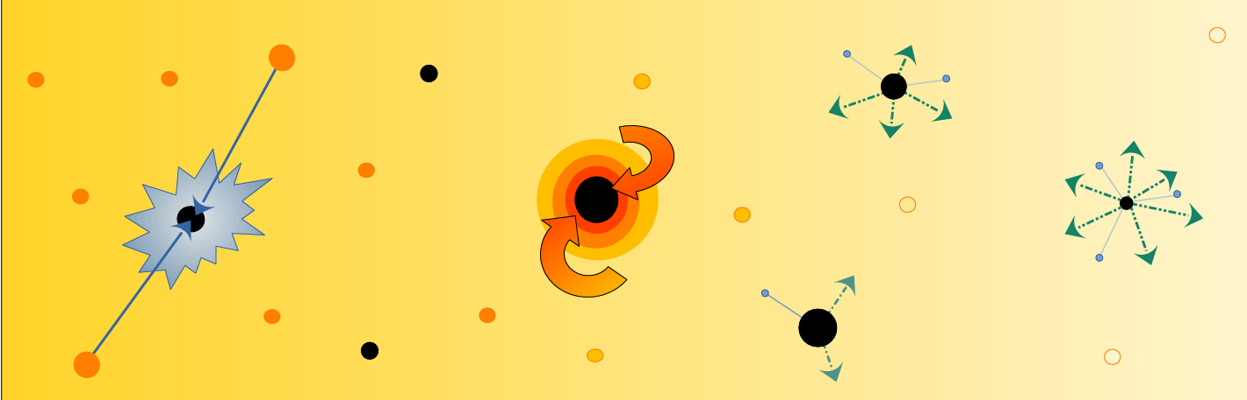

The ADD formalism: Part I
In the context of LED model proposed by Arkani-Hamed, Dvali e Dimopoulos (ADD), there are more possibilities to create PBHs due to the new relations emerging from the model, where there is a fast accretion of their mass in the early Universe essentially because their horizon radii is much larger.
What does this model actually propose? It can explain why Gravity seems so weak respect to the other forces, that’s because if there are other compacted dimensions, Gravity is the only one to leaks out in these extra dimensions, while Standard Model lays on the accessible $3−$dimensional brane (Hierarchy Problem)

Slide 5
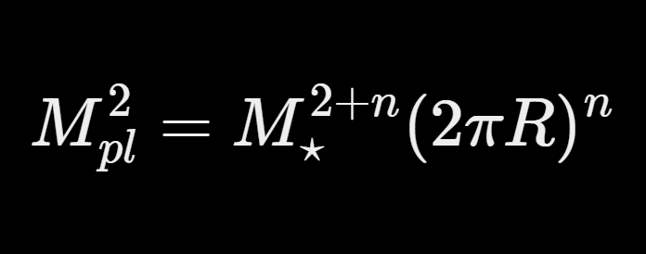
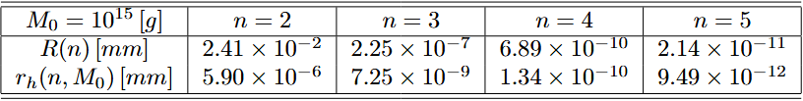


The ADD formalism: Part II
In this model the fundamental energy scale is $M_{⋆}$ of the order of TeV, comparable to the other forces of the Standard model, except that on the brane we feel the much stronger $M_{pl}$ related to the weak gravitational coupling costant $G∼1/M_{pl}^{2}$ and related to $M_{⋆}$ in this way
where $n≥2$ are the extra dimensions in addition to the $4$, and ${10 TeV≤M}_{⋆}≤100 TeV$.
The first constraint on $n$ excludes only $n=1$ because in that case we have a length $R$ for
the extra dimension of the size of our solar system, and we should have seen
something.
The second lower constraint for $M_{⋆}$ derives from the LHC or we should have seen
production of black holes, while the bigger one because we would lose an elegant
solution for the Hierarchy problem.
It is interesting to see, for further results, what are the magnitude orders between the length of the extra dimensions and the modified horizon radius fo a mass $M_{0}={10}^{15}g$

Slide 6

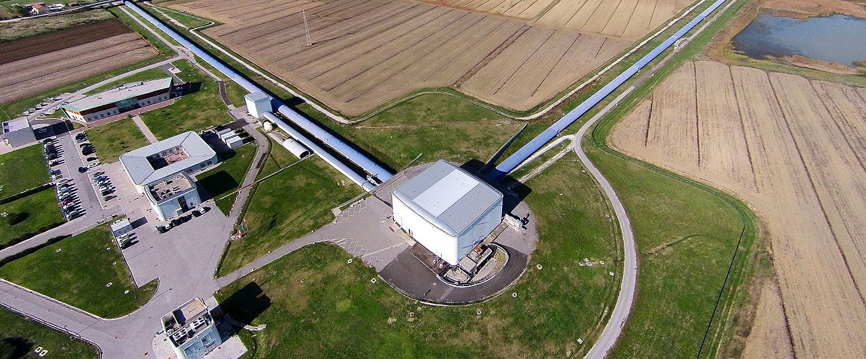
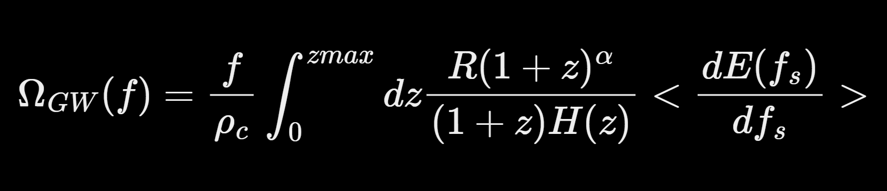

Stochastic Gravitational Wave Background:
Initially, we focused on various possible methods for detecting PBHs, particularly within the ADD framework, which allows for the existence of longer-lived, more stable black holes with very small masses that could constitute a fraction of the dark matter halos in the Universe.
Among the possible detection mechanisms, the most intriguing is the observation of gravitational waves produced by the merging of primordial black holes in the present epoch. These signals could be accessible to current detectors such as LIGO and VIRGO. One can estimate the resulting SGWB that would serve as an indirect probe of their existence:
Where $ρ_{c}$ is the critical density, $zmax$ is the upper bound of the redshift integral, $R$ is the merger rate of PBH binaries per comoving volume, $fs = (1 + z)f$ is the frequency in the source frame, and $dE/df_{s}$is the GW spectrum from a merger in the source frame

Slide 7
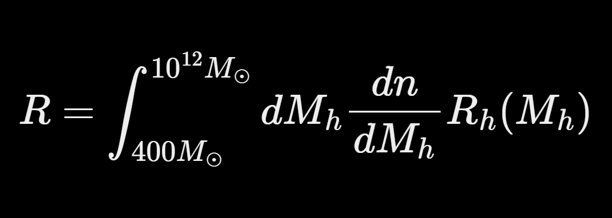
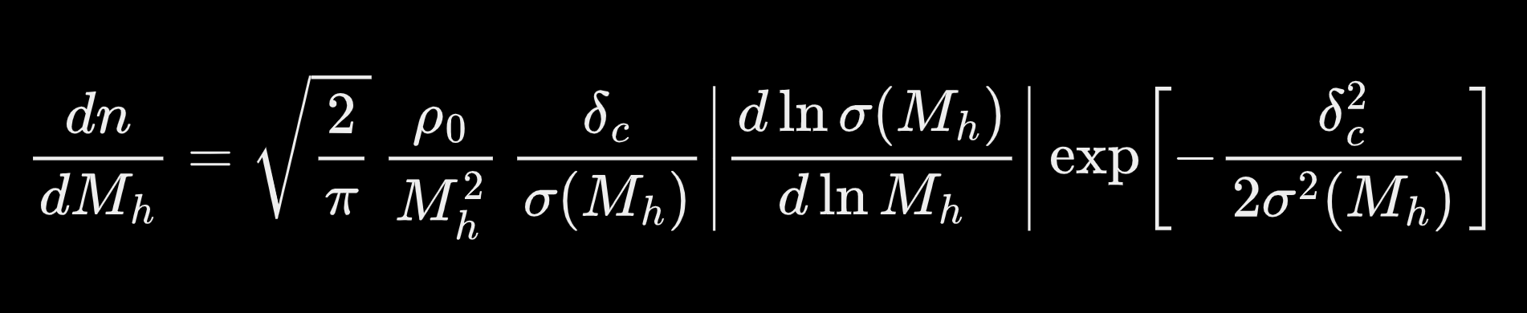


Merger Rate Modeling: Part I
The total merger rate per unit volume and unit time is given by:
where $dn/dM_{h}$ is the halo mass function by the Press-Schechter formalism, which tells us how many halos exist per unit volume and per unit mass, a crucial ingredient for modeling galaxy formation or, in our case, the distribution of primordial black holes in halos.
Here $ρ_{0}$ is the average density matter of the Universe, $δ_{c}∼1,69$ is the threshold for the collapsing of virialized objects according to the spherical collapse model and $σ\left(M\right)$ is the variance of the matter density field computed from the matter power spectrum.

Slide 8
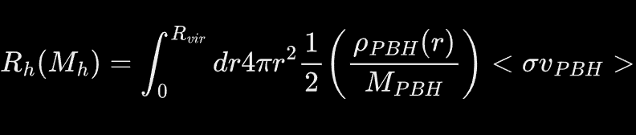
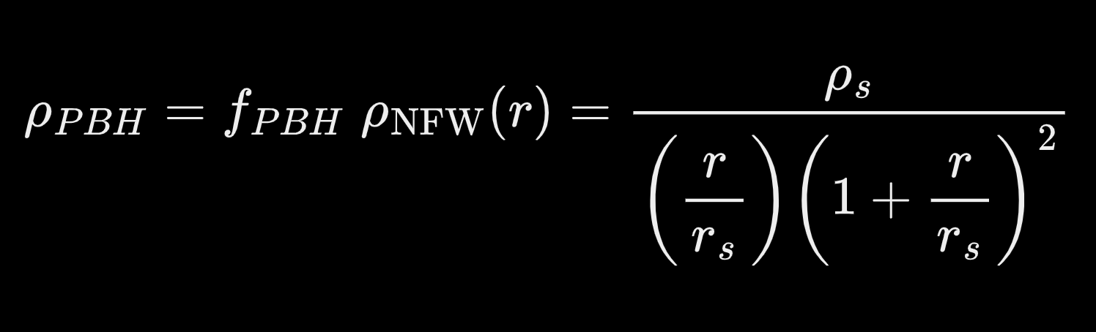

Merger Rate Modeling: Part II
Instead $R_{h}(M_{h})$ comes from
Here $R_{vir}$​ is the virial radius defining the outer boundary of the halo, and assuming PBHs behave as cold, collisionless matter, their density profile within halos follows that of dark matter. Thus, we model the PBH distribution using the Navarro-Frenk-White density profile $ρ_{NFW}(r)$ that describes how dark matter density changes with distance from the center of a halo
Where $ρ_{s}$ is the characteristic density setting the normalization of the profile, and $R_{s}$is the scale radius marking the transition between the inner $ρ∝1/r$ and outer $ρ∝1/r^{3}$regions.

Slide 9
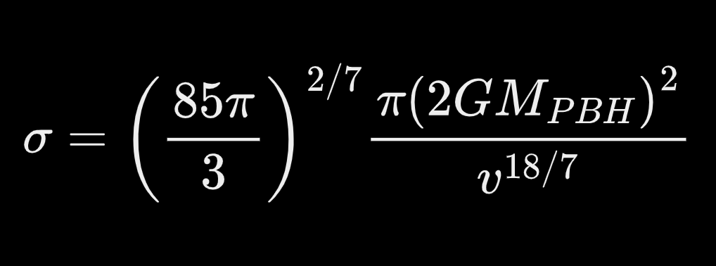
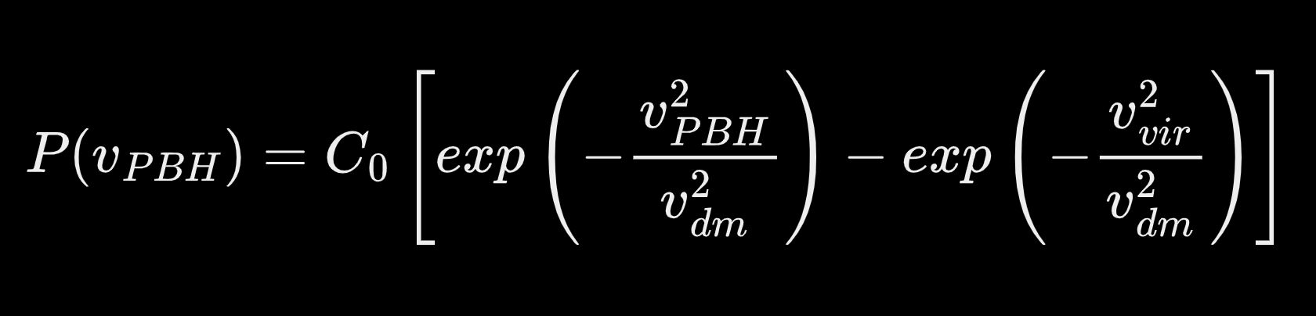



Interaction rate density $<σv_{PBH}>$:
The velocity-averaged interaction rate per pair of PBHs combines the cross-section $σ$ and the relative velocity of two PBHs $v_{PBH}$ and the average $\left\langle ⋯\right\rangle$ is taken over the velocity distribution of PBHs in the halo.
The cross-section $σ$ is computed by the condition of the energy loss due to gravitational radiation during one orbital period $T$ that becomes greater than the reduced kinetic energy $μv^{2}/2$, namely when PBHs form a binary
While the relative velocity distribution of PBHs within a halo as a Maxwell-Boltzmann distribution with a cut o at the virial velocity.
Where $C_{0}$ is a normalization constant and $v_{dm}$ is the circular velocity in the halo.

Slide 10
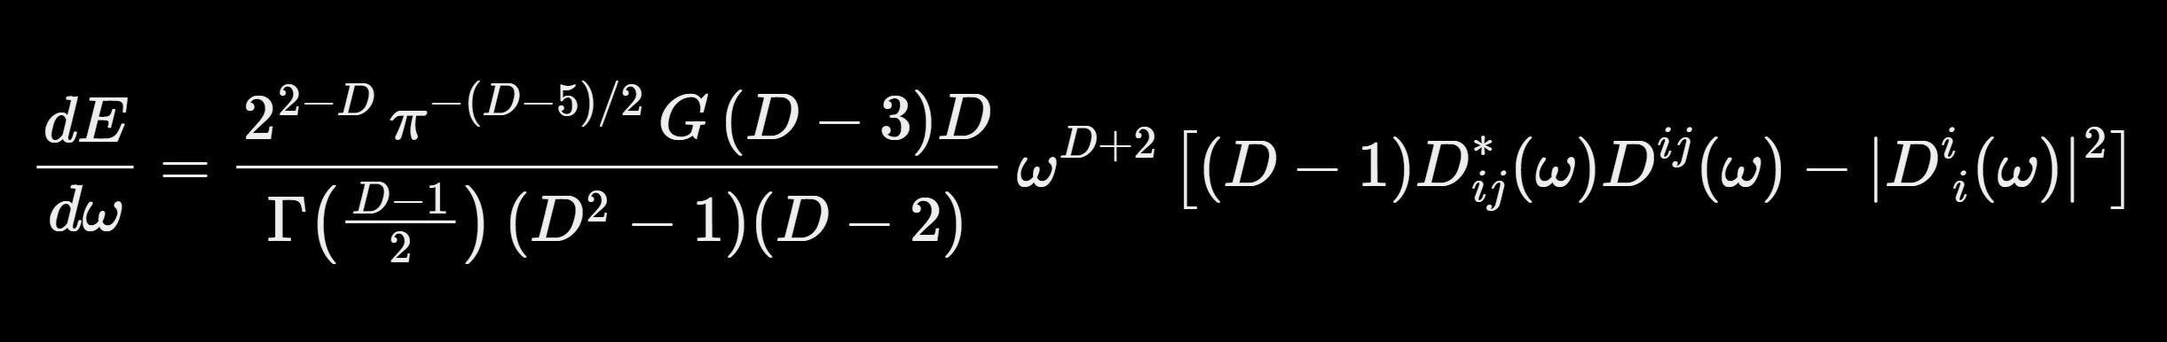
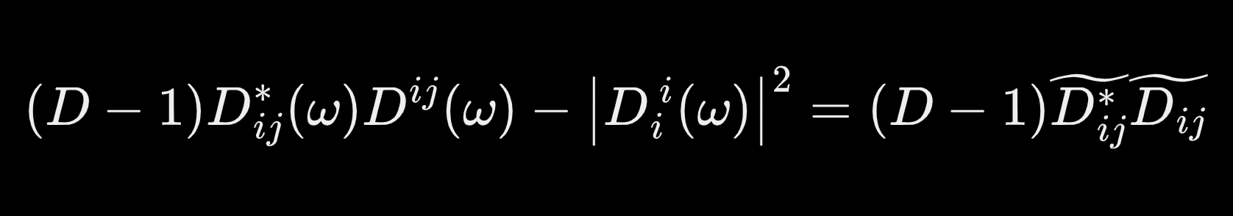
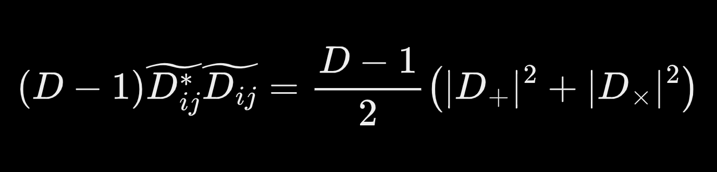

Energy Spectrum in n-dimensions: Part I
The energy spectrum used in this work is taken from the study by V. Cardoso, O. Dias, and J. Lemos $(2003),$in which the authors derived the gravitational-wave energy spectrum emitted in $4+n$ dimensions:
Where $D=4+n$ in our convention and $D_{ij}(w)$ is the Fourier Transform of the quadrupole $Q_{ij}$. The term in square parenthesis
represents the traceless part of $D_{ij}$ that is the effective part of gravitational radiation.
This can be rewritten considering the two polarizations $+$ and $×$

Slide 11
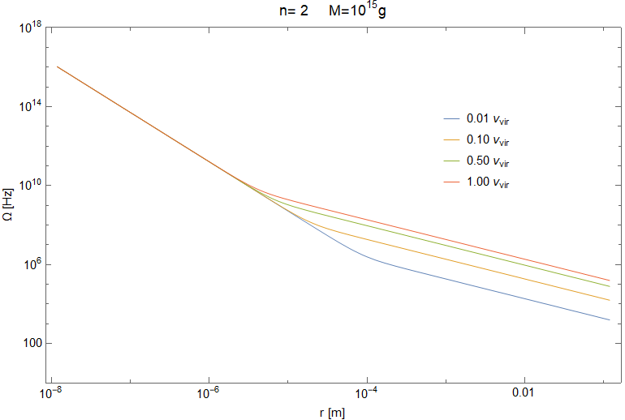
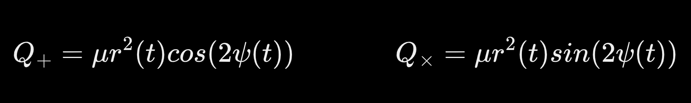
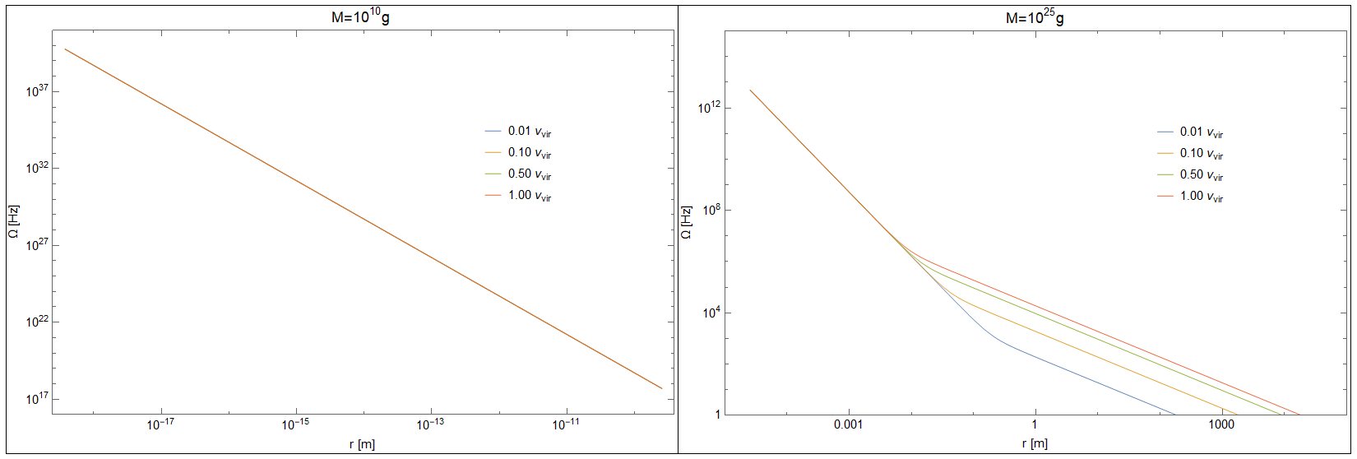
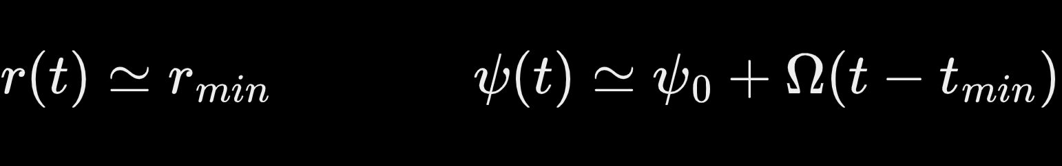
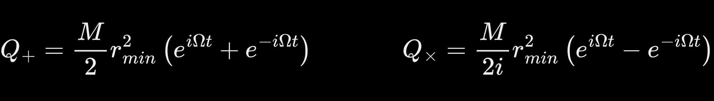
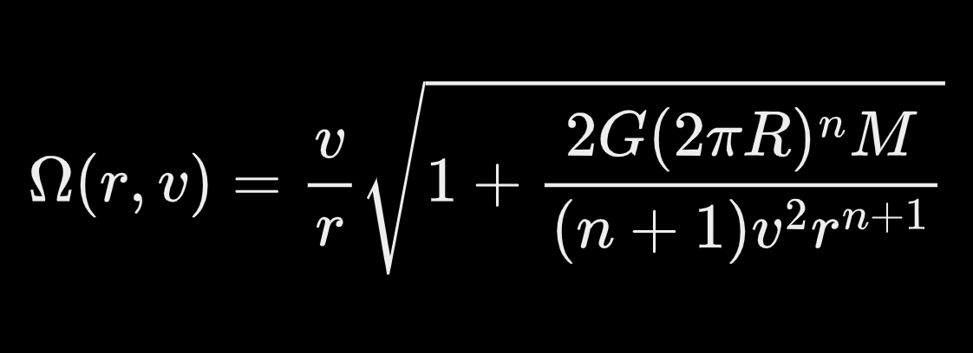
Energy Spectrum in n-dimensions: Part II
In order to find $D_{+,×}$, we need to construct the traceless part $Q_{+,×}$that is
Here we take a linear approximation to consider an emission burst
Where we can set $ψ_{0}=0$ and $t_{min}=0$ that represent only a phase $e^{−iΩt_{min}}$.
We can rearrange to obtain
Here $Ω$ is equal to

Slide 12
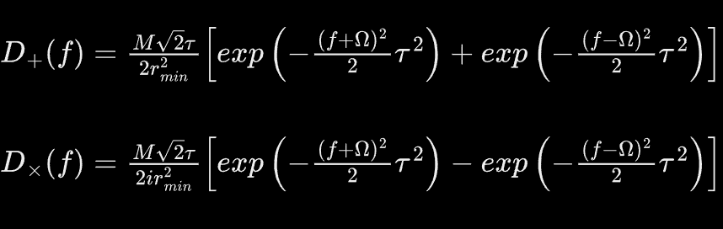
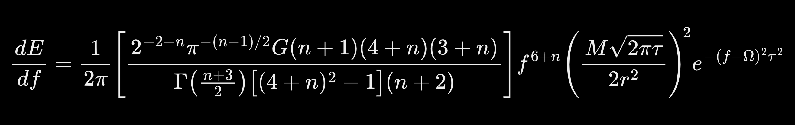
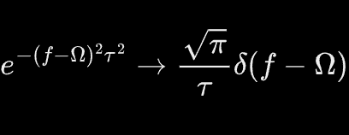
Energy Spectrum in n-dimensions: Part III
Considering a Gaussian window $e^{−t^{2}/2τ^{2}}$ justified by an assumed short time of interaction $τ∼1$, we can calculate $D_{+}$ and $D_{×}$
Finally, we obtain the desired relation
Given our assumptions, we can simplify the exponential expression even further to obtain an even more stable numerical result.

Slide 13
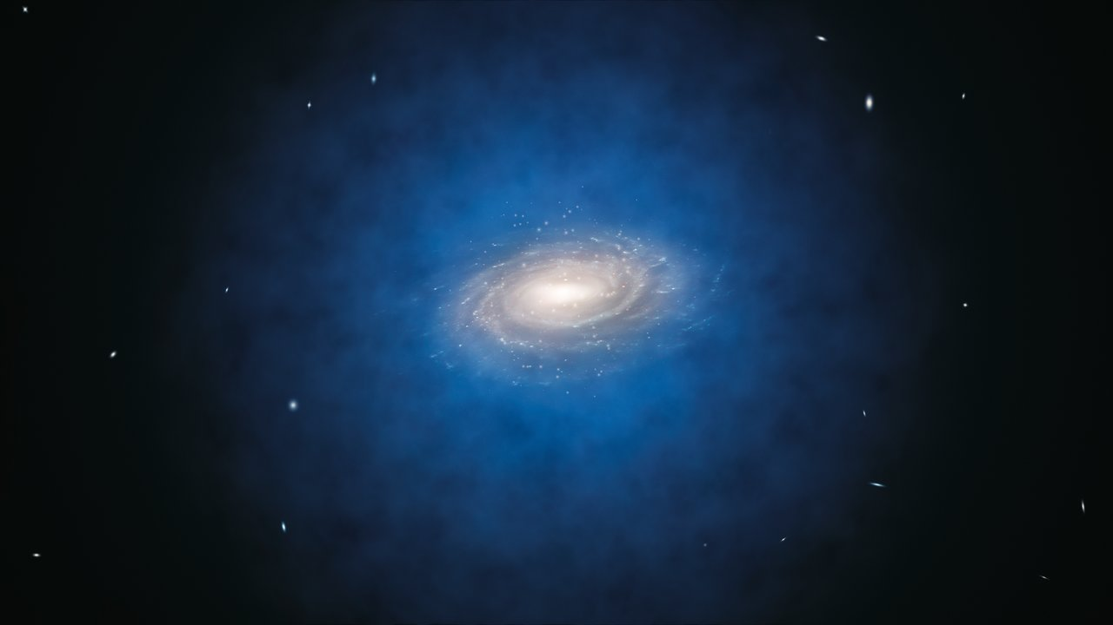
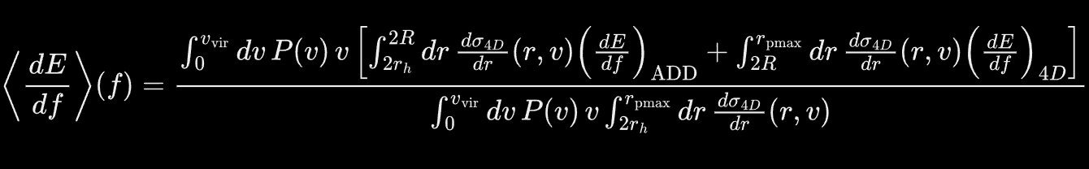


Average Energy Spectrum in n-dimensions:
To obtain a realistic average spectrum, I performed a double averaging: over the relative velocity distribution M-B weighting slower and faster encounters; over the geometrical pericenter distribution, given by the differential cross section $dσ/dr$. The resulting $\left\langle dE/df\right\rangle$ represents the average GW emission from a typical PBH–PBH encounter within a halo.
In this expression, the two integrals distinguish between the $4 + n$-dimensional and $4D$ regimes. The quantity $dσ/dr$ is evaluated in $4D$ for both cases, as it represents a geometrical probability determined by parameters within the $4D$ framework. Conversely, the terms $dE/df$correspond to the energy emission spectra, which discriminate between the two regimes.

Slide 14
Average Energy Spectrum in n-dimensions:
To obtain a realistic average spectrum, I performed a double averaging: over the relative velocity distribution M-B weighting slower and faster encounters; over the geometrical pericenter distribution, given by the differential cross section $dσ/dr$. The resulting $\left\langle dE/df\right\rangle$ represents the average GW emission from a typical PBH–PBH encounter within a halo.
In this expression, the two integrals distinguish between the $4 + n$-dimensional and $4D$ regimes. The quantity $dσ/dr$ is evaluated in $4D$ for both cases, as it represents a geometrical probability determined by parameters within the $4D$ framework. Conversely, the terms $dE/df$correspond to the energy emission spectra, which discriminate between the two regimes.

Slide 15
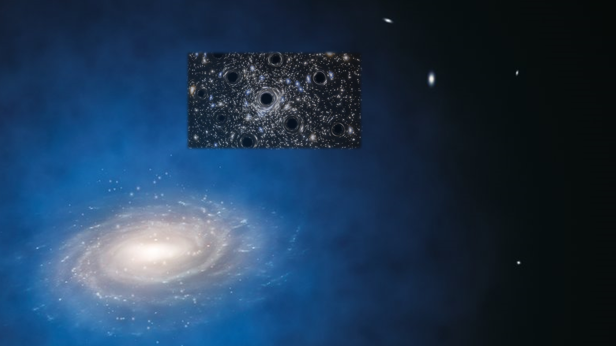
Average Energy Spectrum in n-dimensions:
To obtain a realistic average spectrum, I performed a double averaging: over the relative velocity distribution M-B weighting slower and faster encounters; over the geometrical pericenter distribution, given by the differential cross section $dσ/dr$. The resulting $\left\langle dE/df\right\rangle$ represents the average GW emission from a typical PBH–PBH encounter within a halo.
In this expression, the two integrals distinguish between the $4 + n$-dimensional and $4D$ regimes. The quantity $dσ/dr$ is evaluated in $4D$ for both cases, as it represents a geometrical probability determined by parameters within the $4D$ framework. Conversely, the terms $dE/df$correspond to the energy emission spectra, which discriminate between the two regimes.

Slide 16
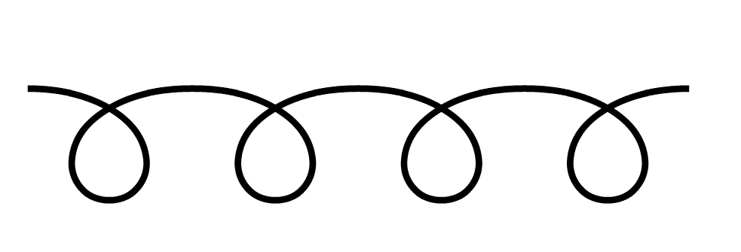





Average Energy Spectrum in n-dimensions:
To obtain a realistic average spectrum, I performed a double averaging: over the relative velocity distribution M-B weighting slower and faster encounters; over the geometrical pericenter distribution, given by the differential cross section $dσ/dr$. The resulting $\left\langle dE/df\right\rangle$ represents the average GW emission from a typical PBH–PBH encounter within a halo.
$$R$$
$$v_{PBH}$$
$$r_{min}$$
$$b$$
$$r_{h}$$
In this expression, the two integrals distinguish between the $4 + n$-dimensional and $4D$ regimes. The quantity $dσ/dr$ is evaluated in $4D$ for both cases, as it represents a geometrical probability determined by parameters within the $4D$ framework. Conversely, the terms $dE/df$correspond to the energy emission spectra, which discriminate between the two regimes.

Slide 17
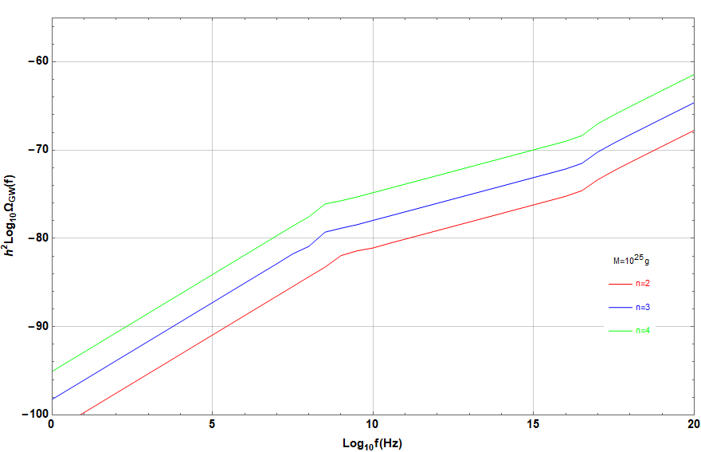
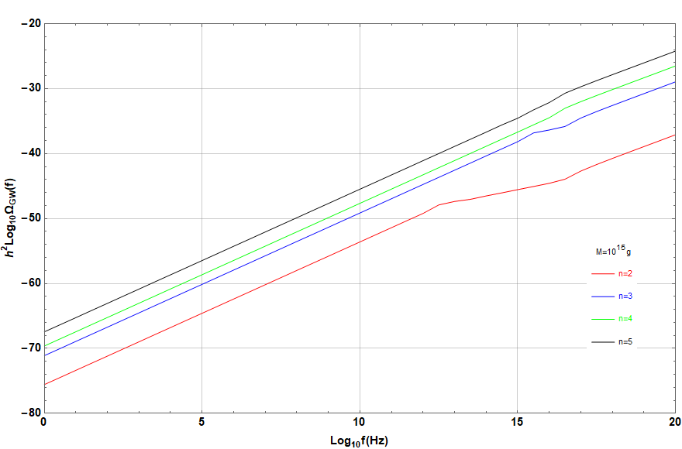
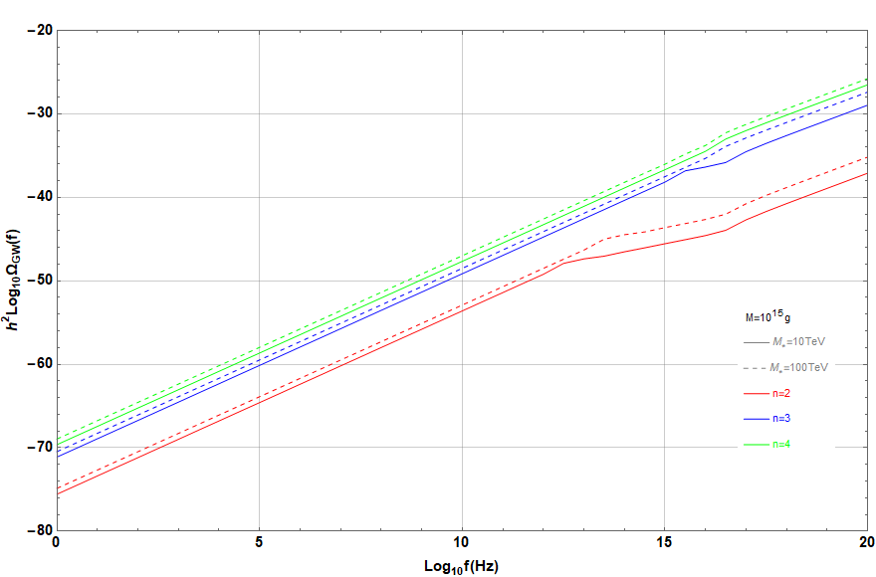
Results:
Finally, with all these ingredients, we can plot the stochastic gravitational-wave background (SGWB) as a function of frequency.
The observed energy fraction is very small, as expected for ${10}^{15} g$ black holes inside halos. The effect grows with the number of extra dimensions, and $n$-dimensional emission becomes visible only when the horizon radius is below about 30% of the extra-dimensional scale.

Slide 18
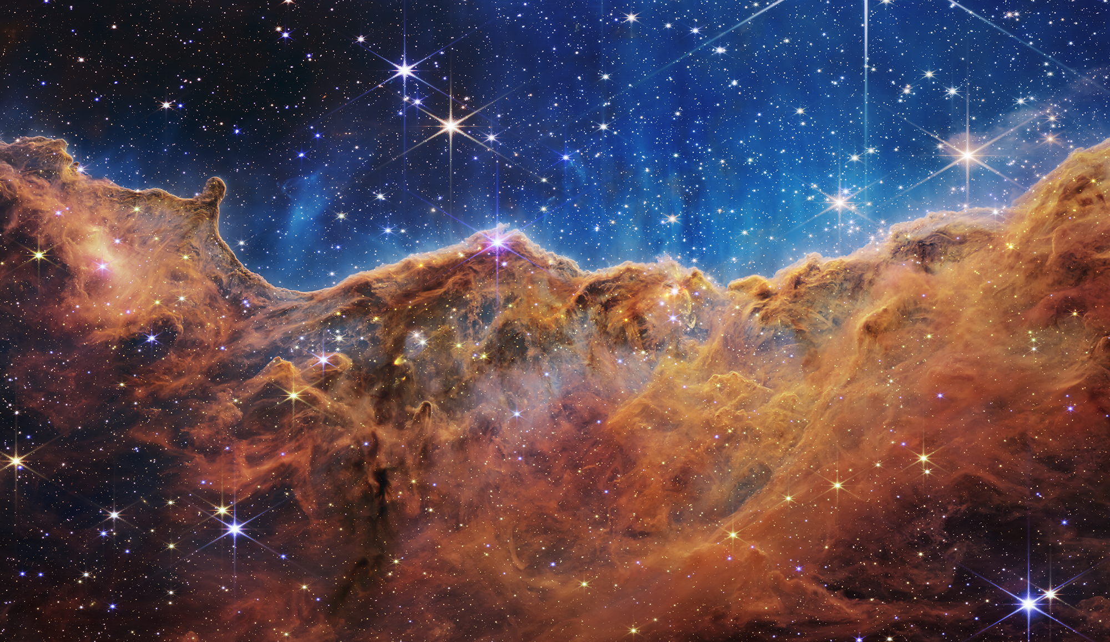
Thank you
for
your attention!
Contacts:
givitale@unisa.it
giuseppef.vitale@gmail.com

