Slide 1
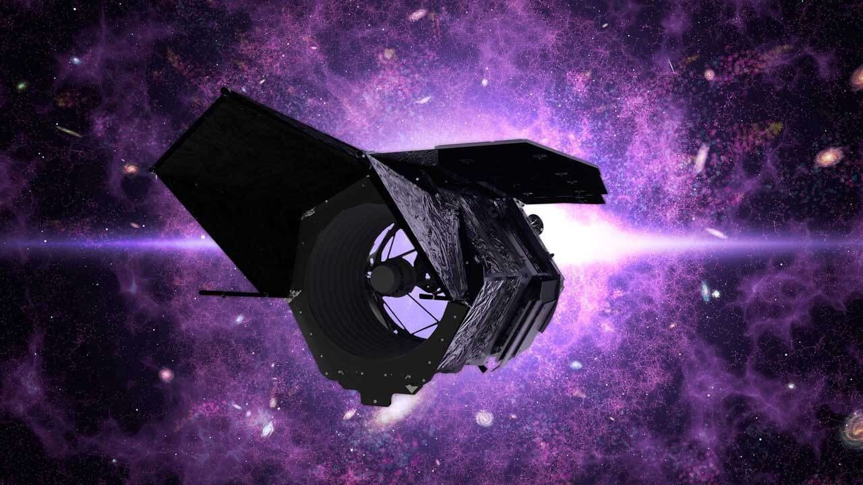
The Roman Galactic Exoplanet Survey: expanding our vision on extrasolar planets
Valerio Bozza
University of Salerno, Italy

Slide 2
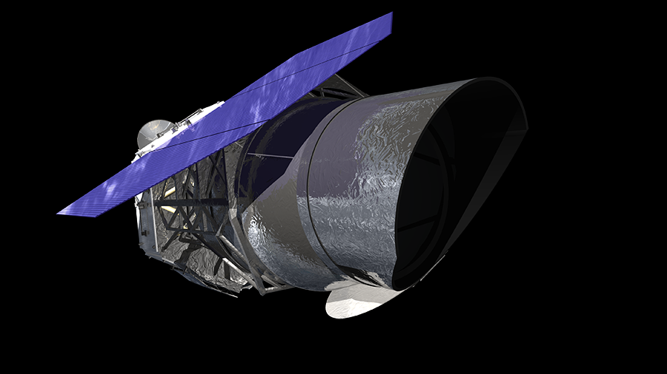
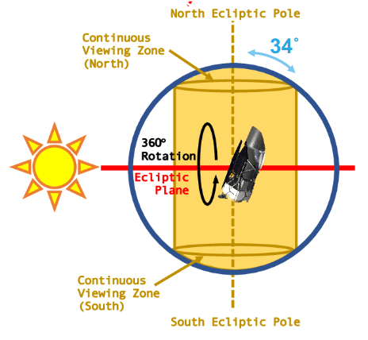
Nancy Grace Roman Telescope
Telescope: 2.4m aperture
Wide Field Instrument
  Vis/Near IR (0.48 – 2.3 micron)
  Field of view 0.281 deg² (~200× HST WFC3-IR)
Coronagraph
  FoV: 0.14’’ - 0.45’’ at λ=573.8nm.
Orbit: Sun-Earth L2
Launch: October 2026!
Science goals:
Dark Energy
Dark Matter
Exoplanets
Core Community surveys:
Galactic Bulge Time-Domain survey
High-Latitude Time-Domain survey
High-Latitude Wide-Area survey
https://roman.gsfc.nasa.gov/

Slide 3
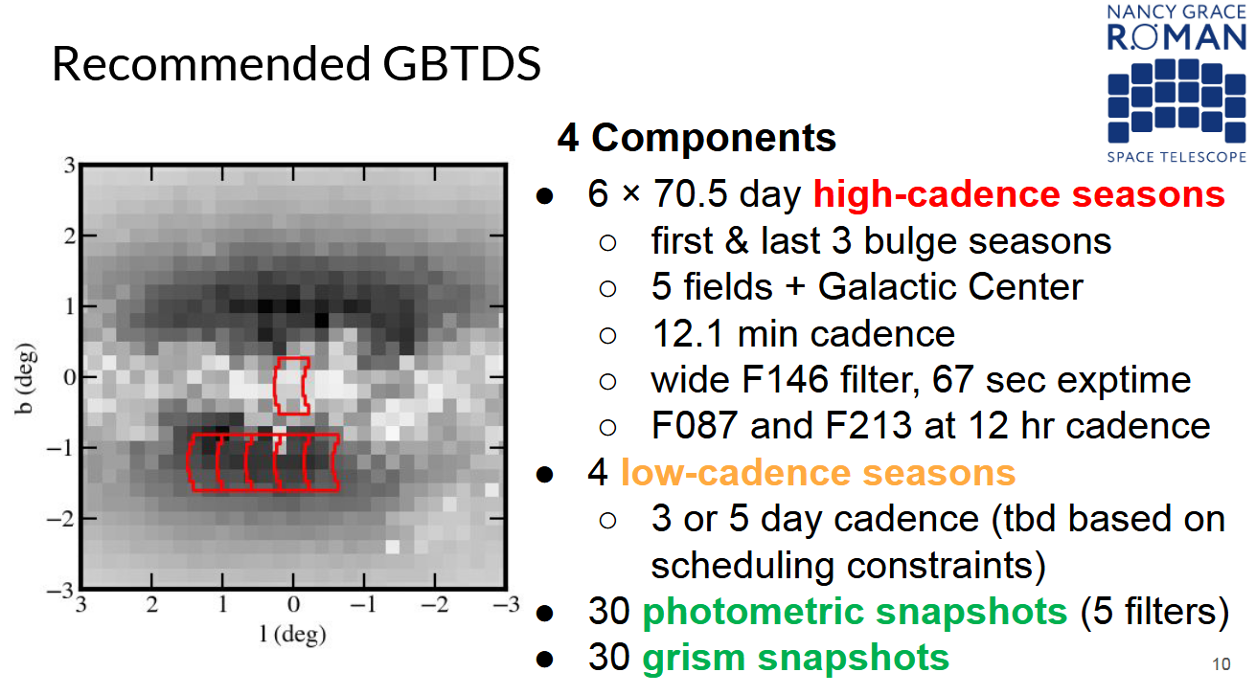
Galactic Bulge Time Domain Survey

Slide 4
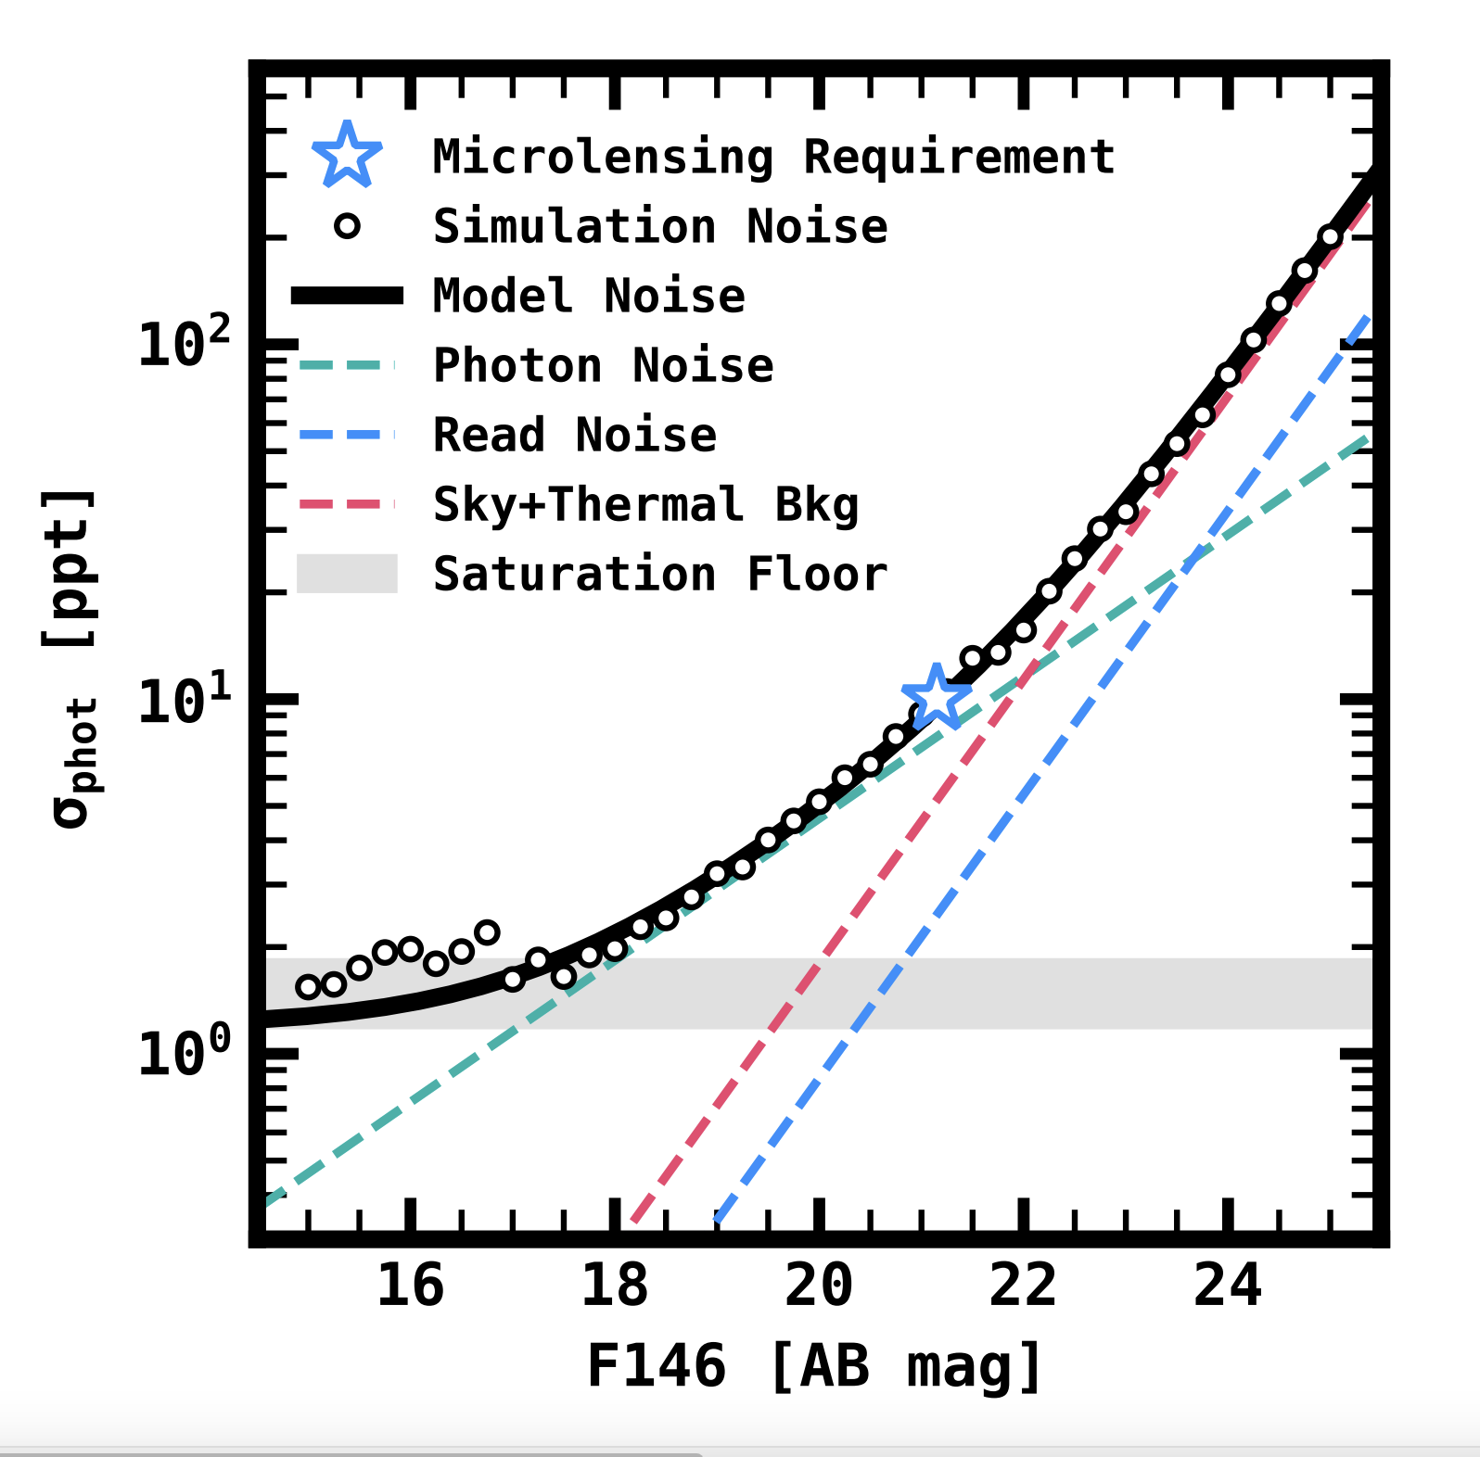
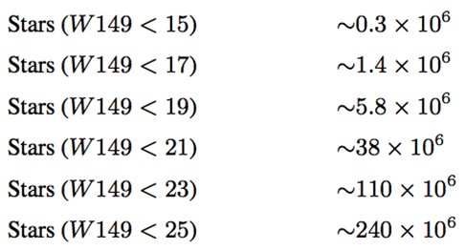
Galactic Bulge Time Domain Survey
40,000 epochs!

Slide 5
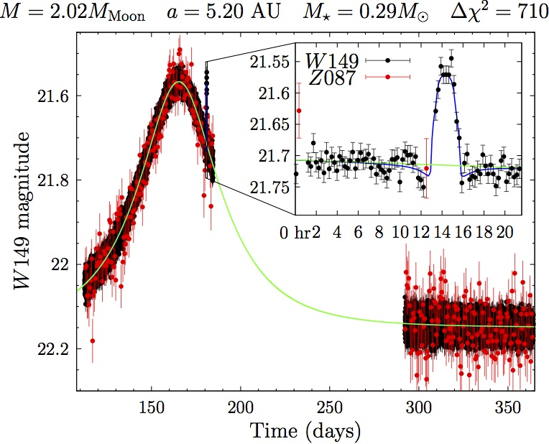
Microlensing with Roman
30,000 microlensing events expected!
Planets as small as 10% Mars
Preliminary!
Wide-orbit planets
Outer habitable zone planets

Slide 6
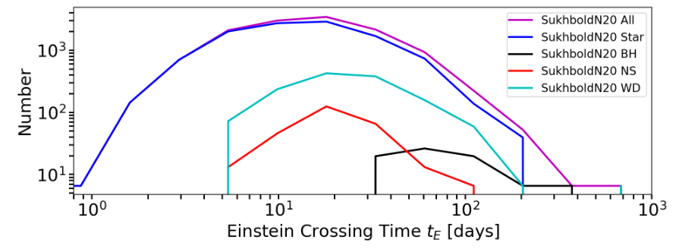
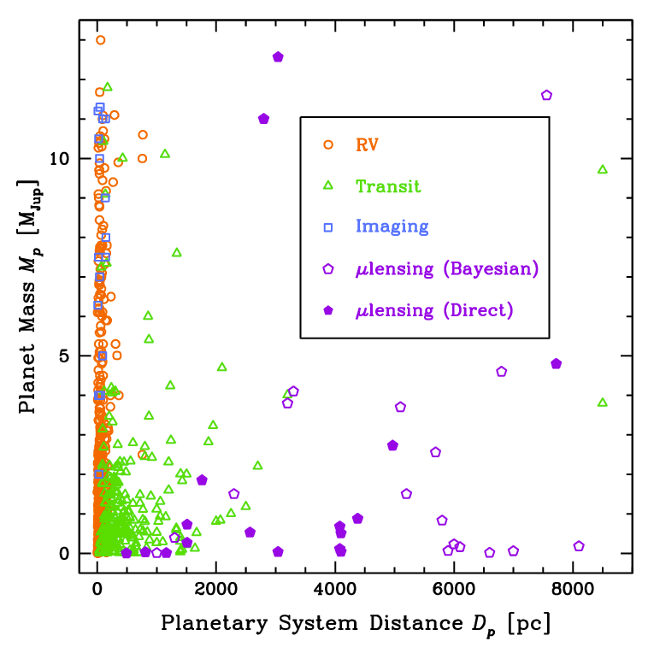
Microlensing with Roman
Hosts: FGKM stars, BD, WD, NS, BH: no need for lens light!
(Rose et al. 2022)
Distribution from disk to bulge
Are planets less common in the bulge?
Are there any dependencies on stellar population?

Slide 7
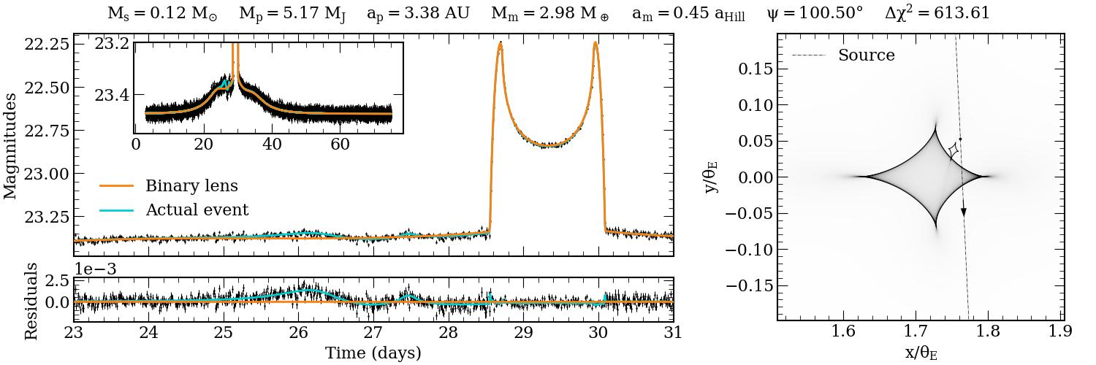
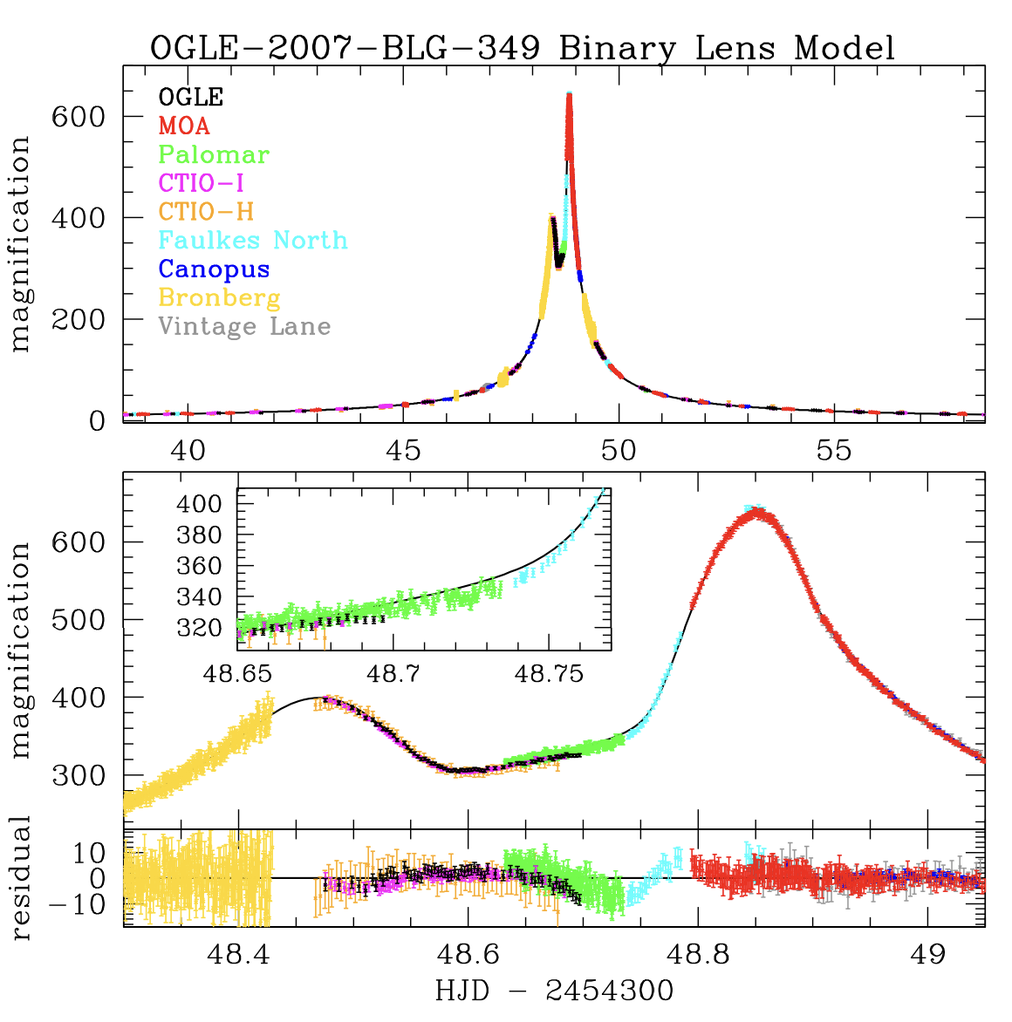
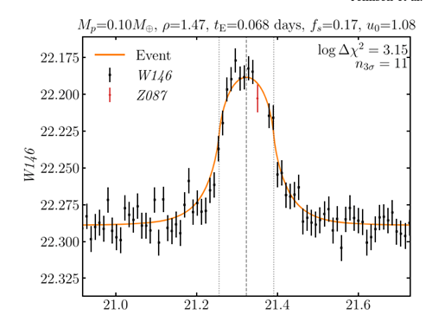
Microlensing with Roman
Multi-planet systems
Solar System Analogs
Circumbinary planets
Exomoons
Free-floating planets > Pluto mass

Slide 8
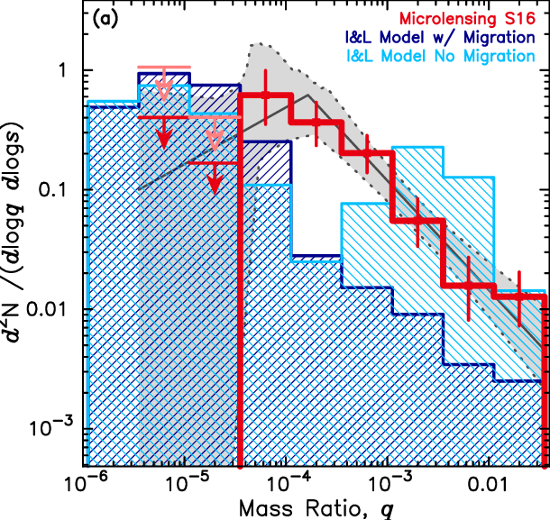
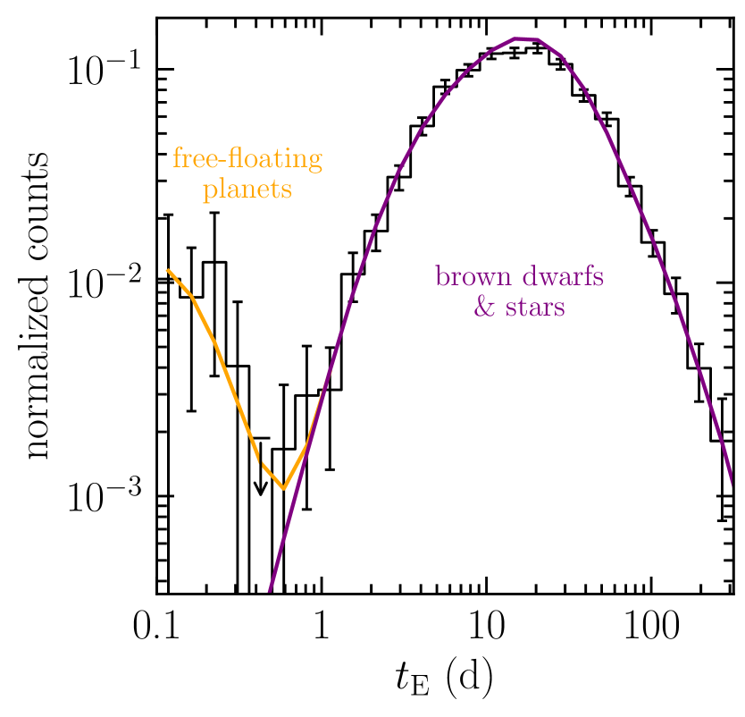
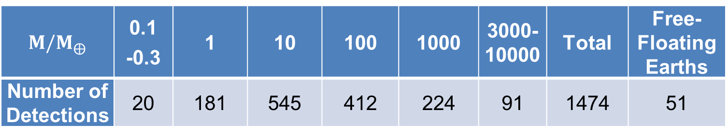
Planet yields
$M/M_{⨁}$ | 0.1 -0.3 | 1 | 10 | 100 | 1000 | 3000-10000 | Total | Free-Floating Earths
Number of Detections | 20 | 181 | 545 | 412 | 224 | 91 | 1474 | 51
Numbers based on existing mass functions (Penny et al. 2019)
(Suzuki et al. 2016)
(Mroz et al. 2020)

Slide 9
Planet yields
$M/M_{⨁}$ | 0.1 -0.3 | 1 | 10 | 100 | 1000 | 3000-10000 | Total | Free-Floating Earths
Number of Detections | 20 | 181 | 545 | 412 | 224 | 91 | 1474 | 51
Numbers based on existing mass functions (Penny et al. 2019)
Bonus: 100,000 transiting planets! (Wilson et al. 2023)

Slide 10
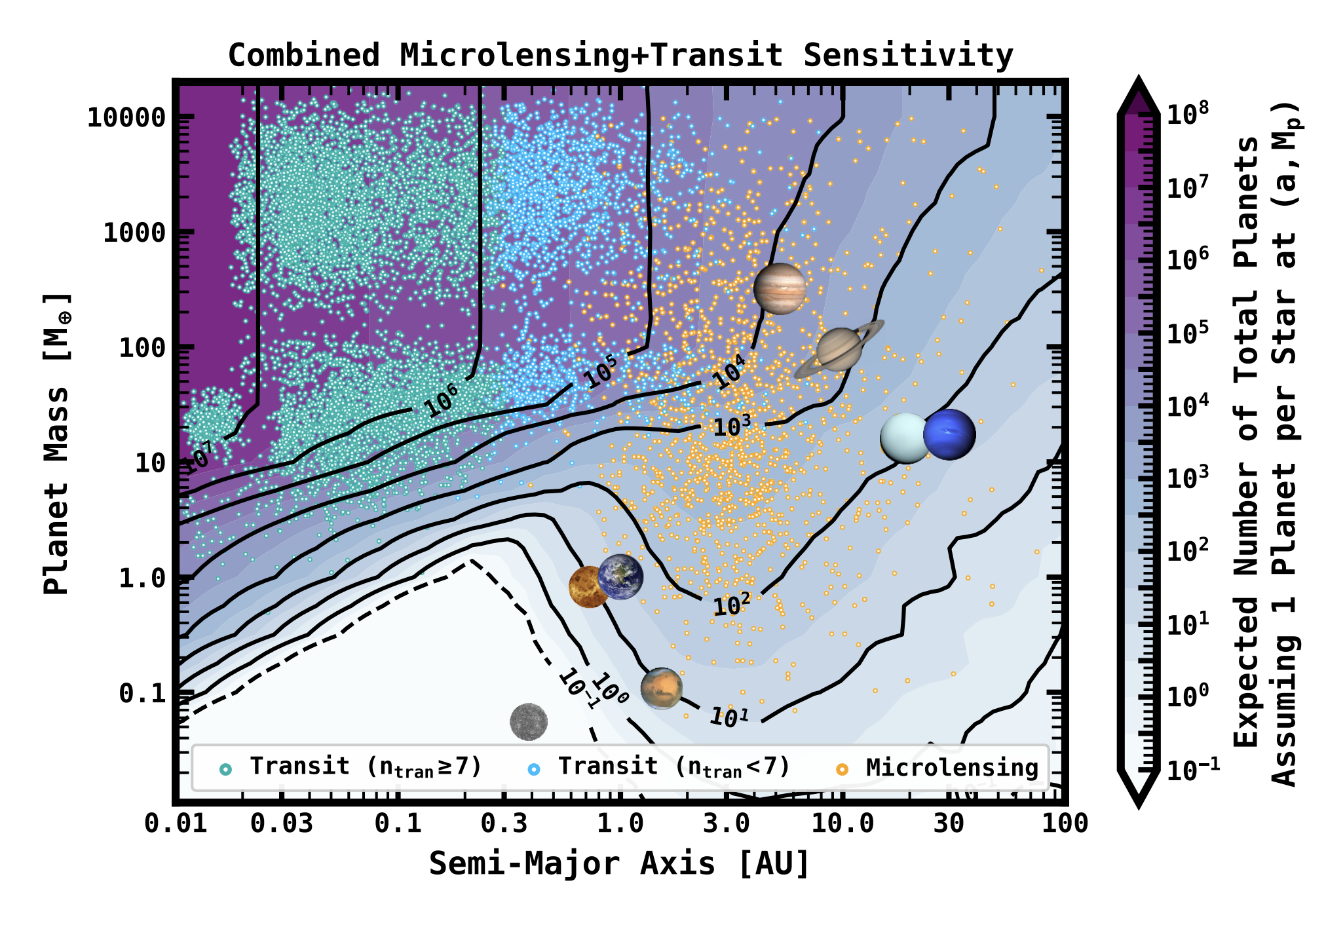
Impact on exoplanetary science
Wilson et al. 2023

Slide 11
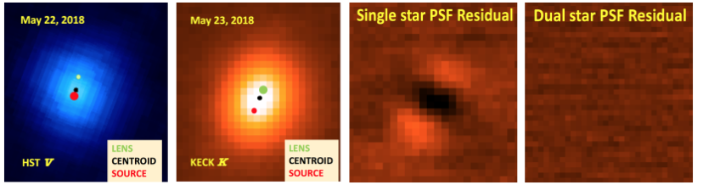
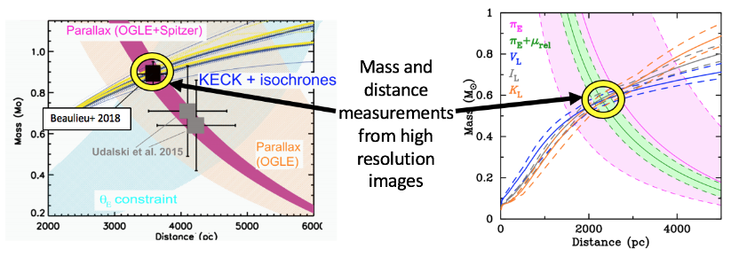
Lens-Flux detection
Lens and source are separate after a few years.
Lens-Mass degeneracy will be broken for a sizeable fraction of microlensing events (Bhattacharya et al. 2020).

Slide 12
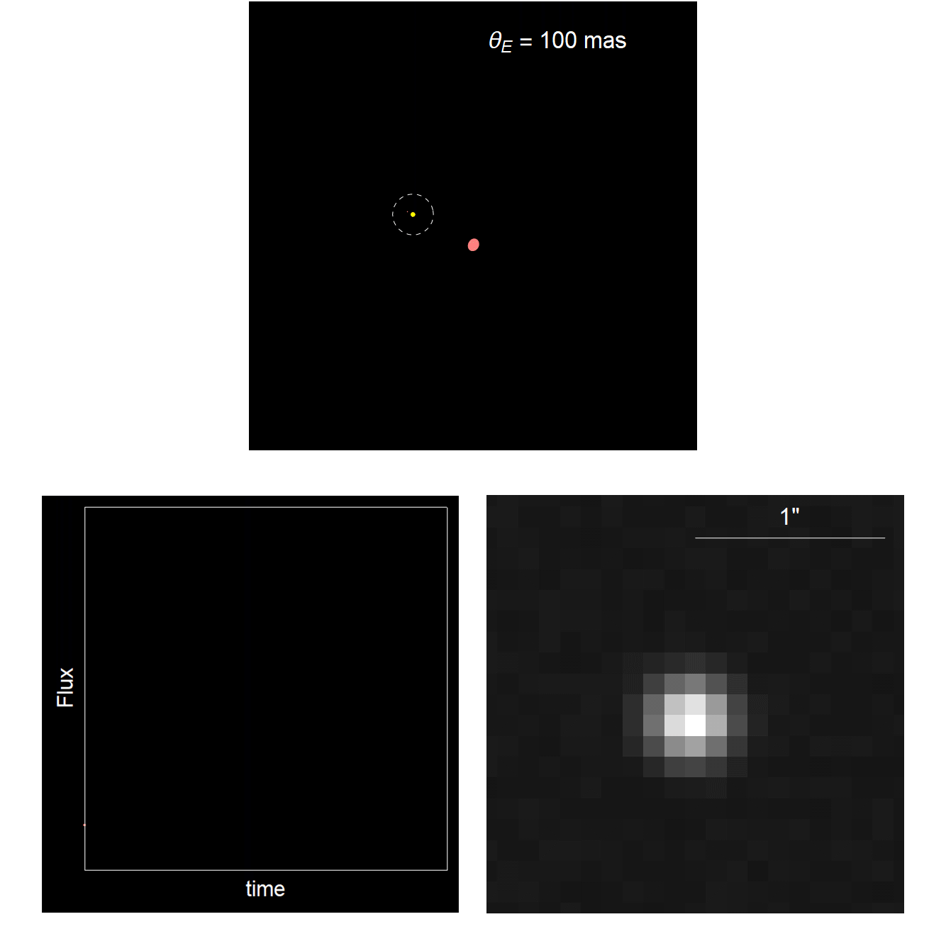
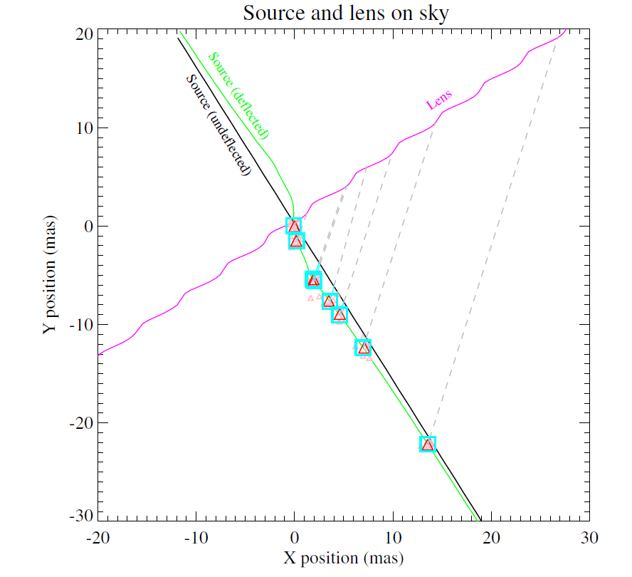
Astrometric centroid
During the microlensing event the centroid of the source is shifted.
The astrometric shift provides an alternative way to measure the Einstein angle (Sahu, …, VB et al. 2022).

Slide 13
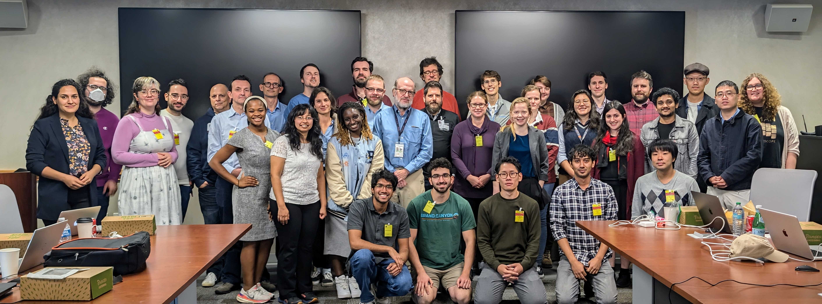
RGES-Project Infrastructure Team
Andrea Bellini
Sebastiano Calchi Novati
rges-pit.org
Vito Saggese
VB
PI: Scott Gaudi, Deputy PI: David Bennett Currently 71 members and 12 working groups!
WG #1: Leadership and Project Management
S. Gaudi, C. Brandon
WG #2: Outreach, and Community engagement
K. Stassun
WG #3: Event Modeling
D. Bennett, V. Bozza
WG #4: Lens Flux Analysis
A. Bhattacharya
WG #5: Event and Anomaly Detection
W. Zang
WG #6: Variable Stars
A. Stephan, R. Street
WG #7: Survey Simulations and Pipeline Validation
M. Penny
WG #8: Contemp. and Precursor Observations
C. Beichman, S. Terry
WG #9: Data Challenges, Citizen Science
A. Crisp, R. Street
WG #10: Microlensing Mini-Courses
A. Crisp, A. Malpas, K. Stassun, A. Stephan
WG #11: Free Floating Planets
W. DeRocco
WG #12: Efficiency and Occurrence Rate Analysis
J. Christiansen

Slide 14
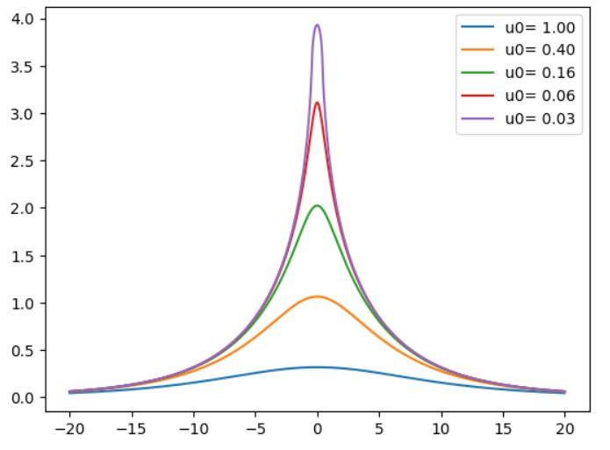
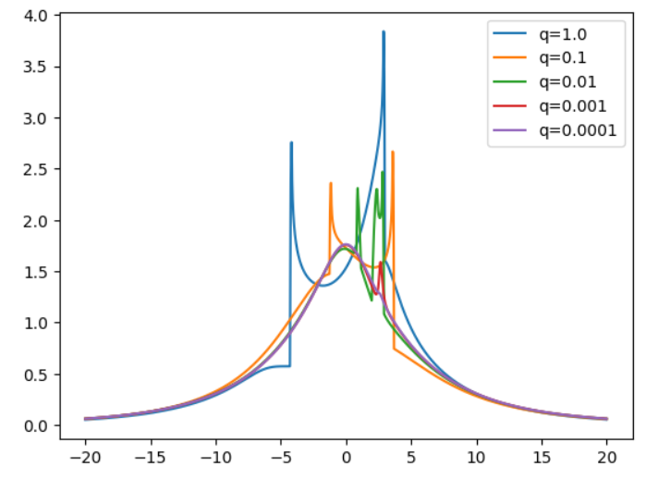
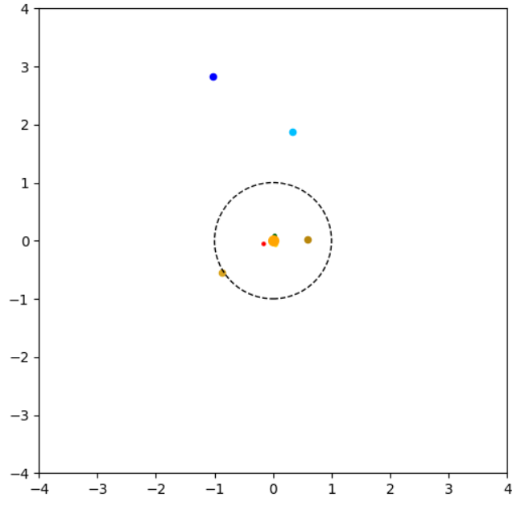
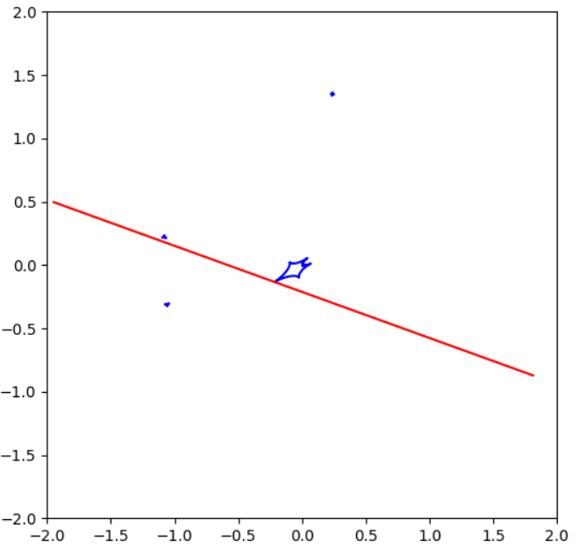
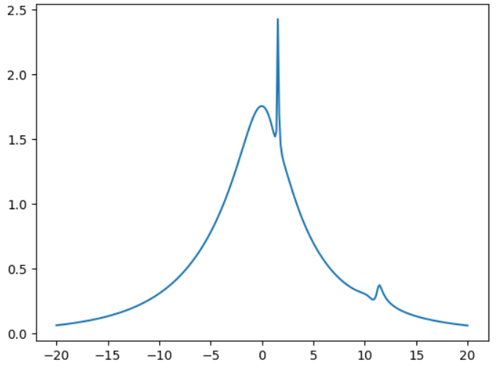
Accurate computations in Microlensing
Our group develops VBMicrolensing for accurate computations in microlensing
(VB, Saggese, Covone, Rota, Zhang, A&A 694, 219 (2025)).
Single-lens
Binary/planetary-lens
Multiple-lens
Officially adopted by RGES-PIT and by all existing microlensing modeling platforms (pyLIMA, MulensModel, muLAN)

Slide 15
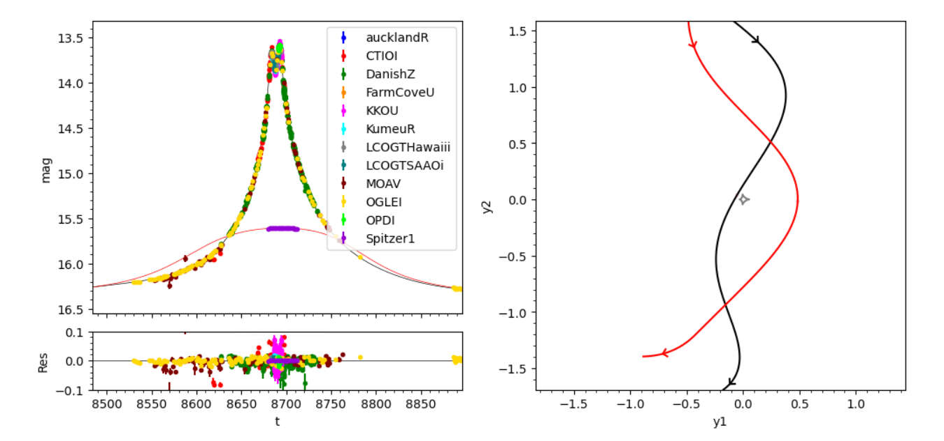
Microlensing modeling
Our software RTModel (VB, A&A 688 (2024) 83) is at the base of the modeling pipeline in Roman.
Python Packages (with modules in C++) are publicly available
  github.com/valboz/VBMicrolensing
  github.com/valboz/RTModel

Slide 16
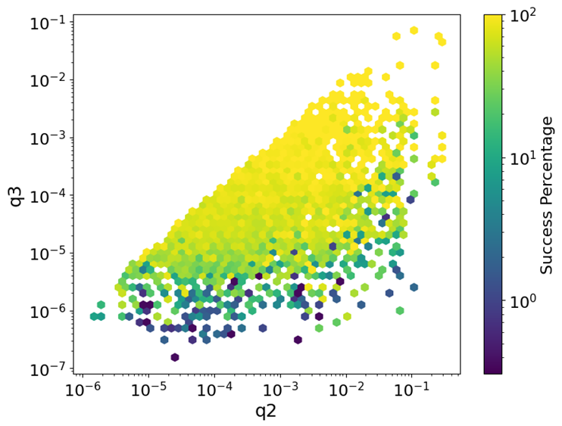
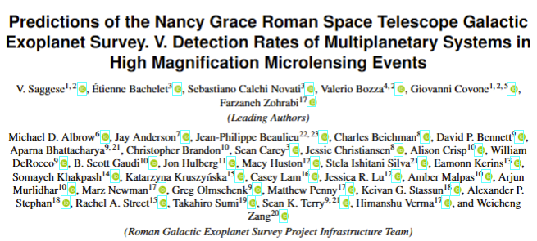
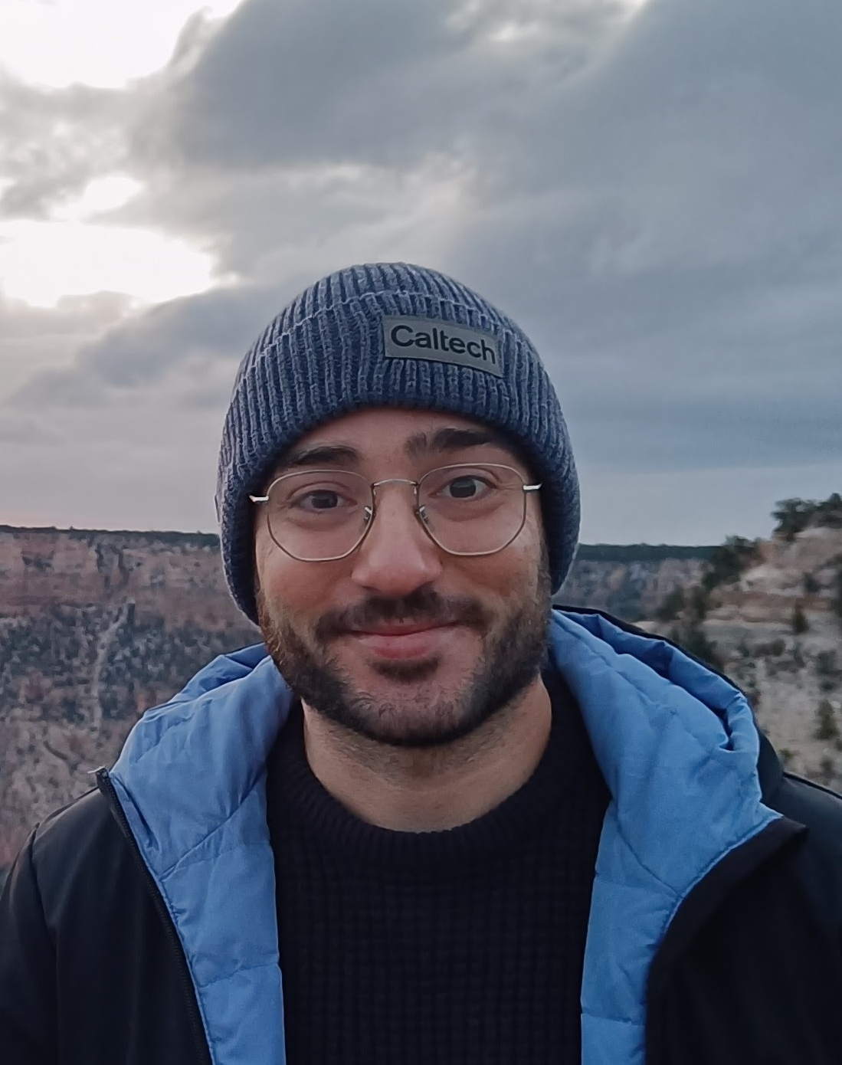
Multiplanetary systems in Roman
Will Roman detect multiplanetary systems?
Using ~1.3 million simulated light curves, we found a detection efficiency of 66% for triple-lens systems.
Detection probability strongly depends on:
  Planetary mass ratios (q ≳ 10⁻³ → nearly 100% efficiency)
  Resonant configurations
Estimated yield: ~64 triple-lens detections over the full Roman survey (~4.5% of planetary events).

Slide 17
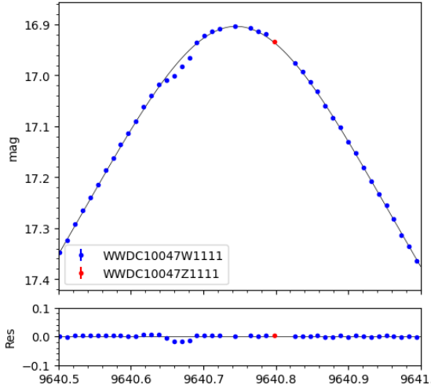
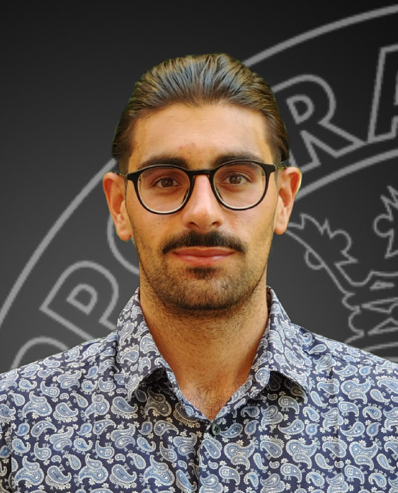
Algorithms for triple-lens fitting
We can easily identify an “anomaly” on a given model as the sequence of consecutive points deviating on the same side with the highest cumulative residual.
Such anomaly can be used to set planetary initial conditions.
It can also be used to seed additional planets to explain anomalies on binary/planetary models.
Work in progress with PhD Antonio Consiglio

Slide 18
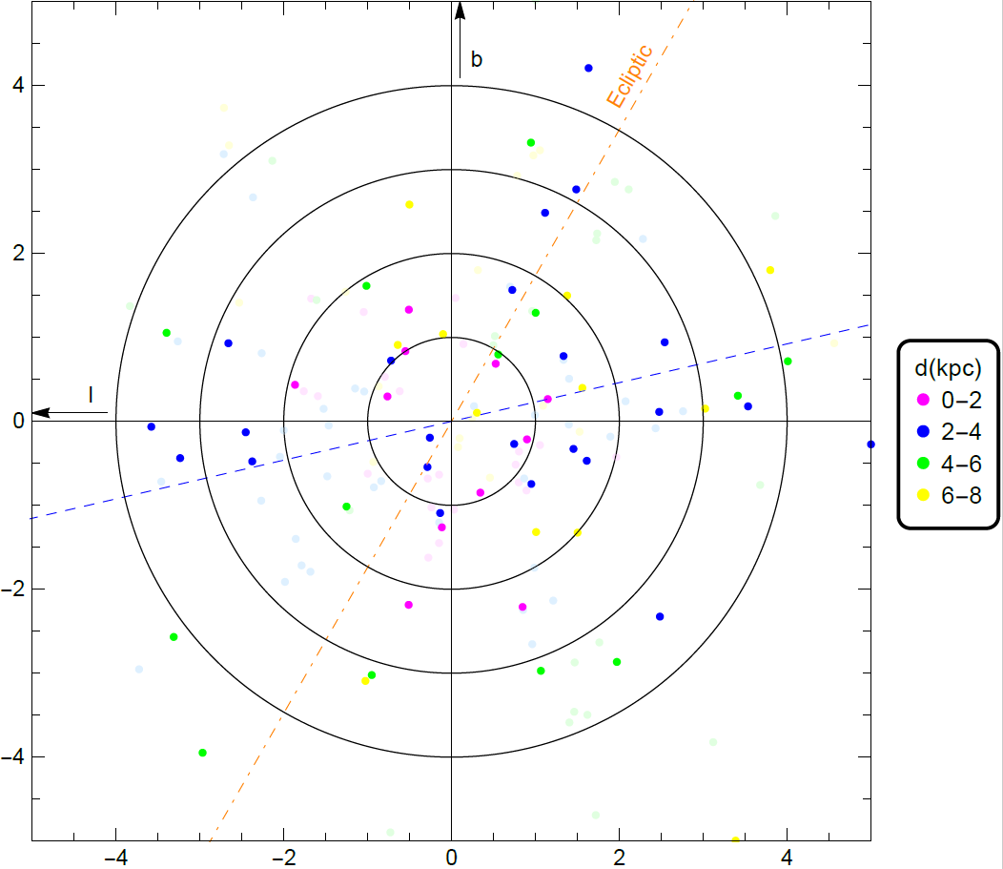
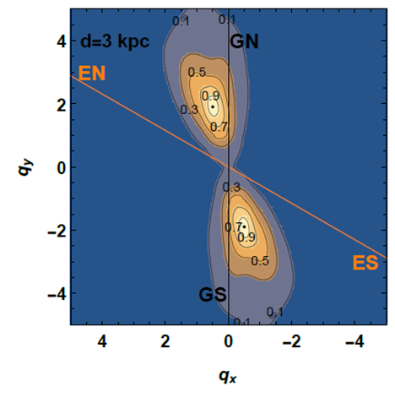
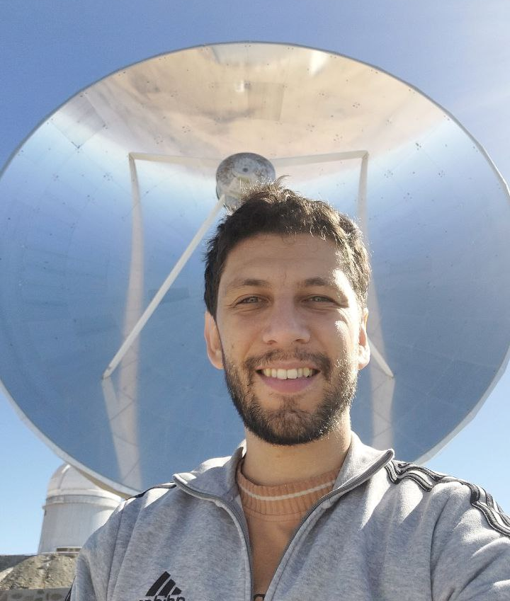
Distribution of orbital planes
Are planets randomly oriented in the sky?
Microlensing planets seem to prefer some alignment with the Galactic plane.
1au
2au
3au
4au
We proved that such alignment is 8 times more likely than a random distribution for planets in the Scutum-Centaurus arm
(VB, P. Rota arXiv:2507.21309)

Slide 19
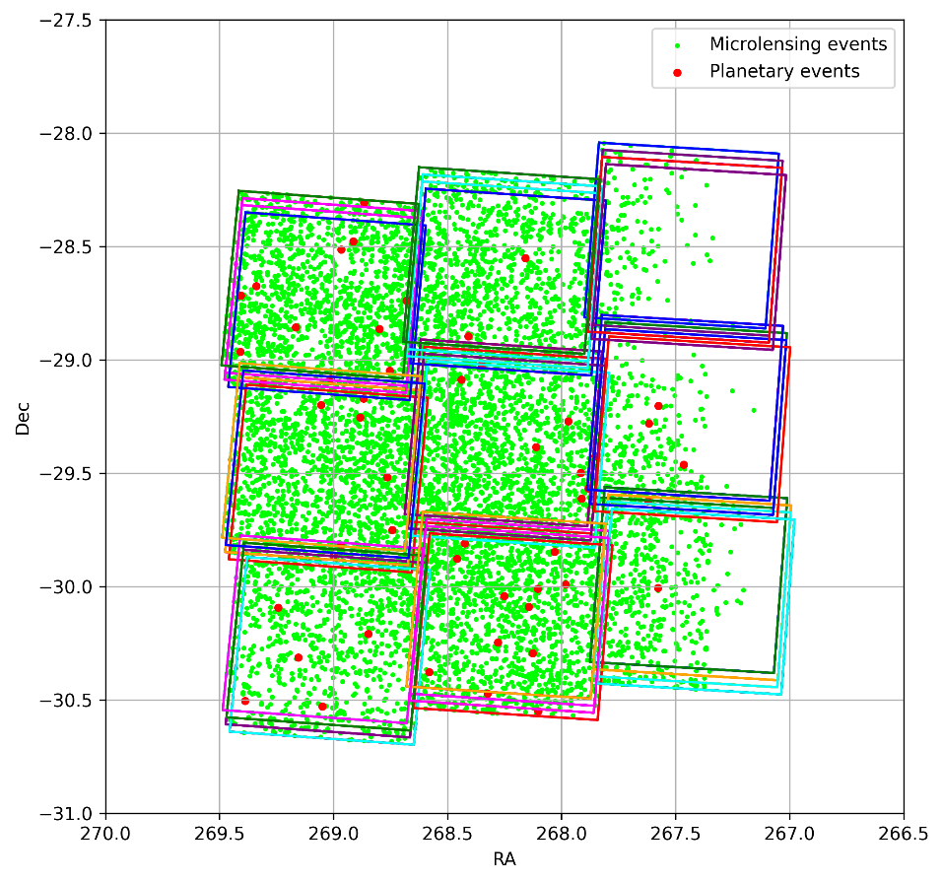
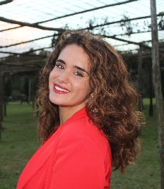
Historic events in Euclid
Euclid Galactic Bulge Survey:
a single snapshot of billion stars in the bulge of our Galaxy
More than 8000 historic microlensing events were discovered in the EGBS footprint, including 51 planetary events!
More than 350 historic events should be resolved by Euclid
Accurate mass determination for planets!
(VB, L. Salmeri, P. Rota, Euclid Science Working Group – Exoplanets, OGLE, MOA, arXiv:2511.03307).

Slide 20
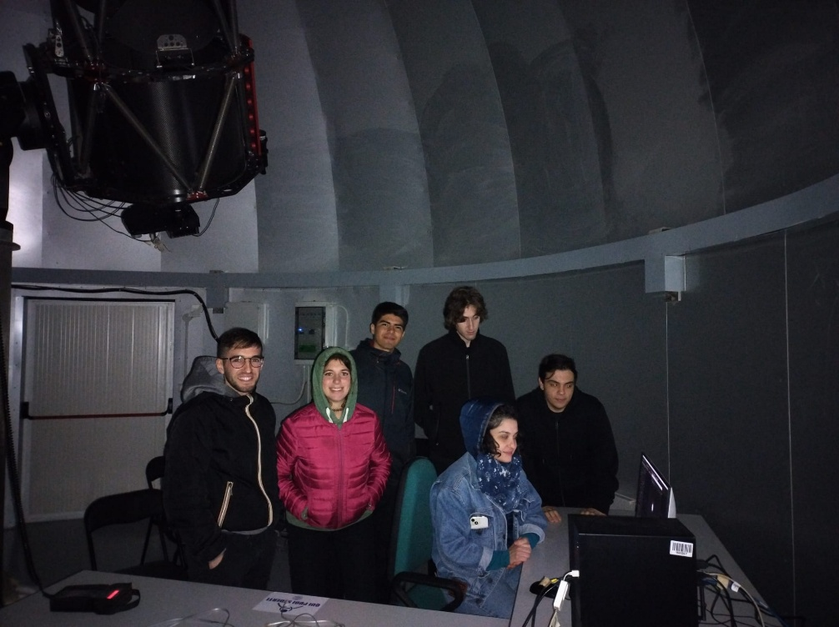
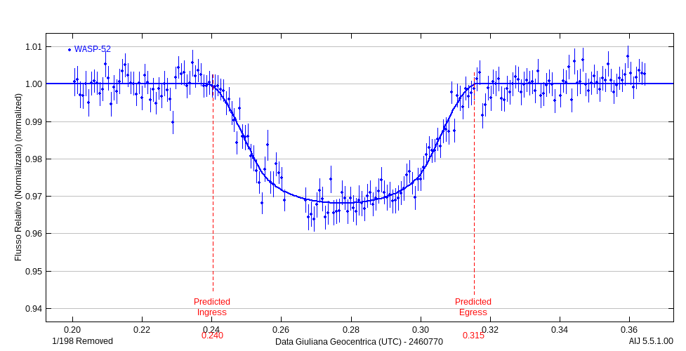
Astronomical Observatory at Salerno U.
The Astronomical Observatory is back!
6.5m dome on the roof of the Physics Department.
60cm Ritchey-Chrétien telescope
Finger Lakes CCD 2048x2048
Opportunities for follow-up of transiting candidates and other transients.
Transit of WASP-52b observed by Master students on 5/11/2025

Slide 21
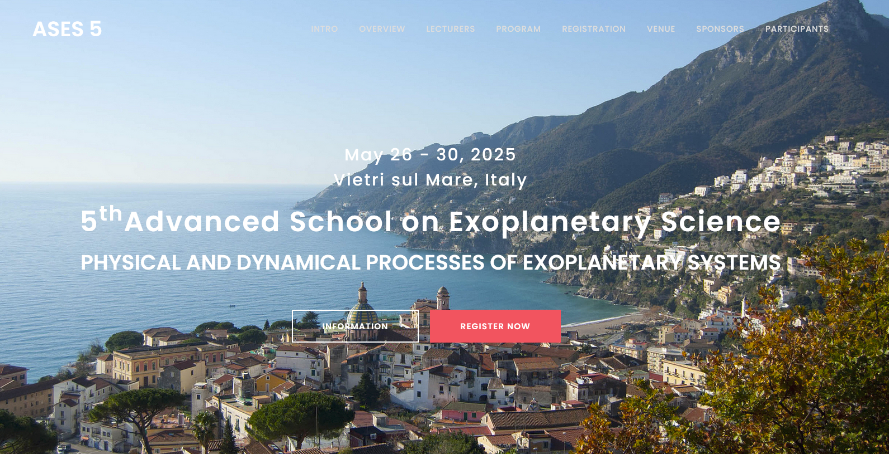
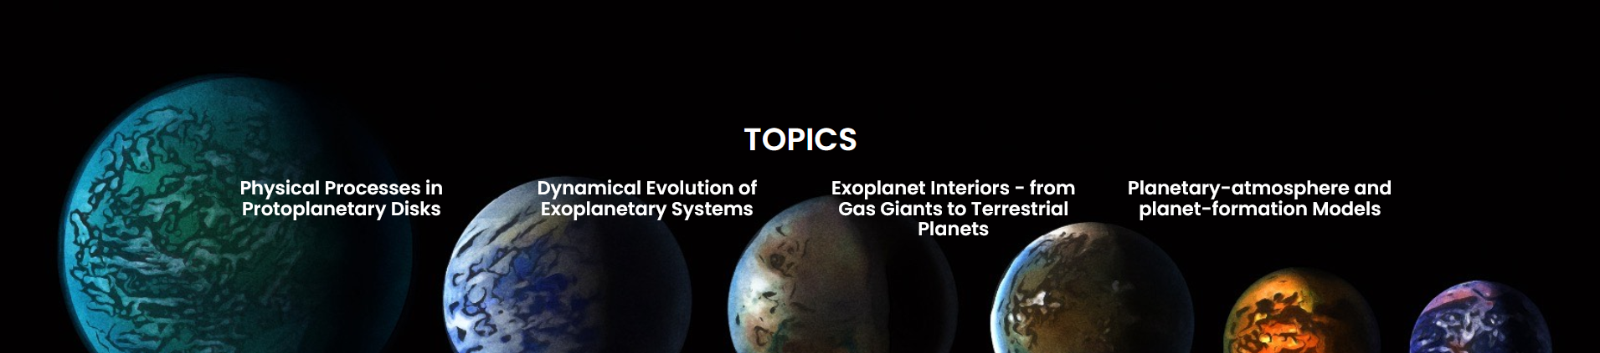

Slide 22
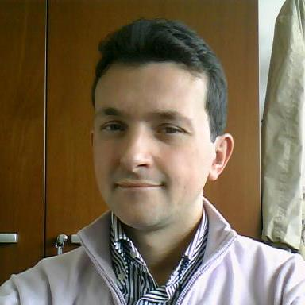
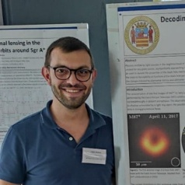
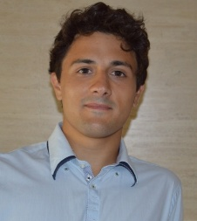
Exoplanets+BH group in Salerno
Microlensing computation code
Vito Saggese
Paolo Rota
VB
(Ass. Prof.)
Paolo Rota
(Post-Doc)
Microlensing modeling code
Antonio Consiglio
Paolo Rota, Vito Saggese
Microlensing astrophysics
Paolo Rota
Vito Saggese
Fabio Aratore (PhD)
Vito Saggese
(PhD, Naples)
Fabiano Feleppa (PhD)
Microlensing with Euclid
Paolo Rota
Laura Salmeri -> POSTER!
Transit observations
Paolo Rota
Antonio Consiglio
(PhD)
Laura Salmeri (PhD, Naples)
Black holes
Fabio Aratore
Fabiano Feleppa
Collaborations: Roman, Euclid, OMEGA, MiNDSTEp, TESS, Gaia, BHTOM, Einstein Tel.

Slide 23
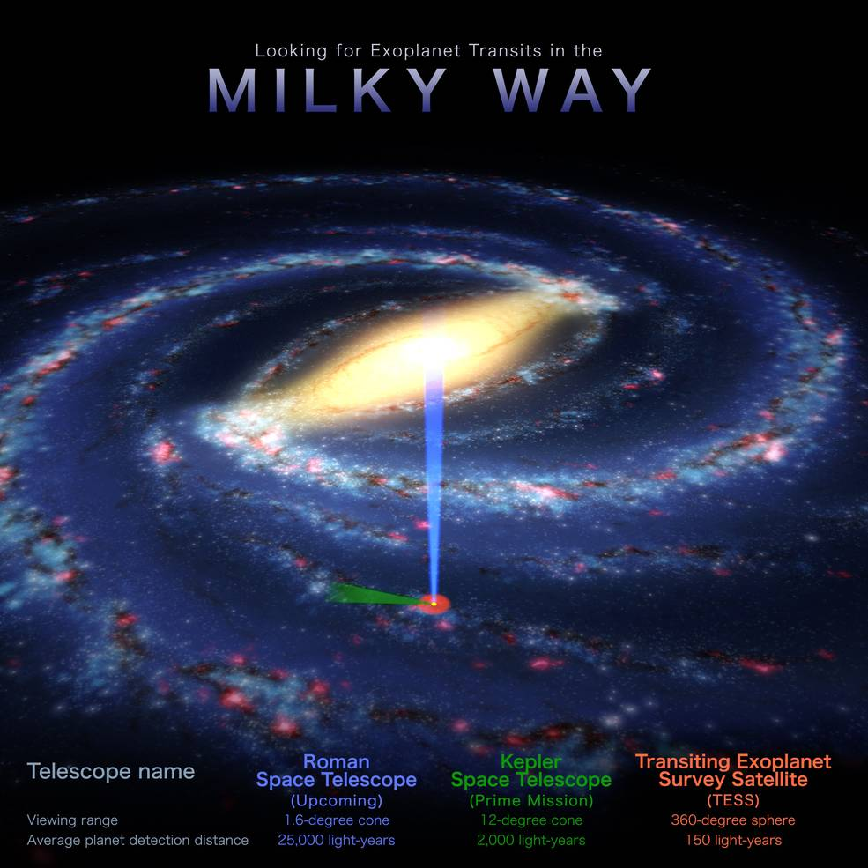
Conclusions
Roman will find 100,000 transiting planets and 1500 microlensing planets
Revolutionize our knowledge of planetary systems beyond the snow line
Quantify the number of free-floating planets
Precise mass measurements by
  Lens-source resolution
  Astrometric shift
  Parallax
Italian contributions on:
  Computation code
  Modeling code
  Simulations, astrophysics

