Slide 1


Pre-geometric Gravity and Emergent Cosmology
Giuseppe Meluccio giuseppe.meluccio-ssm@unina.it
Catania, 13/11/2025
Scuola Superiore Meridionale (SSM), Napoli, Italy
Istituto Nazionale di Fisica Nucleare (INFN), Sezione di Napoli, Italy

Slide 2
Pre-geometric gravity as a theory of quantum gravity
an alternative approach based on gauge theory and emergent metric structure with implications for cosmology

Slide 3
References
Addazi, Capozziello, Marcianò & Meluccio (2025) 10.1088/1361-6382/ada767
Addazi, Capozziello, Marcianò & Meluccio (2025) 10.1103/v5wg-sy4w
Meluccio (2025) 10.1103/kysy-z41p
MacDowell & Mansouri (1977) 10.1103/PhysRevLett.38.739
Pagels (1984) 10.1103/PhysRevD.29.1690
Wilczek (1998) 10.1103/PhysRevLett.80.4851
Wise (2010) 10.1088/0264-9381/27/15/155010
Randono (2010) arXiv:1010.5822
Tresguerres (2008) 10.1142/S0219887808002692
Mielke (2011) 10.1103/PhysRevD.83.044004
Westman & Zlosnik (2013) 10.1016/j.aop.2013.03.012

Slide 4

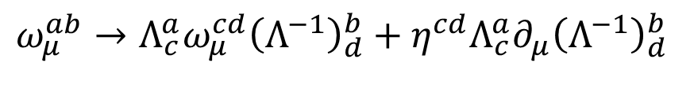
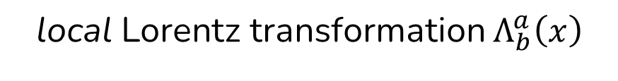
local Lorentz transformation $Λ_{b}^{a}\left(x\right)$
$$ω_{μ}^{ab}→Λ_{c}^{a}ω_{μ}^{cd}{\left(Λ^{−1}\right)}_{d}^{b}+η^{cd}Λ_{c}^{a}∂_{μ}{\left(Λ^{−1}\right)}_{d}^{b}$$
$$e_{μ}^{a}→Λ_{b}^{a}e_{μ}^{b}$$
gauge theory
metric structure
quantise gravity
gravitationalise the quantum

Slide 5

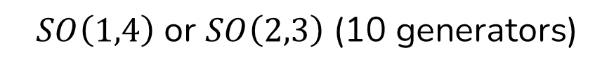


SSB
Higgs-like field $φ^{A}$
$$φ^{A}\underset{→}{SSB}vδ_{4}^{A}$$
$SO\left(1,4\right)$ or $SO\left(2,3\right)$ (10 generators)
$SO\left(1,3\right)$ (6 generators)
SSB

Slide 6







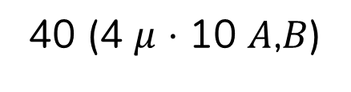
SSB
$$φ^{A}\underset{→}{SSB}vδ_{4}^{A}$$
Higgs-like field $φ^{A}$
40 (4 $μ$ $⋅$ 10 $A$,$B$)
gauge field $A_{μ}^{AB}$
$A_{μ}^{ab}≡ω_{μ}^{ab}$ spin connection
$m^{−1}A_{μ}^{a4}≡e_{μ}^{a}$ tetrads
24 (4 $μ$ $⋅$ 6 $a$,$b$)
16 (4 $μ$ $⋅$ 4 $a$)

Slide 7


$$A_{μ}^{AB}, φ^{A}$$
$$g_{μν}, e_{μ}^{a}, ω_{μ}^{ab}$$
gauge theory
metric structure
SSB
gravitationalise the quantum

Slide 8


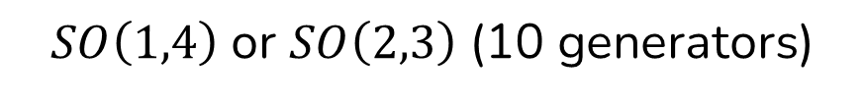
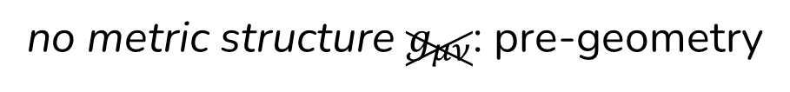


SSB
internal-space generalised Minkowski metric $η_{AB}$
tangent-space Minkowski metric $η_{ab}$
$SO\left(1,4\right)$ or $SO\left(2,3\right)$ (10 generators)
$SO\left(1,3\right)$ (6 generators)
Einstein equivalence principle
no metric structure $g_{μν}$: pre-geometry
Levi-Civita symbol $ε^{μνρσ}$

Slide 9
Assumptions
4D spacetime
principle of general covariance
$ℒ_{EH}$ and EEP after SSB
only $A_{μ}^{AB}$ and $φ^{A}$ before SSB
polynomiality in $A_{μ}^{AB}$ and $φ^{A}$ and their derivatives

Slide 10
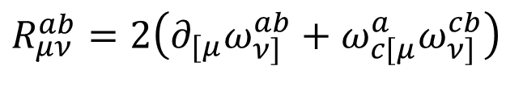
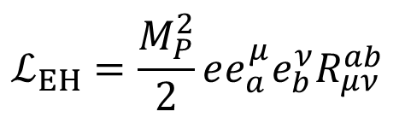

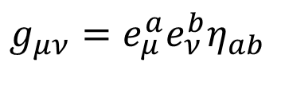
Classical gravity
$$R_{μν}^{ab}=2\left(∂_{[μ}ω_{ν]}^{ab}+ω_{c[μ}^{a}ω_{ν]}^{cb}\right)$$
$$ℒ_{EH}=\frac{M_{P}^{2}}{2}ee_{a}^{μ}e_{b}^{ν}R_{μν}^{ab}$$
$$g_{μν}=e_{μ}^{a}e_{ν}^{b}η_{ab}$$
$$e≡\det{e_{μ}^{a}}$$
$$𝒢=R^{2}−4R_{μν}R^{μν}+R_{μνρσ}R^{μνρσ}=\left(e_{a}^{μ}e_{b}^{ν}e_{c}^{ρ}e_{d}^{σ}−4e_{a}^{μ}e_{d}^{ν}e_{c}^{ρ}e_{b}^{σ}+e_{c}^{μ}e_{d}^{ν}e_{a}^{ρ}e_{b}^{σ}\right)R_{μν}^{ab}R_{ρσ}^{cd}$$

Slide 11








Two possible Lagrangians
$$ℒ_{W}=k_{W}ε_{ABCDE}ε^{μνρσ}F_{μν}^{AB}∇_{ρ}φ^{C}∇_{σ}φ^{D}φ^{E}$$
$$ℒ_{MM}=k_{MM}ε_{ABCDE}ε^{μνρσ}F_{μν}^{AB}F_{ρσ}^{CD}φ^{E}$$
$$ℒ_{W}\underset{→}{SSB}ℒ_{EH}−M_{P}^{2}Λe$$
$$ℒ_{MM}\underset{→}{SSB}ℒ_{EH}−M_{P}^{2}Λe+λe𝒢$$
$$M_{P}^{2}≡±32k_{MM}vm^{2}$$
$$Λ≡±3m^{2}=\frac{3M_{P}^{2}}{32k_{MM}v}$$
$$λ≡−4k_{MM}v$$
$$M_{P}^{2}≡−8k_{W}v^{3}m^{2}$$
$$Λ≡±6m^{2}=∓\frac{3M_{P}^{2}}{4k_{W}v^{3}}$$
$$k_{W}∼−1 {\left[φ\right]}^{−3}⇒v∼{10}^{40} \left[φ\right]$$
$$k_{MM}∼±1 {\left[φ\right]}^{−1}⇒v∼{10}^{119} \left[φ\right]$$

Slide 12
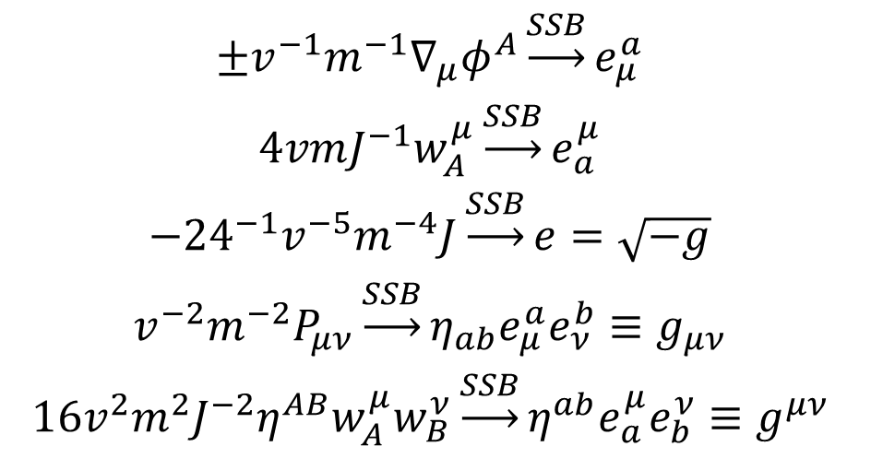
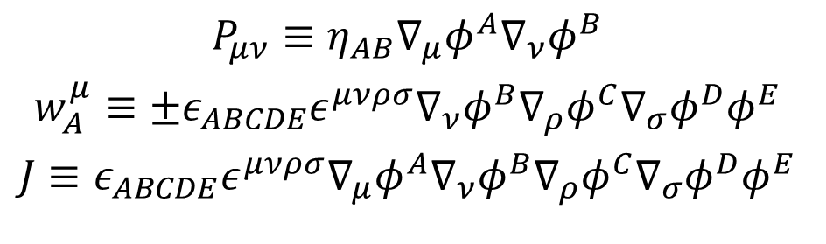
A dictionary for emergent gravity
effective geometric quantities
$$±v^{−1}m^{−1}∇_{μ}φ^{A}\underset{→}{SSB}e_{μ}^{a}$$
$$4vmJ^{−1}w_{A}^{μ}\underset{→}{SSB}e_{a}^{μ}$$
$$−{24}^{−1}v^{−5}m^{−4}J\underset{→}{SSB}e=\sqrt{−g}$$
$$v^{−2}m^{−2}P_{μν}\underset{→}{SSB}η_{ab}e_{μ}^{a}e_{ν}^{b}≡g_{μν}$$
$$16v^{2}m^{2}J^{−2}η^{AB}w_{A}^{μ}w_{B}^{ν}\underset{→}{SSB}η^{ab}e_{a}^{μ}e_{b}^{ν}≡g^{μν}$$
embedding of the Standard Model
auxiliary fields
$$P_{μν}≡η_{AB}∇_{μ}φ^{A}∇_{ν}φ^{B}$$
$$w_{A}^{μ}≡±ε_{ABCDE}ε^{μνρσ}∇_{ν}φ^{B}∇_{ρ}φ^{C}∇_{σ}φ^{D}φ^{E}$$
$$J≡ε_{ABCDE}ε^{μνρσ}∇_{μ}φ^{A}∇_{ν}φ^{B}∇_{ρ}φ^{C}∇_{σ}φ^{D}φ^{E}$$

Slide 13


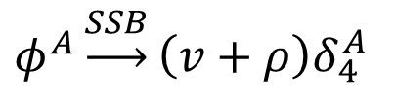
Spontaneous symmetry breaking
symmetry-breaking potential
unitary gauge
$$ℒ_{SSB}=−k_{SSB}v^{−4}\left|J\right|{\left(η_{AB}φ^{A}φ^{B}∓v^{2}\right)}^{2}$$
$$φ^{A}\underset{→}{SSB}\left(v+ρ\right)δ_{4}^{A}$$
$$φ^{A}=vδ_{4}^{A}$$

Slide 14
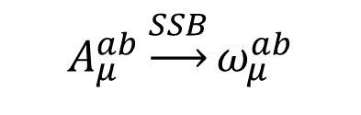
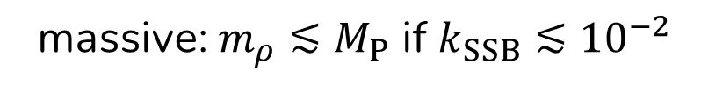
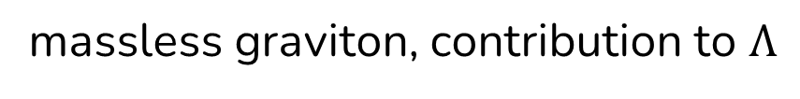
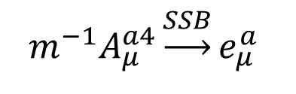
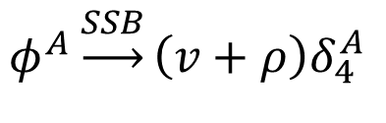
Gravitational Higgs mechanism
kinematics of the Higgs-like field
$$ℒ_{φ}=\frac{1}{3}v^{−3}J^{−1}w_{A}^{μ}w_{B}^{ν}η^{AB}η_{CD}∇_{μ}φ^{C}∇_{ν}φ^{D}\underset{→}{SSB}−\frac{1}{2}m^{2}\sqrt{−g}g^{μν}η_{AB}∇_{μ}φ^{A}∇_{ν}φ^{B}+…$$
$$A_{μ}^{ab}\underset{→}{SSB}ω_{μ}^{ab}$$
massless
$$m^{−1}A_{μ}^{a4}\underset{→}{SSB}e_{μ}^{a}$$
massless graviton, contribution to $Λ$
$$φ^{A}\underset{→}{SSB}\left(v+ρ\right)δ_{4}^{A}$$
massive: $m_{ρ}≲M_{P}$ if $k_{SSB}≲{10}^{−2}$

Slide 15
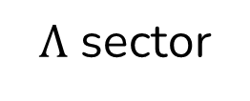
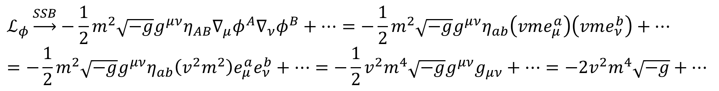
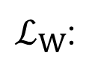
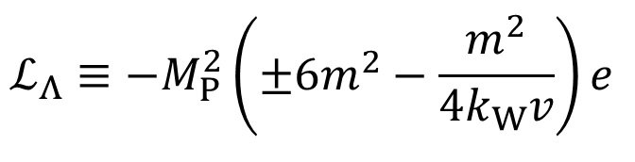
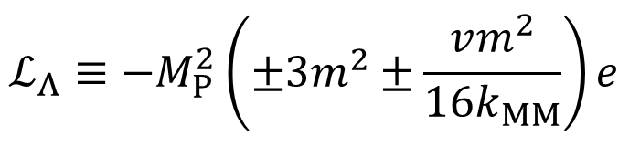
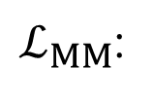
Gravitational Higgs mechanism
$Λ$ sector
$$ℒ_{Λ}≡−M_{P}^{2}\left(±6m^{2}−\frac{m^{2}}{4k_{W}v}\right)e$$
massless graviton
$ℒ_{W}$:
$$ℒ_{Λ}≡−M_{P}^{2}\left(±3m^{2}±\frac{vm^{2}}{16k_{MM}}\right)e$$
$ℒ_{MM}$:
$$ℒ_{φ}\underset{→}{SSB}−\frac{1}{2}m^{2}\sqrt{−g}g^{μν}η_{AB}∇_{μ}φ^{A}∇_{ν}φ^{B}+…=−\frac{1}{2}m^{2}\sqrt{−g}g^{μν}η_{ab}\left(vme_{μ}^{a}\right)\left(vme_{ν}^{b}\right)+…=−\frac{1}{2}m^{2}\sqrt{−g}g^{μν}η_{ab}\left(v^{2}m^{2}\right)e_{μ}^{a}e_{ν}^{b}+…=−\frac{1}{2}v^{2}m^{4}\sqrt{−g}g^{μν}g_{μν}+…=−2v^{2}m^{4}\sqrt{−g}+…$$

Slide 16
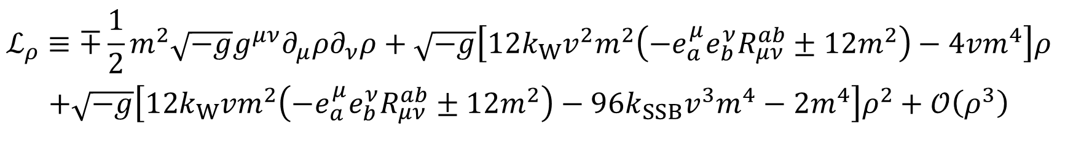
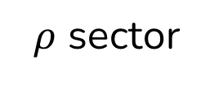


Gravitational Higgs mechanism
$$SO\left(1,4\right)$$
$$SO\left(2,3\right)$$
$ρ$ sector
$$ℒ_{ρ}≡∓\frac{1}{2}m^{2}\sqrt{−g}g^{μν}∂_{μ}ρ∂_{ν}ρ+\sqrt{−g}\left[12k_{W}v^{2}m^{2}\left(−e_{a}^{μ}e_{b}^{ν}R_{μν}^{ab}±12m^{2}\right)−4vm^{4}\right]ρ$$
$$+\sqrt{−g}\left[12k_{W}vm^{2}\left(−e_{a}^{μ}e_{b}^{ν}R_{μν}^{ab}±12m^{2}\right)−96k_{SSB}v^{3}m^{4}−2m^{4}\right]ρ^{2}+𝒪\left(ρ^{3}\right)$$
$$m_{ρ}^{2}=−24\frac{k_{SSB}}{k_{W}}M_{P}^{2}+\frac{36}{v^{2}}M_{P}^{2}+\frac{2}{3}Λ≈\left(1.43⋅{10}^{38}k_{SSB}+2.07⋅{10}^{−42}+2.83⋅{10}^{−84}\right) {GeV}^{2}$$
$m_{ρ}∼M_{P}$ for $k_{SSB}∼{10}^{−2}$ (or $k_{SSB}≪{10}^{116}$ and $v∼10$)

Slide 17
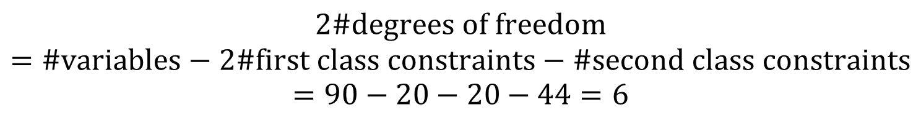
Hamiltonian formulation
Hamiltonian density
$$ℋ_{W}=Π_{AB}^{i}{\dot{A}}_{i}^{AB}+Π_{A}{\dot{φ}}^{A}−ℒ_{W}−ℒ_{SSB}=Π_{AB}^{i}\left(∂_{i}A_{0}^{AB}−2A_{C[0}^{A}A_{i]}^{CB}\right)−Π_{A}A_{B0}^{A}φ^{B}$$
Dirac’s algorithm
$$2\#degrees of freedom=\#variables−2\#first class constraints−\#second class constraints=90−20−20−44=6$$
3 degrees of freedom: $h_{μν}$ and $ρ$, like in scalar-tensor metric theories

Slide 18
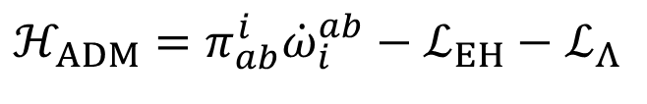
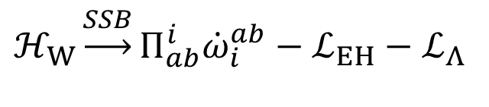
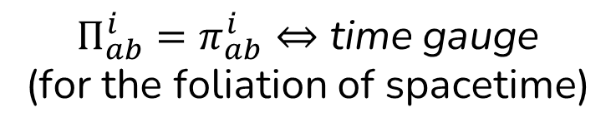
$$ℋ_{W}\underset{→}{SSB}Π_{ab}^{i}{\dot{ω}}_{i}^{ab}−ℒ_{EH}−ℒ_{Λ}$$
ADM formalism
$$ℋ_{ADM}=π_{ab}^{i}{\dot{ω}}_{i}^{ab}−ℒ_{EH}−ℒ_{Λ}$$
$Π_{ab}^{i}=π_{ab}^{i}⇔$ time gauge (for the foliation of spacetime)
recovery of the canonical formulation of General Relativity after SSB (with no foliation of spacetime)

Slide 19

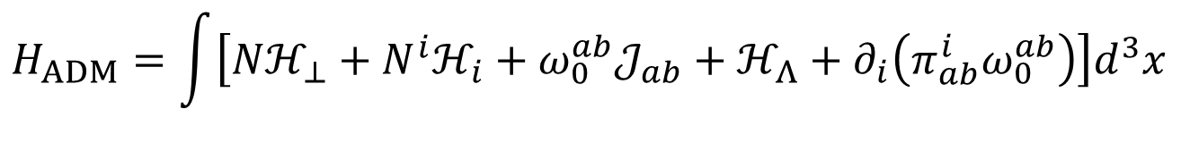
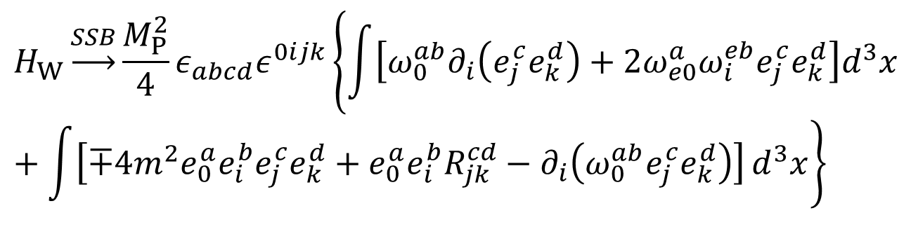

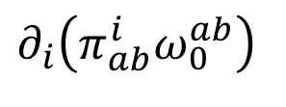

recovery of the canonical formulation of General Relativity after SSB
$$ω_{0}^{ab}𝒥_{ab}$$
$$H_{W}\underset{→}{SSB}\frac{M_{P}^{2}}{4}ε_{abcd}ε^{0ijk}\left\{\int{\left[ω_{0}^{ab}∂_{i}\left(e_{j}^{c}e_{k}^{d}\right)+2ω_{e0}^{a}ω_{i}^{eb}e_{j}^{c}e_{k}^{d}\right]d^{3}x}\right.+\left.\int{\left[∓4m^{2}e_{0}^{a}e_{i}^{b}e_{j}^{c}e_{k}^{d}+e_{0}^{a}e_{i}^{b}R_{jk}^{cd}−∂_{i}\left(ω_{0}^{ab}e_{j}^{c}e_{k}^{d}\right)\right]}d^{3}x\right\}$$
$$ℋ_{Λ}=M_{P}^{2}Λe$$
$$∂_{i}\left(π_{ab}^{i}ω_{0}^{ab}\right)$$
$$Nℋ_{⊥}+N^{i}ℋ_{i}$$
$$H_{ADM}=\int{\left[Nℋ_{⊥}+N^{i}ℋ_{i}+ω_{0}^{ab}𝒥_{ab}+ℋ_{Λ}+∂_{i}\left(π_{ab}^{i}ω_{0}^{ab}\right)\right]d^{3}x}$$

Slide 20
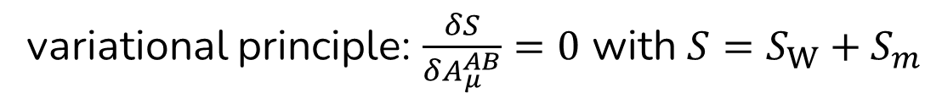
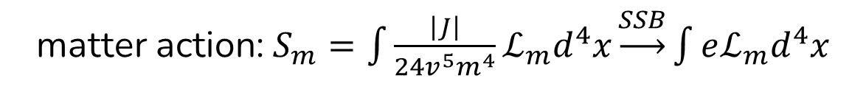
Variational principle
matter action: $S_{m}=\int{\frac{\left|J\right|}{24v^{5}m^{4}}ℒ_{m}d^{4}x}\underset{→}{SSB}\int{eℒ_{m}d^{4}x}$
variational principle: $\frac{δS}{δA_{μ}^{AB}}=0$ with $S=S_{W}+S_{m}$
pre-geometric Einstein–Cartan field equations: $𝒢_{AB}^{μ}=ℳ_{P}^{−2}𝒯_{AB}^{μ}$

Slide 21
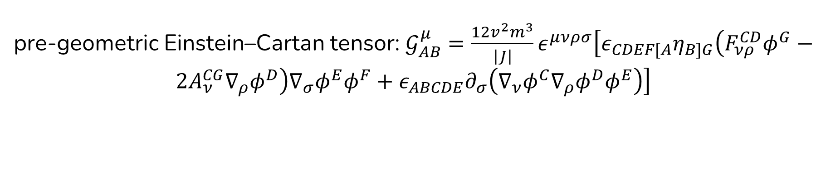
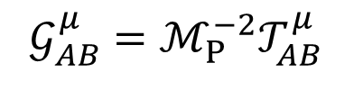
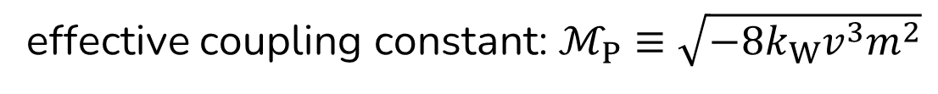
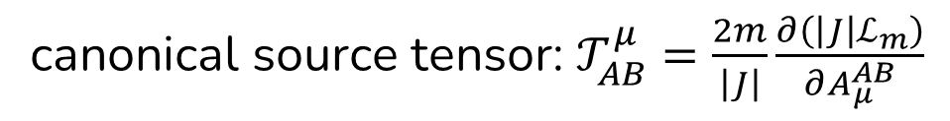
Pre-geometric Einstein–Cartan field equations
$$𝒢_{AB}^{μ}=ℳ_{P}^{−2}𝒯_{AB}^{μ}$$
pre-geometric Einstein–Cartan tensor: $𝒢_{AB}^{μ}=\frac{12v^{2}m^{3}}{\left|J\right|}ε^{μνρσ}\left[ε_{CDEF[A}η_{B]G}\left(F_{νρ}^{CD}φ^{G}−2A_{ν}^{CG}∇_{ρ}φ^{D}\right)∇_{σ}φ^{E}φ^{F}+ε_{ABCDE}∂_{σ}\left(∇_{ν}φ^{C}∇_{ρ}φ^{D}φ^{E}\right)\right]$
canonical source tensor: $𝒯_{AB}^{μ}=\frac{2m}{\left|J\right|}\frac{∂\left(\left|J\right|ℒ_{m}\right)}{∂A_{μ}^{AB}}$
effective coupling constant: $ℳ_{P}≡\sqrt{−8k_{W}v^{3}m^{2}}$

Slide 22
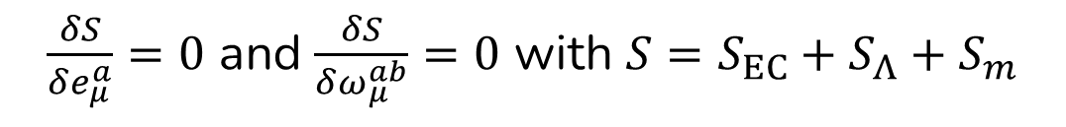
Pre-geometric Einstein–Cartan field equations
$$𝒢_{AB}^{μ}=ℳ_{P}^{−2}𝒯_{AB}^{μ}$$
$𝒢_{a4}^{μ}=ℳ_{P}^{−2}𝒯_{a4}^{μ}\underset{→}{SSB}G_{a}^{μ}+Λe_{a}^{μ}=M_{P}^{−2}τ_{a}^{μ}$ Einstein field equations
$𝒢_{ab}^{μ}=ℳ_{P}^{−2}𝒯_{ab}^{μ}\underset{→}{SSB}{\tilde{T}}_{ab}^{μ}=M_{P}^{−2}σ_{ab}^{μ}$ Cartan field equations
$\frac{δS}{δe_{μ}^{a}}=0$ and $\frac{δS}{δω_{μ}^{ab}}=0$ with $S=S_{EC}+S_{Λ}+S_{m}$

Slide 23
Cosmological implications
phase transition at $T_{c}∼m_{ρ}≲M_{P}$
problem of causality before SSB
supermassive boson $ρ$ after SSB
regular pre-geometric de Sitter universe before SSB: no Big Bang

Slide 24
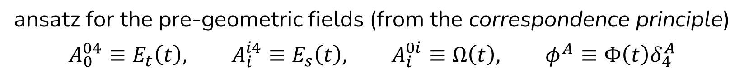
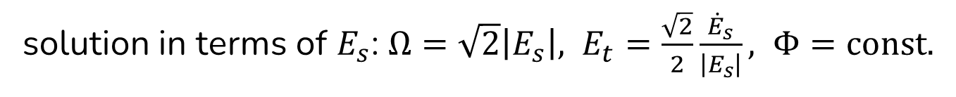

Pre-geometric cosmology solution
pre-geometric de Sitter universe ($SO\left(1,4\right)$, spatial homogeneity, isotropy, no matter) as a solution of the pre-geometric Einstein–Cartan field equations for $S=S_{W}$
ansatz for the pre-geometric fields (from the correspondence principle)
$$A_{0}^{04}≡E_{t}\left(t\right), A_{i}^{i4}≡E_{s}\left(t\right), A_{i}^{0i}≡Ω\left(t\right), φ^{A}≡Φ\left(t\right)δ_{4}^{A}$$
after SSB: $me_{0}^{0}, me_{i}^{i}, ω_{i}^{0i}, vδ_{4}^{A}$ respectively
solution in terms of $E_{s}$: $Ω=\sqrt{2}\left|E_{s}\right|, E_{t}=\frac{\sqrt{2}}{2}\frac{{\dot{E}}_{s}}{\left|E_{s}\right|}, Φ=const.$

Slide 25
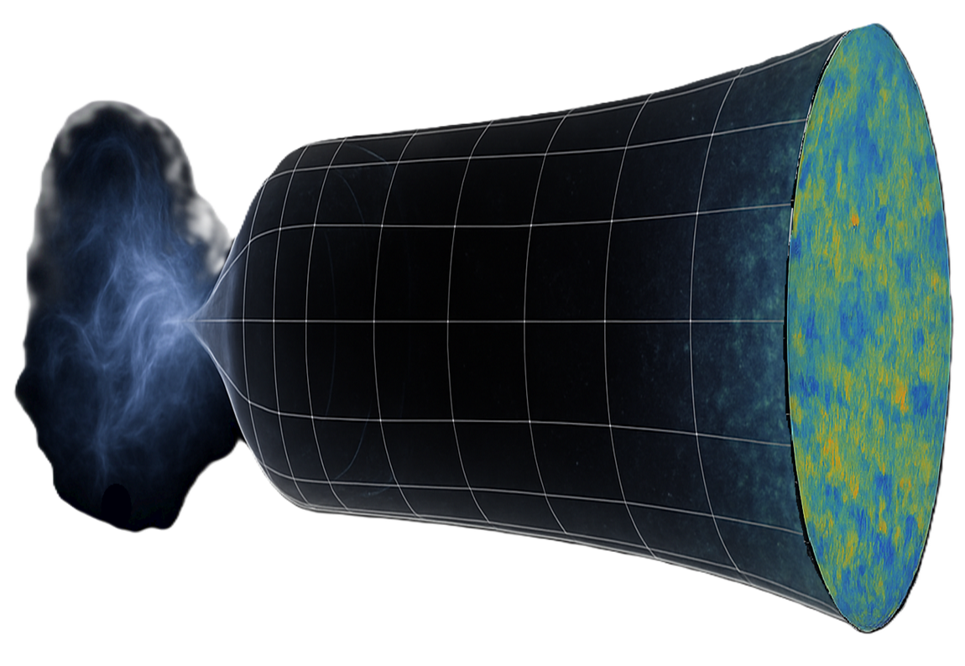
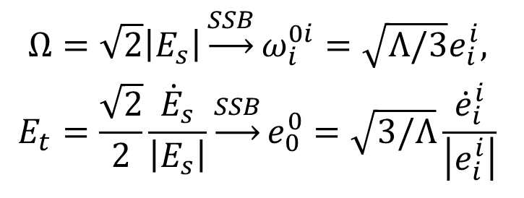
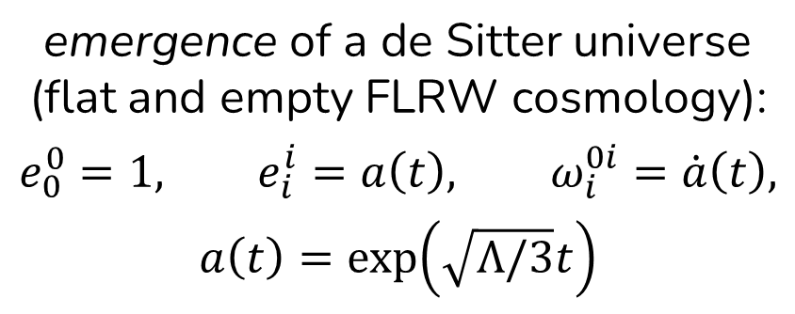
Pre-geometric cosmology solution
$$Ω=\sqrt{2}\left|E_{s}\right|\underset{→}{SSB}ω_{i}^{0i}=\sqrt{Λ/3}e_{i}^{i},$$
$$E_{t}=\frac{\sqrt{2}}{2}\frac{{\dot{E}}_{s}}{\left|E_{s}\right|}\underset{→}{SSB}e_{0}^{0}=\sqrt{3/Λ}\frac{{\dot{e}}_{i}^{i}}{\left|e_{i}^{i}\right|}$$
emergence of a de Sitter universe (flat and empty FLRW cosmology):
$$e_{0}^{0}=1, e_{i}^{i}=a\left(t\right), ω_{i}^{0i}=\dot{a}\left(t\right),$$
$$a\left(t\right)=\exp\left(\sqrt{Λ/3}t\right)$$
regular pre-geometry before the inflationary epoch: no Big Bang

Slide 26
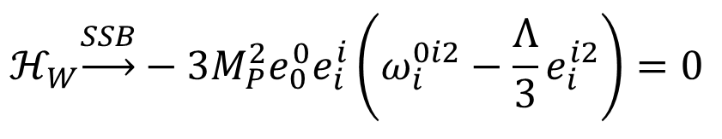
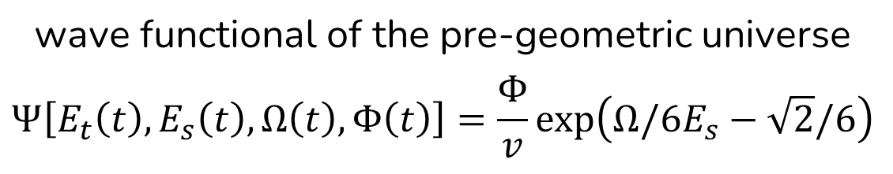
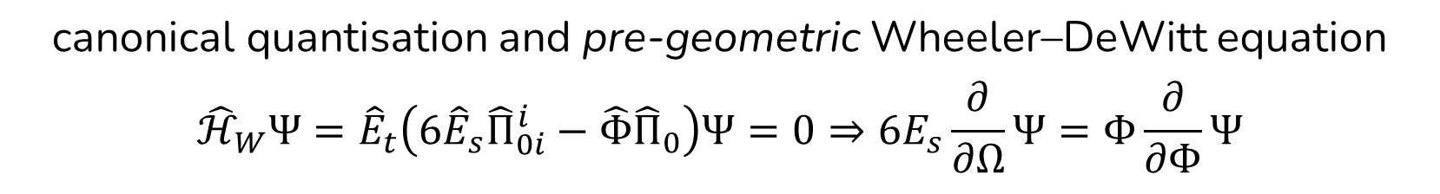
Pre-geometric quantum cosmology
minisuperspace Hamiltonian: $ℋ_{W}=E_{t}\left(6E_{s}Π_{0i}^{i}−ΦΠ_{0}\right)=24k_{W}E_{t}E_{s}Φ^{3}\left(Ω^{2}−2E_{s}^{2}\right)=0$
$$ℋ_{W}\underset{→}{SSB}−3M_{P}^{2}e_{0}^{0}e_{i}^{i}\left(ω_{i}^{0i2}−\frac{Λ}{3}e_{i}^{i2}\right)=0$$
canonical quantisation and pre-geometric Wheeler–DeWitt equation
$${\hat{ℋ}}_{W}Ψ={\hat{E}}_{t}\left(6{\hat{E}}_{s}{\hat{Π}}_{0i}^{i}−\hat{Φ}{\hat{Π}}_{0}\right)Ψ=0⇒6E_{s}\frac{∂}{∂Ω}Ψ=Φ\frac{∂}{∂Φ}Ψ$$
wave functional of the pre-geometric universe
$$Ψ\left[E_{t}\left(t\right),E_{s}\left(t\right),Ω\left(t\right),Φ\left(t\right)\right]=\frac{Φ}{v}\exp\left(Ω/6E_{s}−\sqrt{2}/6\right)$$

Slide 27
Conclusions and perspectives
gravity can emerge via SSB in a pre-geometric universe
$SO\left(1,4\right)\underset{→}{SSB}SO\left(1,3\right)$: emerging principles and energy scales of GR from $ℒ_{W}$
phase transition at $T_{c}≲M_{P}$ and supermassive boson $ρ$
resolution of classical spacetime singularities, quantum cosmology and inflation
quantisation of gravity and UV completion of GR

Slide 28
Thanks for your attention!

