Slide 1
Il progetto APE e il suo impatto sul calcolo scientifico ad alte prestazioni
Piero Vicini (INFN)
La RaRa occasione – Milano,
20 Ottobre 2025

Slide 2
Outlook
Disclaimer:
→ this is the technological side of the APE project. For science wait few minutes for the next talk of Leonardo...
Outlook
A brief introduction of motivations and goals of the APE project
A reasoned collection of pictures from the various APE generations
The legacy of APE: tecnology transfer and impact (influence?) on modern HPC
What’s APE today...

Slide 3
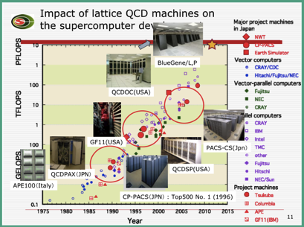
The Scientific Driver: Lattice Quantum Chromodynamics (LQCD)
LQCD (Lattice Quantum Chromo Dynamics) studies the Physics of nucleons particles.
When approximated onto a lattice it becomes a statistical problem solved by iteration of Monte Carlo methods.
LQCD is a killer application
big impact on last decades of HPC developments
one of the most prominent benchmark for modern HPC system
N. Christ plot of LQCD flops usage in the first 20 years of HPC use……

Slide 4
HOW LQCD can be mapped on parallel supercomputer
Discretization of continuous 4-d space-time:
Lattice size (L) has to be large enough
Lattice step (a) has to be small enough
Scales with 7th power of lattice size!!
LQCD need large and powerful systems
Partition of lattice in sub-lattice and map them on different processors
LQCD exploits embarrassing parallelism
For each lattice point compute the inverse of Dirac operator (sparse complex matrix with non-zero elements close to the diagonal)
SIMD (SPMD) architecture
Support for complex arithmetic
For each lattice point we need local and spatial neighbors data
first neighbours (3D mesh) interconnection network (high bandwidth and low latency)
P₀₀
P₀₁
L
a
P₁₀
P₁₁
Notes:
LQCD scale with the 7th power of the lattice size…..
Interstellar jets
Life sciences or computational biology What is possible but…
In order to simulate most proteins at the atomistic level for a simple millisecond we must perform around 10²³ floating point operations, something just impossible with current computer resources. Comparing structure, flexibility, interaction patterns (with proteins or ligands) of the entire human proteome will probably require even larger computational resources

Slide 5
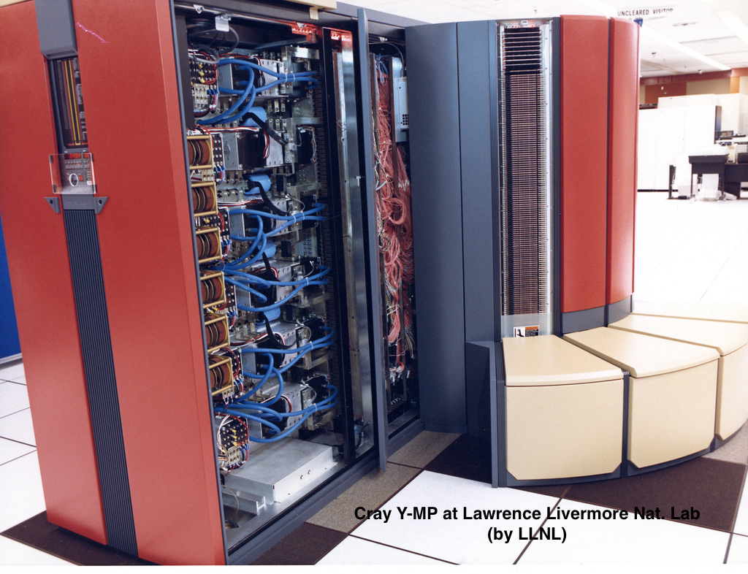
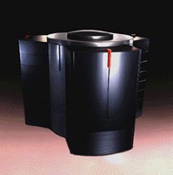
The HPC Landscape in the 80s early 90s: a need for a new approach
Dominant Paradigm: Commercial vector supercomputers (e.g., Cray).
Characteristics: Extremely expensive, “general-purpose” machines, not always efficient for specific scientific problems.
CRAY Y-MP (end of 80’s)
2, 4, or 8 vector processors with a peak of 333 MFlops each
A total computing power of>2.6GFlops
memory shared
dedicated OS: UNICOS
CRAY C90 (from 1992)
vector processors, dual pipeline, clock scaling...
Max configuration (16 nodes) 16GFlops

Slide 6
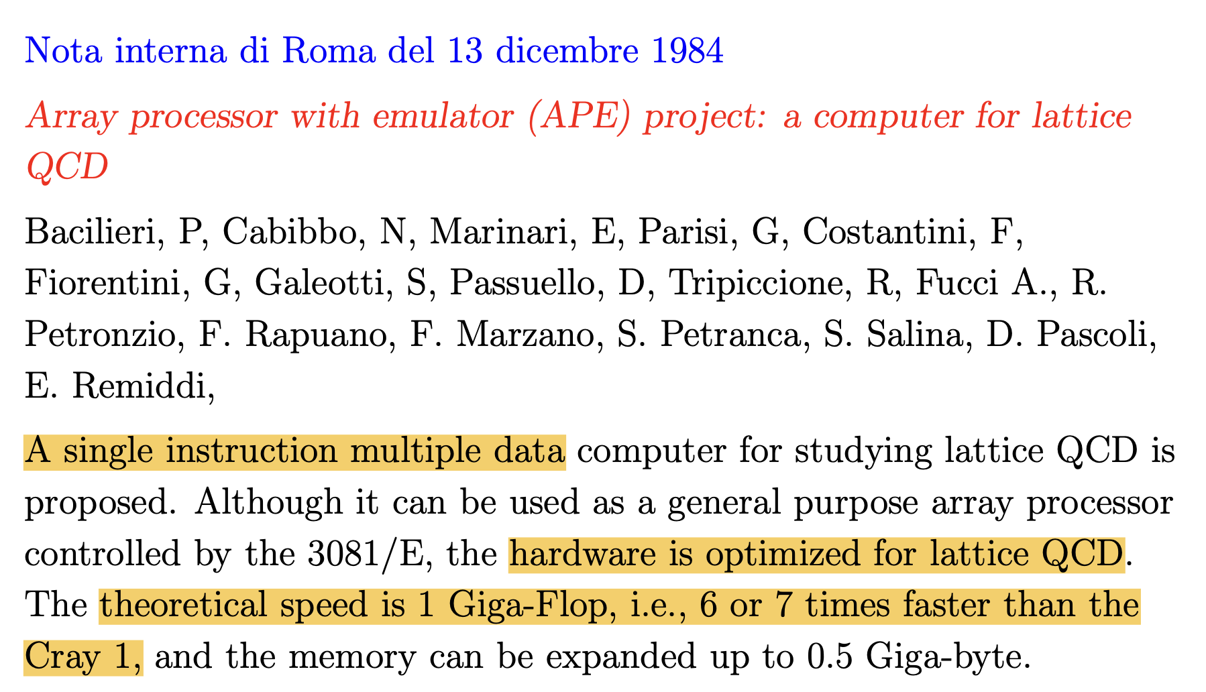
The HPC Landscape in the 80s early 90s: a need for a new approach
A window of opportunity: due to the characteristics of selected scientific applications (LQCD in our case) a custom, parallel machine could outperform expensive supercomputers at a fraction of the cost.
The APE Philosophy:
Build your own research tools through co-design, reuse and improve
hardware and software developed together, following specifications from application
reuse components as much as possible
remove all unnecessary features of a general-purpose computer specializing its HW/SW for target application
Leverage on a heterogenous team of visionary physicists, young staff, post-doc and students

Slide 7
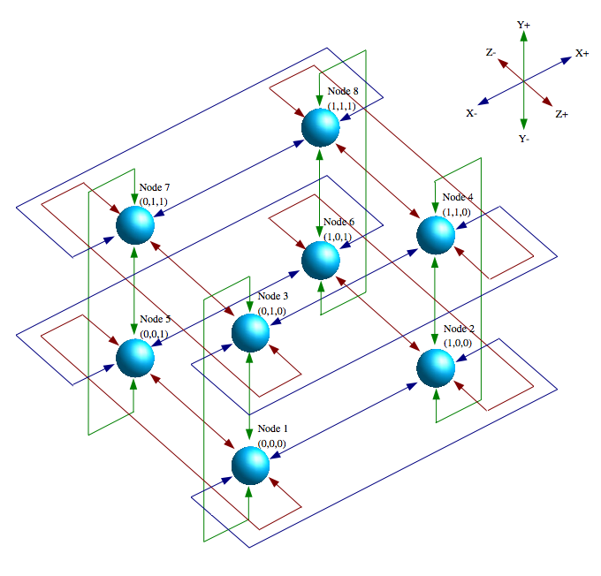
APE keywords (Architectural level)
SIMD (SPMD) architecture i.e. The natural “choice”
MAC pipelined otpimized for complex FP
“unusual” memory interfaces based on large many-port Register File
VLIW and custom software tools
dedicated high level language
optimizing compiler
microcode optimizer
3D torus interconnection network
High bandwidth and low latency
Simple to implement
Point-to-point
Short distance
Scalable
A breakthrough innovation 40 years ago….

Slide 8
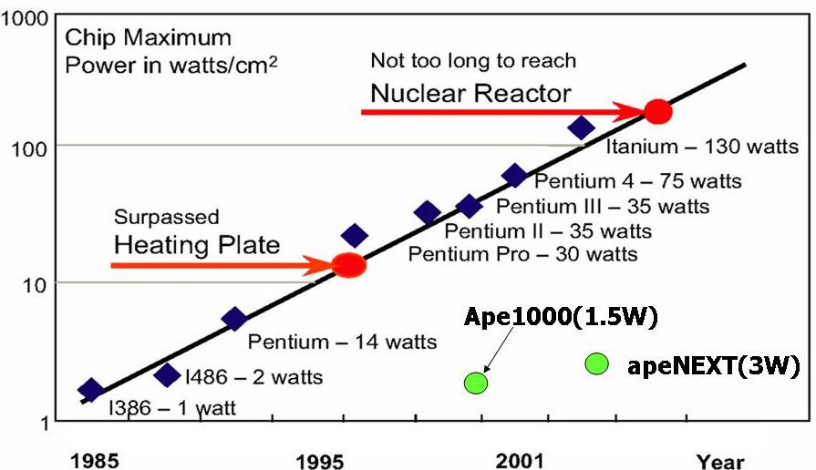
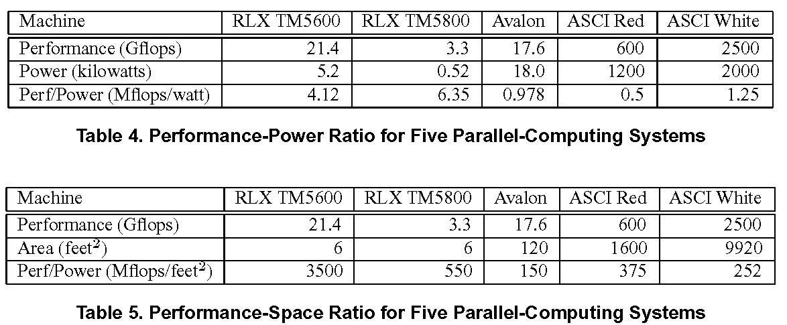

APE keywords (System level)
o(1000) “simple”, low-power and application efficient computing units, running at low clock frequency and tightly interconnected
System level:
Dense and scalable
Very high ratio of Flops/Watt
Very high ratio of Flops/Volume
Simple and achievable
Control needed technology
Reliable and cost effective
0.5 €/Mflops
Very low development cost
Very low cost maintenance
apeNEXT
3670
80
46
apeNEXT
3670
72
50972

Slide 9
APE systems
Our line of Home-Made Computers …
 | APE (1988) | APE100 (1993) | APEmille (1999) | apeNEXT (2004)
 | Italian research team | Italian research team | European research team + Industry(QSW, Eurotech) | European research team + Industry(Eurotech)
Architecture | SIMD | SIMD | SIMD | SPMD
comp. nodes | 16 | 2048 | 2048 | 4096
Interc. Topology | flexible 1D | rigid 3D | flexible 3D | flexible 3D
Memory size | 256 MB | 8 GB | 64 GB | 1 TB
registers(w.size) | 64 (x32) | 128 (x32) | 512 (x32) | 512 (x64)
Clock speed | 8 MHz | 25 MHz | 66 MHz | 200 MHz
Perf./node | 64 Mflops | 50 Mflops | 528 Mflops | 1600 Mflops
Agg. Peak perf. | 1 GFlops | 100 GFlops | 1 TFlops | 7 TFlops
Notes:
Clock at low frequency but exploiting parallelism we get high performance node…..

Slide 10
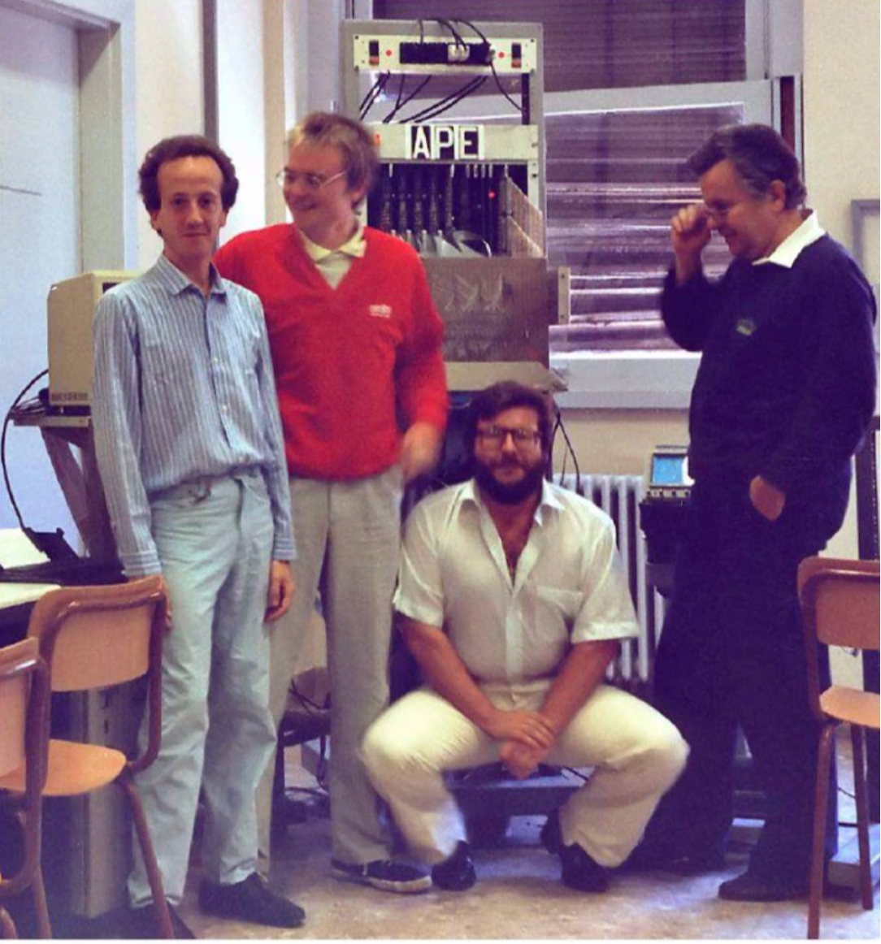
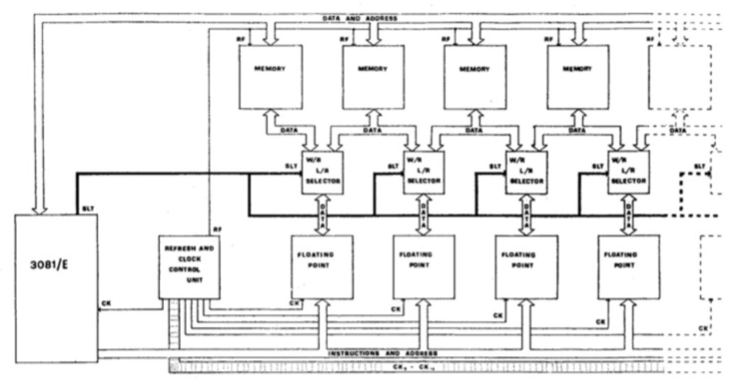
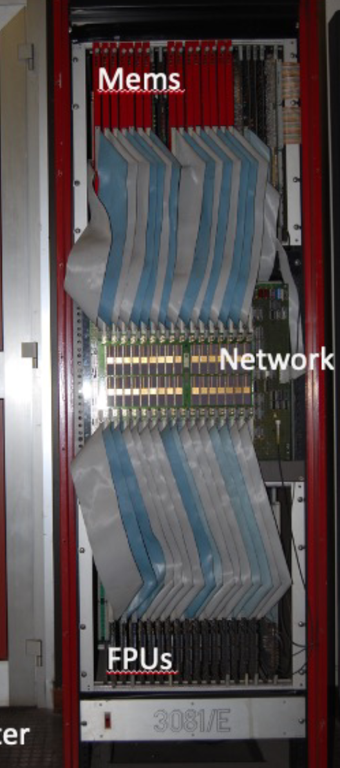
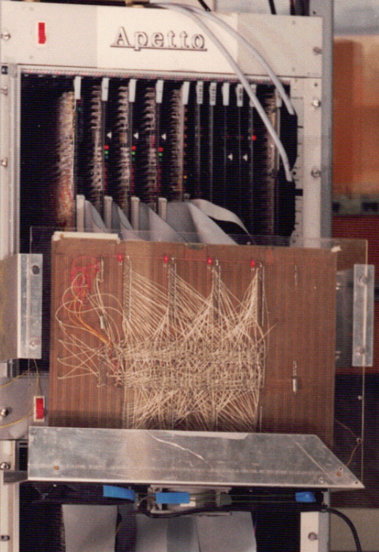
APE1 (1988): the first generation
(a+ib)*(A+iB)+(C+iD)
=(Aa-Bb+C)+i(Ab+Ba+D)
C,A
a
b
B,D
+
+
*
Aa
*
Ab
*
Ba
*
Bb
-
+
APE approach is feasible and effective!
3081e (A. Fucci @CERN) as computer controller
Weitek chipset (derived from DSP) for FP computing
8MFlops each, 8/board, 16 boards → 1GFlops
FPU architecture: RF + Complex FP Multiplier Adder
Fixed crossbar for point-to-point interconnect
Crazy tech... (Wire wrap)

Slide 11
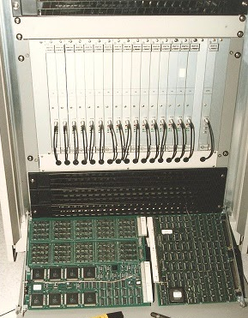
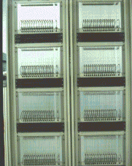
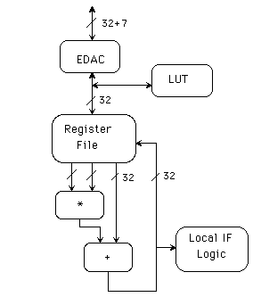
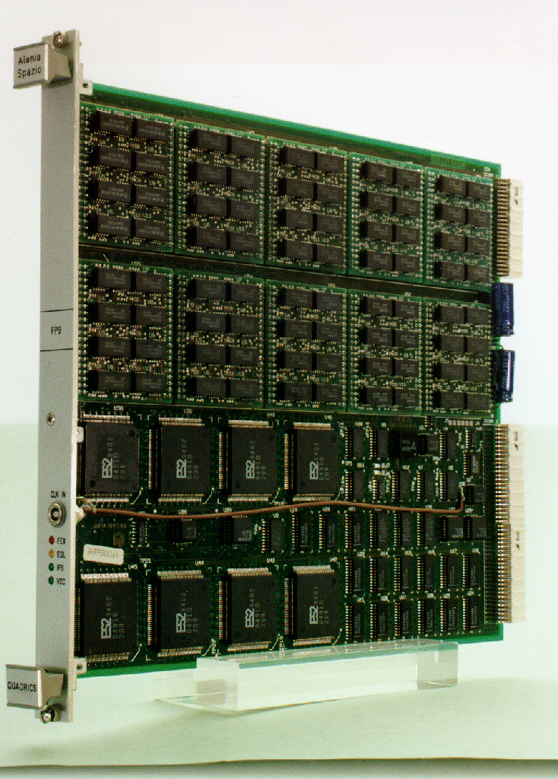
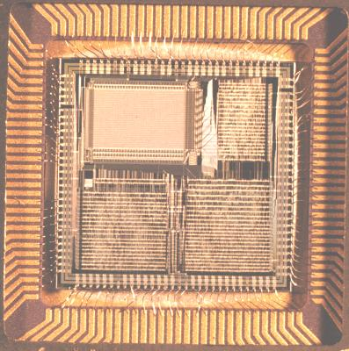
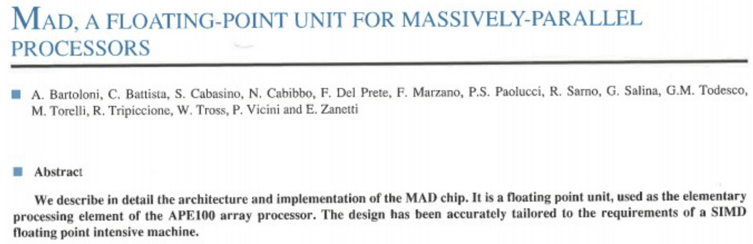
APE100 (1993) – 100 GFlops
100x performance increase over APE1
VLSI Technologies: ZCPU & MAD FPU
Up to 2048 processors connected in a 3D grid
Engineered system → high density, low power
ZZ compiler and the TAO language
https://apegate.roma1.infn.it/mediawiki/index.php/APE100_project
PB (8 nodes) ~ 400 MFlops
Crate: 16PB + comm. board
Rack ~ 25.6 GFlops

Slide 12
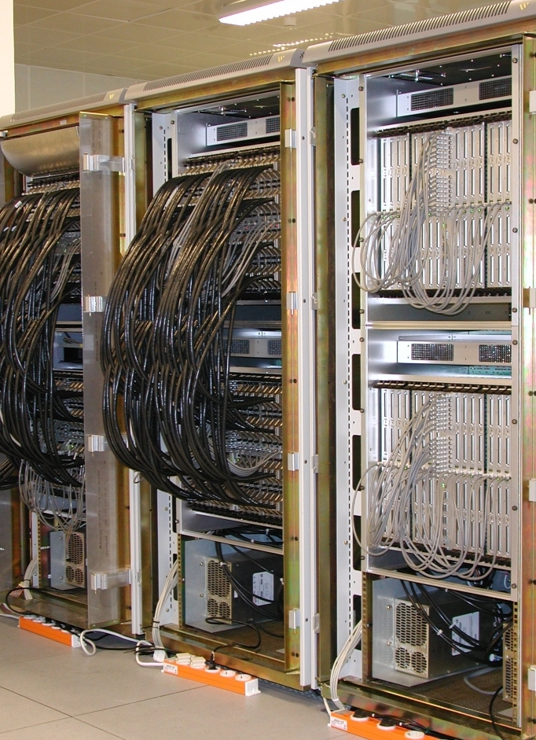
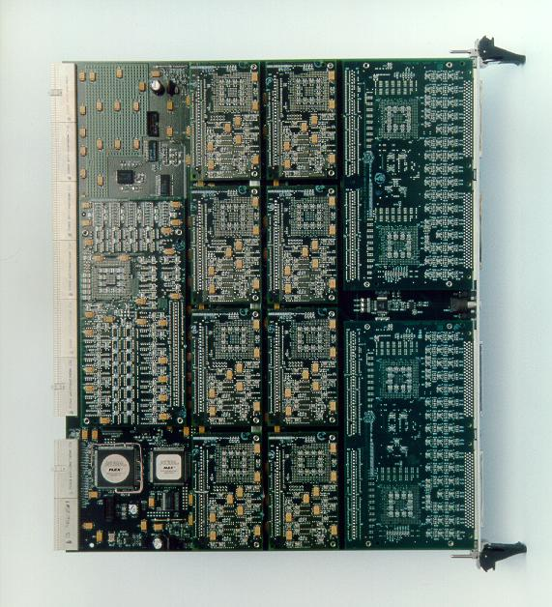
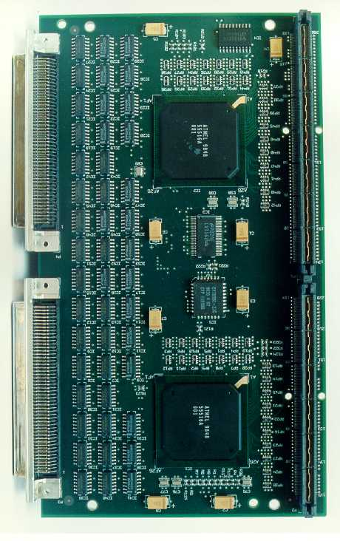
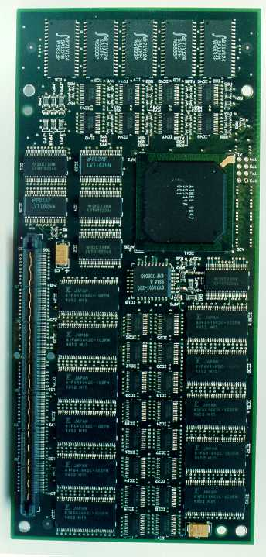
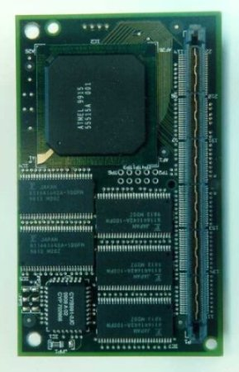
APEmille (1999) – 1 TFlops
https://apegate.roma1.infn.it/mediawiki/index.php/APEmille_project
VLSI Chipset
(T1000, J1000, C1000) → unfortunately, Tarzan Jane and Cheetah were TM...
2048 VLSI processing nodes (0.5 MFlops)
SIMD, synchronous communications
Fully integrated ”Host computer”, 64 PCs cPCI based
2TF installed around Europe
Italy 1365 GF
Germany 650 GF
UK 65 GF
France 16 GF
J1000
“Processing Board” (PB)
8 nodes, 4GFlops
“Torre”
32 PB, 128GFlops
C1000
T1000

Slide 13
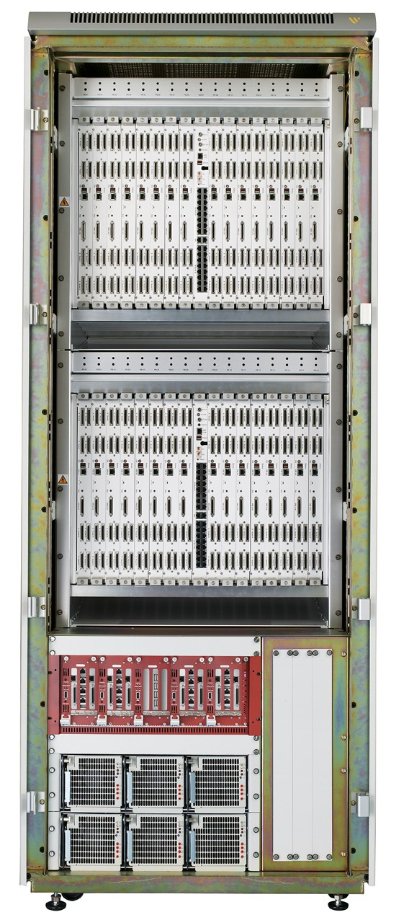
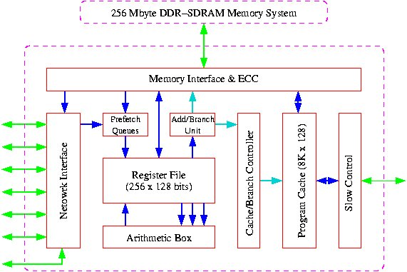
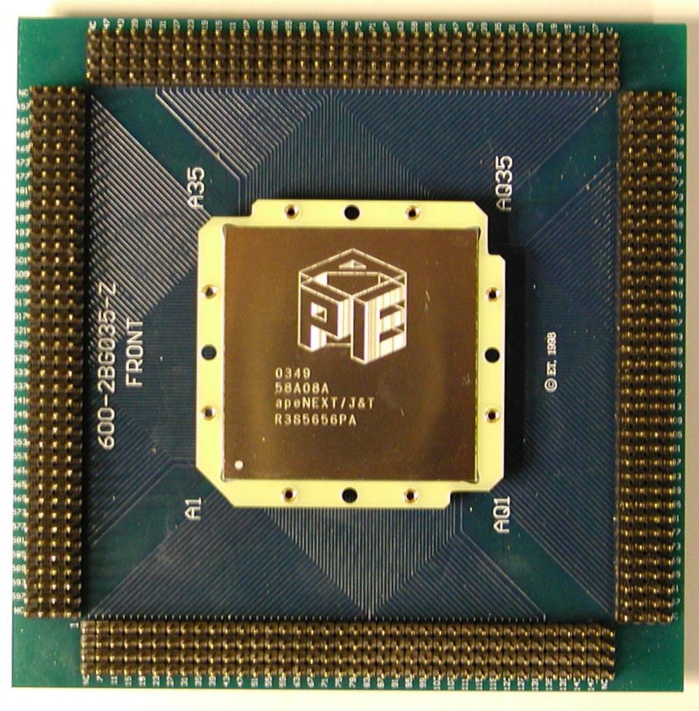
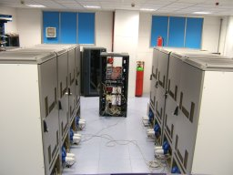
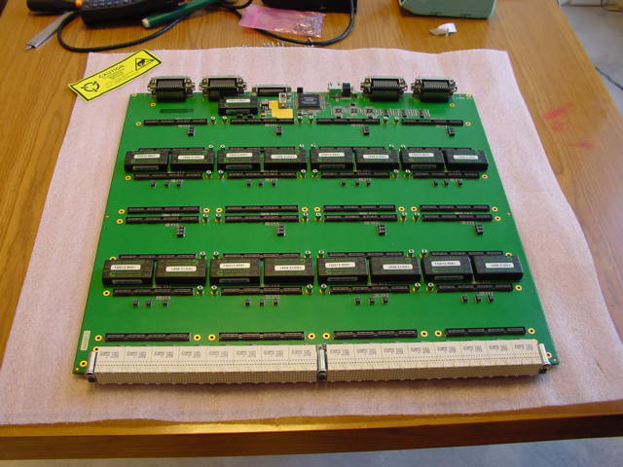
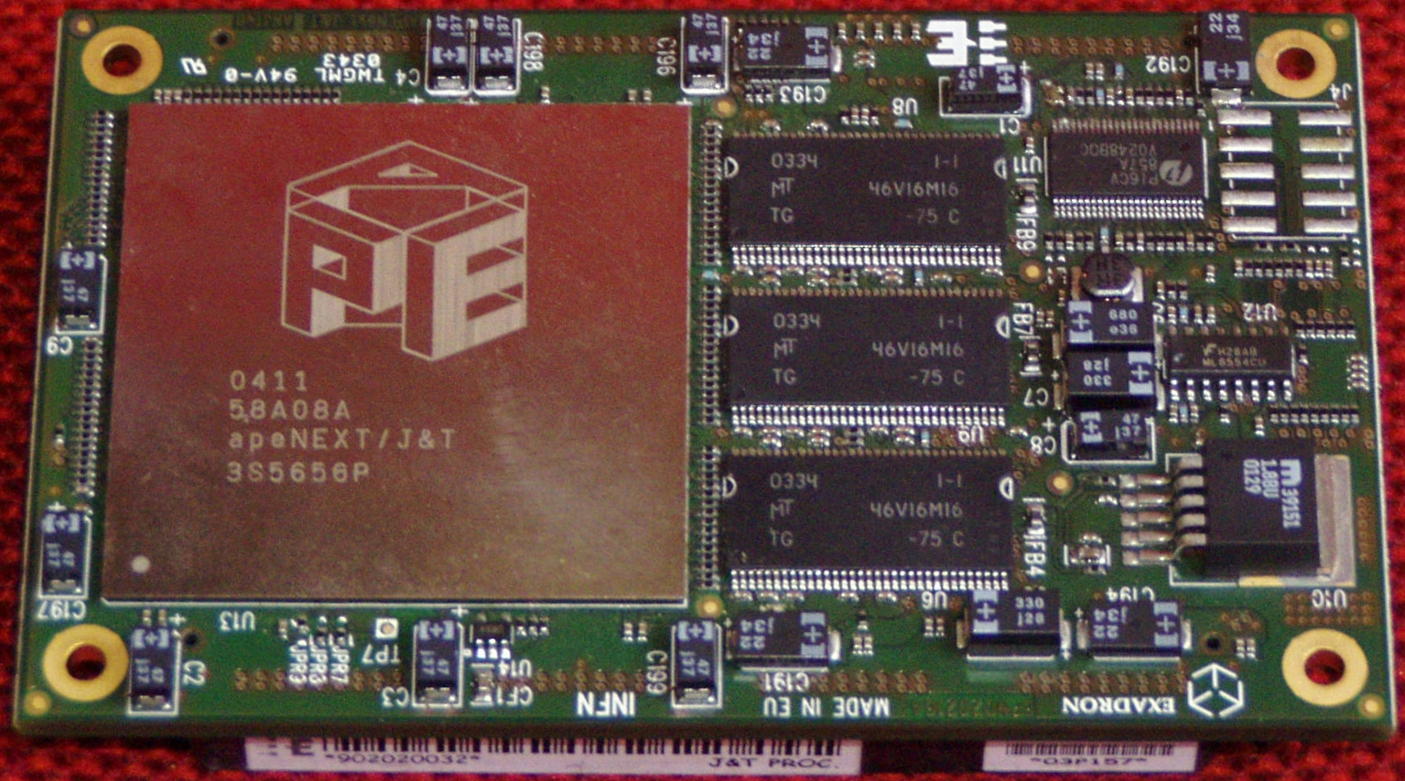
apeNEXT (2005)
apeNEXT (2005):
J&T ASIC: single chip node FP64b
Mass production cost ~ 0.5 €uro/Mflops
Partnership with industry (EuroTECH)
> 20TF installed around Europe:
Italy 12 TF
Germany. 8.0 TF
France 1.6 TF
J&T Asic
J&T module Asic+Mem
PB: 16 Modules 25 GF/s
“Laboratorio di Calcolo apeNEXT”
12 Tflops aggregated peak performances
Rack 512 modules – 0.8 TF/s
https://apegate.roma1.infn.it/mediawiki/index.php/ApeNEXT_project

Slide 14
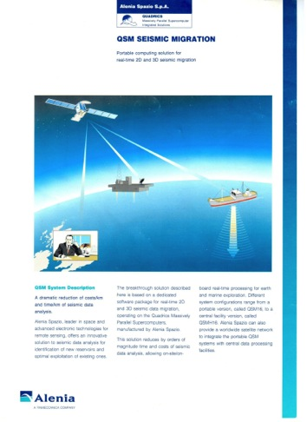
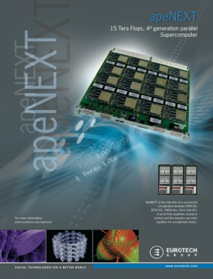
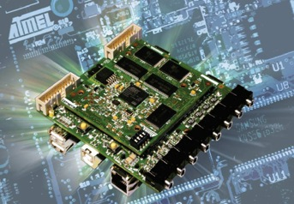
APE MPP and technology transfers
2008: Diopsis board by ATMEL-IPITEC, a spin-off of APE group.
Diopsis chip integrates ARM Core + VLIW FP computing engine derived from APE design
1994: APE100 technology transfer to Alenia Spazio. APE tech in Quadrics System (QSW). Italy as a credible producer of supercomputing technology.
2004: apeNEXT technology transfer to EUROTECH by APE people pioneering the energy-efficient supercomputing. APE tech in Eurotech's Aurora line of supercomputers

Slide 15
APE beyond MPP
In 2006 we were in a (apparently) good situation for next APE MPP
Success of and dissemination in EU of APE technology
Good relationship and integration with industrial partners
many MPP ideas for next HPC system (petape, APotto, Eurora....)
increasing demand for (not only LQCD...) computing power: EU PRACE initiative
But costs were unsustainable
Deep submicron ASIC development became deeply complicated and yield rate steeply dropped down
NRE costs for ASICs quoted (at that time) much much more than the whole cost of APEnext NRE+ mass production
Today 1B$ for NRE cost of a high-end chip
Allowed size of mass production was around 1Million ASICs (...)
The system mechanics (PCB, interconnect etc) had become a game for professionals with associated costs hugely increase
APE's innovations continued along two main paths leveraging on our know-how:
Architectural Concepts: The idea of using specialized co-processors foreshadowed the rise of hybrid computing (CPU + accelerator).
Network Technology: The custom 3D torus interconnect evolved to solve new problems in the era of Big Data and GPU computing.

Slide 16
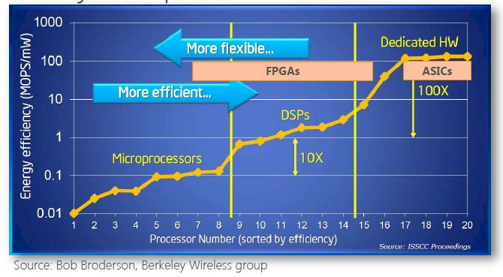
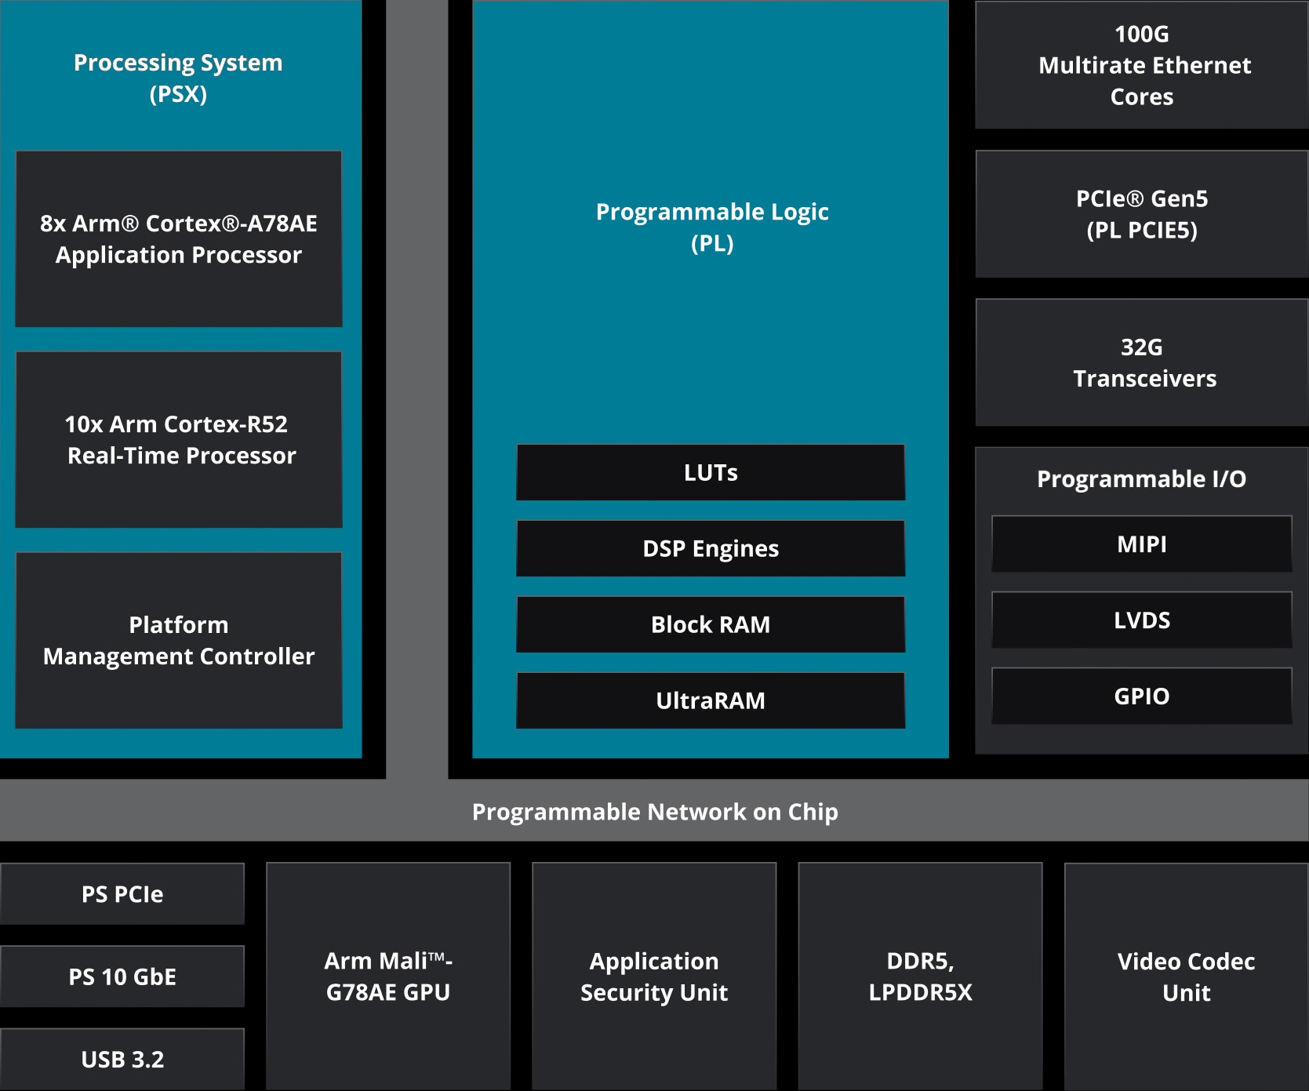
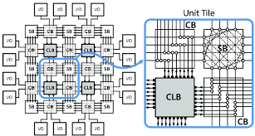
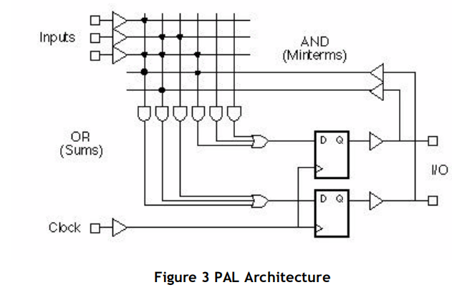
A couple of new players in town: FPGA...
FPGA: programmable device characterized by flexibility, reconfigurability, power efficiency, short time-to-market
from original PAL/GAL to current billion transistors SoC
Example: XCV80 HBM Versal AMD
7nm FinFET node several 10xB transistors
128 transceivers 32-56-(112) Gbps chip-to-chip or via backplane interconnect
Many industrial standards: ETH100g o 200g, PCIExpress gen3/4/5 x16...
38 TOPs (22 TeraMACs) DSP computing performance
IP specialized for ML inference
Very good gym to build supporting hardware for HPC system: control, computing and network

Slide 17
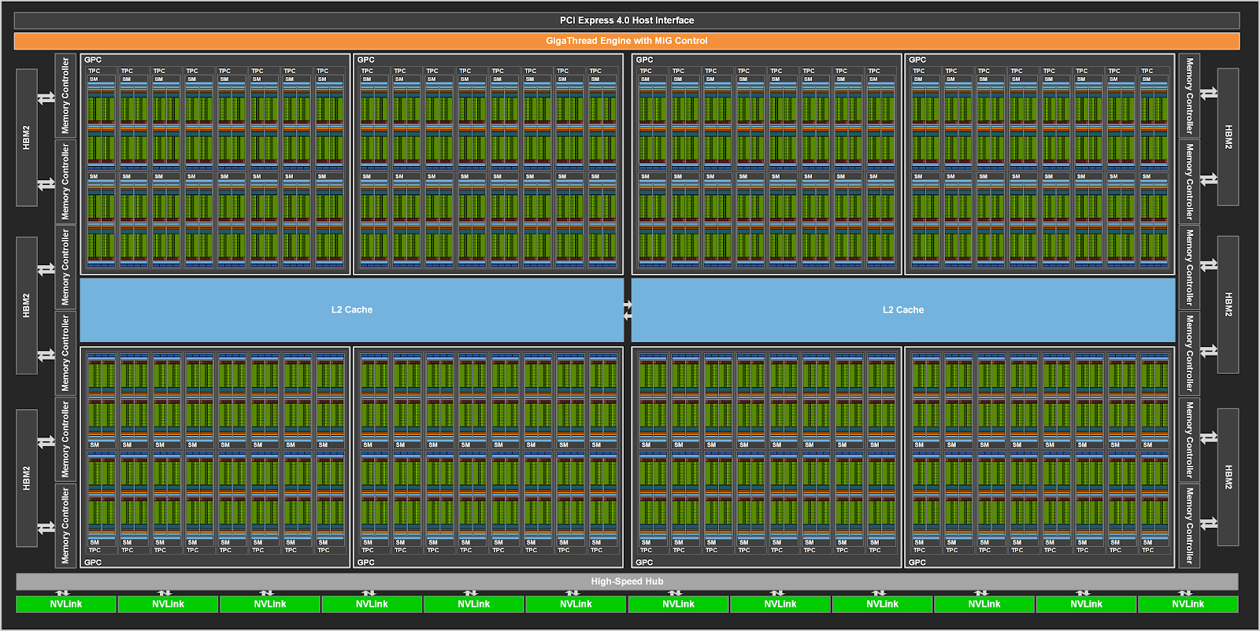
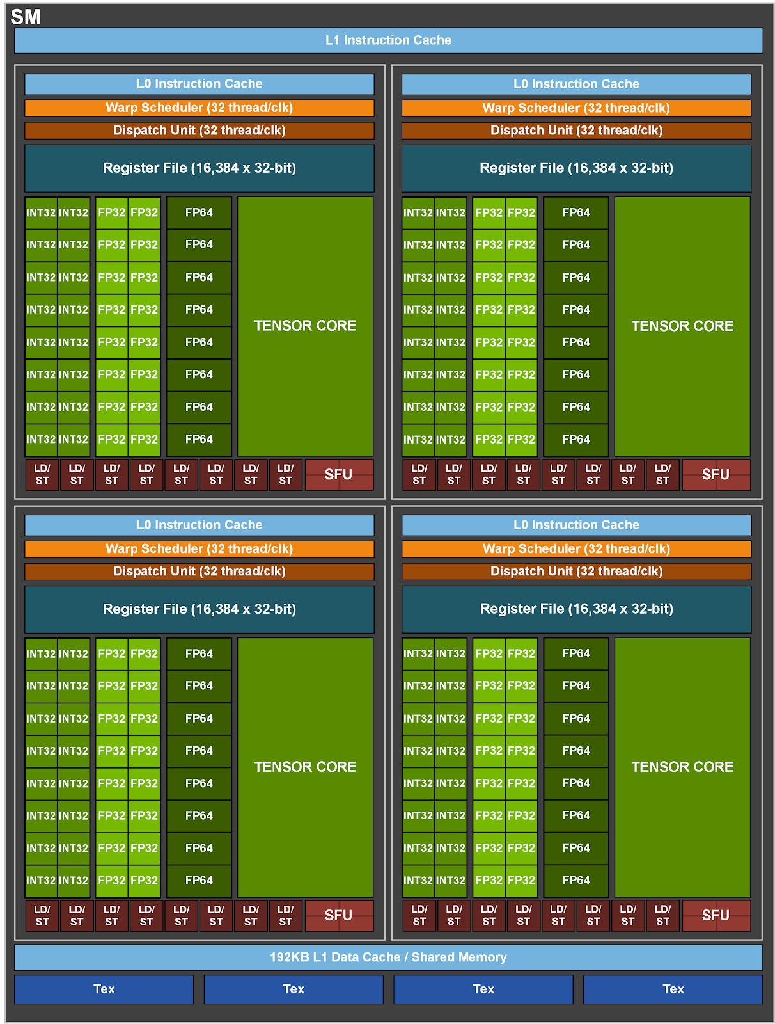
A couple of new players in town: GPU...
GPU were originally specialized processors for graphics
GPUs are highly multithreaded and make intensive use of parallelism to achieve high performance (many SIMD instructions)
execution of many threads (up to 10³...) in parallel distributed over many elementary cores (10³)
no cache needed to mask memory access latency → a lot of computing, less memory
Use of “large” (10² bit) and “fast” (N∗Ghz per bit line) graphic memories
GPU includes lot of state-of-the-art technologies allowing for effective programmability:
Standard (DirectX, OpenGL, OpenCL) or proprietary (NVidia Compute Unified Device Architecture (CUDA)) programming languages
Many keywords resembling APE’s ones.
high density, low clock, high parallelism, SIMD architecture, dedicated programming language,...
Can APE be seen as GPU precursor?!?!

Slide 18
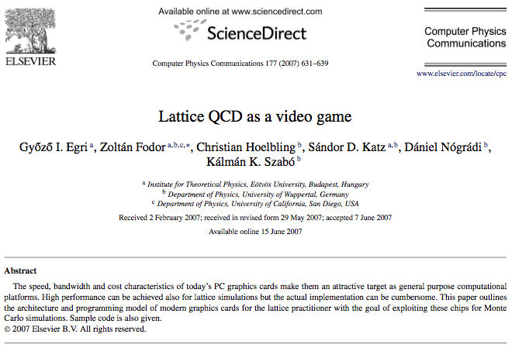
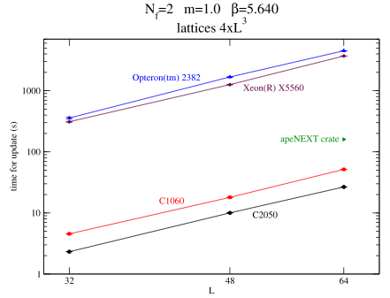
LQCD & GPU: love at first sight…
Story begins with video games… (Egri, Fodor et al. 2006)
C.Rebbi et al. (LATTICE08) “Blasting through Lattice Calculations using CUDA”
Wilson kernel 100 GFLOPs
Kenji Ogawa (TWQCD) (GPU supercomputing 2009,TW)
Wilson kernel 120 Gflops
Definitive work: Quda lib (M.A.Clark et al. 2009):
Double, Single, Half-precision
Half-prec solver with reliable updates > 150Gflops
QUDA parallel: R. Babich et al., arXiv:1011.0024 “Parallelizing the QUDA Library for Multi-GPU Calculations in Lattice QCD”
up to 4 Tflops for Wilson kernel on a cluster of 32 NVIDIA GTX 285
INFN codes development
2D Spin models (Di Renzo et al, 2008)
LQCD Stag. fermions on Chroma (Cossu, D'Elia et al, 2009)
1 cpu+C1060 = 2 apeNEXT crates (!)
but few GPUs are not enough, we need a smart, good and specialized interconnection system to scale up to 100-1000-…

Slide 19
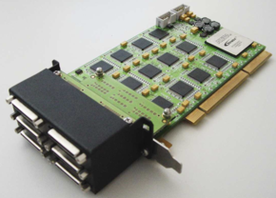
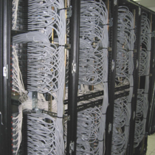
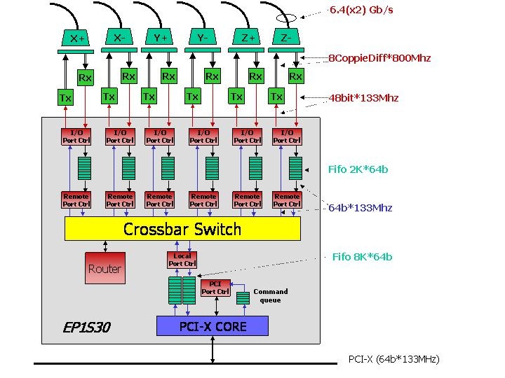
Network a la APE: apeNET
APEnet: PC Cluster 3-D torus network
FPGA-based design
Integrated routing and switching capabilities
High throughput, low latency, “light-weight” protocol
PCI Interface, 6 Links full-bidir on torus side
History
2003-2004: APEnet V3 (PCI-X)
2005: APEnet V3+
same HW with RDMA API
2006-2009: APEnet goes embedded
DNP, D(istributed) N(etwork) Processor
EU SHAPES project co-development
2011: APEnet+
PCI Express, enhanced torus links

Slide 20
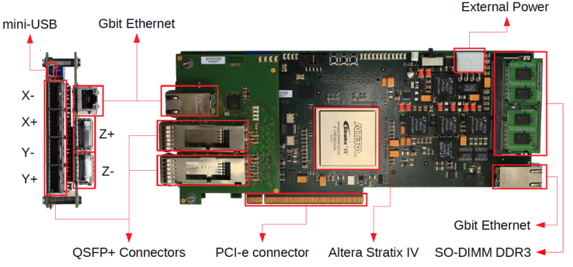
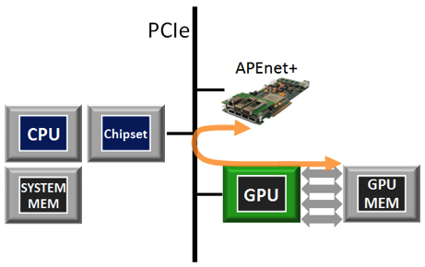
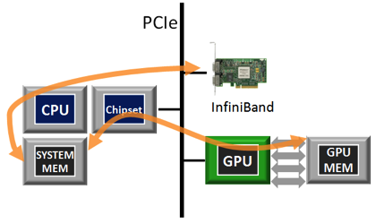
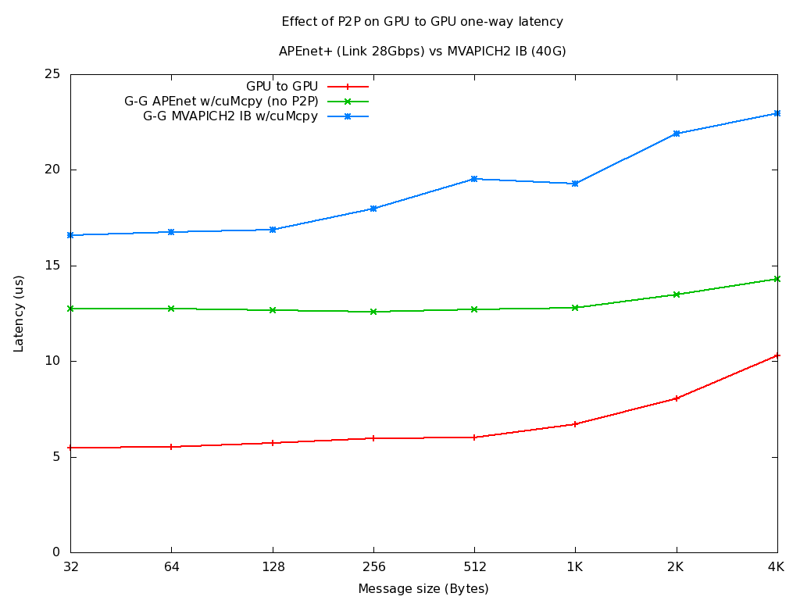
Network a la APE: apeNET+
TRADITIONAL DATA FLOW
APENET+ ENHANCED DATA FLOW
APEnet+ FPGA Card:
3D Torus: Scalable; Cost effective
6x Full bidirectional Channel (~400 Gbps; QSFP+)
Network Interface:
RDMA : Nios II (2011); TLB (2013); ASIP (2013)
GPUDirect: NVP2P (2012); RDMA (2013)
Router: XYZ ; VCT; 7 data flows @2.8GB/s
APEnet+ P2P support
cutting-edge HW/SW technologies developed jointly with Nvidia
Latency saver for small size messages
Today GPUDirect in any network board
MVAPICH2 points from the Ohio State U. web site*
No P2p = 2x cuMemcpy()
on host bounce buffers (~8-10us)

Slide 21
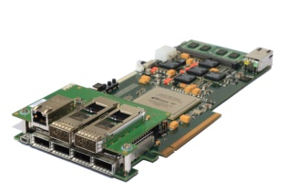
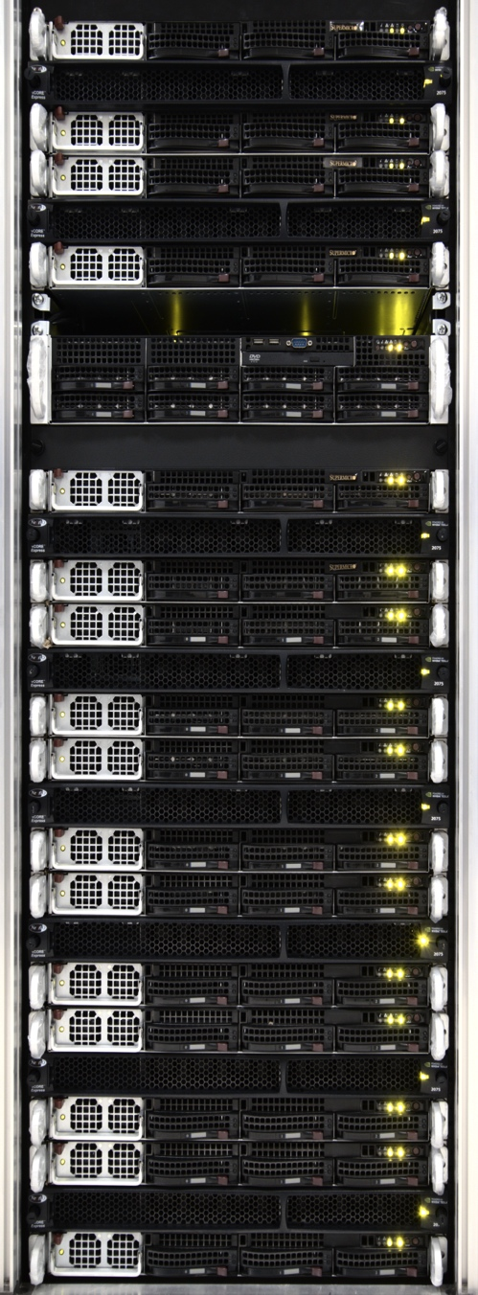
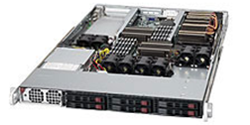
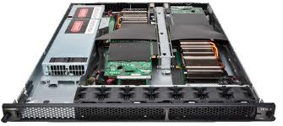
QUonG
QUonG (QUantum chromodynamics ON Gpu): deploy a GPU-accelerated HPC hardware platform mainly devoted to theoretical physics computations.
Heterogeneous cluster: PC mesh accelerated with high-end GPU (Nvidia) and interconnected via 3-D Torus network
Added value:
tight integration between accelerators (GPU) and custom/reconfigurable network (DNP on FPGA) allows latency reduction and computing efficiency gain
Huge hardware resources in FPGA to integrate specific computing task accelerators
ASIP, OpenCL (in the future..)
Communicating with optimized custom interconnect (APEnet+), with a standard software stack (MPI, OpenMP, …)
Community of researchers sharing codes and expertise (LQCD, GWA, Laser-plasma interactions, BioComputing, Complex systems,…)
21

Slide 22

APE LAB TEAM (today)
18 members (11 staff + 2 fixed-term + 5 PHD)
3 main research lines
HPC (system architectures, scalable networks, apps optimization)
Neuroscience (brain simulations, models, neuromorphic systems)
HEP Computing (Read-out systems, online trigger)
Know-how
ASIC design, FPGA design, GPU programming and integration, network design, dense system integration, parallel programming and application coding (LQCD, neural networks, complex systems), system software, compilers and languages, data analysis, data processing, mathematical physics, theoretical models, statistics…
National and International research network and industrial collaborations:
Grenoble Univ., Athena, FORTH, UPC, CINECA, CNR, Julich, LENS, Manchester Univ, UniMi, CERN, NVidia, EuroTech, E4, IceoTope, IDIBAPS, MonetDB, ATOS, EVIDEN, BULL, UCLM, UPV, CINI, ISS,...
https://apegate.roma1.infn.it/
https://twitter.com/APELab_INFN

Slide 23
APE legacy
APE in (HEP) Experiments: NaNet → GPU/FPGA-RICH → APEiron (EIC D-RICH)
FPGA-based distributed read-out for KM3NET (2010->2014)
FPGA-based stream computing and GPU-based online low-level trigger for HEP (NA62) (2012->)
FPGA-based distributed read-out w ML for noise discrimination in EIC D-RICH (2024->)
APE & Neuroscience
Understand physical mechanism of cognition and brainstates via modeling & simulation (WAVESCALES → HPB) (2016->)
Development of a distributed, parallel and scalable spiking neural network simulator and specialize architecture (BRAINSTAIN) (2024->)
Infrastucture for Neuroscience computing (COBRAWAP pipeline for analysis, & participation to EBRAINS – Italy)
APE & HPC (a long list of EU-funded projects)
Exanest (2014-2017) & EuroEXA (2017-2021)
Co-design of HPC oriented interconnection leveraging on APEnet architecture
RED-SEA & TextaRossa (EuroHPC 2021 - 2024)
study of extreme computing efficiency for heterogenous scalable HPC platforms (TR) design of scalable network for ExaScale systems (R_S)
EuroHPC NET4EXA & DARE (2024→)
NET4EXA design and prototype a TRL8 network for future HPC systems
DARE: leverage on APEnet network and distributed programming framework (APEiron) to design a mechanism for scaling distributed low power AI-inference optimized computing systems

Slide 24




APE for physics experiments: NaNet Project
A family of FPGA-based Network Interface Cards for physics experiments
APEnet+ design enhanced by multiple link technologies and network protocols.
Enabling a low and stable communication latency.
Having a high bandwidth.
Processing data streams from detectors on the fly (data compression/decompression and re-formatting, coalescing of event fragments, …).
Optimizing data transfers with GPU accelerators (GPUDirect hardware support).
different use cases:
NA62 Cern Experiment
KM3Net Cherenkov neutrino telescope
….
NaNet architecture
FP7-ICT EURETILE APEnet+ (2012)
NA62 GPU-RICH
NANET-10(40) for KM3net
9/10/2019
P. Vicini - INFN APE Team
24

Slide 25


APE for physics experiments: ML for read-out of EIC D-RICH
Read-out of D-RICH detector of EIC experiment
Streaming Read-out and data filtering via ML to reduce impact of SIPM dark current rate
A mesh of FPGA integrating NN for ML-based noise vs signal discrimination on data flow from detector
A mix of APE legacy components
APEIRON: distributed NN integrated in multi-FPGA system
direct network for FPGA-to-FPGA low latency communications
scaling and integration know-how...
9/10/2019
P. Vicini - INFN APE Team
25

Slide 26


APE & Neuroscience
WaveScales (2016→ HBP)
The goal is to match experimental measures and simulations of slow waves during deep-sleep and anesthesia and the transition to other brain states. Beyond scientific activities, few IT/technological developments:
dedicated large-scale parallel/distributed simulation technologies leveraging on DPSNN code;
dedicated scalable interconnect system optimized for Neural Network simulation
Brain modelling:
from small scale bio-inspired multi-compartment neuron model → large scale simulation of Multi-area model of the macaque cortex (multi-GPU, ~4x106 neurons)
Pipeline for brain wave data analysis: COBRAWAP
→ EBRAINS-Italy: infrastructure for neuroscience
9/10/2019
P. Vicini - INFN APE Team
26

Slide 27

BRAINSTAIN: APE tech in Neuroscience
Explore the use of brain inspired (spiking) network for AI inference task
SNN low power fast learning→ Integration in FPGA interconnected via torus network for scaling size of the network
...
Notes:
BRAIN Studies and Technologies for Artificial Intelligence and Neuroscience
L’obiettivo principale del progetto BRAINSTAIN è quello di raccogliere competenze di vario tipo presenti nella CSN5, dalla modellizzazione e simulazione di sistemi cerebrali al disegno e implementazione di architetture di calcolo, per dare impulso alla ricerca sulle architetture neuromorfiche in ambito INFN, anche facendo leva sulla sinergia offerta dai progetti finanziati tramite PNRR in ambito Neuroscienze/AI (in particolare PNRR-FAIRS10). Riteniamo che per dare inizio a questo processo si rivelerà estremamente efficace focalizzare le atti-vita andando a realizzare architetture di calcolo brain-inspired specializzate per task computazionali di AI selezionati tra quelli presenti nelle attività di ricerca dell’INFN.
Queste architetture saranno disegnate incorporando caratteristiche mutuate dai modelli cerebrali studiati nel progetto PNRR-FAIRS10, ma anche presenti in letteratura ove opportuno, e dovranno mostrare almeno una delle seguenti caratteristiche:
1. Elevata efficienza energetica.
2. Capacita di apprendimento incrementale.
3. Scalabilita, ovvero possibilità di comporre in modo efficace (energeticamente e computazionalmente) un numero crescente di elementi di calcolo per approcciare problemi via via piu` complessi.
Il Progetto è articolato in 3 WP.

Slide 28

Design of Brain-inspired Computing Architecture for AI Tasks

Slide 29

Design of Brain-inspired Computing Architecture

Slide 30



APE in NET4EXA
NET4EXA (Network for EXAscale systems) aims to develop a next-generation high-speed interconnect for HPC and AI systems, building on the success of the BXI European HPC Interconnect and the advancements made through research in the RED-SEA project and other previous European RIA initiatives.​
Leverage on previous project results:
RED-SEA, TEXTAROSSA, INFN APEnet
Several areas of technical contribution
Integration of a medium scale (16-32) FPGA-based testbed
innovative mechanisms to enhance congestion control management (for BXIv4)
ON-NIC processing for task streaming computing,
prototyping new features supporting GPU triggered computing in BXIv4 via and for BXIv4network architecture,
INFN key applications for benchmarking network architecture under design: NEST (Large scale brain simulation), RAIDER (HEP AI-oriented apps)

Slide 31


APE in DARE
DARE (EuroHPC FPA) consortium aims to establish a clear path for software and hardware development in Europe, leveraging early access to RISC-V hardware emulation and simulation, with the goal of deploying the developed technologies in EuroHPC systems.​
INFN (APE group) will design hardware IP (on FPGA) to enable the deployment of large scale NN models over multiple AIPU accelerators boosting performance of applications like AI-accelerated HPC and Generative AI.
Main activities
AI-direct engine
Specialized HW to provide high throughput/low latency access (on PCIe and/or custom direct channel) between different AIPU
APEiron-based orchestration
Scalable applications to benchmark distributed parallel solutions
NEST: brain-inspired neural network scalable simulator (brain modelling at large scale, HBP flagship)
RAIDER: High Energy Physics ML-based applications for particle tracking, identification and calorimeter clustering
AXELERA AIPU
RISC-V based
AI Processing Unit

Slide 32
Conclusions: the enduring philosophy of APE
A short summary of APE's Impact
Science:
It opened a new window into the strong force, enabling decades of world-class research in theoretical physics.
A broad class of scientific applications has been ported with success on APE platforms
Technology:
It pioneered specialized architectures and custom networks for scientific applications, proving the value of co-design.
Industry:
It created a successful model for technology transfer in Italy (Quadrics, Eurotech, NERGAL,...).
Legacy:
Its concepts live on in modern GPU architectures and interconnect.
APE-based platforms are currently used in HEP experiments and neuroscience research fields
APE ideas and methods enable the exploration of new solutions for next generation HPC computing systems
A large group of young researchers, technologists, system architects,... have been trained building and using APE systems
The Core Lesson:
Fundamental scientific curiosity is one of the most powerful drivers of technological innovation.

Slide 33


Federico
Con Federico ci conosciamo da piu’ di 40 anni
Da studente e’ stato il mio tutor di lab del 4°anno
Poi mio co-tutor di tesi insieme a Nicola
mai arrivato alla mia sessione di laurea... era Settembre, mare grosso, niente traghetti ;-)
Durante tutto lo sviluppo di APE APE100 e APEmille
Compagno d’ufficio al CERN nel 1993/94
Insieme a Marchesini (ma soprattutto al suo povero cane...)
Di recente in un tentativo di ricostruzione di tutta la storia scientifica/tecnologica dei “primi” 50 anni di APE (?!)
Quindi, per i prossimi 40 anni cosa dirti se non
”Buon inizio di una nuova avventura”?

