Slide 1
IT updates
Giacomo Traini, Christian Finck

Slide 2
IT mapping
y
117 (1,0), 115(2,3)
27/31
28/32
25/29
26/30
112 (3,2), 110(0,1)
117 (2,3), 115(1,0)
y
x
19/23
20/24
116 (2,3), 114(0,1)
17/21
18/22
112 (0,1), 110(3,2)
11/15
12/16
beam
9/13
10/14
113 (1,0), 111(2,3)
x
116 (0,1), 114(3,2)
3/7
4/8
Front
Rear
1/5
2/6
113 (2,3), 111(1,0)
Sensor crossed by the beam

Slide 3
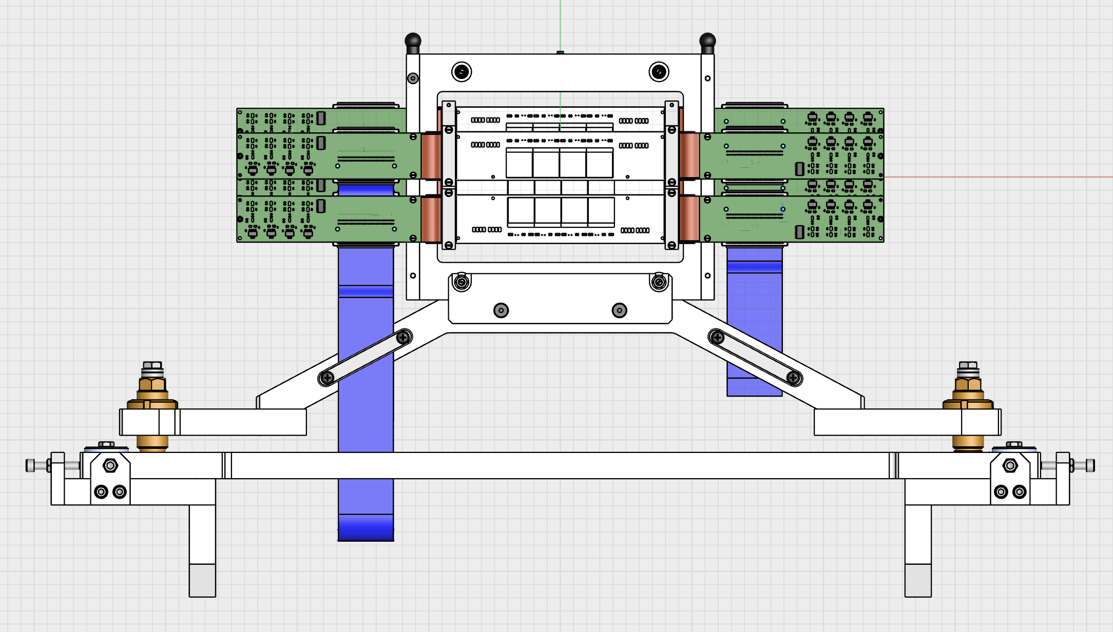
Geometry
I assumed that the origin of CAD is actually the origin of the detector local frame
Beam (entering)

Slide 4
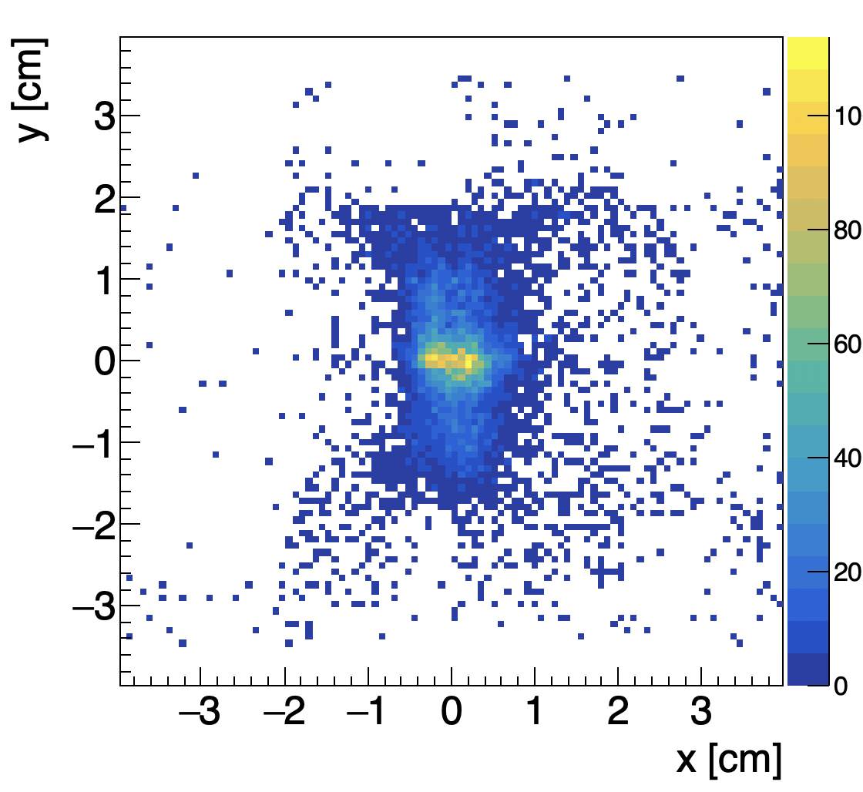
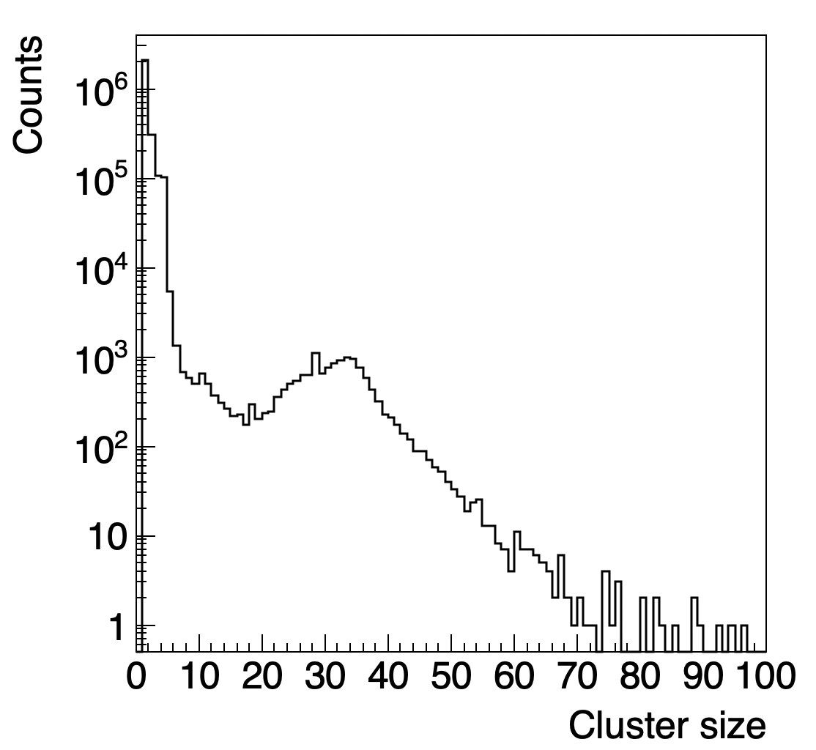
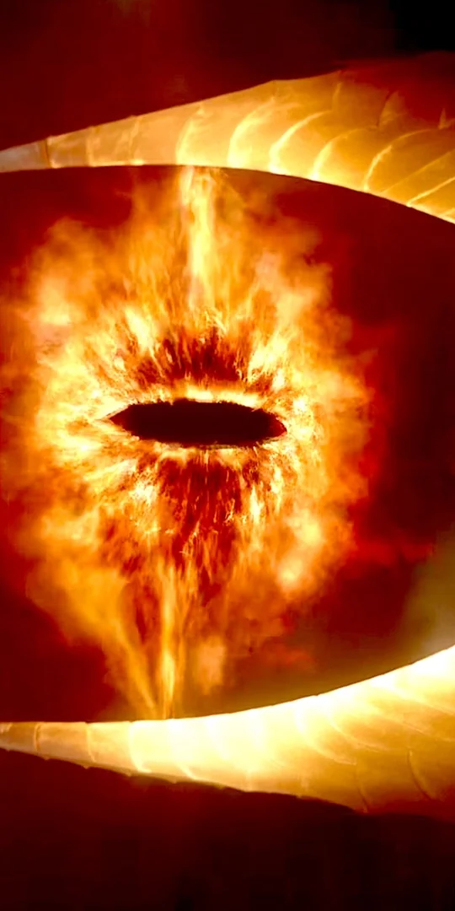
Beam @ CNA02025
Run 7909 sync, 100k events, cluster size>20
IT map
IT clus size

Slide 5
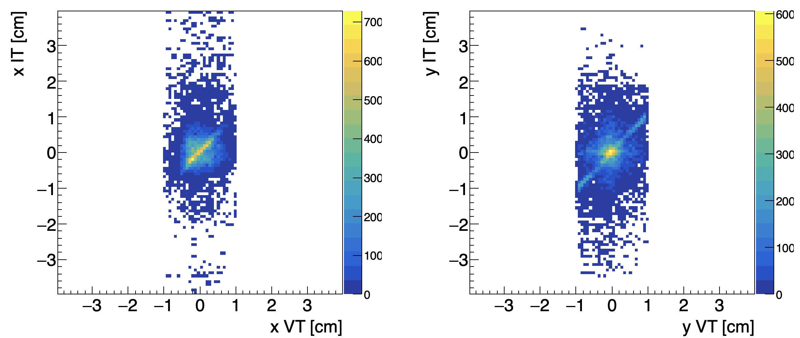
Correlation with VT clusters
Run 7909 sync, 100k events, cluster size>20

Slide 6
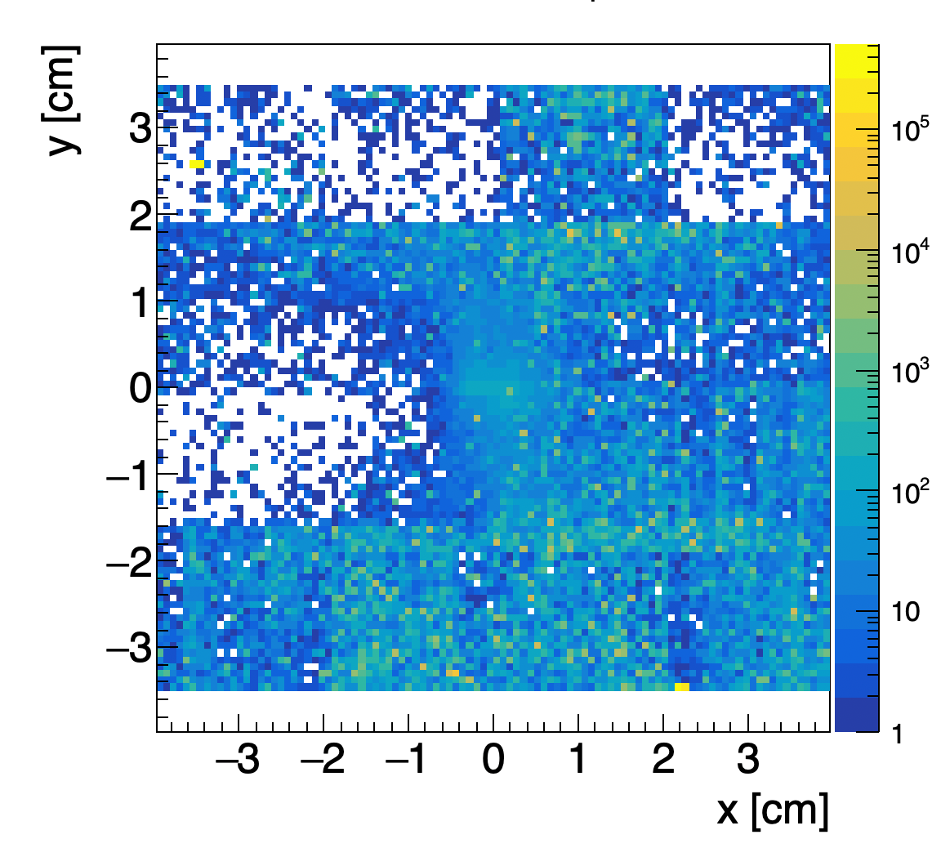
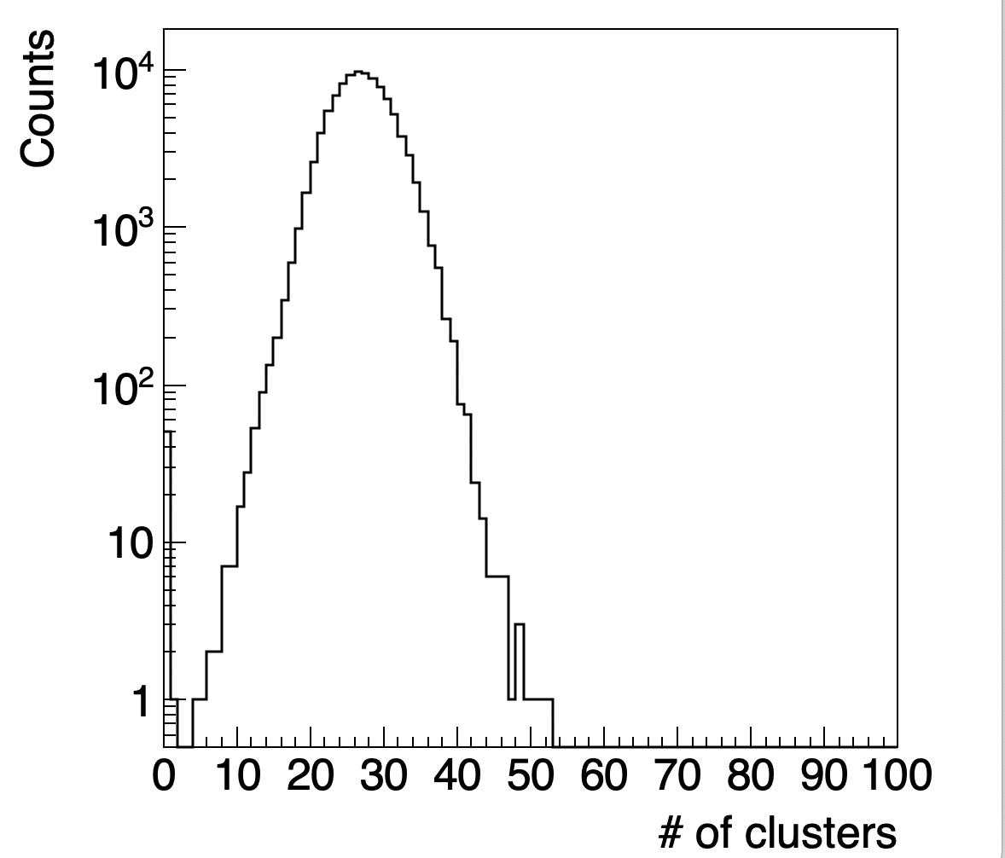
Noise
Run 7909 sync, 100k events, no selection of cluster size
It means ~
1 clus/evt/sensor
Still many hot spots due to noisy pixels → job @ LNF is starting

Slide 7
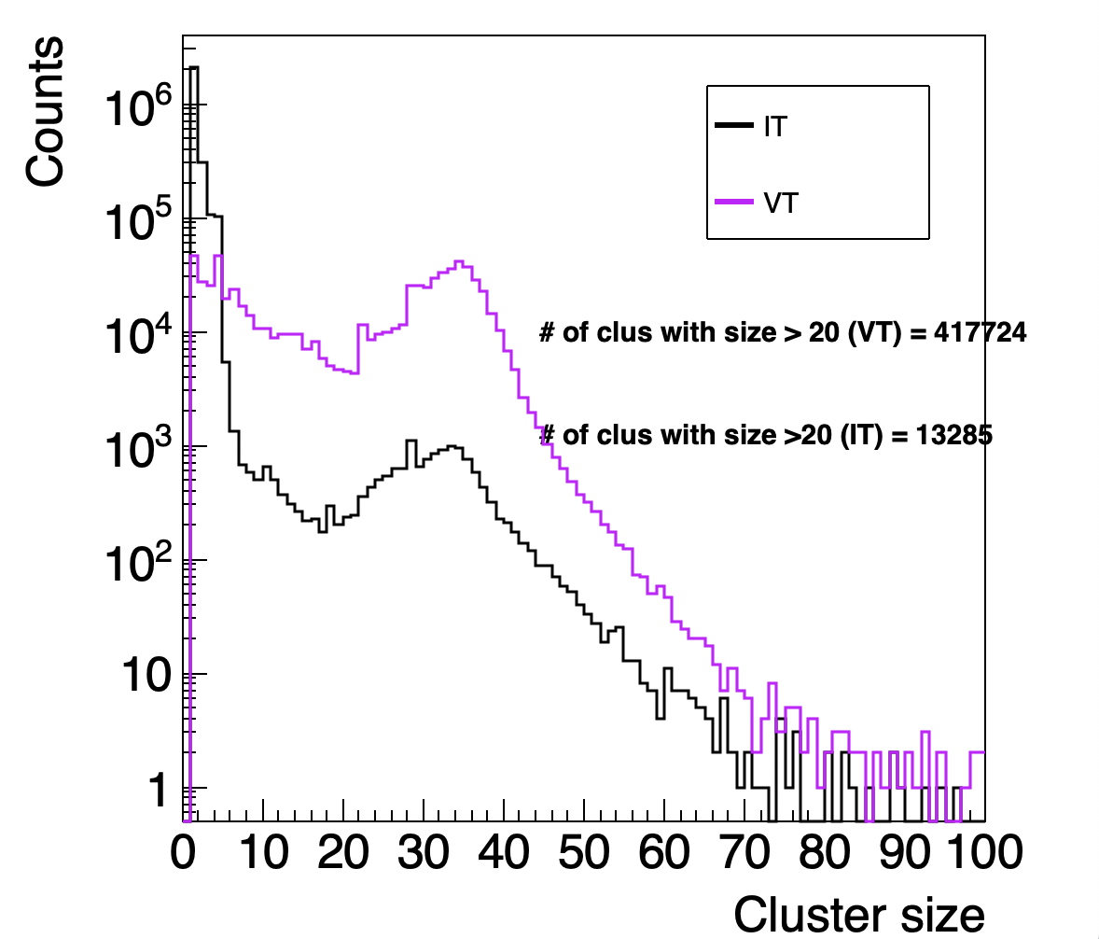
Some numbers
100k events
28/32 IT active sensors
VT threshold @ 7 sigma,
IT thresholds @ 10 sigma
Assuming a 100% efficiency on carbon ions we expect:
            ~400k clusters + pile-up on the VT
            ~200k clusters + pile up on the IT
→ IT “Efficiency” on carbon ion close to 10%

Slide 8
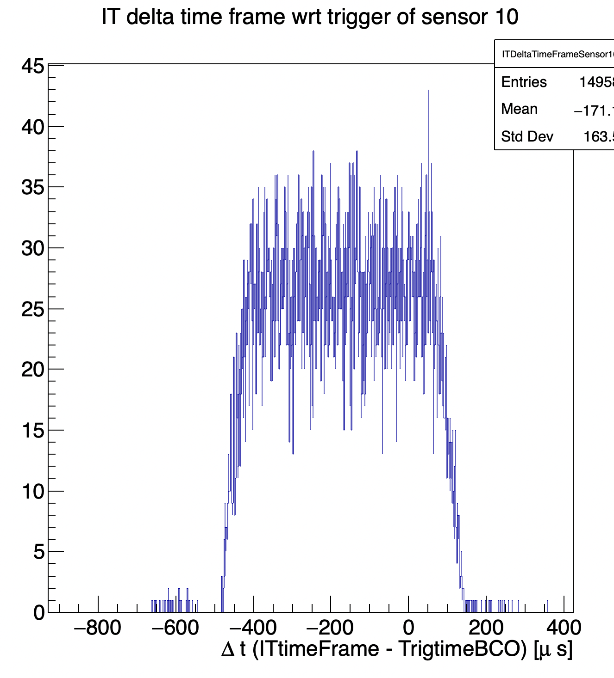
First check: timing…
All sensors shows the same behaviour, no timing issues observed at a first look
600 us

Slide 9
Next steps
LNF work is starting: proper settings of threshold and masks
Cross-check the mapping: possible measurement with laser
Solve the issues observed @ CNAO on specific sensors/board
Understand the reason of such inefficiency

