Slide 1




G.De Palma, E. Bissaldi, L. Di Venere, F. Gargano, F. Giordano, F. Licciulli,
P. Loizzo, M.N. Mazziotta, M. Cecca
CsI and Hodo SMART board for the ADAPT instrument
ADAPT collaboration meeting, Bari, December 4th, 2025

Slide 2
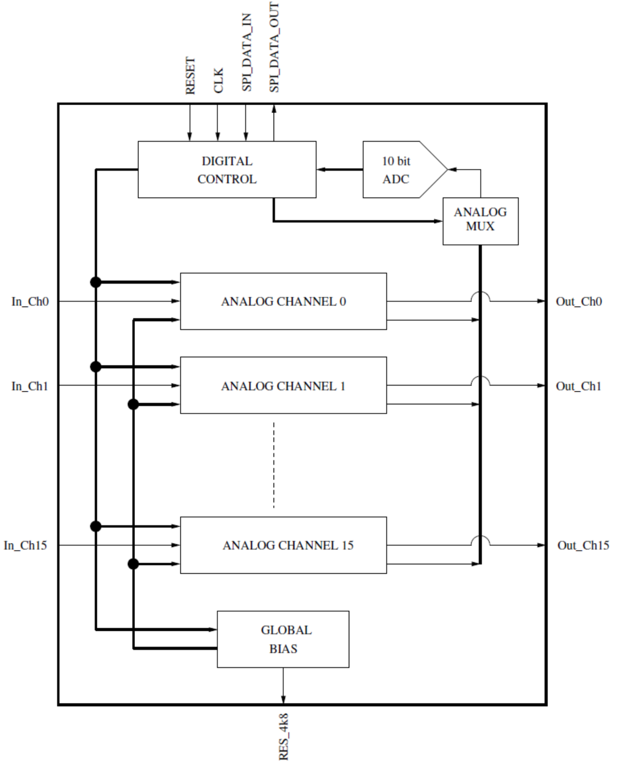
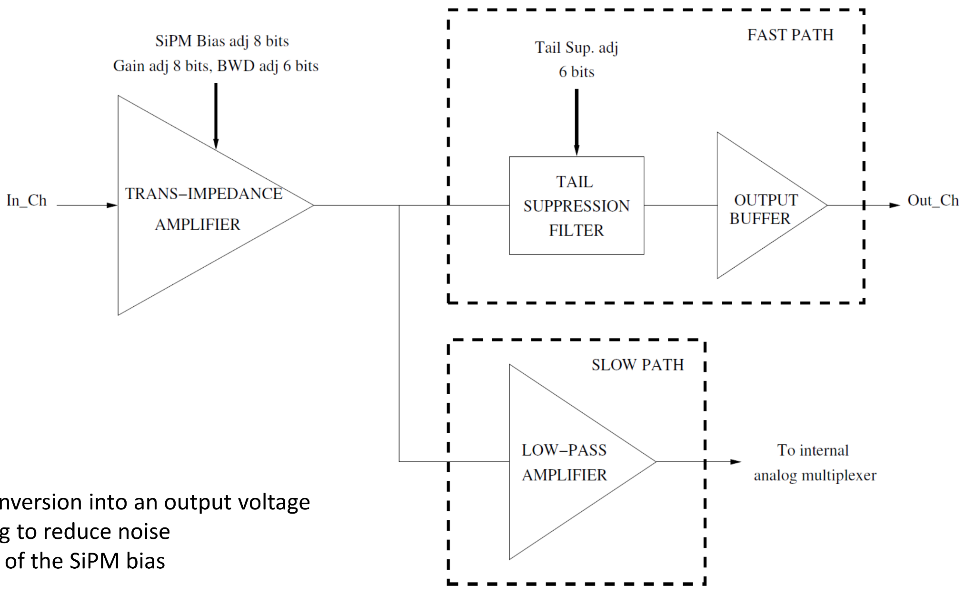
THE SMART2 ASIC
Pre-amplifier designed by INFN Bari
16-channel trans-impedance amplifier
1 MHz LVDS SPI interface
20-bit global adjustment: R (8 bits), C (6 bits), PZ (6 bits)
8-bit per channel for SiPM bias fine tuning
R Gain Resistance
C Filtering Capacitance
PZ Pole Zero Cancellation

Slide 3
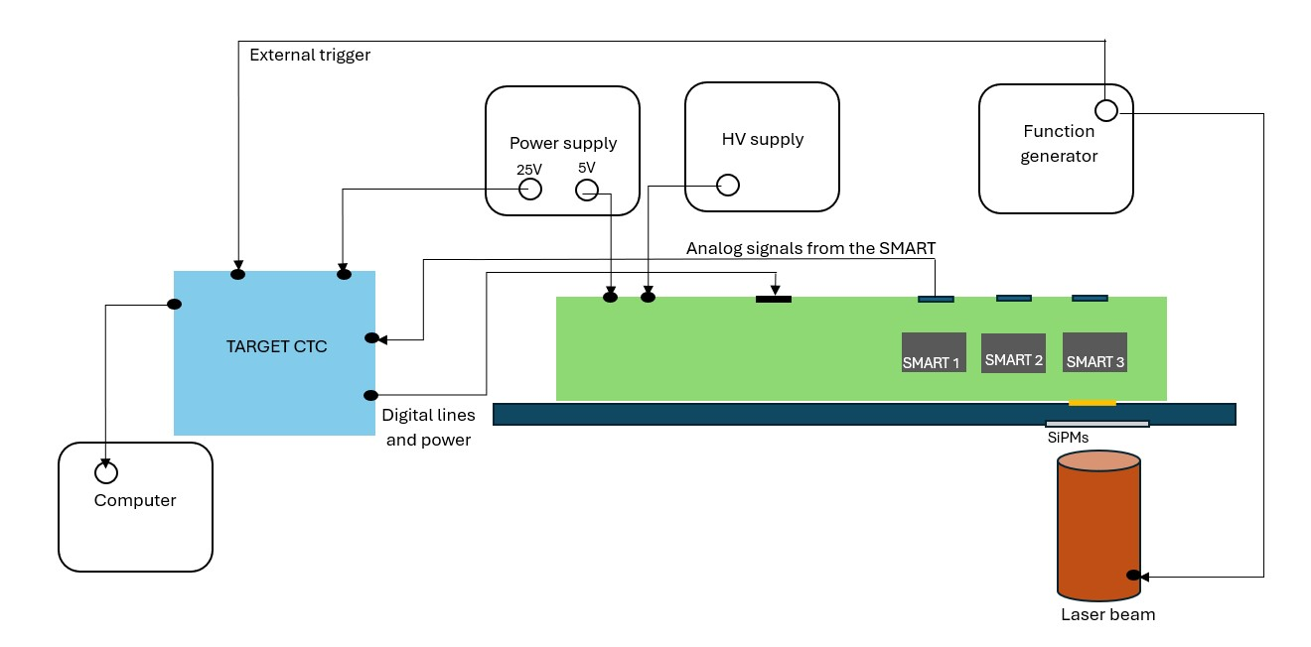
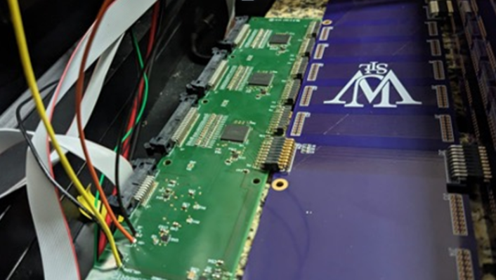
THE HODOSCOPE SMART BOARD
Experimental Setup
3 SMART ASICs (48 channels) divided in six blocks
SiPMs Board: 8 Hamamatsu S13360-2050VE 2x2 mm² SiPMs that are moved on each block separately
Laser to lighten the SiPMs up (350nm)
TARGET CTC (8 channels) that digitizes the signals coming from each block
HV power supply (57 V)
Power supply
Function generator to trigger the laser (square wave, 500 Hz, -1 Vpp, Voffset=0.5 V, simmetry=0.1%)
Tested for the QC
40 boards
3 SMART2 ASICs per board
16 SiPM per SMART2
Total of 1920 channels
R | C | PZ | V_{DAC}
0 | 0 | 63 | 100
0 | 32 | 63 | 100
32 | 32 | 63 | 100
0 | 32 | 63 | 250
0 | 32 | 63 | 5
Notes:
perche calorimetro (imaging)

Slide 4
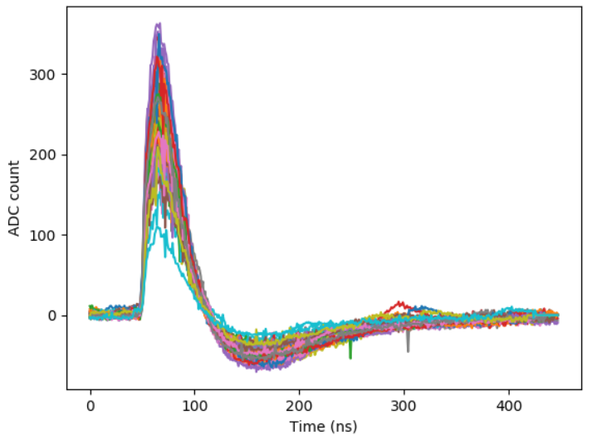
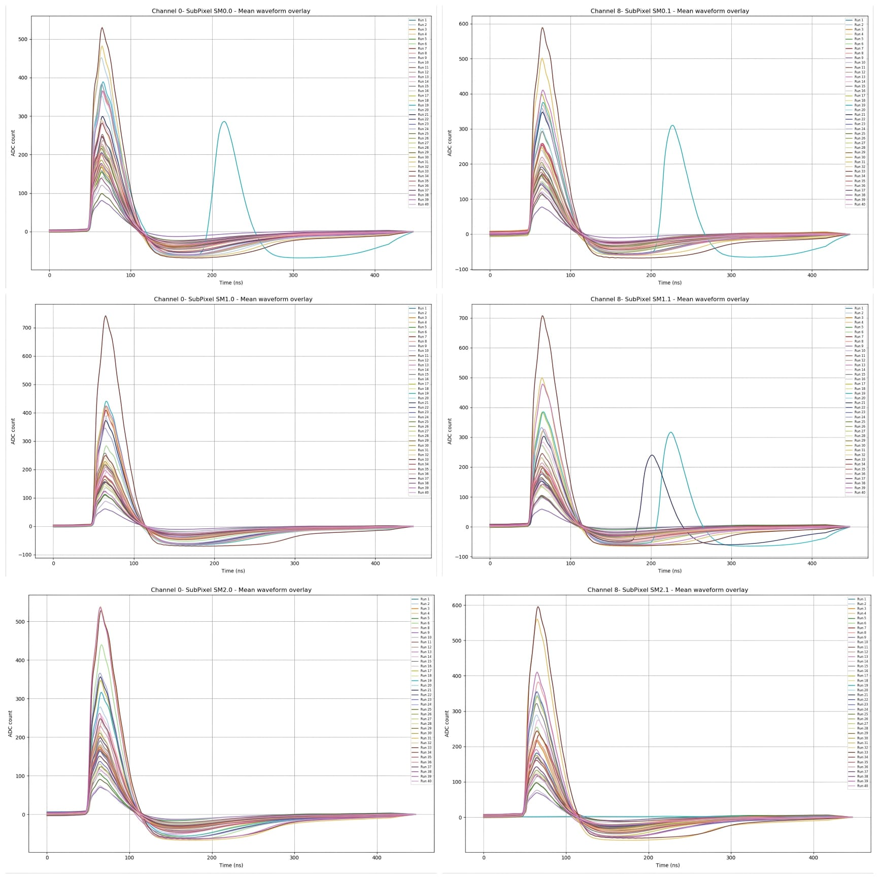
PULSE
Raw waveforms coming from the TARGET for CH0 of board 1
Mean waveform of CH0 for each block of each board (R=0,C=32,PZ=63)

Slide 5
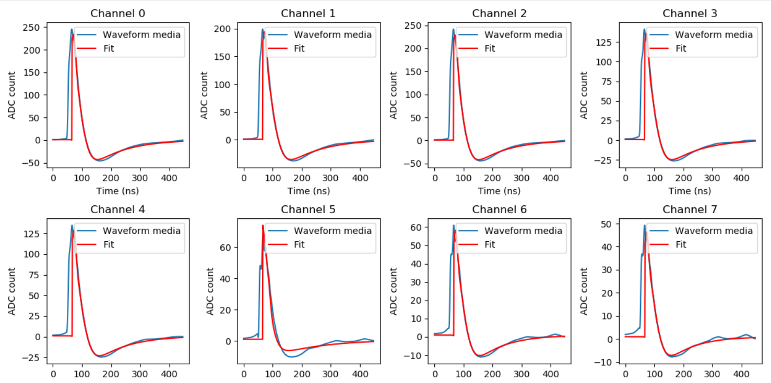
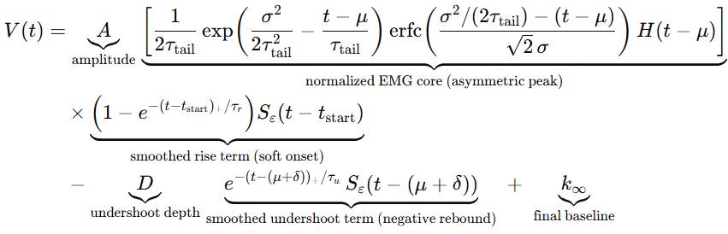

PULSE SHAPE OPTIMIZATION
Fitting
Captures quick rising front, gaussian peak with exponential decay, undershoot and its exponential rise
The function still needs to be optimized in order to better fit the starting point of the rise
The function well fits also the last three SiPMs waveforms; however their peak is lower than the other, due to the fact that they were hit by less light; these channels were not included in the following analysis
Board 1, first block, R=0, C=32, PZ=63

Slide 6
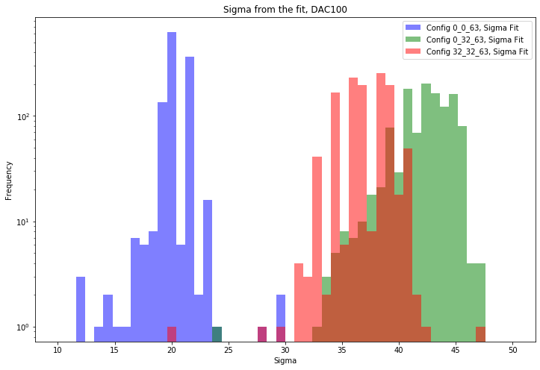
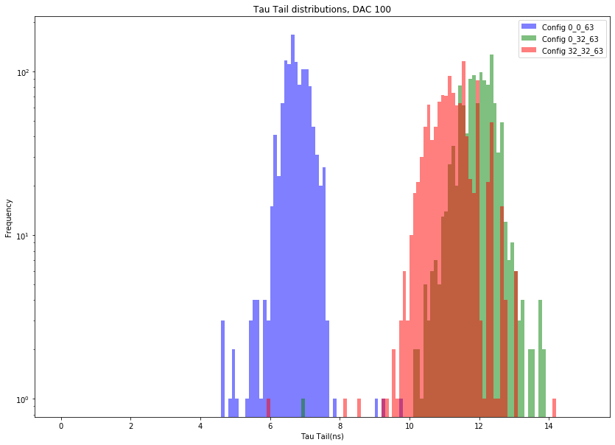
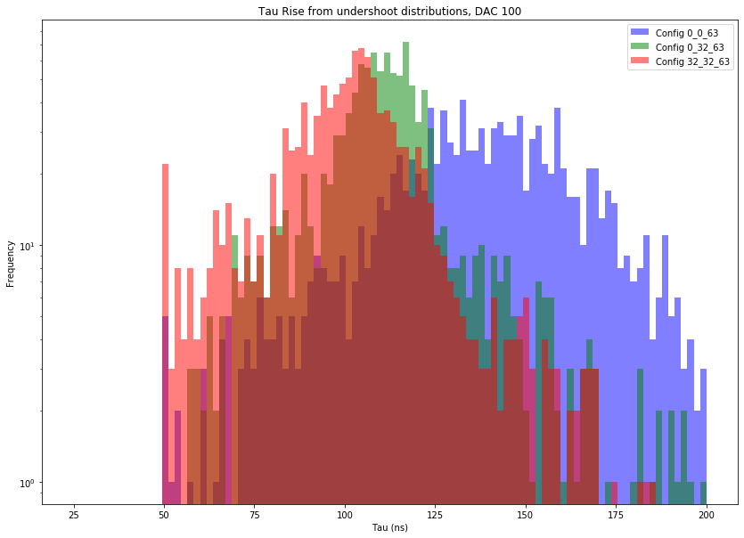
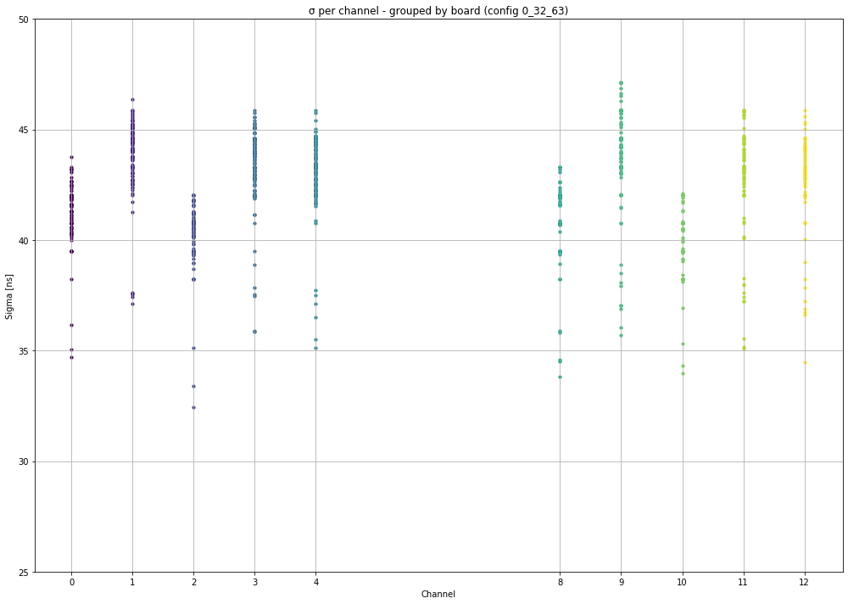
PULSE SHAPE OPTIMIZATION
Fitting Parameters
Three R,C and PZ configurations, fixed V_{DAC} value
Extracted parameters
σ pulse width
τ_{u} rise after undershoot
τ_{tail} exponential fall

Slide 7
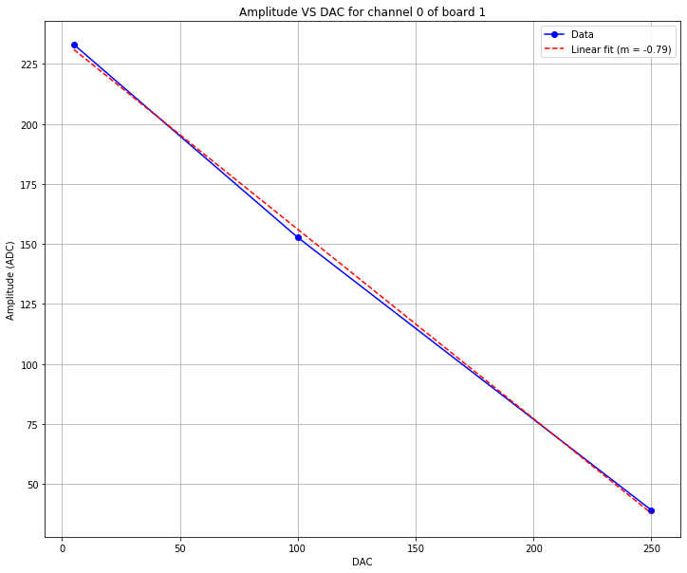
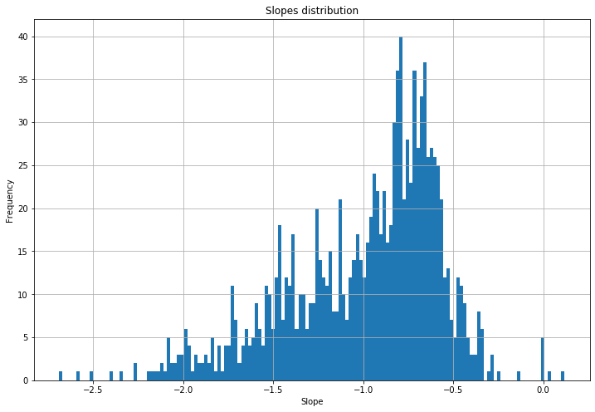
PULSE SHAPE OPTIMIZATION
Fitting Parameters
Extracted parameters
Slopes of how the maximum of the waveform changes with VDAC value at R=0,C=32, PZ=63

Slide 8
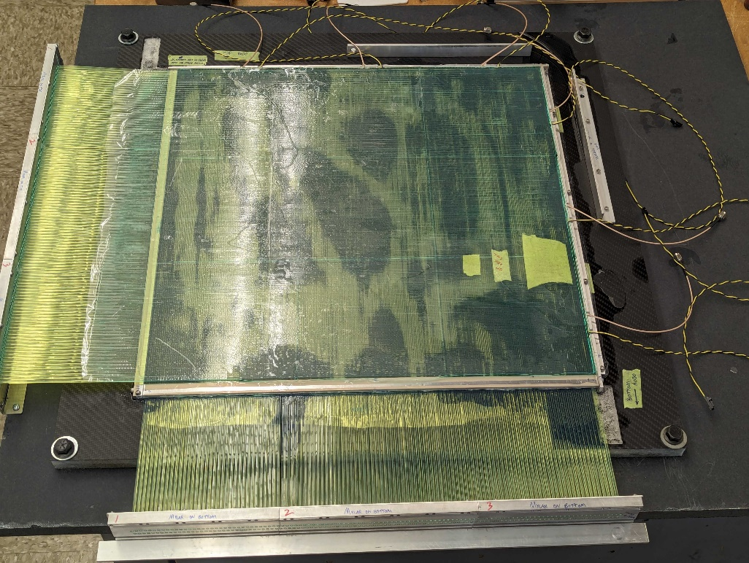
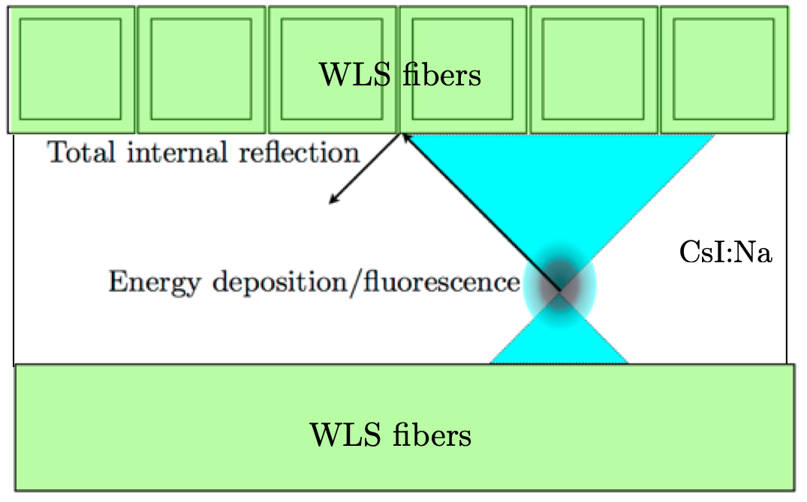
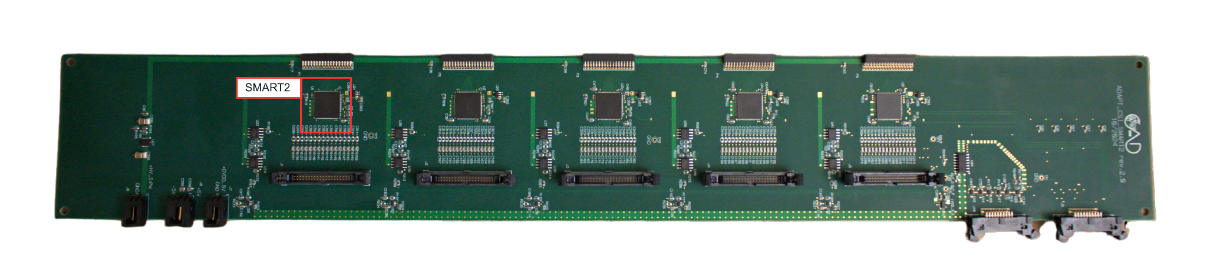
THE IMAGING CSI CALORIMETER
A single plane of ICC is made of 9 15x15x0.5 cm³ CsI:Na tiles
Edge detectors
Each plane is between 225 2x2mm² WLS fibres per view
Each fibre is directly coupled to a single 3x3mm² SiPM
Two crystal edges coupled to 120 3x3mm² SiPM array (edge detectors)
Energy measurement by edge detectors and tracking by WLS fibers
To reduce the number of readout channel a 3-fold SiPMs merge is done
Pre-amplification board hosting 5 SMART2 ASICs (80 channels)
On-board trigger system
Notes:
perche calorimetro (imaging)

Slide 9
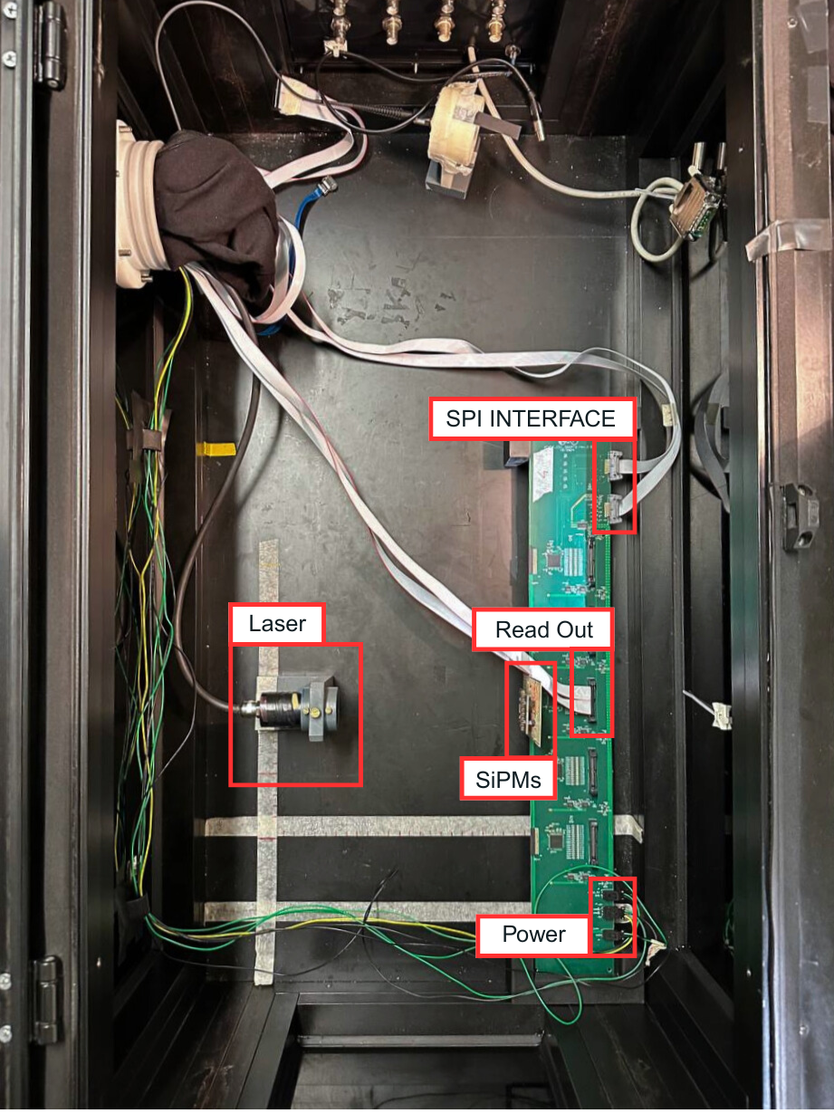
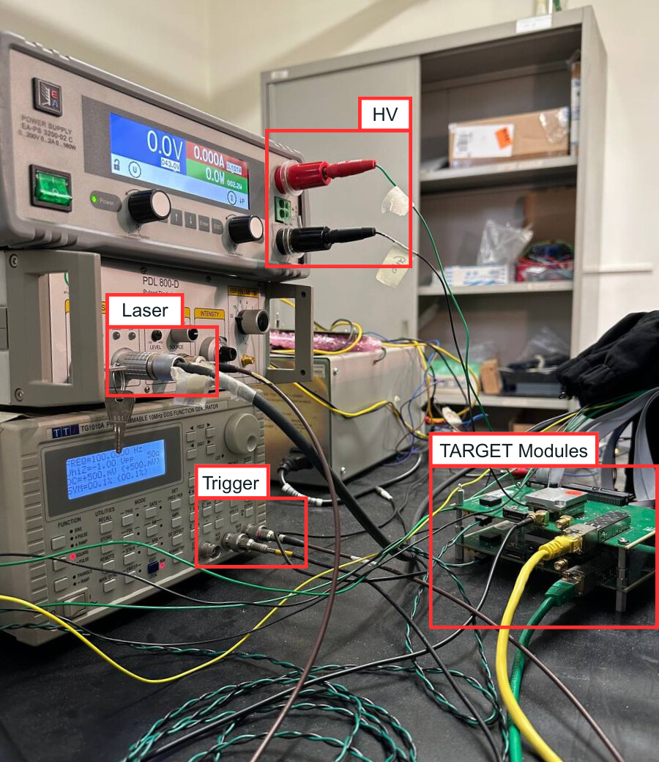
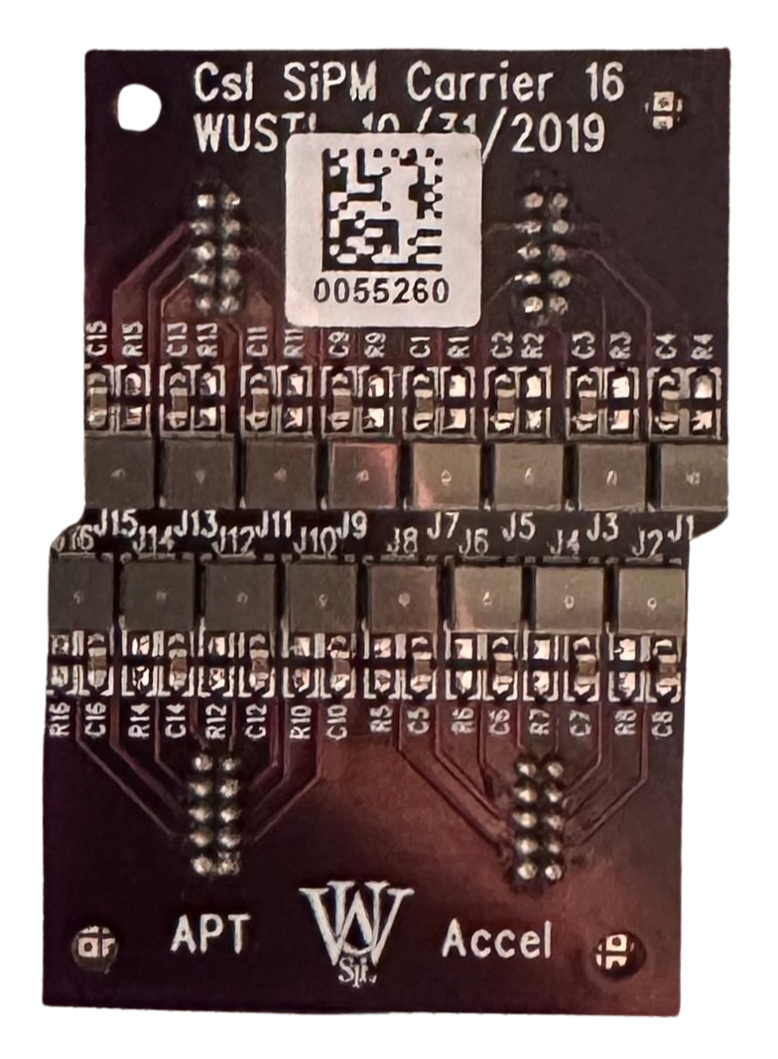
ICC SMART BOARD PROTOTYPE AND QUALITY CONTROL
Experimental Setup
Boards placed in a dark box and illuminated by a pulsed laser
Amplified and shaped signals sent outside to the digitizer (TARGET)
Function generator provides synchronous trigger to laser and digitizer
Tested for the QC
11 pre-amplification boards
5 SMART2 ASICs per board
16 SiPM per SMART2
Total of 880 channels

Slide 10
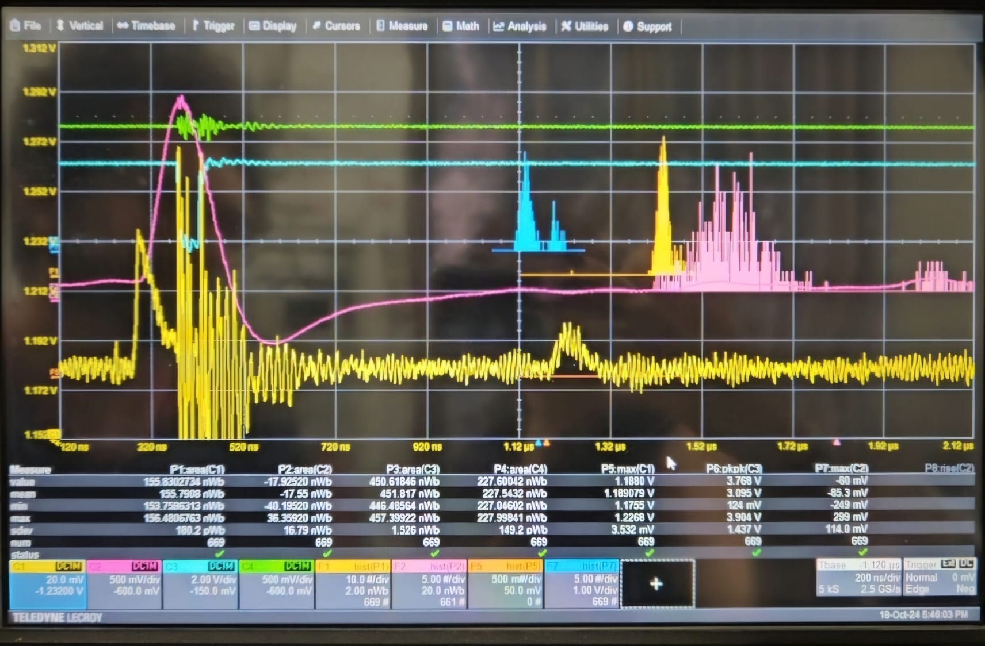
PROTOTYPING PHASE
Method
Tests and analysis performed
Analog output of one SMART channel
Analog output of summer amplifier
NOT Fast OR
Threshold
1
Oscilloscope measurements:
Threshold scan
HV scan
P.E. peaks identification
Gain and efficiency calculation
PROBLEM: Noise as high as the signal on the single SMART channel
2
Signals acquired with the TARGET to check the noise
Threshold scan
Waveform and integrated charge distributions
Scan over integration window

Slide 11
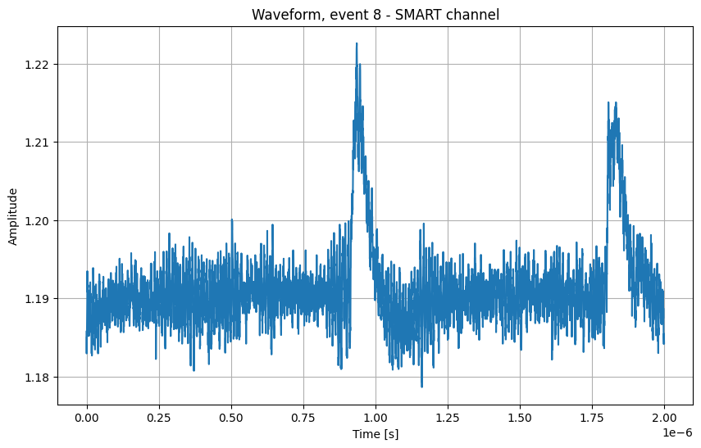
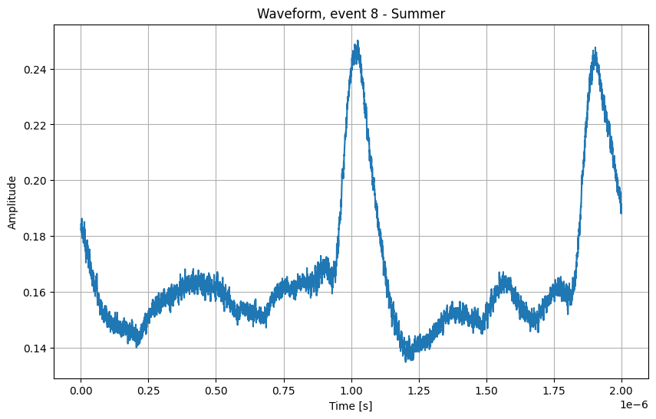
PROTOTYPING PHASE
Oscilloscope analysis
Threshold scan: 300-100 DAC at three HV values, i.e. 42V-43V-44V
1
N.B. results for threshold between 160 and 100 were not included, since there was an high noise due to the proximity of baseline and threshold

Slide 12
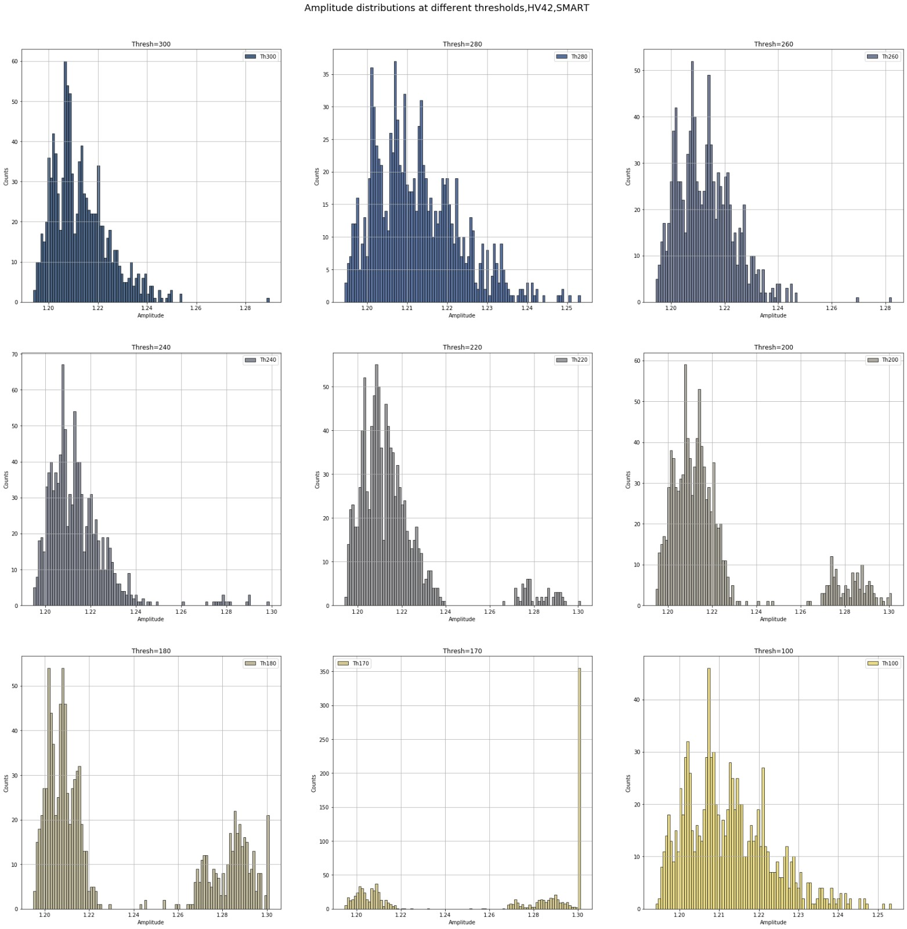
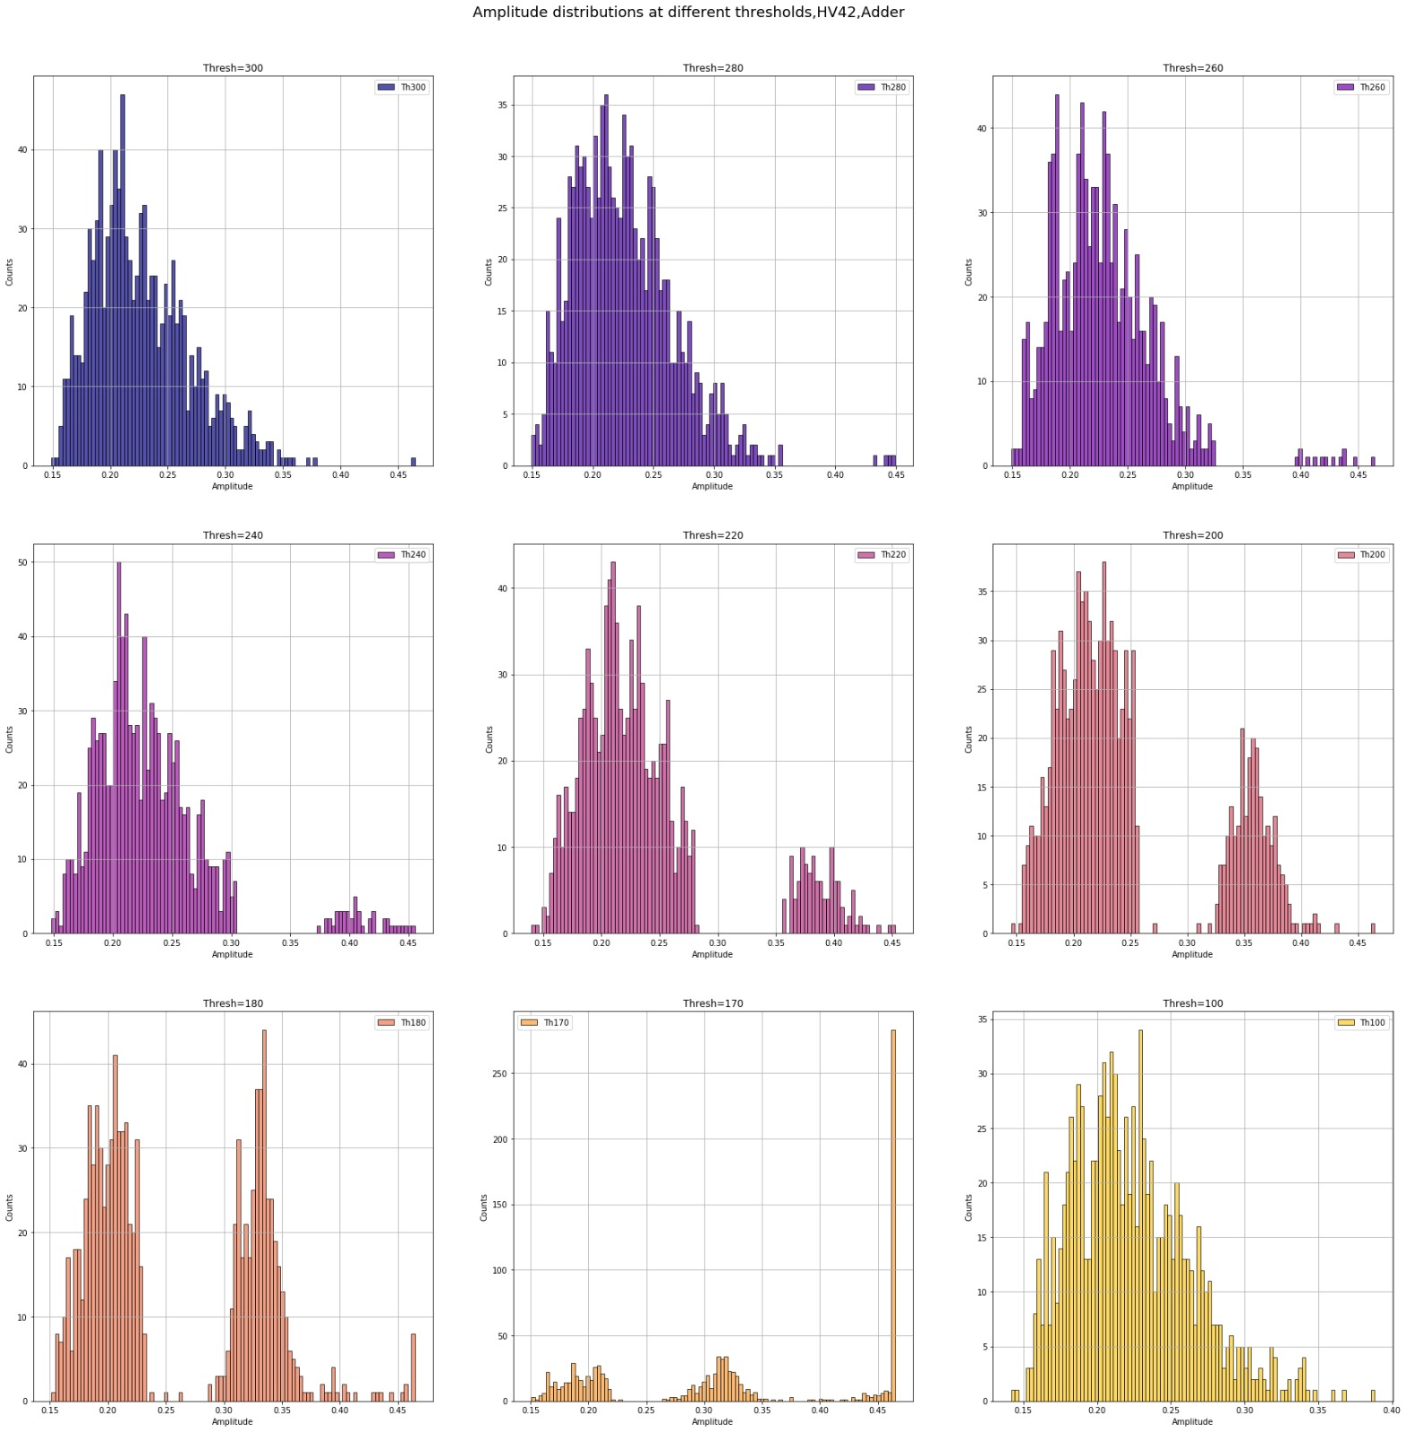
PROTOTYPING PHASE
Oscilloscope analysis
Amplitude distribution for different thresholds
2
Right: amplitude distributions for each threshold, adder output, HV=42 V
Left: amplitude distributions for each threshold, SMART output, HV=42 V

Slide 13
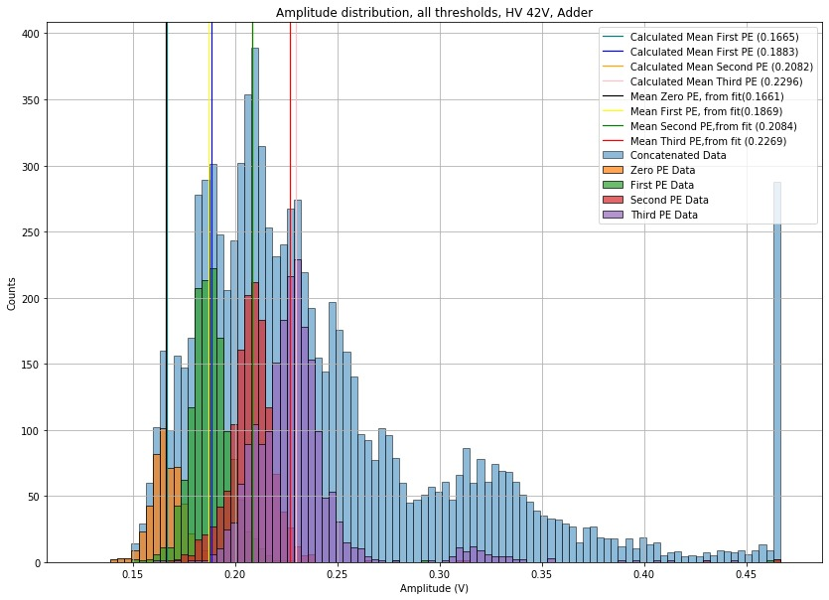
PROTOTYPING PHASE
Oscilloscope analysis
P.E. events identification
3
P.E. events found by identifying the peaks in the amplitude distribution of the SMART, then selecting which events were in the around-peaks intervals and selecting the corresponding ones in the adder.
The values of the peaks were obtained by performing a gaussian fit

Slide 14
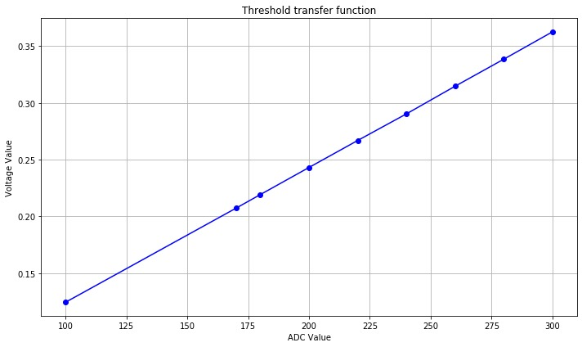
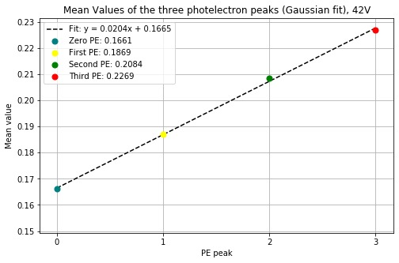
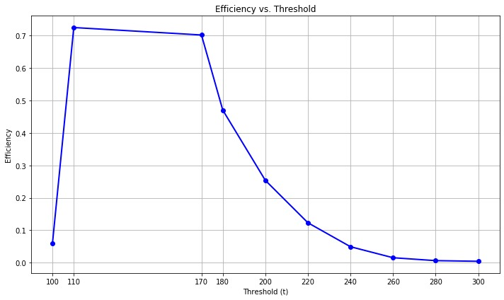
PROTOTYPING PHASE
DAC-mV
transfer function
Oscilloscope analysis
Gain and Efficiency calculation
4
Efficiency: trigger events/total events
N.B. Efficiency was first calculated as a function of threshold in DAC counts; through the transfer function and the gain we were able to perform the DAC->mV and mV->P.E. conversion
HV=42V: 20 mV/p.e
HV=43V: 30 mV/p.e
HV=44V: 37 mV/p.e

Slide 15
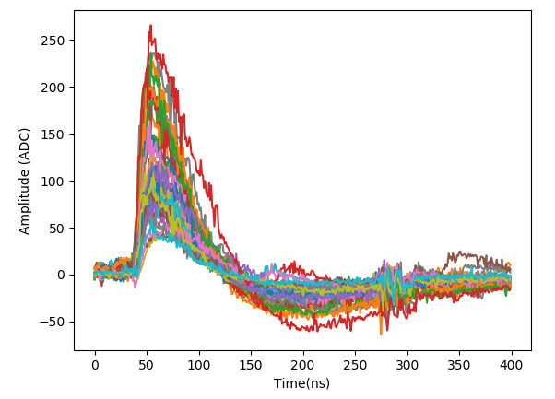
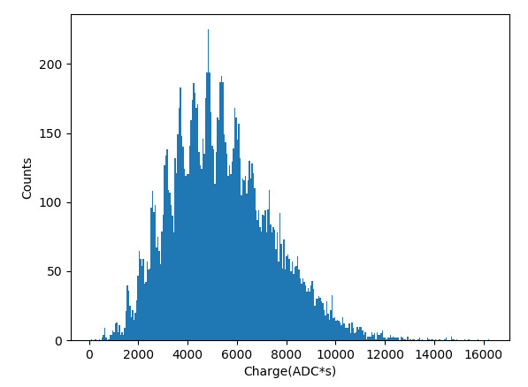
PROTOTYPING PHASE
TARGET analysis
1
Threshold scan to check the noise between 100 and 170 ADC counts present in the oscilloscope data
Large step analysis between 4000 and 200 ADC
Step of 10 between 200 and 80 ADC
Waveforms and integrated charge distributions at a threshold of 80, ch 31, 0_32_63, V_{DAC}100

Slide 16
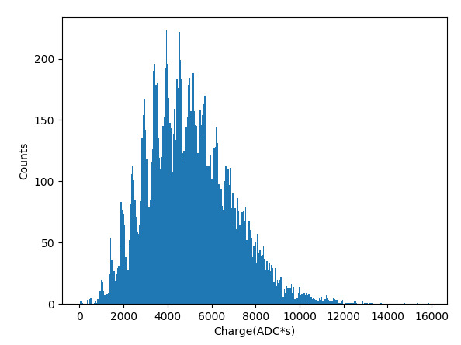
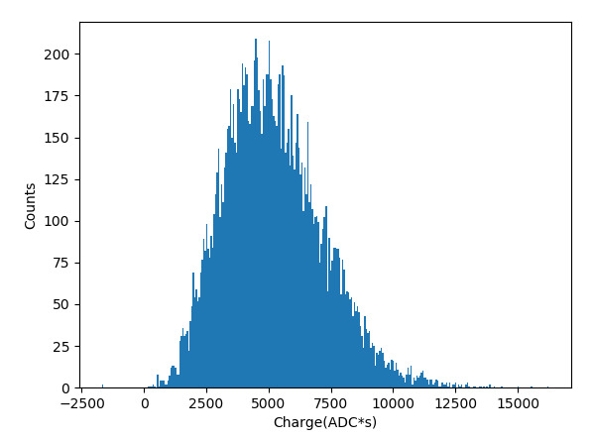
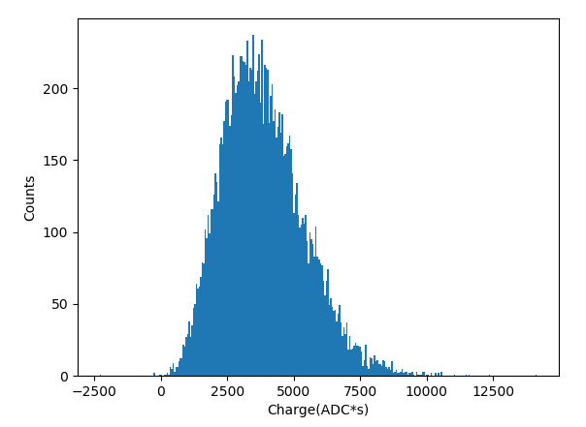
PROTOTYPING PHASE
TARGET analysis
2
Scan on integration window
Since the TARGET performs a filtering on the signal, the noise seen on the oscilloscope on the signal of channel 31, was still visible but was smaller; to see its influence on the integrated charge distribution, the integration window was changed in order to gradually include the noise
Channel 31, Threshold 1500
40:100
40:160
40:220
Since the noise is delayed by 50 ns, when integrating between 40ns and 100ns there is no noise

Slide 17
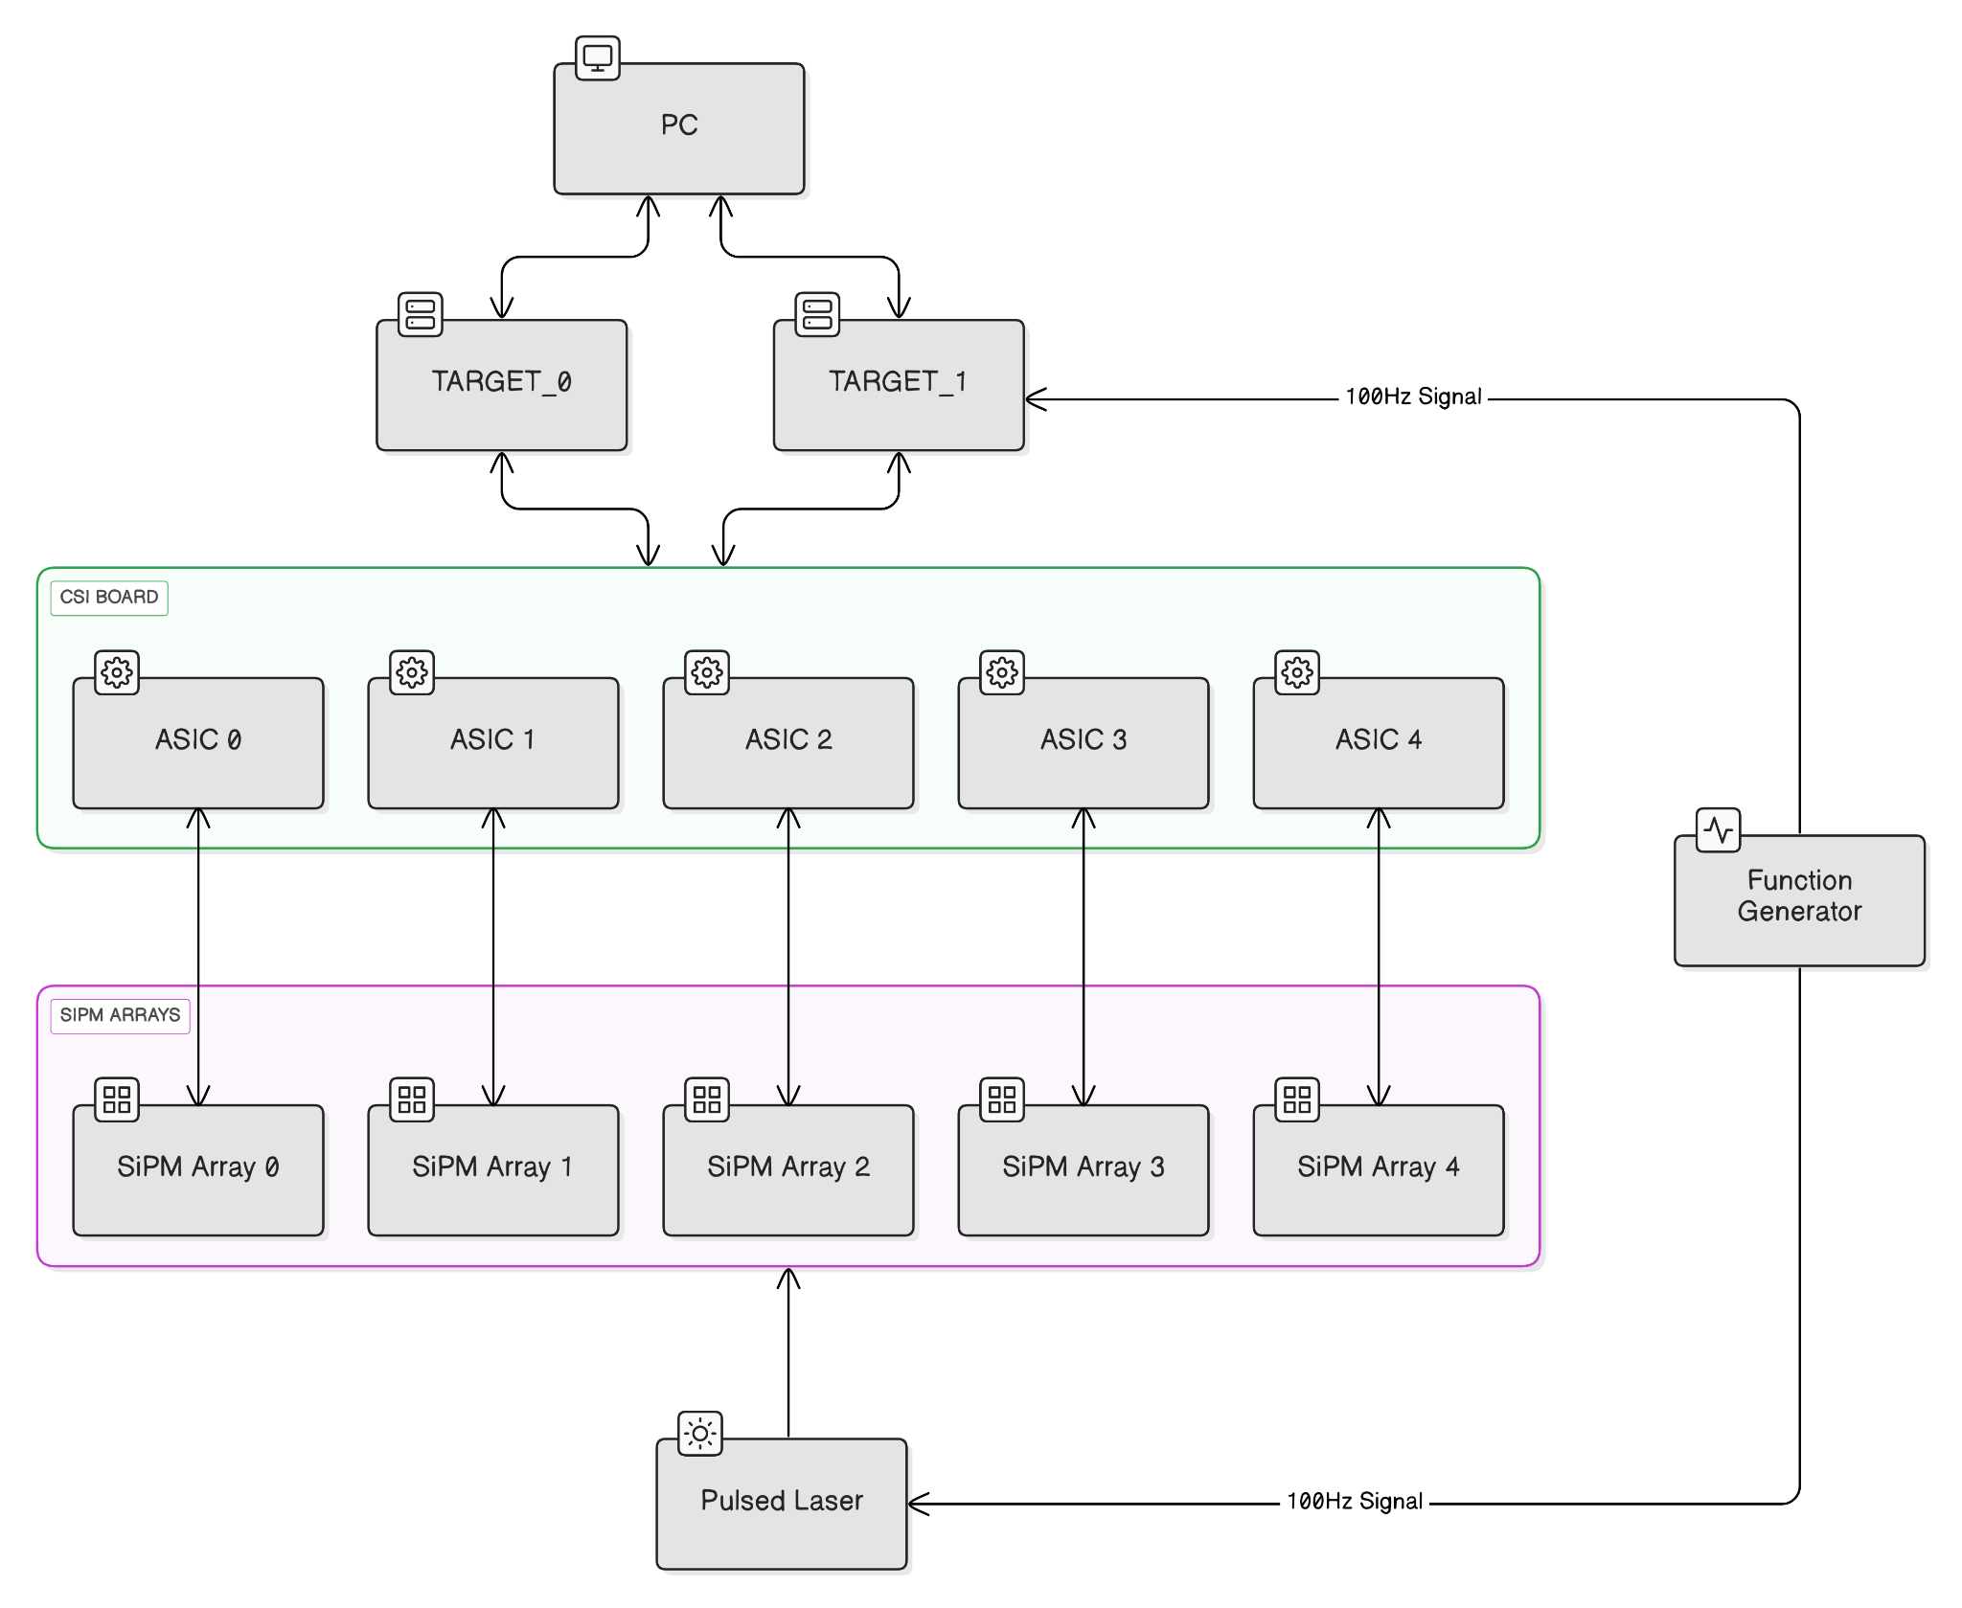
ICC SMART BOARD QUALITY CONTROL
Experimental Setup
Source specifics
• Laser external triggered
• Frequency 100 Hz - Signal Acquisition
• Frequency 1 kHz - Trigger Efficiency
Power Supplies
• TARGET: 24.0 V
• SiPM HV: 43.0 V
• CsI-Board: ± 3.6 V

Slide 18
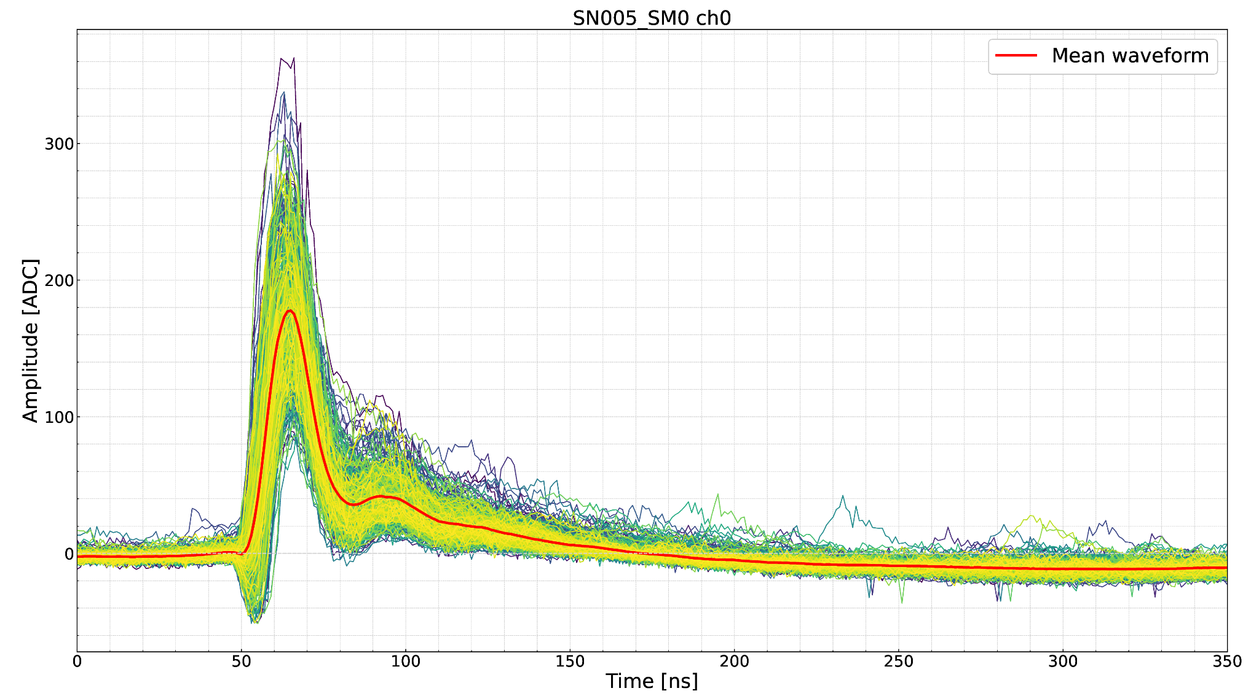
QUALITY CONTROL
Experimental Setup
Test performed
Event display of a typical acquisition after the pedestal subtraction for one channel
1
Power test and DAC functionality test
2
Signal integrity test and SiPM bias scan
3
SMART2 shaping test
4
Trigger response test
1000 waveforms acquired per channel (10 s @ 100 Hz)
Tested 16-channels at a time (1 SMART2)
Notes:
0_13_0

Slide 19
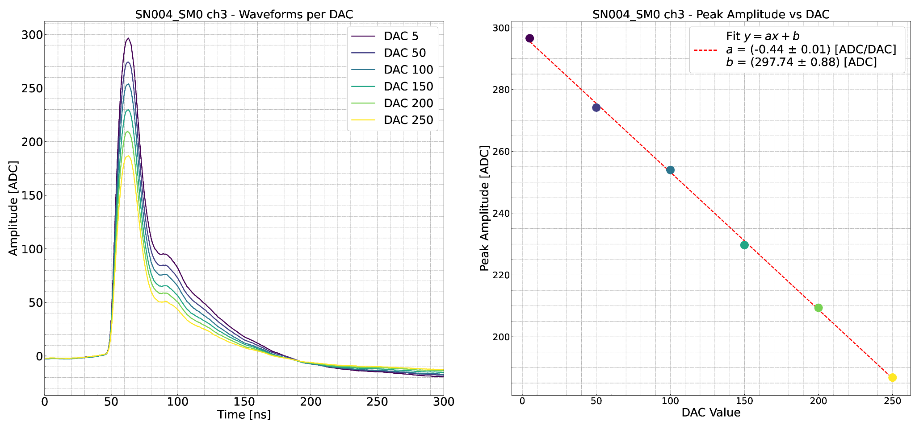
QUALITY CONTROL
SiPM Bias scan
Average slope across 880 channels
a = -0.36 ± 0.08 ADC/DAC
Validate channel uniformity
Waveforms acquired at multiple SMART2 bias-DAC value
Verified linear decrease of pulse amplitude with increasing DAC value
Notes:
0_13_0

Slide 20
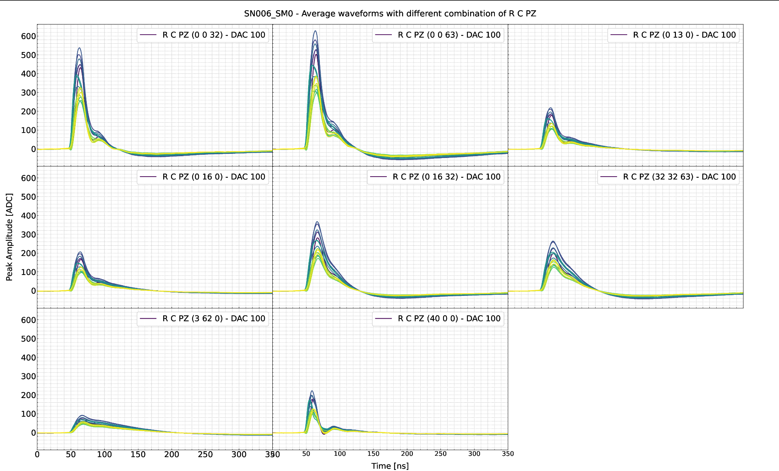
QUALITY CONTROL
SMART2 Shaping test
Waveforms acquired for 7 (R, C, PZ) combinations
Test confirms that shaping registers are correctly applied across all channels
Different shaping settings produce consistent and expected pulse shape variations
Amplitude differences between channels mainly due to laser diffusion non-uniformity
R Gain Resistance
C Filtering Capacitance
PZ Pole Zero Cancellation

Slide 21
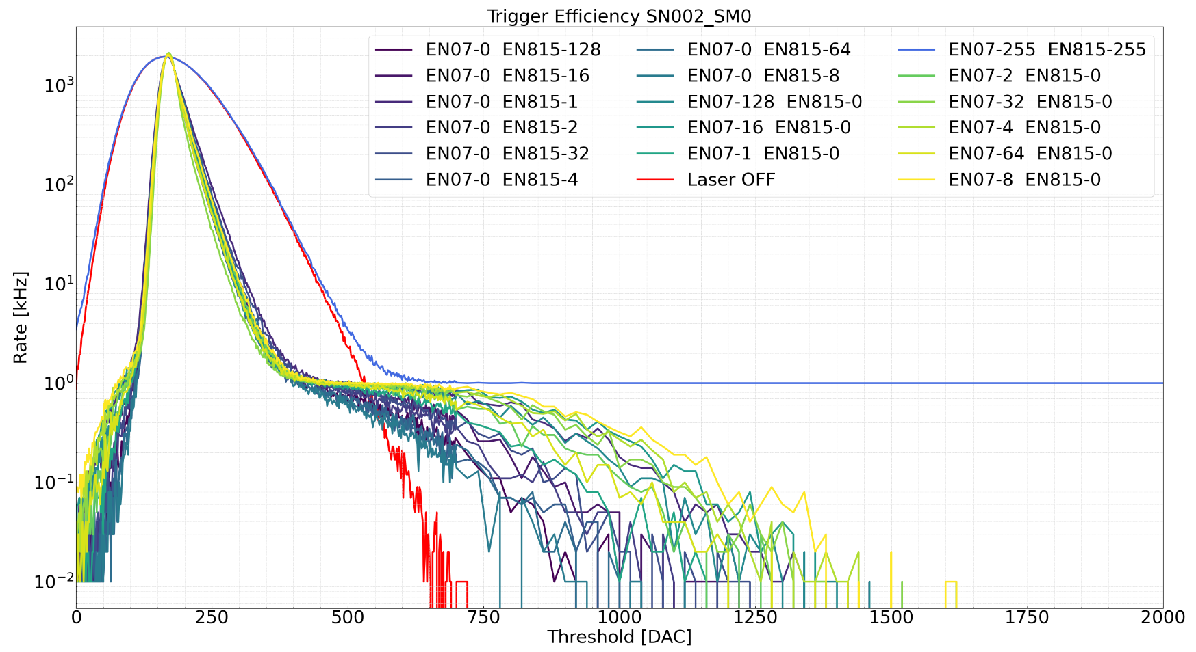
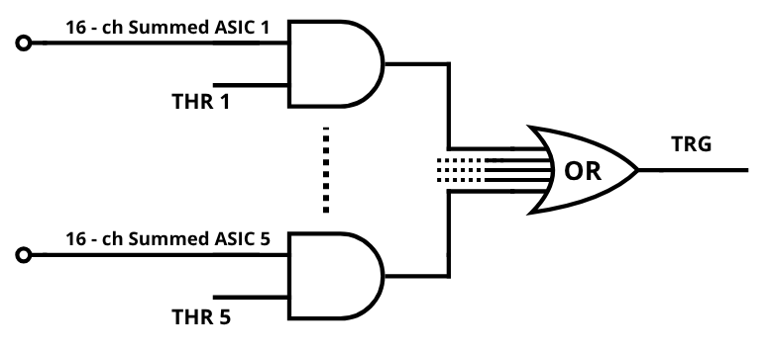
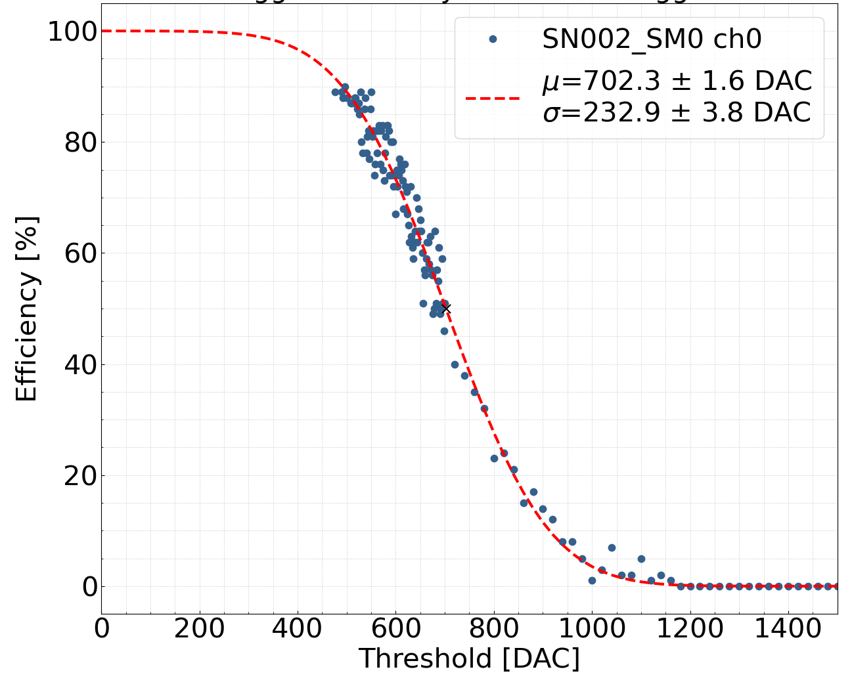
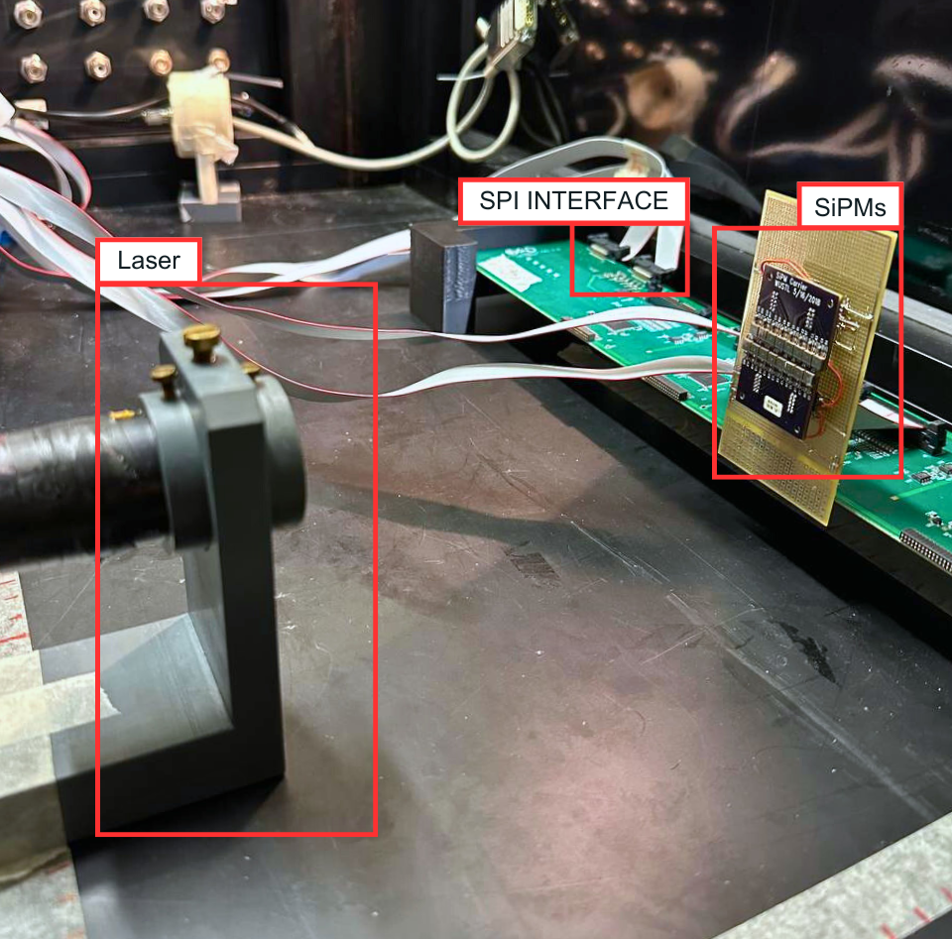
QUALITY CONTROL
Trigger Response
The pre-amplification board has a level-0 trigger chain
bit-mask selects the channel
The 16 outputs of SMART2 are summed and sent to a fast discriminator
1
2
The 5 discriminator outputs are OR-combined
3
The digital output is the trigger signal sent to the digitizer
Used a pulsed laser @ 1 kHz
Tested each channel individually
A register on the digitizer counted the triggers accumulated in a interval Δt
The efficiency curve has been obtained

Slide 22
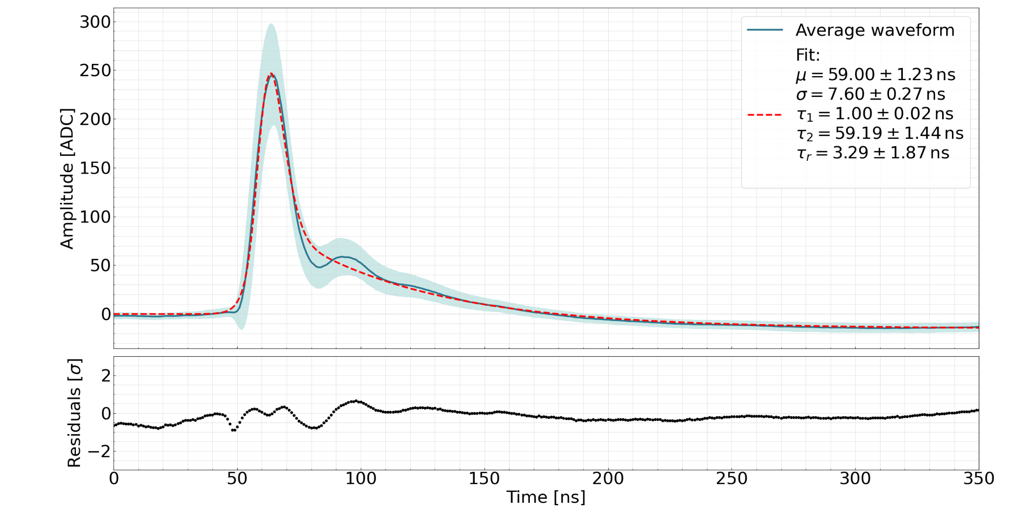
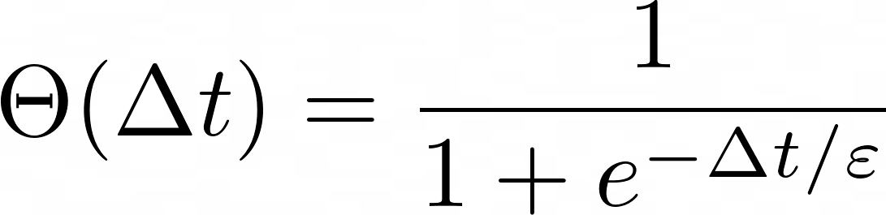
PULSE SHAPE OPTIMIZATION
Fitting
Each waveform averaged over 1000 laser pulses and fitted with analytical function
Captures rising front, double exponential decay, and undershoot
Residuals showed no structured deviations → model accurately describes the signal
Notes:
Configurazione 0_13_0

Slide 23
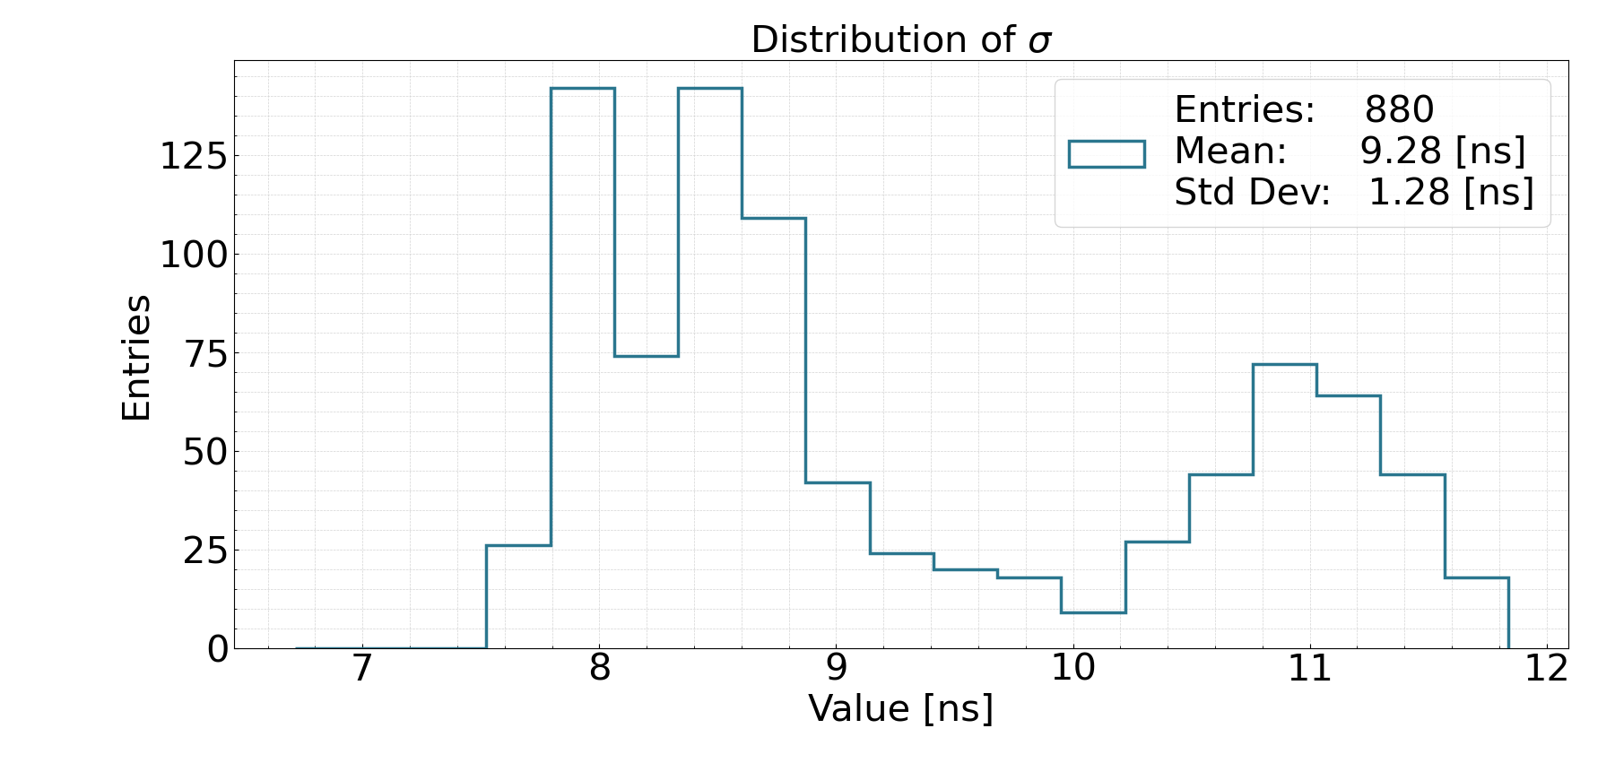
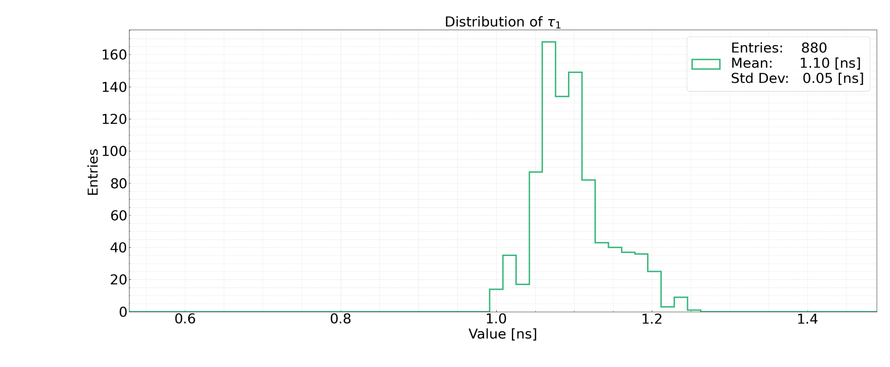
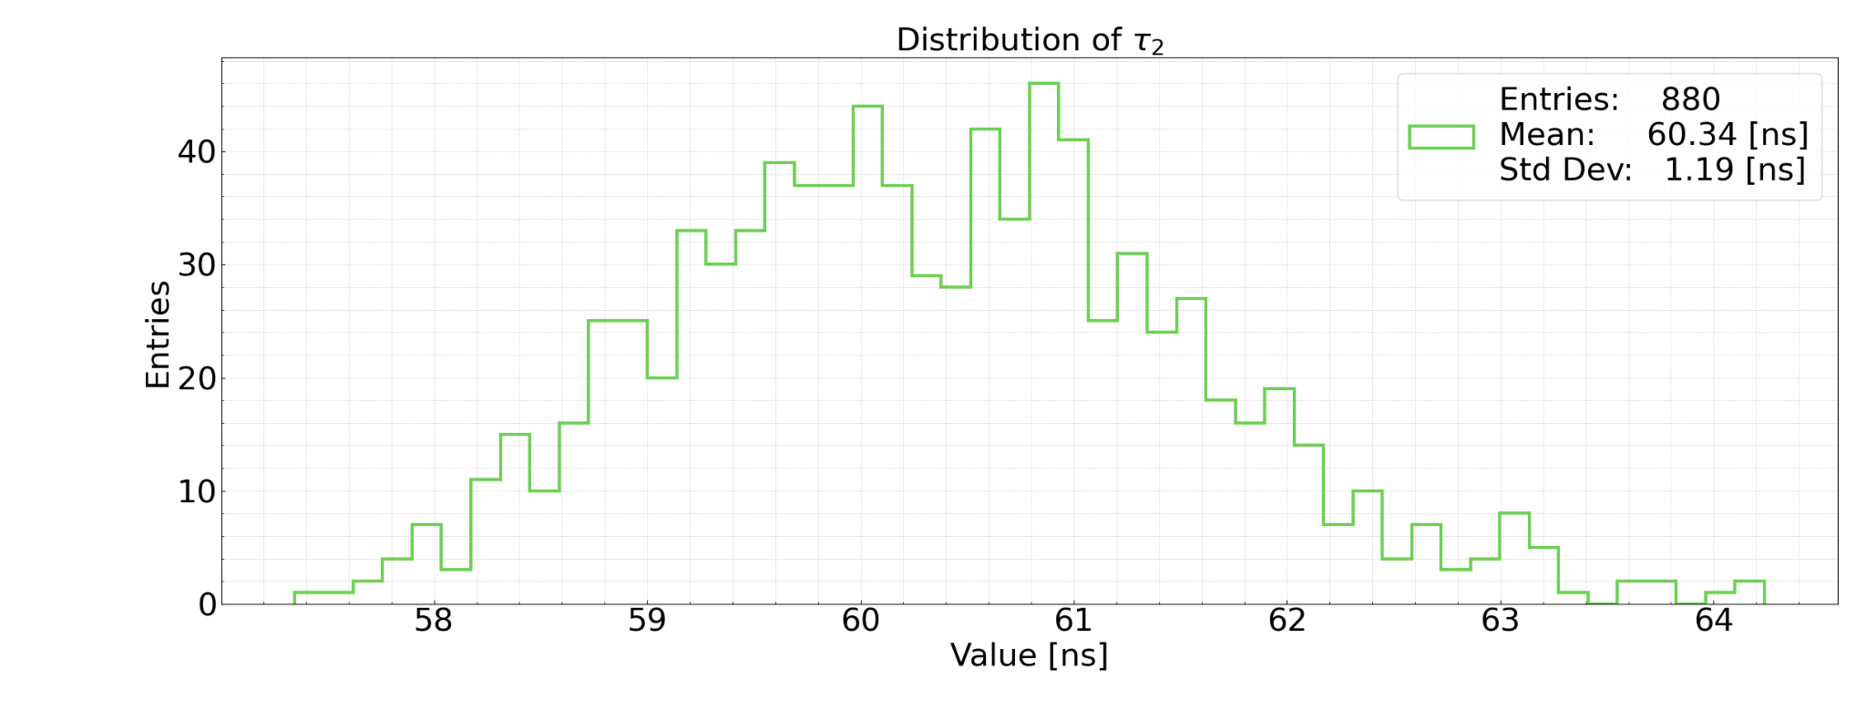
PULSE SHAPE OPTIMIZATION
Fitting Parameters
Extracted parameters
σ pulse width
τ₁ fast fall
τ₂ slow fall
Consistent fall time across channels
σ shows bimodal distribution

Slide 24
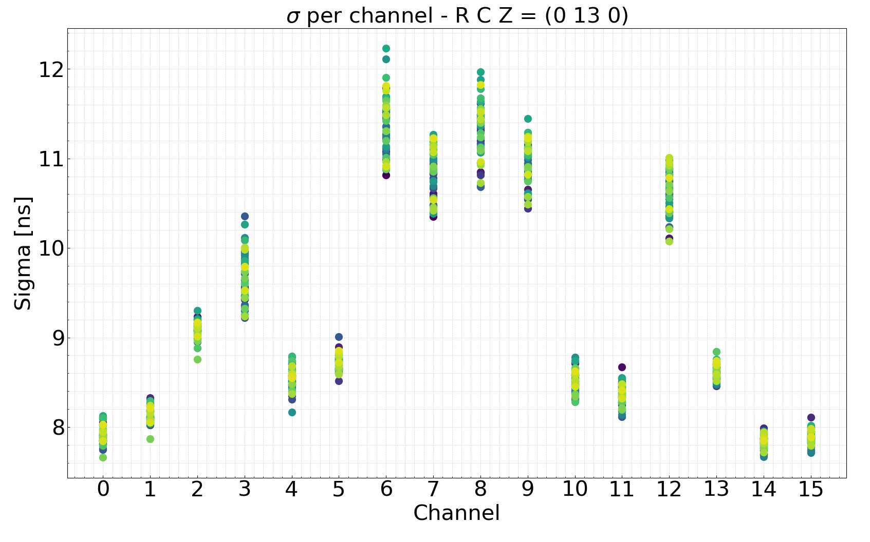
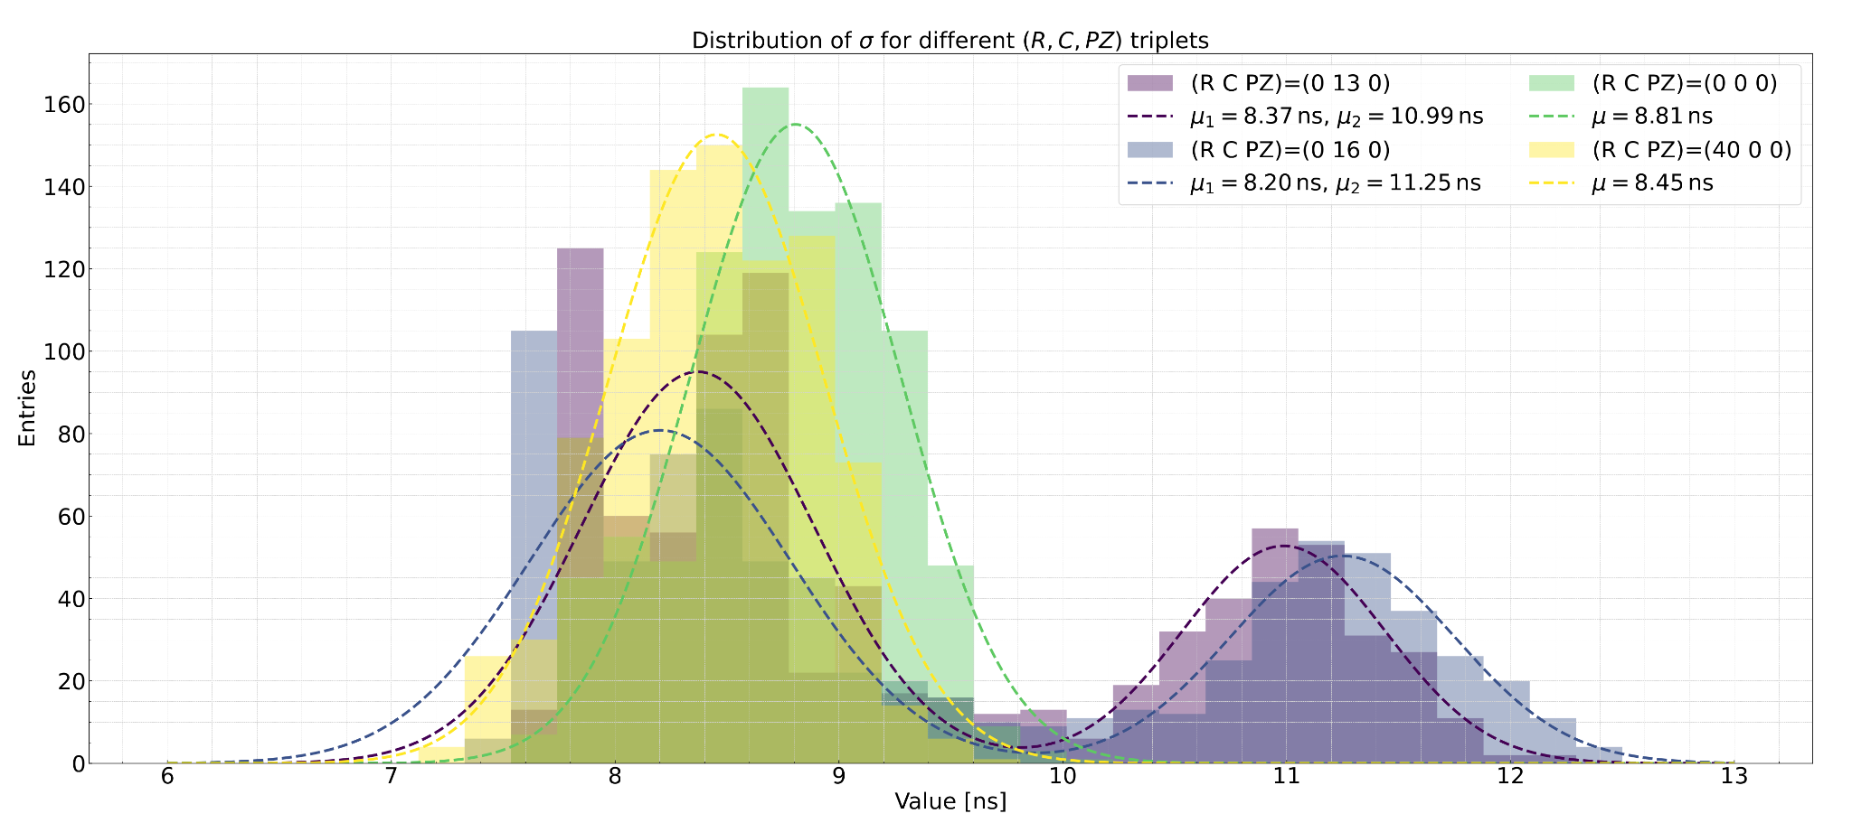
PULSE SHAPE OPTIMIZATION
Fitting Parameters
Distribution of σ for different shaping settings
• C = 0 → unimodal and symmetric
• C ≠ 0 → bimodal, edge effect appears
Systematic lower σ
values for the outermost channels.
Effect attributed to reduced “effective” shaping capacitance at SMART2 edges

Slide 25
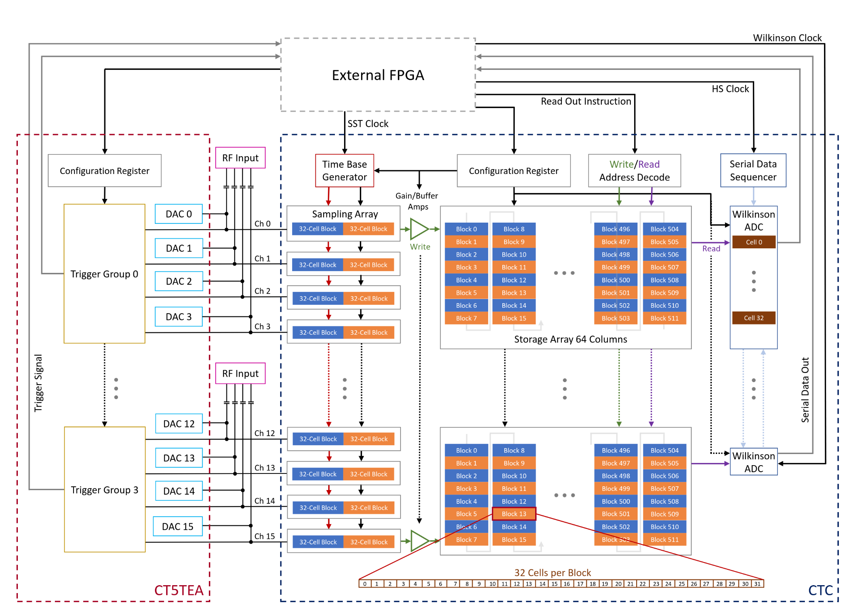

Backup
TARGET Digitizer
16-channel Switched-Capacitor digitizer
Sampling rate: up to 1 GS/s
Storage depth: • Each channel has 512 blocks of 32 cells (1 ns/cell) • Total buffer depth: ~16.4 µs
Ping-pong architecture: • Two blocks of 32 cells alternate between sampling and storage • Enables dead-time-free acquisition
Digitization: • All 32 cells in a block digitized in parallel • 12-bit Wilkinson ADCs per channel
• Voltage range of 2.2 V
Configurable via SPI: • Sampling control, readout addresses, bias trims

