Slide 1
Status of the wirechamber laboratory activities
M. Anelli, G. Bencivenni, P. Ciambrone, R. Kereselidze, G. Morello, M. Palutan, E. Paoletti, G. Papalino, S. Serafino, R. Tesauro, E. Tskhadadze

Slide 2

Joint venture for MWPC construction: gantt chart
 | GIOVEDI 25/09/2025 | VENERD 26/09/2025 | LUNDEDI 29/09/2025 | MARTEDI 30/09/2025 | MERCOLEDI 01/10/2025 | GIOVEDI 02/10/2025 | VENERDI 03/10/2025 | LUNEDI 06/10/2025 | MARTEDI 07/10/2025 | MERCOLEDI 08/10/2025 | GIOVEDI 09/10/2025 | VENERDI 10/10/2025 | LUNEDI 13/10/2025 | MARTEDI 14/10/2025
incollaggio connettori gas | 10
incollaggio pannelli |  | L1A + L2A | L3A + L4A | L5A + L5B | L1B + L2B | L3B + L4B
lucidature + incollaggio barre HV |  |  | L1A + L2A | L3A + L4A | L5A + L5B solo lucidatura 1 lato | L1B + L2B | L3B + L4B
filatura + incollaggio fili |  |  |  |  |  |  |  | L1A + L2A |  | L3A + L4A
saldatura + barre laterali |  |  |  |  |  |  |  |  | L1A + L2A |  | L3A + L4A
test pannello |  |  |  |  |  |  |  |  |  | L1A + L2A |  | L3A + L4A
chiusura camera |  |  |  |  |  |  |  |  |  |  |  |  | L1A + L2A + L3A + L4A + L5A
test camera |  |  |  |  |  |  |  |  |  |  |  |  | camera A
 |  |  |  |  |  |  |  |  |  |  |  |  |  | ULTIMO GIORNO
Material for two quadri-gaps MWPC
The assembly of the second quadri-gaps follows the same steps
The main goal is the technology transfer from the well-skilled LNF
group to the TBilisi institute

Slide 3
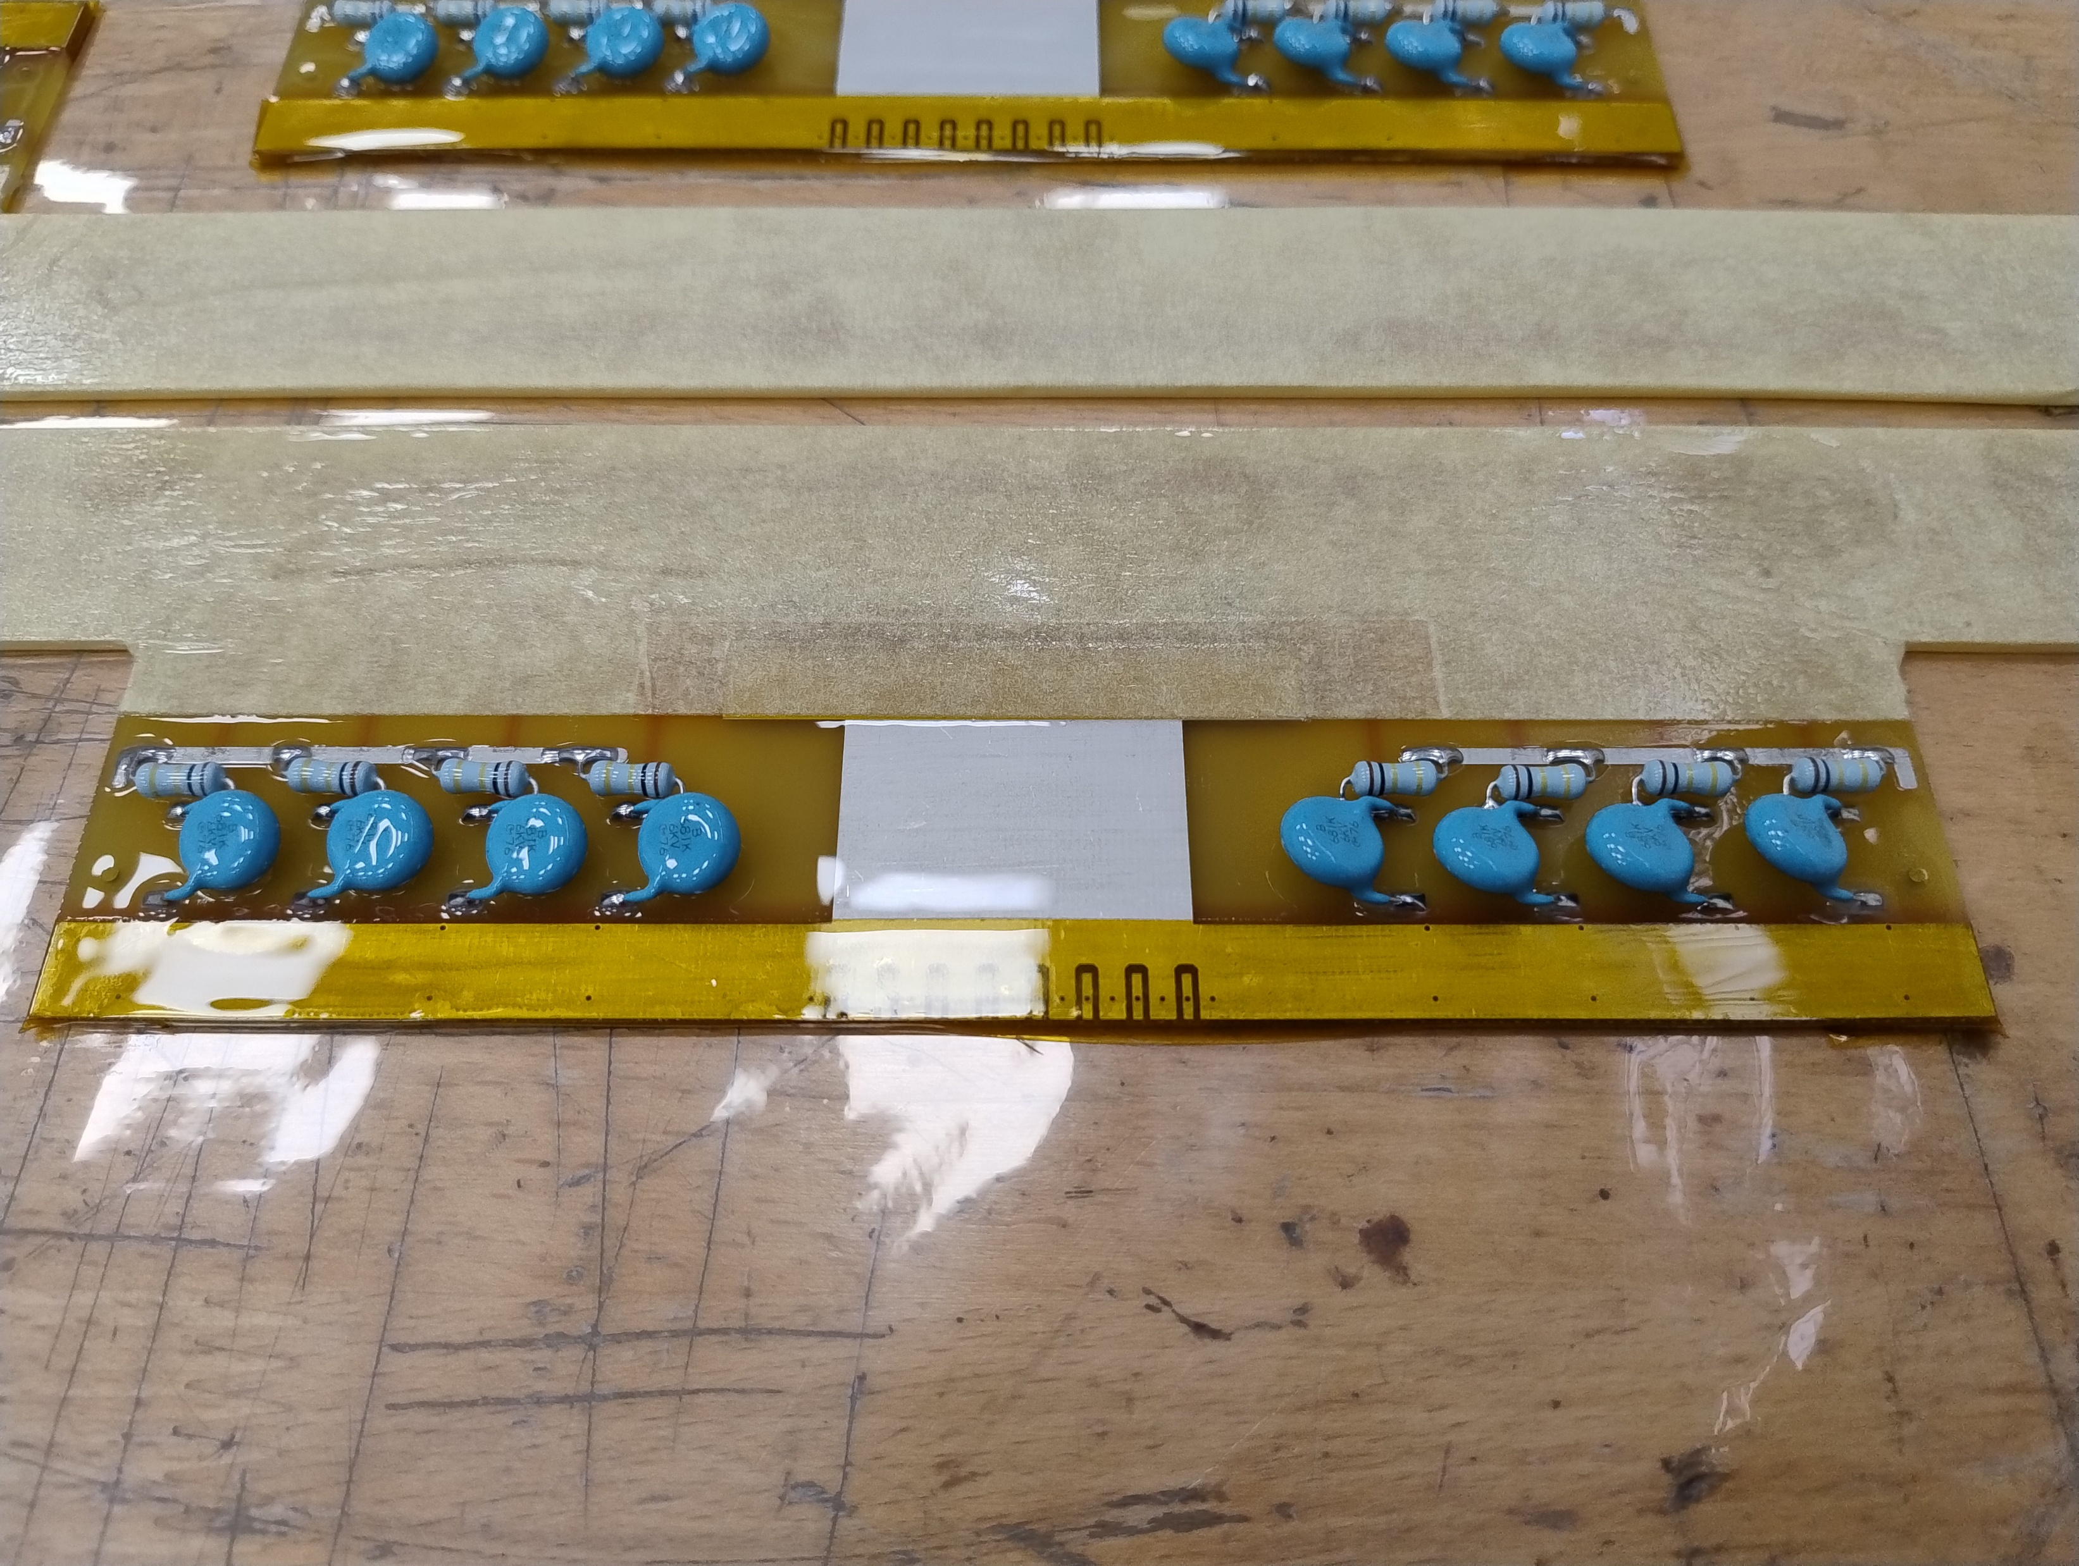
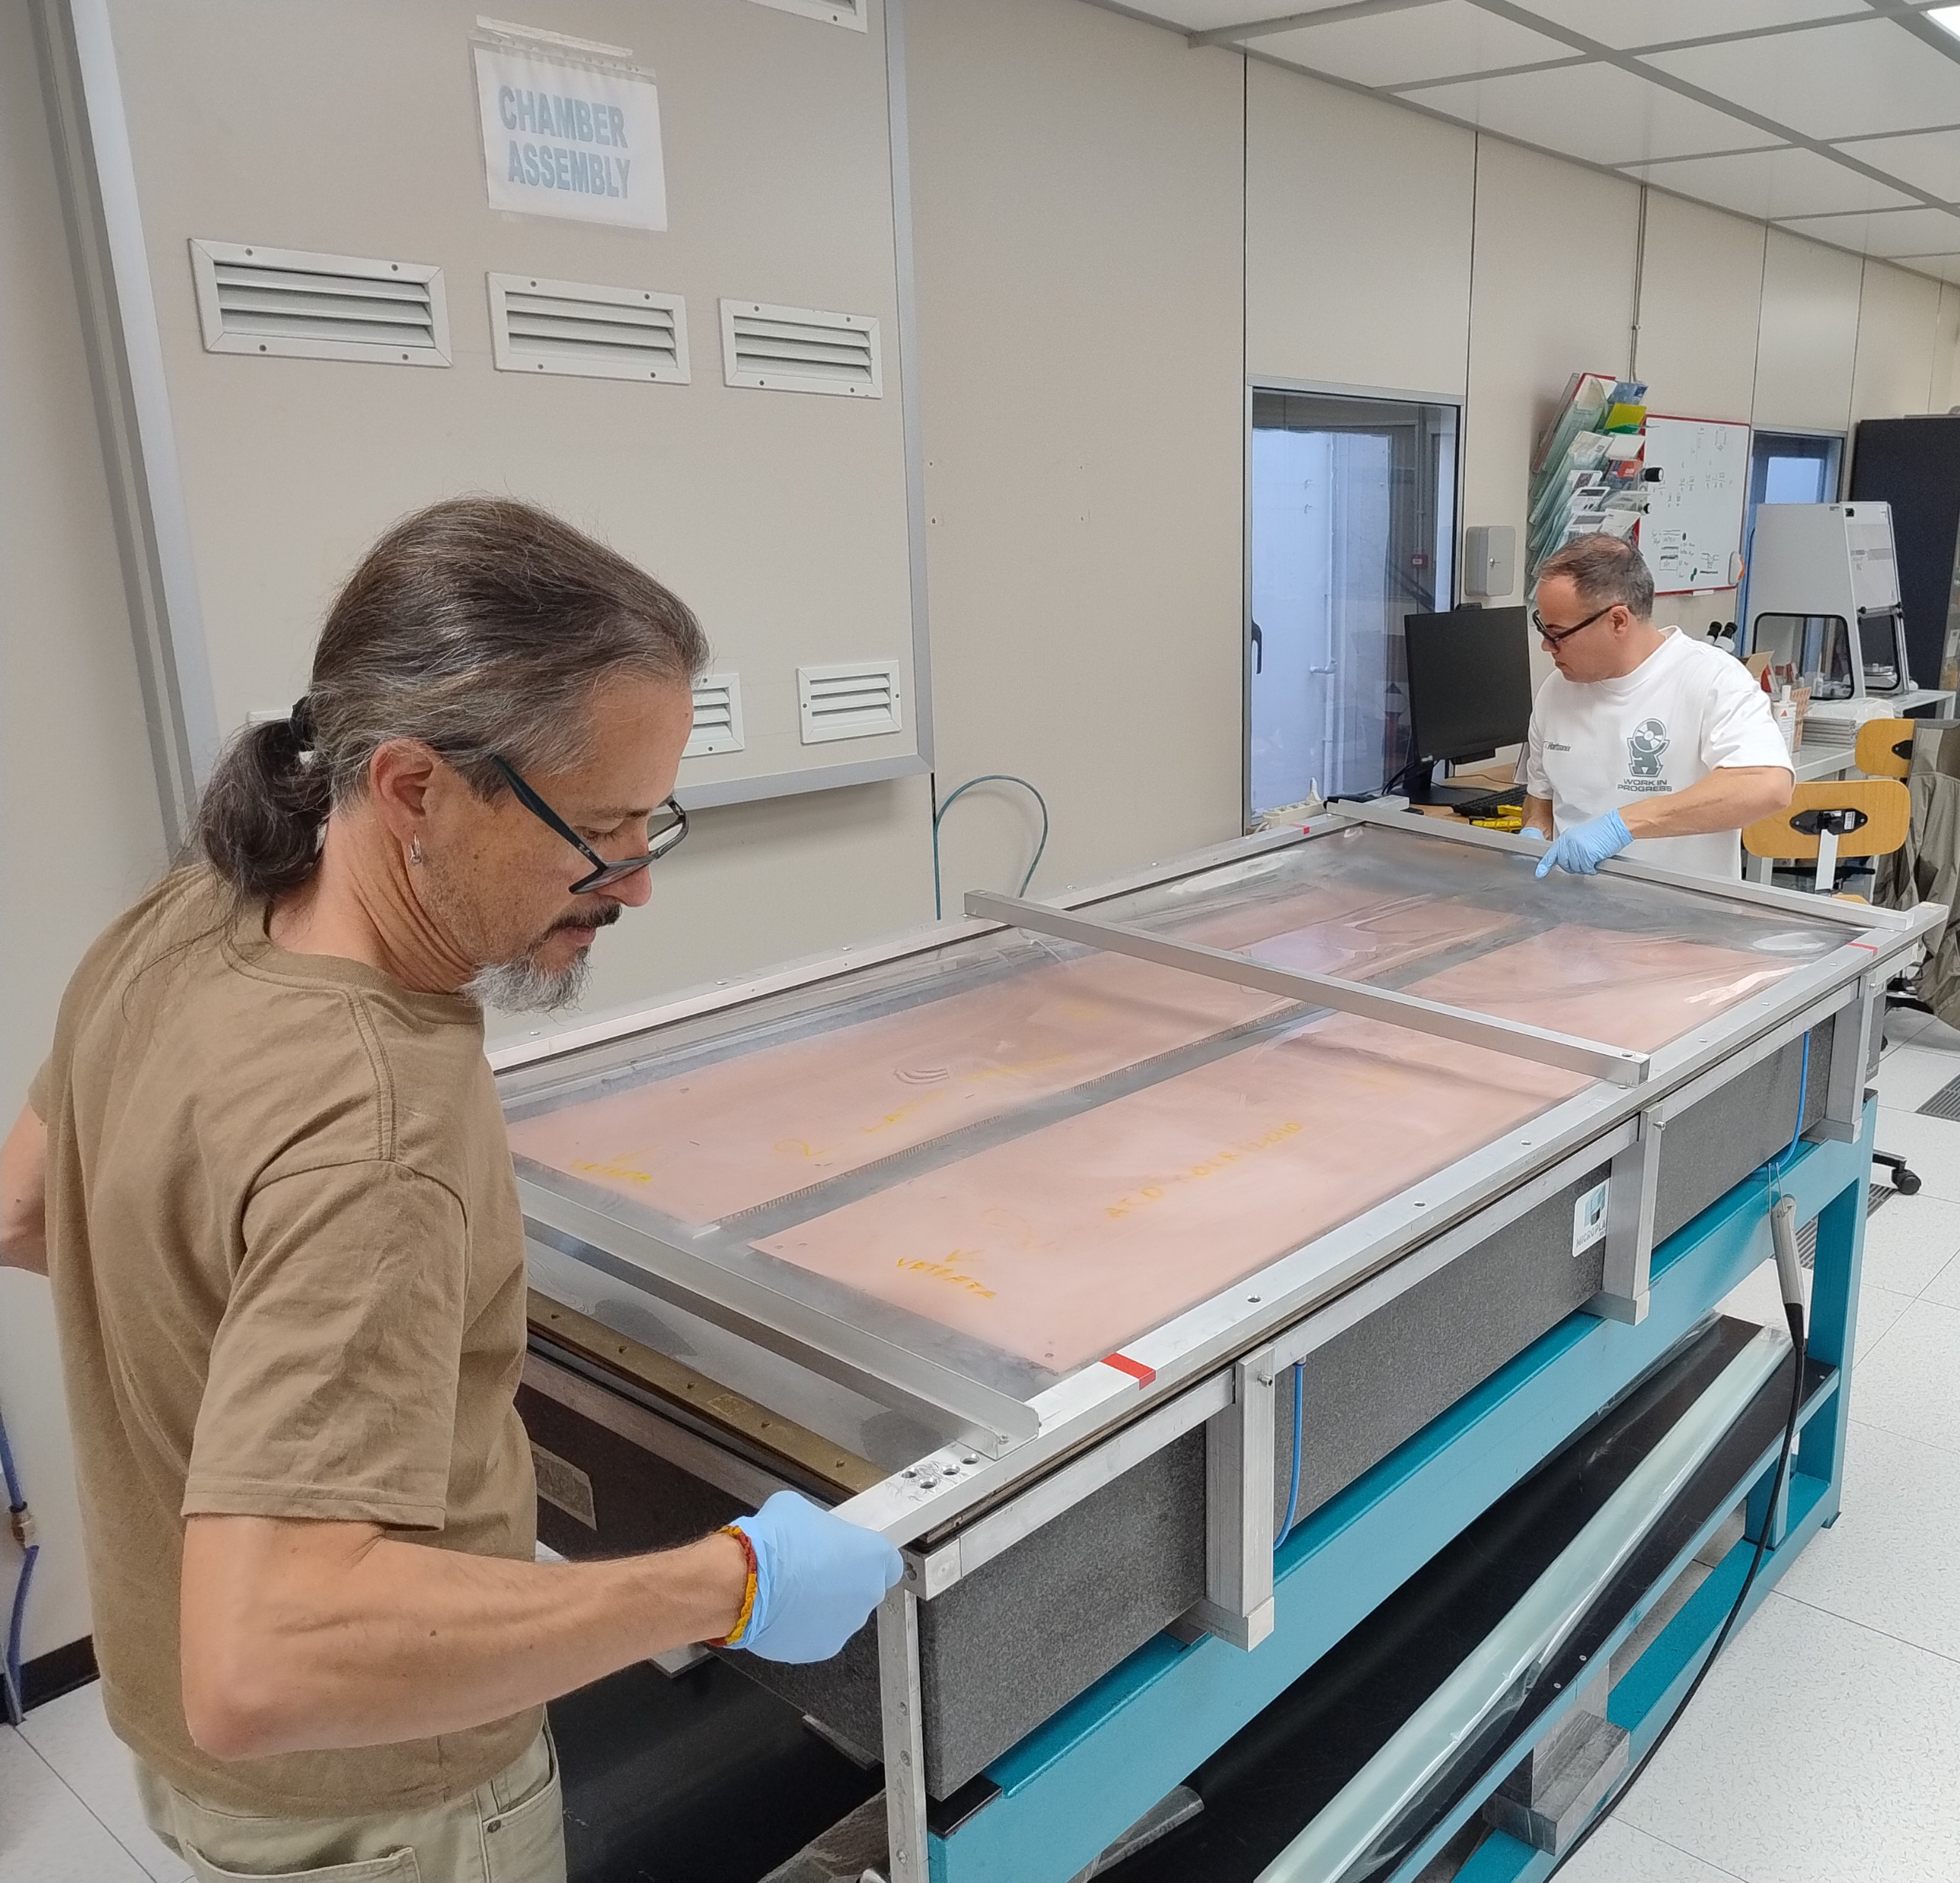
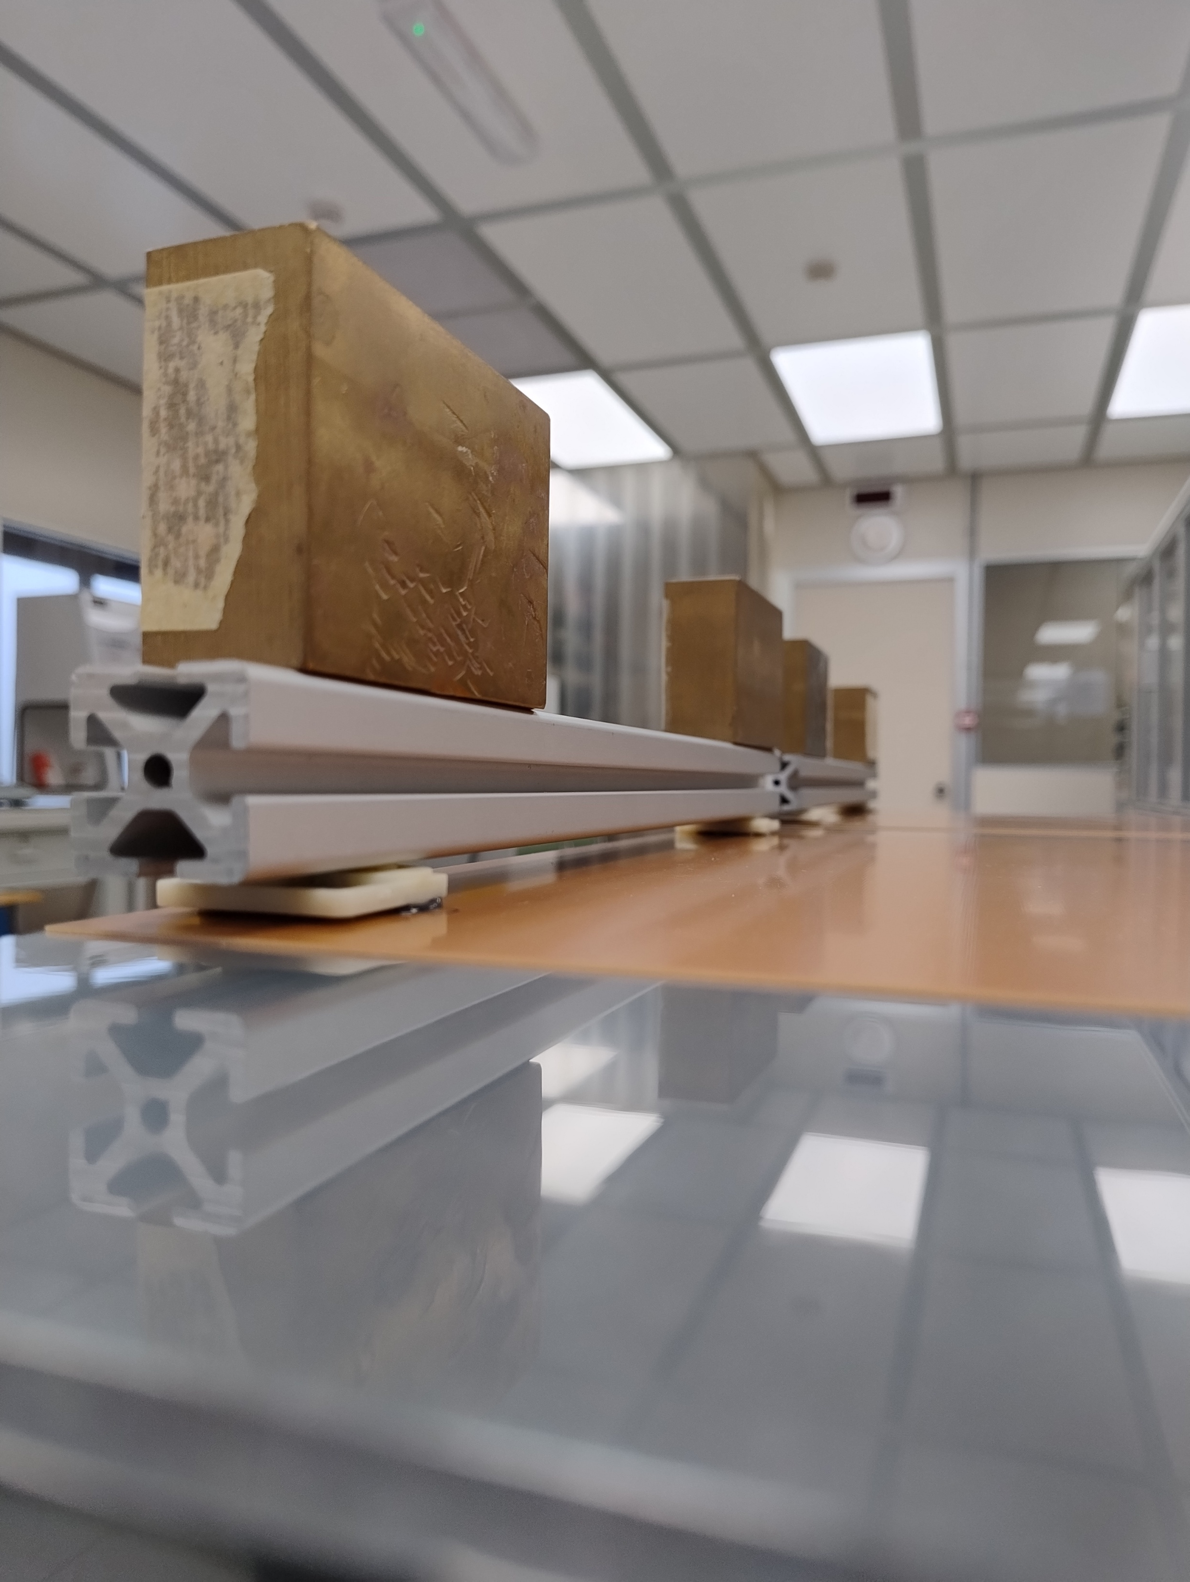
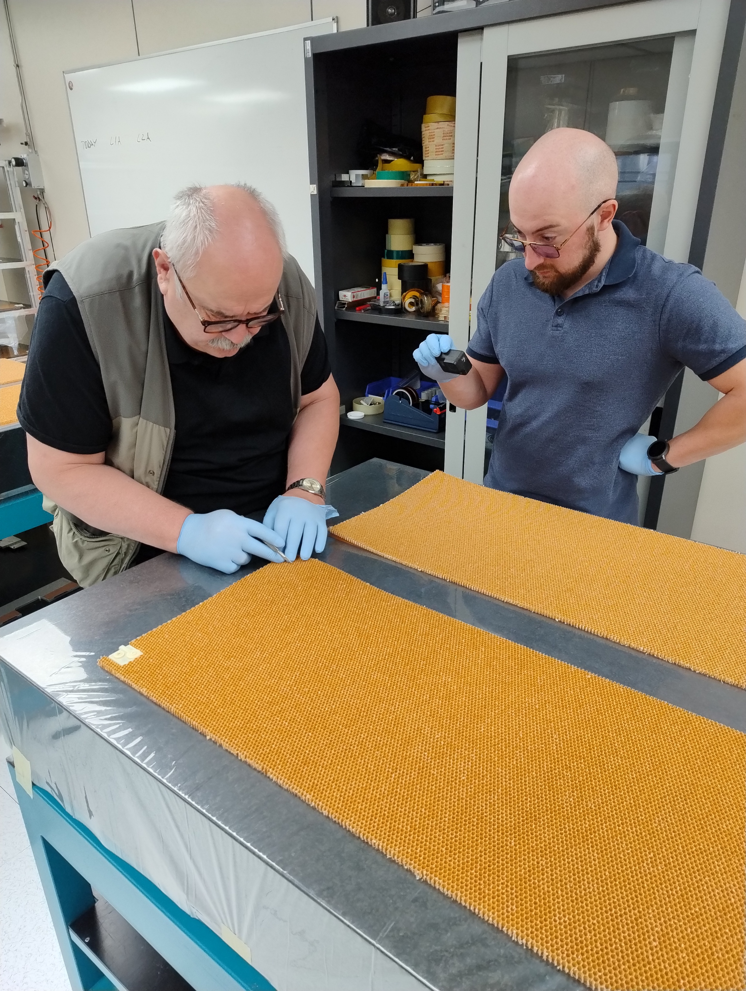
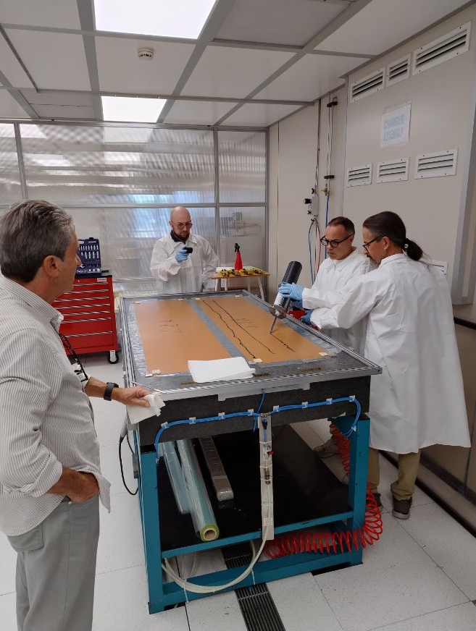
Activities
Electric insulation of the HV filters on the bars
Gluing of the gas connectors on each of the 10 skins for the panels
Honeycomb shaping
Skin-honecomb-skin gluing under vacuum (panel completion)
1
4
4
2
3

Slide 4
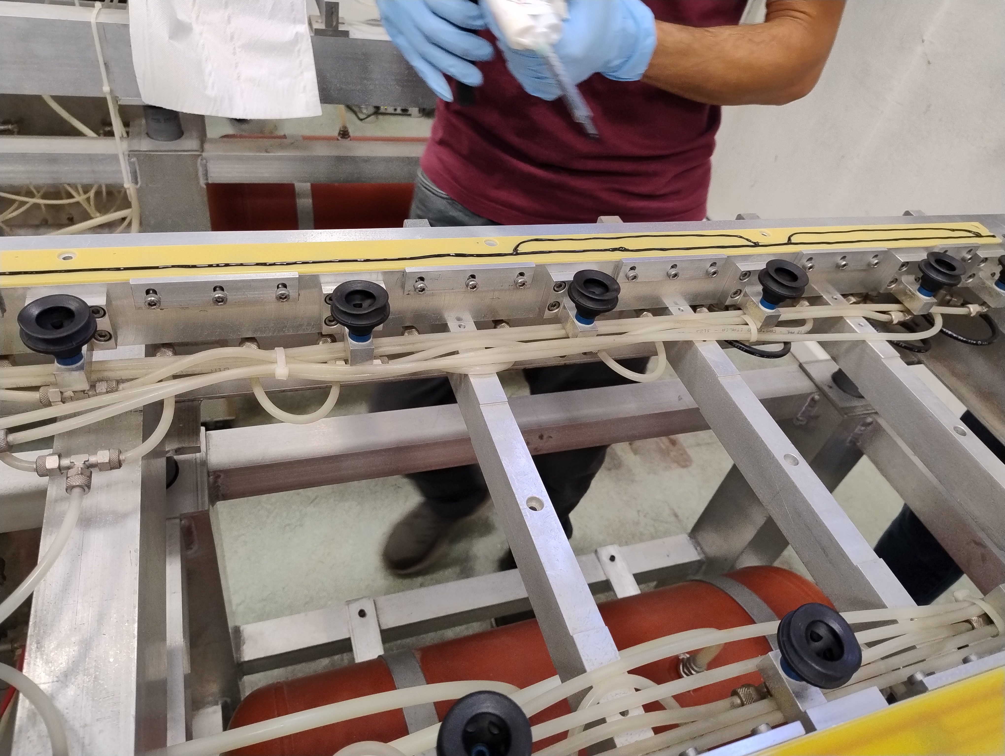
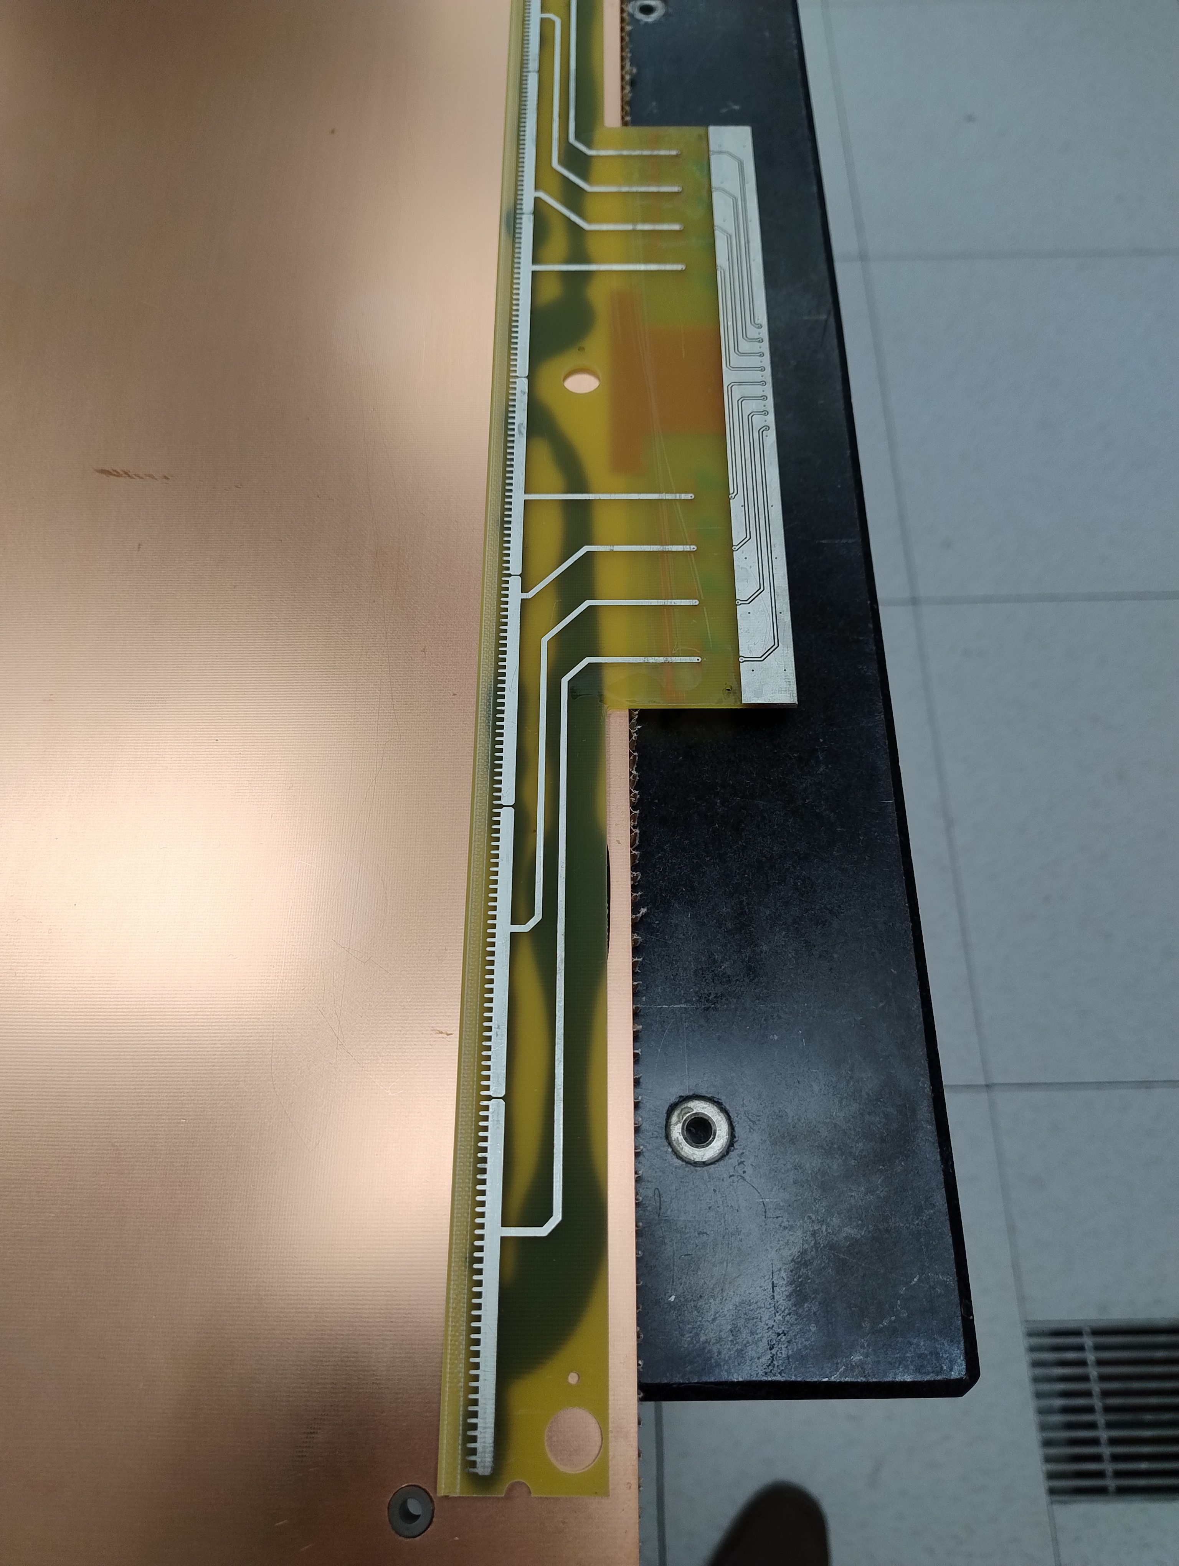
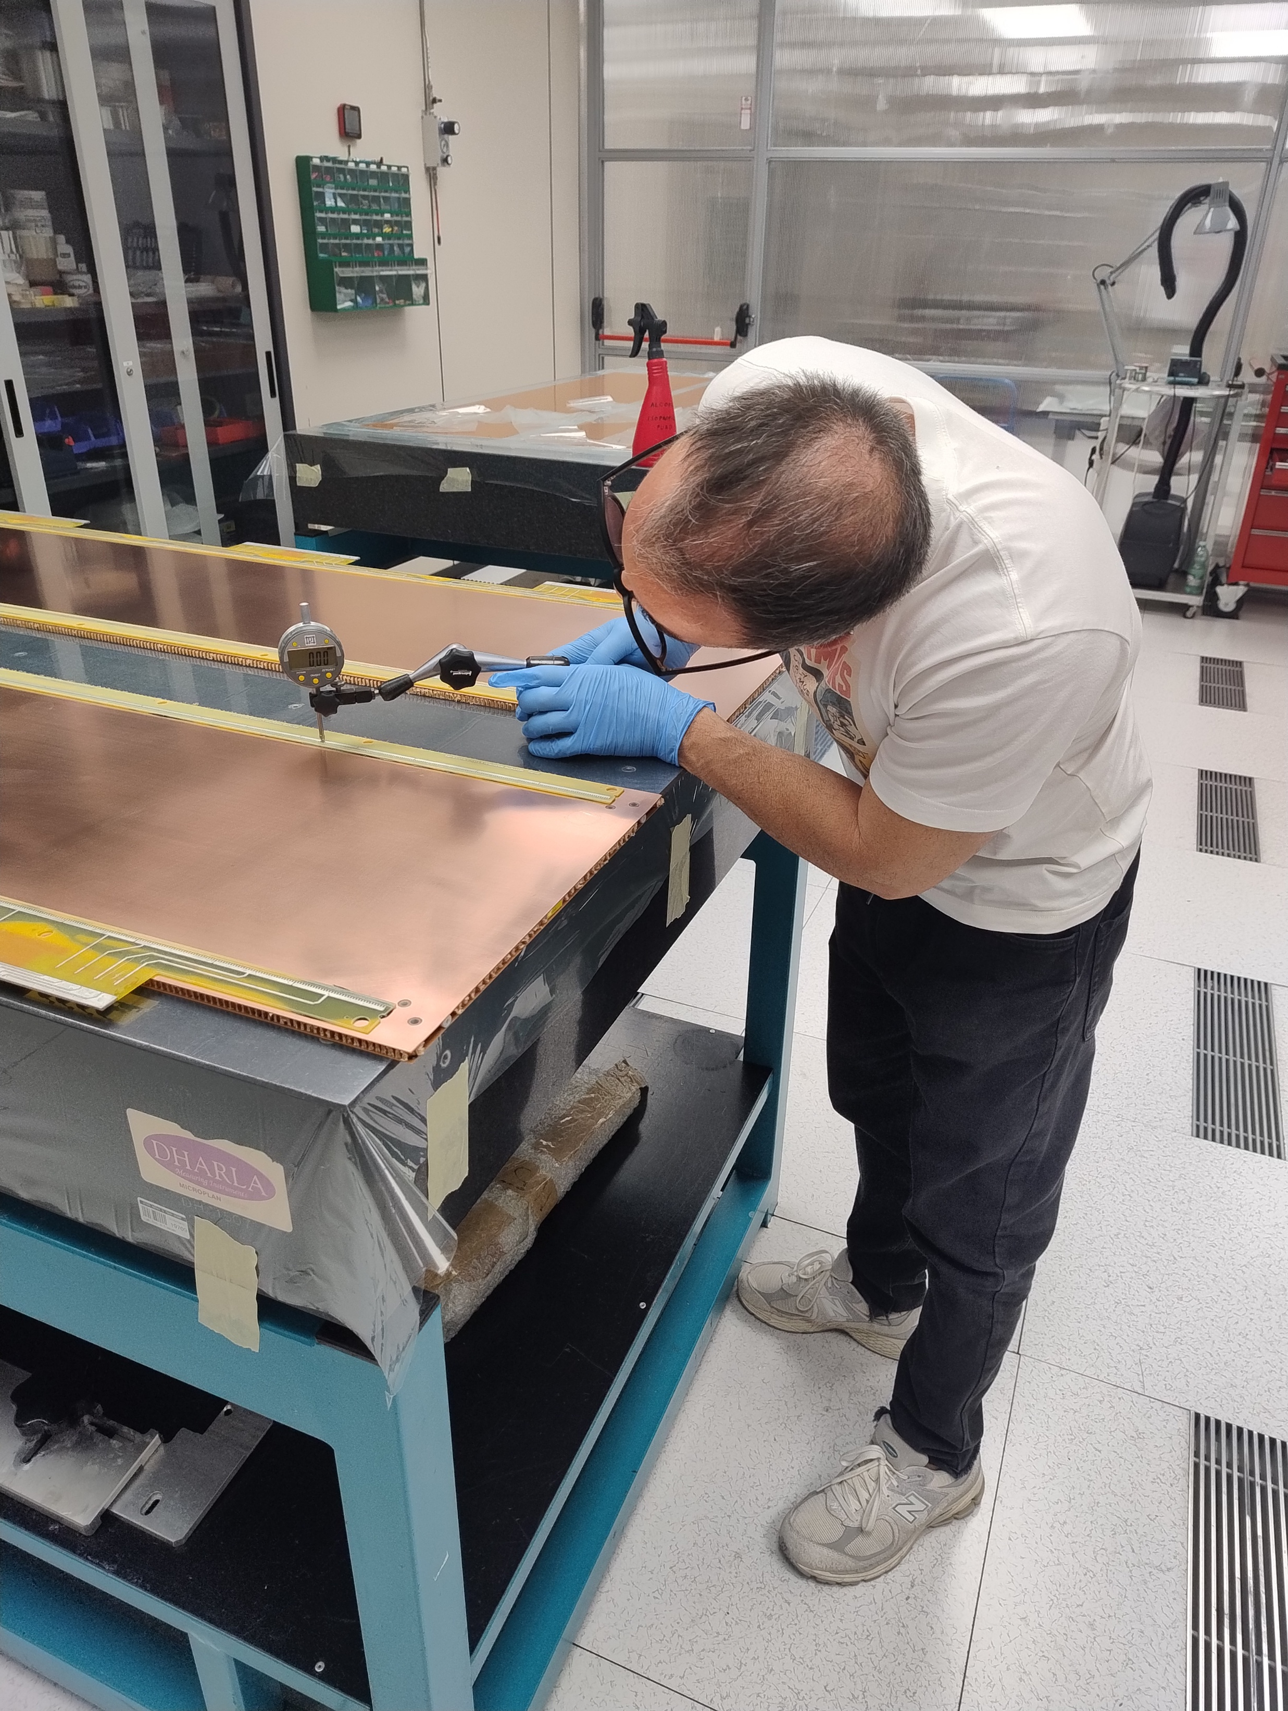
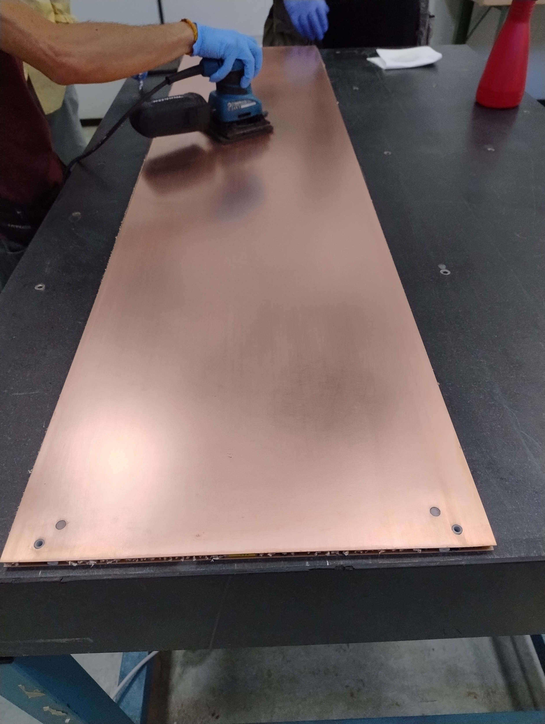
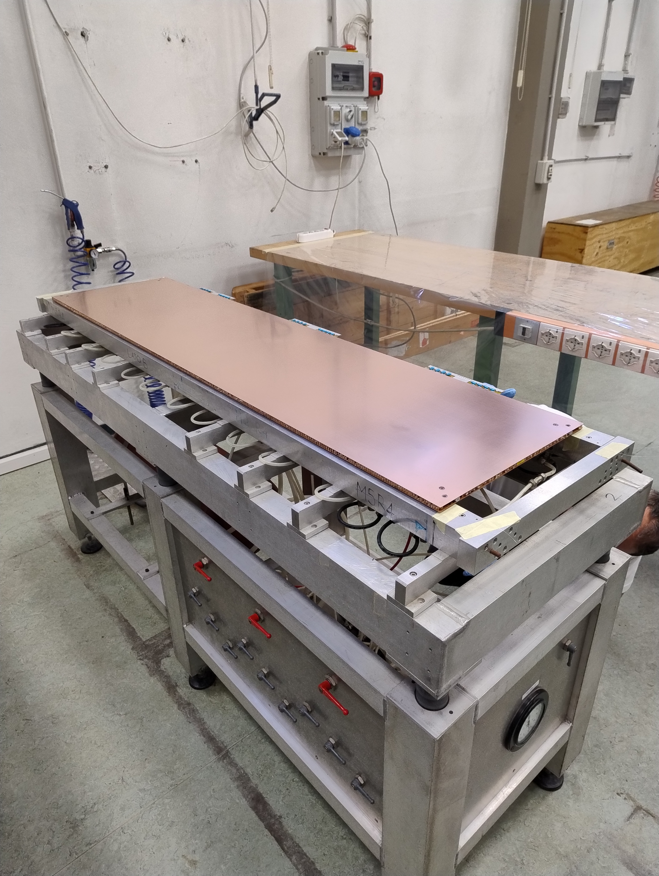
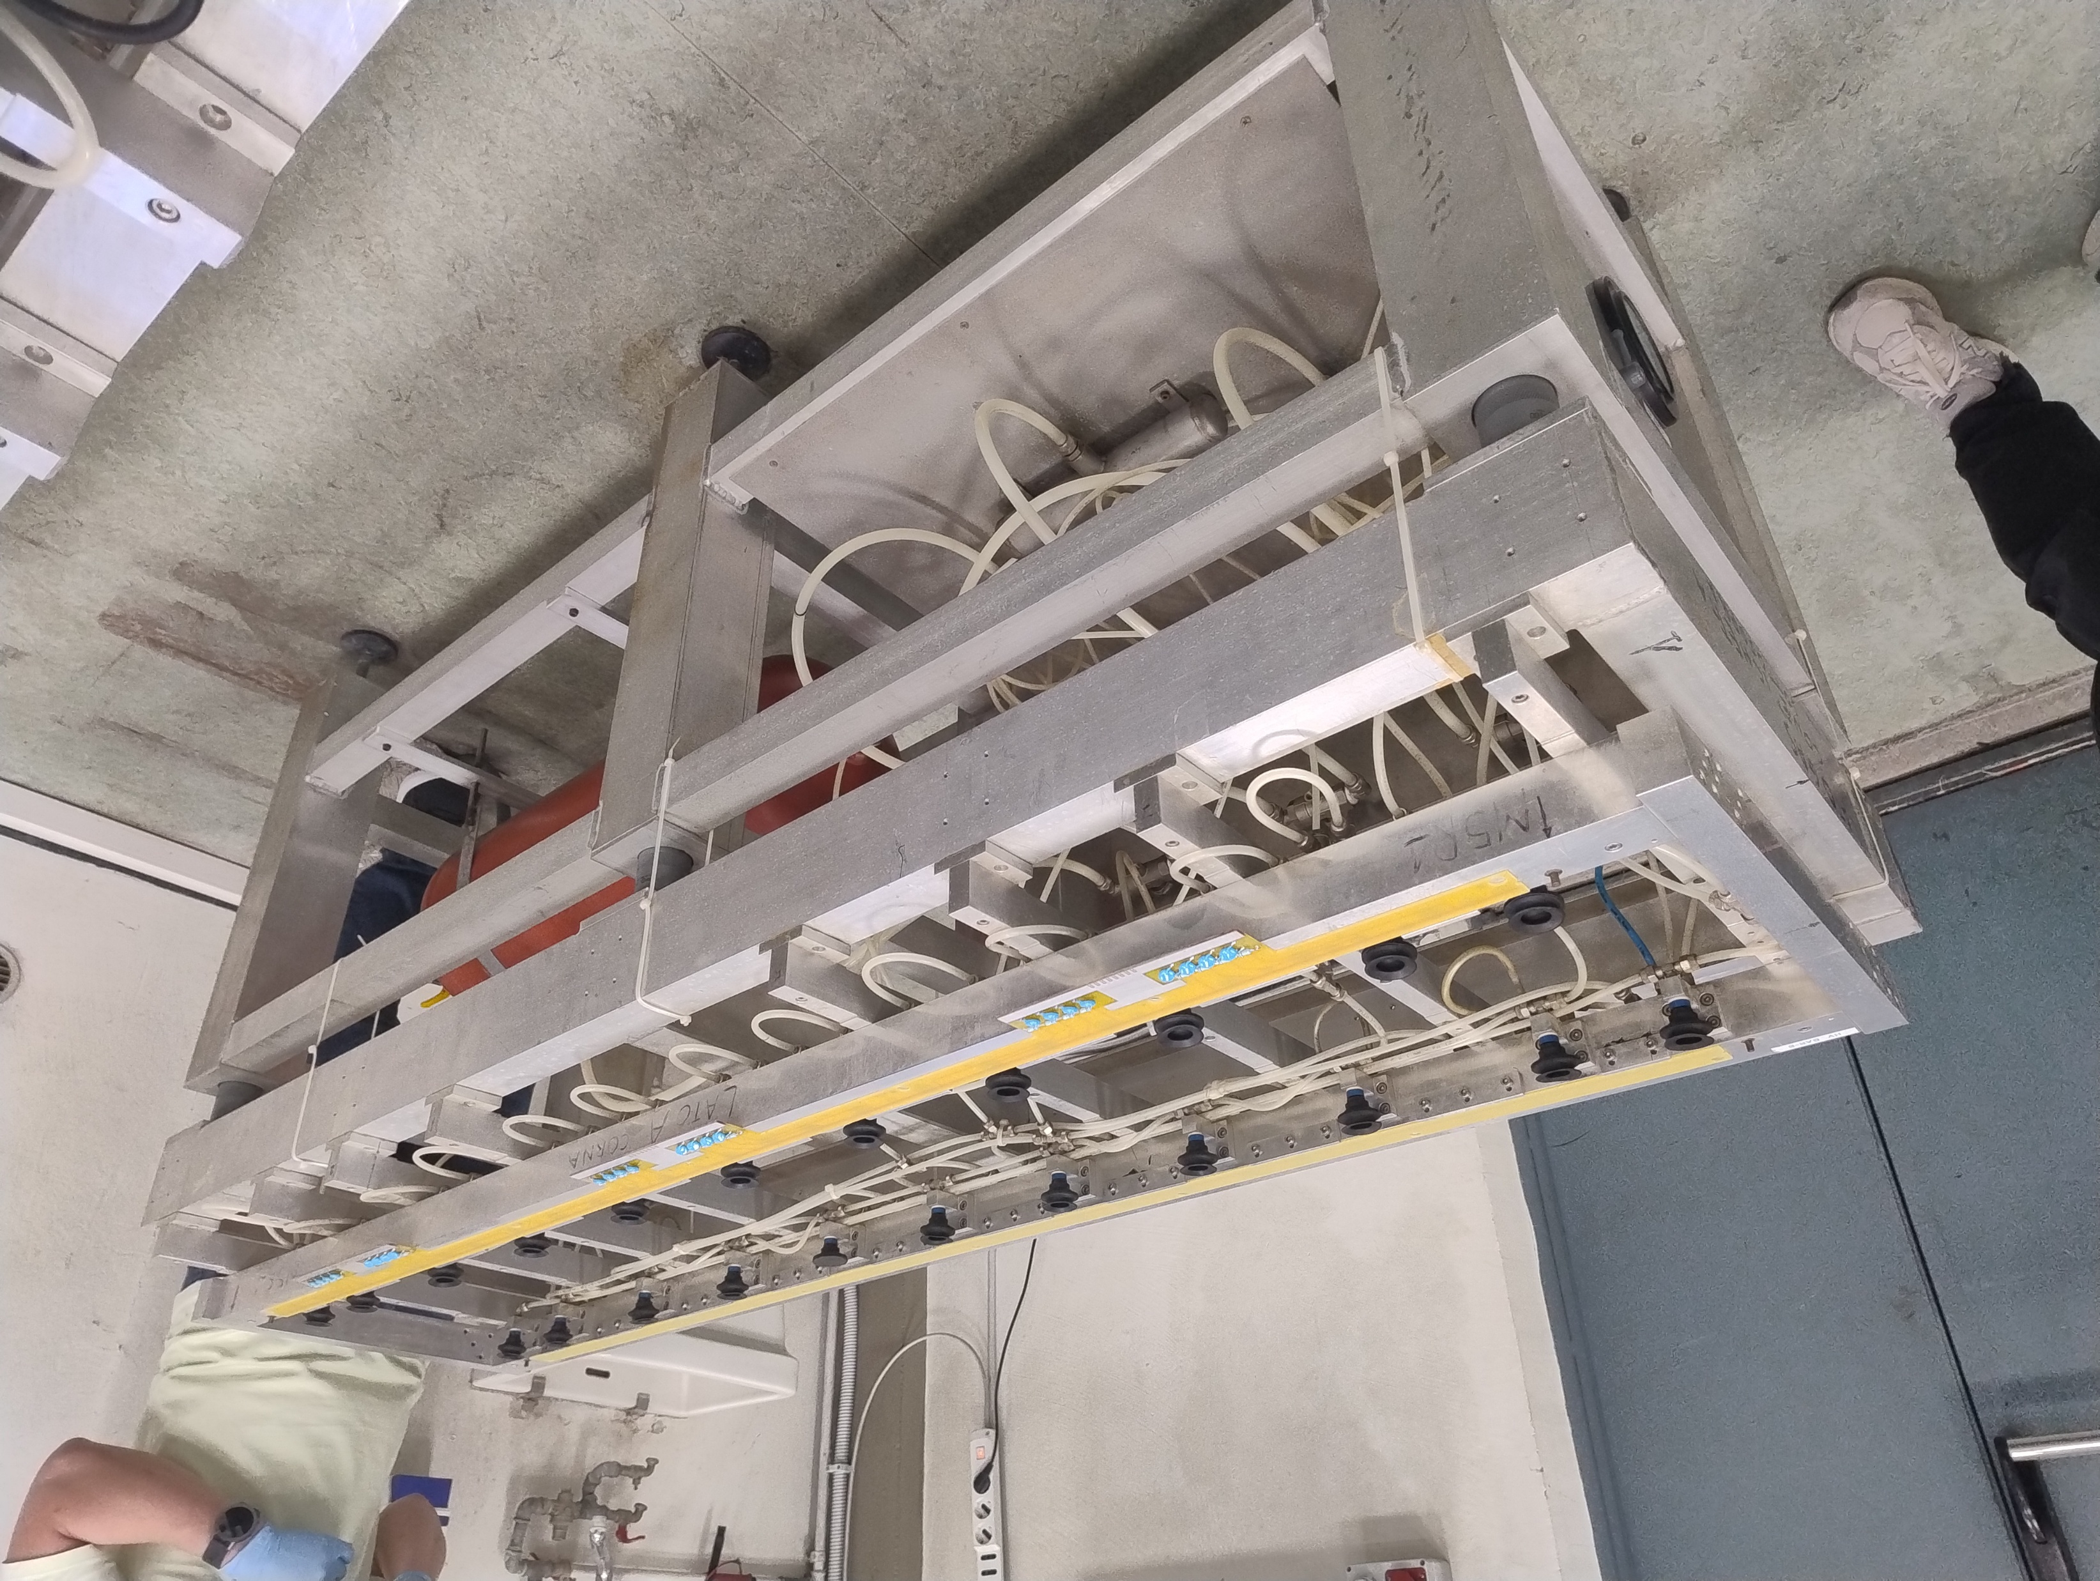
Activities
7
7
5. Panels planarity check
6. Cleaning of the panel surfaces
7. Gluing of the HV bars
5
6
7
7

Slide 5
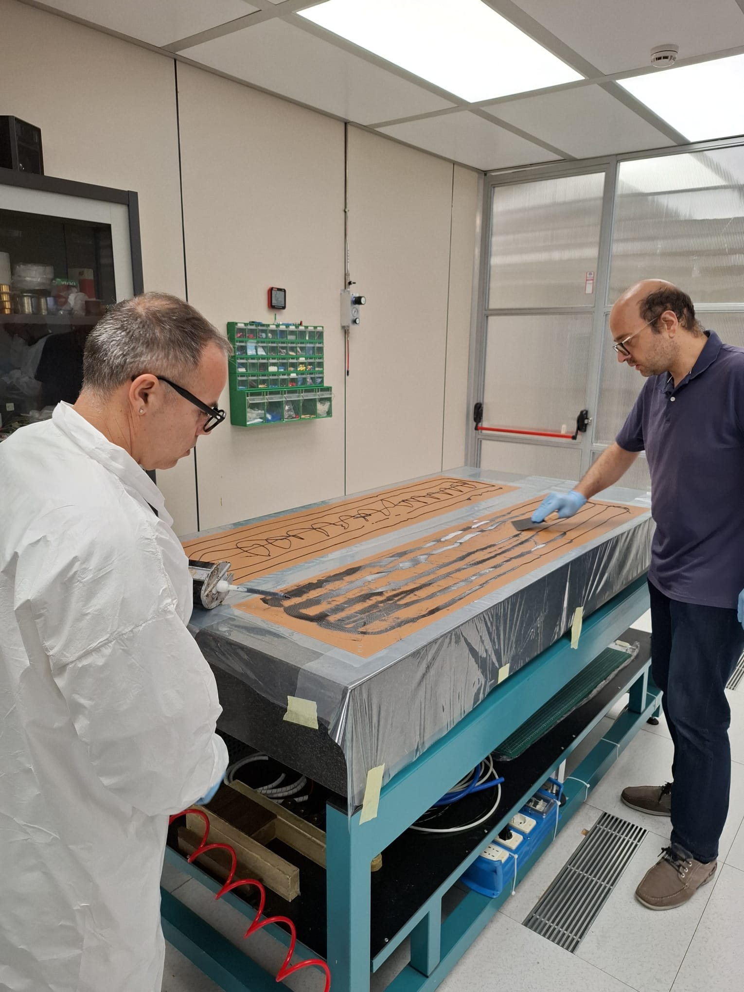
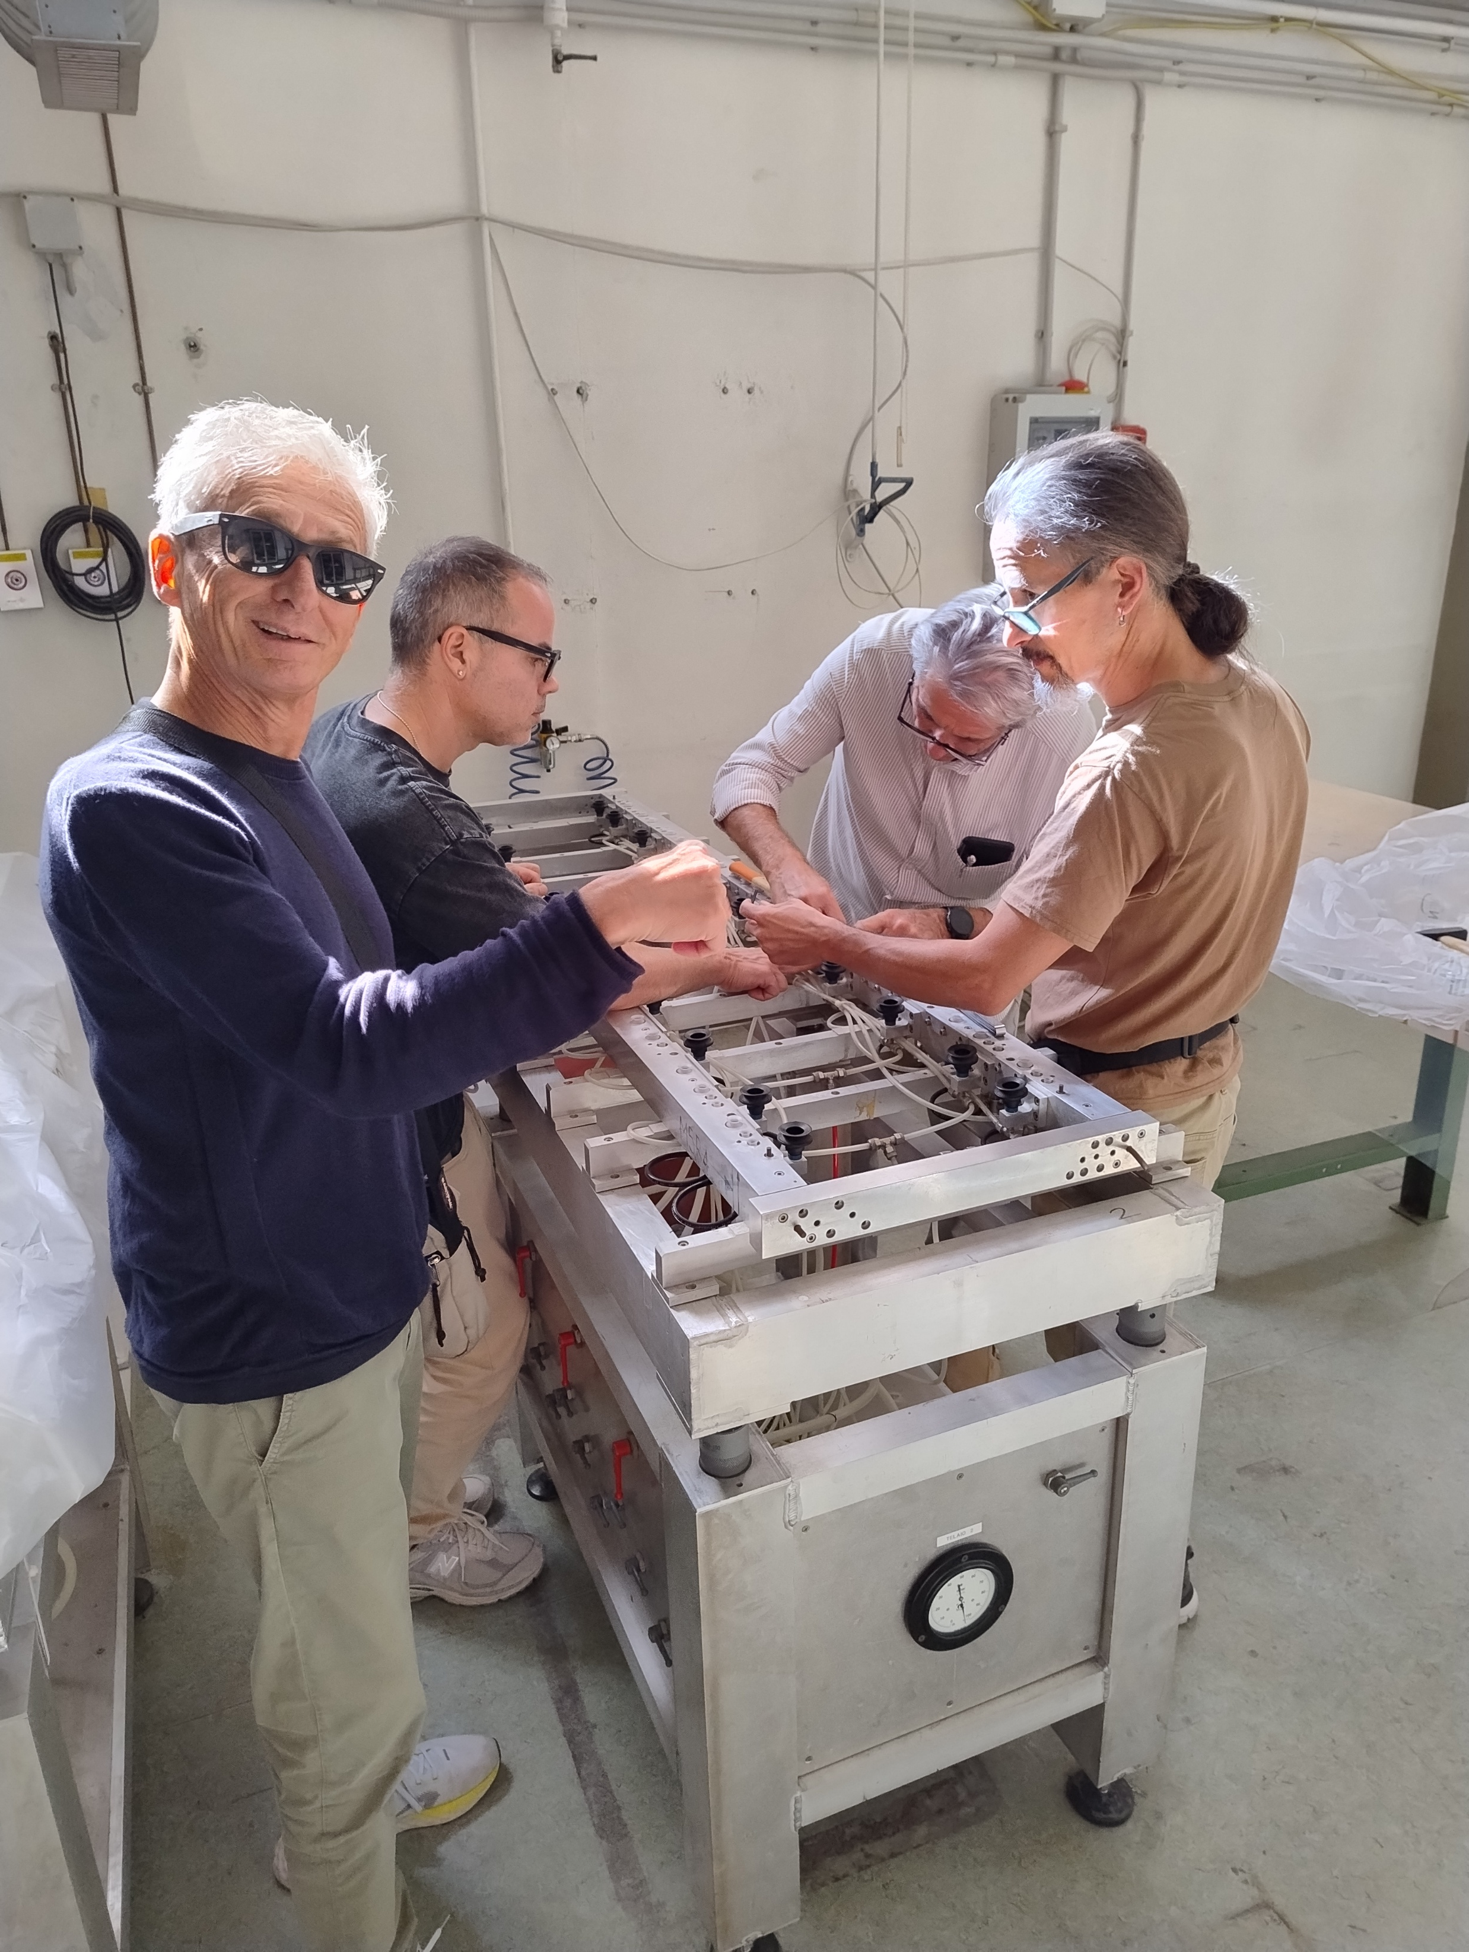
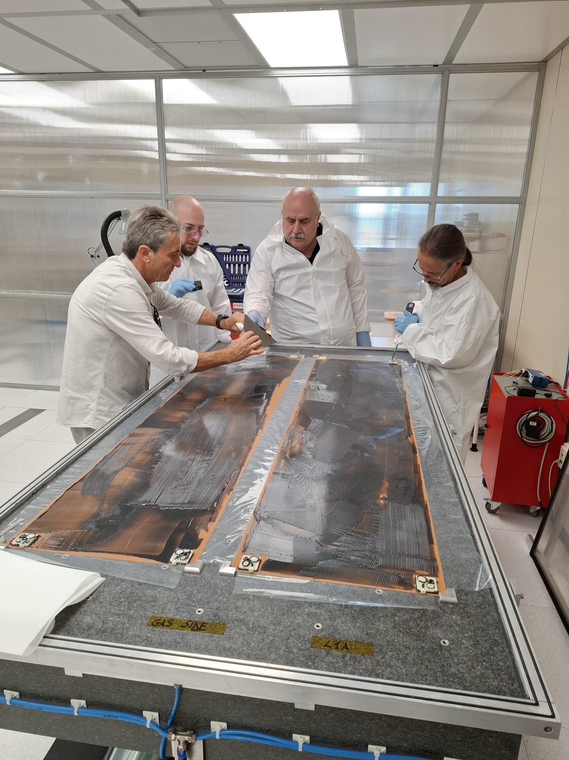
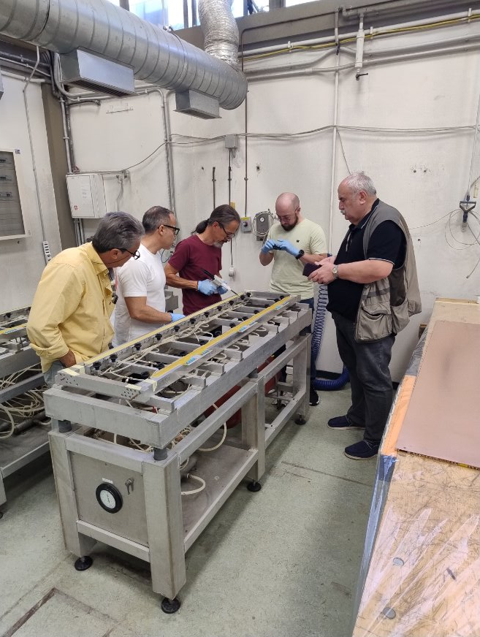
Moments of discussion and hard-working

Slide 6
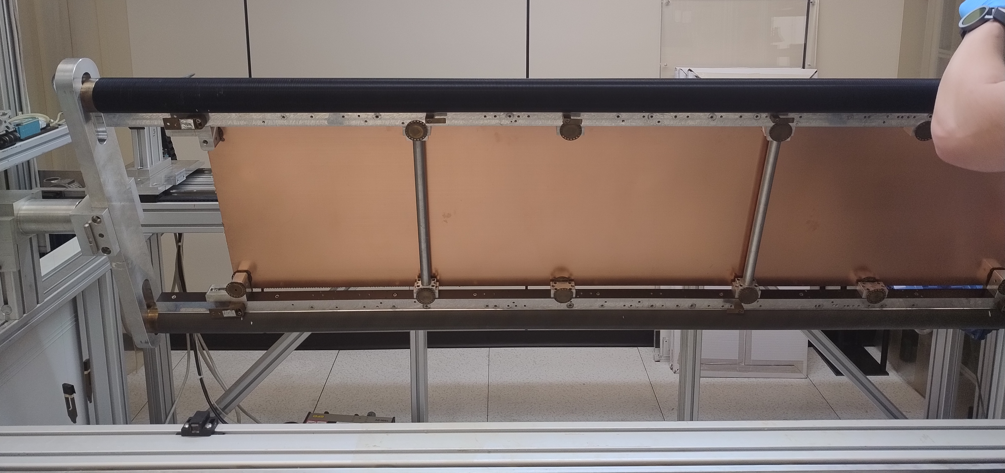
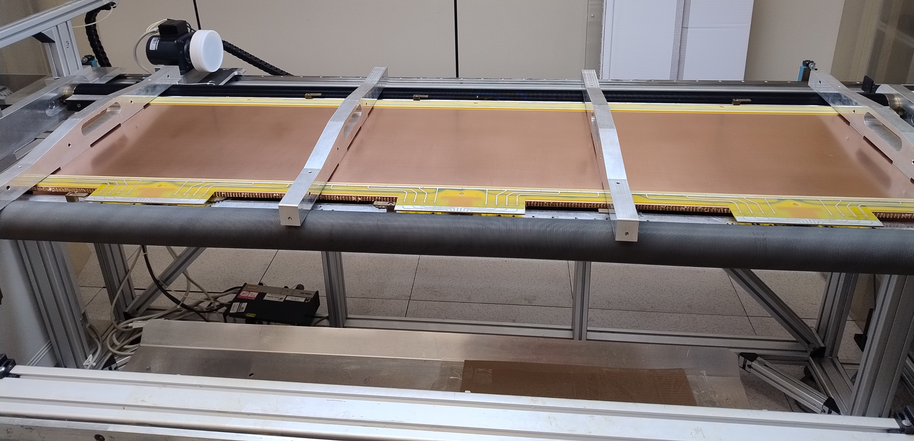
So far so good
8 panels ready (5 to be used for a first detector)
2 panels in this moment under vacuum
Wiring machine tested and fine tuning ongoing
Following soon:
Special cleaning of the clean room
Going on with the schedule
SPECIAL THANKS TO OUR TECHNICIANS EMILIANO AND ROBERTO FOR THEIR AVAILABILITY AND TO MARIO FOR HIS SUPERVISION

