Slide 1
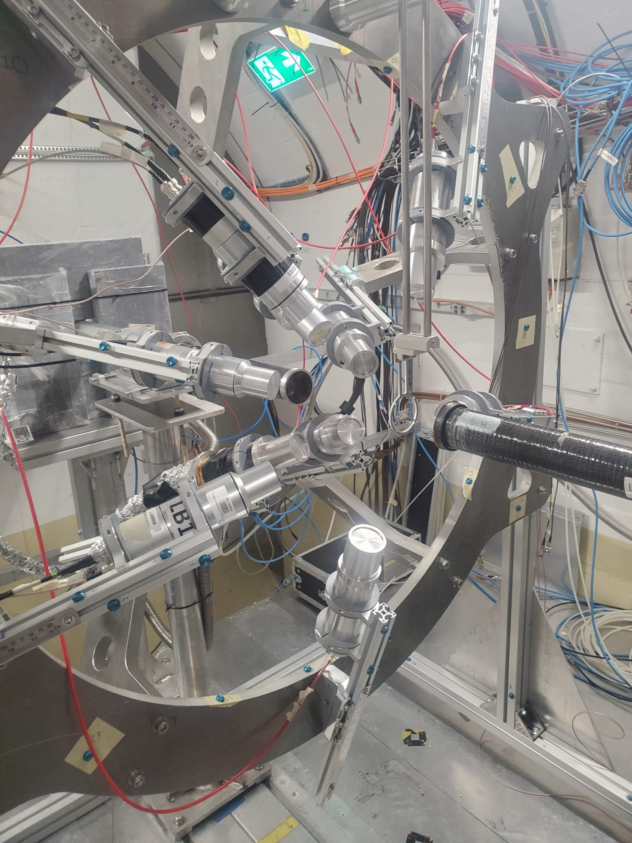
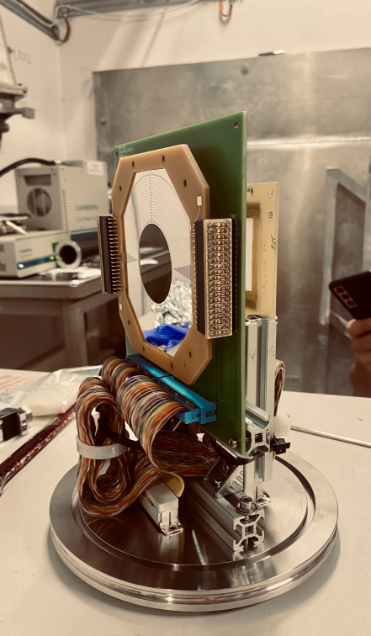
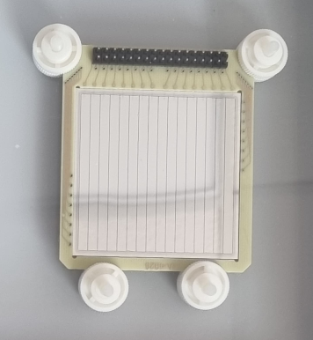
LaBr₃ + Si annular?
n_TOF LaBr₃ array
(n,cp) setup
Silicon annular nTD detector
16 strips x 16 sectors
DSSSD
16x16 (5 x 5 cm²)
+
?

Slide 2
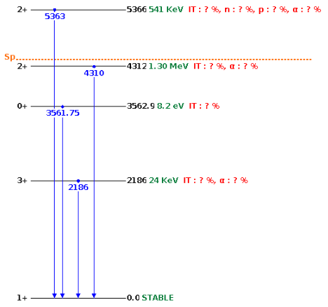
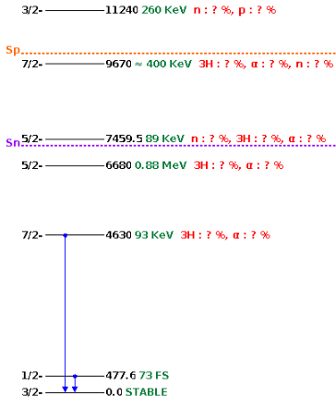
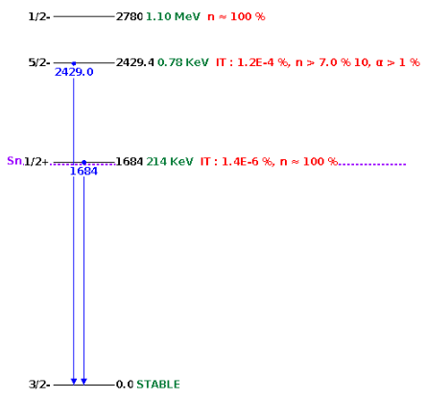
⁷Li(n,n’γ)⁷Li and ⁶Li(n,n’γ)⁶Li parasitic
At some point we may want to propose the ⁶Li(n,n’d)a
α+t
α+d
⁷Li
⁶Li
⁹Be
In principle, the 2nd excited state 7/2- may decay via gamma, it would be interesting to measure the gamma branching, but this is estimated around 10⁻⁵ and our efficiency at 4.6 MeV is 0.12% (10 detectors), I think this will be really hard to measure…
the 3rd (0⁺) and 5th (2⁺) excited state should decay via gamma
Gamma decay branch very small <10⁻⁴

Slide 3
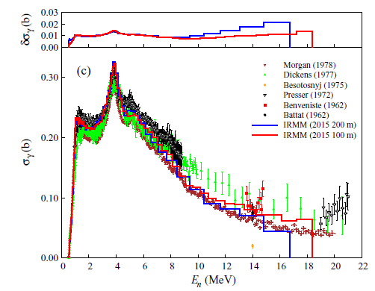
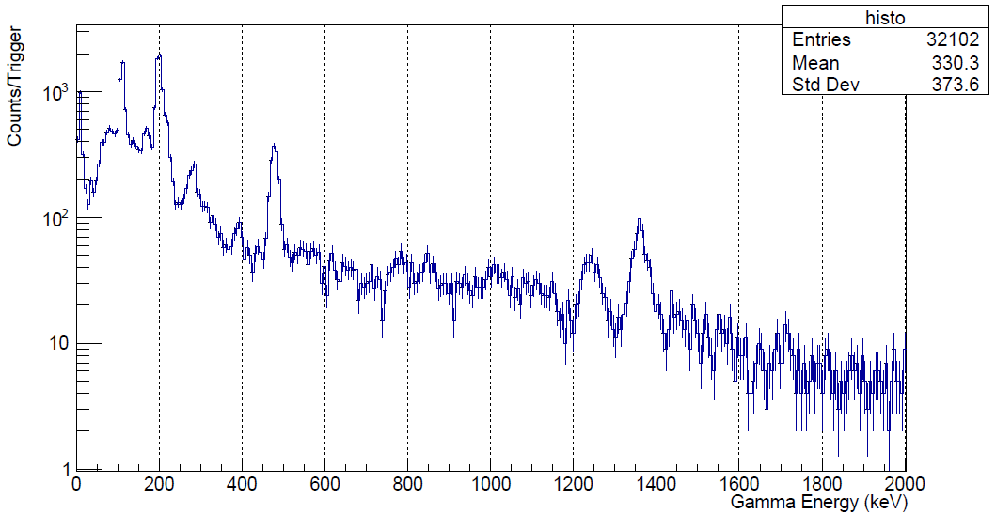
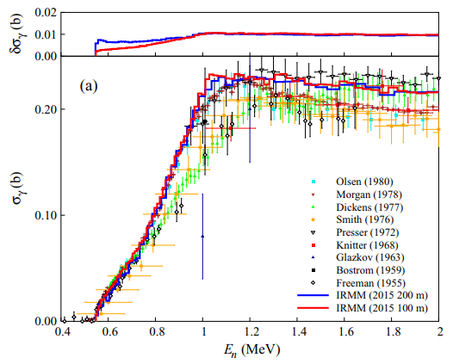
⁷Li(n,n’γ)⁷Li*→477 keV
Latest measurements in 2016 at GELINA + HPGe detectors
In the current ¹⁹F(n,n’) measurement with LiF target we see ~450 counts/1e16 protons (5000/day). Target is 1 mm thick.
M. Nyman, PRC 93, 024610 (2016)
Is it worth re-measuring during the ⁷Li(n,n’t)⁷Li*→477 keV?
Pros: target is pure ⁷Li, this is quite nice/clean measurement
Cons 1: ⁷Li target for (n,cp) is only 20 μm → expect ~ 100 counts/day
Cons 2: outside the Si setup, efficiency could be lower
Cons 3: the Si setup is in vacuum
This cross section is proposed as standard for γ-rays cross section measurements, large discrepancy still exists

Slide 4
Conclusion
Thin target + array efficiency + cross section generally low→ cp+gamma hard to measure
However… we only looked at Li, Be
Other excites states in ⁷Li and ⁹Be are highly unlikely to be detected.
In the future if we propose ⁶Li(n,n’d), there could be scope to measure ⁶Li* using LaBr₃ parasitically
It’s free, why not? But is it free?

