Slide 1



Stilbene detectors: Status and perspectives
Agatino Musumarra, Dimitrios Papanikolaou, Maria Grazia Pellegriti
University of Catania and INFN-Sezione di Catania
C. Massimi, R. Sahoo
University of Bologna and INFN-Sezione di Bologna
N. Patronis, Z. Eleme
University of Ioannina
R. Mucciola
INFN-Sezione di Bari
for the n_TOF collaboration
Meeting Nazionale n_TOF, Frascati 13/11/2025

Slide 2



Outlook
stilbene detectors development
- A new experimental approach for replacing the C₆D₆ for n-γ capture reactions
- Moving further to n-n and n-n’ elastic and inelastic scattering measurements
- New PSTIL stilbene detector array for n_TOF

Slide 3
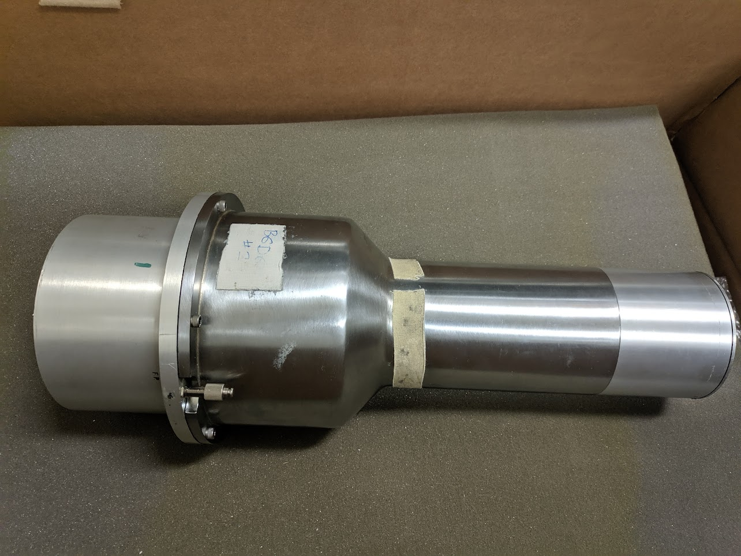
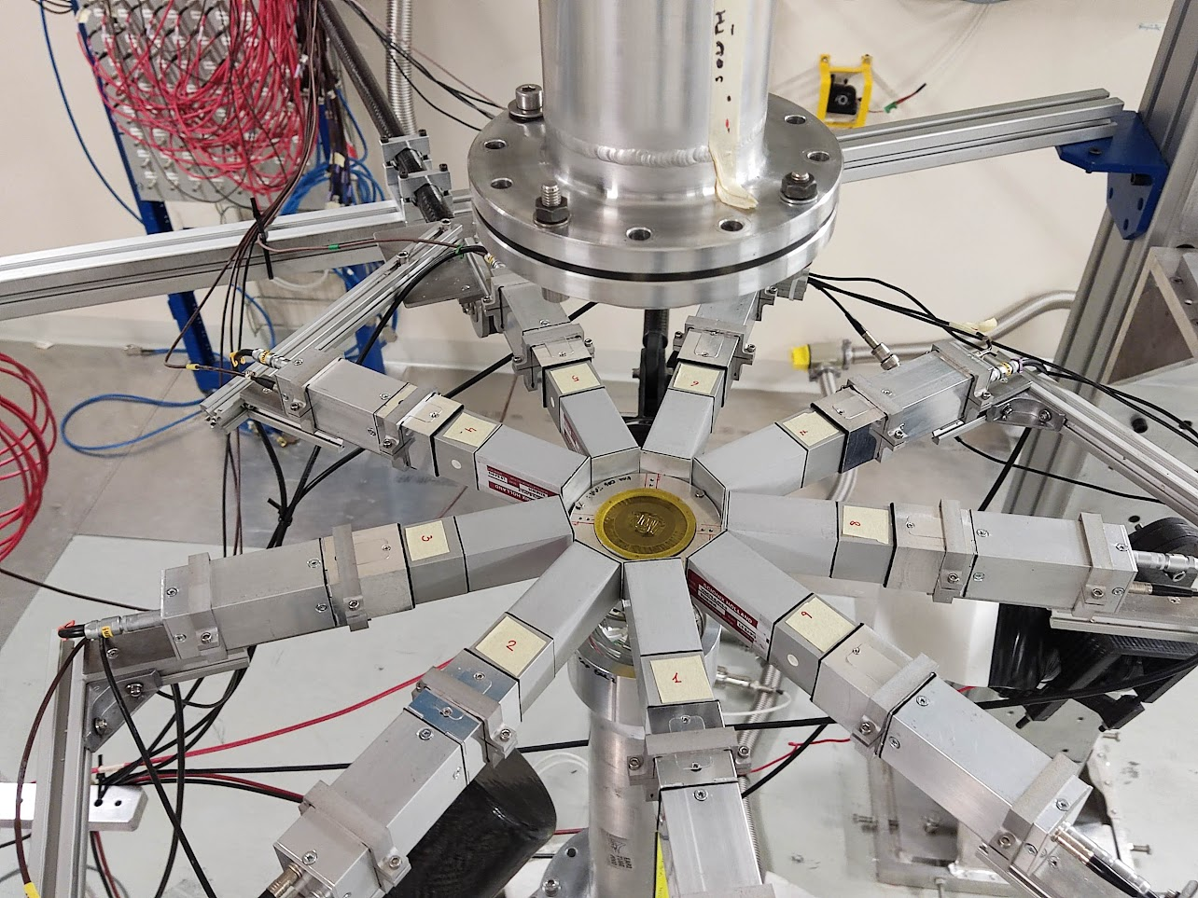
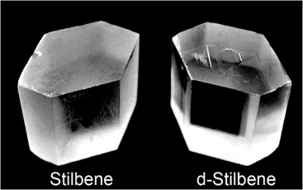
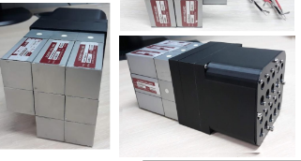
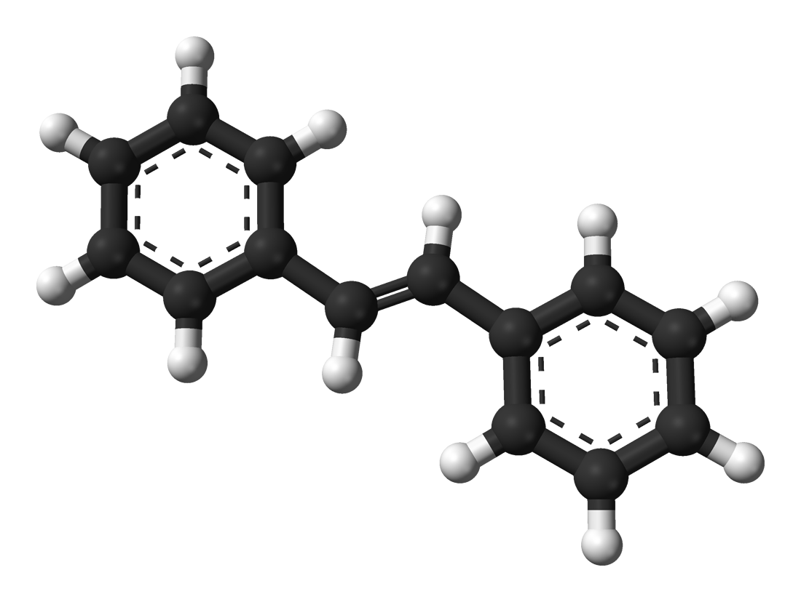
Motivations for developing a new prototype based on stilbene
“Big” C₆D₆ Liquid scintillators
Compact array of small C₆D₆
Large & segmented C₆D₆
Solid organic scintillators
Read-outs/Power supplies
Solid
Higher density
No Chemical hazard
n/γ discrimination

Slide 4
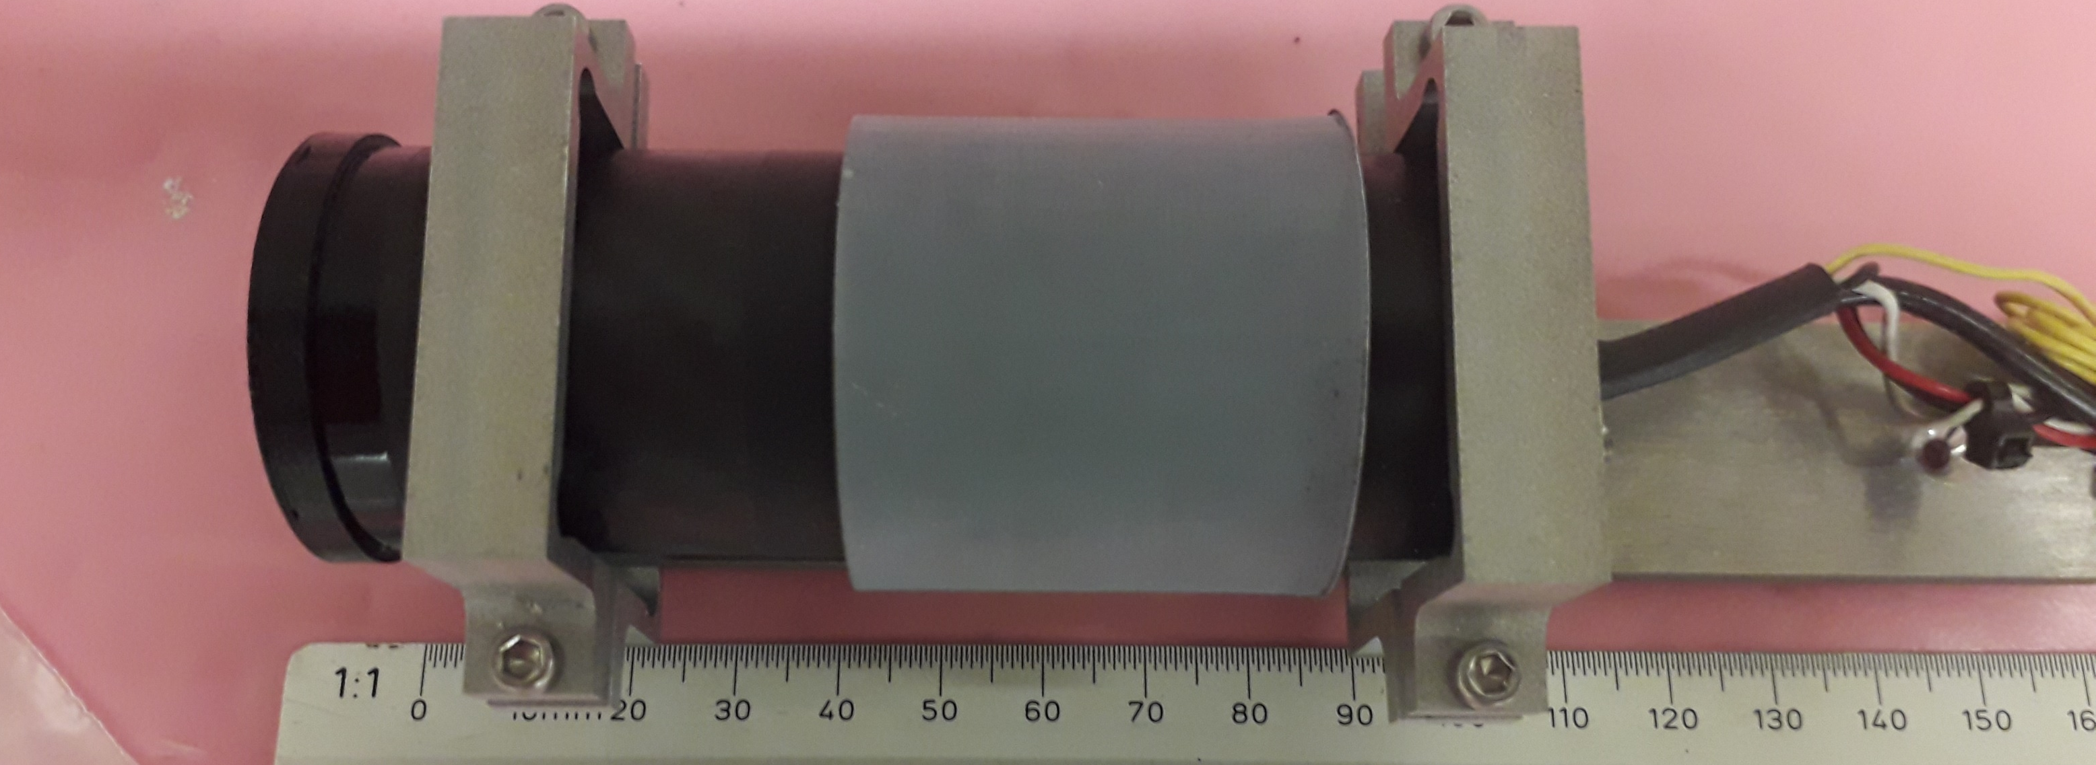
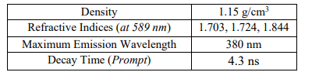
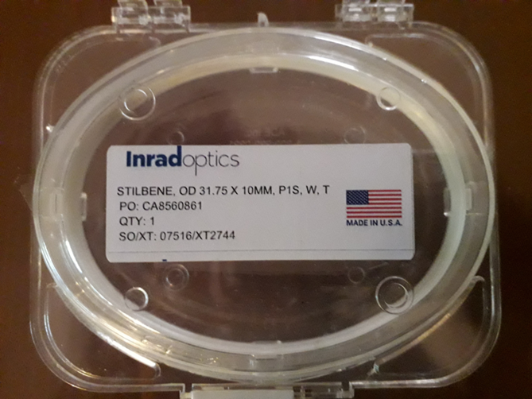
First stilbene prototype (p-stil) - June 2022
3.5 cm
HAMAMATSU R1924A
Sens-Tech PS1807
Ultra compact active base
with DC-DC converter
no HV needed

Slide 5
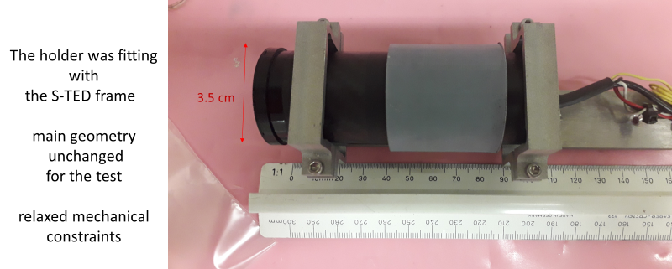
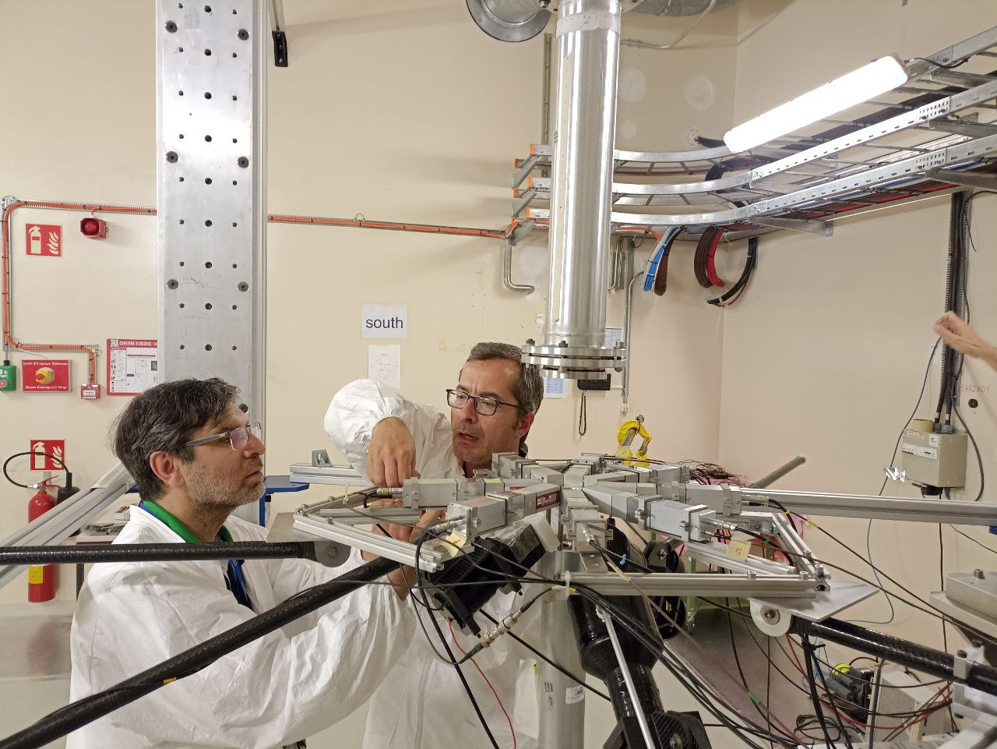
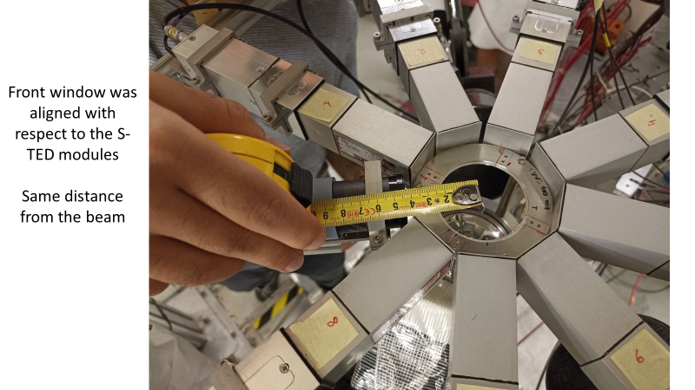
First test @ EAR2 – June 2022
the sTED frame
respect to the sTED module

Slide 6
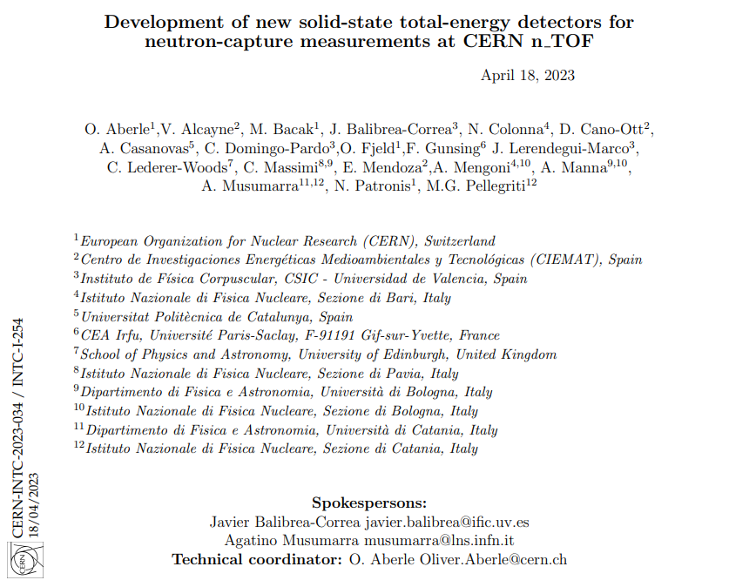
LoI for stilbene detector development @ n_TOF – April 2023

Slide 7
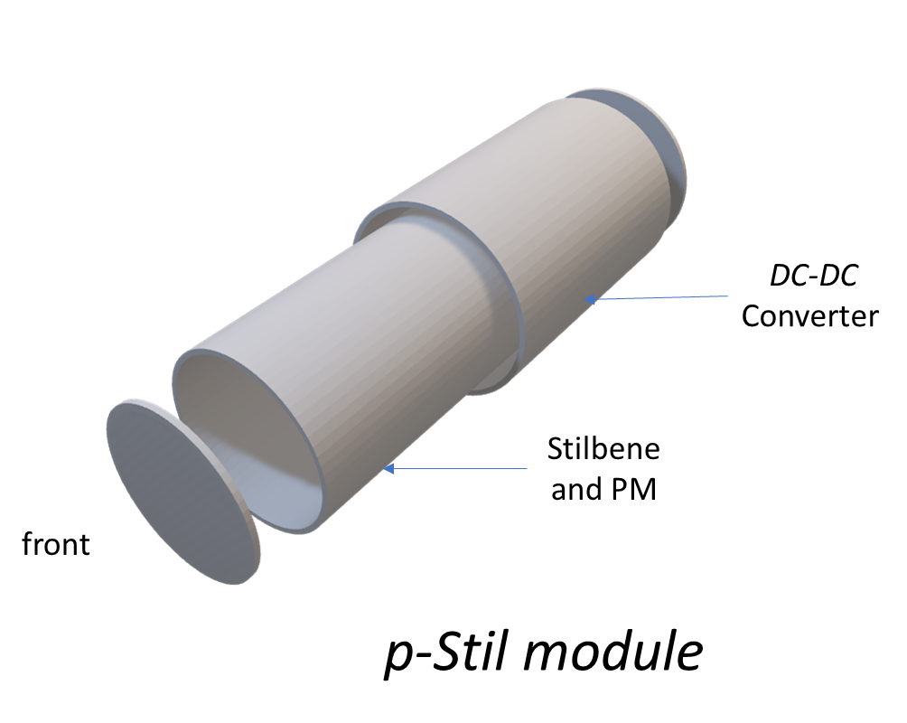
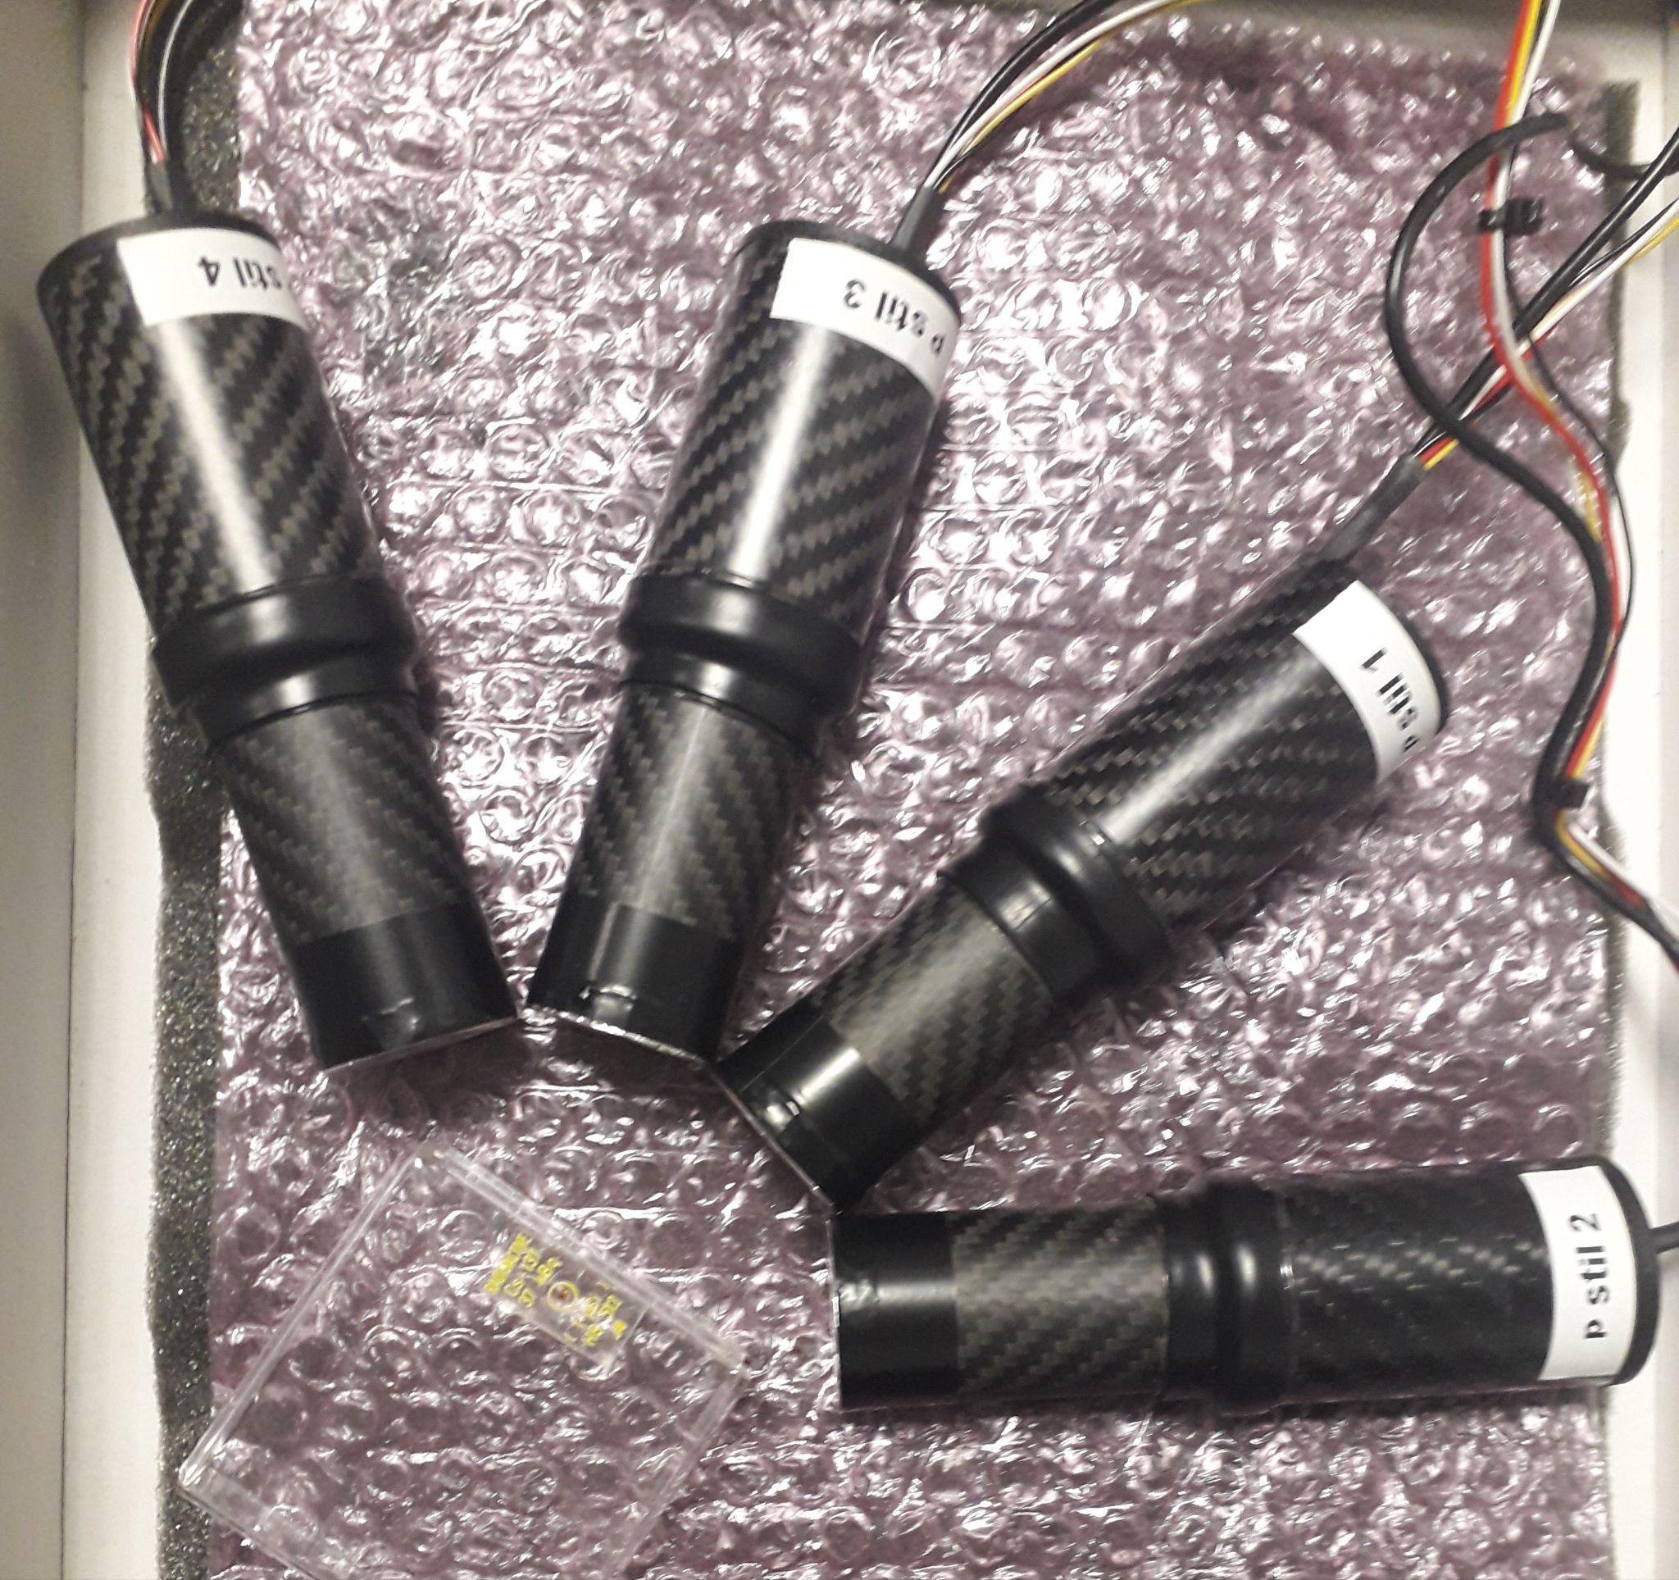
The p-stil detectors - first array (n. 4 INRAD ScintinelTM crystals)
¹³⁷Cs
1”x 1” 4 cylindrical INRAD p-stilbene detectors
PMT R7378A (no borosilicate window)

Slide 8
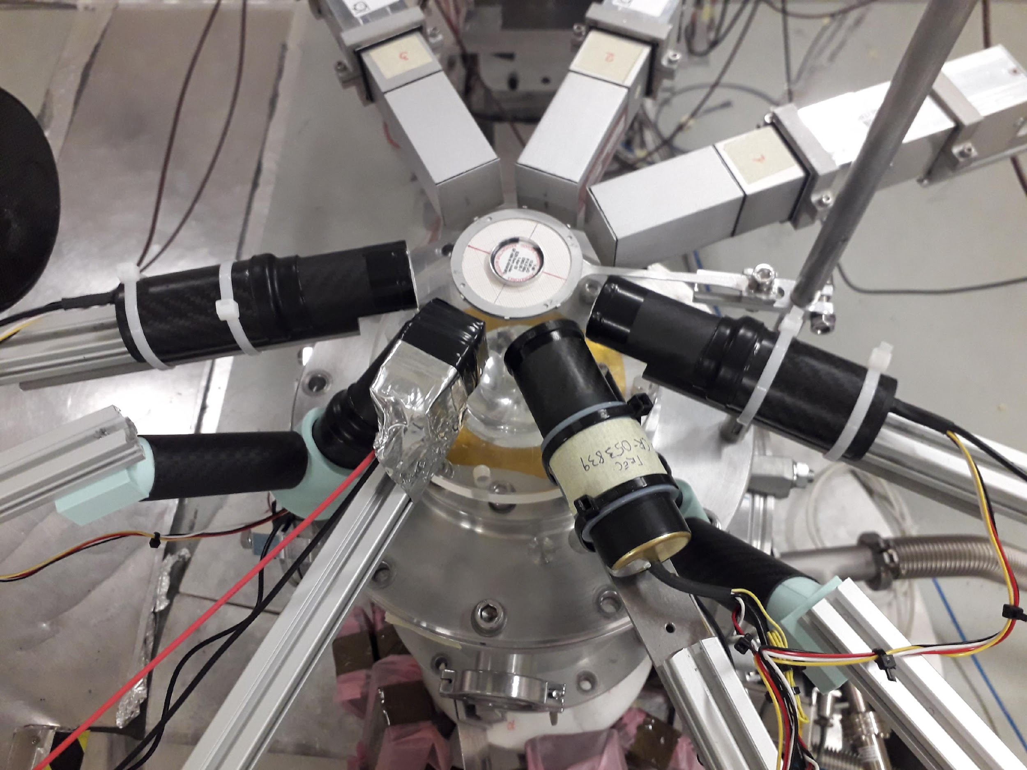
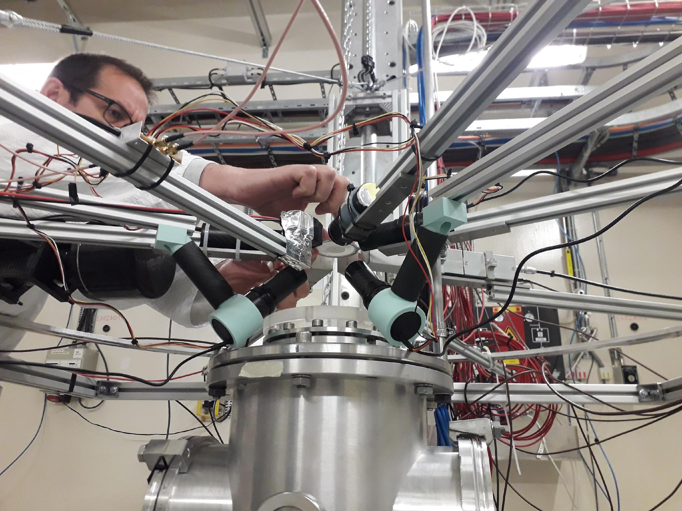
EAR2 May 2023 set-up
90° P-STIL
135° P-STIL

Slide 9
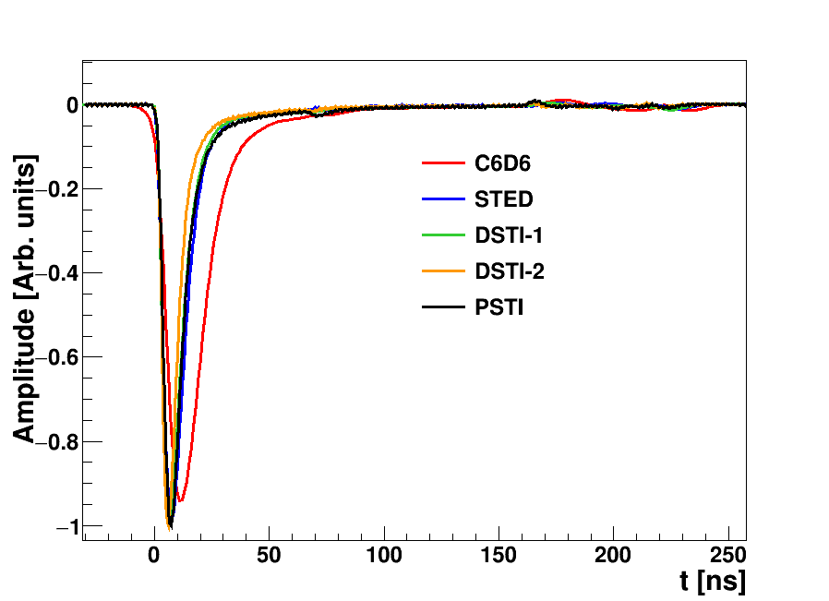
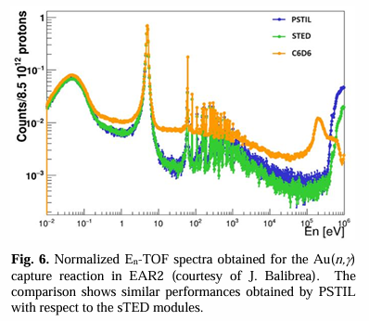
EAR2 May 2023 set-up
Detector | Rise time [ns] | Pulse width [ns]
C6D6 | 8 | 40
sTED | 4 | 24
DSTI-1 | 3 | 20
PSTI & DSTI2 | 3 | 20

Slide 10
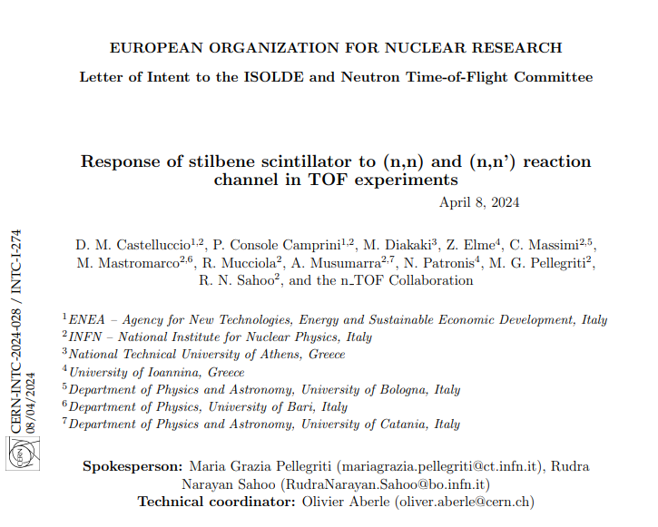
LoI for elastic and inelastic measurements EAR1@n_TOF – April 2024

Slide 11
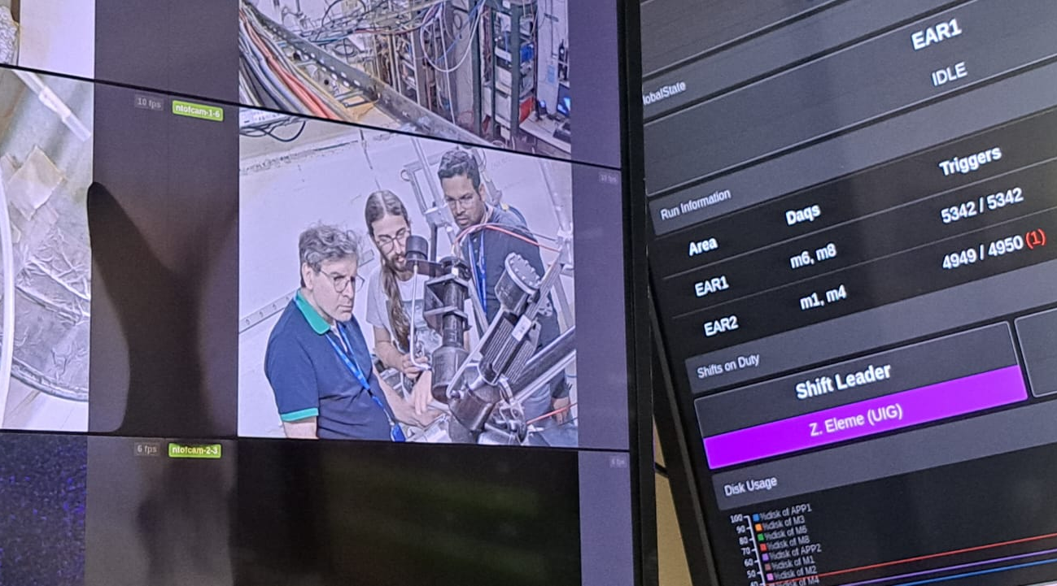
EAR1 test August 2024
(PSTIL1) with Cu setup in place (4xC6D6)

Slide 12
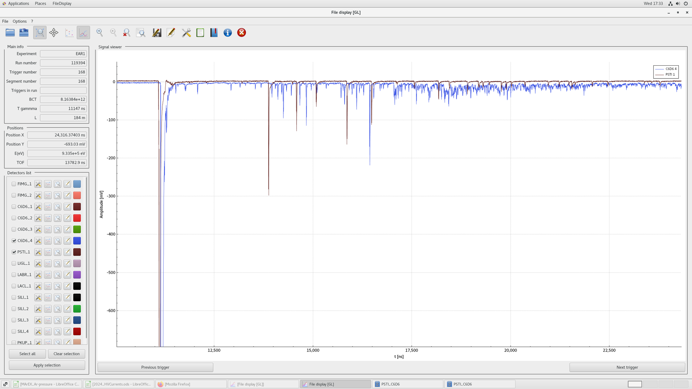
EAR1 test August 2024
PSTIL vs C6D6 comparison in the TOF MeV region
August test (PSTIL1) with Cu setup in place (4xC6D6)
No ringing (skipping the patch panel)
No baseline shift (low PM gain and small PSTIL active volume)
No γ-flash saturation (low PM gain and small active volume)
By inspection the E_{n}=1-100 MeV region is now available
for measurements in EAR1

Slide 13
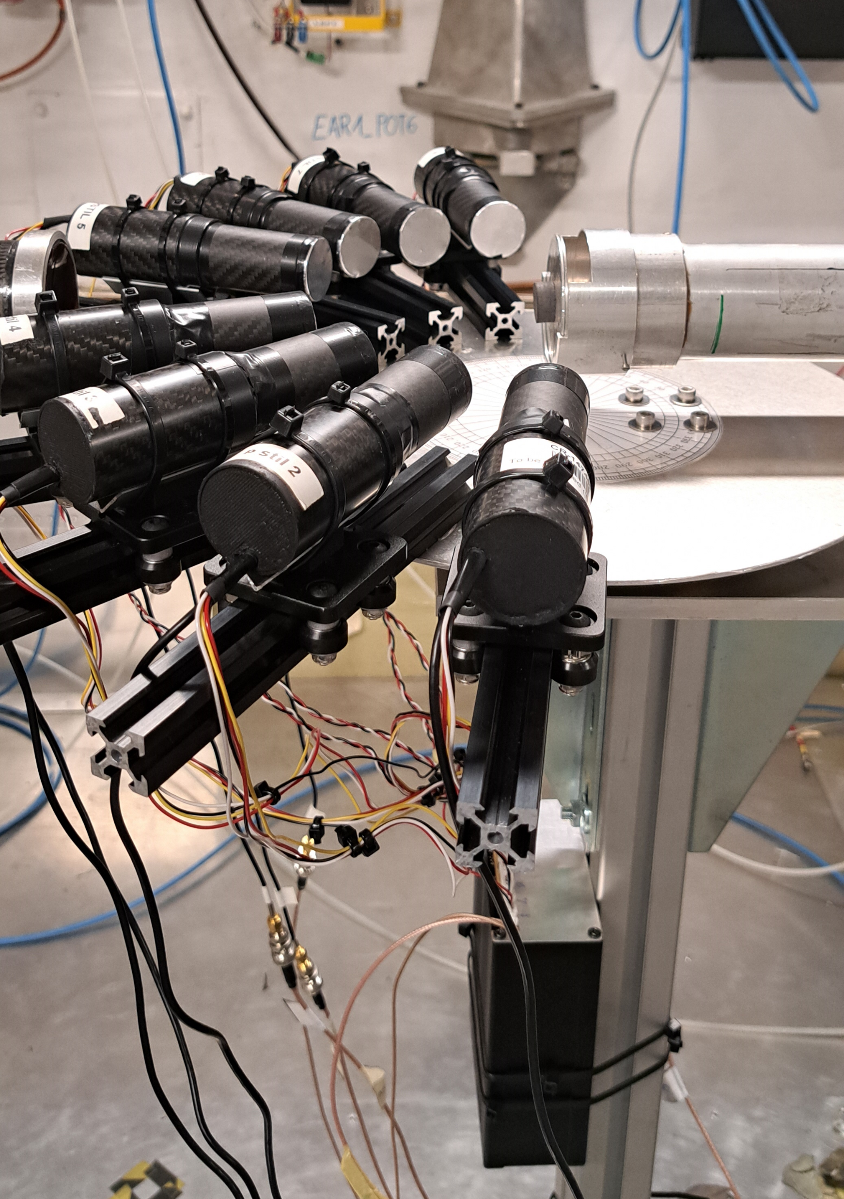
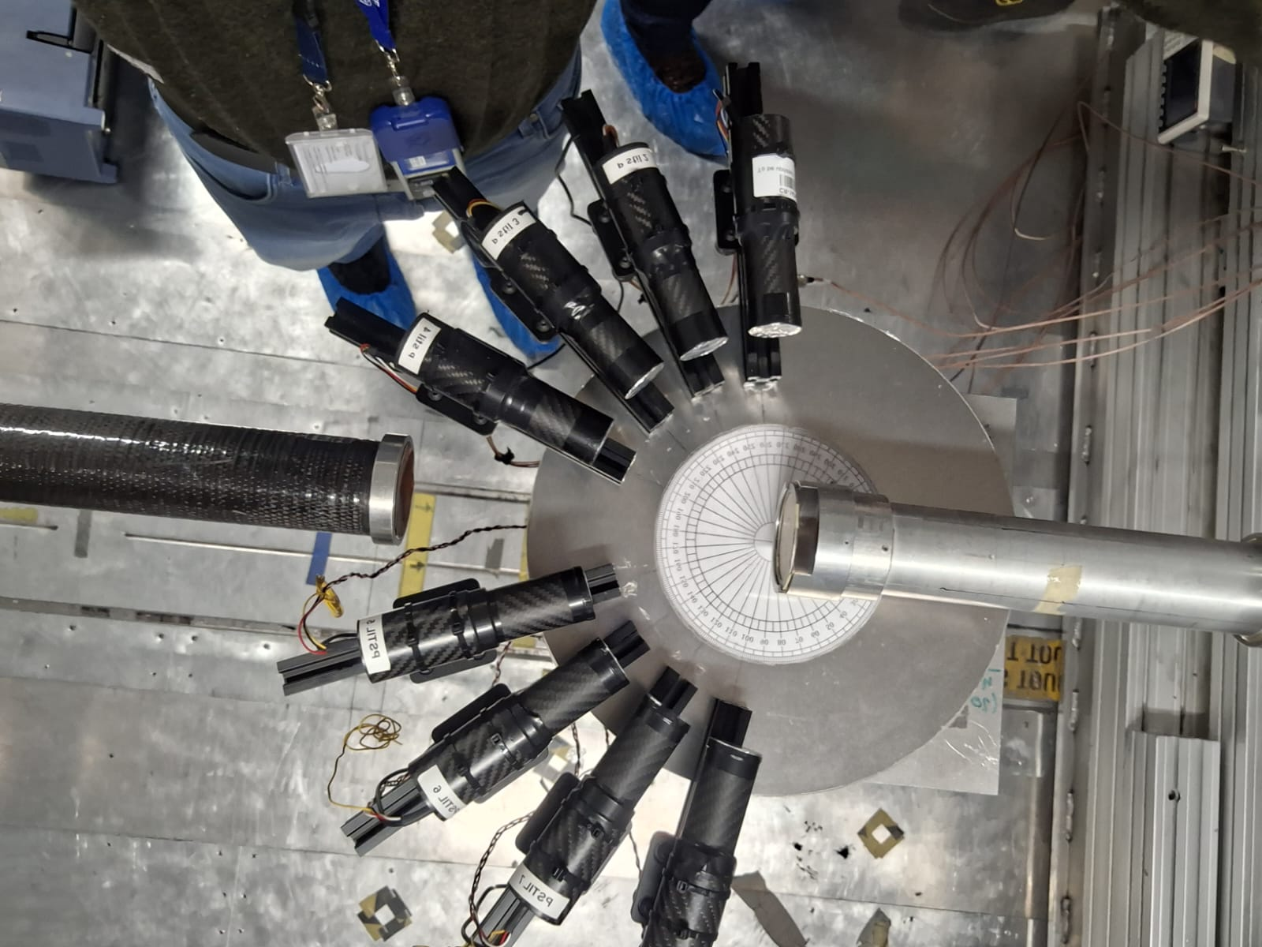
LoI INTC-I-274 - PSTIL set-up in EAR1 – October 2024
Det # | θ_{lab}
1 and 8 | 100°±6°
2 and 7 | 120°±6°
3 and 6 | 140°±6°
4 and 5 | 160°±6°
¹²C target
2
1
3
4
d=12cm, ΔΩ=0.04sr
5
6
7
8
Equalization/distribution box
full carbon fibre setup ready, by INFN-Trieste, supporting the full array

Slide 14
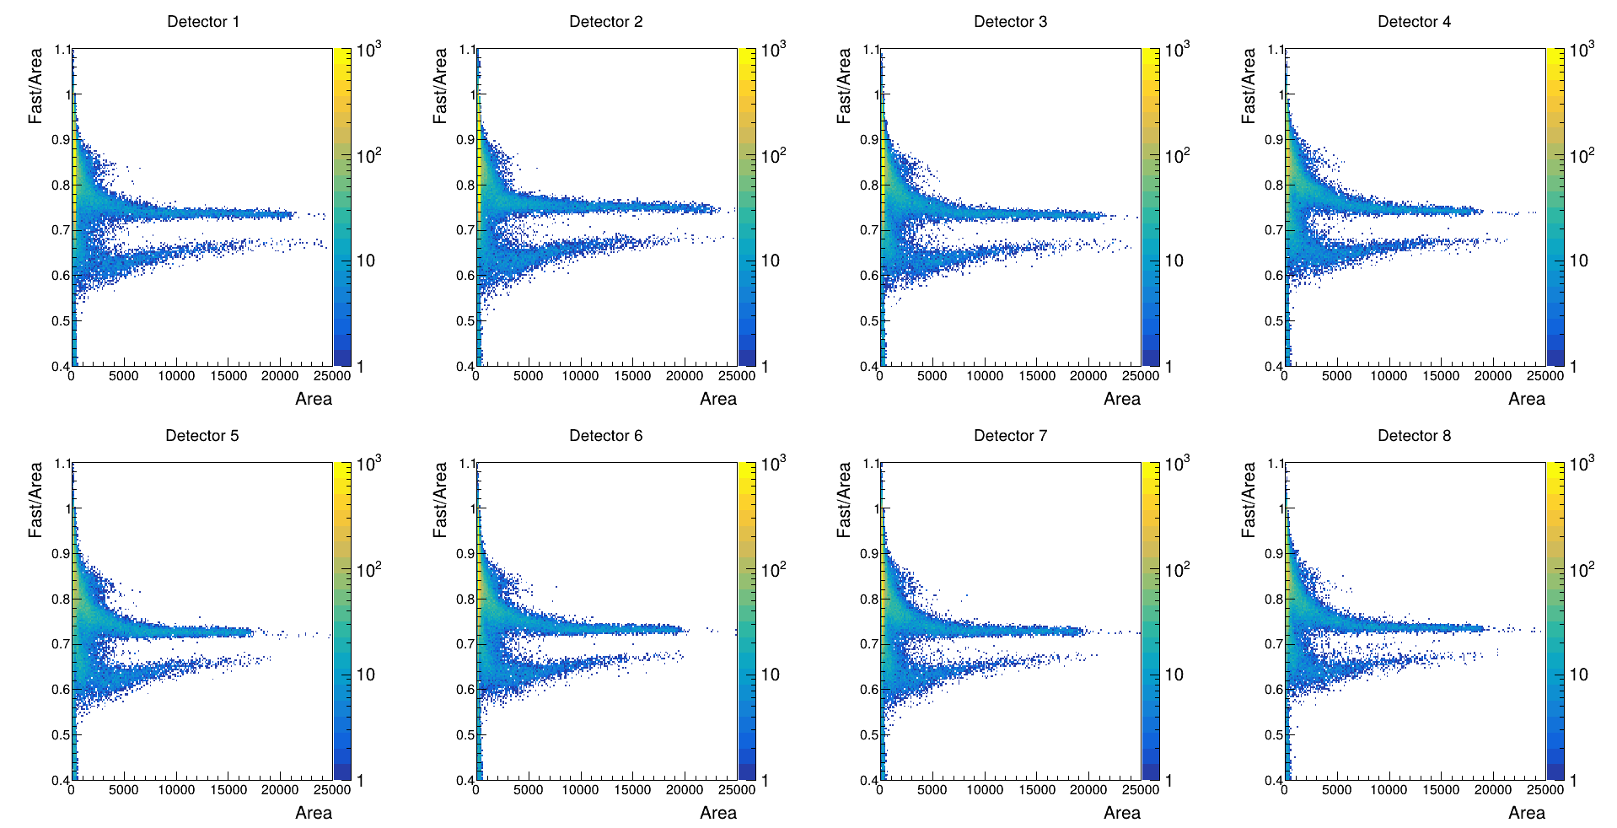
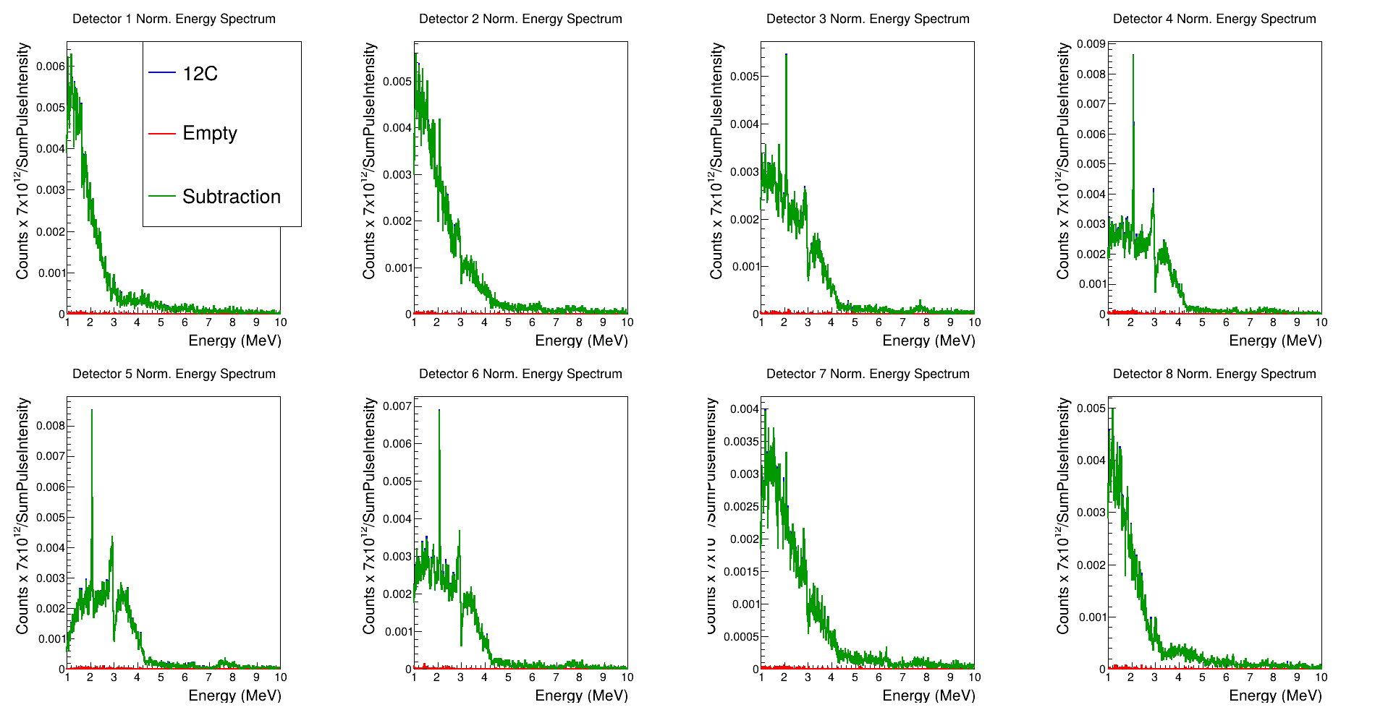
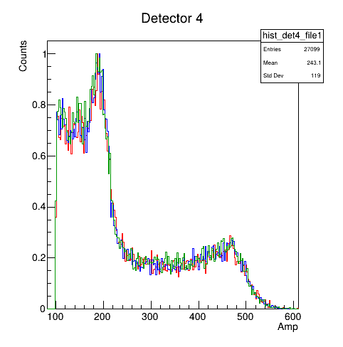
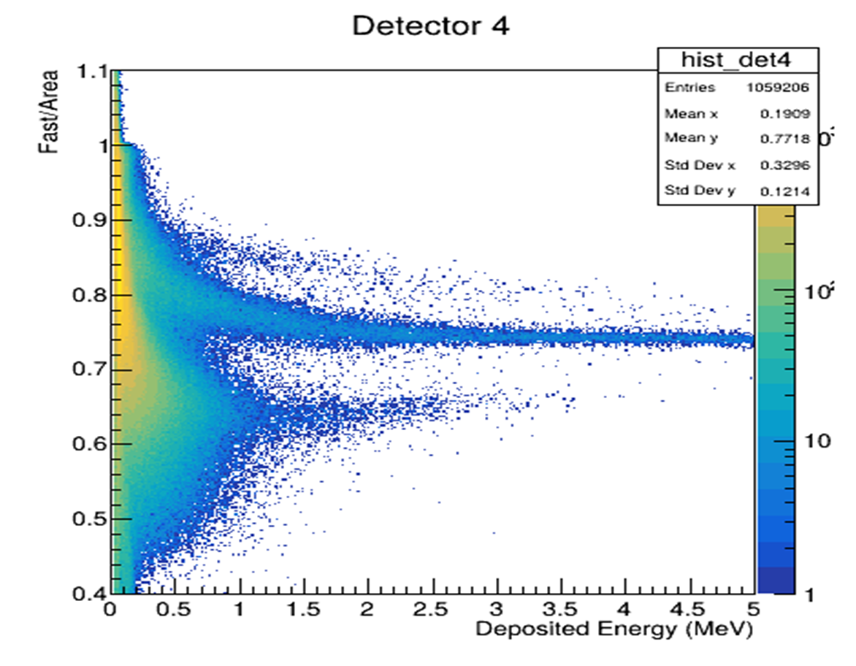
LoI INTC-I-274 - Preliminary results
new PSA
(improved signal analysis and parametrization)
n-¹²C measurement results
Conditions:
Pile-up rejection
Neutron selection
10 keV energy binning
Pulse Intensity normalization
In EAR1:
→non saturated γ-flash response
→baseline free of electromagnetic disturbance were observed
Am-Be
(n/γ discrimination)
PSTIL Gain stability check
(one week 3xY-88 calibrations)
raw TOF
n-energy spectra
neutrons
n+¹²C
(n/γ discrimination)
By D. Papanikolaou

Slide 15
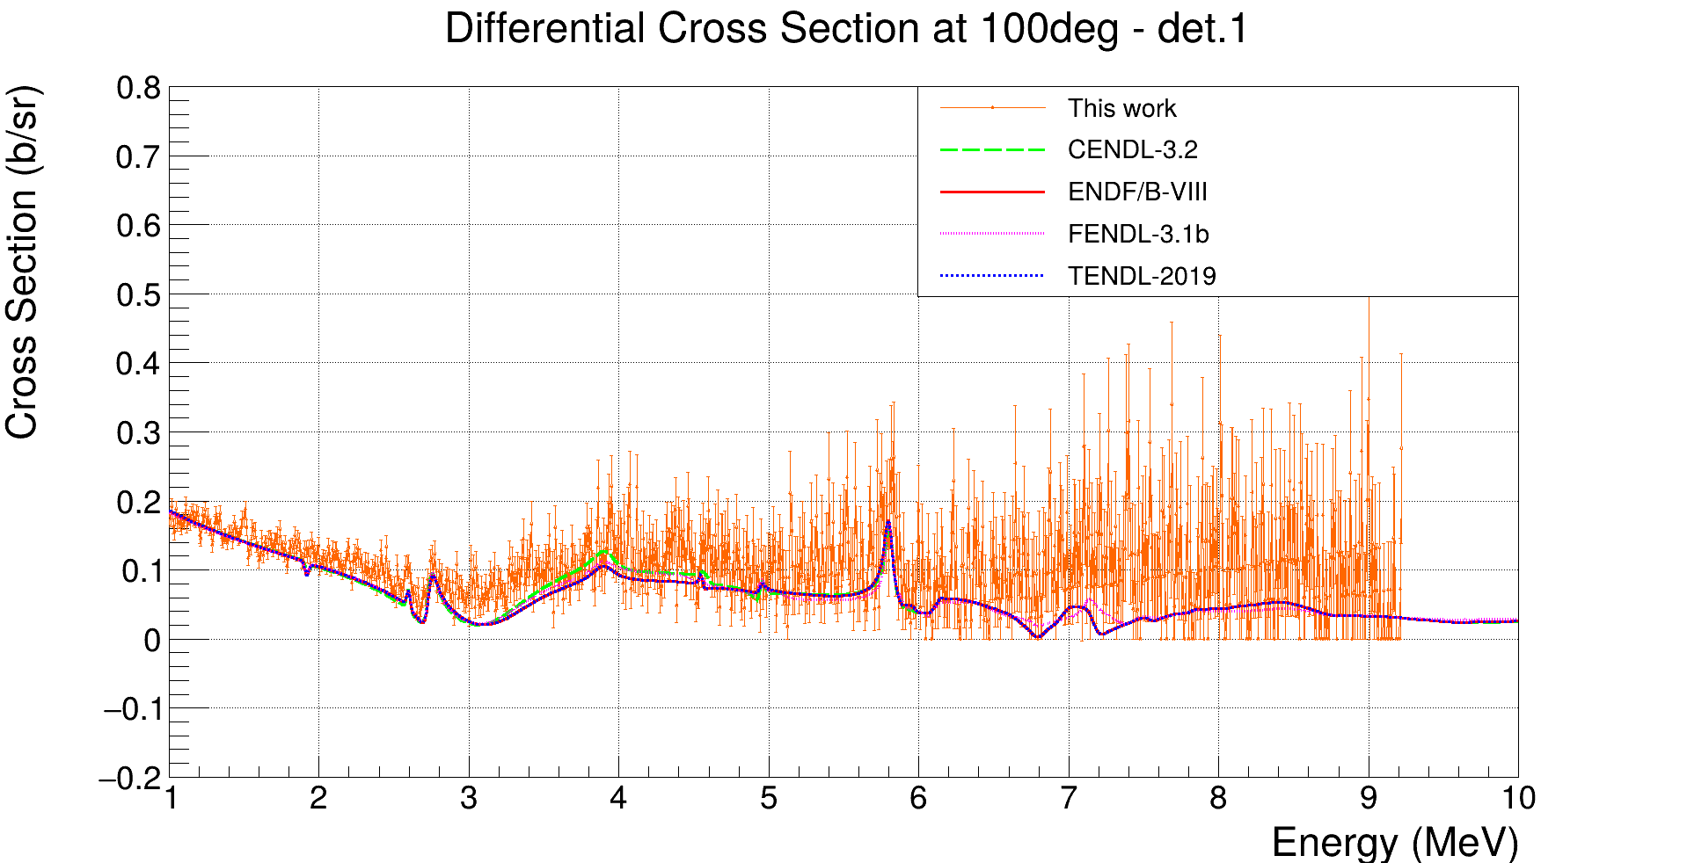
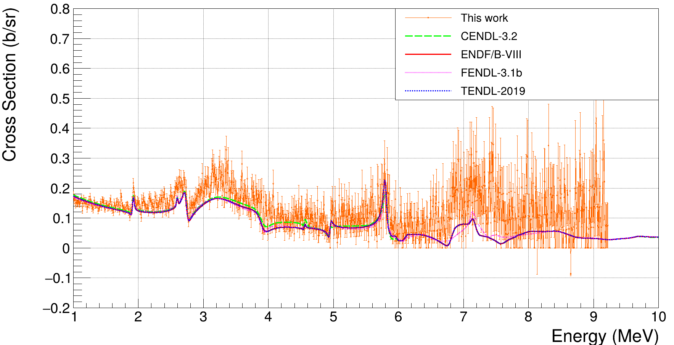
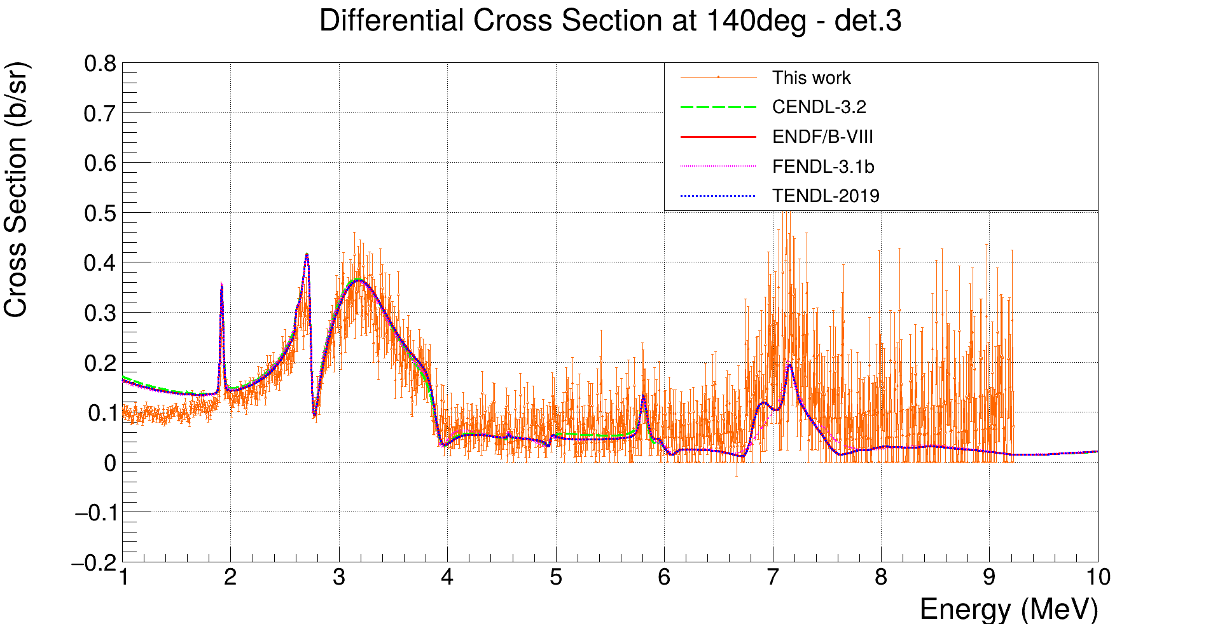
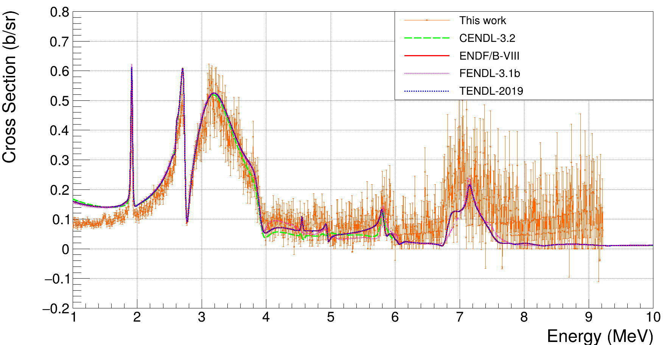
LoI INTC-I-274 - Preliminary results on ¹²C(n,n)¹²C scattering
Measurement vs evaluated data
100°
120°
dσ/dΩ (b/sr)
dσ/dΩ (b/sr)
E_{cm}(MeV)
E_{cm}(MeV)
6.862 MeV, Γ=7.68keV
140°
160°
dσ/dΩ (b/sr)
dσ/dΩ (b/sr)
E_{cm}(MeV)
E_{cm}(MeV)
By D. Papanikolaou

Slide 16
Status of PSTIL set-up
item | status | Location | Finanziamenti
n. 4 INRAD p-stil modules | Ready | @ CERN | 2022 (n_TOF_INFN, dot gr.III, CERN)
n. 4 Proteus p-stil modules | Ready | @ CERN | 2023 - n_TOF_INFN
n. 10 Proteus stilbene crystals | Delivered | @ Catania | Ant. 2025 - n_TOF_INFN
n. 10 Hamamatsu PMT | Delivered | @ Catania | 2025 - n_TOF_INFN
n. 10 Sens-tech Power supply | Delivered | @ Catania | 2025 - n_TOF_INFN
8 modules ready and 10 modules to be assembled
Milestones 2025 → accomplished
Stilbene test for inelastic and inelastic scattering (August & September 2024 EAR1)
Preliminary results presented at ND2025, Madrid
A. Musumarra, Development of a trans-Stilbene multi-detector array for measuring elastic and inelastic neutron cross-section channels

Slide 17
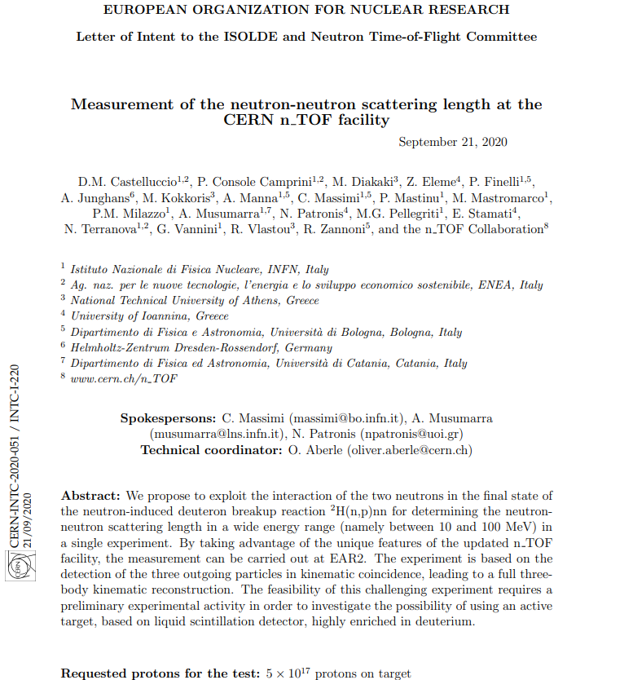
Development of TARAT (active target) for n-n measurements – 2020
²H(n,nn)p
To develop a deuterated target
Active target to detect the protons
Deuterated stilbene was the candidate

Slide 18
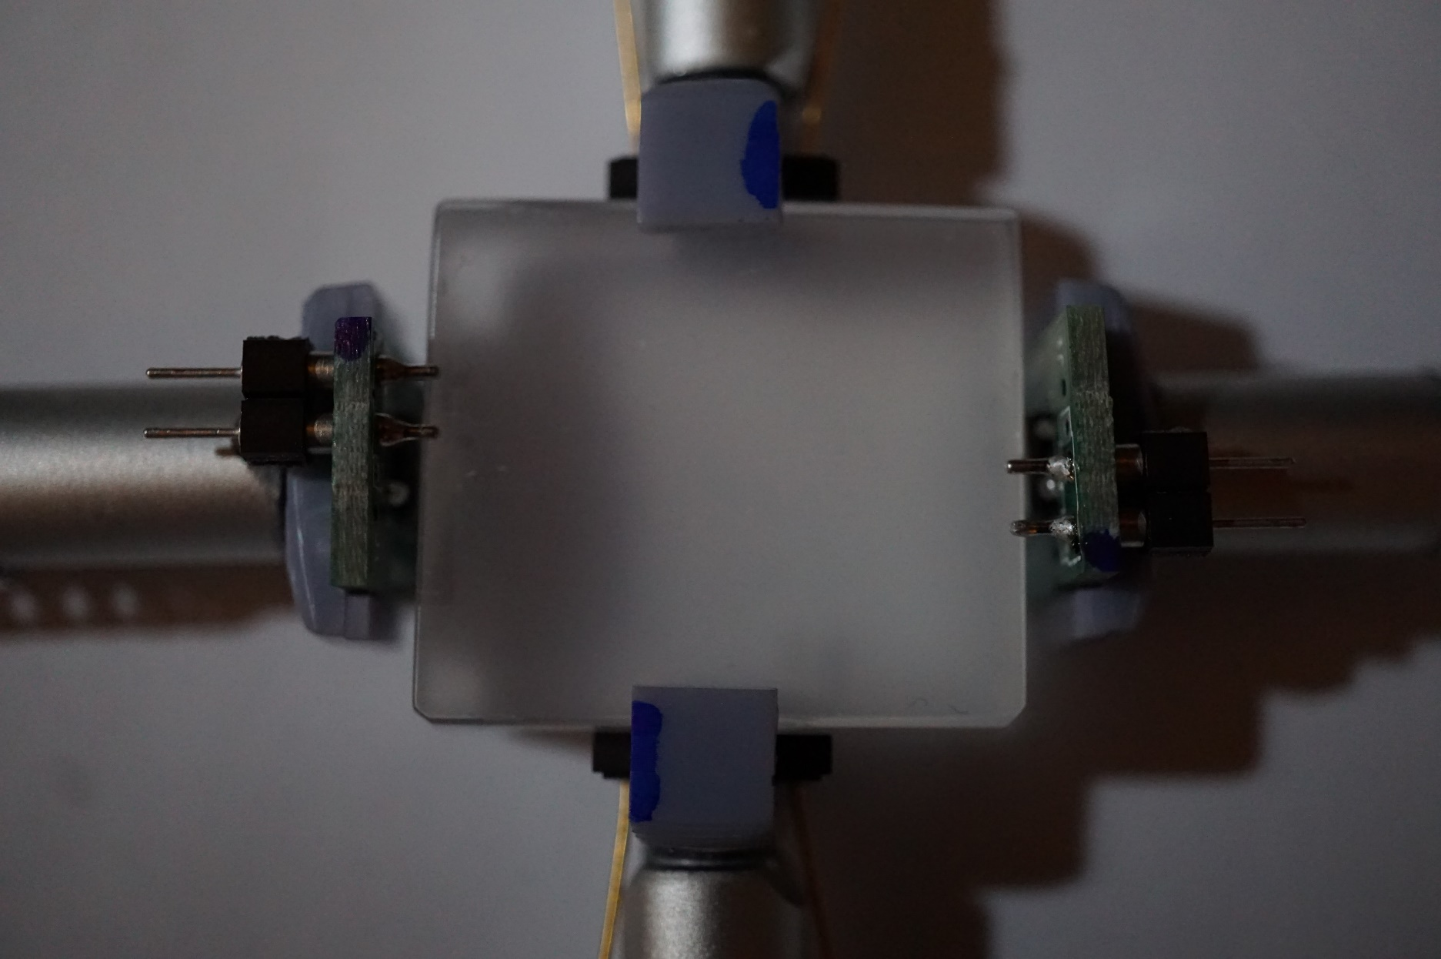
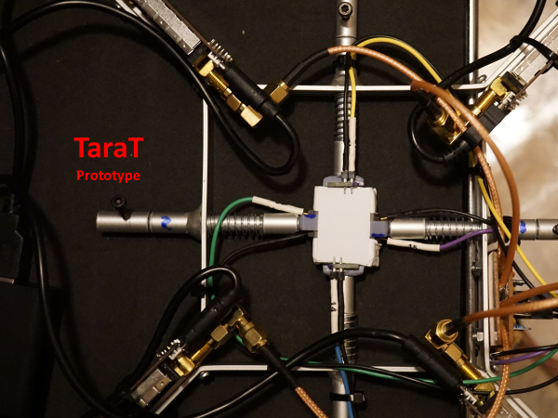
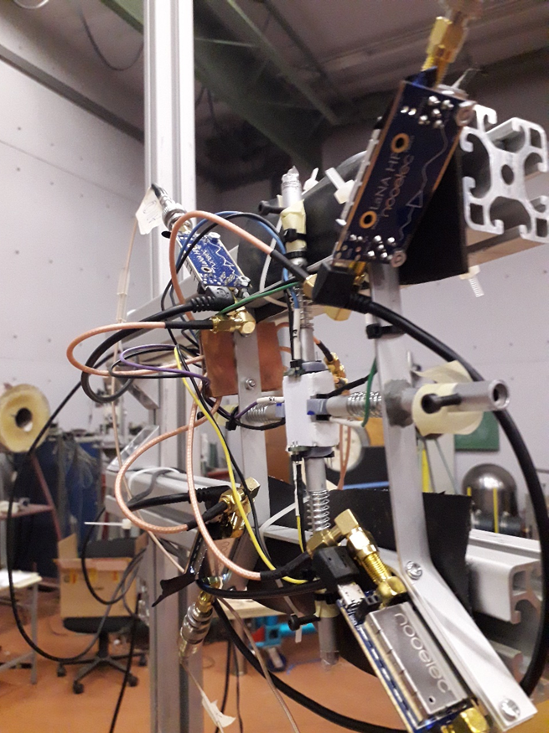
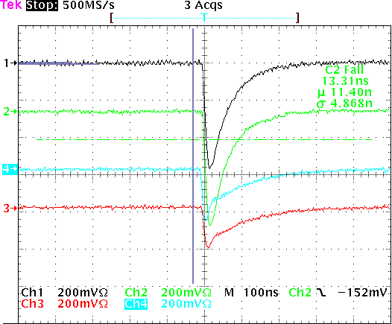
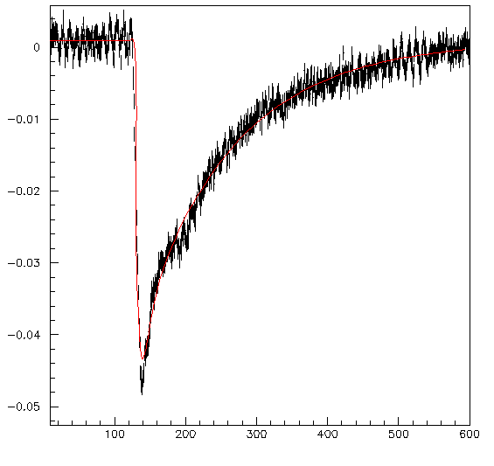
TaraT test run at NCSR Demokritos (Athens) June 2021
d-Stilbene
26 x 23 x 11 mm³
thanks to
Natalia P. Zaitseva
LLNL
Signal parametrization
$f\left(t\right)=P0+A∗(⍴ ∗(exp⁡(−\frac{t+t0}{τ_{r1}}$) -$exp⁡(−\frac{t+t0}{τ_{d1}}$)) + (1-⍴) *($exp⁡(−\frac{t+t0}{τ_{r2}}$) -$exp⁡(−\frac{t+t0}{τ_{d2}}$)))
2 HAMAMATSU 6x6
2 AdvanSid 4x4

Slide 19
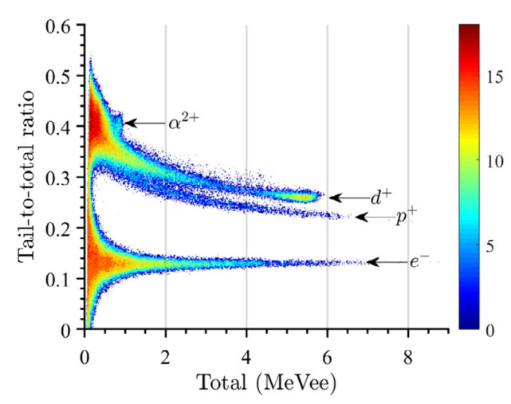
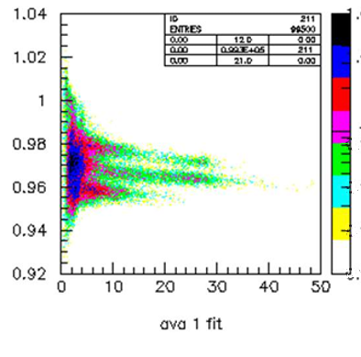
TaraT paper status: analysis upgrades
TARAT measurements Demokritos En=15MeV
Standard PMT
(Q_{tot}-Q_{fast})/Q_{tot}
d
p
e
Q_{tot (a.u.)}
Zhou, NIM A 1027 (2022) 166287
p-d discrimination, it is working also for SiPM
Possibility to disentangle break-up protons!

Slide 20
Talk and papers 2024-2026
A. Musumarra, invited Talk a HINPW7 2024 Ioannina, Greece
Towards the next generation of detectors for neutron induced reactions at n_TOF (CERN)
EPJ Web of Conferences 304 (2024) 01009
https://doi.org/10.1051/epjconf/202430401009
D. Papanikolaou, talk a ANP2024, Tessalonikki, Greece
“SOLARIS”: A neutron tracker for the next generation of solar missions
D. Papanikolaou, talk a HNPS-2024 Tessalonikki, Greece
Neutron capture reactions for nuclear astrophysics: Development & characterization of an innovative detection setup based on trans-Stilbene organic scintillators
HNPS Advances in Nuclear Physics 31 (2025) 1
https://doi.org/10.12681/hnpsanp.7995
A. Musumarra, talk a NPD2025, Madrid, Spain
Development of a trans-Stilbene multi-detector array for measuring elastic and inelastic neutron cross-section channels
(to be submitted to EPJ Web of Conferences)
D. Papanikolaou et al., Applied Radiation and Isotopes 227 (2026) 112304
“SOLARIS”: A neutron tracker for the next generation of solar missions
https://doi.org/10.1016/j.apradiso.2025.112304

Slide 21
Looking forward
C-12 (B-11) analysis is in progress (EAR1 measurement)
8 Modules up and ready for the n_TOF community (at CERN)
Total 18 modules available by the end of 2025 (beginning 2026)
Carbon fibre frame before LS3 (Trieste-Bologna-Catania)
Complementary setup:
PSTIL & Fission set-up: 236U(n,f) and LoI INTC-I-294
PSTIL+LaBr3 n/γ coincidences En=0.1 – 10 MeV
PSTIL as ancillary detectors in (n,cp) setup (in-vacuum)

