Slide 1
Schools: various institutes of Veneto region, Italy
November 13, 2025
National Laboratories of Legnaro (INFN)
Logo
school/institute

Slide 2
Introduction
Today our schools took part at the International Cosmic Day 2025 in Legnaro, Padua.
They explained us the story of INFN, the cosmic rays and in particular the muons, Einstein‘s theory of relativity and the radioastronomy.
At the end we measured the flux of cosmic rays with the muon telescope.

Slide 3
Muon detector
Scintillator and absorbing plate
Fiber optic cable
SiPM
DAQ board
Raspberry Pi
Trasductor

Slide 4
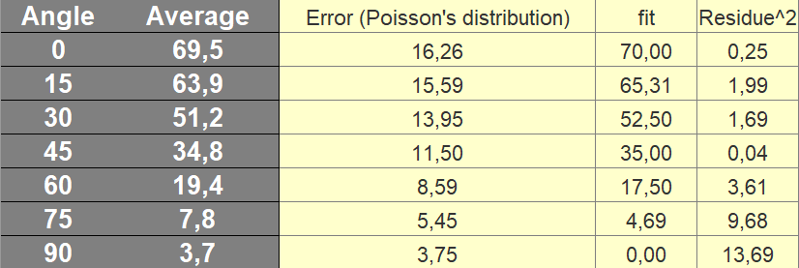
Conclusions
The data showed:
quadratic cosine proportion between the amount of coincidences and the angle in which the detector was rotated

Slide 5
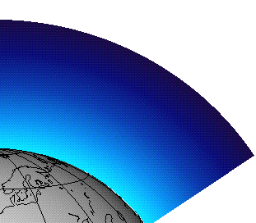
Conclusions
This is caused by the effect that varing the angle changes the amount of atmosphere that the muons have to travel through before getting to the detector

