Slide 1


Online DCR measurements on CMOS SPADs
Lodovico Ratti
Università di Pavia and INFN Pavia
(lodovico.ratti@unipv.it)
WP2 meeting
https://cern.zoom.us/j/6401428621
September 9, 2025

Slide 2
Device under test: 150 nm CMOS SPAD
P+/N-well junction, isolated from substrate by deep n-well
150 nm CMOS technology
Available for characterization in single- and dual-layer configuration

Slide 3
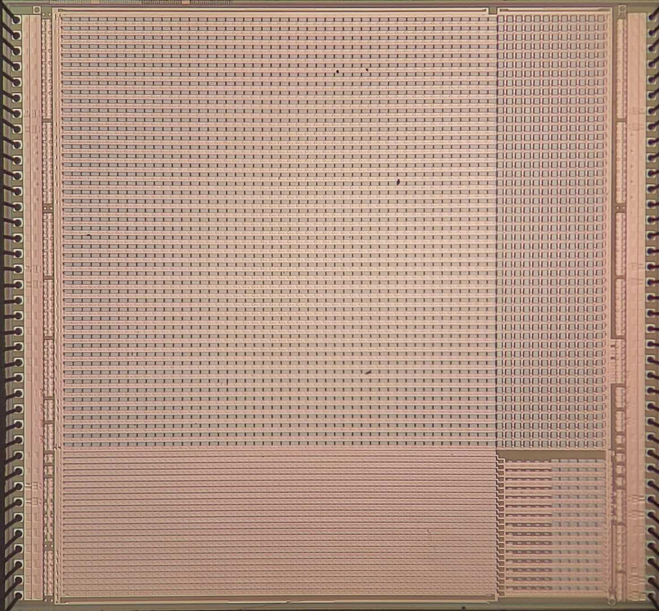
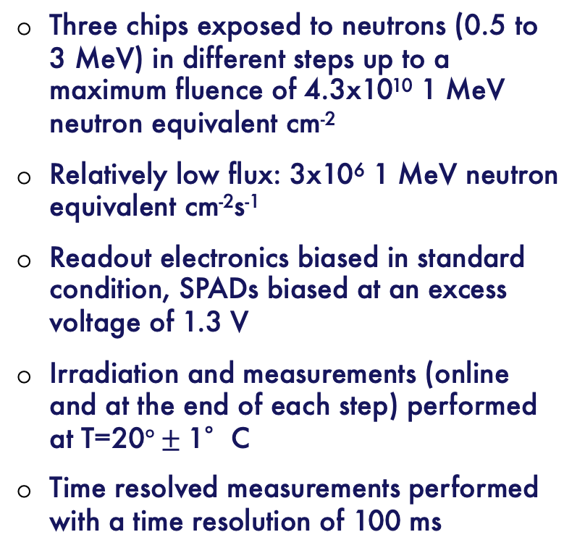
Neutron irradiation and test procedure
Three chips exposed to neutrons (0.5 to 3 MeV) in different steps up to a maximum fluence of 4.3x10¹⁰ 1 MeV neutron equivalent cm⁻²
Relatively low flux: 3x10⁶ 1 MeV neutron equivalent cm⁻²s⁻¹
Readout electronics biased in standard condition, SPADs biased at an excess voltage of 1.3 V
Irradiation and measurements (online and at the end of each step) performed at T=20$°±\text{1}$°C
Time resolved measurements performed with a time resolution of 100 ms
5 mm
5 mm

Slide 4
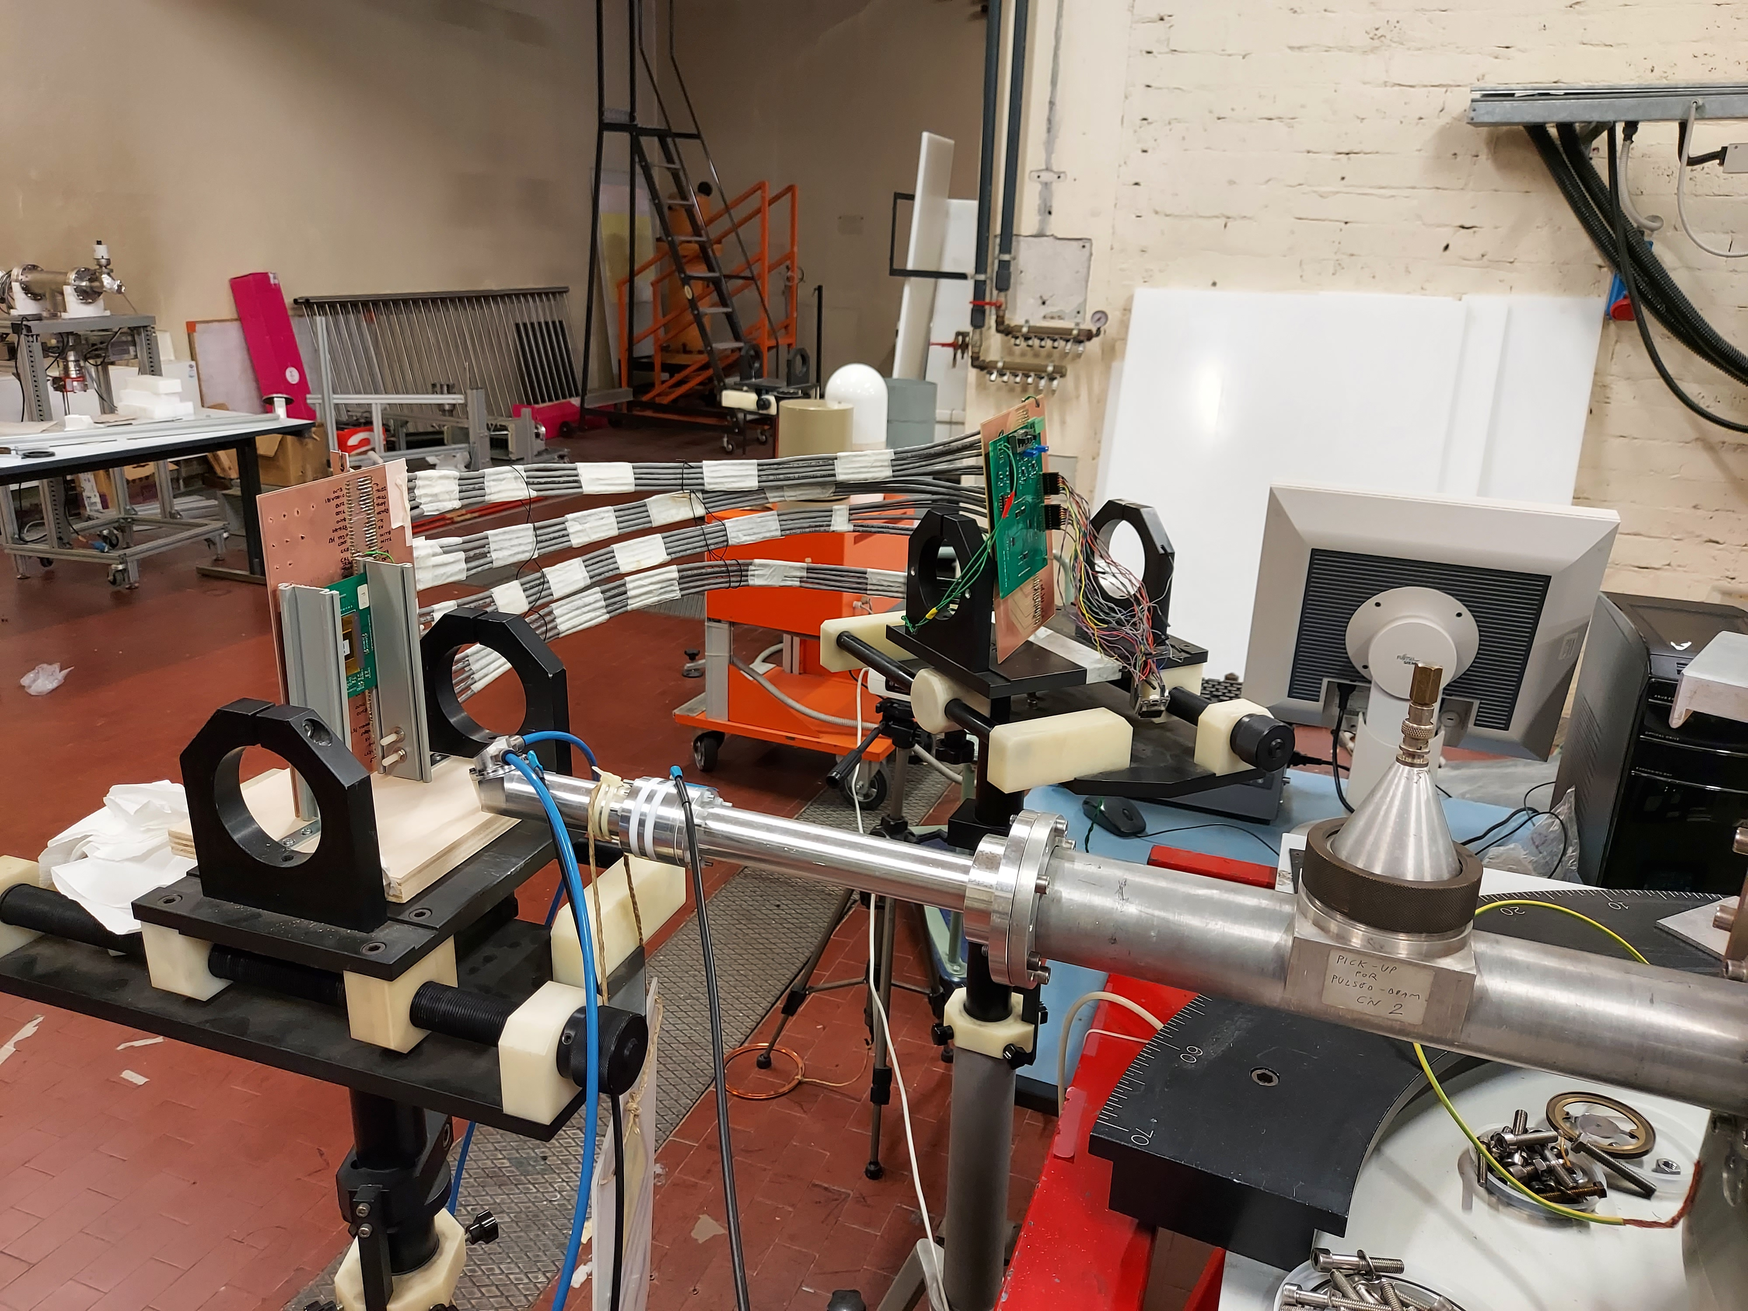
Test setup
test board (bias, configuration, readout)
DUT
proton beam pipe

Slide 5
Online DCR measurements
72 pixels, 48 from array A1 and 24 from array A3, were monitored during irradiation ➔ DCR was measured while the samples were being irradiated
Three chips, two single layer, one dual layer
Online DCR measurement procedure: of the 72 pixels
    9 pixels at a time are enabled for a Δt time window, then their single bit memories are read out in parallel and reset
    the previous operation is repeated N_{r} times for the same 9 pixels, resulting in an overall integration time N_{r} Δt, ensuring a sensitivity 1/N_{r} Δt
    the previous two steps are repeated for the other 63 pixels, 9 at a time
    with Δt=2 us, N_{r}=2500, sensitivity=200 Hz
    with the previous settings, we were able to measure the DCR of each of the 72 pixels every 100 ms
A similar approach can be replicated in the 110 nm test chip, where 6 pads for parallel readout of A1 and A3 arrays are available

Slide 6
Time resolved DCR measurements
150 s
Φ=8.10x10⁹ cm⁻²
Single-layer, A1 subarray (75 μm pitch)
Online DCR measurements (100 ms time resolution) make it possible to study short-term annealing processes – to be taken into account when estimating damage based on fluence and non-ionizing energy loss (NIEL)
Significantly large set of events with pseudo-exponential recovery

Slide 7
Neutron-triggered RTS fluctuations
mostly bi-stable defect, two seldom appearing additional levels
RTS fluctuations beginning a few tens to a few hundred of seconds after irradiation starts
bi-stable defect

