Slide 1
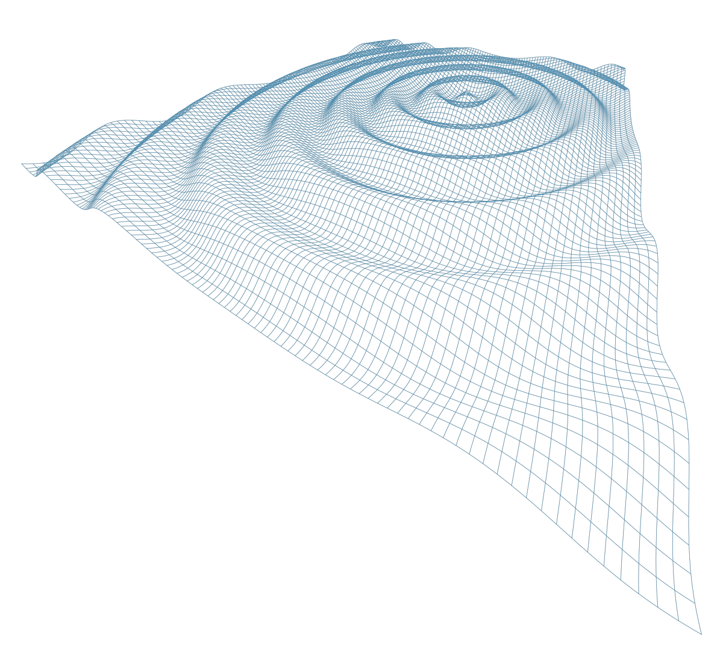


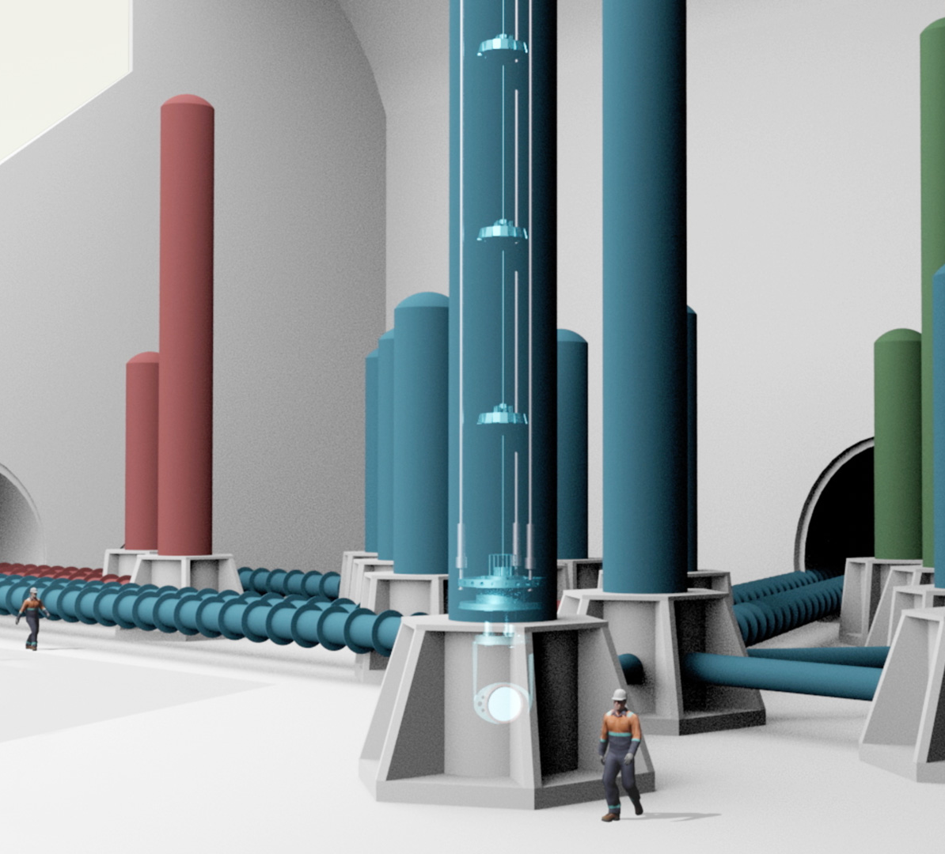

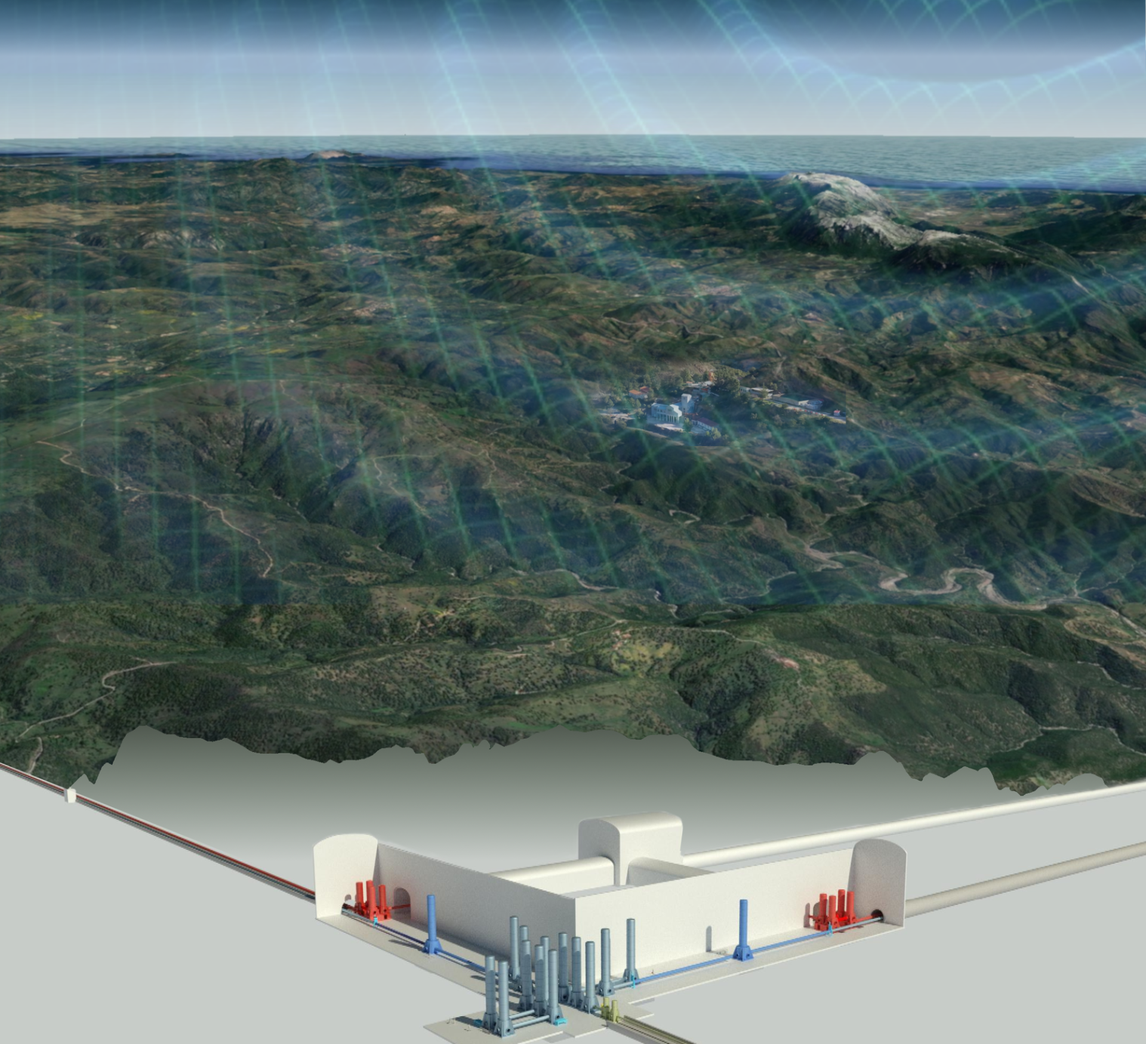
Prof. D. D’Urso
Univ. di Sassari & INFN Cagliari
ET STATUS

Slide 2
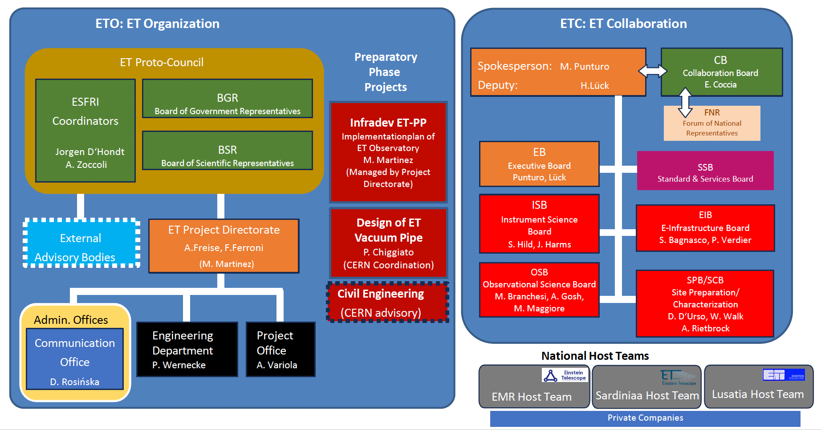
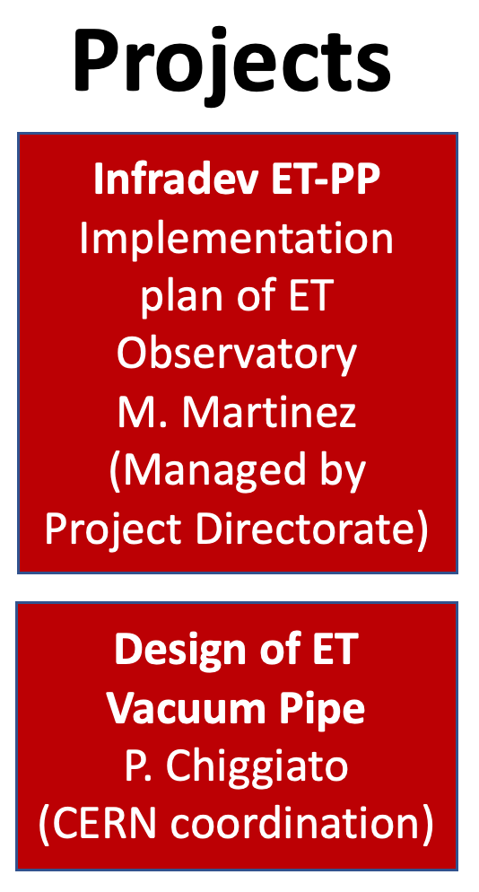



ET Project: Current Organization
ETO: ET Organization
ET Collaboration
ET Proto-Council
SP: M. Punturo
DSP: H.Lück
CB
Collaboration Board
ESFRI Coordinators
S. Bentvelsen
A. Zoccoli
BGR
Board of Government Representatives
BSR
Board of Scientific Representatives
EB
Executive Board
SSB
Standard & Services Board
ISB
Instrument Science Board
EIB
E-Infrastructures Board
External Advisory Bodies
ET Project Directorate
A.Freise, F.Ferroni
M. Martinez
Civil Engineering
(CERN advisory)
OSB
Observational Science Board
SPB/SCB
Site Preparation/ Characterization
Admin. Offices
Eng. Dept
Project Off.
Communic.Off.
National Host Teams
EMR
Host Team
Sardinia
Host Team
Lausitz
Host Team
Private companies
Private companies
Private companies

Slide 3
Activities on three fronts
ETO (international project organisation) • Provide project management and all engineering work. • Decide on governance, type of legal entity and financial frameworks, ... • Engineering work and technical design of the research infrastructure.
ET Collaboration (international)
Define scientific vision and detector requirements. For example: science case for ET, which are the key characteristics of a good ET site.
Research and development the technology required for ET. For example, silicon mirrors, cryogenic suspension systems, ...
Local teams
Site characterisation with seismic and geological studies.
Deliver design and implementation plans that are unique to the region.
Develop economic case and deliver socio-economic impact plan.

Slide 4
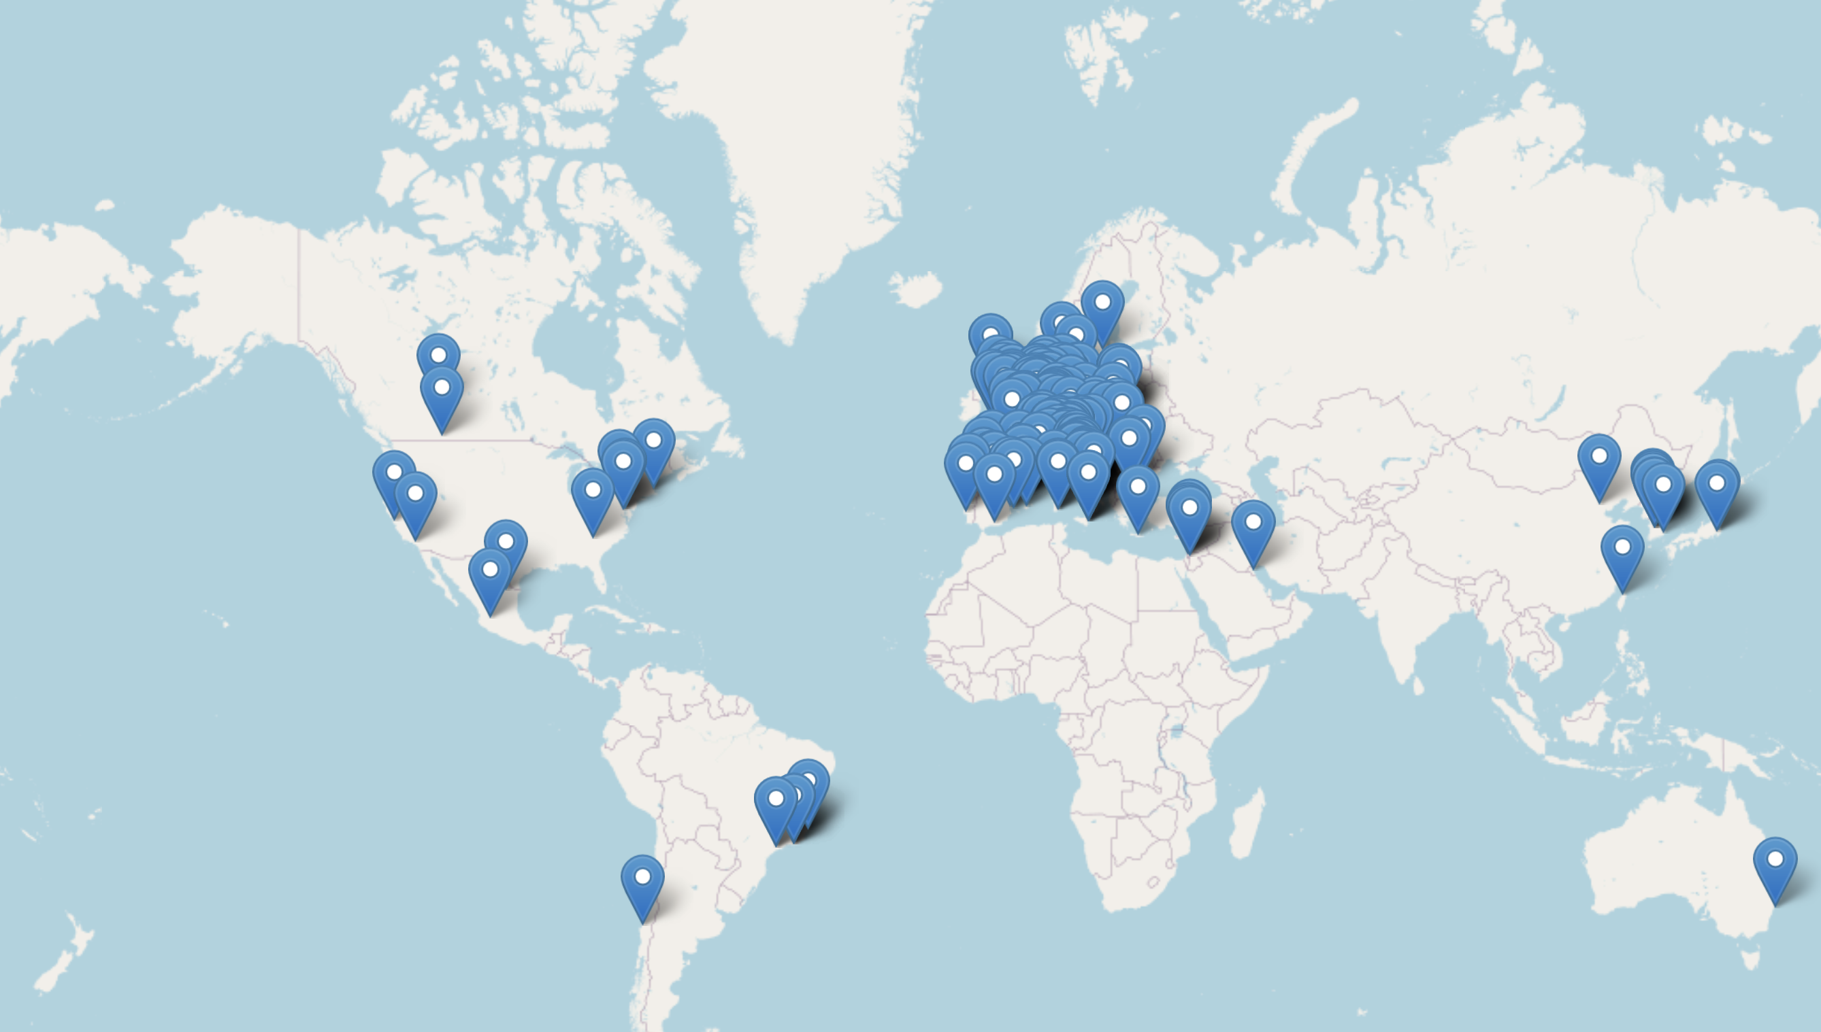
ET Collaboration
ET Member‘s affiliation map
Sept 22th 2025
1874 Members
94 Research Units
271 Institutions
31 countries.

Slide 5
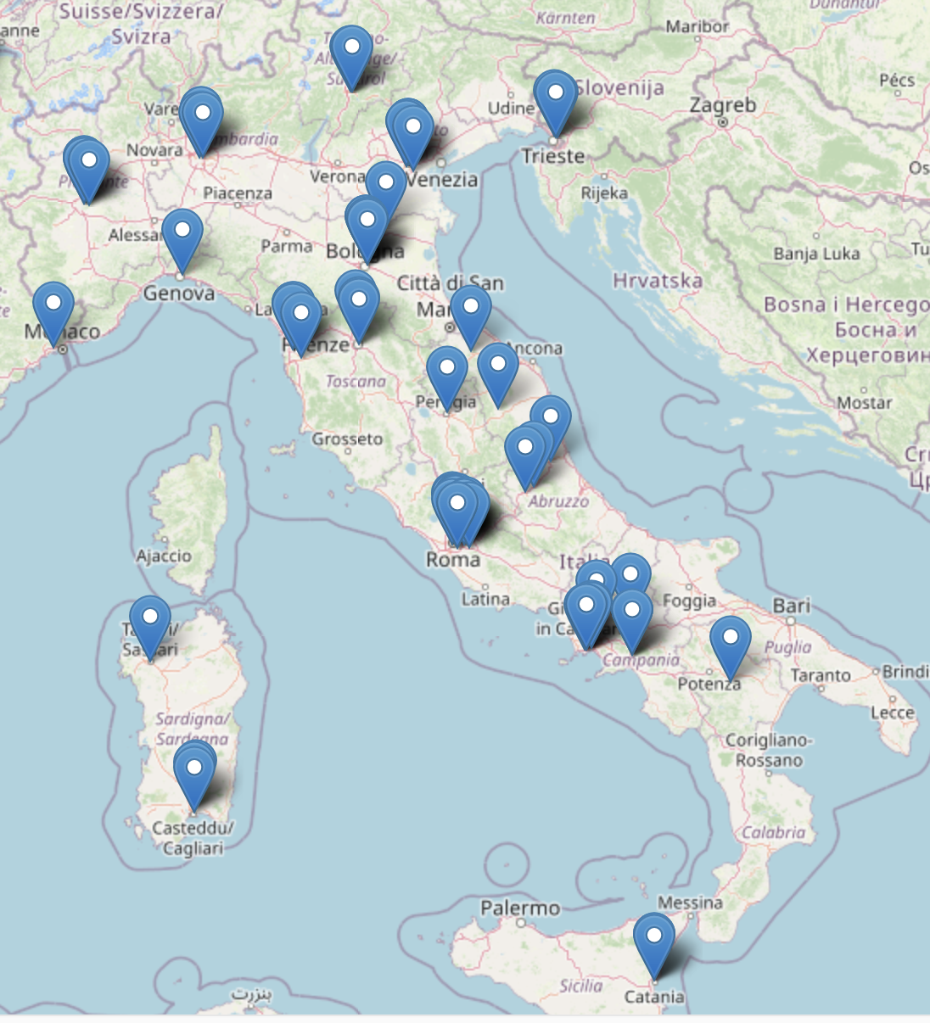

ET Italy
~ 600 members of 81 institutions for 27 RU
Site Characterization
R&D enabling technologies
Science case

Slide 6
Current Main Activities
Updating the ET science case Δ or 2L
Define a feasible optical layout and the key elements of the ET detector
Realizing a European network of R&D infrastructures
Developing the design of the ET governance, civil and technical infrastructures, evaluating their costs
Preparing the bidbook for the candidature of the sites

Slide 7
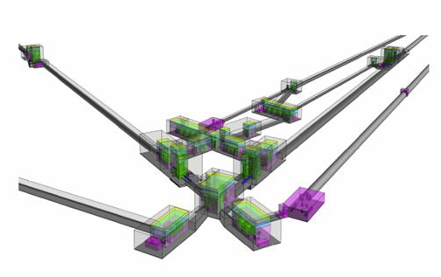
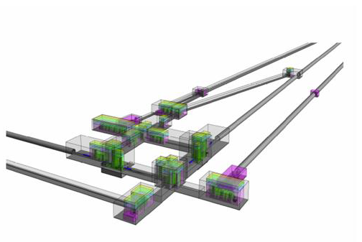
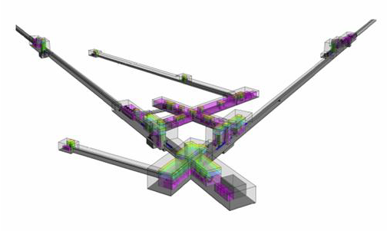
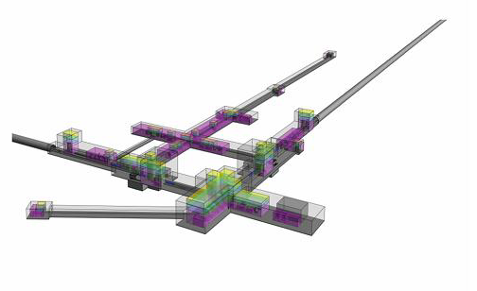
Define the ET Optical Layout
Background
2020 ESFRI proposal
2022 CDR update
2024 optical layout update
ETO TASK FORCE
Filter cavities in arm tunnels, simplified vertex design
reduction of benches footprint and tower height
Better definition of technical infrastructure
Identification of main cost drivers
estimate relative cost changes vs detector layout configuration
Identification of main engineering requirements on technical and civil infrastructure
Risk and flexibility analysis on design choices and alternative configurations
Noise budget, comparison with the official ET science case, scientific requirements on design parameters
Volume claims and infrastructure cost reduced by ~25% from 2024 reference layouts
2024 ET Optical Layout
2025 ET Optical Layout

Slide 8
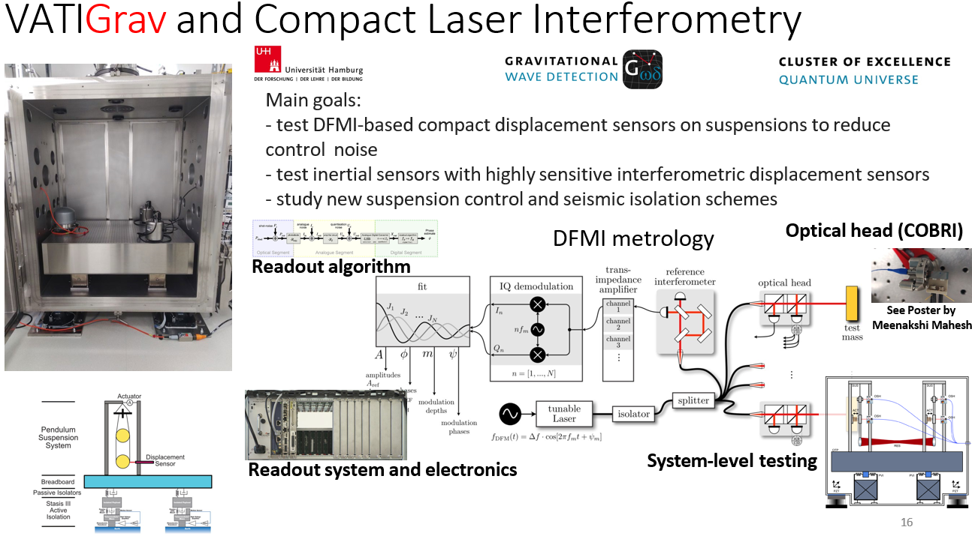
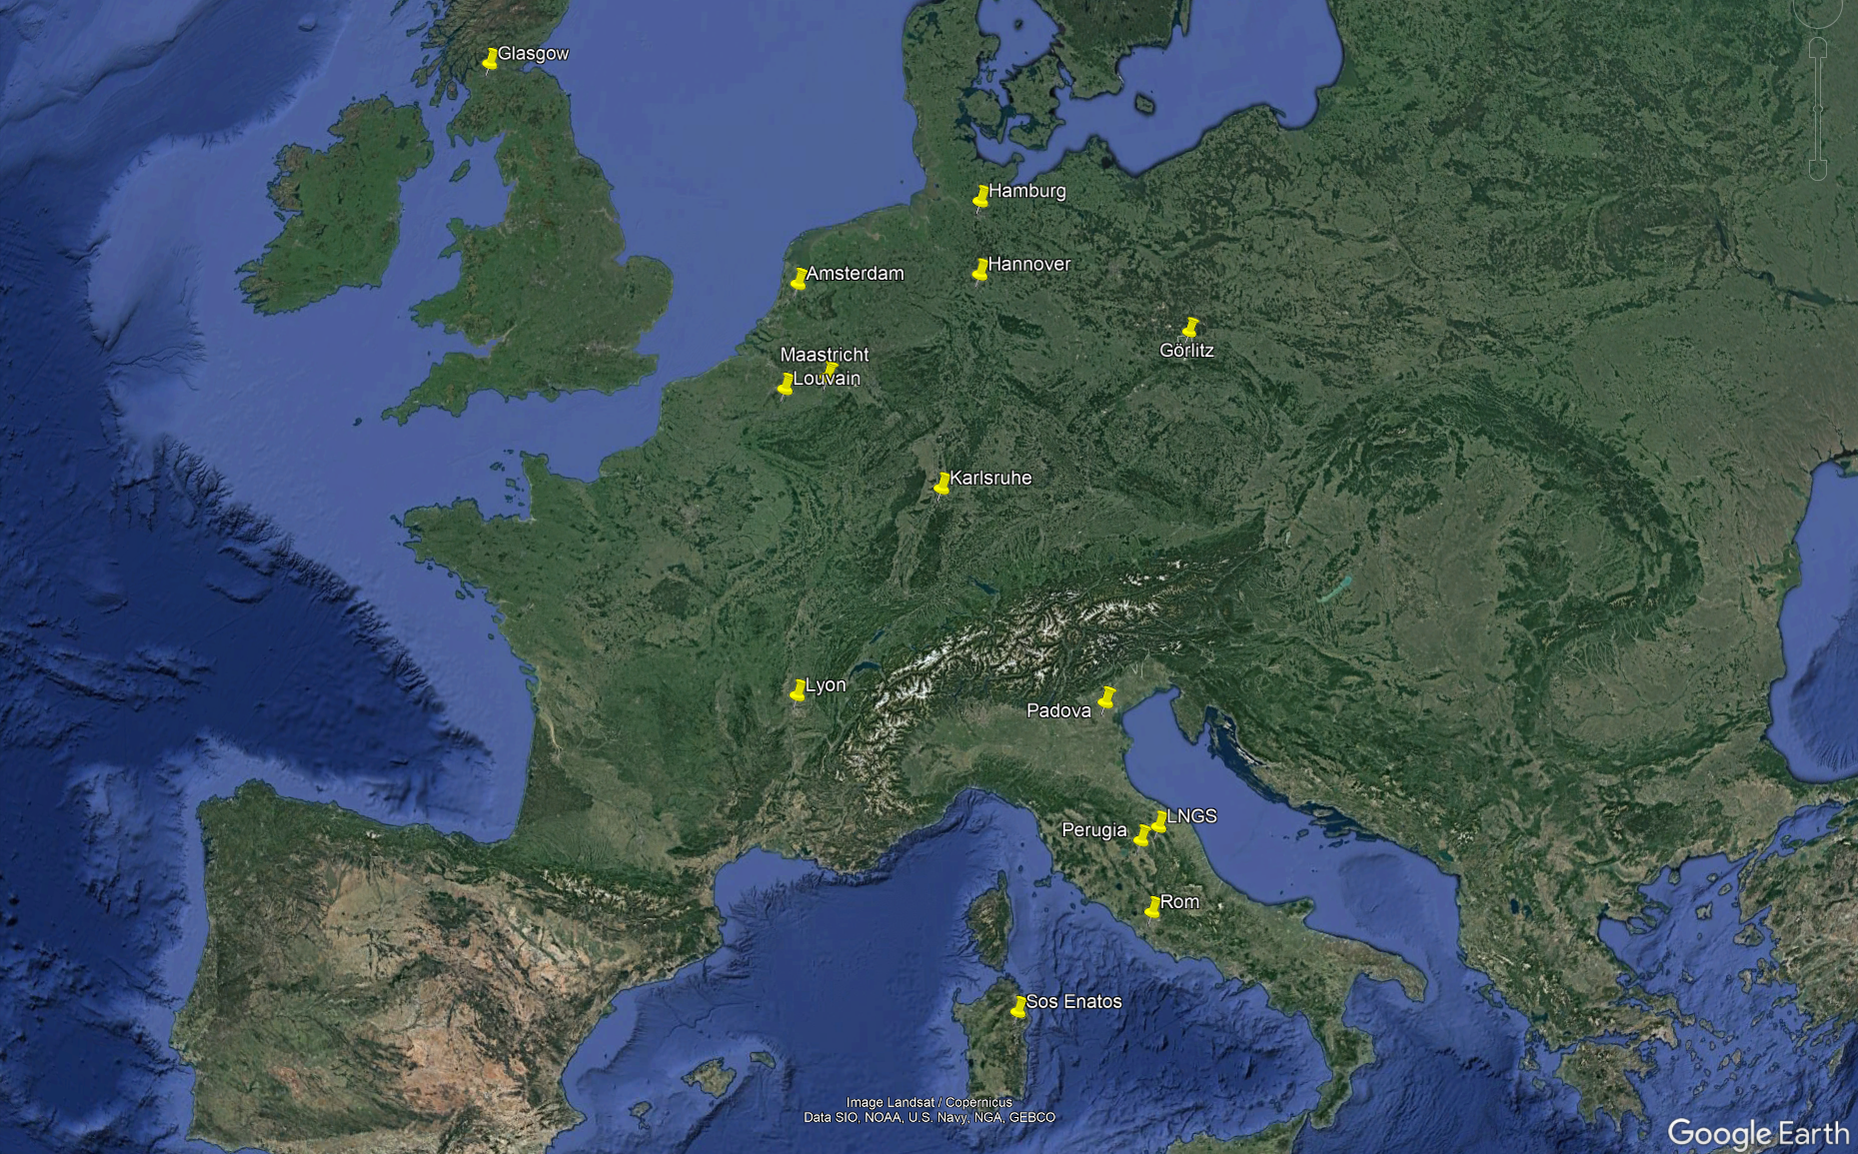
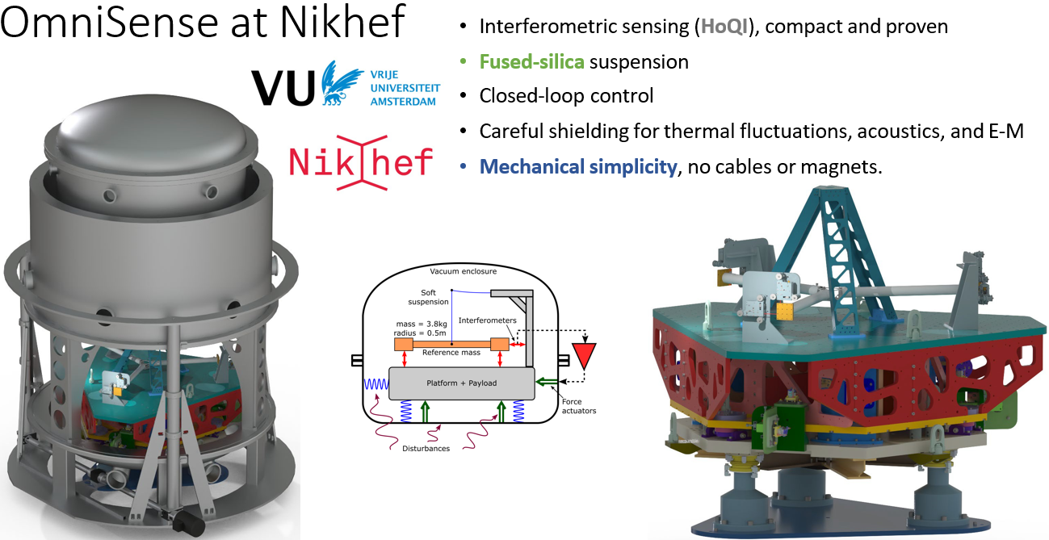
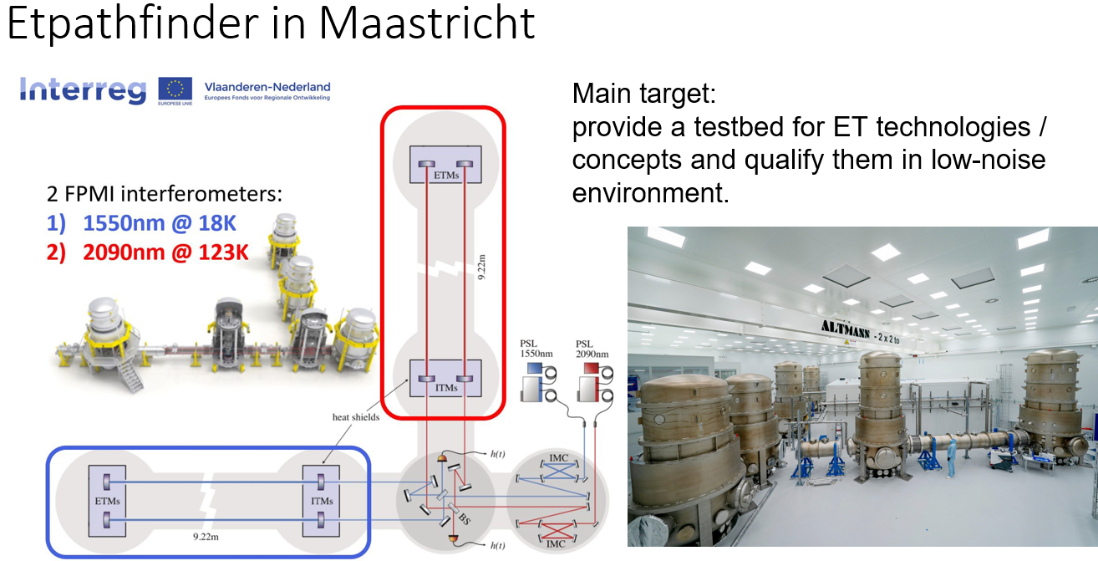
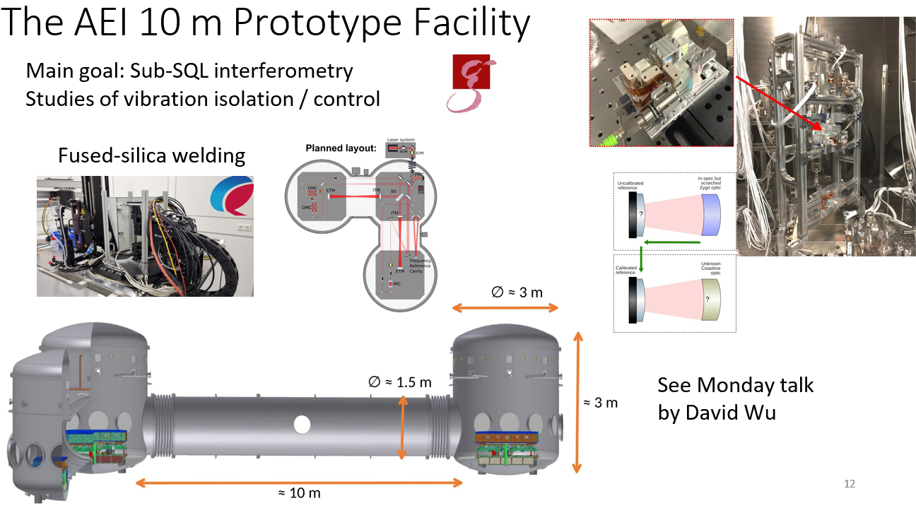
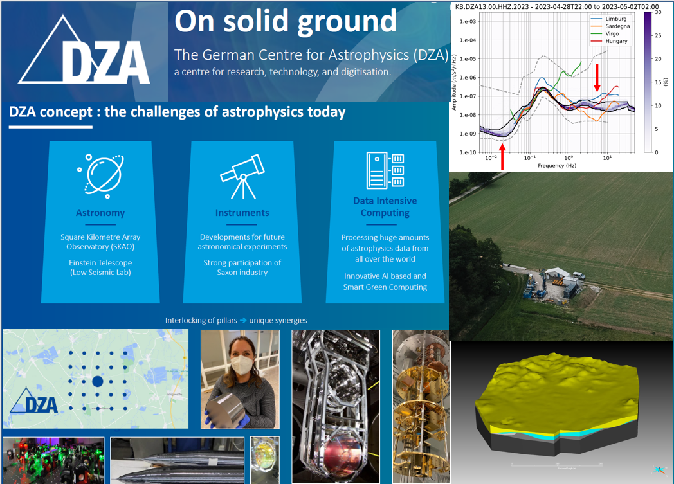
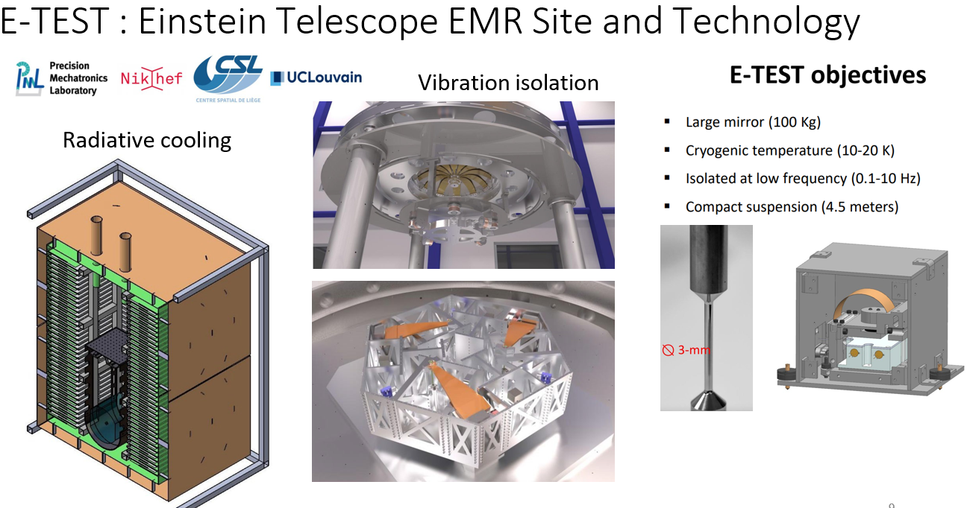
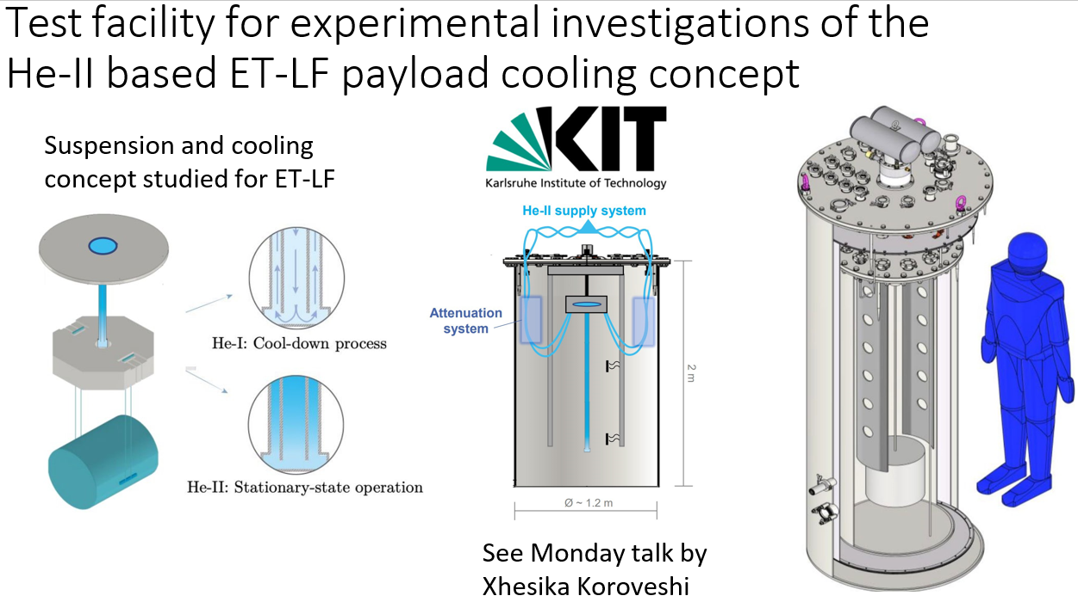
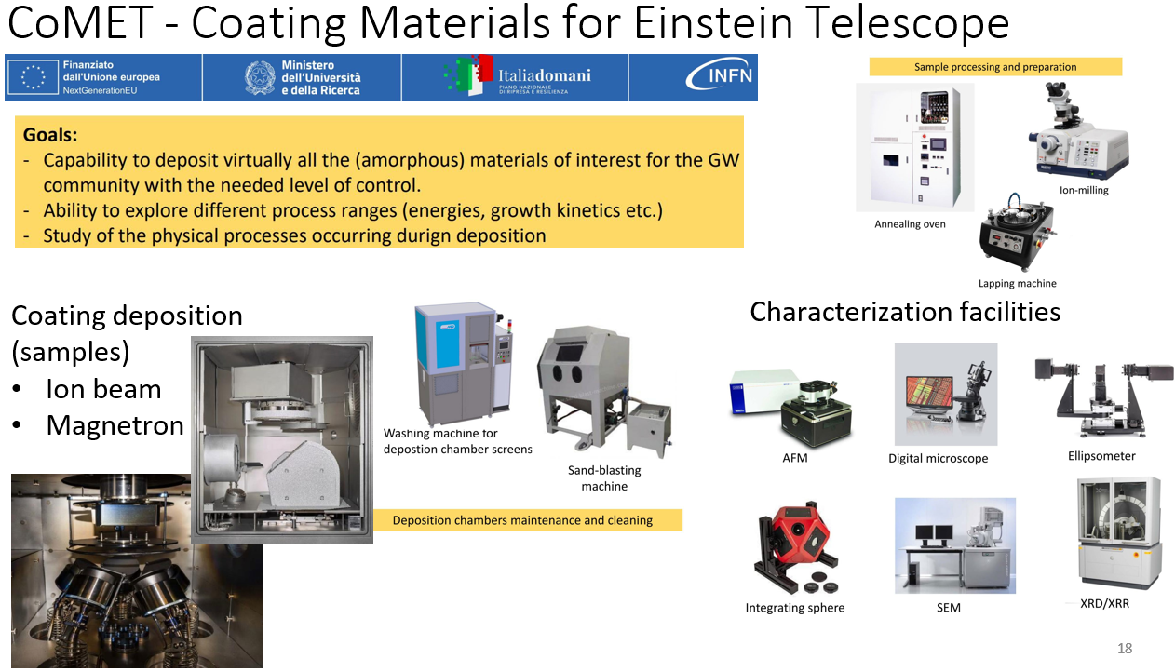
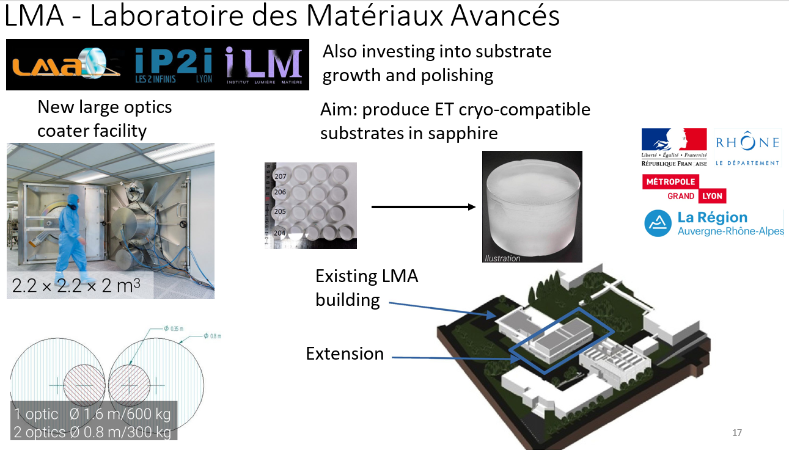
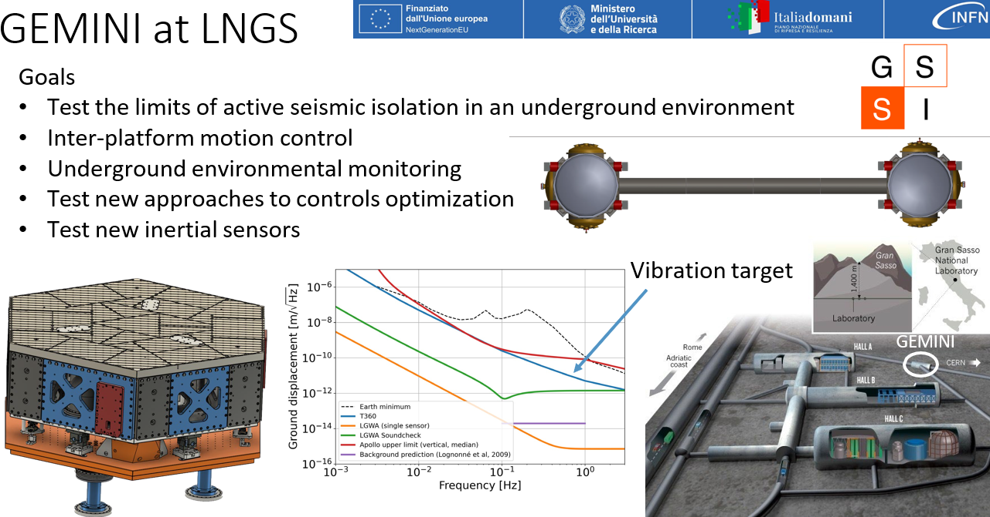
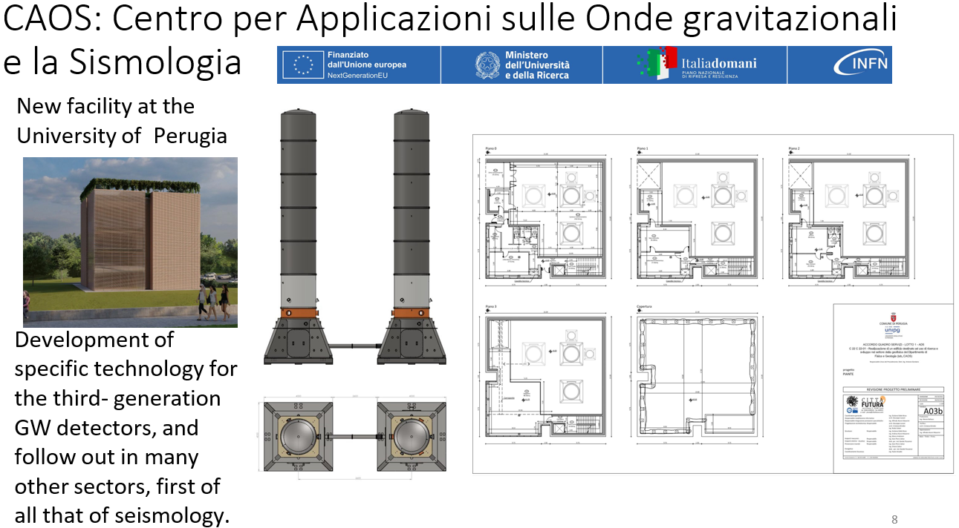
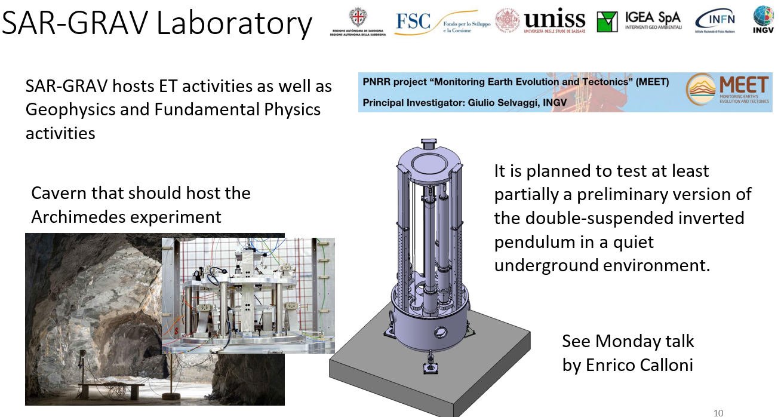
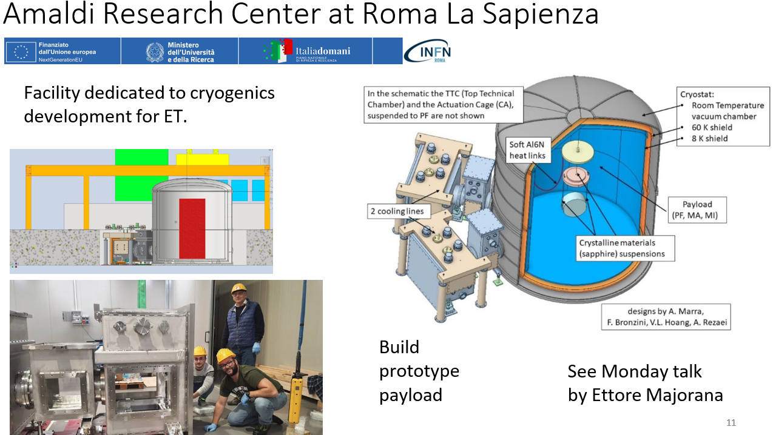
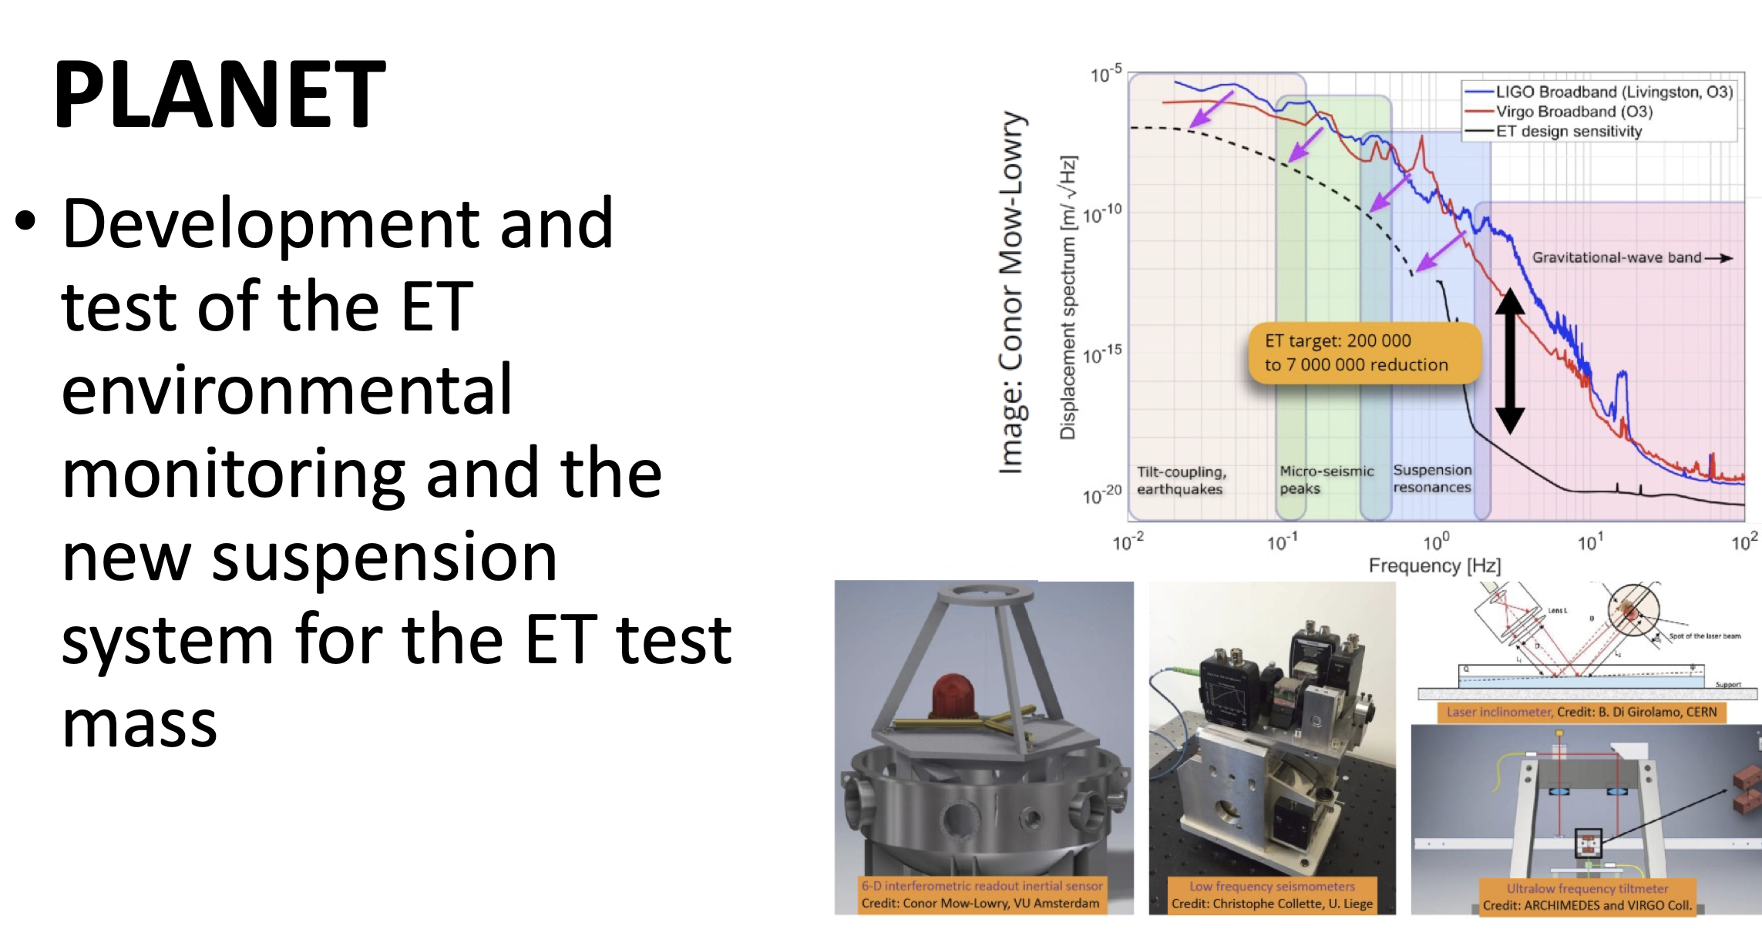
ET R&D Map (incomplete)
From the XIII ET symposium, an incomplete selection of thepresented large facilities
Credits to M. Punturo
Notes:
We have got a good numer of large research facilities scattered over the participating countries.
This map only shows a rather random and incomplete selection, i.e. those R&D ´facilities that were presented at the last ET Symposium.

Slide 9
Candidate sites
Three candidate sites:
EMR EUregio, border region between Nederland, Belgium and Germany
Sardinia (Sos Enattos area)
Saxony (Lusatia, since Oct. 2024)
Overall site evaluation is a complex task depending on:
Detector performance
Geophysical and environmental quality
Financial and organization aspects
Services, infrastructures
Saxony

Slide 10
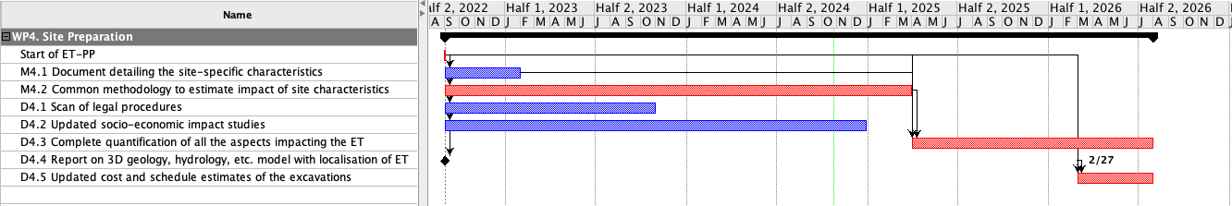
Steps towards the Site Selection: ET-PP WP4
Code | Name | Expected date
4.1 | Scan of legal procedures | M18/Oct.23
4.2 | Updated socio-economic impact studies | M27/Dec24
4.3 | Complete quantification of all the aspects impacting the ET performance for each site | M47/Jul26
4.4 | Report on 3D geology, hydrology, etc. model with localization of the ET infrastructure | M42/Feb26
4.5 | Updated cost and schedule estimates of the excavations | M47/Jul26
Code | Name | Expected date
M2 (M4.1) | Document detailing the site-specific characteristics that impact ET sensitivity and its duty cycle | M6/Feb23 M25/Oct24
M3 (M4.2) | Common methodology to estimate impact of site characteristics | M32/March25

Slide 11
Steps towards the Site Selection: SiSe WG
Mandate from BGR:
identification and definition of the criteria to be taken into account
establishment of respective weightings
Scope and purpose
consider all of the criteria relevant to the ET site selection process, including technical, economic, environmental and societal impact, costs, risks, and governance
build on the preparatory work done by ETO, within the relevant activities of the INFRA-DEV ET-PP Project², and by the “Site Characterisation Board” of the ET Collaboration
final report to the BGR by the end of Q2 2026

Slide 12
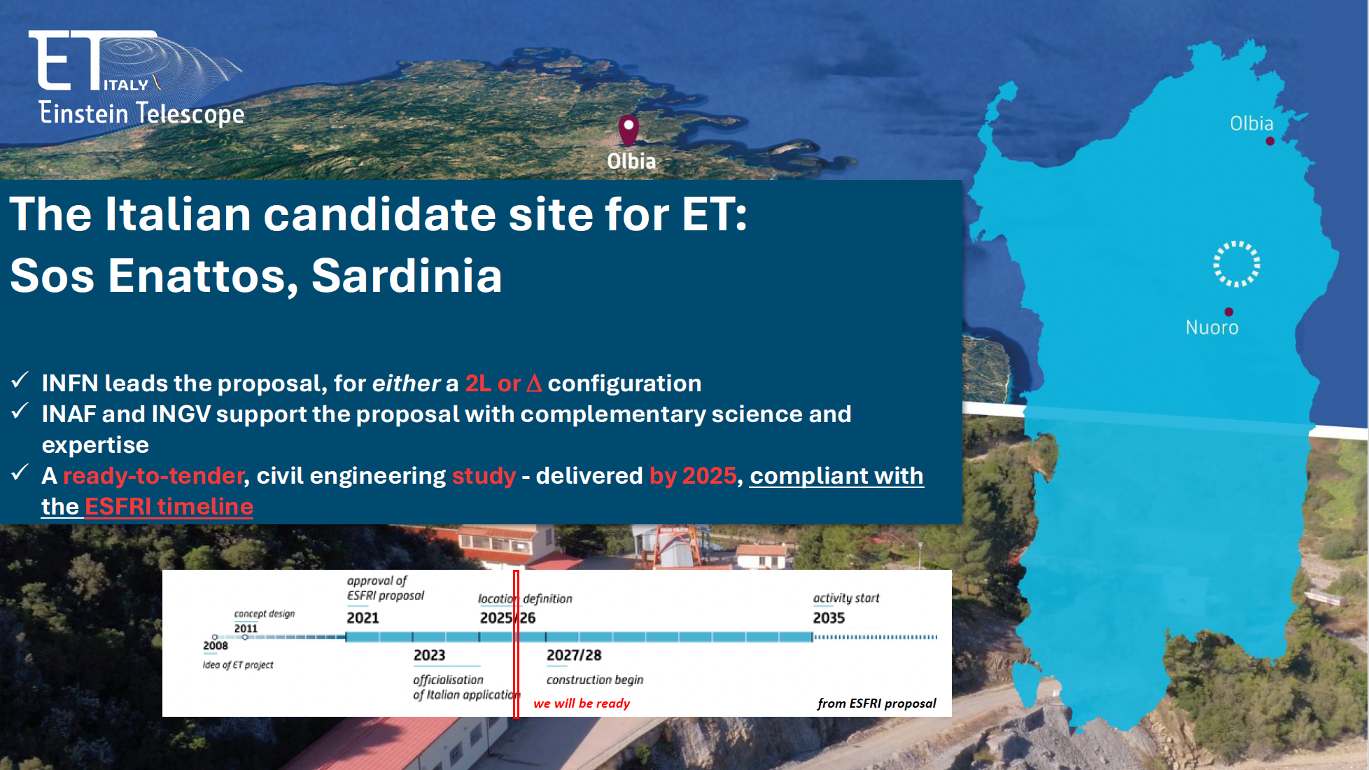
Credits to G. Bisoffi

Slide 13
Action lines
Two Geometrical Options: Δ vs 2L
Legal Framework and authorization
Socio-economic impact
Site monitoring
Geological studies
Noise impact Evaluation
Engineering studies
cost and time estimation

Slide 14
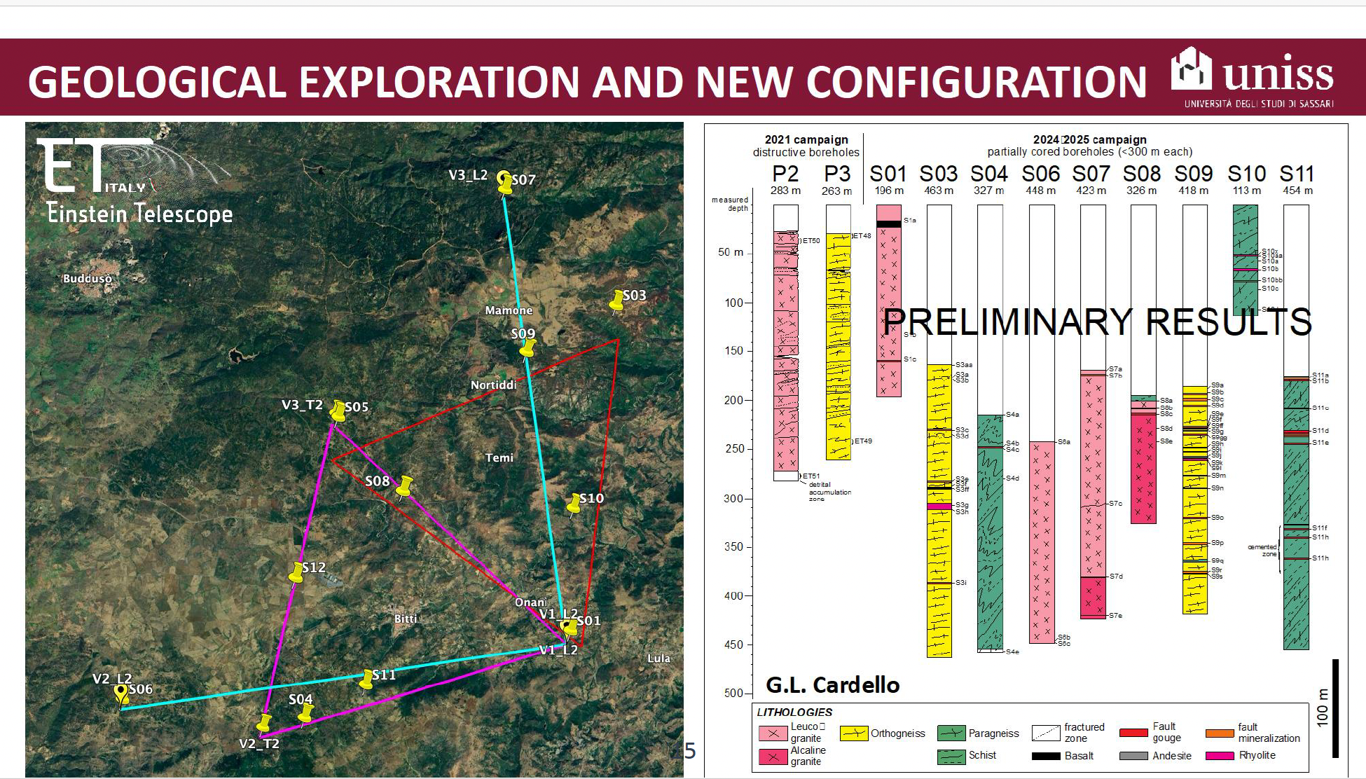

Slide 15
Site Monitoring and Noise impact Evaluation

Slide 16
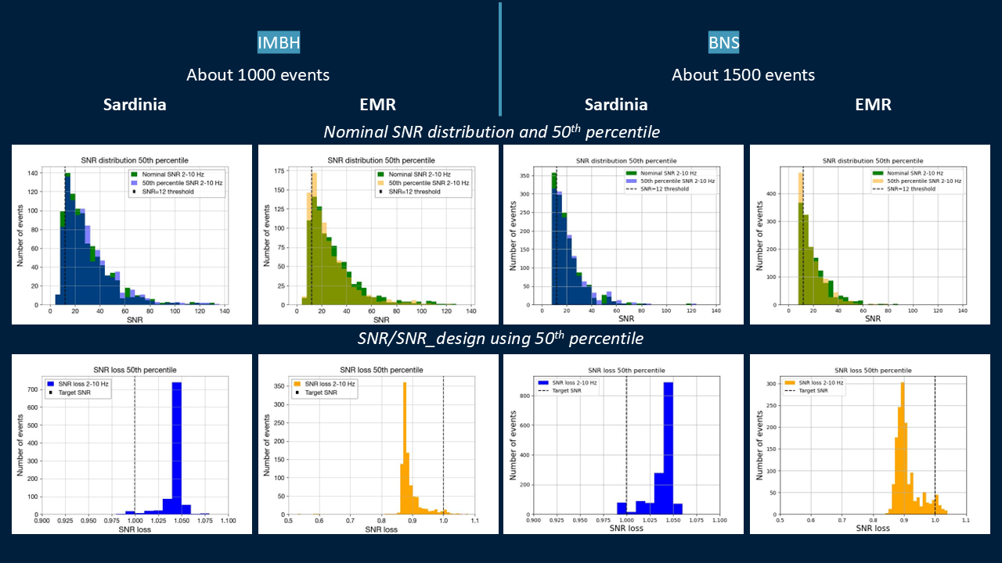
Preliminary Site comparison
Results:
Seismic Newtonian Noise effect on GW signal detection
Terziet ( )
Terziet ( )
2025 Class. Quantum Grav. 42 155001, https://doi.org/10.1088/1361-6382/aded67
https://arxiv.org/abs/2503.02166

Slide 17
Engineering Studies

Slide 18
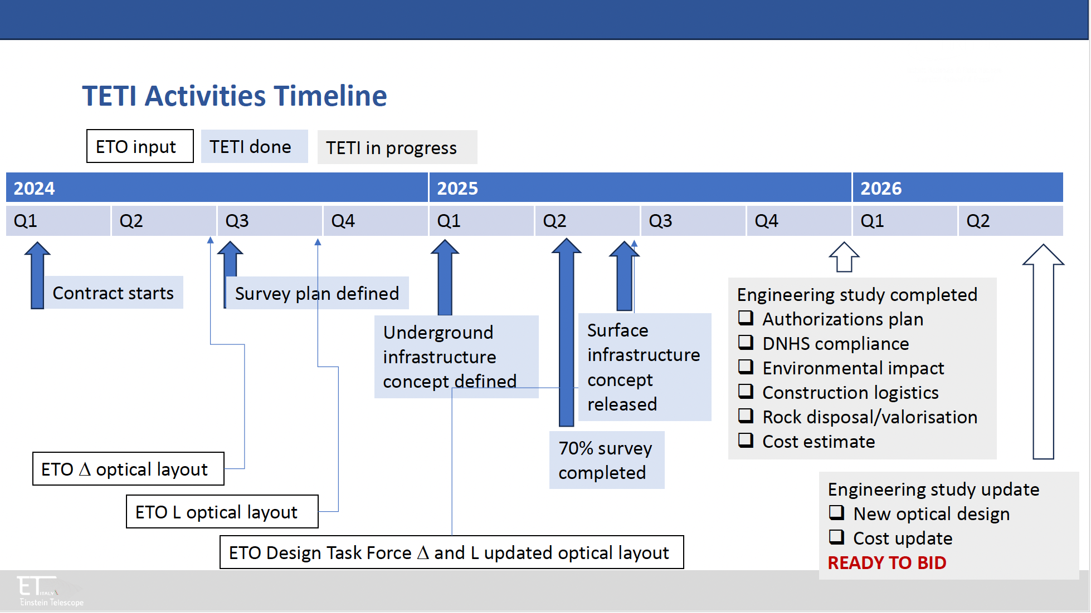
Credits to G. Bisoffi
TETI (Team for ET in Italy)

Slide 19
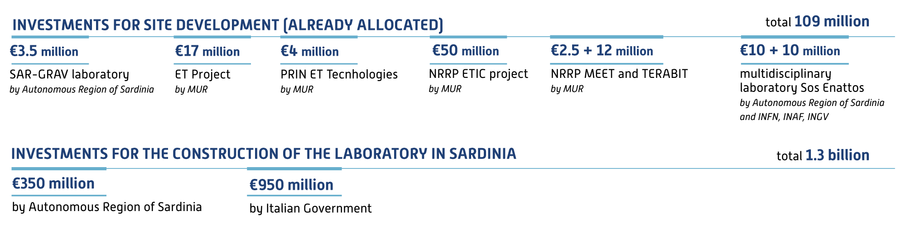
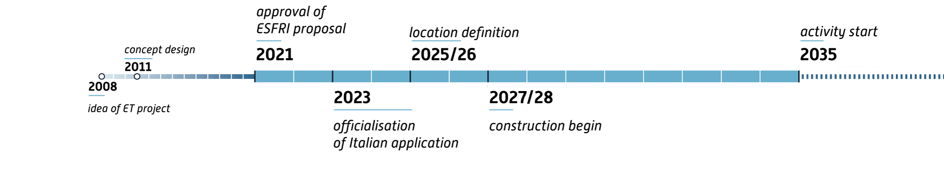
Investments and Timing
Credits to G. Bisoffi

Slide 20

Q3-22
Q4-22
Q1-23
Q2-23
Q3-23
Q4-23
Q1-24
Q2-24
Q3-24
Q4-24
Q1-25
Q2-25
Q3-25
Q4-25
Q1-26
Q2-26
Q3-26
Q4-26
Phase 1 Construction Initial Model
Phase 2 Thorough geophysical and geological investigations to refine subsurface model and start focusing on prioritized trajectory
Phase 3 Selection most promising traject determine remaining mitigation
Phase 4 Mitigation of selected trajectory, Bidbook
Baseline geo-model and 4 boreholes
1st campaign 11 boreholes
2nd campaign 5-6 boreholes
Current Timeline EMR
Subsurface activities only
Schedule does not include additional work for L layout
Hydro-packer and pumping tests, Geomechanical tests, ERT, Gravity, Passive Seismic
Subsurface
Active Seismic
Active Seismic
Noise measurements of downhole Newtonian noise, Antropogenic noise, ET Operational (pumping) noise
Integrated interpretation of all measured subsurface data and develop 3D model
Infrastrucure and Facilities
Infrastructure and construction alternatives – cost and schedule evaluation
ET-PP & SCB deliverables
Scan of legal procedures and permit requirements (7/23)
Site-specific characteristics ET sensitivity and duty cycle (6/24)
Site-specific characteristics impacting ET performances (10/24)
Updated socio-economic impact study (3/25)
3D hydro-geo model wth localisation of ET infrastructure (2/26)
Complete quantitative performance impact
Cost/schedule update (7/26)
✓
✓
✓
✓
now
Critical milestones
Sufficient availability drilling firms
Drilling procedures (permits, implementation, costs) effective
Continue, unless Structural geology – so far
Refinement of baseline model - most likely trajectory
Continue, unless Noise budget Evaluation
Continue, unless Hydromodel Evaluation
Continue, unless Cost estimate
Bidbook subsurface text & data
Active seismic effective
✓
✓
✓
✓
Notes:
Bjorn on Geology and the upcoming campaign, Marc on core measurements
Daniel and Quentin on Hydro
Hadrien Surface noise measurements
Michael on Active seismic
Tomorrow:
Yannick on ERT
Sacha, Soumen and Stan on Noise modeling

Slide 21
Q1-24
Q2-24
Q3-24
Q4-24
Q1-25
Q2-25
Q3-25
Q4-25
Q1-26
Q2-26
Q3-26
Q4-26
Phase 1 Thorough geophysical and geological investigations to refine existing subsurface model
Phase 2 Define rockclasses and seismic background noise at the surfae and at depth
Phase 3 Preparing bid book and refininf Newtonian Noise models
Geological-model and 1 central borehole
1st campaign 5 boreholes
2nd campaign 3-4 boreholes
Current Timeline Lausitz
Subsurface activities
Geomechanical tests, ERT, Gravity, Magnetic, Passive Seismic, Active Seismic
Environmental Noise (surface and downhole) Newtonian noise, Windfarms? , Querries?, Agriculture?, open pit mining?
Developing a digital twin for seismic (newtonian nosie) budget
✓
Infrastructure and construction – cost and schedule evaluation
ET-PP & SCB deliverables
Official candiate site
Updated socio-economic impact study (4/25)
3D hydro-geo model wth localisation of ET infrastructure (2/26)
Complete quantitative performance impact
Cost/schedule update (7/26)
✓
now
Critical milestones
Structural geology model
Rockmechanics and permeability
Baseline cost estimate for tunneling
Continue, unless Noise model Evaluation
Continue, unless Cost estimate
✓
✓
✓
Notes:
Bjorn on Geology and the upcoming campaign, Marc on core measurements
Daniel and Quentin on Hydro
Hadrien Surface noise measurements
Michael on Active seismic
Tomorrow:
Yannick on ERT
Sacha, Soumen and Stan on Noise modeling

Slide 22


























ET Italian Community
Official web page https://www.einstein-telescope.it
Contacts
Matteo Serra, ET Italy communication, matteo.serra@ca.infn.it
Monique Bossi, ETIC Project Manager, monique.bossi@pg.infn.it
Projects: Etic, ETpp/Infra-Dev, Sar-Grav, Terabit
nel progetto Etic
nel progetto Terabit
nel progetto ETpp/Infra-Dev
nel progetto Terabit
nel progetto Etic
nel progetto Etic
nei progetti Meet/Faber, Sar-Grav
nel progetto Terabit
nel progetto Etic
nei progetti Etic, Sar-Grav
nel progetto Etic
nel progetto Etic
nel progetto Etic
nel progetto Etic
nel progetto Etic
nel progetto Etic
nel progetto Etic
nel progetto Etic
nel progetto Sar-Grav

