Slide 1



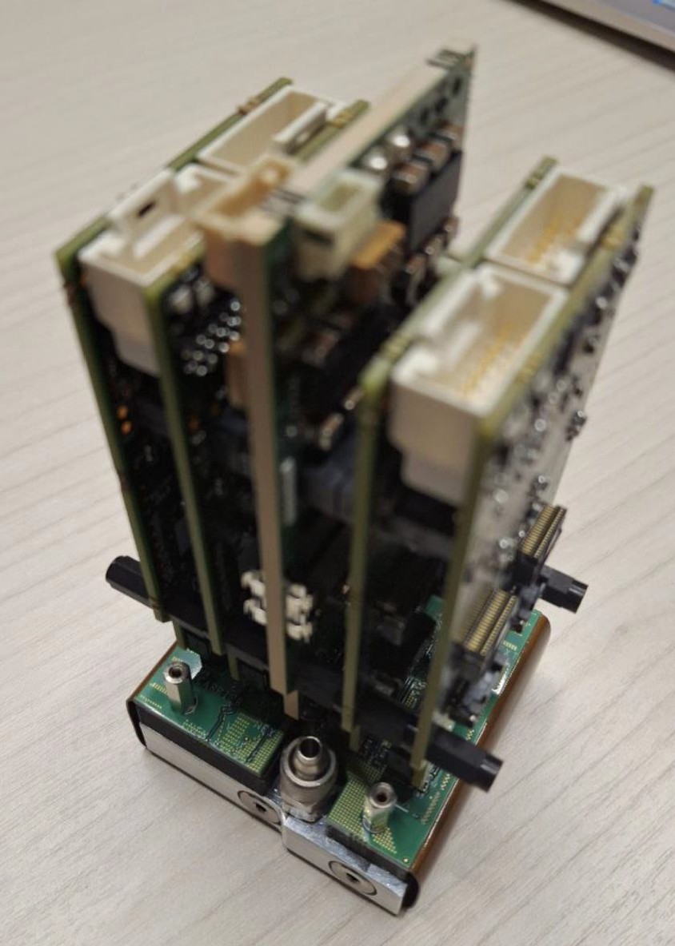
dRICH frontend RDO: status/updates
Authors: Sandro Geminiani, Pietro Antonioli, Davide Falchieri, Luigi Rignanese, Giovanni Torromeo
Date: 02/09/2025

Slide 2
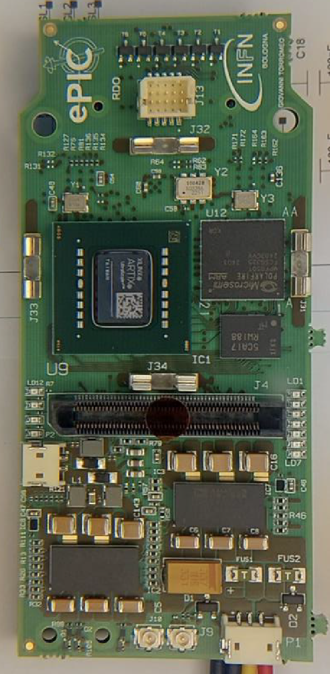
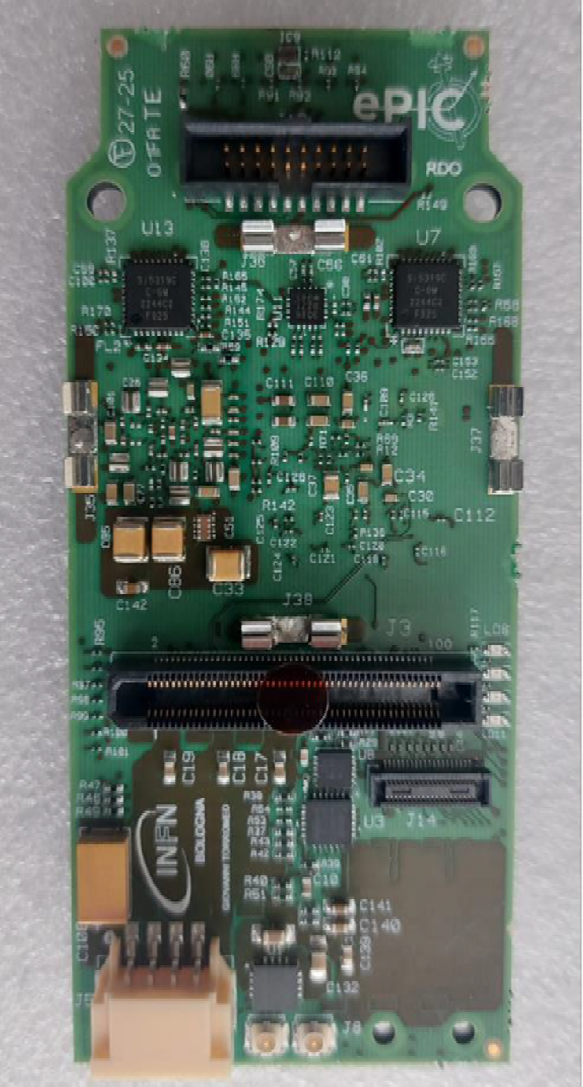
RDO first prototype
Bottom side
Top side
The RDO card hosts different devices:
The AU15P FPGA for ALCOR readout
The MPF50T for the scrubbing routine of the AU15P configuration memory
2 LDOs (LTM4709) to set the board power rails
The Si5319 and Si5326 clock multipliers (2 Si5319 were mounted instead)
The ATtiny417 power microcontroller
The VTRx+ optical link from CERN (it is not plugged in the picture)
2 RDOs arrived on the 24th of July and the first debug tests have started.

Slide 3
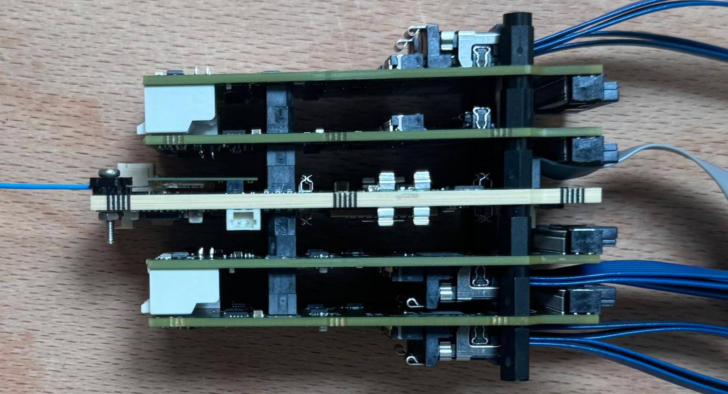
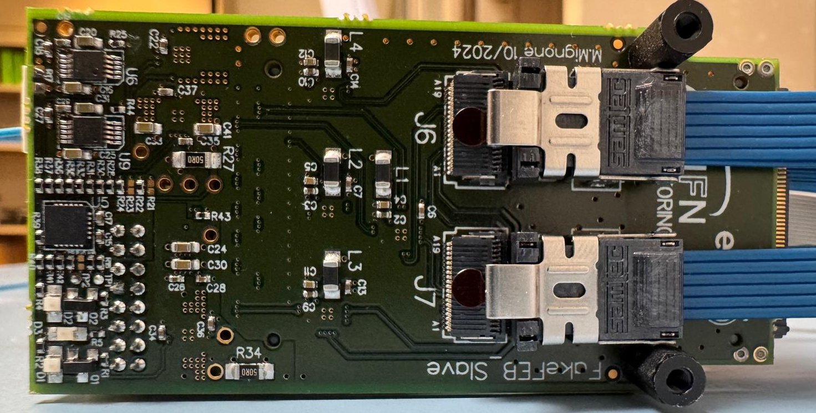
Fake-FEB and PDU prototype
First PDU prototype
Fake-FEB
Top
Slave-FEB
FireFly
Master-FEB
Master-FEB
Slave-FEB
FireFly
Bottom
This is the Fake-FEB device produced by Torino INFN for control and readout of the ALCOR32 FEBs, using FireFly cables.
First PDU test: provide the readout of 8 ALCOR32 chips through 4 Fake-FEBs via 1 Gb/s Ethernet link (IPbus protocol).

Slide 4
RDO first evaluation test
Mechanical pairing with Fake-FEB
Power-up : 2.7/ 1.4 jumper to avoid power to other sections
Prg uC via external connector
Power-up with uC (post-programming uC): check Vout LDO
Prg Artix via external connector
Prg Polarfire via external connector
Check UFL I/Os → For external signals
Prg Artix → SkyWorks (programming 125 MHz of Si5319 for VTRX+ communication)
Check consumptions
IBERT test (loopback tool integrated in Vivado) to check link [MT-MPO adapter + fibers ]
Link IPBUS via VTRX+
Turn on Fake-FEB via I2C from RDO
Prg ALCOR via Fake-FEB (via IPBUS → VTRX+)
ALCOR readout (via IPBUS → VTRX+)
Green light for mounting other 8 RDOs for November beam test ?

Slide 5


RDO first evaluation test
Mechanical pairing with Fake-FEB
Power-up : 2.7/ 1.4 jumper to avoid power to other sections
Prg uC via external connector
Power-up with uC (post-programming uC): check Vout LDO
Prg Artix via external connector
Prg Polarfire via external connector
Check UFL I/Os → For external signals
Prg Artix → SkyWorks (programming 125 MHz of Si5319 for VTRX+ communication)
Check consumptions
IBERT test (loopback tool integrated in Vivado) to check link [MT-MPO adapter + fibers ]
Link IPBUS via VTRX+
Turn on Fake-FEB via I2C from RDO
Prg ALCOR via Fake-FEB (via IPBUS → VTRX+)
ALCOR readout (via IPBUS → VTRX+)
Before August
Today
Green light for mounting other 8 RDOs for November beam test

Slide 6
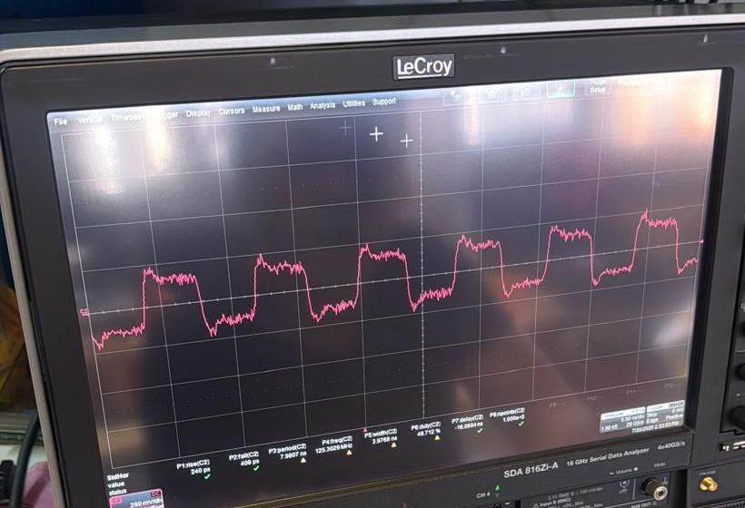
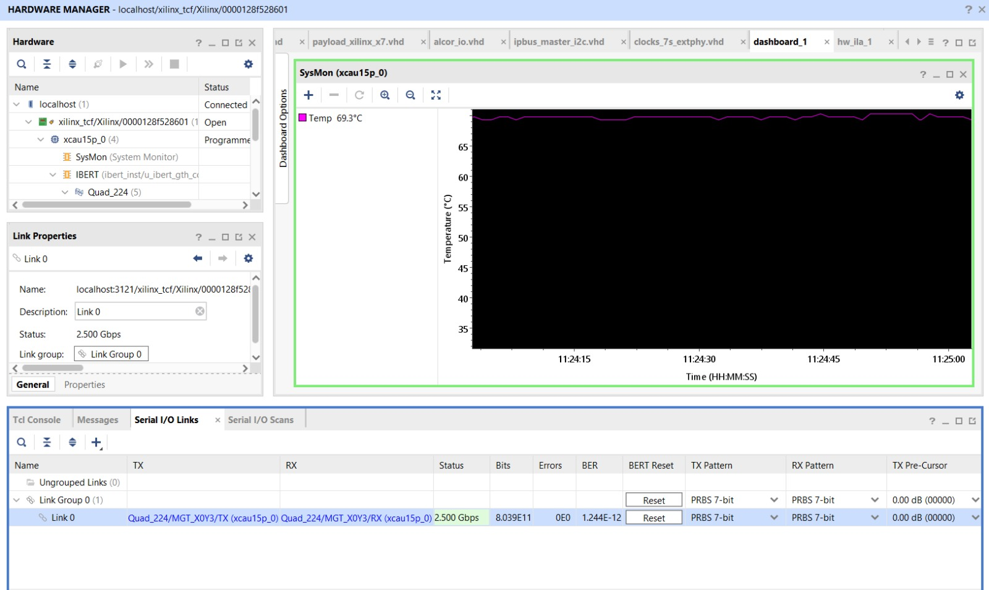
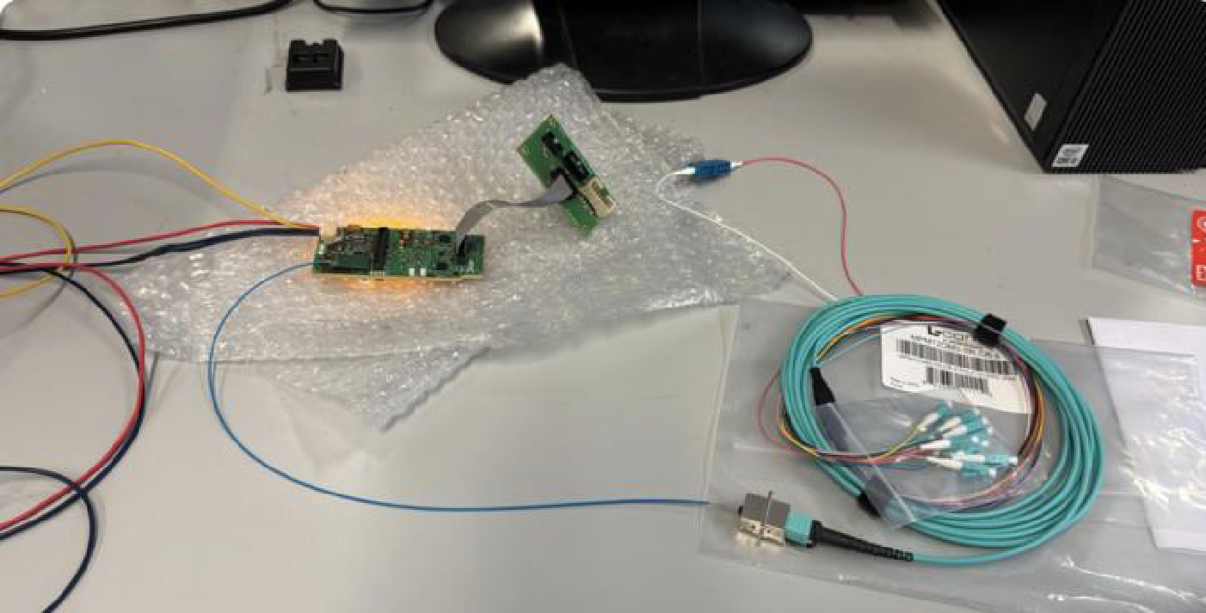

The Si5319 Clock and
the IBERT test
Si5319 125 MHz clock
2.5 Gbs stable loopback
(the max bandwidth of the VTRX+ is 10 Gb/s for each Tx and 2.5 Gb/s for Rx)
Fiber loopback MT/MPO
LC-to-LC
MT/MPO

Slide 7
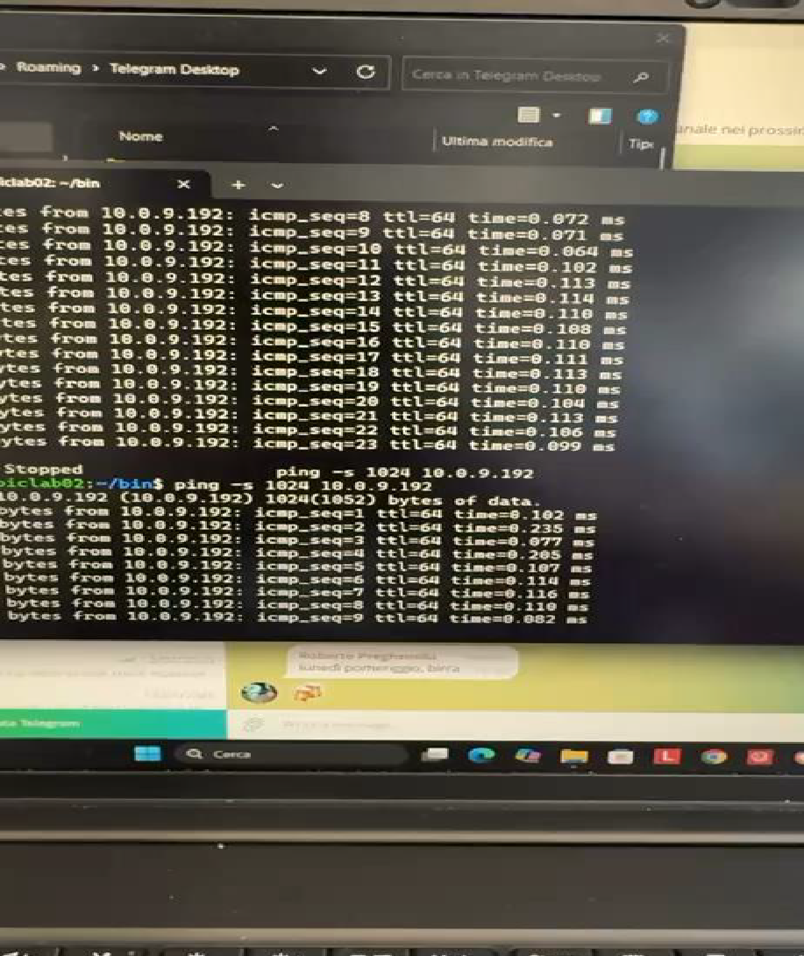
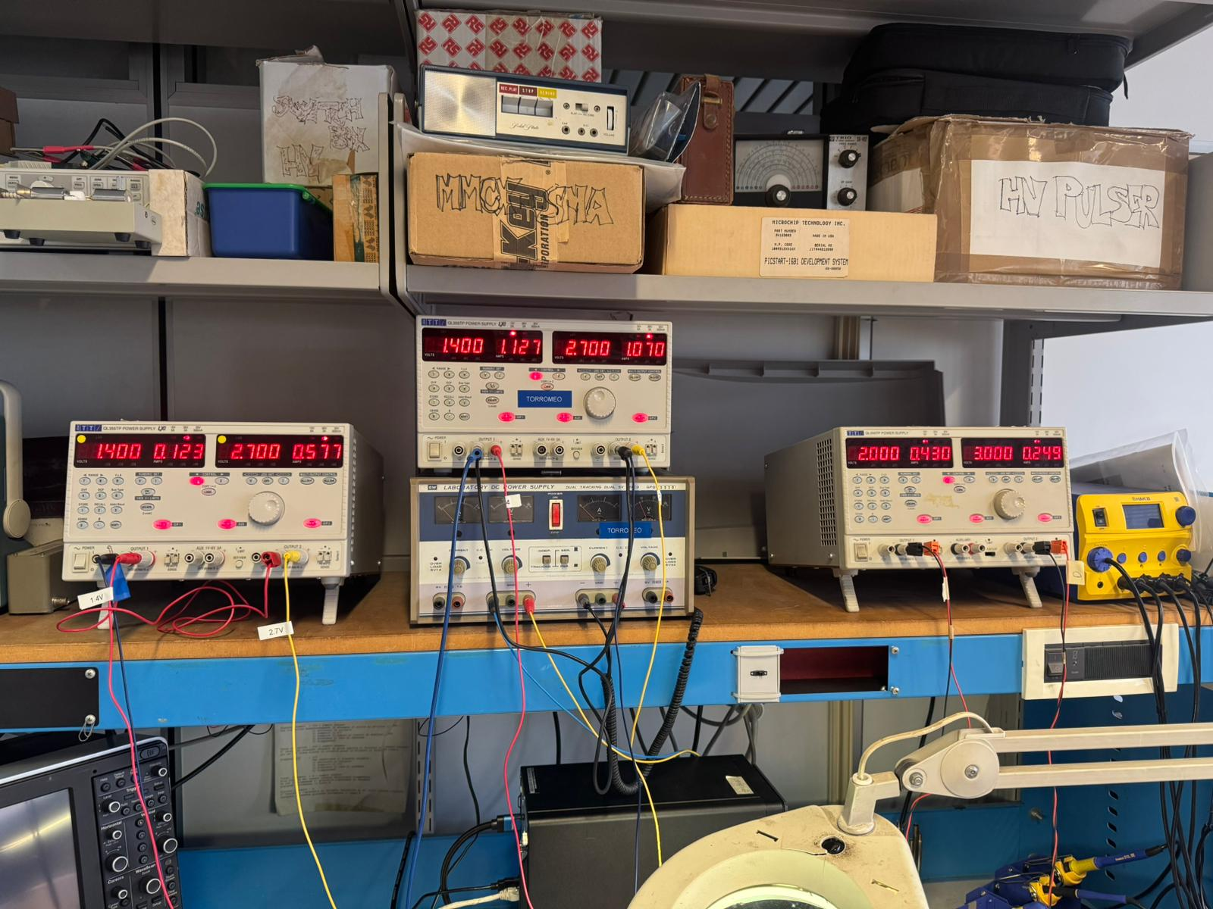
IPbus communication
Test of the IPbus communication to power on Fake-FEB via I2C on ALCOR BUS:
  The test was successful for all the FEBs .
  Good current levels at FEB power on:
Ping test for Ethernet communication achieved!
Top FEBs consumptions
For each FEB:
1.4 V → Current limit: 500 mA
2.7 V → Current limit: 640 mA

Slide 8
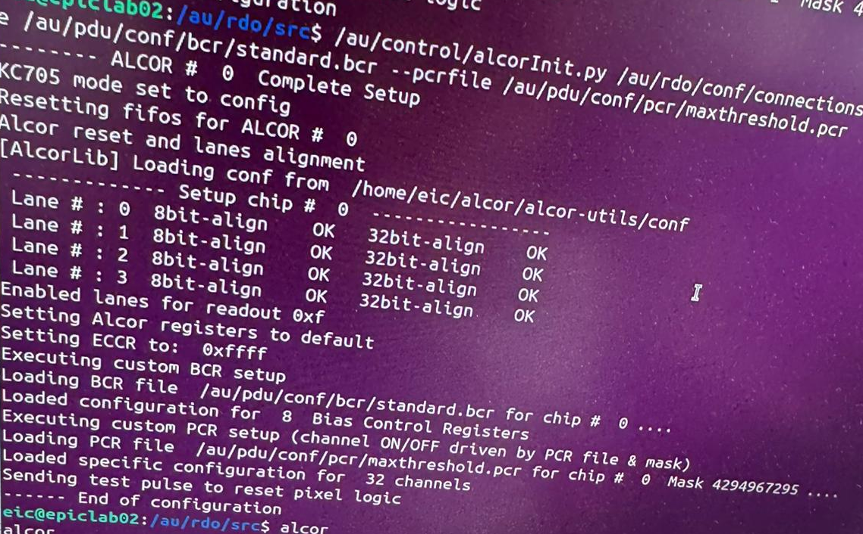
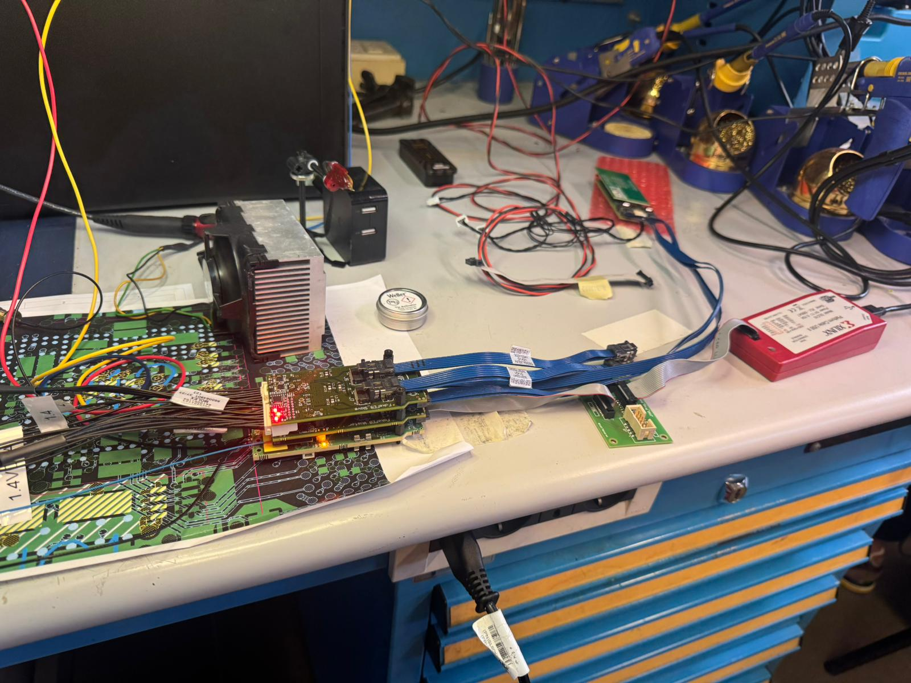
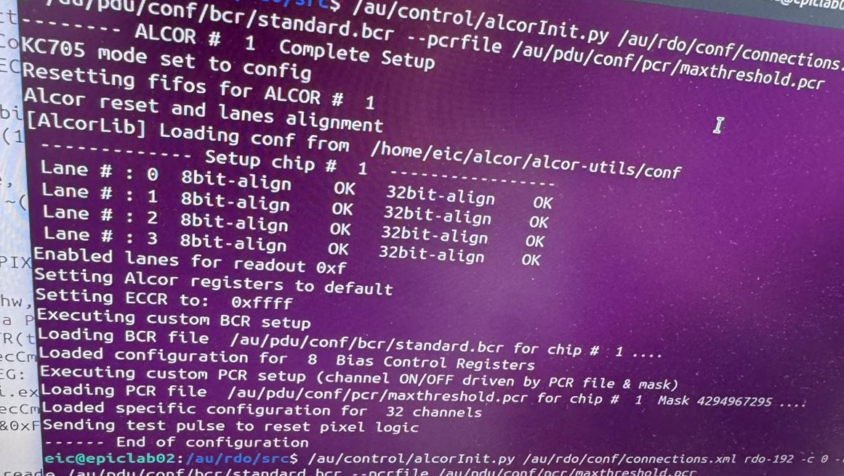
Full ALCOR chain connected
Both ALCOR chips were configured!
ALCOR chain on the top Master-FEB
Dual-ALCOR FEB
AU15P Programmer
Half of a PDU

Slide 9
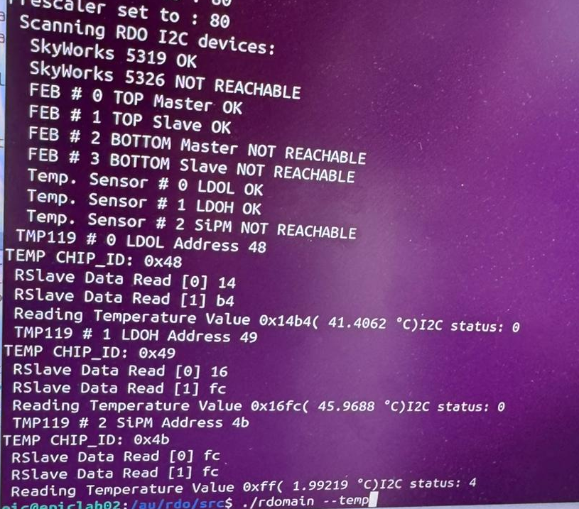
I2C Networks on board
Si5326 is not reachable since it is not powered-on (another Si5319 is mounted on the RDO).
The bottom FEBs are not plugged.
ATTiny417 I2C is under development.
All the temperature sensors were checked:
  On RDO #1: The sensor near the PDU SiPMs is not responding (0x4 NACK status).
  The reworking by ARTEL during production could be the reason.
  RDO #2 sensor is working and responding!

Slide 10
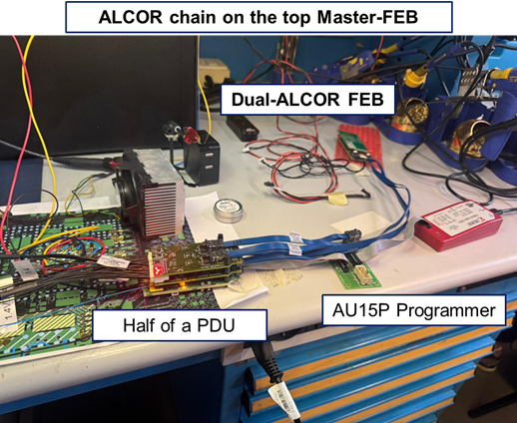
Power consumptions
  Considering the full ALCOR chain, the RDO power consumptions are:
  1.6 W on the 1.4 V rail
  2.9 W on the 2.7 V rail
  The RDO card system has some devices that are switched-off or not working:
    The Si5326 PLL is switched off.
    The MPF50T FPGA is not programmed.
    Both bottom FEBs are not plugged.
    Only two ALCORs are connected and configured.
RDO card
Top FEBs
Dual-ALCOR FEB
4.5 W out of the estimated 7 W power consumption for the RDO

Slide 11
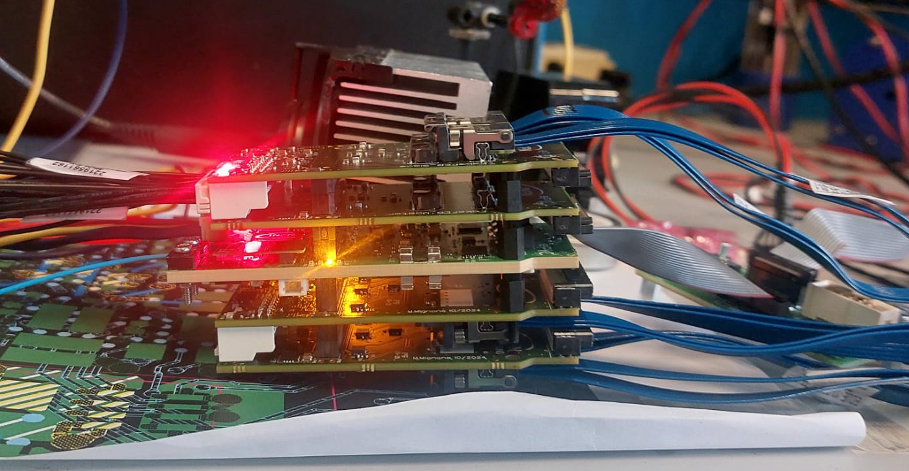
Full-PDU:
The PDU was mounted and 2 FEBs were powered-on.
We configured all the ALCOR32s successfully.
We read back the data aligned with the 320 MHz supplied clock.
This process was repeated for both sides without any problem from both hardware and software!

Slide 12
Conclusion and next steps
Both the RDO were validated for the beam test (some hardware reworking is needed).
All the first tests passed and we will send the OK to ARTEL for other 8 RDOs.
We are ready for future integration of the RDO readout with the existing dRICH prototype (8 PDUs + 2 RDO system).
CONCLUSIONS:
Complete the setup and data acquisition for the November beam test .
Develop the scrubbing routine for the AU15P FPGA.
Prepare irradiation test at TIFPA in December
Give up the IPbus protocol and implement the GBT protocol within the AU15P FPGA.
NEXT STEPS:

Slide 13
Conclusion and next steps
Both the RDO were validated for the beam test (some hardware reworking is needed).
All the first tests passed and we will send the OK to ARTEL for other 8 RDOs.
We are ready for future integration of the RDO readout with the existing dRICH prototype (8 PDUs + 2 RDO system).
CONCLUSIONS:
Complete the setup and data acquisition for the November beam test .
Develop the scrubbing routine for the AU15P FPGA.
Prepare irradiation test at TIFPA in December
Give up the IPbus protocol and implement the GBT protocol within the AU15P FPGA.
NEXT STEPS:
Thank You for the attention!

Slide 14
Backup slides

Slide 15
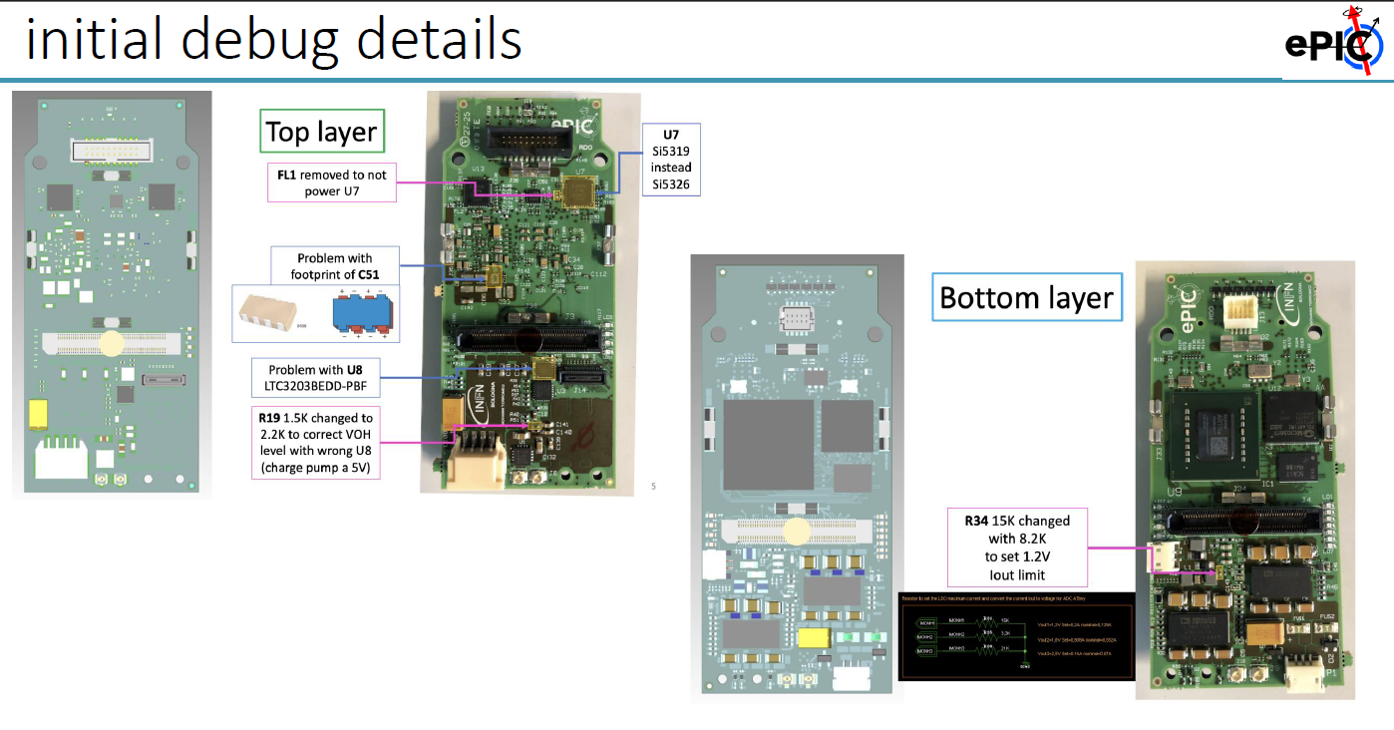
RDO hardware debugging

Slide 16
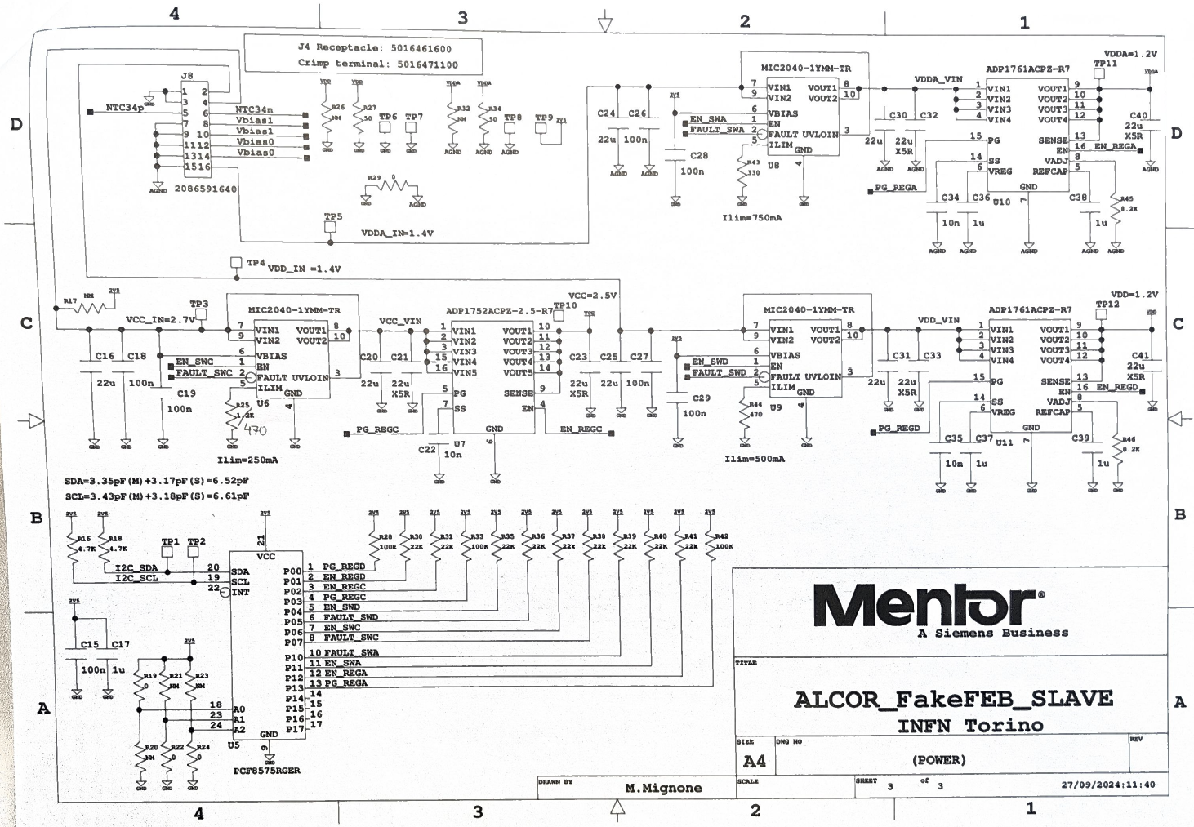
FEB power rails

