Slide 1



Debugging status of the RDO card
Author: Sandro Geminiani, Pietro Antonioli, Davide Falchieri, Luigi Rignanese, Giovanni Torromeo
Date: 02/09/2025

Slide 2
RDO first evaluation test
Mechanical pairing with fake-FEB
Power-up : 2.7/ 1.4 jumper to avoid power to other sections
Prg uC via external connector
Power-up with uC (post-programming uC): check Vout LDO
Prg Artix via external connector
Prg Polarfire via external connector
Check UFL I/Os → For external signals
Prg Artix → SkyWorks (programming 125 MHz of Si5319 for VTRX+ communication)
Check consumptions
IBERT test (loopback tool integrated in Vivado) to check link [MT-MPO adapter + fibers ]
Link IPBUS via VTRX+
Turn on fake-FEB via I2C from RDO
Prg ALCOR via fake-FEB (via IPBUS → VTRX+)
ALCOR readout (via IPBUS → VTRX+)
Green light for mounting other 8 RDOs for test-beam ?

Slide 3


RDO first evaluation test
Mechanical pairing with fake-FEB
Power-up : 2.7/ 1.4 jumper to avoid power to other sections
Prg uC via external connector
Power-up with uC (post-programming uC): check Vout LDO
Prg Artix via external connector
Prg Polarfire via external connector
Check UFL I/Os → For external signals
Prg Artix → SkyWorks (programming 125 MHz of Si5319 for VTRX+ communication)
Check consumptions
IBERT test (loopback tool integrated in Vivado) to check link [MT-MPO adapter + fibers ]
Link IPBUS via VTRX+
Turn on fake-FEB via I2C from RDO
Prg ALCOR via fake-FEB (via IPBUS → VTRX+)
ALCOR readout (via IPBUS → VTRX+)
Meeting:
29/07
Today
Green light for mounting other 8 RDOs for test-beam

Slide 4
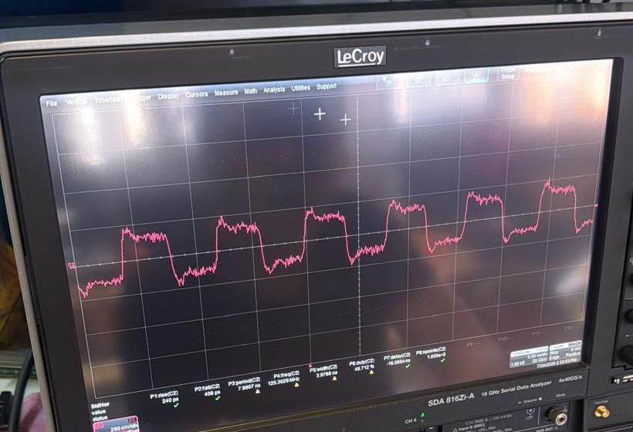
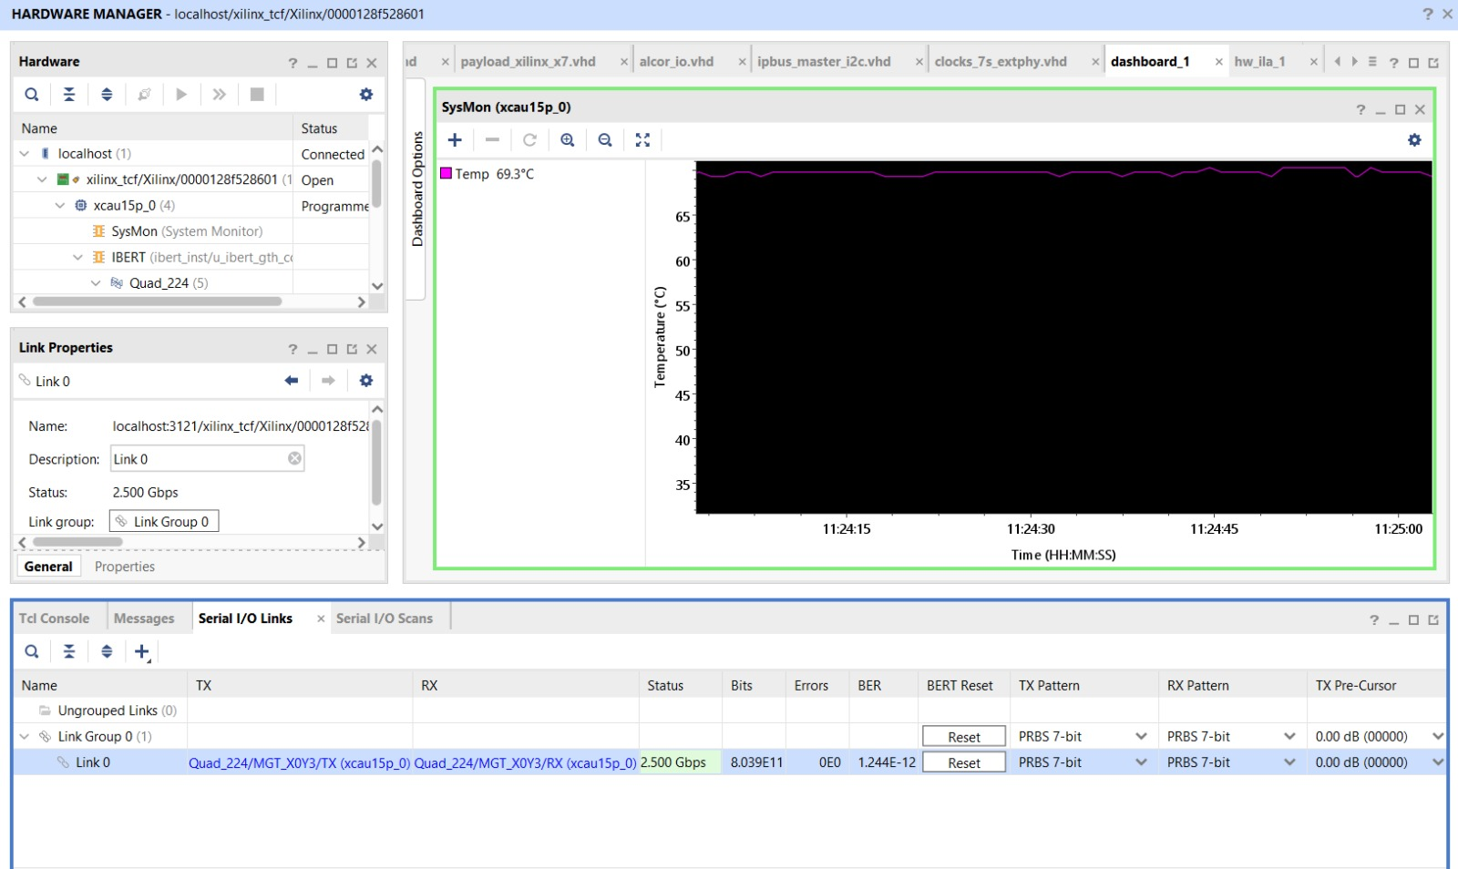

The Si5319 Clock and
the IBERT test
Si5319 125 MHz clock
Fiber loopback MT/MPO
LC-to-LC
2.5 Gbs loopback stable
MT/MPO
BER of $\sim {10}^{−12}$ after few minutes of acquisition

Slide 5
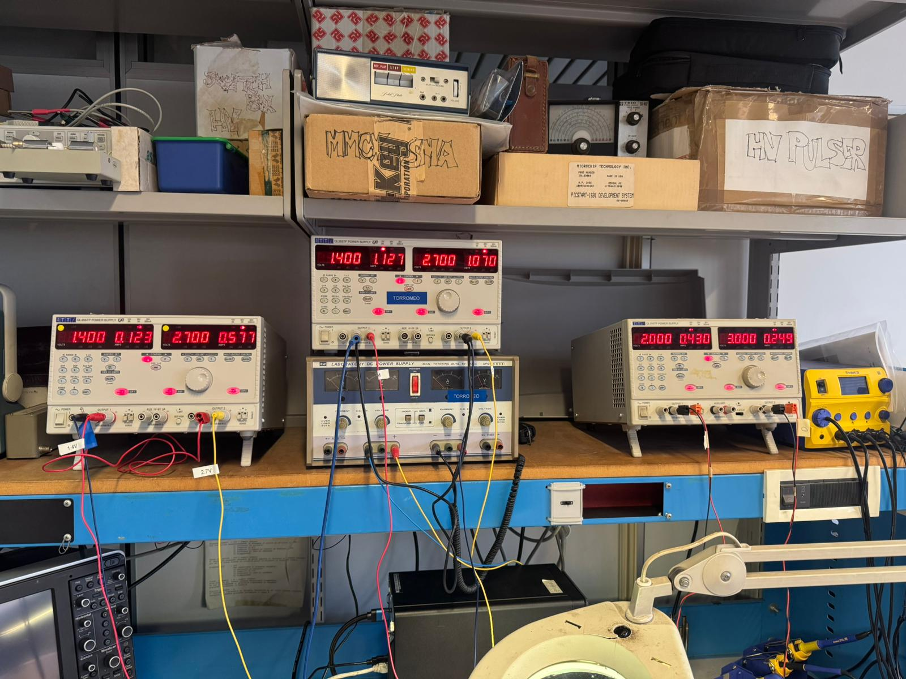
IPbus communication
Test of the IPbus communication to power on fake-FEB via I2C on ALCOR BUS:
  The test was successful for the TOP FEBs.
  Good current levels at FEB power on:
Ping test for Ethernet communication achieved!
For each FEB:
1.4 V → Current limit: 500 mA
2.7 V → Current limit: 640 mA (?)
I2C data read from FEB at power-on/off are weird.
Are we missing something ?

Slide 6
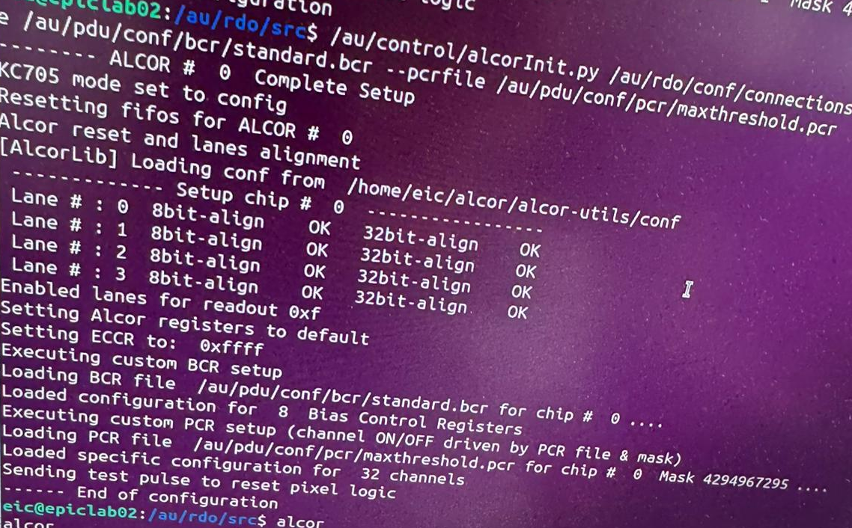
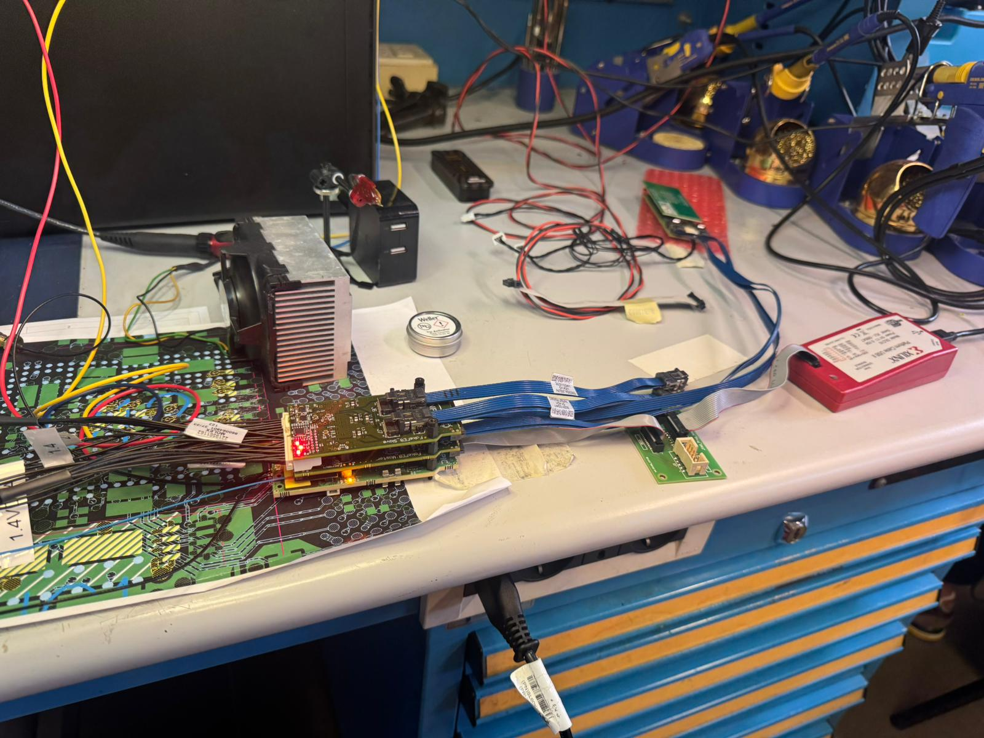
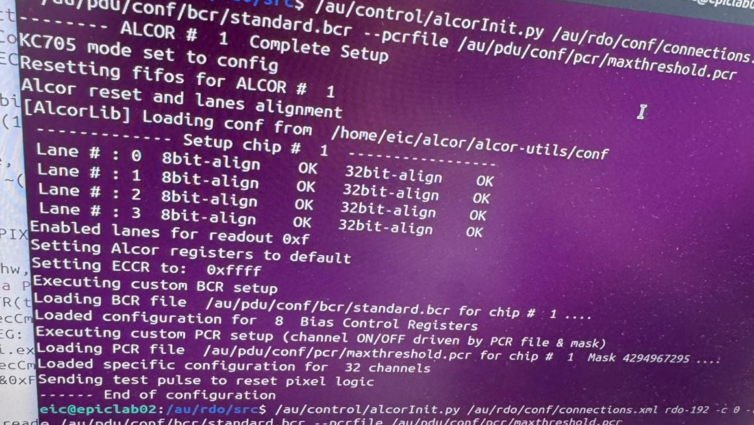
Full ALCOR chain connected
Both ALCOR chips were configured!
ALCOR chain on the top Master-FEB
ALCOR-dual FEB
AU15P Programmer
Half of a PDU

Slide 7
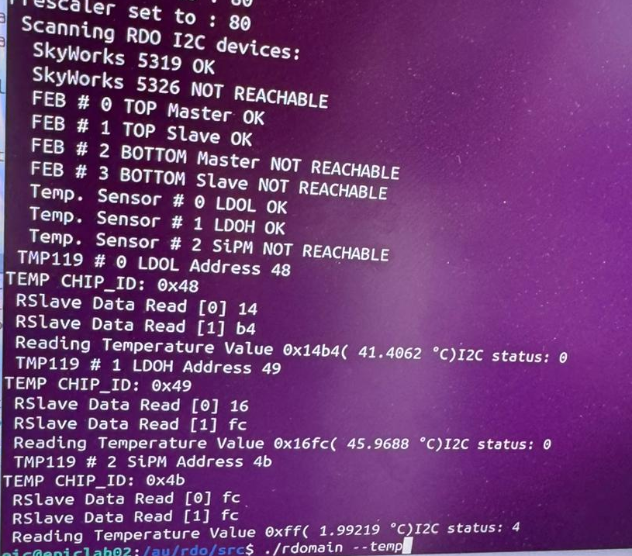
I2C Networks on board
Si5326 is not reachable since it is not powered-on (another Si5319 is mounted on the RDO).
The bottom FEBs are not plugged.
ATTiny417 I2C is under development.
All the temperature sensors were checked:
  The sensor near the PDU SiPMs is not responding (0x4 NACK status).
  The reworking by ARTEL during production could be the reason.

Slide 8
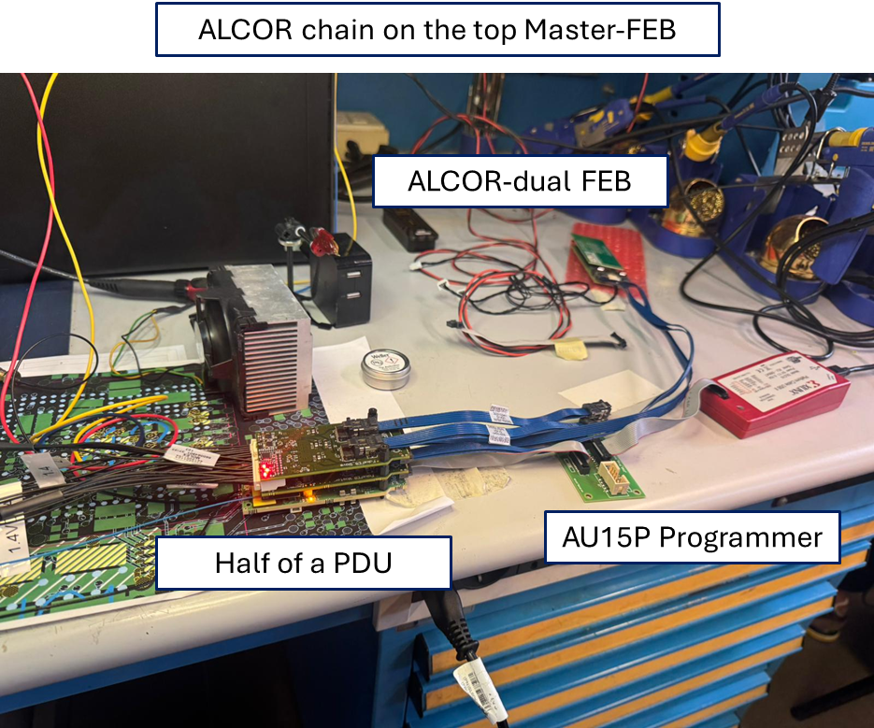
Power consumptions
  Considering the full ALCOR chain, the RDO power consumptions are:
  1.6 W on the 1.4 V rail
  2.9 W on the 2.7 V rail
  The RDO card system has some devices that are switched-off or not working:
    The Si5326 PLL is switched off.
    The MPF50T FPGA is not programmed.
    Both bottom FEBs are not plugged.
    Only two ALCORs are connected and configured.
RDO card
Top FEBs
ALCOR-dual FEB

Slide 9
Next steps
Plug the bottom FEBs to test the full-PDU hardware and check power consumptions.
Test the readout chain to check the output frequency of ALCOR.
→ OK to ARTEL for production
Test the full PDU readout, considering 8 ALCOR chips connected.
Integrate the RDO system into the dRICH prototype.

Slide 10
Next steps
Plug the bottom FEBs to test the full-PDU hardware and check power consumptions.
Test the readout chain to check the output frequency of ALCOR.
→ OK to ARTEL for production
Test the full PDU readout, considering 8 ALCOR chips connected.
Integrate the RDO system into the dRICH prototype.
Thank You for the attention!

Slide 11
Backup slides

Slide 12
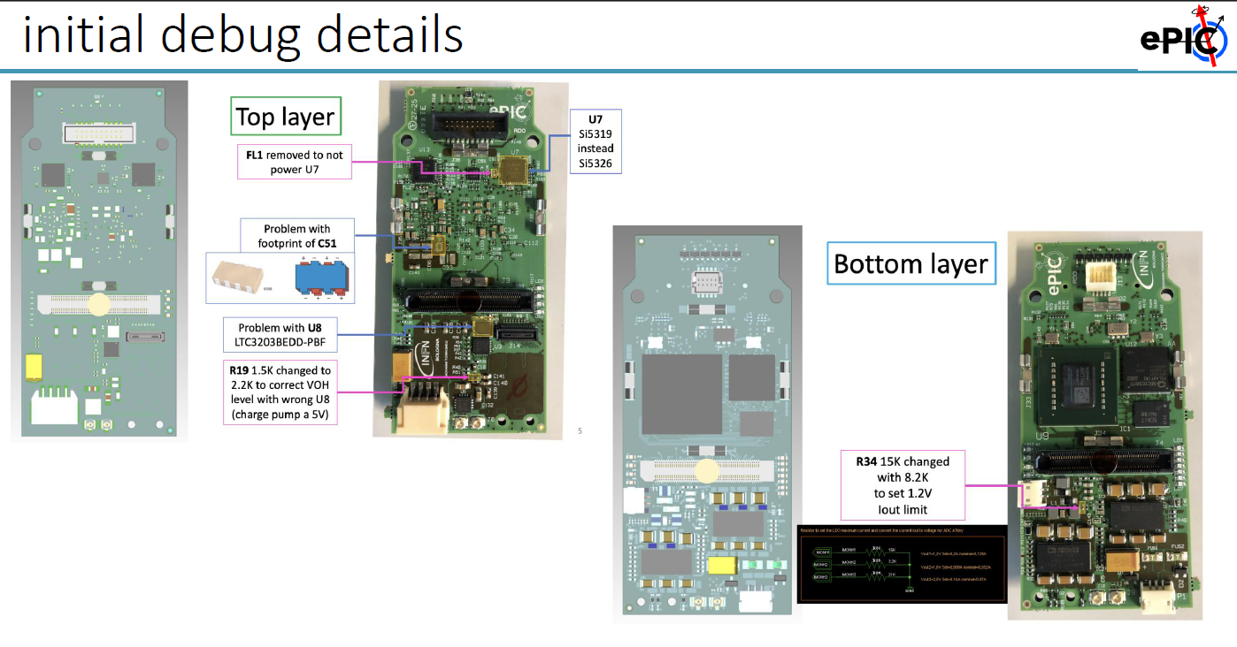
RDO hardware debugging

Slide 13
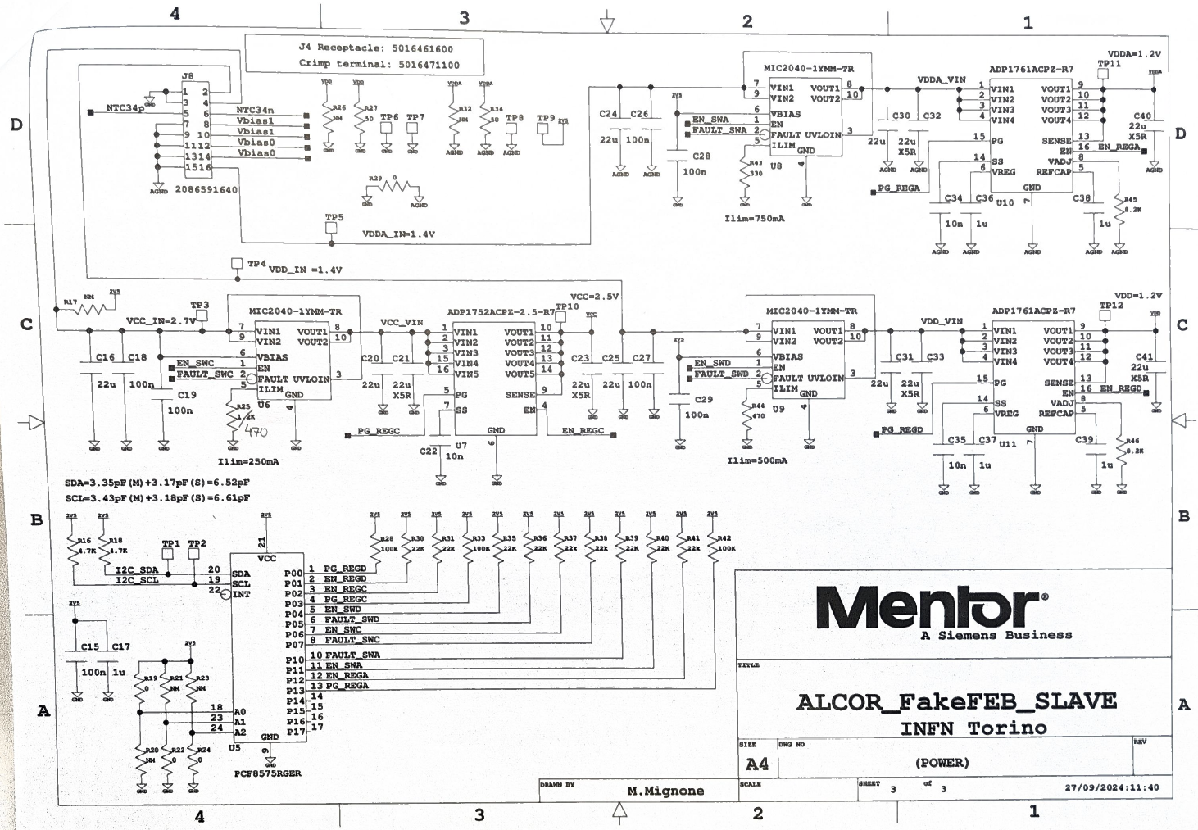
FEB power rails

