Slide 1


Updates from the FOOT Experiment
M. Villa (INFN Bologna)
20 June 2025 --(9 June actually!)

Slide 2
Outline
Present status of FOOT
Physics case and collaboration
Status of apparatus
Results (and publications)
Plans for the near future
Next data takings
Financial requests 2025

Slide 3
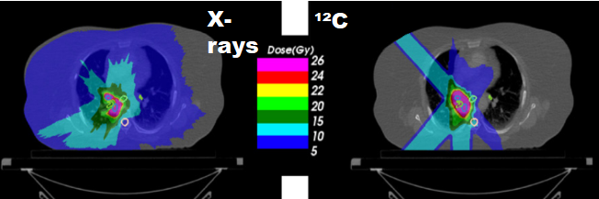
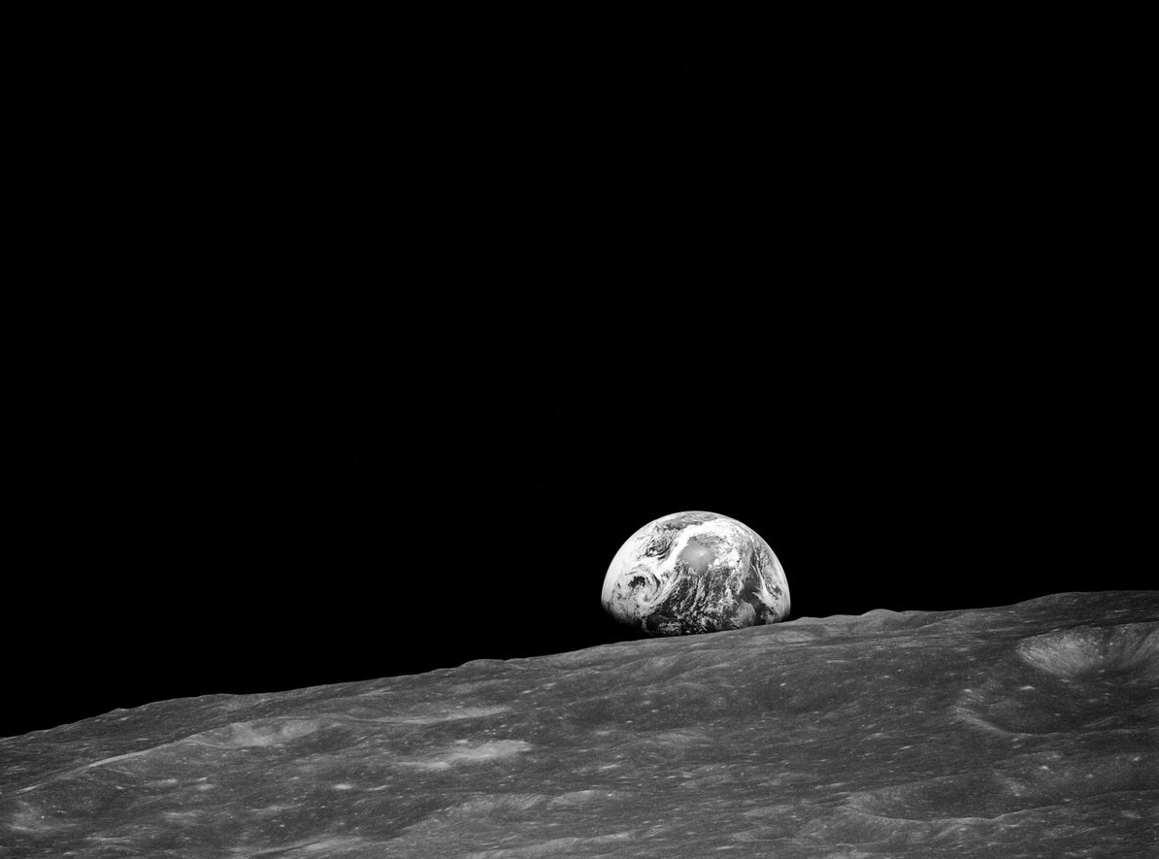
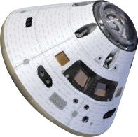



FOOT Purposes
p + C, O, N
C + C, O, Si
O + C, O
Fe + C, Si, Al
$$\frac{dσ}{dΩ}, \frac{dσ}{dE_{kin}}$$
Measurement of fragmentation cross sections
for Hadrontherapy and deep space radioprotection
Goal accuracy <5%
$$80 MeV/N<E_{kin}<400 MeV/N$$
0.5$GeV/N<E_{kin}<2 GeV/N$
Spacecraft shielding
Radio-protection in Space
Traditional radiotherapy
Humans to Mars!
Particle therapy

Slide 4
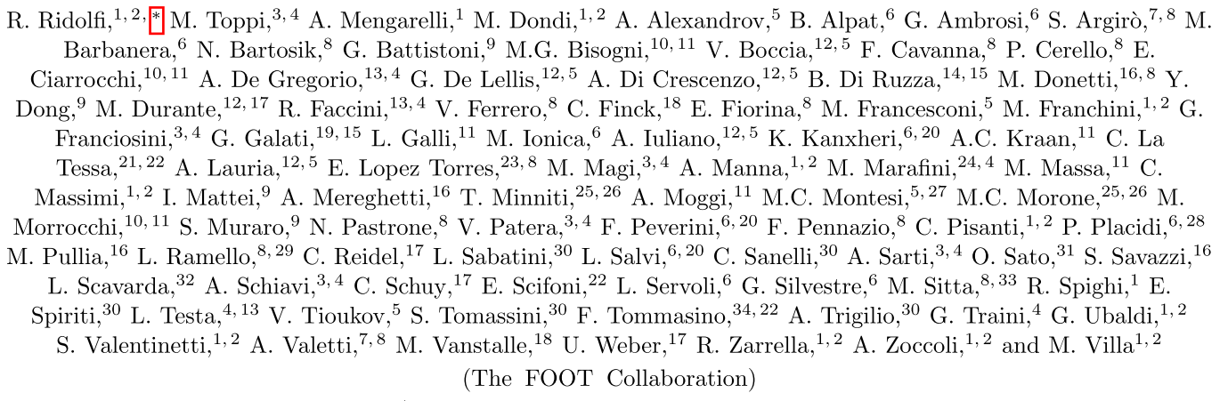
The FOOT Collaboration (2025)
INFN:
12 units (Ba, Bo, LNF, LNGS, Mi, Na, Pg, Pi, Rm1, Rm2, TIFPA, To)
64 researchers & 12 technologists
29.8 FTE (26.6 res.,
3.2 tech.)
2026 extensions?
Talks ongoing with
An Aarhus group (DK)
A Grenoble group (FR)
99 Authors (+6)
35 Institutions (+2)
Italy, France, Germany, India, Japan, Cuba
3 Continents (Europe, Asia, America)
54% women

Slide 5
Physics data taking done up to now
Beam | Target | Energy MeV/u | Statistics (millions) | Integral Differential elemental | Integral Differential isotopic | direct | inverse | Emulsions | campaign
O | C C2H4 | 200 400 | 0.06 | angle | NO | YES | NO | Yes Yes | GSI 2019 GSI 2020
O | C C2H4 C C2H4 | 200 200 400 400 | 14.2 12.2 5.5 6.5 | angle | NO | YES | NO | Yes | GSI 2021
He | C | 100 140 200 220 | 18.5 19.6 13.5 14.4 | angle | NO | YES | NO | No | HEID 2022
C | C | 200 | 4.1 | angle | NO | YES | NO |  | CNAO 2022
C | C C2H4 | 200 200 | 3.2 2.0 | Angle Energy | YES | YES | YES | Yes | CNAO 2023
C | C | 200 | Mostly tests VTX, IT, Calo, NIT | Angle | YES | YES | NO | NIT tests | CNAO 2024

Slide 6
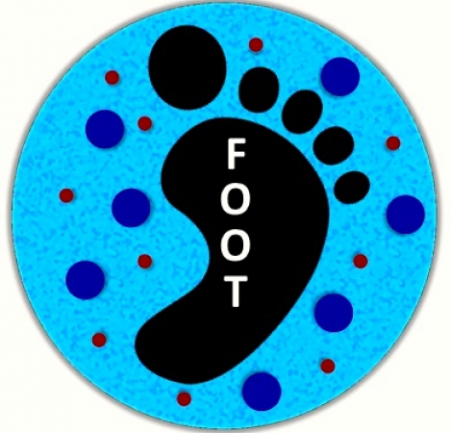


The three year plan - updated
Beam | Target | Energy MeV/u | Integral Differential elemental | Integral Differential isotopic | Emulsions | Campaign
C | C, C2H4 | 100-200 | Angle Energy | YES | YES | CNAO 2025
C | C, C2H4, Al | 700 -1500 | Angle Energy | YES | NO | GSI 2026/27
C | C, C2H4 | 200-300 | Angle Energy | YES | - | CNAO 2026
P | C | 100-220 | Angle Energy | YES | NIT | CNAO 2026
C | C, C2H4 PMMA | 320-400 | Angle Energy | YES | YES | CNAO 2027
He | C, C2H4 PMMA | 200-400(?) | Angle Energy | YES | YES | CNAO 2027

Slide 7
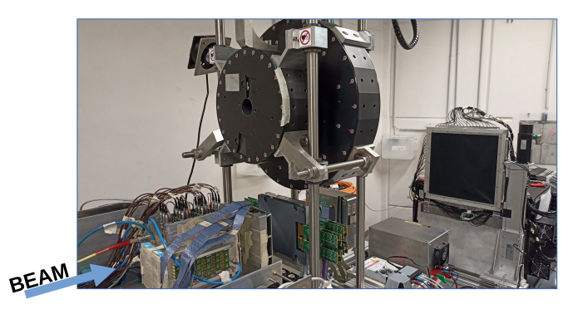
Detector status (electronics)
Up and running!
Standard «Calibration» activities on several detectors: SC, BM, TOFWALL, MSD
More detailed studies ongoing on VTX, IT & Magnet, CALO
Both calibration and detailed studies involve several data taking campaigns at the same time → study of performances over time

Slide 8
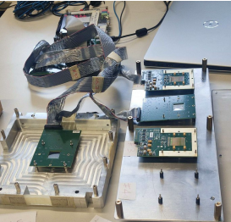
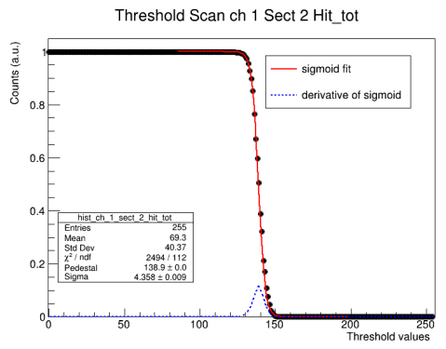
Vertex detector
CNAO 2024 data: 2 VTX sensors changed
No more spares; detailed thr. Scans

Slide 9
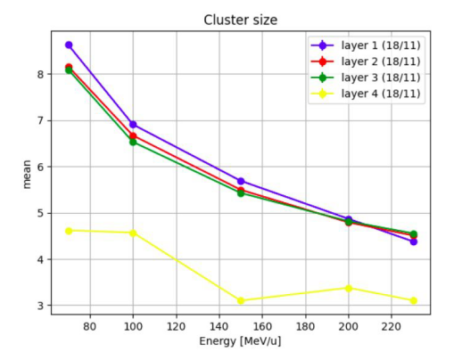
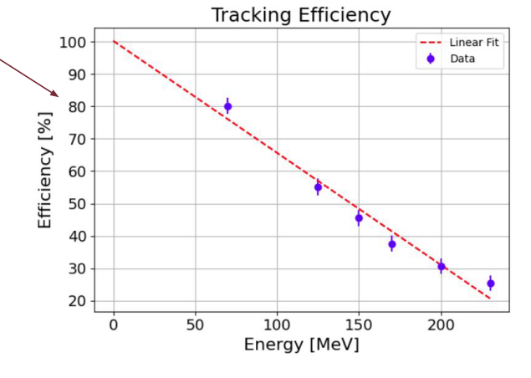
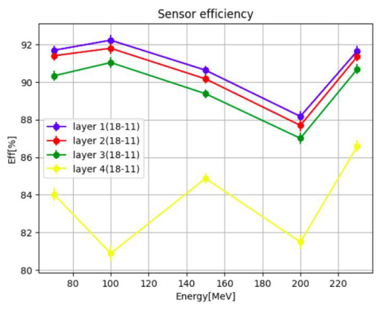
Vertex tracking efficiency for protons
Higher efficiency for higher Z fragments
Decided for a new batch of 5 sensors
(paid on the MAECI project)

Slide 10
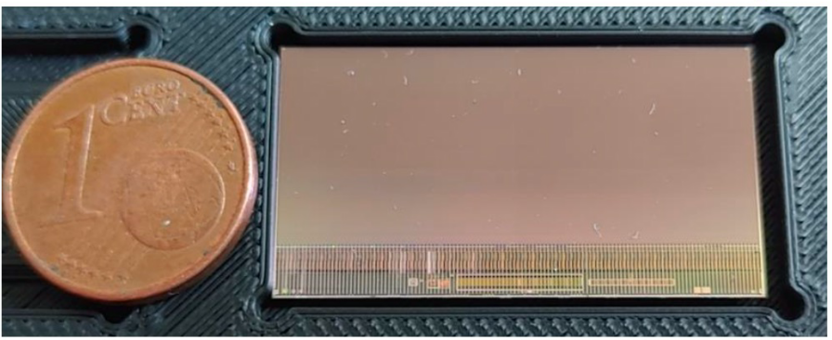
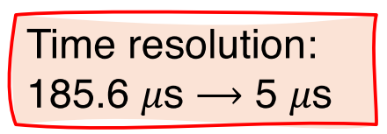
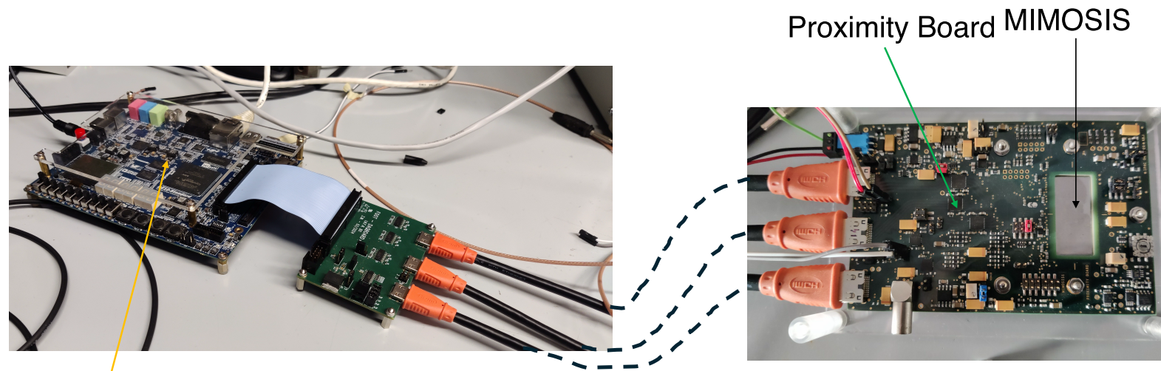
Vertex substitution: Mimosis 2.1 sensor (MAECI)
Mimosis 1.0
(for tests)

Slide 11
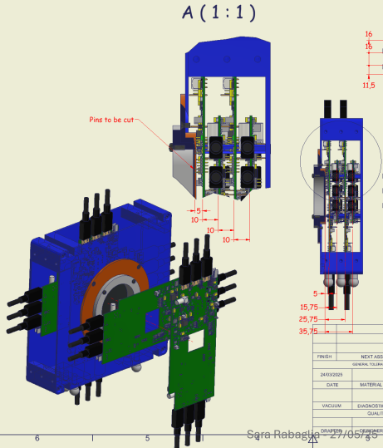
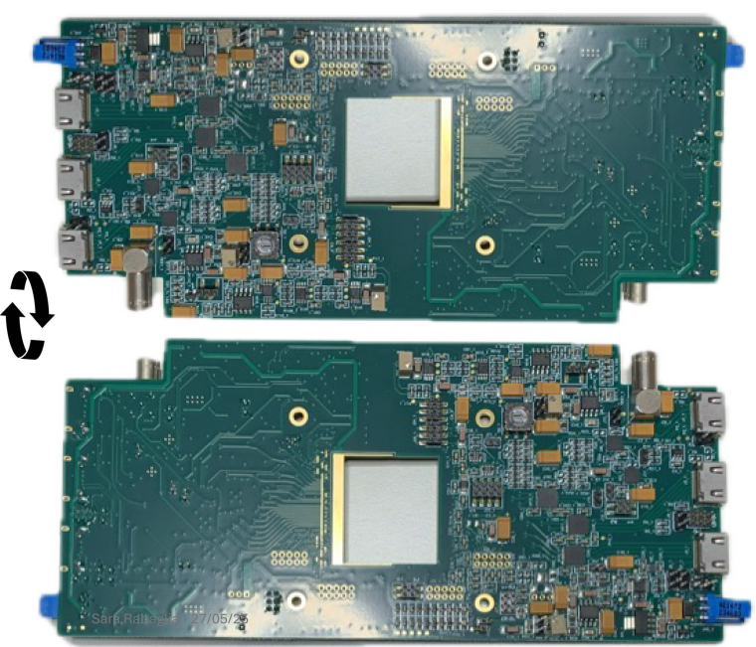
New vertex design
Final set up:
5 layers with
2 sensors each
1 layer
before TG
4 after TG
(as now)
Proximity board:
One board, 2 sensors
Chip mounting at the end of June →tests in July

Slide 12
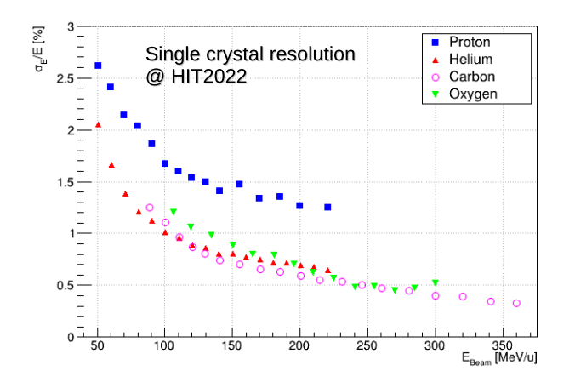
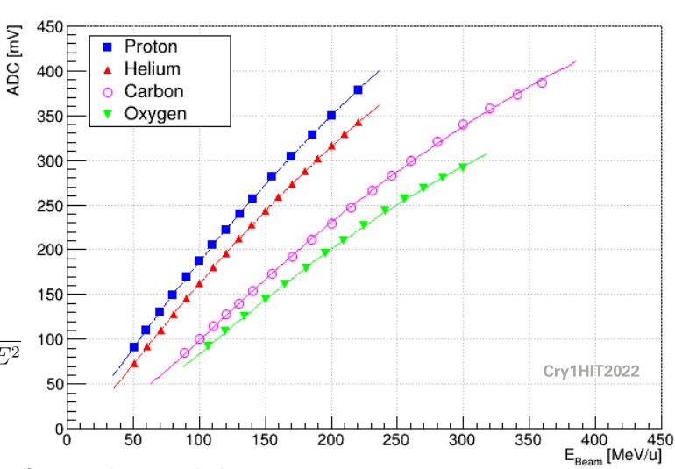


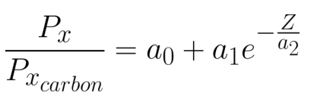
Calorimeter calibration
Non linearity:
Z dependance
Desired resolution below 2% for all fragments with Z>1

Slide 13
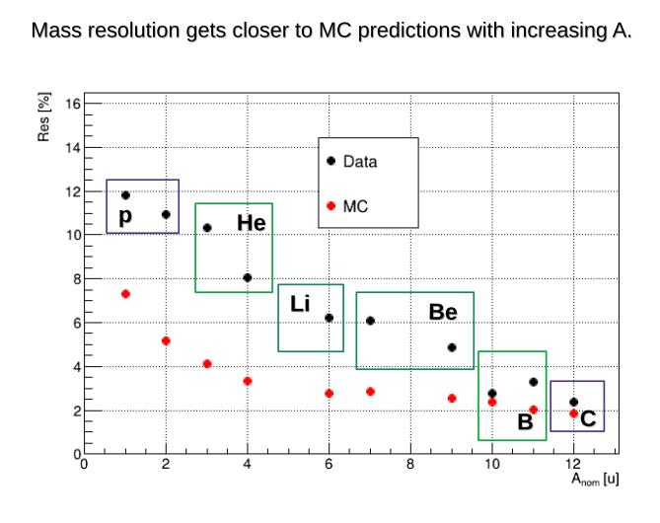
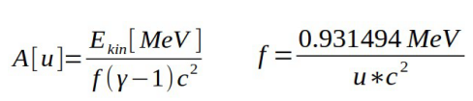
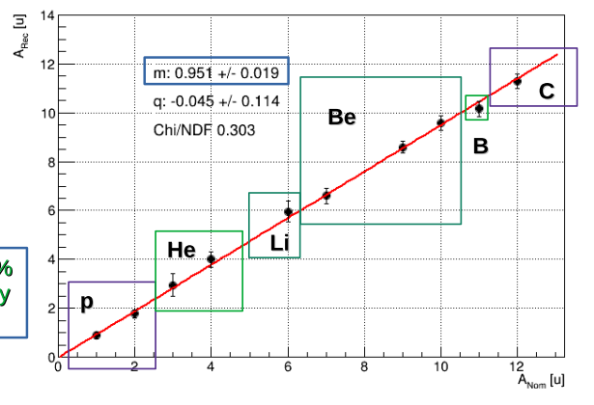
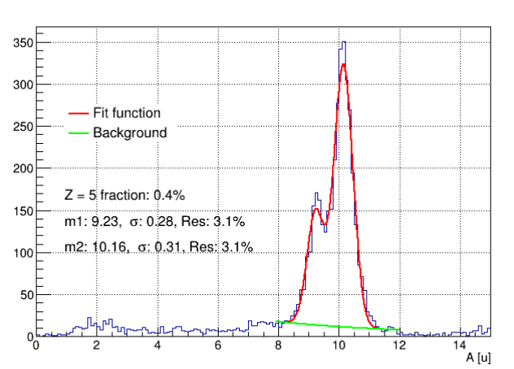
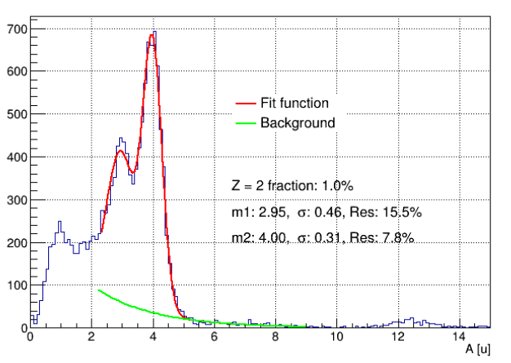
Mass reconstruction without magnet
Reconstructed A of the fragment
Nominal A of the fragment

Slide 14
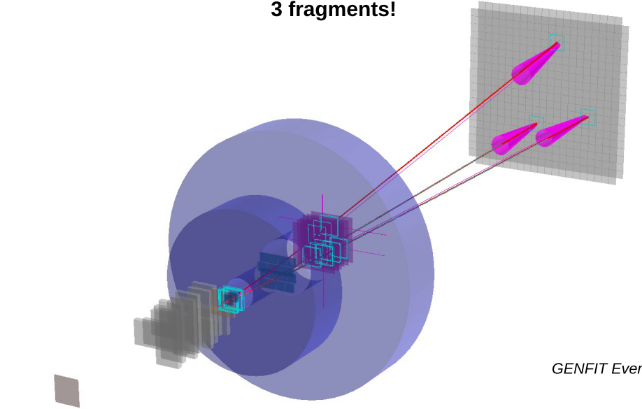
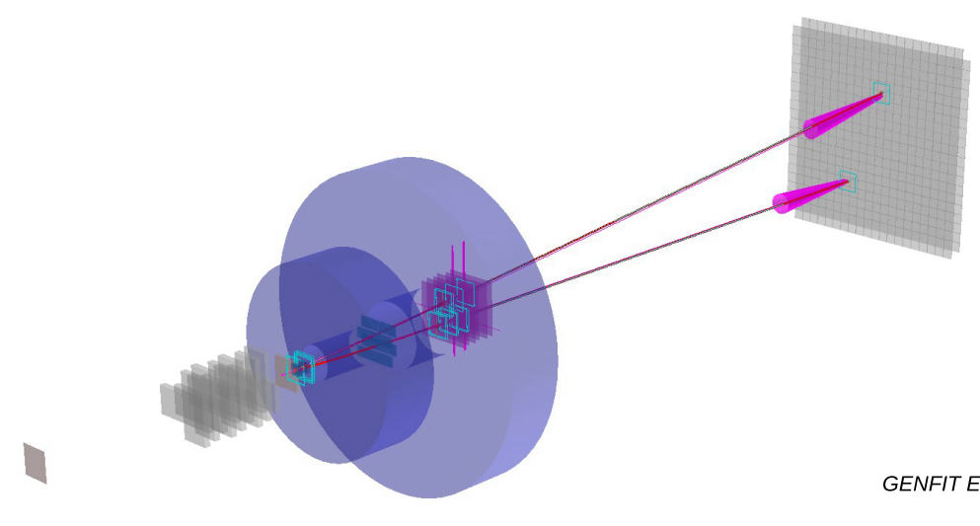
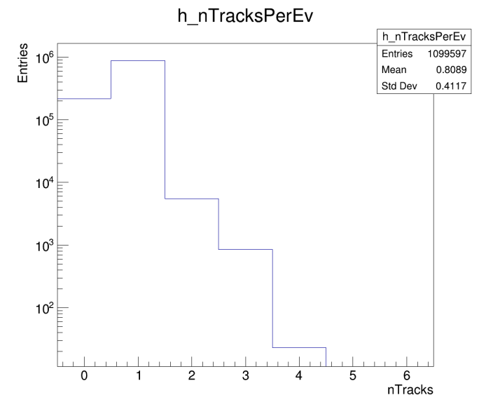
Tracking in Magnetic field (CNAO 2024)
Tracking in VTX, (IT), MSD, TOFWALL
usually 11 points, max 13

Slide 15
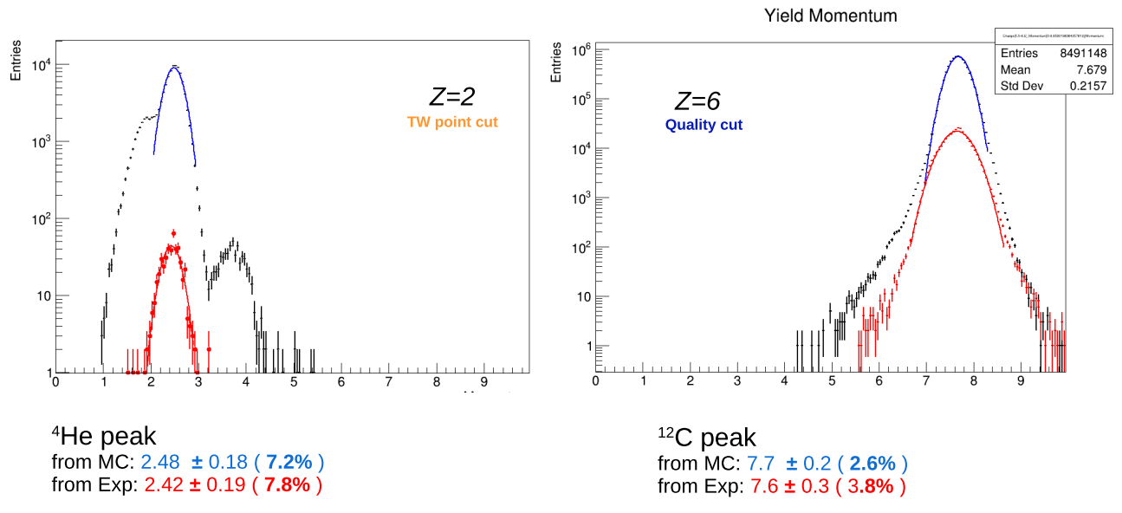
Sample plots: momentum resolution
Fragment momentum (GeV/c)
Fragment momentum (GeV/c)

Slide 16
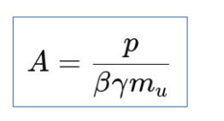
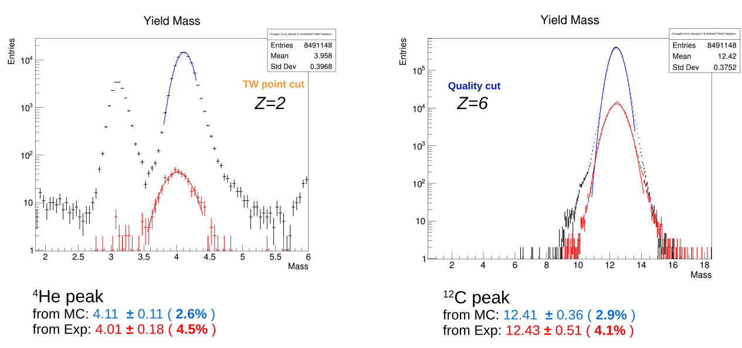
Sample plots: mass reconstruction
First attempts: tracking not yet optimal; we are a factor 2 above expectations

Slide 17
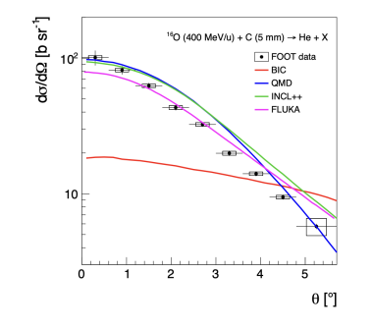
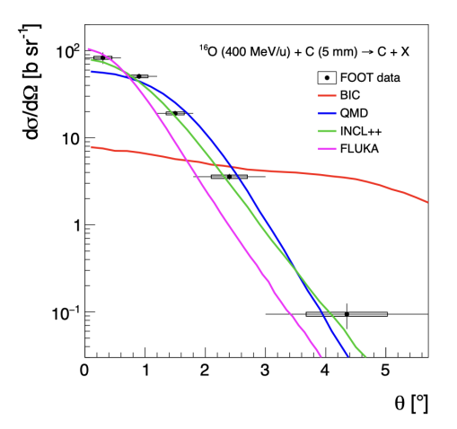

Results on GSI 2021 O+C, 400 MeV/N
$$σ_{frag}\left(Z\right) \frac{dσ_{frag}\left(Z\right)}{dθ} Z<8$$
Accepted
for publication
on PRC
(28 may 2025)
%
%
Z=6
Z=2
24

Slide 18


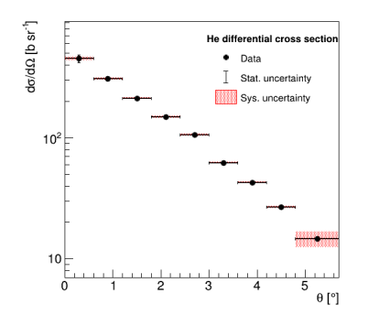
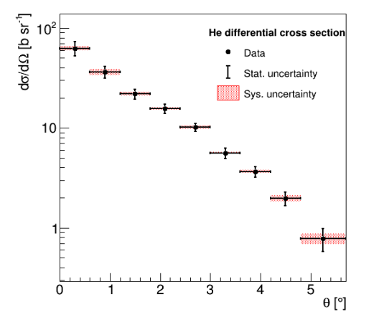

Sister analysis: O+C₂H₄, 400 MeV/N
$$σ_{frag}\left(Z\right) , \frac{dσ_{frag}\left(Z\right)}{dθ}, \frac{dσ_{frag}\left(Z\right)}{dβ}, \frac{dσ_{frag}\left(Z\right)}{dE_{kin}} Z<8$$
$$σ_{f}\left(O+H\right)=\frac{1}{4}\left(σ_{f}\left(O+C_{2}H_{4}\right)−2σ_{f}\left(O+C\right)\right)$$
Analysis finished;
Model predictions
Available
Paper
in preparation
(journal: PRC)
24

Slide 19
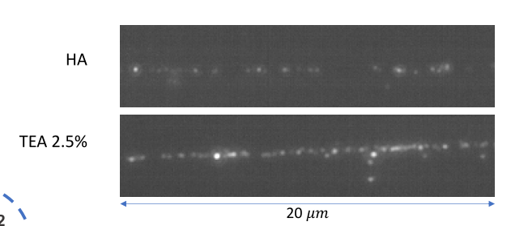
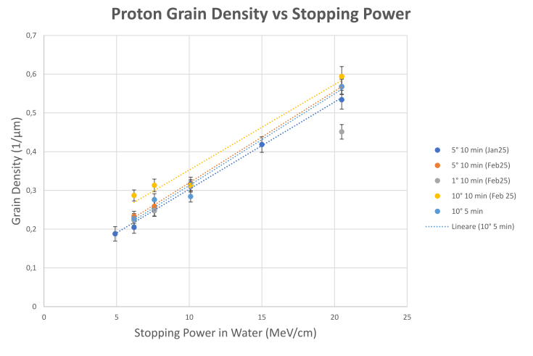
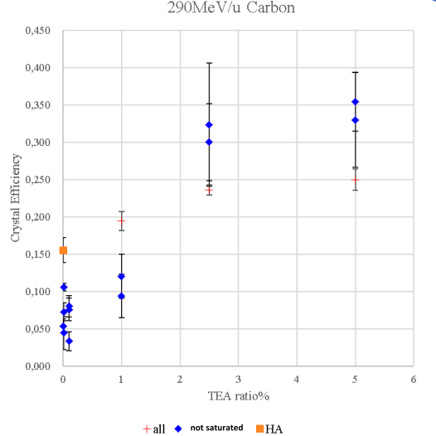
R&D on Nano Imaging Tracker: a trip to Japan (G.G., V.B.)
Sensitization
Tuning development parameters

Slide 20
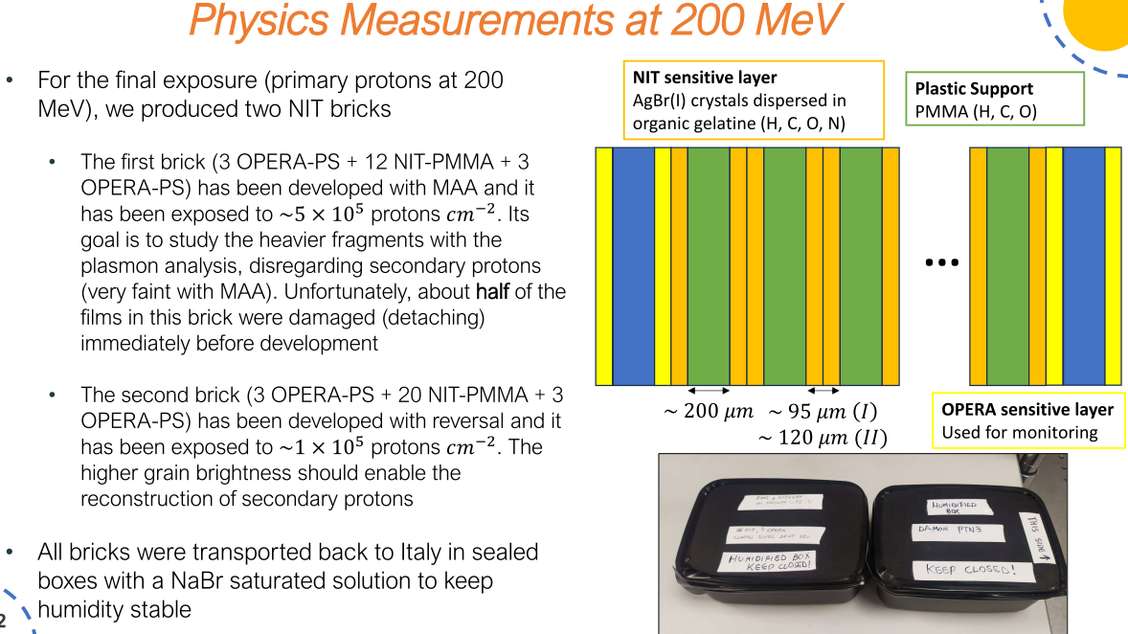
Developed, not scanned yet

Slide 21
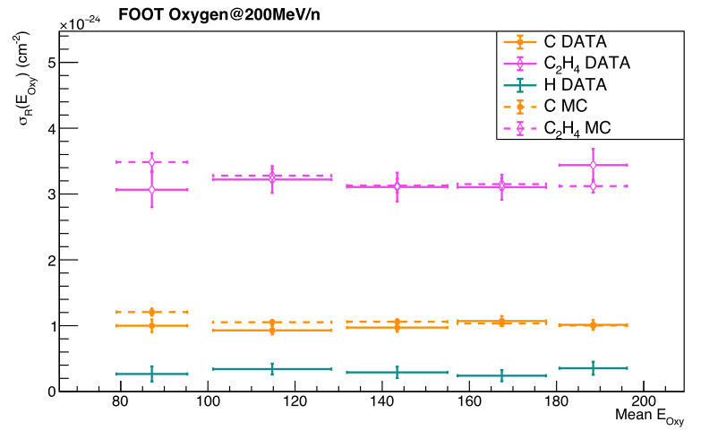
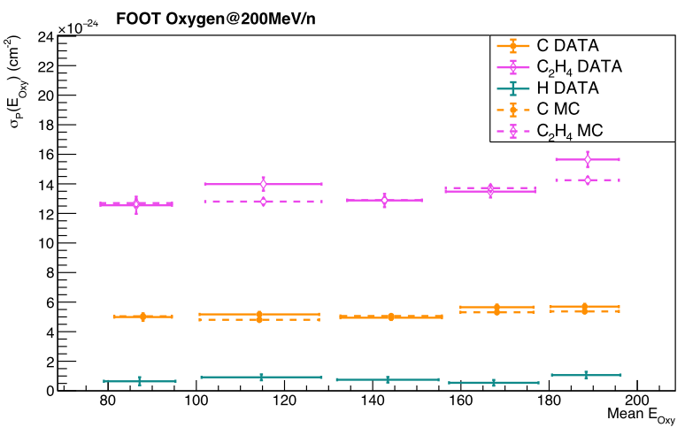
Emulsion analysis
(vertices)
(fragments)
Paper almost ready to be submitted to PRC (Models, circulation, authorlist)
24

Slide 22
Paper in 2024 and 2025
Paper | Rivista | Status
Charge identification of fragments produced in 16O beam interactions at 200 MeV/n and 400 MeV/n on C and C_2H_4 targets | Frontiers in Physics | Published 2024
The FLUKA Monte Carlo Simulation of the magnetic spectrometer of the FOOT experiment | Computer Physics Communications | Published 2024
Development and Performance Assessment of the Calorimeter Module for the FOOT experiment | JINST | Published 2025
Angular differential and elemental fragmentation cross sections of a 400 MeV/nucleon 16O beam on a graphite target with the FOOT experiment | Phys Rev C | Accepted may 25
Cross Section Measurements for Large Angle Fragments Production in the Interaction of Carbon with Thin Targets | Eur Phys J A | Submitted 25
Characterization of a Permanent Magnetic Dipolar System for the FOOT experiment |  | Internal circulation
Measurement of 200 MeV/n 16O nuclear reaction cross-section on carbon and polyethylene targets with the nuclear emulsion detector of the FOOT experiment | Phys Rev C | Internal circulation
+ 6 proceedings in 2024 and 4 proceedings in 2025 (up to now)
+ 13 talks/posters accepted in 2025 and 6 talks/posters submitted (up to now)

Slide 23
Plans for the near future

Slide 24
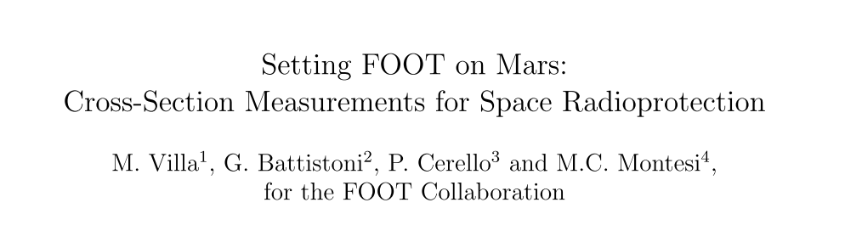
Esa PAC
Setting FOOT on Mars:
Cross-Section Measurements for Space Radioprotection
Decided to measure cross sections in the very high energy range: 0.7 and 1.5 GeV/n
¹²C on C, CH₂ and Al, 40 h of beam time
Proposal under evaluation
Beam in 2026-2027

Slide 25
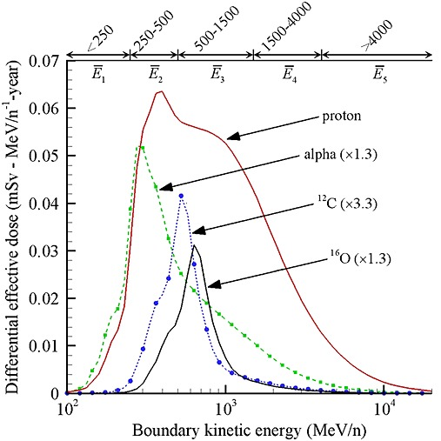

Energy/beam selection
Simulations of GCR secondary Particle flux behind 20 g/cm² of Al in deep space
@solar minimum
Foot contribution: fragmentation cross sections on Al;
C and p fragmentation in human body
T. Slaba and S. Blattnig, “GCR environmental models I: Sensitivity analysis for GCR environments,”
Space Weather, vol. 12, pp. 217–224, 2014.
See J. Norbury talk for more motivations
https://agenda.infn.it/event/45978/timetable/#20250526

Slide 26
CNAO 2025
Decided to investigate VTX & IT properties well before the main data taking
1 shift at the beginning of september
5 shifts at the end of october – exact dates still to be announced (as of today).
Program:
Beam | Target | Energy MeV/u | Integral Differential elemental | Integral Differential isotopic | Emulsions | Campaign
C | C, C2H4 | 100-200 | Angle Energy | YES | YES | CNAO 2025

Slide 27
Activities in 2026
Beam | Target | Energy MeV/u | Integral Differential elemental | Integral Differential isotopic | Emulsions | Campaign
C | C, C2H4, Al | 700 -1500 | Angle Energy | YES | NO | GSI 2026/27
C | C, C2H4 | 200-300 | Angle Energy | YES | - | CNAO 2026
p | C | 100-220 | Angle Energy | YES | NIT | CNAO 2026
No manpower for GSI and CNAO……
we put GSI as «Plan A» and CNAO as «Plan B»
On financial modules Data taking travel money will appear SJ.

Slide 28
Financial requests for this CSN3 Meeting
With few exceptions (BA, RM2, TIFPA), we ask to unlock SJ on CNAO data taking (some money needed at the beginning of september)
LNGS: unlock SJ 2k€ on consummables
BO: additional 2k for CNAO split data taking; 4 k€ for next general meeting and Strasbourg visit
RM1: additional 2k for CNAO split data taking (and no more INFN van)
PhD quota: Free the V. Boccia (Japan) quota;
A. De Gregorio now not a PhD (and not on FOOT…) ??
Additional SJ unlocking in september

Slide 29

Conclusions
We are continuing to understand the electronic detector
We’re working also on some improvements: new VTX (+old spare sensors), new TW, NIT
Continuing the process to produce cross section results → aiming at high ranked journals
We have split in two the CNAO 2025 data taking for tracking studies (more costs)
We have submitted a project on the ESA PAC (GSI). If accepted they will pay for the beam.
We continue to keep an eye on financial opportunities that might change (improve) the plan! (e.g. GER-ITA MAECI, ERC starting, ….)

