Slide 1



International Master on
Advanced Methods in Particle Physics
Second year, first semester @Bologna
prof. Angelo Carbone

Slide 2
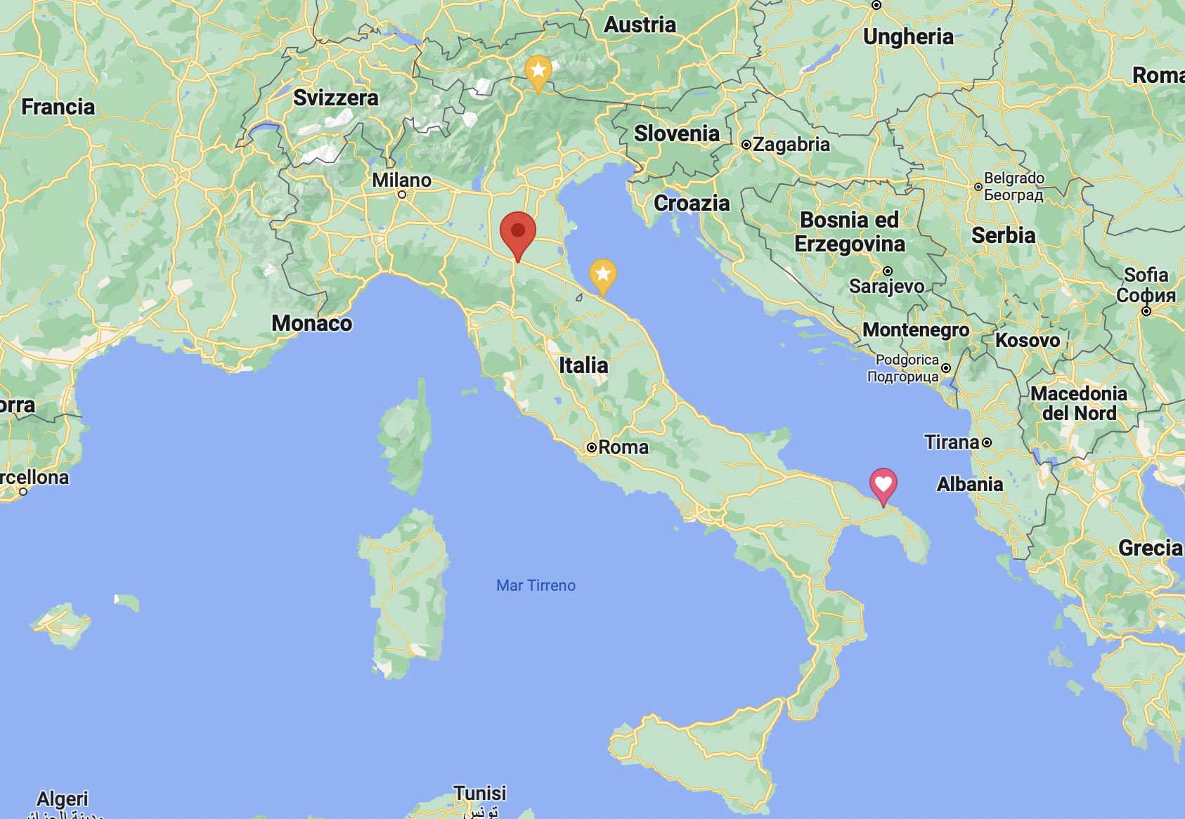
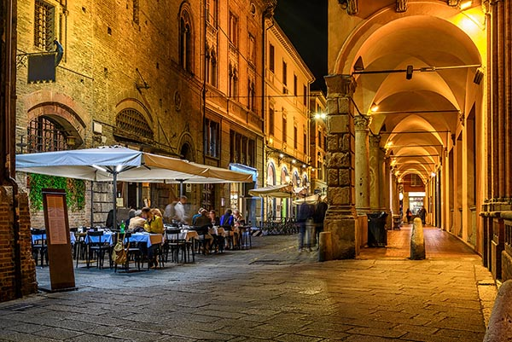
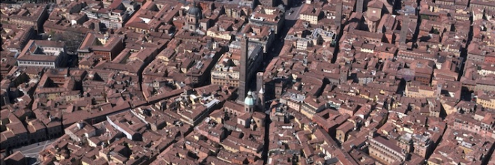
Bologna

Slide 3
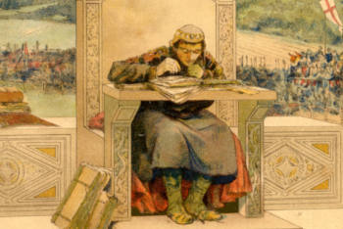
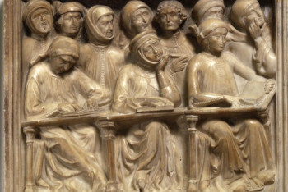
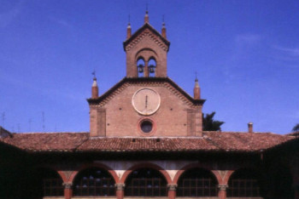
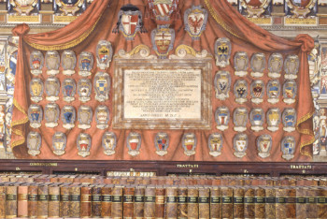
History – Alma Mater Studiorum - UNIBO
The University of Bologna is considered to be the oldest university in the Western world
Founded in 11th-12th centuries - The birth of the Studium and the Commune
It was the outcome of the spontaneous and informal initiative of a few students
A long history over Nine centuries
In the 21st century, UNIBO set up the first Multicampus scheme in Italy

Slide 4
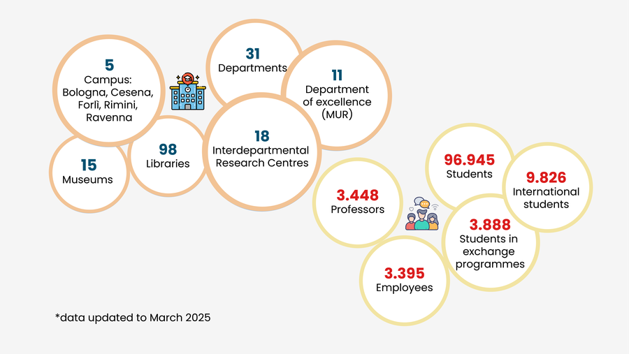
The University of Bologna in figures

Slide 5
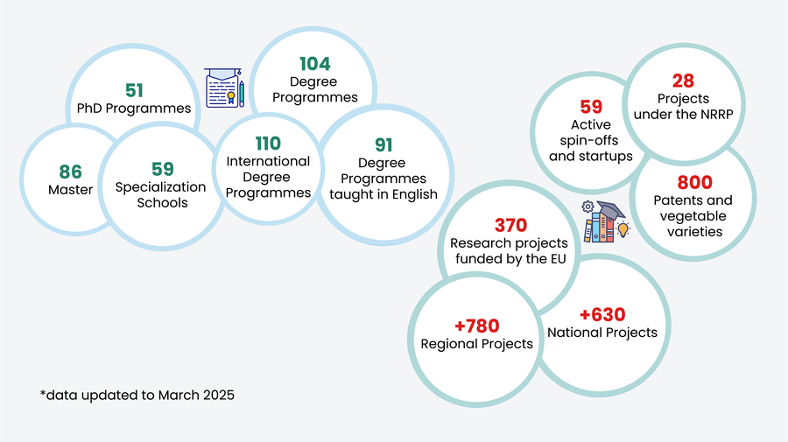
What we are working on

Slide 6
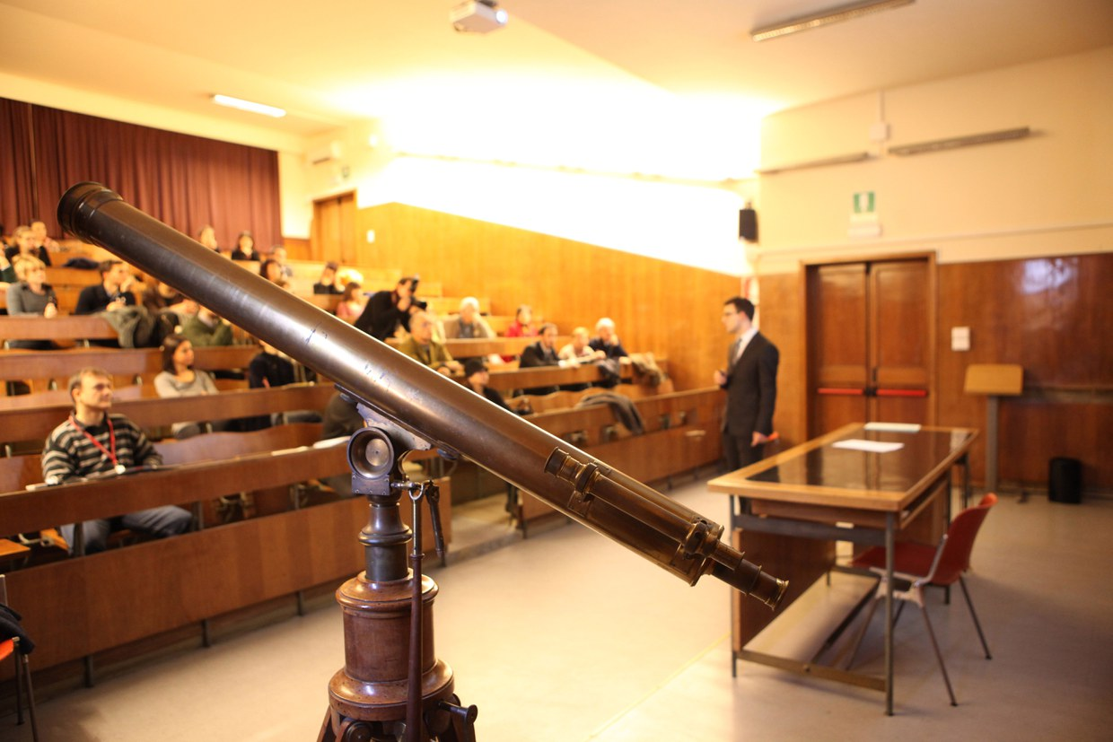
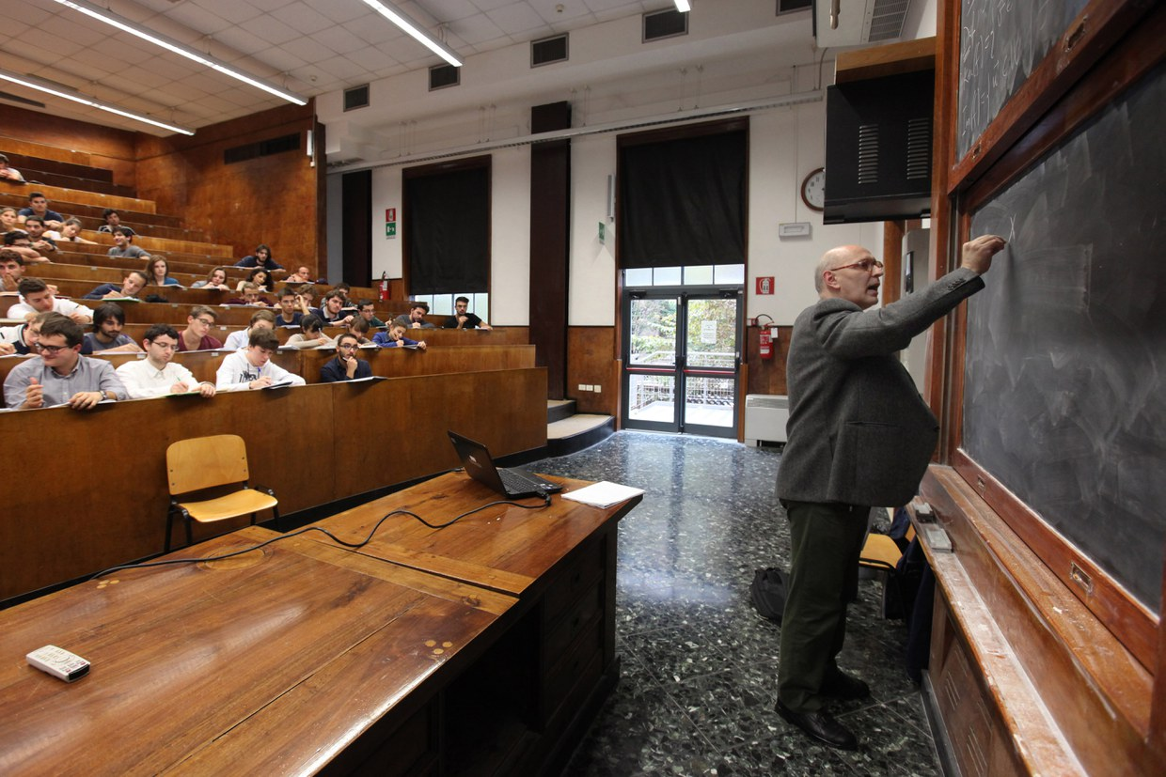
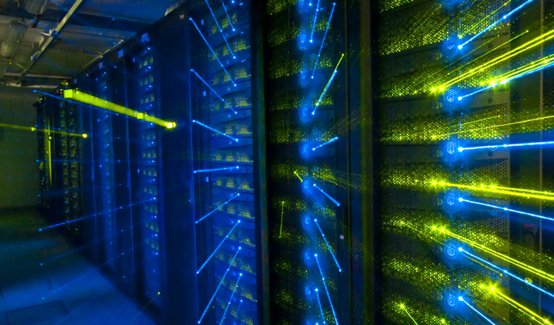
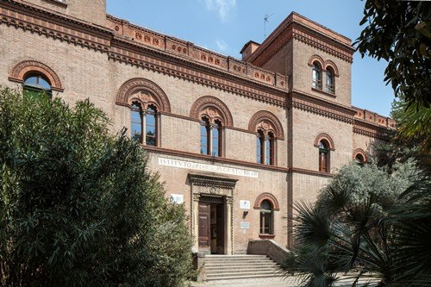
Department of Physics and Astronomy (DIFA)
DIFA is a significant structure integrated with almost 500 researchers achieving a level of excellence in Research and Teaching
DIFA area hosts researchers, laboratories and infrastructures of
Istituto Nazionale di Fisica Nucleare (Bologna's branch of INFN)
INFN's Centro nazionale tecnologie informatiche (CNAF)
CNAF- Particle physics computing centre
It is located in the city centre of Bologna

Slide 7
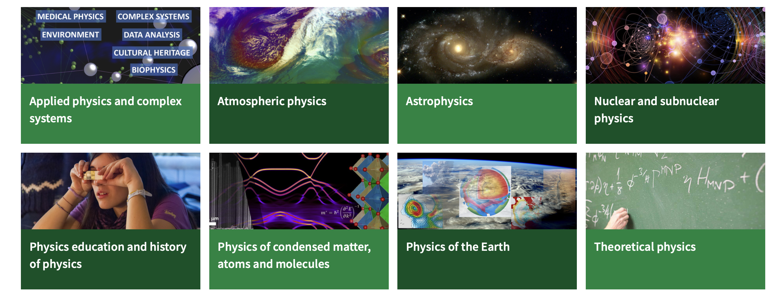
Research areas

Slide 8
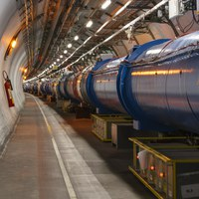
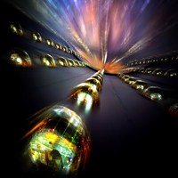
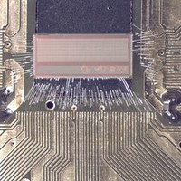
Research areas
High Energy Particle Physics with accelerators
ATLAS, ALICE, CMS, LHCb
Nuclear Physics
FOOT, FAMU, n_TOF, NUCL-EX
Neutrino Physics
CUORE, ENUBET, NU@FNAL
Astroparticle Physics and Cosmology
AMS, DarkSide, EUCLID, KM3, LVD, XENON
Detector R&D, Technology Transfer and Computing

Slide 9
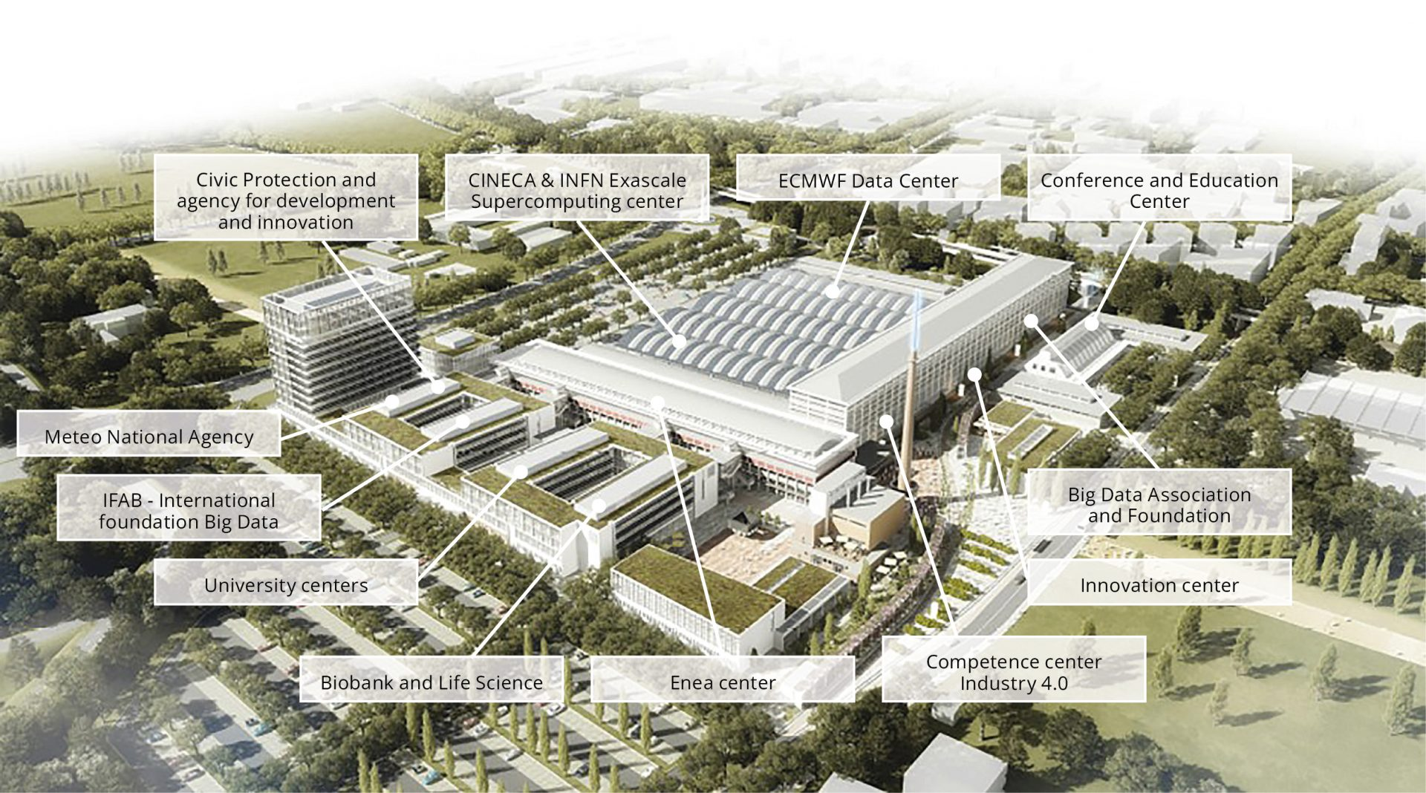
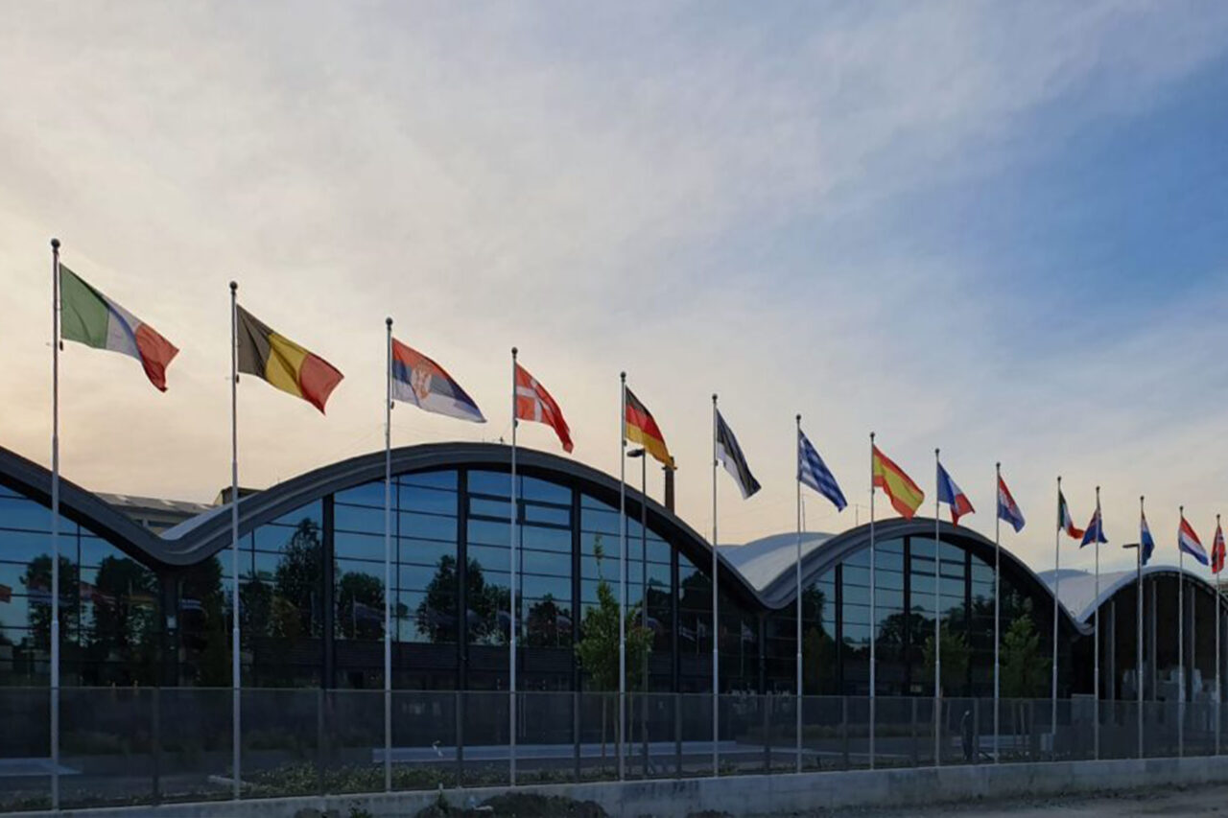
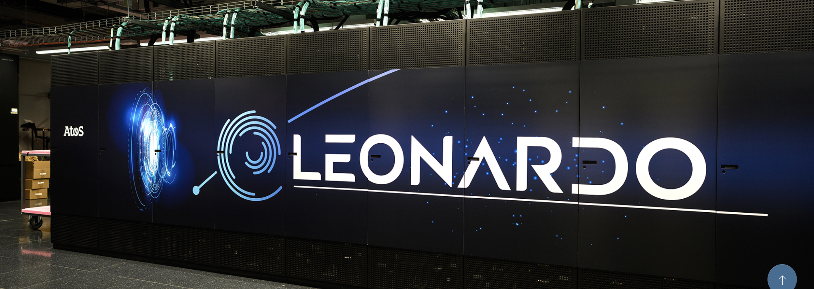
Bologna, in the heart of Data Valley
Bologna hosts 70% of Italian computing and storage capacity at the European research hub: the Big Data Technopole
Leonardo is one of the fastest and most powerful supercomputers in the world, ranking among the top positions in the TOP500 list

Slide 10
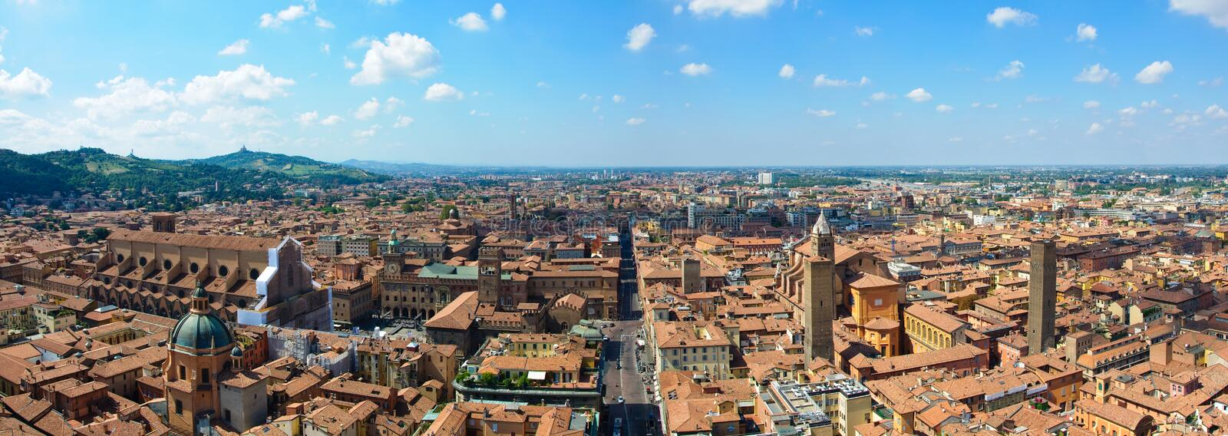
The semester in Bologna
First semester – second year
Introduction day in Bologna: mid-September 2025
Courses start in Bologna: mid-September 2025
Courses end in Bologna: 23 December 2025
Exam period: January-February 2026
Focus:
Particle Physics and Computer Science

Slide 11
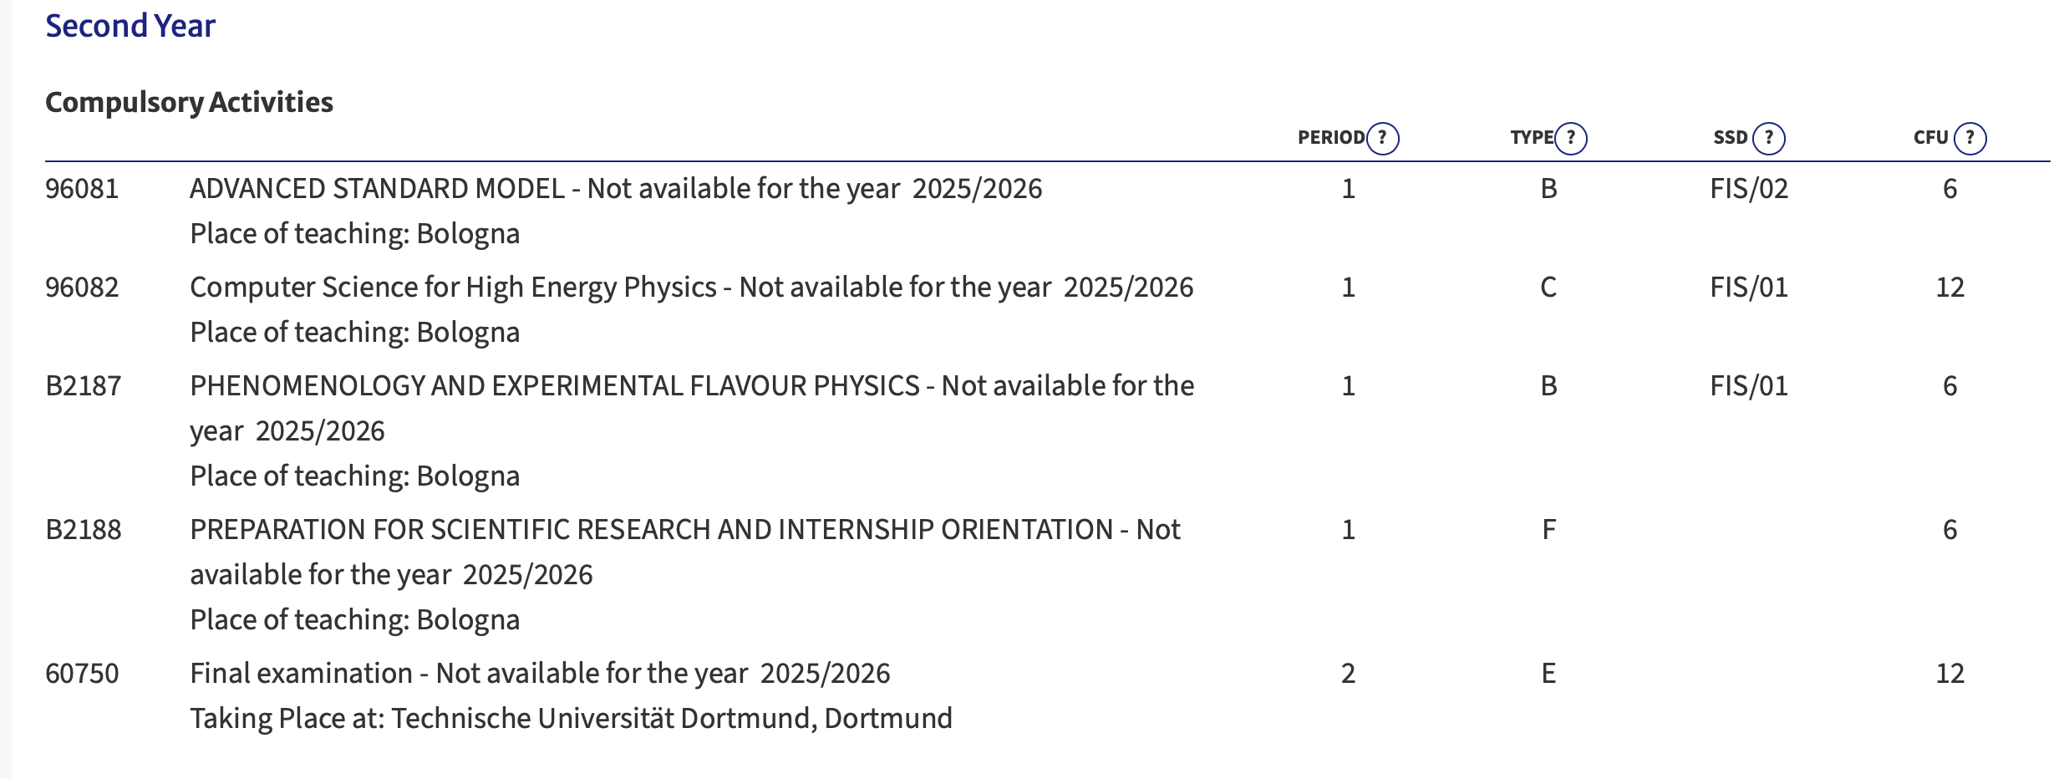
Second year – second semester

Slide 12
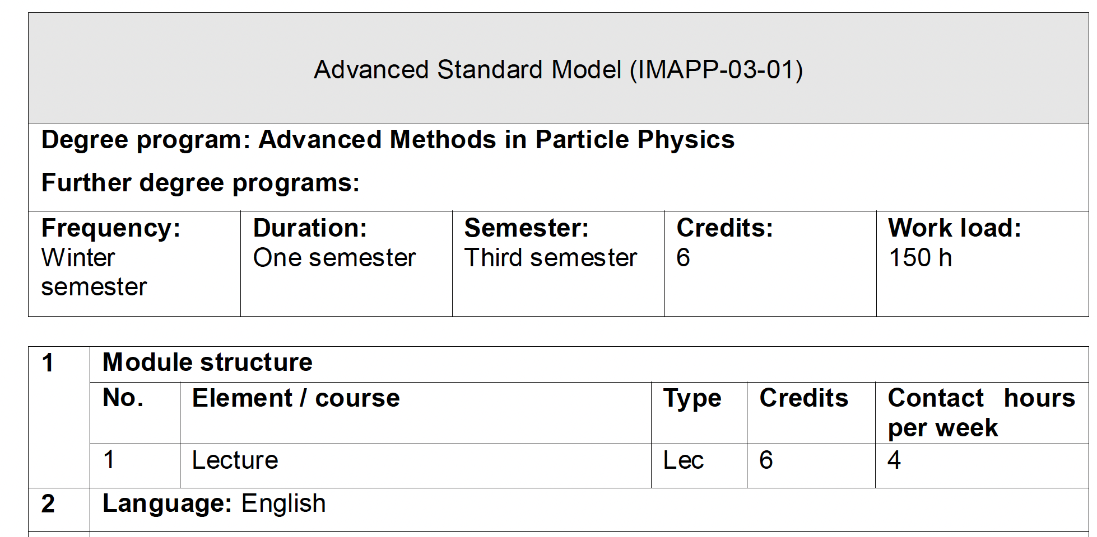
The courses
Teachers:
Prof. Ilaria Brivio
Dr. Davide Pagani
Dr. Xabier Marcano Imaz
Content
Advanced knowledge of the theory of the Standard Model of elementary particles, with open questions from a theoretical and phenomenological perspective

Slide 13
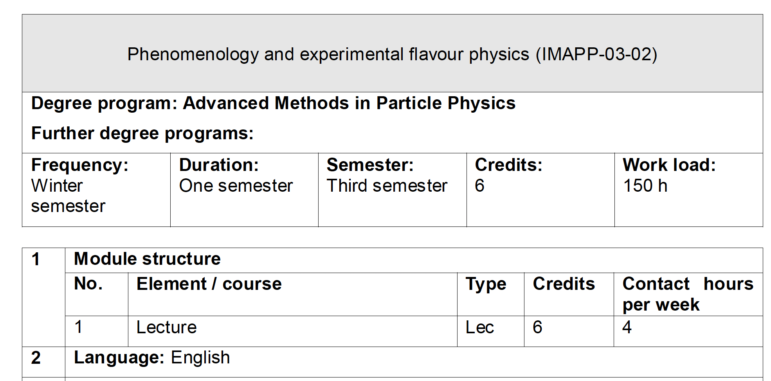
The courses
Teachers:
prof. Angelo Carbone
prof. Maximilliano Sioli
Content
The course covers aspects of flavor physics in the hadronic and the leptonic sector.

Slide 14
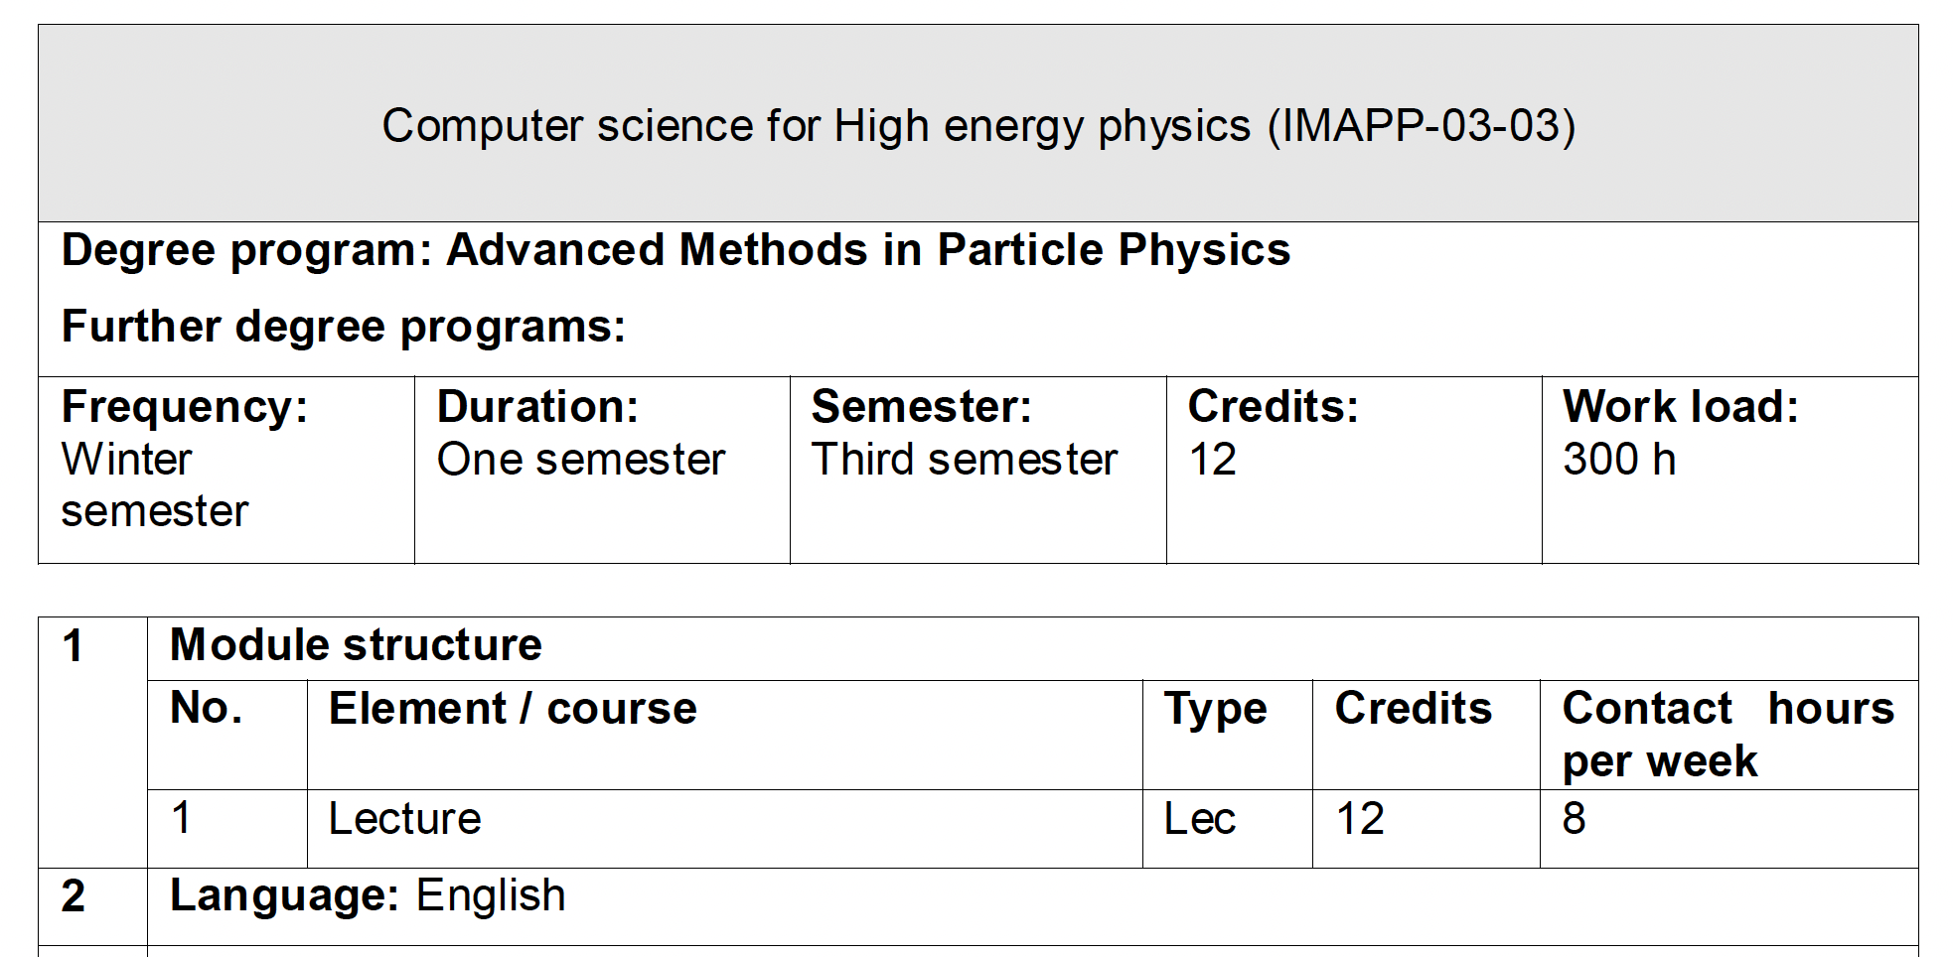
The courses
Content
Statistical data analysis for high-energy physics
Data processing infrastructures for scientific applications
Advanced C++ programming for computer science
.
Teachers:
Dr. Luca Clissa
Dr. Matteo Negrini
Dr. Gabriele Sirri
Dr. Francesco Giacomini
Dr. Andrea Chierici

Slide 15
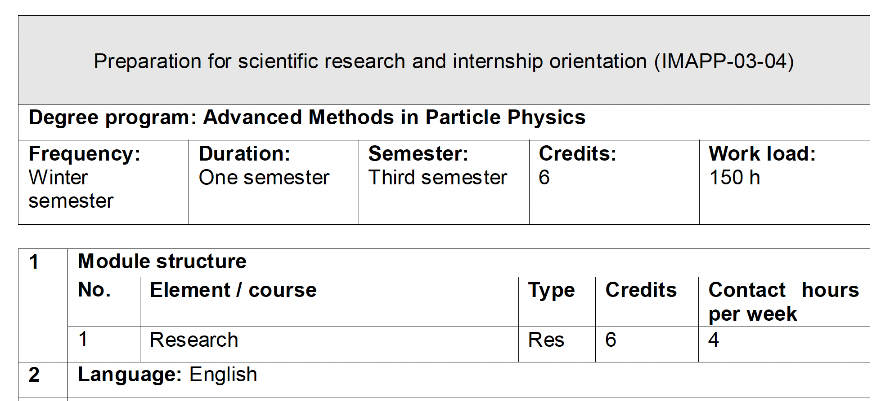
The courses
Content
How to perform a data anlysis in Particle Physics
Seminars for internship opportunities
.
Teachers:
Dr. Serena Maccolini
Several Invited speakers

Slide 16
Registration’s to Bologna University
To access UNIBO services, you need to register on the UNIBO portal
It is not urgent, you will receive an email at the beginning of 2026 when the registration process for IMAPP is completed

Slide 17
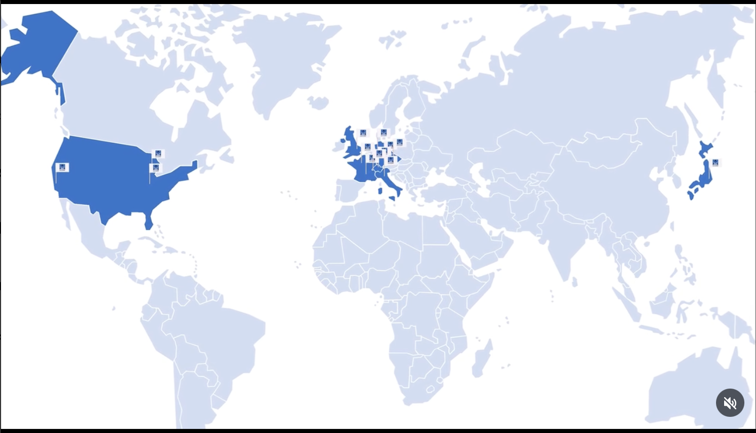
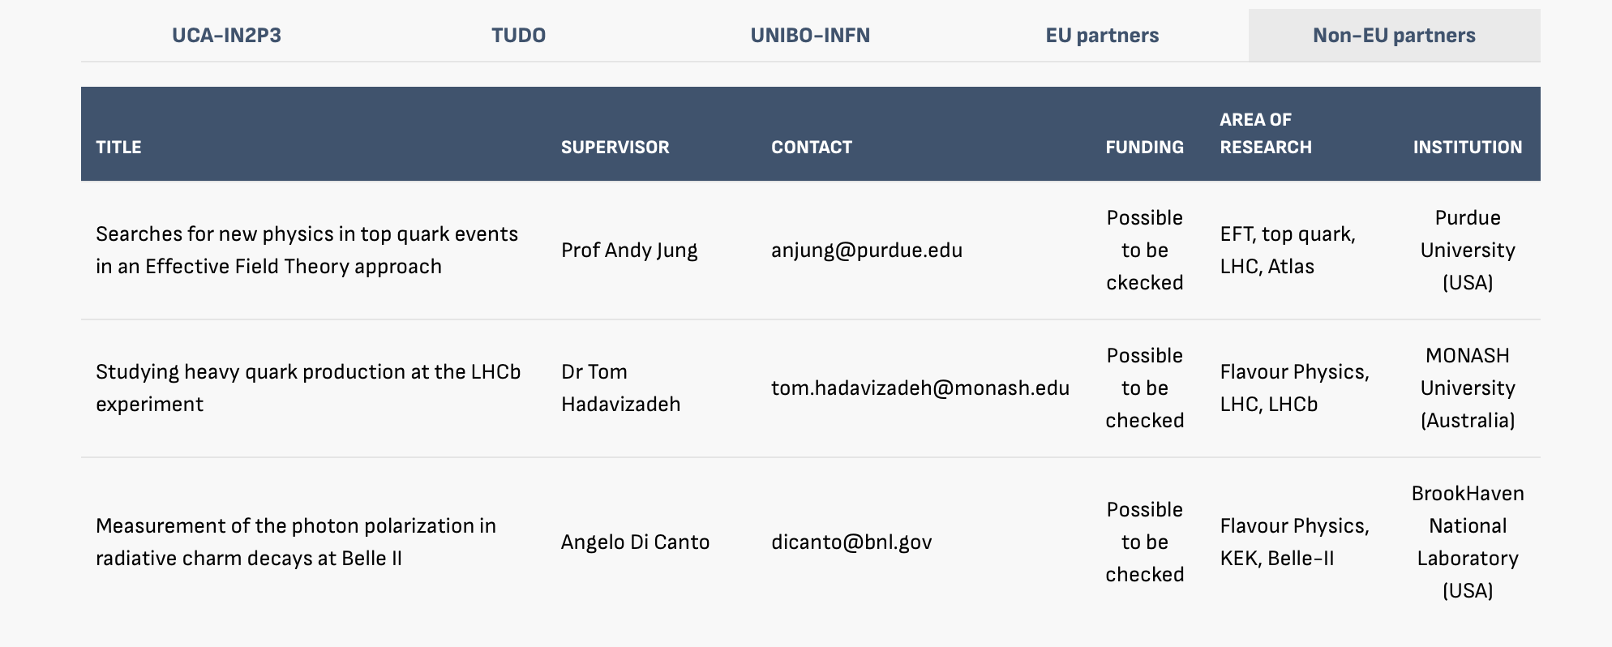
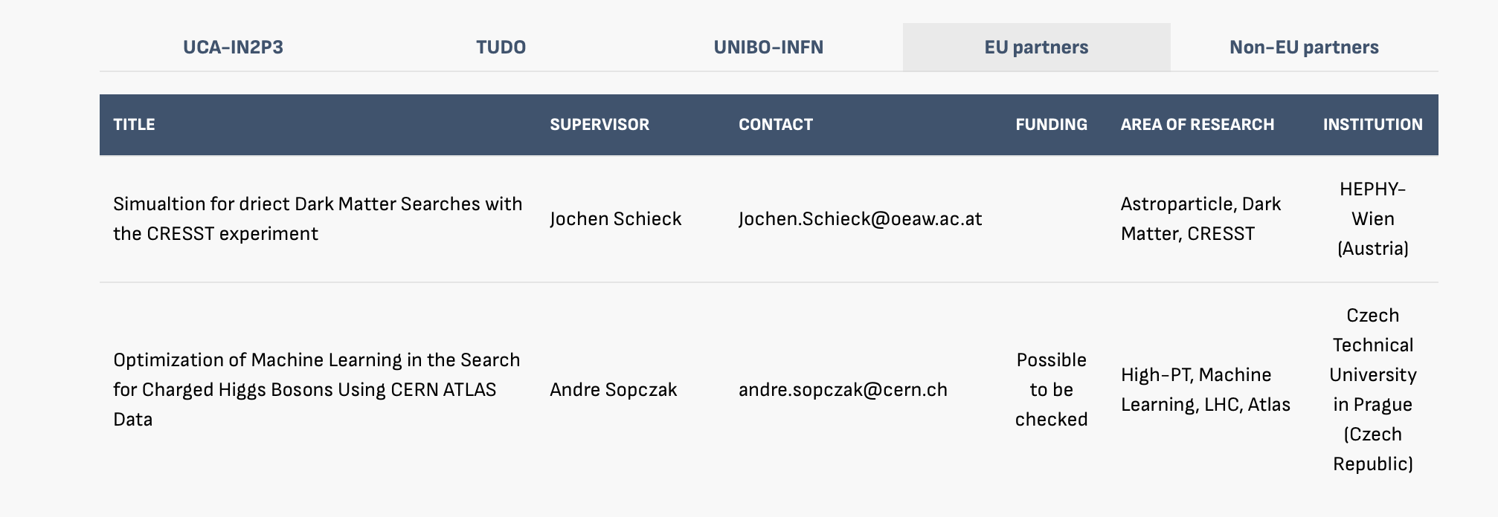
Internship
Internship will last six months (maximum). It will conclude with a written Master’s thesis, which has to be submitted within the duration of the Master’s project. → 15th of September deadline for delivering the document
You are required to have earned at least 86 ECTS credits before beginning the internship.

Slide 18
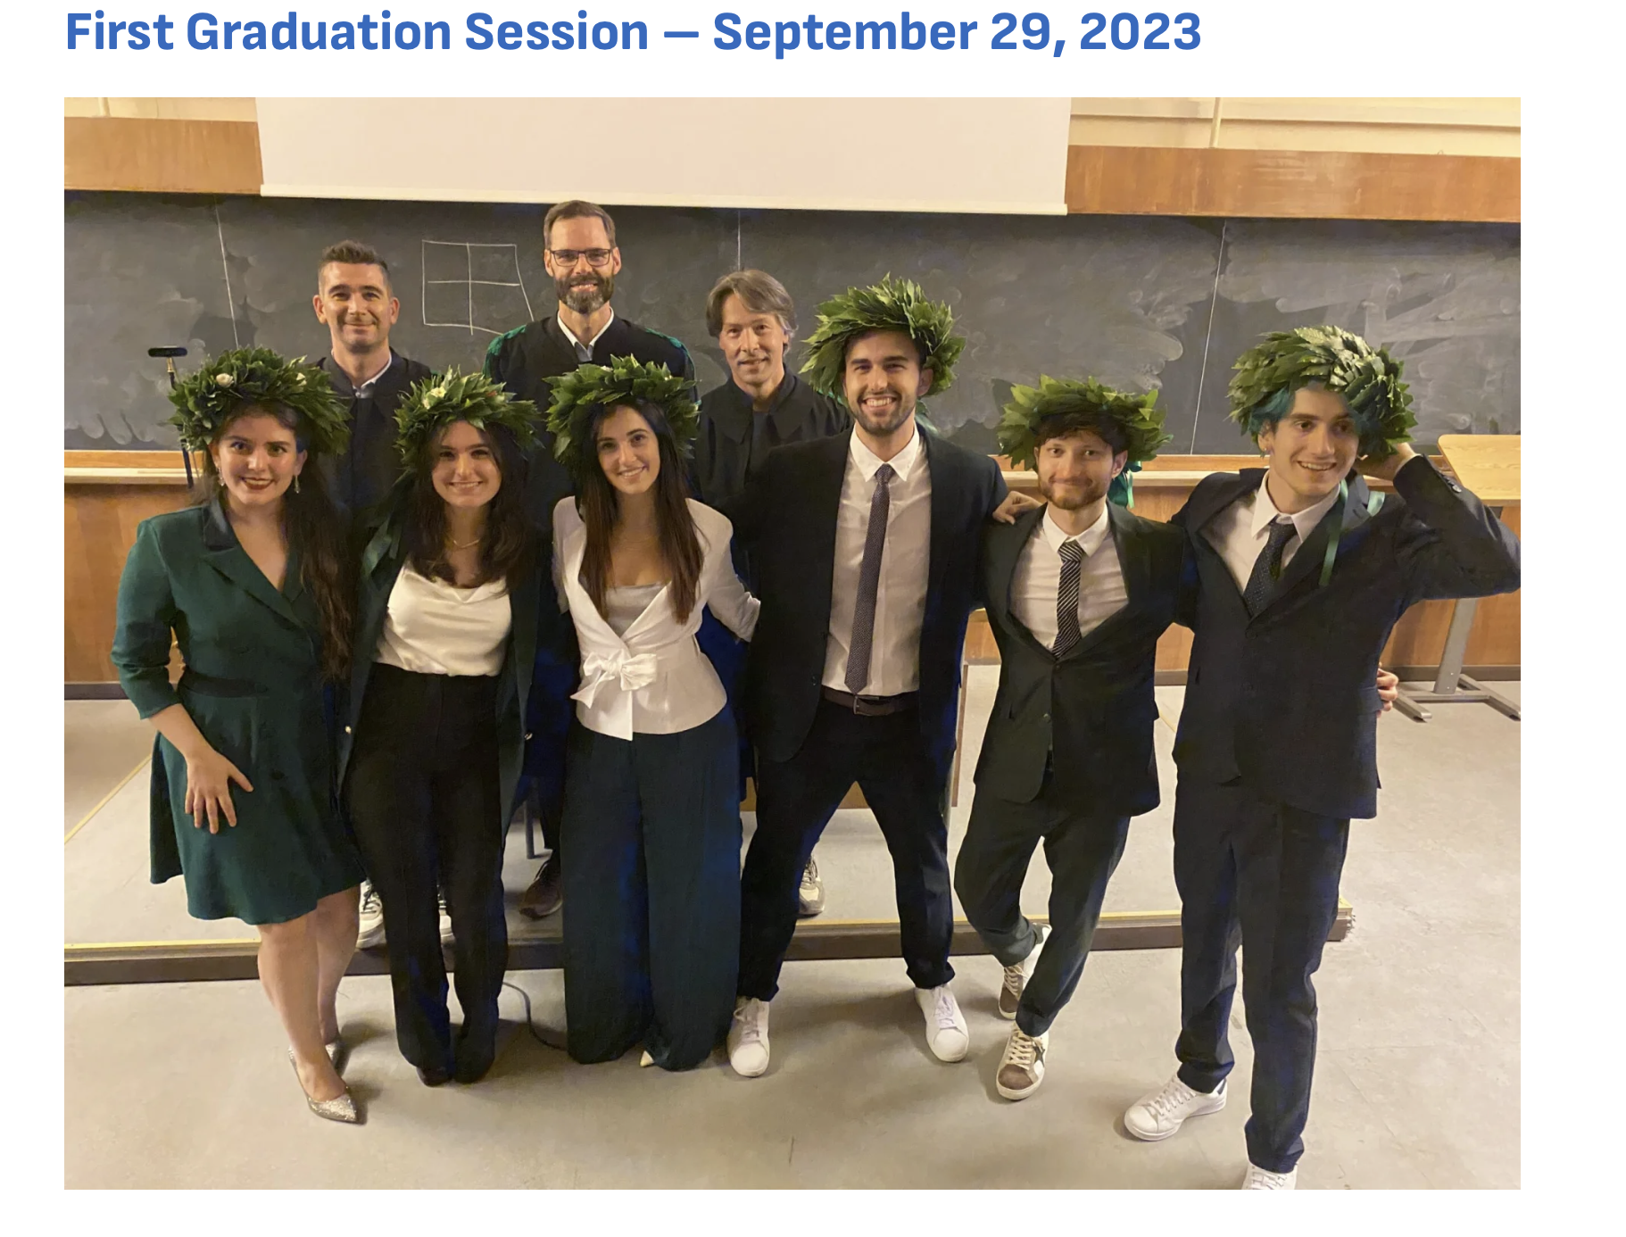
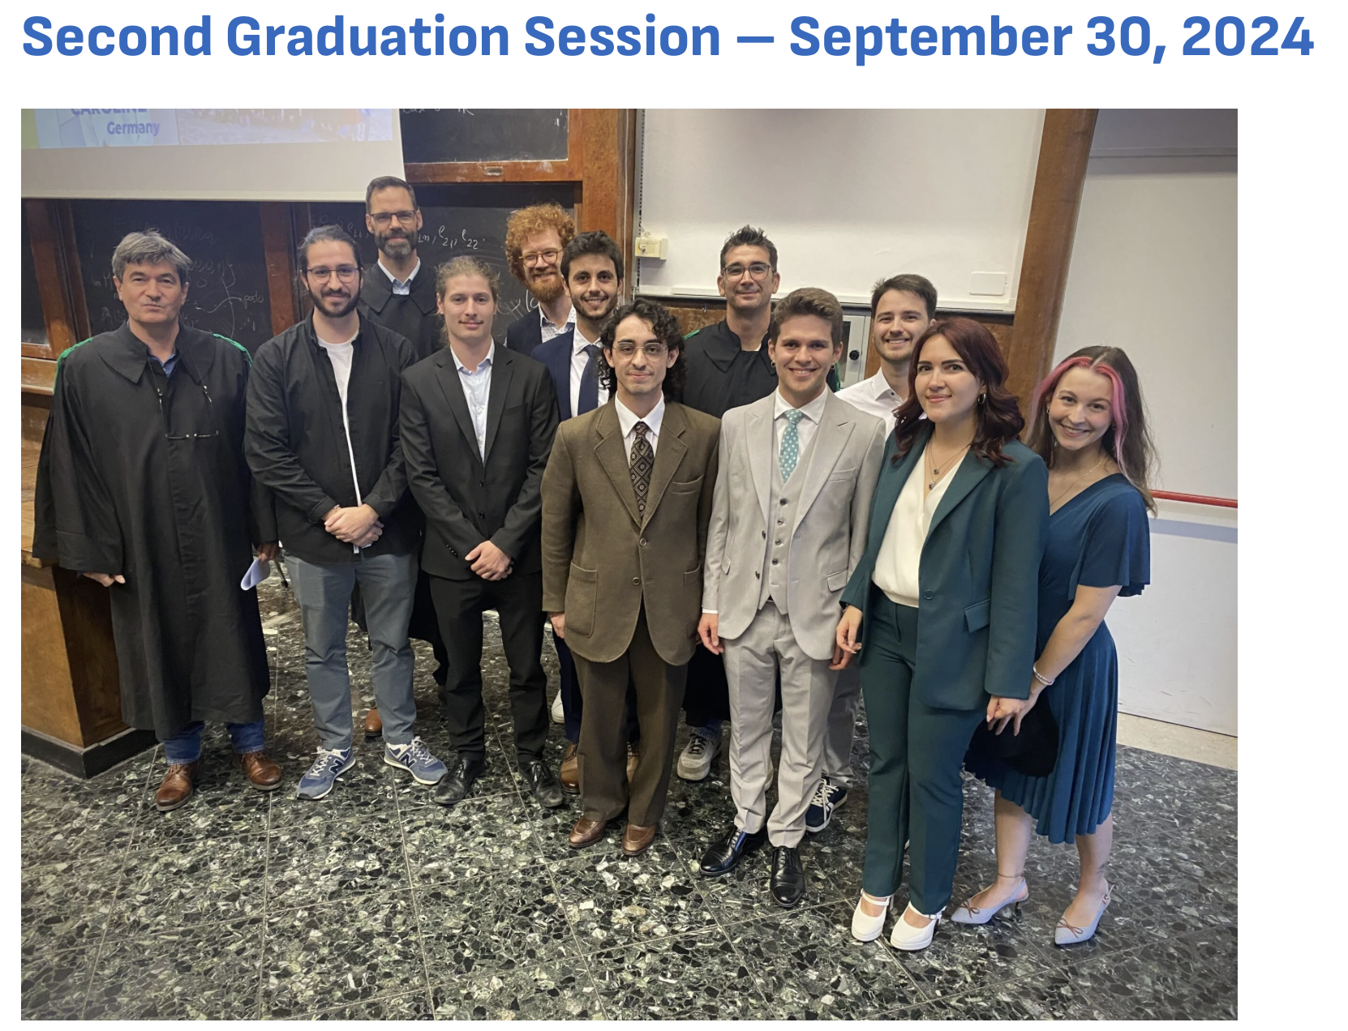
Final examination
The final examination is held annually at the end of September
So far, the University of Bologna has hosted the discussion of the thesis and the diploma Ceremony
The third graduation session will be on the 29th and 30th of September in Bologna. About 36 students will discuss the thesis and receive the final diploma

Slide 19
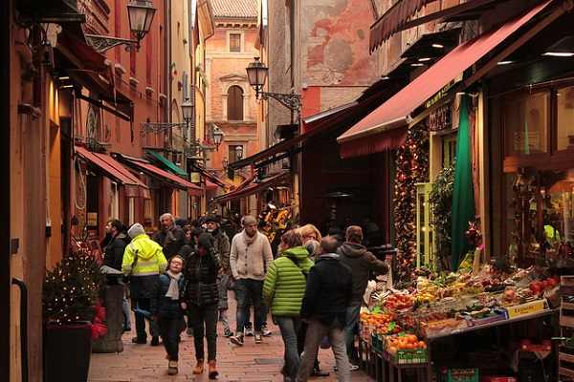
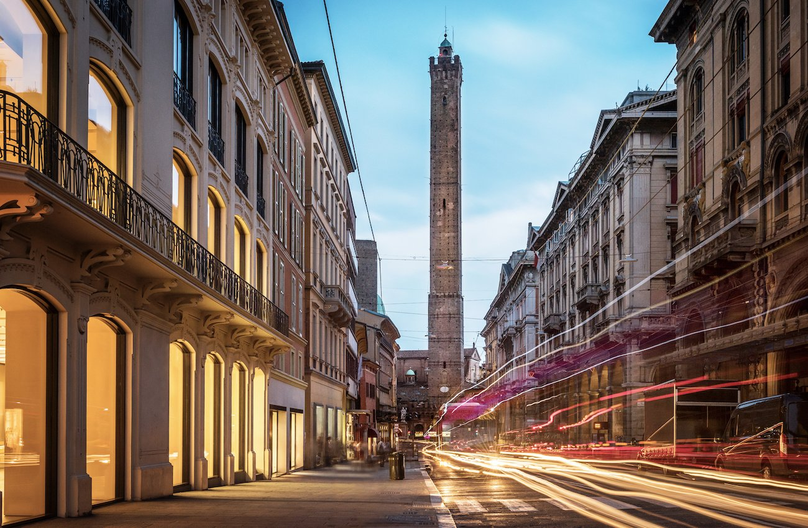
Bologna’s life
Bologna is an important agricultural, industrial, financial, and transport hub, where many large mechanical, electronic and food companies have their headquarters as well as one of the largest permanent trade fairs in Europe
Famous for nicknames
“la dotta” (the erudite), it's home to the oldest university in Europe
“la grassa” (the fat), referring to its rich cuisine
“la rossa” (the red) for the colour of its buildings (alternatively, for its past communist leanings)
Bologna is a lovely place to live for numerous reasons.

Slide 20
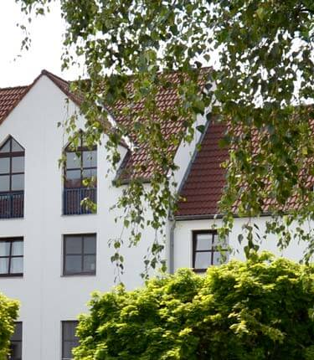
Accomodation
There is not a pre-bookgin procedure for getting accommodation, however, the University of Bologna offer several supports
Accommodation Showcase (Vetrina Alloggi) virtual bulletin board
SAIS (Student Accommodation and Information Service) supports international exchange students and enrolled students in finding accommodation
Agreement with Camplus (private companies), which offers in May/June possible solutions for the semesters
Typical price
Single room: 500-600 euros
Double room: 300-400 euros

